Slide 1
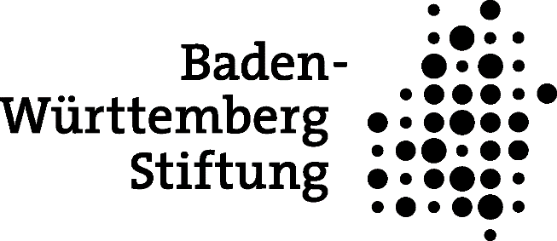
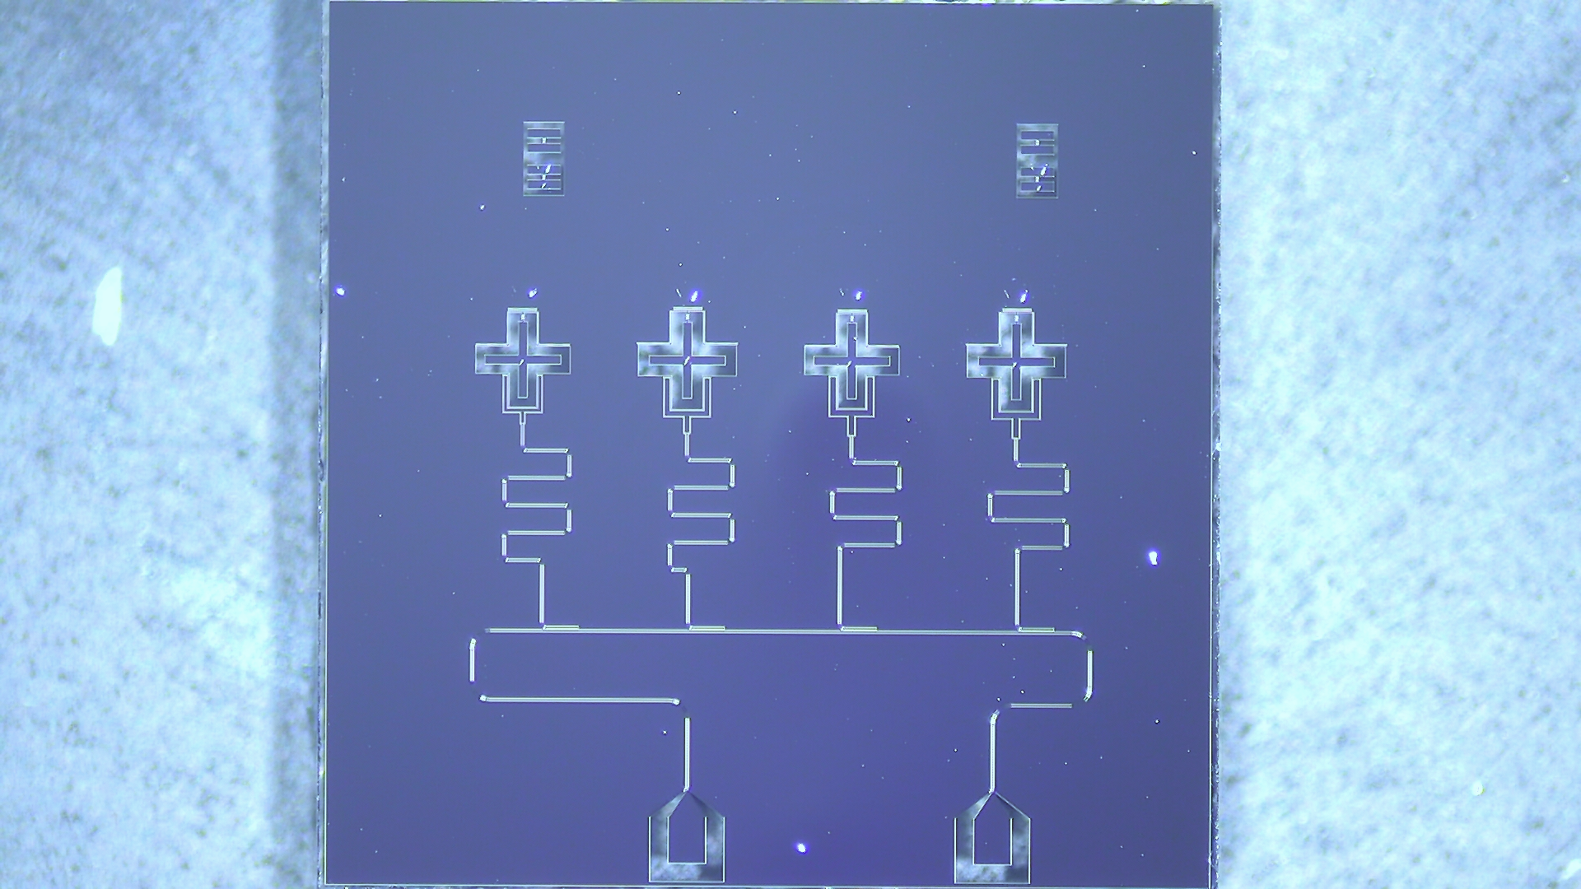
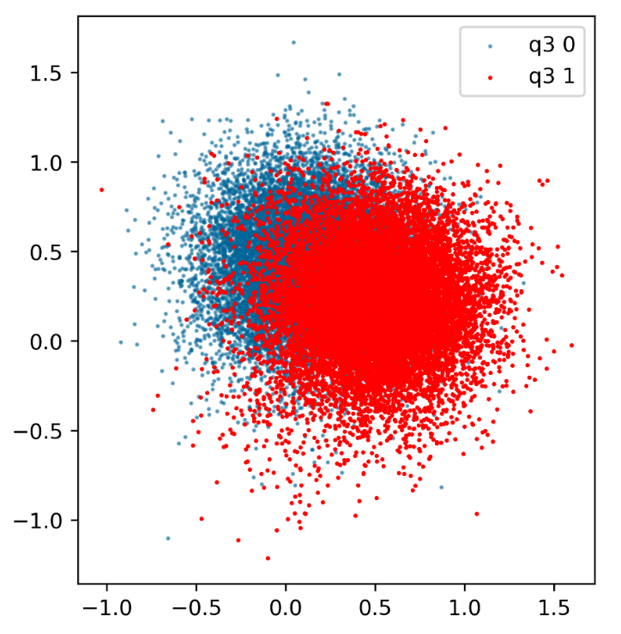
Physikalisches Institut
Readout errors from a superconducting qubit‘s perspective
Andras Di Giovanni, Adrian Aasen, Martin Gärttner, Hannes Rotzinger, Alexey Ustinov
$$\left|0\right\rangle$$
$$\left|0\right\rangle$$
$$\left|1\right\rangle$$
$$\left|1\right\rangle$$

Slide 2
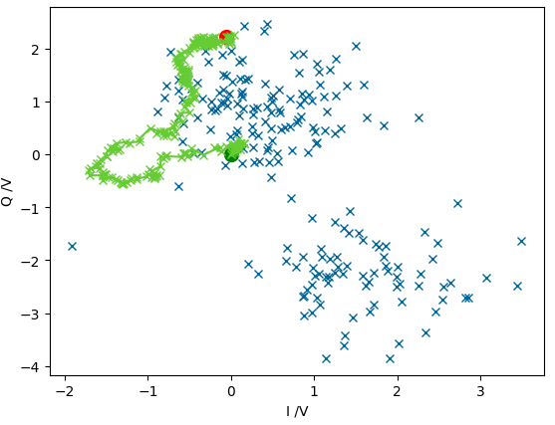
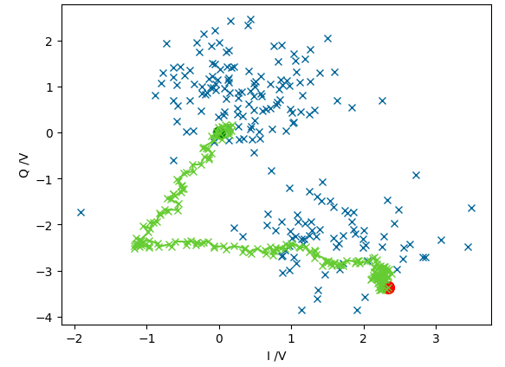
Dispersive readout: wavefunction collapse
Single qubit wavefunction: $Ψ_{q}=α\left|0\right\rangle +β\left|1\right\rangle$
Readout collapses to basis state: $\left|0\right\rangle$ or $\left|1\right\rangle$
Resonator excited by microwave pulse
Time series is integrated by FPGA
Test junctions
Qubits
$$\left|0\right\rangle$$
$$\left|0\right\rangle$$
$$\left|0\right\rangle$$
$$\left|1\right\rangle$$
$$\left|1\right\rangle$$
$$\left|1\right\rangle$$
Resonators
Transmission line
Qubits
Readout
State
Device
Multiplex
Conclusion
Benchmark

Slide 3
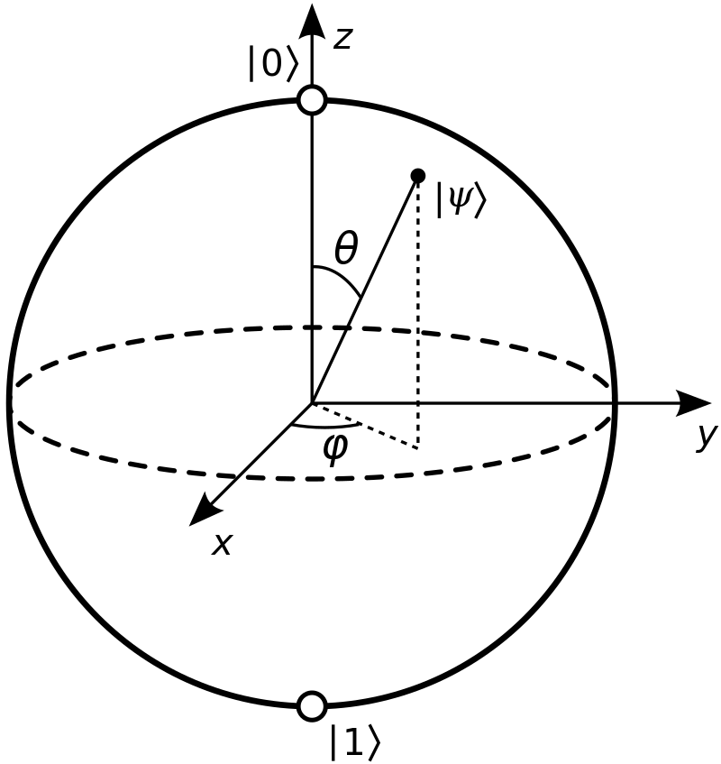
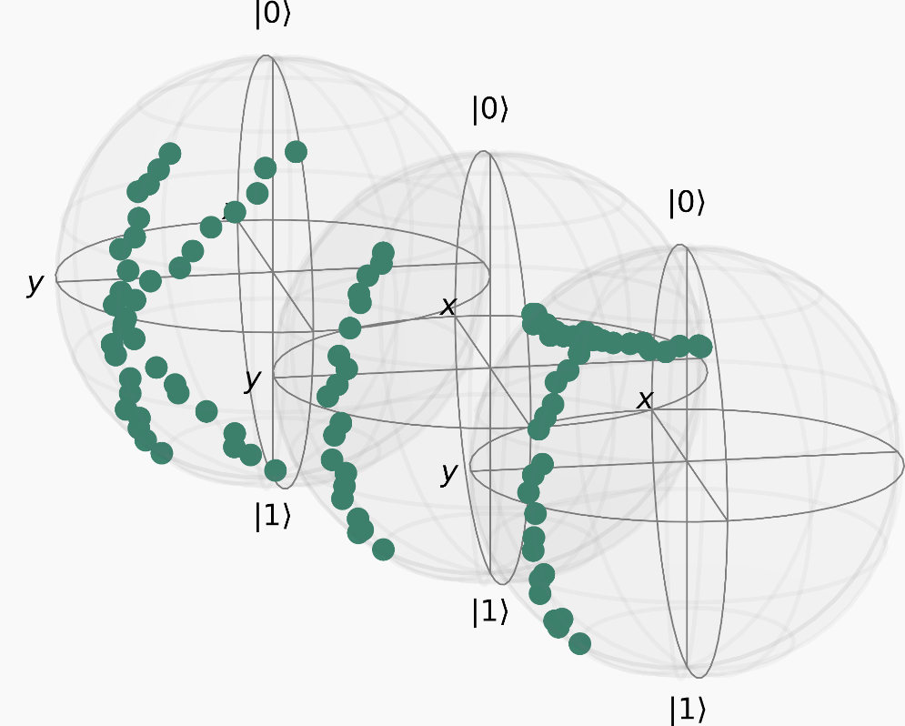
State tomography: finding the original state
Can prepare quantum states many times
Tomographic reconstruction:
$R, σ_{x}R,σ_{y}R$
Use maximum likelihood- or Bayesian mean estimation
$$R$$
$$σ_{x}R$$
Experimental data
$$σ_{y}R$$
Qubits
Readout
State
Device
Multiplex
Conclusion
Benchmark

Slide 4
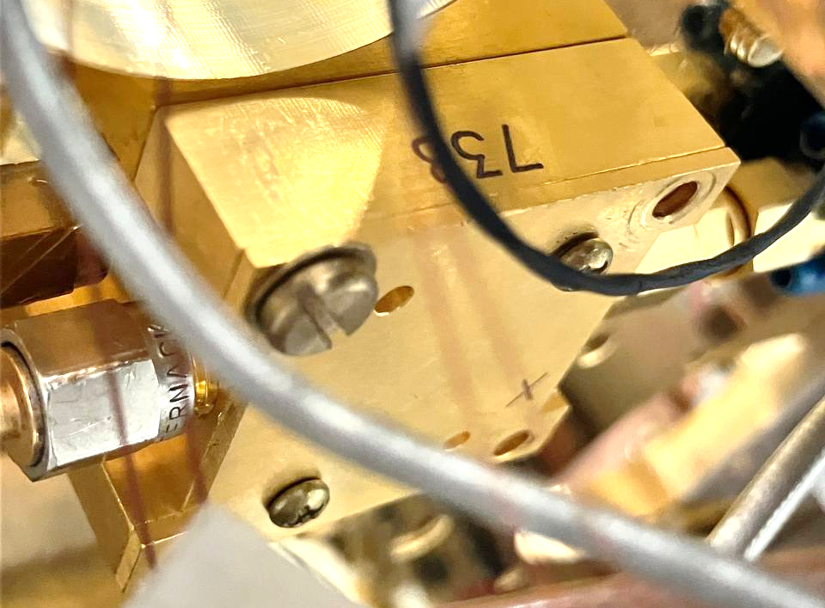
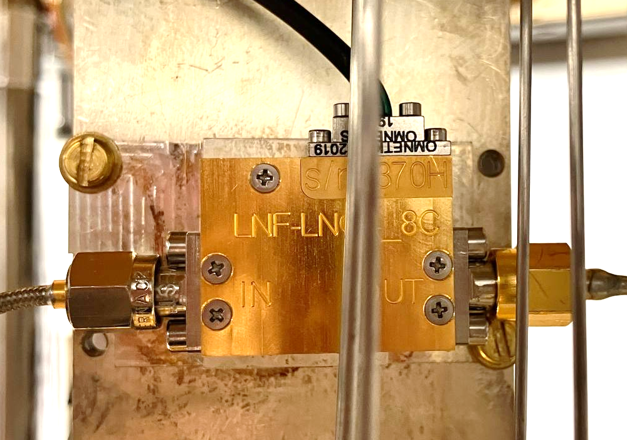
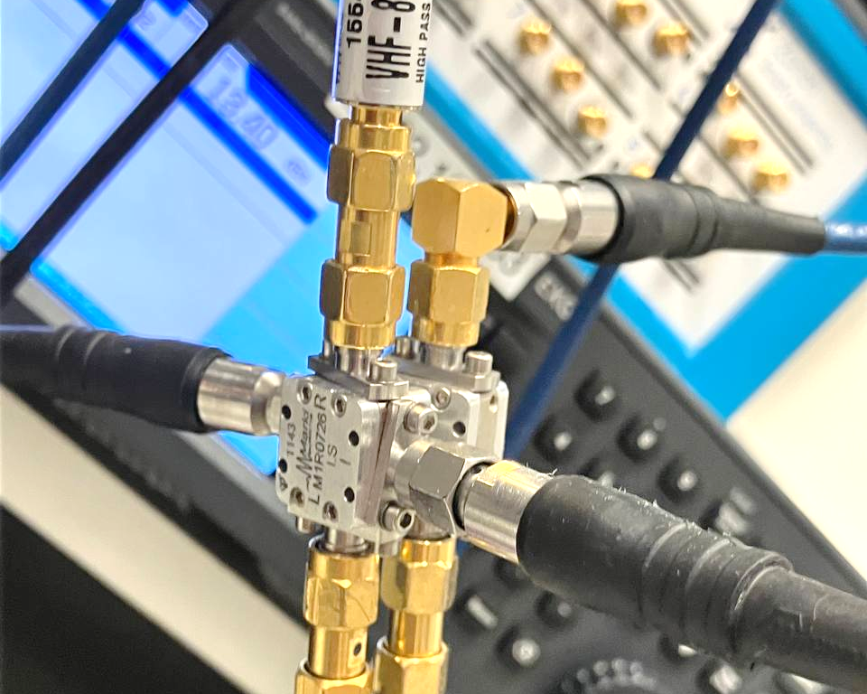
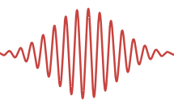
Device tomography: Understanding readout
Resonator signals
Cryogenic microwave switch
Parametric amplifier (TWP amplifier)
Low noise amplifier (HEMT amplifier)
Signal down-conversion
Signal degradation and biasing happens before digitization
Device tomography learns the effectively performed measurement
F. Maciejewski et al: Mitigation of readout noise in near-term quantum devices by classical post-processing based on detector tomography, Quantum 4, 257 (2020)
Qubits
Readout
State
Device
Multiplex
Conclusion
Benchmark

Slide 5
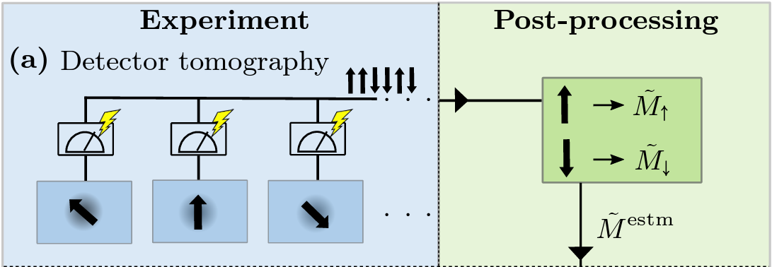
Device tomography II: Learning readout errors
Microwave switch: signal loss
TWP amplifier: pump tone leakage
HEMT amplifier: added noise photons
Signal downconversion: phase instability, off-resonant signal leakage
$$\left|0\right\rangle$$
$$\left|1\right\rangle$$
$$\left|0\right\rangle$$
$$\left|1\right\rangle$$
Readout
State
Device
Multiplex
Conclusion
Benchmark
Qubits

Slide 6
Benchmarking: reconstruction infidelity
Less amplification:
Precise QST without parametric amplifier possible
Weaker/stronger readout:
Relaxes strict requirement on readout power
A. Aasen, A. Di Giovanni et al: Universal readout error mitigation scheme characterized on superconducting qubits, preprint arXiv:2312.04211 (2023)
Qubits
Readout
State
Device
Multiplex
Conclusion
Benchmark

Slide 7
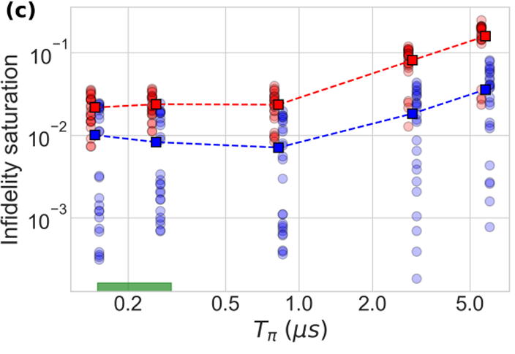
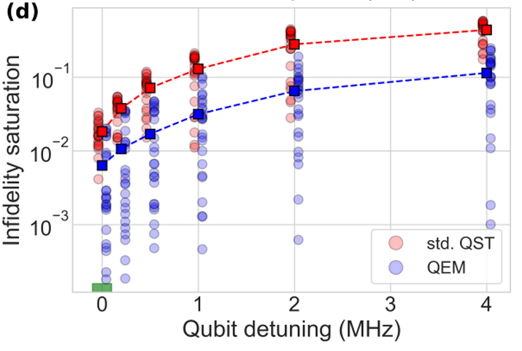
Benchmarking: reconstruction infidelity
$T_{1}, T_{2}$ decoherence and qubit detuning are only partially readout errors
Some improvement visible, but fails with stronger noise
Qubits
Readout
State
Device
Multiplex
Conclusion
Benchmark

Slide 8
Case study: Multiplexed qubit readout
Rabi
Ramsey
Single-shots
Readout mitigation
Qubits
Readout
State
Device
Multiplex
Conclusion
Benchmark

Slide 9
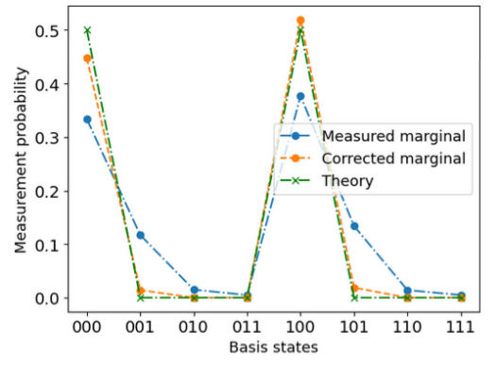
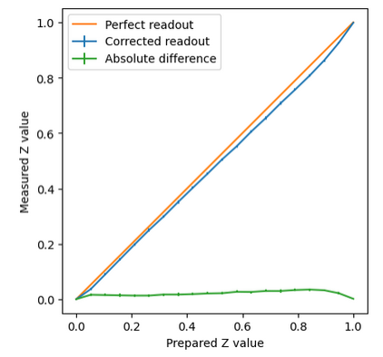
Case study: Multiplexed qubit readout
Observable $\left\langle \left.Z_{q1}\right\rangle \right.$ from reconstruction of state $Ψ=\frac{α\left|000\right\rangle +(1−α)\left|100\right\rangle }{\sqrt{2α^{2}−2α+1}}$
Reconstruction of state $Ψ=\frac{\left|000\right\rangle +\left|100\right\rangle }{√2}$
Qubits
Readout
State
Device
Multiplex
Conclusion
Benchmark

Slide 10
Quantum devices need readout error mitigation
Observed $20x$ infidelity improvement for state tomography
Tested more scalable methods on multi-qubit chip
Extension of quantum volume with better state visibility
Meaningful experiments possible with very noisy readout
arXiv:2312.04211

