Slide 1
Fault-tolerant quantum computing with the parity code and noise-biased qubits
Anette Messinger, ReAQCT 2024
PARITYQC.com
INFO@PARITYQC.com

Slide 2
Introduction to the Parity Code
How the choice of stabilizers influences connectivity
Universal Parity Quantum Computing Michael Fellner, Anette Messinger, Kilian Ender, and Wolfgang Lechner, Phys. Rev. Lett. 129, 180503 (2022)

Slide 3
The parity code
Definition via parity
Every physical qubit in the parity code is labelled and associated with a set of logical qubits $ℒ$ such that
$Z_{ℒ}|ψ⟩=\underset{k∈ℒ}{∏}{\overset{\sim }{Z}}_{k}|ψ⟩$,
For example:
$Z_{\{1,2\}}|ψ⟩={\overset{\sim }{Z}}_{1}{\overset{\sim }{Z}}_{2}|ψ⟩$.
Definition via stabilizer
The code space is stabilized by parity constraints
$\underset{ℒ_{i}∈C}{∏}Z_{ℒ_{i}}|ψ⟩=|ψ⟩$
where $C$ contains physical qubits in whose labels all logical qubits appear an even number of times, i.e.,
$ℒ_{1}⊖ℒ_{2}⊖…=∅$.
For example: $Z_{\{1,2\}}Z_{\{2,3\}}Z_{\{3,1\}}|ψ⟩=|ψ⟩$

Slide 4
The parity code
05
15
25
35
45
5
04
14
24
34
4
$$Z_{\{0,3\}}={\overset{\sim }{Z}}_{0}{\overset{\sim }{Z}}_{3}$$
Definition of
parity qubit:
03
13
23
3
$$Z_{ℒ}|ψ⟩=\underset{k∈ℒ}{∏}{\overset{\sim }{Z}}_{k}|ψ⟩$$
02
12
2
Stabilizer:
$$\underset{ℒ_{i}∈C}{∏}Z_{ℒ_{i}}|ψ⟩=|ψ⟩$$
01
1
$$Z_{\{0\}}Z_{\{0,1\}}Z_{\{1\}}|ψ⟩=|ψ⟩$$
$$Z_{\{0\}}={\overset{\sim }{Z}}_{0}$$
0

Slide 5
The parity code: Logical operators
Pauli-Z
${\overset{\sim }{Z}}_{i}=Z_{\{i\}}$ follows from qubit definitions.
Pauli-ZZ…
${\overset{\sim }{Z}}_{i}{\overset{\sim }{Z}}_{j}...=Z_{\{ij...\}}$ follows from parity qubit definitions.
Pauli-X
Must commute with all stabilizers
Must fulfil correct commutation relations with other X and Zs.
Solution:
${\overset{\sim }{X}}_{i}=X_{\{i\}}X_{\{i,j\}}X_{\{i,k\}}...$ for all physical qubits containing the logical index.
03
13
23
3
$${\overset{\sim }{X}}_{3}$$
02
12
2
$${\overset{\sim }{X}}_{2}$$
01
1
$${\overset{\sim }{X}}_{1}$$
0
$${\overset{\sim }{X}}_{0}$$
easier when encoded
harder when encoded

Slide 6
The parity code: Error correction
Stabilizers are Z products
Bit-flip correction
03
13
23
3
Each logical X/Y operator touches at least N qubits
code distance d=N
02
12
2
01
1
$$N$$
0
repetition code with same d would need twice as many physical qubits!
$$[[\frac{N(N+1)}{2},N,N]]$$

Slide 7
Different Code Shapes -> Different Connectivity/Distance
all-to-all / 4-body interactions
one (two)-to-all
0134
04
14
24
34
4
14
4
04
4
03
13
23
3
13
3
03
4
3
02
12
2
12
2
02
3
2
01
1
1
01
Any parity qubit can be created from square or triangle plaquette stabilizers!
2
1
0
0
1
0
Flexible constraint compilation in the parity architecture, arXiv:2304.12879
0

Slide 8
Code Deformations
Add or remove each stabilizer operator together with a qubit
using CNOTs
using measurements and classical control
Constant Depth Code Deformations in the Parity Architecture, DOI:10.1109/QCE57702.2023.00022

Slide 9
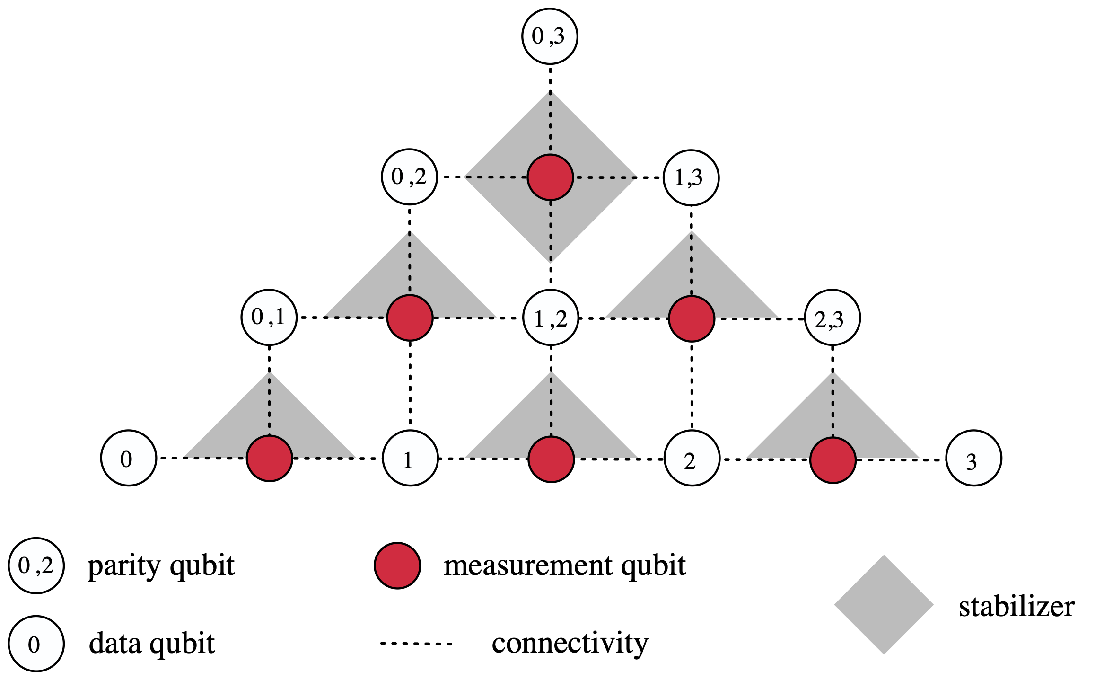
Physical Implementation on Chip
Only square lattice nearest-neighbor connectivity required

Slide 10
The Parity Code on Cat Qubits
Full fault tolerance through code concatenation
Anette Messinger, Valentin Torggler, Berend Klaver, Michael Fellner, Wolfgang Lechner, arXiv:2404.11332 (2024)

Slide 11
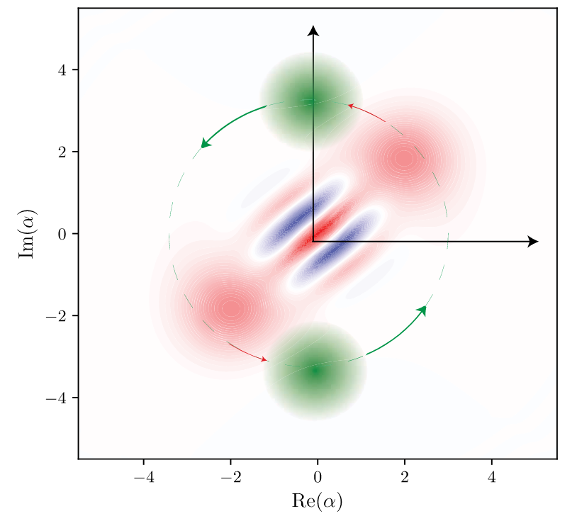
Fault-tolerant Quantum Computing with the parity code
Correction of Bit-flip errors -> Need another encoding to protect against phase flips
Cat Code (Cat qubits):
Encode a qubit in the bosonic degrees of freedom of an oscillator
$|+_{L}⟩≈|α⟩$, $|−_{L}⟩≈|−α⟩$
Phase flips can be exponentially suppressed at the expense of a linearly increasing bit-flip rate
Some gates can be performed bias-preserving, e.g. Rx, Z, CNOT
$$|±⟩↔|0/1⟩$$
https://aws.amazon.com/blogs/quantum-computing/designing-a-fault-tolerant-quantum-computer-with-cat-qubits/
Use a Cat qubit for each parity qubit

Slide 12
Fault-tolerant Quantum Computing with the parity code
FT logic gates: Z
Perform on corresponding physical qubit
$${\overset{\sim }{Z}}_{i}=Z_{\{i\}}$$
${\overset{\sim }{Z}}_{i}{\overset{\sim }{Z}}_{j}...=Z_{\{ij...\}}$
$${\overset{\sim }{X}}_{i}=X_{\{i\}}X_{\{i,j\}}X_{\{i,k\}}...$$
03
02
13
01
12
23
0
1
2
3
Z
$${\overset{\sim }{Z}}_{2}=Z_{\{2\}}$$

Slide 13
Fault-tolerant Quantum Computing with the parity code
FT logic gates: CNOT
transversal,
target every qubit with the logical label
control always single-label qubits
$${\overset{\sim }{Z}}_{i}=Z_{\{i\}}$$
${\overset{\sim }{Z}}_{i}{\overset{\sim }{Z}}_{j}...=Z_{\{ij...\}}$
$${\overset{\sim }{X}}_{i}=X_{\{i\}}X_{\{i,j\}}X_{\{i,k\}}...$$
4
46
4
$$⊕$$
03
56
45
4
$$⊕$$
02
13
6
5
4
$$⊕$$
01
12
23
$$⊕$$
0
1
2
3
$${\overset{\sim }{CX}}_{40}=CX_{\{4\}\{0\}}CX_{\{4\}\{0,1\}}CX_{\{4\}\{0,2\}}CX_{\{4\}\{0,3\}}$$

Slide 14
Fault-tolerant Quantum Computing with the parity code
FT logic gates: $Rzz(α)=e^{−i\frac{α}{2}ZZ}$
perform physical rotation of corresponding parity qubit
Problem: Rz is not bias-preserving in the cat code
Solution: Gate teleportation onto the parity qubit
$${\overset{\sim }{Z}}_{i}=Z_{\{i\}}$$
${\overset{\sim }{Z}}_{i}{\overset{\sim }{Z}}_{j}...=Z_{\{ij...\}}$
$${\overset{\sim }{X}}_{i}=X_{\{i\}}X_{\{i,j\}}X_{\{i,k\}}...$$
Rz?
03
02
13
01
12
23
0
1
2
3
$$\overset{\sim }{R}zz_{0,3}=Rz_{\{0,3\}}$$

Slide 15
Fault-tolerant Quantum Computing with the parity code
S and T magic states: Phys. Rev. A 92, 062309 (2015)
A
Magic state
A
$$⊕$$
03
A
$$⊕$$
03
Parity qubit encoded in repetition code
$$⊕$$
03
02
13
01
12
23
0
1
2
3
$$\overset{\sim }{R}zz_{0,3}=Rz_{\{0,3\}}$$

Slide 16
Examples of useful gates on parity qubits
teleported “physical” operation
$S=e^{i\frac{π}{4}Z}$ on parity qubit (ij)
$S$ on parity qubit (ij), $S^{†}$ on data qubits (i) and (j)
$T=e^{i\frac{π}{8}Z}$ on parity qubit (ij)
$Rz(α)$ on parity qubit (ijk…)
logical effect
$e^{i\frac{π}{4}Z_{i}Z_{j}}$ (entangling, clifford)
CZ (entangling, clifford)
$e^{i\frac{π}{8}Z_{i}Z_{j}}$ (entangling, non-clifford)
$$e^{−i\frac{α}{2}Z_{i}Z_{j}Z_{k}...}$$
0123
03
Rz
02
13
S
T
01
12
23
0
1
2
3
S
S

Slide 17
Conclusion
The parity code
is a classical LDPC code
is a generalization of the repetition code (with higher encoding rate)
has easy and parallelizable logical many-body gates without occupying much space for braiding or lattice surgery
can be tailored to the algorithm (on the fly)
03
02
13
01
12
23
0
1
2
3

Slide 18
Thank you!
Join the team!
www.parityqc.com/careers
PARITY QUANTUM COMPUTING GMBH
RENNWEG 1 / TOP 314
6020 INNSBRUCK, AUSTRIA

Slide 19
PARITY QUANTUM COMPUTING GMBH
RENNWEG 1 / TOP 314
6020 INNSBRUCK, AUSTRIA
PARITYQC.com
a.messinger@PARITYQC.COM

