Slide 1


Problem-informed Graphical Quantum Generative Learning
Bence Bakó, Wigner RCP
arXiv:2405.14072
ReAQCT 2024

Slide 2


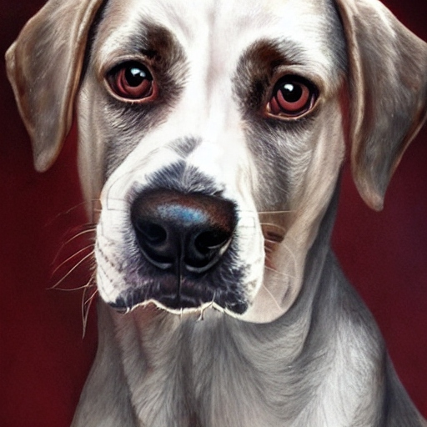



Generative modeling
Learn a representation of some probability distribution in order to generate realistic samples.
Train Model$(θ)$
Generated with DeepAI image generator

Slide 3
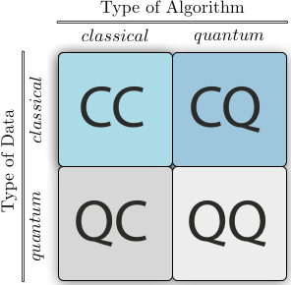
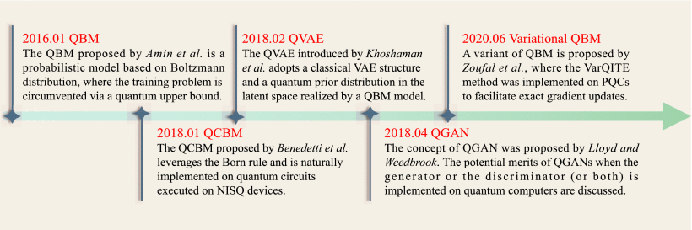




Generative QML
“Natural” ML application for quantum computers.
Source: Wikipedia
Source: J. Tian, et al., IEEE Transactions on Pattern Analysis and Machine Intelligence, Oct. 2023.
Quantum Circuit Born Machine
  Paradigmatic quantum generative model
  Inherits the Born rule
Data
Target
distribution
Model
distribution

Slide 4
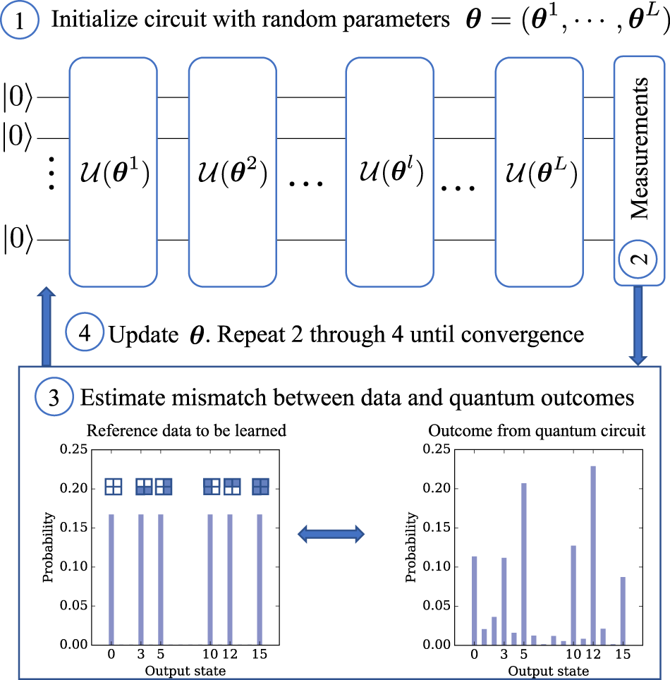




Quantum Circuit Born Machines
General task:
Learn a representation of the (target) probability distribution over binary random variables.
Access to explicit distribution (not realistic) OR a limited number of samples.
QCBM task:
Learn a quantum state via optimizing the parameters of a variational quantum circuit s. t.
where
Source: M. Benedetti, et al., npj QI, vol. 5, no. 1, p. 45, 2019.

Slide 5
General-purpose QCBMs
Task: learn P(A,B,C,D) – joint probability distribution of correlated (binary) random variables
No problem-specific knowledge
+
General-purpose Ansatz

Slide 6
General-purpose QCBMs
Task: learn P(A,B,C,D) – joint probability distribution of correlated (binary) random variables
No problem-specific knowledge
Trainability issues (e.g., barren plateaus)
Poor average performance (no-free-lunch theorem)
+
General-purpose Ansatz

Slide 7
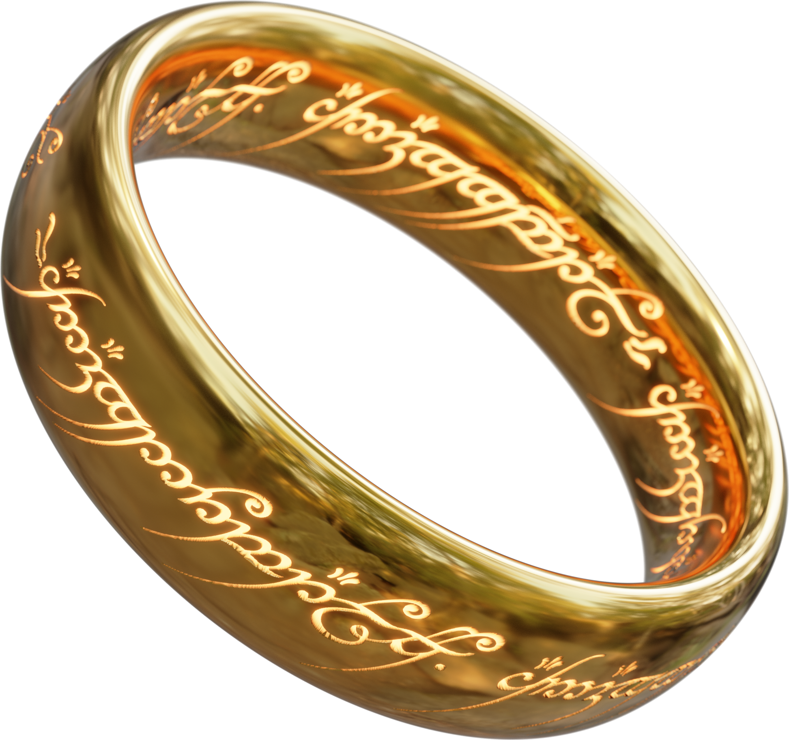
General-purpose QCBMs
Task: learn P(A,B,C,D) – joint probability distribution of correlated (binary) random variables
Trainability issues (e.g., barren plateaus)
Poor average performance (no-free-lunch theorem)
No problem-specific knowledge
+
NO “one model to rule them all!”
General-purpose Ansatz
WHY?

Slide 8
General-purpose QCBMs
Task: learn P(A,B,C,D) – joint probability distribution of correlated (binary) random variables
Trainability issues (e.g., barren plateaus)
Poor average performance (no-free-lunch theorem)
No problem-specific knowledge
+
Insufficient inductive bias!
General-purpose Ansatz
How to incorporate problem-specific knowledge?

Slide 9


General-purpose vs Problem-informed
Task: learn P(A,B,C,D) – joint probability distribution of correlated (binary) random variables
No problem-specific knowledge
Independencies:
+
→
General-purpose Ansatz
Problem-informed Ansatz
Use Probabilistic Graphical Models (PGMs)

Slide 10



Problem-informed Generative QML Framework
Generative learning problem
Structure represented as PGMs
Inductive bias in quantum circuit model
Natural Language Processing
Bayesian network
Sensor networks
Markov network
Computer vision
Mixed model

Slide 11






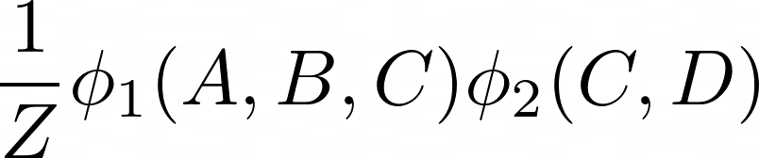

Probabilistic Graphical Models
Graph
Independencies
Factorization
Bayesian networks
Markov networks

Slide 12
Markov Networks (MN)
Clique 1
Maximal clique factorization
✕
Clique 2
We use this framework for benchmark construction.

Slide 13
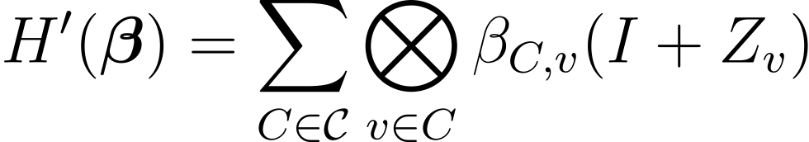


Quantum Circuit Markov Random Field (QCMRF)
Higher-order Ising Hamiltonian
Duplicate terms and identities discarded
→
→
→
→
Quantum Circuit Ising Born Machine (QCIBM)
  Similar, but problem-agnostic Ansatz
  Only 2-local interactions
  All-to-all connectivity
B. Coyle, et al., npj QI, vol. 6, no. 1, p. 60, 2020.

Slide 14

QCMRF example
Clique 1
Clique 2

Slide 15
MNs can represent ANY probability distribution!
When is this representation useful (for our model)?

Slide 16
1. When does it outperform problem-agnostic?
Performance decreases!
Can capture higher-order correlations!
Problem complexity

Slide 17
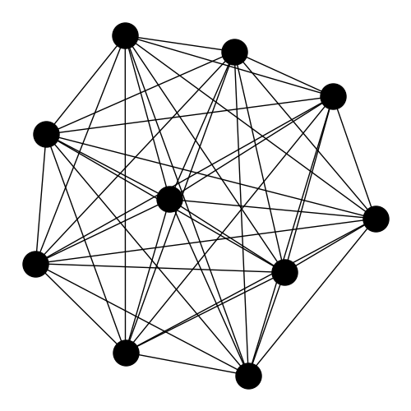

2. What problems should we consider?
Complete graph with maximal clique factorization
$𝒪\left(2^{n}\right)$degrees of freedom
Can this be trainable?
Exponential decay $→$ deterministic barren plateaus

Slide 18

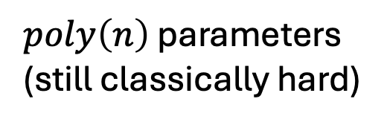
2. Efficient MN representation
$poly\left(n\right)$ parameters
(still classically hard)
better trainability
$$→$$
Efficient MN representation
Exponential decay $→$ deterministic barren plateaus

Slide 19
3. Potential for Quantum Advantage?
Sampling MNs is hard in general!
PGM
1. Quantum learning advantage in
  Accuracy
  Learning speed
  Sample complexity
BN
MN
Our work
QAOA
QCMRF
Sampling QAOA circuits is hard!
Farhi, Harrow. arXiv:1602.07674, 2019.
Krovi. arXiv:2206.05642, 2022.
2. Quantum advantage in sampling the unknown target distribution:
  Target distribution is learnable (up to given error) by both a classical and a quantum model
  Sampling the trained quantum circuit is more efficient

Slide 20
Most promising problems
To outperform problem-agnostic
Higher-order correlations
Polynomial number of parameters
Hard to sample classically
Better trainability
Potential for Q advantage

Slide 21

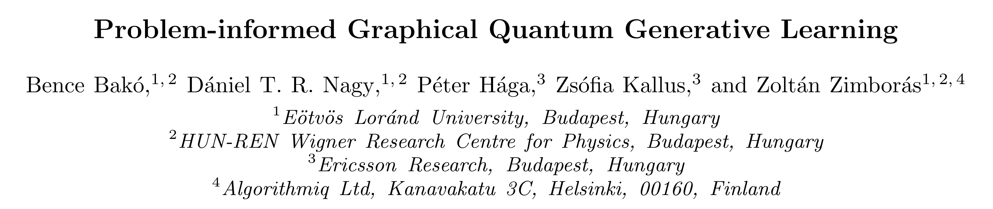
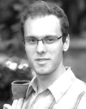
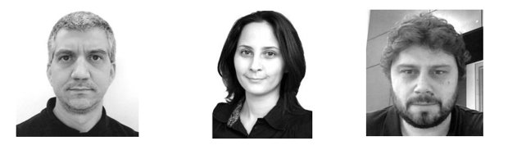
arXiv:2405.14072

