Slide 1
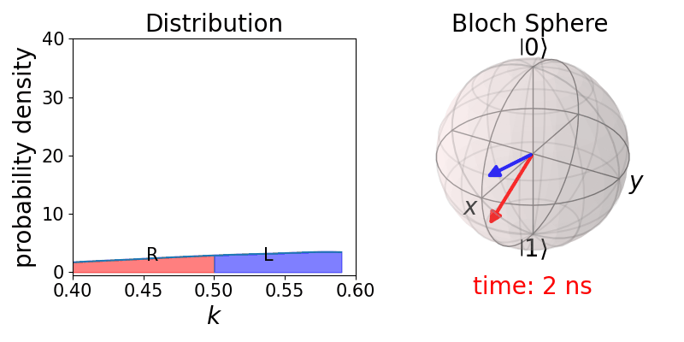
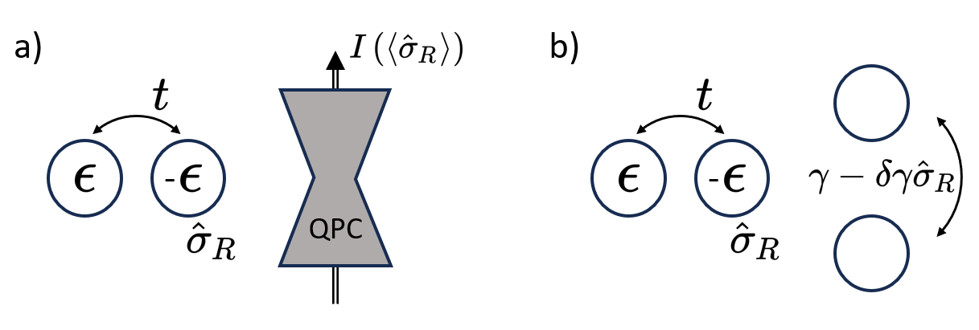
Theory of charge-sensing-based noisy readout of semiconductor qubits
Domonkos Svastits
Budapest University of Technology and Economics
Joint work with Gábor Széchenyi, Daniel Loss, Stefano Bosco and András Pályi
1/9

Slide 2
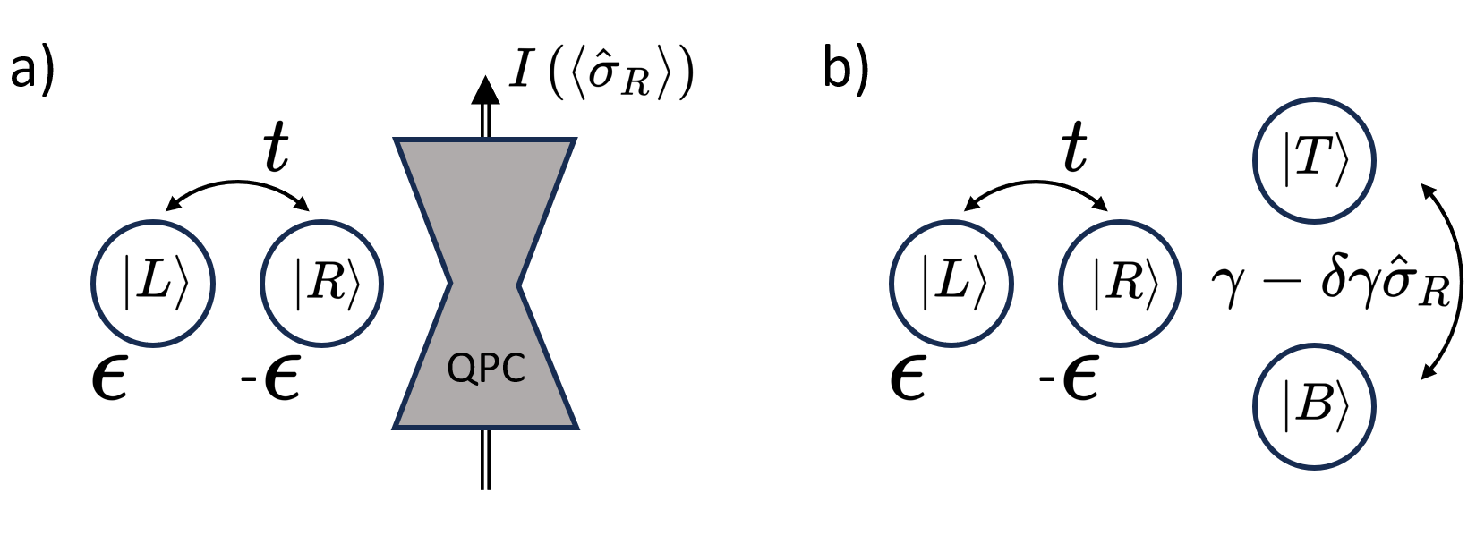
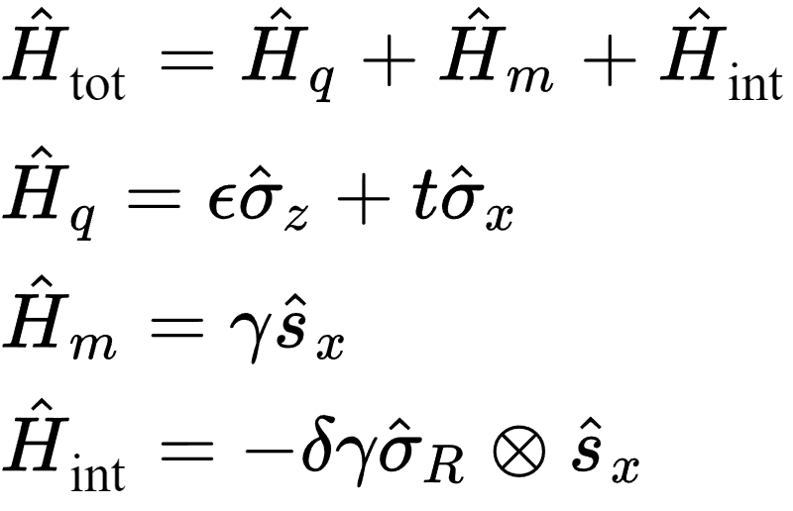
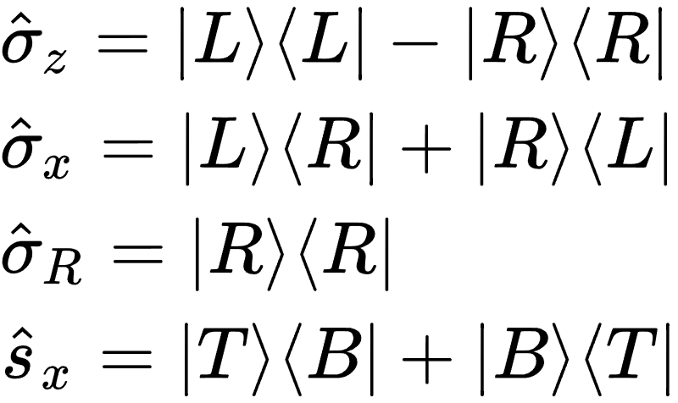
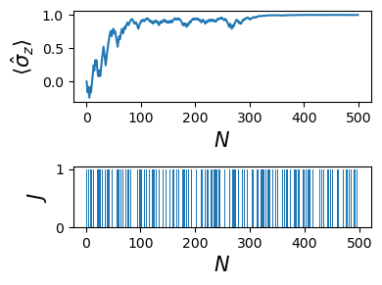
The qubit measures qubit model
Model Hamiltonian:
Data qubit
Meter
Measurement process:
Perform N weak measurements:
Initialization of the electron of the meter in the bottom dot
Unitary time evolution for time $∆τ$
Projective measurement of the meter
2/9

Slide 3
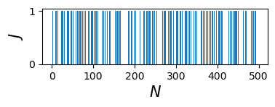
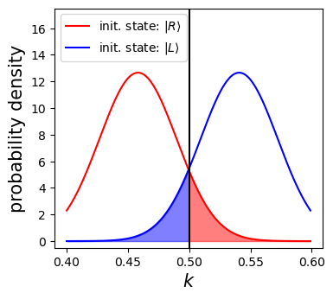
The initial qubit state is inferred based on the average current
Total number of transmitted electrons: $K$
Fraction of transmitted electrons: $k=\frac{K}{N}$
Average current: $\overline{I}=\frac{ek}{Δτ} \sim k$
Maximum likelihood inference based on $k$:
$k≤0.5 ⇒ R$
$k>0.5 ⇒ L$
Two corresponding quantum channels:
$${\text{𝓜}}_{L};{\text{𝓜}}_{R}$$
3/9

Slide 4
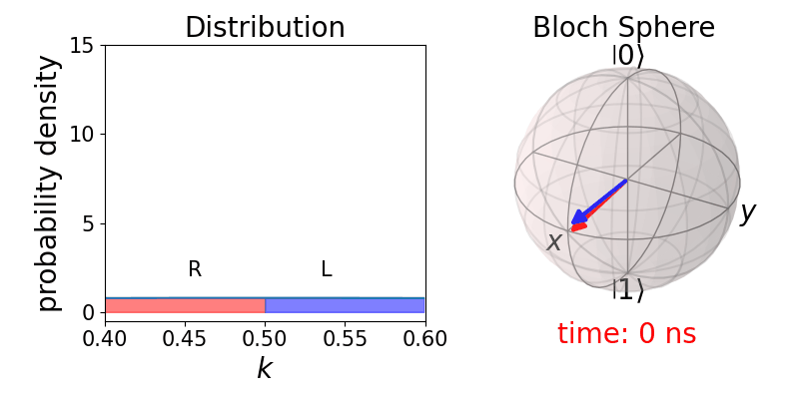
The computational basis states are stable for zero residual tunneling
Two dynamical features:
Loss of coherence between the eigenstates of the Hamiltonian (dephasing): dephasing rate: $Γ_{d}=\frac{1}{2}{\left(\frac{δγ}{ℏ}\right)}^{2}Δτ$
Gaining information about the qubit state: width of Gaussian distributions ~ $\frac{1}{\sqrt{Γ_{m}τ}}$ measurement rate: $Γ_{m}=\frac{1}{2}{\left(\frac{δγ}{ℏ}\right)}^{2}Δτ$
Initial state:
$\left|+\right\rangle =(|L⟩+|R⟩)/\sqrt{2}$
Parameters:
$ε=10$ μeV $t=0$ μeV
$γ=5$ μeV $↔ I∼1$ nA
$δγ=0.5$ μeV $↔ ΔI∼100$ pA
$Δτ=\frac{π}{4}/(γ−\frac{δγ}{2})$
4/9

Slide 5
Residual tunnelling amplitude induces relaxation
Three dynamical features:
Dephasing
Gaining information about the qubit state
Measurement induced relaxation: $Δρ≡ρ_{ee}−ρ_{gg}$ $Δρ∼e_{ }^{−Γ_{rel}τ}$ relaxation rate: $Γ_{rel}=\frac{1}{2}{\left(\frac{δγ t}{ε^{2} \sqrt{Δτ}}\sin\left(\frac{εΔτ}{ℏ}\right)\right)}^{2}$
Initial state:
$\left|+\right\rangle =(|L⟩+|R⟩)/\sqrt{2}$
Parameters:
$ε=10$ μeV $t=2$ μeV
$γ=5$ μeV $↔ I∼1$ nA
$δγ=0.5$ μeV $↔ ΔI∼100$ pA
$Δτ=\frac{π}{4}/(γ−\frac{δγ}{2})$
5/9

Slide 6
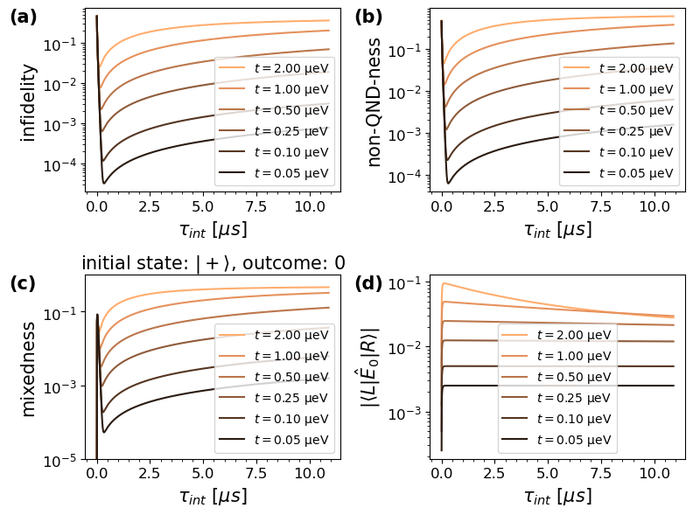
The optimal integration time depends on the magnitude of the residual tunnelling
Measurement benchmarks:
Readout fidelity $F =\frac{1}{2}\left(ε_{↑}+ε_{↓}\right)$
Quantum non-demolitioin-ness $Q=\frac{1}{2}\sum_{r∈\{L, R\}}{⟨r|\text{𝓜}[|r⟩ ⟨r|] |r⟩}$
Mixedness $m\left(|ψ\right\rangle ,r)=1−Tr[{\hat{ρ}}_{r}]$
Magnitude of offdiagonal matrix elements of the effects $α=\left|\left\langle L\left|{\hat{E}}_{0}\right|R\right\rangle \right|$
6/9

Slide 7
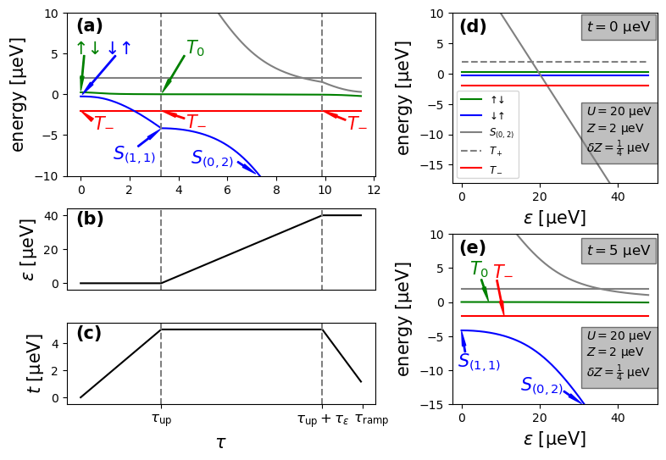
Spin qubit readout using Pauli blockade spin-to-charge conversion
Reference spin: ↓
Reference spin: ↓
Unknown spin
Unknown spin
Hamiltonian:
Spin to charge conversion:
↓↓ ↓↓
↓↑ $S_{(0,2)}$
7/9

Slide 8
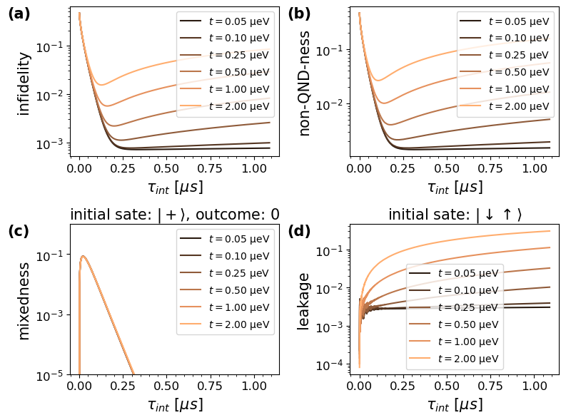
Residual tunnelling induces leakage
Additional errors from imperfect ramping
Residual tunnelling induces leakage instead of relaxation
Measurement benchmarks:
Readout fidelity $F =\frac{1}{2}\left(ε_{↑}+ε_{↓}\right)$
Quantum non-demolition-ness $Q=\frac{1}{2}\sum_{r∈\{↓↓, ↓↑\}}{⟨r|{\text{𝓜}}_{r}[|r⟩ ⟨r|] |r⟩}$
Mixedness $m\left(|ψ\right\rangle ,r)=1−Tr[{\hat{ρ}}_{r}]$
Leakage $L(|ψ⟩)=1−\sum_{r∈\{↓↓, ↓↑\}}{⟨r|\text{𝓜}\text{[}|ψ⟩⟨ψ\left|\text{]}\right|r}⟩$
8/9

Slide 9
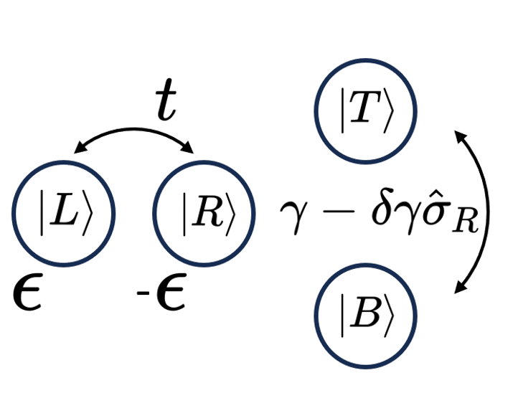
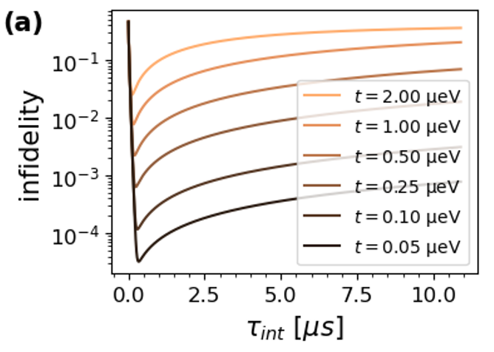
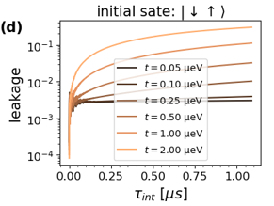
Overview
The model
The QPC is modelled as a double quantum dot
The data qubit is measured inirectly
Future plans
Refine the model to match experiments better
Imperfect current sensing
Coupling to environment
Consider anisotropic $g$-factor for spin qubit readout
Use additional soft-information to enhance the quality of the readout
Optimize ramping sequence of Pauli blockade spin-to-charge conversion
Charge qubit readout
Measurement induces relaxation for $t≠0$.
Optimal integration time
Potential applications of the model
Optimization of readout
Optimiziation of qubit state inference based on soft-information
Optimization of adaptive circuits, including quantum error correction circuits
Spin qubit readout
Additional errors due to spin-to-charge conversion
Tunnelling induces leakage
9/9

