Slide 1
Exchange-driven hole spin qubit in Germanium
Jaime Saez-Mollejo
ReAQCT 2024, Budapest
June 19th 2024

Slide 2
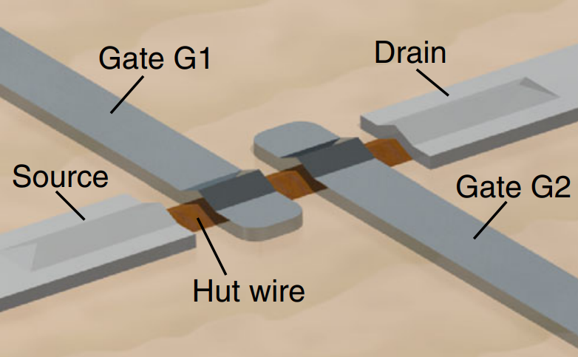
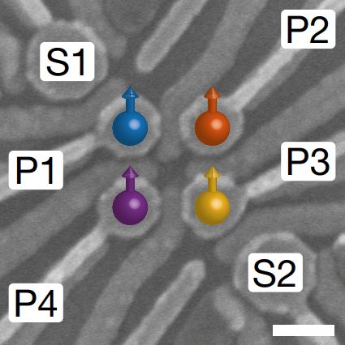
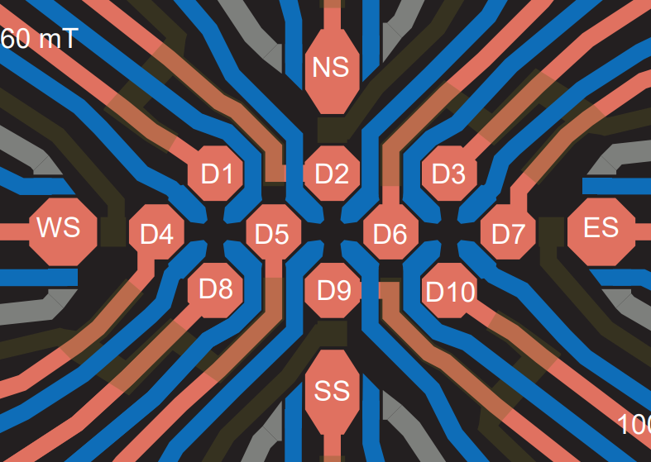
Introduction to spin qubits in Ge
Germanium has become really interesting platform for spin qubit experiments
Why Ge?
Strong spin-orbit interaction → Fast electrical driving
Low hyperfine interaction → Increase of coherence time
Compatible with superconducting technologies →
A gate tunable transmon qubit in planar Ge (arXiv:2403.16774v1)
Watzinger et al. Nature comm. (2018)
Hendrickx et al. Nature (2020)
Wang et al. arxiv (2024)
Our goal: understanding the Physics of holes

Slide 3
Our design
Cross section
Top view
Confinement
Reflectometry circuit
$$B_{y}$$
Occupation
$$L_{ }$$
$$B_{z}$$
$$C_{p}$$
80 nm
$$V_{L}$$
$$V_{g}$$
$$V_{R}$$
Microwave source
$$Al_{2}O_{3}$$
Ohmic contact
$$Si_{0.3}Ge_{0.7}$$
20 nm
Ge
18 nm
$$Si_{0.3}Ge_{0.7}$$
Microwave source
Material: Isella group
Holes accumulated at V=0
Notes:
2D heterostructure grown by our collaborators in Como
Not deeply buried
Microwaves generate and effective magnetic field via SOI interaction
To read the qubit we measure a reflected RF signal in the sensor

Slide 4
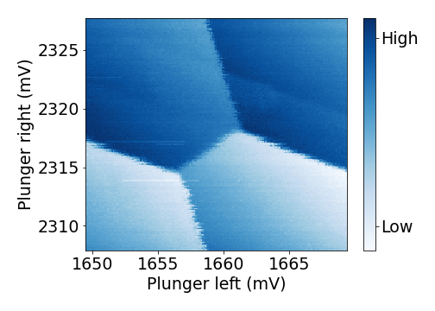
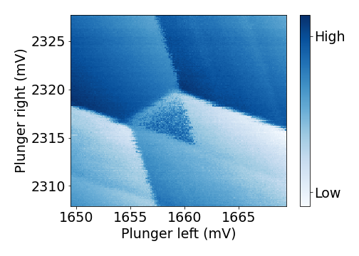
Readout: a simple picture of Pauli spin blockade
Sensitive to charge occupation
A
‘1,1’
‘0,1’
B
B
+
Driving
‘1,2’
C
‘0,2’
C
A
Signal low
Signal high
Spin-to-charge conversion!
Ono et al. Science (2002)
Johnson et al. PRB (2005)

Slide 5
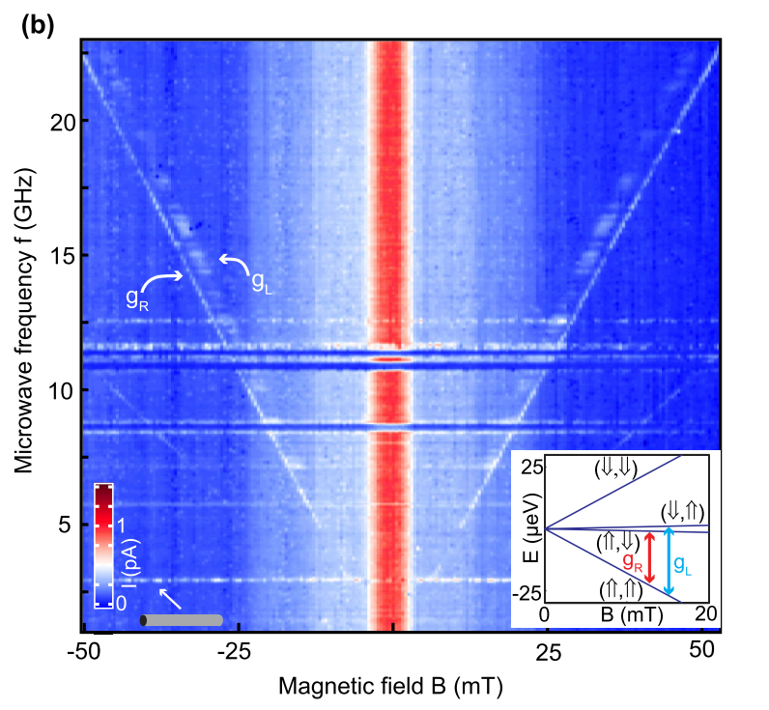
Find the qubit line: Magnetic spectroscopy
$ΔE=h⋅f_{MW}$
In-plane magnetic field
$${ΔE}_{Z}=gμ_{B}B$$
Nadj-Perge et al. PRL (2012)
$S:\frac{1}{√2} (↑↓−↓↑)$, $T_{0} :\frac{1}{\sqrt{2}}(↑↓+↓↑)$
$T_:↓↓$, $T_{+} : ↑↑$
Spin transition of 2-spin states. Why?
Similar spectroscopy J-dominated
$↑↓$, $↓↑$, $↓↓, ↑↑$
Spin transitions of single spin states
Nadj-Perge et al. PRL (2012)
Ono et al. PRL (2018)

Slide 6
Magnetic spectroscopy
Fixed B=0
Fixed 
$$T_{+},T_{−}, T_{0}$$
S
$\tilde{T_{−}}$→$\tilde{T_{0}}$
$\tilde{T_{−}}$→$\tilde{T_{+}}$
$\tilde{T_{−}}$→$\tilde{S}$
‘1,1’
Tunability of exchange interaction, J, with detuning
B
$$ε>0$$
$$ε=0$$
C
Uncommon feature
$\tilde{T_{−}}$→$\tilde{T_{+}}$ transition is a double spin flip → Typical driving results in single spin flips
‘0,2’
$$ε<0$$
A

Slide 7
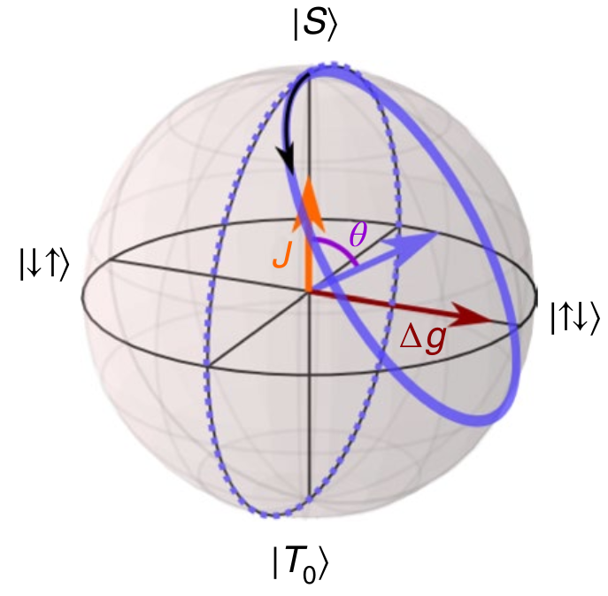
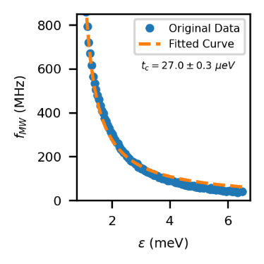
ST qubit with orthogonal rotation axis
By fitting the magnetic spectroscopy
ST qubits NOT microwave driven
Rotation axis is not orthogonal
Imposing constraints to the operation
Previous work in the group:
Jirovec et al. Nature Mat. (2021)
$$g_{1}≈0.2$$
$$g_{2}≈0.4$$
MW driving provides orthogonal axis
Here we show a microwave driven ST qubit with orthogonal axis
Extracting all the parameters we verify we are in the ST basis

Slide 8
Can they be coherently driven?
$\tilde{T_{−}}$→$\tilde{S}$
$\tilde{T_{−}}$→$\tilde{T_{0}}$
$\tilde{T_{−}}$→$\tilde{T_{+}}$
$$f_{Rabi}≈3 MHz$$
$$f_{Rabi}≈1.1 MHz$$
$$f_{Rabi}≈0.8 MHz$$
Why can we drive them?
Why do they have different Rabi frequencies?

Slide 9
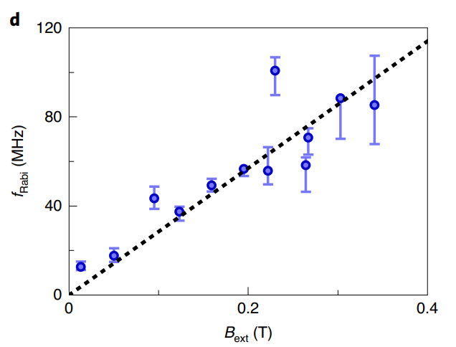
Driving mechanism
Studying the Rabi frequency vs B and  we obtain information about the driving mechanism
Froning et al. Nature Nano (2021)
Electric Dipole Spin Resonance or g-tensor Magnetic Resonance
$$f_{Rabi}∝B$$
J and $f_{Rabi}$ follow the same trend with detuning

Slide 10
Driving mechanism
AC electric field applied on BR is coupled to the detuning of the DQD
Modulation of exchange
As a result:
H=$\left(\begin{matrix}E_{0} & f(J\left(t\right)) \\ f(J\left(t\right)) & E_{1}\end{matrix}\right)$
Microwave source
Off-diagonal terms which drive the system
: Lever arm on the quantum dot
: Amplitude of microwave burst

Slide 11
Driving mechanism: exchange modulation
Studying the Rabi frequency vs B and  we obtain information about the driving mechanism
Froning et al. Nature Nano (2021)
Electric Dipole Spin Resonance or g-tensor Magnetic Resonance
$$f_{Rabi}∝B$$
J and $f_{Rabi}$ follow the same trend with detuning

Slide 12
Driving mechanism: exchange modulation
Studying the Rabi frequency vs B and  we obtain information about the driving mechanism
Froning et al. Nature Nano (2021)
Electric Dipole Spin Resonance or g-tensor Magnetic Resonance
$$f_{Rabi}∝B$$
J and $f_{Rabi}$ follow the same trend with detuning
Theory exchange modulation driving (solid lines)

Slide 13
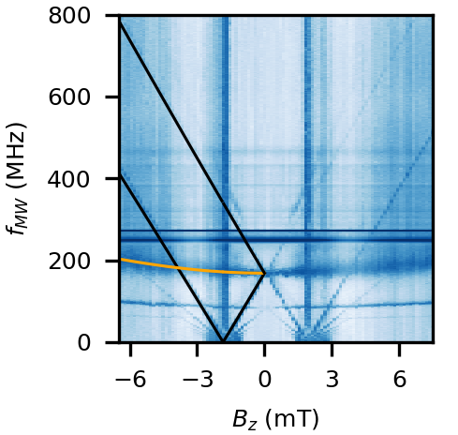
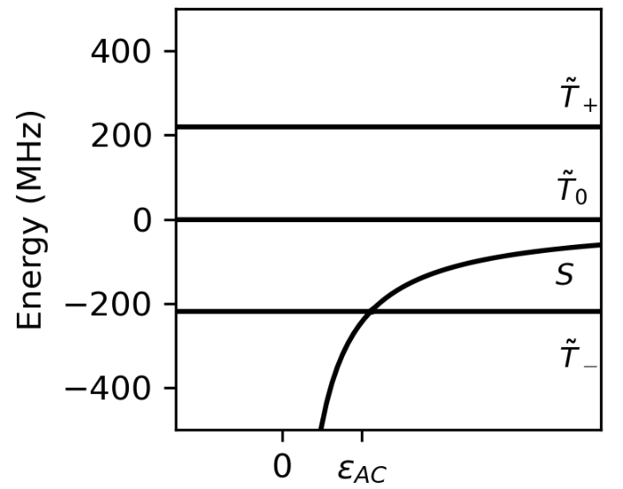
What about out-of-plane?
This qubit was out-of-plane
Magnetic spectroscopy
Initial state is a S
$\tilde{S}$→$\tilde{T_{+}}$
$$g_{1}=5.90$$
${ g}_{2}=7.37$
$$g_{1}≈5$$
$$g_{2}≈7$$
$\tilde{S}$→$\tilde{T_{−}}$
$\tilde{S}$→$\tilde{T_{0}}$
Jirovec et al. Nature Mat. (2021)
Open questions:
$ST_{−}$ and $ST_{+}$ transitions are not coherent?
Why we don’t observe EDSR or g-TMR driving?
Rabi frequencies also compatible with exchange modulation

Slide 14
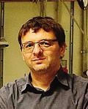
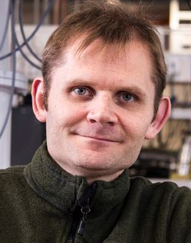
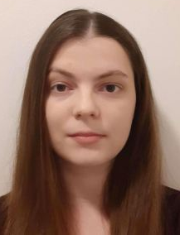
Summary
Take home messages
Transitions driven are two-spin states
Exchange modulation causes the driving
ST qubit with orthogonal axis
G. Isella
D. Chrastina
A. Ballabio
S. Bosco
M. Rimbach-Russ
D. Jirovec
$\tilde{T_{−}}$→$\tilde{T_{0}}$
$\tilde{T_{−}}$→$\tilde{S}$
$\tilde{T_{−}}$→$\tilde{T_{+}}$
G. Katsaros
Y. Schell
Thank you for your attention!

Slide 15
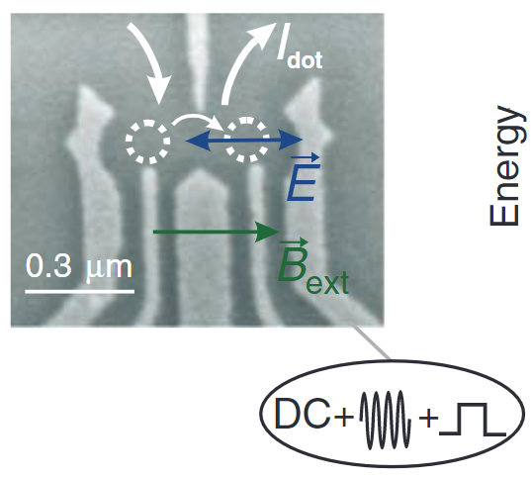
How to drive a spin qubit: oscillating magnetic field
Strip line
Micromagnet
Spin orbit mediated
No strip line or micromagnet needed!
Koppens et al. Nature (2006)
Pioro-Ladrière et al. Nature Physics (2008)
Novak et al Science (2007)
Notes:
https://www.nature.com/articles/nature05065
https://www.science.org/doi/epdf/10.1126/science.1148092

Slide 16
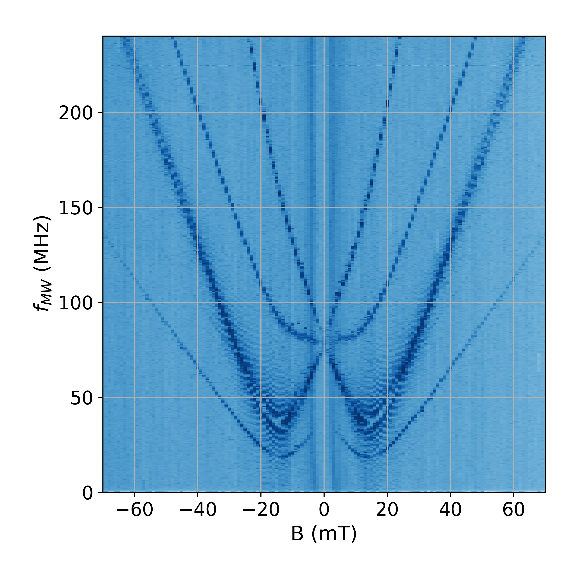
Two-photon process
Single photon process
$$f_{MW}$$
$$E_{Z}=gμ_{B}B$$
$$E_{photon}=h⋅f$$
Two-photon process
$$\frac{f_{MW}}{2}$$
$$E_{Z}=gμ_{B}B$$
$$E_{ 2 photons}=2⋅(h⋅\frac{f}{2})$$

