Slide 1
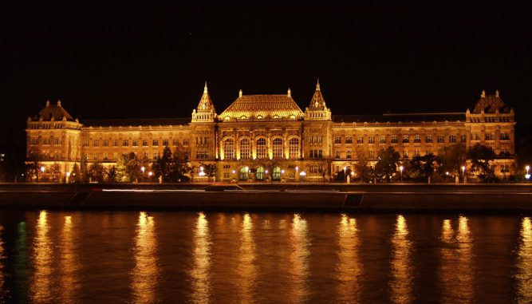
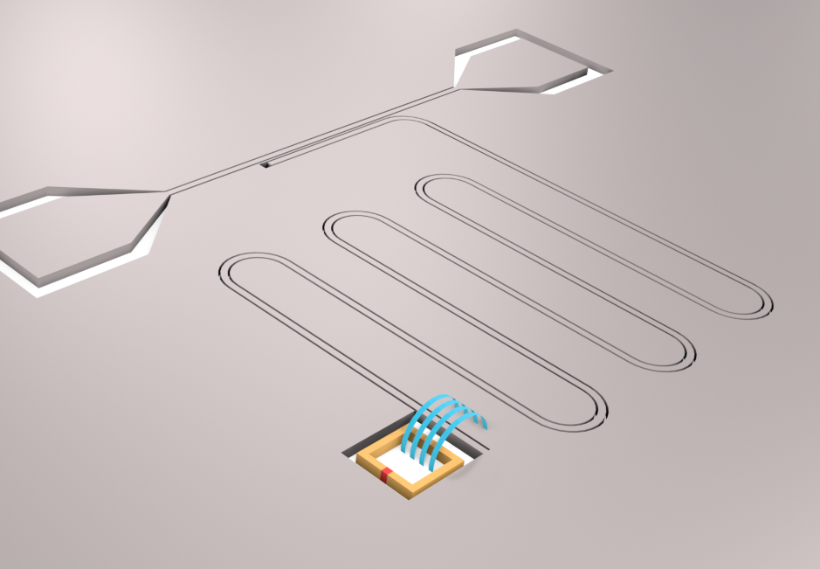
Measuring the current-phase relation in Josephson junctions using superconducting resonators
Peter Makk
nanoelectronics.physics.bme.hu
Notes:
In the last few years there was an immense development in the field of quantum computing architectures, but Information loss in quantum hardware places a serious limitation on the realization of useful quantum computers. This could be overcome by the idea of topological protection, which requires advanced quantum materials as a platform.

Slide 2



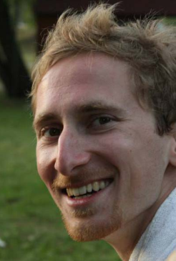
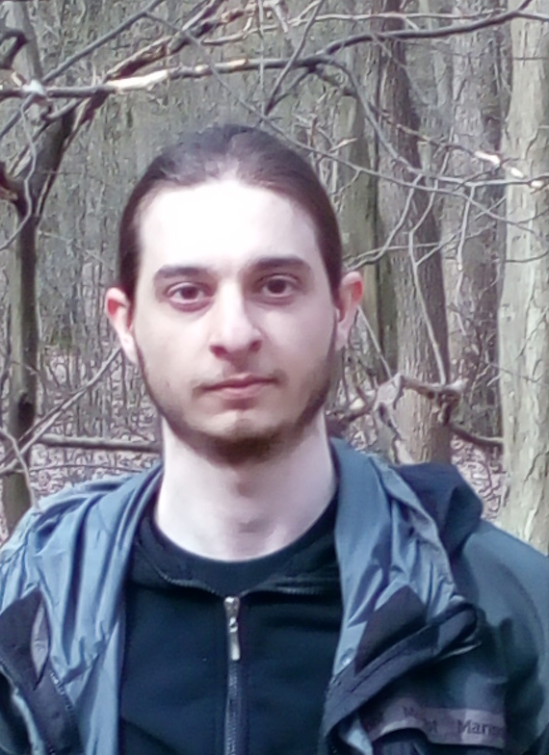
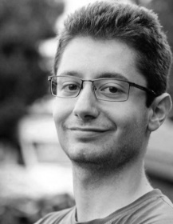


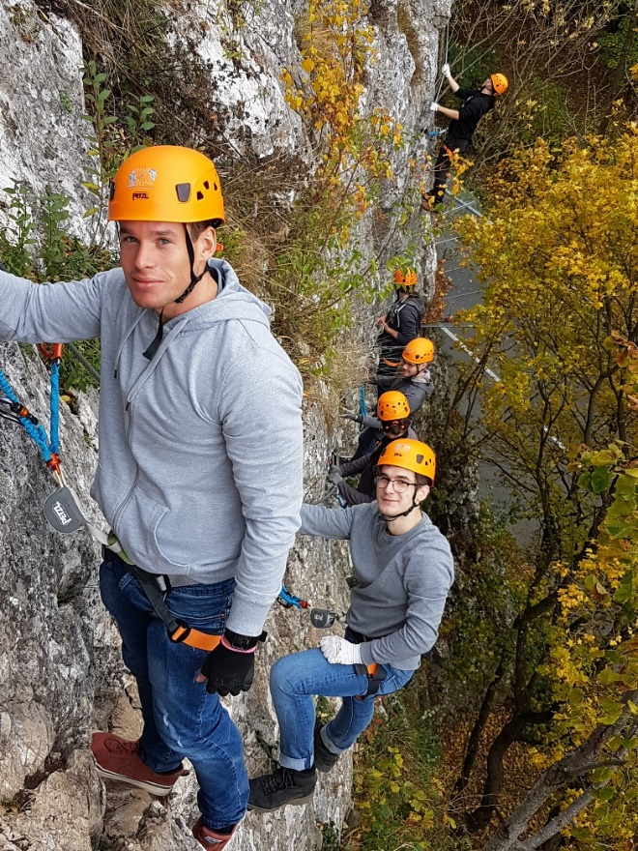
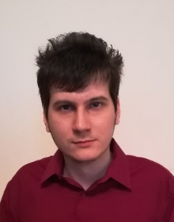
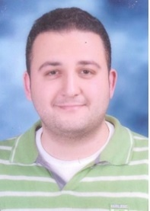
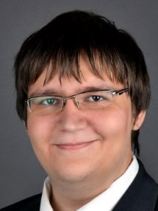

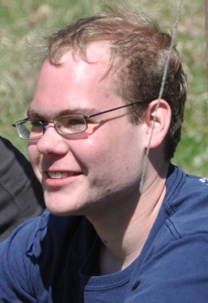






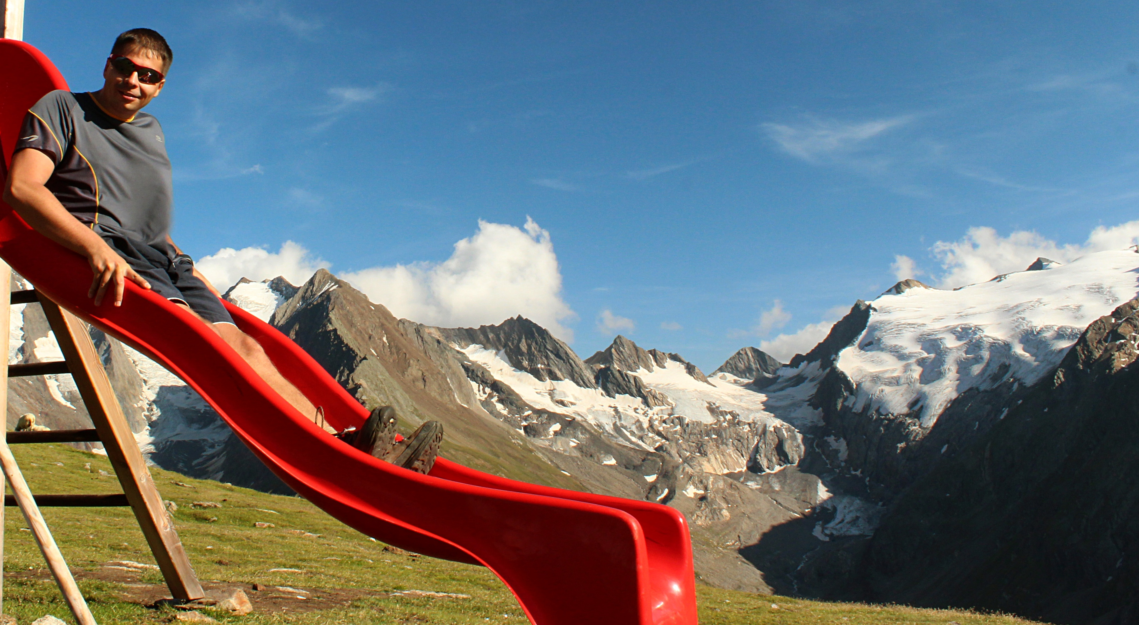


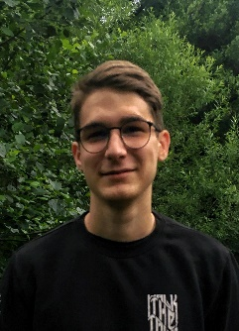
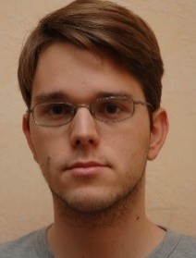



Quantum electronics Group
Notes:
In the last few years there was an immense development in the field of quantum computing architectures, but Information loss in quantum hardware places a serious limitation on the realization of useful quantum computers. This could be overcome by the idea of topological protection, which requires advanced quantum materials as a platform.

Slide 3
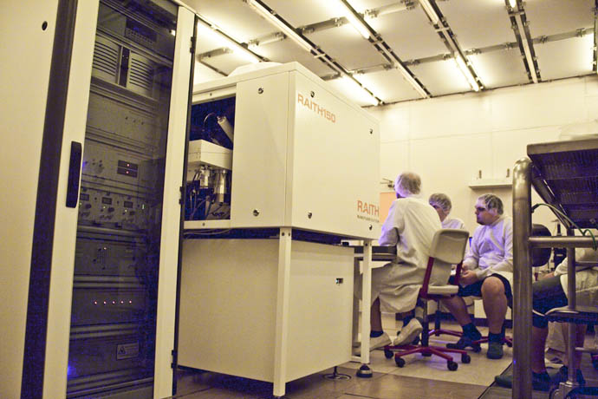
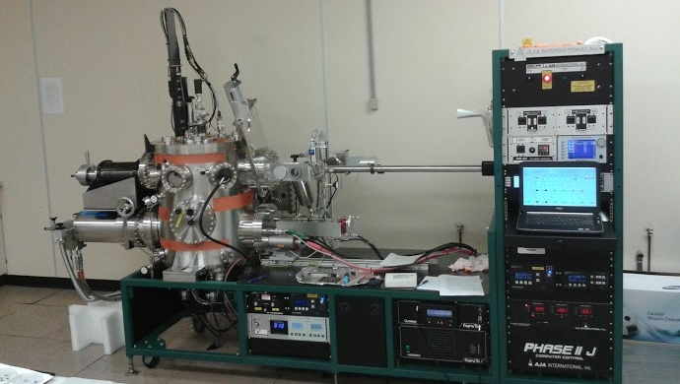
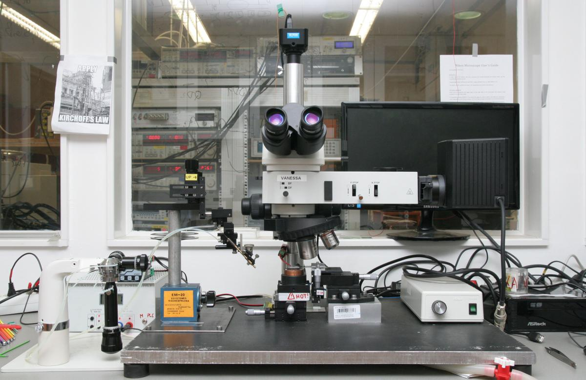
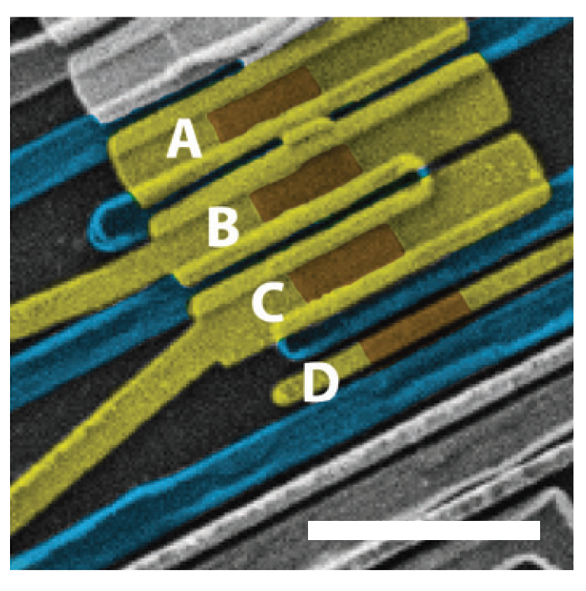
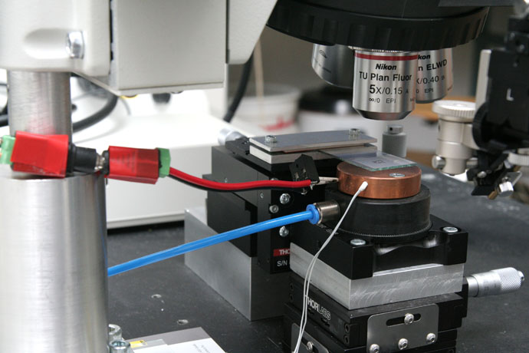
Fabrication facilities
@MFA
Fabrication at BME & MFA
(Energy Research Institute)
Notes:
In the last few years there was an immense development in the field of quantum computing architectures, but Information loss in quantum hardware places a serious limitation on the realization of useful quantum computers. This could be overcome by the idea of topological protection, which requires advanced quantum materials as a platform.

Slide 4
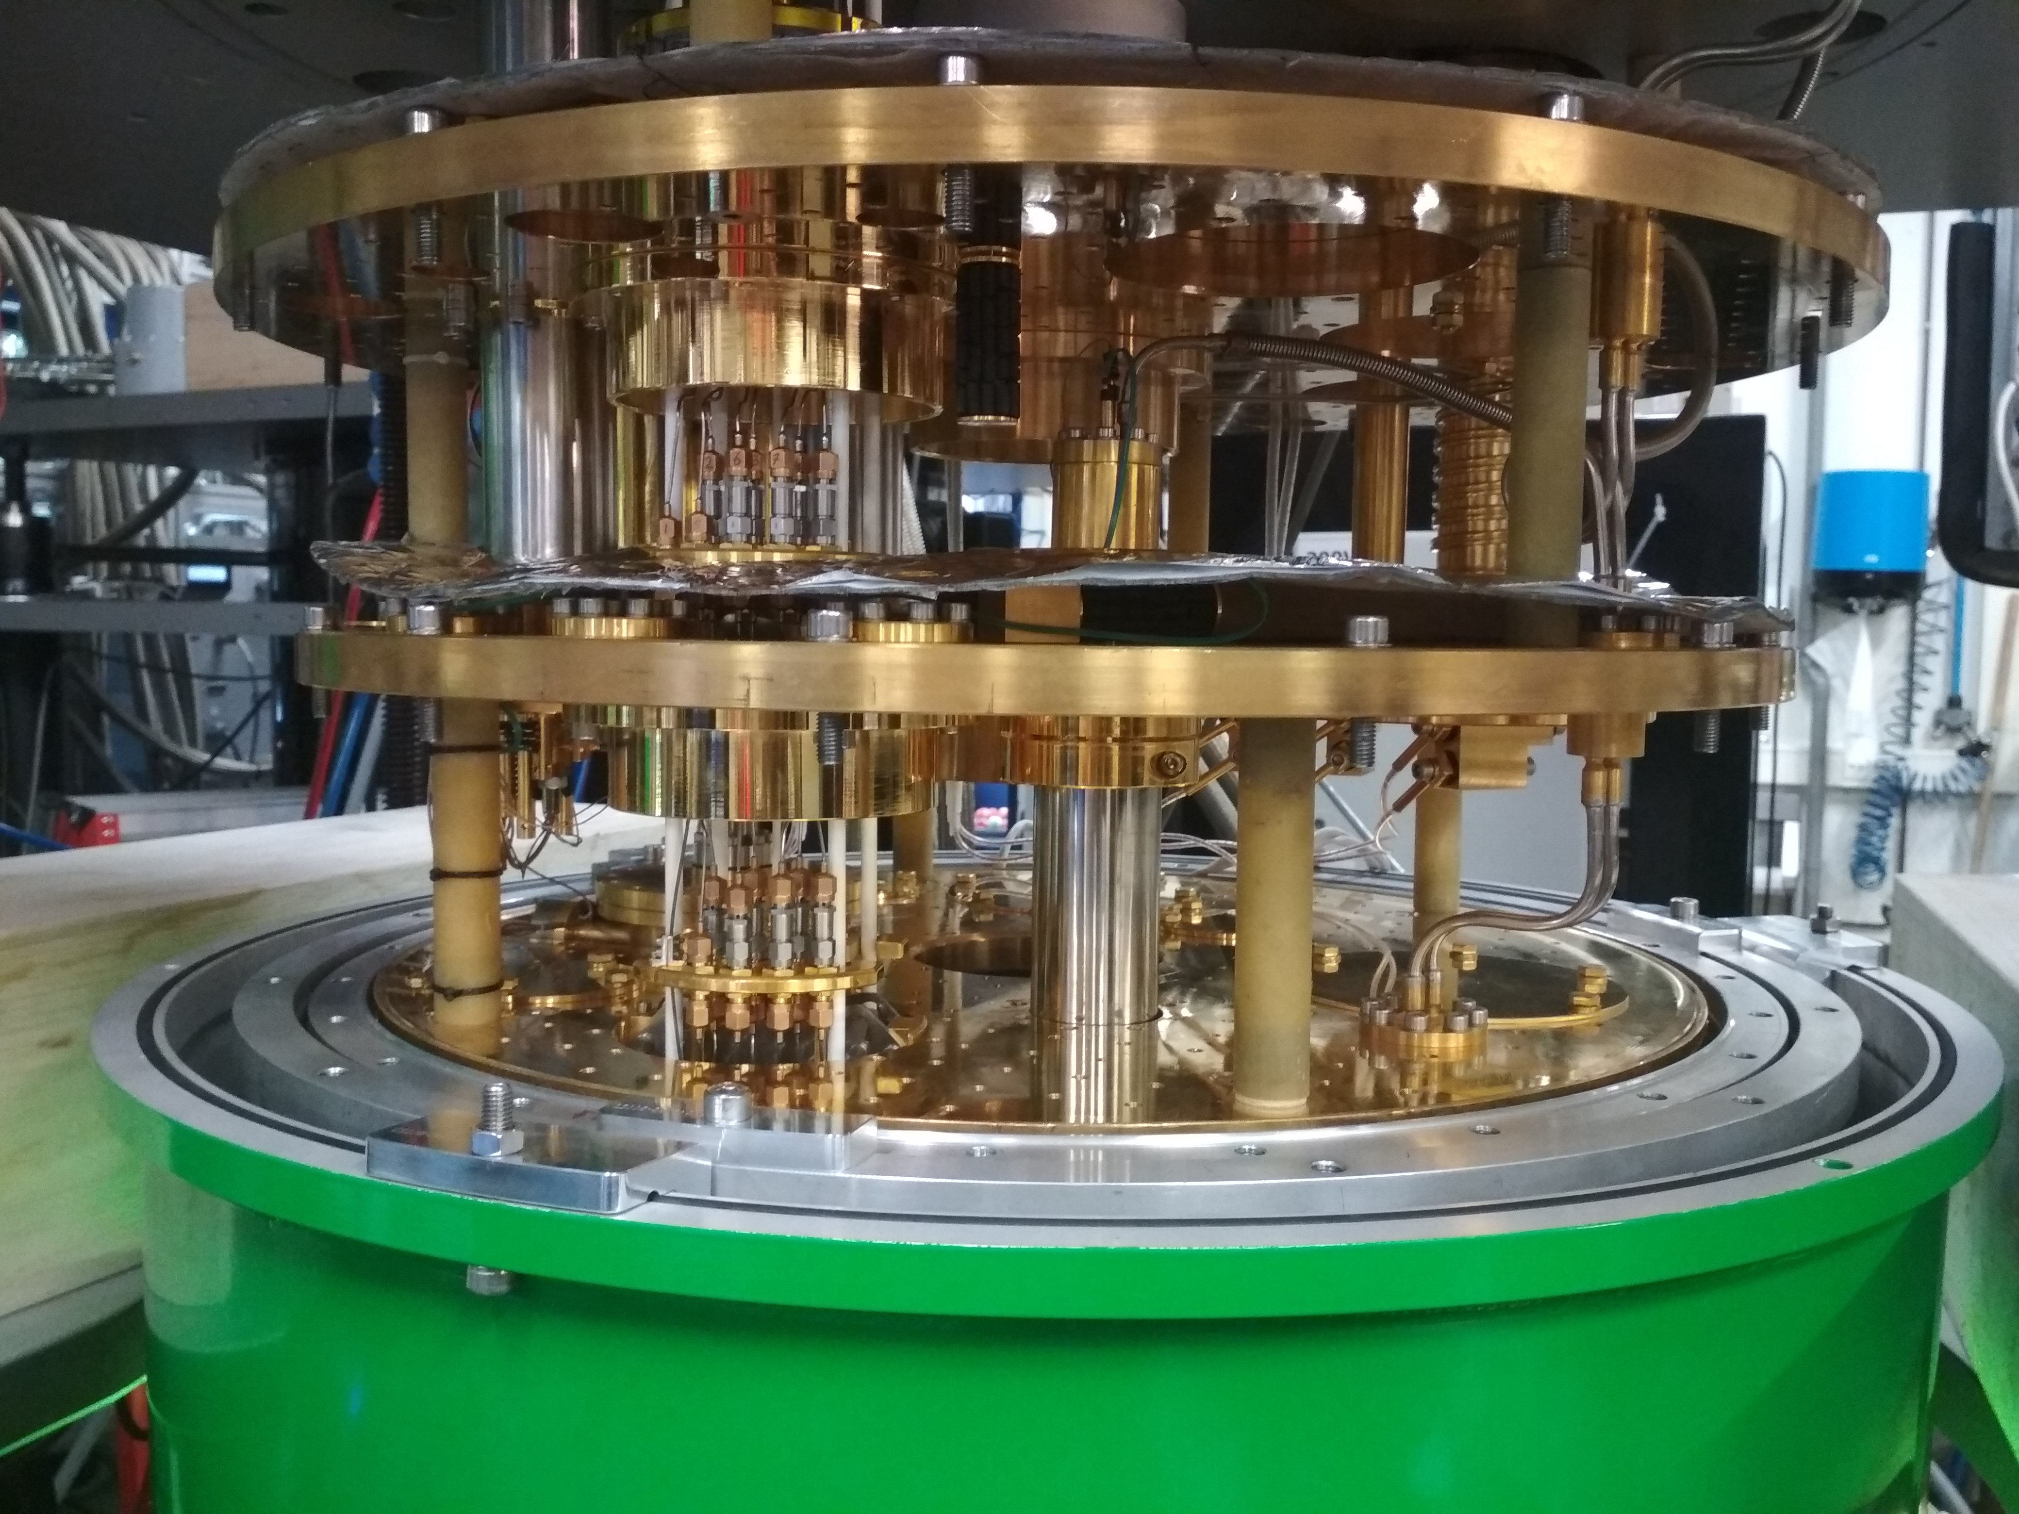
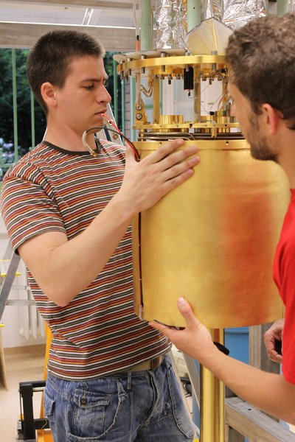
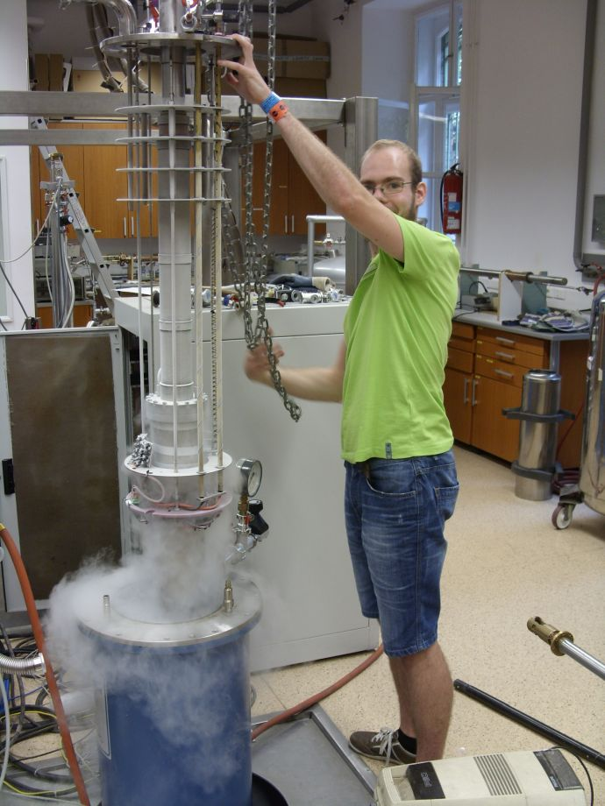
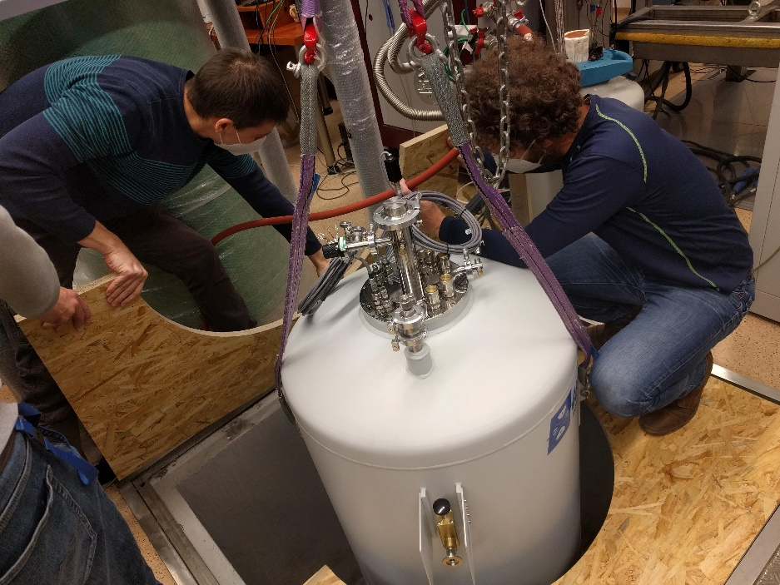
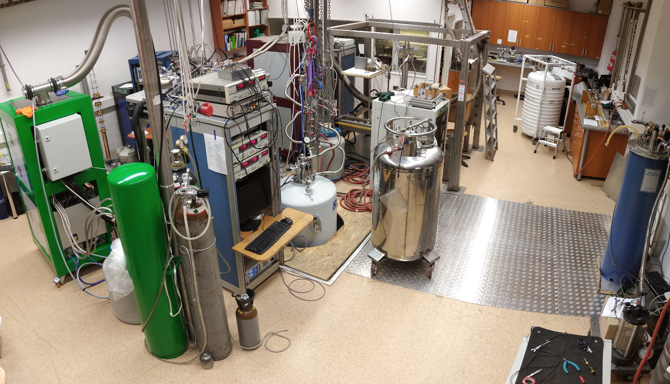
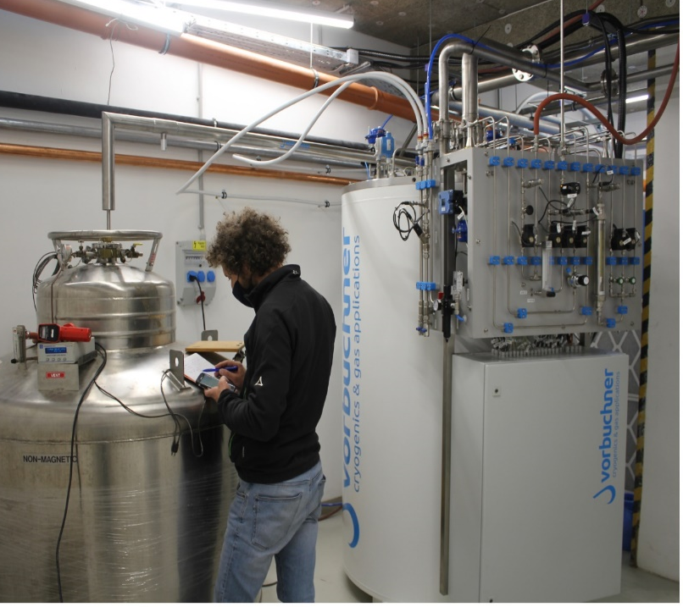
Lab facilities
Fridge, Tfridge ≈ 7mK
RF lines
3D Vector magnet:
6-2-2T
Notes:
In the last few years there was an immense development in the field of quantum computing architectures, but Information loss in quantum hardware places a serious limitation on the realization of useful quantum computers. This could be overcome by the idea of topological protection, which requires advanced quantum materials as a platform.

Slide 5
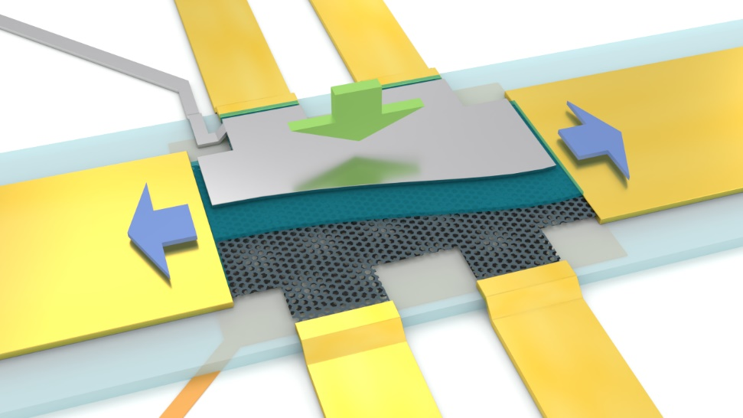
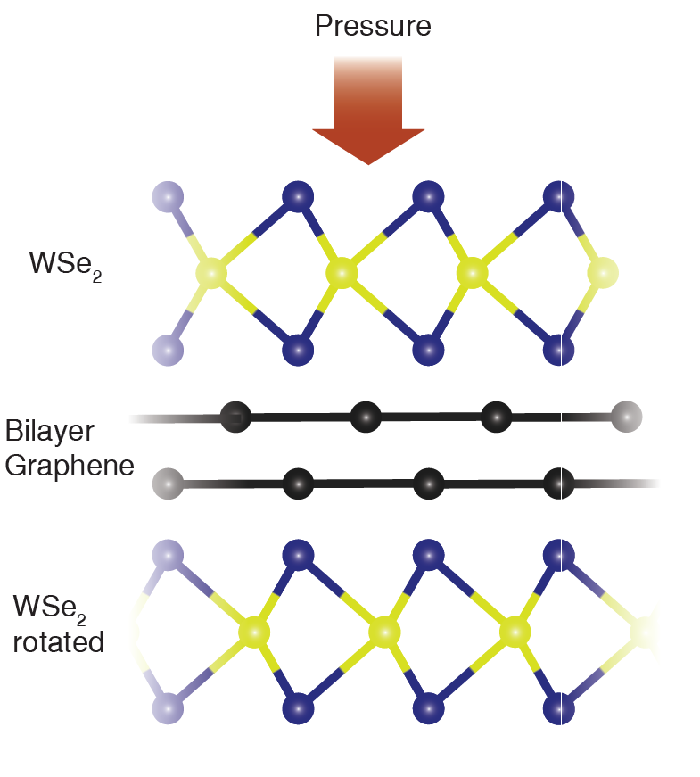
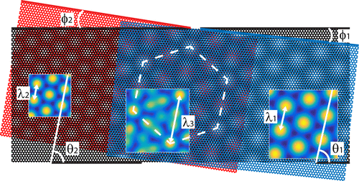
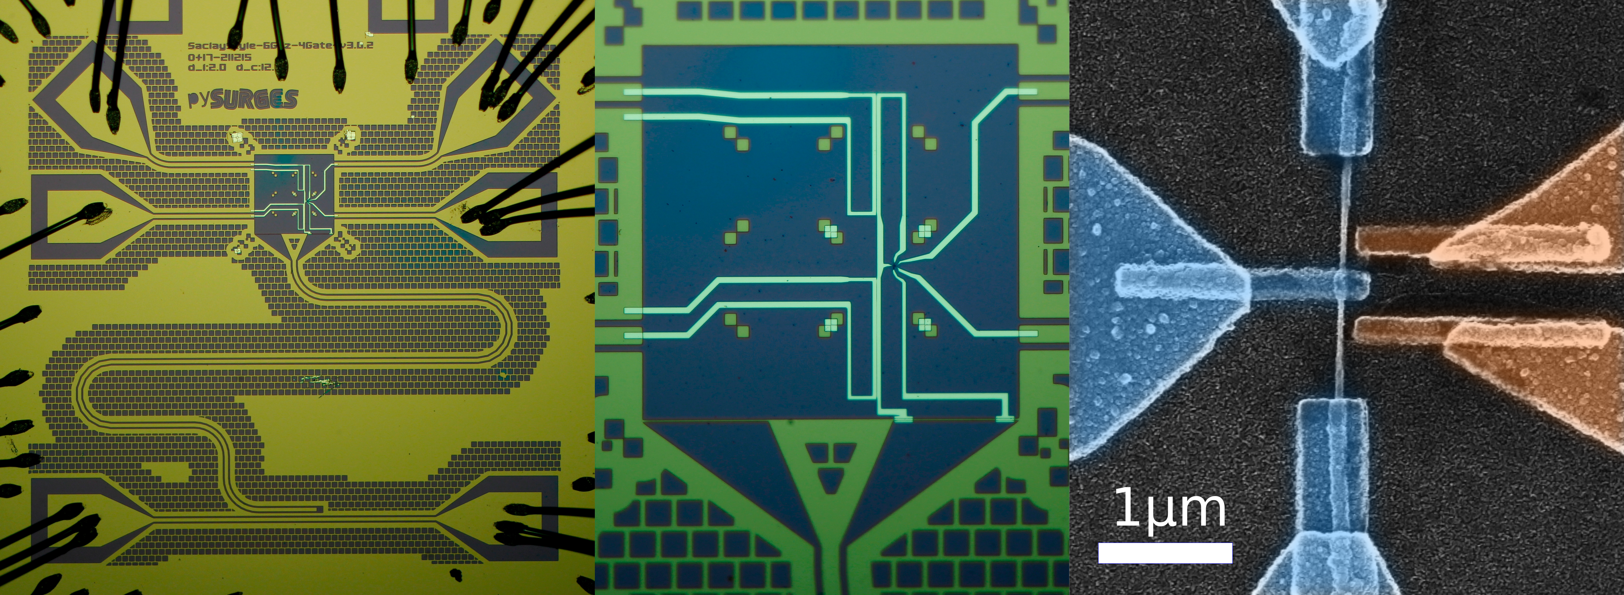
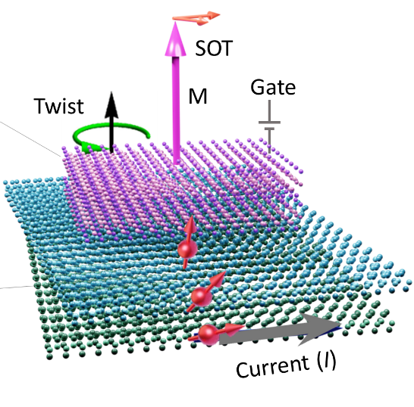
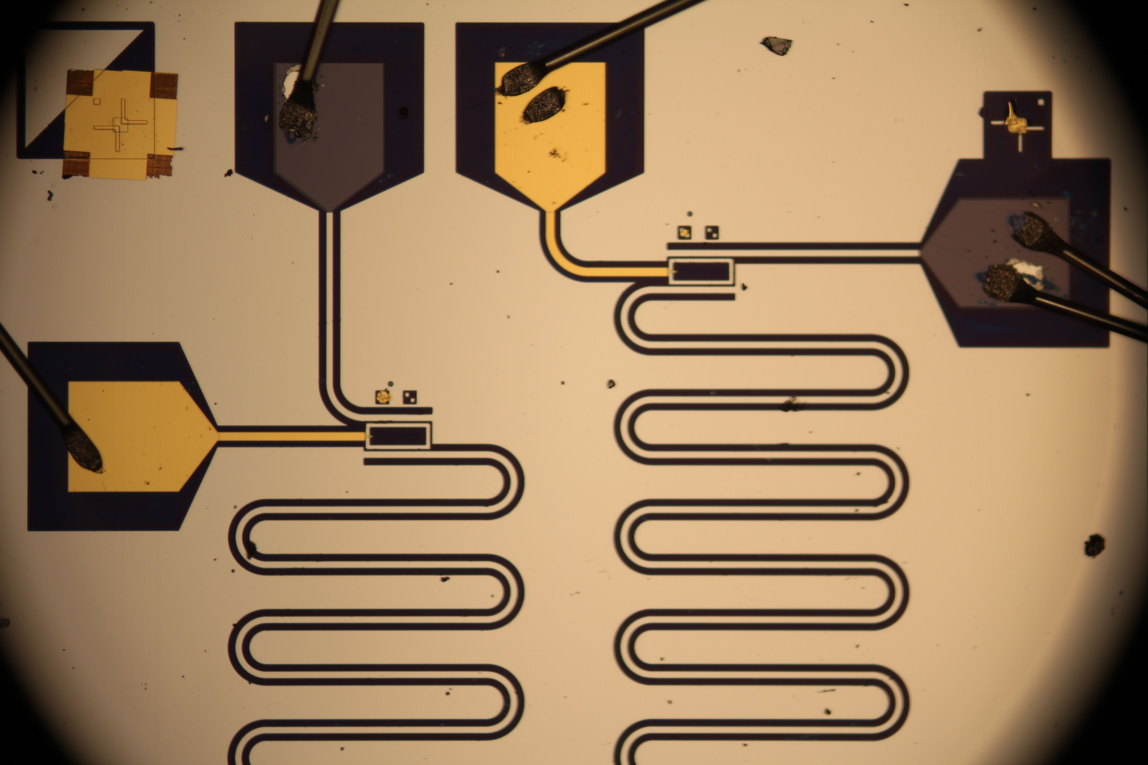
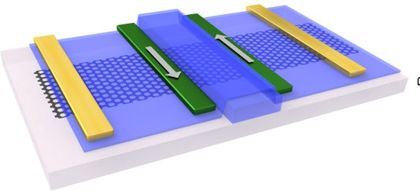
Research focus – Hybrid quantum circuits
Quantum electronics lab
Van der Waals heterostructures
High frequency studies and qubits
Spintronics

Slide 6
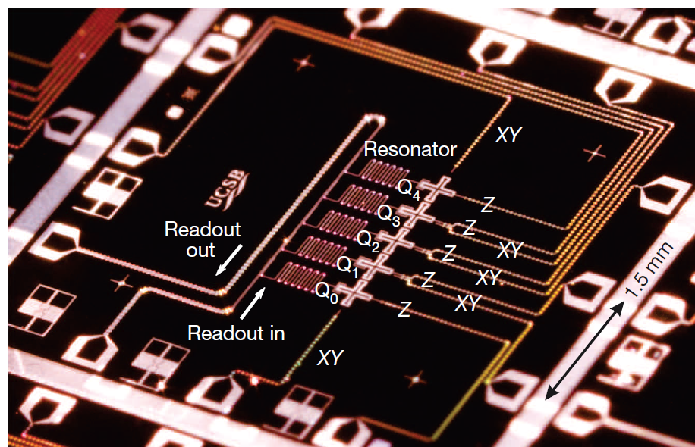
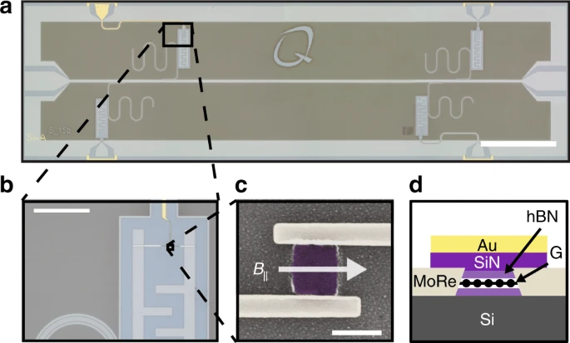
Josephson junctions
Josephson junctions are basic building blocks of quantum circuits
=
R. Barends et al, Nature 508, 500 (2014)
Nanocircuits, e.g. graphene allows gate tunable JJs → gatemon
J.G. Kroll et al, Nat. Comm 9, 4615 (2018))
Notes:
In the last few years there was an immense development in the field of quantum computing architectures, but Information loss in quantum hardware places a serious limitation on the realization of useful quantum computers. This could be overcome by the idea of topological protection, which requires advanced quantum materials as a platform.

Slide 7
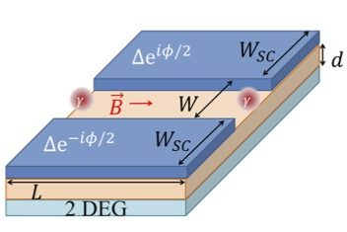
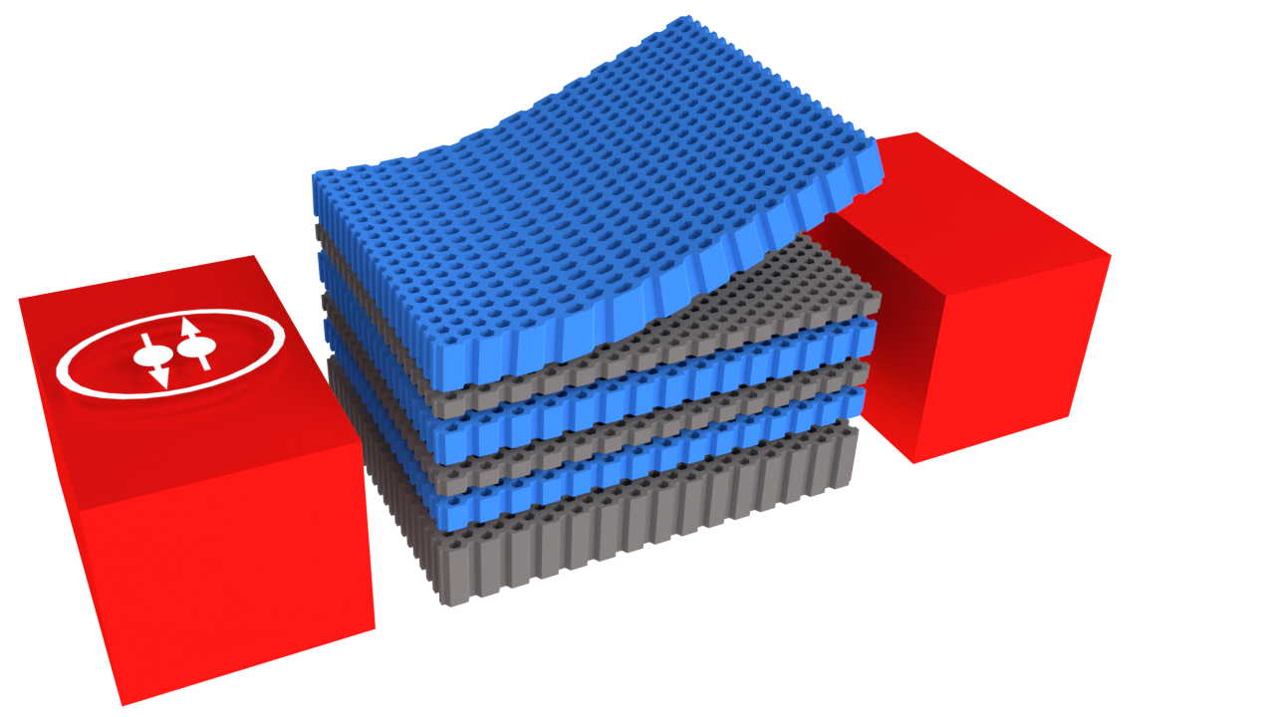
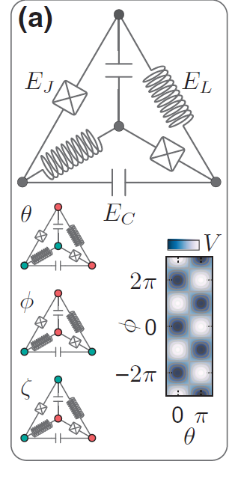
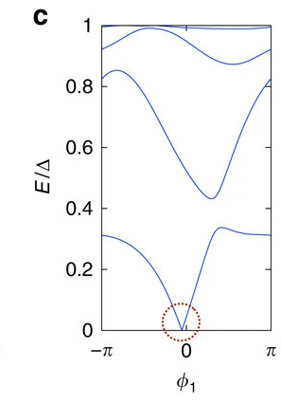
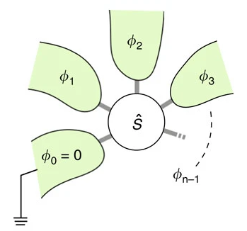
What else they are good for?
Topological SC with large SOC coupling
SC with quantum Hall physics
Protected qubits
Multiterminal junctions

Slide 8
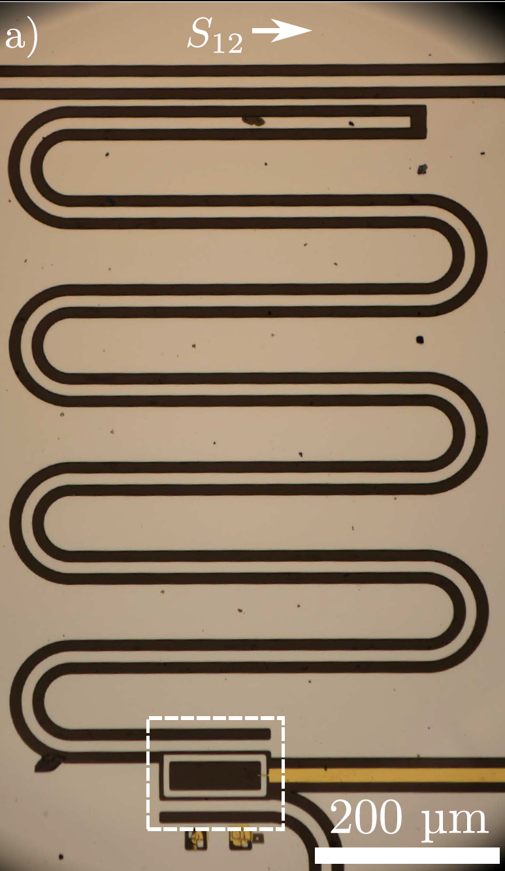
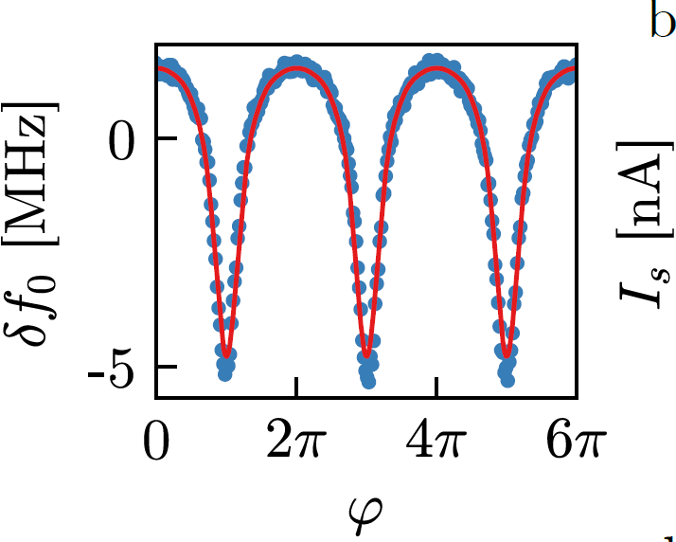
Outline
Current-Phase Relation
InAs 2DEG platform
RF measurements
Next steps
Notes:
In the last few years there was an immense development in the field of quantum computing architectures, but Information loss in quantum hardware places a serious limitation on the realization of useful quantum computers. This could be overcome by the idea of topological protection, which requires advanced quantum materials as a platform.

Slide 9
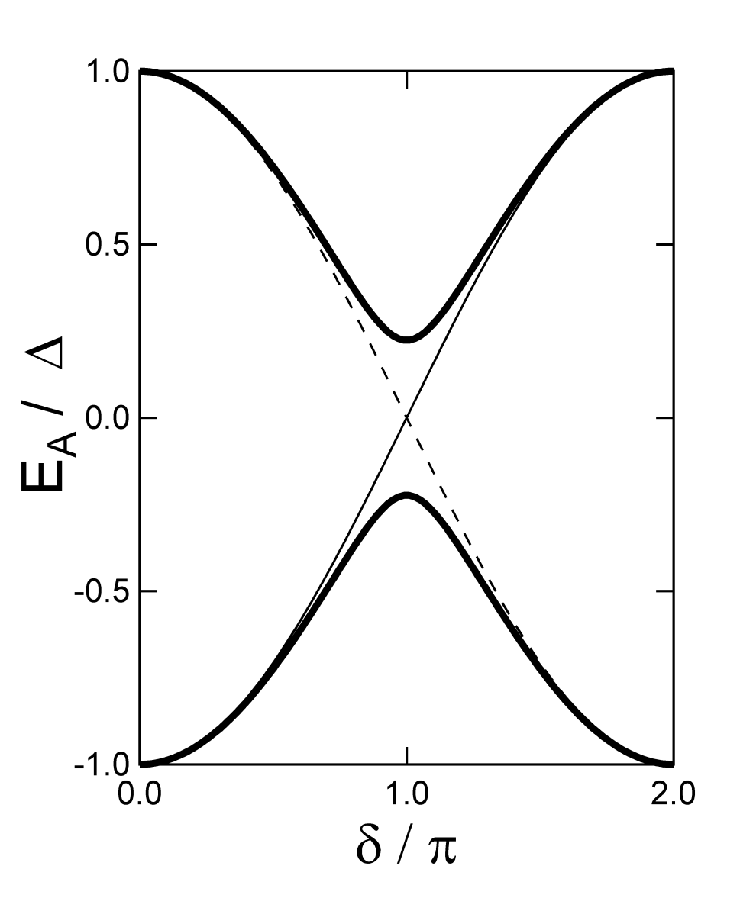


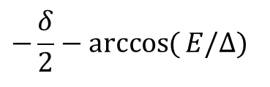







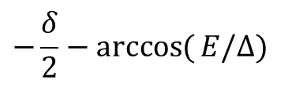
Josephson junctions
For finite transmission - normal reflection in the N part
$$E=Δ\sqrt{1−τ\sin^{2}{(}δ/2)}$$
$$−δ/2$$
$$δ/2$$
E
$$∆$$
$$µ$$
$$−∆$$
E < Δ
$$L≪ξ=\frac{ℏv_{F}}{Δ}$$
$$k_{x}$$
AR
AR
$$−\frac{δ}{2}−\arccos{(}E/Δ)$$
For a tunnel junction (τ<<1):
$$−\frac{δ}{2}−\arccos{(}E/Δ)$$
We get back the
Josephson relation

Slide 10
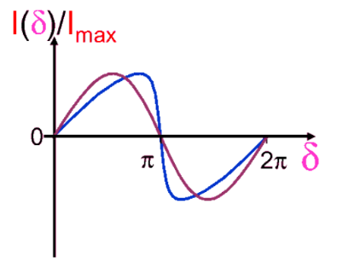

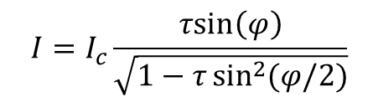







Josephson junctions
Short junction
S₁
I
S₂
S₁
N
S₂
$$φ=Φ_{L}−Φ_{R}$$
General current-phase relation:
Josephson equations:
$I=I_{C} f⁡(φ_{L}−φ_{R})$
$I\left(φ=0\right)=0$
$$I_{s}=I_{c}sin⁡(φ)$$
protected by time-reversal
and parity symmetries
$$\dot{φ}= \frac{2eV}{h}$$
$$φ$$
Long junction
Single Andreev bound state:
$$I=I_{c}\frac{τsin\left(φ\right)}{\sqrt{1−τ\sin^{2}{(φ/2)}}}$$
$$φ$$

Slide 11
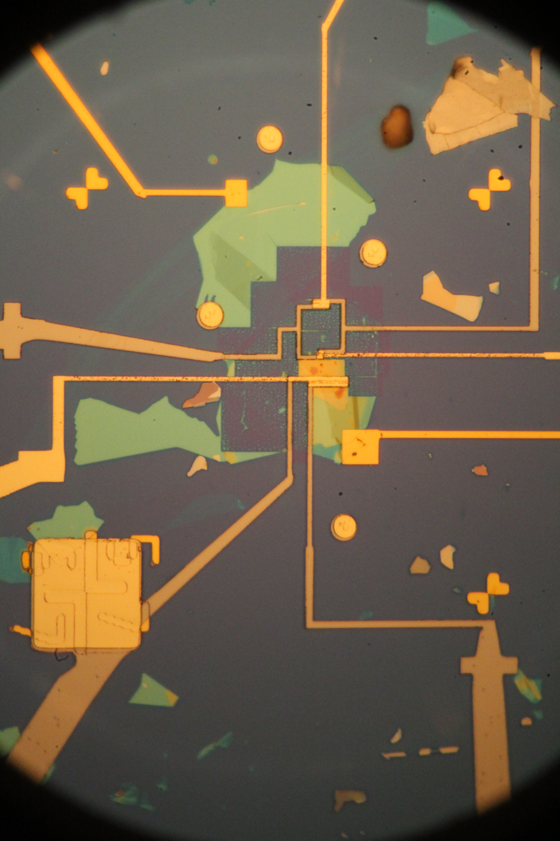
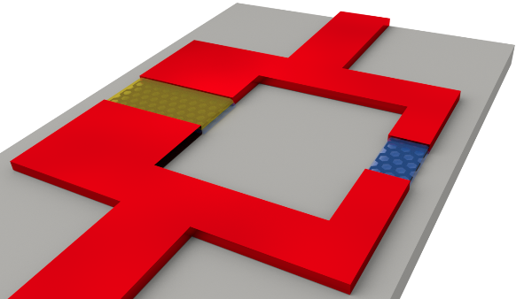
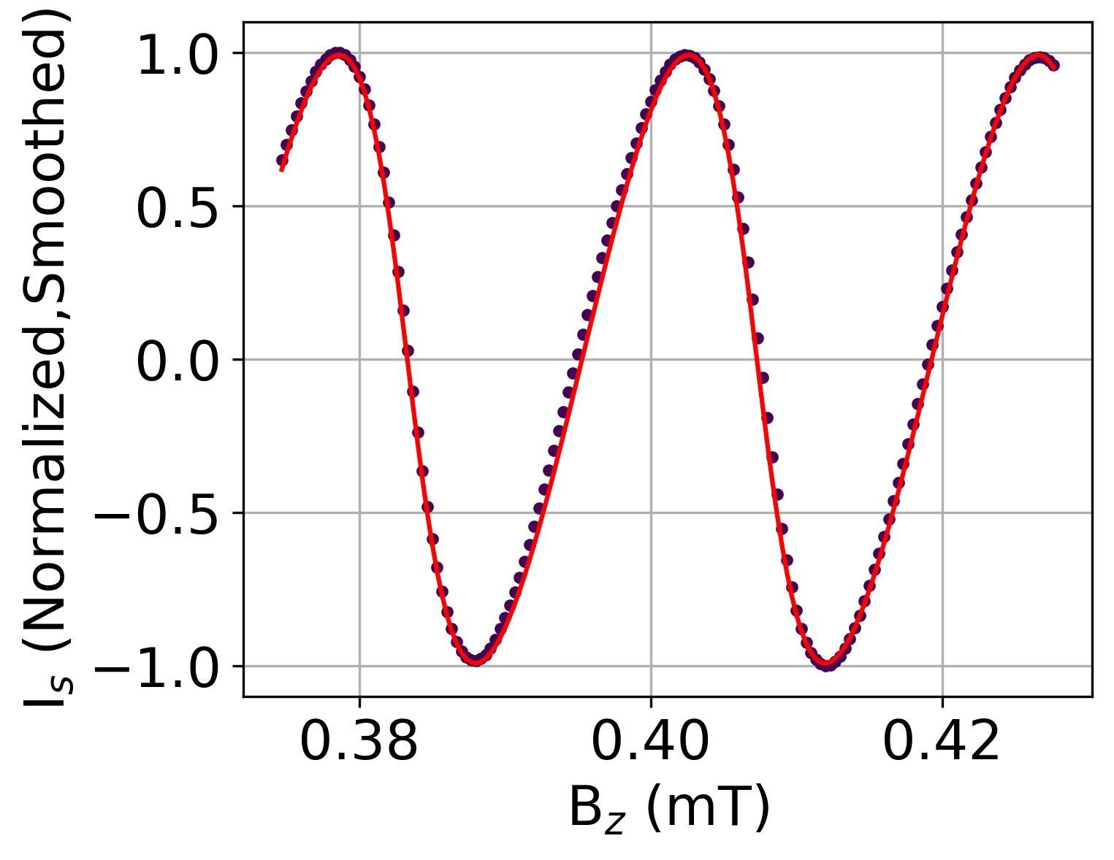
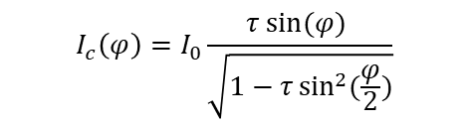
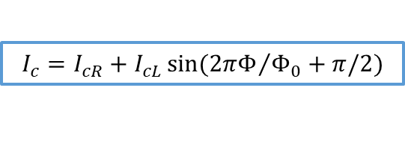

CPR measurements – DC SQUIDs
How to measure CPR?
Asymmetric SQUID
$$I_{c}\left(φ\right)=I_{0}\frac{τ\sin{(φ)} }{\sqrt{1−τ\sin^{2}{(\frac{φ}{2})}}}$$
$$I_{cL}≪ I_{cR}$$
WSe₂/Gr/WSe₂ junctions
Asymmetric case:
$$I_{c}=I_{cR}+I_{cL}\sin{({2πΦ}/{Φ_{0}}+π/2})$$

Slide 12






CPR measurements via RF SQUIDs
Non-linear (Josephson) inductance:
Readout: SC resonator
RF – SQUID acts as a tunable load
$$\frac{1}{L_{J}\left(φ\right)}=\frac{2e}{ℏ}\frac{∂I\left(φ\right)}{∂φ}$$
JJ is a non-linear inductor
RF- SQUID
$$φ$$
$$Φ$$
$$2πn=φ+2π\frac{Φ}{Φ_{0}}$$
R. Haller et al., Phys. Rev. Res. 4, 013198 (2022)

Slide 13



InAs heterostructures
InAs 2DEG
Superconductor
2DEG
Good coupling to the SC layer
High quality devices
From SdHO measurements
50’-100’000 cm²/Vs mobility
M. Sütő et al., Phys. Rev. B 106, 235404 (2022)
Notes:
In the last few years there was an immense development in the field of quantum computing architectures, but Information loss in quantum hardware places a serious limitation on the realization of useful quantum computers. This could be overcome by the idea of topological protection, which requires advanced quantum materials as a platform.

Slide 14




Device outline
InAs 2DEG
Al SC resonator from the epi-Al layer
Inductive coupling
Gate tunability
ALD AlOx dielectric
Notes:
In the last few years there was an immense development in the field of quantum computing architectures, but Information loss in quantum hardware places a serious limitation on the realization of useful quantum computers. This could be overcome by the idea of topological protection, which requires advanced quantum materials as a platform.

Slide 15








CPR measurements
V_{g} = -6.06V
V_{g} = -7.82V
V_{g} = -8.06V
V_{g} = -8.6V
f (GHz)
B (μT)
B (μT)
B (μT)
B (μT)
$$I\left(φ\right)=\frac{e∆}{2ℏ}\frac{τ sin\left(φ\right)}{\sqrt{1−τ \sin^{2}\left(φ/2\right)}}$$
$$I\left(φ\right)=\sum_{k}{{\left(−1\right)}^{k−1}A_{k}sin\left(kφ\right)}$$
$A_{k+1}<A_{k}$ ➔ $k_{max}$
Notes:
In the last few years there was an immense development in the field of quantum computing architectures, but Information loss in quantum hardware places a serious limitation on the realization of useful quantum computers. This could be overcome by the idea of topological protection, which requires advanced quantum materials as a platform.

Slide 16




CPR measurements
Higher harmonics lead to skewed CPR – large transmission for higher doping
Dissipation is higher at odd multiples of $π$
Transitions between ABS (thermal population is non-negligible)
Notes:
In the last few years there was an immense development in the field of quantum computing architectures, but Information loss in quantum hardware places a serious limitation on the realization of useful quantum computers. This could be overcome by the idea of topological protection, which requires advanced quantum materials as a platform.

Slide 17


Interference pattern
Measurement in homogenous perpendicular magnetic field
Fraunhofer pattern $|\frac{\sin{x}}{x}|$
SQUID-like pattern $|\cos\left(x\right)|$
Finite magnetic field an interference pattern emerges
Can be seen as the envelope of the CPR
Background stemming from the resonator subtracted
Homogenous current flow seen - Fraunhofer like pattern
Notes:
In the last few years there was an immense development in the field of quantum computing architectures, but Information loss in quantum hardware places a serious limitation on the realization of useful quantum computers. This could be overcome by the idea of topological protection, which requires advanced quantum materials as a platform.

Slide 18





In-plane B-field measurements
In-plane B-field leads to (anisotropic decrease) of Ic
Fraunhofer becomes asymmetric, characterized by
Asymmetry comes from disorder + ${φ }_{0}$junctions?
H. J. Suominen, et al., Phys. Rev. B 95, 035307 (2017).
A. Assouline et al., Nature Comm., 10, 126 (2019).
Notes:
In the last few years there was an immense development in the field of quantum computing architectures, but Information loss in quantum hardware places a serious limitation on the realization of useful quantum computers. This could be overcome by the idea of topological protection, which requires advanced quantum materials as a platform.

Slide 19



Next steps - QPC
SC+QPC to achieve single mode
Address with two-tone
Preliminary
InAs nanowire
Notes:
In the last few years there was an immense development in the field of quantum computing architectures, but Information loss in quantum hardware places a serious limitation on the realization of useful quantum computers. This could be overcome by the idea of topological protection, which requires advanced quantum materials as a platform.

Slide 20


Next steps – Andreev molecules
Strong coupling leads to formation of Andreev states
Josephson junctions are ballistic channels
Coupling by proximity
Non-local phase and gate tunability
With dots – more interesting ground state manifold
J.-D. Pillet et al., Nano Letters 19, 7138 (2019)
On InAs wires
See talk of Szabolcs Csonka
Notes:
In the last few years there was an immense development in the field of quantum computing architectures, but Information loss in quantum hardware places a serious limitation on the realization of useful quantum computers. This could be overcome by the idea of topological protection, which requires advanced quantum materials as a platform.

Slide 21
Summary
InAs 2DEG as scalable SC-Semi platform
RF measurements show highly transmissive modes
Towards Andreev molecules
Notes:
In the last few years there was an immense development in the field of quantum computing architectures, but Information loss in quantum hardware places a serious limitation on the realization of useful quantum computers. This could be overcome by the idea of topological protection, which requires advanced quantum materials as a platform.

Slide 22









Quantum electronics Group

Slide 23



CPR of SLG
Normal state data
P-N-P
N-N’-N
P-P’-P
N-P-N
Device
hBN/WSe2/Gr/WSe2/hBN
$V_{BG}$(graphite gate)
$V_{TGdev}$ (topgate)
Reference
hBN/Gr/hBN
$V_{TGref}$ (topgate)
Both device and reference CNP visible (~0 V)
Reference gate is independent from device
Device TG and BG tunes differently
Small PNP and NN’N junctions form
Notes:
In the last few years there was an immense development in the field of quantum computing architectures, but Information loss in quantum hardware places a serious limitation on the realization of useful quantum computers. This could be overcome by the idea of topological protection, which requires advanced quantum materials as a platform.

Slide 24



CPR measurement – Andreev description
Fitting with Andreev formula:
Phase: $φ=\frac{2πB_{z}}{p_{B}}−φ_{0}$
Fit function:
$$I_{c}\left(φ\right)=I_{0}\frac{τ\sin{(φ)} }{\sqrt{1−τ\sin^{2}{(\frac{φ}{2})}}}$$
Fitting results
$φ_{0}$ (phase shift)
$\overline{τ}$ (average transmission)
Notes:
In the last few years there was an immense development in the field of quantum computing architectures, but Information loss in quantum hardware places a serious limitation on the realization of useful quantum computers. This could be overcome by the idea of topological protection, which requires advanced quantum materials as a platform.

Slide 25

Resonator response
Notes:
In the last few years there was an immense development in the field of quantum computing architectures, but Information loss in quantum hardware places a serious limitation on the realization of useful quantum computers. This could be overcome by the idea of topological protection, which requires advanced quantum materials as a platform.

Slide 26

Notes:
In the last few years there was an immense development in the field of quantum computing architectures, but Information loss in quantum hardware places a serious limitation on the realization of useful quantum computers. This could be overcome by the idea of topological protection, which requires advanced quantum materials as a platform.

Slide 27






Research focus – RF measurements
Readout of current-phase relation using SC resonators in InAs based QDs
Non-local tunings
Qubit
$$\left.|e\right\rangle$$
I_{s}
$$\left.|g\right\rangle$$
I_{s}
Notes:
In the last few years there was an immense development in the field of quantum computing architectures, but Information loss in quantum hardware places a serious limitation on the realization of useful quantum computers. This could be overcome by the idea of topological protection, which requires advanced quantum materials as a platform.

Slide 28

















Josephson junctions
Microscopic picture: Andreev reflection
S-N-S junctions: Bound states form
$$δ/2$$
$$−δ/2$$
$$δ/2$$
$$y$$
E
E
$$x$$
$$∆$$
$$∆$$
$$µ$$
E < Δ
$$µ$$
E < Δ
$$−∆$$
$$−∆$$
$$k_{x}$$
$$k_{x}$$
AR
AR
$$−\frac{δ}{2}−\arccos{(}E/Δ)$$
$$−\frac{δ}{2}−\arccos{(}E/Δ)$$
$$−\frac{δ}{2}−\arccos{(}E/Δ)$$
$$−δ−2\arccos{\frac{E}{∆}}+\left(k_{e}+k_{h}\right)L=0 (\operatorname{mod}{2}π)$$

Slide 29




Double layer SQUID
TG
AlOx
hBN
Gr
hBN
SC
SC
Gr
hBN
Graphite
Double layer SQUID
Separate bottom and top gates
The supercurrent in the top and the bottom layer are separately tunable
Can be driven in magnetic field to an artificial QSH system
No SC in the QH regime
D. Indolese et al., Nano Lett., 20, 7129 (2020)

Slide 30



Double layer SQUID
Act as SQUID with in-plane magnetic field
Can be used to measure CPR
No Fraunhofer correction needed
No split supercurrent observed
D. Indolese et al., Nano Lett., 20, 7129 (2020)
Notes:
In the last few years there was an immense development in the field of quantum computing architectures, but Information loss in quantum hardware places a serious limitation on the realization of useful quantum computers. This could be overcome by the idea of topological protection, which requires advanced quantum materials as a platform.

