Slide 1
Benchmarking Quantum Computers: Towards a Standard Performance Evaluation Approach
Rubén Peña Guzmán
Basque center for applied mathematics

Slide 2
Collaboration
Mikel Sanz, PhD
Arturo Acuaviva,
PhD student

Slide 3
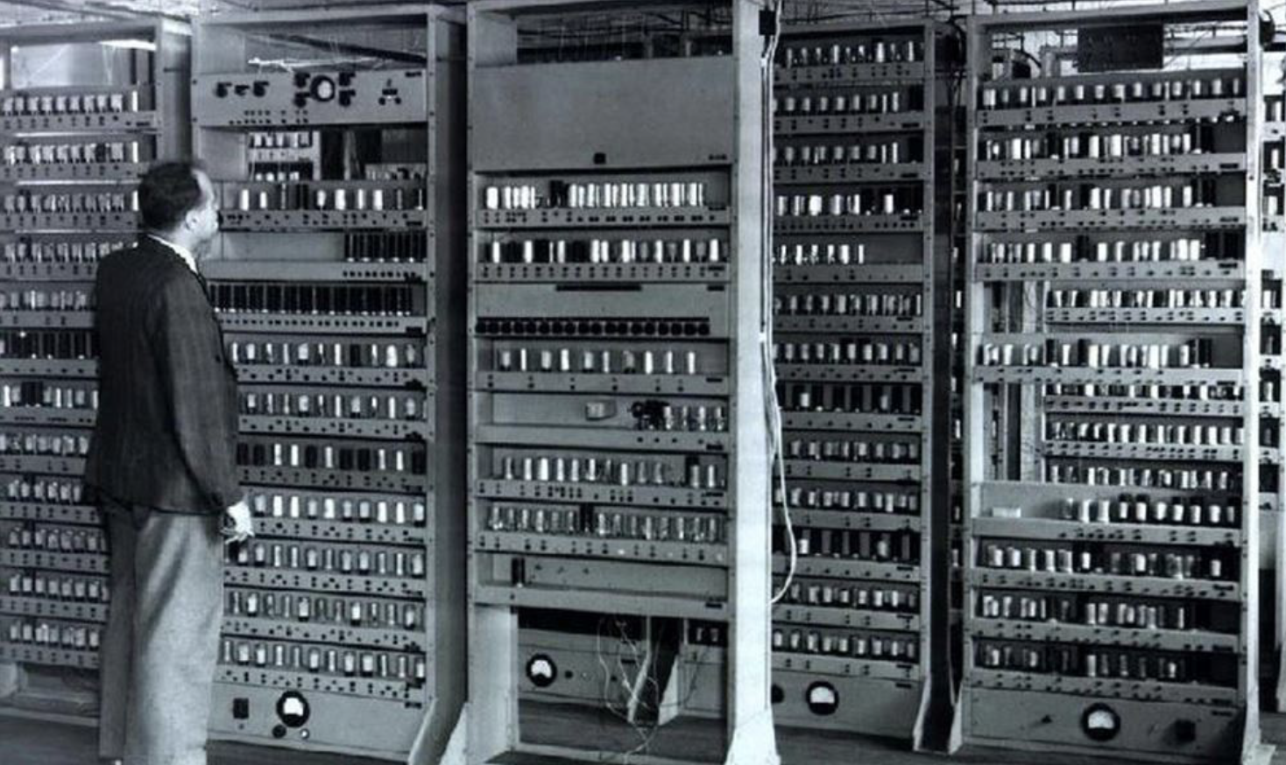
Introduction
Why do we want to measure the performance of a quantum computer?
Strengths
and weakness
Areas
for improvement
The devices
capabilities
Compare different devices
What can quantum benchmarking learn from classical benchmarking?
Classical computer

Slide 4
Quantum Benchmark
Quantum Benchmark:
A test, or set of tests, that aims to measure or evaluate the performance of a quantum processor for a certain task.
Metric:
A quantum performance metrics allow us to characterize a given performance-related property of a system.
1.Execute
Benchmark
2.Data
3.Metrics

Slide 5
Roadmap for Quantum Benchmarking
Guideline 1: Benchmarks must uphold the key quality attributes: relevance, reproducibility, fairness, verifiability, and usability.
Benchmark
Relevance
Reproducibility
Fairness
Verifiability
Usability
Provide relevant information about the performance of interest.
Reproduce the same results.
Without Bias.
Verify the results of the Benchmark.
Easy to use.

Slide 6
Roadmap for Quantum Benchmarking
Guideline 2. Benchmarks metrics must uphold the key quality attributes: practical, repeatable, reliable, and consistent.
Practical
Repeatable
Reliable
Consistent
A metric is practical if it
can be measured in
a viable and realistic time.
The same value must
be measured.
Indicate whether a quantum computer has better performance than another value must be measured.
A metric is consistent if it has the same units and the same precise definition across different systems.

Slide 7
Roadmap for Quantum Benchmarking
Guideline 3: Benchmarks must offer peak and base performance results.
Benchmark
QC
Compiler
High level
Low-level
How should Benchmarks be compiled?
Base performance
Require that the benchmark are compiled using the same rules.
Peak performance
Peak run allow more
freedom, allow to use
different compilation rules for each benchmark.

Slide 8
Roadmap for Quantum Benchmarking
Guideline 4: Different technological eras necessitate different types of benchmarks.
NISQ era
Post-NISQ era
Guideline 5. Do not rely solely on a single benchmark to measure performance.
Benchmark suite
Benchmark
Benchmark
1.Execute
2.Data
Benchmark
Benchmark
3.Metrics

Slide 9
Roadmap for Quantum Benchmarking
Benchmark Structure
Device verification
Benchmark suite
Define the set the benchmark to be executed.
Benchmark metrics
Define metrics that capture the behaviour of interest
Transpiler/Compiler rules
Define base and peak experiment flags allowed.
Execute test suit for base setup
Execute the test suit using the base configuration.
Execute test suit for peak setup
Execute the test suit using the peak configuration.
Benchmark report results: Compile all results.

Slide 10
Roadmap for Quantum Benchmarking
The creation of a Standard Performance Evaluation for Quantum Computers (SPEQC)
Public administraton
Hardware and
software vendors
Scientific
community
SPEQC should be a non-profit organization that establishes criteria for evaluating the performance of quantum computers, developing and distributing a set of tests to be used as benchmarks.
Reduce Bias
Technological development:
Helps to identify areas for improvement
Ensures fair and objective:
By establishing criteria for performance evaluation, bias and subjectivity can be eliminated.
Ensures that all quantum devices are evaluated using the same criteria.

Slide 11
Roadmap for Quantum Benchmarking
Thanks for your attention!

