Slide 1
(Recent Advances in) Responsible Quantum Technologies
20.06.2024
Zeki C. Seskir
Karlsruhe Institute of Technology (KIT)
Institute for Technology Assessment and Systems Analysis (ITAS)

Slide 2
Outline
Introduction: ITAS and QuTec
Responsible (and Irresponsible) Tech. Development
Responsible QT Efforts (by others)
Collingridge Dilemma, Path-dependency, and TEP
Social acceptance and understanding of QT
Concluding Remarks
Email: zeki.seskir@kit.edu
LinkedIn: Zeki Seskir

Slide 3
Disclaimer: Technology Assessment in English/German
Institute for Technology Assessment and Systems Analysis
Institut für Technikfolgen­abschätzung und System­analyse (ITAS)
intended and unintended consequences & acceptability of future technological developments

Slide 4
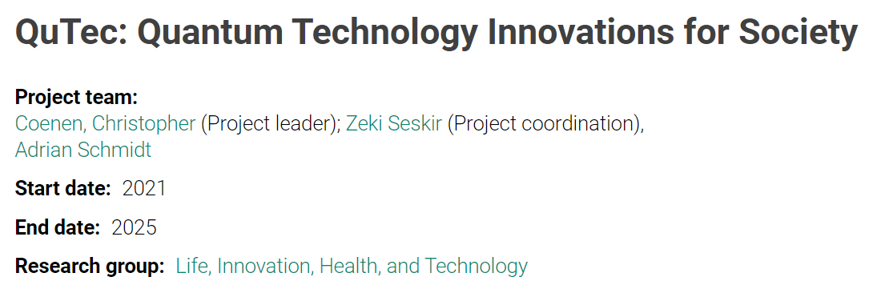
Three main topics:
Landscaping of the QT Ecosystem(s)
Education and Outreach Research in QT
Concept Exploration and Operationalization for ELSA Research on QT

Slide 5
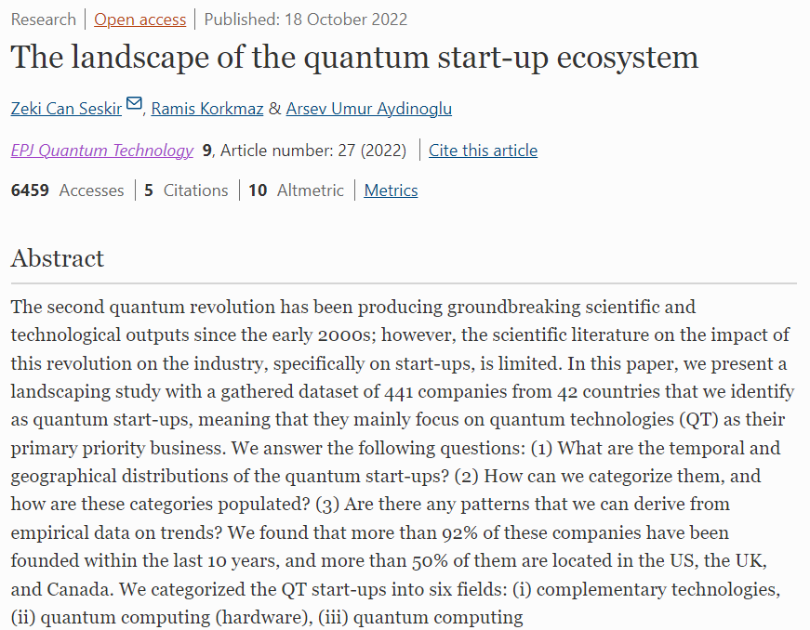

Slide 6
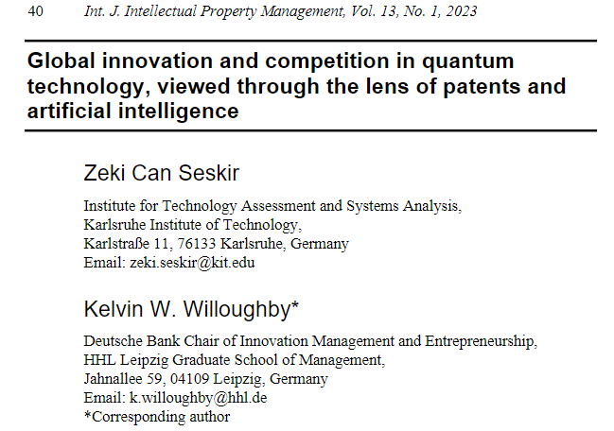

Slide 7
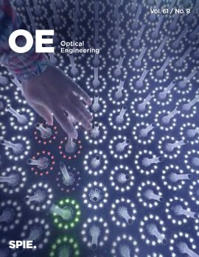
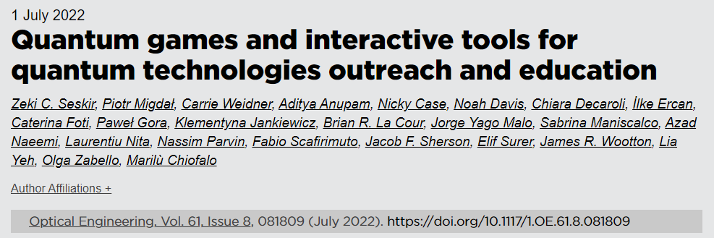
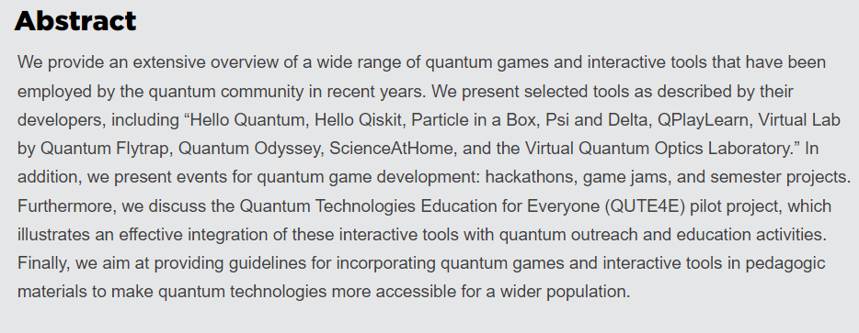

Slide 8
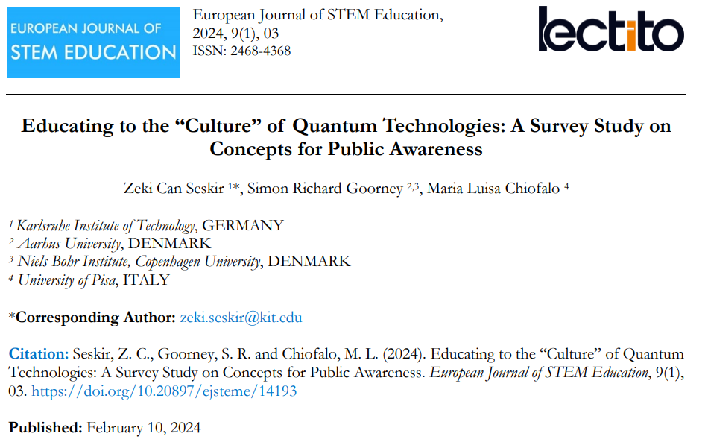

Slide 10
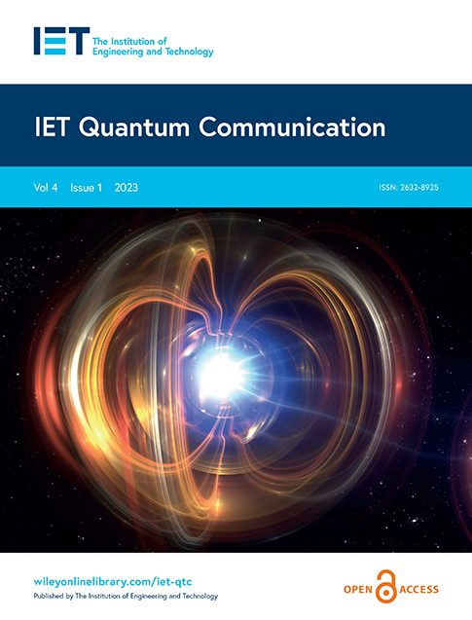

Slide 11
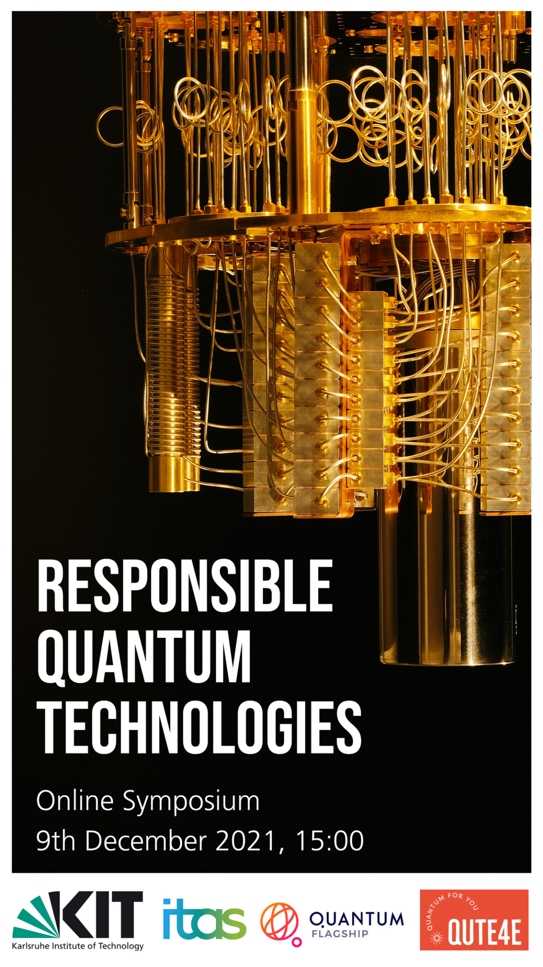
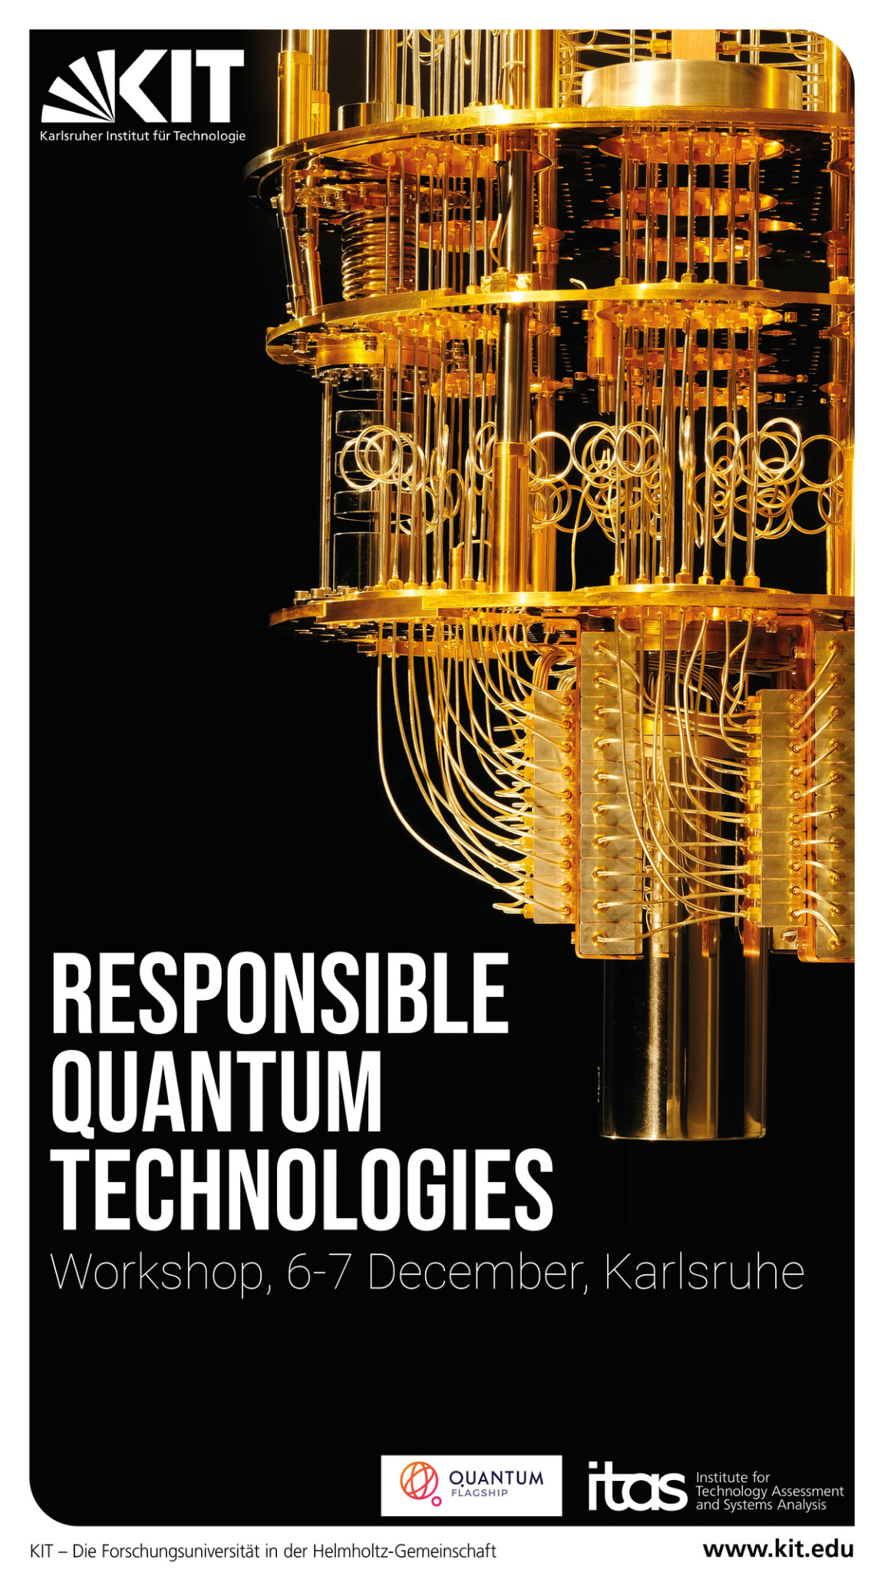
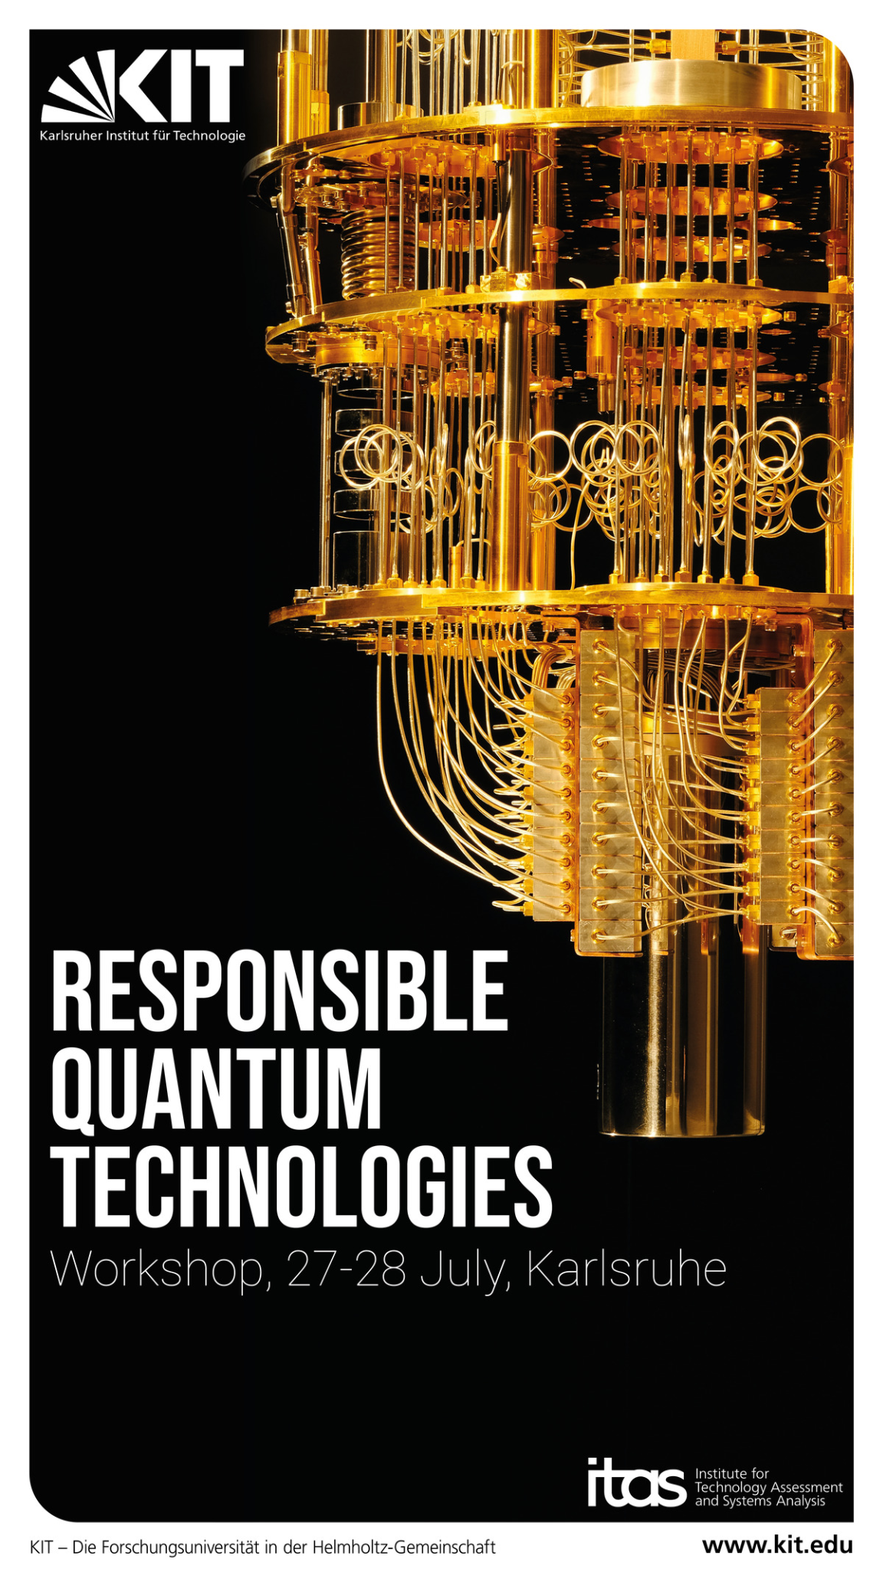

Slide 13
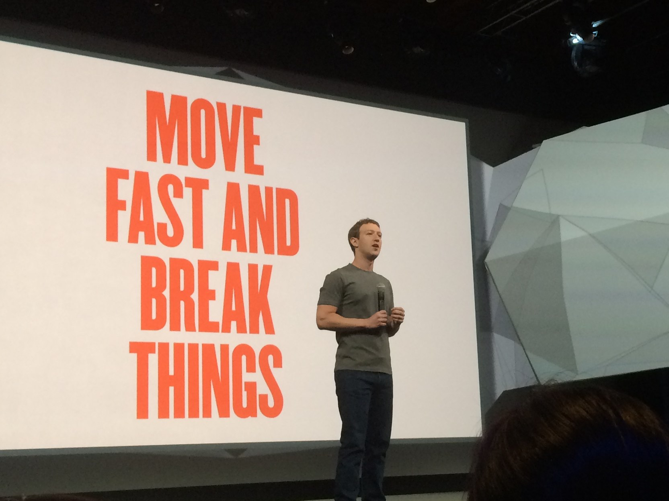

Slide 14
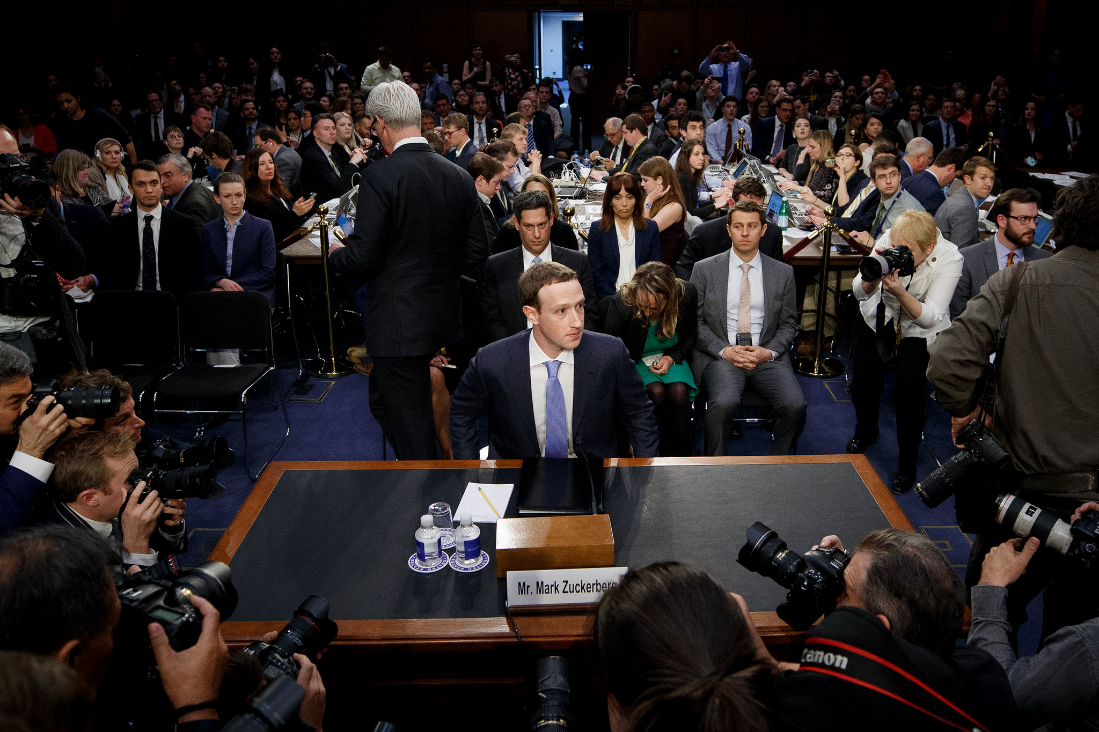

Slide 15
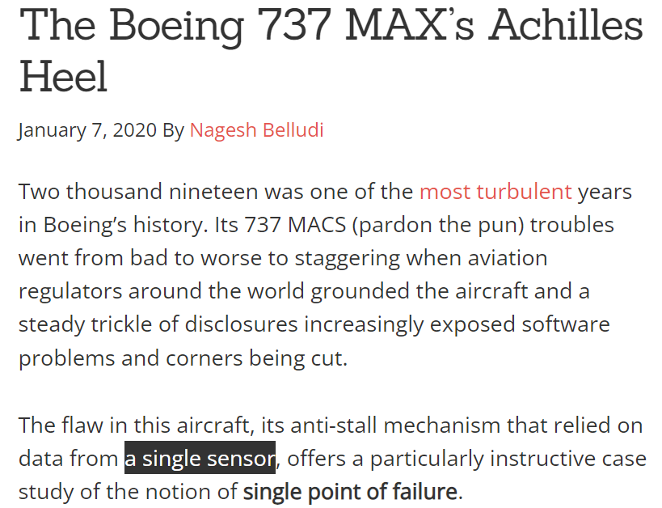

Slide 16
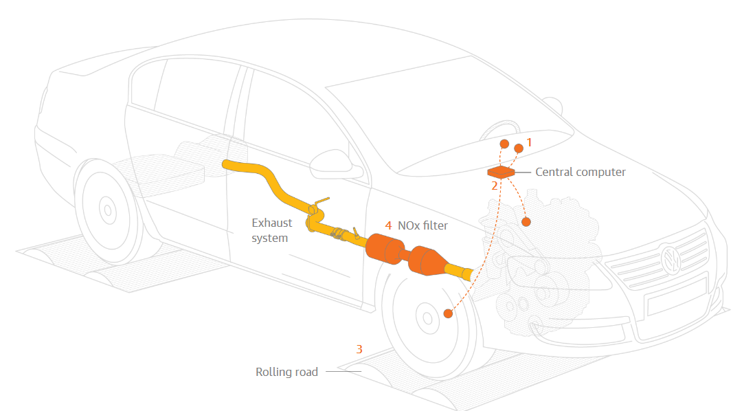

Slide 17
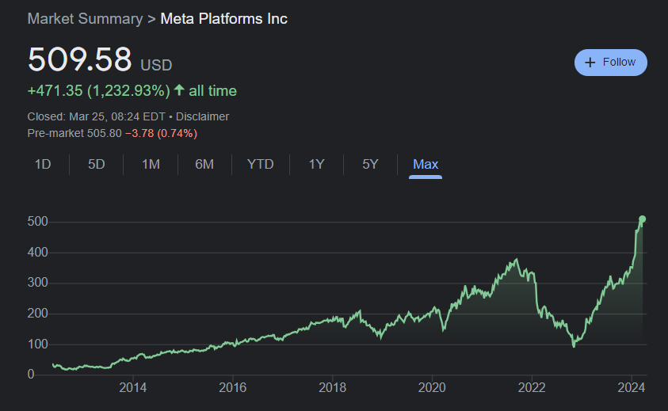
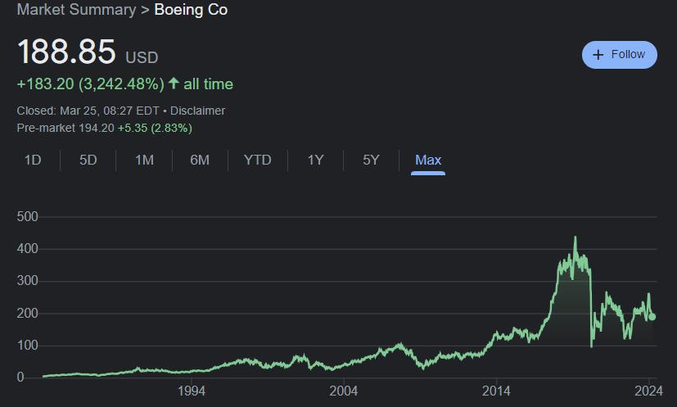
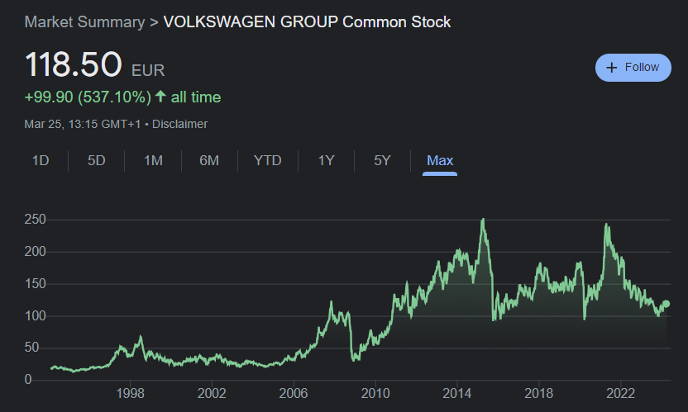

Slide 18
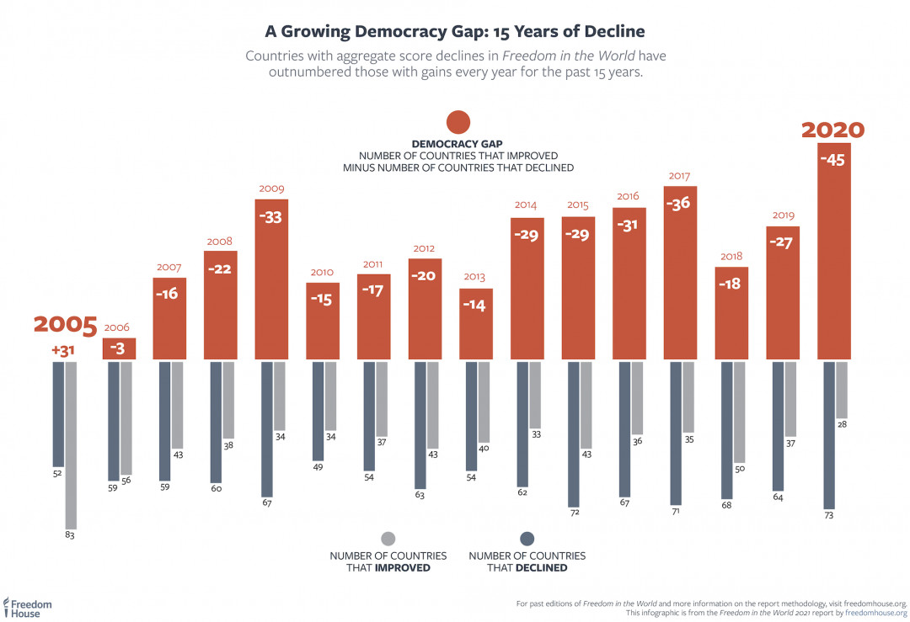

Slide 19
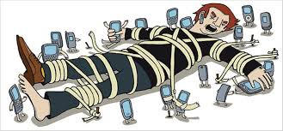
Is technology good or bad for society?
vs.

Slide 20
Consequences of Technology
Between:
intended and unintended effects
desired and undesired consequences
main and side effects
expected and unexpected effects
direct and indirect stakeholders

Slide 22
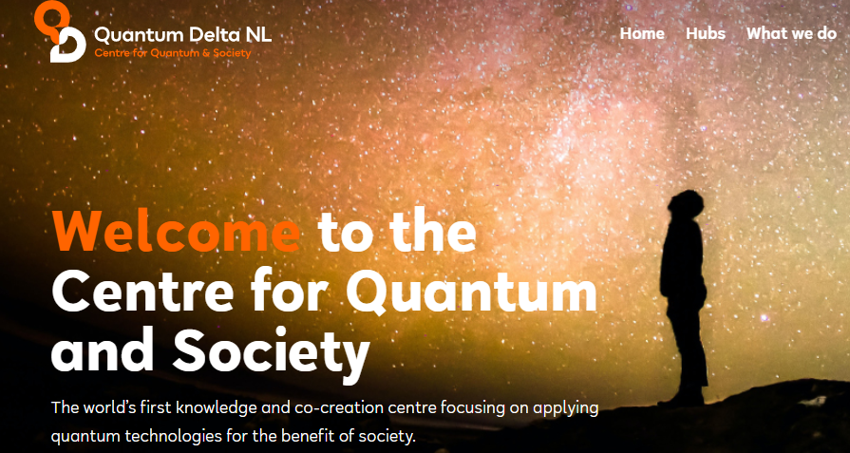

Slide 24
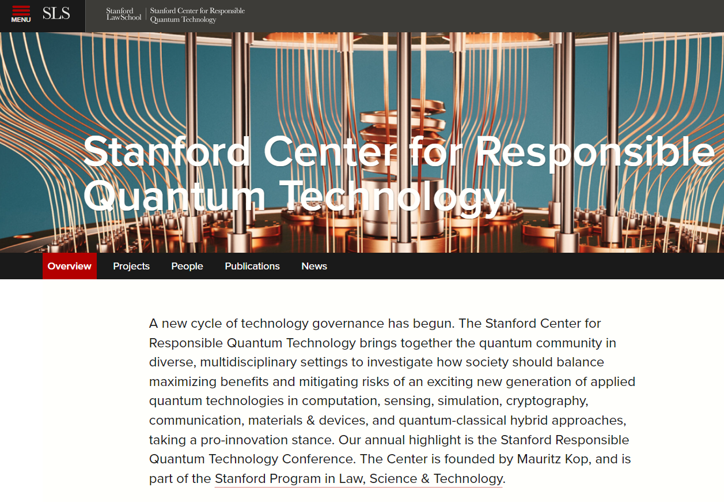

Slide 26
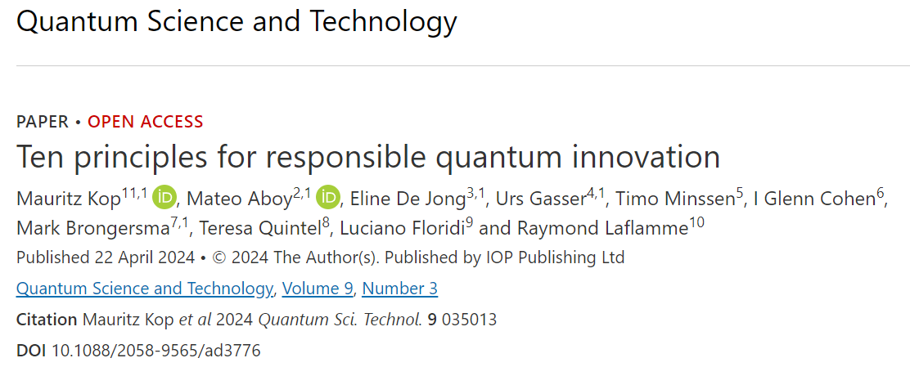

Slide 27
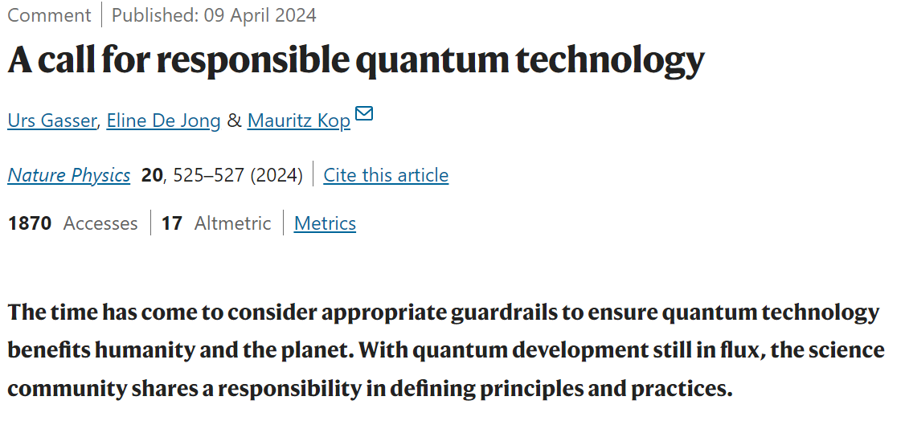

Slide 28
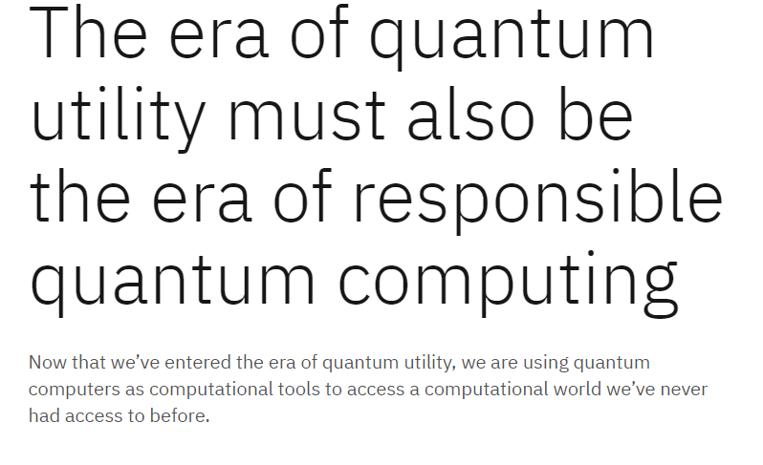

Slide 30
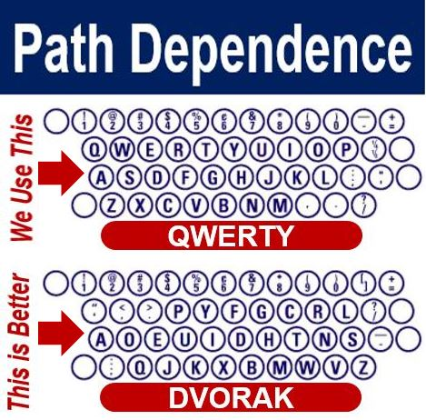
Image credits: Christian Nordqvist

Slide 32
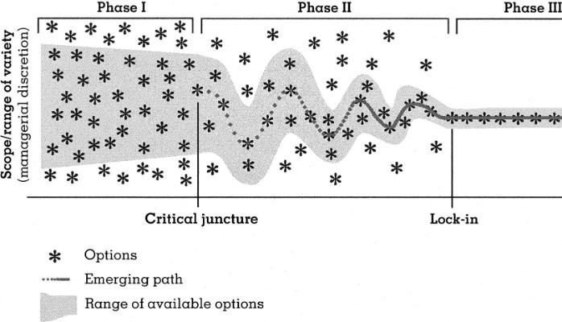

Slide 33
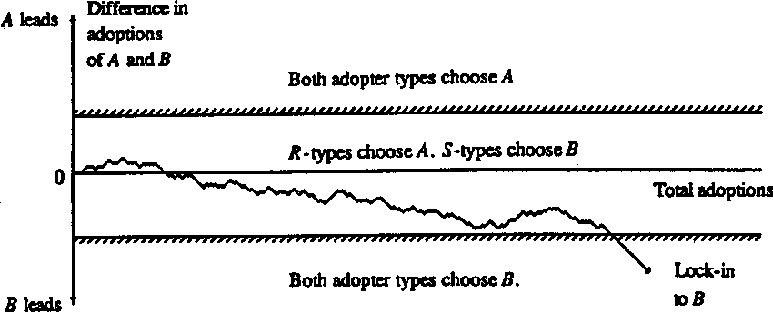

Slide 34
Emergence of a new techno-economic paradigm
“…the space of the technologically possible is much greater than that of the economically profitable and socially acceptable.” (Perez, 2010)
Technologically possible
Economically profitable
Socially acceptable
Carlota Perez -
“Technological Revolutions and Financial Capital” (2002)

Slide 35
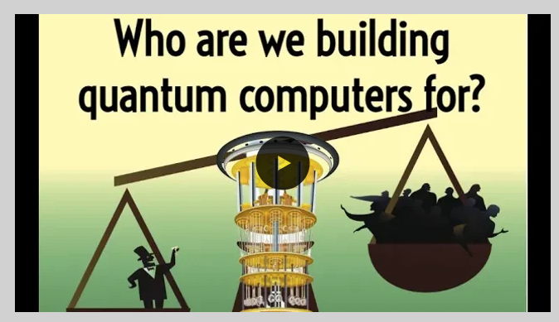

Slide 36
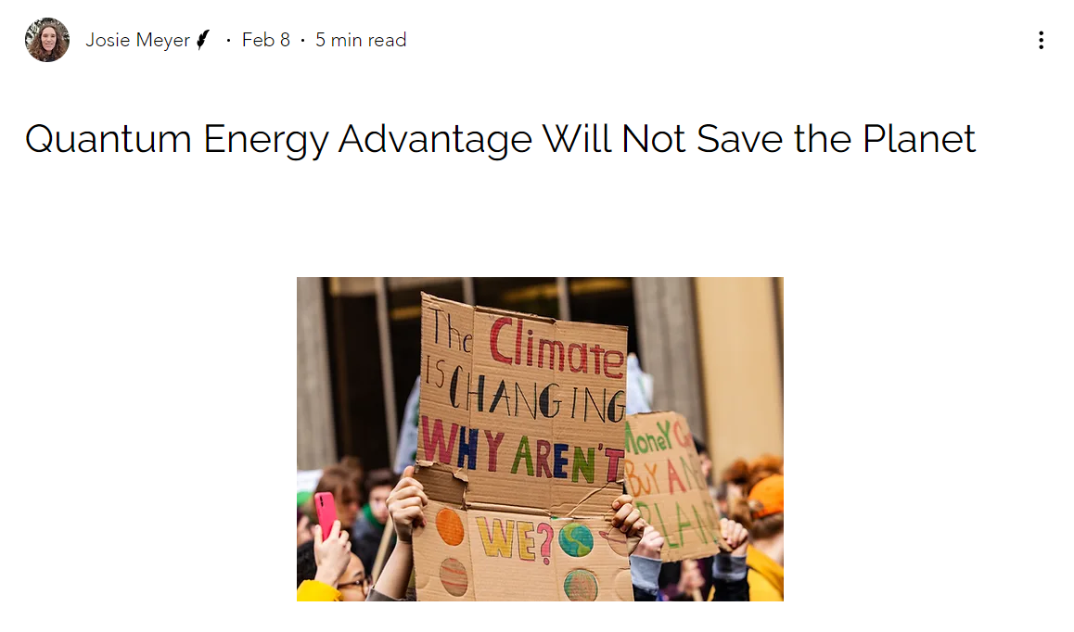

Slide 37
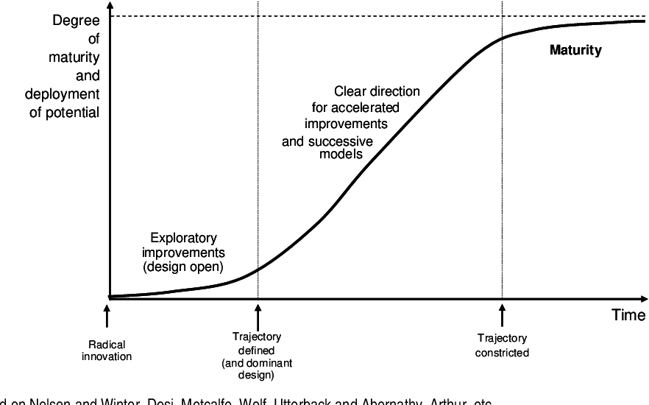
?

Slide 39
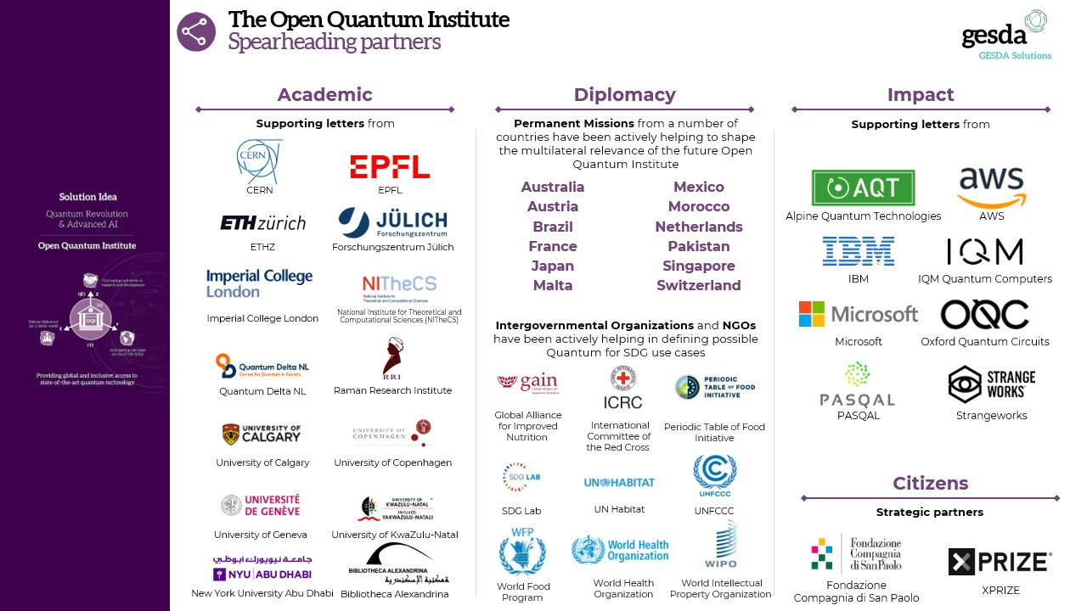

Slide 40
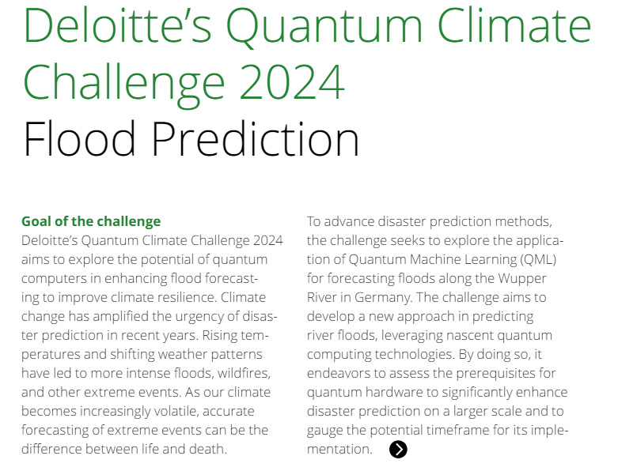
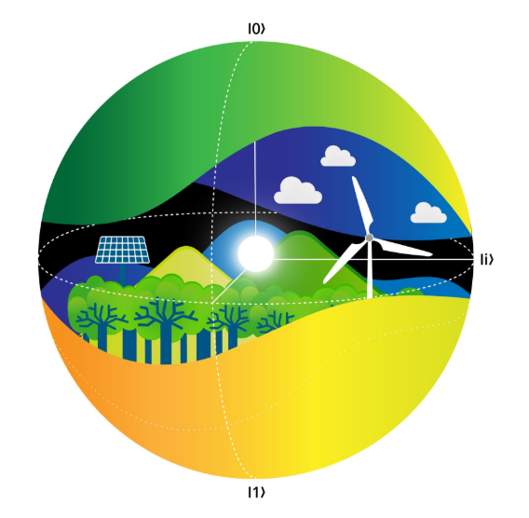

Slide 41
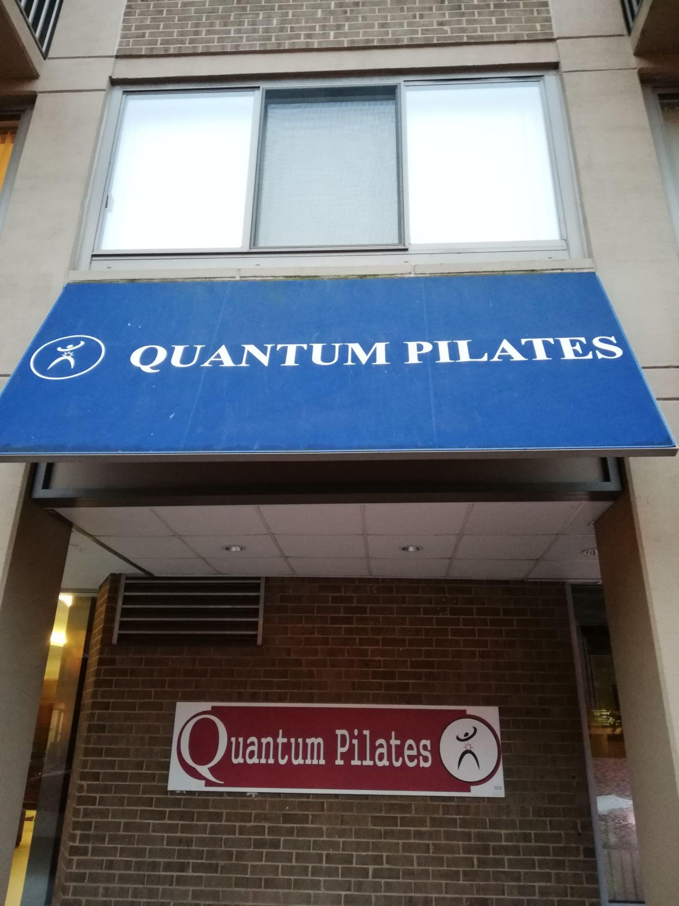

Slide 42
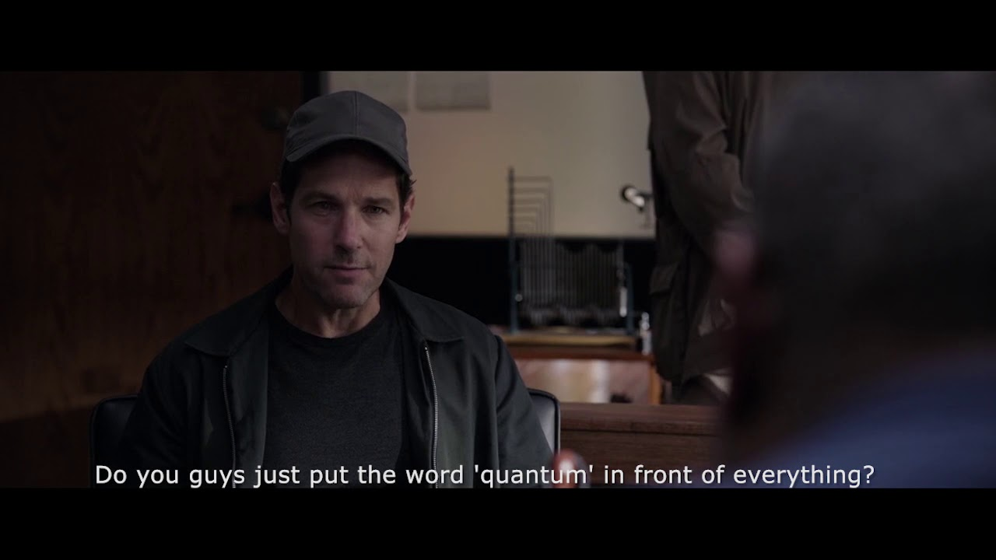

Slide 43
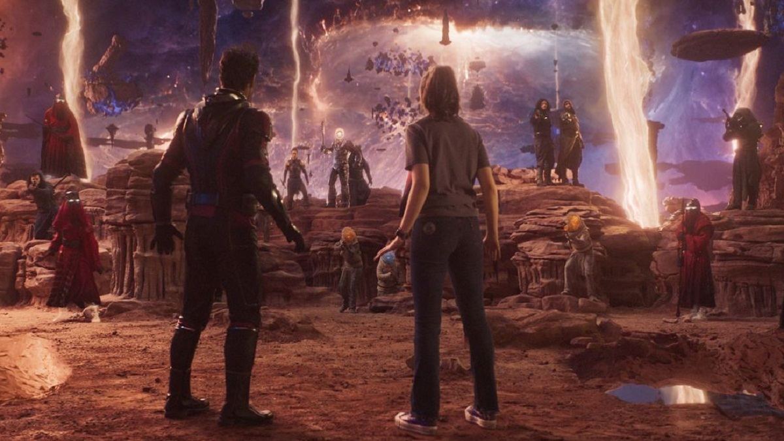
There are quantum people in the quantum realm!

Slide 45
Concluding Remarks
Technology is not science, QT is a concept beyond scientific research
There has been an increasing amount of research into “responsible” QT
Concepts such as the Collingridge dilemma, path dependency, lock-in, and techno-economic paradigms can be utilized for making better QT
If QT is to bring a new paradigm, we need to consider beyond just the tech.
“Quantum” is culturally present, but QT is a rather new cultural phenomenon

Slide 46
Thank you for your attention!
Let’s discuss.

