Slide 1
Bichromatic Rabi control of semiconductor qubits
Valentin John¹, Francesco Borsoi¹, Zoltán György² ,Chien-An Wang¹, Gábor Széchenyi², Floor van Riggelen¹, William I.L. Lawrie¹, Amir Sammak³, Nico W. Hendrickx¹, Giordano Scappucci¹, András Pályi⁴, and Menno Veldhorst¹
1 - QuTech and Kavli Institute of Nanoscience, Delf University of Technology
2 – ELTE Eötvös Loránd University
3 - QuTech and Netherlands Organisation for Applied Scientific Research (TNO)
4 - Department of Theoretical Physics, Institute of Physics, Budapest University of Technology and Economics
ReAQCT 2024
V. John, F. Borsoi, Z. György et al., Phys. Rev. Lett. 132, 6 (2024)

Slide 2
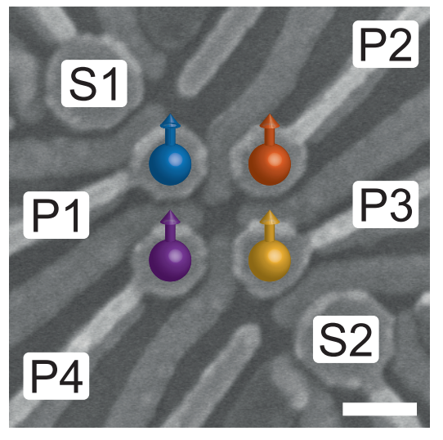
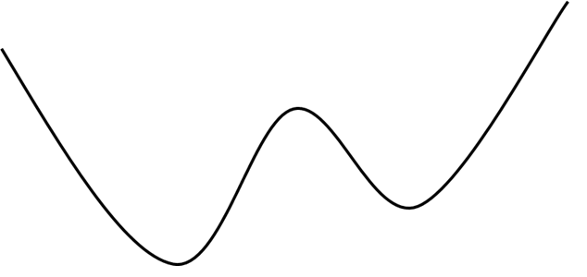
Germanium spin qubits
1/17
B
100 nm
Hendrickx, Nico W., et al. "A four-qubit germanium quantum processor." Nature 591.7851 (2021): 580-585.
Qubit:
Advantage: small size, scalability

Slide 3
Scalability issue
2/17
Goal: large number of qubits
B
Every qubit requires a plunger gate for driving
100 nm
Interconnect bottleneck
Hendrickx, Nico W., et al. "A four-qubit germanium quantum processor." Nature 591.7851 (2021): 580-585.

Slide 4
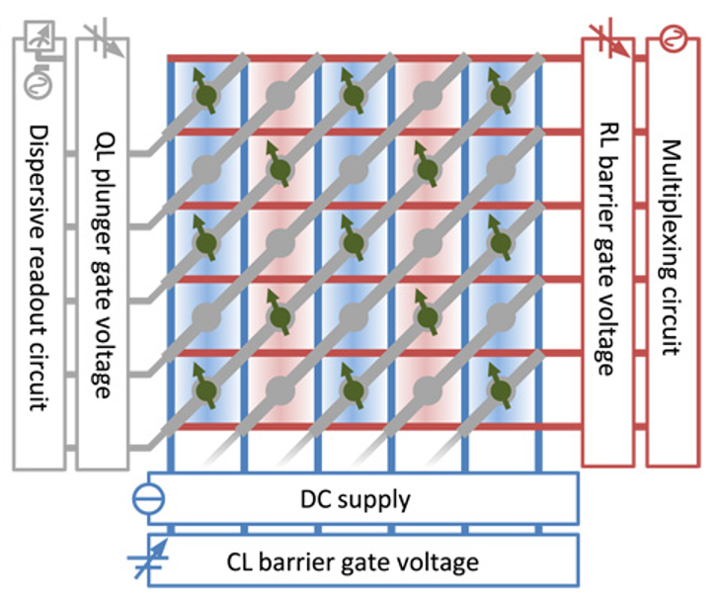
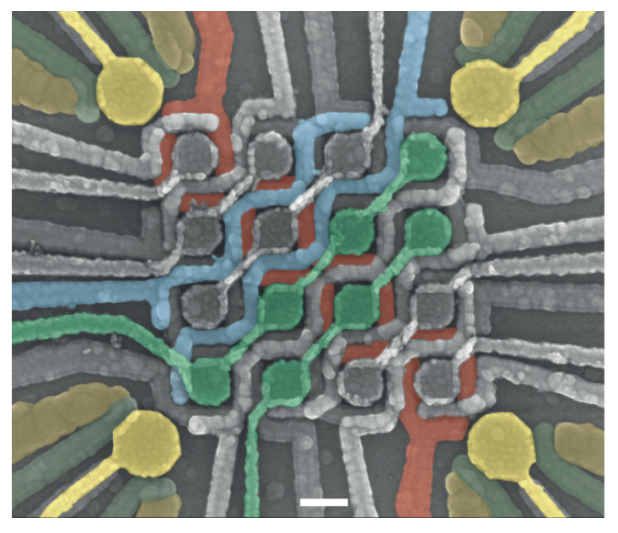
Solution: Crossbar architecture
3/17
Shared control, sublinear scaling
Li, Ruoyu, et al. "A crossbar network for silicon quantum dot qubits." Science advances 4.7 (2018): eaar3960.
Borsoi, Francesco, et al. "Shared control of a 16 semiconductor quantum dot crossbar array." Nature Nanotechnology 19.1 (2024): 21-27.

Slide 5
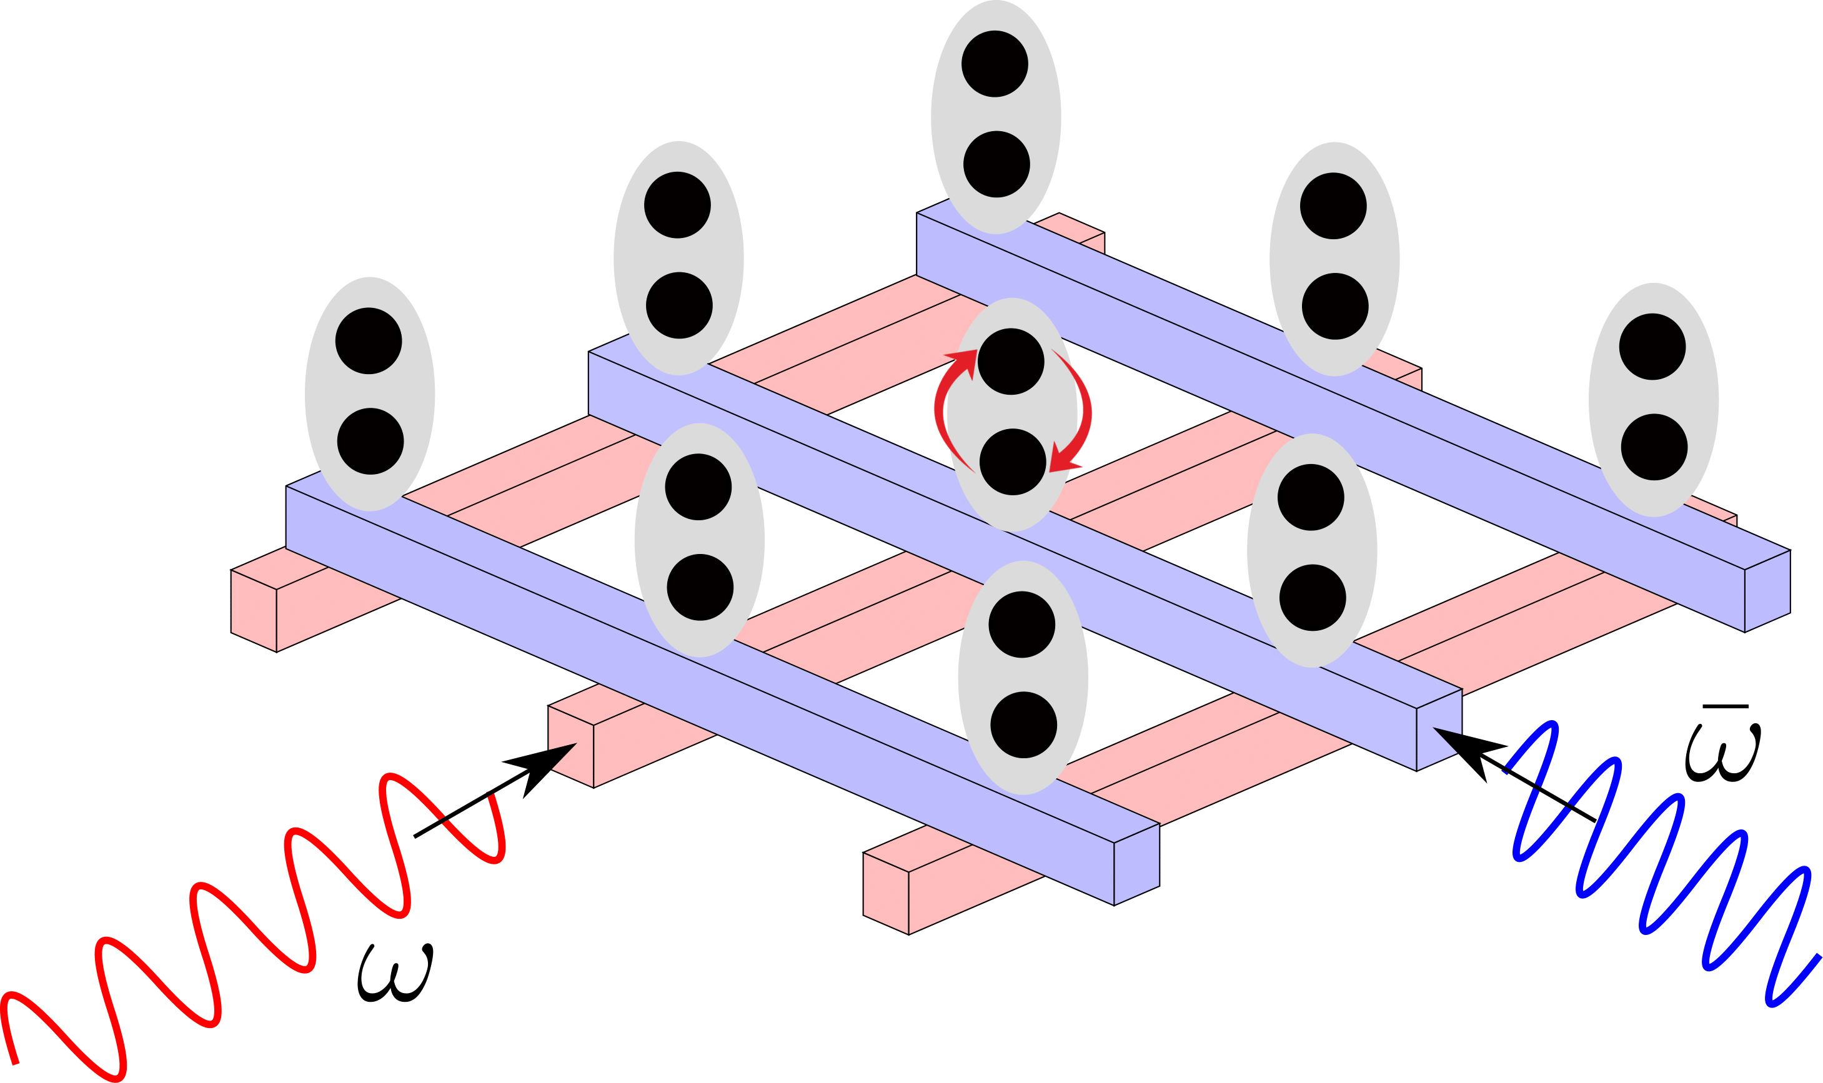
Bichromatic selective addressing
4/17
Spin qubits in 2D array
Two-tone electrical driving
No driving
No driving
and
Driving
György, Z., Pályi, A., & Széchenyi, G. (2022). Electrically driven spin resonance with bichromatic driving. Physical Review B, 106(15), 155412.

Slide 6
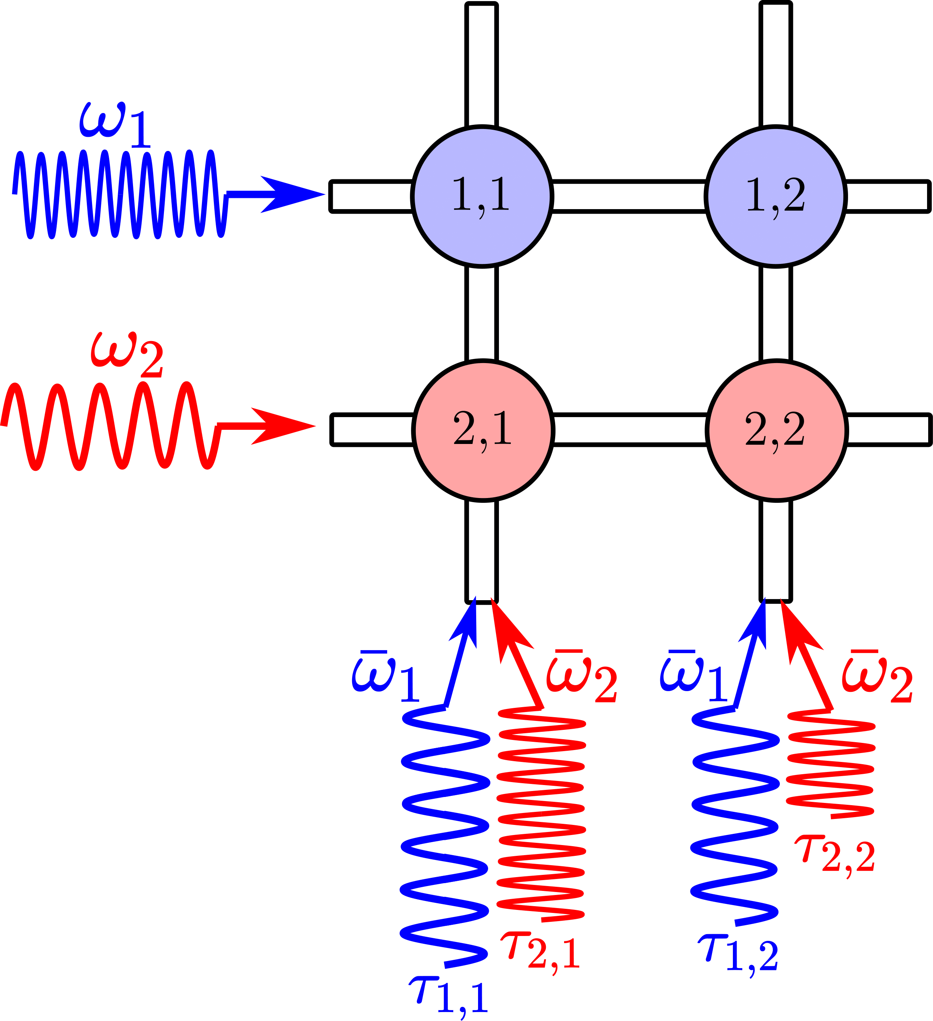
Parallelized single-qubit gates
5/17
Frequency multiplexing
Crosstalk can be avoided
By tuning the initial phases and the duration of the pulses, arbitrary single-qubit gate can be realized
György, Z., Pályi, A., & Széchenyi, G. (2022). Electrically driven spin resonance with bichromatic driving. Physical Review B, 106(15), 155412.

Slide 7
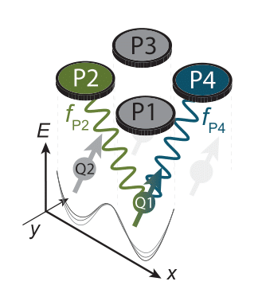
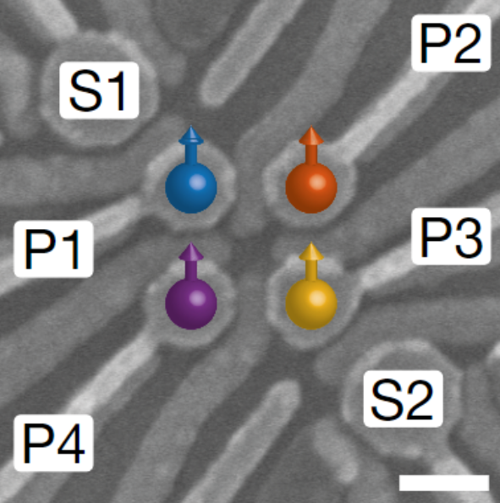
Experimental demonstration – Veldhorst Lab
6/17
2x2 germanium processor
Q1
Q2
100 nm
Hendrickx, Nico W., et al. "A four-qubit germanium quantum processor." Nature 591.7851 (2021): 580-585.

Slide 8
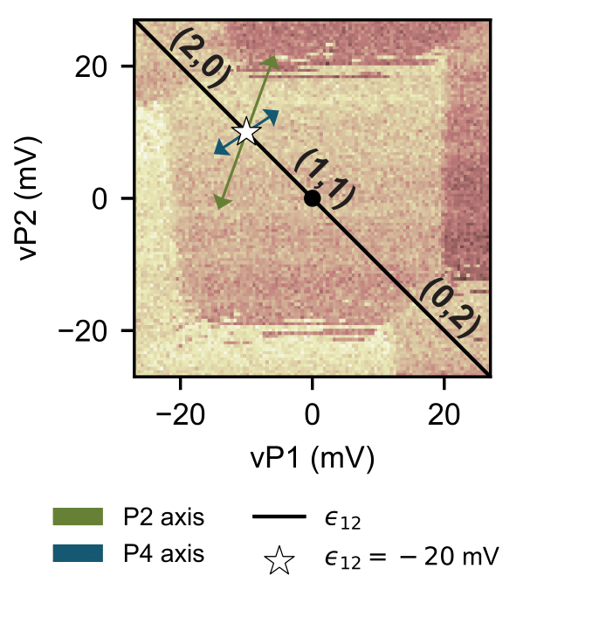
Experimental demonstration – Veldhorst Lab
7/17
2x2 germanium processor
Highly detuned!
Q1
Q2
100 nm
Hendrickx, Nico W., et al. "A four-qubit germanium quantum processor." Nature 591.7851 (2021): 580-585.

Slide 9
Theoretical model
8/17
$$|↑,↓⟩$$
$$|↓,↑⟩$$
$$|↑,↑⟩$$
$$|↓,↓⟩$$
$$|0,2⟩$$
$$|2,0⟩$$
Spin conserving ($t_{0}, Ω_{z}$)
Spin flipping ($Ω_{x}, Ω_{y}$)
Detuning modulation
Bichromatic driving:

Slide 10
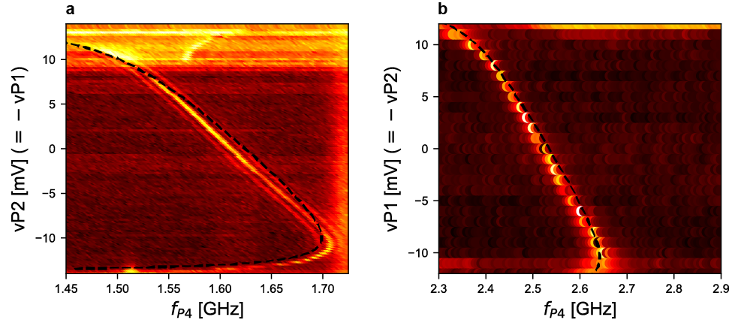
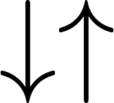
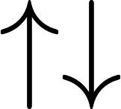
Fitting the spectrum
9/17
Q1 spectrum
Q2 spectrum
Q1_
Q2_
Q1
Q2
modulated g-factor

Slide 11
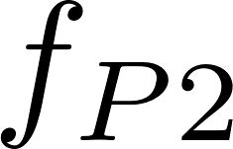
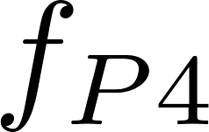
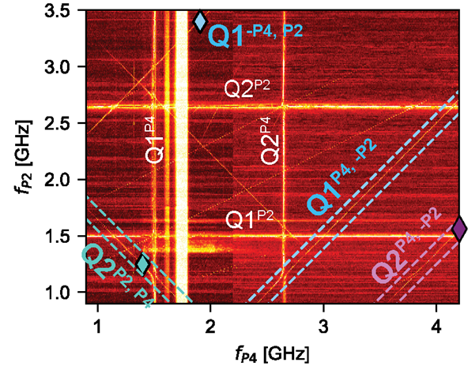
Bichromatic transitions
10/17
Four relevant states:
Q1_
Q2_
exchange int.
Q1
Q2
Multi-photon transitions:

Slide 12
Theoretical methods
11/17
Non-trivial driving:
Floquet theory [1,2]: time-dependent, periodic Hamiltonian
Infinite, time-independent Floquet-matrix
Schrieffer-Wolff transformation
Low-dimensional, time-independent
[1] - Shirley, J. H. (1965). Solution of the Schrödinger equation with a Hamiltonian periodic in time. Physical Review, 138(4B), B979.
[2] - Ho, T. S., Chu, S. I., & Tietz, J. V. (1983). Semiclassical many-mode Floquet theory. Chemical Physics Letters, 96(4), 464-471.

Slide 13
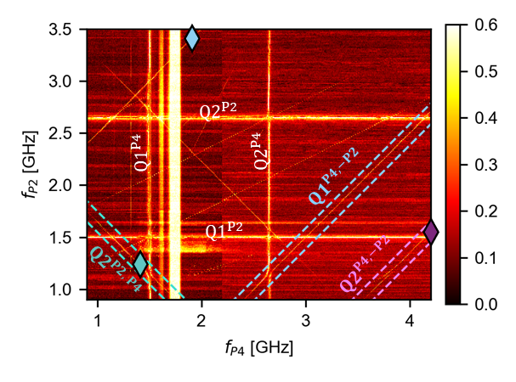
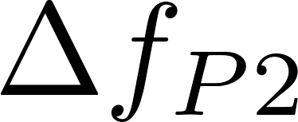
Resonance anticrossings
12/17
High resolution measurements along bichromatic lines

Slide 14
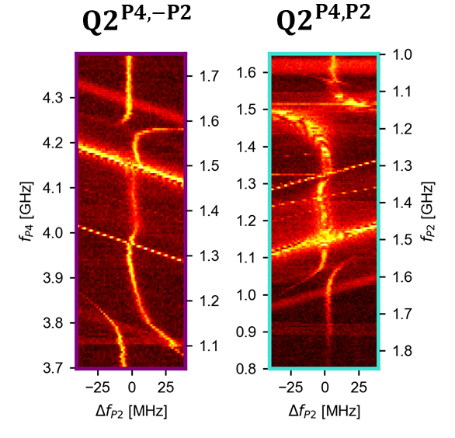
Resonance anticrossings
13/17
Anticrossings due to AC Stark shift

Slide 15
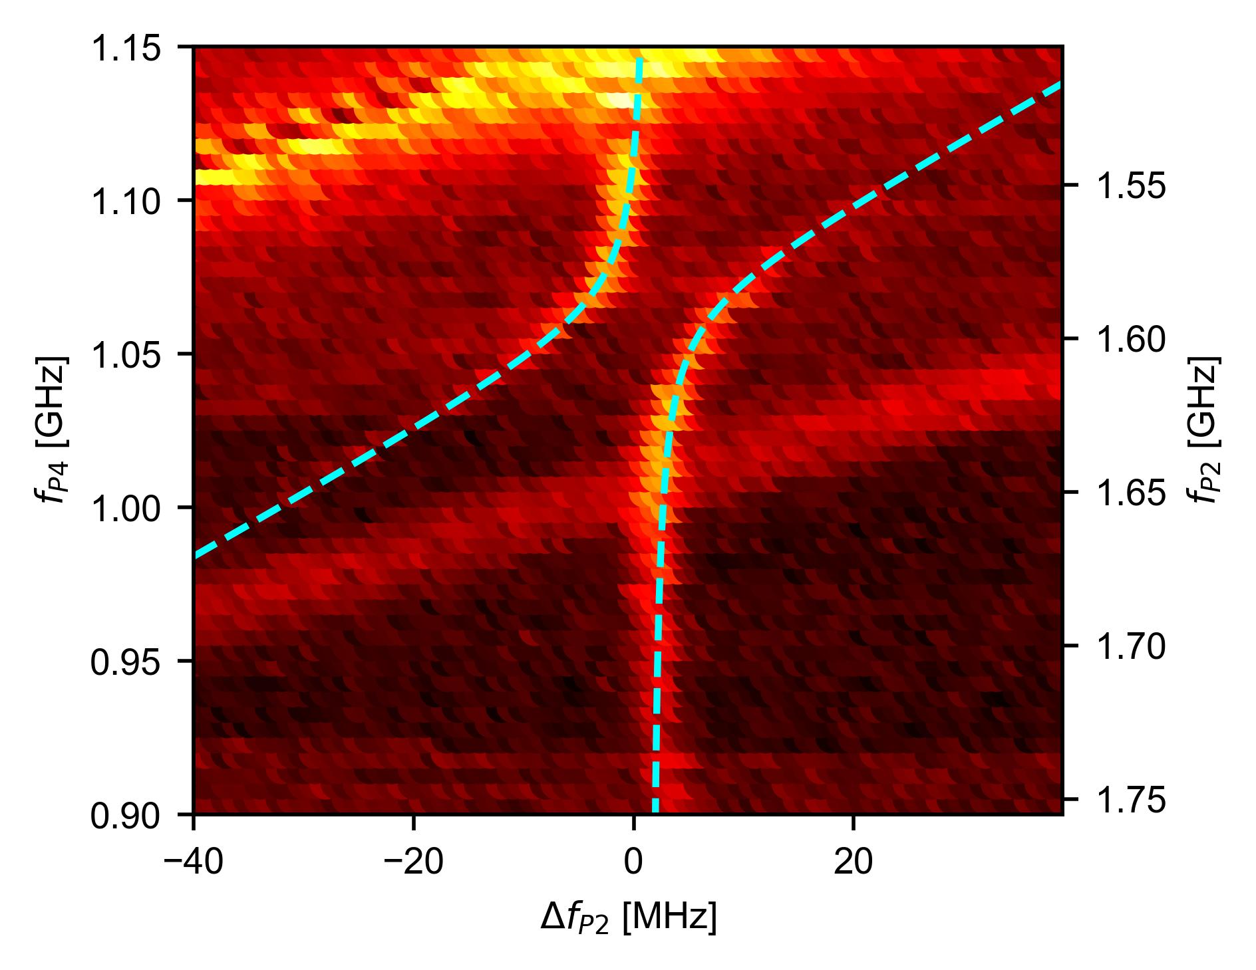
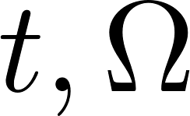
Description of anticrossings
14/17
3x3 effective matrix
Equation of anticrossings
fitting
- Tunneling amplitudes

Slide 16
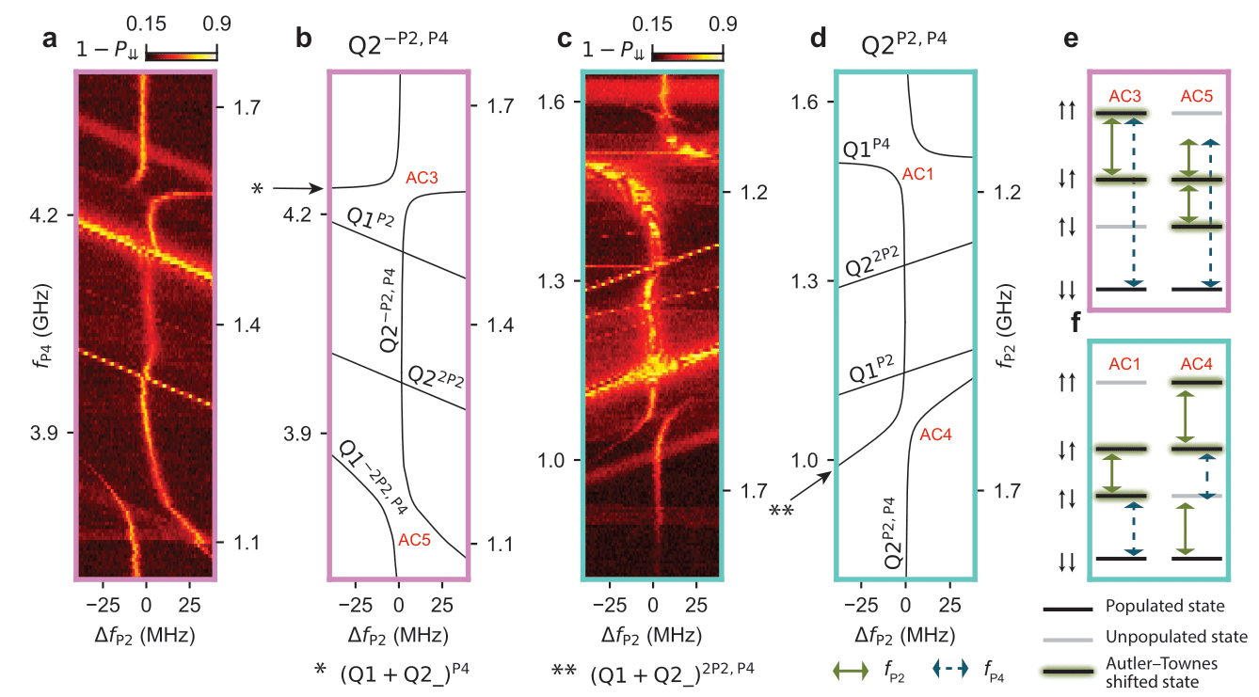
Results
15/17

Slide 17
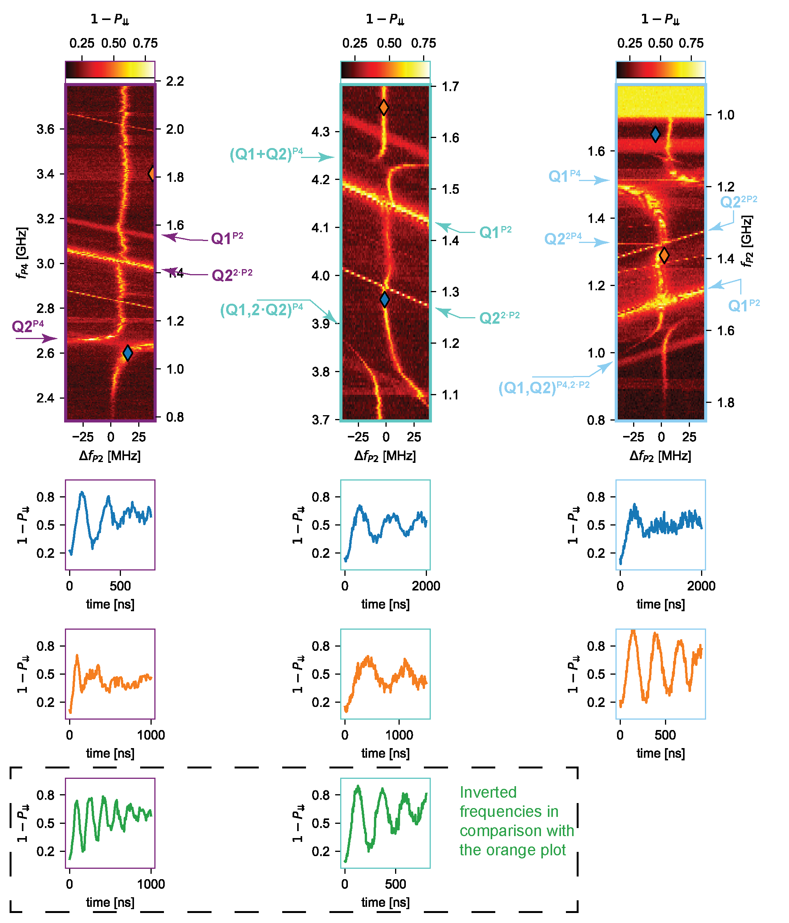
Rabi oscillations
16/17
Slower than fastest germanium operations
(4 MHz vs 540 MHz) [1]
Fidelity is not high, further optimization needed
Larger driving amplitude required
Not well understood
[1] - Wang, K., Xu, G., Gao, F., Liu, H., Ma, R. L., Zhang, X., ... & Guo, G. P. (2022). Ultrafast coherent control of a hole spin qubit in a germanium quantum dot. Nature Communications, 13(1), 206.

Slide 18
Conclusions
17/17
First experimental demonstration of bichromatic driving of spin qubits
By fitting the spectrums and the anticrossings, the model parameters could be determined
Bichromatic driving in large qubit arrays might be an efficient driving scheme

Slide 19
Thank you for your attention!
Author contributions
Delft – Experiments
Delft – Device development
Budapest – Theory
Valentin John
Francesco Borsoi
Chien-An Wang
Floor van Riggelen
Menno Veldhorst
William Lawrie
Amir Sammak
Nico W. Hendrickx
Giordano Scappucci
Zoltán György
Gábor Széchenyi
András Pályi
John, V., Borsoi, F., György, Z., Wang, C. A., Széchenyi, G., van Riggelen-Doelman, F., ... & Veldhorst, M. (2024). Bichromatic Rabi control of semiconductor qubits. Physical review letters, 132(6), 067001.

Slide 20
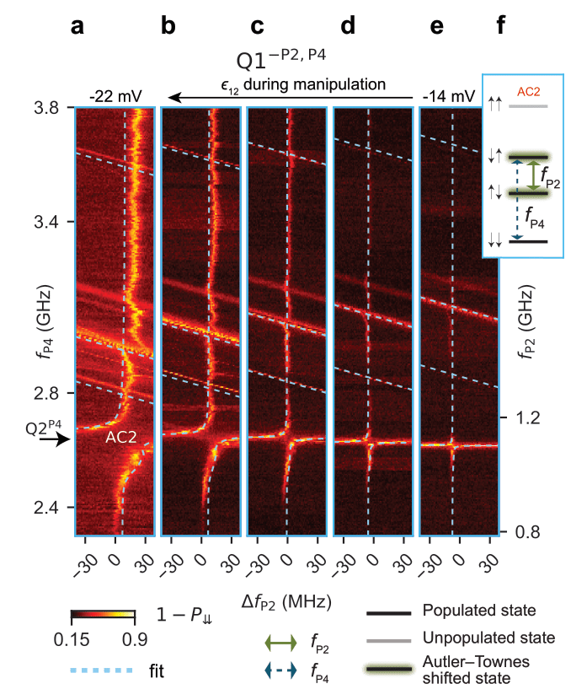
Results
Changing the detuning

Slide 21
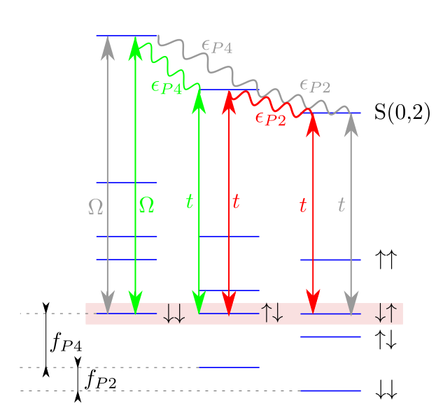
Description of anticrossings
Three degenerate Floquet-levels
3x3 effective Hamiltonian
Condition for anticrossing, AC Stark shift
single-photon > two-photon > three-photon
Predicting crossings and anticrossings
Driving with P2 > P4

Slide 22
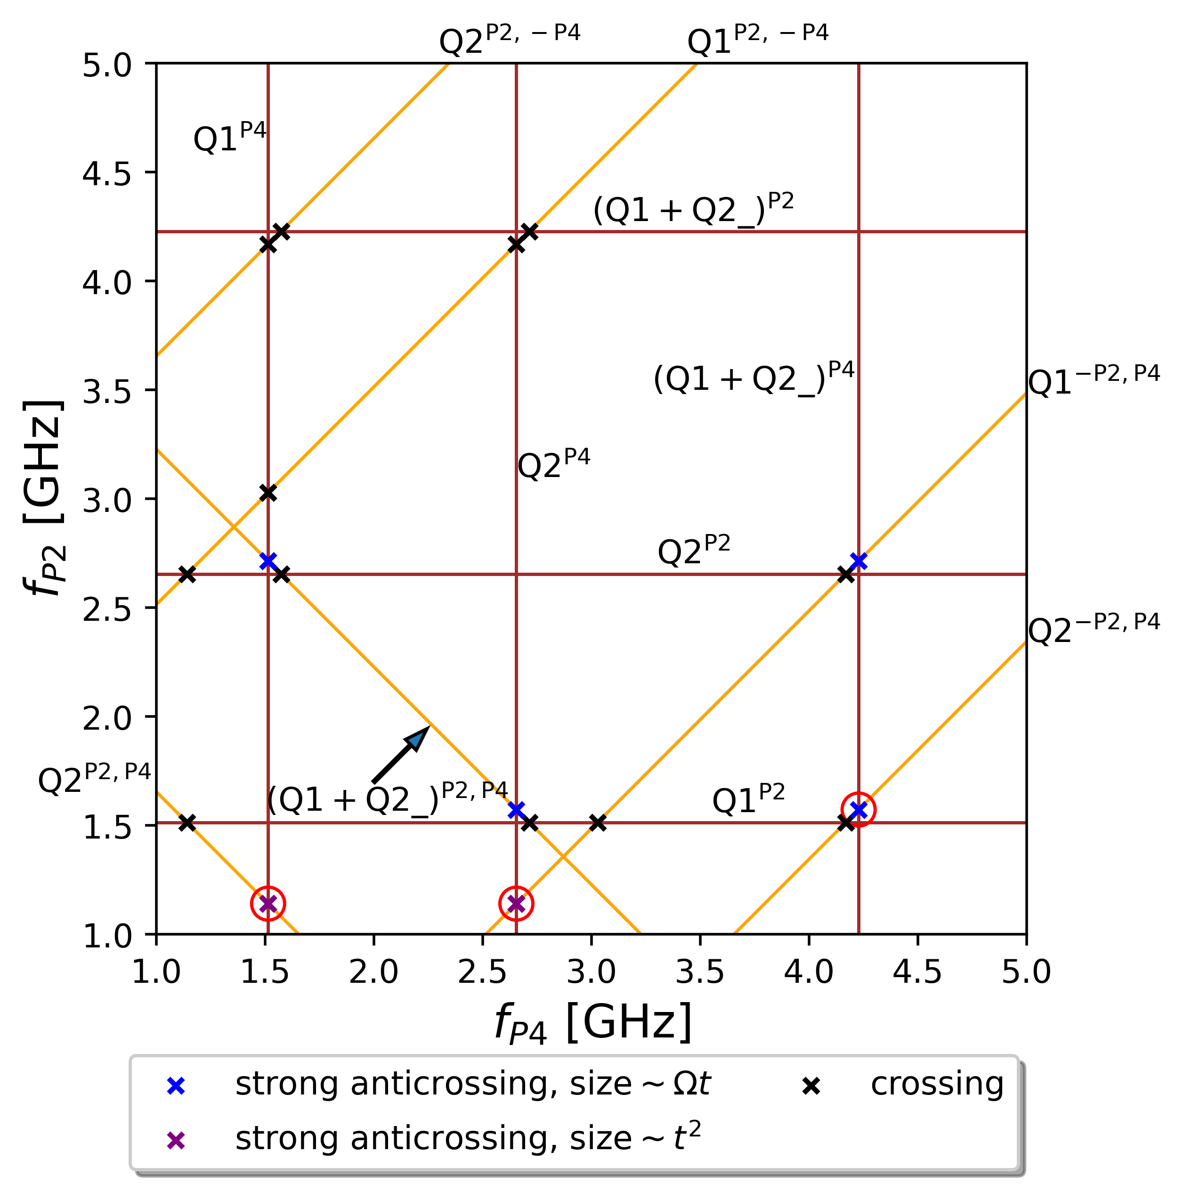
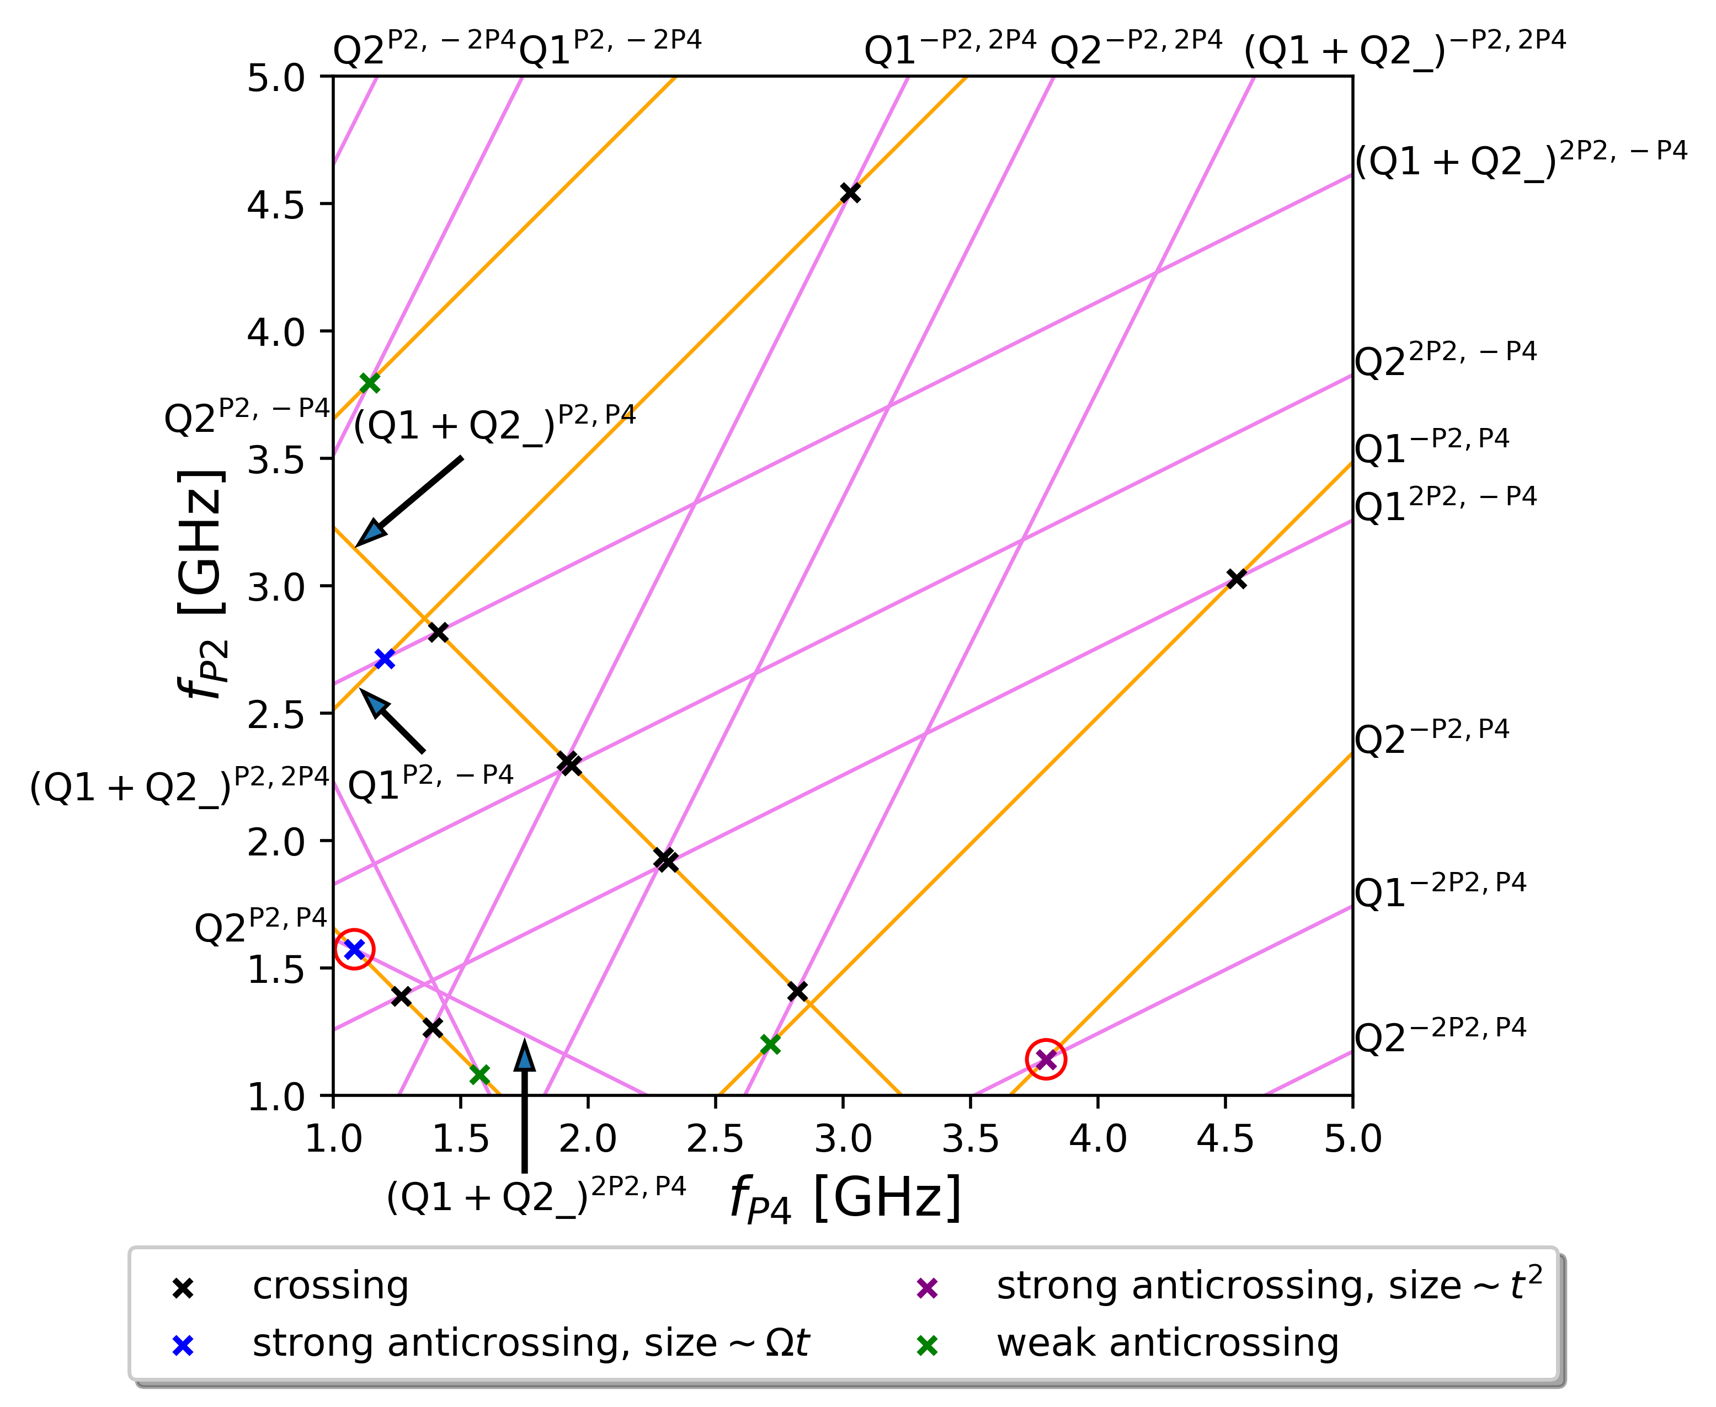
Characterization of anticrossings
Single-photon and two-photon lines
Two- and three-photon lines

Slide 23
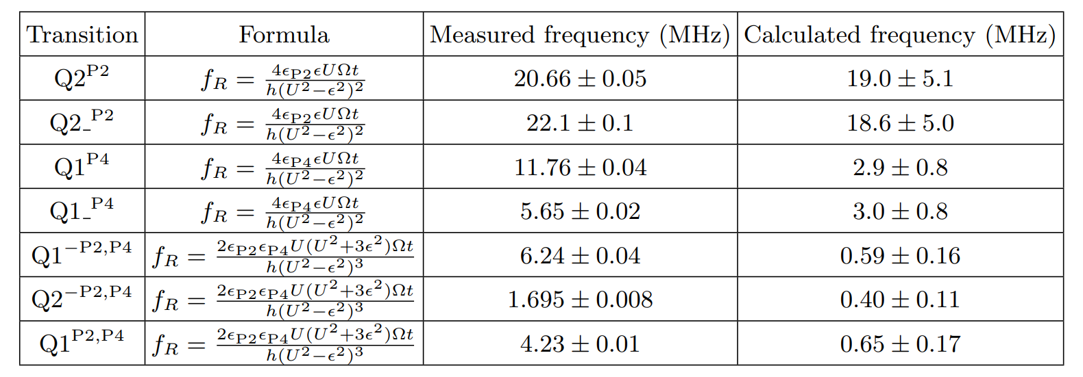
Problem with Rabi frequencies
Problem with driving using P4

Slide 24
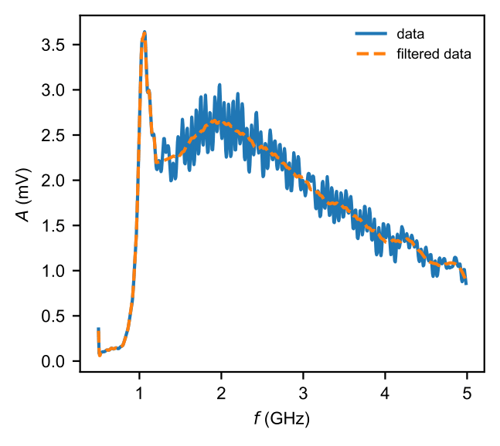
Power attenuation
Distortion of anticrossings

