Slide 1

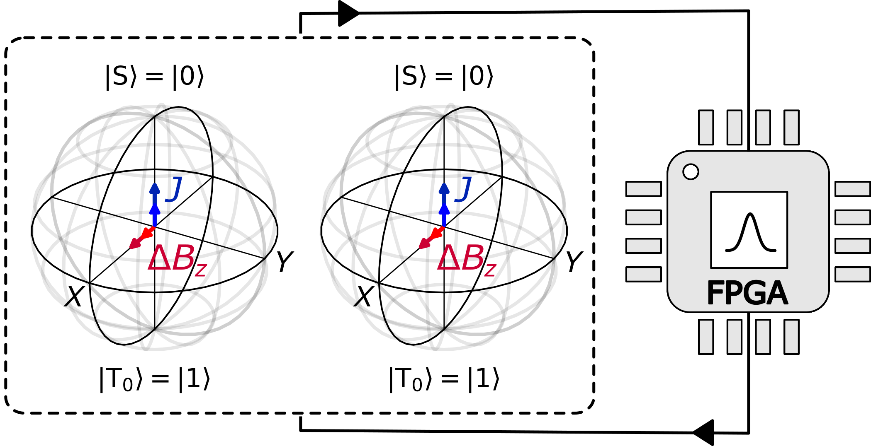
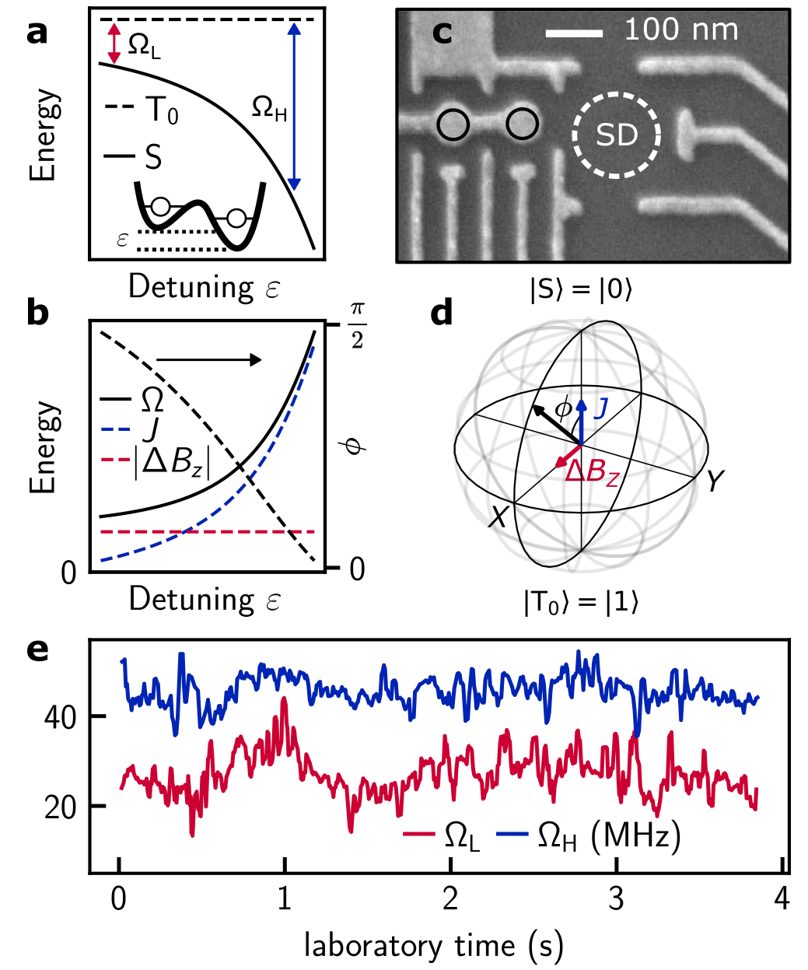
Real-time Two-axis Control of Spin Qubits
by Adaptive Hamiltonian Estimation
Fabrizio Berritta
June 29th, 2020
Physics-informed model
1

Slide 2
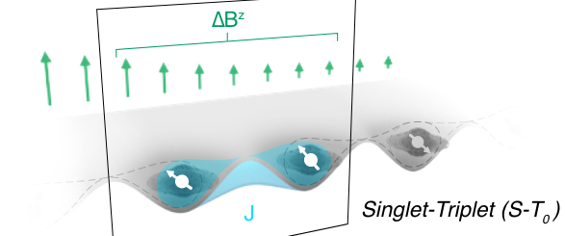
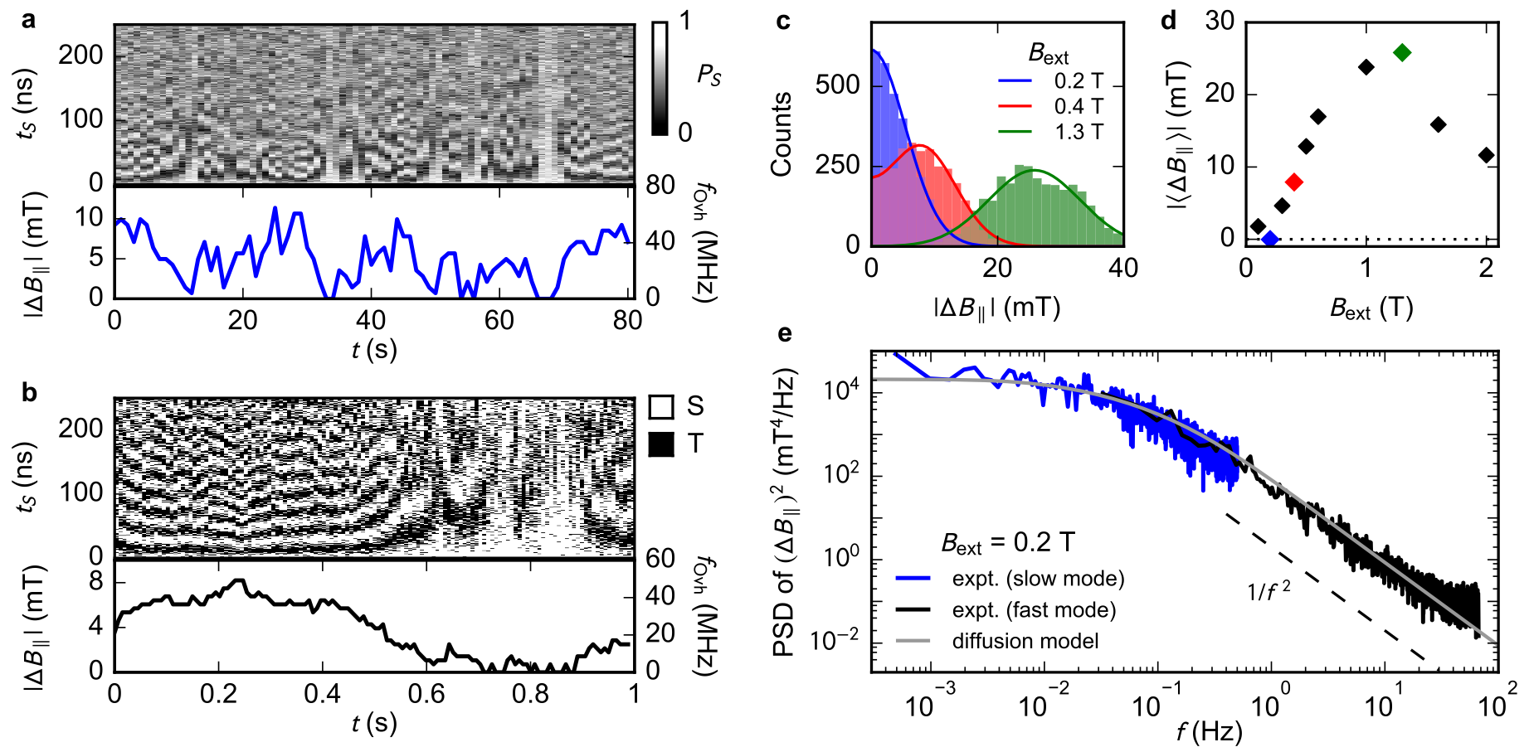
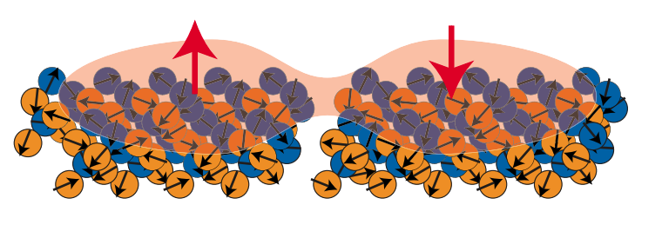
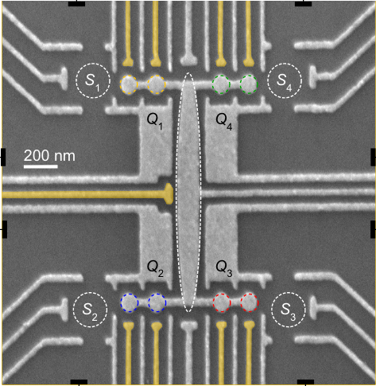
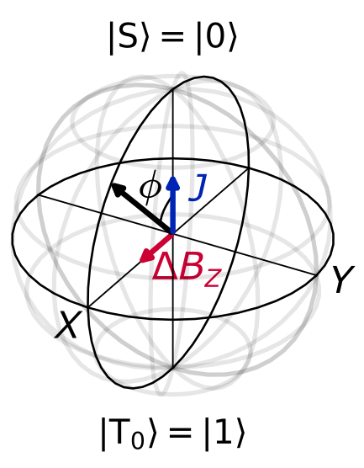
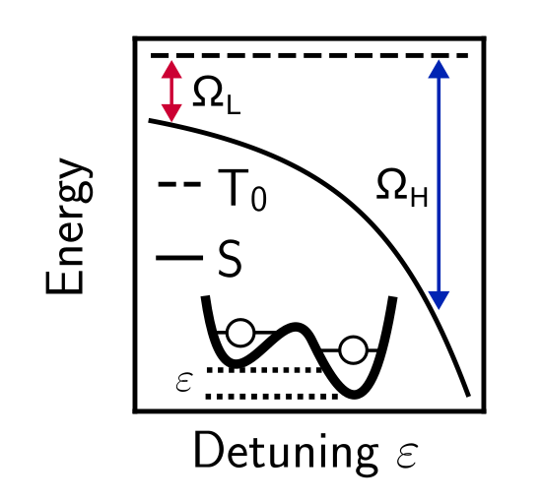
Singlet-triplet qubit: 2 electrons in a double quantum dot
⁷⁵As
⁷¹Ga
⁶⁹Ga
Burkard, G. et al, RMP 2023
J. M. Taylor et al, PRB (2007)
F. K. Malinowski et al, PRL (2017)
      Each electron spin interacts with ~10⁶ nuclear spins, that provide an effective Overhauser field B_{nuc} by hyperfine coupling
dominating ΔB_{z}
dominating J
Fedele, F. et al, PRX Quantum (2021)

Slide 3
Real-time two-axis control of a spin qubit
Berritta F. et al, Nat. Commun 15, 1676 (2024)

Slide 4
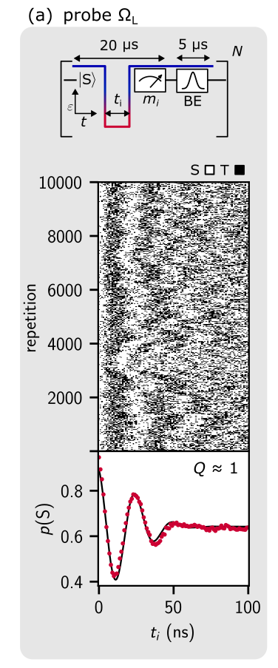
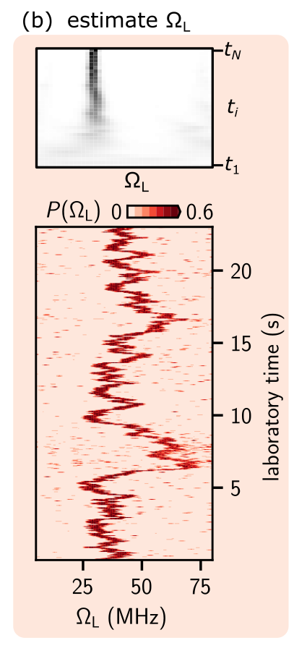
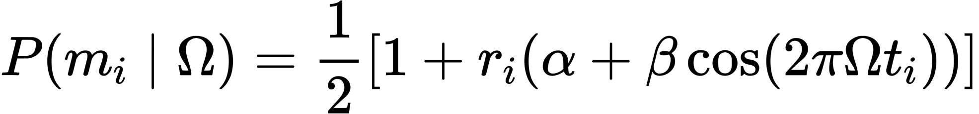
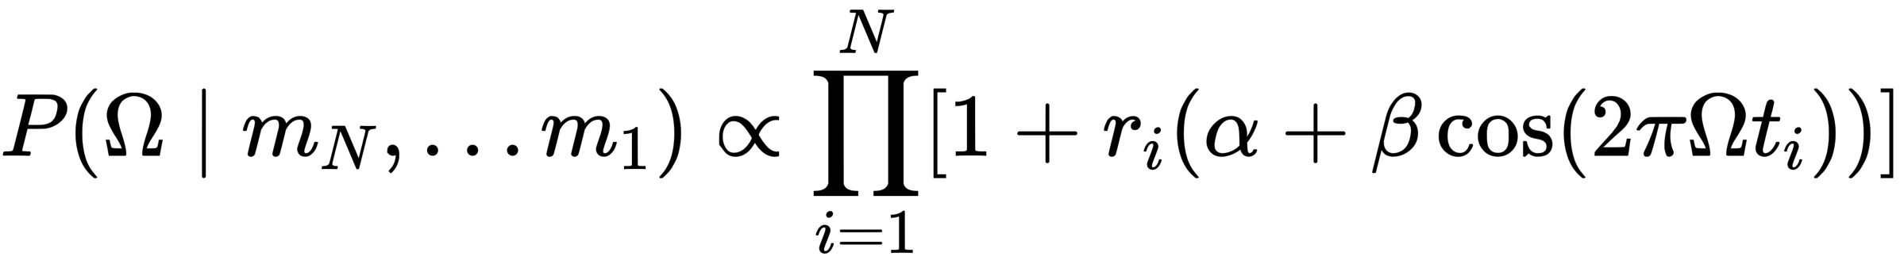
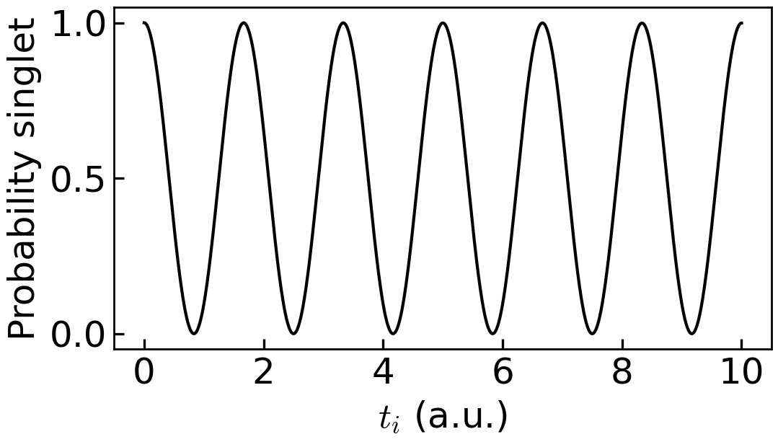
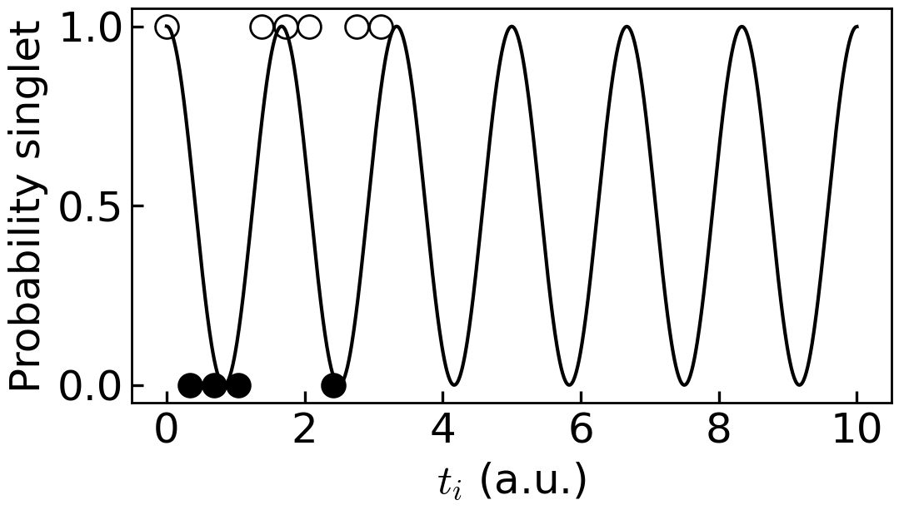
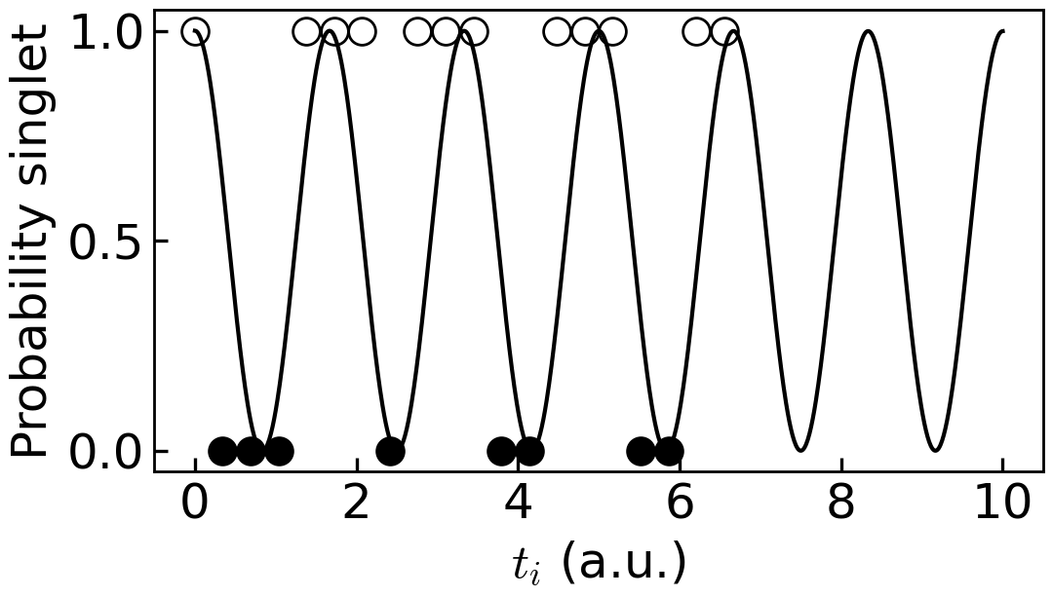
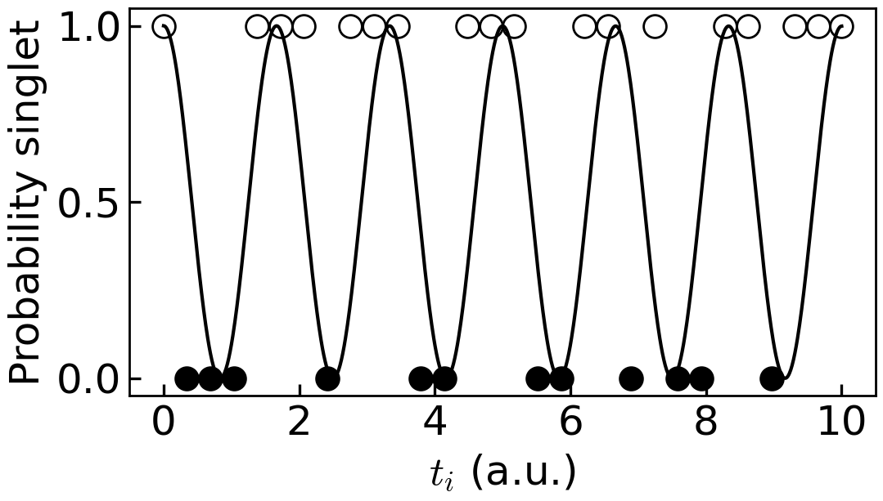
Real-time Bayesian estimation
Probability of m_{i} = S or T given a driving frequency Ω
The FPGA infers Ω by Bayesian estimation*
S
T
Berritta F. et al, Nat. Commun 15, 1676 (2024)
*Shulman M.D. et al, Nat. Commun 5, 5156 (2014)

Slide 5
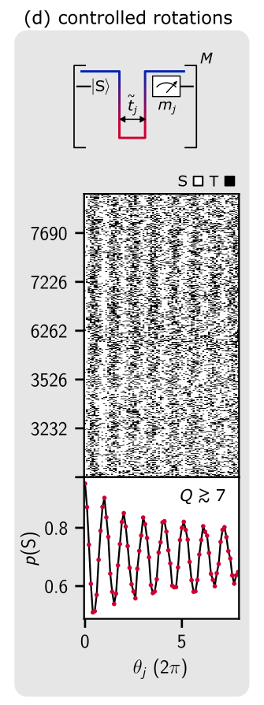
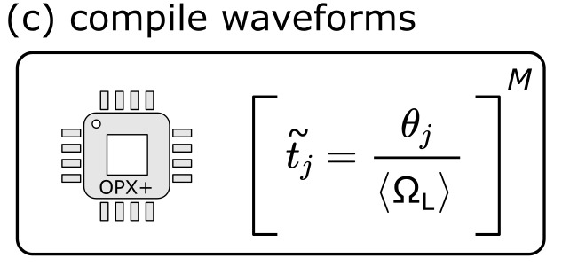
Feedback enables noise-driven coherent qubit rotations
Berritta F. et al, Nat. Commun 15, 1676 (2024)

Slide 6
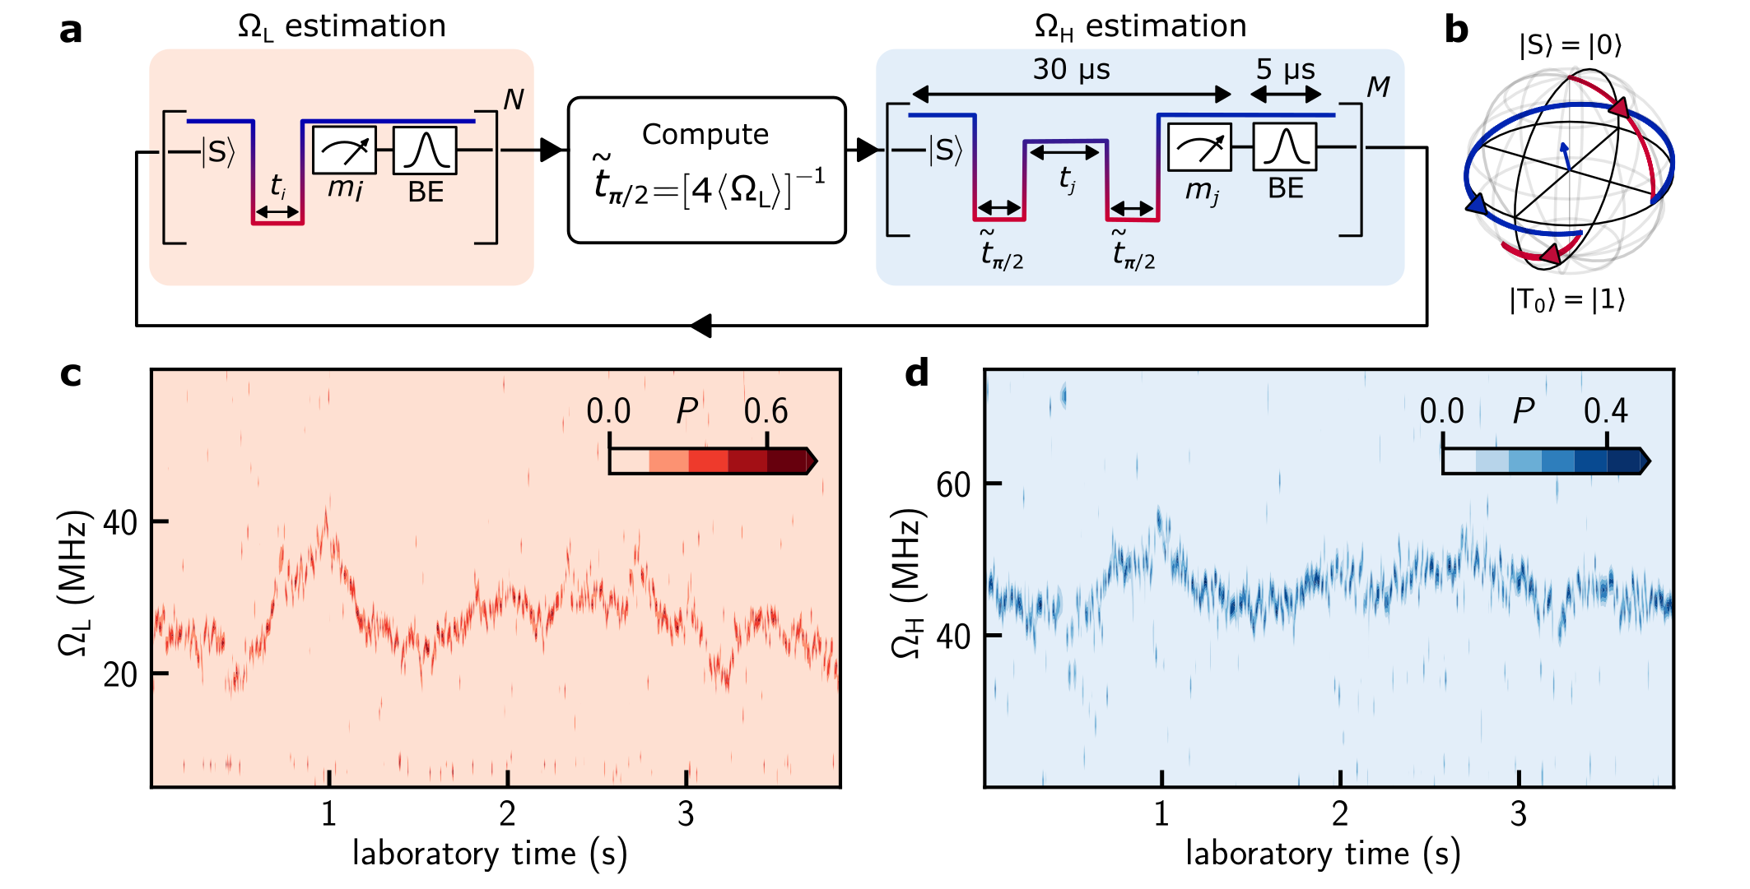
Real-time Bayesian estimation of two control axes.
Berritta F. et al, Nat. Commun 15, 1676 (2024)

Slide 7
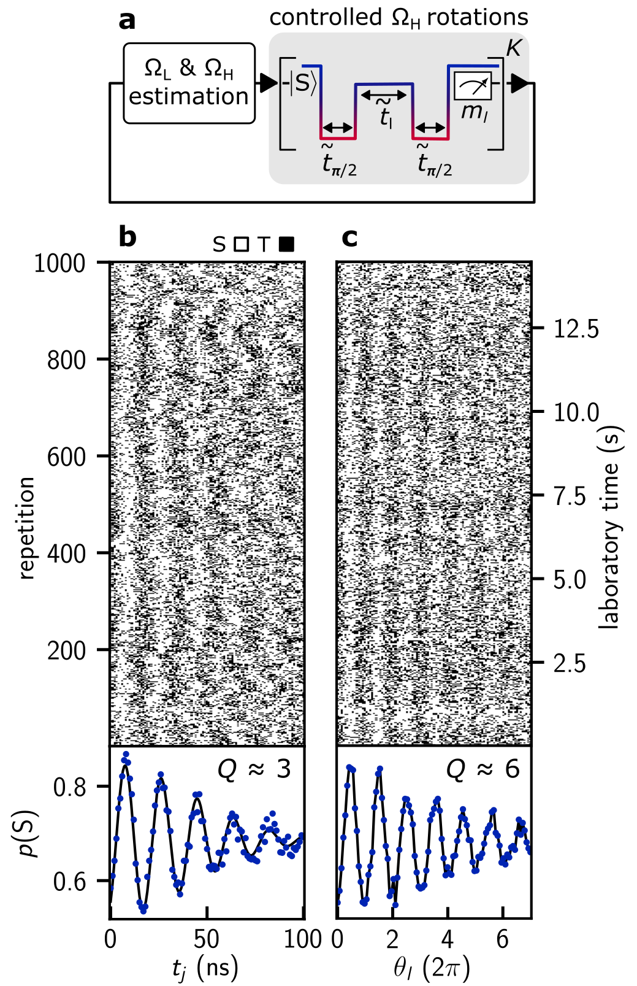
Real-time-controlled exchange-driven qubit rotations.
We have dynamically changed the pulse duration.
But exchange J(ε) is a function of detuning as well!
Berritta F. et al, Nat. Commun 15, 1676 (2024)

Slide 8
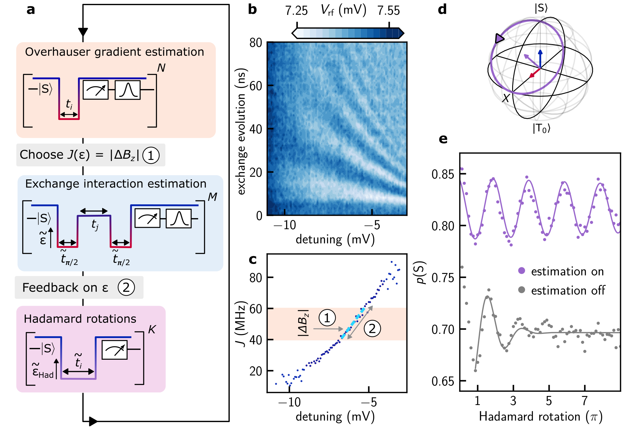
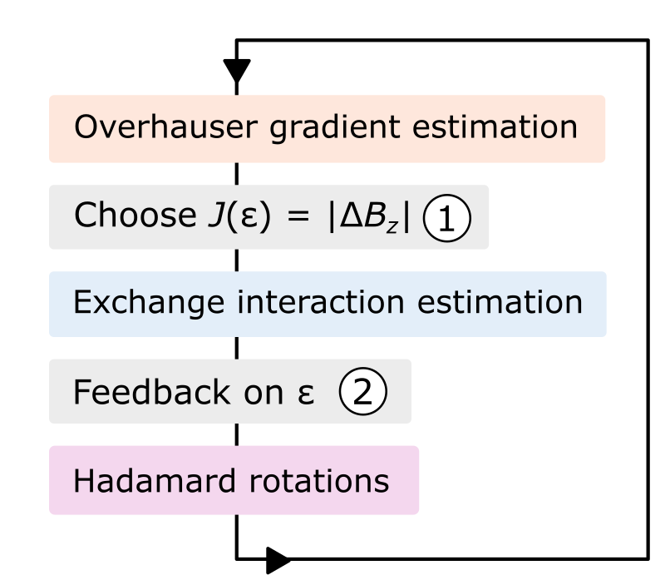
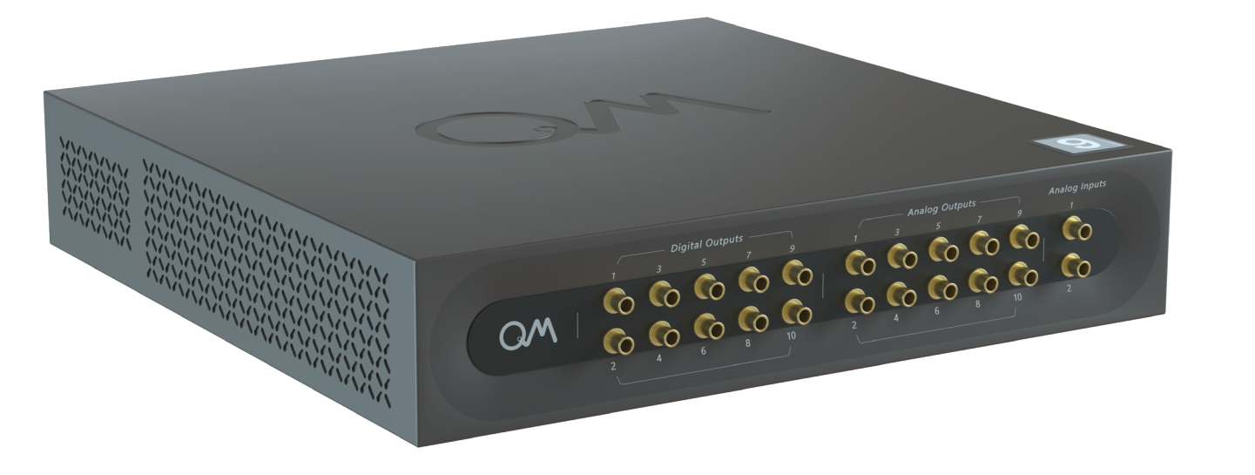
Real-time universal ST₀ control demonstrated by Hadamard rotations
dominating J
dominating ΔB_{z}
Berritta F. et al, Nat. Commun 15, 1676 (2024)

Slide 9
Physics-informed tracking of qubit fluctuations
Berritta F. et al, arXiv:2404.09212 (2024)

Slide 10
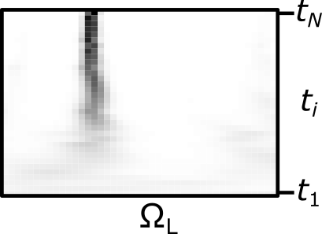
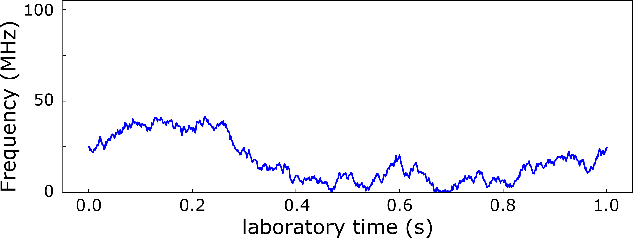
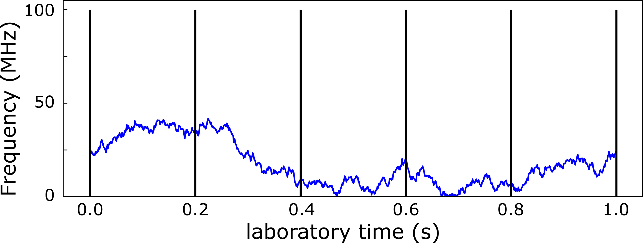
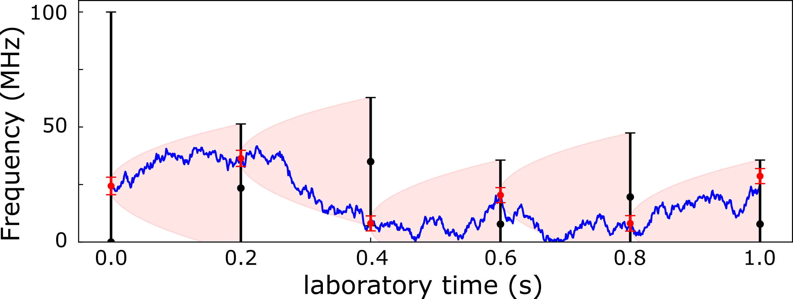
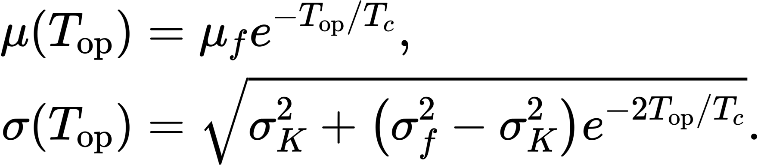
Physics-informed Tracking: Fokker-Planck Equation
P_{final}
How can we improve the new estimation based on the past repetitions?
Prior
Simulated Overhauser gradient
Predicted frequency
f_{B}
Non-tracking prior
P_{final}
Non-tracking prior
Physics-informed prior
Fokker-Planck equation*
T_{op}
µ_{f},σ_{f}
µ(T_{op}), σ(T_{op})
*T_{c} ~ 5 s
σ_{K}~ 50 MHz
Berritta F. et al, arXiv:2404.09212 (2024)

Slide 11
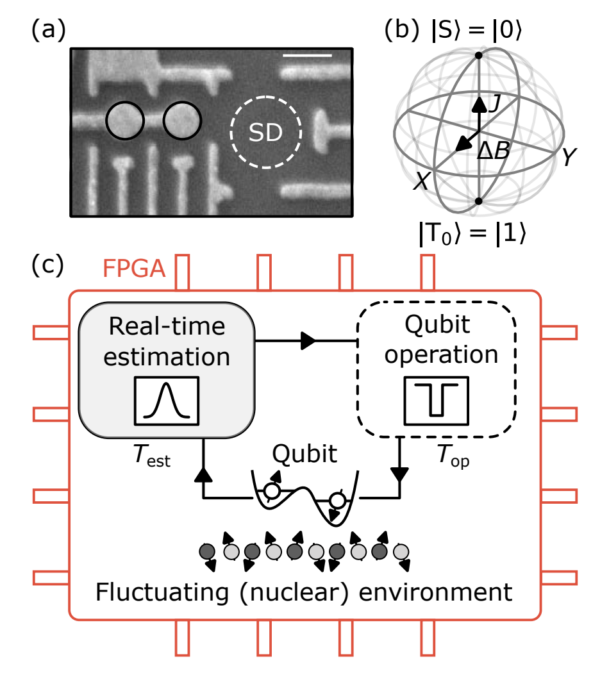
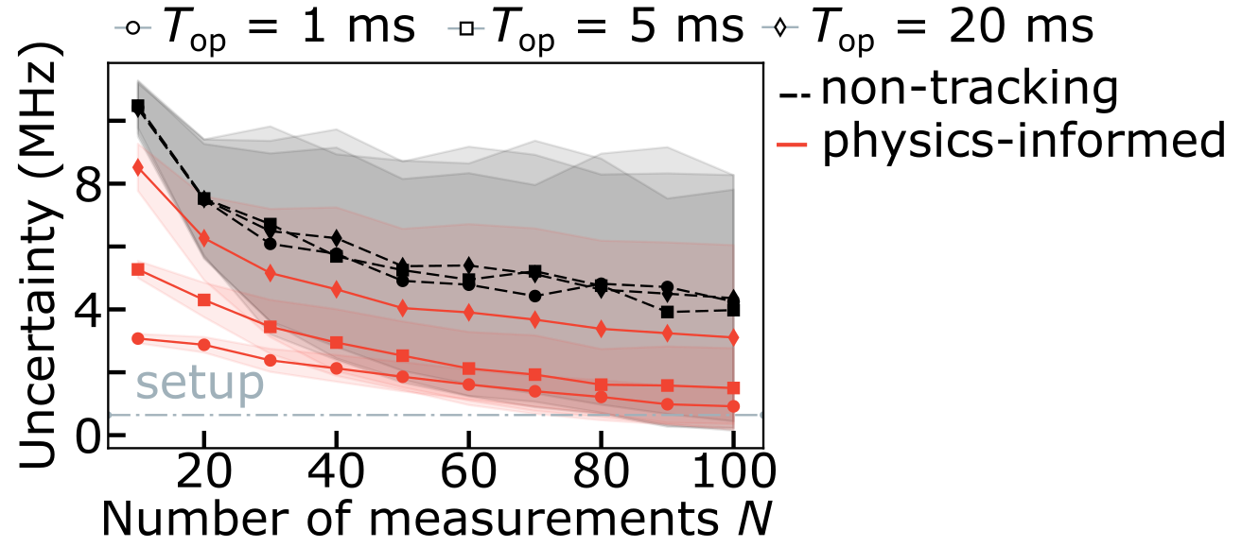
Physics-informed prior
Non-tracking prior
Berritta F. et al, arXiv:2404.09212 (2024)

Slide 12
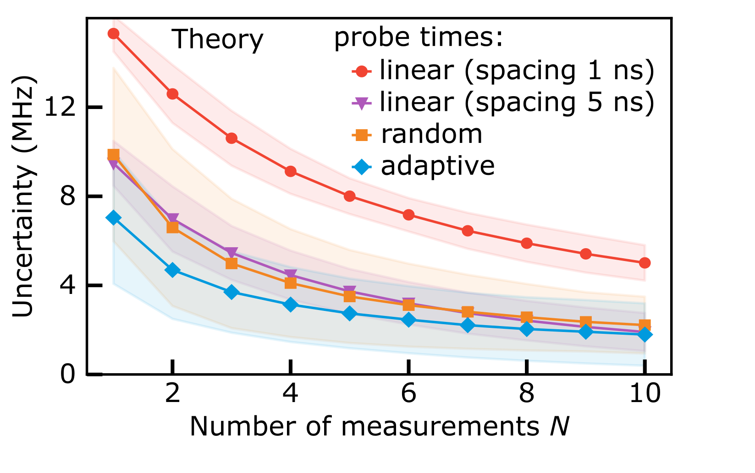
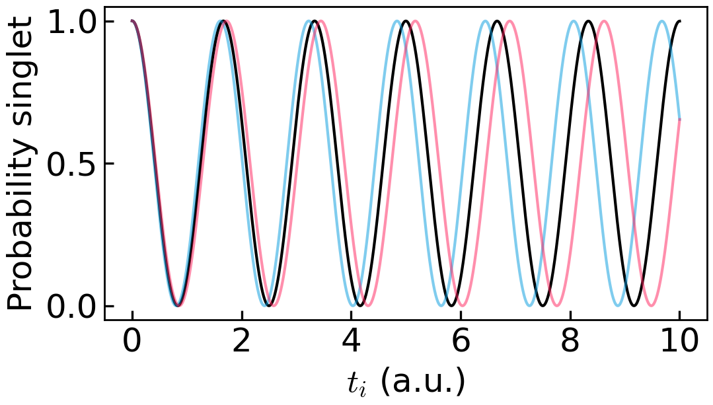
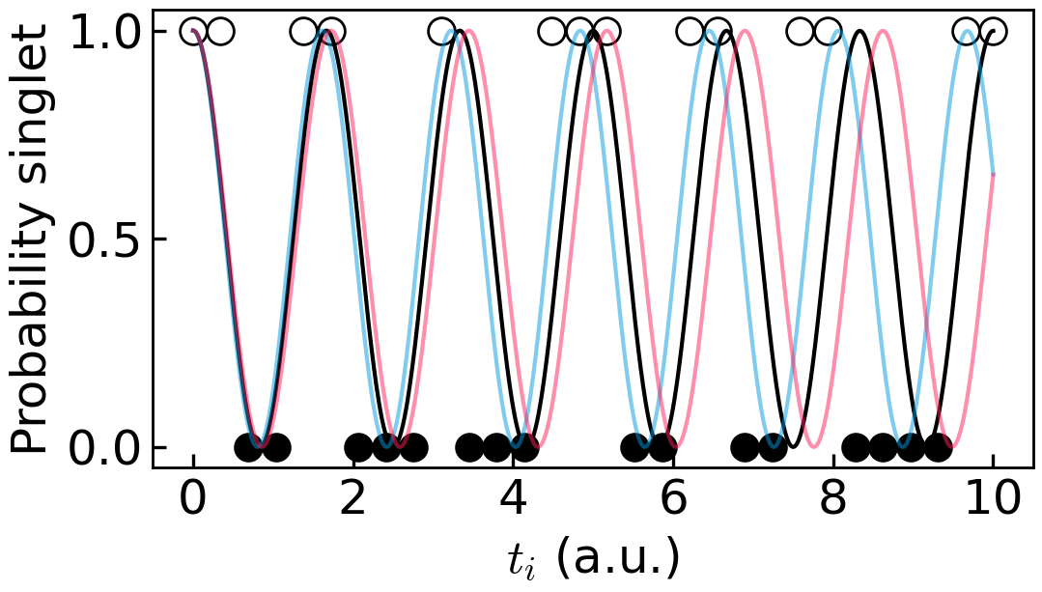
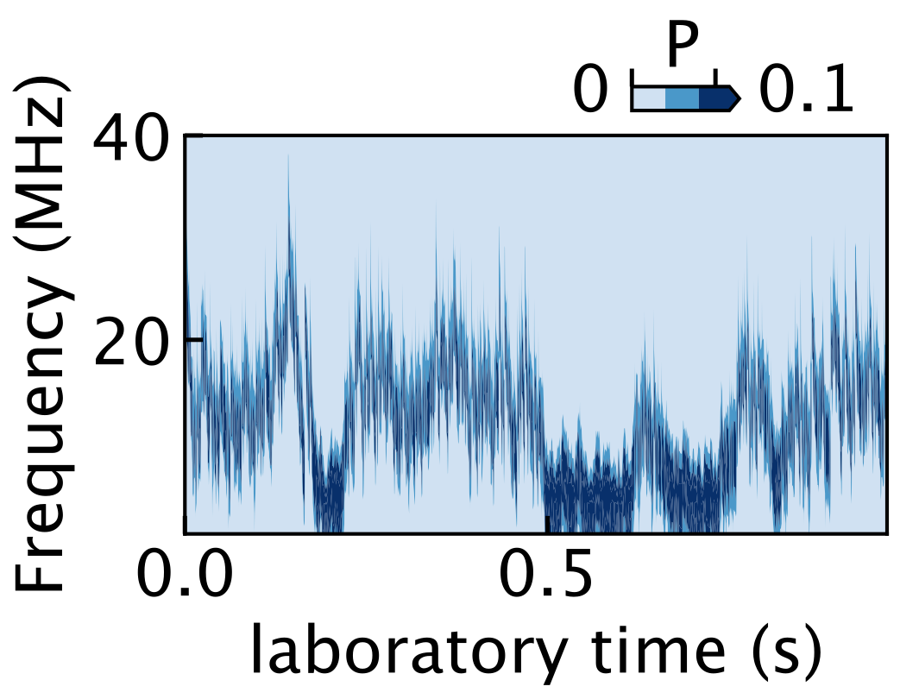
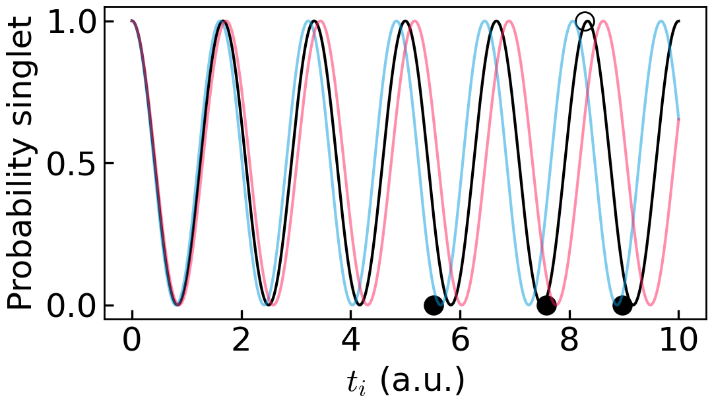
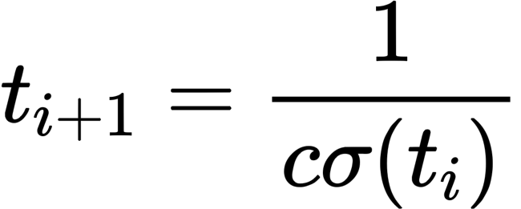
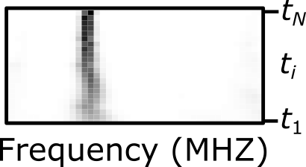
Adaptive estimation
Linear sampling time
Adaptive sampling time
N = 10 (experiment)
Berritta F. et al, arXiv:2404.09212 (2024)

Slide 13
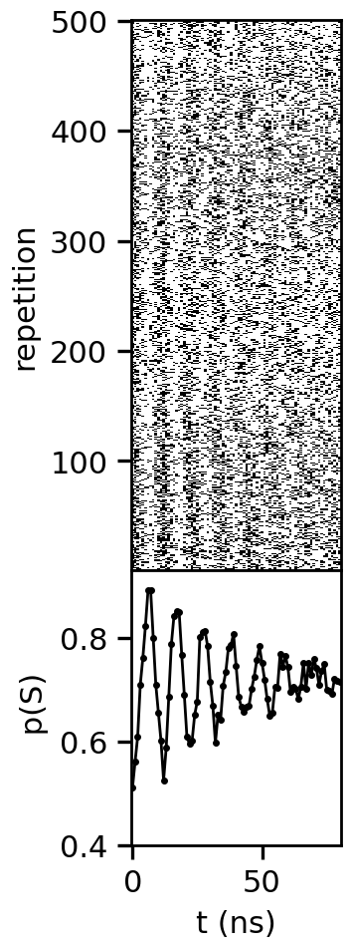
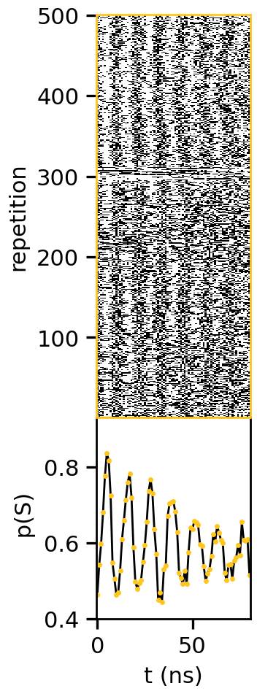
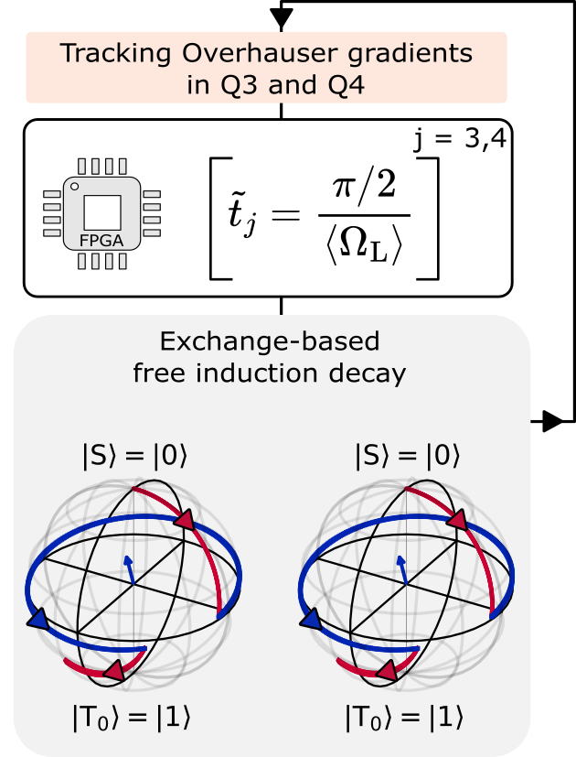
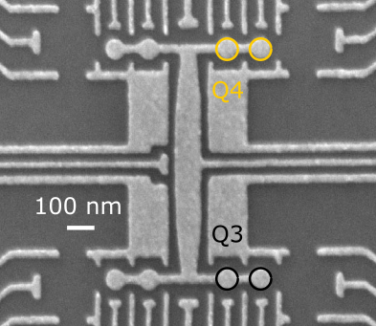
E.g., Simultaneous controlled rotations in 2 singlet-triplet qubits
Q3
S
T
Q4
j
Q3
Q4
Fedele, F. et al, PRX Quantum 2021

Slide 14
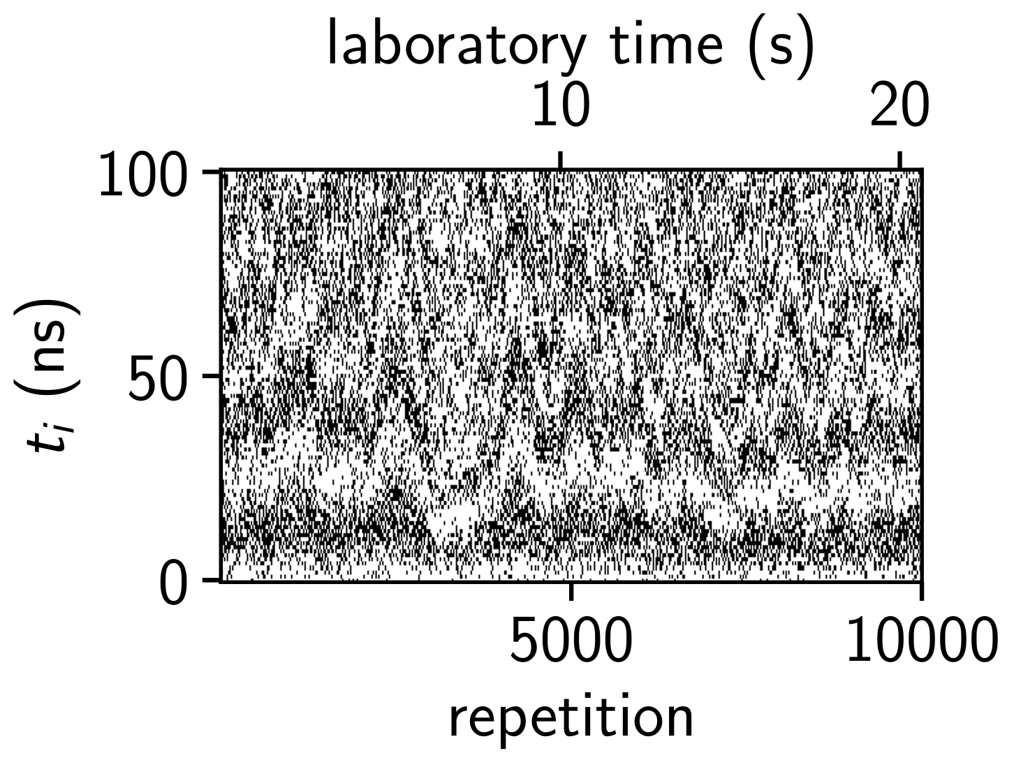
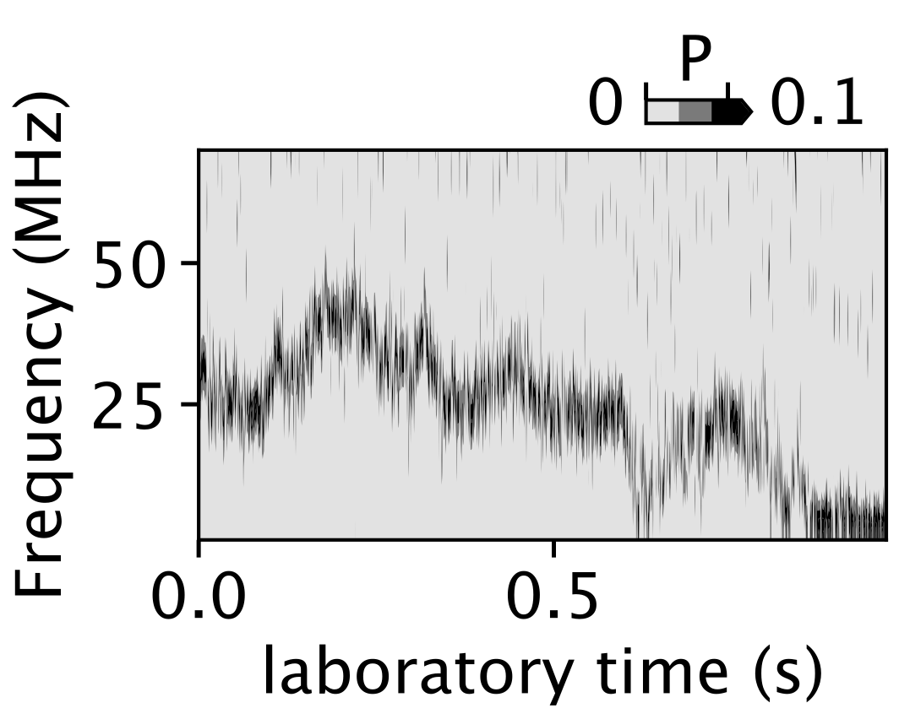
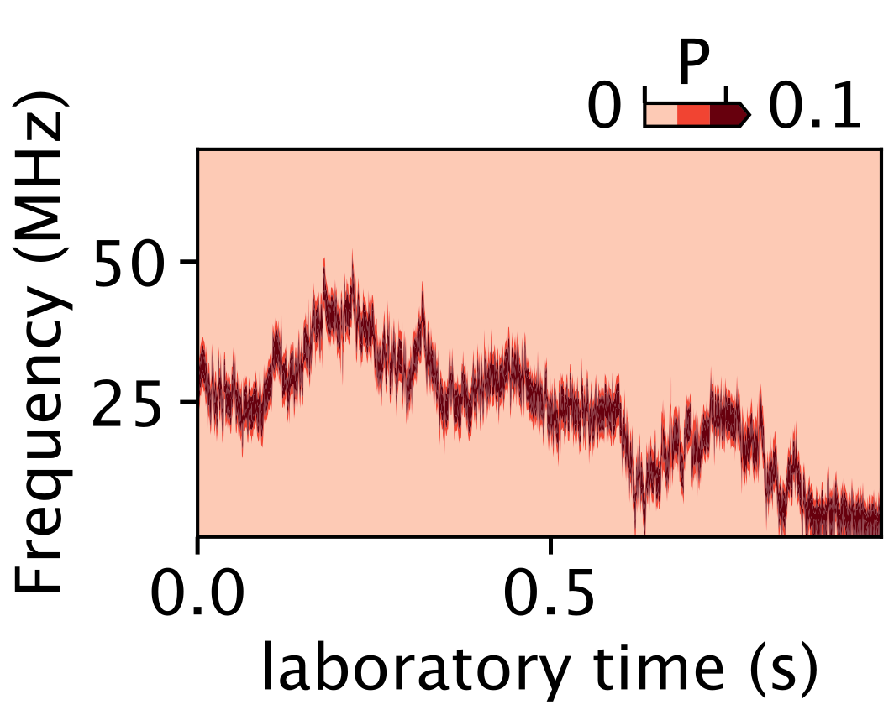
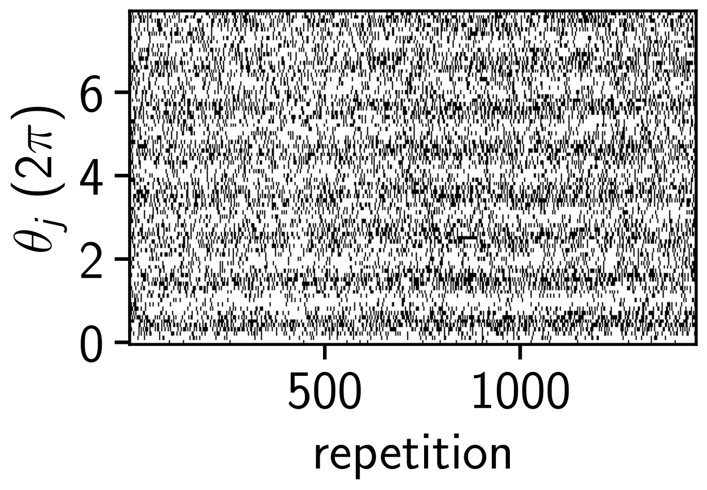
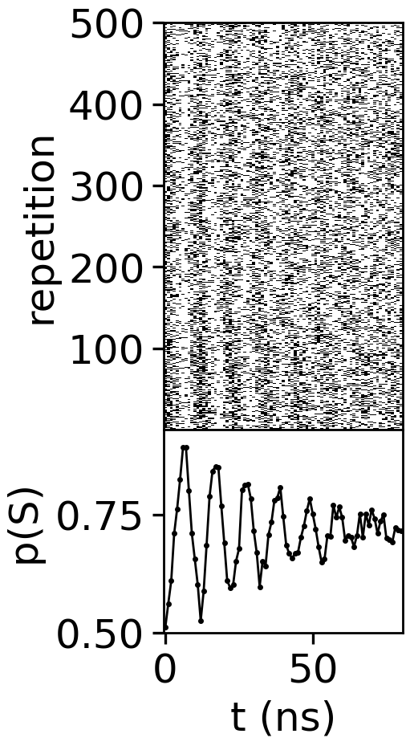
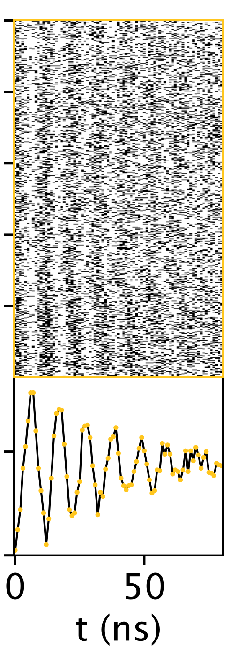
Noise-driven coherent qubit rotations & two-axis control [1]
Physics-informed model in real time [2]
S
T
Adaptive Bayesian estimation in 100 10 measurements [2]
Estimation & operation in two ST qubits
[1] Berritta F. et al, Nat. Commun 15, 1676 (2024)
[2] Berritta F. et al, arXiv:2404.09212 (2024)

Slide 15


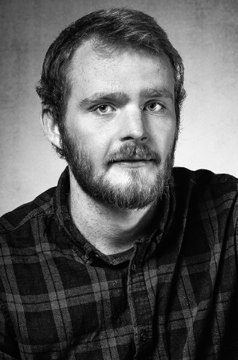
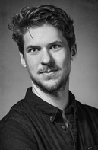

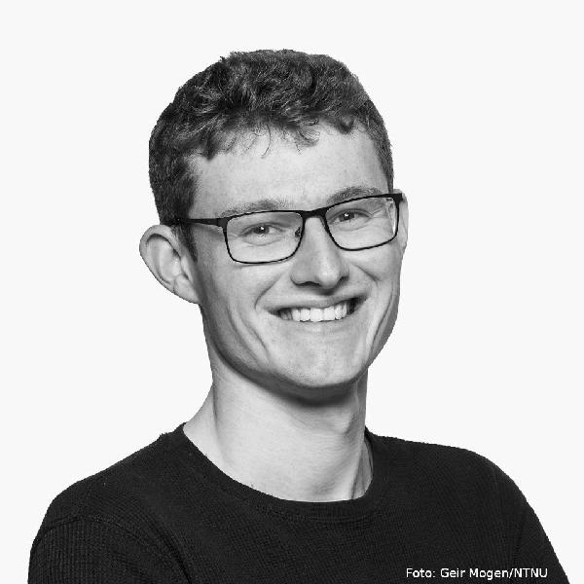















^{Thank you}
ConSpiQuOS team (UCPH)
T. Rasmussen
J. Van der Heijden
Jeroen Danon
Jacob Benestad
Evert Van Neiuwenberg
Jan Krzywda
Thu 20 June
15:00, PAS8.2
A. Chatterjee
F. Kuemmeth
Anton Zubchenko
Marcin Kepa
Funding: EU Quantera II (CONSPIQUOS), EU FETFLAG RIA (QLSI 951852), EU RIA (IGNITE 101069515)

Slide 16

Singlet-triplet qubits in GaAs
All Gallium and Arsenic atoms carry nuclear spins
(with some random polarization).
depletion gates →
60 nm
+ + + + + + + + + + +
2DEG→
Fedele, F. et al, PRX Quantum 2021
      Each electron spin: interacts with ~10⁶ nuclear spins, effective Overhauser field Bnuc due to hyperfine coupling
⁷⁵As
⁷¹Ga
⁶⁹Ga
J. M. Taylor et al, PRB 2007

Slide 17


Singlet-triplet rotations due to nuclear spins in GaAs
Prepare
t=0
Separate
Evolve
Average over lab time
for many seconds
Power spectral density
t=τS
Measure
cf. Petta, Science (2005)
F. K. Malinowski et al PRL 118, 177702 (2017)

Slide 18



Setup

Slide 19


Slide 20


Slide 21


Slide 22


Slide 24


Slide 25


Slide 26


Slide 27


Slide 28


Slide 29

Improvement of the visibility of coherent oscillations by rejecting low-quality estimates

