Slide 1
Optimizing
T and CNOT gates in
quantum ripple-carry adders
Maxime REMAUD
ReAQCT 2024

Slide 2
Relations between arithmetic operators
Log / Trig
Exp
GCD
Div
Sqrt
Mult
Add / Sub
Inc / Dec
Compare

Slide 3
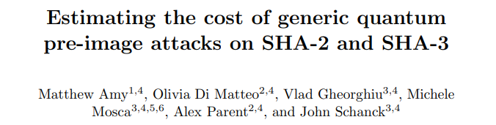
Why do we care ?

Slide 4
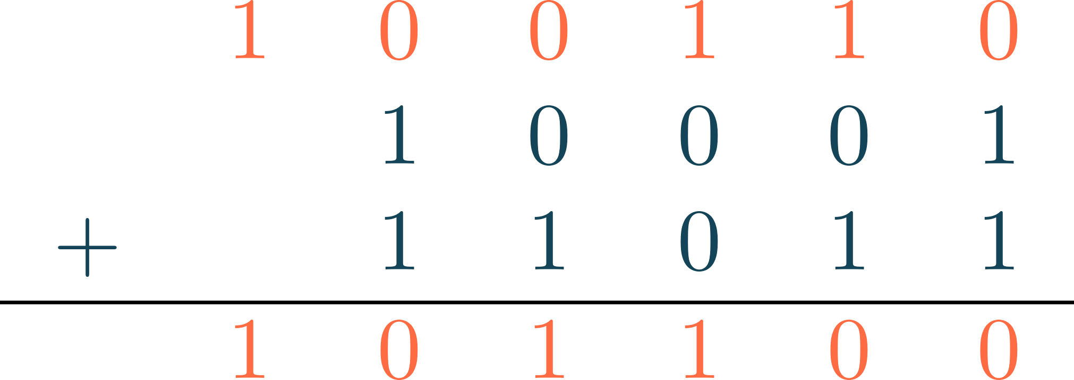
Addition

Slide 5
Complexity of quantum addition

Slide 6
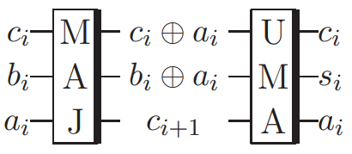
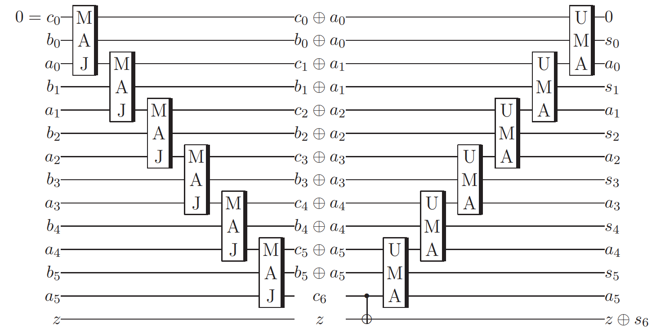
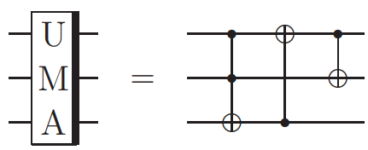
Ripple-carry technique (Cuccaro et al. adder (1))

Slide 7
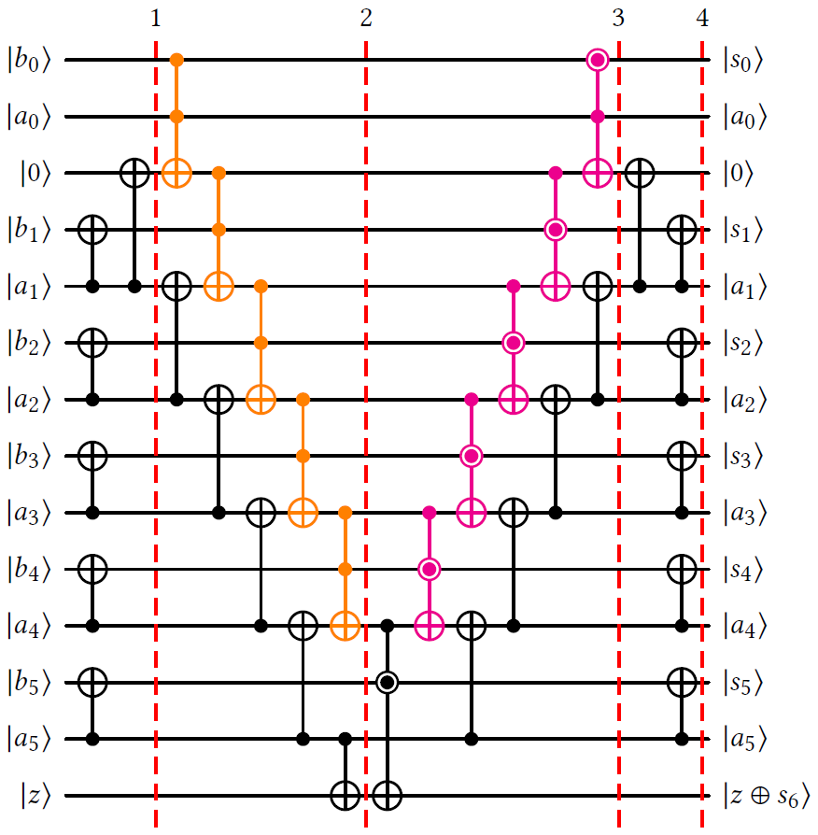
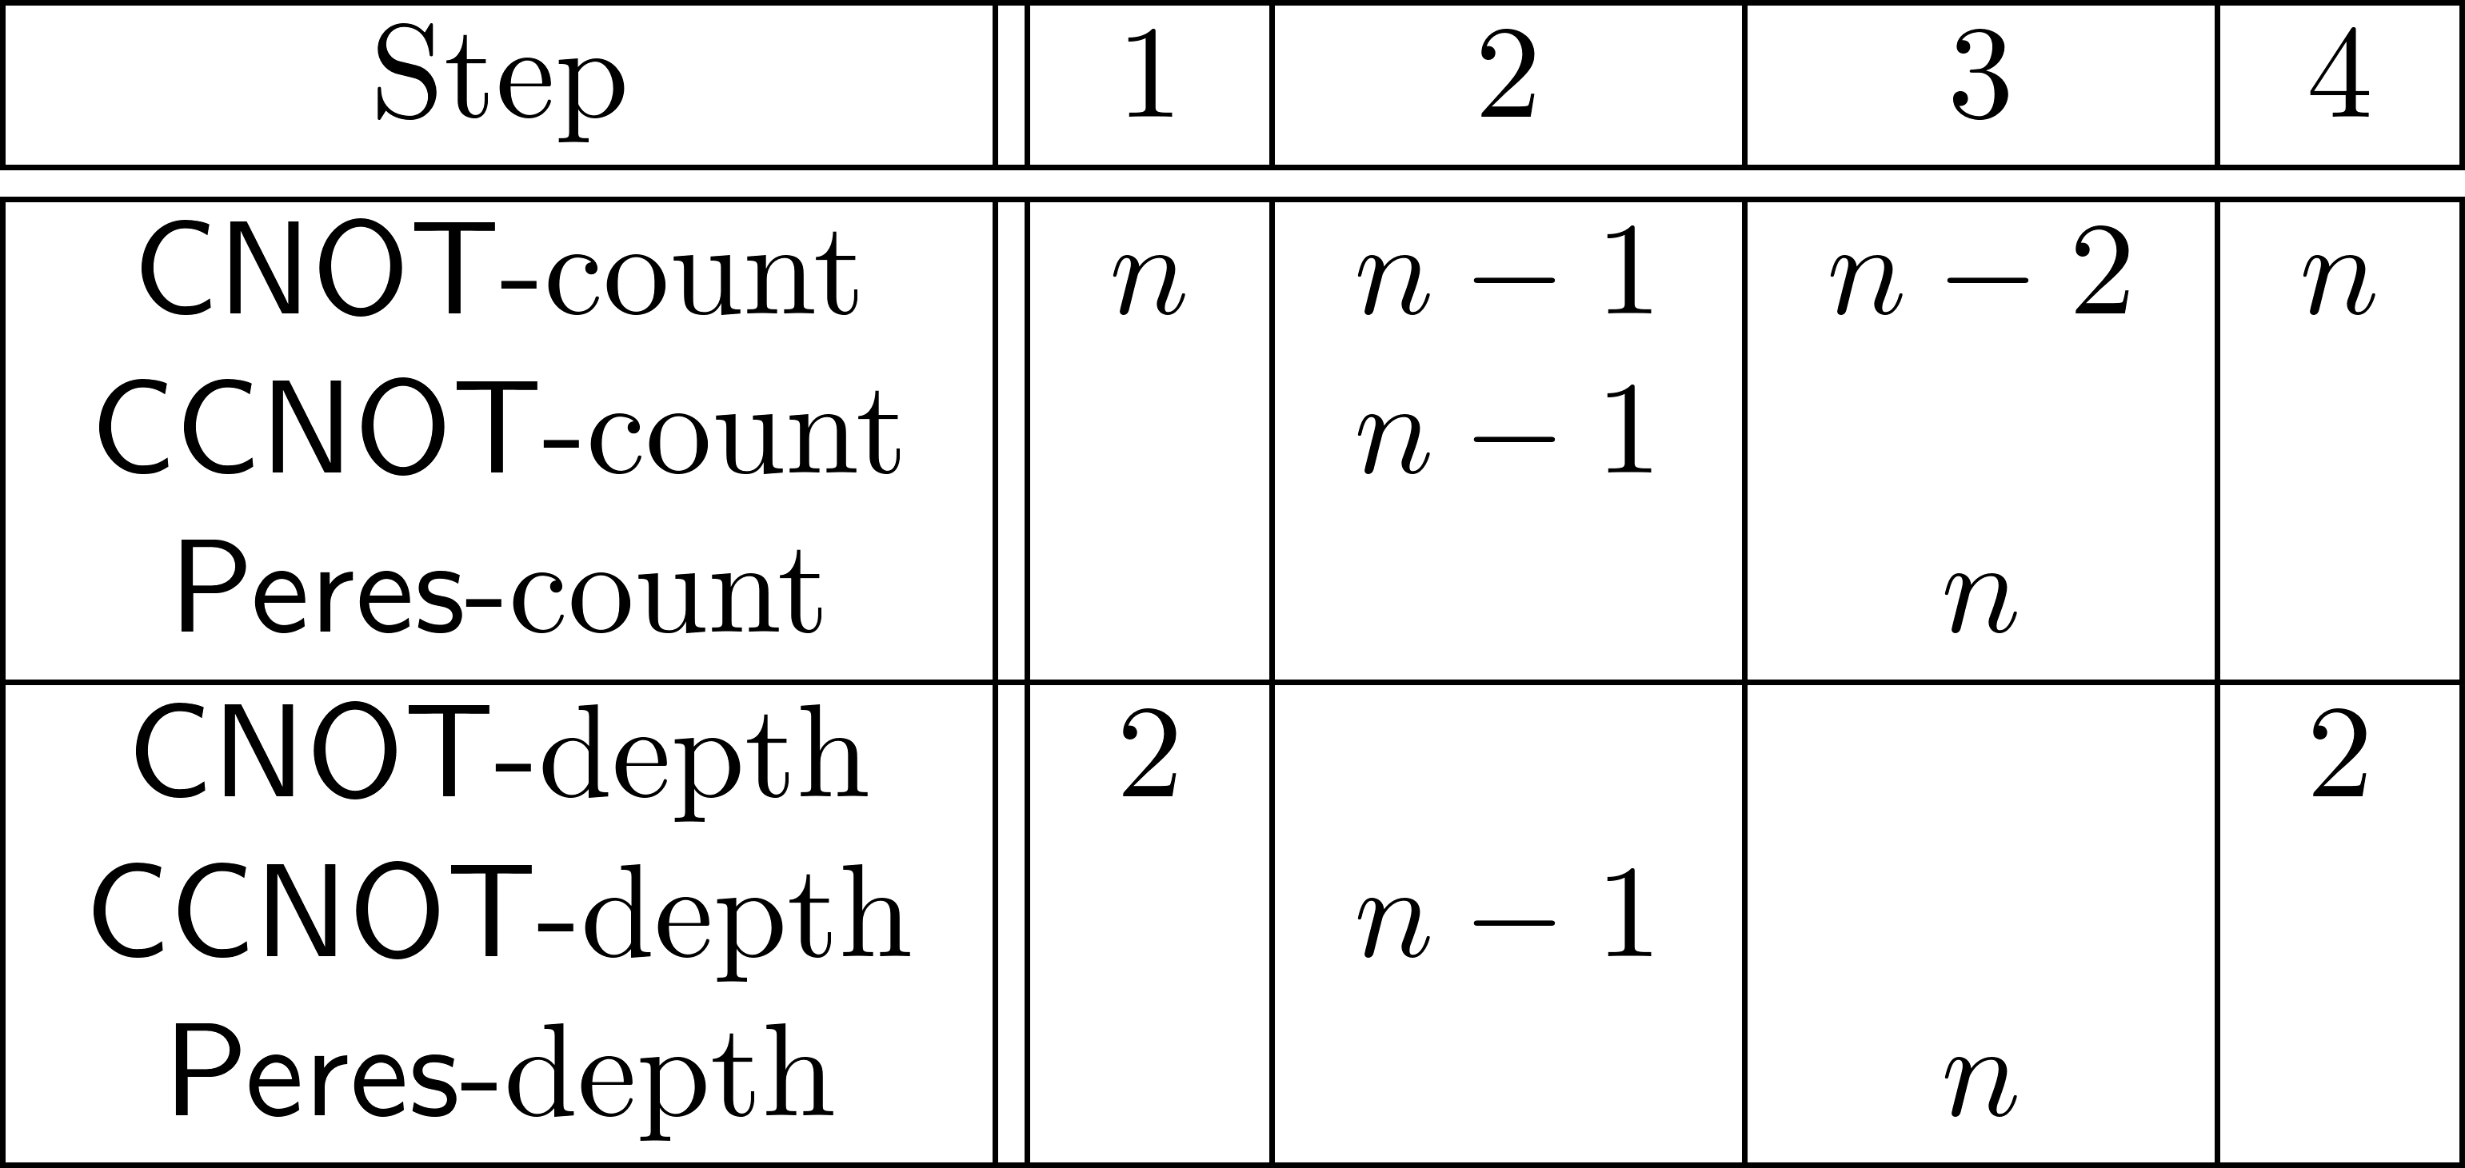
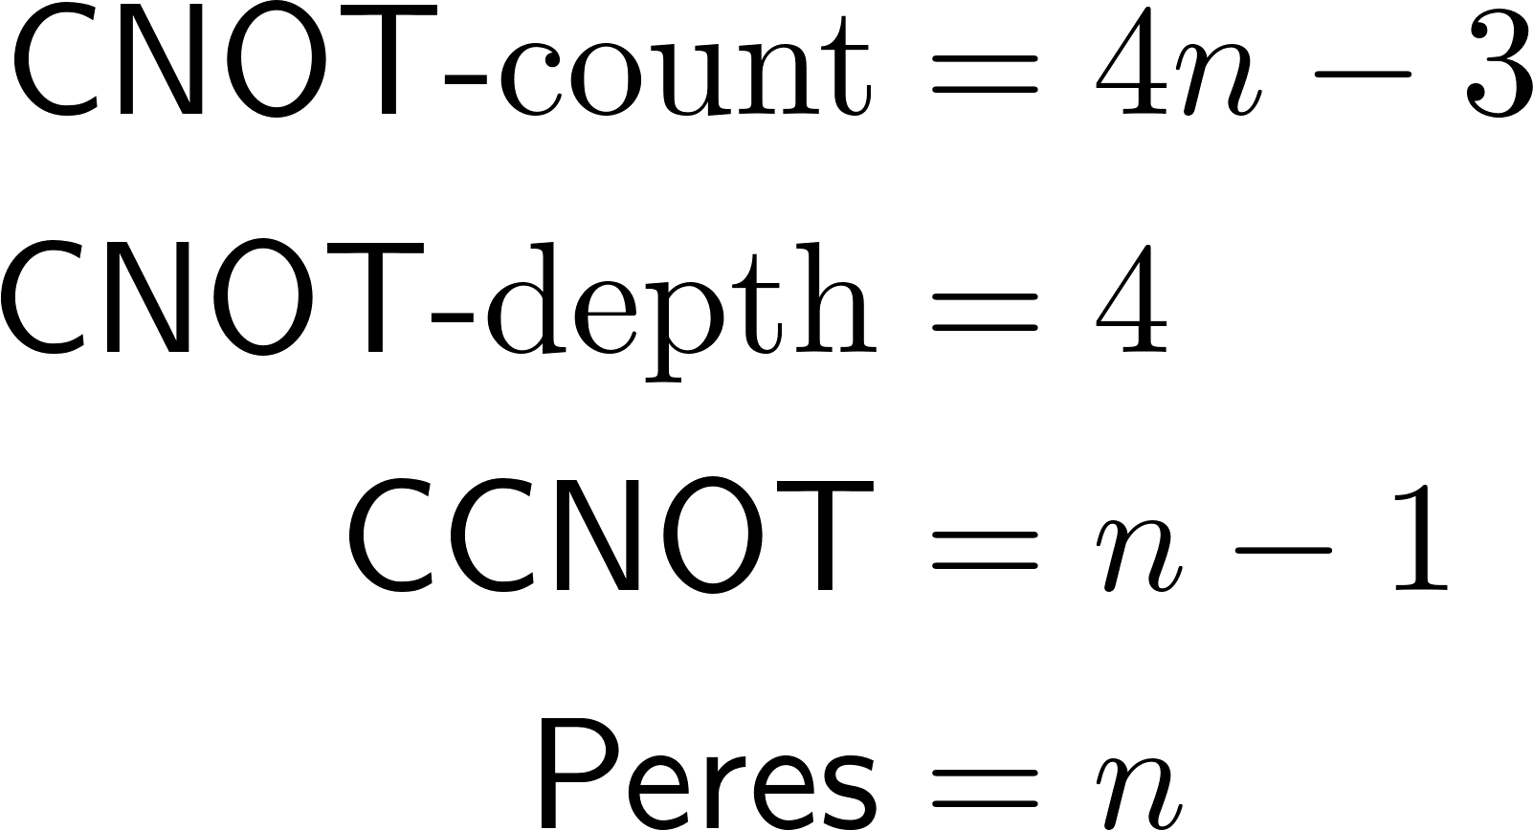
Cuccaro et al. adder (2)

Slide 8
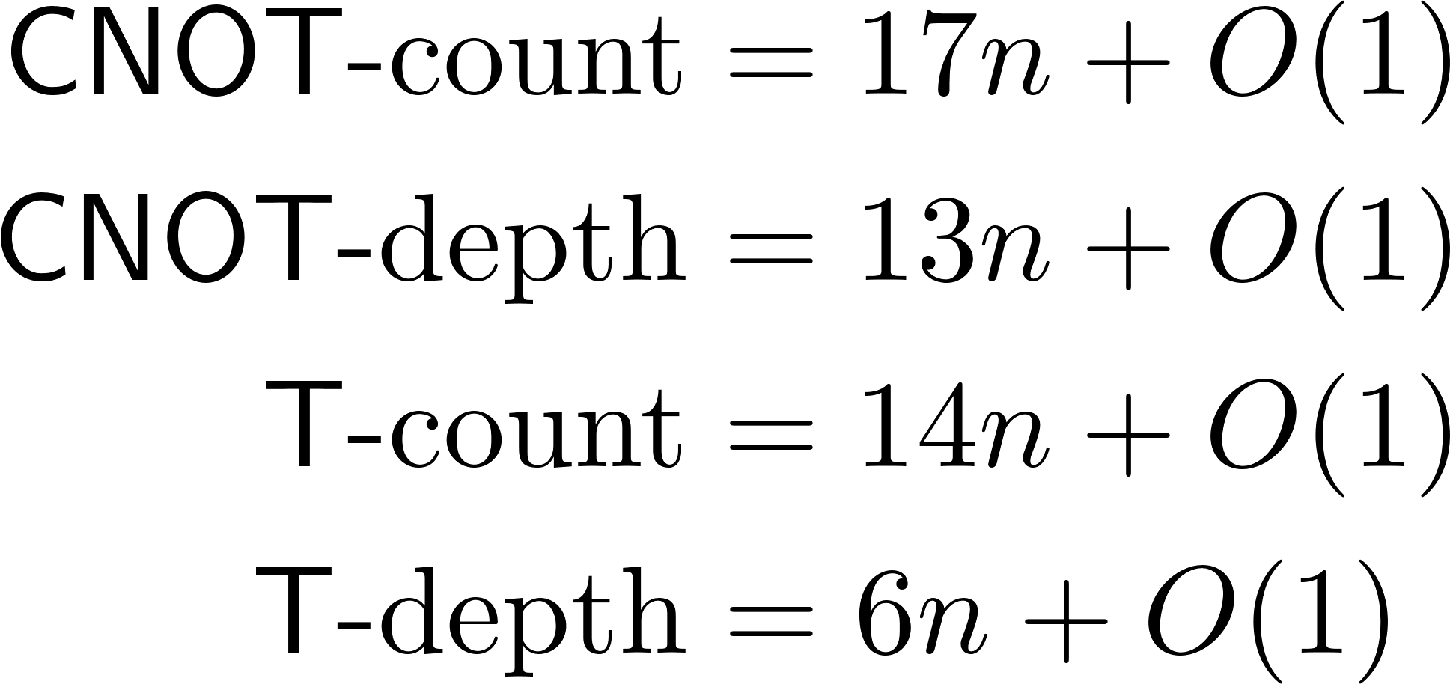
Clifford+T gate set

Slide 9
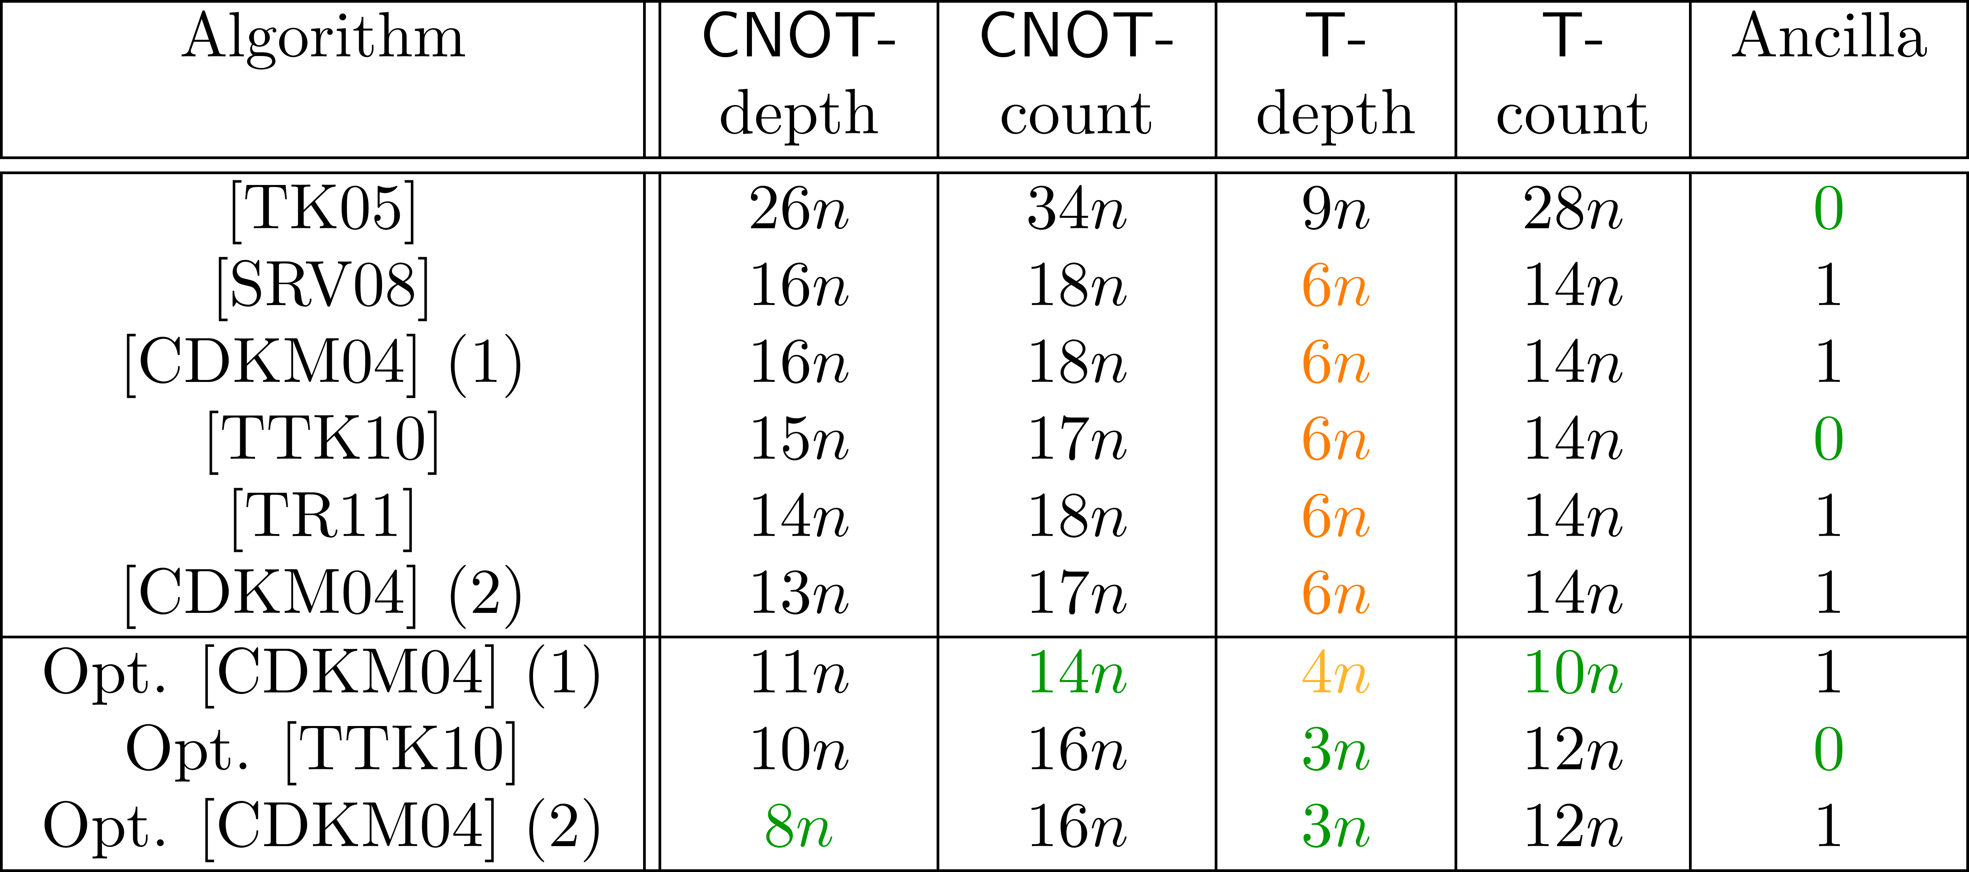
Ripple-carry adders

Slide 10
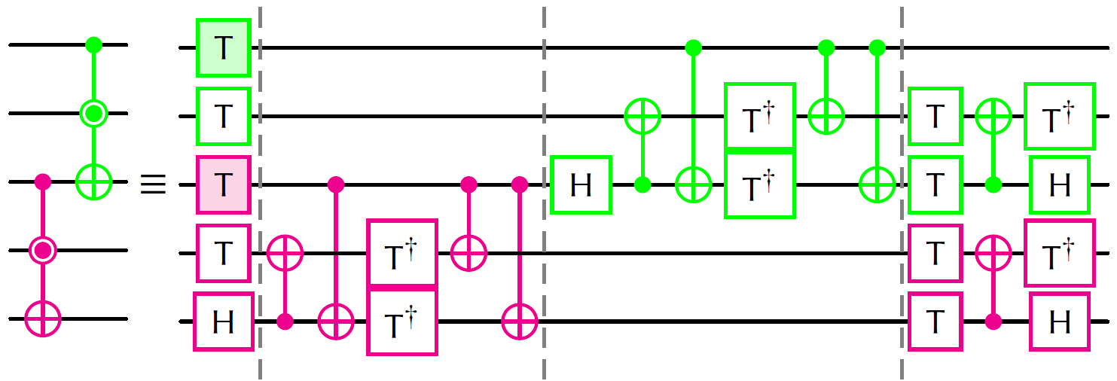
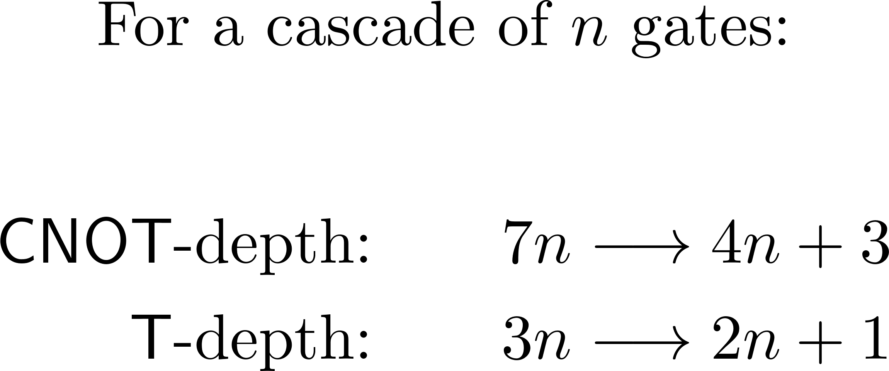
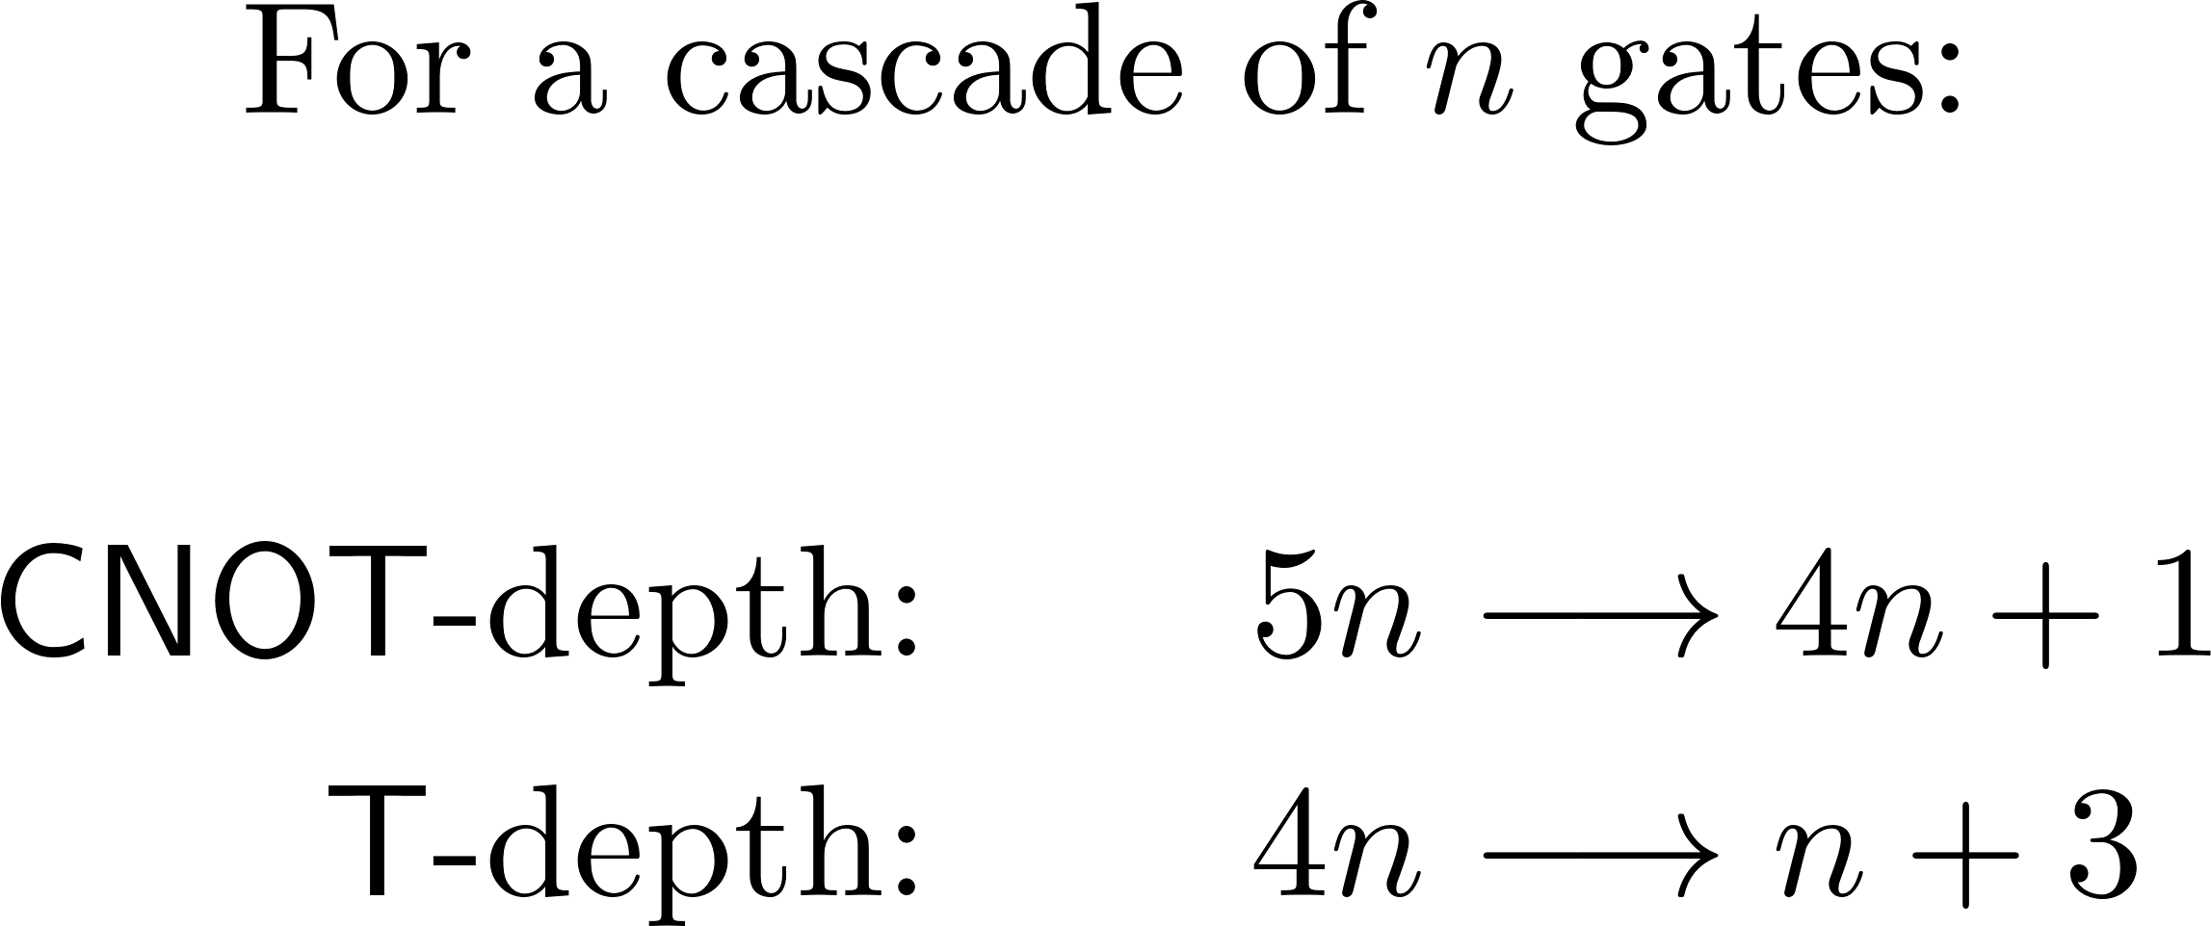
Optimization rules (depth)

Slide 11
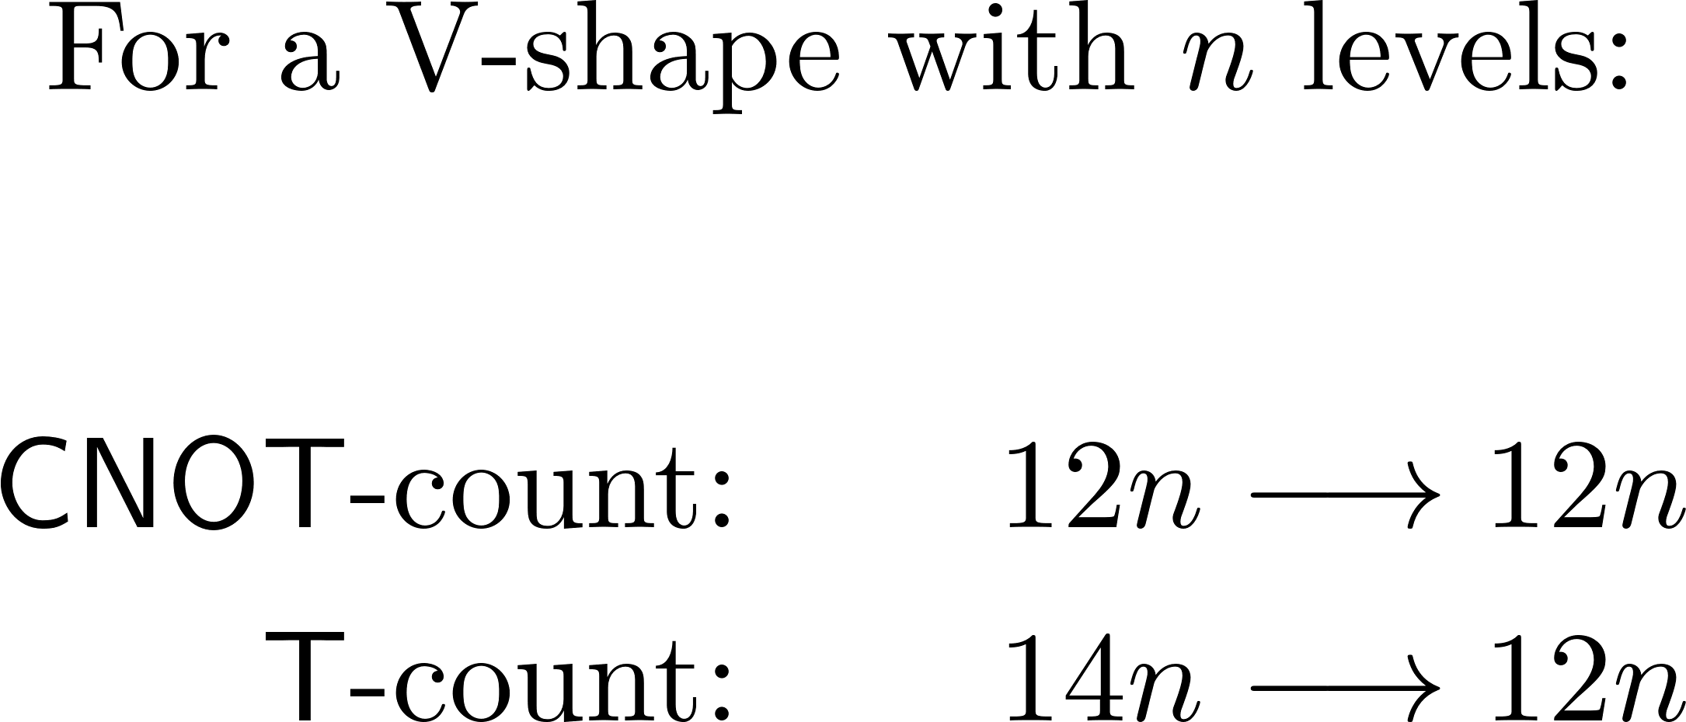
Optimization rules (count)

Slide 12
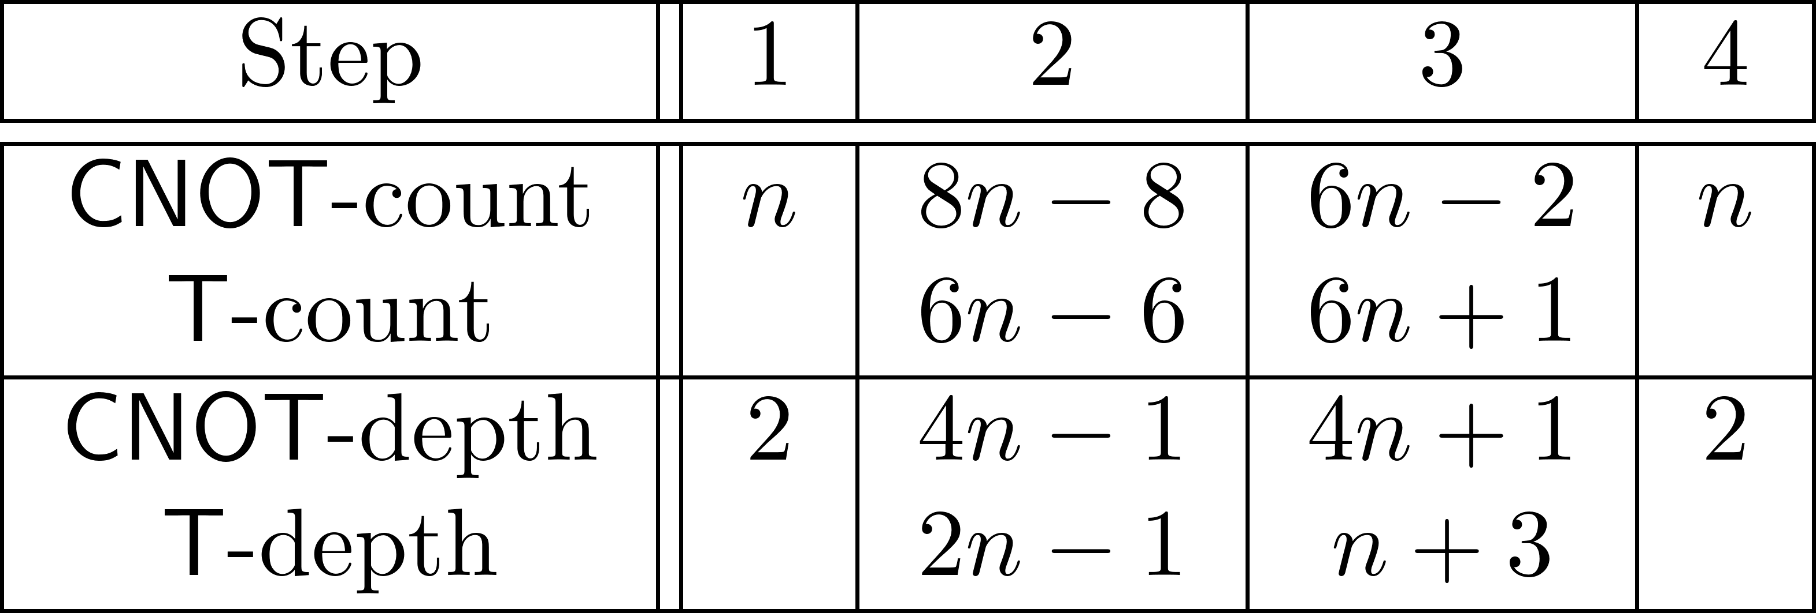
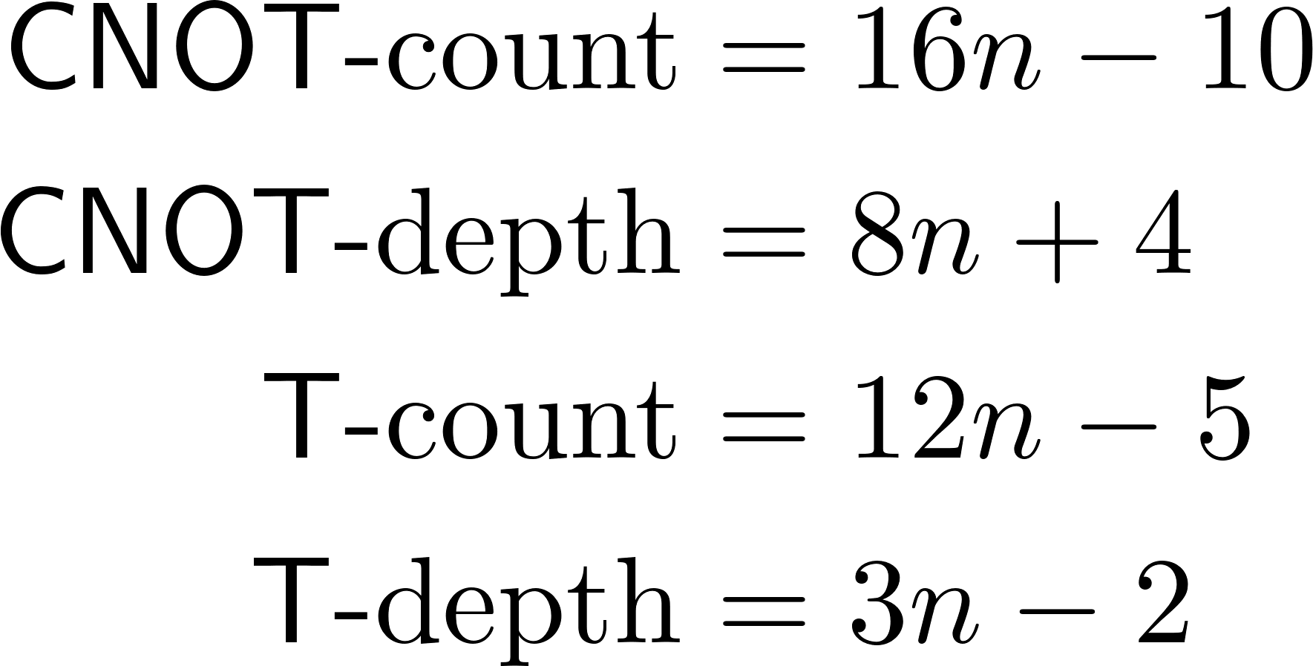
Opt. Cuccaro et al. adder (2)

Slide 13
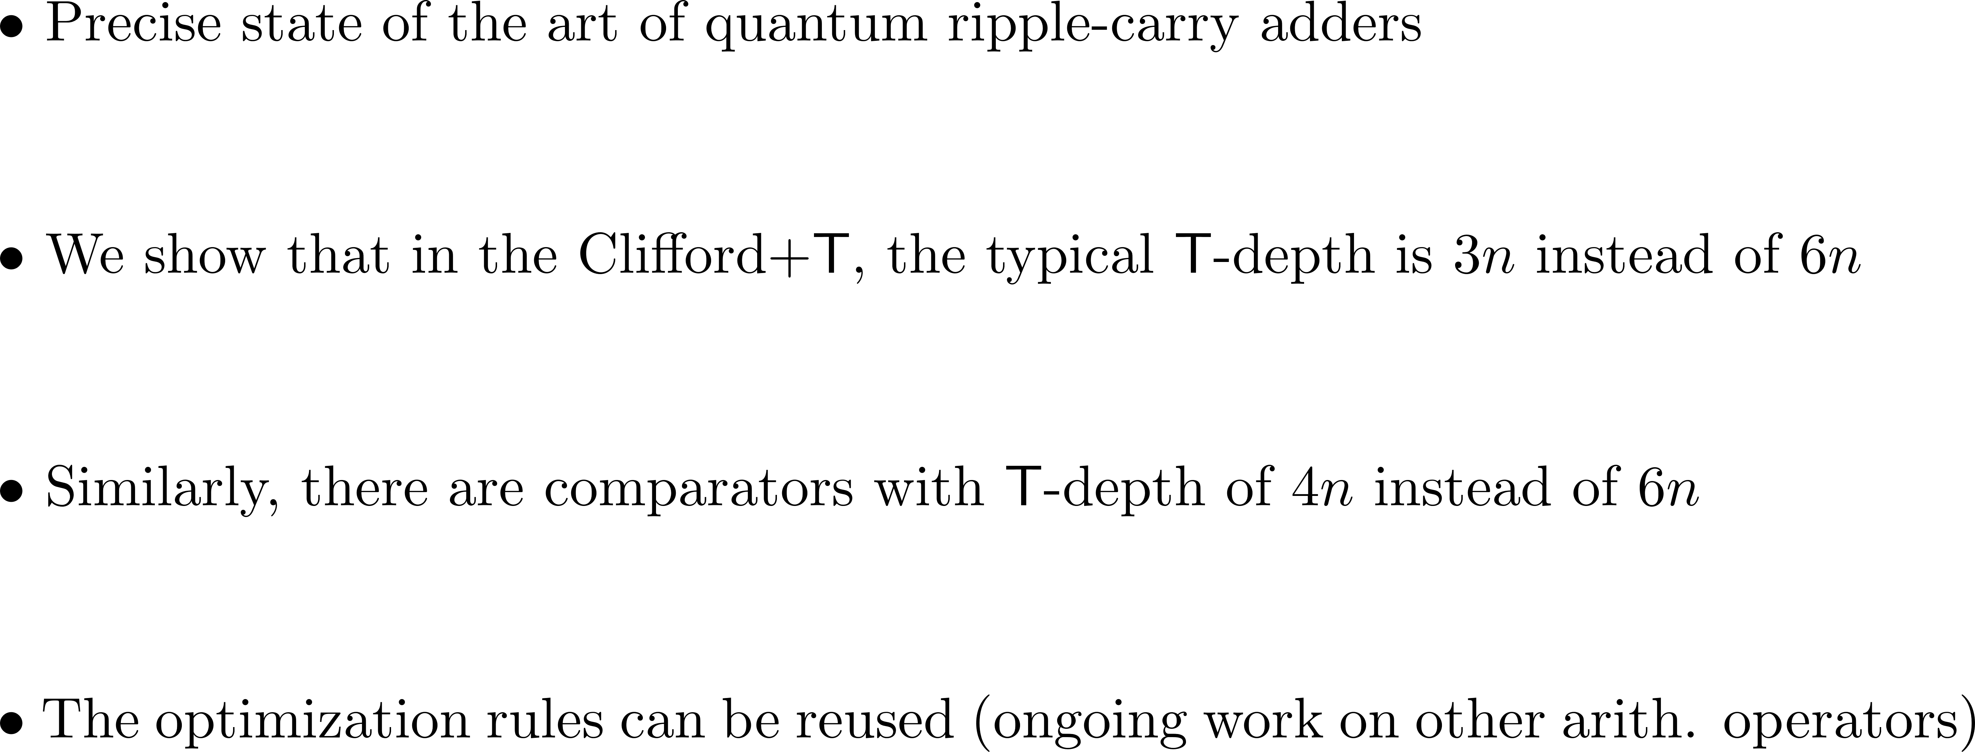
Take away

Slide 14
Questions ?
For more information, please contact me:
maxime.remaud@eviden.com

