Slide 1
Quantum-Resilient Security Controls
*Karthikeyan Sabari Ganesan
Shivam Gupta
Suyash Kandele
Sudesh Kumar
Harika Chowdary Maddipati
Rajeev Anand Sahu
*Vishal Saraswat
Bosch Global Software Technologies, Bangalore, INDIA
20 June 2024
ReAQCT’24, Budapest

Slide 2
Overview
Quantum-Resilient Security Controls
Introduction
Motivation
Objective
Secure TLS
Secure Update
Secure Boot
Secure Access
Conclusion & Future Work

Slide 3
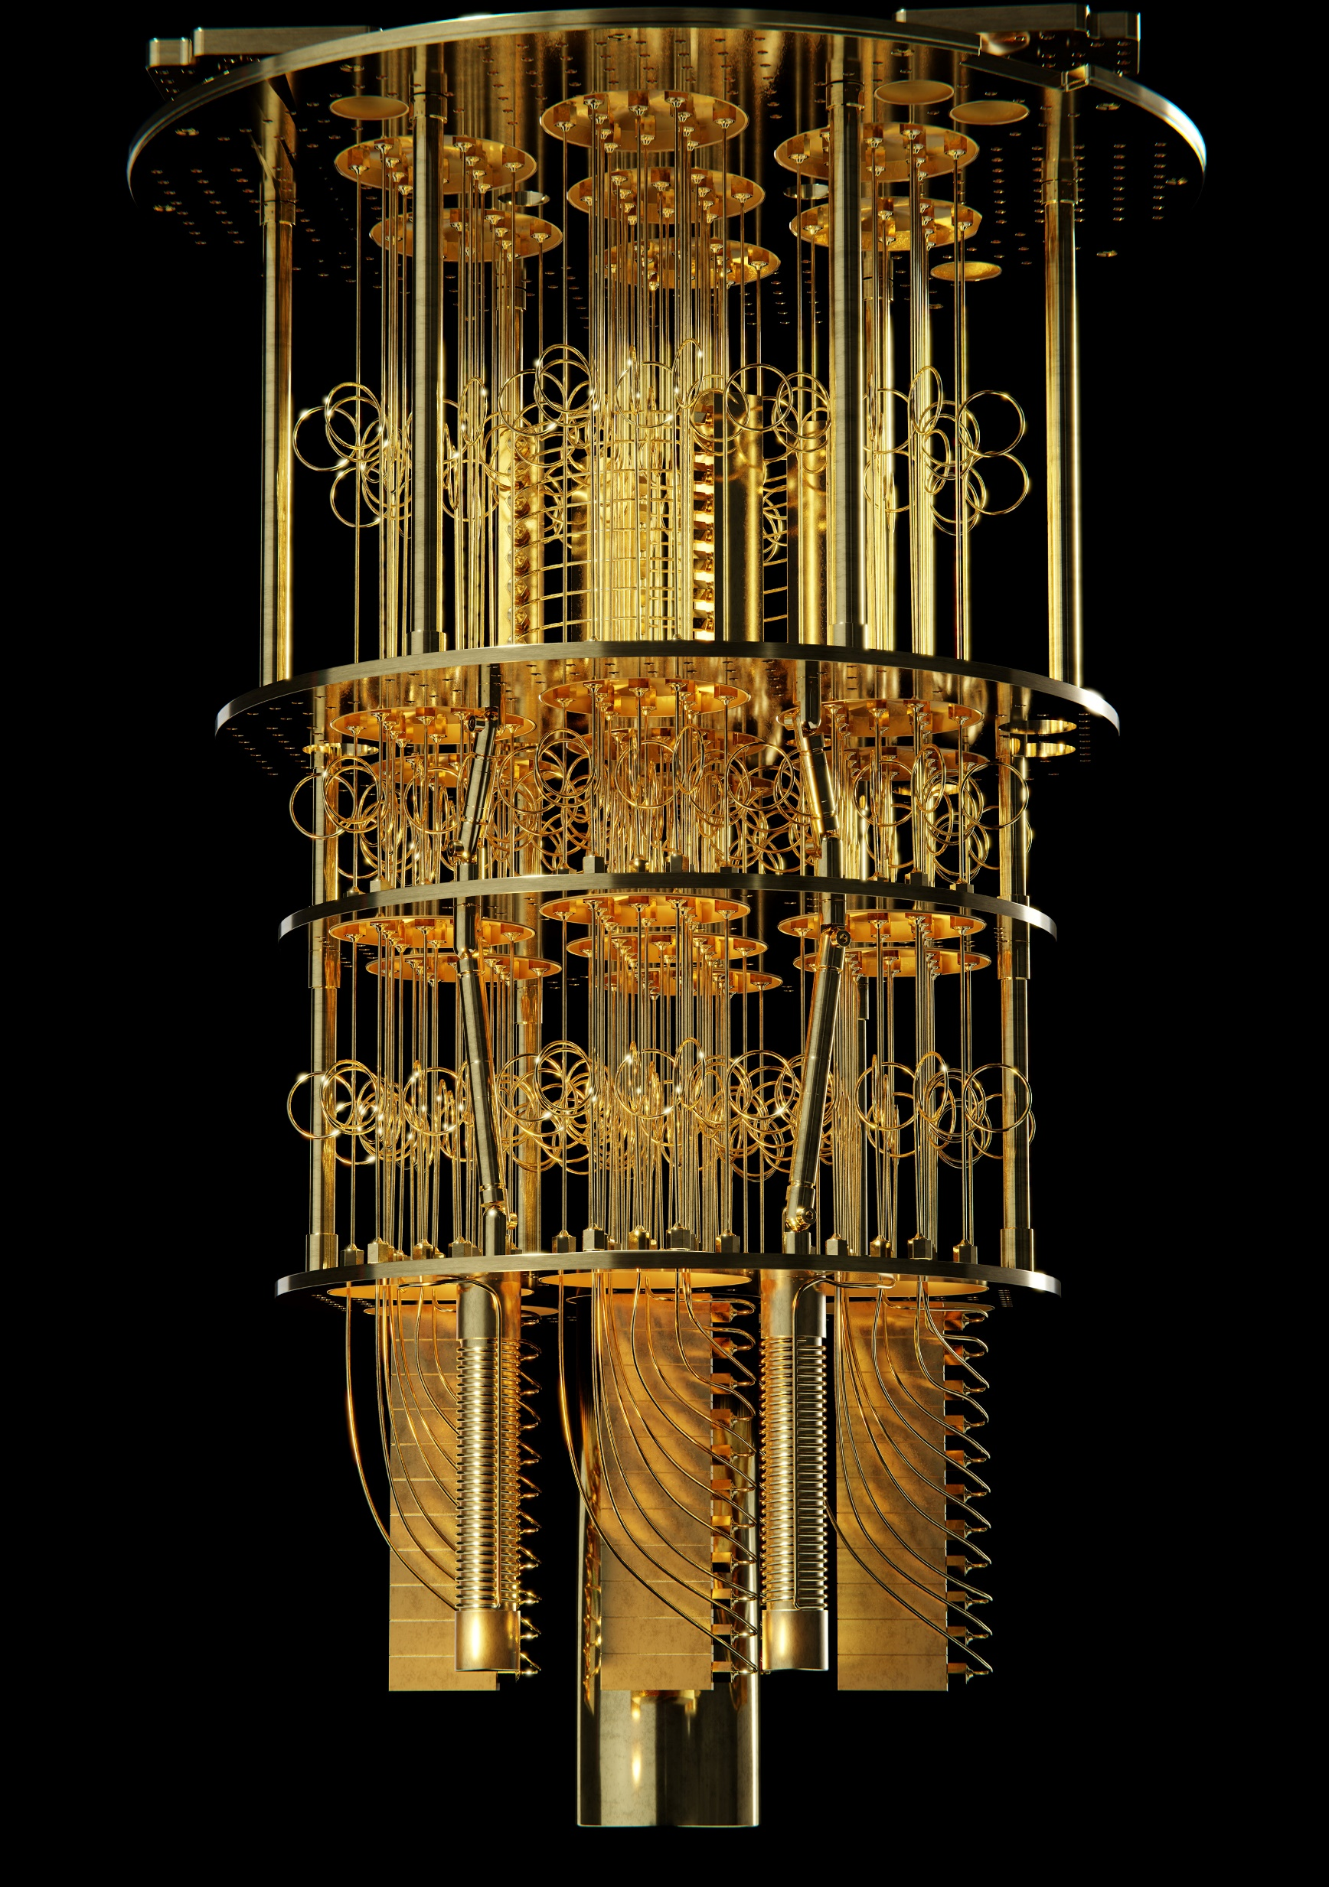
Introduction
Advent of Quantum Computers → Annihilate current PKC.
QUANTUM COMPUTER

Slide 4
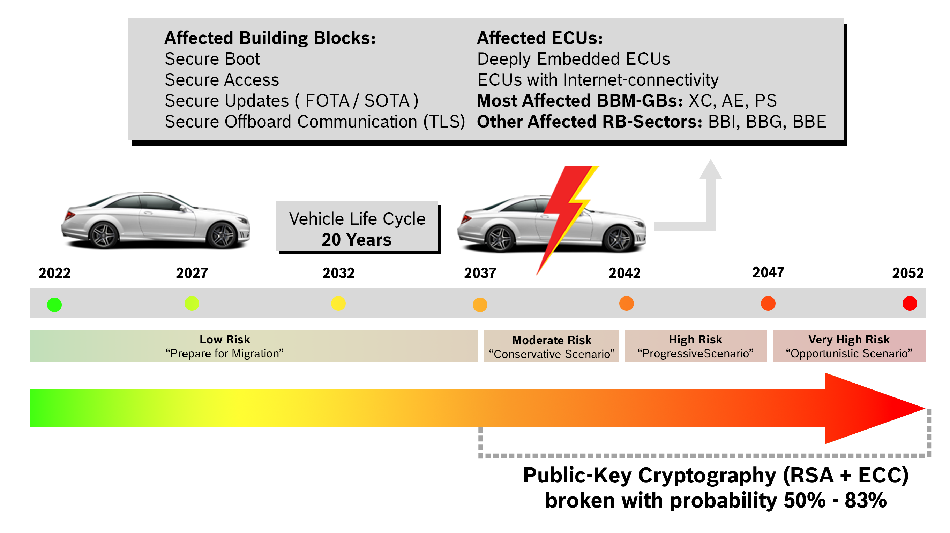
Motivation

Slide 5
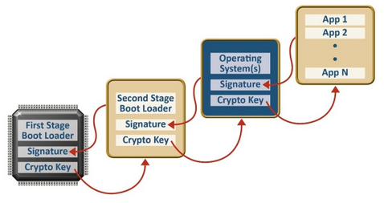
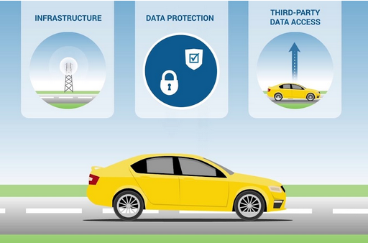
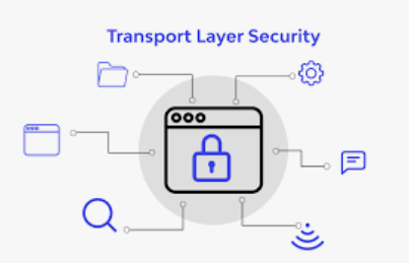
Objective
Traditional/Classical
Security Controls
Quantum-Resilient (QR)
Security Controls
Secure Boot
Secure Update
QR Secure Boot
QR Secure Update
DH
ECDSA
RSA
Kyber
Dilithium
SPHINCS+
Falcon
XMSS
Secure Access
Secure TLS
QR Secure Access
QR Secure TLS
VULNERABLE
SECURE

Slide 6
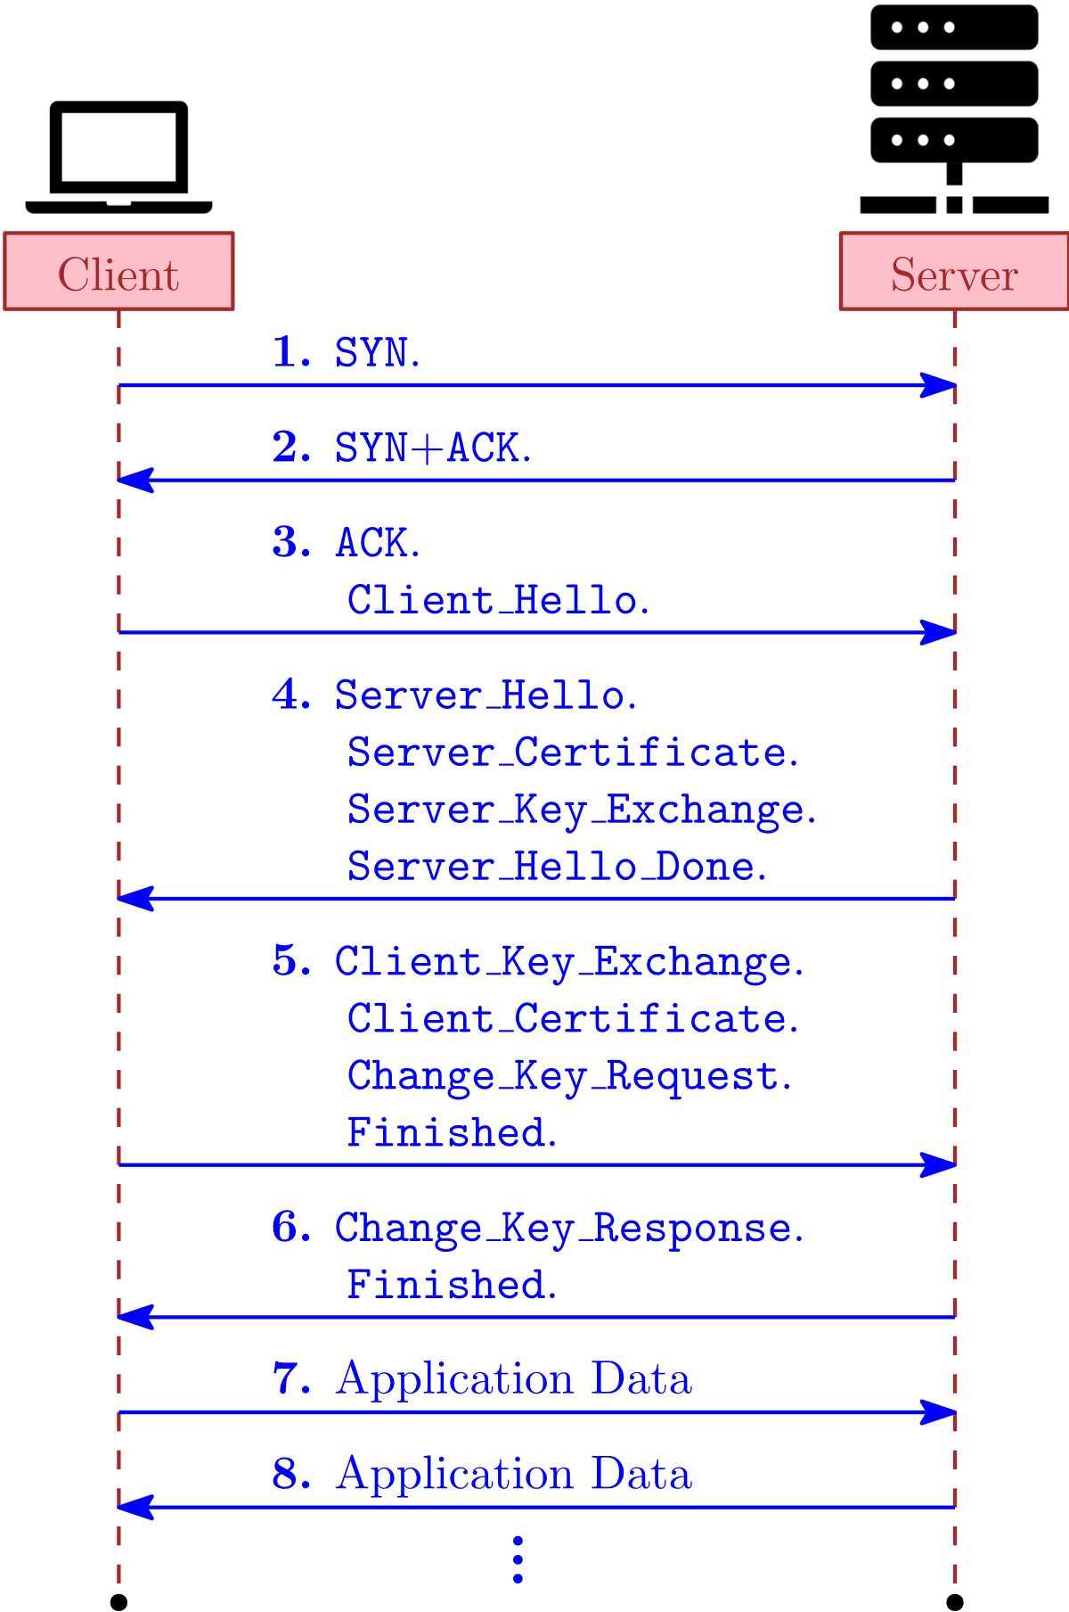
Secure TLS
Objectives:
Data integrity: Ensures data remains unaltered during transmission.
Server Authentication: Certificates from trusted CAs verify server identity.
Secure key exchange: Establishes a confidential shared secret.
Non-Repudiation: Proves data origin, preventing denial by sender.

Slide 7
PKI – Certificate path validation
Secure TLS
✓
1
Root CA
Certificate of Sub-CA-1 is OK!
Certificate
Certificate validation
PK_{Sub-CA-1}
2
Certificate
✓
Sub-CA-1
Certificate of Sub-CA-1-1 is OK!
PK_{Root-CA}
Certificate
Certificate validation
PK_{Sub-CA-1-1}
✓
3
Certificate
Sub-CA-1-1
Bob‘s certificate is OK!
PK_{Sub-CA-1}
Certificate
Certificate validation
PK_{Bob}
Certificate
PK_{Sub-CA-1-1}
Bob
Alice
Certificate
PK_{Bob}

Slide 8
Secure TLS
Certification Type | Scheme | Handshake Duration Time (ms) | Client Connect Time (ms) | Server Connect Time (ms) | Client Hello (Bytes) | Server Hello (Bytes) | Client Cert. Verification (Bytes) | Server Cert. Verification (Bytes)
Classical | EDSA1-ECDSA1-ECSDA1-KYBER1 | 44.30 | 1.13 | 44.04 | 913 | 831 | 1124 | 1124
 | ECDSA1-SP1-SP1-KYBER1 | 1086.51 | 1085.69 | 1085.82 | 913 | 813 | 8032 | 8032
 | ECDSA1-FAL1-FAL1-KYBER1 | 47.60 | 8.45 | 47.01 | 913 | 831 | 833 | 833
 | ECDSA1-XMSS1-XMSS1-KYBER1 | 48.59 | 7.13 | 47.93 | 913 | 831 | 2676 | 2676
 | ECDSA3-ECDSA3-ECDSA3-KYBER5 | 77.68 | 32.91 | 77.58 | 1681 | 1631 | 1248 | 1248
 | ECDSA3-SP3-SP3-KYBER5 | 3048.16 | 3046.23 | 3047.90 | 1681 | 1631 | 3469 | 16400
 | ECDSA3-DIL3-DIL3-KYBER5 | 61.04 | 18.54 | 60.56 | 1681 | 1631 | 3469 | 3469
Level 1 | FAL1-FAL1-FAL1-KYBER1 | 48.40 | 8.86 | 47.70 | 913 | 831 | 833 | 833
 | FAL1-SP1-SP1-KYBER1 | 1104.30 | 1103.44 | 1103.76 | 913 | 831 | 8032 | 8032
 | FAL1-SP1-SP1-KYBER1 | 48.81 | 7.16 | 48.27 | 913 | 831 | 2676 | 2676
 | XMSS1-XMSS1-XMSS1-KYBER1 | 48.92 | 7.66 | 48.20 | 913 | 831 | 2676 | 2676
 | XMSS1-FAL1-FAL1-KYBER1 | 49.44 | 10.40 | 48.77 | 913 | 831 | 833 | 834
 | XMSS1-SP1-SP1-KYBER1 | 1113.85 | 1113.10 | 1113.31 | 913 | 831 | 8032 | 8032
 | SP1-SP1-SP1-KYBER1 | 1117.40 | 1116.59 | 1116.75 | 913 | 831 | 8032 | 8032
 | SP1-FAL1-FAL1-KYBER1 | 48.09 | 8.92 | 47.38 | 913 | 831 | 833 | 832
 | SP1-XMSS1=XMSS1-KYBER1 | 49.30 | 7.89 | 48.74 | 913 | 831 | 2676 | 2676
Level 3 | DIL3-DIL3-DIL3-KYBER5 | 47.36 | 4.35 | 47.12 | 1681 | 1631 | 3469 | 3469
 | DIL3-SP3-SP3-KYBER5 | 3123.66 | 3121.41 | 53.11 | 1681 | 1631 | 16400 | 16400
 | SP3-SP3-SP3-KYBER5 | 3150.48 | 3148.68 | 3150.25 | 1681 | 1631 | 16400 | 16400
 | SP3-DIL3-DIL3-KYBER5 | 53.49 | 8.01 | 53.11 | 1681 | 1631 | 3469 | 3469
Level 5 | FAL5-FAL5-FAL5-KYBER5 | 67.36 | 37.42 | 67.03 | 1681 | 1631 | 1443 | 1453
 | FAL5-XMSS5-XMSS5-KYBER5 | 82.64 | 43.36 | 82.16 | 1681 | 1631 | 9268 | 9268
 | XMSS5-XMSS5-XMSS5-KYBER5 | 87.58 | 38.31 | 87.19 | 1681 | 1631 | 9268 | 9268
 | XMSS5-FAL5-FAL5-KYBER5 | 75.77 | 44.61 | 75.43 | 1681 | 1631 | 1447 | 1448

Slide 9
Software Benchmarking
Secure TLS

Slide 10
Software Benchmarking
Secure TLS

Slide 11
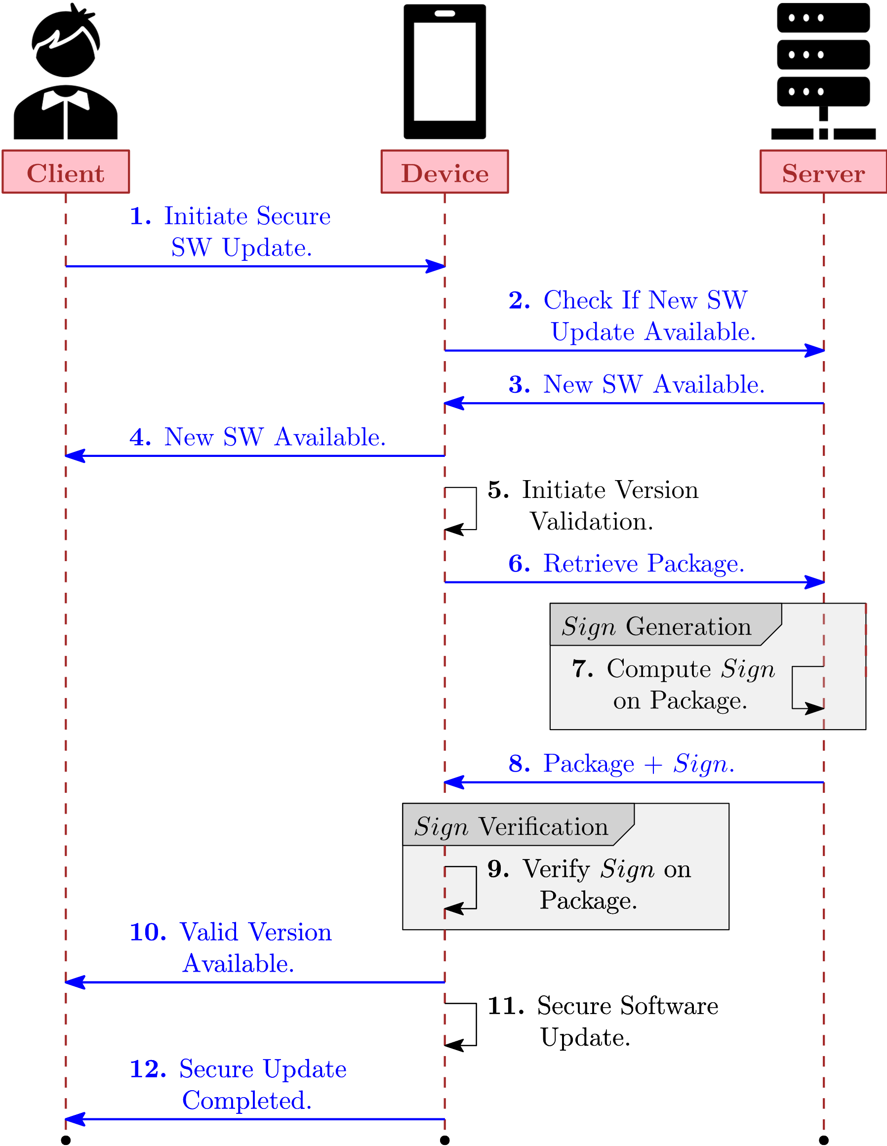
Secure Update
Ensures updates are from trusted sources by verifying digital signatures.
Protects update data in transit to prevent tampering and unauthorized access.
Prevents reverting to older, potentially vulnerable versions of software.
Requires verification of the update source before installation.
Automatically rejects updates with invalid or missing digital signatures.

Slide 12
Software Benchmarking
Secure Update
Signature generation and verification time computed on encryption of a 28-B message.
Execution time for encryption and decryption for quantum secure communication.
NIST Security Level | Scheme | Signature Generation Time (ms) | Signature Verification Time (ms)
Level 1 | FAL1 | 5.53 | 0.51
 | SP1 | 841.50 | 2.33
 | XMSS1 | 2.38 | 1.21
Level 2 | DIL2 | 0.55 | 0.55
Level 3 | DIL3 | 1.14 | 0.92
 | SP3 | 1005.28 | 2.60
Level 5 | FAL5 | 13.40 | 0.68
 | XMSS5 | 6.18 | 3.23
Scheme | Purpose | Encryption Time (ms) | Decryption Time (ms)
AES-256-CBC | Encrypting 28-Byte message | 4.875 | 5.107
Kyber-512 | Encrypting AES-256 secret key | 0.045 | 0.055

Slide 13
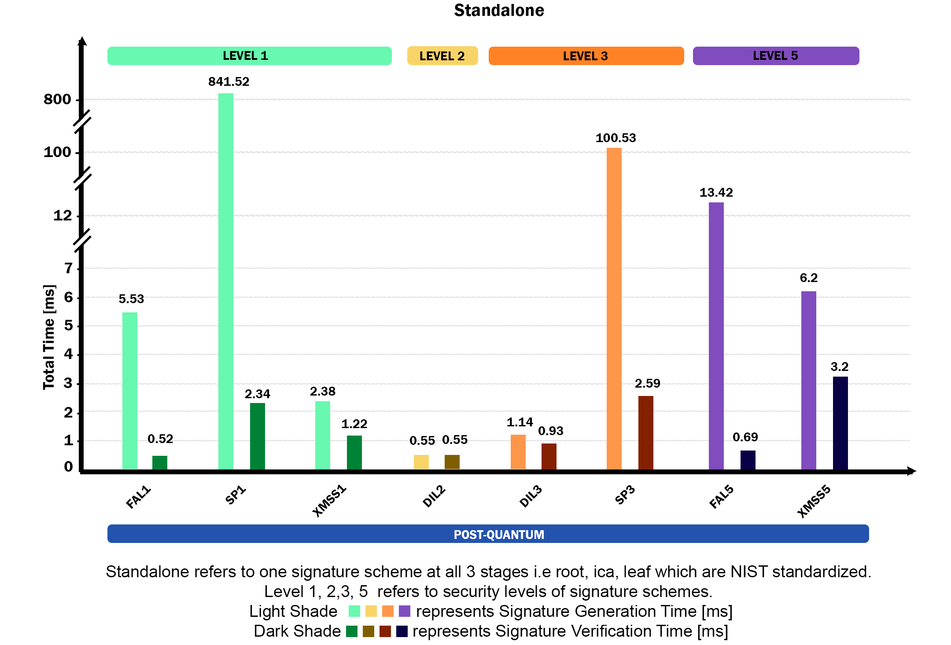
Software Benchmarking
Secure Update
The graph refers the respective encryption and decryption times during the secure update process.

Slide 14
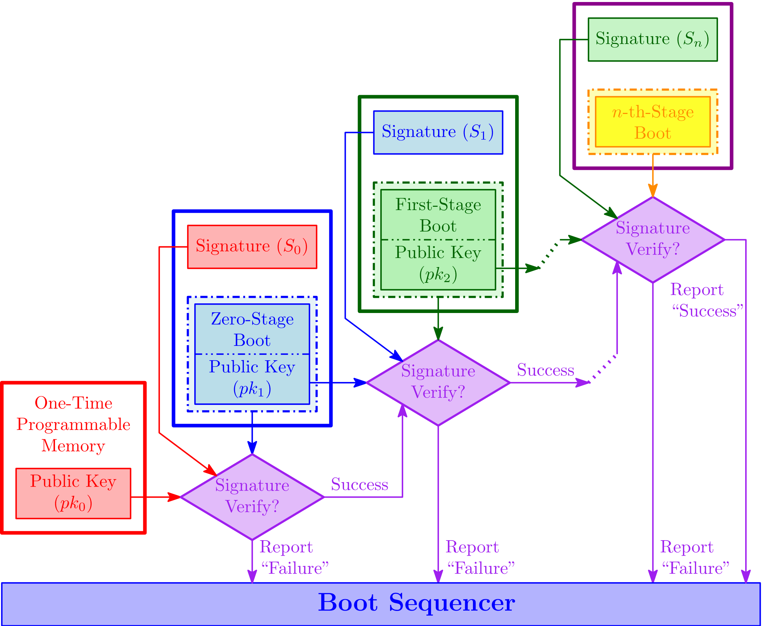
Secure Boot
Ensuring SW authentication and integrity during Boot.
Advatages:
Establishes Trust: Creates a secure chain from hardware to OS.
Tamper Prevention: Blocks untrusted or modified software by verifying digital signatures.
Multiple Stages of Authentication.
Every stage verifies the corresponding signature.

Slide 15
Software Benchmarking
Secure Boot
NIST Security Level | Scheme |  | Signature Generation Time (ms) | Signature Verification Time (ms)
 | (root) | (ICA, leaf)
Level 1 | FAL1 | FAL1 | 18.979 | 16.337
 | FAL1 | XMSS1 | 15.554 | 18.247
 | FAL1 | SP1 | 1064.554 | 1.155
 | SP1 | SP1 | 1641.769 | 29.795
 | SP1 | XMSS1 | 880.342 | 10.565
 | SP1 | FAL1 | 543.917 | 32.482
 | XMSS1 | XMSS1 | 17.764 | 24.069
 | XMSS1 | SP1 | 1709.764 | 47.444
 | XMSS1 | FAL1 | 18.383 | 16.912
Level 2 | DIL2 | DIL2 | 9.198 | 17.342
Level 3 | DIL3 | DIL3 | 9.485 | 16.891
 | DIL3 | SP3 | 3157.465 | 42.227
 | SP3 | SP3 | 2930.65 | 31.786
 | SP3 | DIL3 | 1588.589 | 31.006
Level 5 | FAL5 | FAL5 | 30.611 | 15.828
 | FAL5 | XMSS5 | 43.04 | 13.141
 | XMSS5 | XMSS5 | 27.799 | 29.393
 | XMSS5 | FAL5 | 28.595 | 20.432

Slide 16
Software Benchmarking
Secure Boot

Slide 17
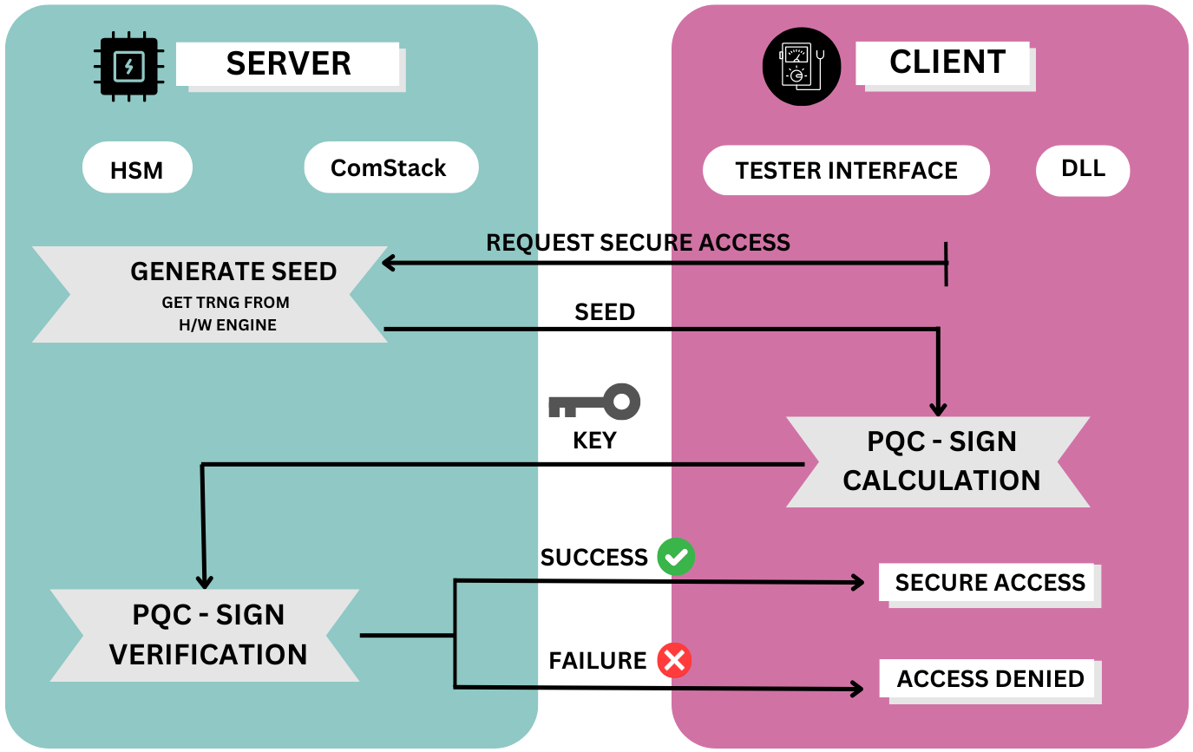
Secure Access
Controls access of data, diagnostic services etc. which have restricted access for security reasons.​
For example, there may be use cases as:
Diagnostic services for downloading or uploading routines or data into a server.
Reading specific memory locations from a server.
International standard - ISO 14229-1.

Slide 18
Software Benchmarking
Secure Access

Slide 19
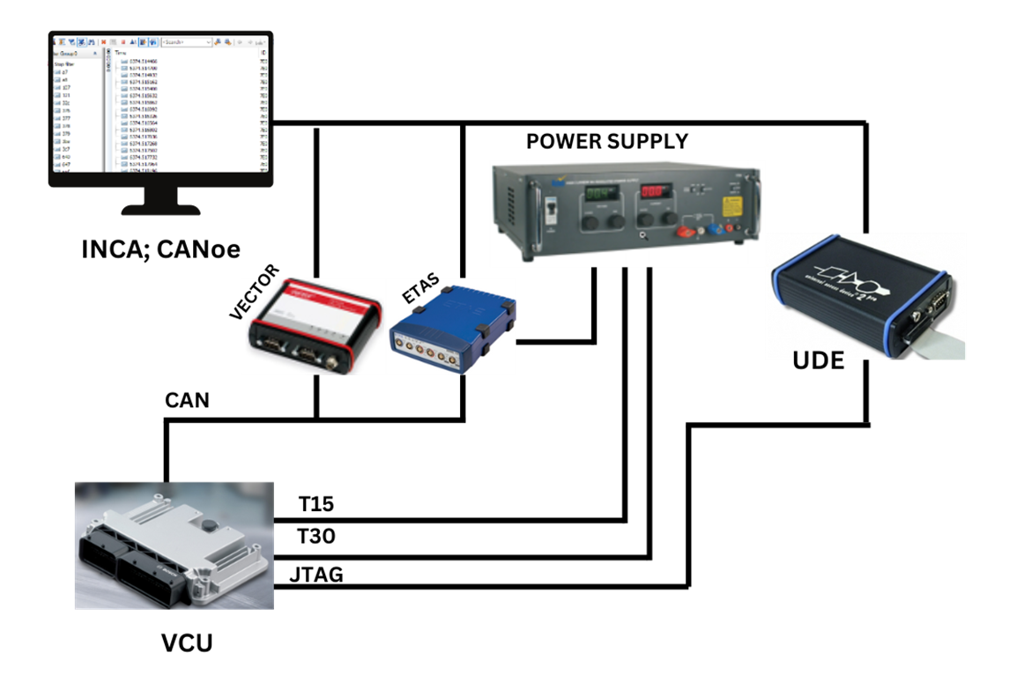
Our Experiment
Secure Access
We chose a Standard Vehicle Control Unit device developed by Bosch.
Initial flashing of the intended hex is done by Universal Access Device with Universal Debug Engine.
Client is demonstrated by INCA (Integrated Calibration and Application Tool) software which sends the messages to VCU via ETAS ES592 HW via CAN.
Vector CANalyser is used to do measure the communication between the client and the server(VCU).
The device is Infineon TC37x with Hardware security Module (HSM) activated.

Slide 20
Our Results: Execution Time for Secure Access
Secure Access
Hardware implementation:
HSM core on SAK-TC377TP96F300S AA Infineon micro-controller with HW accelerated Hash function
Category | Signature Scheme | Size (bytes) | Resources​ | Time (ms)
Non PQC | ECDSA | Public key : 64 Private Key : 32 Signature : 64 | ROM: ~3KB(incl public key)​ RAM: ~1KB (in stack)​ | ~800
 | ECDSA with HW ECC accelerator |  |  | ~20
PQC | XMSS with SHA-256 | Public key: 64 Private key: 132 Signature: 2532 (incl 32 of Msg) | ROM: 4KB (incl public key)​ RAM: ~14KB (incl signature buffer)​ | ~70
PQC | DILITHIUM 2 (SHAKE128) | Public Key: 1312 Private Key: 2528 Signature: 2452 (incl 32 of Msg) | ROM: ~5KB(incl public key)​ RAM: ~37KB(incl signature buffer) | ~100
 | DILITHIUM 3 (SHAKE128) | Public key : 1952 bytes​ Private Key : 4000 bytes​ Signature : 3325(incl 32 bytes of Msg)​ | ROM: ~6KB(incl public Key)​ RAM: ~60KB(incl signature buffer)​ | ~ 165
 | Controller: IFX 3 40nm (TC37x) with HSM activated

Slide 21
Conclusion
Security controls like secure boot, secure update, secure access, and secure TLS rely on classical asymmetric cryptographic algorithms which are vulnerable to quantum attacks.
We implemented of these controls with quantum resilient asymmetric algorithms:
CRYSTALS-Dilithium, CRYSTALS-Kyber, FALCON, XMSS and SPHINCS+
Our benchmarks show that the migration to quantum resilient solutions are practical and even more efficient than their classical counterparts for specific usecases.
Future Work
Resource Optimization: lightweight, low-power quantum-resistant solutions.
Side-Channel Attacks and proposed Countermeasures.
Exploiting existing hardware accelerators
Hardware Accelerators (New) for quantum resilient schemes

Slide 22
Thank You
vishal.saraswat@in.bosch.com

Slide 23
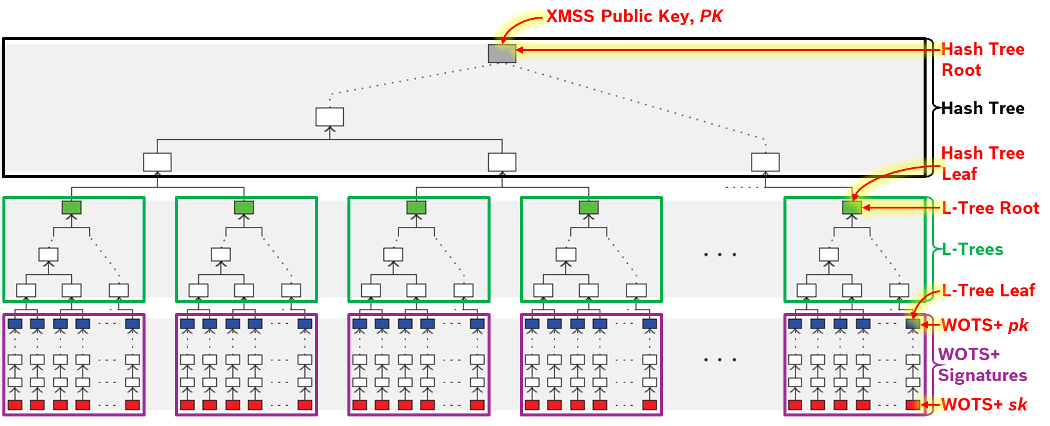
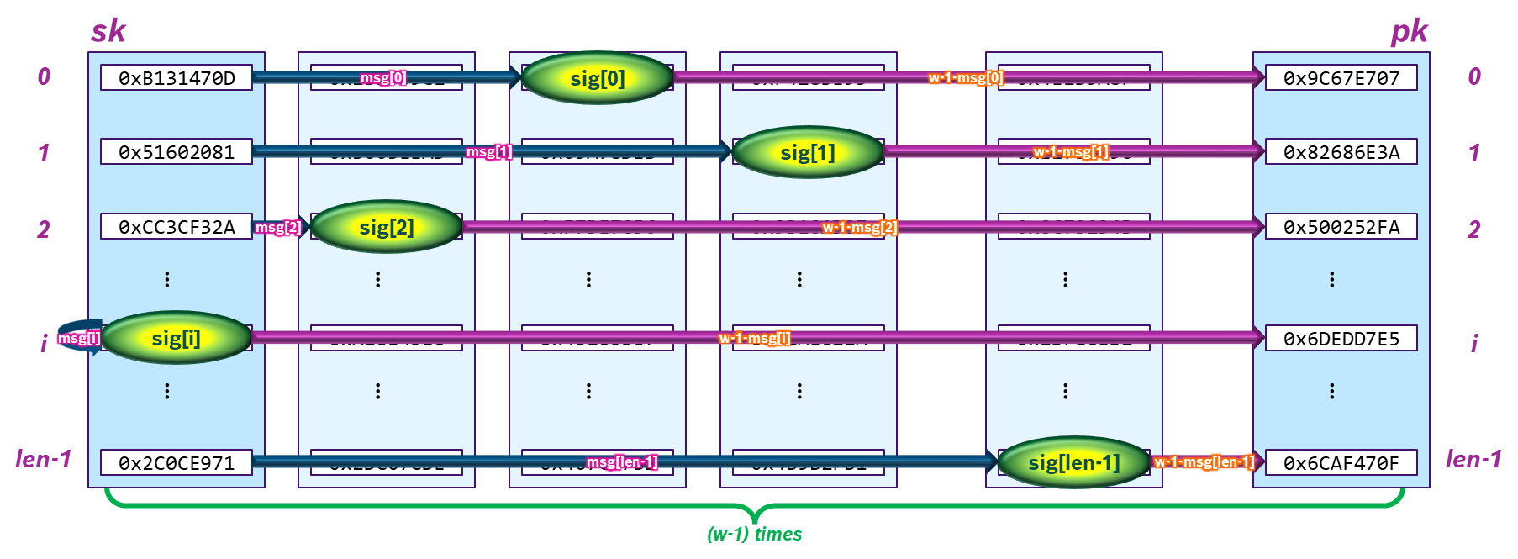
XMSS - Overview
XMSS – eXtended Merkle Signature Scheme
Hash-based Many-Time Signature (MTS) Scheme.
Cryptographic Security Assumption: One-way Hash Function.
Combines Large Number of WOTS+ keys, using XMSS Tree.
03 Parts: Hash Tree, L-Trees & WOTS+ Signatures.
Cryptographic Tools Used:
WOTS+ Signature Scheme.
Pseudo-Random Function (PRF).
Keyed Hash Function.
Merkle Tree.
Advantages:
Performance.
Compact implementations.
Small Public Key, Private Key and Signature.
Resists Side-channel & Quantum attacks.
Disadvantages:
Stateful Signature Scheme – Requires Memory (to store) and Communication overhead (for synchronizing) the State.
Figure: XMSS Tree.
Figure: WOTS+ Signature Scheme.

Slide 24
Dilithium - Overview
Crystals – Dilithium
lattice-based digital signature scheme
based on the ”Fiat-Shamir with Aborts”
hardness of finding short vectors in lattices
Cryptographic Tools Used:
NTT (Number Theoretic Transform)
Polynomial Multiplication and Convolution
SHAKE128
Advantages
compact and secure
smallest public key + signature size of any lattice-based signature scheme

Slide 25
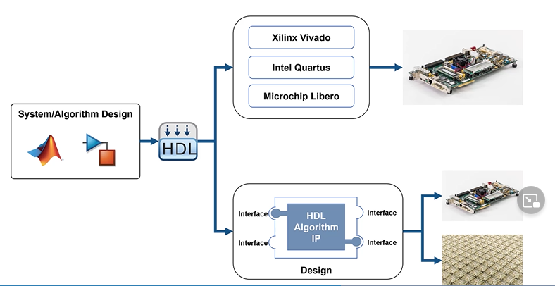
HW Accelerator
Quantum Resilient Security Controls
Proof of Concept
Functional Model
Scalable in cost-time factors
Modular for adaptations
Extensible dev. as HDL code
Deploy in FPGA
Functional validation and perf Measurements
PQC HW Accelerator IP
XMSS with SHA3 Hashing scheme
HW Functional Model
SHA3 HASH Engine
XMSS – WOTS, L Trees and Merkle Tree
MATLAB Simulink – HW Functional Model
HW IP Development
Test Bench creation and evaluation
RTL Code Development using Functional Models
RTL synthesis to FPGA
Functional, Timing and performance evaluation
Integrity and HW optimizations

