Slide 1
QuaCiDe
A General Purpose Quantum Circuit Design and Simulation Interface
Speaker: Asimakis Kydros | asimakis@csd.auth.gr
Co-authors: Dr. Konstantinos Prousalis | kprousalis@csd.auth.gr Prof. Nikos Konofaos | nkonofao@csd.auth.gr
Notes:
Hello everyone, my name is Asimakis Kydros, I am with the Aristotle University of Thessaloniki and I will be presenting QuaCiDe, a new quantum circuit designer I’ve built in collaboration with my professors.

Slide 2
Why a new interface?
Τhere is a growing boom in the field of quantum algorithms using the circuit model. Large and complicated circuits raise the need for faster and stronger EDA tools.
Modern, simplistic, sleek design
Jump-in philosophy: web-hosted, no installations
Zero-knowledge assumption for programming details
Unrestricted scalability in circuits
User quality-of-life; shortcuts, automated mechanisms and stat monitoring
Easily adaptable to new quantum computational models and simulating kits
Interactive output visualization
Intuitive sub-circuit encapsulation
Notes:
Many such excellent tools already exist; however, the rapid growth of the field and the increasing complexity of the proposed circuits demand new EDA tools that match the required complexity.
This new designer interface improves upon already existing UI’s by providing a simple but powerful web-hosted environment that allows for the creation and execution of arbitrarily large circuits, while requiring no prior programming knowledge and no installation efforts. It employs many QOL mechanisms to elevate the user experience, and its structure remains untied to the computational backend, making it adaptable to all quantum simulation models. It provides the output in an interactive, optical manner and allows for the intuitive encapsulation of circuit-routines into gates.

Slide 3
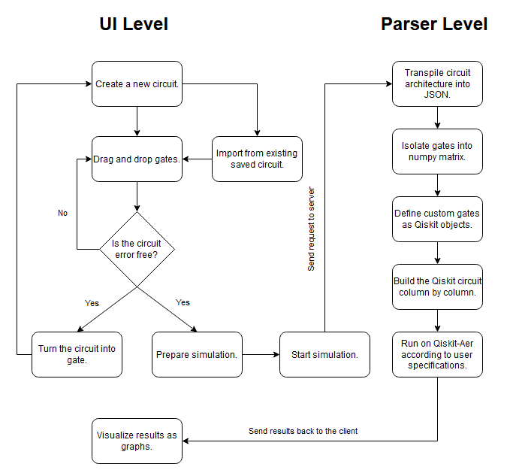
Architecture
Public website service
Server-client schema
Client/UI offers simplicity and design freedom for arbitrarily complex circuits
Server absorbs the computational payload
Hardware capabilities easily scalable and user-independent
Notes:
The functionality of the website is split between the UI and the Parser, as a client-server schema. As the flowchart suggests, on the client side, the user is free to manipulate the circuit(s) as they desire, and as long as it is free of errors, request its execution at any time. Should this request trigger, the circuit transpilation is sent to a remote server, the Parser, that absorbs the computational payload so as not to burden the user’s system. This remote environment is easily scalable and translates in simple and quick steps the transpilation into an executable Qiskit object, which it then runs; the results are sent back to the client for visualization.

Slide 4
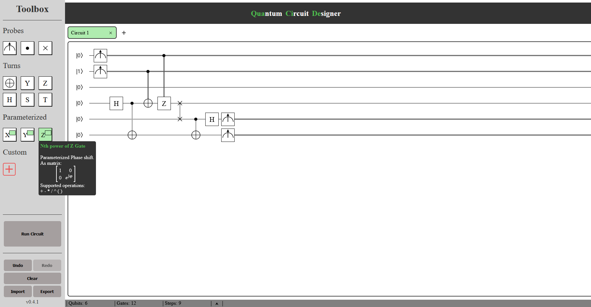
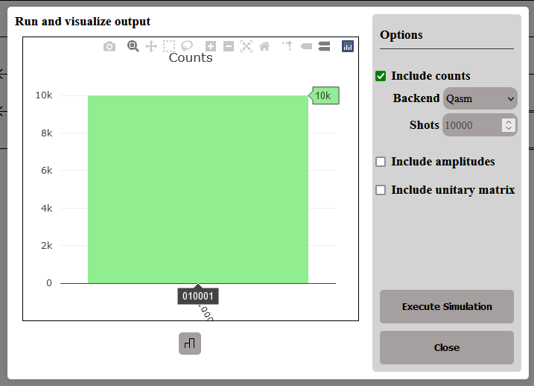
Interface overview
Toolbox containing important gates and user actions
Gates show educational context on hover
Undo, redo, clear, import and export supported
Import/Export in parsable JSON format
Toolbar displaying circuit statistics and endian modes
#Qubits, #Gates, #Steps displayed
Endianness toggleable
Tab stack holding multiple circuits
New tabs can be created anytime
Each tab remembers its own circuit
Customizations and endianness sustained
Notes:
This is the main view of QuaCiDe; a single tab with a big canvas, hosting the circuit. I’ve constructed and ran the single-qubit version of the Superdense coding circuit here, as an example. One can see the toolbox on the left-hand side, which hosts the gate set and user action buttons. The gates show contextual information about their operation and unitary matrix definition on hover. The actions behave exactly as one might expect, the user can undo, redo, clear and run the circuit, but they can also import and export it in parsable JSON format. Below, the toolbar includes stat monitors for the active tab, that display the number of used qubits, gates and steps, and are updated live with each change. The user can also see the endianness mode of the active tab there, and can choose to toggle it between Little and Big Endian. I say “active” tab, because the user can have multiple tabs open and thus multiple circuits. Each tab remembers its own architecture and preserves its stats and customizations.

Slide 5
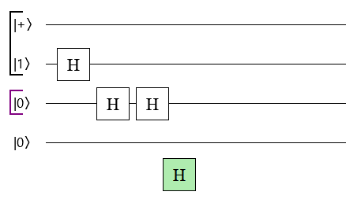
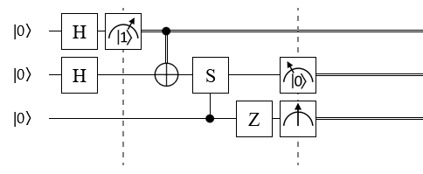
Gate and Qubit features
Gates draggable, attachable to qubit “wires”
Steps shift automatically to enlarge or minimize the circuit
Intermediate measuring and postselection supported
Permanent decoherence after measuring
New qubits spawn when dragging gates, unused ones are discarded automatically
Qubit states initializable
Computational, Hadamard and Imaginary bases supported
Qubits groupable with colored borders
Up to 5 colors
Neighboring same-colored borders merge
Notes:
The gate set consists of the standard Pauli set and its parameterized exponential form; the Hadamard gate; the phase gates S and T; and the SWAP gate. Controls and measurements are also offered as gate-like objects. Measurements can be freely placed wherever, even in the middle of the circuit, and support state postselection.
All gates are draggable and attach to the qubit wires. As placement occurs, the interface automatically removes redundancies to minimize the circuit. For example, in the top image, the voids underneath the first Hadamard gate are assumed to be intentional and are filled with Inertia gates under the hood; but should this lone gate be removed, the step becomes empty, which is assumed to be redundant and thus the circuit deletes it.
New qubit wires appear when dragging gates, and similar automations ensure that unused ones are promptly discarded. Qubit state displays -on the left of each wire- are interactable twice-fold; they can cycle through different initial states and differently colored borders. Same-colored neighboring borders unify into one, implying that the qubits belong in the same sub-register.

Slide 6
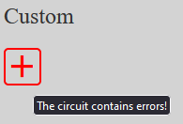
Error management
Theoretical errors are detected immediately
Wrong SWAP gate placement
Non-arithmetic inputs on parameterized gates
Non-control gates on top of collapsed qubits
Execution and gate creation blocked while errors present
Errored gates shine red to indicate the mistake
Cause of error is displayed on hover
Notes:
The freedom in gate placement will inevitably lead to circuit declarations contradictory with Quantum Theory. For the user’s protection, such errors are detected immediately and automatically, and until they are resolved, critical operations are blocked. One can see possible errors in the top image; SWAP gates are strictly two-qubit operations, and anything else constitutes a mistake; non-arithmetic exponents are equally meaningless; and, as permanent decoherence is assumed, non-control gates are prohibited after measurement. As can be seen, all such errors are indicated to the user by shining red borders. The cause of each error can be inferred by hovering each gate-culprit.

Slide 7
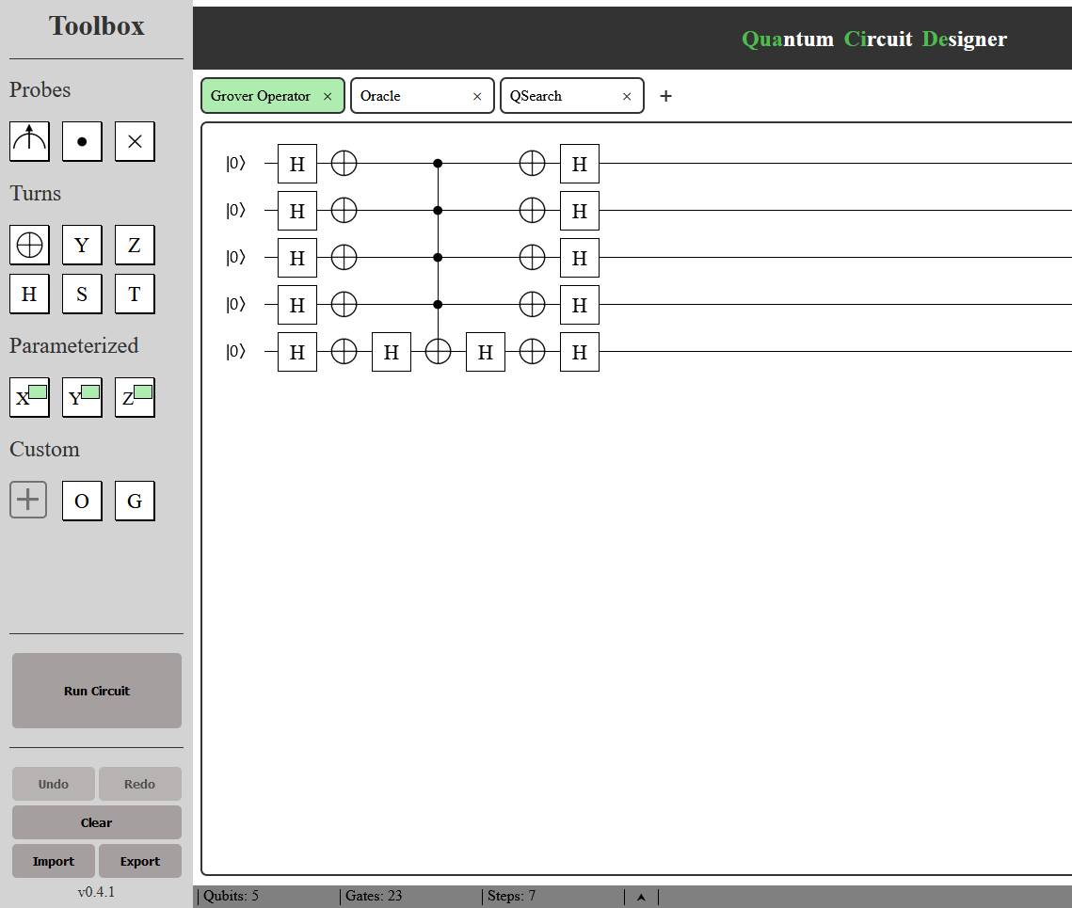
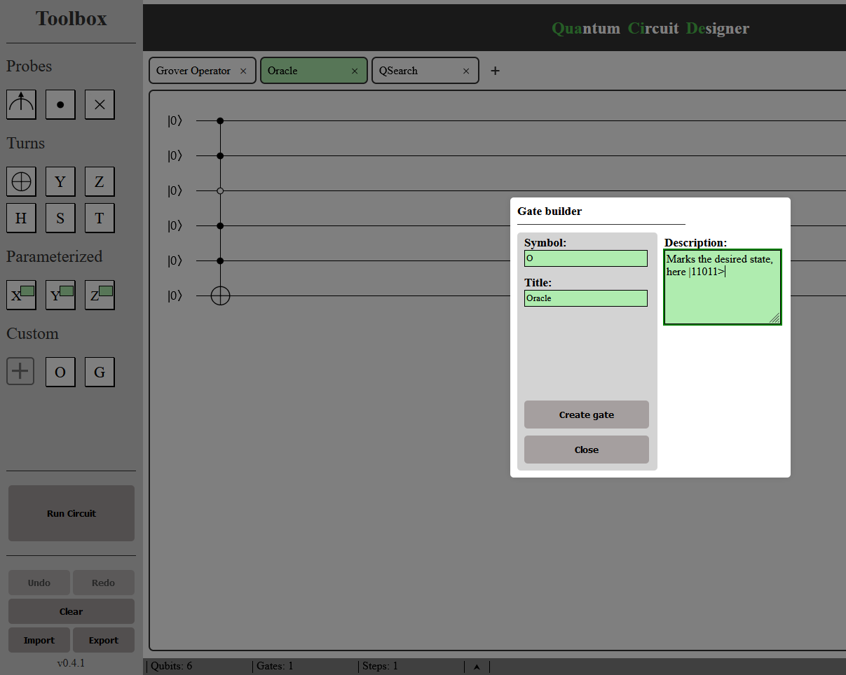
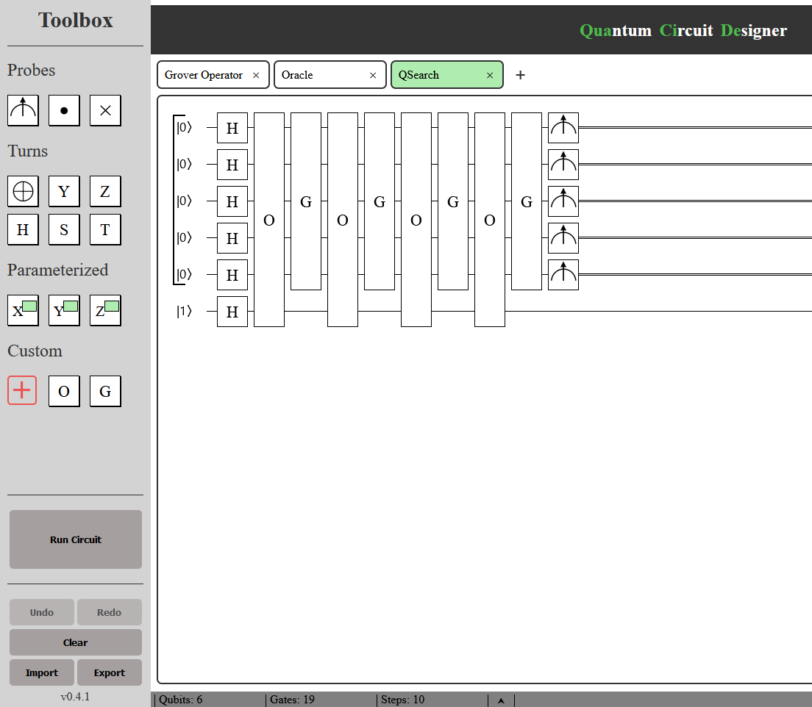
Sub-circuits and Gate creation
Circuits can make use of other defined circuits as gates
New gates declarable from non-empty, error- and measurement-free circuits
Creation uses the currently active tab as definition
New gates customizable with symbols, titles and descriptions
Visible in the toolbox on hover
Each gate remembers its own definition on creation
Subsequent changes on the parent circuit have no effect on the created gate
No chance of recursive definitions
Initializations in the parent circuit ignored during gate creation
Notes:
As said, the user can encapsulate entire circuits into custom gates. This can occur from any non-empty error- and measurement- free circuit definition. To do so, the user needs only have the desired circuit active and press the cross button on the toolbox; a modal appears, where the user can customize this new gate with a symbol, a title and a description. This information can be seen by hovering the gate in the toolbox. After creation, the new gate acts as any other, and be freely placed anywhere. It remembers its own definition independently of the parent circuit, meaning it can be promptly deleted and there’s no chance for recursive definitions. Note that creation uses the entire active circuit as its definition, save only the qubit states.

Slide 8
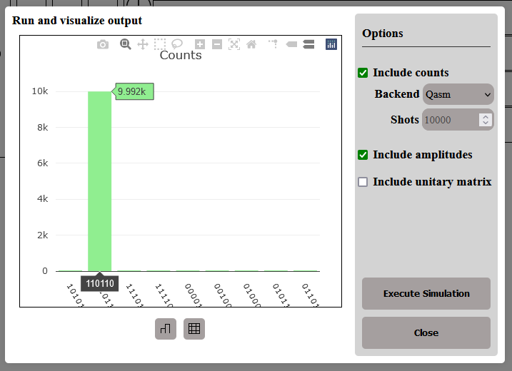
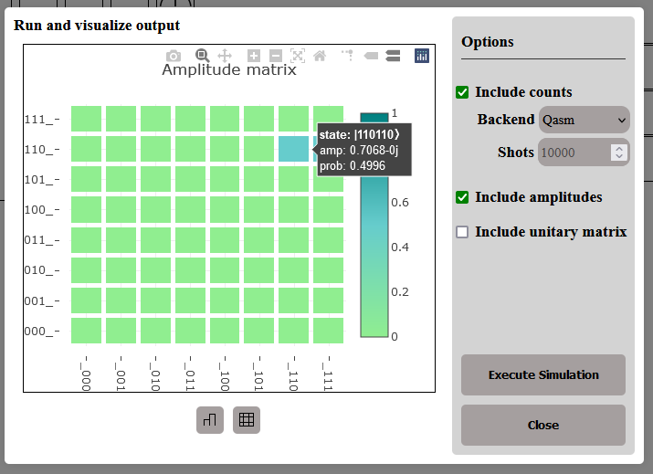
Execution and Output
Only the currently active tab is concerned
Definitions of sub-circuits present are taken into account
Multiple backend options
Qiskit-Aer simulators: QASM, Statevector, Aer, Unitary
Specify shots and result types
Measurement counts → Histogram
Amplitudes → Probability Heatmap
Total unitary matrix → Heatmap & text
Interactive graphs
Count number, amplitude, probability and phase visible on hover
Downloadable as PNGs and text
The above is the resulting output of the previously shown circuit definition.
Lov K. Grover. 1996. A fast quantum mechanical algorithm for database search. arXiv:quant-ph/9605043 [quant-ph]
Notes:
Should it be error-free, the active circuit can be executed anytime. As it stands, the user can request three different kinds of output; measurement counts, amplitude statevector and unitary matrix. These are visualized as an occurrences-state histogram, probability heat map and magnitude heat map respectively. For counts, the user can choose among multiple Qiskit-Aer backends, such as QASM, Aer and Statevector, and also declare the desired amount of shots. All plots are completely interactive, show numerical results on hover and can be downloaded as PNGs. The unitary matrix can also be downloaded as text to be copy and pasted elsewhere as needed.

Slide 9
Parsing and simulation process
Circuit definition in JSON Lines format; sub-circuits first, main circuit last
Line-by-line reconstruction to QuantumCircuit objects
Gate isolation into matrix
Each column (step) mapped to a unified Qiskit Gate and added serially to the circuit object
Controls are added manually and to the entire step
Measurements added last for each step; postselections are kept as memory flags
Resulting subcircuits are turned into Qiskit gates themselves; otherwise, execution
Final circuit ran on selected Qiskit-Aer backend(s)
Results filtered according to declared postselections
UI and Parser intertwined only on I/O format
Notes:
Execution follows a simple sequence: first, the client sends the experiment transpilation to the server in JSON lines format, where each line represents either a custom gate definition or the final circuit definition. Each such line is then mapped into an actual QuantumCircuit object, by unifying each step into a single Qiskit gate and appending it to the circuit object. Controls are added manually to these unified gates so as to affect it in its entirety, and measurements are added last after each step, keeping any postselections in memory. This mapping happens in such a way that ensures that required custom gates are already defined. If a line represents a custom gate, then its resulting circuit object is turned into a Qiskit gate, otherwise it is ran on the declared backends. The raw results are sent back to the client.
Note that the only point on which the UI and the Parser are intertwined is the format of the transpilation and the result. Indeed, any program that can mimic this communication format can completely replace the Parser. This was done intentionally, to ease development, to facilitate the adaptability of the designer, but also to encourage experimentation from independent developers and users.

Slide 10
Comparison with published work
[1] Andreas de Vries. 2015. JQuantum: A Quantum Computer Simulator. (2015). https://jquantum.sourceforge.net/
[2] I. G. Karafyllidis. 2005. Quantum Computer Simulator based on the Circuit Model of Quantum Computation. IEEE Transactions on Circuits and Systems I 52 (2005), 1590–1596.
[3] N. Konofaos and K. Prousalis. 2016. QuCirDET: A design and simulation tool for quantum circuits. In 2016 5th International Conference on Modern Circuits and Systems Technologies (MOCAST). IEEE, Thessaloniki, Greece, 1–4. https://doi.org/10.1109/MOCAST.2016.7495162
[4] IBM. 2016. IBM Quantum Composer. https://quantum.ibm.com/composer/files/new
[5] C. Gidney and contributors. 2019. Quirk: a toy for exploring and understanding quantum circuits. (2019). https://github.com/Strilanc/Quirk
[6] Qiskit contributors. 2023. Qiskit: An Open-source Framework for Quantum Computing. https://doi.org/10.5281/zenodo.2573505
[7] I. Bush et al, T. Jones and A. Brown. 2019. QuEST and High Performance Simulation of Quantum Computers. Scientific Reports 9 (2019), 10736–. https://doi.org/10.1038/s41598-019-47174-9
Notes:
In comparison with previous works, our designer accounts for immense computational adaptability, as previously explained, while also being one of the first to introduce live stat trackers and allow for postselection. Our sub-circuit creation environment is more refined and in line with classical computing simulation environments. It moves away from system and programming requirements by being a live hosted website and employing a drag-and-drop philosophy on gate placement. Finally, it removes the complexity roadblock by allowing an unrestricted amount of qubits and gates.

Slide 11
Conclusions
Simple enough to ease new students into Quantum Computing
Powerful enough to support professional research
No system requirements apart from running a browser
No software requirements or compatibility issues with other programs or the Operating System
Adaptable to all simulating techniques and computational models
Error handling immediate and intuitive to the user
Can also be ran locally, should the user chooses to do so
F/OSS distribution
Development version and a short usage guide can be found on:
https://github.com/asimakiskydros/QuaCiDe , free and open to anyone.
Notes:
To sum up, QuaCiDe is a great choice for both getting to know Quantum Computing and professional research. It asks nothing from the user, such as system compatibility, installations or adequate memory capacity, it only requires an internet connection and access to a browser. Its features allow the user to experiment with many different algorithms, on many different configurations, using different computational models. It offers free-flow handling of theoretical errors, enabling testing and learning at the same time.
It is our plan to offer this interface as a completely free and open website, as well as a F/OSS distribution, in the near future. In the meantime, the development version, along with a short usage guide, can be found on the relevant github page listed here and inside our paper.

Slide 12
What’s to come
New parsing implementations benefitting from optimized simulating techniques such as QMDDs
Direct compilation from and to QASM
Communication with real backends
New execution modes (e.g. for variational algorithms)
More visualization options
More gates
Suggestions are welcome! Thank you for your attention!
Notes:
We are currently looking into massively improving the parser, by making use of Multi-Valued Decision Diagrams. It is our desire to allow for circuit compilation into QASM and other formats, such as Qiskit or Cirq, but also for communication with real Quantum Computers. Further down the line, we are very interested in providing different execution modes, such as for variational algorithms, as it was suggested to us, and for stabilizers. And finally, we are always looking into adding more visualization options and more operations.
That sums up my presentation. Thank you kindly for your attention!

