Slide 1
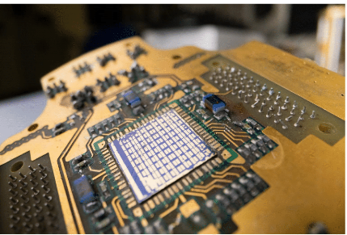

Fully autonomous control and characterisation of quantum devices
Natalia Ares
University of Oxford
Notes:
Hello, I will focus on the role of machine learning in the development of quantum technologies. This not about the machine learning algorithms that we can run in a quantum computer but those we can run in a classical computer to allow us for optimal control of the quantum hardware.

Slide 2
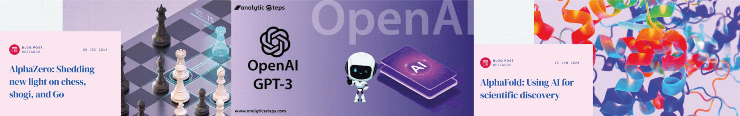
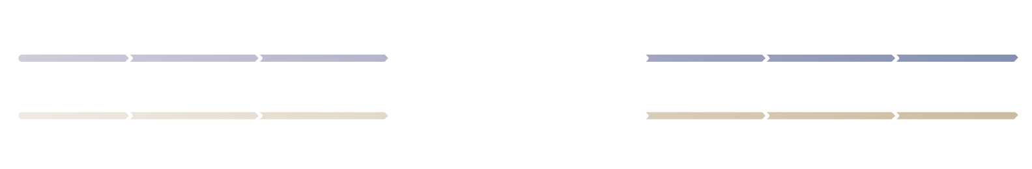
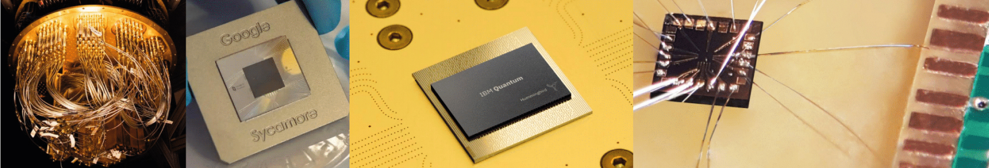
Unlocking quantum technologies
with machine learning
Machine Learning
Quantum Technologies

Slide 3
Machine Learning WITH quantum devices
(QML)
Machine Learning FOR quantum devices
Notes:
Hello, I will focus on the role of machine learning in the development of quantum technologies. This not about the machine learning algorithms that we can run in a quantum computer but those we can run in a classical computer to allow us for optimal control of the quantum hardware.

Slide 4
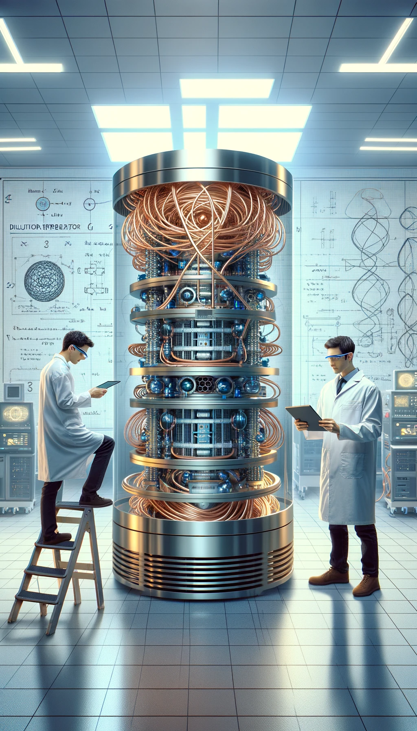

A quantum device lab
Quantum hardware
Human
Human
Notes:
So what do we do in the lab. We have our quantum hardware being controlled by scientists. These scientist are who decide on the several parameters that allow for qubit operation and maintains such operation over time. Now look this is depicted by this imaged created by AI, by DALLE, now look how it solved the wiring problem! We should have thought of that.

Slide 5
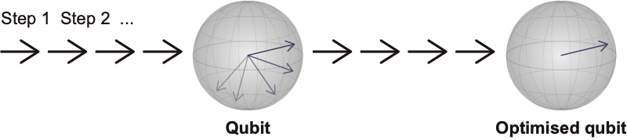
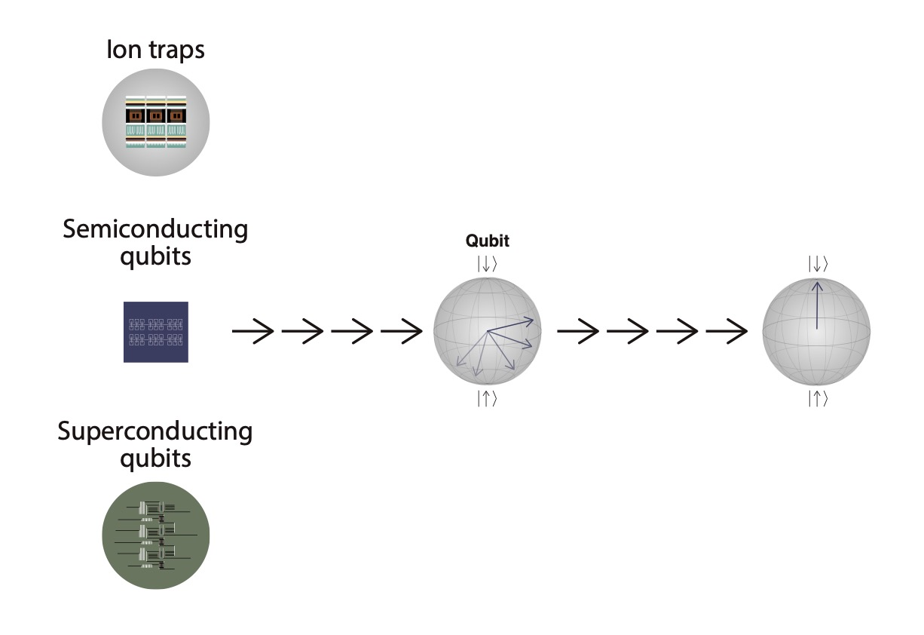
From quantum device to qubit
Quantum devices
Semiconductor
devices
Machine
Learning
Machine
Learning
N. Ares, Nature Reviews Materials 6,870 (2021)
Notes:
For many quantum device realisations, having a chip with some devices does not mean we have a chip with operational qubits. There are a set of steps to complete and once a qubit is operational is also has to be optimised. Now if you think you need millions of devices, this task is not feasible. So we thought ML should we able to help, but of course this is not an easy problem, each device is different and there is not much data for learning.

Slide 6
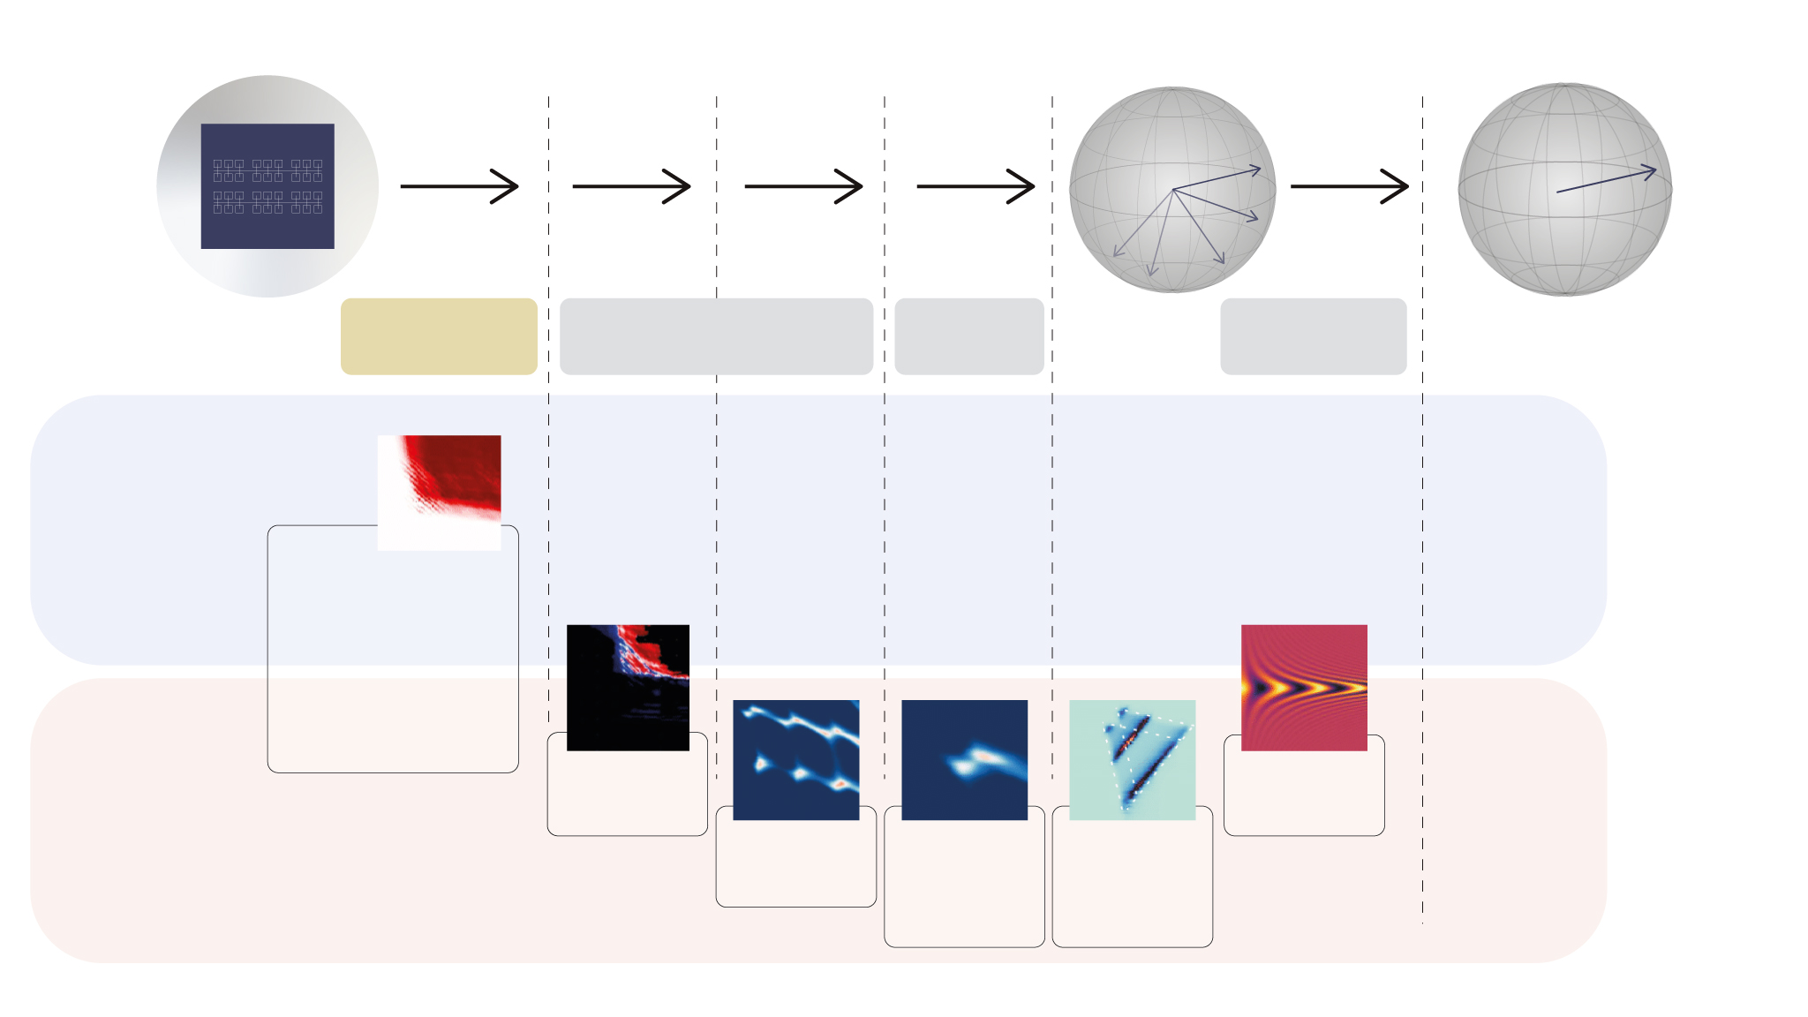
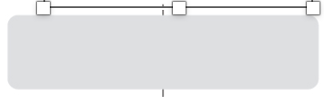
Automating quantum device tuning
Semiconductor chip
Qubit
Optimised
qubit
Stage 1:
Define
Stage 2:
Tune
Stage 3:
Find
Stage 4: Readout
No Deep
learning
- van Straaten et al. arXiv:2211.04504
- Severin et al. arXiv:2107.12975
- Craig et al. Phys. Rev. X 14, 011001 (2024)
- Moon et al. Nat. Commun. (2020)
Lennon et al.
npj QI (2019)
Schuff et al.
arXiv:
2402.03931
Deep
learning
Nguyen et al.
npj QI (2021)
van Esbroeck
et al. NJP
(2020)
Schuff et al.
Quantum 7,
1077 (2023)
https://github.com/oxquantum-repo/
Notes:
To solve this problem, we have focused on semiconductor qubits, and we divided the process of converting a semiconductor device into a qubit in stages and we develop a set of machine learning techniques to automate each of these steps. In these we used a mixed of types of ML techniques, more Deep Learning heavy ML for those stages where simulations can help us with training sets. But this year, for the first time in 20 year of manual or semi manual tuning of spin qubits, we managed to complete the full pipeline completely automatically.

Slide 7
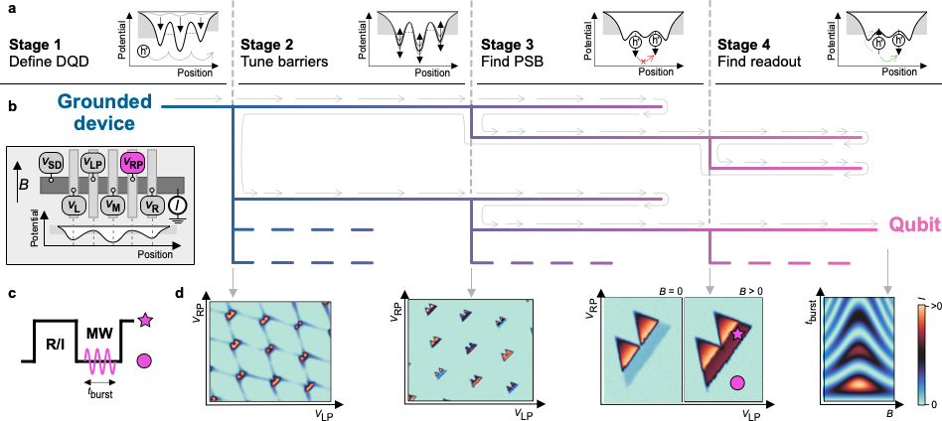
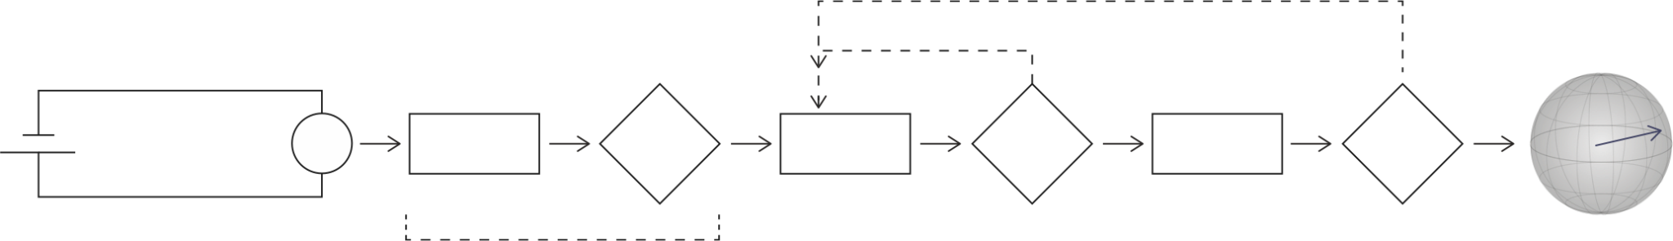
Fully autonomous tuning of a spin qubit
current
current
V₂
V₂
V₂
current
current
Device
Qubit
V₁
V₁
V₁
Stage 1:
Define
Stage 2:
Tune
Stage 3:
Find operation point
Stage 4:
Readout
Schuff et al. Fully automous tuning of a spin qubit, arXiv:2402.03931
Notes:
For the sake of this fully autonomous tuning algorithm, the device can be thought as inputs, the control voltages we apply to the circuit, and the output, the current or voltage measured across the device. The algorithm goes stage by stage, outputting relevant measurements along the way. But of course, the process is not that linear, the algorithms knows when to come back to the previous stage and try a different path if the previous strategy fails.
Stage 4: Find readout The final stage of the process is dedicated to finding an operating point for qubit readout and manipulation. This stage not only identifies a suitable location in plunger voltage space but also determines the optimal driving frequency and duration of the pulse

Slide 8
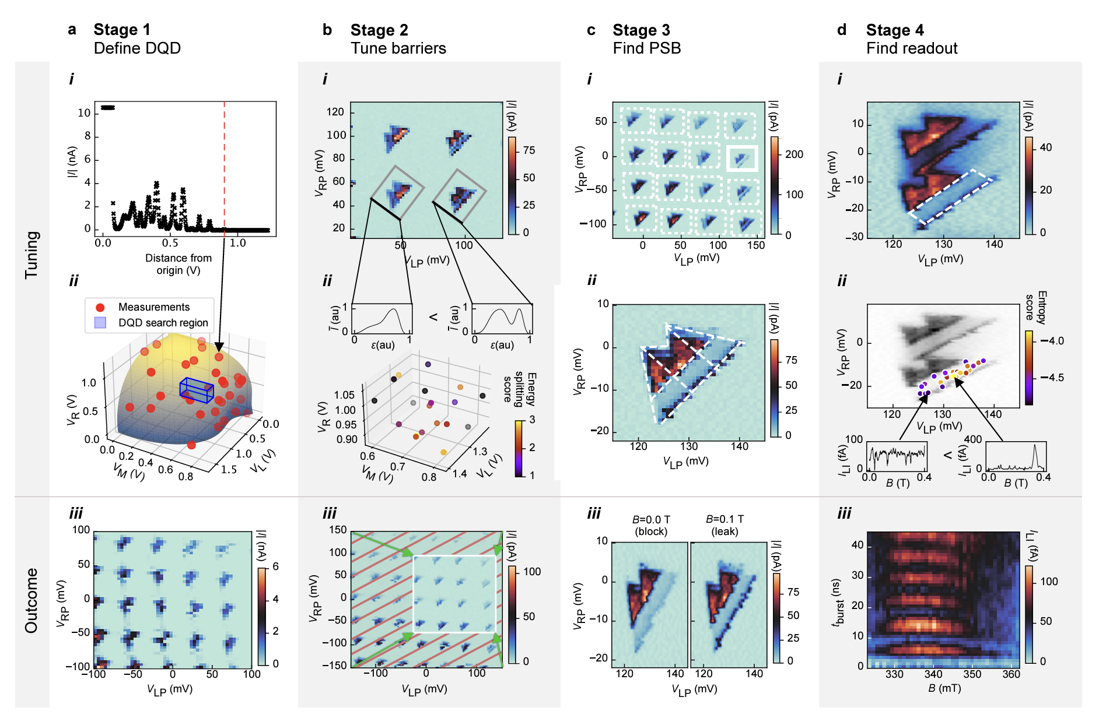

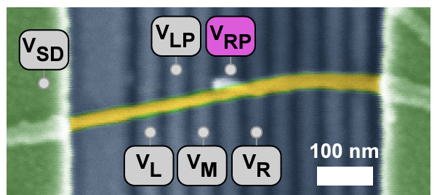
Fully autonomous tuning of a spin qubit
current
Device
Schuff et al. Fully automous tuning of a spin qubit, arXiv:2402.03931
Notes:
For the sake of this fully autonomous tuning algorithm, the device can be thought as inputs, the control voltages we apply to the circuit, and the output, the current or voltage measured across the device. The algorithm goes stage by stage, outputting relevant measurements along the way. But of course, the process is not that linear, the algorithms knows when to come back to the previous stage and try a different path if the previous strategy fails.
Stage 4: Find readout The final stage of the process is dedicated to finding an operating point for qubit readout and manipulation. This stage not only identifies a suitable location in plunger voltage space but also determines the optimal driving frequency and duration of the pulse

Slide 9
Fully autonomous tuning of a spin qubit
Gate voltage 2
Gate voltage 3
Past stage 2
Past stage 3
Gate voltage 1
Gate voltage 1
Qubits
Schuff et al. Fully automous tuning of a spin qubit, arXiv:2402.03931
Notes:
Now this is great, not only because we can fully automate a process that takes scientists days, but also because many more configurations that lead to qubits. Most of our devices architectures have more than two DC control voltages, naturally and here you can see how changing these gate voltages we can find different configurations in which qubits can be encoded.

Slide 10
Variability of spin qubit metrics
Gate voltage 3
Gate voltage 3
Gate voltage 2
Gate voltage 2
Gate voltage 1
Gate voltage 1
Schuff et al. Fully automous tuning of a spin qubit, arXiv:2402.03931
Notes:
In fact we can create maps of rabi frequency and qubit energies as a function of control voltages.

Slide 11
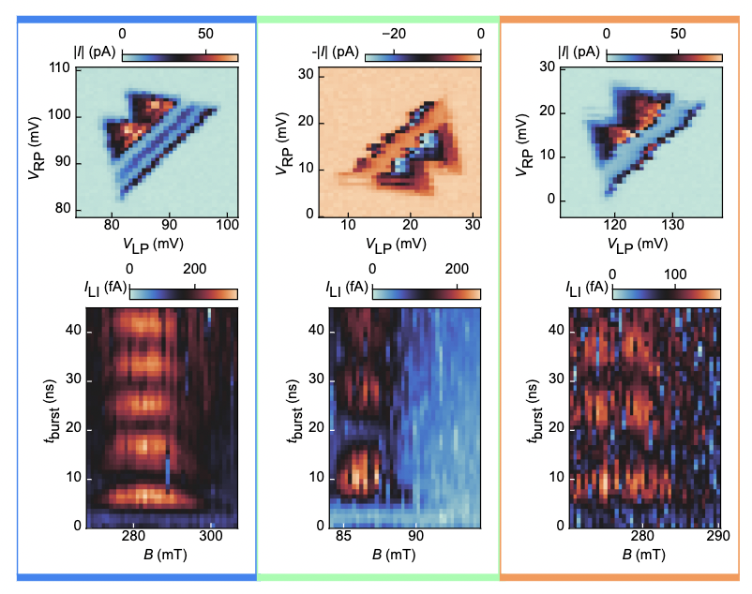

Variability of spin qubit metrics
Control voltage land
Optimised
qubit?
Gate voltage 3
Gate voltage 1
Gate voltage 2
Schuff et al. Fully automous tuning of a spin qubit, arXiv:2402.03931
Notes:
So you can think of a parameter landscape, which is rough, in which there are some optimal qubit properties that ML could find.

Slide 12
Leveraging fast measurements

Slide 13
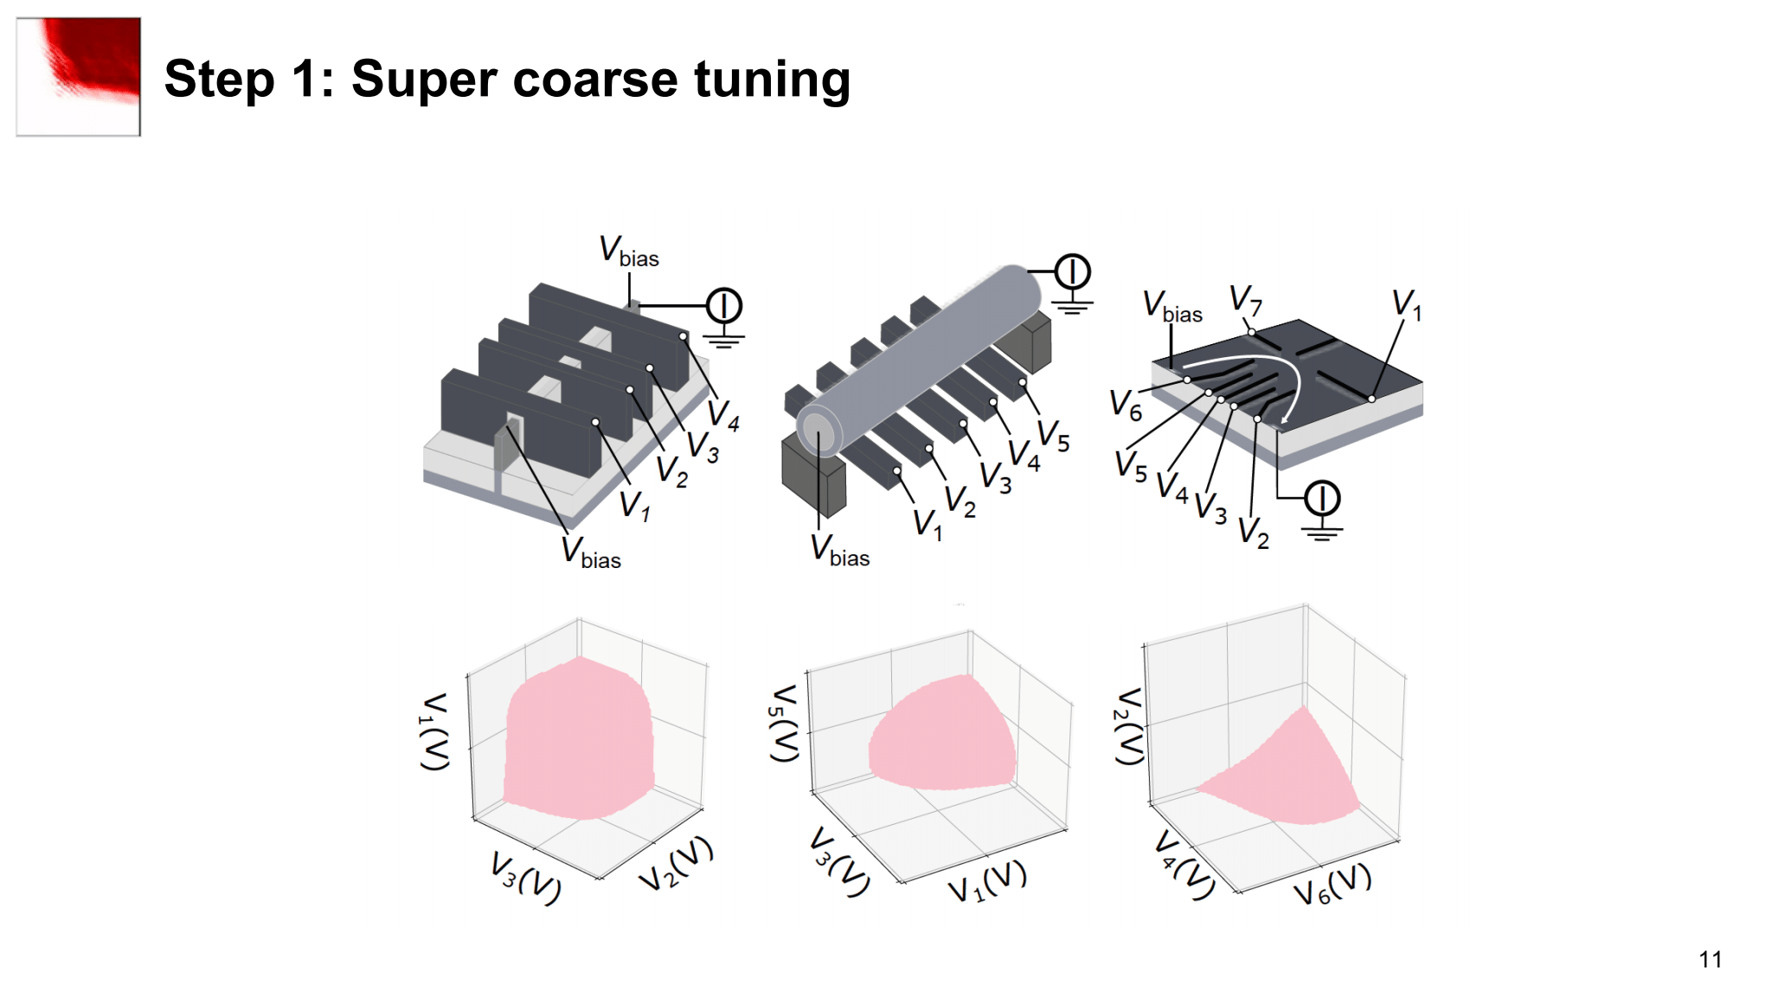
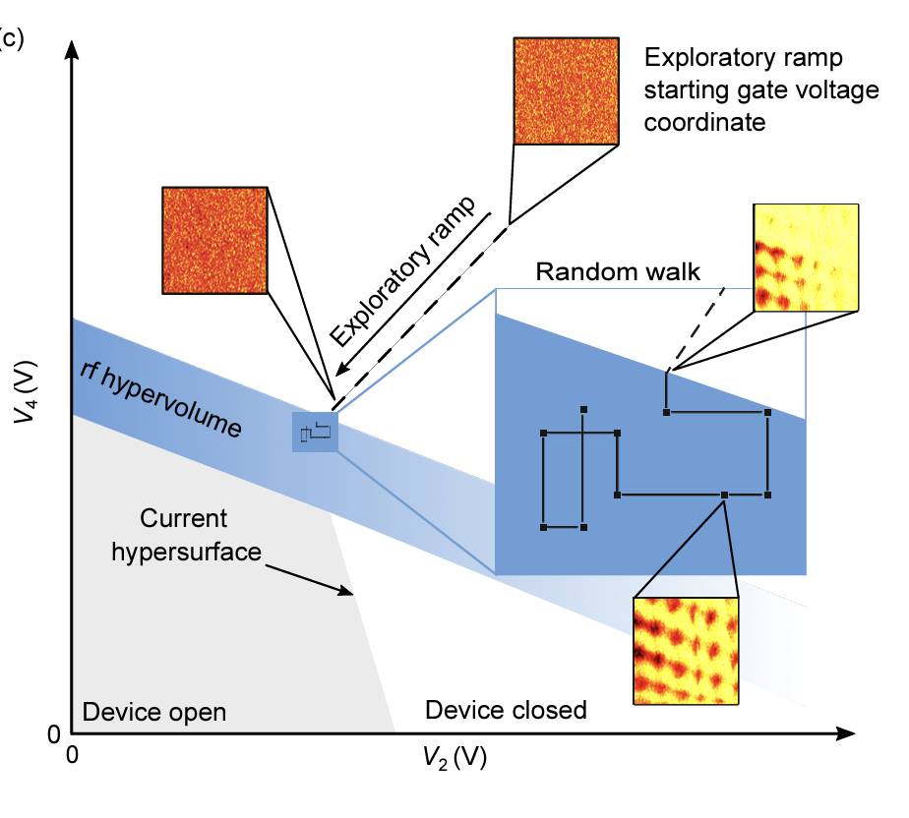
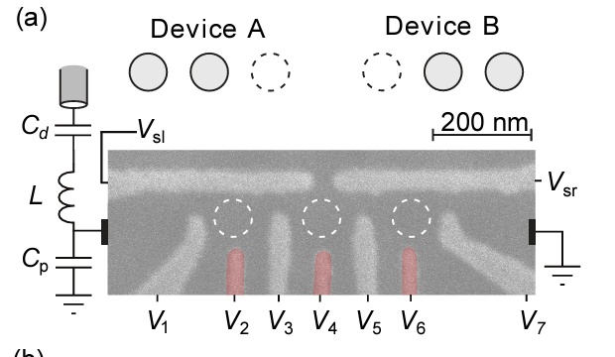
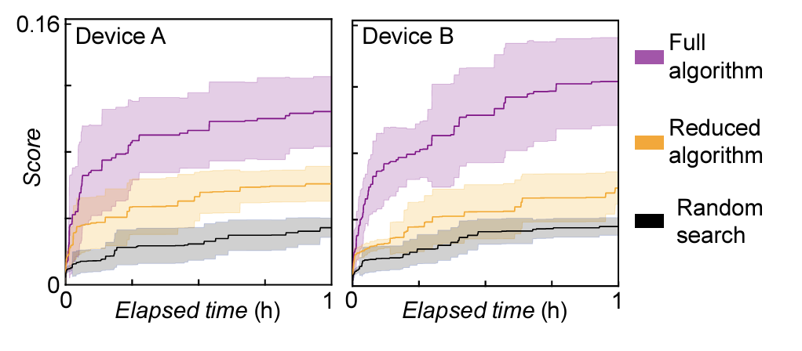
All rf-based tuning
van Straaten et al. arXiv:2211.04504
Notes:
10 ms no averae, AWG 4, 5 frames per seconds

Slide 14
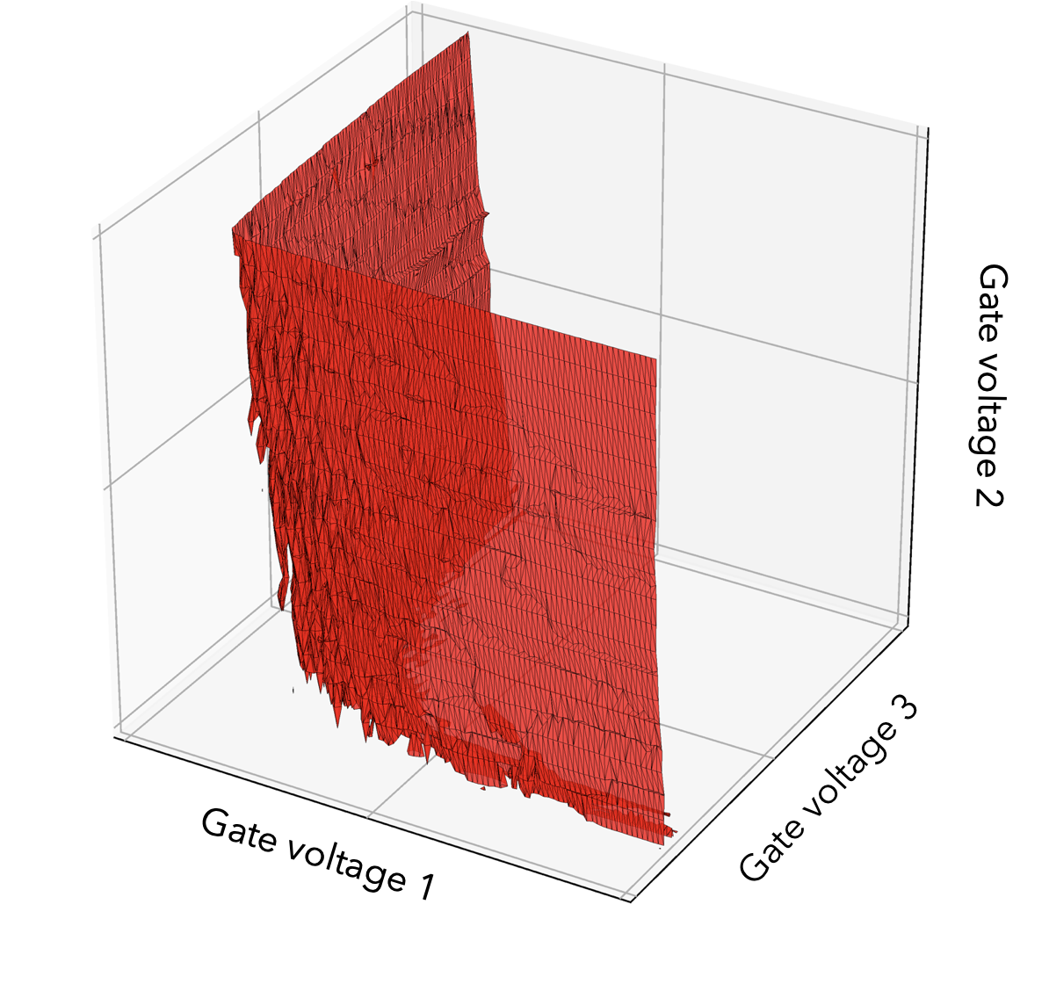
Exploring device variability
ON
OFF
Notes:
This leads us to think, what can be learn about device variability using ML.

Slide 15
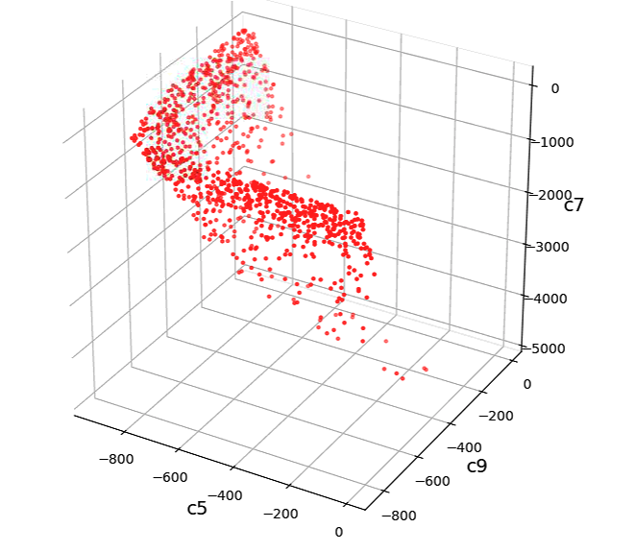
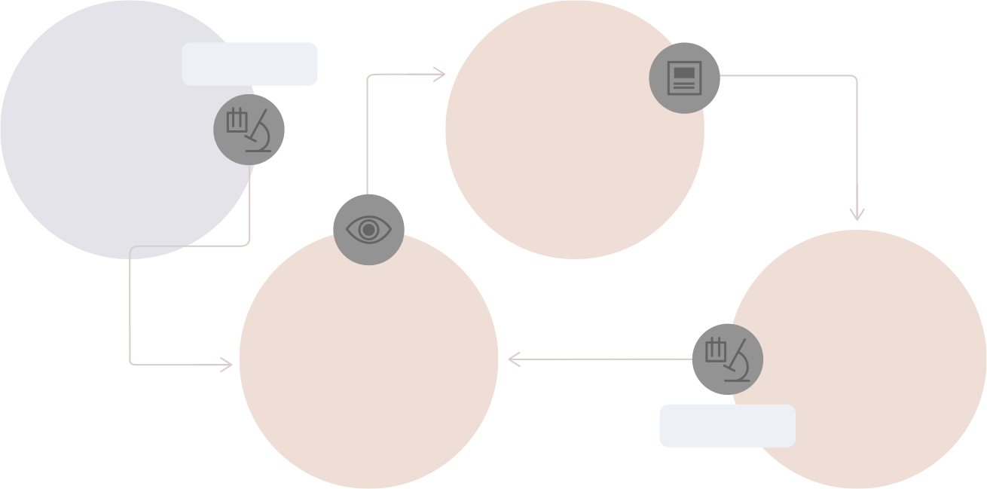
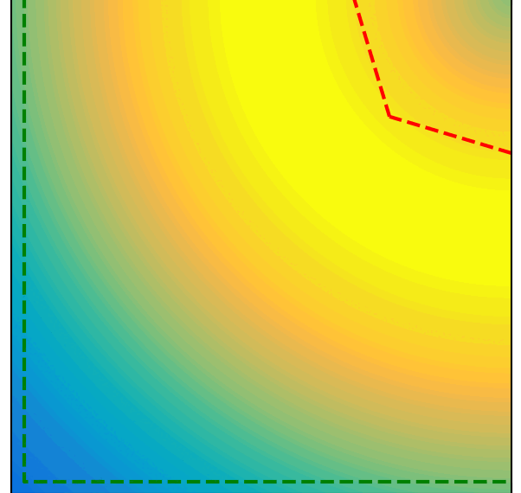
Exploring device variability
i
iii
REAL TIME
Initial
observations
Choose promising locations
Gate voltage 2
ii
iv
Model
Investigate candidate locations
Gate voltage 3
REAL TIME
Gate voltage 1
Gate voltage 2
Gate voltage 1

Slide 16
Exploring device variability
Silicon FinFET
Ge/Si core/shell Nanowire
Ge/SiGe Heterostructure
Holes, Accumulation
Holes, Depletion
Holes, Depletion

Slide 17
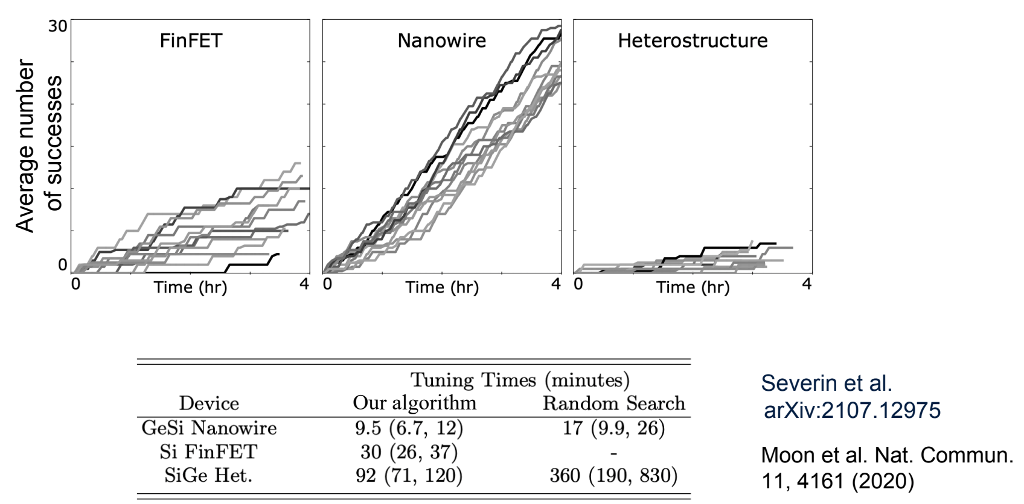
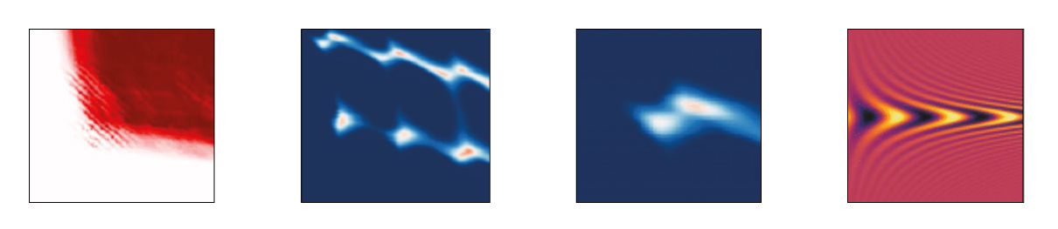
Exploring device variability
current
Gate Voltage 2
Gate Voltage 1

Slide 18
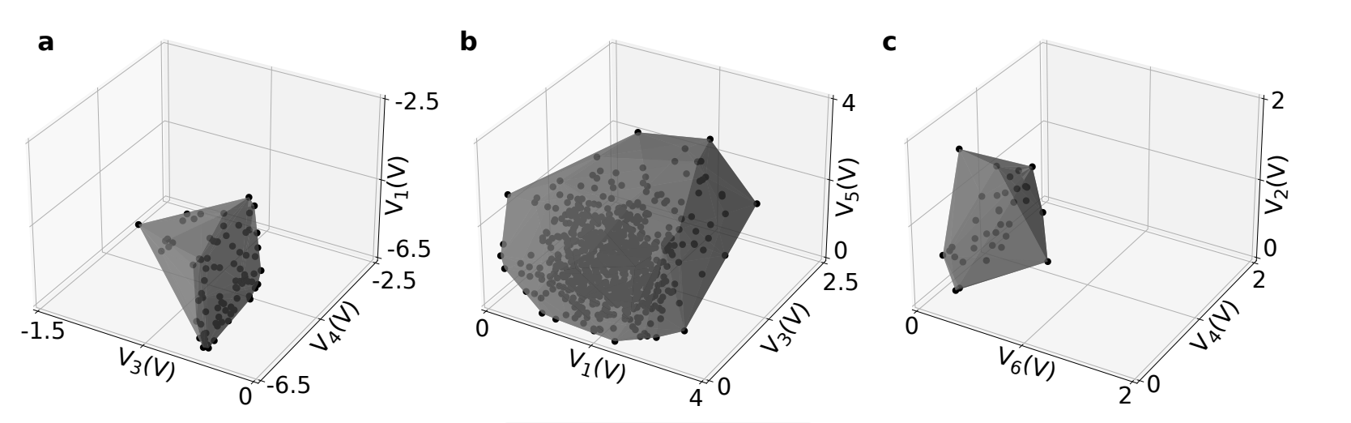
Exploring device variability
Silicon FinFET
Ge/Si core/shell Nanowire
Ge/SiGe Heterostructure
Holes, Accumulation
Holes, Depletion
Holes, Depletion
Severin et al. arXiv:2107.12975

Slide 19
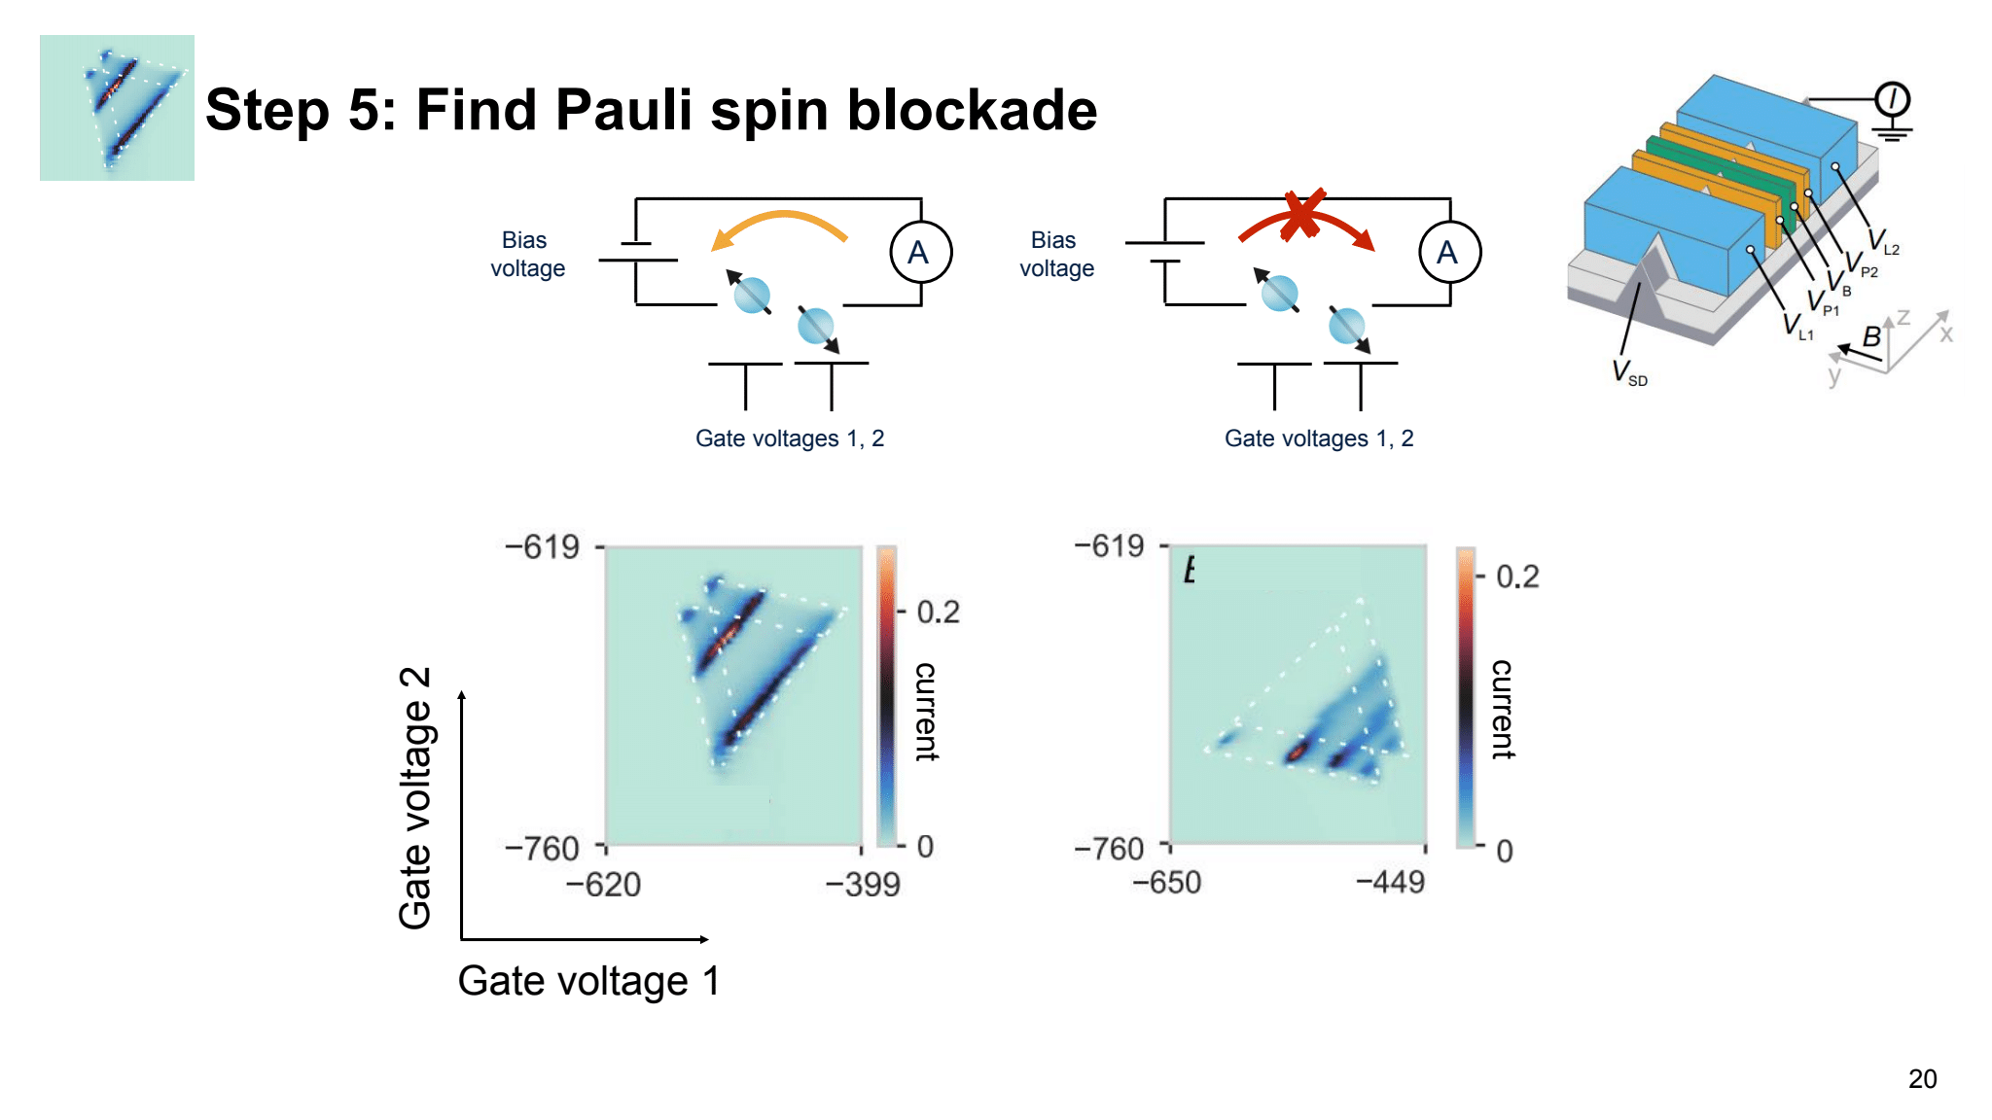

Finding PSB in CMOS devices

Slide 20
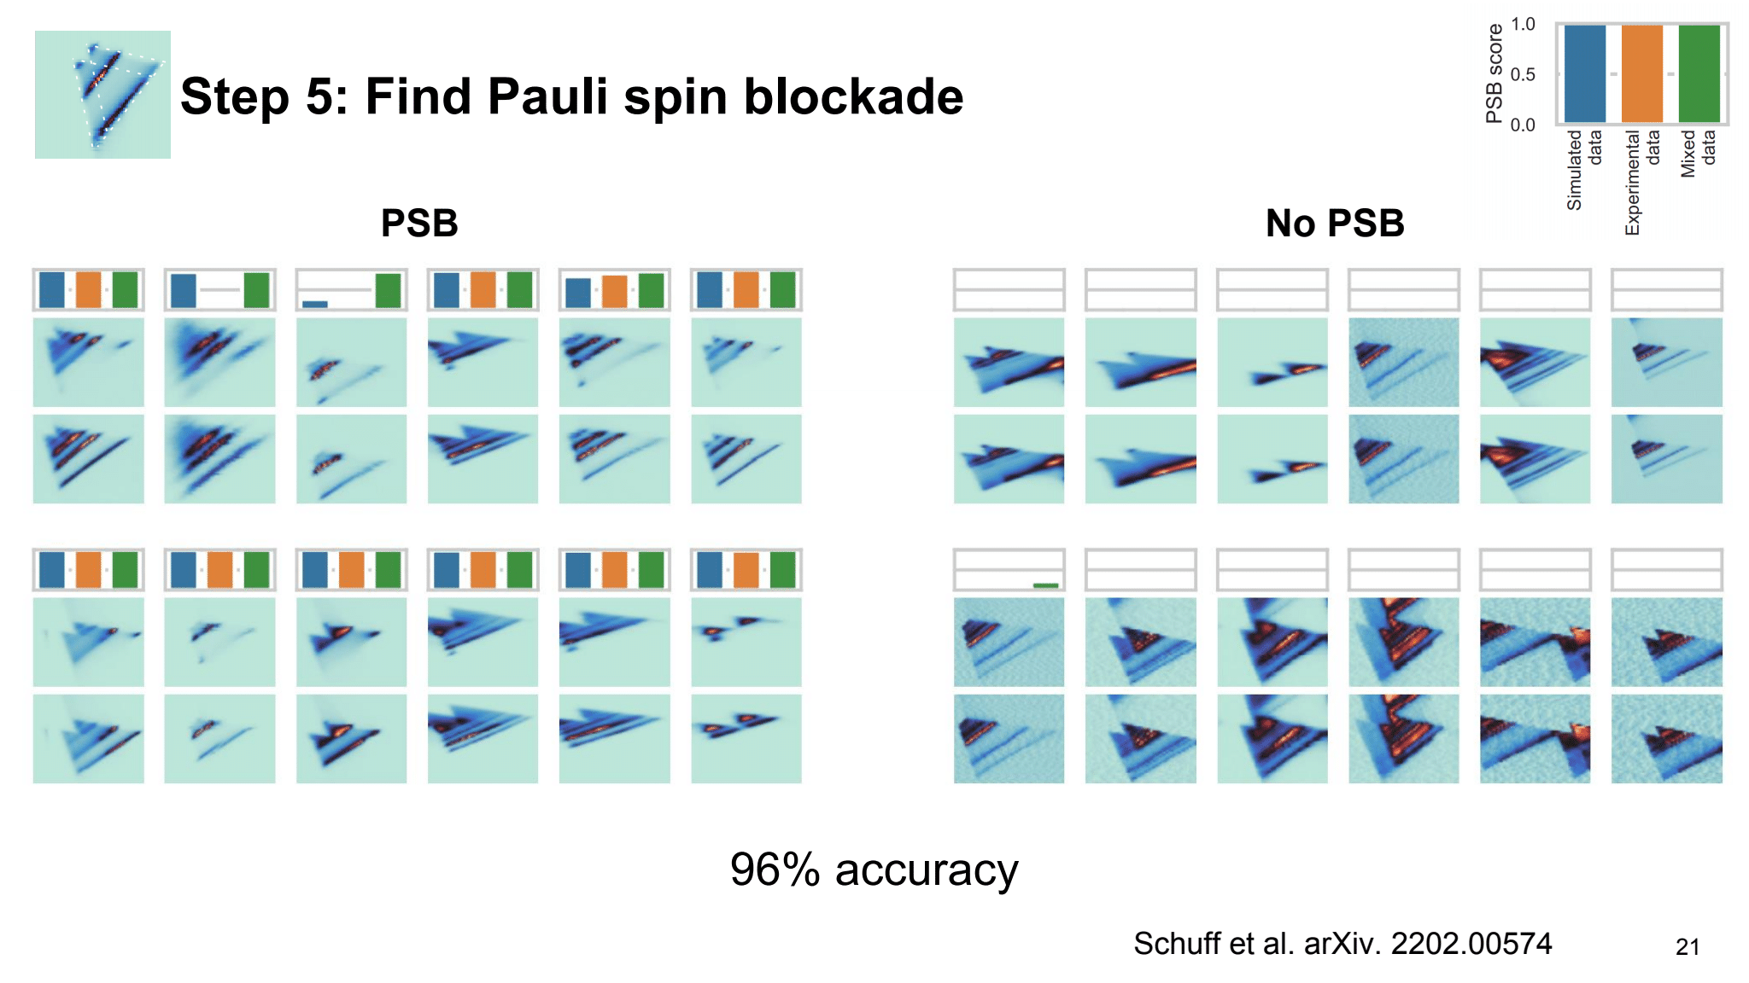
Finding PSB in CMOS devices
PSB
No PSB
96% accuracy
Schuff et al. Quantum 7, 1077 (2023)

Slide 21
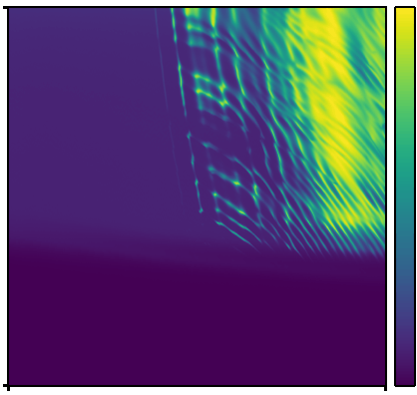
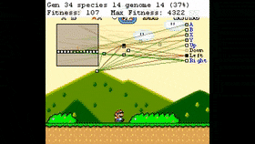
Deep Reinforcement Learning for quantum device tuning
Current
Deep Reinforcement Learning
Gate voltage 2
Gate voltage 1
Notes:
breakout (Atari) Human-level control through deep reinforcement learning
Nature volume 518, pages 529–533 (26 February 2015

Slide 22
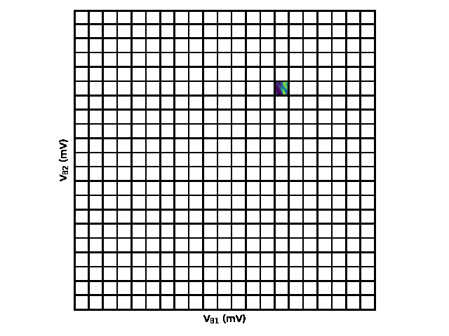
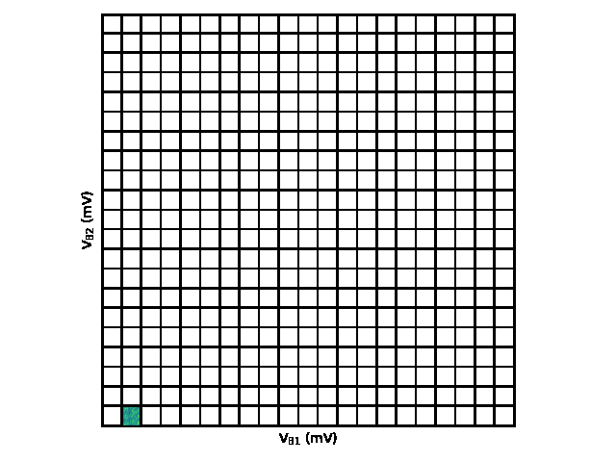

Deep Reinforcement Learning for quantum device tuning
Current
Gate voltage 2
Gate voltage 1
Nguyen et al. npj QI 7,100 (2021)

Slide 23
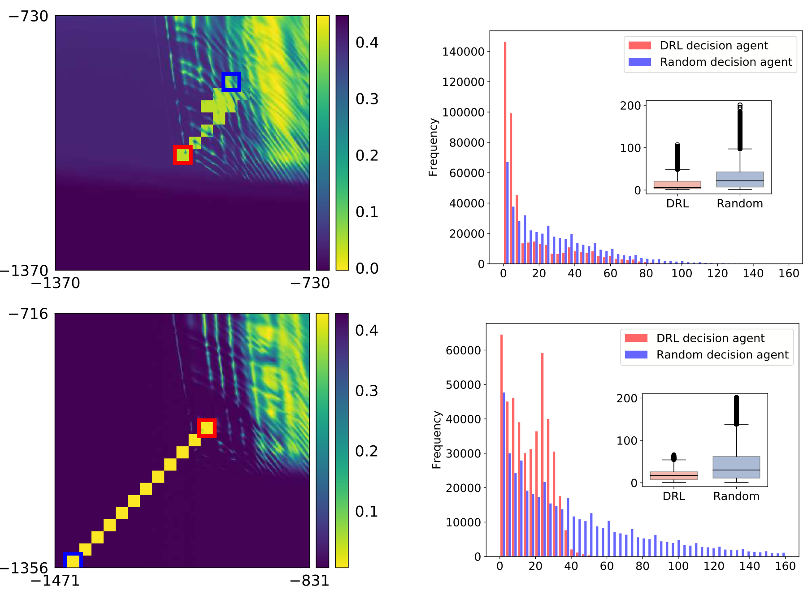
Deep Reinforcement Learning for quantum device tuning
Gate voltage 2
Frequency
Number of
blocks measured
Gate voltage 1
Number of blocks measured
Gate voltage 2
Frequency
Number of
blocks measured
Gate voltage 1
Number of blocks measured

Slide 24
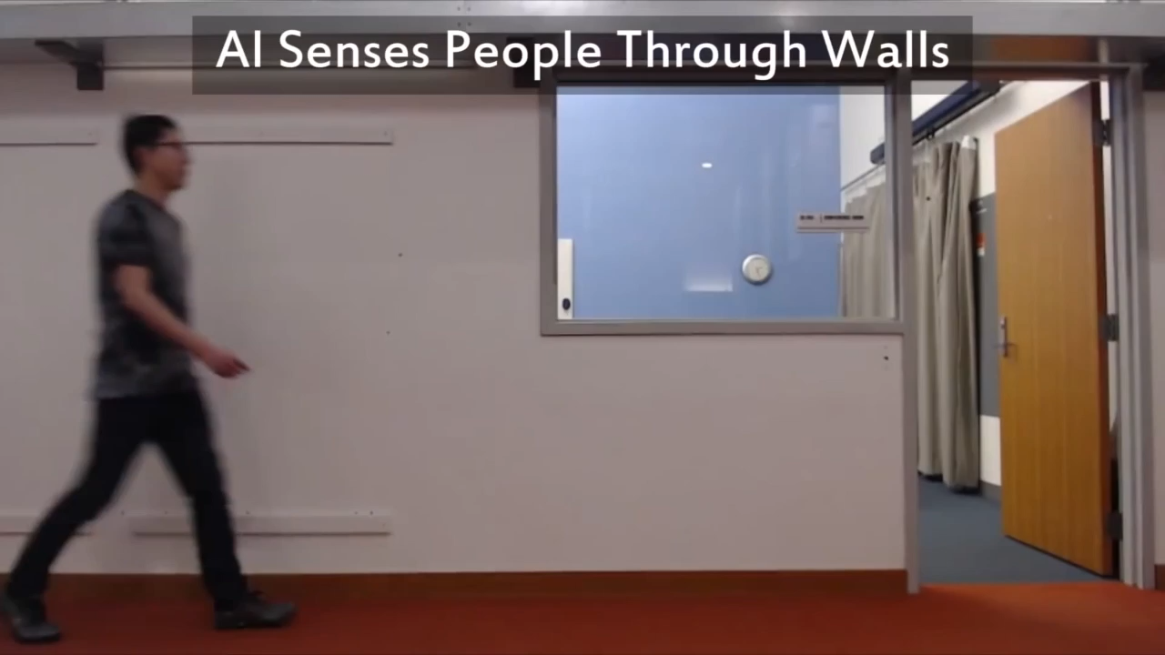
MIT’s Computer Science and Artificial Intelligence Laboratory (CSAIL)

Slide 25
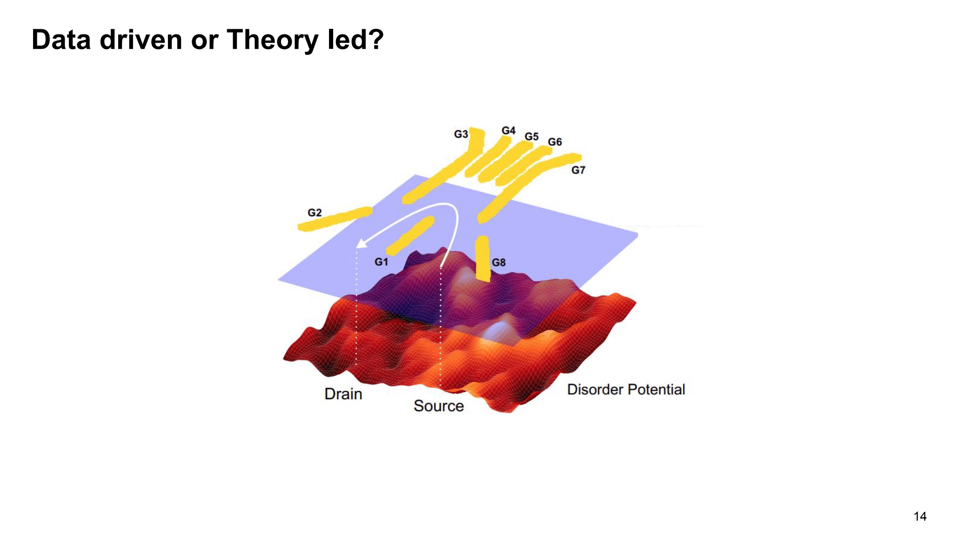
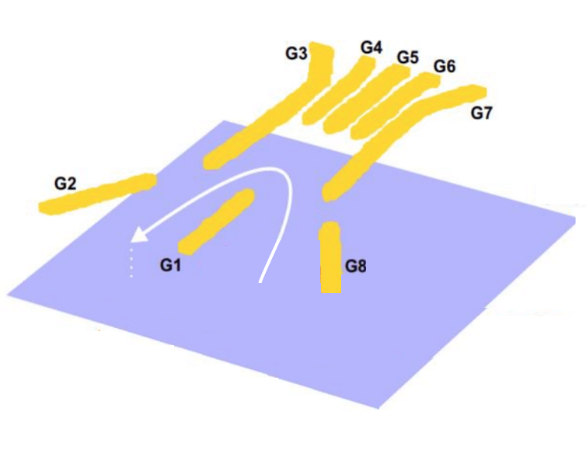
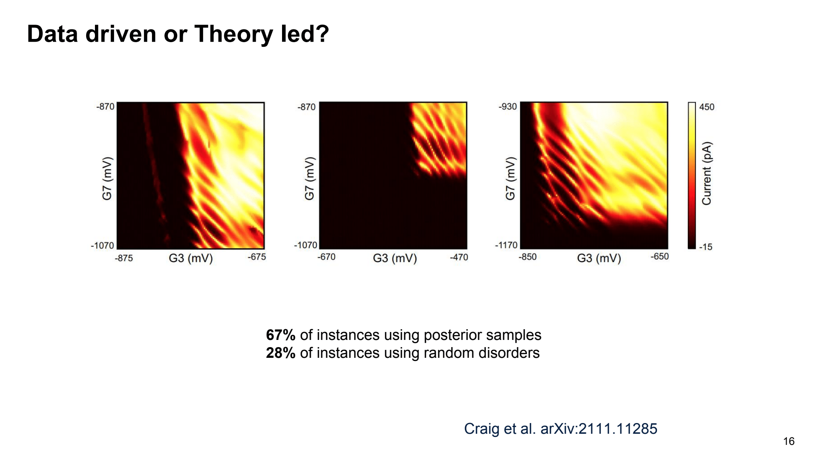
Learning disorder potentials
Simulator
Difference
Experiment
electrons
Craig et al. Bridging the reality gap. Phys. Rev. X 14, 011001 (2024)

Slide 26
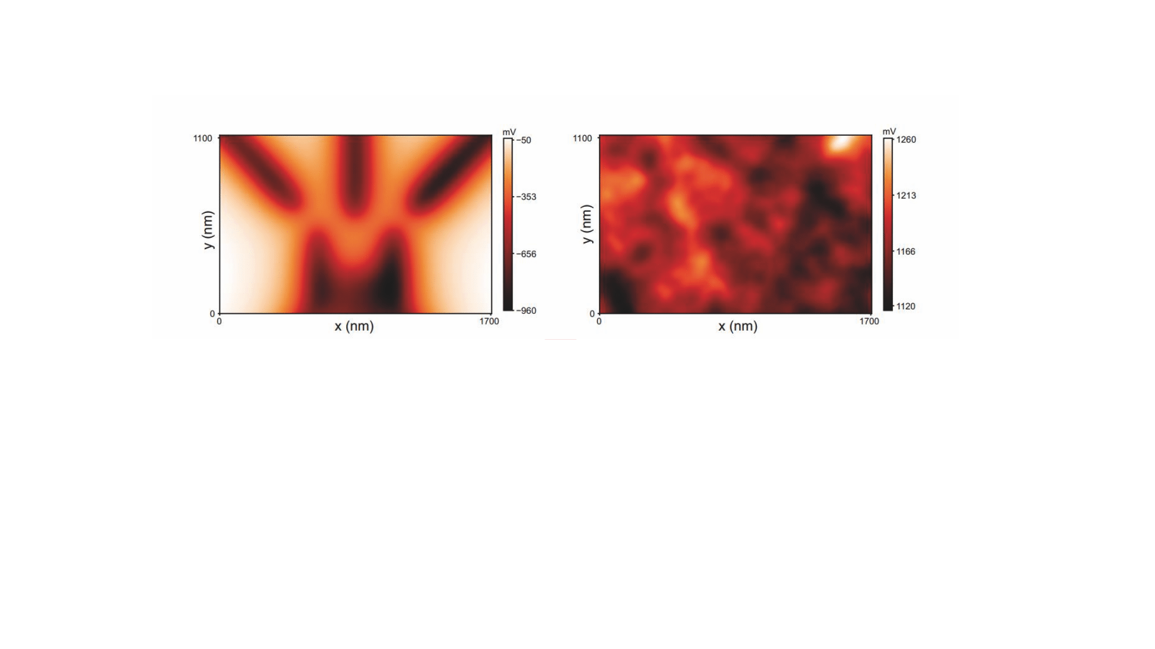
Learning disorder in semiconductor devices
Electrical potential simulation
Current measurement
y (nm)
Potential
electrons
x (nm)
+
y (nm)
Potential
x (nm)

Slide 27
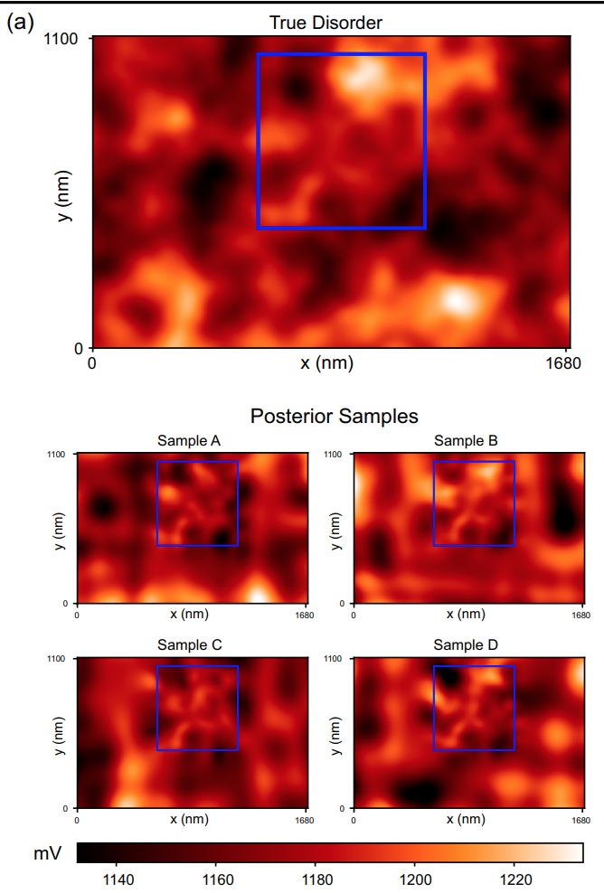
Learning disorder in semiconductor devices
Posterior samples
True disorder

Slide 28
Learning disorder in semiconductor devices
67% of instances using posterior samples
28% of instances using random disorders
Craig et al. Bridging the reality gap. Phys. Rev. X 14, 011001 (2024)

Slide 29
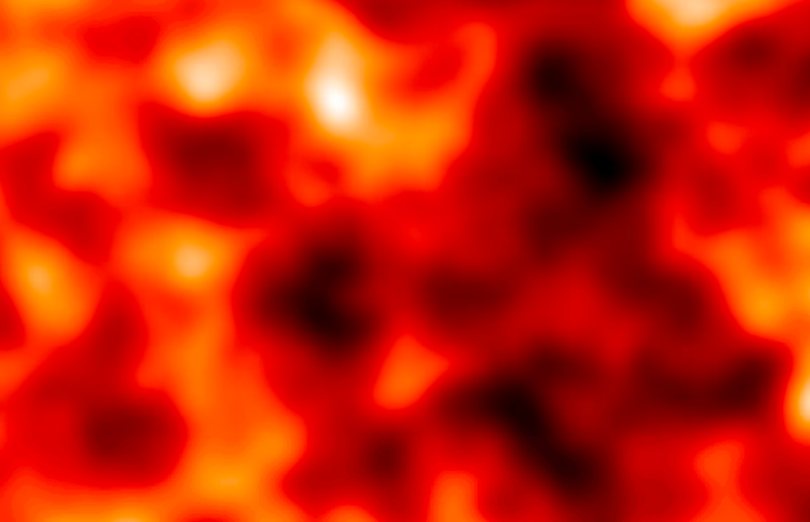
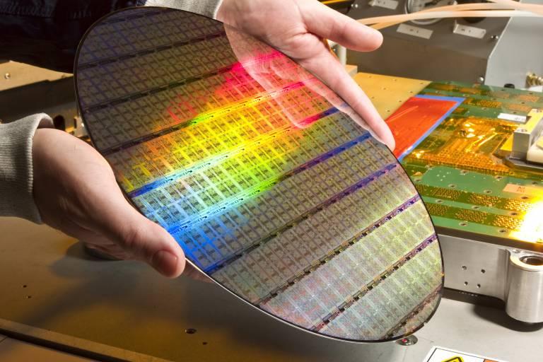
Quantifying device variability at wafer scales
y (nm)
Potential
x (nm)
CEA LETI
y (nm)
Potential
x (nm)

Slide 30
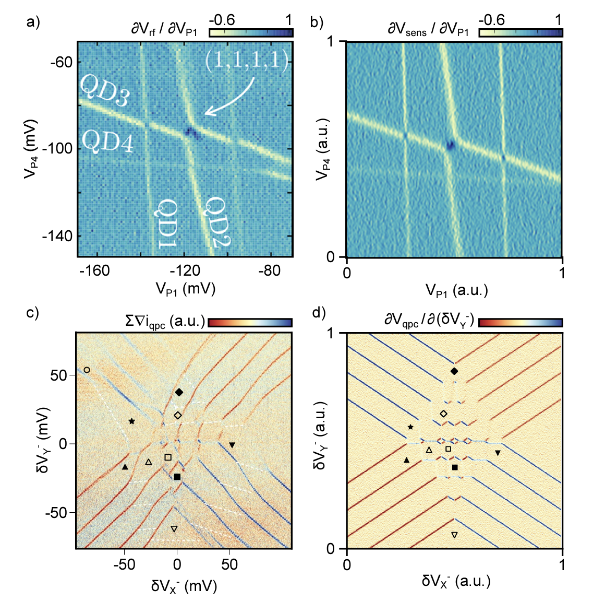
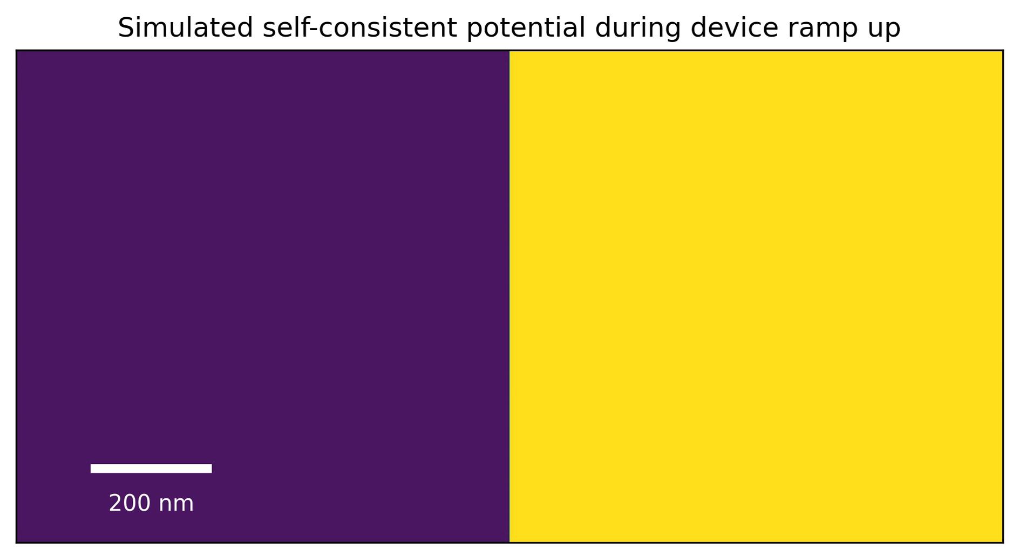
Digital twins
Straaten et al. QArray: a GPU-accelerated constant capacitance model simulator, arXiv:2404.04994

Slide 31
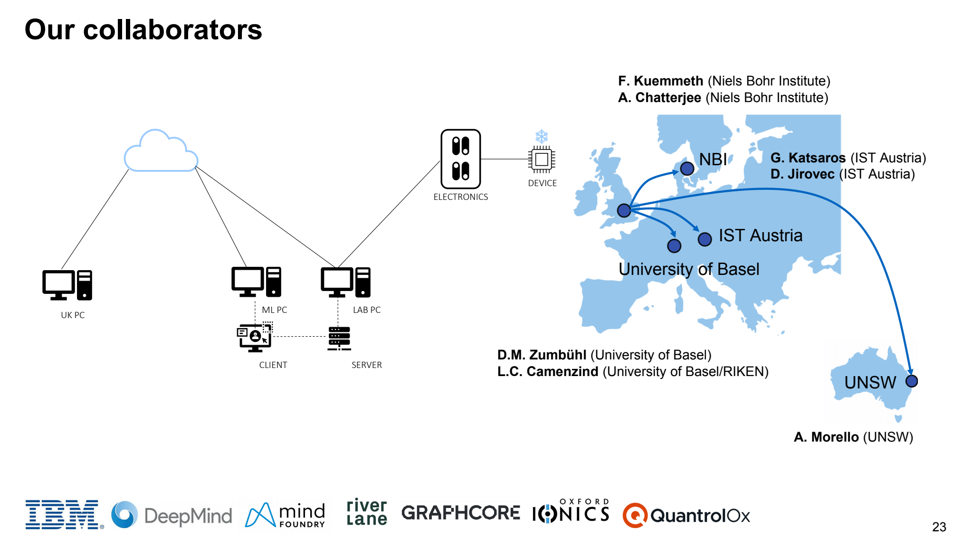
Our network
M. Carballido (University of Basel)
Prof Michael Osborne and Prof Jakob Foerster (University of Oxford)
Prof Dino Sejdinovic (University of Adelaide)

Slide 32
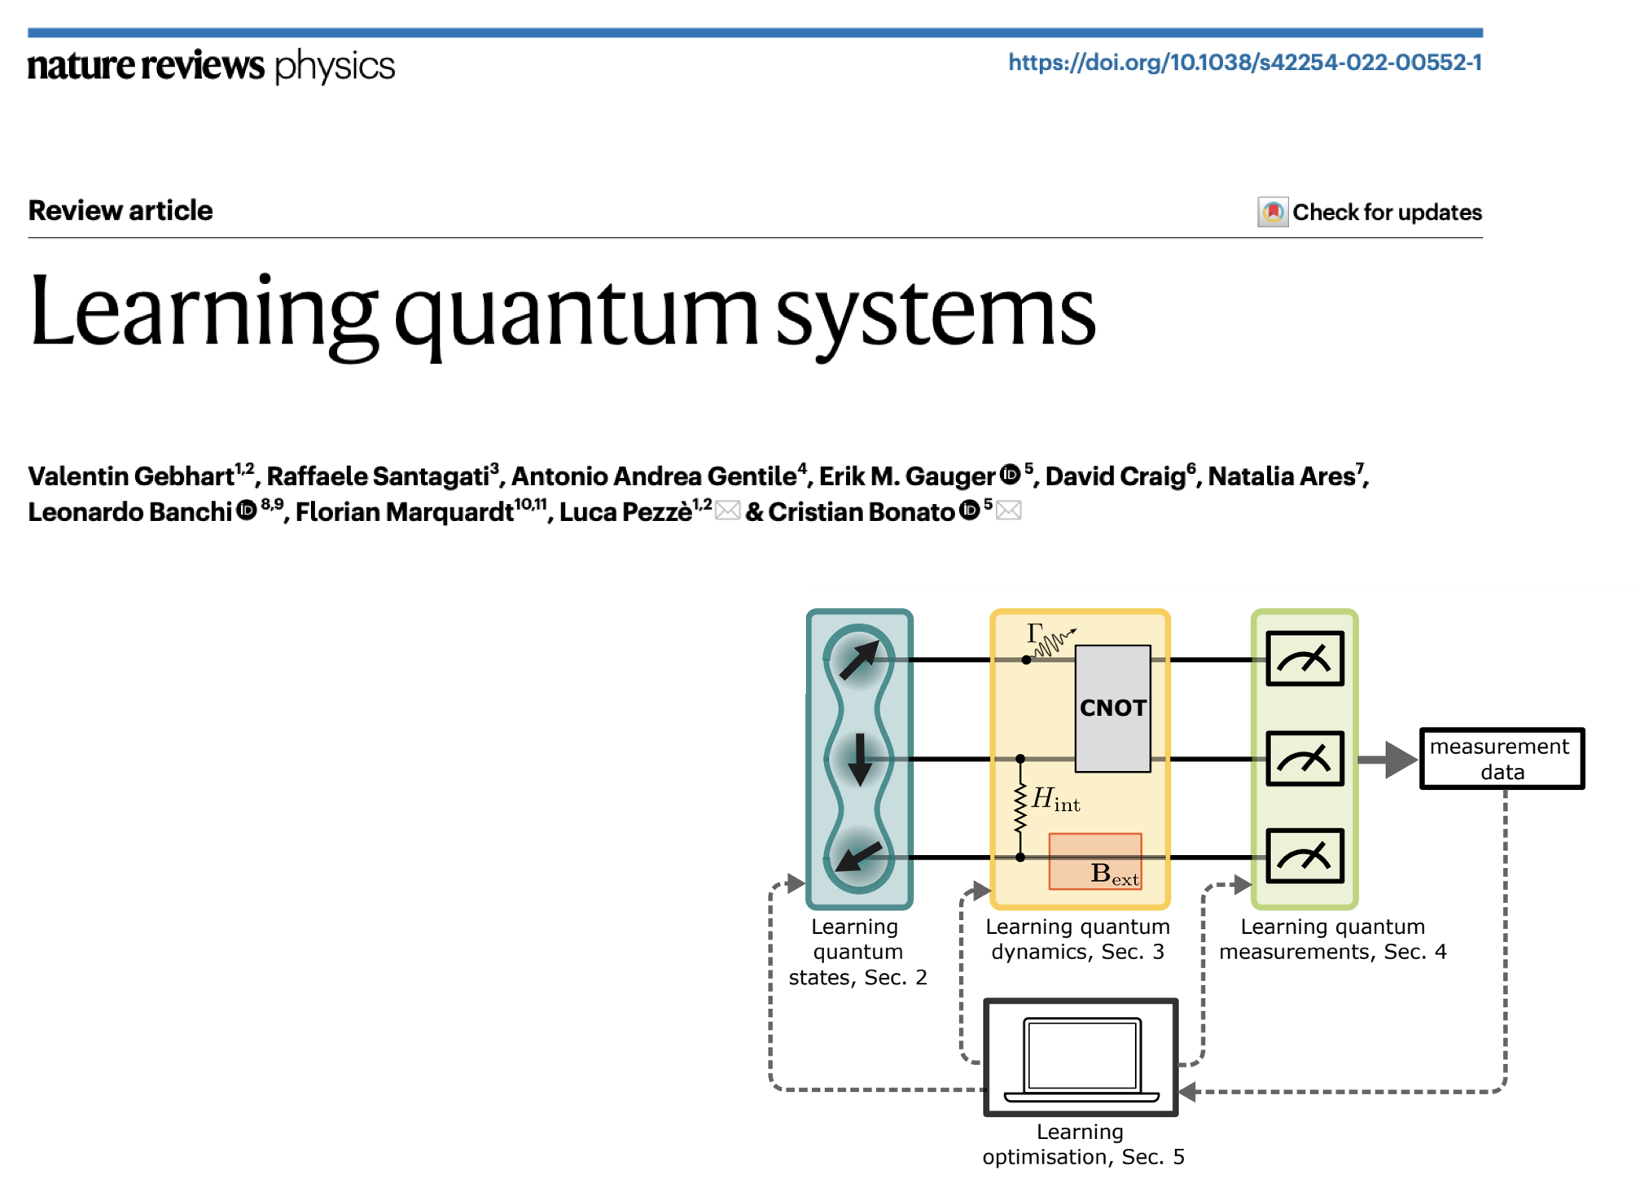

Slide 33
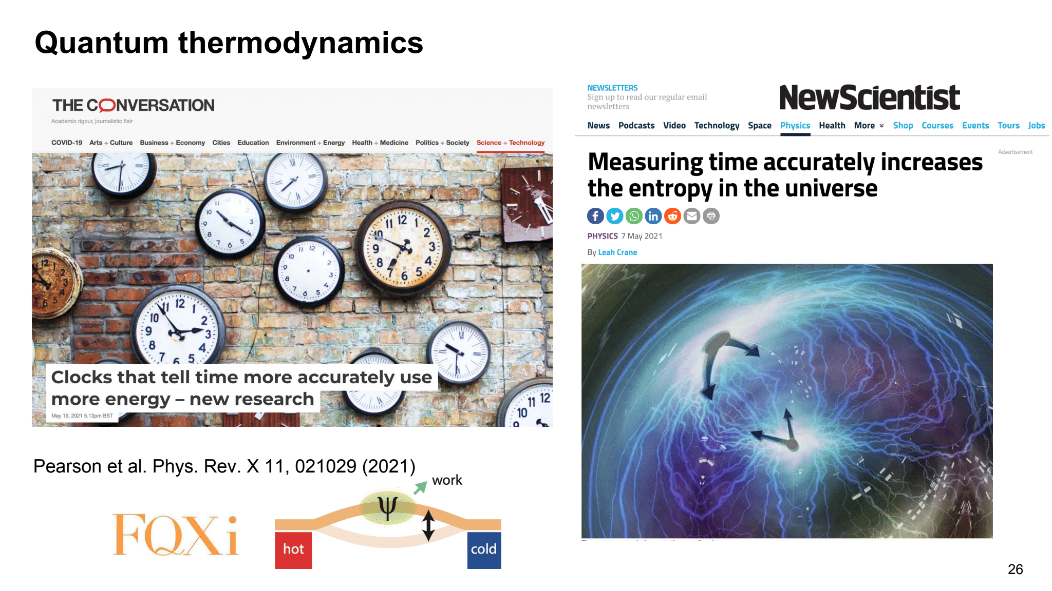
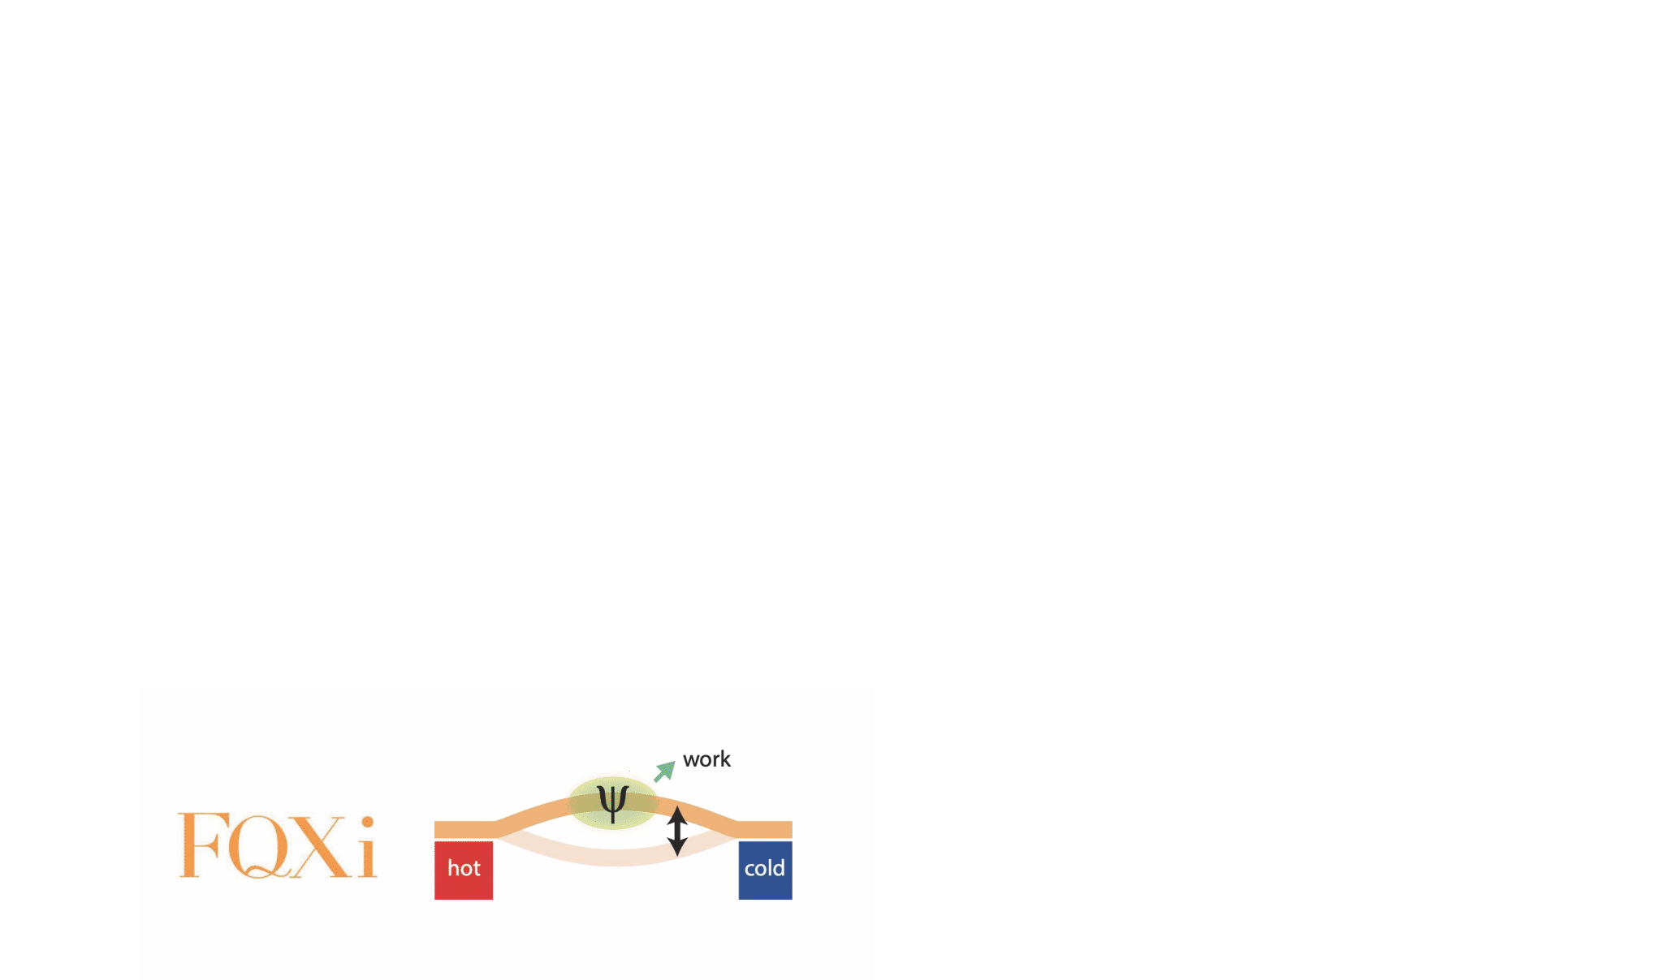
Quantum thermodynamics
Alexia Aufféves
Janet Anders
Juan Parrondo
Marcus Huber
András Pályi
Pearson et al. Phys. Rev. X 11, 021029 (2021)

Slide 34
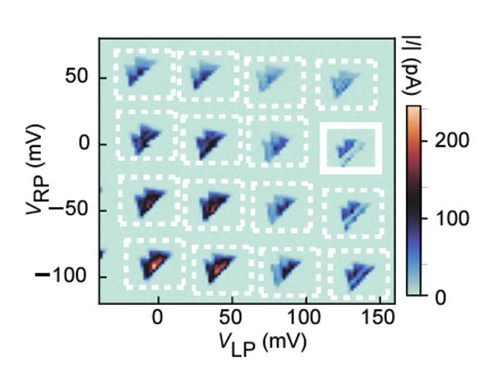
Machine Learning FOR quantum devices
Autotuning
Characterisation
Digital twining
Gate voltage 3
electrons
Gate voltage 1
Gate voltage 2
Notes:
Hello, I will focus on the role of machine learning in the development of quantum technologies. This not about the machine learning algorithms that we can run in a quantum computer but those we can run in a classical computer to allow us for optimal control of the quantum hardware.

Slide 35
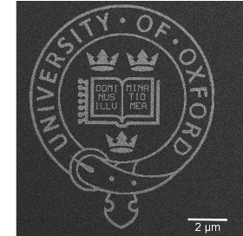
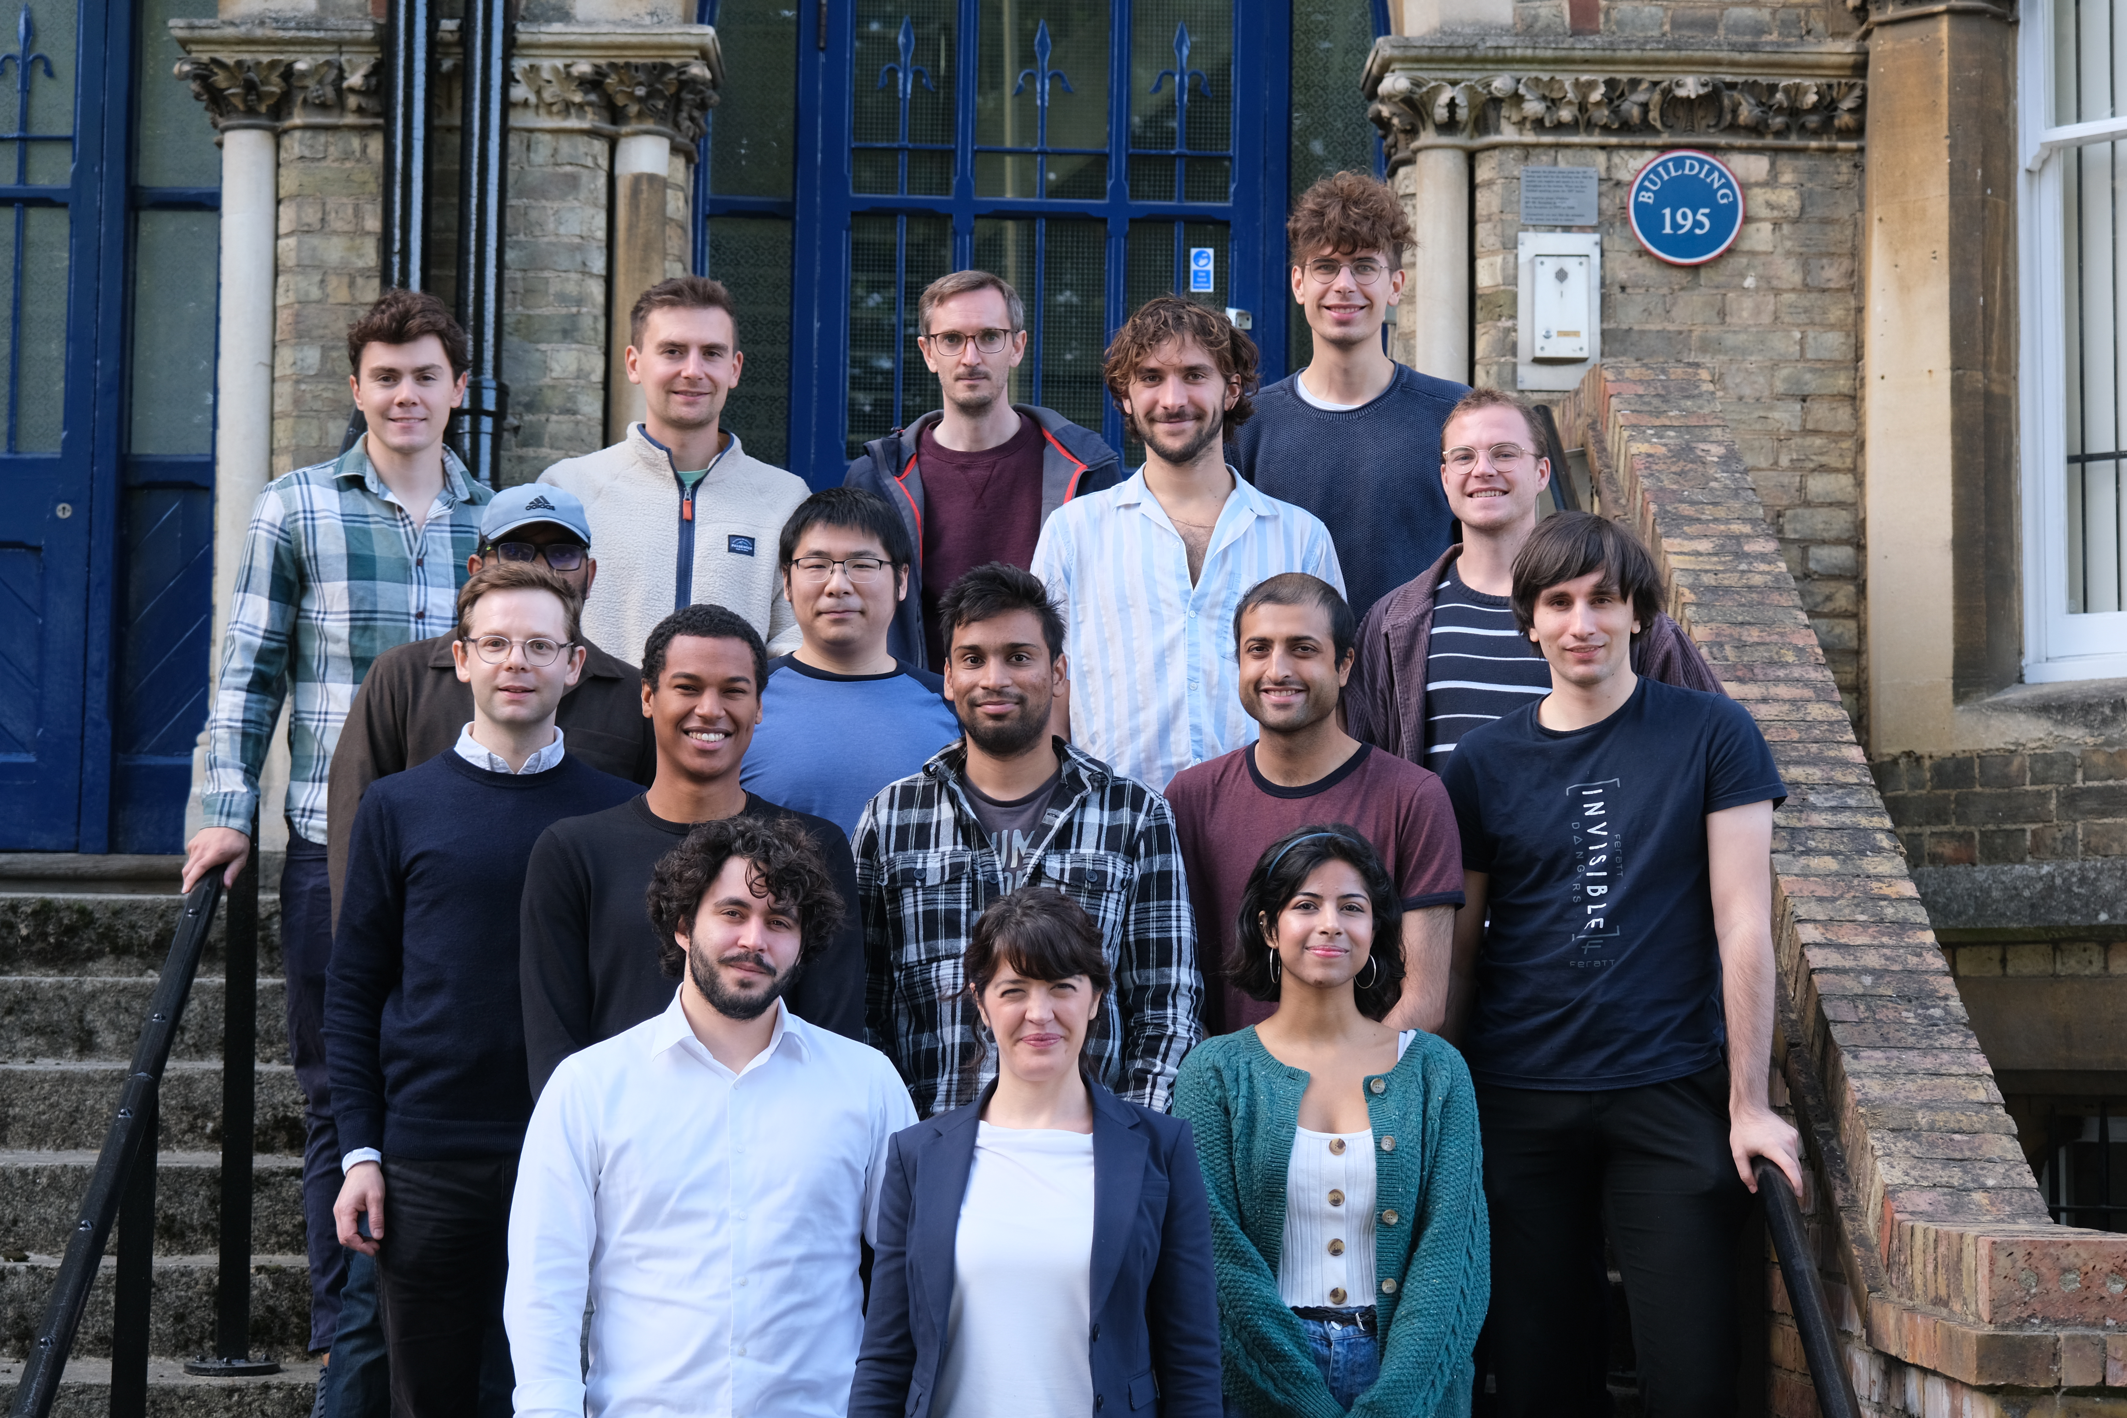

The group and our ML collaborators
D.M. Zumbühl (University of Basel)
M. Carballido (University of Basel)
L.C. Camenzind (RIKEN)
G. Katsaros (IST Austria)
M. Osborne (Oxford)
A. Chatterjee (NBI)
F. Kuemmeth (NBI)
A. Morello (UNSW)
N. Korda (Mind Foundry)
E. Gauger (HW University)
G. Milburn (University of Sussex)
Join us
Notes:
But first let me thank my students and colleagues at Oxford and my collaborators and funding agencies.

Slide 36
Thank you

Slide 37
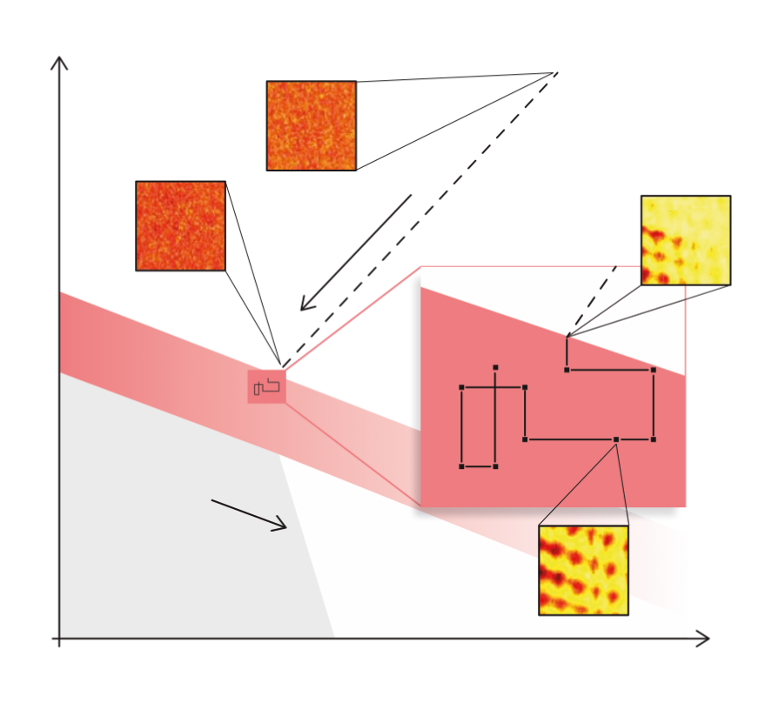
Leveraging fast measurements
Exploratory Ramp
Random Walk
Gate voltage 2
RF Hypervolume
Current
Hypersurface
Gate voltage 1
van Straaten et al. arXiv:2211.04504
Notes:
10 ms no averae, AWG 4, 5 frames per seconds

Slide 38
Quantifying device variability at wafer scales
CEA LETI
y (nm)
Potential
x (nm)

Slide 39
Step 5: Find Pauli spin blockade

Slide 40
Step 5: Find Pauli spin blockade
PSB
No PSB
96% accuracy
Schuff et al. Quantum 7, 1077 (2023)

Slide 41



Quantifying device variability
Device 1
Device 2
Gate voltage 2
Gate voltage 1

Slide 42


Quantifying device variability
(University
of Basel)
Moon et al. Nat. Commun. (2020)

Slide 43


Machine learning for quantum device control

Slide 44

Qubit optimisation and high throughput characterisation
Optimised
qubit?

Slide 45


Slide 46




Van Diepen, C . J . et al . Appl . Phys .
Lett . 113 , 033101 (2018)
Botzem, T. et al. Phys. Rev. Appl. 10 ,
054026 (2018)
Teske, J . D . et al . Appl . Phys .
Lett . 114 , 133102 (2019)
Machine learning for spin qubit tuning
Baart, T. A. et al. Appl. Phys. Lett. 108 ,
213104 (2016)
Darulová, J. et al. Phys. Rev. Appl. 13 ,
054005 (2020)
Kalantre, S . S . et al . npj QI 5 , 6 (2019)
Zwolak, J. P. et al. Phys. Rev. Appl. 13 , 034075
(2020)
Durrer, R., et al. Phys. Rev. Appl. 13 , 054019 (2020)
Chatterjee et al. arXiv:2108.10656
Krause et al. arXiv:2205.01443
Krause et al. Electronics 15, 2327 (2022)
Gate Voltage 2
Gate Voltage 2
Gate Voltage 1
Gate Voltage 2
Mills, A. R. et al. Appl. Phys. Lett. 115 ,
113501 (2019)
Volk, C . et al . npj QI . 5 , 29 (2019)
Gate Voltage 1
Gate Voltage 1

Slide 47

Deep Learning
x
y
Let’s play with it

Slide 48

Bayesian optimisation

Slide 49

Step 1: Super coarse tuning
How does success look like?
current
Gate Voltage 2
Gate Voltage 1

Slide 50



Step 1: Charge sensor tuning
Hickie et al. arXiv:2310.02135

Slide 51

Step 2 and 3: Characterise

Slide 52
Automating quantum device tuning
https://github.com/oxquantum-repo/
Semiconductor
chip
Qubit
Optimised
qubit
Step 1:
Tune
Step 2 and 3:
Characterise
Step 4:
Refine
Step 5:
Find optimal
No Deep
learning
- van Straaten et al. arXiv:2211.04504
- Severin et al. arXiv:2107.12975
- Craig et al. Phys. Rev. X 14, 011001 (2024)
- Moon et al. Nat. Commun. (2020)
Lennon et al.
npj QI (2019)
soon…
Deep
learning
Nguyen et al.
npj QI (2021)
van Esbroeck
et al. NJP
(2020)
Schuff et al.
Quantum 7,
1077 (2023)
N. Ares, Nature Reviews Materials 6,870 (2021)

Slide 53


Step 4: Fine tuning
van Esbroeck et al. NJP 22, 095003 (2020)

Slide 54




Slide 55



Step 4: Fine tuning
other gate voltages
Encoder
latent vector
score
Notes:
2200 8700
t-distributed Stochastic Neighbour Embedding

Slide 56

Quantifying device variability at wafer scales
CEA LETI
Current
Current
Bavdaz et al. npj QI 8, 86 (2022)
Gate voltage
Gate voltage

Slide 57




Slide 58

Gate voltage 2
Quantifying device variability
Gate voltage 1
Device 1
Device 2
ON
OFF
Moon et al. Nat. Commun. (2020)

Slide 59
Where are we at?
https://github.com/oxquantum-repo/
Semiconductor
chip
Qubit
Optimised
qubit
Step 1:
Tune
Step 2 and 3:
Characterise
Step 4:
Refine
Step 5:
Find optimal
No Deep
learning
- van Straaten et al. arXiv:2211.04504
- Severin et al. arXiv:2107.12975
- Craig et al. Phys. Rev. X 14, 011001 (2024)
- Moon et al. Nat. Commun. (2020)
Lennon et al.
npj QI (2019)
soon…
Deep
learning
Nguyen et al.
npj QI (2021)
van Esbroeck
et al. NJP
(2020)
Schuff et al.
Quantum 7,
1077 (2023)
N. Ares, Nature Reviews Materials 6,870 (2021)

Slide 60
Quantifying device variability at wafer scales
y (nm)
Potential
x (nm)
CEA LETI
y (nm)
Potential
x (nm)

Slide 61






A quantum device lab
Human’s loop
while human not satisfied with the result
fix parameters
measure
evaluate measurement
else:
go for coffee
Quantum hardware
Human
Human
Semiconductor
chips
Ion traps
Superconducting
chips
Big parameter space
Big variability between devices
Error thresholds >99%
Small data sets
Big variability between devices
Flat optimisation landscapes
Noisy data and (in some cases) hysteretic

Slide 62

From quantum chip to qubit
Quantum devices
Superconducting
devices
Semiconductor
devices
Ion traps
Machine
Learning
Machine
Learning
N. Ares, Nature Reviews Materials 6,870 (2021)

Slide 64

Notes:
8 ms no averae, AWG 4, 5 frames per seconds

Slide 65
Step 1: Super coarse tuning, model led
67% of instances using posterior samples
28% of instances using random disorders

Slide 66





Step 1: Super coarse tuning
A
Bias
voltage
i
iii
REAL TIME
Initial
observations
Choose promising locations
Gate voltages 1, 2, 3
ON
ii
iv
Model
Investigate candidate locations
Gate voltage 2
REAL TIME
OFF
Gate voltage 3
Hypersurface
Hypersurface evaluation
Real hypersurface
Prediction (with uncertainty)
Gate voltage 1
Gate voltage

Slide 67
Spin qubit tuning
Semiconductor device
A
SET
features
Charge
transition
PSB
found
Rabi
Freq
tuned
ON/OFF
Bias
voltage
Step 1
Step 2 and 3
Step 4
Step 5
Gate voltages 1 and 2
current
current
current
current
Gate Voltage 2
Gate Voltage 2
Gate Voltage 2
Frequency
Gate Voltage 1
Gate Voltage 1
Gate Voltage 1
Time

Slide 68
Van Diepen, C . J . et al . Appl . Phys .
Lett . 113 , 033101 (2018)
Botzem, T. et al. Phys. Rev. Appl. 10 ,
054026 (2018)
Teske, J . D . et al . Appl . Phys .
Lett . 114 , 133102 (2019)
Machine learning for spin qubit tuning
Baart, T. A. et al. Appl. Phys. Lett. 108 ,
213104 (2016)
Darulová, J. et al. Phys. Rev. Appl. 13 ,
054005 (2020)
Kalantre, S . S . et al . npj QI 5 , 6 (2019)
Zwolak, J. P. et al. Phys. Rev. Appl. 13 , 034075
(2020)
Durrer, R., et al. Phys. Rev. Appl. 13 , 054019 (2020)
Chatterjee et al. arXiv:2108.10656
Krause et al. arXiv:2205.01443
Krause et al. Electronics 15, 2327 (2022)
Gate Voltage 2
Gate Voltage 2
Gate Voltage 1
Gate Voltage 2
Mills, A. R. et al. Appl. Phys. Lett. 115 ,
113501 (2019)
Volk, C . et al . npj QI . 5 , 29 (2019)
Gate Voltage 1
Gate Voltage 1

Slide 69
Step 4: Fine tuning
van Esbroeck et al. NJP 22, 095003 (2020)

Slide 70


Slide 71


Slide 72

Machine learning for spin qubit scalability
F. Kuemmeth, Niels Bohr Institute,
Copenhagen

Slide 73



Step 1: Super coarse tuning
Model
Choose
Hypersurface
Hypersurface evaluation
Real hypersurface
Prediction (with uncertainty)
Gate voltage
Notes:
This is what we call BO. Our score function in the parameter space where we are looking for features has a functional form we don’t know. For a given iteration n we have a prediction of how this score function looks like, and we aim to find the max or a minimum of this score function. This prediction has some uncertainty that I represent here with a light blue shade. Each measurement, we evaluate the score function and reduce this uncertainty. The acquisition map is going to tell us, according to the model, where is more informative to evaluate the score function according to the model. As you can see, the acquisition functions has minimums where the score function has already been evaluated and a maximum where the model predicts a minimum of the score function. Evaluating the score function at the most informative point in the next iteration, our model is updated and so our acquisition function. Now our model is more accurate and we are guided towards the max or min of the score function.
gaussian process (uncertainty information) (one of stochastic process) + acquisition function (information theoretic)
CVAE+ acquisition function
target function is the score function
in our case CVAE gives the target function
Mutual information is an information theoretic model

Slide 74

Step 1: Super coarse tuning, data driven or model led?
y (nm)
Electron density
y (nm)
Potential
x (nm)
current
+
x (nm)
Gate Voltage 2
Gate Voltage 1
y (nm)
Potential energy (au)
Potential
x (nm)
Distance (nm)

