Slide 1
Large language models in scientific coding
Marcell Stippinger Department of Computational Sciences, HUN-REN Wigner Research Centre for Physics
November 20, 2024

Slide 2
About Me
2011: MSc in Physics (BME) MSc in Engineering (EC Lille, France, double degree program)
2017: PhD in Physics (BME)
statistical physics, computer simulations of networks in C++ and hybrid phase transitions
taking some machine learning courses in Python
Since 2016: Wigner RCP
theoretical neuroscience, complex systems, machine learning
using cloud computing, some GPU programming (in Python :D)
since September 2024 an AI Ambassador

Slide 3
HUN-REN AI Ambassador program
Ambassadors
Example: https://ai.wigner.hu
spread information about the services provided by the headquarters
organize inspiration events and workshops
forward the researchers’ needs to the headquarters
Experts are available similarly to the Helmholz.ai initiative
Gergő Szabó (BME mechatronics engineer; freelance Data Scientist): idea validation
Dániel Szittya (University of Glasgow, computer science): AI tools, method development
Gergő Kóczán (Óbuda University, IT engineer; experience in DevOps): infrastructure
Similar talk
Notes:
Nagykövetek működésének három pillére van.
A Helholtz.ai mintájára a projekteket élettartamuk fázisaiban segítik
Validálás
Megvalósítás során konzultáció
Utógondozás, tapasztalatok megosztása (támogatásra specializált szakértők)
Három munkatárs már elérhető.

Slide 4
Contents
Theory
From AI to ChatGPT
Limitations and potential risks
Pair programming
Examples
ChatGPT: Ising model with GUI
Llama: Working with input files
GitHub Copilot: code completion, writing test cases, etc.

Slide 5
Choose your IDE
Azure Data Studio
JetBrains IDEs (e.g., PyCharm)
Vim/Neovim
Microsoft Visual Studio
Visual Studio Code ← Cross-platform, we will be using this one during the demo
Xcode
For the demo, data is over here bit.ly/3AC4KaE →

Slide 6
How do we define artificial intelligence?
Scientific picture
Legal picture (AI Act)
If you sell AI or offer it as a service don’t forget to ask your lawyer
Computer system
makes decision
Can adapt
has autonomy
„AI System”

Slide 7
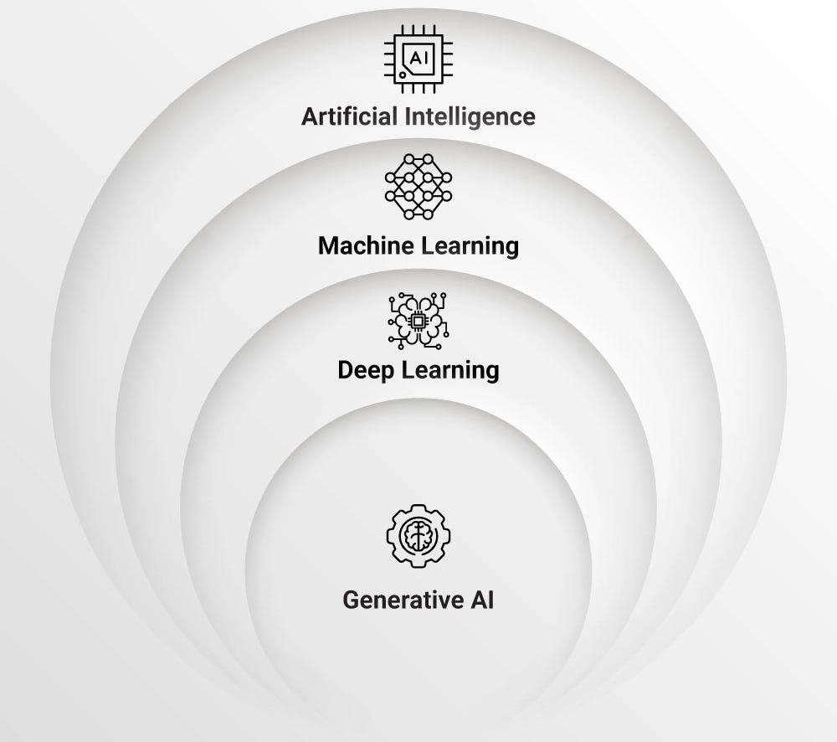
How do we define artificial intelligence?
Scientific picture
Legal picture (AI Act)
If you sell AI or offer it as a service don’t forget to ask your lawyer
Computer system
'40s - '50s
makes decision
Can adapt
'80s - '90s
has autonomy
2000s - 2010s
„AI System”

Slide 8
How do we define artificial intelligence?
Scientific picture
Legal picture (AI Act)
If you sell AI or offer it as a service don’t forget to ask your lawyer
Computer system
makes decisions
Can adapt
has autonomy
„AI System”

Slide 9
ChatGPT
A text prediction tool (AI → ML/NNs → NLP → LLM → Transformer → GenAI → ChatGPT)
Trained on web corpus, including books, Wikipedia, StackOverflow and similar
It is good at typical tasks
No logical reasoning or understanding expected
However, it can be instructed
Prompt engineering: formulating task for a GenAI in natural language (no programming skills)
Instructions shall be clear, specific and describe all important aspects, use examples
Can take roles (“Please, explain as an expert speaking to a 6-year old.” or “Be sarcastic.”)
Takes no responsibility for the output
Not a coauthor (see EU’s AI Act)
May be wrong, biased or stereotypic
Rapidly developing: what we see tomorrow may be surpassed tomorrow.

Slide 10
Shall I use ChatGPT*?
* or any other large language model for my research tasks
Many clones exist, for the original:
https://chatgpt.com/
https://chat.openai.com/

Slide 11
Ask nicely not to use our data
Here it is: Settings → Data controls → Improve the model for everyone → Off
I believe it when I see it.

Slide 12
Ingredients of a prompt
priming (personality): “You are an expert at writing clear, concise, Python code.”
question (task): “Create a doubly linked list.”
decorator (presentation): “Insert comments for each line of code.”
Notes
Model is instructed to tolerate typos, to be helpful and polite.
The more data, the better performance (English and Python > Hungarian and Fortran)
Providing context restricts the creativity and increases the probability of success.
Guide the model with example solutions or provide cases to be avoided.
Usually it is a good idea to break down the task into steps (or asking for it to do so).
Same input may produce different output.

Slide 13
Some typical LLM mistakes
Misunderstanding instructions
e.g. Create a dataset for 2023-2024 NBA for two variables: points (integer) and win/loss (binary).
ChatGPT wrote code that generated random numbers (credit Miklós Sebők, Rebeka Kiss)
Refine the prompt “download dataset” or provide data by upload
Getting stuck at an idea and keeping repeating the same unsatisfying response
Start a new conversation as there is no memory between conversations (unless you ask for it)
Hallucination
e.g., Asking for help with ESP32 (Wifi+Bluetooth chip) functions and events
ChatGPT invented a new event that was not in the API or documentation
Ask for clarification, pointing out that the solution did not work

Slide 14
Some typical LLM mistakes
Acknowledging hallucination
mistake

Slide 15
Example 1.
Physics-motivated task
Ising model simulation
interactive GUI

Slide 16
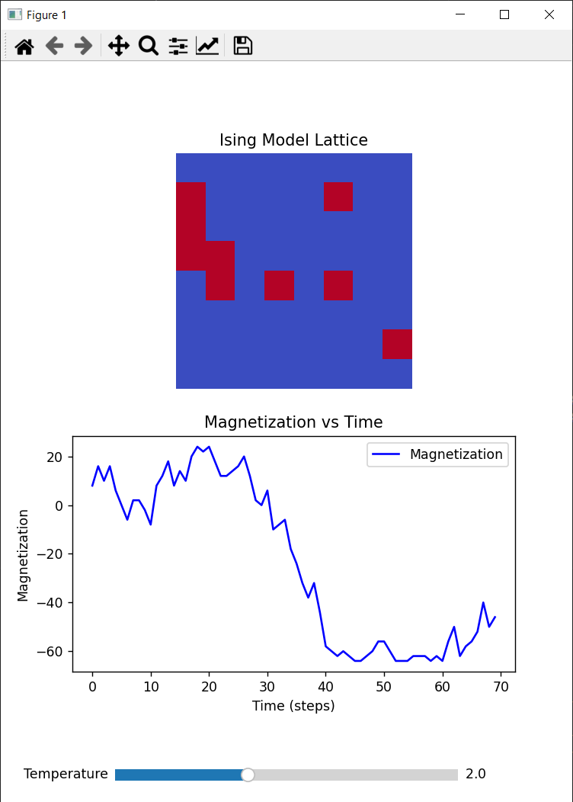
Writing code with ChatGPT

Slide 17
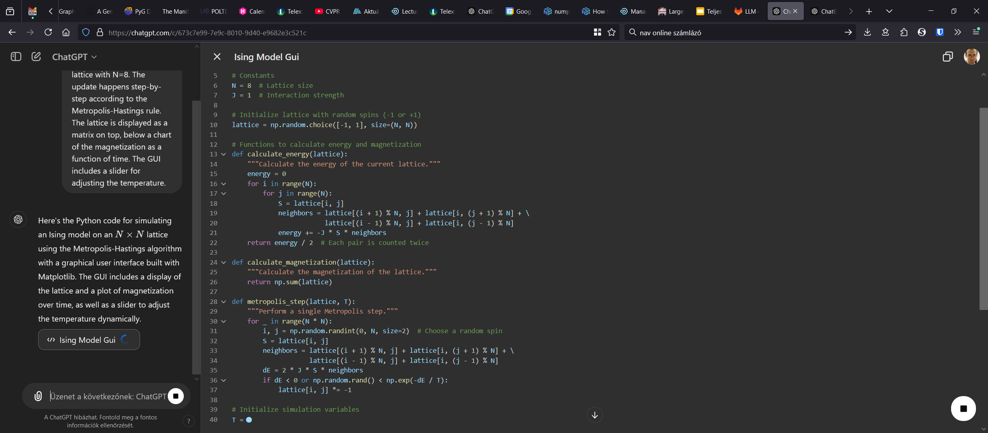
Previously I presented an example task of webpage source modification, step-by-step, now it can be done in a single step

Slide 18
Writing and analyzing code with ChatGPT
Continue the conversation, refine the code if needed:
“Can you use open boundary conditions?”
“Change the color of the line plot to …”
…
(free version has no diff tool, cf. Canvas)
Analyze and debug the code
Find unhandled cases
Find poorly documented parts
Performance and reproducibility issues
Visualization and GUI improvements

Slide 19
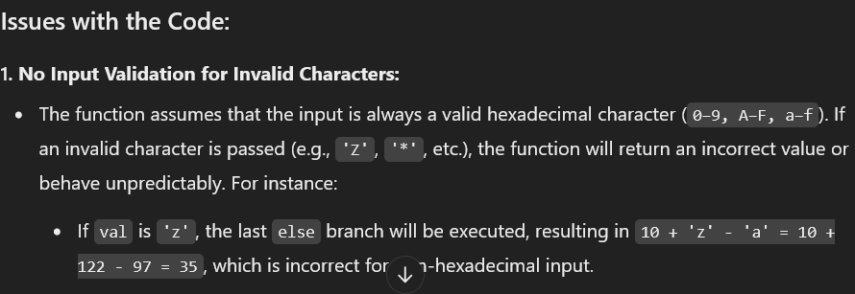
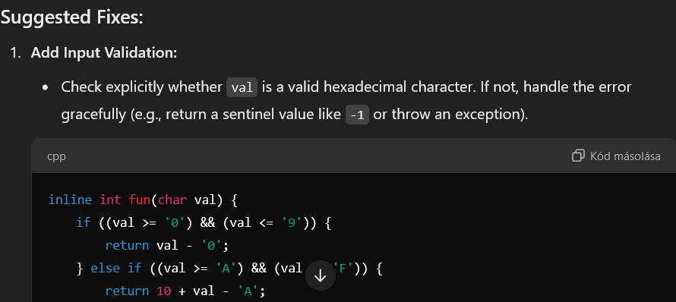
Explaining C code
What does the following code do?
Are there any issues with it?
inline uint8_t hexchar2uint8(char val) {
if ((val >= '0') && (val <= '9'))
{ val = val - '0'; }
else if ((val >= 'A') && (val <= 'F'))
{ val = 10 + val - 'A'; }
else
{ val = 10 + val - 'a'; }
return val;
}
Now ChatGPT-4o automatically analyzes code, provides example uses, potelntial issues (no need to ask for it)

Slide 20
Working with ChatGPT canvas

Slide 21
Example 2.
Data science
No third party allowed
Retrieval augmented generation

Slide 22
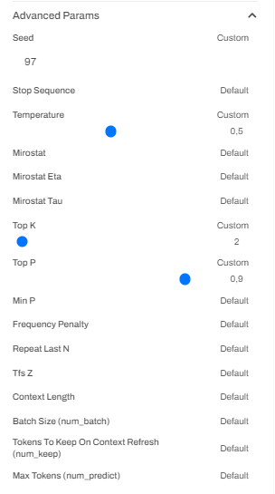
SZTAKI GenAI platform
https://genai.science-cloud.hu/
Modell | Erősségek | Limitációk | Felhasználási esetek
codellama:7b | Kódgenerálásra és kódmegértésre specializált | Általános tudásban korlátozott a nagyobb modellekhez képest | Programozási segítség, hibakeresés (debugging)
gemma:2b | Hatékony kisebb feladatokhoz | Korlátozott képességek bonyolult feladatokban, kevesebb kontextuális megértés | Alapvető szövegfeldolgozás, egyszerű lekérdezések
gemma:7b | Közepes méretű, 2B-nél összetettebb feladatokhoz is alkalmas | Nem olyan erős, mint a nagyobb modellek, nehézségek a nagyon összetett lekérdezéseknél | Általános célú NLP, chatbotok
llama3.1:8b | Kiegyensúlyozott általános NLP feladatokra | Még mindig kevesebb teljesítmény a nagyobb kapacitású modellekhez képest | Sokoldalú, általános szöveggenerálás és megértés
llama3:8b | Hasonló a llama3.1:8b-hez, általános NLP feladatok megoldása | Korlátozottabb a nagyobb teljesítményű modellekhez képest | Sokoldalú, általános szöveggenerálás és megértés

Slide 23
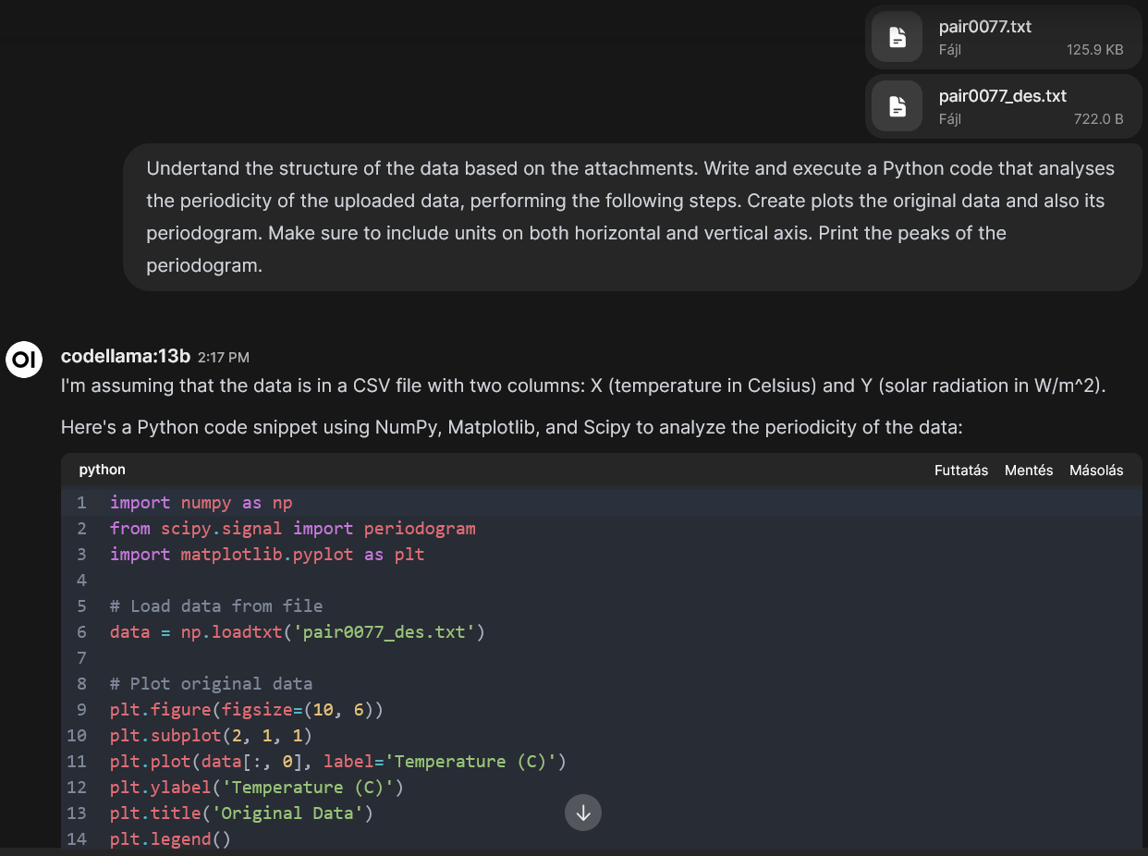
SZTAKI GenAI platform
Open WebUI
Can work with files
Can search the web
Data source
https://webdav.tuebingen.mpg.de/cause-effect/
Questions
Which of the two files it is using?
Why?
Run!

Slide 24
SZTAKI GenAI platform
Advantages
Data does not leave the research network
Can compare multiple language models
Control LLM parameters
Gotchas
Could not make it use the uploaded data when running code, neither make the remote Python download the data.
Data is in pair0077.des
Verify!

Slide 25
SZTAKI GenAI platform
Code ran on my computer

Slide 26
Example 3.
Everyday code development
Yes, you have to write test cases too
Code review requires properly written commit messages

Slide 27
What is Copilot
Copilot
ChatGPT
LLM trained specifically on programming
ChatGPT is Copilot has your repository as context (may replicate errors already made)
Suggestions on the fly, while typing
A plugin in your favorite IDE
We will do a demo.
General-purpose AI, even multimodal
Context is conversation (plus persona, general settings)
Linear (except that now we have canvas)
You have to send prompts
There is a preview of Llama and Gemma LLM-s hosted in the HUN-REN Cloud https://genai.science-cloud.hu

Slide 28
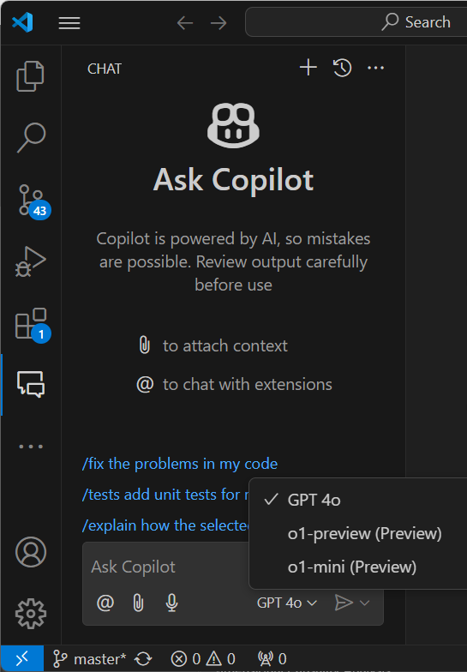
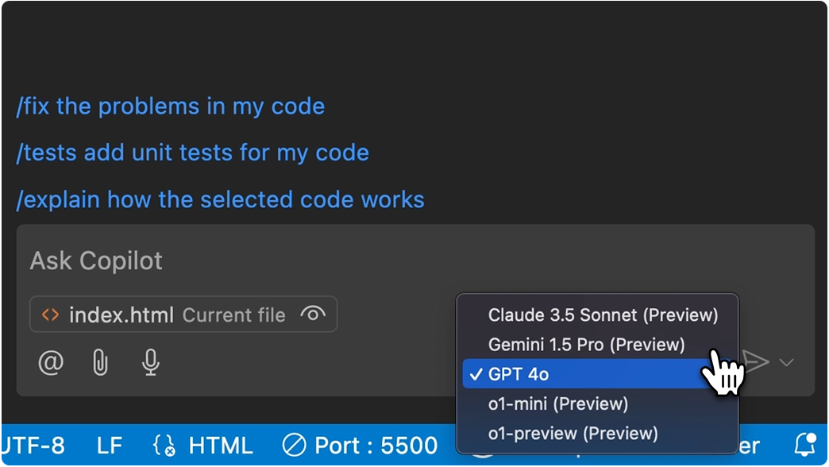
What is Copilot
November 1 announcement:
Claude 3.5 Sonnet proficient with complex and multi-step coding tasks
Gemini 1.5 Pro features a two-million-token context window
My experience

Slide 29
(Very brief) history of computer programming
1940
Machine code
1950s
Assembly language
High level programming languages (Fortran, Lisp, ALGOL, COBOL)
1960s
Integrated Development Enverionments
Fundamental programming paradigms, structured programming
Rapid application development, scripting languages
Newer programming paradigms
Transformer-based large language models
2017
Credit: Ferenc Csikor
Automation, new levels of abstraction
Helping the programmer
Older ways persist too
Notes:
Other approaches to rapid development include the adaptive, agile, spiral, and unified models.
Bash 1988 (shell existed before, sh 1971, Bourne shell 1979).
Newer paradigms include functional, concurrent, distributed, composability ans modularity, visual programming.

Slide 30
GenAI as a pair programming partner
pair programming: two programmers work on the same code together to produce something that is higher-quality than either of them would produce by themselves
the “driver,” who actually writes code
the “navigator,” who checks the driver’s work as it’s done and keeps an eye on the big picture
instead of being twice as slow and expensive, coding this way actually adds just 15% more time to the development process, and in exchange returns 15% fewer bugs and defects
GenAI of today is like a newly-hired mediocre junior programmer who’s read tons of documentation, taken every bootcamp, and checked out every Stack Overflow Q&A page
you take the navigator role, while the AI is the coder; as the knowledgeable one, you should be planning, thinking about design, and reviewing any code produced, while the tool does what it does best: cranks out code fast
it’s the AI’s job to be fast, it’s your job to be good
hint: embrace multiple LLM tools and interfaces, results can completely change from one week to the next

Slide 31
Register
You can opt for a 30-day trial too
If you work at a university or a research institute:
register an account on github.com with the e-mail address wigner.hu, that of your institution or add this address to an existing account
you have to register (join) on education.github.com for a license, log in, if the organization is in the database, it shall be recognized automatically
request an employer's certificate in English from the HR department
you have to fill out the GitHub profile carefully, so you don't get rejected, the educational registration page states what contents is expected
choose to register, by presenting a document, upload the received file in jpg format <2MB (pdf is not good)
wait for approval (1-3 days), in the meantime GitHub Copilot plugin can be installed
Thats’s a good sign

Slide 32
Ask nicely not to use our data
Here it is: (avatar) → Your copilot → Allow GitHub to use my code snippets → unticked
I believe it when I see it.

Slide 33
Choose your IDE
Azure Data Studio
JetBrains IDEs (e.g., PyCharm)
Vim/Neovim
Microsoft Visual Studio
Visual Studio Code ← Cross-platform, we will be using this one during the demo
Xcode
Let’s do the demo. Data is over here bit.ly/3AC4KaE →

Slide 34
More ideas for GitHub Copilot
1. Run terminal commands from GitHub Copilot Chat
2. Write pull request summaries with a single click
3. Generate commit messages in your IDE
4. Get help in the terminal with GitHub Copilot in the CLI
5. Talk to your repositories on GitHub.com
6. Fix code inline with GitHub Copilot suggestions
7. Bulk close 1000+ GitHub Issues
8. Generate documentation for your code
9. Write code in natural language
10. Create amazing content with GitHub Copilot
Source: https://github.blog/developer-skills/programming-languages-and-frameworks/10-unexpected-ways-to-use-github-copilot/

Slide 35
Even more ideas for GitHub Copilot
1. Assisting non-native English speakers
2. Creating dictionaries with lookup data
3. Testing your code
4. Matching patterns with regular expressions
5. Preparing for technical interviews
6. Sending tweets
7. Exiting Vim
8. Navigating a new codebase with Copilot Labs
Source:
https://github.blog/developer-skills/github/8-things-you-didnt-know-you-could-do-with-github-copilot/

Slide 36
Conclusions
ChatGPT and GitHub Copilot support multiple programming languages
They can generate and analyze code, it is your responsibility to provide context
Output code is well structured, commented
Vast knowledge of existing software libraries
Capable of analyzing new code and predicting its output (paid version can run code)
Same input prompt may result in different responses
Or sometimes it can get stuck in the same wrong solution
You have to verify and validate output yourself

Slide 37
Announcements
Some AI-related sessions at MTA Magyar Tudomány Ünnepe
November 28, 2024: HUN-REN Cloud Meetup (allow GenAI service for all researchers)
December 6, 2024: Szabó Gergő (BME, HUN-REN AI4Science support team)
Visit the homepage of the AI Ambassadors: https://ai.wigner.hu
Find the following connections in the top row
Visit the Wiki for learning materials and these slides https://gitlab.wigner.hu/ai/best-practices
Subscribe to our calendar https://ai.wigner.hu/events/index.ics

Slide 39
Additional Example 1.
Code understanding and debugging

Slide 40
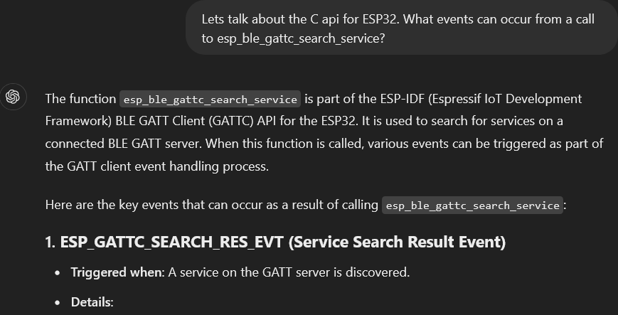
Code understanding
Situation: I have to use an API that is widespread but poorly documented.
Input:

Slide 41
Hallucinations may occur

Slide 42
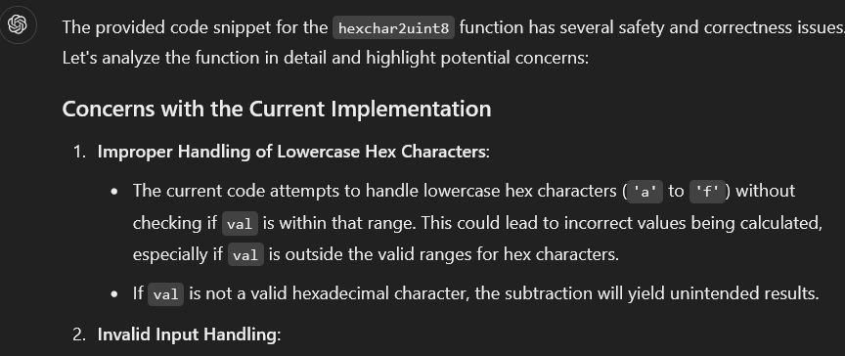
Debugging
I am concerned with the safety of the code. Any thoughts?
Notes:
Further examples https://www.codecademy.com/article/using-chatgpt-to-debug-python-code and https://dev.to/techiesdiary/chatgpt-prompts-for-code-review-and-debugging-48j

Slide 43
Additional Example 2.
Working and refining step-by-step
Editing web page source programmatically
Using examples for defining output

Slide 44
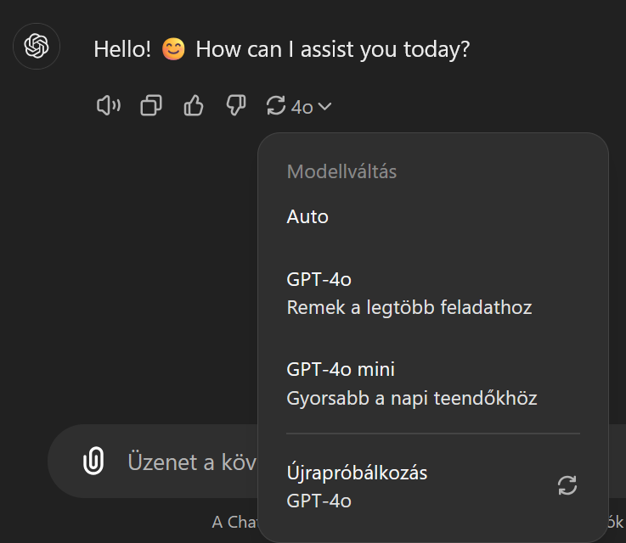
Coding task specification
Task:
Replace remote resources in a webpage source (this is not a Physics question because we want to focus on abstraction)
Let’s work step by step and show possible mistakes. (Generated with version 3.5)
Input:
I need a linux bash script that extracts the source URL and the name of javascript that is loaded from remote server in a html file, e.g., for the line "<script src="//cdnjs.cloudflare.com/ajax/libs/jquery-cookie/1.4.1/jquery.cookie.min.js"></script>" it should output //cdnjs.cloudflare.com/ajax/libs/jquery-cookie/1.4.1/jquery.cookie.min.js and jquery.cookie.min.js

Slide 45
First attempt
The model took „and” literally
Code output
Working and usage explained. Note: free version does not use internet nor does it execute code.

Slide 46
Add details to specification
ChatGPT retains context within the same conversation. We continue the dialogue.
Input:
Thanks, great. Let's refine that because links may come with a checksum, then I need to extract that too: <script //maxcdn.bootstrapcdn.com/bootstrap/3.3.7/js/bootstrap.min.js" integrity="sha384-Tc5IQib027qvyjSMfHjOMaLkfuWVxZxUPnCJA7l2mCWNIpG9mGCD8wGNIcPD7Txa" crossorigin="anonymous"></script>
Let's downloads the JavaScript files to a local static/js directory, and check their integrity.

Slide 47
Second attempt
Downloads, tries to check.
Actually fails because:
sha<NNN>sum has binary output, instead of base64
sha384sum is not on all systems
Asked to correct for that base64, installed a package with sha384 sum
When trying to reproduce those output:

Slide 48
More experiences
grep –P was not on the target system
sed could be used but ChatGPT got the regex string escaping wrong
I copy-pasted my modified code, it still continued to edit its latest version
Each time we got a new version of our code
ask ChatGPT to describe the changes
use canvas function (paid plan) to work on part of the output
Splitting a task into steps is usually a good idea
result was a quite complicated code
Models evolve, with GPT 4o, this prompt did it in one step:
I need a bash script that processes a html file and outputs the modified source. The script extracts the source url and the name of javascripts loaded from remote servers, e.g., for the line "<script src="//cdnjs.cloudflare.com/ajax/libs/jquery-cookie/1.4.1/jquery.cookie.min.js"></script>" it should download //cdnjs.cloudflare.com/ajax/libs/jquery-cookie/1.4.1/jquery.cookie.min.js into the js/ folder and replace the original src value with js/jquery.cookie.min.js The <script> tags may include attributes like integrity (checksum) and crossorigin, in that case we shall check the hash of the downloaded file. Our script should use a return code.

