Slide 1
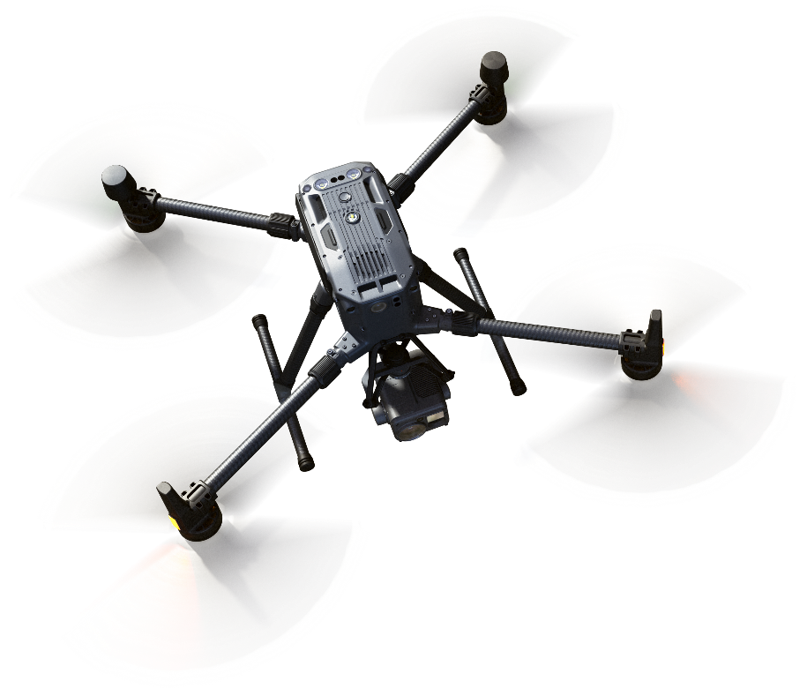
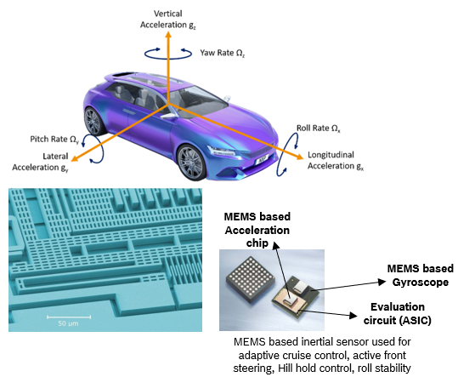
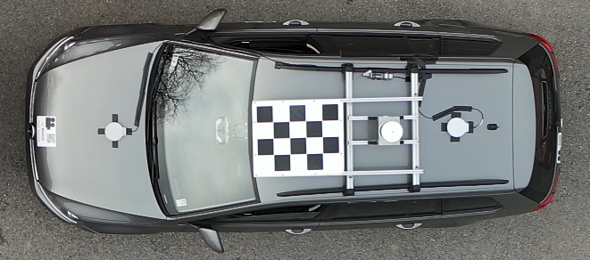
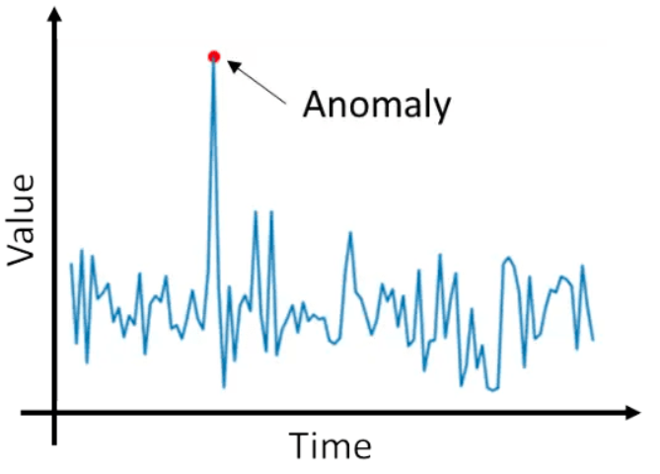
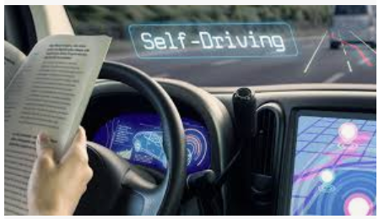
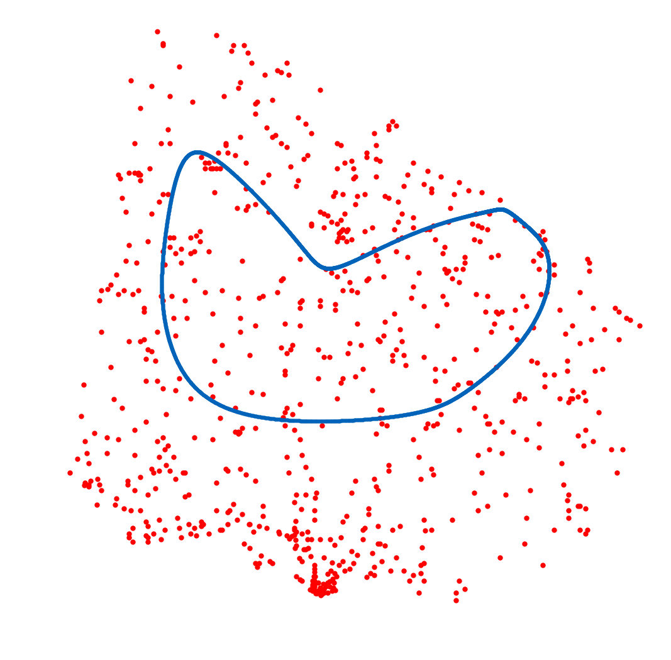
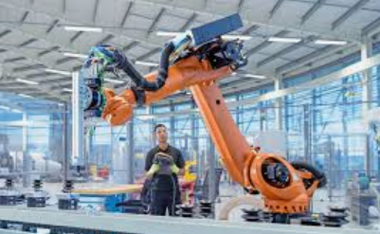
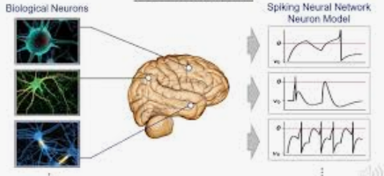
Projects at the Bosch-ELTE Cooperation
Hunor István Lukács (lukacs.hunor@inf.elte.hu)
Dronetruth
Generative AI
Machine Vision
AI for MEMS sensors
Interior sensing
Anomaly detection
Autonomous driving
AI & Robotics
Spiking Neural Network (SNN)
Process Flow Optimization

Slide 2
Attention U-Net-based semantic segmentation for welding line detection
Hunor István Lukács (lukacs.hunor@inf.elte.hu)
Bence Beregi (beregi.bence@hotmail.com)
Tamás Fischl (tamas.fischl@hu.bosch.com)
Balázs Porteleki (balazs.porteleki@bosch.com)
János Botzheim (botzheim@inf.elte.hu)

Slide 3
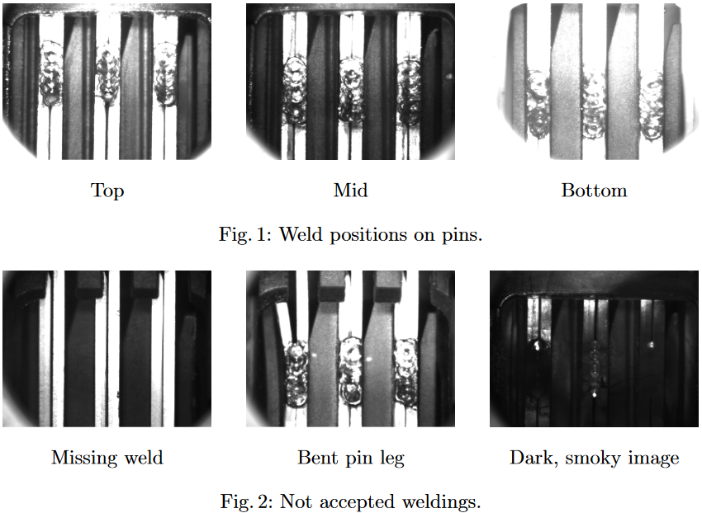
Dataset
Data preparation
Manual check for all images → ~3600 each day
The manual inspection is time-consuming, but it is essential to ensure the quality
More than 1500 labeled images available for training
Four classes for segmentation based on the weld position: Bottom, Middle, Top, Missing
Based on the light condition we can distinguish bright and dark images
However, the pin positions are fixed and the pin legs appear almost at the same position on each image.
Our dataset contains images of welds from the SCU. Based on several criteria an image is accepted or declined.

Slide 4
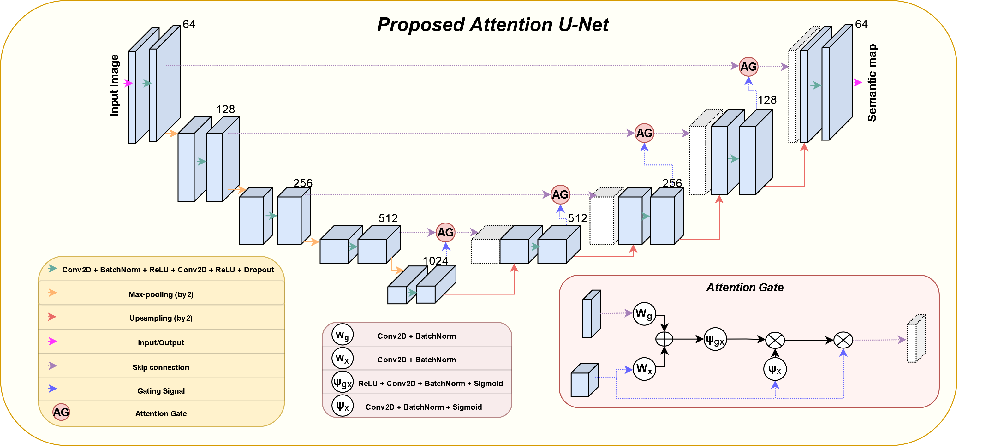
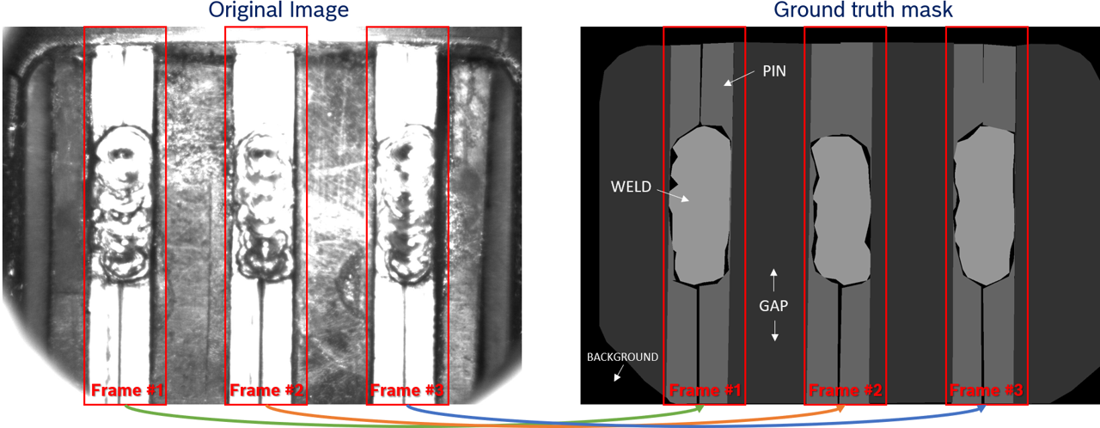
Semantic segmentation
U-Net
Using the state-of-the-art UNet model on the pin frames, the validation accuracy reaches over 95%.
Using a UNet architecture with an added Attention layer (paying more attention to the weld areas)
Generalized Dice- and Cross-entropy loss (prioritizing the weld pixels)
The model is trained on the pin frames separately
Architecture
Pin separation
Attention U-Net architecture with weighted loss

Slide 5
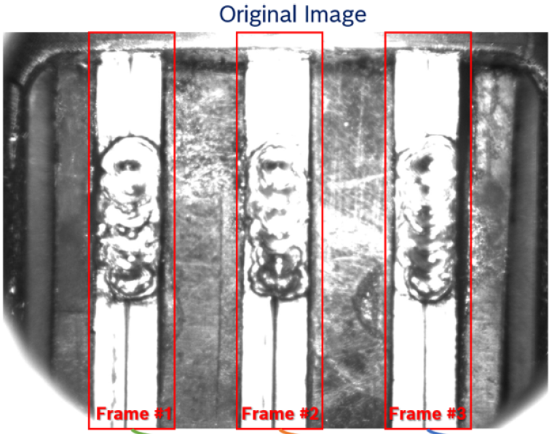
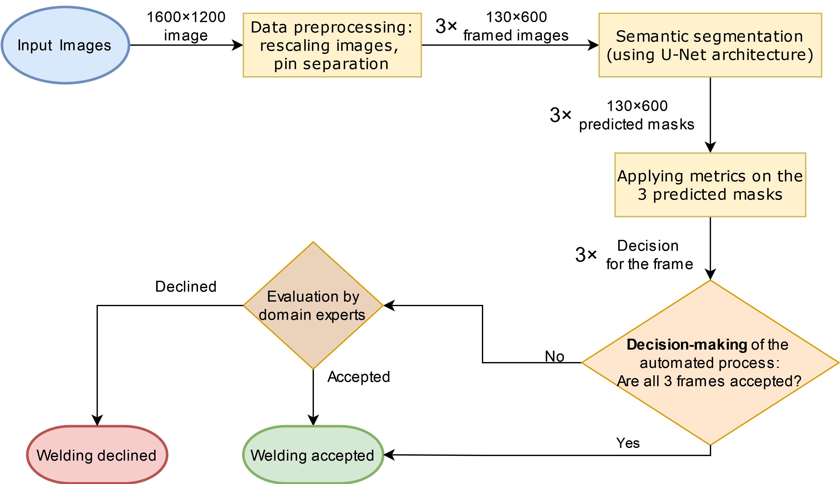
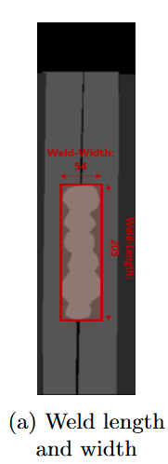
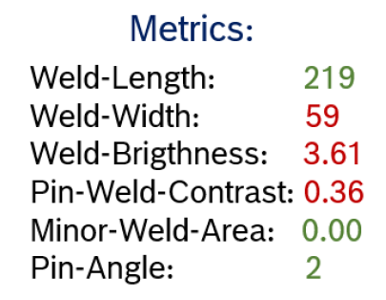
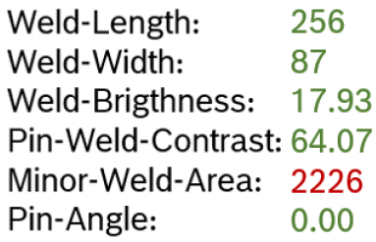
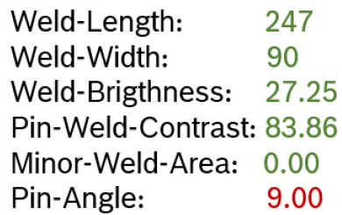
Workflow
U-Net
Workflow created for the production process

Slide 6
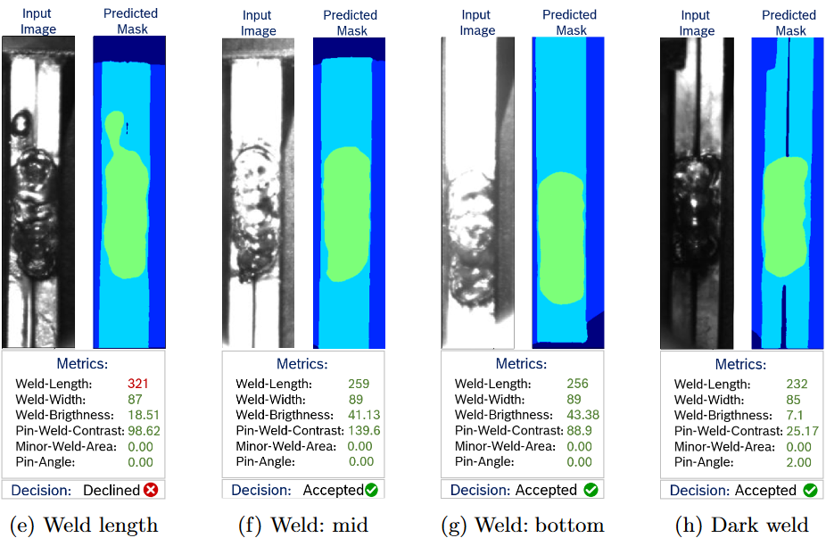
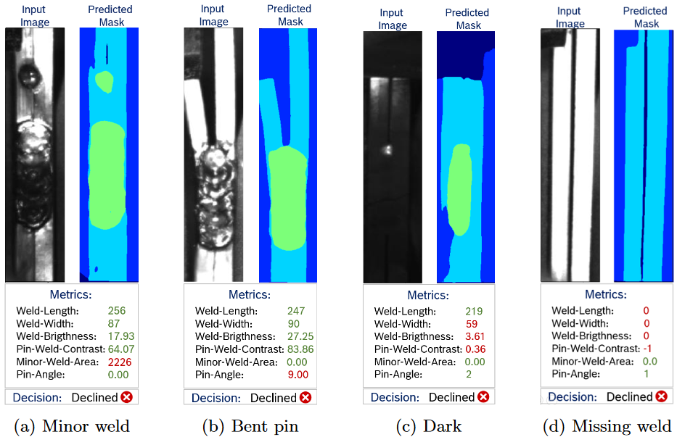
Results
Model evaluates each pin individually based on metrics with its targets

Slide 7
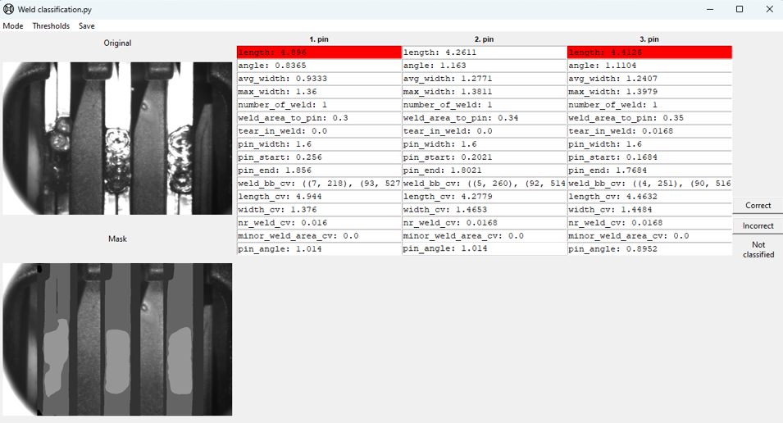
GUI
How the process experts are using this technology?
process experts can easily inspect the predicted masks of the pins along with the calculated metrics
If thresholds are applied, the outliers are highlighted
GUI:Snapshot
GUI for user-friendly interaction

Slide 8
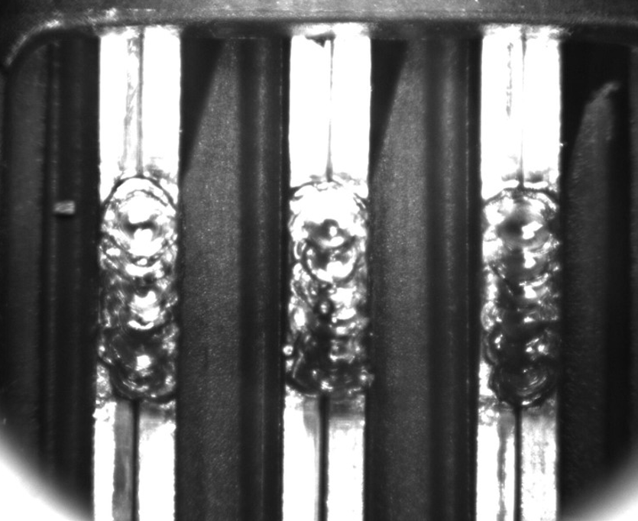
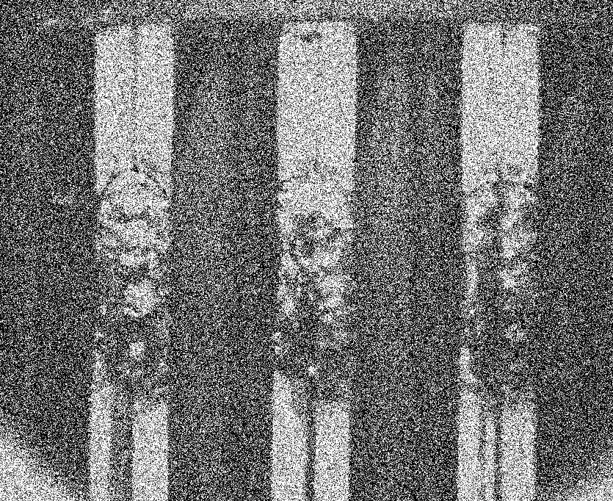
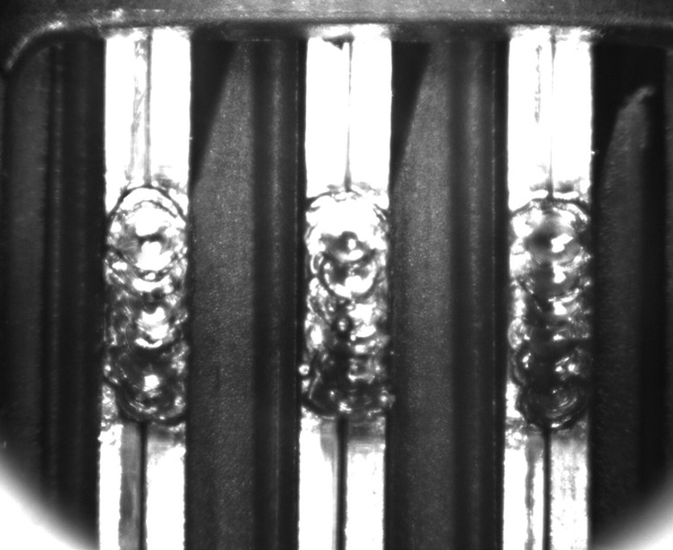
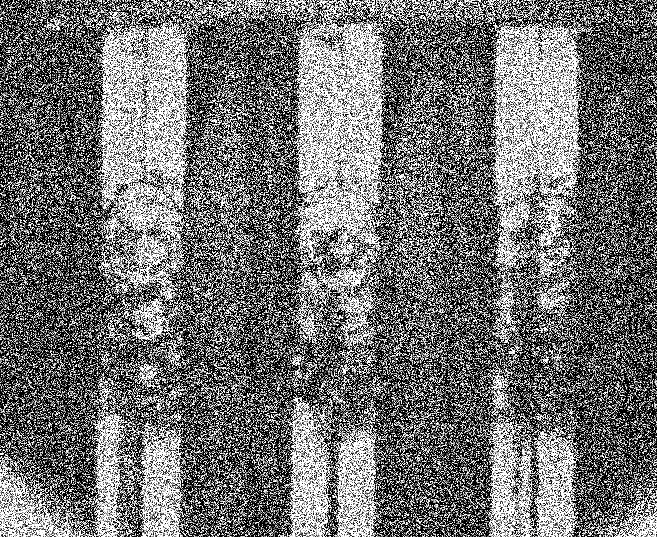
Future work
Diffusion model-based
Anomaly detection
Forward process
Using for anomaly detection
Investigates the data between the three pin-frames also
Steps:
Forward process: gradually adds noise to the image over several steps, transforming it into random noise
Reverse process: The model is trained to reverse this noise process, learning how to reconstruct the original data step-by-step, by subtracting the predicted noise.
Reverse process
Diffusion model-based anomaly detection as future work

Slide 9
Anomaly detection in serial production and product development
Hunor István Lukács (lukacs.hunor@inf.elte.hu)
Tamás Fischl (tamas.fischl@hu.bosch.com)
János Botzheim (botzheim@inf.elte.hu)

Slide 10
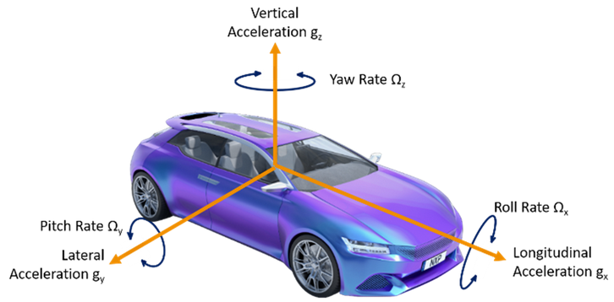
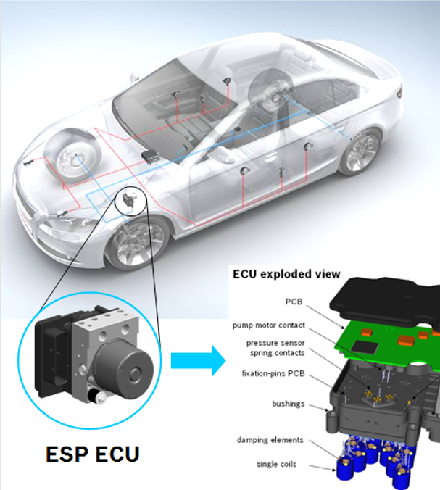
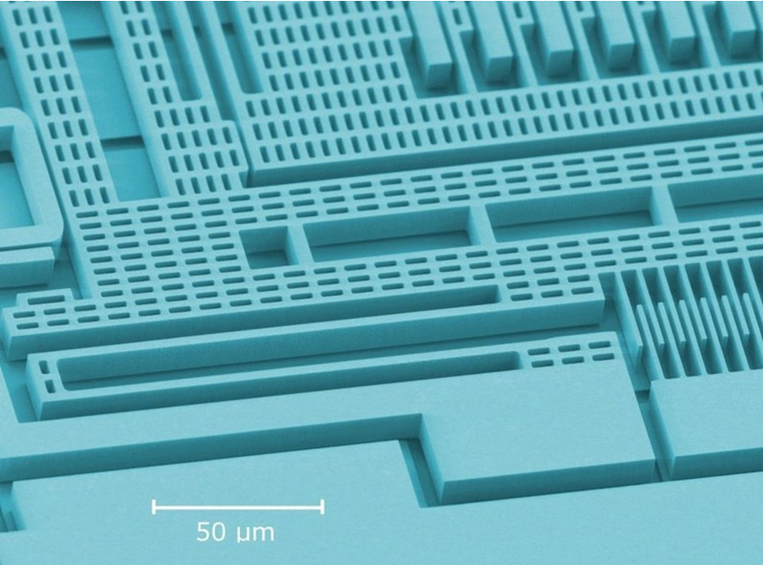
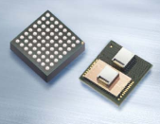
Introduction to Inertial MEMS Sensors
MEMS based Acceleration chip
MEMS based
Gyroscope
Accident, vehicle without ESP
Evaluation circuit (ASIC)
MEMS based inertial sensor used for adaptive cruise control, active front steering, Hill hold control, roll stability
ESPi: Electronic Stability Program in vehicles with MEMS based inertial sensors
Micro-electromechanical Systems (MEMS) based inertial sensor usage in vehicles

Slide 11
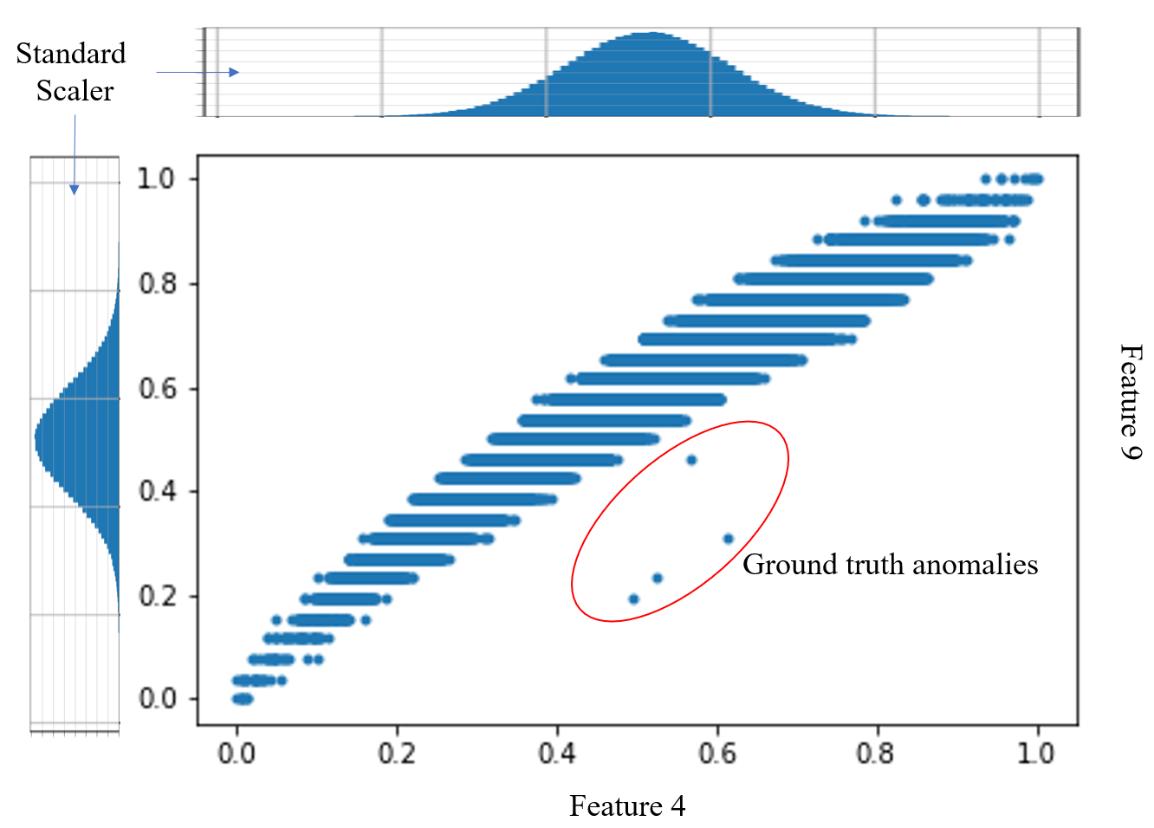
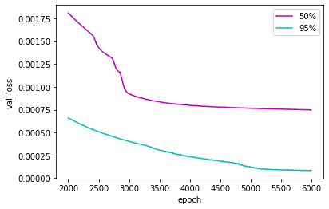
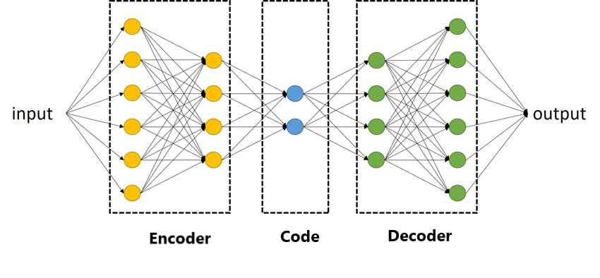
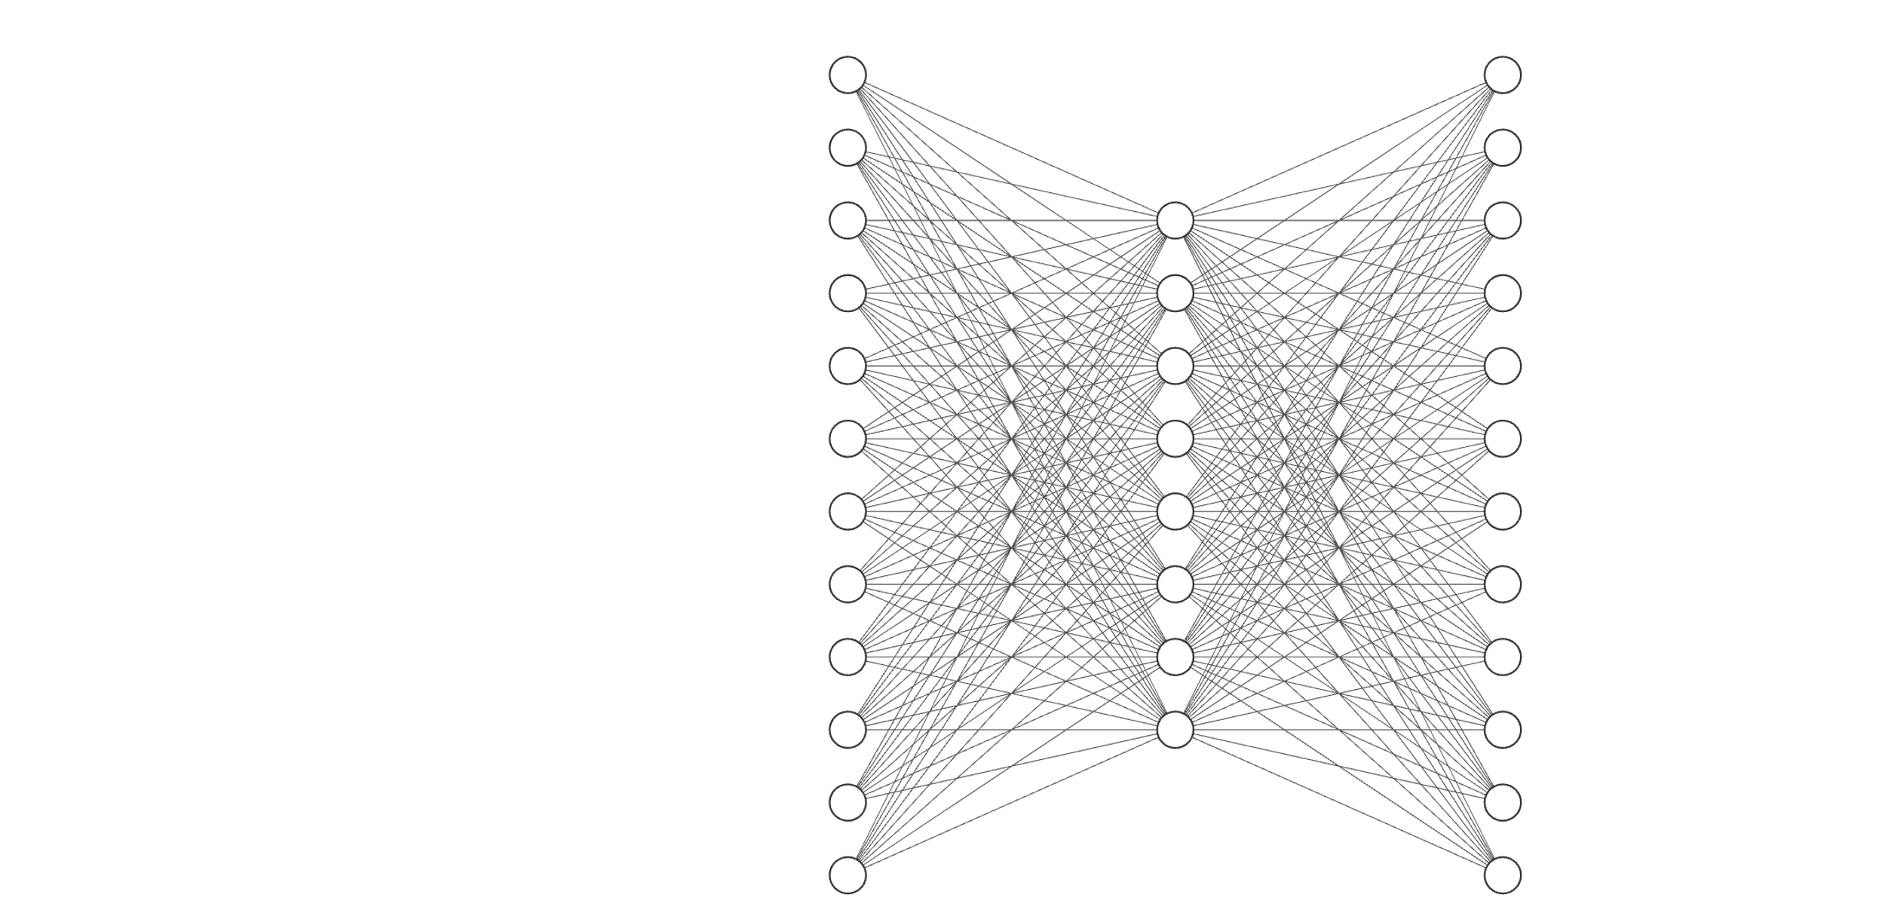
Anomalies, Autoencoders, Benchmark model
Fig. 1
Fig. 2
Ground truth anomalies
Training processes
Trying manually set architectures:
The task is to find an autoencoder architecture,
that detects the ground truth anomalies
and to investigate other arising real anomalies.
Autoencoder
Corresponding Architectures
(Layers)
Architectures: IN Hidden OUT
“Model 50%”: 61 30 61
“Benchmark”: 61 57 61
These 4 ground truth anomalies were discovered by domain experts.
The Standard Scaler method is not capable of recognizing
these anomalies.
The autoencoders perform a dimension reduction
(typically) in order to learn an efficient representation.
Experiments: the used architecture and the training process
Benchmark model
ℝ⁵⁷
ℝ⁶¹
Code
ℝ⁶¹
Input Layer
Output Layer

Slide 12
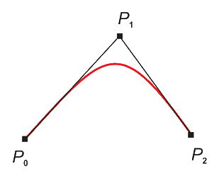
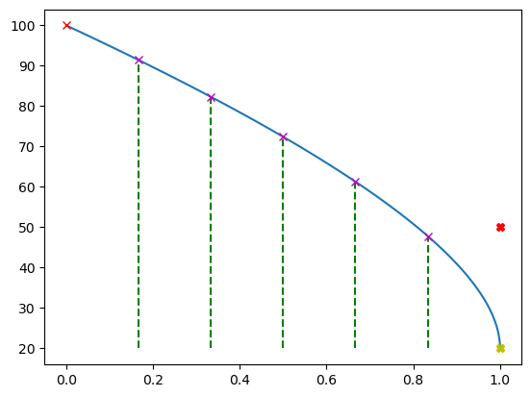
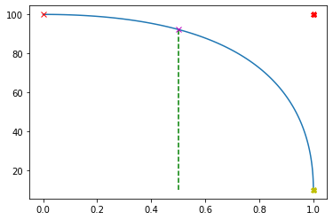
Architecture optimization
Architecture representation based on Bézier curves:
The architecture representation of a symmetric autoencoder
based on Bézier curves provides a model with reduced number of parameters.
Quadratic Bézier curves:
Degree of freedom is 4:
Bottleneck/Code size (y coordinate of control point P2)
Number of layers
Coordinate x of control point P1
Coordinate y of control point P1
Constraints :
P₀ fixed at [0, inp_{dim}]
The x coord. of P₂ is fixed at 1
The x coord. of P₁ ∈ [0, 1]
The y coord. of P₁ ∈ [code_size, inp_{dim}]
Examples:
Example #1
Example #2
The y coordinate (rounded value) of the
intersection points will give the
neuron number in the given layer
P0 = [0,100]
P0 = [0,100]
92
91
P1 = [1,100]
82
Neurons per layer
Neurons per layer
72
61
P1 = [1, 50]
A quadratic Bézier curve is the path traced by the
function B(t), given points P0, P1, and P2 (control points):
48
P2 = [1, 20]
P2 = [1,10]
Derived
Architecture
Number of layers = 1
We divide the x axis into
{number of layers} equal parts
Number of layers = 5
Derived architecture
Encoder’s fc layers: [100->91], [91->82], [82->72], [72->61], [61->48], [48->20]
Code size: 20
Decoder’s fc layers: [20->48], [48->61], [61->72], [72->82], [82->91], [91-> 100]
Encoder’s fc layers: [100->92], [92->10]
Code size: 10
Decoder’s fc layers: [10->92], [92>100]
The Benchmark model’s architecture was set manually. The proposed method automatizes this architecture search problem.

Slide 13
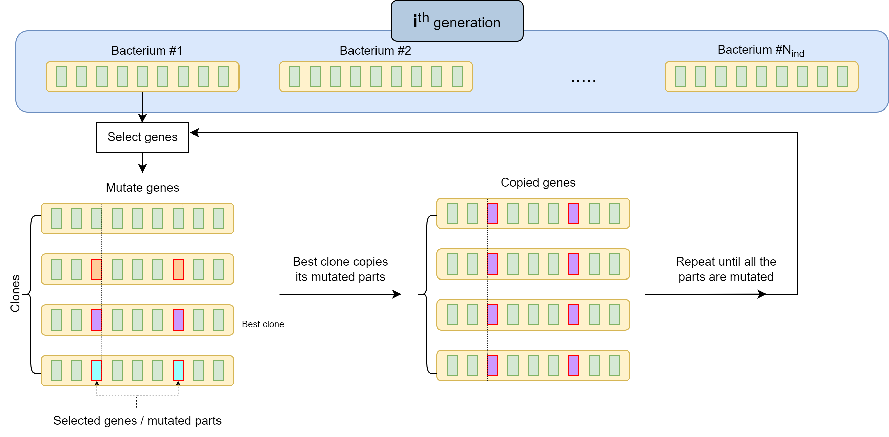
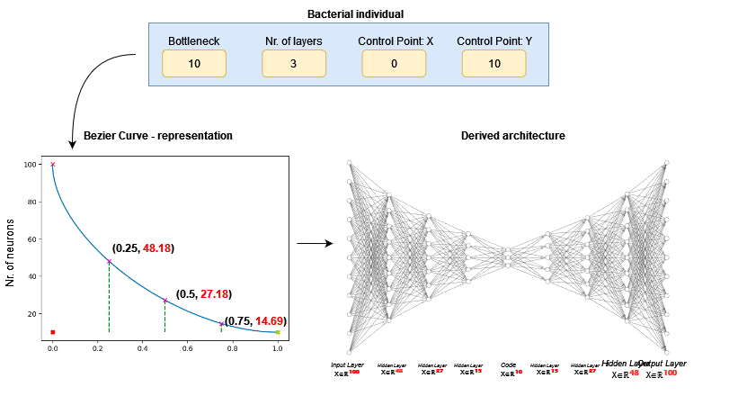
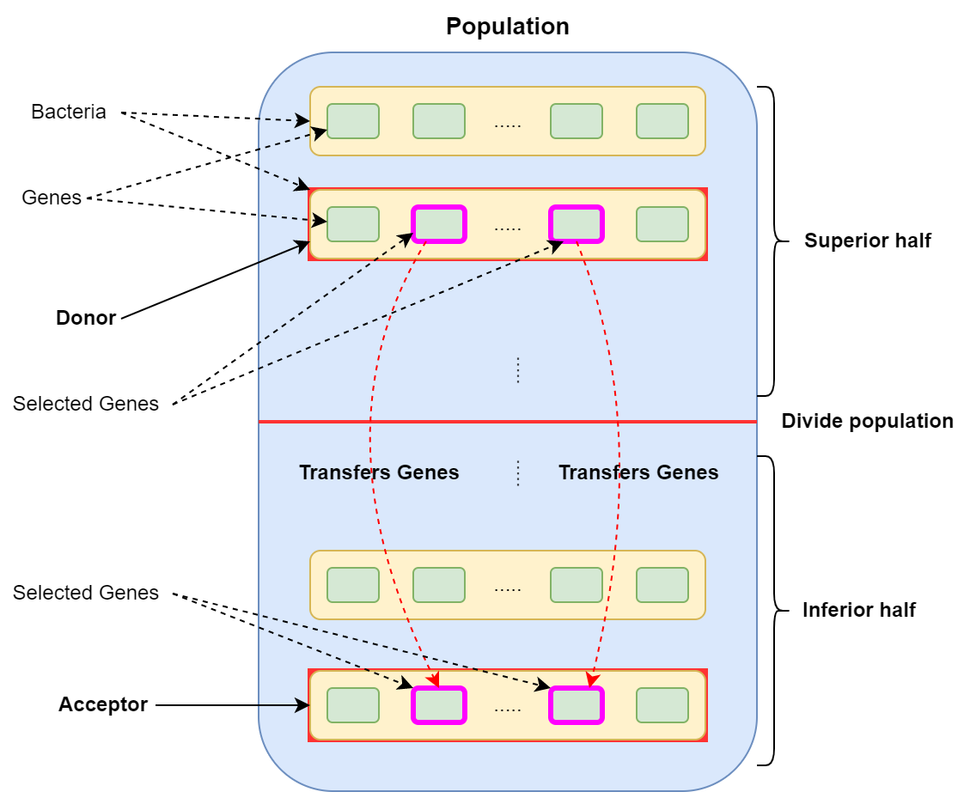
Optimization with Bacterial Evolutionary Algorithm (BEA)
Individum encoding, abstract representation
Bacterial
mutation
BEA
operators
Gene
transfer
Architecture Search with BEA; BEA operators: bacterial mutation and gene transfer

Slide 14
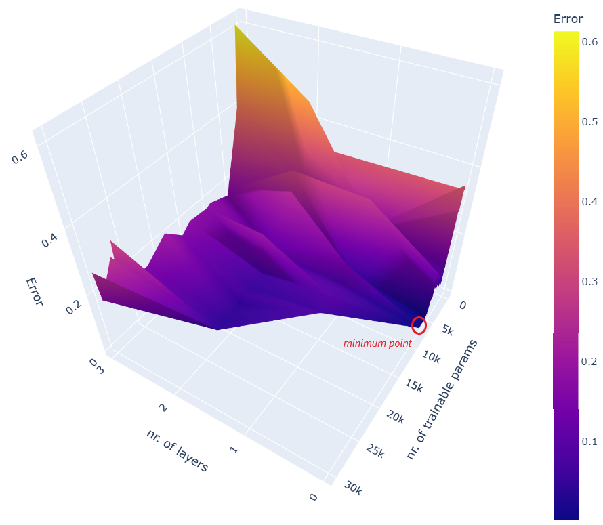
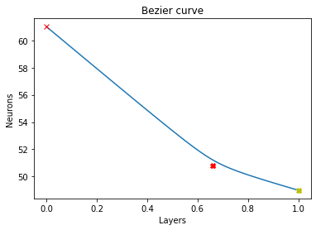
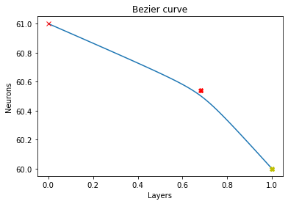
Results
λ = 10⁻¹
λ = 10⁻⁴
Error
meshgrid
The error meshgrid, presenting
the error values of all the
tried architectures in the
evolutionary algorithm
Genes: [49 0 0.66 50.834]
Solution
The solution is the lowest
point in the error meshgrid
Genes: [60 0 0.681 60.641]
Encoder’s fc layers: [61 -> 49]
Code size: 49
Decoder’s fc layers: [49 -> 61]
Corresponding
architecture
Encoder’s fc layers: [61 -> 60]
Code size: 60
Decoder’s fc layers: [60 -> 61]
Architecture search: results

Slide 15
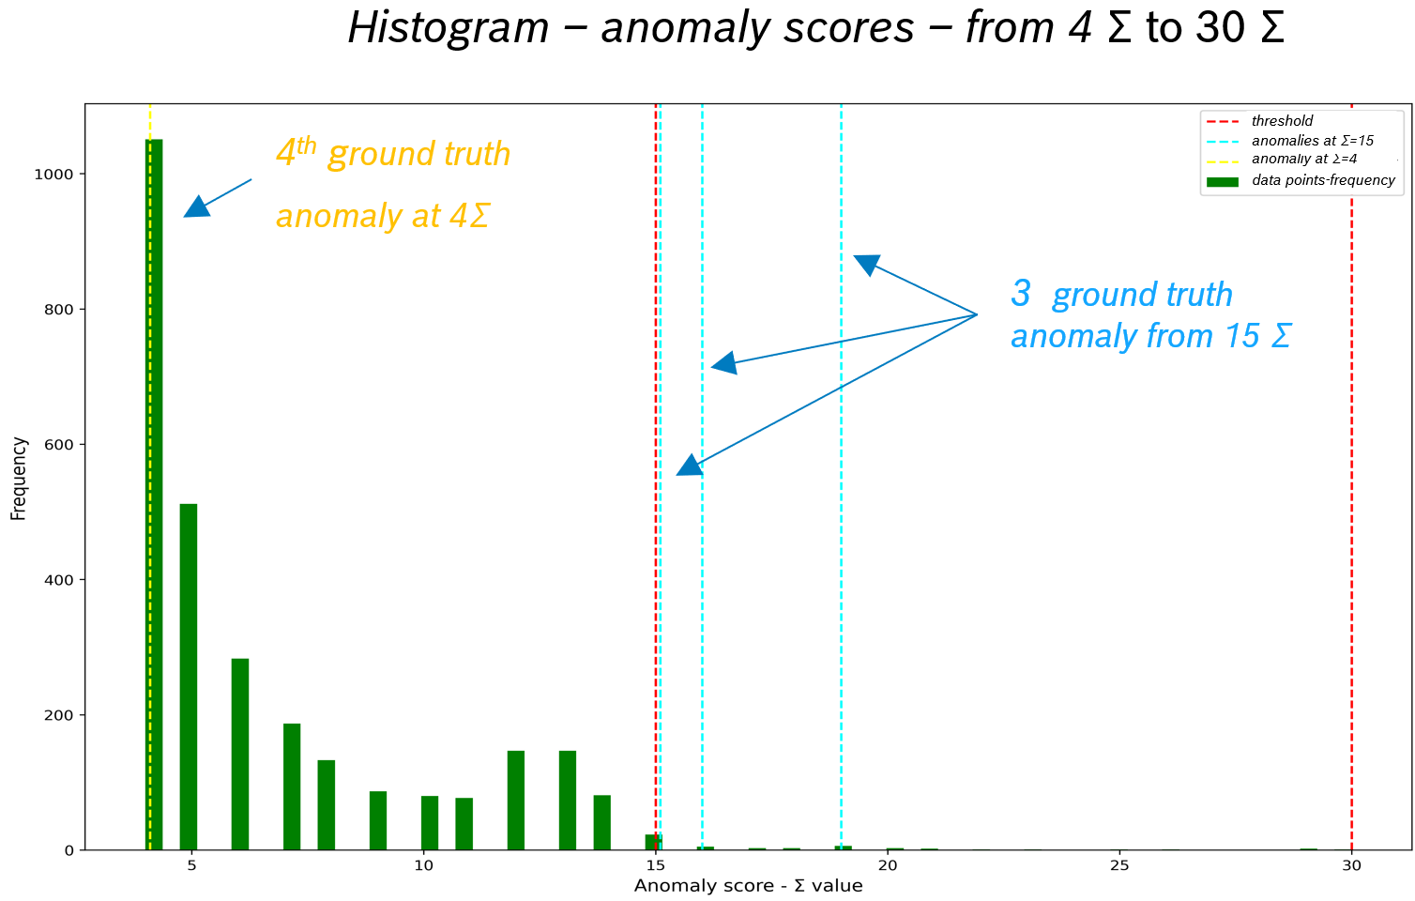
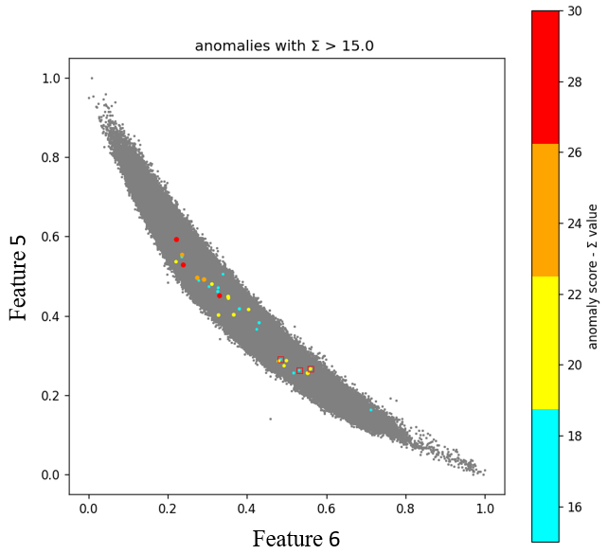
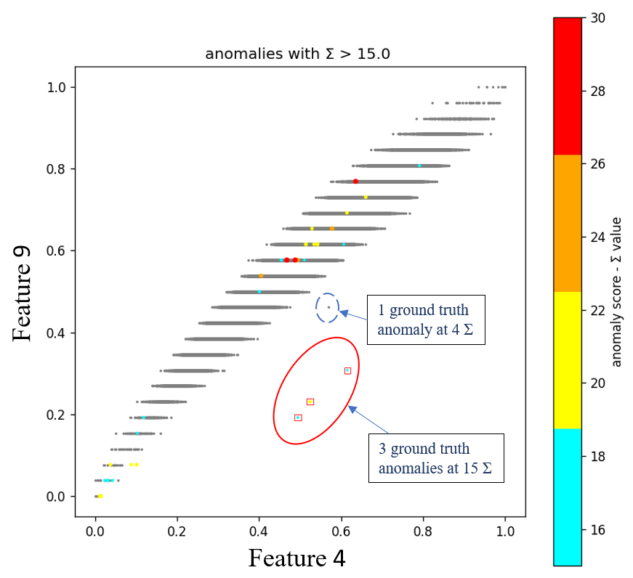
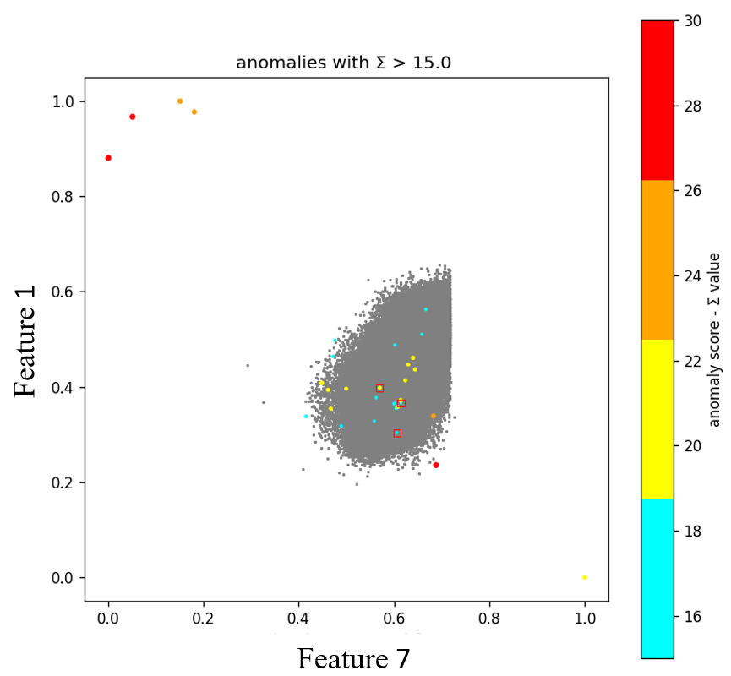
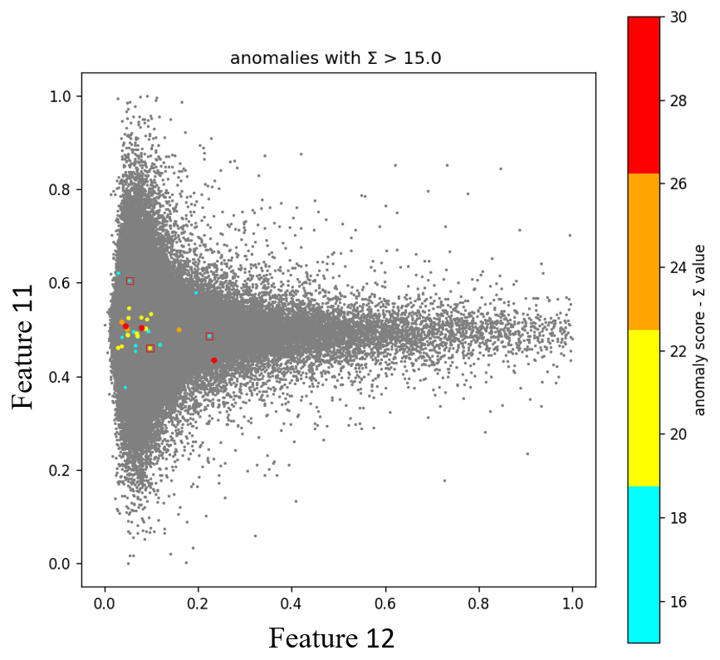
Results, found anomalies
Fig. 1
Fig. 5
Fig. 2
Fig. 3
Fig. 4
datapoints with high dispersion
datapoints with high anomaly score
Results of the Benchmark model. Discovered anomalies at different Σ

Slide 16
Fuzzy Rule-Based Anomaly Explanation in Micro-Electromechanical Systems
Hunor István Lukács (lukacs.hunor@inf.elte.hu)
Tamás Fischl (tamas.fischl@hu.bosch.com)
János Botzheim (botzheim@inf.elte.hu)

Slide 17
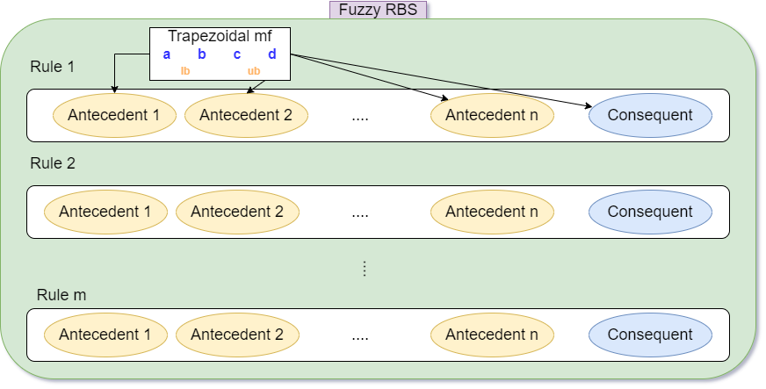
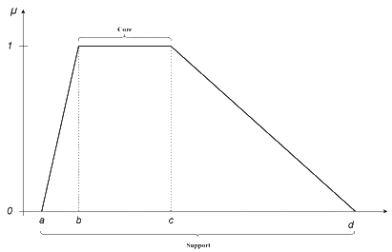
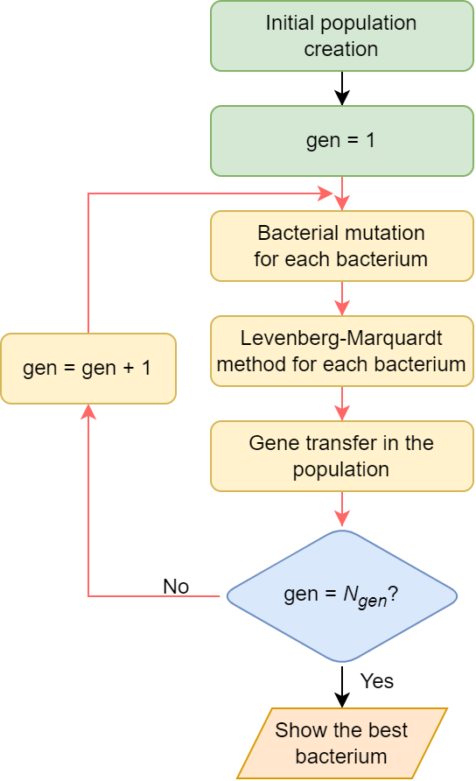
Fuzzy rule-based system (FRBS)
The FRBS model consists of a rule base
where R_{i} are the fuzzy rules
trapezoidal
membership function:
Each Antecedent
and Consequent
is a trapeze
Linguistic interpretation
of Fuzzy rules. E.g.:
Bacterial representation of an FRBS
We are going to use this representation
In the Bacterial Memetic Algorithm.
FRBS is optimized with the
Bacterial Memetic Algorithm:
Bacterial representation:
FRBS: model’s bacterial representation and optimization with bacterial memetic algorithm

Slide 18
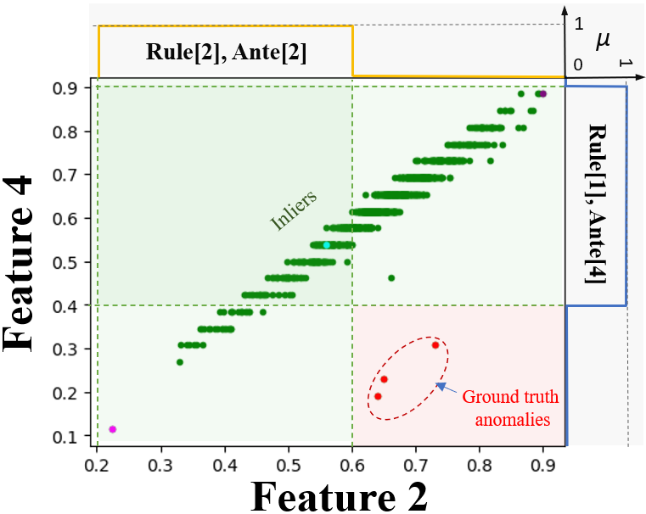
FRBS: initialization based on expert knowledge
Expert knowledge
describing gt_anomalies
The same fuzzy expression
rephrased for inliers
The initialized FRBS model
visualized
Initialization of the FRBS model based on the fuzzified expert knowledge

Slide 19
FRBS applied on MEMS dataset
Found anomalies; Fuzzy explainability

Slide 20
References
Lukács, H.I., Fischl, T., Botzheim, J. (2023). Bacterial Evolutionary Algorithm Based Autoencoder Architecture Search for Anomaly Detection. In: Nguyen, N.T., et al. Advances in Computational Collective Intelligence. ICCCI 2023. Communications in Computer and Information Science, vol 1864. Springer, Cham. https://doi.org/10.1007/978-3-031-41774-0_44
Lukács, H.I., Fischl, T., Botzheim, J. (2024). Fuzzy Rule-Based Anomaly Explanation in Micro-electromechanical Systems. In: Advances in Computational Collective Intelligence. ICCCI 2024. DOI: https://doi.org/10.1007/978-3-031-70259-4_3

Slide 21
Thank you for your attention!
Hunor István Lukács (lukacs.hunor@inf.elte.hu)
PhD student at ELTE Dept. of Artificial Intelligence | Data Scientist at Robert Bosch Kft.

