Slide 1




Artificial Intelligence National Laboratory Hungary
Gábor Érdi-Krausz
Supported by the European Union project RRF-2.3.1-21-2022-00004 within the framework of the Artificial Intelligence National Laboratory Program

Slide 2
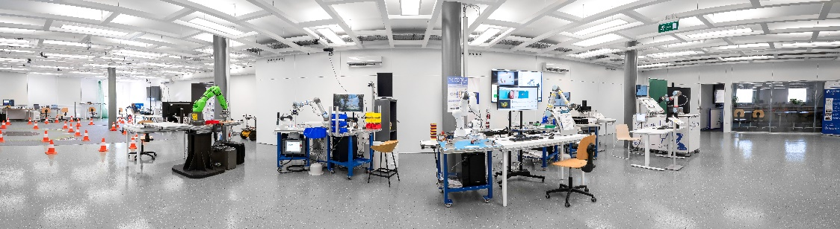
HUNgarian REsearch Network SZTAKI in a nutshell
Some facts from our history
  Established in 1964
  EU Center of Excellence in IT, Computer Science and Control, 2001 and in Production Informatics and Control (EPIC), 2017
  Common technology transfer company with Fraunhofer: EPIC InnoLabs Ltd, 2018
  Artificial Intelligence and Autonomous Systems National Laboratories, 2020
  Staff ~ 300; ~ 90 with scientific degree
Basic research
  Computer science and AI
  Systems and control theory
  Machine perception, human-computer interaction
  Applied research and innovation
  Vehicle and transportation systems
  Smart factories, logistics
  Energy and sustainable development
  Security and surveillance
  Networked systems and services, cloud, HPC

Slide 3


HUNgarian REsearch Network AI4Science Initiative
DOMAIN RESEARCHER
AI/ML expert
AI idea validation form
AI research plan
form
Joint research intent form
HUN-REN AI4Science Program
Application with research idea for validation or planning
AI/ML research competency and capacity proposition
AI / ML technical support for research
Joint research based on mutual interest
Joint research and publications

Slide 4
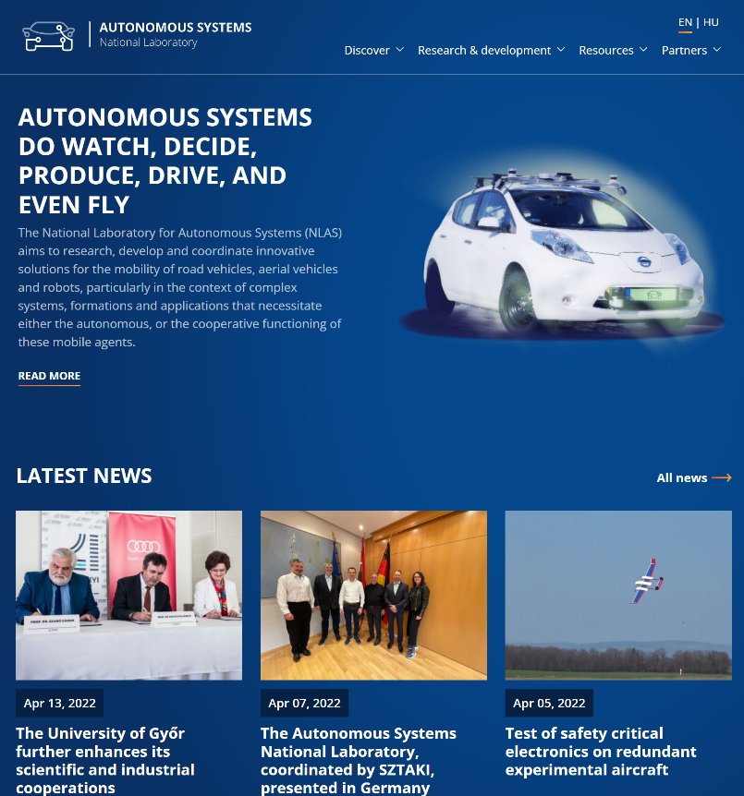
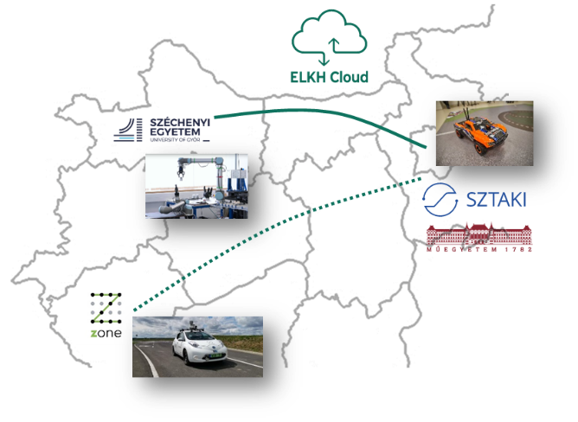
Autonomous Systems
National Laboratory
Component and functional design of vehicles
Cyber-physical manufacturing and logistics systems
Infrastructure development related to ZalaZone
Operation of autonomous systems
Testing and validation in industrial environment

Slide 5
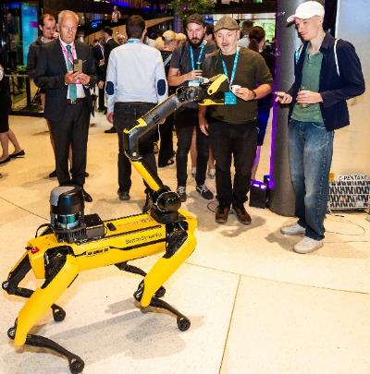
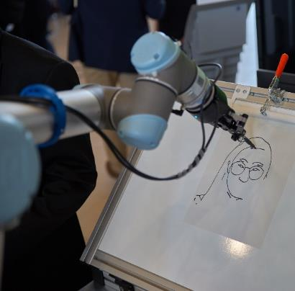










The Artificial Intelligence National Laboratory Hungary (MILAB)
5 Universities, 4 Research Centers
Special Service for National Security, Hungarian State Treasury
External partners: Hungary sites of Audi, Bosch, Continental, Ericsson, Nokia, …
Members in advisory boards
  Roland Jakab, HUN-REN CEO, president, AI Coalition Hungary, former regional director, Ericsson
  András Kemler, István Szászi, directors of engineering, Bosch

Slide 6

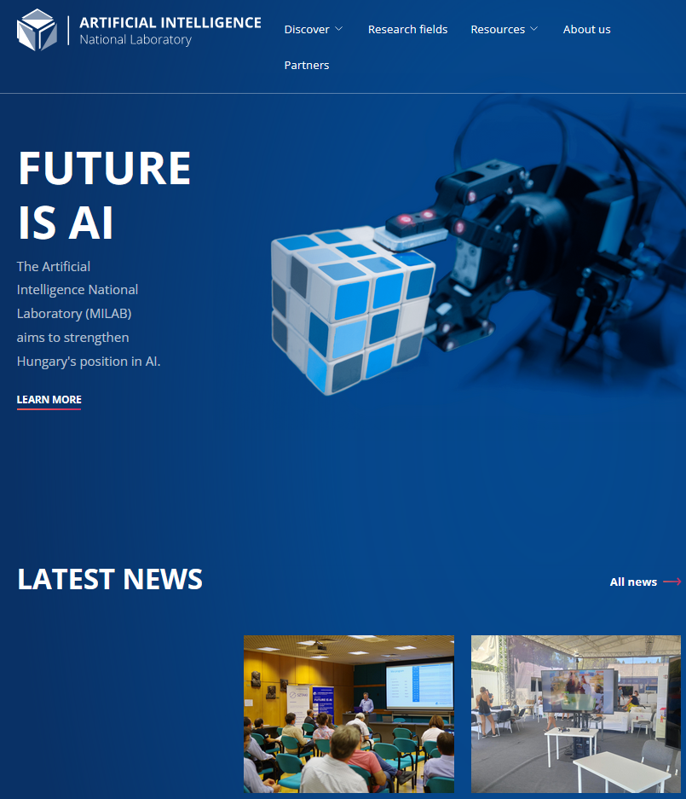
5-year project with planned total budget ~35MEUR (2020 July – 2025 June)
AI National Lab 2020-24
Industry contract value | EUR 5 M
International projects submitted (n) | 116
International projects funded (n) | 42
International project HU funding (M EUR) | EUR 10 M
HU top10% researchers | 68
PhD students | 134
Top tier publications | 160
Main goals
High impact basic and applied research (publications, patents, industry relations, tech transfer)
Networking, unified external relations, international projects, Horizon Europe
Resource multiplication; high risk and high societal value research
Coordination for market and application needs, demonstrations, conferences

Slide 7
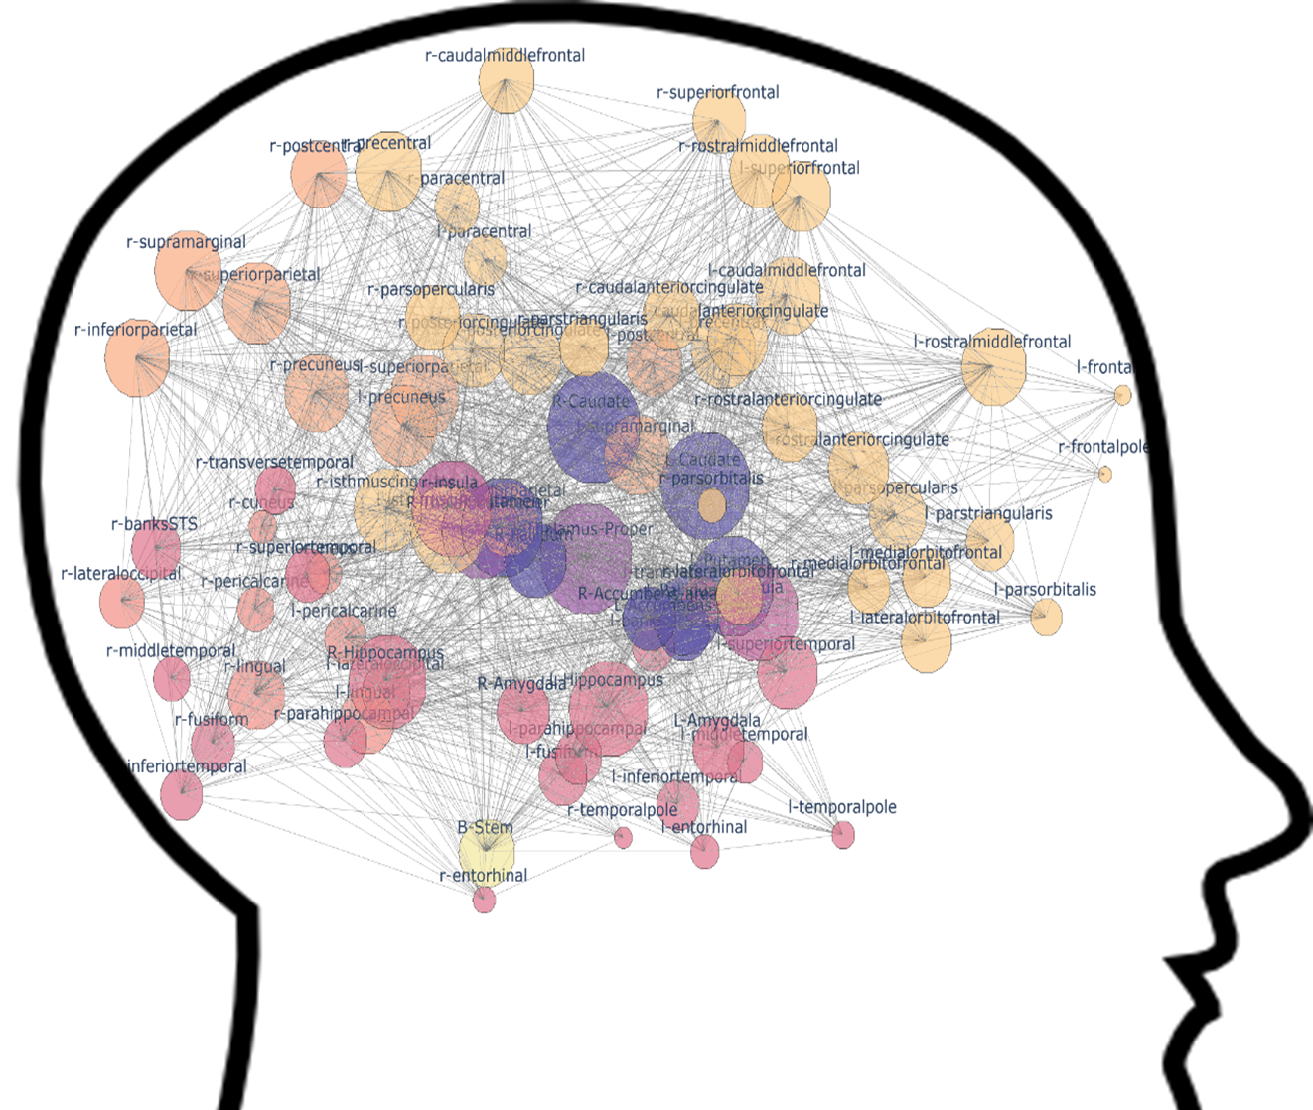
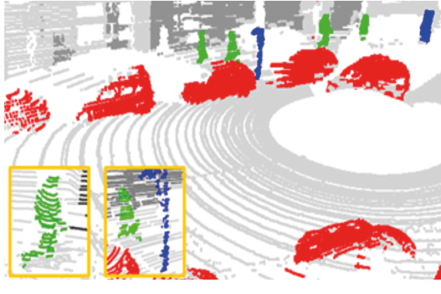
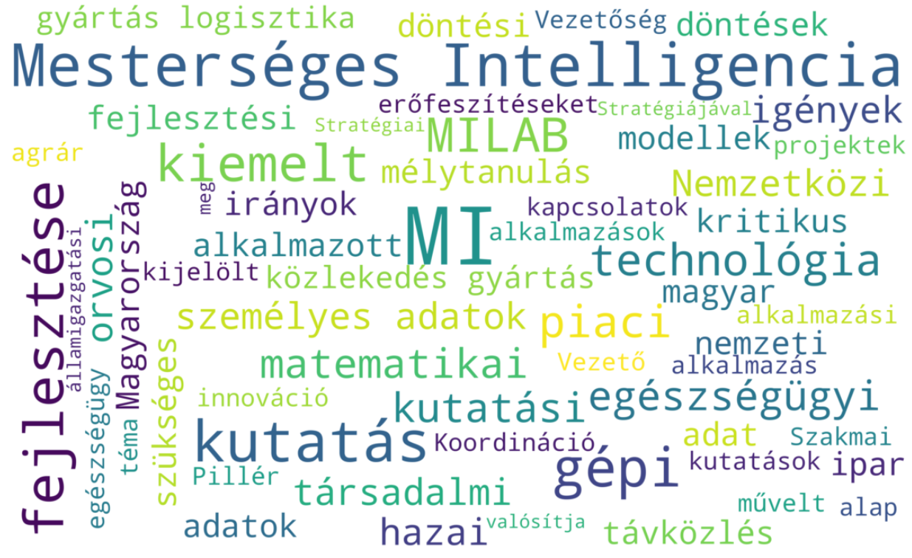
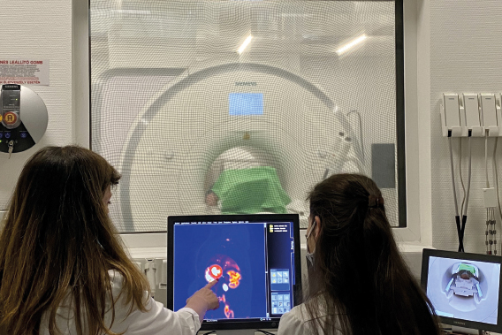
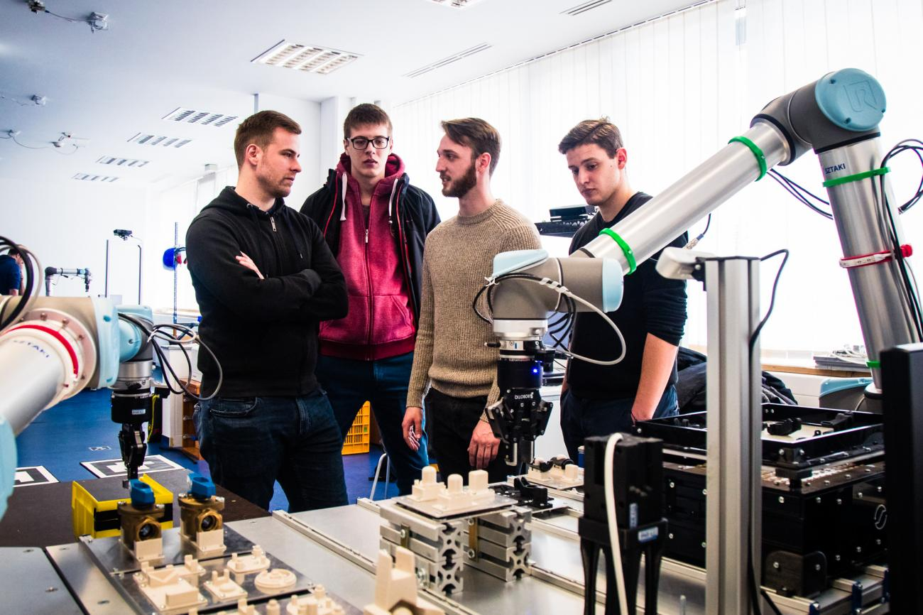
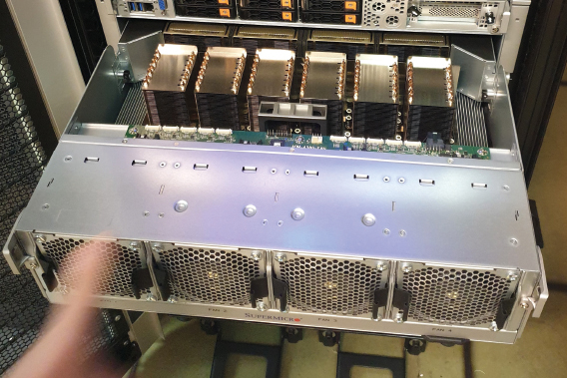
MILAB: Six Subprojects
Foundations
Machine perception
Human Language Technologies
Medical, Health
Sensor, IoT, Telecom
Security, Privacy, Infrastructure

Slide 8

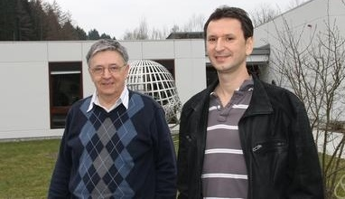

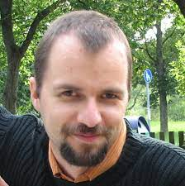


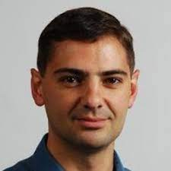
Six subprojects
Foundations
(Balázs Szegedy, Rényi)
Machine perception (István Csabai, ELTE)
Human language tech
(Richárd Farkas, SZTE)
Medical, health
(Dávid Becker, SE)
Sensor, IoT, Telecommunications
(János Levendovszky, BME)
Security, Privacy, Infrsstructure
(Rudolf Ferenc, SZTE)

Slide 9
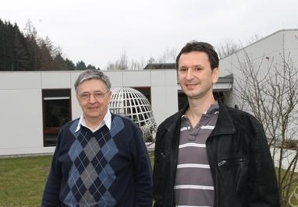
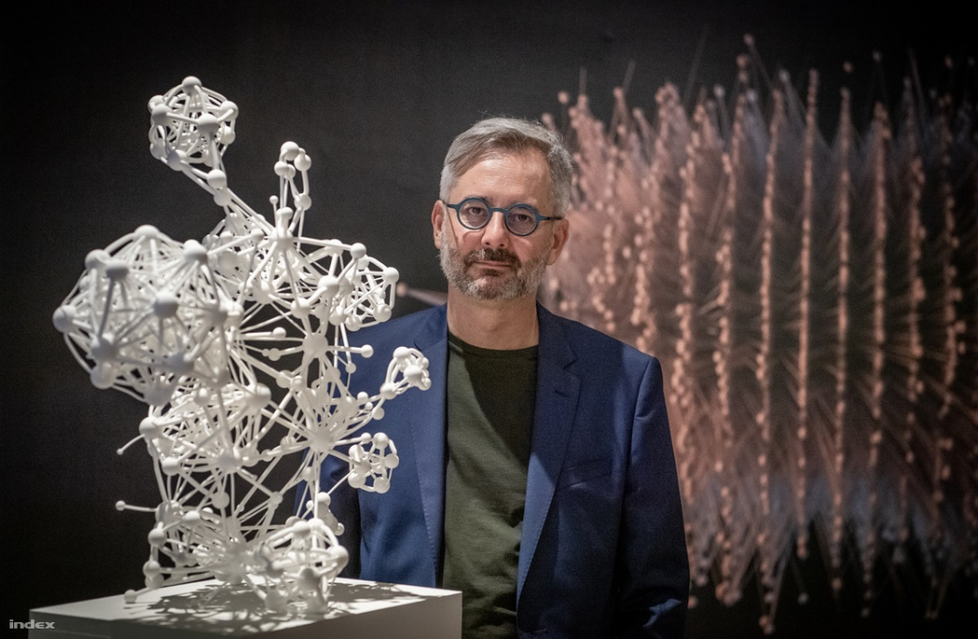
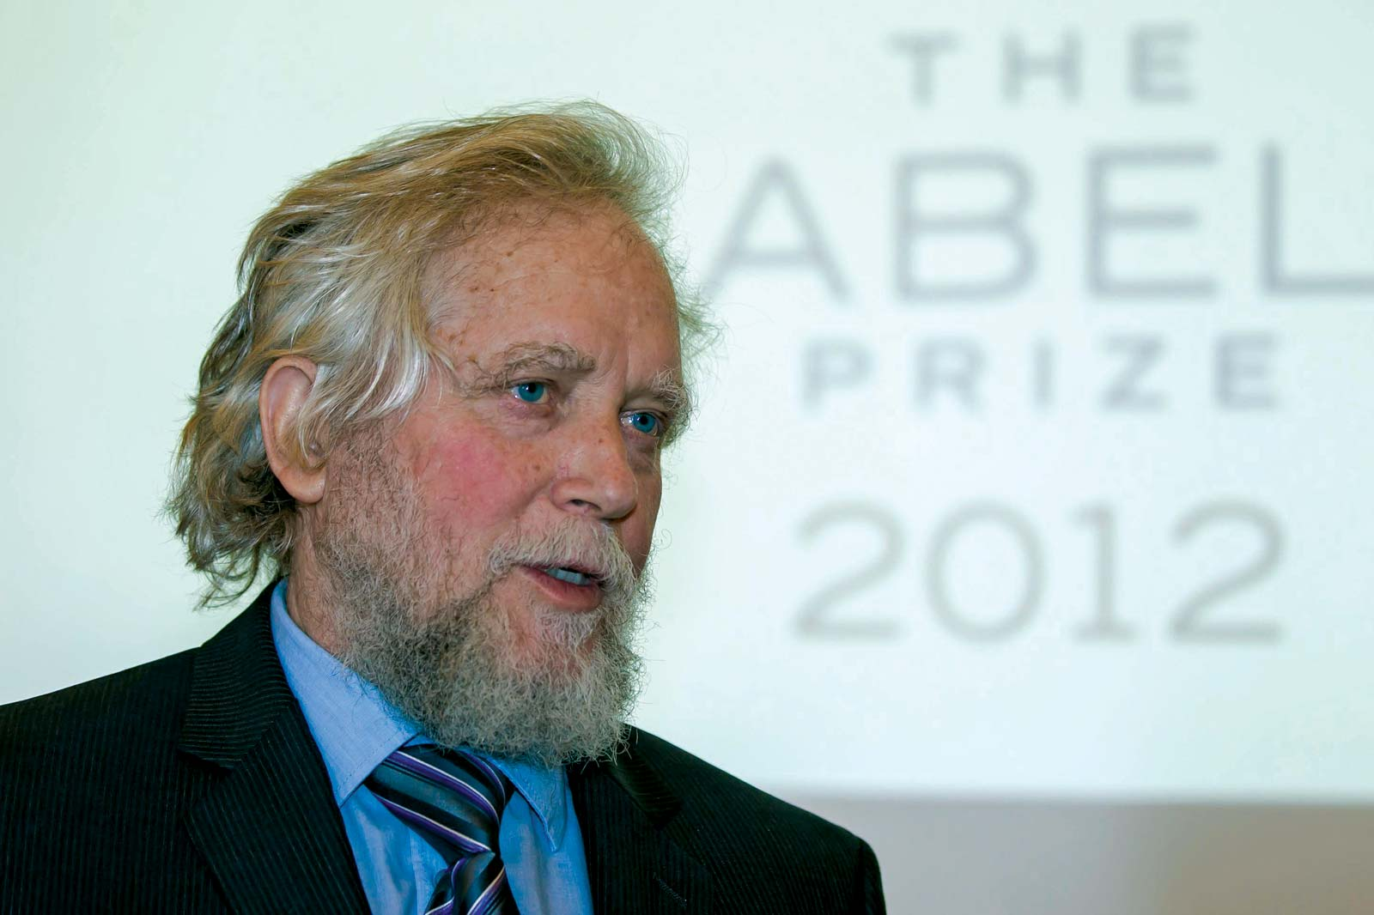
Mathematical foundations: Our strength
Mathematicians, Scientists, Networks, Graphs
László Lovász, Abel prize, 2021
Szegedy Balázs
AI foundations research lead
László Barabási Albert
Endre Szemerédi, Abel prize, 2012

Slide 10


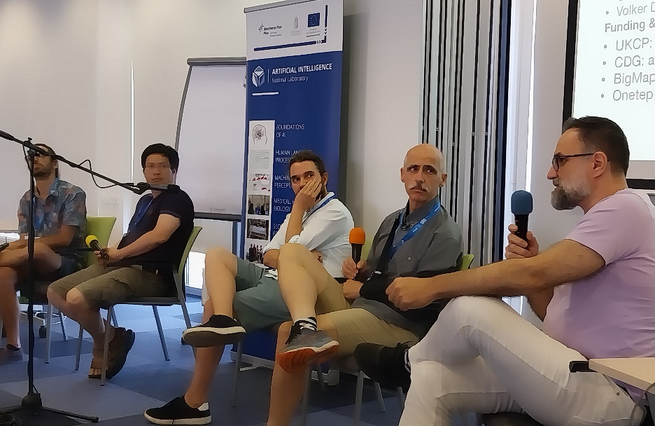
AI researchers from Hungary
Involvement
Annual summer gathering (3-day conference in Aug)
Regular online involvement
Networking aid for Hungarian students at conference
Christian Szegedy
Adversarial examples
Batch normalization
Inception network
X.AI, formerly Google AI
Csaba Szepesvári
UTC algorithm – breakthrough in computer go
U Alberta, formerly SZTAKI

Slide 11
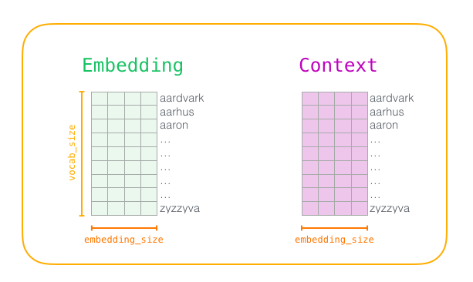
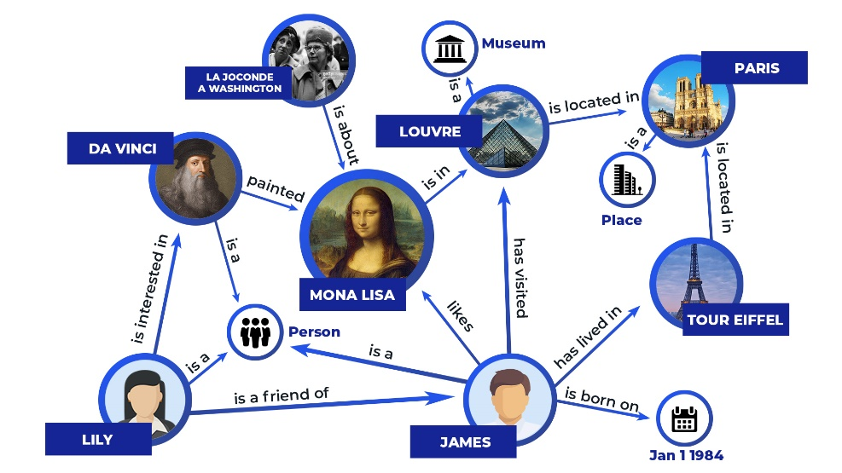


Human language technologies
Combining language models and knowledge bases
Collaboration on Hungarian LLM with the Digitial Heritige National Laboratory

Slide 12
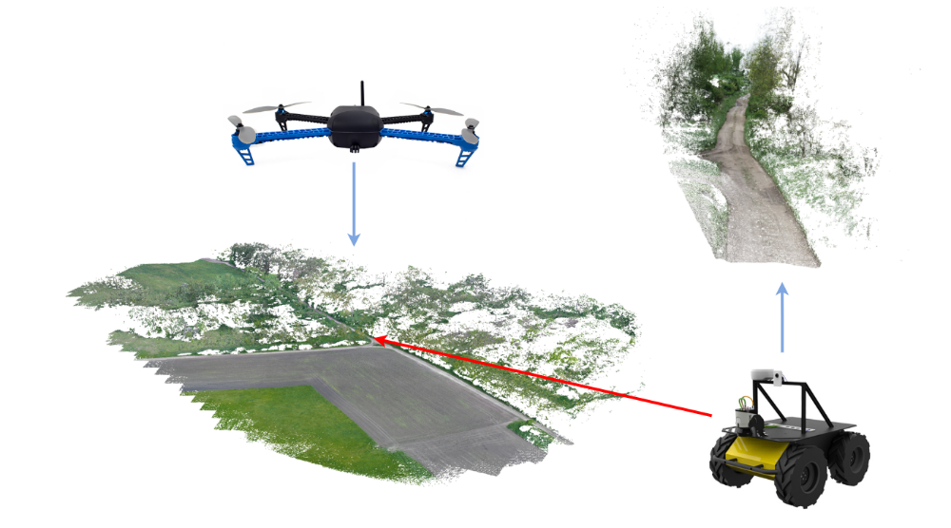
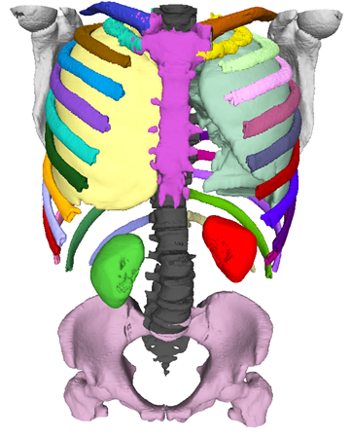
Machine Perception
Collaboration with the NL for Autonomous Systems
Environment perception and mapping by various sensors (camera, Lidar, depth sensors, stereo) and platforms (aerial, terrestrial, space-borne; static and mobile)
Medical data analysis, modeling, augmented reality

Slide 13
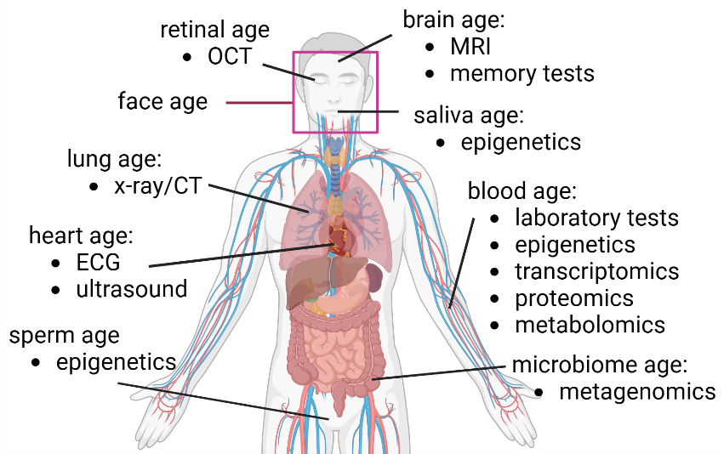


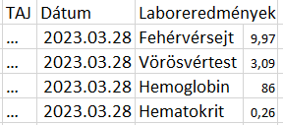

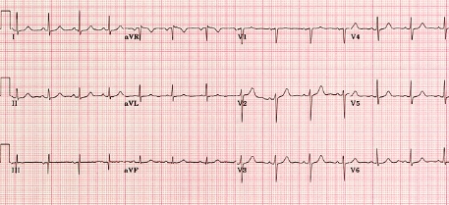



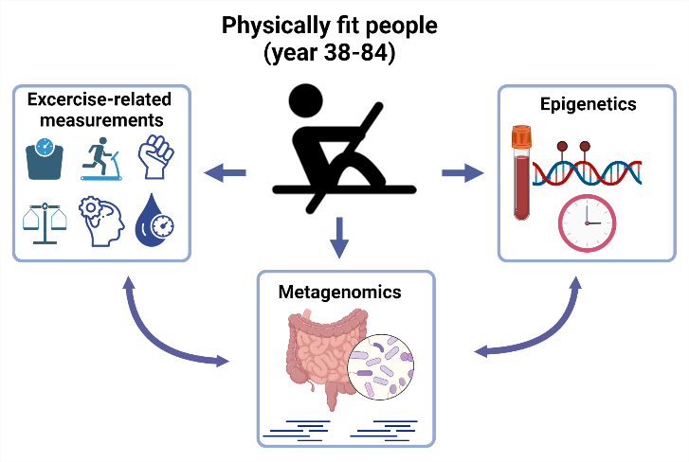
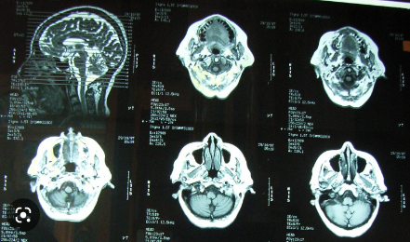

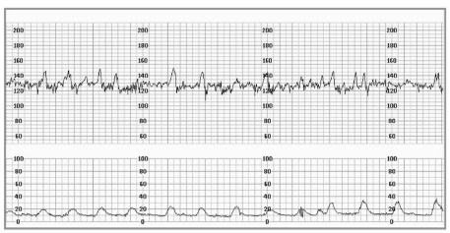

AI in Medical, health
Electronic health records and medical imaging databases
RISK SCORE
Research on healthy aging
MEDICAL DECISION SUPPORT
In collaboration with the Health Security National Laboratory
CAPACITY PLANNING AND OPTIMIZATION
Kerepesi and Gladyshev. 2023. Aging Cell
Torma, Kerepesi et al. 2024. Aging Cell

Slide 14
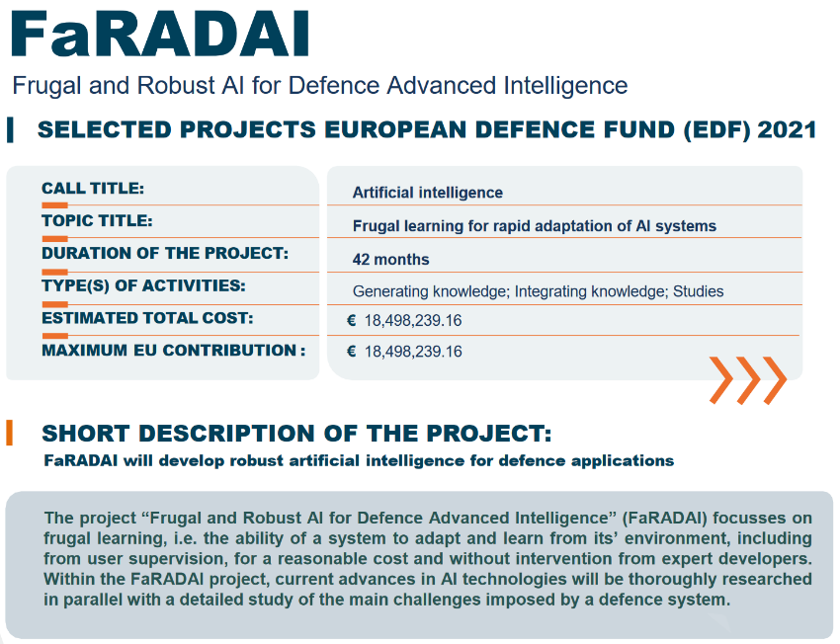
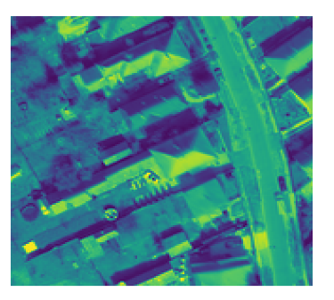
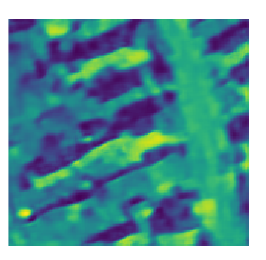
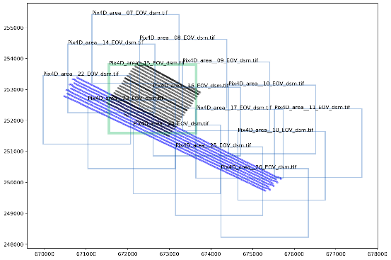
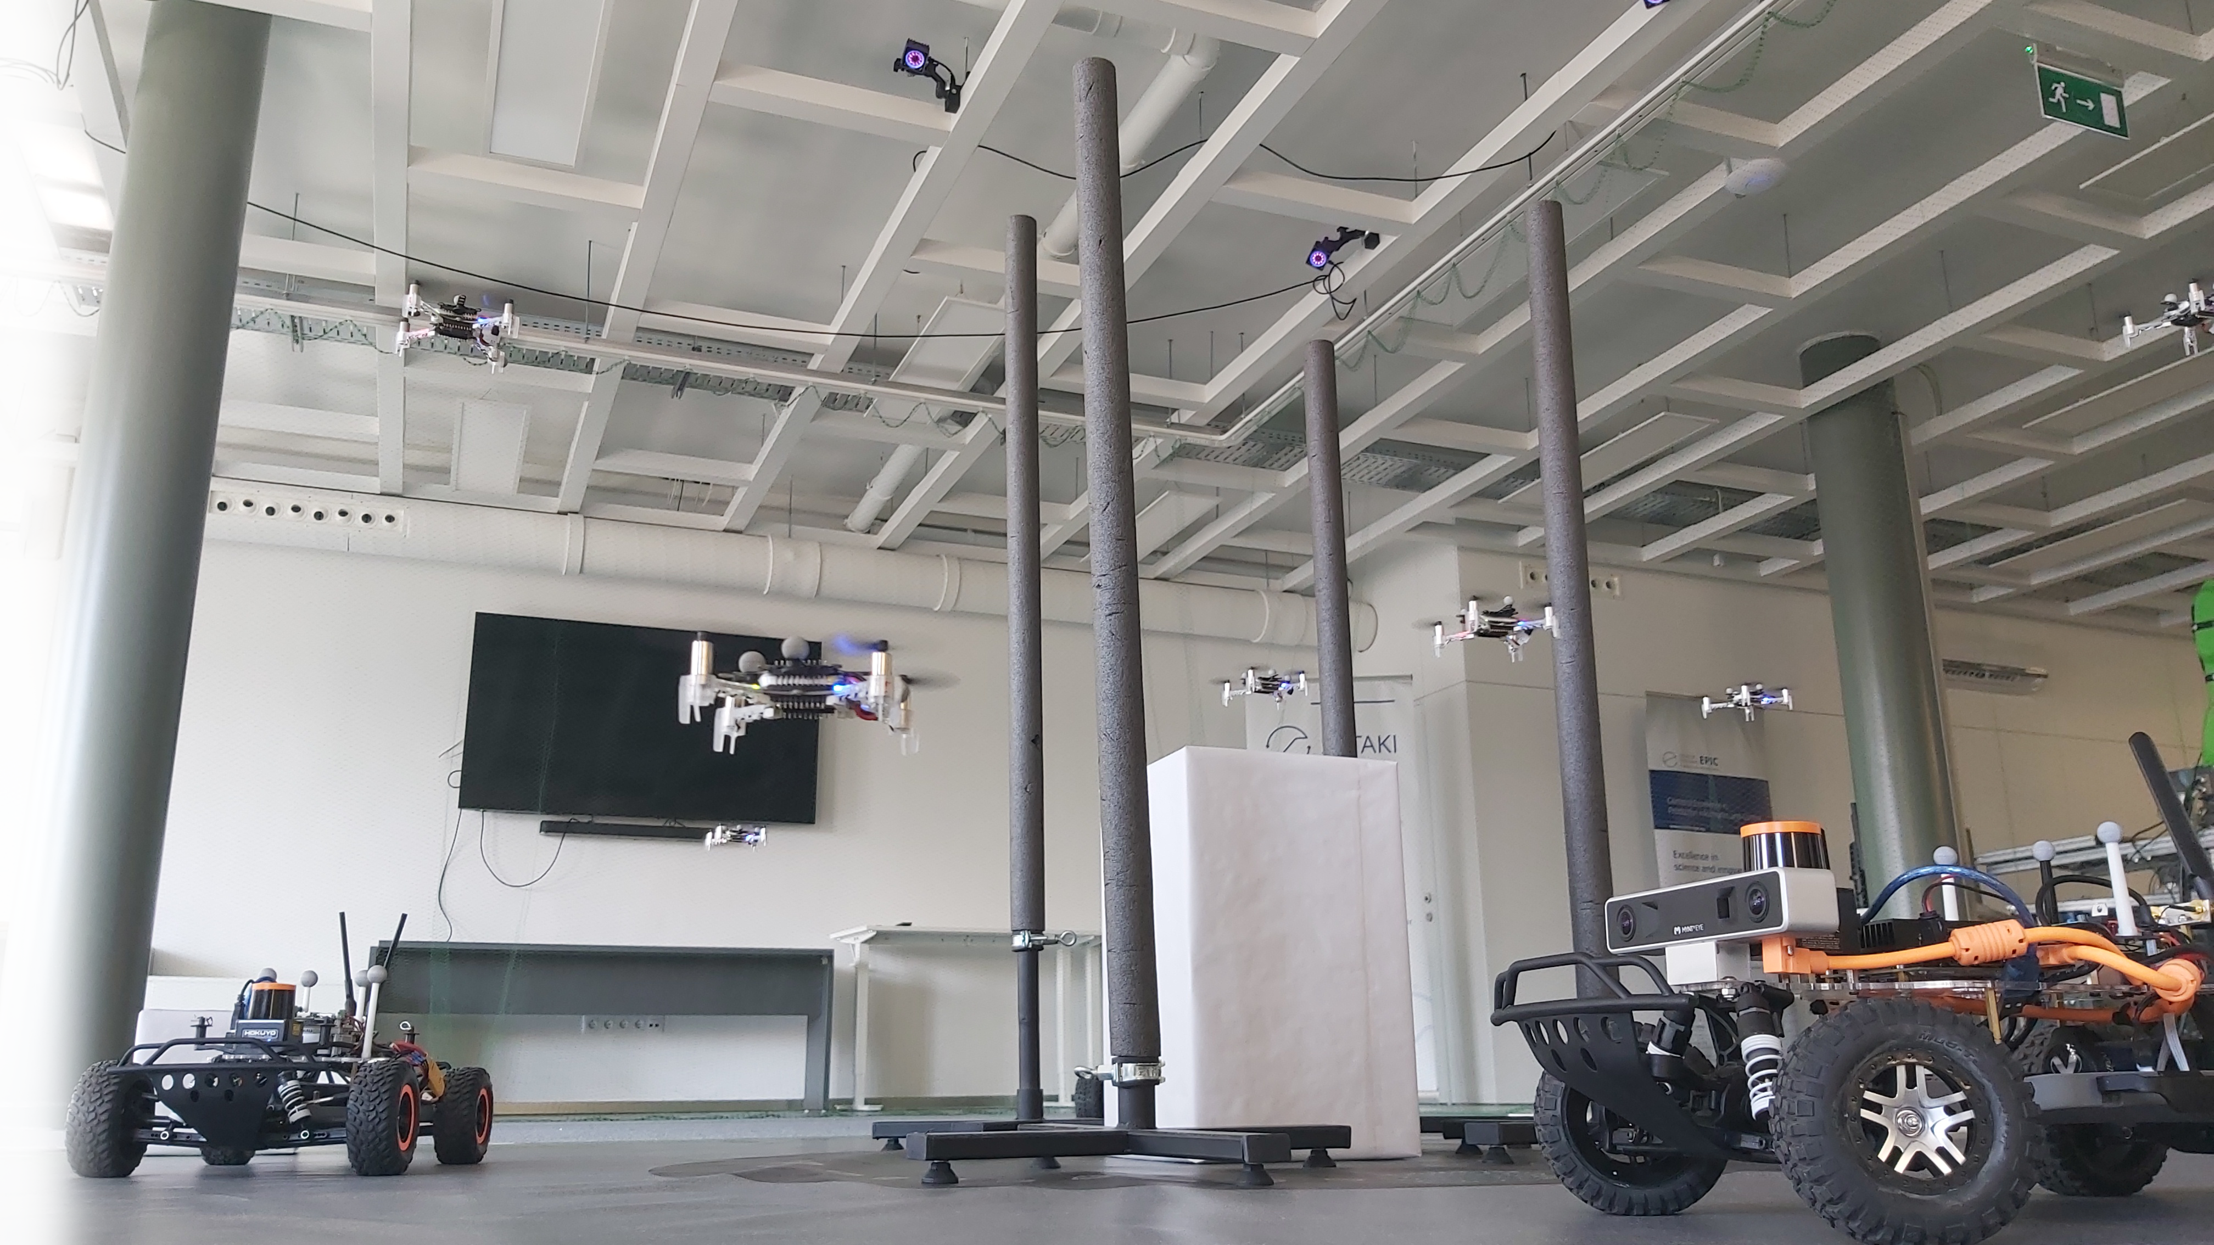
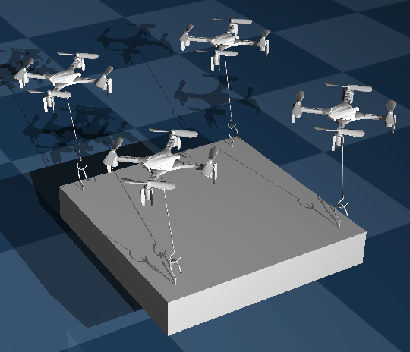
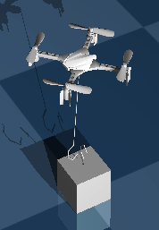
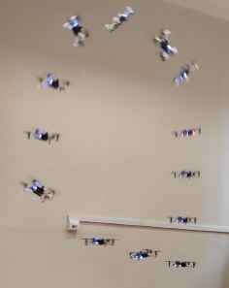
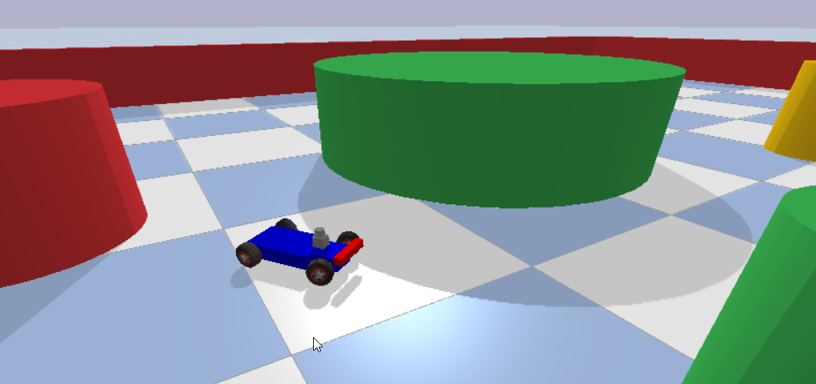
Hungarian Military Force Modernization Initiative
Defence
Camera image
AI representation
CEA – INDRA – Leonardo – Rheinmetall – Thales – …
SZTAKI AI and Systems & Control Laboratories
Drone navigation by onboard camera only

Slide 15
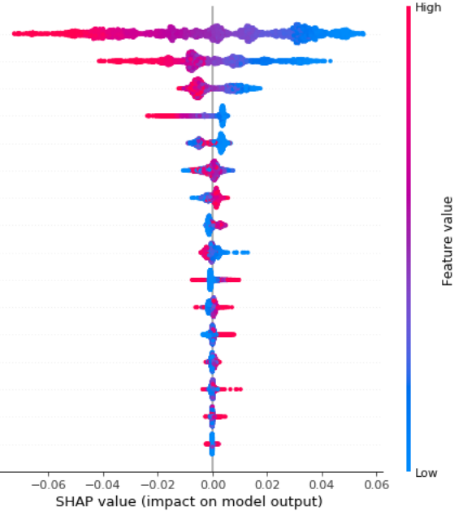
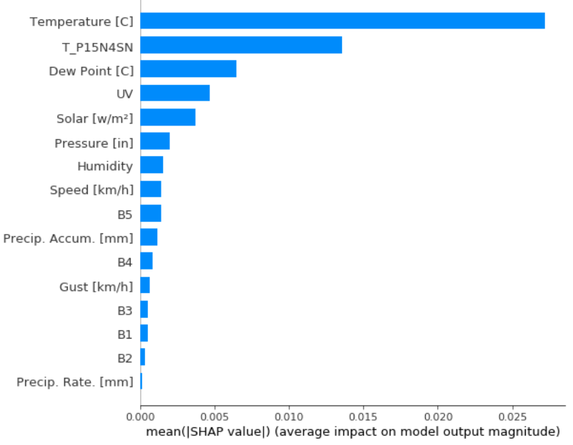
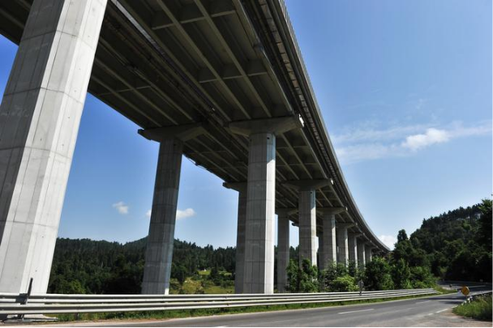
Data-driven explainable model for bridge monitoring, subtracting environmental effects
Ravbarkomanda highway bridge in Slovenia
Local contributions of effects on eigenfrequency change of prestressed cables
Influencing effects of cable eigenfrequency

Slide 16
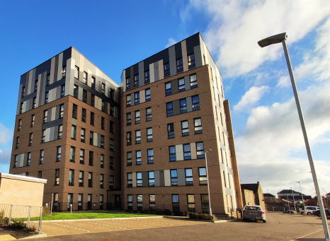
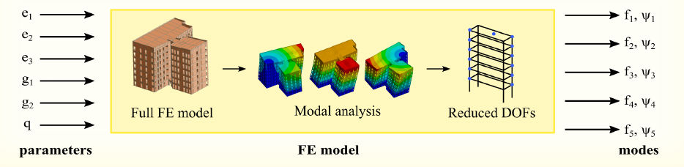
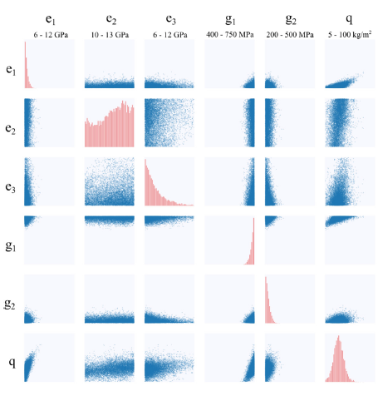
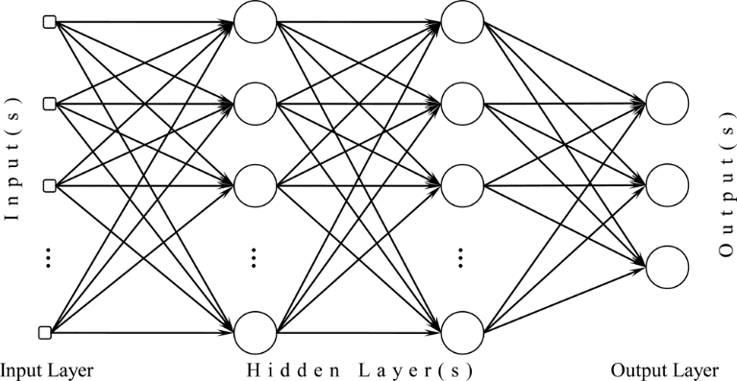
Bayesian inference for design parameter update or digital twinning of building structures
Yoker Tall Timber Building
in Glasgow
Bayesian update of simulation model
Measurements of modal properties from forced vibration tests
Blaž, Friedman et al. "Bayesian model updating of eight-storey CLT building using modal data." Probabilistic Engineering Mechanics 2024

Slide 17

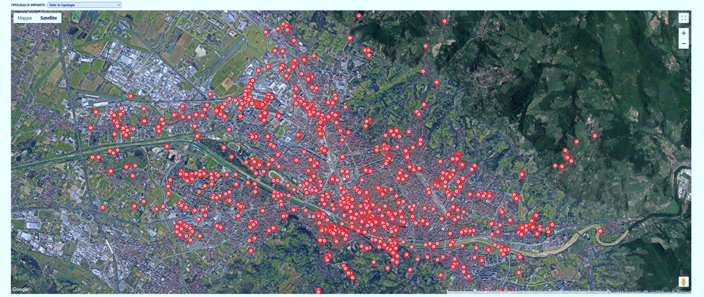
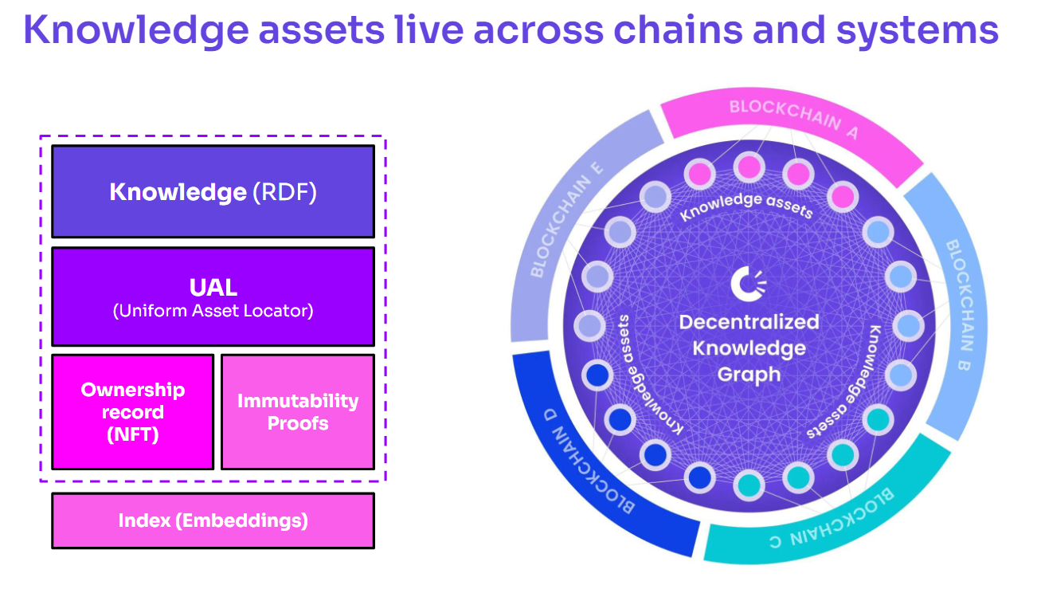
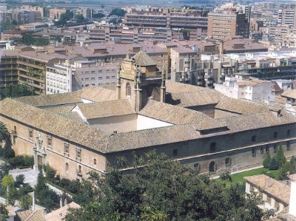
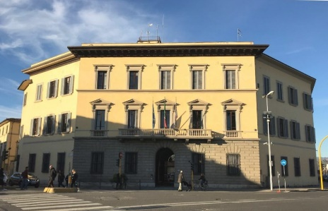
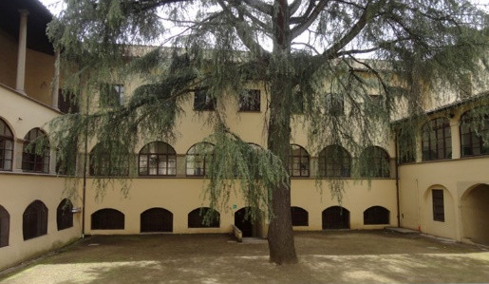
Knowledge and data sharing by decentralized knowledge graphs – the project
DKG platform will include specific building-related ontologies, so that the whole knowledge base about the life-cycle of the building can be logged and by that continuously updated, providing mechanisms and interfaces for the relevant stakeholders, to publish, trace, share, tokenize, end even trade models in a market economy.

Slide 18





Data driven analysis in mobile networks
Session drop prediction
Dynamic load balancing
Daróczy, Vaderna, Benczúr. "Machine learning based session drop prediction in LTE networks and its SON aspects." VTC Spring 2015
Merluzzi, Borsos, Rajatheva, Benczúr, ..., Uusitalo. The Hexa-X project vision on Artificial Intelligence and Machine Learning… IEEE Access, 2023.
Timing advance (TA): distance measured by radio
Cell load: number and volume
Interference: measurement
Channel quality: delay, loss
High quality
Low quality
Kelen et al. "Theoretical Evaluation of Asymmetric Shapley Values for Root-Cause Analysis." ICDM 2023.

Slide 19


AI in B5G / 6G Mobile Radio Networks
(25 partners, Nokia, Ericsson, SZTAKI)
H2020 B5G/6G Flagship

Slide 20





MAVIR Energy prediction

Slide 21



Audi: data driven analysis in manufacturing
Annually over 100,000 cars produced, each over 1000 optical measurement points
Paint shop control novel home developed measurement method for surface smoothness
Electric engine acoustic spectrum and manufacturing parameters
Goal is full cycle data driven analysis
Root cause analysis by heterogeneous measurements and a very large number of variables
Paint shop quality control
Car body optical measurement
Source: https://autopro.hu/gyartosor/a-legnagyobb-magyar-gyarban-jartunk-karosszeriauzem/148609

Slide 22

Data is the central asset for AI / ML
AI is data hungry
Large language models have already consumed all available text data
Other application areas (healthcare, manufacturing, finance, …) do not share data – probably the reason for lack of breakthrough in other areas
  Privacy, regulations (GDPR, fears of Technological Big Brother)
  Business and other interests against sharing
Typically, a few 1000 images to train medical diagnostics
  Data chauvinism, data sovereignty, …
Christian Szegedy, 2023

Slide 23


Gaia-X
Hungary joined Gaia-X Federated and Secure Data Infrastructure
Hungarian National Hub – creation and coordination by SZTAKI
Supported by Ministry of Technology and Industry
Hub coordinators meeting – Paris, France
CEE Hub meeting – Vienna
Hub workshop and vertical data spaces – Palma, Spain
CEE Hub meeting @ AI&AUT EXPO
Market-X EXPO, Vienna

Slide 24





Meetups
2023-09-20 GenAI, Christian Szegedy
2023-10-25 Electronic health records
2023-12-05 Human-Machine @ ELTE
2024-01-24 Manufacturing @ Bosch
2024-03-12 Law
2024-05-21 Medical imaging
2024-06-26 RAG, joint w Budapest Deep Learning Reading Seminar
21 November 2024

Slide 25















International events
14-15 February 2023
15 countries 480+ visitors 30 exhibitors
40+ 66 20%
demos presentations international
EBDVF: Annual event of the Big Data Value Association
21 November 2024

Slide 26





Community: AI researchers from Hungary
Csaba Szepesvári (2nd right)
Ferenc Huszár
Cambridge
Christian Szegedy
X.AI, formerly Google AI
Selected best ML researchers of Hungarian origin in Budapest every August: Cambridge, Carnegie Mellon, Google, Yahoo, DeepMind, Huawei, Warwick, …
https://mi.nemzetilabor.hu/magyar-machine-learning-talalkozo-2024/

Slide 27



Summary
Critical mass, collaboration and networking in Hungary and Europe
Horizon Europe, European Defence Fund
Applied AI research in 6 subprojects:
Mathematical foundations
Machine vision, deep learning
Human Language Technologies
Medical, health
Sensors, Industrial IoT – Audi, Bosch, Ericsson, Nokia, …
Security, privacy
Building on our existing industry relations
milab@sztaki.hu
https://milab.hu/

