Slide 1
Laser-Ion Acceleration using Gold Nanorods
For plasmonic enhancement of Fusion reactions
Dr. Chris Grayson
The NanoPlasmonic Laser Induced Fusion Energy (NAPLIFE)

Slide 2
Laser Fusion
Our goal is to use low energy lasers to accelerate ions to produce nonequilbirum nano fusion.
Equilibrium fusion requires enormous energies and densities
NIF – 2 MJ
$$∞$$
$$BBN$$
$$Stars$$
~100 nm
$$km$$
$$ITER$$
$$MegaJoule$$
10^-8
$$V (process volume)$$
$$NIF$$
20 mJ
$$cm$$
$$μCF$$
$$nm$$
$$pB$$
plasmonics
$$fS$$
$$μS$$
$$minutes$$
$$hours$$
$$∞$$
$$Δt (process time)$$
HAC inaugrial lecture RafelskiCite lecture

Slide 3
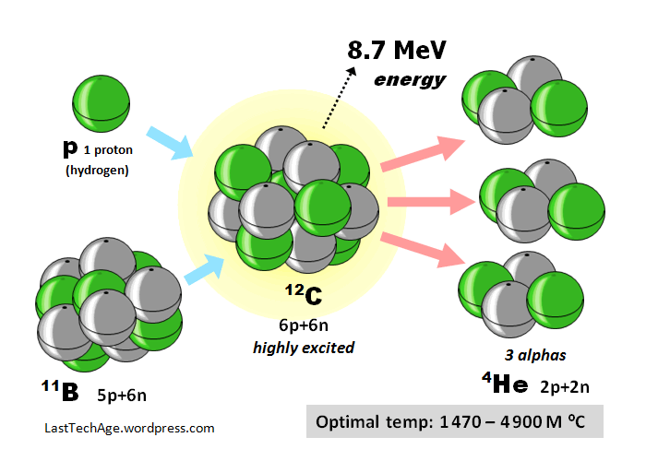
Laser Fusion
*Equilibrium fusion requires enormous energies and densities*
NIF – 2 million joules
Our goal is to use low energy lasers to accelerate ions to produce nonequilbirum nano fusion.
Aneutronic proton-boron fusion
p+¹¹B → (3 ⁴He) + 8.7 MeV
$$∞$$
$$BBN$$
$$Stars$$
$$km$$
$$ITER$$
$$MegaJoule$$
$$V (process volume)$$
$$NIF$$
$$cm$$
$$μCF$$
$$nm$$
$$pB$$
plasmonics
$$fS$$
$$μS$$
$$minutes$$
$$hours$$
$$∞$$
$$Δt (process time)$$

Slide 4
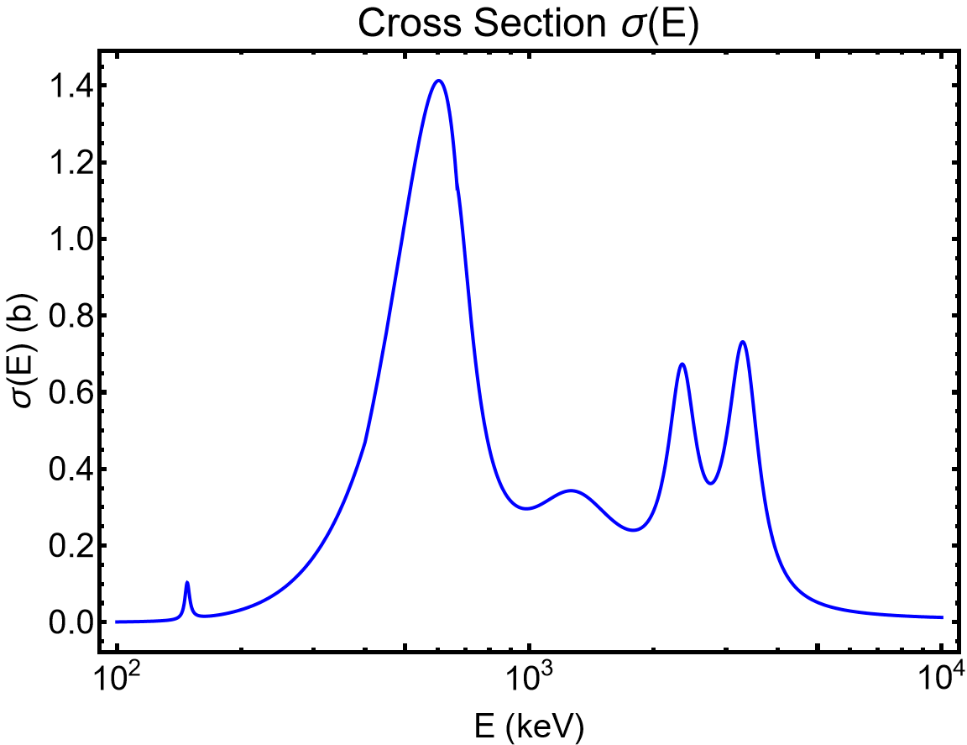
Laser Fusion
*Equilibrium fusion requires enormous energies and densities*
NIF – 2 million joules
Our goal is to use low energy lasers to accelerate ions to produce nonequilbirum nano fusion.
Aneutronic proton-boron fusion
p+¹¹B → (3 ⁴He) + 8.7 MeV
Corresponds to ~0.1 picojoule per particle

Slide 5
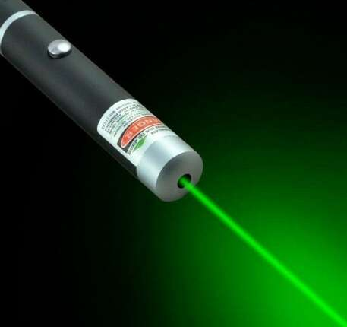
Laser Fusion
*Equilibrium fusion requires enormous energies and densities*
NIF – 2 million joules
Our goal is to use low energy lasers to accelerate ions to produce nonequilbirum nano fusion.
Aneutronic proton-boron fusion
p+¹¹B → (3 ⁴He) + 8.7 MeV
Typical laser pointers have ${10}^{9}$ times more energy
Corresponds to ~0.1 picojoule per particle
(5 mJ)

Slide 6
Laser Fusion
*Equilibrium fusion requires enormous energies and densities*
NIF – 2 million joules
Our goal is to use low energy lasers to accelerate ions to produce nonequilbirum nano fusion.
Aneutronic proton-boron fusion
p+¹¹B → (3 ⁴He) + 8.7 MeV
Typical laser pointers have ${10}^{9}$ times more energy but the energy is not sufficiently focused.
Corresponds to ~0.1 picojoule per particle
(5 mJ)

Slide 7
Laser Fusion
Our goal is to use low energy lasers to produce nonequilbirum fusion reactions .
Typical laser pointers have ${10}^{9}$ times more energy but the energy is not sufficiently focused.
(5 mJ)
Notes:
1 MeV is the cutoff energy of TNSA electrons

Slide 8
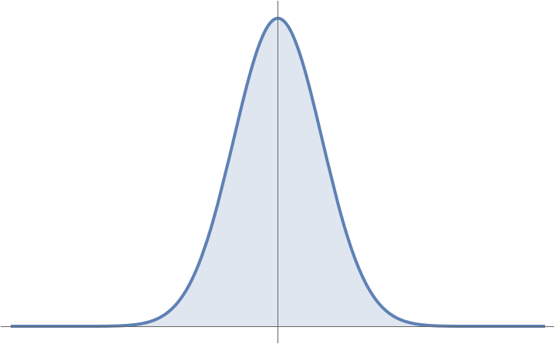
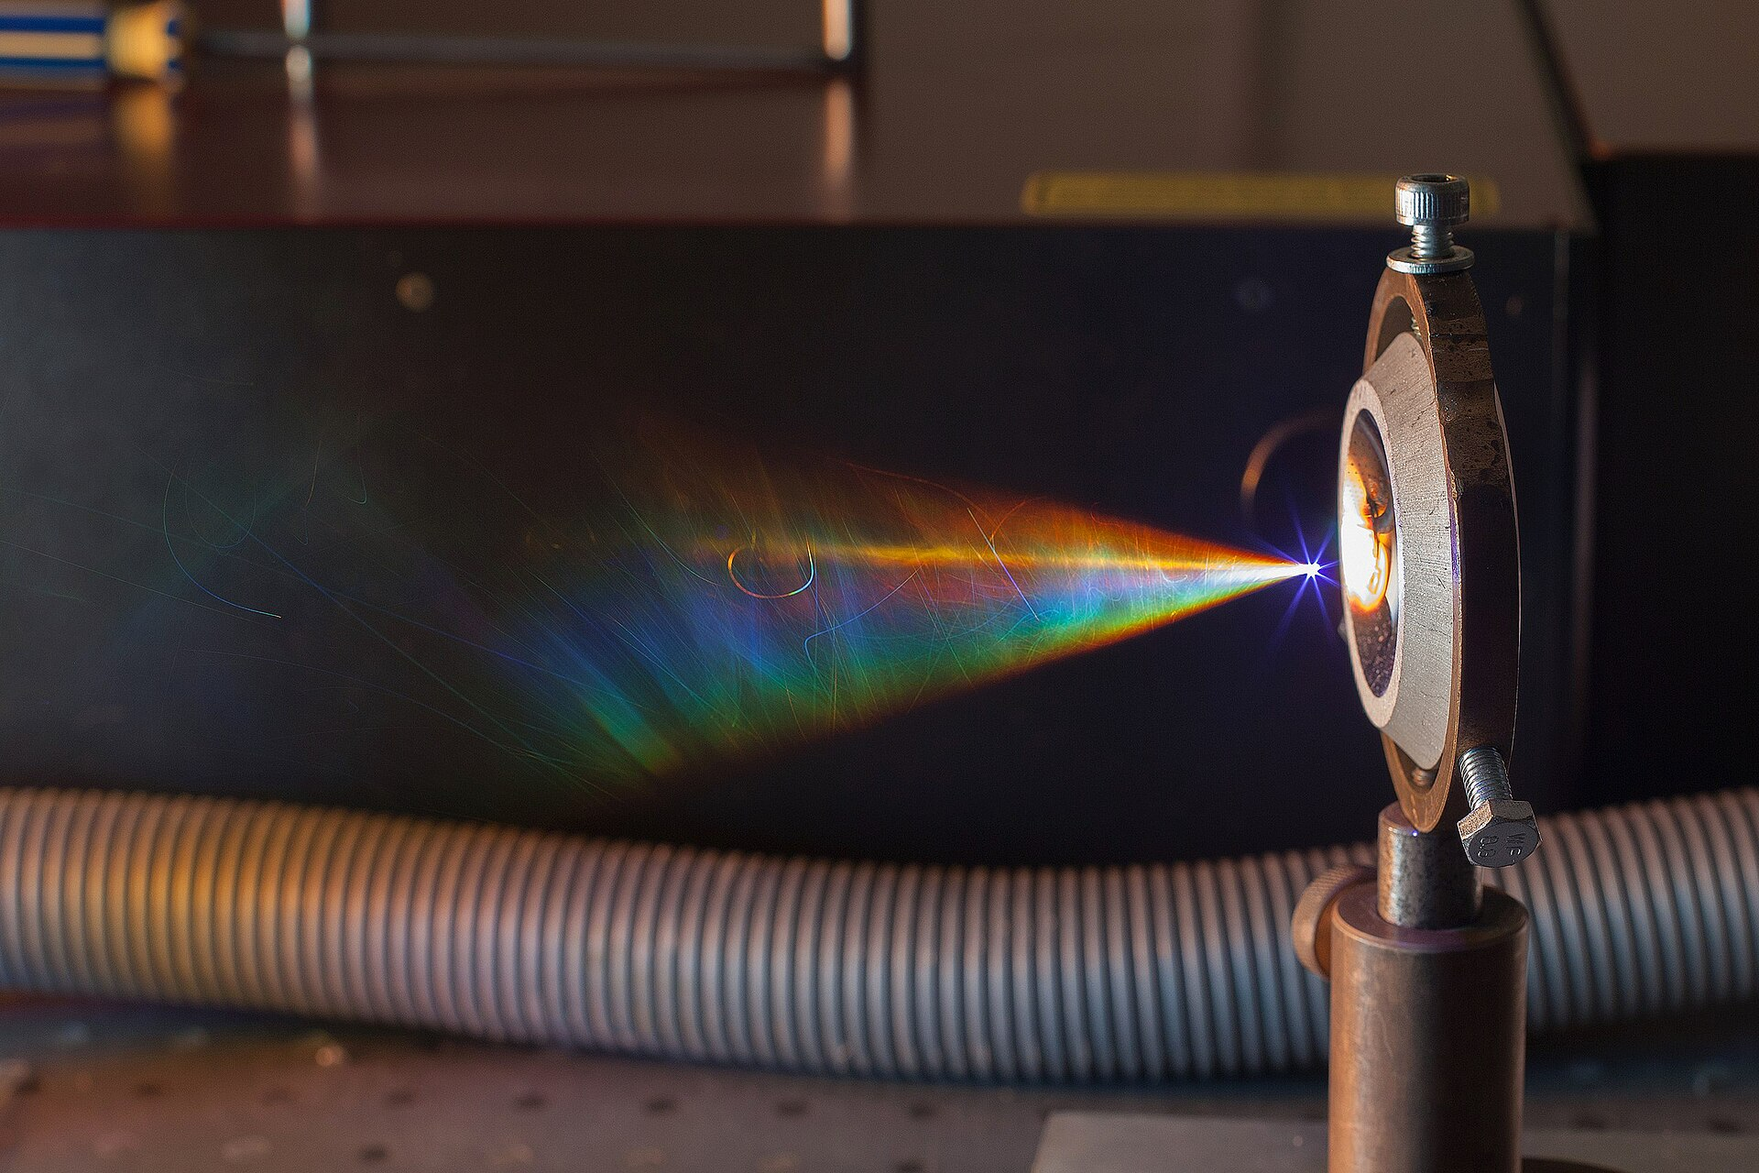
Laser Fusion
Our goal is to use low energy lasers to produce nonequilbirum fusion reactions .
Focus in time
Pulsed laser
Temporal compression
High peak power
Allows for nanoscale particle acceleration
Typical laser pointers have ${10}^{9}$ times more energy but the energy is not sufficiently focused.
(5 mJ)
5mW
50 GW
(${5×10}^{10}$ W)
Femtosecond scale pulses ${10}^{−15}$
Notes:
1 MeV is the cutoff energy of TNSA electrons

Slide 9
Laser Fusion
Our goal is to use low energy lasers to produce nonequilbirum fusion reactions .
Focus in time
Pulsed laser
Temporal compression
High peak power
Allows for nanoscale particle acceleration
Typical laser pointers have ${10}^{9}$ times more energy but the energy is not sufficiently focused.
(5 mJ)
5mW
50 GW
(${10}^{9}$ W)
Femtosecond scale pulses ${10}^{−15}$
Light cannot be focused past the diffraction limit
$$d_{limit }≈\frac{λ}{2}≈400 nm$$
$$100 fs∗c$$
$u_{EM}=1$ MeV/nm³
400 nm
Notes:
1 MeV is the cutoff energy of TNSA electrons

Slide 10
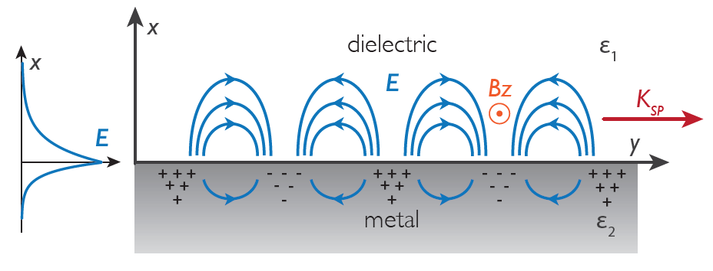
Laser Fusion
Our goal is to use low energy lasers to produce nonequilbirum fusion reactions .
Focus in time
Pulsed laser
Temporal compression
High peak power
Allows for nanoscale particle acceleration
Typical laser pointers have ${10}^{9}$ times more energy but the energy is not sufficiently focused.
(5 mJ)
5mW
50 GW
(${10}^{9}$ W)
Femtosecond scale pulses ${10}^{−15}$
Focus in space
Couple to massive electron wave
Surface Plasmon Resonance (LSPR)
Our Novel Approach
Light cannot be focused past the diffraction limit
$$d_{limit }≈\frac{λ}{2}≈400 nm$$
$$100 fs∗c$$
$u_{EM}=1$ MeV/nm³
400 nm
Focuses light past the diffraction limit
$$400 nm →85 nm$$
Notes:
1 MeV is the cutoff energy of TNSA electrons

Slide 11
The NanoPlasmonic Laser Induced Fusion Energy
How can nano-structured targets lead to femtosecond scale ion acceleration?
Huge Energy mismatch between laser and Fusion threshold
$$E=ℏω_{laser}=2 eV →{100}^{′}s keV$$
50,000 photons
“Atomic”
“Nuclear”

Slide 12
The NanoPlasmonic Laser Induced Fusion Energy
How can nano-structured targets lead to femtosecond scale ion acceleration?
Huge Energy mismatch between laser and Fusion threshold
$E=ℏω_{laser}=2 eV →{100}^{′}s keV$(Nuclear Scale)
Solution
Use collective electron motion.
like (TNSA)
$$E_{laser}$$
$$85 nm$$
$$25 nm$$
$$−$$
$$+$$
$$E_{Nano}$$
$$+$$
$$−$$
Locally increased Electric field Strength and Field Gradient

Slide 13
The NanoPlasmonic Laser Induced Fusion Energy
How can nano-structured targets lead to femtosecond scale ion acceleration?
Antennas For Light
Huge Energy mismatch between laser and Fusion threshold
These nanorods resonantly absorb $800 nm$ light via Localized Surface Plasmon resonance (LSP)
$E=ℏω_{laser}=2 eV →{100}^{′}s keV$(Nuclear Scale)
Solution
Use collective electron motion.
like (TNSA)
$$α=4 π a^{3}\frac{ε\left(ω\right)−ε_{D}}{ε\left(ω\right)+2 ε_{D}}$$
$$p= ε_{0} ε_{D} α E_{0}$$
$$E_{laser}$$
$$85 nm$$
The classical polarizability diverges when
$$E_{0}$$
$$a$$
$$25 nm$$
$$Re\left[ε\left(ω\right)\right]=−2 ε_{D}$$
$$−$$
$$ε\left(ω\right)$$
$$+$$
Maier, Stefan A. Plasmonics: fundamentals and applications. Vol. 1. New York: springer, 2007.
$$ε_{D}$$
$$E_{Nano}$$
$$+$$
$$−$$
LSP resonance can respond incredibly fast.
$ω_{LSP}=2.65 fs$
Locally increased Electric field Strength and Field Gradient

Slide 14
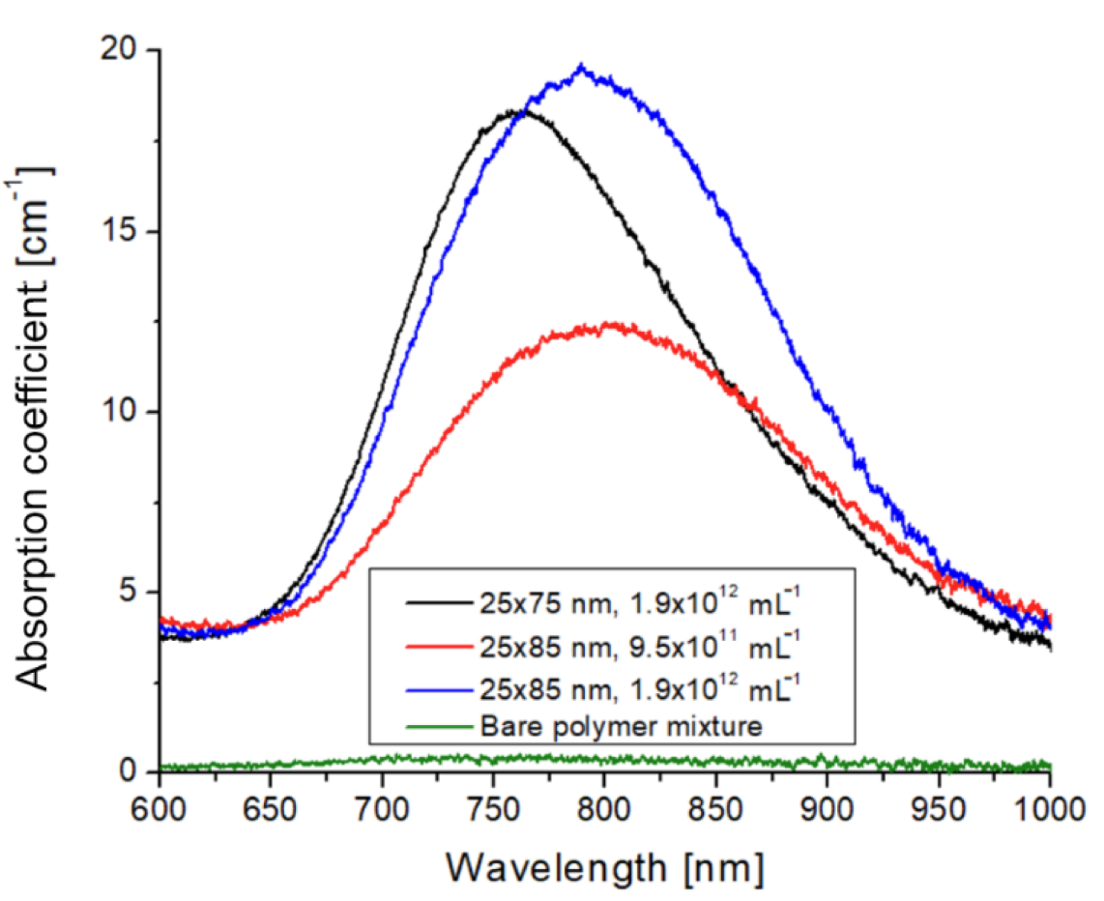
The NanoPlasmonic Laser Induced Fusion Energy
How can nano-structured targets lead to femtosecond scale ion acceleration?
Antennas For Light
Huge Energy mismatch between laser and Fusion threshold
These nanorods resonantly absorb $800 nm$ light via Localized Surface Plasmon resonance (LSP)
$E=ℏω_{laser}=2 eV →1 MeV$(Fusion threshold)
Solution
Use collective electron motion.
like (TNSA)
$$Re\left[ε\left(ω\right)\right]=−2 ε_{D}$$
$$E_{laser}$$
$$85 nm$$
$$25 nm$$
$$−$$
$$+$$
$$E_{Nano}$$
$$+$$
$$−$$
Locally increased Electric field Strength and Field Gradient
Bonyár, A. et al. Int. J. Mol. Sci. 2022, 23, 13575.

Slide 15
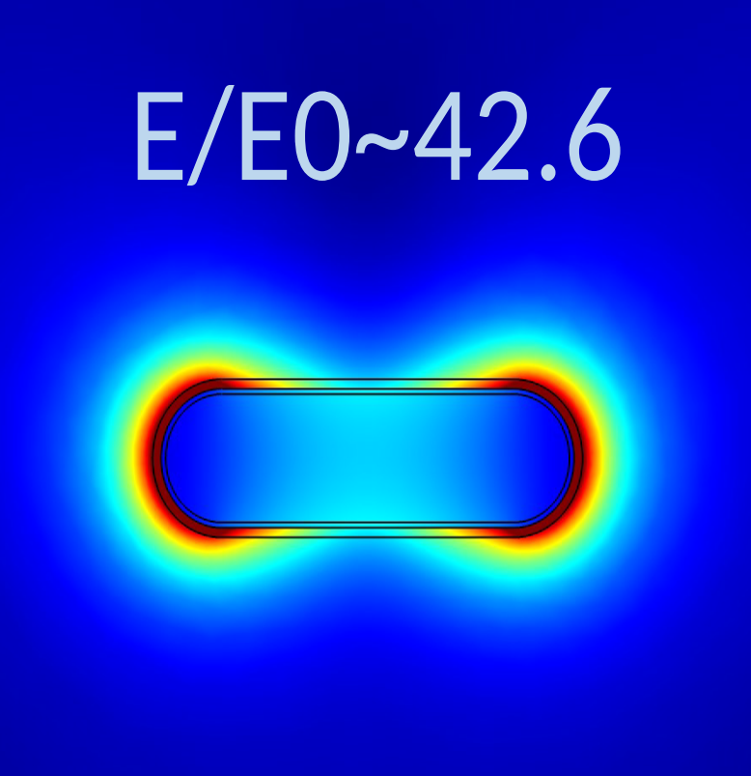
The NanoPlasmonic Laser Induced Fusion Energy
How can nano-structured targets lead to femtosecond scale ion acceleration?
Antennas For Light
Huge Energy mismatch between laser and Fusion threshold
These nanorods resonantly absorb $800 nm$ light via Localized Surface Plasmon resonance (LSP)
$E=ℏω_{laser}=2 eV →1 MeV$(Fusion threshold)
Solution
Use collective electron motion.
like (TNSA)
Near Field Enhancement (NFE) of the electric field around the Nano rods causes increased ion acceleration
$$E_{laser}$$
$$85 nm$$
The electric field around the nanorod $E$ is enhanced over the background laser field $E_{0}$on the scale of 10’s of nm
$$25 nm$$
$$−$$
$$+$$
$$E_{Nano}$$
$$+$$
$$−$$
M. Csete Group: Dávid Vass, Emese Tóth, András Szenes, Balázs Bánhelyi
Field enhancement and absorption measured at low intensity: $I∼{10}^{12}$W/cm²
Locally increased Electric field Strength and Field Gradient

Slide 16
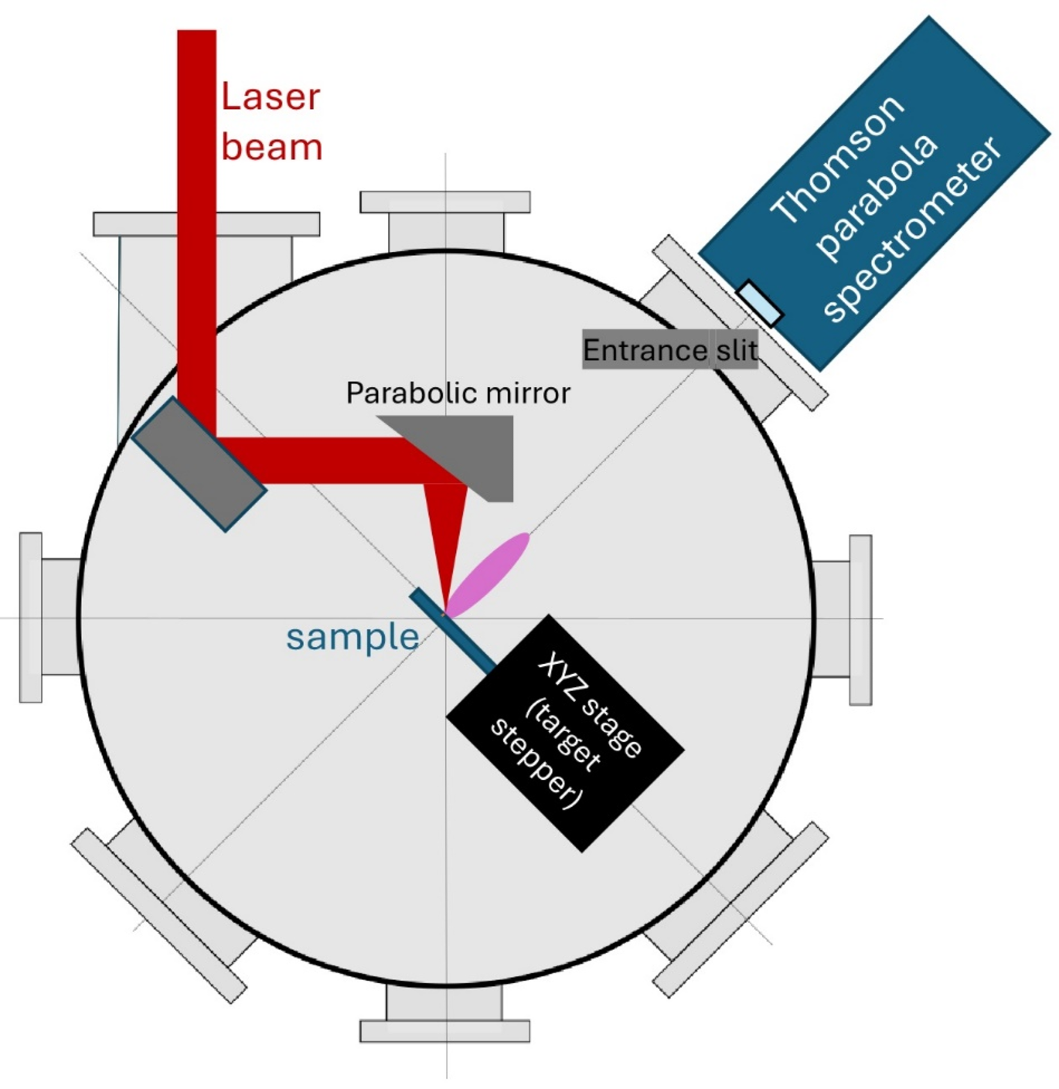
The NanoPlasmonic Laser Induced Fusion Energy (NAPLIFE)
UDMA-TEGMA (polymer)
The NAPLIFE project introduces nanostructured laser targets to generate more efficient proton acceleration for ultra-fast pulsed lasers.
$$150 μm$$
$$85 nm$$
$$=\frac{λ_{eff}}{2}$$
Joined Sept. 2024
$$530 nm$$
(not to scale)
$$25 nm$$
$$λ=795 nm$$
$$E≈20−30 mJ$$
Many other initiatives use nanostructures to enhance ion acceleration – ours is unique in that we use resonant localized plasmons (LSPR).
Tamas
Biro
Norbert
Kroo
Miklós Kedves
$$Δt=20−120 fs$$
Márk Aladi
$${I≈10}^{17}−{10}^{18}W/{cm}^{2}$$
And many more!

Slide 17
The NanoPlasmonic Laser Induced Fusion Energy (NAPLIFE)
UDMA-TEGMA (polymer)
The NAPLIFE project introduces nanostructured laser targets to generate more efficient proton acceleration for ultra-fast pulsed lasers.
$$150 μm$$
$$85 nm$$
$$=\frac{λ_{eff}}{2}$$
Joined Sept. 2024
$$530 nm$$
(not to scale)
$$25 nm$$
$$λ=795 nm$$
$$E≈20−30 mJ$$
Many other initiatives use nanostructures to enhance ion acceleration – ours is unique in that we use resonant localized plasmons (LSPR).
Tamas
Biro
Norbert
Kroo
Miklós Kedves
$$Δt=20−120 fs$$
Márk Aladi
$${I≈10}^{17}−{10}^{18}W/{cm}^{2}$$
And many more!

Slide 18
The NanoPlasmonic Laser Induced Fusion Energy (NAPLIFE)
UDMA-TEGMA (polymer)
The NAPLIFE project introduces nanostructured laser targets to generate more efficient proton acceleration for ultra-fast pulsed lasers.
$$150 μm$$
$$85 nm$$
Joined Sept. 2024
$$500 nm$$
(not to scale)
$$25 nm$$
$$λ=795 nm$$
$$E≈20−30 mJ$$
Many other initiatives use nanostructures to enhance ion acceleration – ours is unique in that we use resonant localized plasmons (LSPR).
Tamas
Biro
Norbert
Kroo
$$Δt=20−60 fs$$
$${I≈10}^{17}−{10}^{18}W/{cm}^{2}$$
UDMA-TEGMA (polymer)

Slide 19
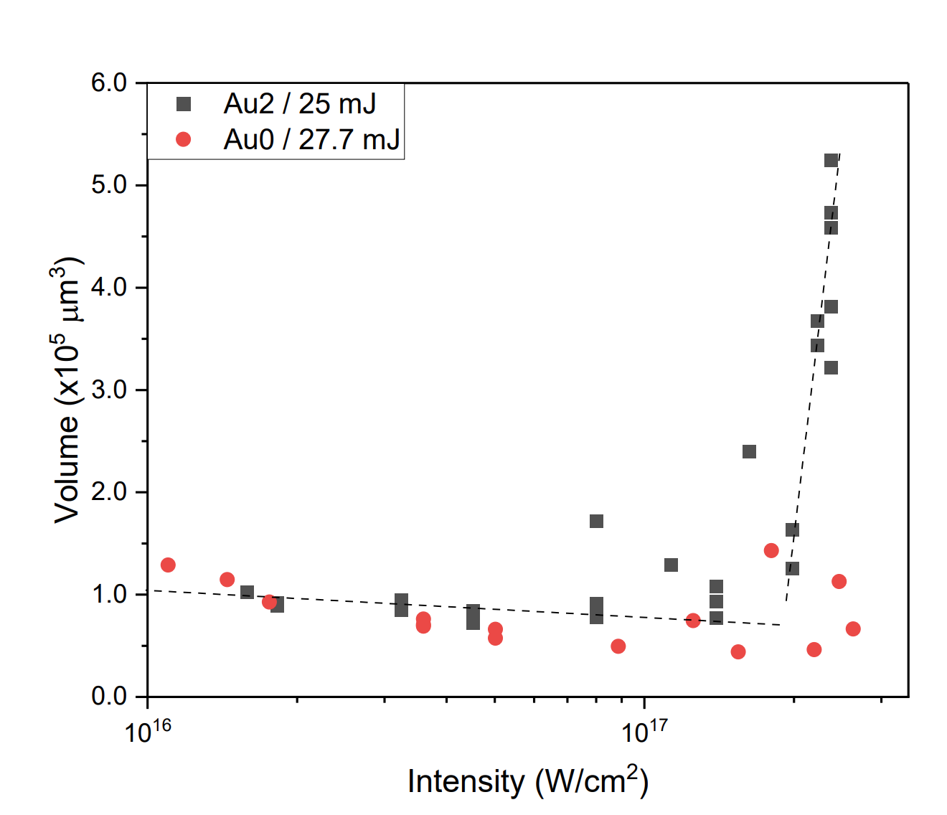
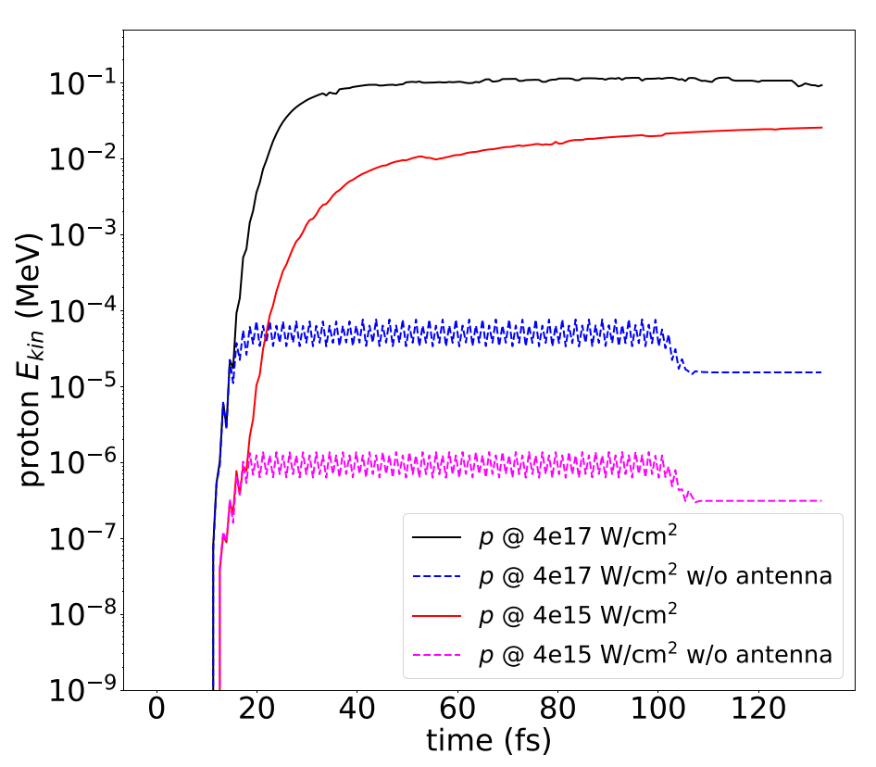
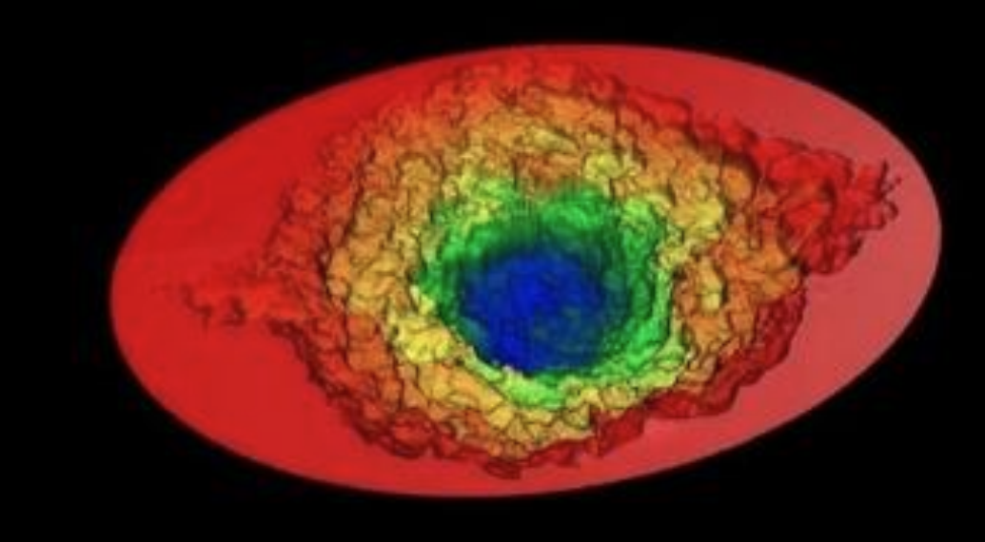
The NanoPlasmonic Laser Induced Fusion Energy
NAPLIFE Previous Results
Wigner Experimental Results
EPOCH 3D PIC Simulation of Surface plasma
- Nanorods
- Control
Higher maximum proton energy
Nanorods lead to increased proton acceleration in EPOCH Simulations
Nanorod doped samples led to exponential energy deposition in the target.
István Papp et al. 2023 arXiv:2306.13445v2
Ágnes Szokol et al. arXiv:2402.18138

Slide 20
The NanoPlasmonic Laser Induced Fusion Energy
NAPLIFE Previous Results
Wigner Experimental Results
EPOCH 3D PIC Simulation of Surface plasma
- Nanorods
- Control
What causes direct proton acceleration?
- Use this knowledge to tune nanostructures for better acceleration
Higher maximum proton energy
Nanorods lead to increased proton acceleration in EPOCH Simulations
Nanorod doped samples led to exponential energy deposition in the target.
István Papp et al. 2023 arXiv:2306.13445v2
Ágnes Szokol et al. arXiv:2402.18138

Slide 21
Proton Acceleration from Nanoplasmons
Laser is approximately a plane wave on the scale of the nanorod
Laser light (795 nm, I~${10}^{18}$W/${cm}^{2}$) impinges on Gold nanorod (~85 nm)
The acceleration of protons and ions in the pre-plasma, is simulated with the EPOCH (Particle in Cell) simulation software in 3D for a single nanorod.
The output of PIC programs can tell you with accuracy what proton energies you will get but not the mechanisms by which they are accelerated
Using PIC to determine this dependencies requires a huge amount of computation time and data storage.
$$F\left(E,B, Z,λ, I,…\right)= ?$$

Slide 22
Proton Acceleration from Nanoplasmons
Laser is approximately a plane wave on the scale of the nanorod
Laser light (795 nm, I~${10}^{18}$W/${cm}^{2}$) impinges on Gold nanorod (~85 nm)
Simple theoretical calculations motivated by simulation can serve as efficient guiding principles to determine how to perform experiments and simulations.
$F\left(E,B, Z,λ, I,…\right)=F_{CoulombExp}+F_{pond}$+ $F_{TNSA}+…$
We will focus on forces that come directly from the nanorod the ponderomotive force and Coulomb Explosion
Goal: make simplest model possible and compare to experiment

Slide 23
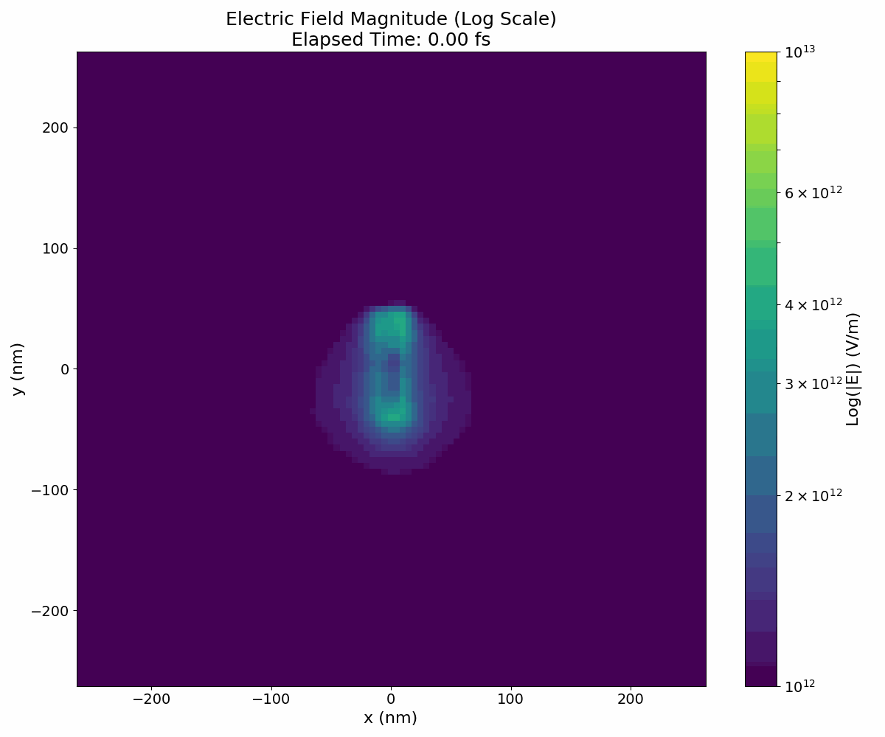
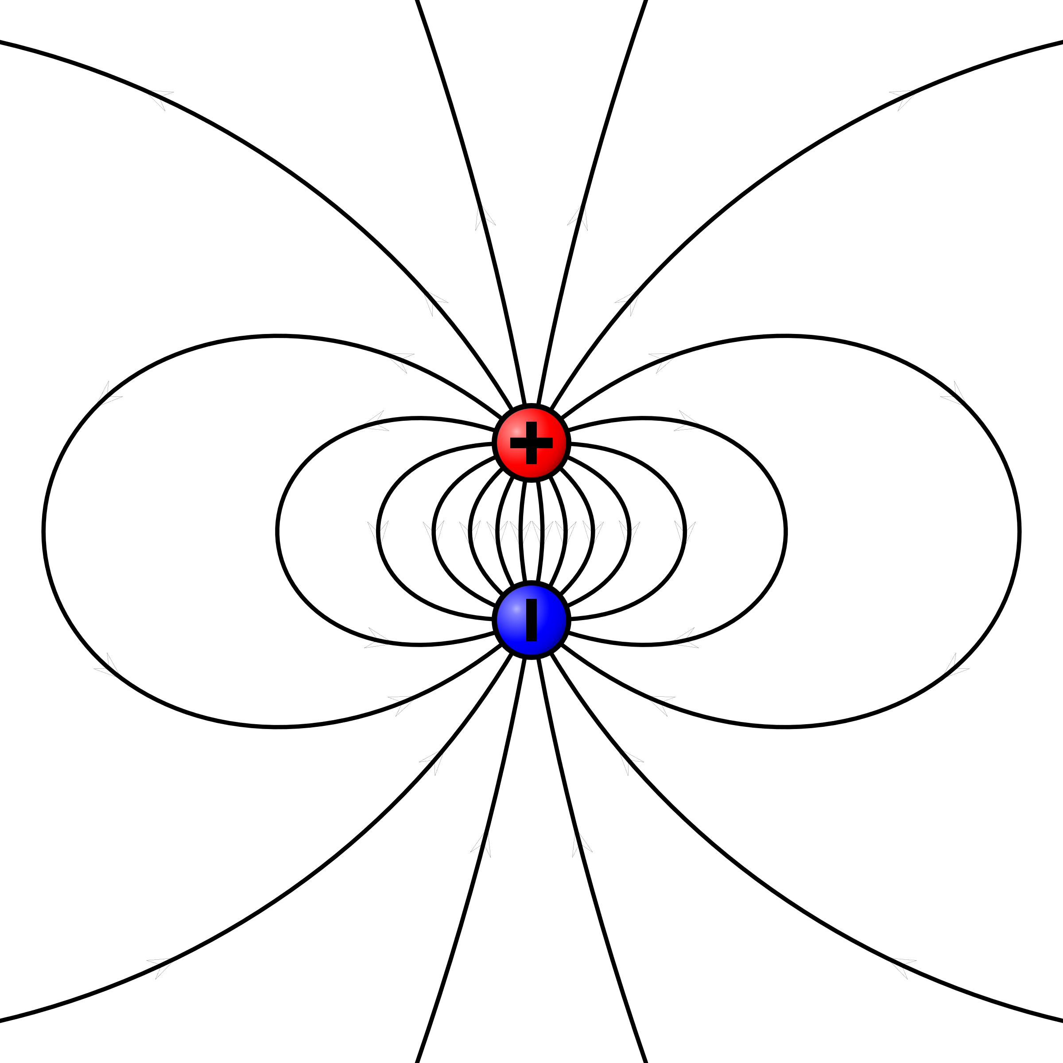
Plasmonic Ponderomotive Force
$ω=2.65 fs$
$hc=0.197$ keV nm
Drift force due to the oscillating electron cloud around the gold nanorod due to LSP resonance that could directly couple to ions.
3D Simulations of Single Nanorods
Typically, the ponderomotive force is far too small to cause direct acceleration to protons due to their large mass.
Using EPOCH
$F_{p}=−\frac{Z^{2} {\left(hc\right)}^{2}}{2 m ω^{2}}∇{\left\langle {\left(eE\right)}^{2}\right\rangle }_{2 π/ω}$
proton
However, the ponderomotive force due to the oscillating field around a nanorod can be much larger due to field enhancement and increase in the field gradient.
the $∇E^{2}$ term is ~1600 times larger for the nanorod than the laser by field enhancement.
electron
Near field approx.
Increase in the ponderomotive force leads to more efficient electron and ion acceleration

Slide 24
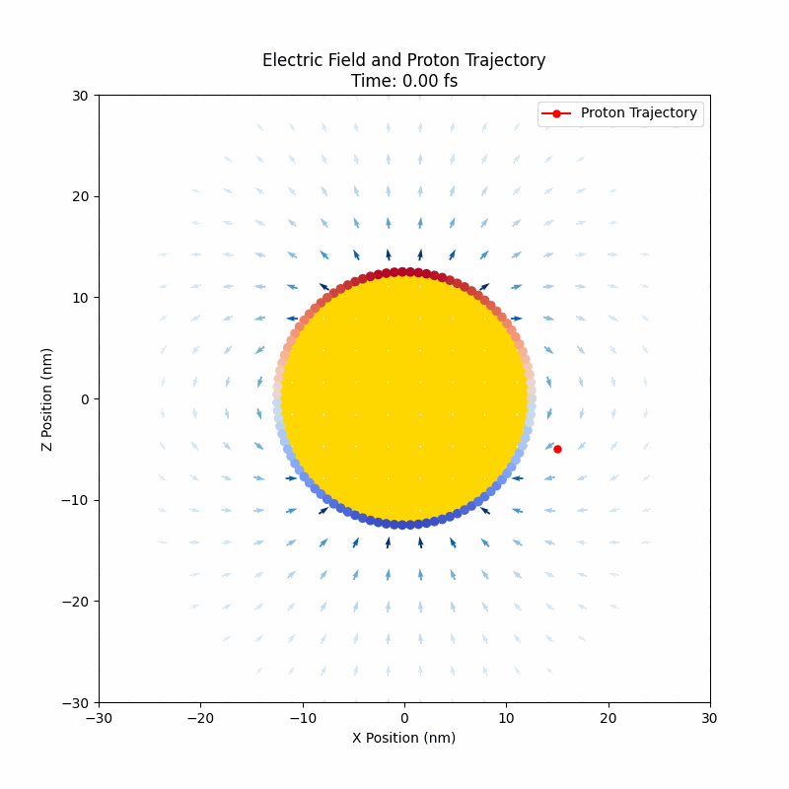
Toy Model – Conducting Sphere
$$λ=3 μm$$
(for demonstration purposes)
$$I\sim {10}^{18}W/cm^{2}$$
Proton
(Ionized H)
Conducting shell
$R=12.5$ nm
proton
Dipole moment $p=Z_{e} R$ decide the field strength outside the nanorod
$\left|E\right|\left(R\right)={10}^{12}$V/m
$$Z_{e} −number of electrons≈{10}^{6}$$

Slide 25
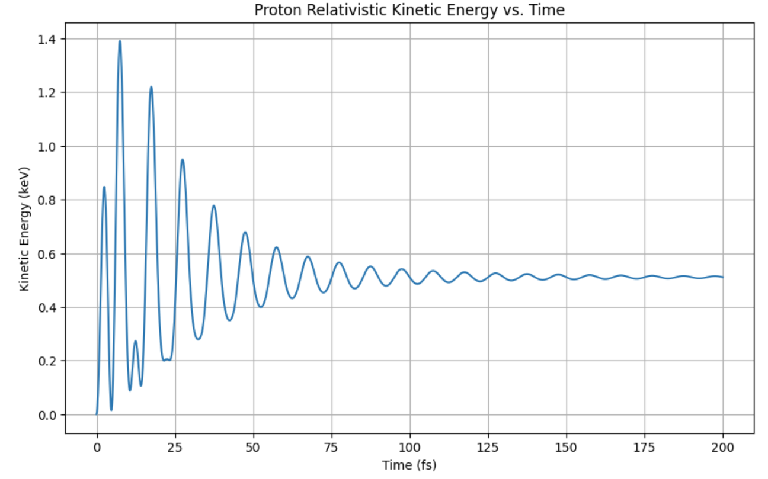
Toy Model – Conducting Sphere
Proton
(Ionized H)
$$r_{osc}\left(t\right)$$
$$r_{drift}(t)$$
If the laser frequency is much larger than the characteristic timescale of proton acceleration
$$ω≫\frac{qE}{mc}$$
$$r\left(t\right)=r_{osc}\left(t\right)+r_{drift}(t)$$

Slide 26
Simulations on GPU Cluster
The 3D nanorod simulation study's the plasmonic effects of a single nanorod (made partially by me and the previous postdoc István Papp)
Simple model contains a gold cylinder with spherical end caps (85x25 nm) at solid density $5.9×{10}^{22} cm^{−3}$ with charge state ${Au}^{3+}$ covered with a neutralizing cloud of “conducting” electrons. The nanorod is surrounded by an ionized medium of carbon and hydrogen. The nanorod is then illuminated with $λ=795 nm$ light with some pulse duration $∆t_{pulse}$ with open boundary conditions for fields and particles run for 200 fs.
Focus on analyzing evolution of:
Electric field
Charge density
Number density
Particle energies
Ion Energy spectra – observable via Thompson parabola in experiment.
$$795nm$$
y
$$530nm$$
x
4 nm
z

Slide 27
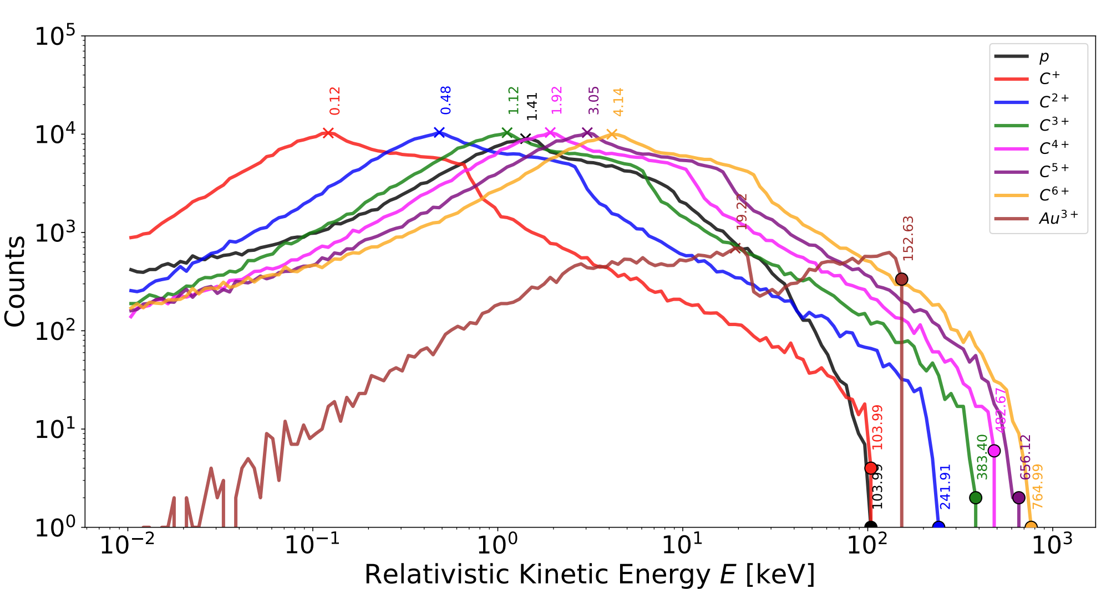
Ion spectra -EPOCH
$$I=4.28×{10}^{18} W/cm^{2}$$
$$∆t_{pulse}=21 fs$$
Taken at
$$t=200 fs$$
Cutoff energies scale with Z
Plotted in python

Slide 28
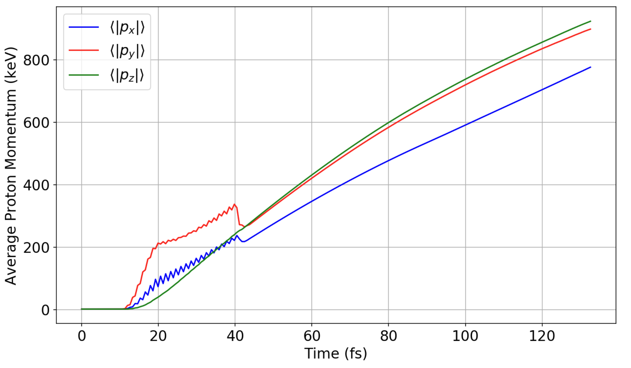
Proton Acceleration
$$I=4.28×{10}^{18} W/cm^{2}$$
$$∆t_{pulse}=21 fs$$
y
x
Laser pulse duration
z
What causes late time momentum increase?

Slide 29
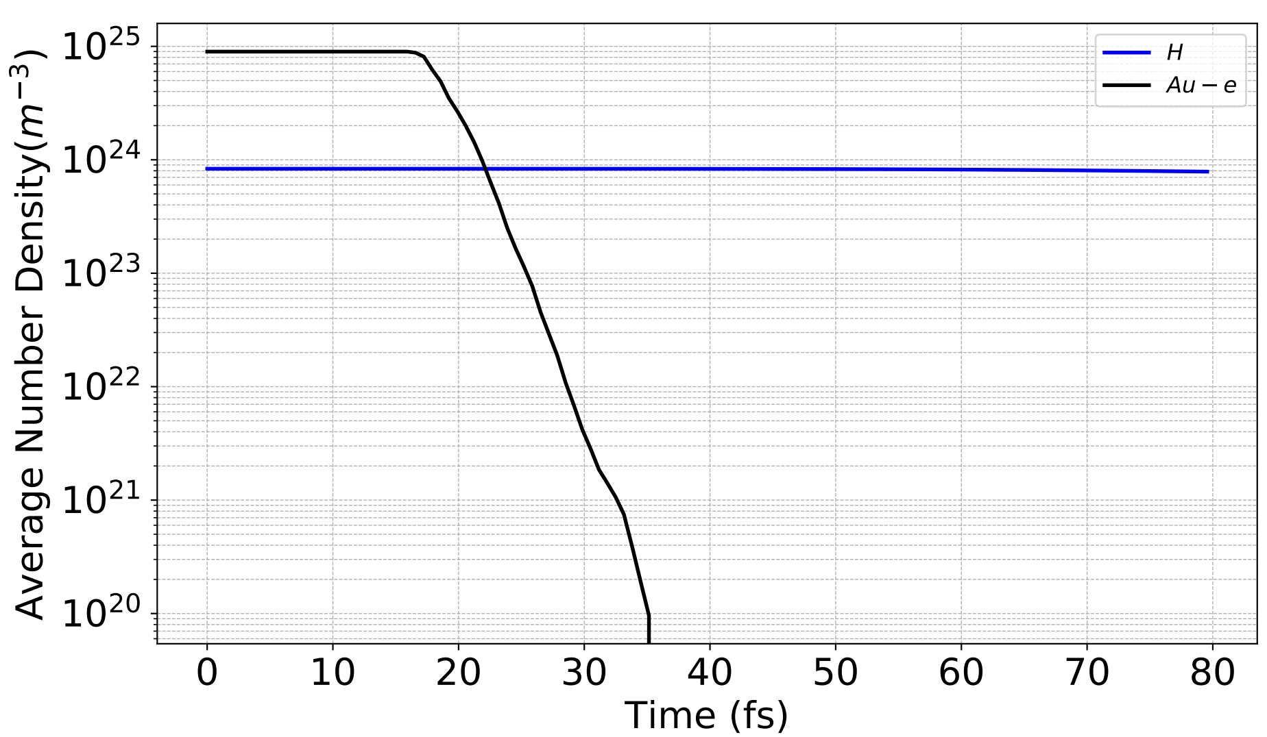
Electron Density
$$I=4.28×{10}^{18} W/cm^{2}$$
$$∆t_{pulse}=21 fs$$
y
After this point the nanorod is heavily ionized
x
z
Ionization
Ionization limit was set to ${Au}^{3+}$, but ionization can go up to ${Au}^{20+}$
Electron loss is exaggerated here due to small simulation size

Slide 30
Electron Density
$$I=4.28×{10}^{18} W/cm^{2}$$
$$∆t_{pulse}=21 fs$$
Highly ionized gold nanorod causes a Coulomb explosion in the local material.
After this point the nanorod is heavily ionized
y
+
+
+
$${Au}^{3+}$$
+
+
+
+
+
x
Ionization
+
+
+
z
Electron loss is exaggerated here due to small simulation size
Ionization limit was set to ${Au}^{3+}$, but ionization can go up to ${Au}^{20+}$

Slide 31
Electron Density
$$I=4.28×{10}^{18} W/cm^{2}$$
$$∆t_{pulse}=21 fs$$
Highly ionized gold nanorod causes a Coulomb explosion in the local material.
After this point the nanorod is heavily ionized
How important is coulomb explosion for ion spectra?
y
+
+
+
$${Au}^{3+}$$
+
+
+
+
+
x
Ionization
+
+
+
z
Electron loss is exaggerated here due to small simulation size
Ionization limit was set to ${Au}^{3+}$, but ionization can go up to ${Au}^{20+}$

Slide 32
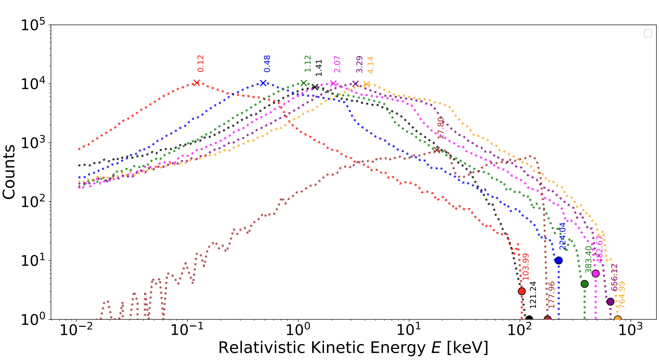
Ion spectra –Coulomb Explosion
$$I=4.28×{10}^{18} W/cm^{2}$$
$$∆t_{pulse}=21 fs$$
y
+
+
+
$${Au}^{3+}$$
+
No
Laser
+
+
+
+
x
+
+
+
z

Slide 33
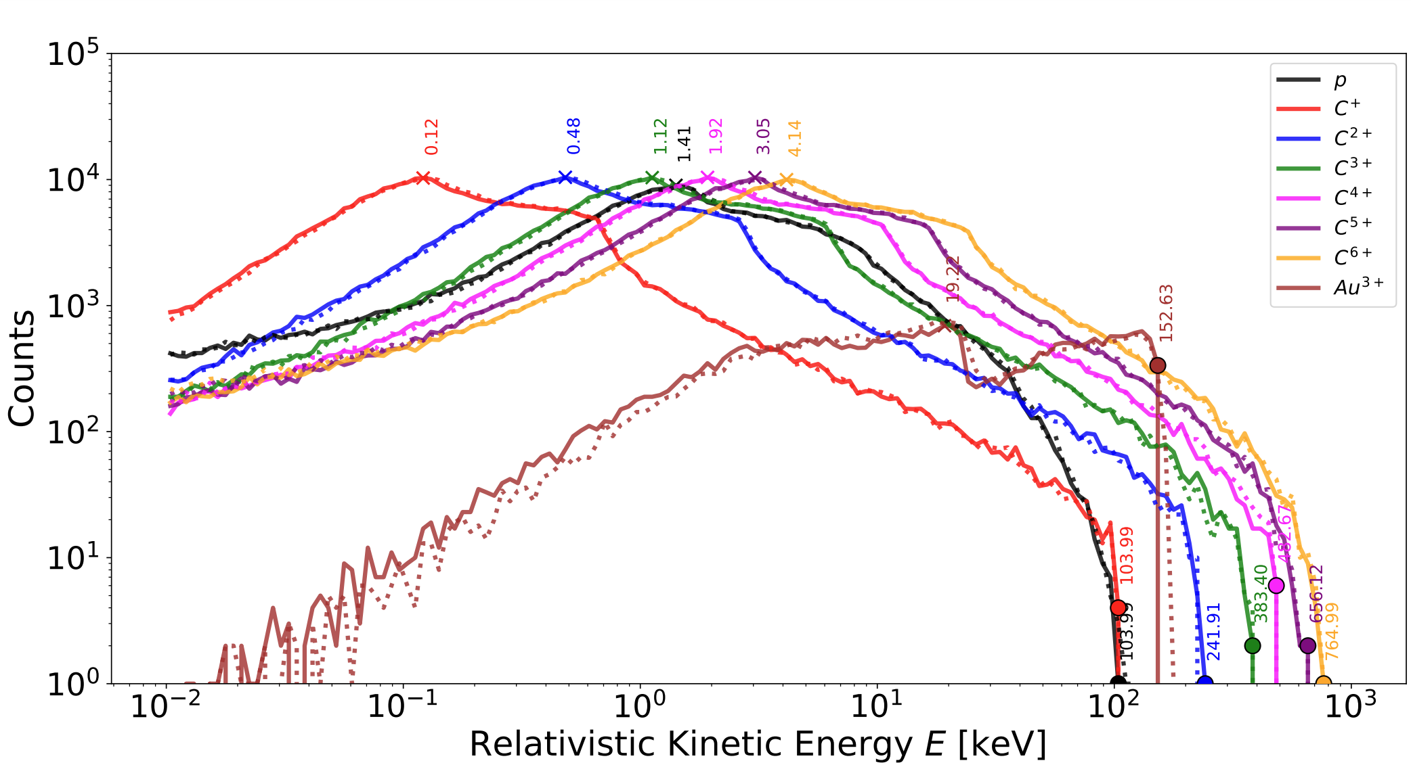
Ion spectra - Comparison
$$I=4.28×{10}^{18} W/cm^{2}$$
$$∆t_{pulse}=21 fs$$
Cutoff energies mainly due to Coulomb Explosion
Coulomb Exp
Ponderomotive + Coulomb Exp

Slide 34
Ion spectra - Comparison
$$I=4.28×{10}^{18} W/cm^{2}$$
$$∆t_{pulse}=21 fs$$
Cutoff energies mainly due to Coulomb Explosion
Why is the ponderomotive force so small?
Coulomb Exp
Ponderomotive + Coulomb Exp

Slide 35
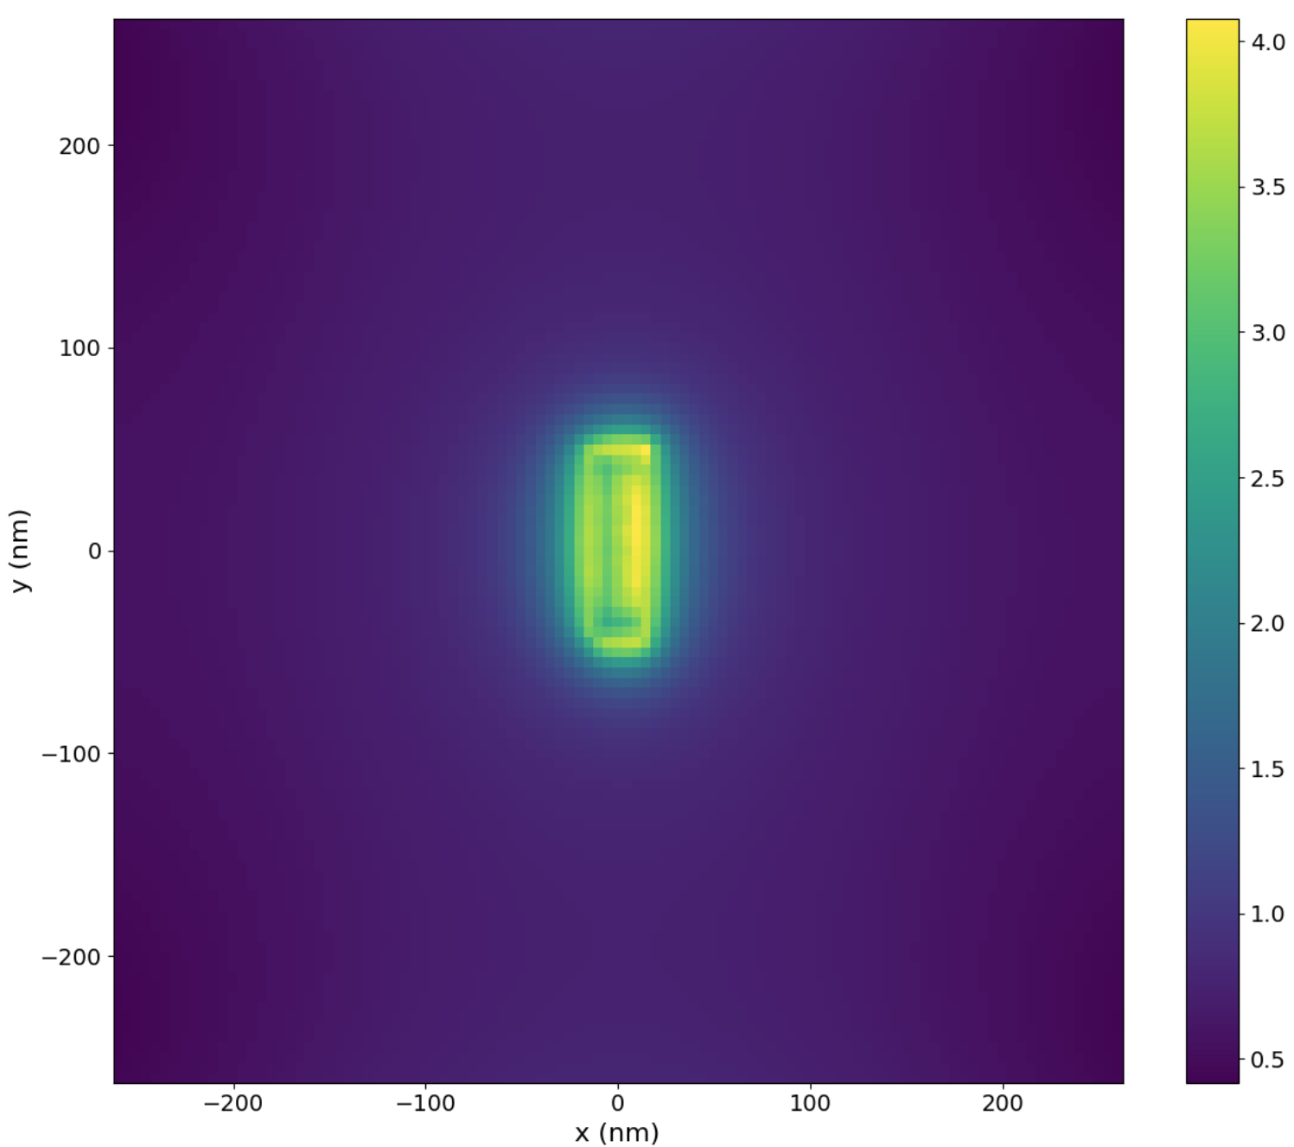
Why is the Ponderomotive effect on ions so small?
$$E_{0}=\sqrt{\frac{2 I}{ε c}}$$
$${E_{sim}/E}_{0}$$
$$I=4×{10}^{18} W/cm^{2}$$
$$ε= ε_{r}ε_{0}=2.25ε_{0}$$
$$NFE≈2−4$$
similar results found in a previous publication
I. Papp (2022)
$$NFE=\sqrt{25.9}≈5$$
EPOCH predicts very small near field enhancement (NFE) in comparison to theory.

Slide 36
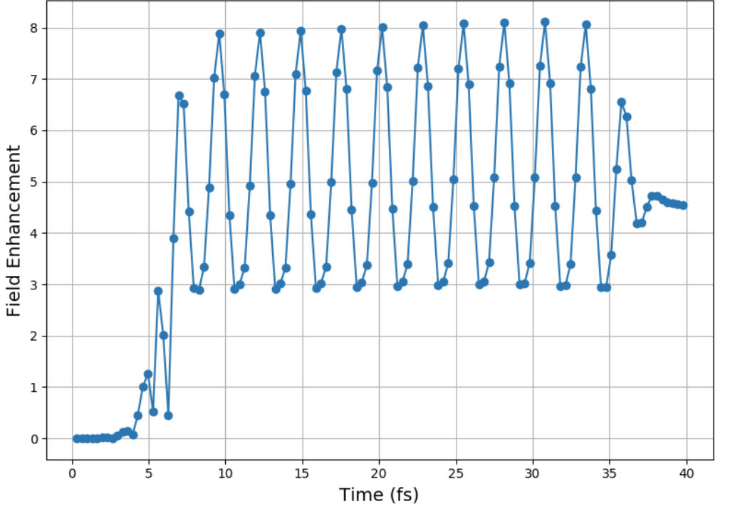
Simulations
The 3D nanorod simulation study's the plasmonic effects of a single nanorod
gold cylinder with spherical end caps (85x25 nm) at solid density $5.9×{10}^{22} cm^{−3}$ with charge state ${Au}^{3+}$ covered with a neutralizing cloud of “conducting” electrons. The nanorod is surrounded by an ionized medium of hydrogen. The nanorod is then illuminated with $λ=795 nm$ light with some pulse duration $∆t_{pulse}$ with open boundary conditions for fields and particles run for 200 fs.
Measure the Near Field Enhancement Predicted by Epoch
$$795nm$$
y
x
$$530nm$$
Calculate Average
5 nm
z

Slide 37
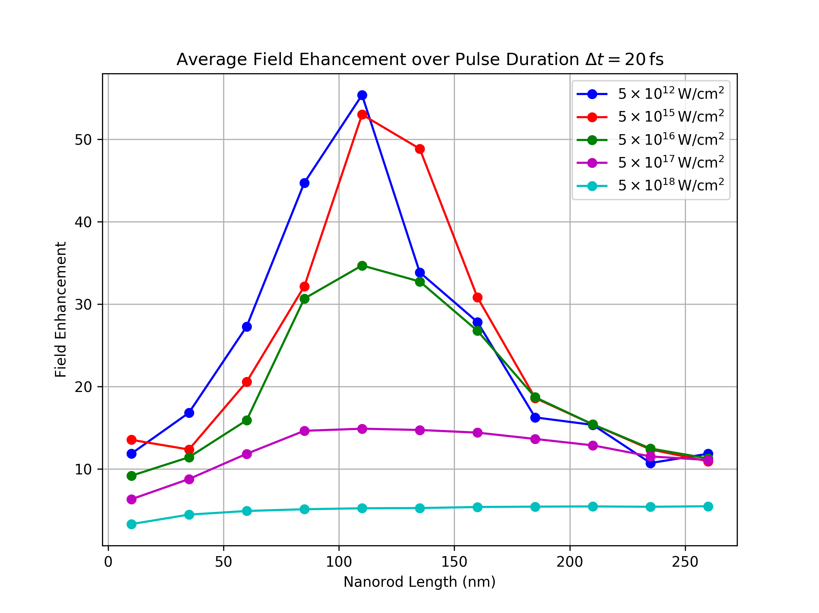
55 simulations
2,200 fs
11hrs – Wall hours
704 – CPU hours
$$Diameter=25 nm$$
At 1 nm from
The surface

Slide 38
$$Diameter=25 nm$$
At 1 nm from
The surface

Slide 39
$$135 nm$$
Vacuum
$$Diameter=25 nm$$
At 1 nm from
The surface
UDMA
$$85 nm$$

Slide 40
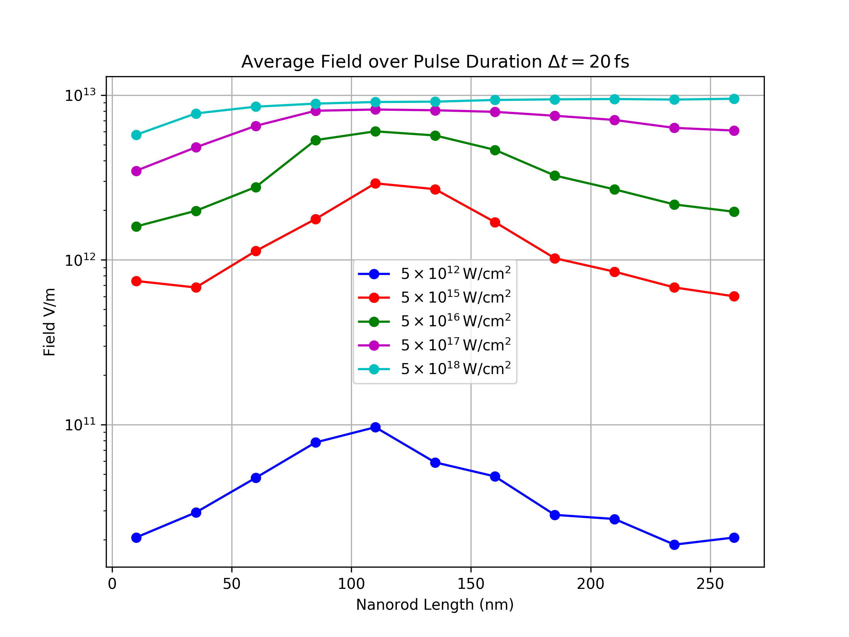
At 1 nm from
The surface
UDMA
$$85 nm$$

Slide 41
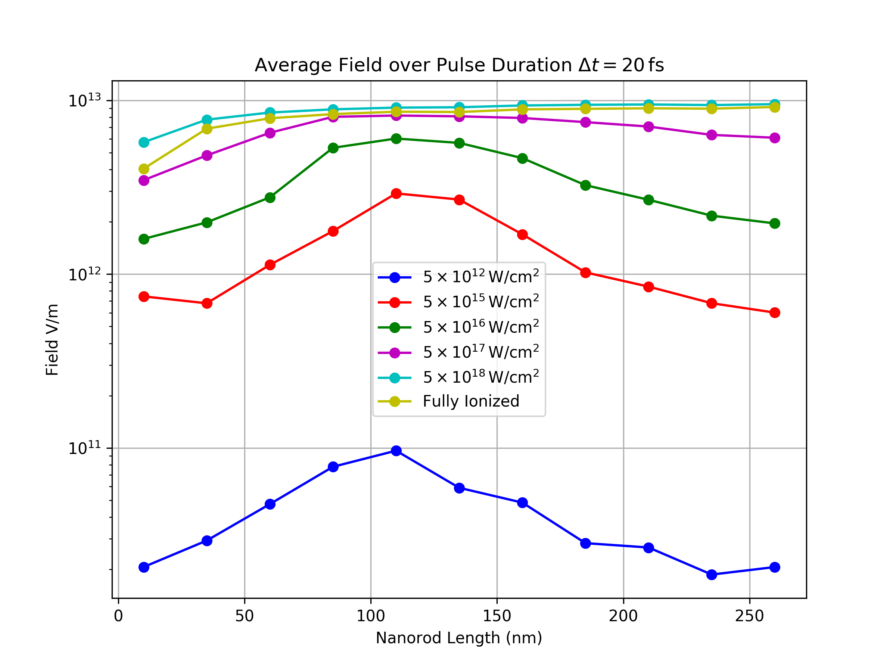
Plasmonic field saturates at the field strength of a fully ionized nanorod
The near field enhancement cannot go above the ionization field of the nanorod
At 1 nm from
The surface
y
+
+
+
$${Au}^{3+}$$
+
+
+
+
+
x
+
+
+
UDMA
$$85 nm$$
z

Slide 42
$$E_{WB}∼n_{e}^{1/2}$$
$$E_{WB}≈{10}^{13}V/m$$
Plasmonic field saturates at the field strength of a fully ionized nanorod
The nanorod cannot support a coherent oscillating electric field above this limit.
The near field enhancement cannot go above the ionization field of the nanorod
At 1 nm from
The surface
y
+
+
+
$${Au}^{3+}$$
+
+
+
+
+
x
+
+
+
UDMA
$$85 nm$$
z

Slide 43
Conclusion
For low density of nanorods unoriented, short pulse duration and high intensity ($I>{10}^{17}W/cm^{2}$). The dominant acceleration process is coulomb explosion.
In the future we will use nanorod arrays which can reduce electron spillage by sharing electrons.
Preliminary results show that arrays lead to larger peak energies for ions and increase in electron temperature $T_{e}$.
Previously shown for non-resonant nanorods Vallières et al. (2021)
For ponderomotive nanorod acceleration one must use low intensity ${<10}^{15}W/cm^{2}$ and long pulse duration, and structured nano targets, such that protons will continue to acquire energy from multiple nano rods.
Next week we go to ELI in Szeged for more measurements!
Notes:
Ad near field enhancement add slide describing simulation

Slide 44
The NanoPlasmonic Laser Induced Fusion Energy
Resonance condition
These nanorods resonantly absorb $800 nm$ light via Localized Surface Plasmon resonance (LSP)
$$α=4 π a^{3}\frac{ε\left(ω\right)−ε_{D}}{ε\left(ω\right)+2 ε_{D}}$$
$$p= ε_{0} ε_{D} α E_{0}$$
$$E_{laser}$$
$$85 nm$$
The classical polarizability diverges when
$$E_{0}$$
$$a$$
$$25 nm$$
$$−$$
$$Re\left[ε\left(ω\right)\right]=−2 ε_{D}$$
$$+$$
$$ε\left(ω\right)$$
$$ε_{D}$$
Maier, Stefan A. Plasmonics: fundamentals and applications. Vol. 1. New York: springer, 2007.
$$E_{Nano}$$
$$+$$
$$−$$
This leads to quantum effects such as focusing past the diffraction limit, resonant absorption of light, and electric field enhancement.
Locally increased field Strength and Field Gradient
LSP resonance can respond incredibly fast.
$ω_{LSP}=2.65 fs$

Slide 45
Why is the NFE effect on ions so small?
$$E_{0}=\sqrt{\frac{2 I}{ε c}}$$
$${E_{sim}/E}_{0}$$
$$I=4×{10}^{17} W/cm^{2}$$
$$ε= ε_{r}ε_{0}=2.25ε_{0}$$
$$NFE≈2−4$$
similar results found in a previous publication
I. Papp (2022)
$$NFE=\sqrt{25.9}≈5$$
EPOCH predicts very small near field enhancement (NFE) in comparison to theory at high intensities.
$$ε_{D}\left(ω\right)?$$

Slide 46
Simulations
The 3D nanorod simulation study's the plasmonic effects of a single nanorod
gold cylinder with spherical end caps (85x25 nm) at solid density $5.9×{10}^{22} cm^{−3}$ with charge state ${Au}^{3+}$ covered with a neutralizing cloud of “conducting” electrons. The nanorod is surrounded by an ionized medium of hydrogen. The nanorod is then illuminated with $λ=795 nm$ light with some pulse duration $∆t_{pulse}$ with open boundary conditions for fields and particles run for 200 fs.
Measure the Near Field Enhancement Predicted by Epoch
$$795nm$$
y
x
$$530nm$$
Calculate Average
5 nm
z

Slide 47
55 simulations
2,200 fs
11hrs – Wall hours
704 – CPU hours
-fairly cheap simulation
$$Diameter=25 nm$$
At 1 nm from
The surface

Slide 48
$$Diameter=25 nm$$
At 1 nm from
The surface

Slide 49
$$135 nm$$
Vacuum
$$Diameter=25 nm$$
At 1 nm from
The surface
UDMA
$$85 nm$$

Slide 50
At 1 nm from
The surface
UDMA
$$85 nm$$

Slide 51
Conclusion
Measure the Near Field Enhancement Predicted by Epoch
Open Questions and Improvements:
Tailor medium to better represent UDMA $ε_{D}\left(ω\right).$
Why does the resonance decrease at high intensity?
NFE does not decrease due to ionization….
Why is there a late time NFE?
Can the phenomena responsible for this be used to create more resonance at higher intensities?
Ionization of electrons

Slide 52
Thompson parabola spectra

Slide 53
Thompson parabola spectra

Slide 54
Thompson parabola spectra

Slide 55
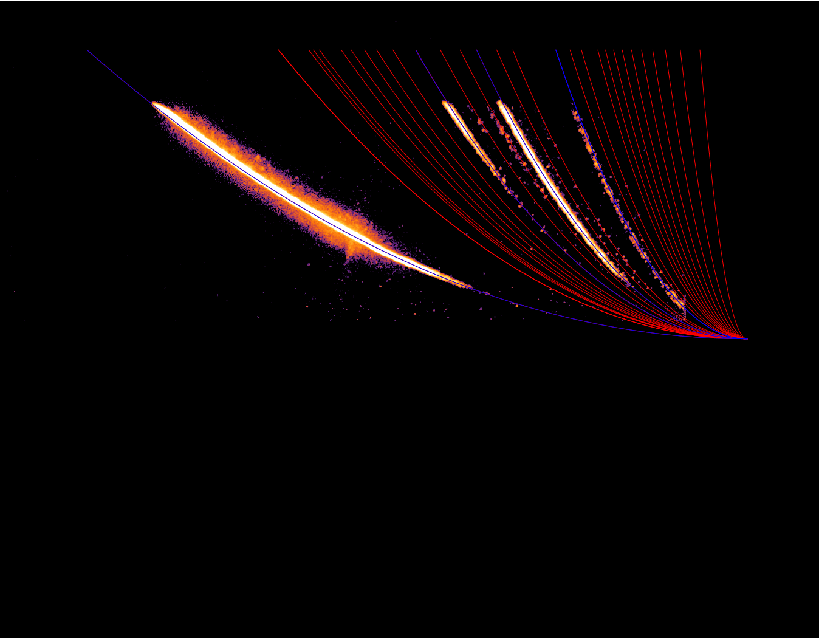
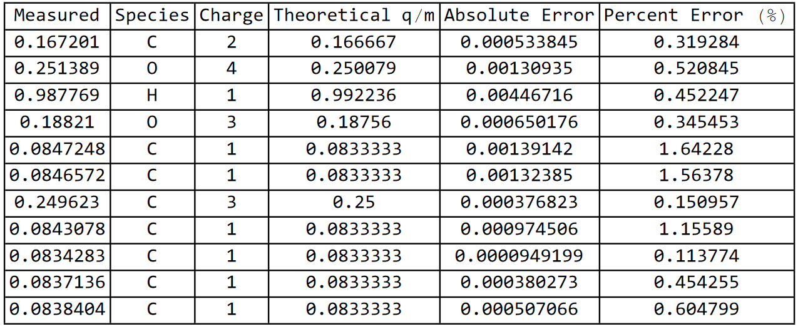
Thompson parabola spectra

Slide 56
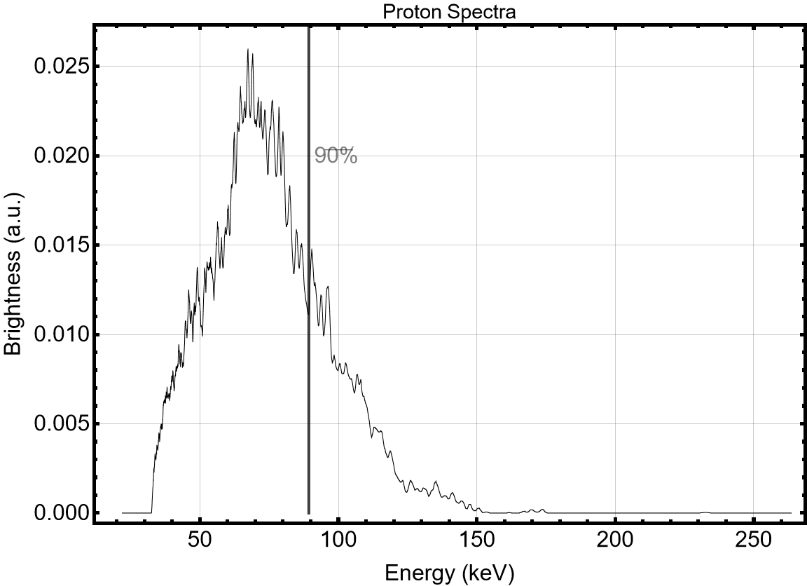
Thompson parabola spectra

Slide 57
Thompson parabola spectra
Run statistics over all the days of shots

Slide 58
Thompson parabola spectra

Slide 59
The NanoPlasmonic Laser Induced Fusion Energy
Can nano-structured targets lead to femtosecond scale ion acceleration?
These nanorods resonantly absorb $800 nm$ light via Localized Surface Plasmon resonance (LSP)
$$\frac{a_{0p}}{a_{0e}}=\frac{m_{e}}{m_{p}}≈5×{10}^{−4}$$
$$α=4 π a^{3}\frac{ε\left(ω\right)−ε_{D}}{ε\left(ω\right)+2 ε_{D}}$$
Huge factor to overcome $→$
$$p= ε_{0} ε_{D} α E_{0}$$
Solution
Use collective electron motion.
like (TNSA)
The classical polarizability diverges when
$$E_{0}$$
$$E_{laser}$$
$$85 nm$$
$$a$$
$$Re\left[ε\left(ω\right)\right]=−2 ε_{D}$$
$$ε\left(ω\right)$$
$$ε_{D}$$
Maier, Stefan A. Plasmonics: fundamentals and applications. Vol. 1. New York: springer, 2007.
$$25 nm$$
$$−$$
$$+$$
This leads to quantum effects such as focusing past the diffraction limit, resonant absorption of light, and electric field enhancement.
$$E_{Nano}$$
$$+$$
$$−$$
LSP resonance can respond incredibly fast.
$ω_{LSP}=2.65 fs$
Locally increased field Strength and Field Gradient

Slide 60
Plasmonic Ponderomotive Force
$ω=2.65 fs$
$hc=0.197$ keV nm
Our group was mainly interested in forces due to the oscillating electron cloud around the gold nanorod due to LSP resonance that could directly couple to ions.
Typically, the ponderomotive force is far too small to cause direct acceleration to protons due to their large mass.
proton
However, the ponderomotive force due to the oscillating field around a nanorod can be much larger due to field enhancement and increase in the field gradient.
electron
the $∇E^{2}$ term is ~1600 times larger for the nanorod than the laser by field enhancement.
$U_{p}\left(nanorod\right)=4 MeV$ (for a proton)
$$p=N_{e}ed ≈{10}^{6}e \left(85 nm\right)\hat{z}$$

Slide 61
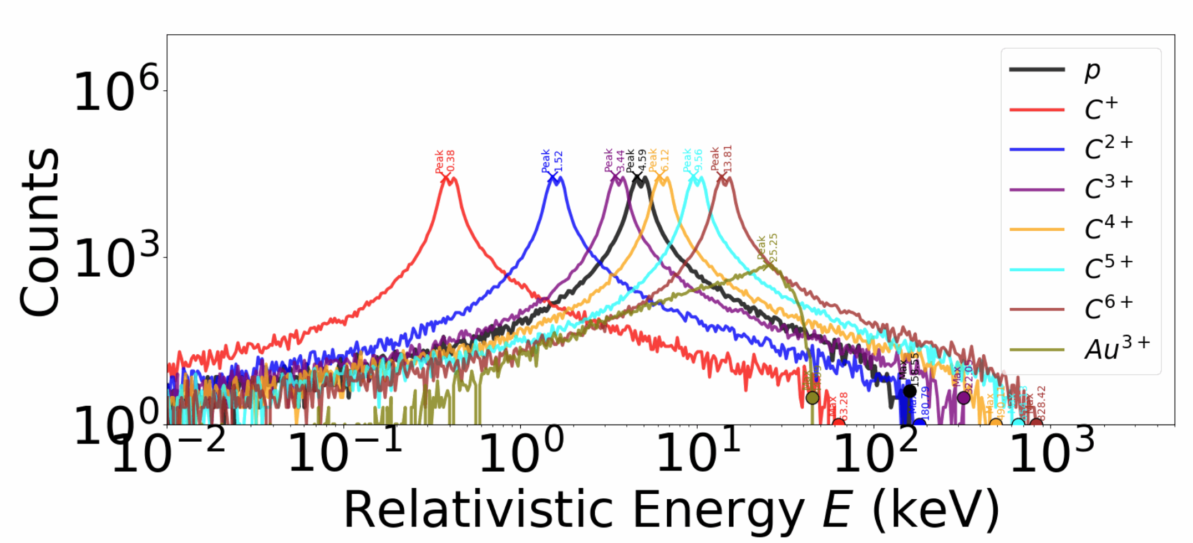
Ion spectra -EPOCH
$$I=4.28×{10}^{18} W/cm^{2}$$
$$∆t_{pulse}=21 fs$$
Taken at
$$t=40 fs$$
Periodic Boundary conditions for particles

Slide 62
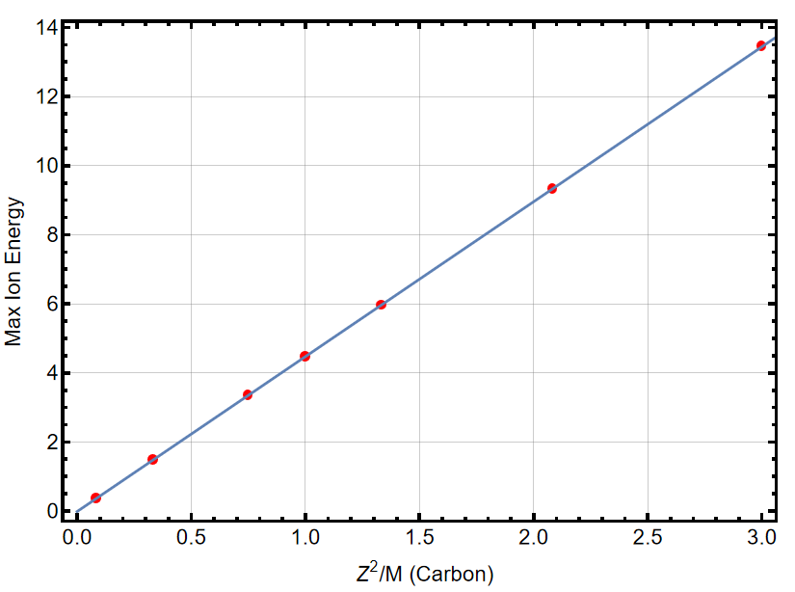
Ion spectra -EPOCH
$$I=4.28×{10}^{18} W/cm^{2}$$
$$∆t_{pulse}=21 fs$$
Peak Energies scale with $Z^{2}/M_{i }$-Ponderomotive
Taken at
$$t=40 fs$$
Cutoff energies scale with Z - Coulomb
Periodic Boundary conditions for particles

Slide 63
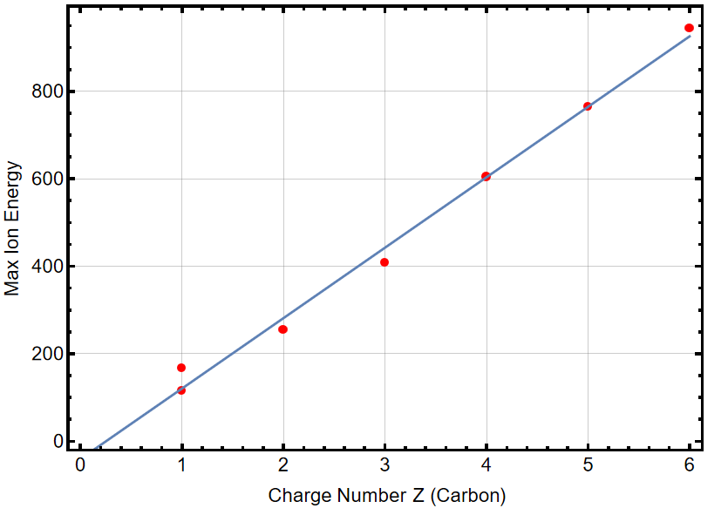
Ion spectra -EPOCH
$$I=4.28×{10}^{18} W/cm^{2}$$
$$∆t_{pulse}=21 fs$$
Peak Energies scale with $Z^{2}/M_{i }$-Ponderomotive
Taken at
$$t=40 fs$$
Cutoff energies scale with Z - Coulomb
Periodic Boundary conditions for particles

Slide 64
Ion spectra -EPOCH
$$I=4.28×{10}^{18} W/cm^{2}$$
$$∆t_{pulse}=21 fs$$
Peak Energies scale with $Z^{2}/M_{i }$-Ponderomotive
Taken at
$$t=40 fs$$
Cutoff energies scale with Z - Coulomb
Periodic Boundary conditions for particles

Slide 65
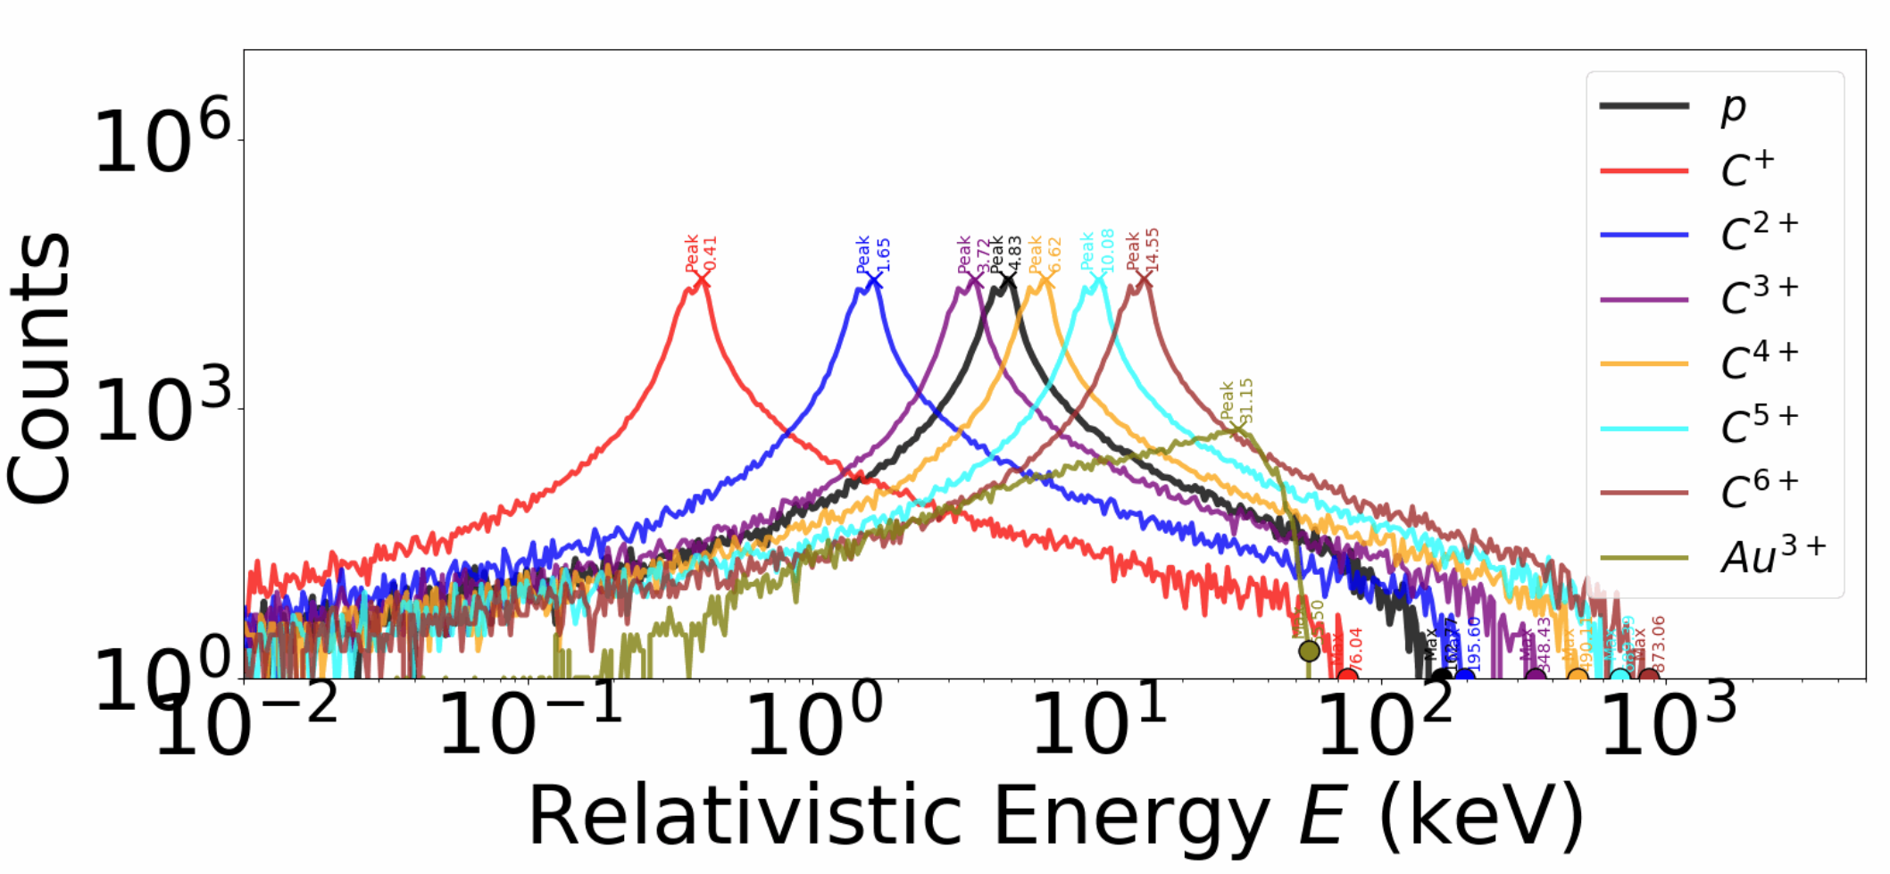
Ion spectra -EPOCH
$$∆t_{pulse}=60 fs$$
$$I=4.28×{10}^{18} W/cm^{2}$$
Ponderomotive potential is saturated
Taken at
$$t=60 fs$$
Periodic Boundary conditions for particles

Slide 66
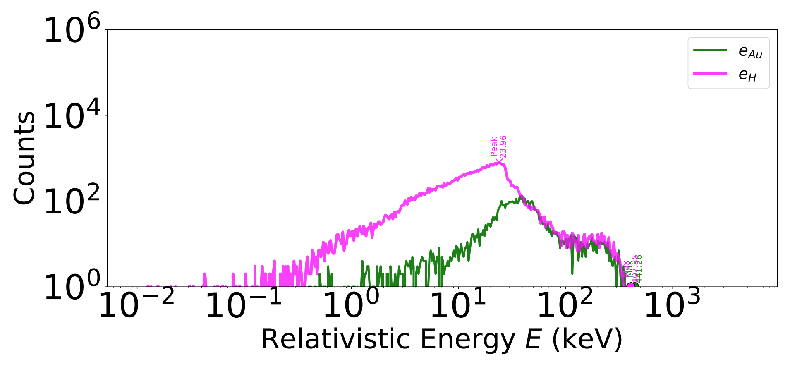
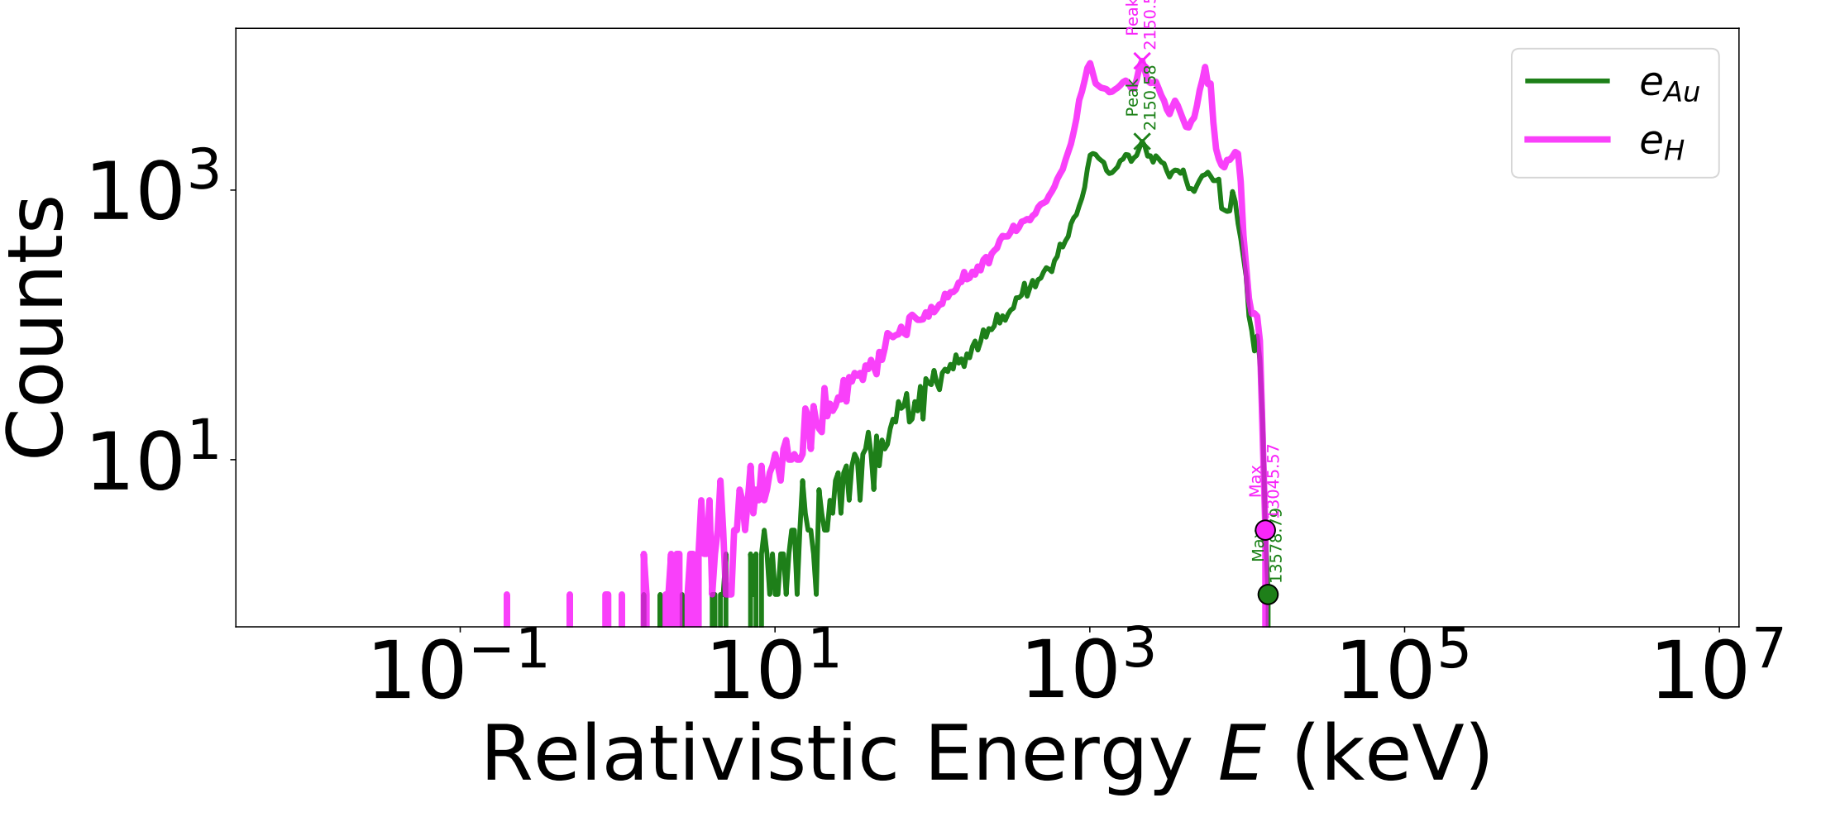
Ion spectra -EPOCH
$$I=4.28×{10}^{18} W/cm^{2}$$
$$∆t_{pulse}=21 fs$$
Taken at
$$t=200 fs$$
Single nanorod

Slide 67
Ion spectra -EPOCH
$$I=4.28×{10}^{18} W/cm^{2}$$
$$∆t_{pulse}=21 fs$$
Nanorod array
Taken at
$$t=200 fs$$

Slide 68
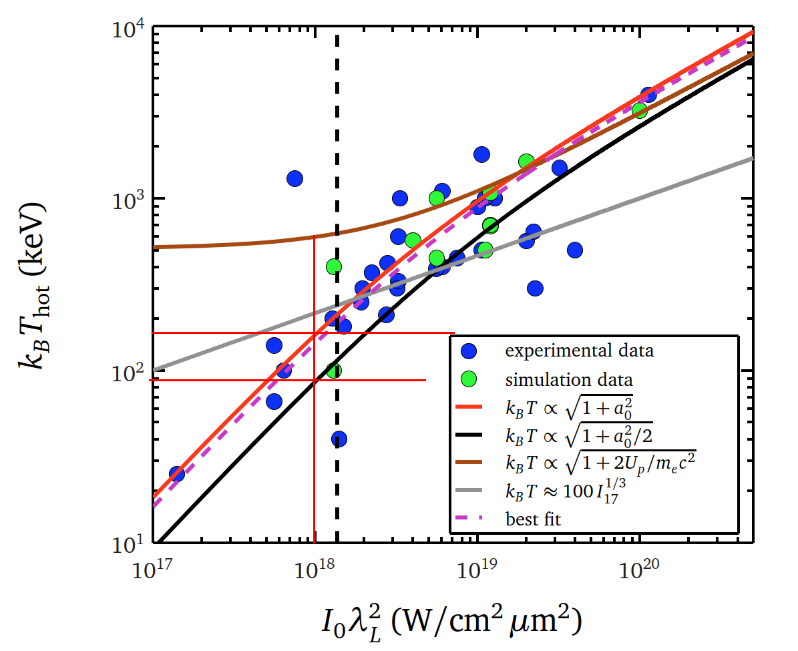
Ion spectra -EPOCH
$$I=4.28×{10}^{18} W/cm^{2}$$
$$∆t_{pulse}=21 fs$$
Plasmonic
Taken at
$$t=200 fs$$
$$E_{max}(Ion)\sim T_{hot}$$

