Slide 1

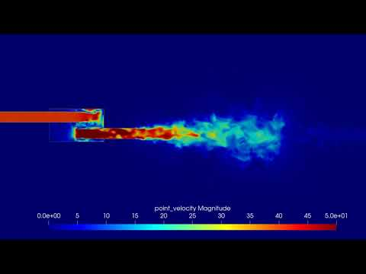
GPU-cluster-accelerated 3D FVM simulation for the compressible Navier-Stokes equations on unstructured meshes
Mátyás Constans, Zoltán Horváth
HUN-REN Wigner, 2025-05-22
GPU DAY 2025

Slide 2
Contents
Overview of the European HPC ecosystem
  EuroHPC and EuroCC
  HiDALGO2 Centre of Excellence
  SZE HPC-activities
    Urban Air Project application
    RedSim: native MPI+CUDA 3D Navier-Stokes solver on unstructured mesh
GPU implementation and optimization of RedSim
  RedSIM Architecture Overview
  Memory Access Pattern Optimization
    Data locality, linear allocations
    Partitioning, communication with MPI + CUDA
  Benchmark Results

Slide 3
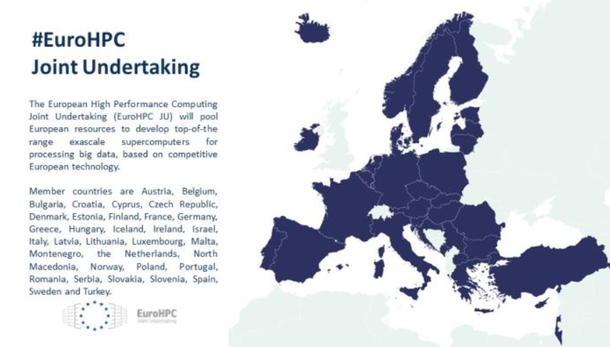

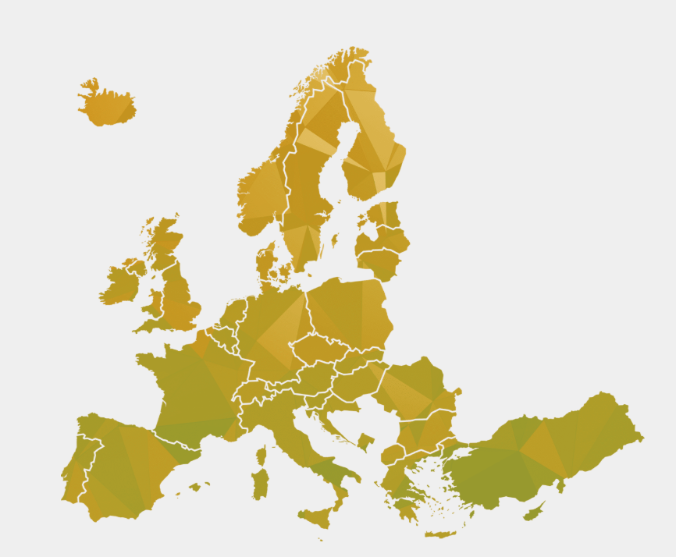

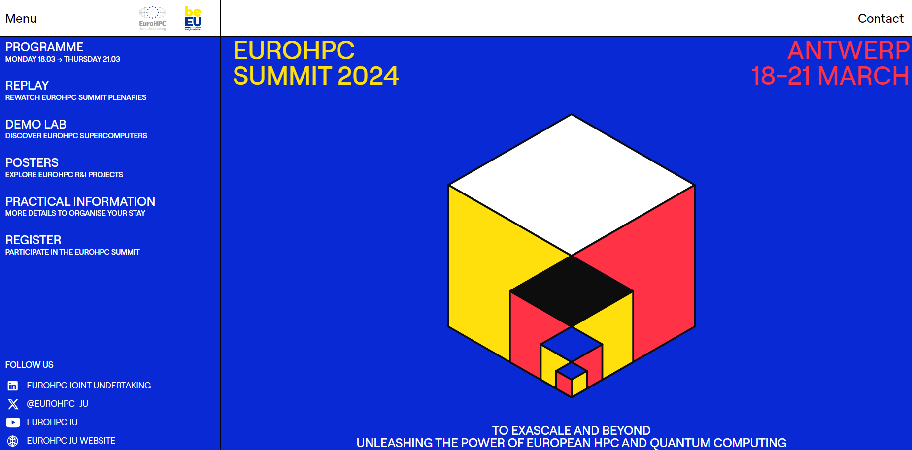
1.1 Overview of the European HPC ecosystem
EuroHPC Joint Undertaking, https://eurohpc-ju.europa.eu/
  Centre of Excellence projects (CoEs) on selected domains
  Projects: RIA and flagship projects: AI Factories, OpenEuroLLM, …
  Education (e.g. EUMaster4HPC)
EuroCC
  The National Competence Centres (NCCs) are the central points of contact for
  HPC and related technologies in their country
  The Hungarian NCC: DKF
CASTIEL2: Coordination and Support Action over CoEs and NCCs
EUROHPC SUMMIT
  The main event of all EU HPC activities, organized each year

Slide 4










1.2 Overview of the HiDALGO2 CoE
Tackling Global Challenges by means of HPC, Big Data Analytics, Artificial Intelligence and Immersive Visualization
Advancing selected applications towards Exascale systems
Provisioning a platform for processing advanced environmental- and societal-oriented simulations
Enabling collaboration with communities focused on environmental scientific and industrial domains
Developing HPC-codes and tools for developers and good practice guidelines for decision-makers of environmental and social phenomena

Slide 5
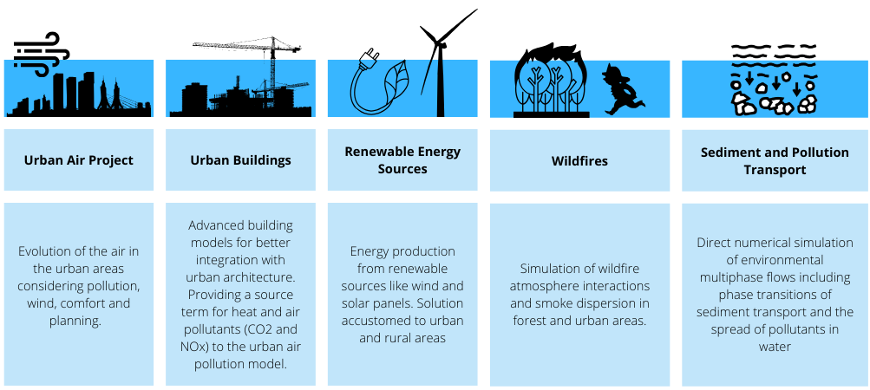
1.2 The HiDALGO2 Use Cases
Notes:
Mission
Bring together advanced solutions in High-Performance Computing (HPC), High-Performance Data Analytics (HPDA), and Artificial Intelligence (AI)
Provide stakeholders with powerful tools to tackle the pressing issues of climate change and urbanisation on a global scale
Vision
Exploring synergies between modelling, data acquisition, simulation, data analysis, and visualisation while achieving better scalability on current and future HPC and AI infrastructures

Slide 6




1.3 SZE HPC activities: a series of 3 Horizon HPC projects
MSO4SC, H2020 project, 2016-2018
  Goal: develop containerized solutions for societal challenges and math frameworks
  SZE role: Scientific coordinator, WP-leader, use-case provider, code developer: UAP, containerization, portal co-developer
HiDALGO, H2020 CoE project, 2018-2021
  SZE role: use-case provider, code developer: OpenFOAM, RedSim (aka FluidSolver)
HiDALGO2, EuroHPC CoE project 2022-2026 (Horizon Europe)
  SZE role: use-case provider (UAP), WP5 leader, Data&Ethics leader, code developer: RedSim, CFDR, OpenFOAM, Xyst, HiDALGO2-portal (task leader)

Slide 7
1.3. Overview of the recent SZE HPC activities
As partner of HiDALGO2 CoE, CASTIEL2 organized several webinars, trainings devoted to SZE activities. Recently,
  9th ”Code of the Month” presentation of the SZE in July 2024
  Success Stories for HPC applications for the SZE RedSim code applied to Stockholm
  WEBINAR: HiDALGO2 COE and ENCCS: use case with SLB Analys (Stockholm city) – 26 May 2025, 13:00-14:00 CEST.
    Register in advance for this meeting: https://zoom.us/meeting/register/YiKjbOxtREufS_-pdgDVug
    After registering, you will receive a confirmation email containing information about joining the meeting.
  Student Workshop on AI and HPC Applications – hybrid event at NTU Athens, 26 and 30 May 2025, organized by NTUA and SZE
JOIN THE ACTIVITIES OF EUROHPC AND EUROCC!

Slide 8

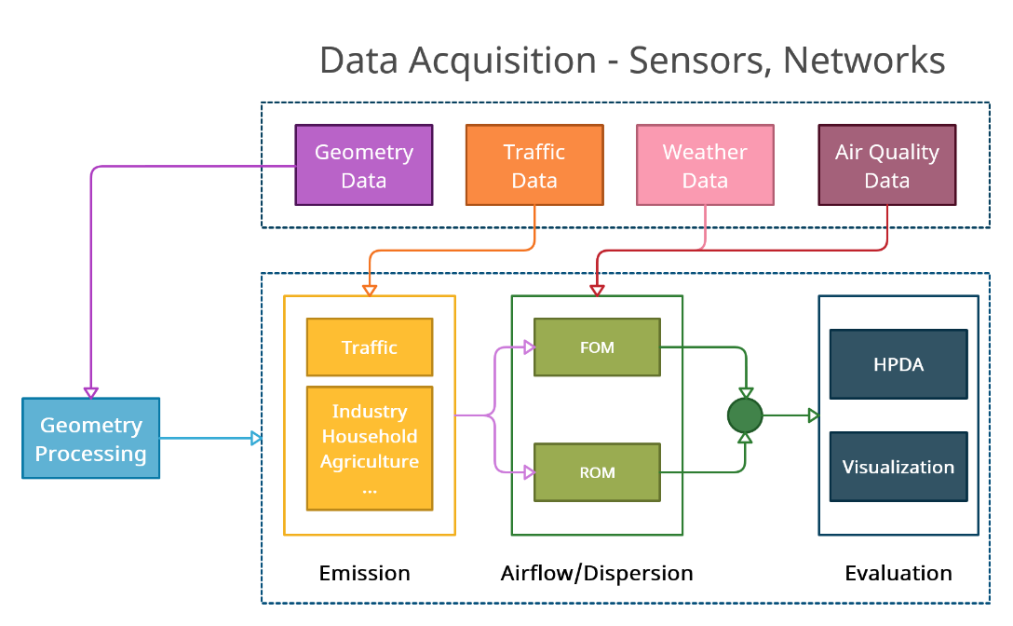
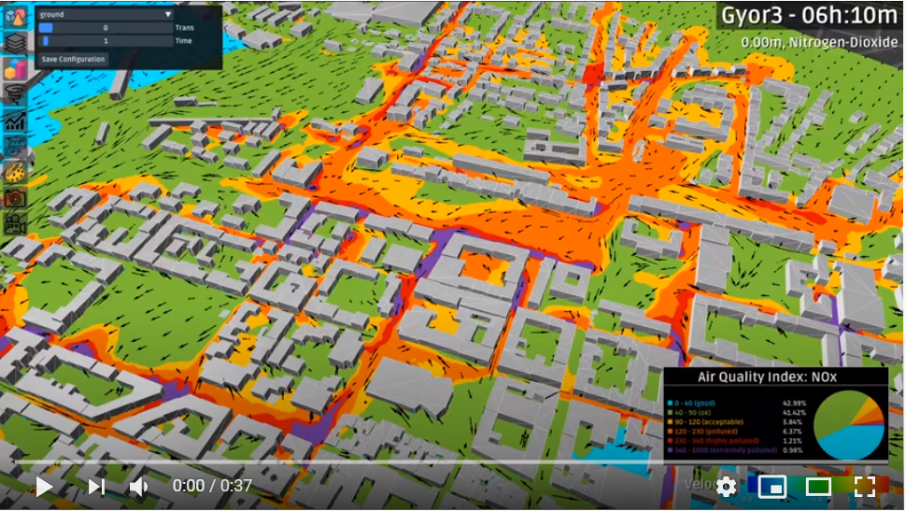


1.3.1 HiDALGO2 SZE Urban Air Project (UAP)
Importance of Urban Challenges
55% of the world’s population lives in urban areas now
Estimated to be 68% by 2050
Develop Urban Airflow-related Solutions
Air Quality
  6.7 million deaths/year attributable to air pollution
  Many cities have air quality above health-critical levels
Wind Comfort and Safety
  Urban wind can cause pedestrian discomfort and safety issues
Urban Planning
  Urban policymakers need to mitigate negative effects
Codes
, xyst, RedSim
CFDR, MathSO portal
https://xyst.cc/
https://redsim.mathso.sze.hu/

Slide 9
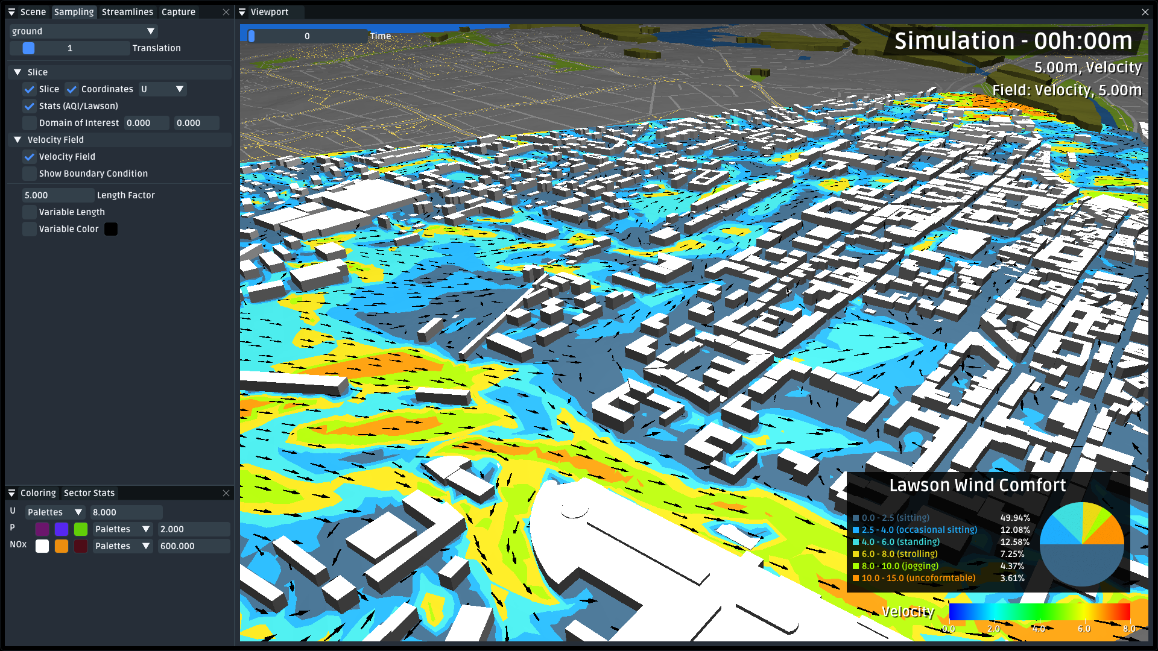
1.3.1. Preview of the results: urban wind comfort, computed within real-time on 1 GPU

Slide 10
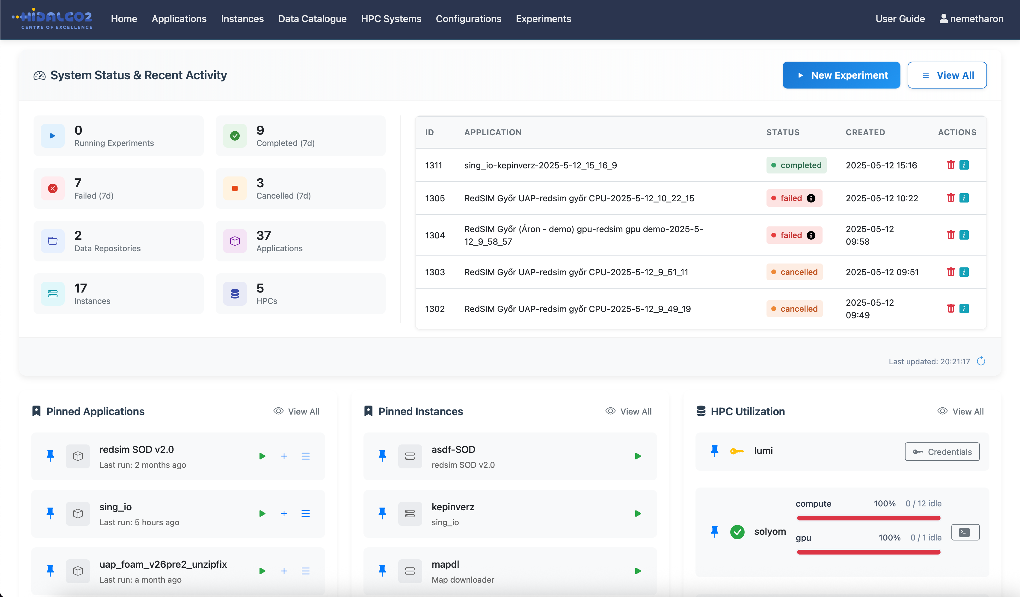
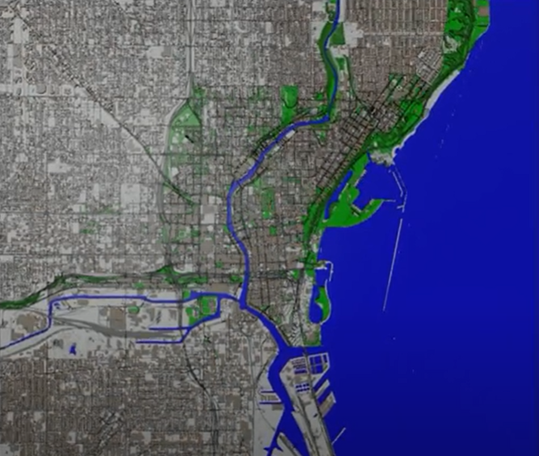
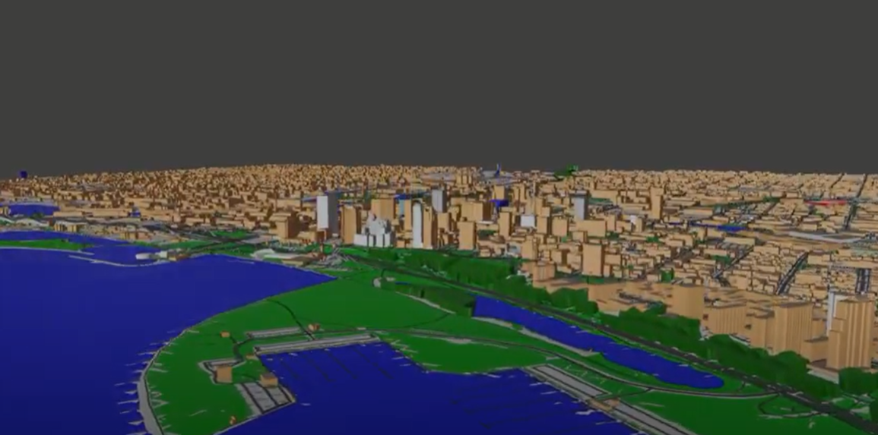
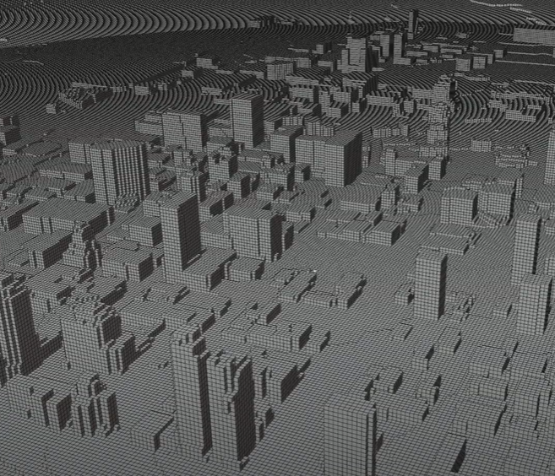
1.3.1. Overview of the workflow of the UAP application
MathSO-portal (forked to HiDALGO2 portal):
Automated workflow orchestration of containerized solutions with CI/CD to HPC platforms for
  Configuration (on the web application)
  Preprocessing (geometry from OpenStreetMap, meshing),
  Simulation (OpenFOAM, RedSim), and
  Visualization (with CFDR).

Slide 11
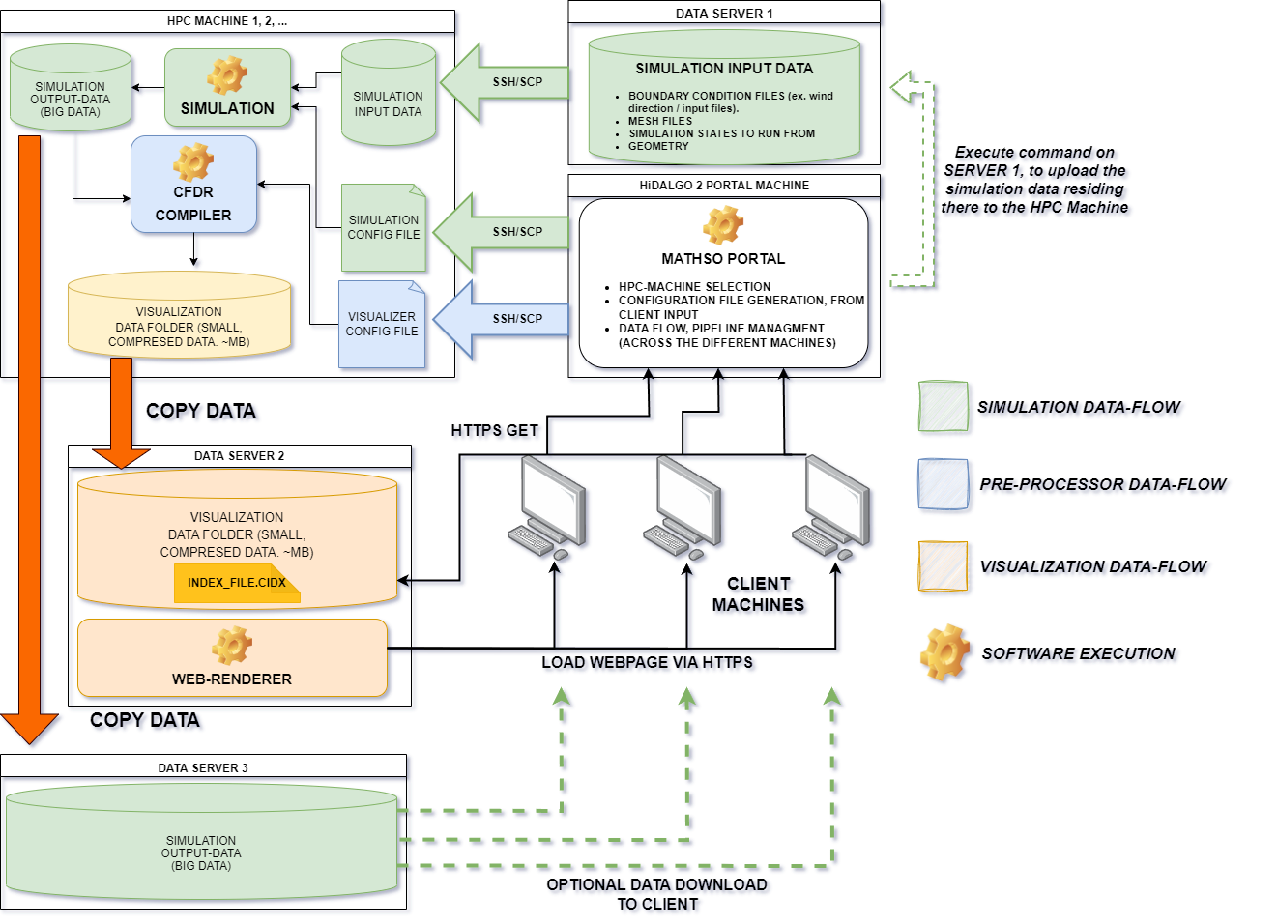
1.3.1 UAP workflow overview
Handling huge amount of data
Authenticating and running jobs on different HPC systems
Container-based application handling
User-friendly UI
Define applications with TOSCA blueprints
Built-in repository management
Visualfeedbacks for every action

Slide 12
1.3.2 The RedSIM software
Algorithms and data structures
Solves the compressible Euler and Navier-Stokes equations with the ideal equation of state (EOS)
Native OpenMPI + CUDA implementation
Uses finite volume method for the spatial (semi)discretization
One single algorithm for 2D/3D computations
Input/Output data formats: industrial standards, e.g. Nastran, Ensight Gold, NetCDF
AI/ML-based module for surrogate modeling → ROM
For the dispersion simulation, implicit time-stepping by using the NVIDIA AMGX for solving linear systems on MPI+GPU machines

Slide 13
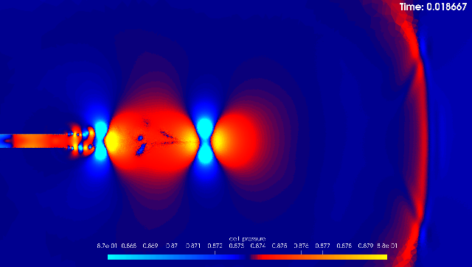
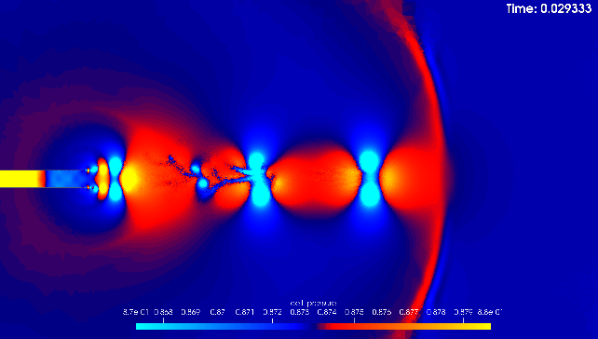
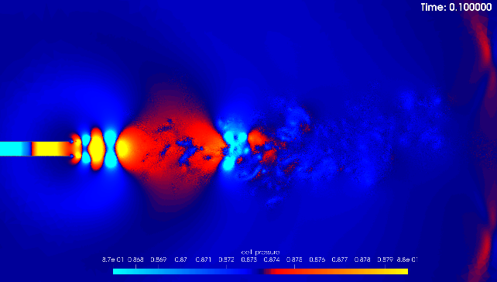

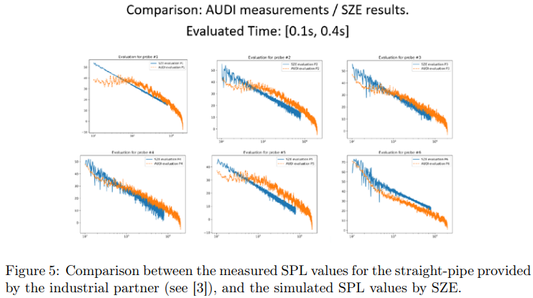
1.3.2. RedSim benchmarks
Benchmark problem 2: Exhaust pipe acoustics problem
  Runtime: 6 hours with the multi-GPU version, video: https://www.youtube.com/watch?v=rAKsChm9-b8
  Validation to measurements

Slide 14
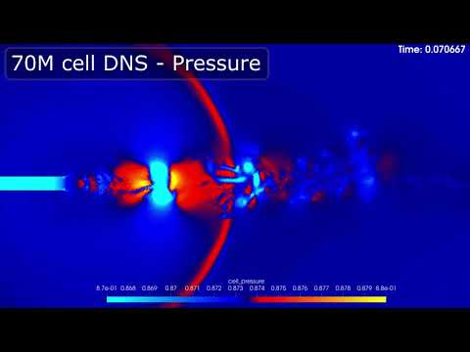
RedSIM - Exhaust Pipe Acoustics (70M Cells)

Slide 15
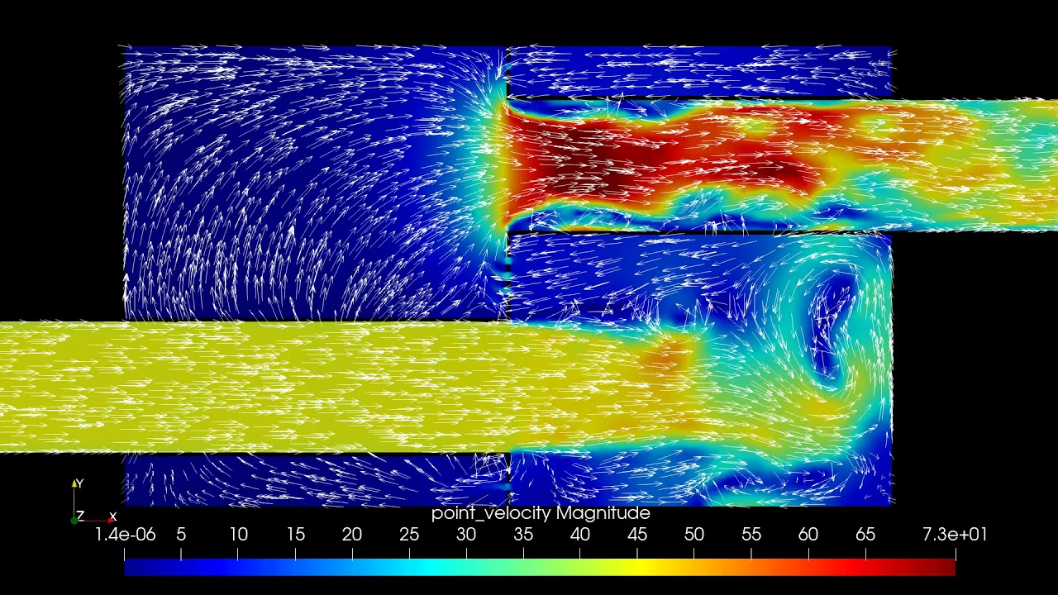
RedSIM - Muffler Velocity Field (4M Cells)

Slide 16
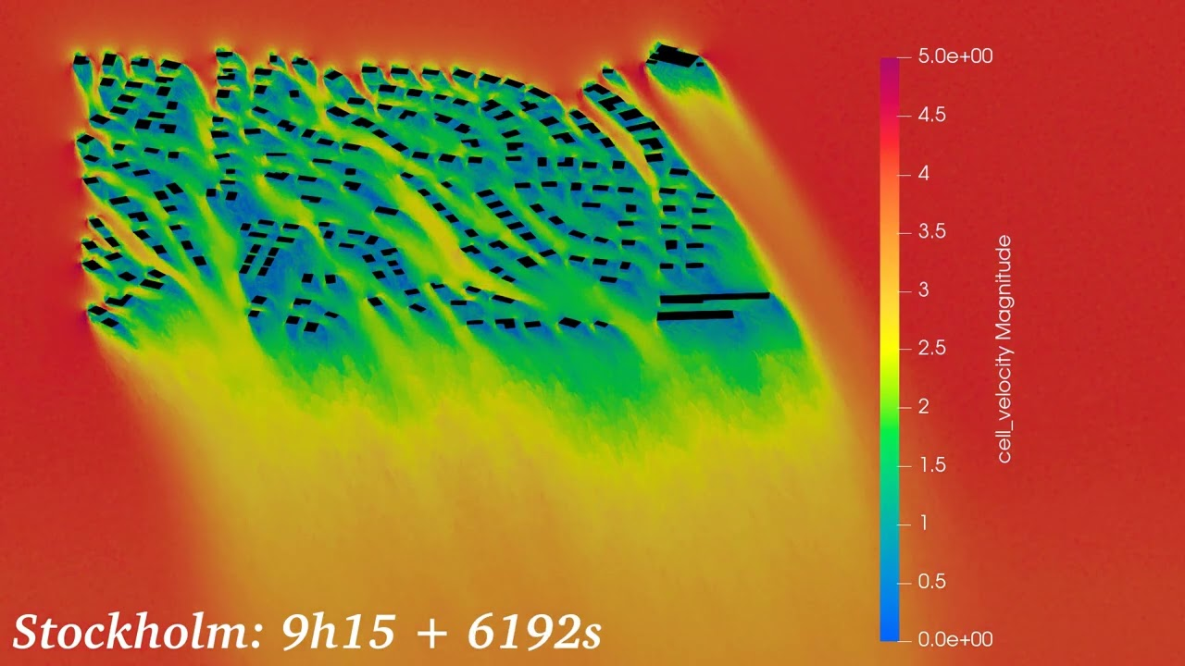
Stockholm - Urban Wind Simulation

Slide 17
2. RedSIM - Architecture Overview
RedSIM is an unstructured, polyhedral Finite Volume Method (FVM) CFD solver, for the Compressible Navier-Stokes Equations. It uses the Vijayasundaram method. We use the Explicit-Euler method for simulating unsteady flows.
Written in C/C++, CUDA, MPI, targeting CUDA HPC architectures, with multiple GPU nodes.
Designed for GPU architectures from day 1, leveraging the strength of CUDA GPU-s.
Heavily Data Oriented Design. We use a custom memory allocation system both on the CPU and GPU side based on Virtual Memory Paging and build our own custom data structures, like dynamic arrays and hash tables on top of it.
Rationale for our own containers: Current standard library implementations (ie. STL) can suffer heavily from memory fragmentation when multiple containers are declared (placement new can help); having a continuous address space, with allocations back-to-back, allows us to upload multiple containers in a single cuMemcpy, by just uploading our
entire Arena (Bump Allocator)
In the same line of thought: no exceptions, no RAII; Allocations on the GPU are expensive, copies even more expensive. We want to be explicit about when copies happen. In a lot of ways, it’s very similar to optimizing resource loads/transfers in video-games (models, textures, …)

Slide 18
RedSIM - Architecture Overview
Flux Computation Kernels.
Primitive Computations.
(ie. Compute the flux on a tetrahedra)
Solvers.
Dispatches kernel batch calls,
with an optimal GRID/THREAD
size
Iterators.
Call different solvers,
in order to solve some equations with some integration method (ie. Explicit Euler).

Slide 19
RedSIM - Architecture Overview
Flux Computation Kernels.
Primitive Computations.
(ie. Compute the flux on a tetrahedra)
Solvers.
Dispatches kernel batch calls,
with an optimal GRID/THREAD
size
Iterators.
Call different solvers,
in order to solve some equations with some integration method (ie. Explicit Euler).
Most of our optimization efforts went into the kernels,
since they are the main computational bottleneck.
All kernel code is platform/hardware specific (x86, ARM, CUDA).
On the CPU-side, all code is manually written in SIMD (AVX512, if available).
For CUDA, we manually optimize our kernels by viewing PTX disassembly,
and using NSight compute on windows.

Slide 20
RedSIM Overview
- Memory Access Pattern Optimization is arguably the most important thing in HPC.
- More often than not applications are not compute-bound, but memory throughput-bound.
- GPU-s have relatively low VRAM, compared to CPU architectures, that often times have terabyte of RAM
to work with in HPC.
- In CFD especially, when computing very large Reynolds number simulations with over 100M cells, proper
compression of data determine whether we can fit everything in VRAM.
- Proper data locality is also incredibly important in order to avoid cache misses, thread contention.

Slide 21
Memory Access Pattern Optimization
Memory Optimization Concerns
  Keeping Allocations Linear & Data Locality.
    Avoid memory fragmentation (thousands of disjoint malloc calls). The more fragmentation, the more cache misses.
    Make sure that data access is always local to some extent.
  Efficient Data Compression.
    Compressing things into lower-precision variants is really common in GPU programming. This is
    especially challenging in scientific computing, since heavy lossy compression doesn’t play well with
    Simulation stability.
  Communication Latency
    CPU <-> GPU transfers are very expensive, stall the pipeline, and should be minimized. Moreover, inter-node
    communication between two GPU-s on different nodes is even MORE expensive, and work dispatch has to be very
    carefully considered.

Slide 22
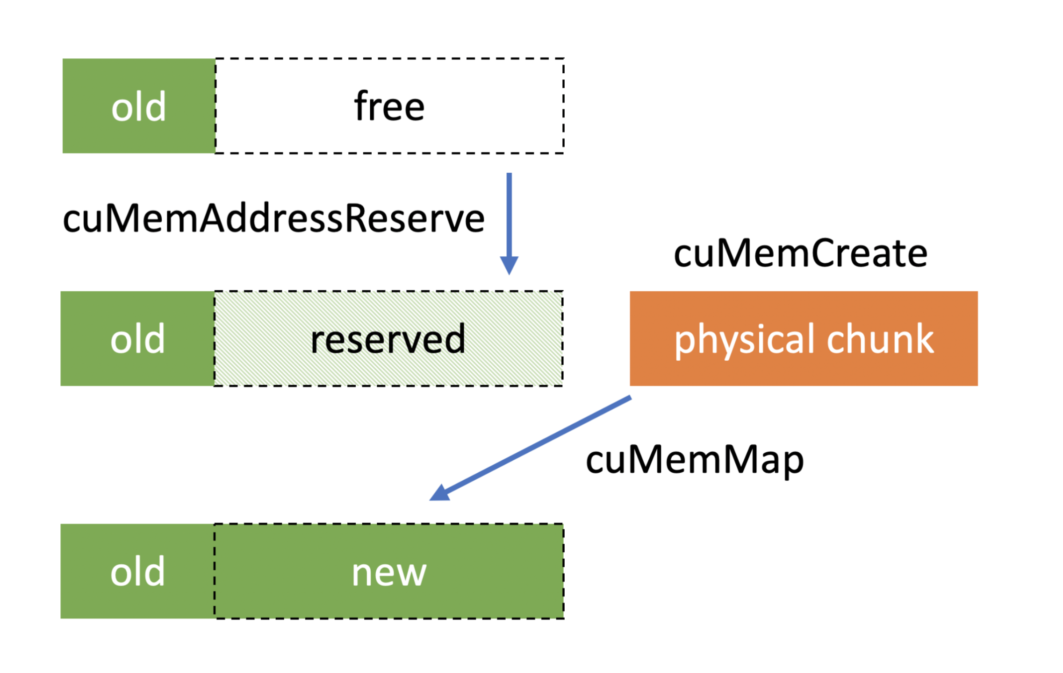
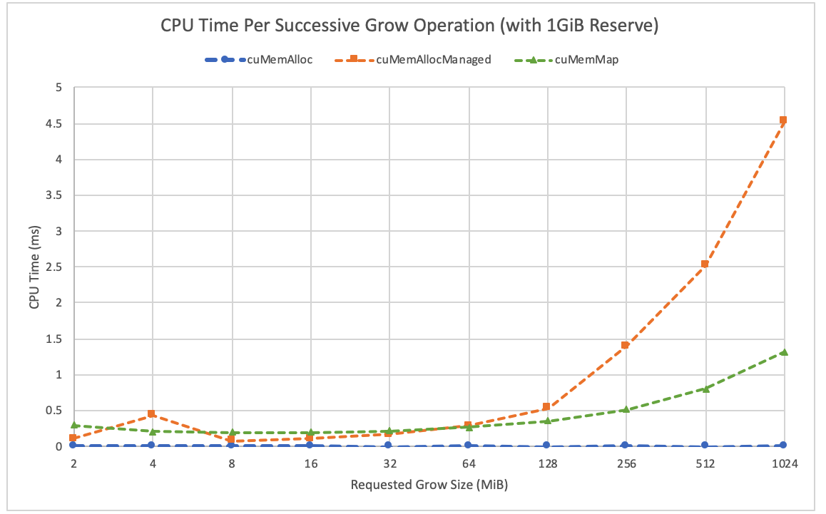
Keeping Allocations Linear
  On the CPU-side: We manage memory ourselves, using virtual memory reserves / commits. (VirtualAlloc on win32, mmap on linux), with a combination of our own custom allocation structures: Arenas (also known as Bump Allocators), Pools, Free Lists. This allows us to have complete control over memory fragmentation, and pass large chunks of data around between the CPU/GPU with CUDA, CPU/CPU with MPI.
  On the GPU-side: We do the exact same thing - thanks to cuMemAddressReserve, cuMemCreate, cuMemMap, we can manage virtual memory in a similar but slightly different way.

Slide 23
Memory Access Locality - Inside a single Node.
- Inside a single partition, we use space filling curves in order to guarantee some form of data locality, and avoid cache misses.
- Morton Curves are really great because they only take a couple of cycles to compute (bit interleaving), yet produce optimal results (better than Hilbert curves for our application).
- Fun Fact: For graphics API-s, texture lookups usually using Morton curves for minimizing cache misses, alongside chunks (consider how many cache misses there would be if data was stored in rows).
3D generalization

Slide 24
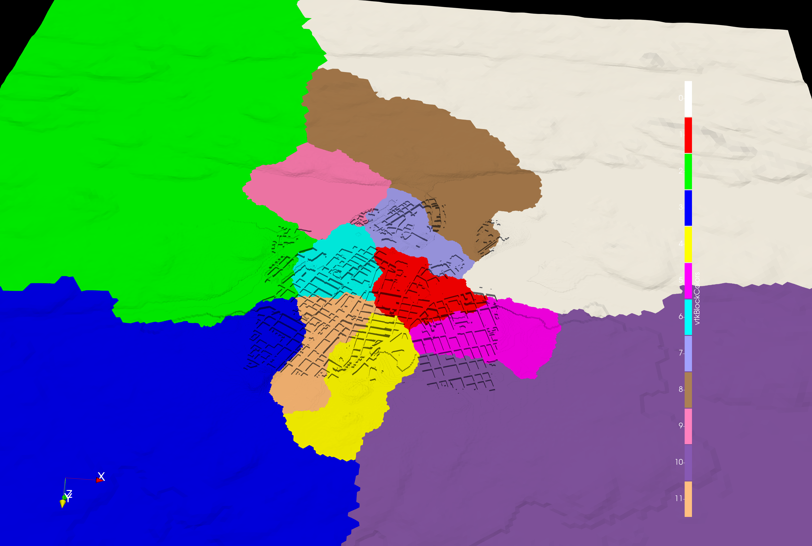
Memory Access Locality - Multi-Node communication
- In order to communicate between multiple GPU nodes (1 CPU is attached to 8 GPU-s, typically A100-s),
we have to decompose our domain into multiple partitions. Correct decomposition is key for optimal performance. A good decomposition
must have a minimal contact surface, and minimize the amount of data exchange needed between GPU-s. It should also cluster GPU-s on
the same node in an adjacent way, in order to avoid unnecessary communication between different nodes.
CPU NODE 1
CPU NODE 2
GPU 1
GPU 2
GPU 5
GPU 6
GPU 3
GPU 4
GPU 7
GPU 8

Slide 25
Typical HPC Architecture
CPU NODE 1
CPU NODE 2
GPU 1
GPU 2
GPU 5
GPU 6
GPU 3
GPU 4
GPU 7
GPU 8

Slide 26
Typical HPC Architecture
MPI_Send / MPI_Recv
SLOW!
CPU NODE 1
CPU NODE 2
GPU 1
GPU 2
GPU 5
GPU 6
GPU 3
GPU 4
GPU 7
GPU 8

Slide 27
Typical HPC Architecture
MPI_Send / MPI_Recv
SLOW!
CPU NODE 1
CPU NODE 2
GPU 1
GPU 2
GPU 5
GPU 6
GPU 3
GPU 4
GPU 7
GPU 8
SLI INTRA-GPU COMMUNICATION (NVLINK)
FAST!

Slide 28
Partitioning Strategy - CUDA + MPI
We partition with ZOLTAN, keeping these facts in mind.
MPI_GRAPH partitioning communicator for describing topology.
NVLINK for GPU/GPU communication via SLI. (We use the CUDA API).
MPI for CPU/CPU communication.
Partitioning Strategy
GPU
1
GPU
2
GPU
5
GPU
6
GPU
3
GPU
4
GPU
7
GPU
8
GPU
9
GPU 10
GPU 13
GPU 14
GPU 11
GPU 12
GPU 15
GPU 16

Slide 29
Partitioning Strategy - CUDA + MPI
We partition with ZOLTAN, keeping these facts in mind.
MPI_GRAPH partitioning communicator for describing topology.
NVLINK for GPU/GPU communication via SLI. (We use the CUDA API).
MPI for CPU/CPU communication.
Partitioning Strategy
GPU
1
GPU
2
GPU
5
GPU
6
GPU
3
GPU
4
GPU
7
GPU
8
SLOW,
Keep partitions spatially
further apart
GPU
9
GPU 10
GPU 13
GPU 14
GPU 11
GPU 12
GPU 15
GPU 16

Slide 30
Partitioning Strategy - CUDA + MPI
We partition with ZOLTAN, keeping these facts in mind.
MPI_GRAPH partitioning communicator for describing topology.
NVLINK for GPU/GPU communication via SLI. (We use the CUDA API).
MPI for CPU/CPU communication.
Partitioning Strategy
GPU
1
GPU
2
GPU
5
GPU
6
FAST,
Keep partitions spatially
close to each other.
GPU
3
GPU
4
GPU
7
GPU
8
GPU
9
GPU 10
GPU 13
GPU 14
GPU 11
GPU 12
GPU 15
GPU 16

Slide 31
Minimum Reduction - Global Time Stepping
Since we’re using a Global Time Stepping Scheme, we need to find a minimum
tilmestep to use. To painful part is that in order to determine the global minimum,
each GPU, GPU NODE has to find a global minimum.
In order to parallelize this, we use BLOCK BASED minimum-reduction in CUDA.
Once we find the minimum on each GPU on a given node, we use MPI_Reduce to find the global minimum.

Slide 32
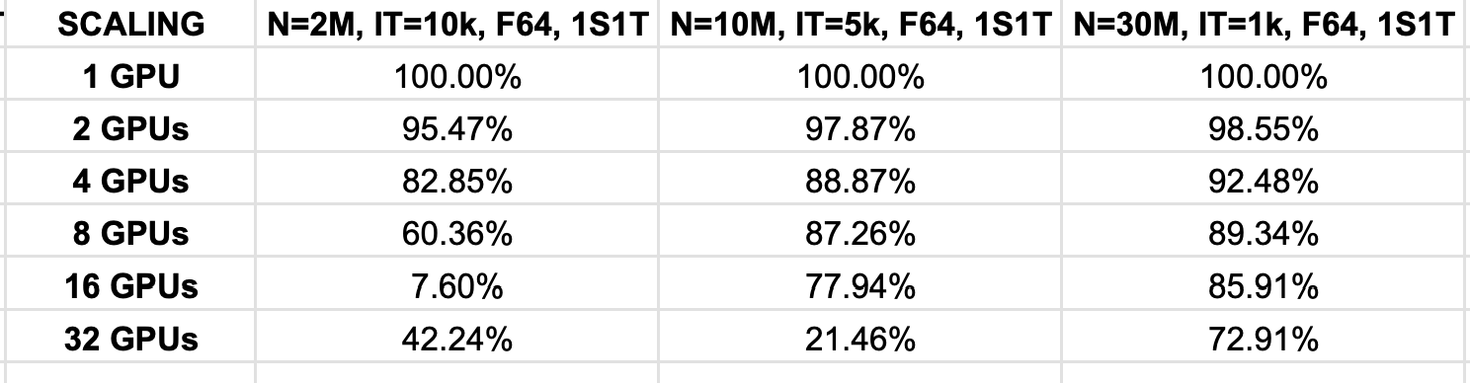
RedSIM - Scaling
- Current Scaling Numbers on KAROLINA HPC, Nvidia A100s.’
- For N=2M, and N=10M, we relatively bad scaling numbers for 8, 16, 32GPU-s. The reason is, 2M cells starts being a problem too small for 16-32 GPUs, so we start stalling with communication time.
- As can be seen, with N=30M, our scaling numbers are much better, since each GPU is busy all the time with compute, and the GRID/THREAD distribution is much better.

Slide 33


Acknowledgments
Funded by the European Union. This work has received funding from the European High Performance Computing Joint Undertaking (JU) and Poland, Germany, Spain, Hungary, France, Cyprus under grant agreement number: 101093457.
This publication expresses the opinions of the authors and not necessarily those of the EuroHPC JU and Associated Countries which are not responsible for any use of the information contained in this publication.
Disclaimer
Funded by the European Union. Views and opinions expressed are however those of the author(s) only and do not necessarily reflect those of the European Union or the European High Performance Computing Joint Undertaking (JU) and Poland, Germany, Spain, Hungary, France, Cyprus. Neither the European Union nor the granting authority can be held responsible for them.
Further acknowledgments
SZE acknowledges DKF, the Hungarian NCC for providing HPC resources for the GPU code development and benchmarking.

Slide 34
Q&A

