Slide 1


Roland Jakab
CEO
HUN-REN
AI for Impact
27 November 2025.
Budapest
https://hun-ren.hu/ai4impact-hu

Slide 2
WHAT CAN WE USE TODAY?
HOW CAN WE PREPARE FOR THE FUTURE?
AND

Slide 3
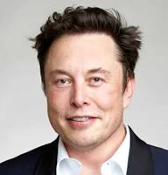
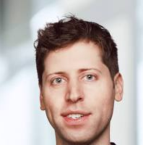

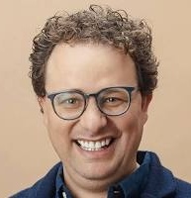
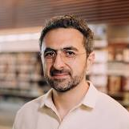
2025 BIG PREDICTIONS: When will we have AGI?
Elon Musk
Grok, Tesla, x.ai…
Sam Altman
OpenAI
Demis Hassabis
Google Deep Mind
2025-26
2025-28
2030-35
‘smarter than the smartest human’ will be available in 2025 or by 2026.”
„AGI will probably get developed during [Trump’s] term.”
„…we’ll have something that we could sort of reasonably call AGI… maybe in the next five to 10 years, possibly the lower end of that.”
Dario Amodei
Anthropic
Mustafa Suleyman
Microsoft AI CEO
2027-28
<2035
„…that’s the thing I think we’re quite likely to get in the next two or three years.”
„Soon to me is sometime in the next ten years.”

Slide 4
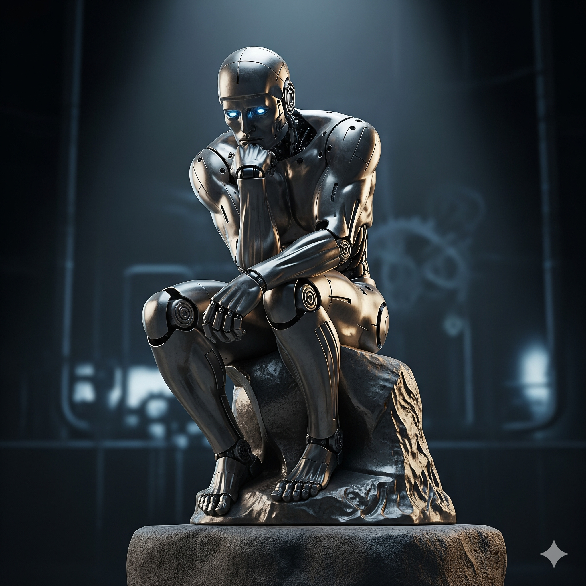
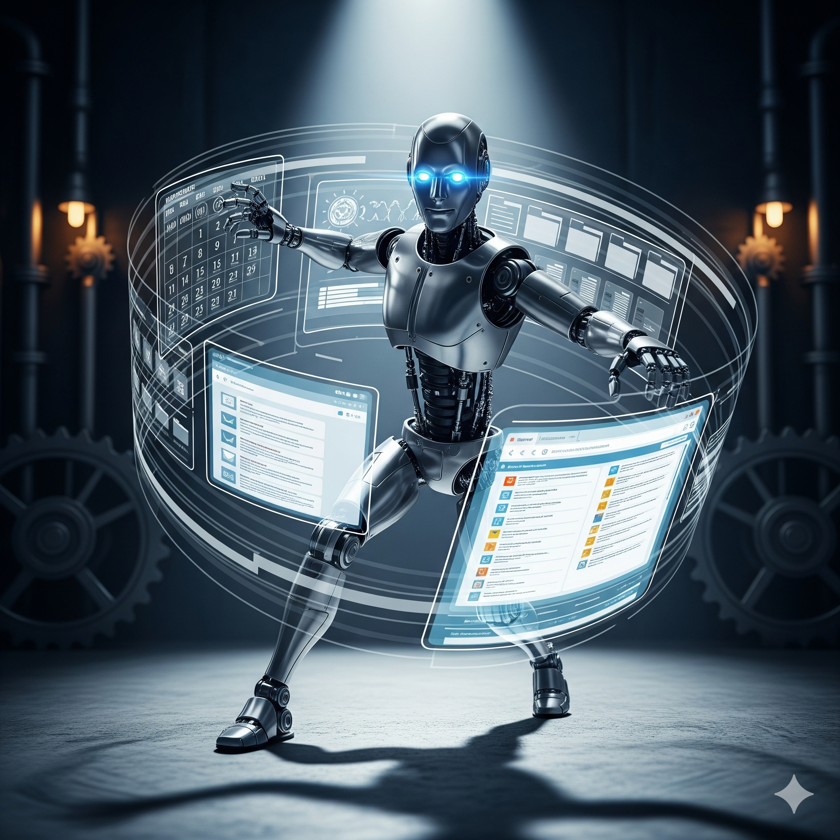
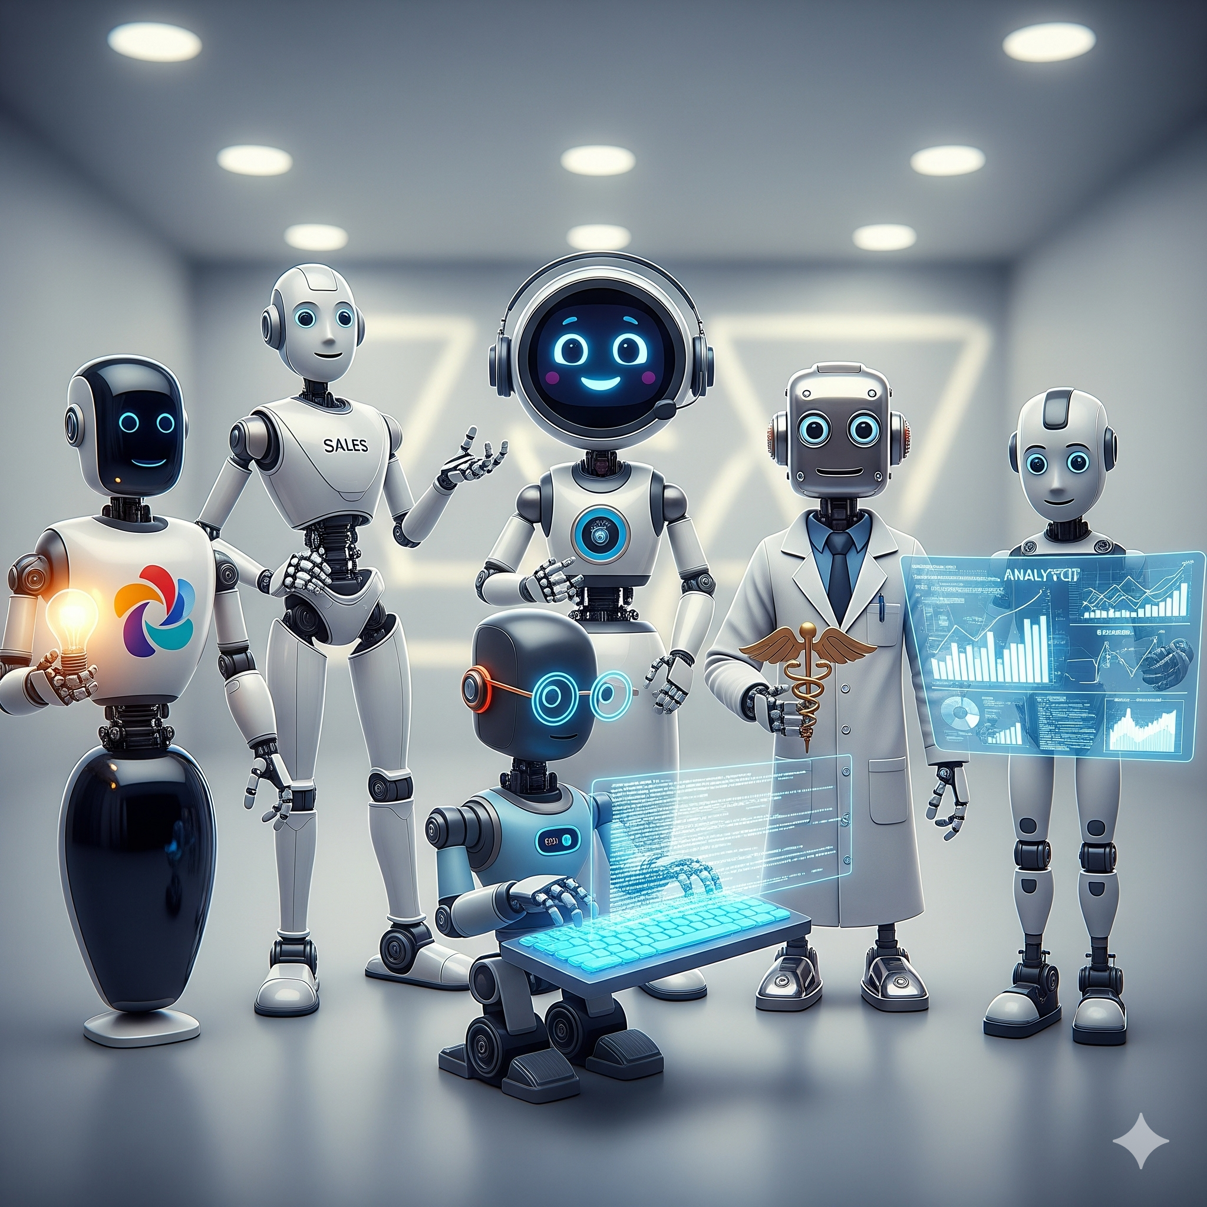
2025 THE BIG TRENDS
Thinking
Tool usage
Specialization
More time to reason and build consistency
Email, file system, calendar, integrating internal systems
Coding, sales, lawyer specialists

Slide 5


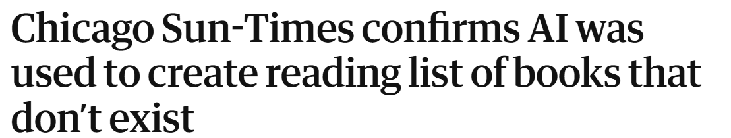
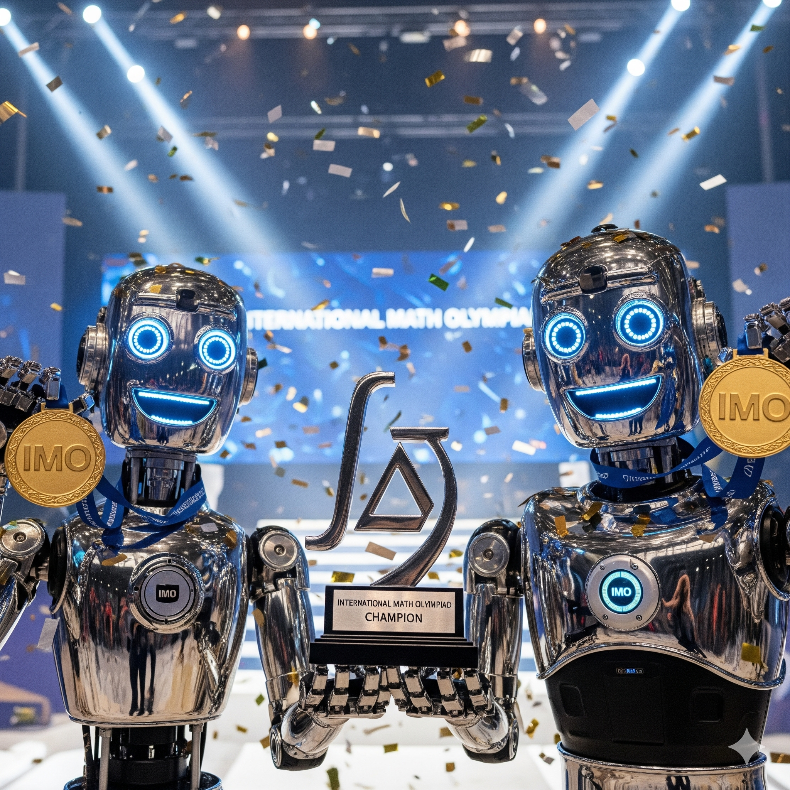
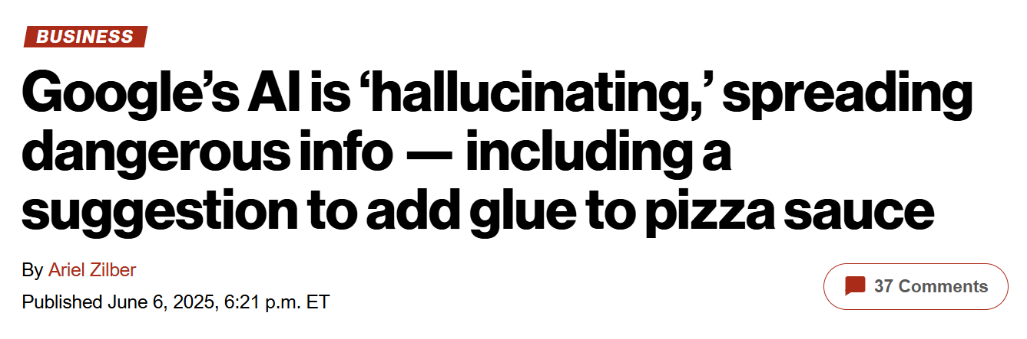
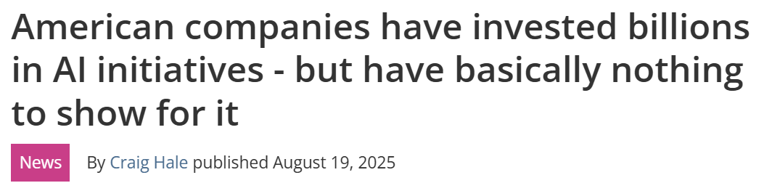
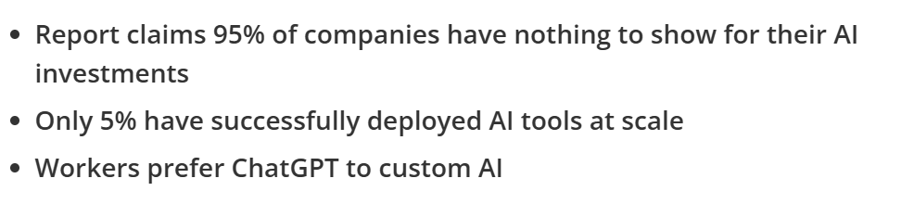
2025 THE BIG CONTRADICTION
Still hallucinating
Gold medal at the International Mathematical Olympiad
VS
No clear return on investment

Slide 6
JAGGED INTELLIGENCE
2025
GENERAL INTELLIGENCE
2027-30
VS

Slide 7
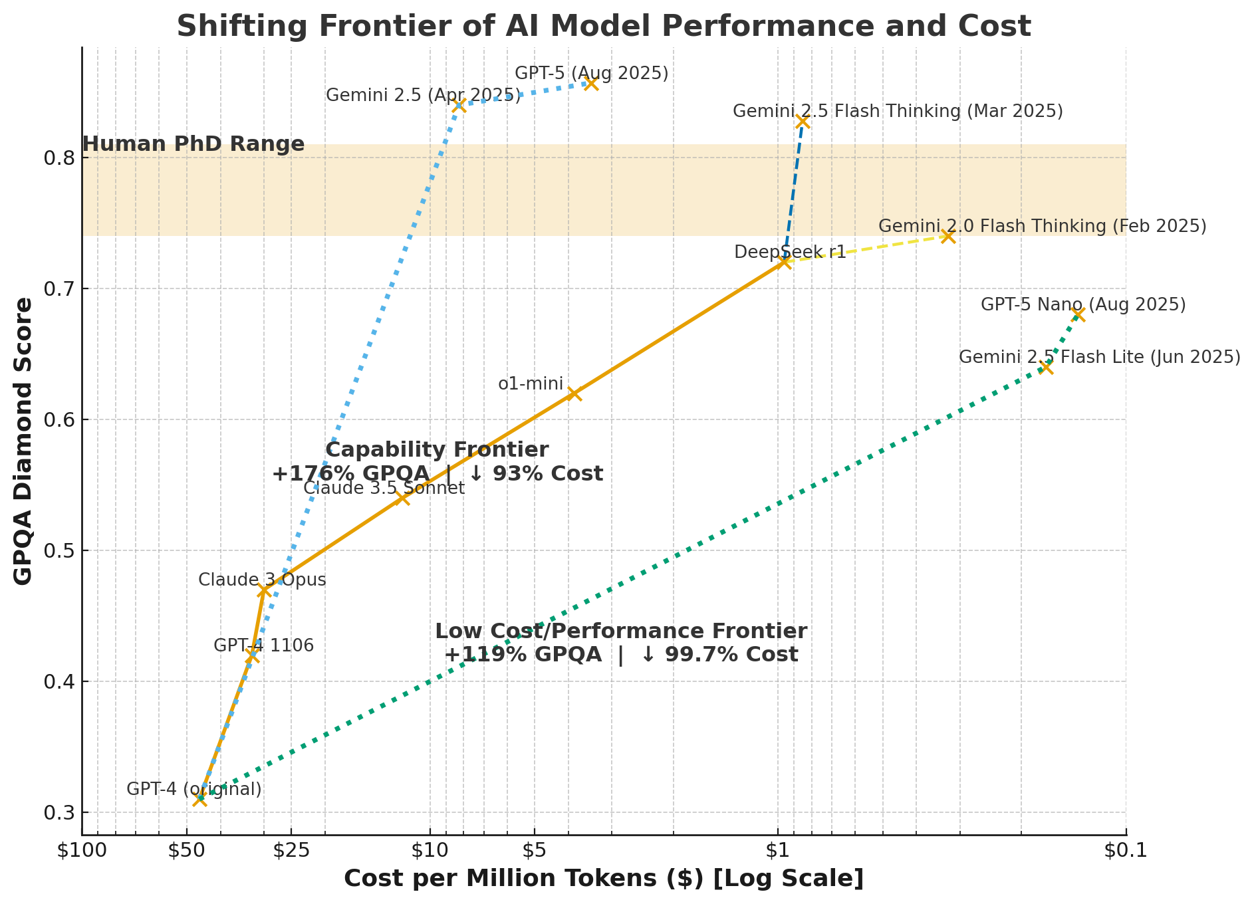
Let’s watch how it evolves, not where it is
Mass Intelligence – Ethan Mollick

Slide 8






Three waves of AI that we have to manage Augmented… Automated… Autonomous… Intelligence
AI-s can be more and more a central part of how we do science
DEFINE OBJECTIVES
SOLVE
DELEGATE
DISCUSS
SOLVE
EXPLORE
Augmented Intelligence
Automated Intelligence
Autonomous Intelligence
Disrupting how science can be done. Orchestrating autonomus intelligencies Needs a dedicated pioneering team.
Getting help for a concrete task. Needs culture change
Defining tasks and delegating a to specialized virtual teams. Needs designed flows.

Slide 9
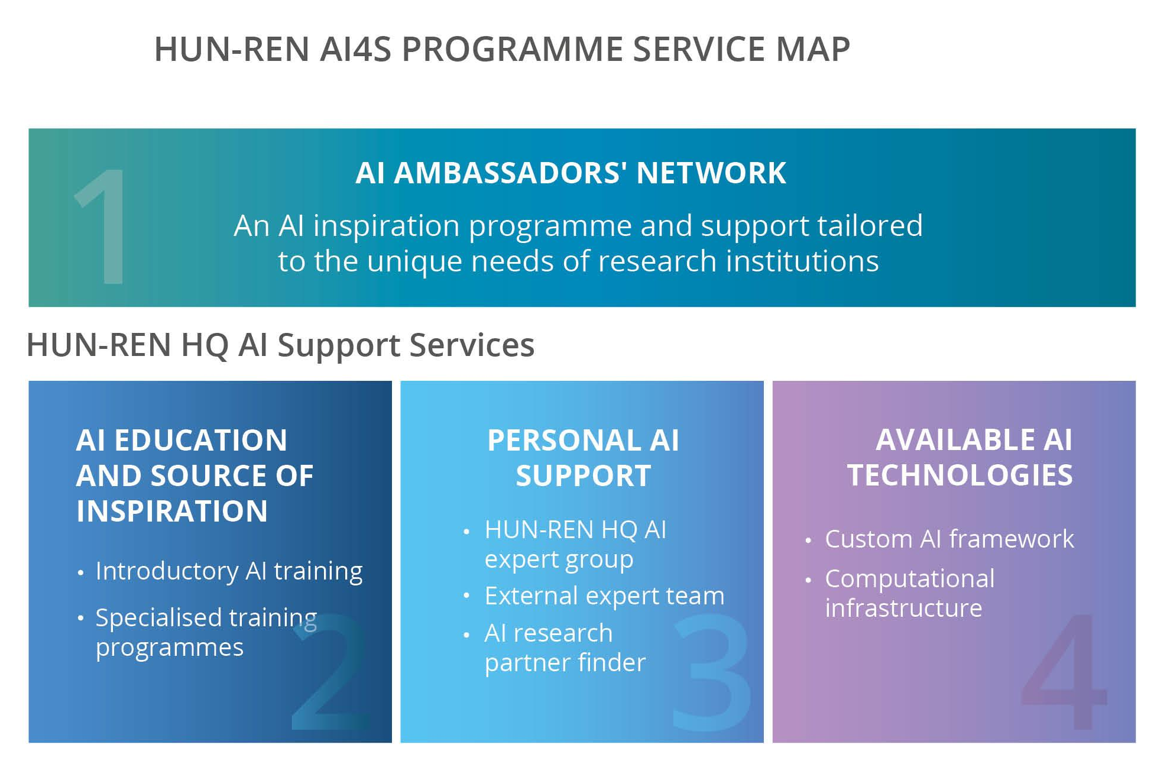
Supporting research processes with a variety of AI tools
AI FOR SCIENCE
Supporting all activities with AI
AUGMENTED Intelligence
AUTOMATED Intelligence

Slide 10
Two ways to support processes with AI
AI FOR SCIENCE
Understand State of the Art
SCIENCE FOR AI
Add to State of the Art
Formulate Hypothesis
Supporting all activities with AI
Researching the science of AI
Peer-Review Findings
Design Experiment
Scientific Process
AUGMENTED Intelligence
Write Paper
Conduct Experiment
AUTOMATED Intelligence
AUTOMATED Intelligence
AUTONOMOUS Intelligence
Analyze Results

Slide 11
Creating space for AI breakthroughs
SCIENCE FOR AI
AI RESEARCH CENTER
SPECIALIST AI RESEARCH
FOUNDATIONAL AI RESEARCH
AUTONOMOUS AI RESEARCH
Researching the science of AI
Autonomous execution of phases
Research on Human-AI collaboration
Research on an autonomous AI scientistn
Biologically related AI developments
AI developments in drug research
AI developments in agriculture
Development of machine perception
Specialized foundational model developments
Explainable AI developments
Development of AI mathematics
AUTOMATED Intelligence
AUTONOMOUS Intelligence

Slide 12



2026 AI FACTROY ANTENNA: a new way to support
AI FOR BUSINESS
AI-FIRST BUSINESS
AI FACTORY ANTENNA
Supporting business processes with AI
Supporting AI enabled innovations
Redefining the business around AI
HPC capacity
JULLICH
Consulting capacity
HUN-REN
MKIK
Researcher capacity
SZTAKI
WIGNER
ELTE
AUGMENTED Intelligence
AUTOMATED Intelligence
AUTOMATED Intelligence
AUTONOMOUS Intelligence

Slide 13
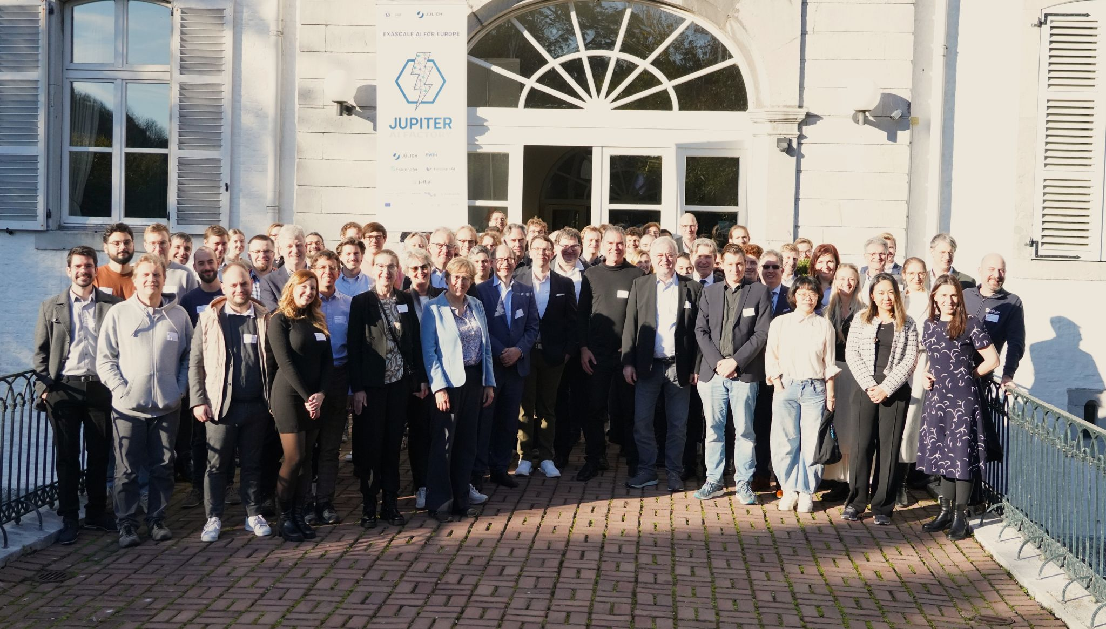
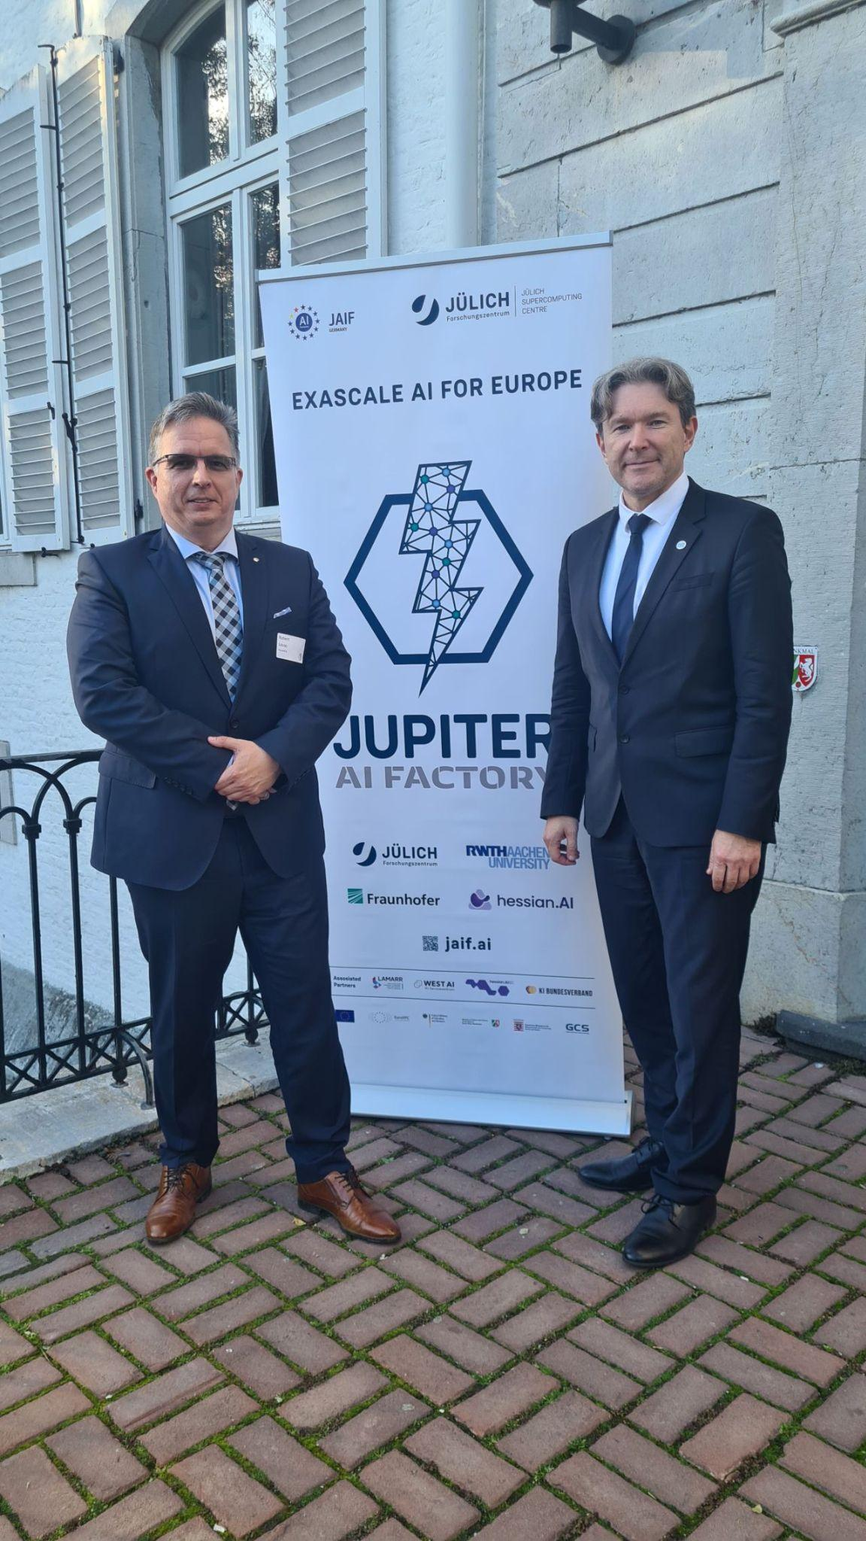
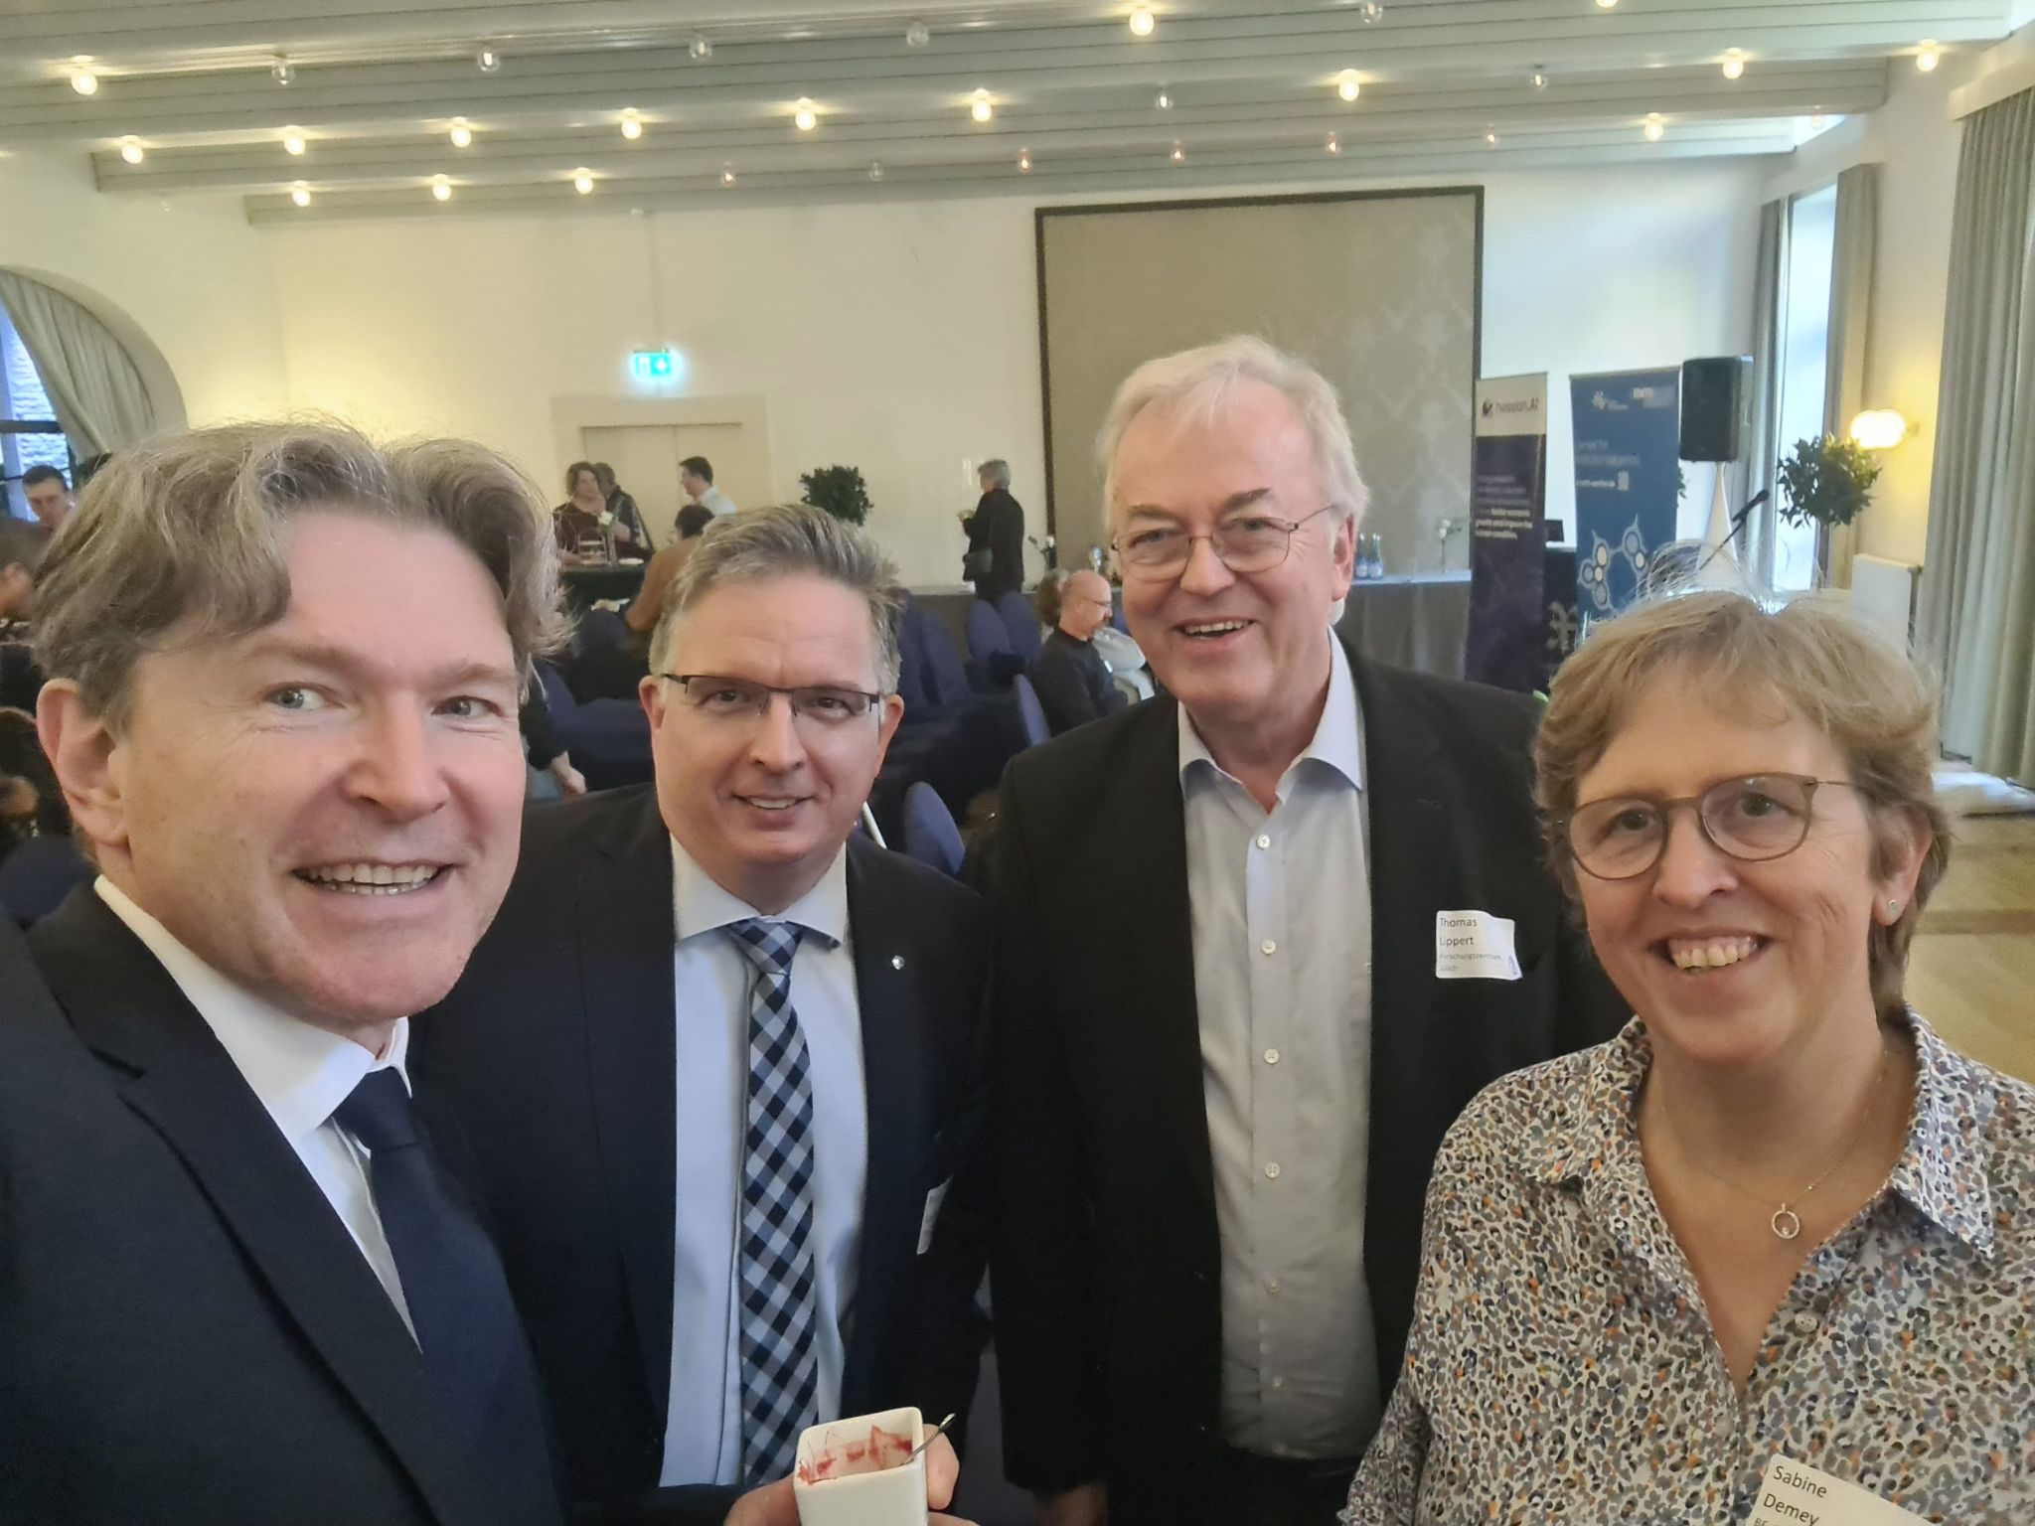
2026 AI FACTROY ANTENNA: launching the European network

Slide 14


The future of Science and Business
is AI-first!
https://hun-ren.hu/ai4impact-hu
www.ai1science.com

