Slide 1


MI in Biology:
Machine Learning and Protein Language Models
to Improve Knowledge and Therapy
Tamás Hegedűs
hegedus.tamas@hegelab.org
SEMMELWEIS University 1769
Department of Biophysics and Radiation Biology
HUN-REN-SE Biophysical Virology Research Group
hegelab.org

Slide 2
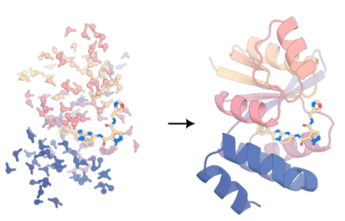
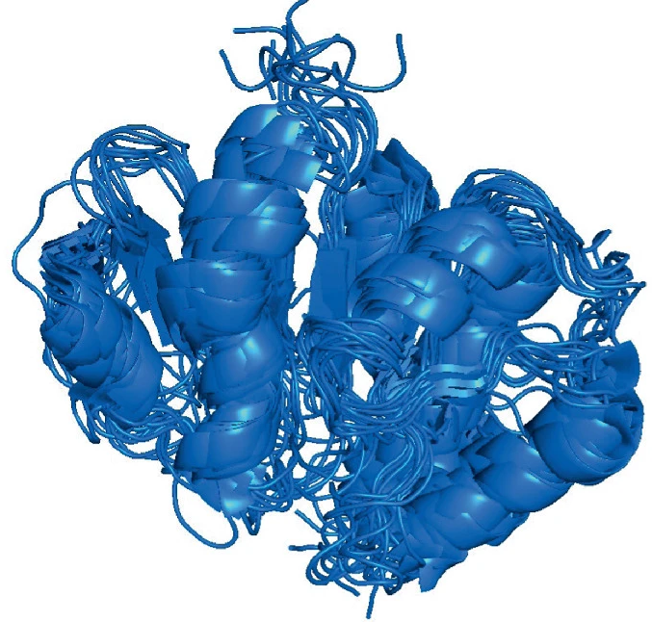


Major objectives
Atomic-level basis of diseases
Identification
of drug binding sites
Protein design of biologics
Not a single structure but
a conformational ensemble
SEMMELWEIS University 1769
Department of Biophysics and Radiation Biology
HUN-REN-SE Biophysical Virology Research Group
hegelab.org

Slide 3
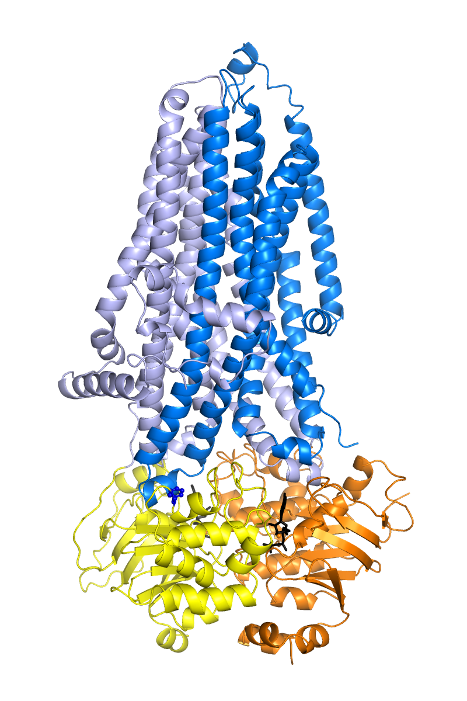
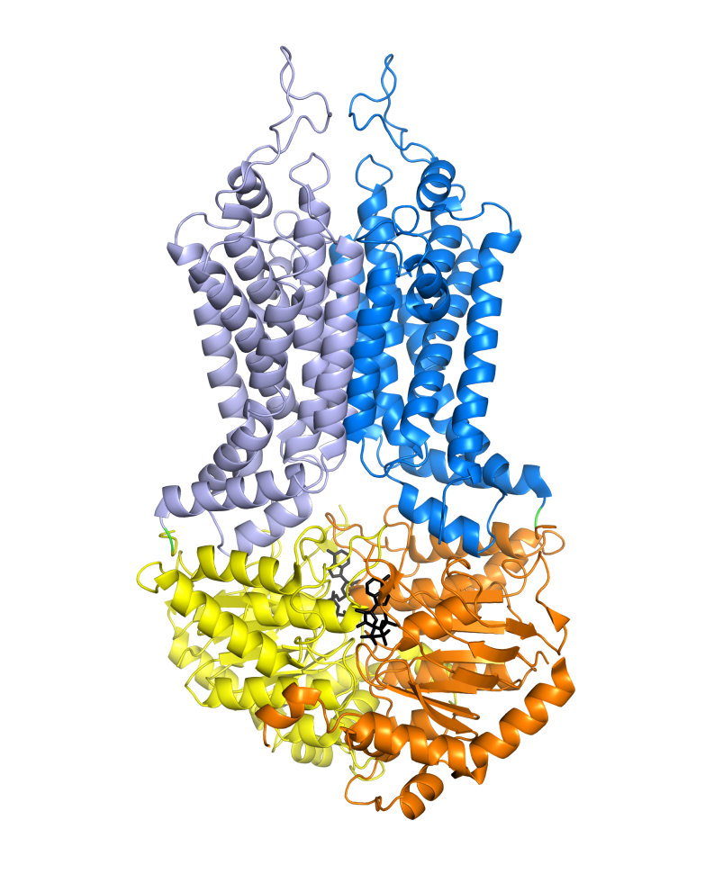
Multidrug ABC transporters
P-glycoprotein/MDR1/ABCB1
MPR1/ABCC1
BCRP/ABCG2
drug
out
drug
drug
drug
MDR
protein
ATP
in
nucleus
DNA
ADP+P_{i}
target proteins
SEMMELWEIS University 1769
Department of Biophysics and Radiation Biology
HUN-REN-SE Biophysical Virology Research Group
hegelab.org

Slide 4
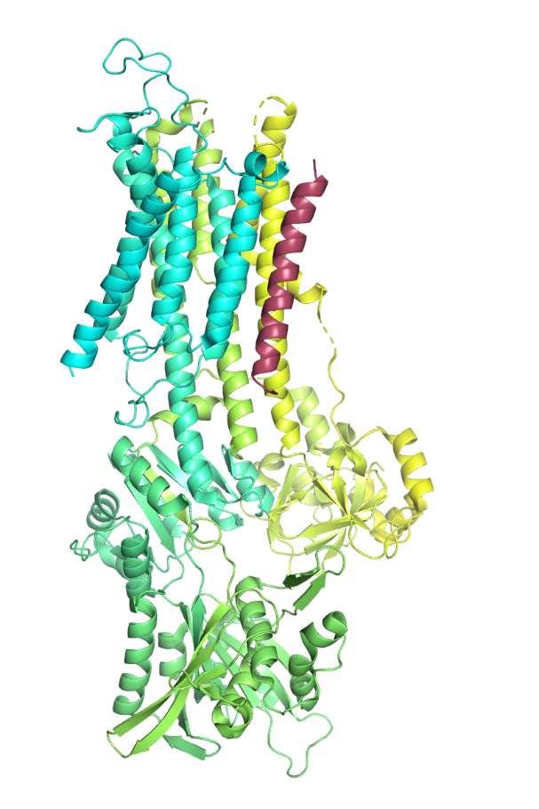
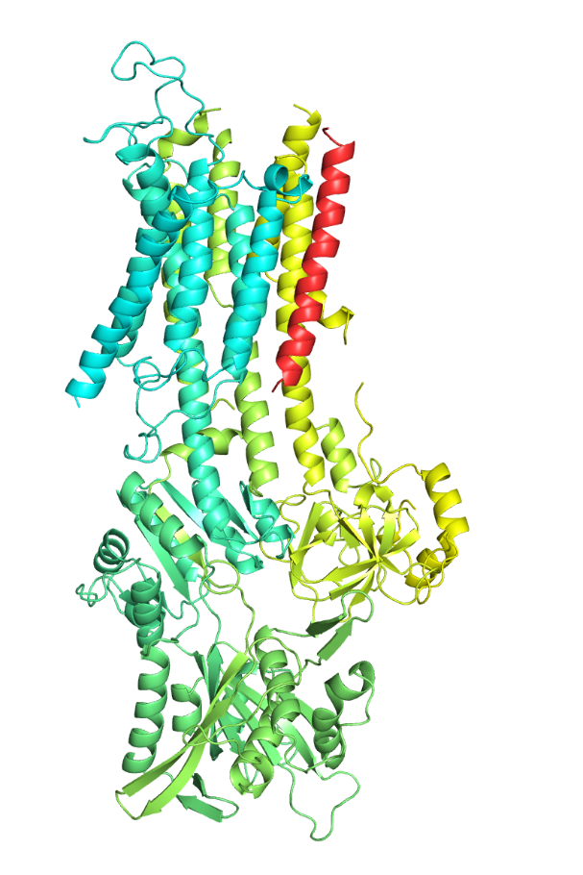
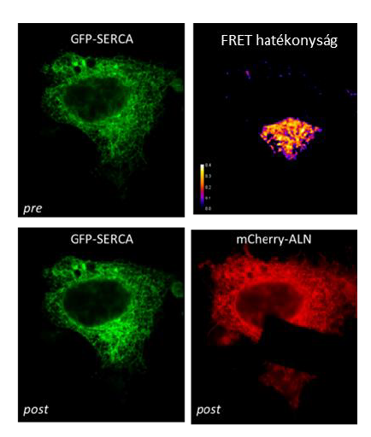
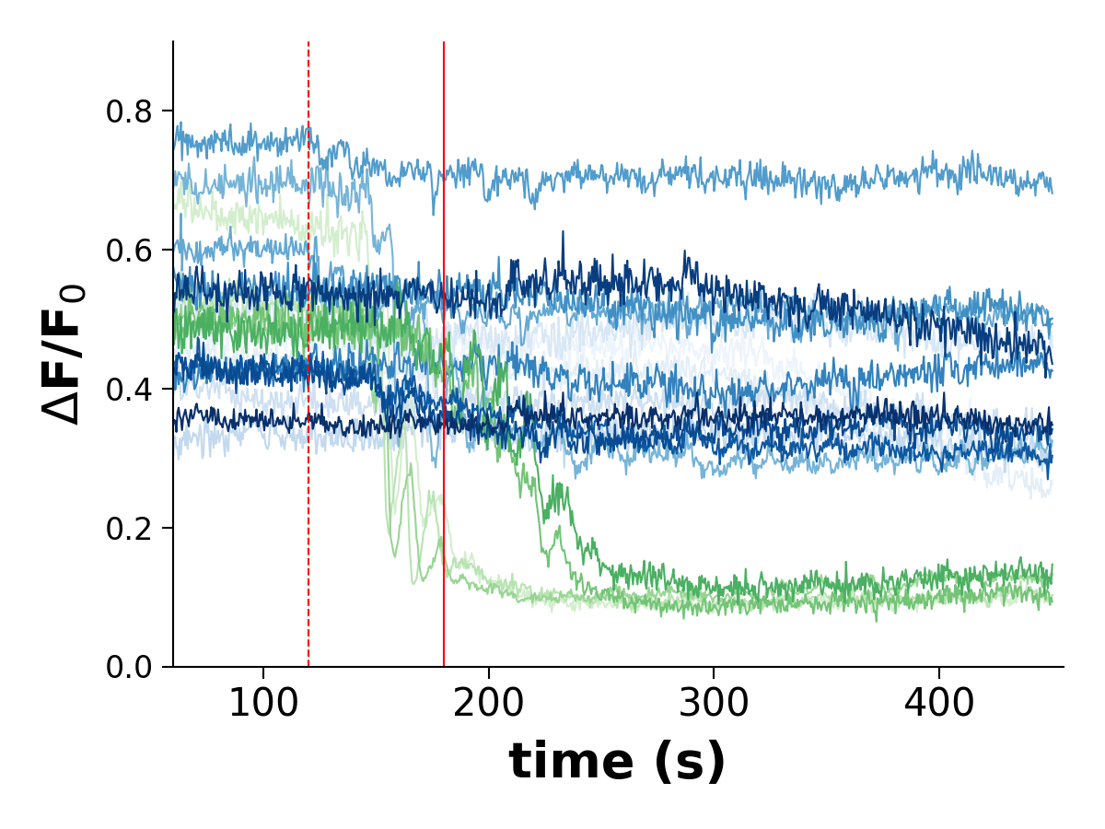
Calcium pumps and single-pass TM proteins
FRET
Ca²⁺ signal
PLN
(4kyt)
SARS-CoV-2
Envelope
(AF3)
240
400 µM ATP
SEMMELWEIS University 1769
Department of Biophysics and Radiation Biology
HUN-REN-SE Biophysical Virology Research Group
hegelab.org

Slide 5
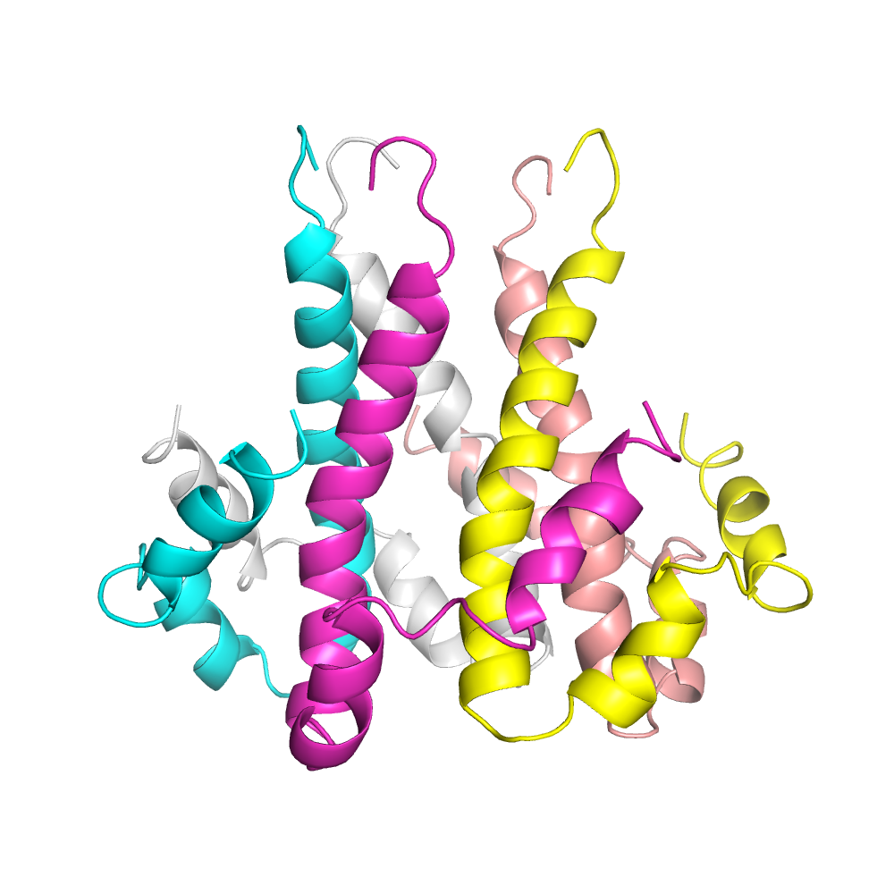
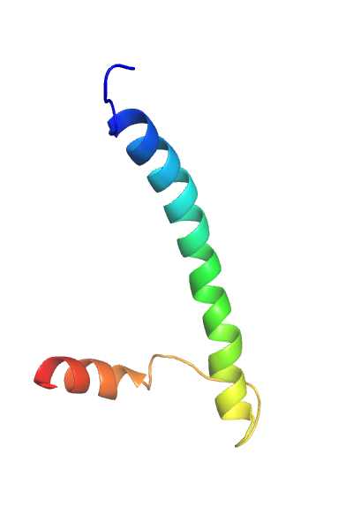
SARS-CoV-2 E protein, (exo)regulins
approx. 2,500 out of 5,000 human TM proteins are single-pass, 1TM
SEMMELWEIS EGYETEM 1769
Biofizikai és Sugárbiológiai Intézet

Slide 6
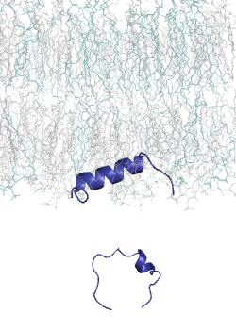
MemMoRF.hegelab.org
Membrane Molecular Recognition Features
https://memmorf.hegelab.org
Csizmadia et al. NAR 2020
disordered
interacts with lipids
ordered if interacting
KRAS, STX17 autophagy protein, phospholamban…
SEMMELWEIS University 1769
Department of Biophysics and Radiation Biology
HUN-REN-SE Biophysical Virology Research Group
hegelab.org

Slide 7
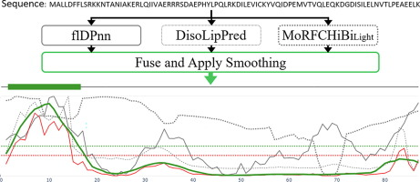
Classical sequence information versus pLM
0
1
1
…
CoMemMoRFPred
Machine learning model
binary classifier
e.g. logistic regression and NN
V₁
V₂
V₃
V_{L}
L amino acid embeddings
Self-attention layers
transformer model
e.g. prot-T5, Ankh, …
Basu, Hegedus, Kurgan
J Mol Biol. 2023 Nov 1;435(21):168272
decoder
encoder
Tokenization & encoding
Input of length L
S
E
Q
…
SEMMELWEIS University 1769
Department of Biophysics and Radiation Biology
HUN-REN-SE Biophysical Virology Research Group
hegelab.org

Slide 8
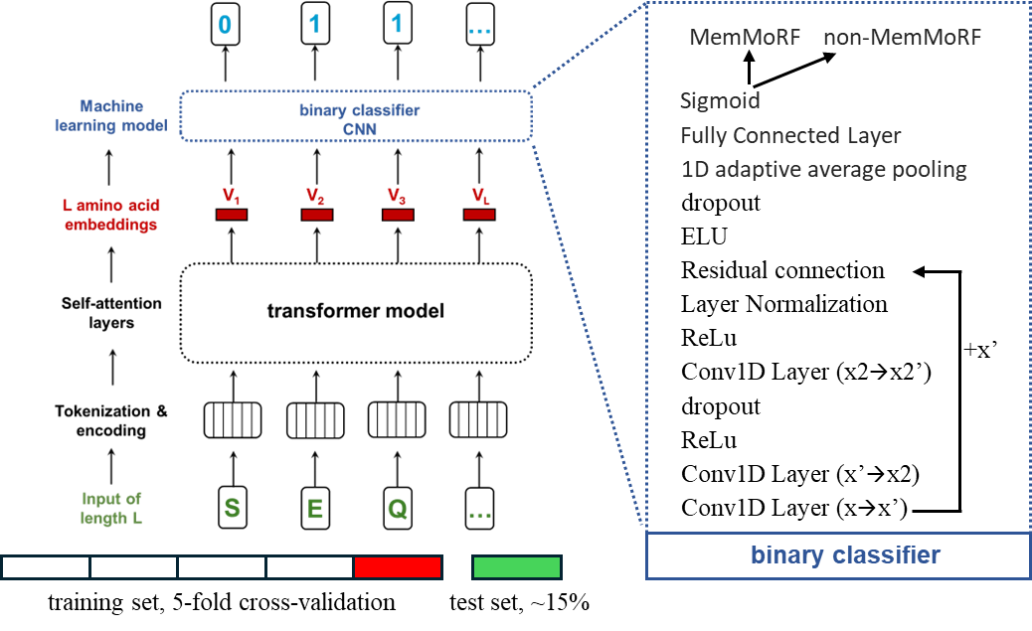
Classical sequence information versus pLM
SEMMELWEIS University 1769
Department of Biophysics and Radiation Biology
HUN-REN-SE Biophysical Virology Research Group
hegelab.org

Slide 9
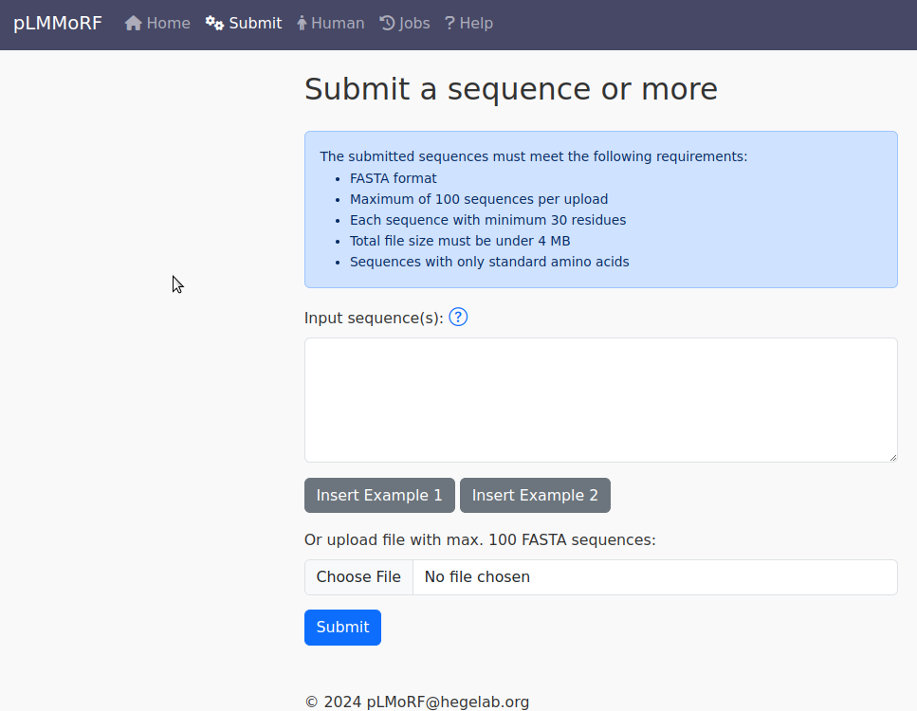
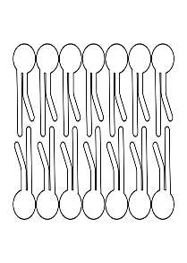
pLMMoRF.hegelab.org
0
0
0
0
0
0
0
0
1
1
0
1
0
0
0
1
1
1
1
1
1
1
1
0
1
0
0
0
0
0
0
0
0
0
0
0
0
0
0
0
0
0
0
0
0
0
0
0
0
0
0
0
pLMMoRF.hegelab.org
Csepi et al. J Mol Biol 2025
SEMMELWEIS University 1769
Department of Biophysics and Radiation Biology
HUN-REN-SE Biophysical Virology Research Group
hegelab.org

Slide 10
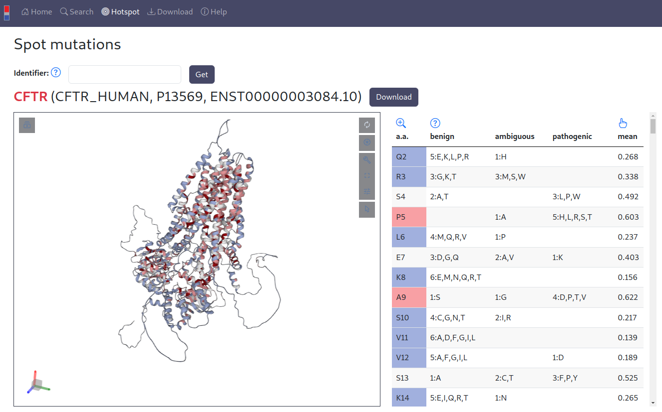
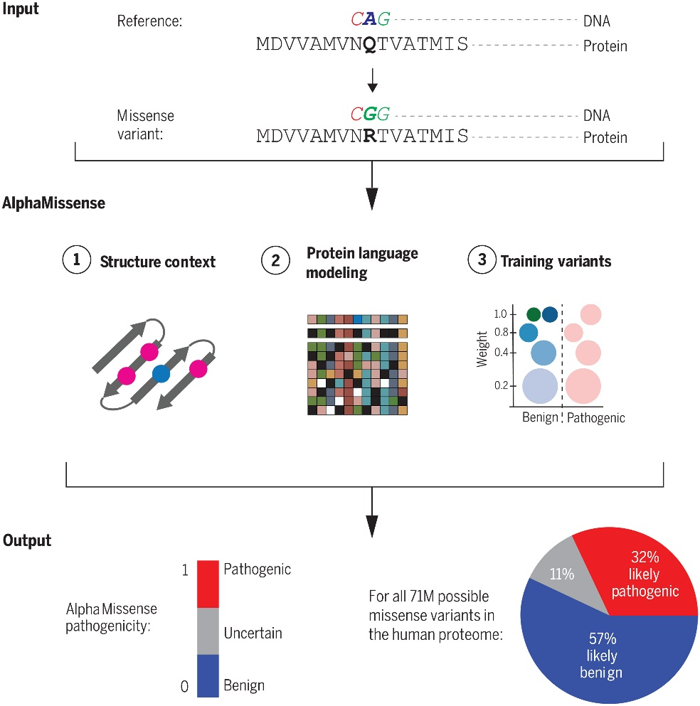
DeepMind – AlphaMissense
.hegelab.org
Cheng et al. Science 2023
Tordai et al. Sci. Data 2024
> 2,000 users/month
SEMMELWEIS University 1769
Department of Biophysics and Radiation Biology
HUN-REN-SE Biophysical Virology Research Group
hegelab.org

Slide 11
Δ-embeddings
An embedding with f₁, f₂, … f₁₅₃₆ features
X: Δembedding = emb(WT)_{i} – emb(MUT) _{i}
y: label (neutral/0, pathogen/1)
Eff10k/SNAP2 folds
protein sequence-based grouping:
fold 0, test set
fold 1-9, nested cross-validation
Rost lab
Hecht et al. BMC Genomics 2015
SEMMELWEIS University 1769
Department of Biophysics and Radiation Biology
HUN-REN-SE Biophysical Virology Research Group
hegelab.org

Slide 12
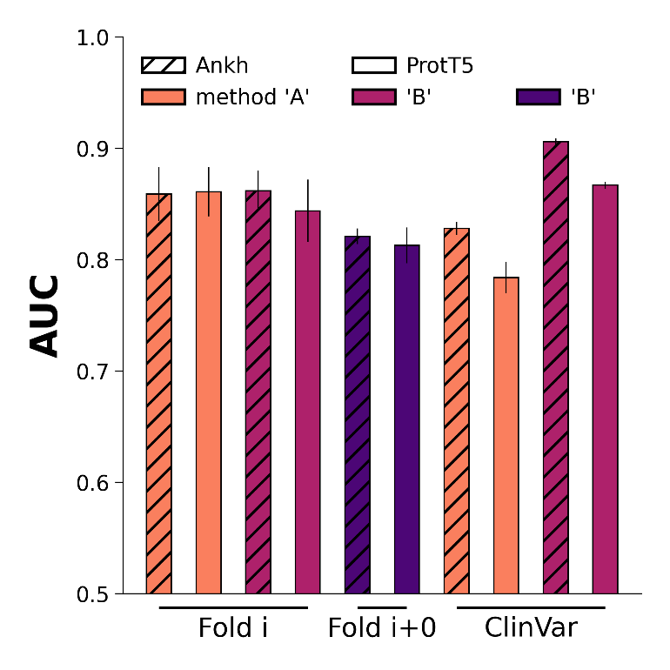
Performance on test sets and the ClinVar database
SEMMELWEIS University, 1769
Institute of Biophysics and Radiation Biology
HUN-REN-SU Biophysical Viorology Research Group
hegelab.org

Slide 13
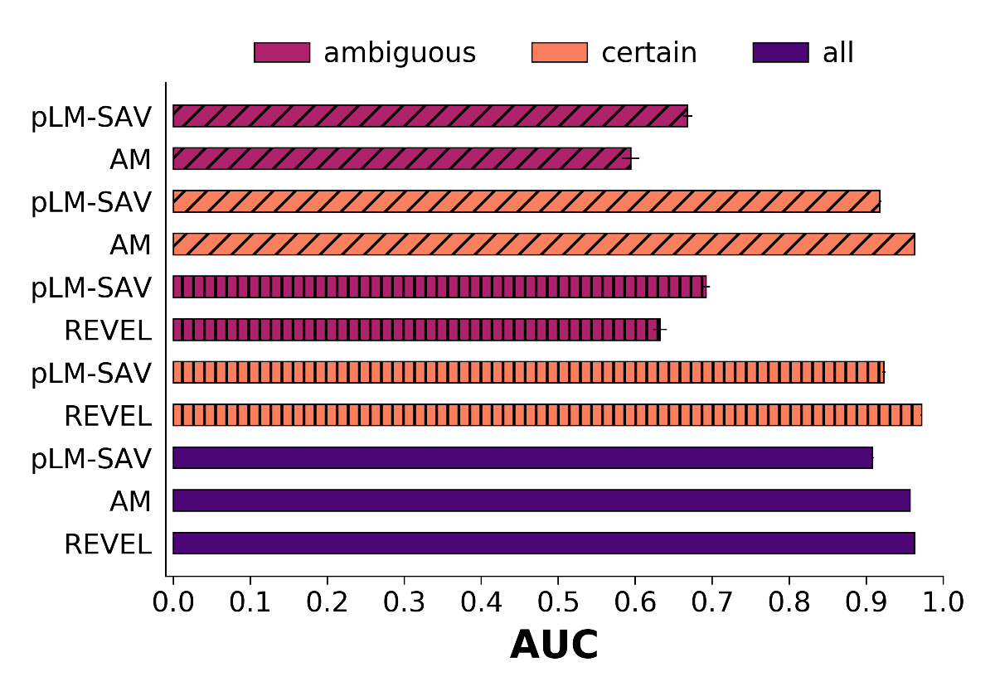
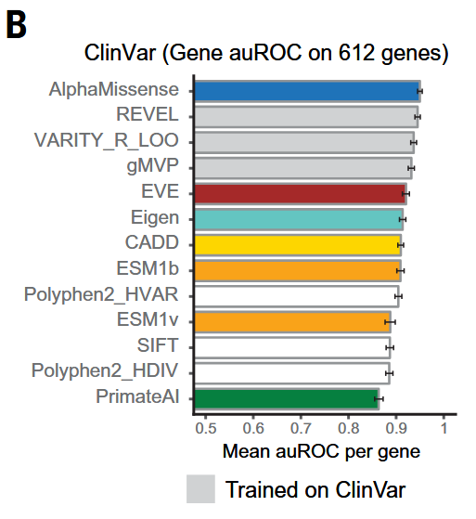
Benchmarking pLM-SAV against AlphaMissense and REVEL
AM split
REVEL split
Cheng et al. Science 2023
SEMMELWEIS University, 1769
Institute of Biophysics and Radiation Biology
HUN-REN-SU Biophysical Viorology Research Group
hegelab.org

Slide 14
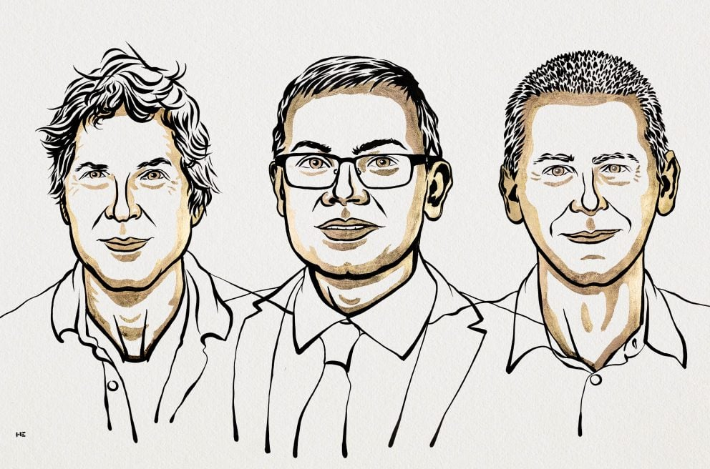
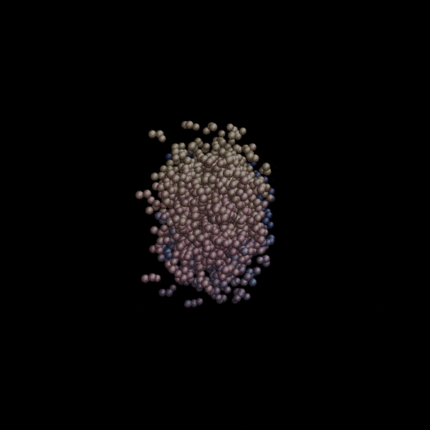
Protein design, protein engineering
D. Baker
D. Hassabis
J. Jumper
https://www.ipd.uw.edu/software
SEMMELWEIS University 1769
Department of Biophysics and Radiation Biology
HUN-REN-SE Biophysical Virology Research Group
hegelab.org

Slide 15
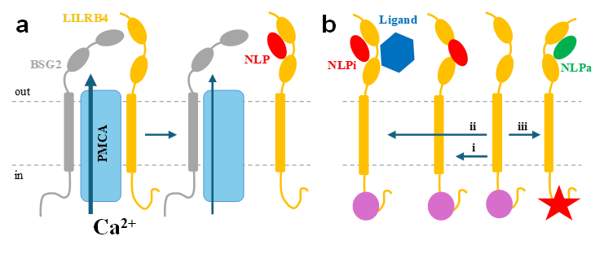
Protein design, protein engineering
D. Baker
D. Hassabis
J. Jumper
SARS-Cov2 E protein
LILRB4
inhibitory nanobody design
https://github.com/hegelab/RFantibody
human Pals1
PDZ-clamp design
Sagar Khare
Rutgers Univ.
HU-RIZONT 2024-0003
NKFIH 137610, 2021-2025
SEMMELWEIS University 1769
Department of Biophysics and Radiation Biology
HUN-REN-SE Biophysical Virology Research Group
hegelab.org

Slide 16
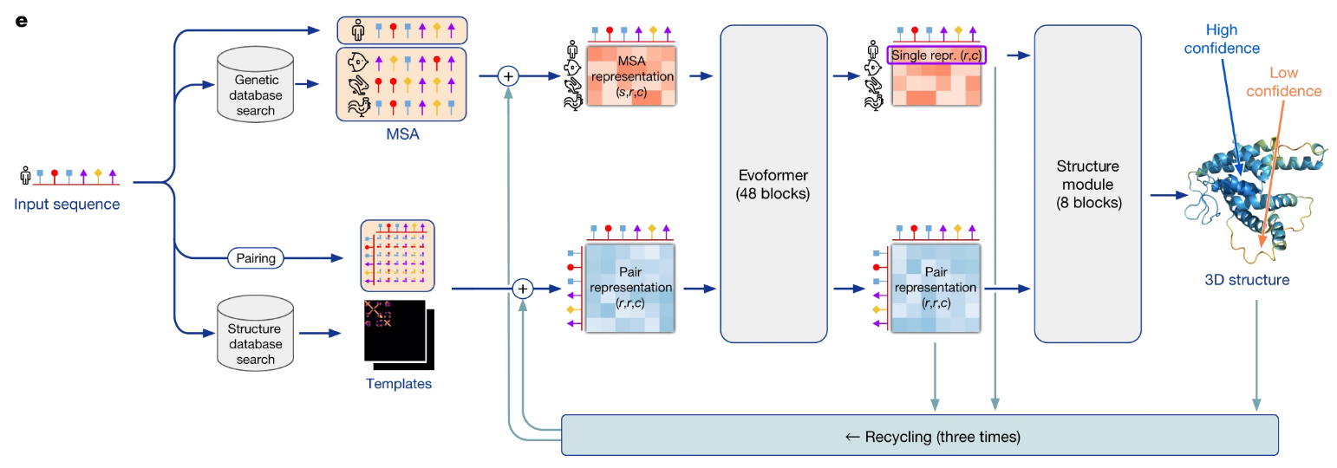
AlphaFold from DeepMind
D. Baker
D. Hassabis
J. Jumper
Jumper et al. Nat 2021
SEMMELWEIS University 1769
Department of Biophysics and Radiation Biology
HUN-REN-SE Biophysical Virology Research Group
hegelab.org

Slide 17
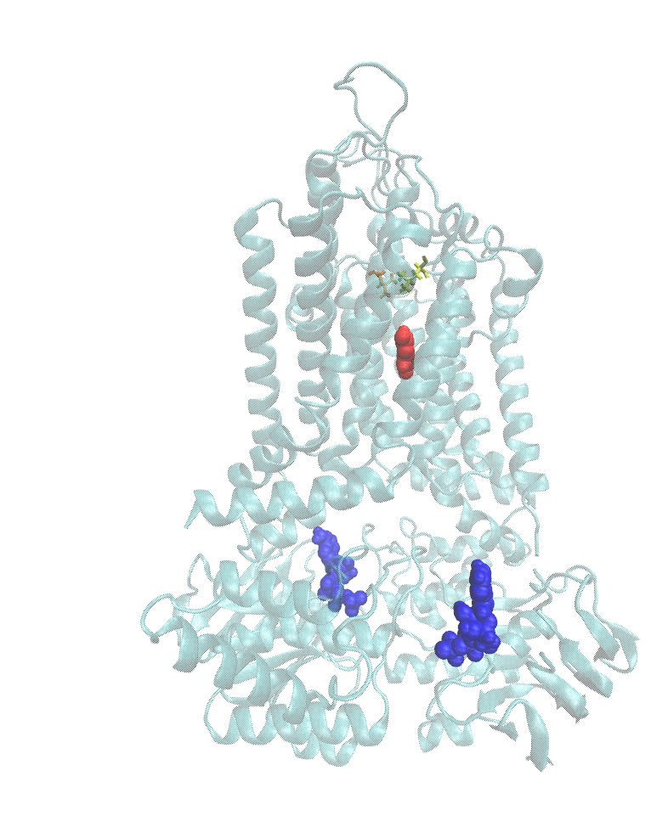
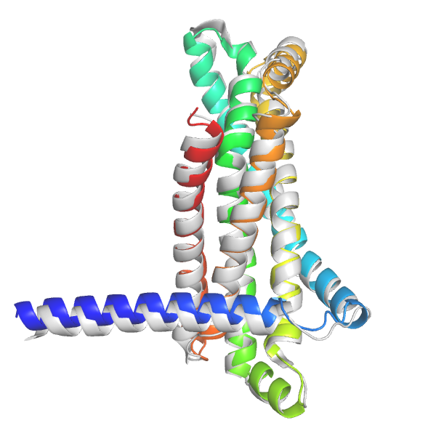
Prediction of new folds – dynamics?
MlaE-like fold
PDBID: 7ch0
RMSD of 1.28 Å
SEMMELWEIS University 1769
Department of Biophysics and Radiation Biology
HUN-REN-SE Biophysical Virology Research Group
hegelab.org

Slide 18
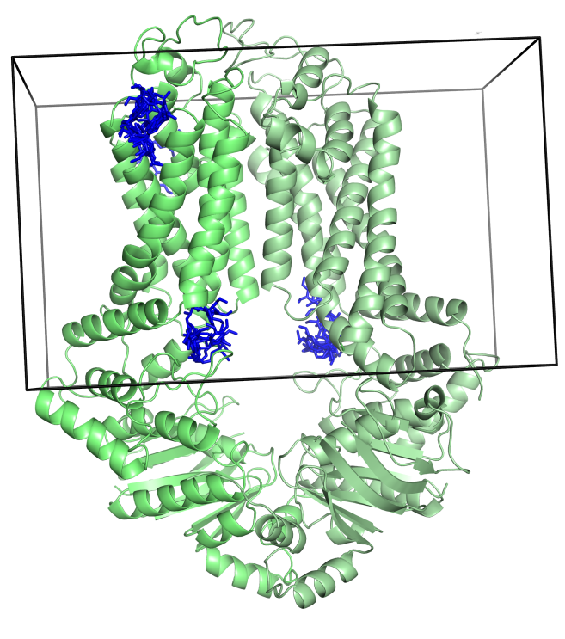
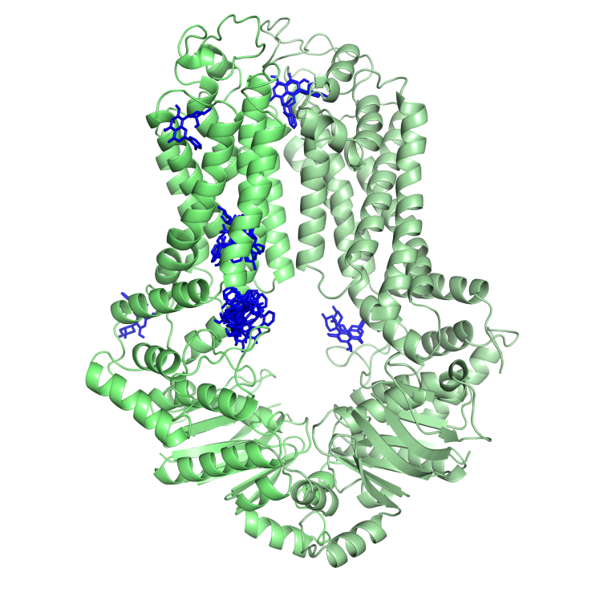
Protein/drug and protein/protein interactions
verapamil
flavopiridol
4
4
2
3
2
3
R482G
1
1
Laszlo et al. PLOS ONE 2016
SEMMELWEIS University 1769
Department of Biophysics and Radiation Biology
HUN-REN-SE Biophysical Virology Research Group
hegelab.org

Slide 19
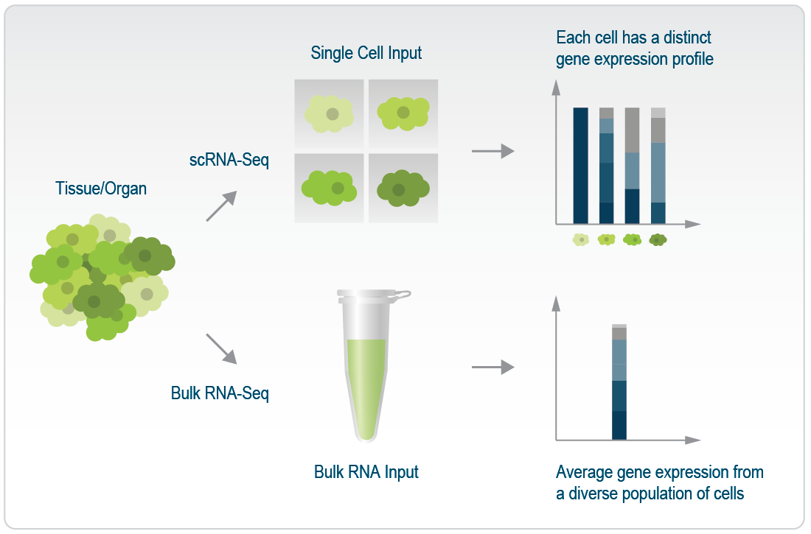
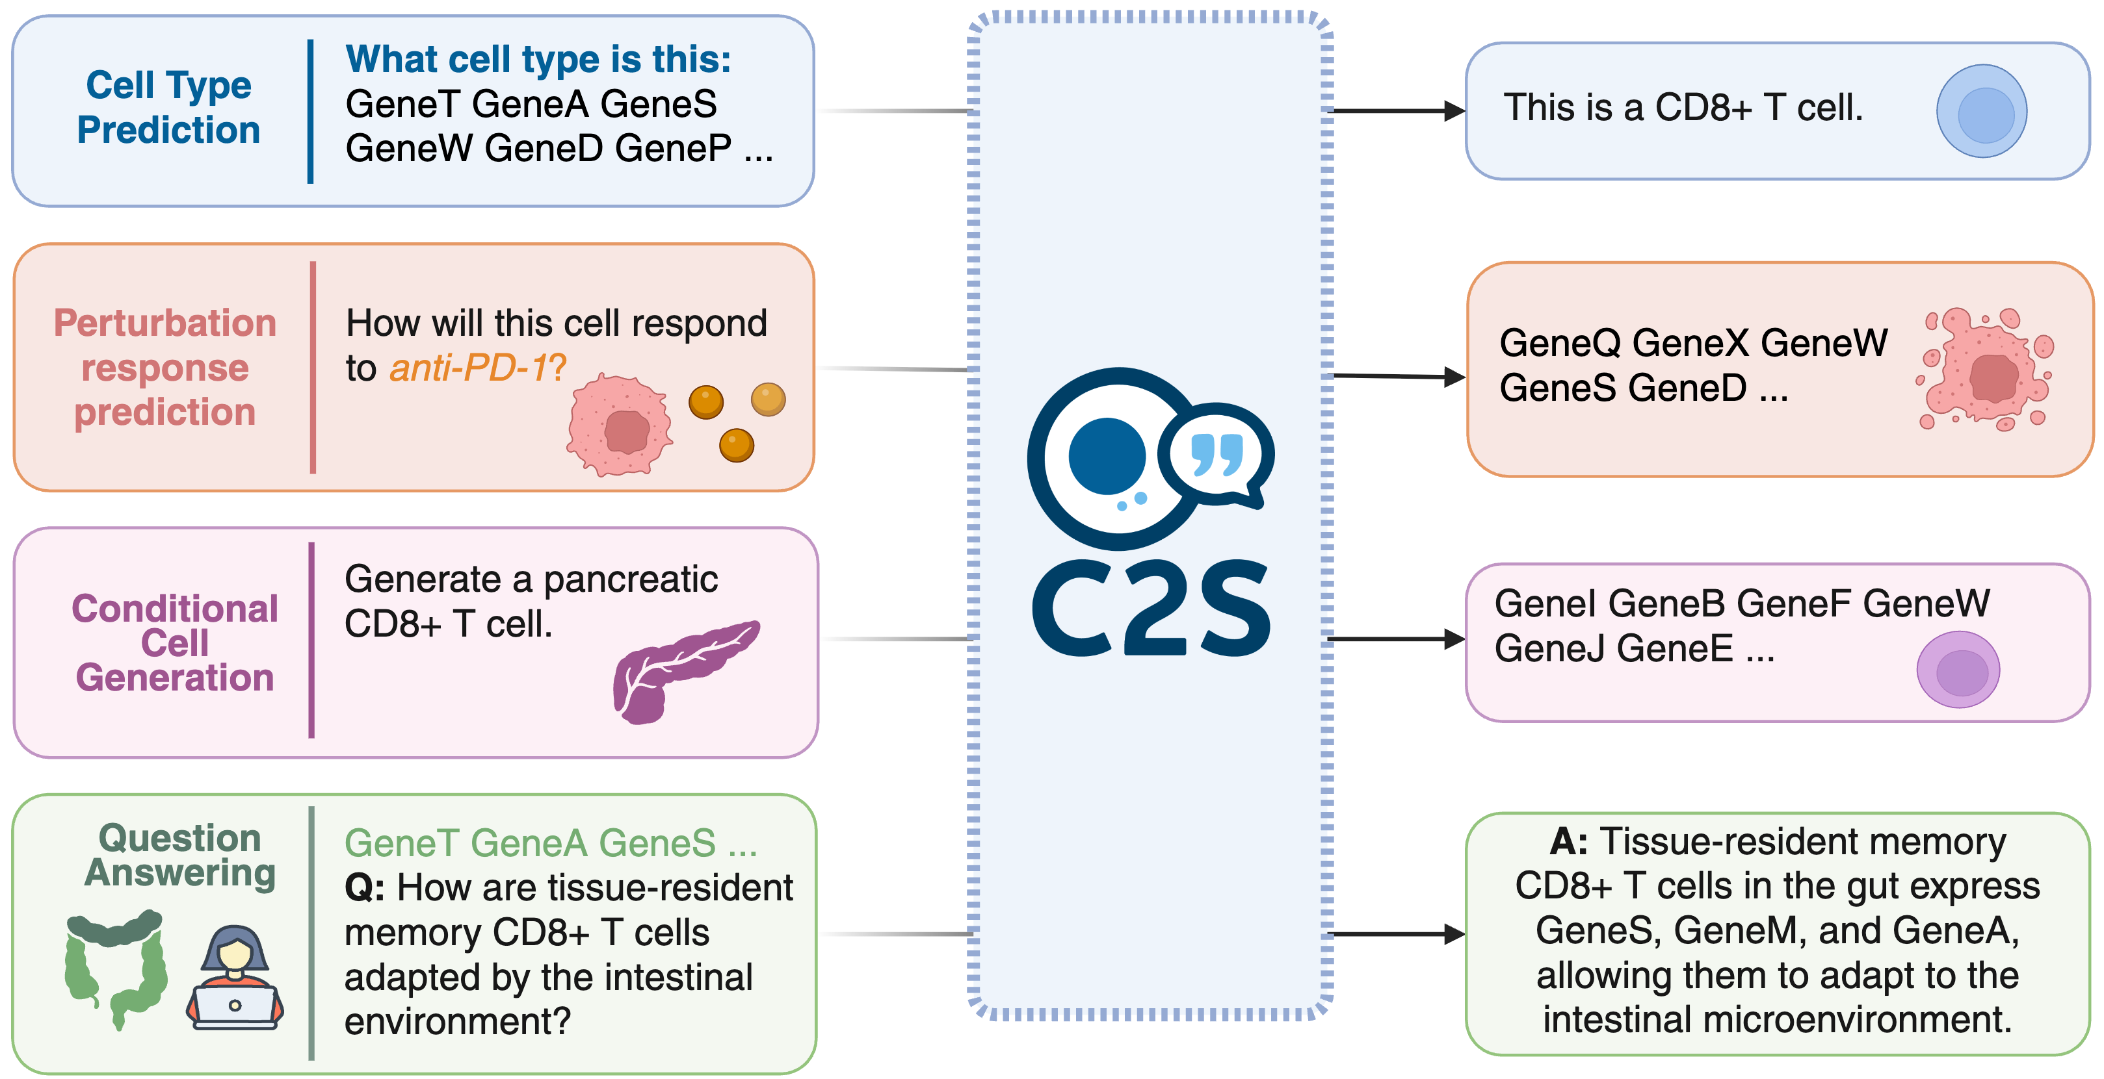
Single cell RNA-seq
Google DeepMind
https://www.lexogen.com
https://github.com/vandijklab/cell2sentence
SEMMELWEIS University, 1769
Institute of Biophysics and Radiation Biology
HUN-REN-SU Biophysical Viorology Research Group
hegelab.org

Slide 20
Conclusions, perspectives
TM proteins are not so difficult in silico targets anymore
pLMs solve ~every sequence-based prediction problems
What biology/chemistry/physics is behind the answer?
hLMs may help to answer this
Unresolved issues
  Conformations generation (drugs, protein dynamics)
  Complexes (drug/protein, protein/protein)
    Missing data? Missing concept?
  Quantum Computing?
    Conformation generation of small molecule
    Docking of small molecules to proteins
    (both simulated and real quantum computer)
SEMMELWEIS University, 1769
Institute of Biophysics and Radiation Biology
HUN-REN-SU Biophysical Viorology Research Group
hegelab.org

Slide 21
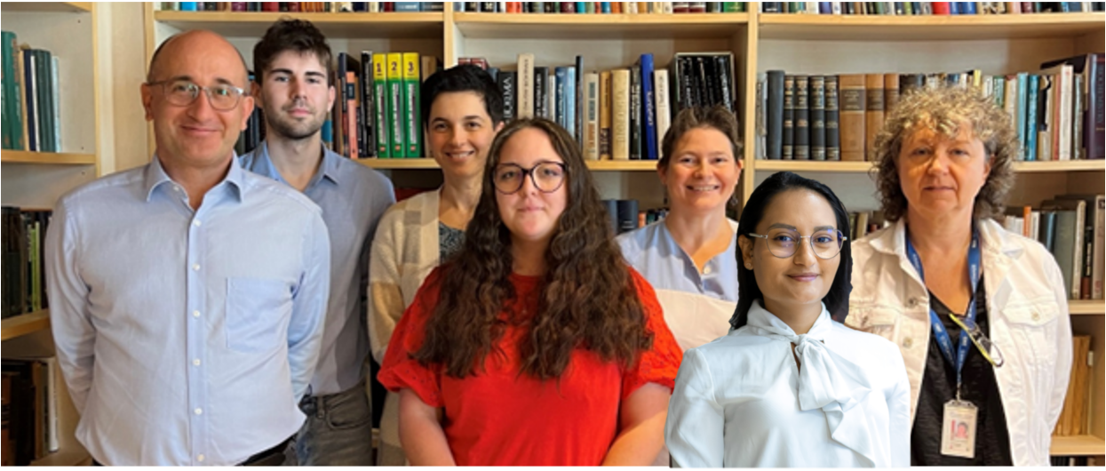
Thanks for your attention!
Institute of Biophysics and Radiation Biology
Semmelweis University, Budapest, HU
HUN-REN-SU Biophysical Virology Research Group
Collaborators
Ágnes Telbisz
Balázs Sarkadi
HUN-REN TTK
Zoltán Wiener and colleagues
Semmelweis University, Budapest
3D-bioinformatics, Elixir
IDP, Elixir
Barnaföldi Gergely
Wigner Scientific Computing Laboratory
Orsolya Gereben
Péter Hunyadi
Eszter Kozák
Rita Padányi
Hedvig Tordai
Kriszti Lór
Ágnes Enyedi
Makai Marianna
Berta Blanka
Lana Khamisi
Réka Nagy
Karen Torres
HU-HPC Komondor
NKFIH 137610
HU-RIZONT 2024-0003
MAPS
SEMMELWEIS University, 1769
Institute of Biophysics and Radiation Biology
HUN-REN-SU Biophysical Viorology Research Group
hegelab.org

