Slide 1
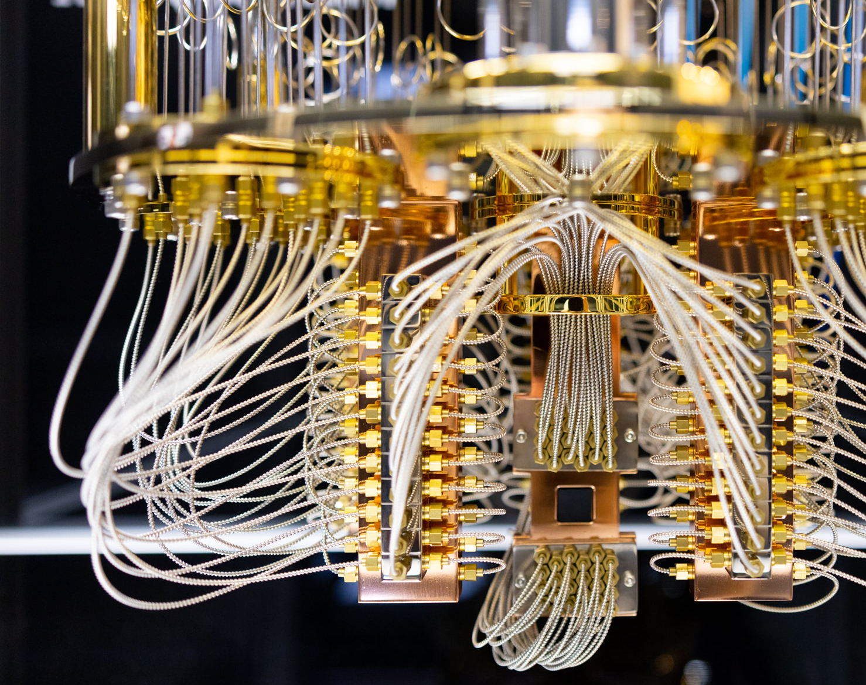
At the Intersection of Two Technological Revolutions: Quantum Computing and Artificial Intelligence
Arpad Pikethy
Country Leader
IBM Hungary

Slide 2
Reinventing how work gets done | +AI to AI+
Customer-facing functions and experiences
HR, Finance, and Supply chain functions
IT development and operations
Core business operations
IBM is actively engaging with enterprise clients across a broad set of business domains
Customer service
Empower customers to find solutions with easy, compelling experiences
HR automation
Reduce manual work and automate recruiting, sourcing and nurturing job candidates
App modernization, migration
Generate code, tune code generation response in real time
Threat management
Reduce incident response times from hours to minutes or seconds
90% customer inquiries handled by an AI assistant
40% improvement in HR productivity
60% software development content auto generated by AI
Contain potential threats 8x faster
Marketing
Increase personalization, improve efficiency across the content supply chain
Supply chain
Automate source to pay processes, reduce resource needs and improve cycle times
IT automation
Reduce automation development, identify deployment issues, avoiding incidents, optimize application demand to supply
Asset management
Optimize critical asset performance and operations while delivering sustainable outcomes
Client results and analyst studies
Reduce derivative content creation spend
Reduce cost per invoice by up to 50%
Reduce mean time to repair (MTTR) by 50%+
Reduce unplanned downtime by 43%
Content creation
Ex. Enhance digital sports viewing with auto-generated spoken AI commentary
Planning and analysis
Make smarter decisions, focus on higher value tasks with automated workflows and AI
AIOps
Assure continuous, cost-effective performance and connectivity across applications
Product development
Ex. Expedite drug discovery by inferring structure with AI from simple molecular representations
Scale live viewing experiences cost effectively
Process planning data up to 80% faster
Reduce application support tickets by 70%
Faster and less expensive drug discovery
Knowledge worker
Enable higher value work, improve decision making, and increase productivity
Regulatory compliance
Support compliance based on requirements / risks, proactively respond to regulatory changes
Data platform engineering
Redesign the approach for data integration using generative AI
Environmental intelligence
Provide intelligence to proactively plan and manage impact of severe weather and climate
Reduce 90% of text reading and analysis work
Reduce time spent responding to issues
Reduce data integration time by 30%+
Increase manufacturing output by 25%

Slide 3
Quantum AI for complex data structure use cases
Slide ID: 2147482443
Until Now
Different Quantum AI heuristics methods:
QSVM, QNN, Quantum Gen AI, etc.
Quantum AI could add value:
Find new patterns
with less data
in complex data structure
with better trainability
Quantum AI a complementary tool to AI
Few potential industry use cases identified and explored with real-world data
What’s next?
Identify more value-added use cases for QML
More experimentation with real world data in real world context
Scale experimentation to utility prototype
Quantum AI business workflow redefined
Think about real world applicability & constraints
Continue to find better QML algorithms through theory & experimentation with real HW

Slide 4

Computationally complex problems exist across almost every industry.
Slide ID: 2147483460
Banking
Automotive
Chemicals
Life sciences
Healthcare
Logistics
Public services
Fraud monitoring
Portfolio optimization
Risk simulation
Customer analytics
Time series forecasting
Battery material design
Material design
Mobility as a Service
Quality control
Self-driving and ADAS
Production optimization
Sustainable products
Low-carbon manufacturing
Resilient supply chains
Process optimization
Asset health
Efficient drug research and development
Clinical trials
Tractable protein folding
Cell-centric therapeutics
mRNA
Accelerated diagnoses
Personalized interventions
Adherence to drugs
Biomarkers
Image processing
Global logistics optimization
Disruption management
Routing optimization
Predictive maintenance
Forecasting
Security/safety
Multimodal transport
City resource planning
Disaster management
Fraud detection in tax and social
Insurance
Electronics
Airlines
Energy and utilities
Aerospace
Oil and gas
Telecom
Catastrophe modeling
Precise customer profiling
Efficient risk management
Optimized pricing of premiums
Faster product design
Circuit defect identification
Process optimization
Production optimization
Quality control
Forecasting and revenue
Irregular operations
Network planning
Safety and maintenance
Hyper-personalization
Energy trading
Optimization of energy grid
Renewables system design
Energy forecasting
Hyper-personalization
Asset health
Material discovery
Aircraft design
Asset health
Corrosion and material interaction
Fuel efficiency
Emissions reduction
Reservoir simulation
Virtual flow meters
Subsurface modeling
Failure prediction
Network optimization
Network anomaly detection
Contextual customer segmentation
Cybersecurity network

Slide 5
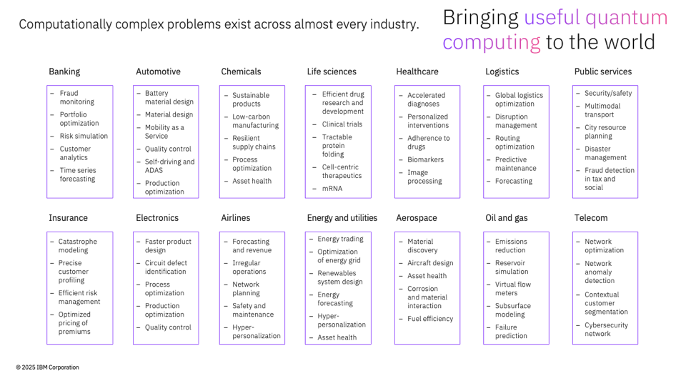
Quantum AI could be leveraged in all industries
Slide ID: 2147482452

Slide 6

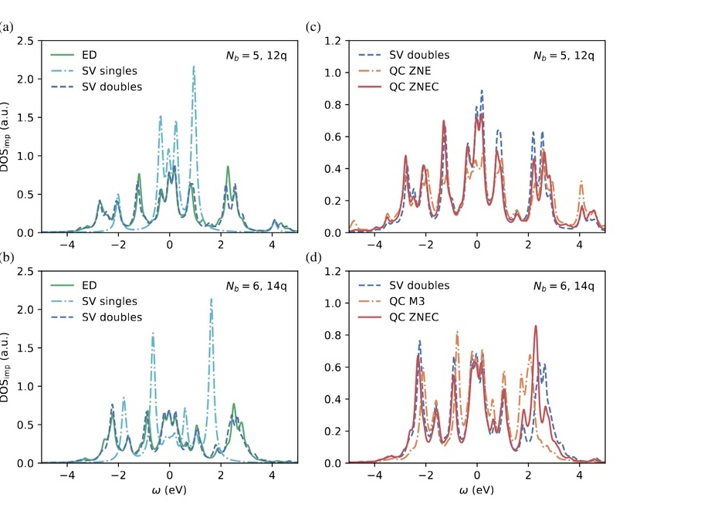
Advancing materials simulation for high-temperature superconductors
Slide ID: 452
Simulation
Bosch partnered with IBM to develop a scalable hybrid quantum-classical workflow for simulating the energy distribution of electrons in real materials, starting with Ca₂CuO₂Cl₂, a parent compound for high-temperature superconductors with highly correlated structure.
Using the IBM Quantum Heron processor, they ran the largest simulation at the time for a real monocrystalline material on a quantum computer, the validity of which was proven by agreement with experimental data and best-in-class classical simulations.
“The combination of the new Heron chip with the new error mitigation scheme developed by Bosch gave us beautiful results, with excellent agreement of the mobility of electrons between the quantum calculation and experimental data.”
Thomas Eckl Chief Expert, Bosch Research
These figures show the calculation of a materials science quantity-of-interest called the density-of-states. The top row and bottom row represent 12 and 14-qubit experiments, respectively. The left column represents the brute-force answer with a solid line, and the technique discussed in the paper run on a simulator with dotted lines. The right column compares the simulator results with real hardware performance on ibm_torino with error mitigation applied.
Read the paper: arXiv:2404.09527
6

Slide 7
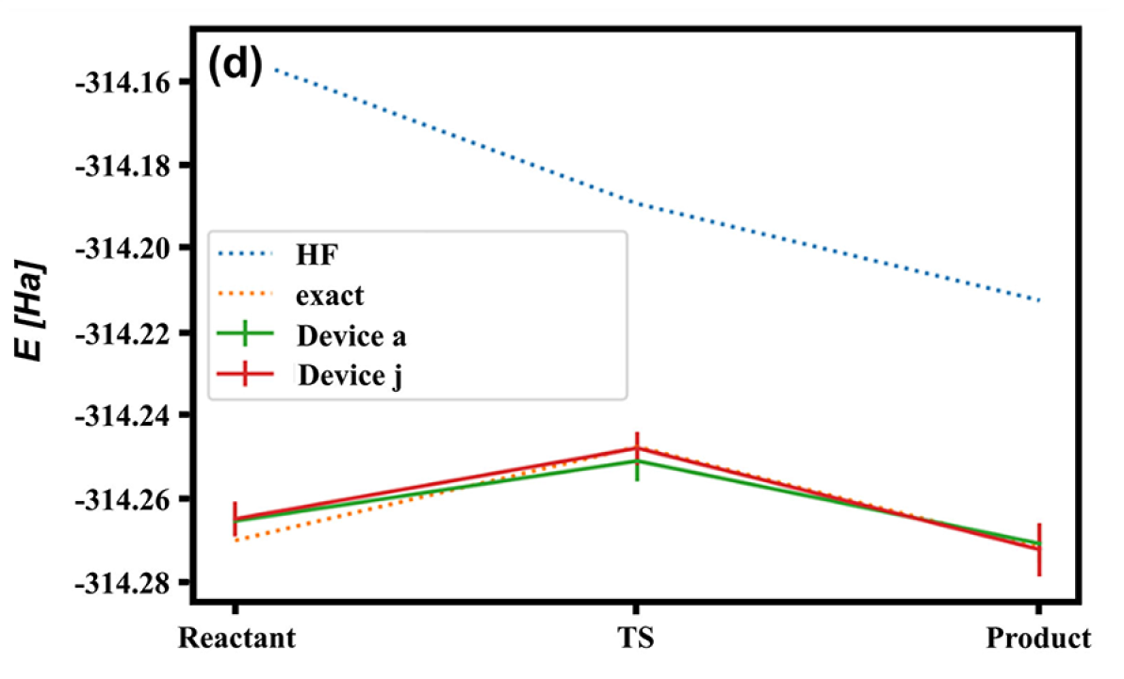
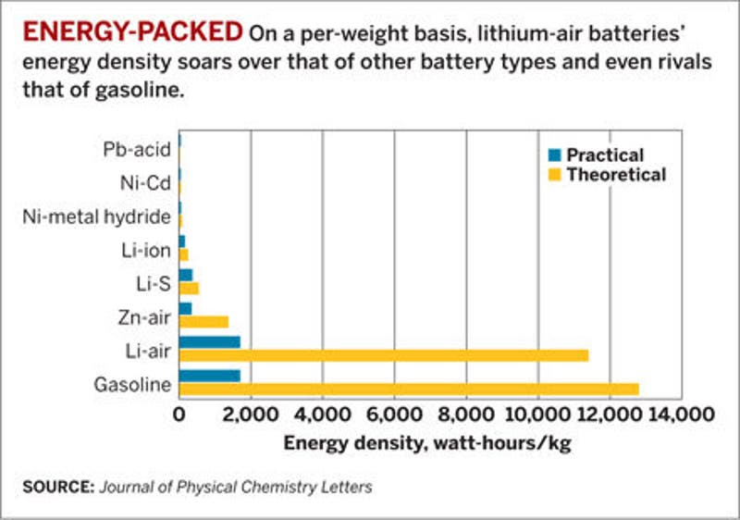
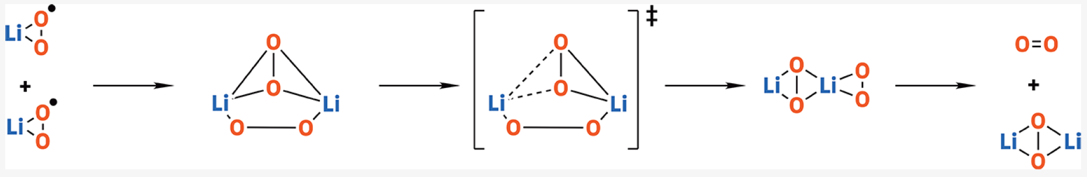
Mitsubishi Chemical Lithium-air battery chemistry
Slide ID: 2147481624
Simulation
Classical (Hartree-Fock)
Lithium-air batteries have demonstrated energy densities 5x higher than lithium-ion batteries and theoretical energy densities comparable to gasoline yet face many challenges in chemistry industrialization.
IBM Quantum Computer Amsterdam
IBM Quantum Computer Johannesburg
Exact Solution
Mitsubishi Chemical and IBM investigated the rearrangement of the lithium superoxide dimer, which requires an accurate description of bond breaking and formation through a transition state. The team demonstrated proof of principle of a complete reaction with a quantum computer (state-of-the-art at the time).
Source: The Journal of Physical Chemistry A 125.9 (2021): 1827-1836.
© 2025 IBM Corporation
7

Slide 8

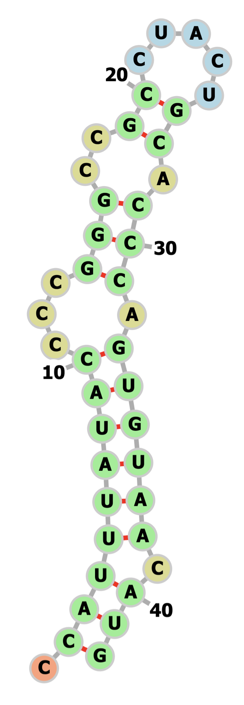
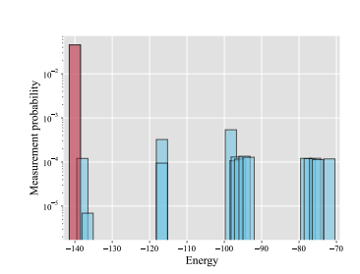
Predicting mRNA secondary structures with quantum optimization techniques
Slide ID: 455
Optimization
Moderna partnered with IBM to develop quantum computing algorithms for predicting mRNA secondary structures at greater scale and accuracy, with the goal of unveiling novel and more diverse mRNA therapies.
Running the CVaR-VQA algorithm on IBM Quantum Eagle and IBM Quantum Heron processors yielded accurate insights into folding mechanisms for mRNA sequences of up to 42 nucleotides (mapped to 10–80 qubits) and their associated energy states that match the results of the classical solver CPLEX.
“Our world is a quantum mechanical world, and so when we try to simplify things in a deterministic world, we’re not going to really be able to emulate that complexity.”
Wade Davis Senior Vice President, Digital for Business, Moderna
These figures show (a) the measurement probability of sampled bitstrings plotted against bitstring energies for the 80-qubit problem, where the red bar indicates the probability corresponding to the lowest energy bitstring; and (b) the optimal folded structure of the 42-nucleotide, 80-qubit mRNA sequence based on the corresponding lowest energy bitstring found by the hardware run.
Read the paper: arXiv:2405.20328
Explore the demo: ibm.biz/BdGAB6
8

Slide 9

ExxonMobil Routing optimization
Slide ID: 303
In 2021, more than 500 liquified natural gas (LNG) ships were used to transport critical fuel supplies across the oceans. Together, they make thousands of journeys per year to destination ports where the LNG is deployed to power critical infrastructure.
Finding optimal routes for a fleet of such ships can be a mind-bendingly complex optimization problem.
https://www.ibm.com/case-studies/exxonmobil/ IEEE Trans Quantum Engineering, vol. 2, p. 1
Quantum computers take a new approach to addressing this sort of complexity, with the potential to find solutions that classical supercomputers alone cannot handle. Industry leaders like ExxonMobil are getting involved now to explore how blending classical and quantum computing techniques might solve big, complex, pressing global challenges.

Slide 10
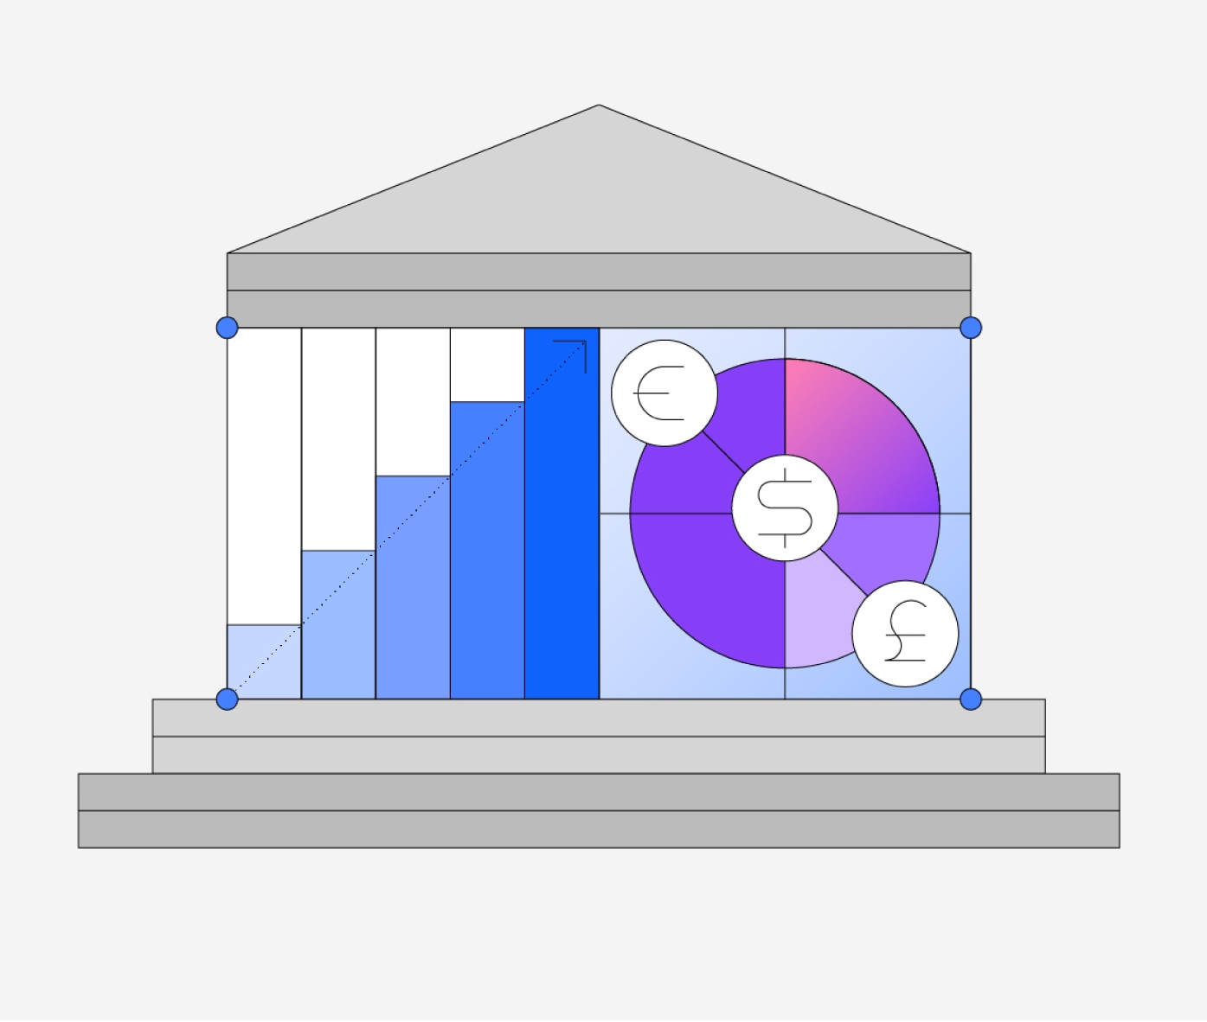
Voice of our first adopters HSBC
Slide ID: 2147482153
“This technology has the potential to transform how we run areas of the bank by addressing challenges which classical computers may never be able to solve, alone. Our work with IBM, a leading provider of quantum computing, is essential to harnessing this potentially game-changing technology for financial services.”
Colin Bell, CEO of HSBC Bank and HSBC Europe
→ Pricing and portfolio optimization
→ Sustainability
→ Fraud management
→ Risk management

Slide 11

Exploring business value with quantum and AI
LONDON, Sept 25 (Reuters) - Europe's biggest bank HSBC said on Thursday that a trial use of quantum computers to aid bond trading had produced promising results, in a rare example of a major finance company finding early benefits from the emerging technology.
HSBC said its quantum computing pilot - run with technology firm IBM had delivered a 34% improvement in predicting how likely a bond trade would be filled at a quoted price, giving it a competitive edge compared to normal computing.

Slide 12


































Ecosystem
IBM Quantum Platform hosts the strongest ecosystem advancing quantum computing
Slide ID: 439
The IBM Quantum Network has 275+ members
50+
Industry members
55+
Commercial partners and startups
170+
Academic and research institutions
Oak Ridge National Laboratory and the oak leaf symbol are registered trademarks of the U.S. Department of Energy. Use of this mark does not constitute or imply its endorsement, recommendation, or favoring by the United States Government or any agency thereof or its contractors or subcontractors.

Slide 13
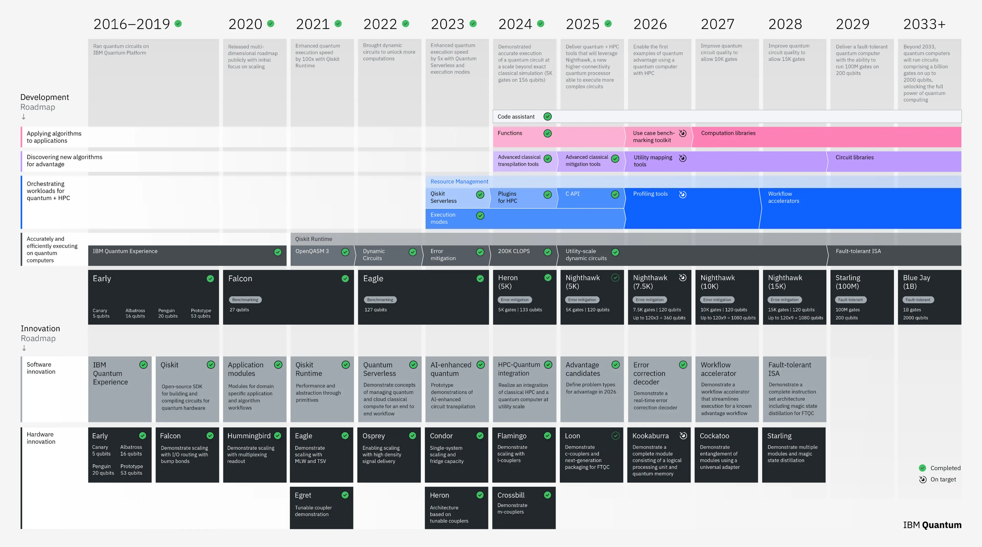
Slide ID: 2147481712

Slide 14
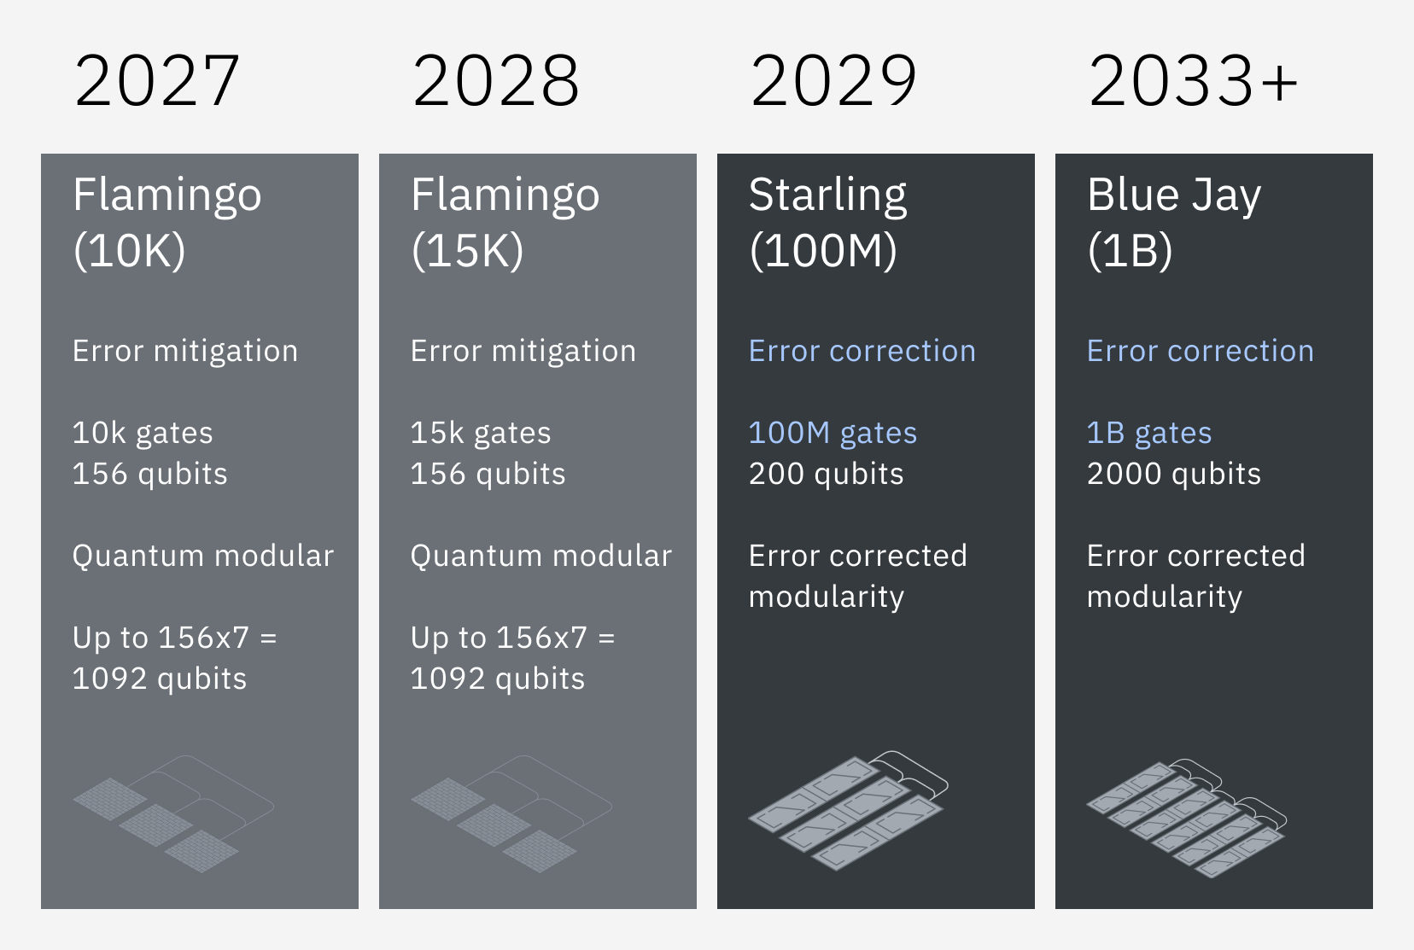
Scaling circuit size through the error correction transition
Slide ID: 2147482077
As we focus on performance, our roadmap highlights a more important metric than qubit count alone: The gate count, which measures the circuit’s complexity. We calculate it by multiplying the width—the number of qubits—by the depth, the number of operations you can run on a qubit before it decoheres.
Error mitigation will allow us to increase circuit complexity for the next four years. The tradeoff is that you must run more circuits iteratively and perform classical post processing.
In 2029, we introduce error correction. The width of these circuits—the number of qubits in your calculation—is essentially the same, but you can now run much deeper circuits — those with more operations. The tradeoff is it requires much more physical hardware.
With error correction implemented, we can then start scaling to circuits that are both deeper and wider as we move from Starling to Blue Jay.

Slide 15
To realize Quantum Advantage, we need a dedicated community of industries, researchers, and practitioners to activate the use of quantum algorithms.
QSCP in Hungary
Slide ID: 333

Slide 16
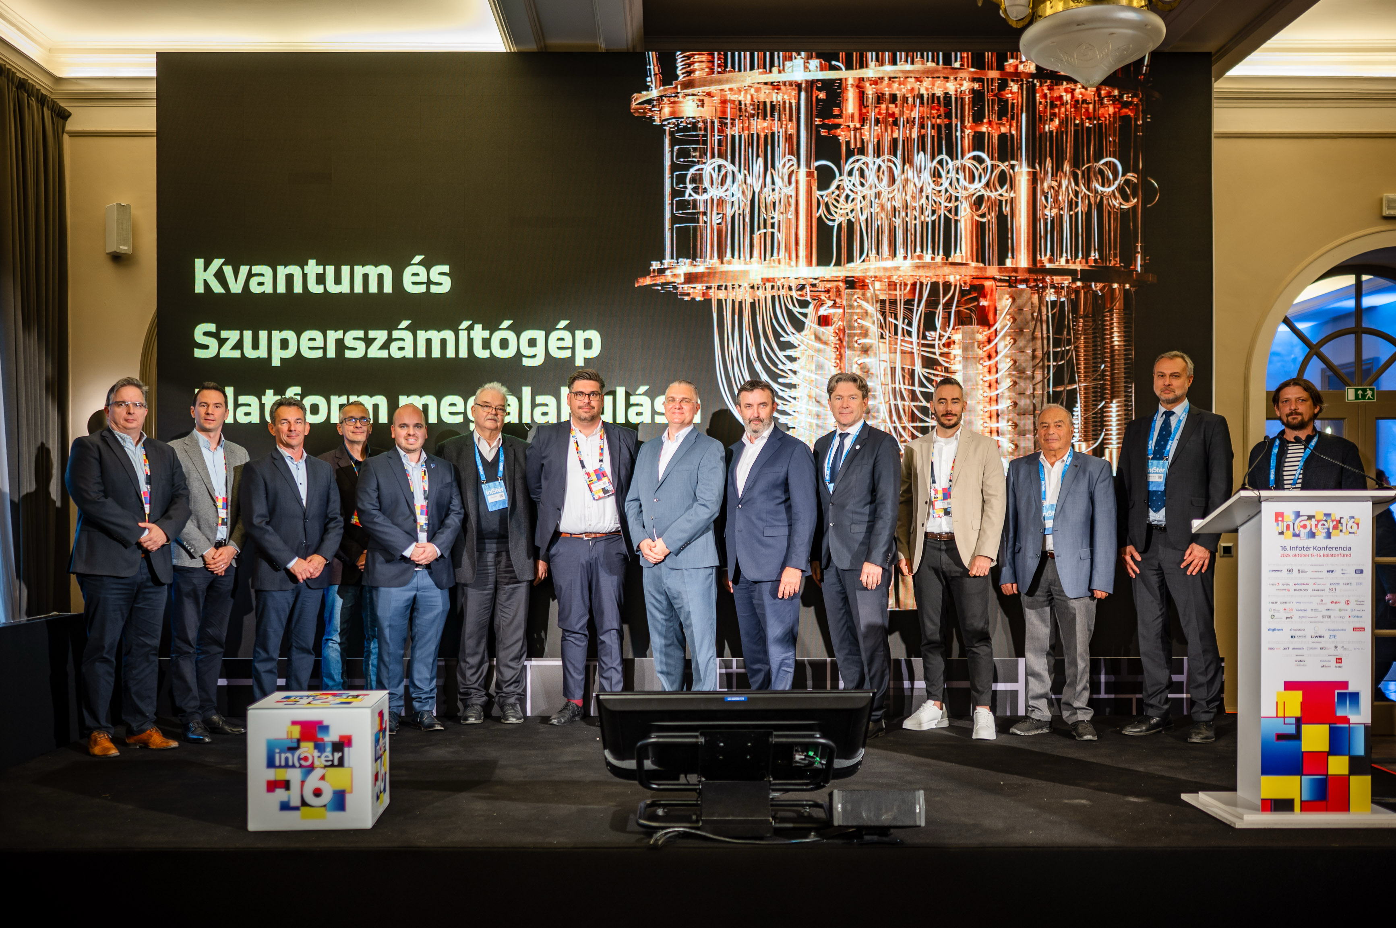
Quantumtechnology and Supercomputer Platform QSCP
Our vision is to unite the leading minds of research, industry, academia, and the public sector, forging an ecosystem where the combined power of quantum computing, artificial intelligence, and high-performance computing unlocks unprecedented possibilities and drives transformative progress for the Hungarian economy and society

Slide 17
QSCP Future Goal / Vision
Collaborate & leverage internationals resources to scale
International partnerships
A strategic focus on attracting foreign companies, knowledge, talent and capital to the quantum ecosystem in Hungary
Becoming one of the preferred locations for quantum technology development globally.
Economic growth
Accelerate the existing quantum legacy
Make the unique Hungarian quantum ecosystem even more attractive to foreign companies
Attract investors
Strengthen the influx of young students into the fields of quantum technologies
Internships
Participation in research & enablement exchanges
Upskill and reskill the current workforce to build in-house expertise
Special events to increase awareness & engagement in Quantum Innovation Center
Support the emerging Hungarian quantum ecosystem
Stimulate industry and small technology companies
Development of curriculums
Research and solutions commercialization
Academic engagements
Camps and local hack-a-thons to increase reach
Participation in advocate networking events
Increased international presence.
Notes:
Master Draft 1
Master Draft 1
17

