Slide 1

Beyond Classical
Demonstration of Quantum Optimization for Industrial Problems

Slide 2

Dual Innovation Platform
Startup
for business development
Association
for quantum ecosystem and collaborations

Slide 3
Quantum Computing for complex optimization
What can quantum computing be used for?
  Tasks that classical computers struggle with
  Tasks that to quantum formulations
map naturally

Slide 4
Combinatorial optimization
map naturally
onto quantum hardware
Hamiltonian
Ground state energy = optimal solution
Quantum Computers can naturally work with these systems
Effective on quantum hardware

Slide 5
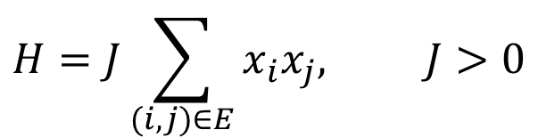
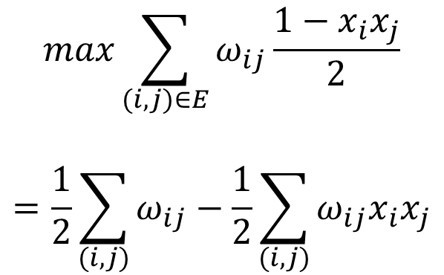
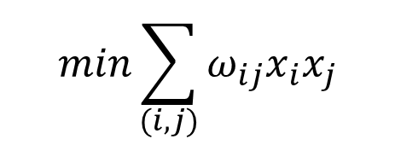
Graph partitioning on quantum computers
Can be mapped as a Hamiltonian with the Ising Model
Graph problem:
Antiferromagnetic Ising Hamiltonian:
(Quantum formula)
$$max\sum_{(i,j)∈E}{ω_{ij}\frac{1−x_{i}x_{j}}{2}}$$
$$=\frac{1}{2}\sum_{(i,j)}{ω_{ij}}−\frac{1}{2}\sum_{(i,j)}{ω_{ij}x_{i}x_{j}}$$
$$H=J\sum_{(i,j)∈E}{x_{i}x_{j}, J>0}$$
Finding the ground state of the Hamiltonian
$$min\sum_{(i,j)}{ω_{ij}x_{i}x_{j}}$$
Maximalization = Minimalization
Effective on Quantum Computer
☺

Slide 6
Real industrial optimization problems
Telecommunication

Slide 7
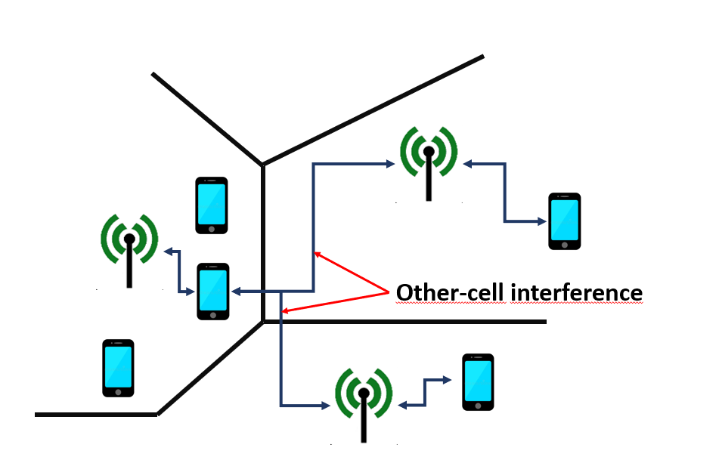
Frequency allocation
The problem:
Limited range
Limited frequency bands
Dynamically changing environment (number of people)
Towers interfere

Slide 8

Frequency allocation
The problem:
Limited range
Limited frequency bands
Dynamically changing environment (number of people)
Towers interfere

Slide 9
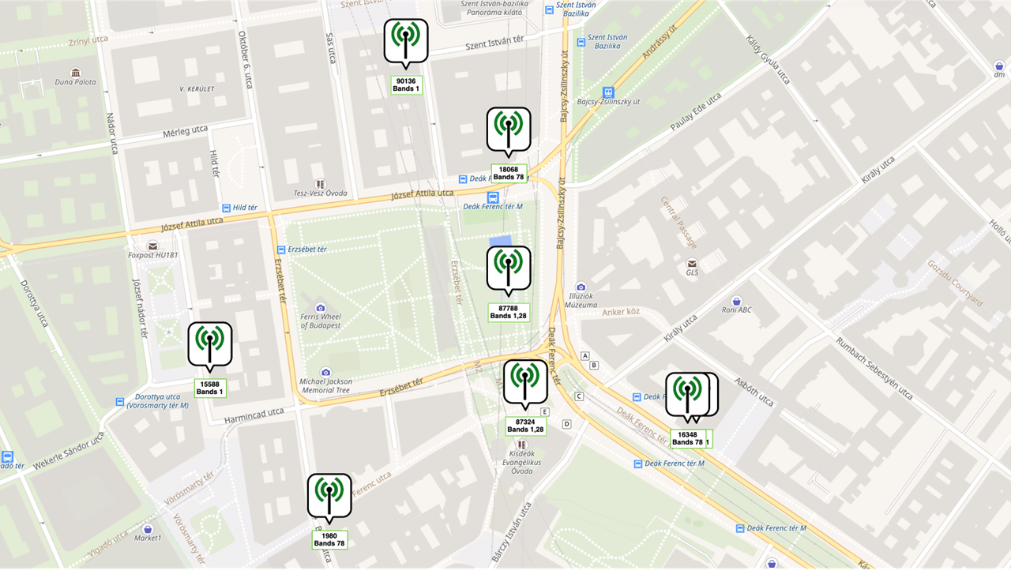

Slide 10
Solving on Quantum Computer
Hibrid Quantum-Classical Algorithms can find the ground state → the optimal solution
Classical Optimizer
Finds parameters
Variational Quantum Algorithms (VQA):
Uses parameters
to run quantum circuits
Quantum Computer

Slide 11
Running LIVE demo of interference optimization on previous Deák square example...

Slide 12
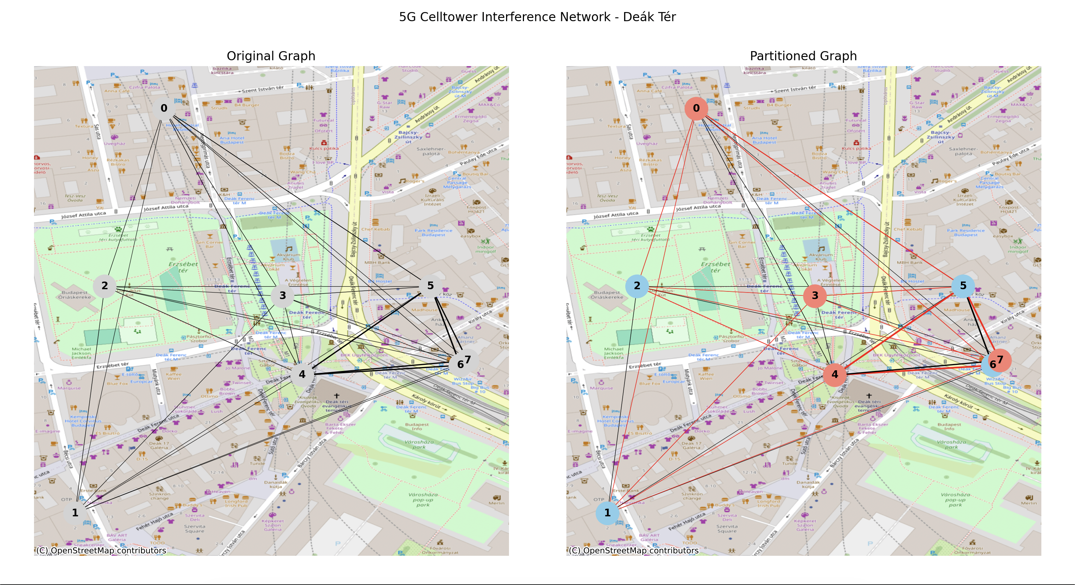
(Result after LIVE demo – running on IBM quantum hardware)

Slide 13
Other industries
Logistics & Supply-Chain → Vehicle routing and delivery route optimization
Finance → Portfolio optimization
Manufacturing → Production scheduling
Telecommunication → Network Routing, Interference Minimalization
Energy Sector → Unit commitment
Chemistry/Material Science → Molecular configuration search
Drug Discovery → Molecular docking
Cybersecurity/Military → Attack graph optimization, resource allocation

Slide 14
Now let’s take a look at the future!
Huge hype all around the globe regarding useful market applications
Is it possible today? Can we do it?
The reality: NO
(The technology isn’t quite there yet)

Slide 15
Now let’s take a look at the future!
Huge hype all around the globe regarding useful market applications
Is it possible today? Can we do it?
The reality: NO
(The technology isn’t quite there yet)
But, as the first signs show, we will harness them

Slide 16
However what we CAN do today is...

Slide 17
However what we CAN do today is...
engage in PARTNERSHIPS
To identify and understand the problems that are out there
To start the work today
To get everybody who is ready to take the quantum leap there in time

Slide 18
Thank you for your attention!
We believe that the only way to step into the Quantum Era is
together.
Contact: info@quantumnexus.hu

