Slide 1

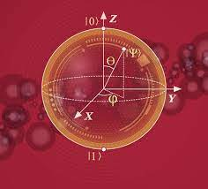



Quantum computing platforms and related experimental activities
Ádám Gali
HUN-REN Wigner Research Centre for Physics
Budapest University of Technology and Economics
Academia-Industry Matching Event (AIME25)
November 27-28, 2025, 15:30-16:00, HUN-REN Headquarters, Budapest (Hungary)

Slide 2

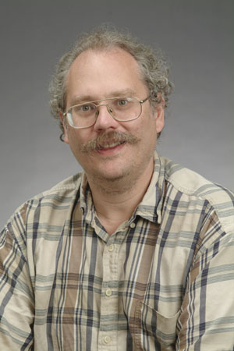
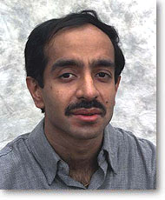
Quantum information processing
Di Vincenzo’s five + two criteria
Scalable quantum memory
Ability to initialize qubits
Universal quantum gates
Qubit readout
Long coherence times for qubits
Interconversion between stationary and flying qubits
Faithful transmission of flying qubits
Scalable and controllable quantum bits (qubits): long coherence time
Universal quantum gates
Production of “flying” qubits are needed for quantum information processing
  single photon emitters
Richard. P. Feynman
Pioneer quantum computer scientists:
Peter Shor Lov Grover

Slide 3
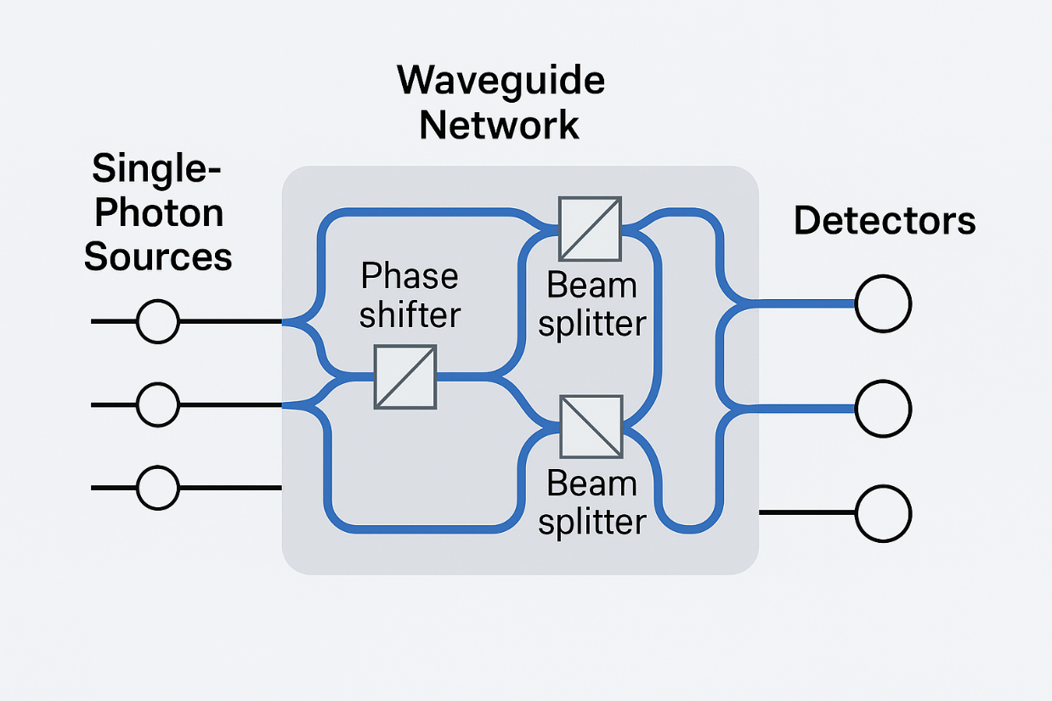
Photonics quantum simulation and computation
The key bottleneck is photon loss, compounded by the lack of nearly perfect deterministic photon sources and low-loss components
Jian-Wei Pan et al., Nature Photonics volume 19, pages 387–391 (2025)
@Wigner RCP: development of multiplexed single photon sources that may drive the optical quantum chip @ELTE

Slide 4
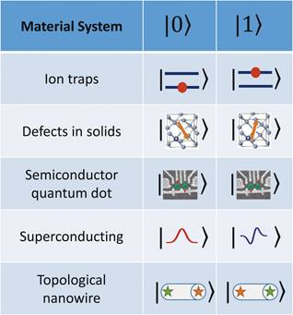
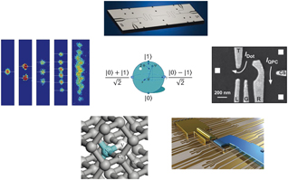
Potential quantum bit materials
Materials system | |0⟩ | |1⟩
Ion traps/Neutral atoms
Point defects in solids
Semiconductor quantum dots
Superconductor circuits
Topological quantum bits
James N. Eckstein and Jeremy Levy, MRS Bulletin 38, 783, (October 2013)
Topological quantum bits (e.g., Majorana fermions) would guarantee fault-tolerant quantum computers.

Slide 5
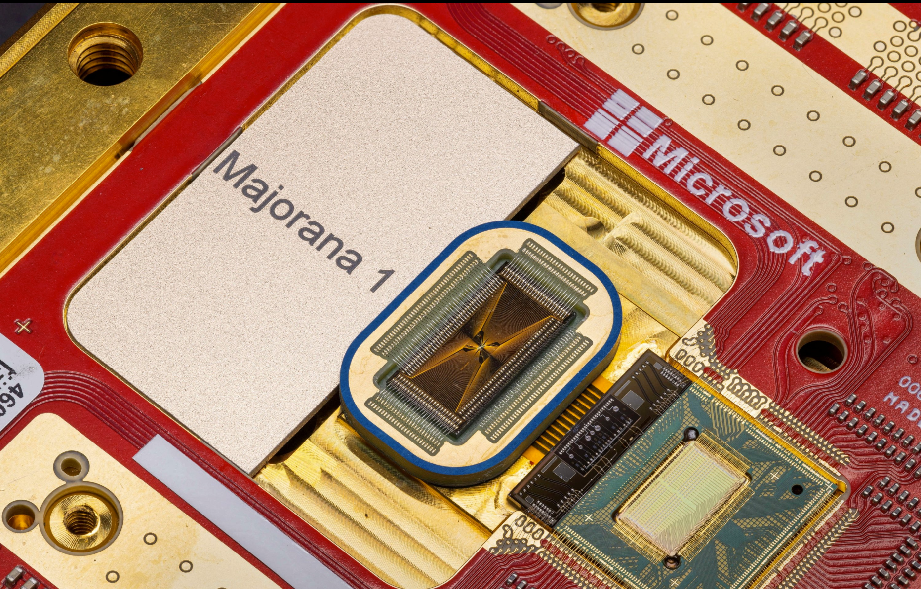
Towards topological quantum bits
10 mK temperatures
Experimental topological quantum bit research @BME
Theoretical research (on materials) @Wigner RCP and @BME

Slide 6
Potential quantum bit materials
Materials system | |0⟩ | |1⟩
Ion traps/Neutral atoms
Point defects in solids
Semiconductor quantum dots
Superconductor circuits
Topological quantum bits
James N. Eckstein and Jeremy Levy, MRS Bulletin 38, 783, (October 2013)
Superconductor circuits readout by microwave resonator and/or fields.

Slide 7
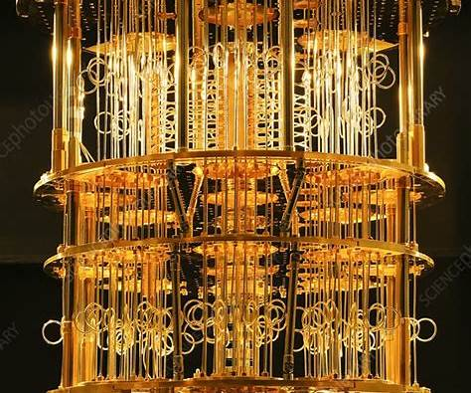
Superconductor circuits quantum computer
10-20 mK temperatures
No experimental research group in Hungary is working on it; low-temperature physics expertise is available @BME and @Wigner RCP
Benchmarking of these quantum computers @Wigner RCP and @ELTE

Slide 8
Potential quantum bit materials
Materials system | |0⟩ | |1⟩
Ion traps/Neutral atoms
Point defects in solids
Semiconductor quantum dots
Superconductor circuits
Topological quantum bits
James N. Eckstein and Jeremy Levy, MRS Bulletin 38, 783, (October 2013)
Semiconductor quantum dots qubits are read out by spin-selective quantum tunelling.

Slide 9
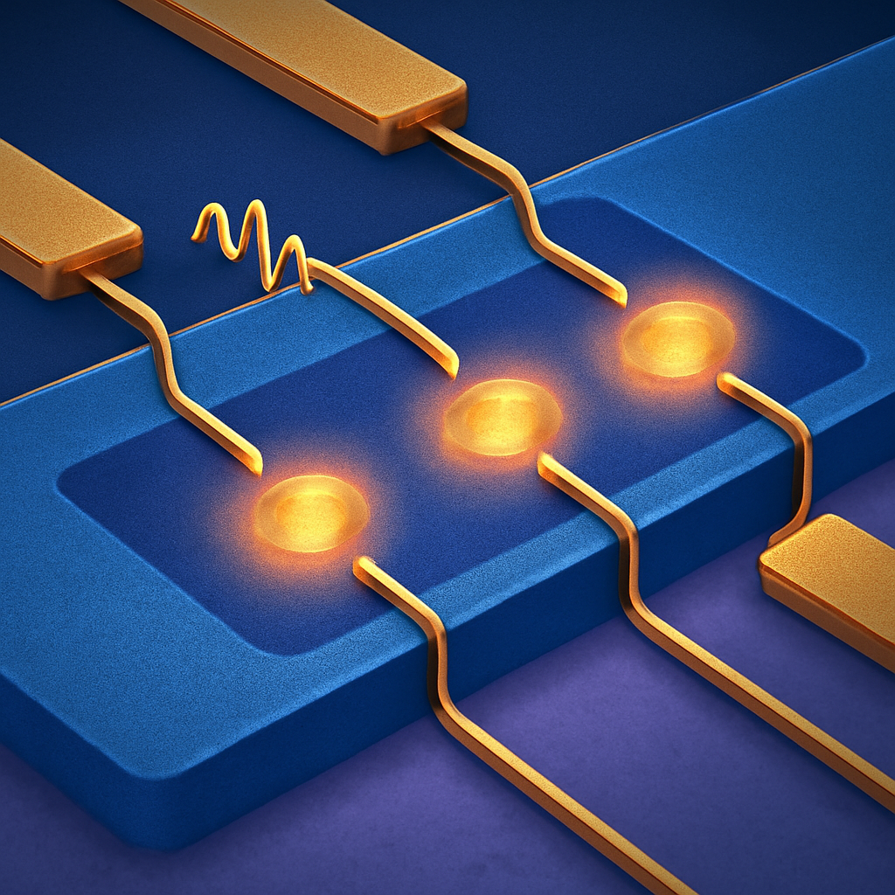
Semiconductor quantum dots
cryogenic temperatures
No experimental research group in Hungary is working on it; theory @BME

Slide 10
Potential quantum bit materials
Materials system | |0⟩ | |1⟩
Ion traps/Neutral atoms
Point defects in solids
Semiconductor quantum dots
Superconductor circuits
Topological quantum bits
James N. Eckstein and Jeremy Levy, MRS Bulletin 38, 783, (October 2013)
Quantum optics for readout and initialization with electron and nuclear spins acting as qubits

Slide 11
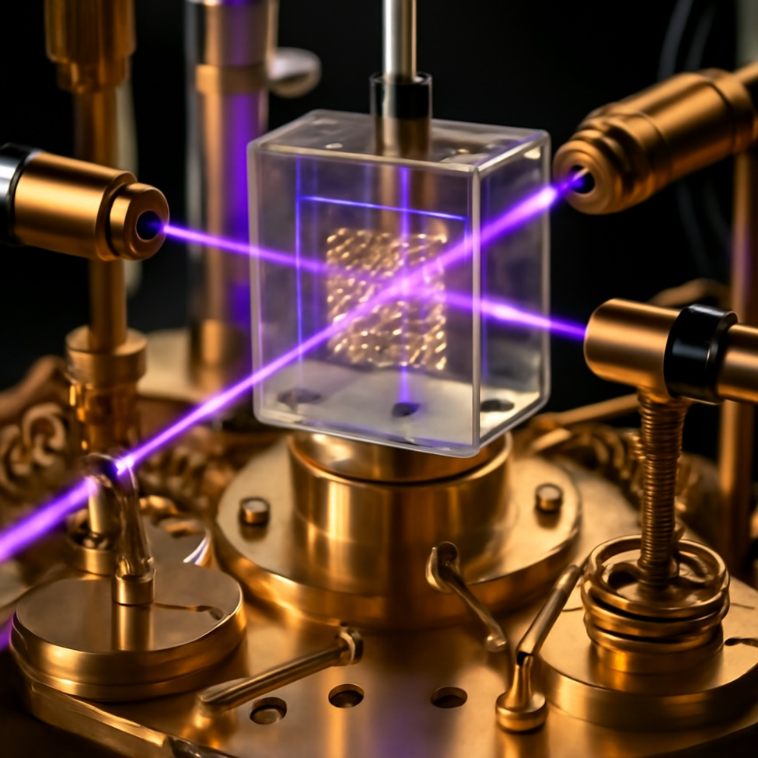
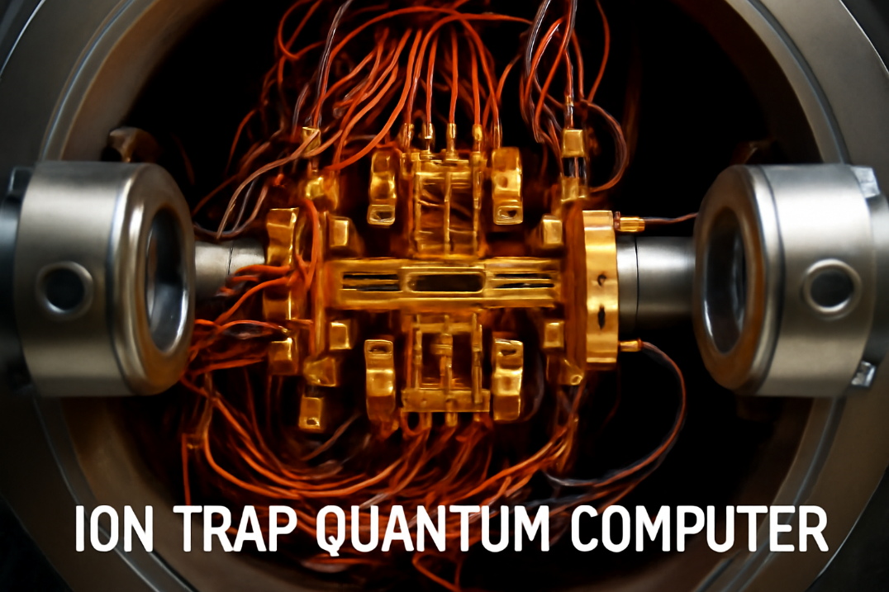
Ion traps and neutral atoms
Neutral atoms quantum computer
Ultrahigh vacuum and cryogenic temperatures
Scalability is an issue
Ultrahigh vacuum
>10,000 physical qubits
@Wigner RCP: technology of ultrahigh vacuum for neutral atoms

Slide 12
Potential quantum bit materials
Materials system | |0⟩ | |1⟩
Ion traps/Neutral atoms
Point defects in solids
Semiconductor quantum dots
Superconductor circuits
Topological quantum bits
James N. Eckstein and Jeremy Levy, MRS Bulletin 38, 783, (October 2013)
Physics of solid state point defect qubits:
Precise placement of defects in a clean host environment
Ultra-precise magneto-optical measurements & spectral analysis
Readout of solid state defect spins:
Spin-dependent transport (current)
Spin-dependent optical signal (luminescence)

Slide 13
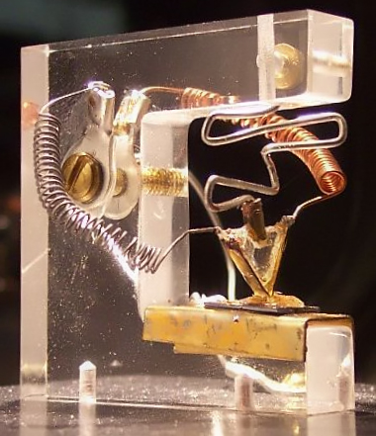
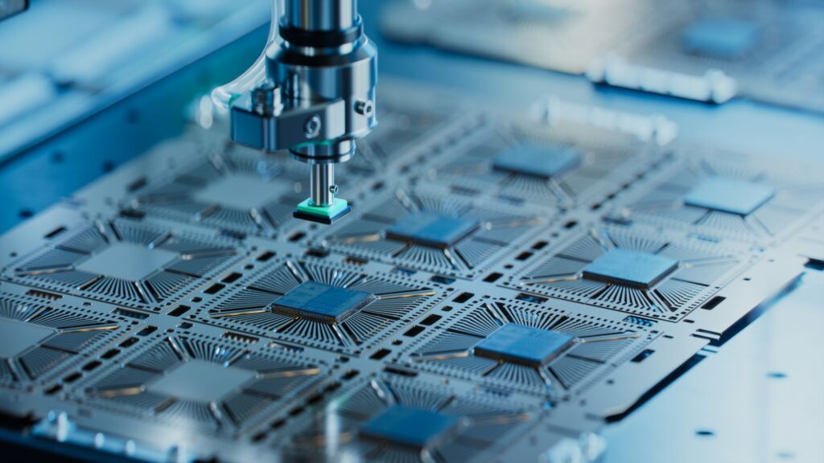
Some Important Spectroscopic Methods for Defects
Physics of Point Defects
Photoluminescence
Electron spin resonance (ESR/EPR), electron–nuclear double resonance (ENDOR)
Photo-electron spin resonance: optical spin polarisation, leading to an enhanced ESR signal, which also serves as electron spin initialization
Optically detected magnetic resonance (ODMR): spin-dependent photoluminescence signal, which also provides electron spin state readout
1948
1970
1990

Slide 14
Optically addressable defect qubits
verified quantum bits
Room-temperature defect qubits
Diamond NV center
Science 276, 2012 (1997)
SiC V_{Si} (low contrast)
Nat. Mat. 14, 164 (2015)
SiC divacancy (high contrast)
Nature 479, 84 (2011)
Nat. Comm. 4, 1819 (2014)
Nat. Sci. Rev. 9, nwab122 (2022)
T-center
GaN centers (low and high contrasts)
Nat. Mat., 23, 512 (2024)
hBN (high contrast)
Nat. Mat., 23, 1379 (2024)
Nature, 643, 943 (2025)
Material Platforms for Defect Qubits and Single Photon Emitters,
Gang Zhang, Yuan Cheng, Jyh-Pin Chou, and Adam Gali,
Applied Physics Reviews, 7, 031308 (2020)

Slide 15
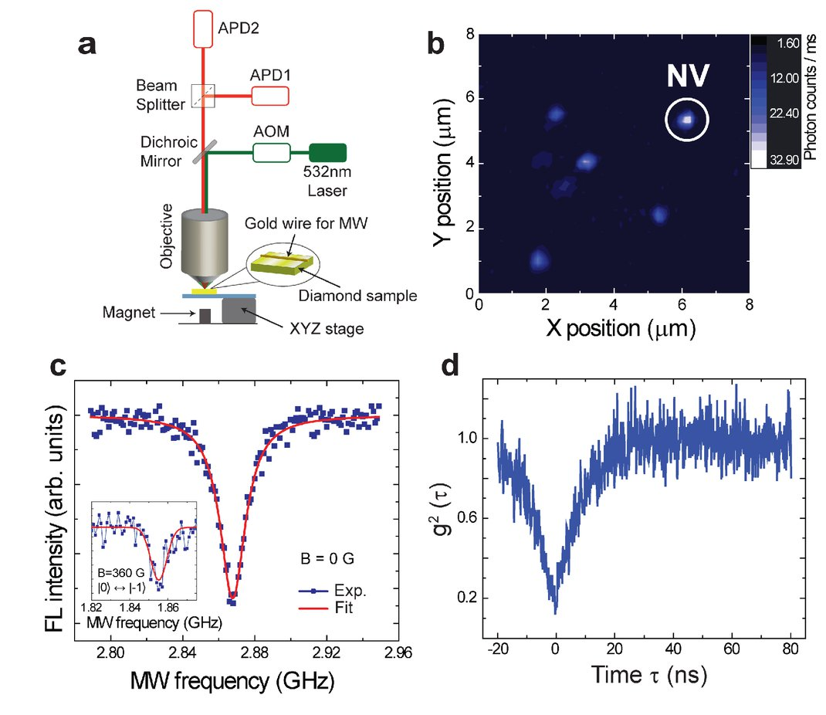
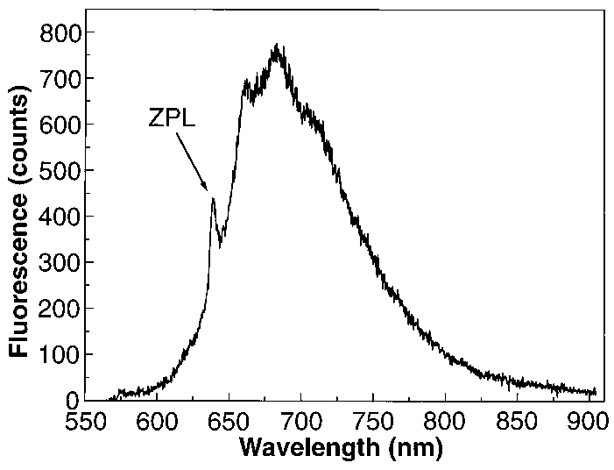
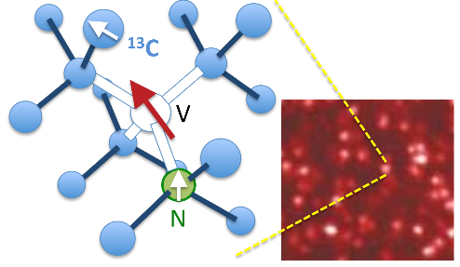
Optically addressable nitrogen-vacancy center in diamond
T = 300K
Science 314, 281 (2006)
optically detected magnetic resonance (ODMR)
room temperature operation
  electron spin – nuclear spin registers

Slide 16
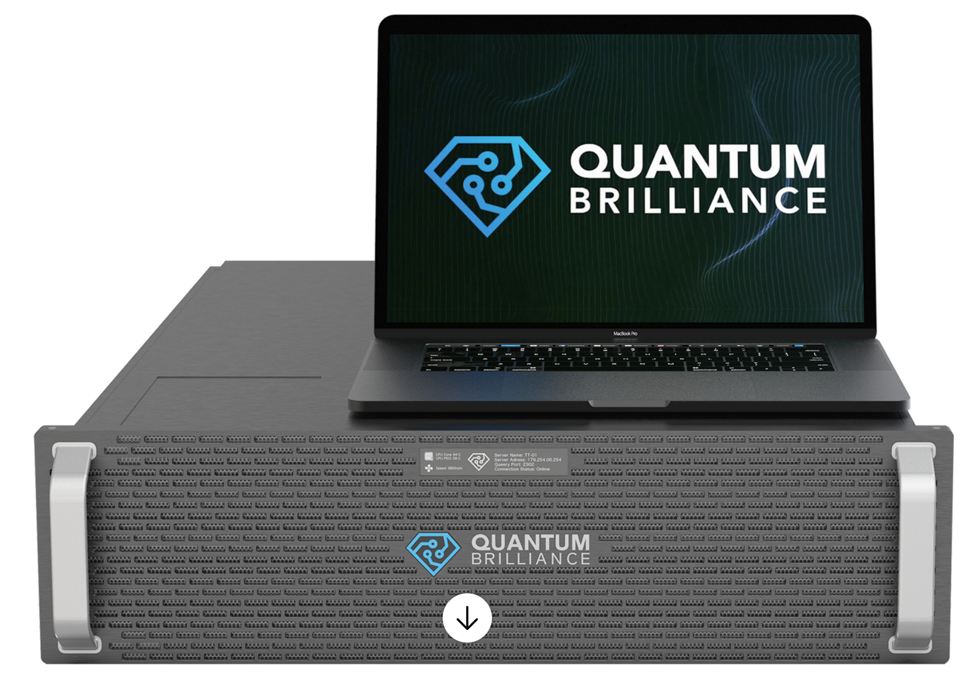
Optically addressable nitrogen-vacancy center in diamond
Room temperature quantum accelerator computation device (> 3 companies)

Slide 17
Nitrogen-vacancy center in diamond: concept for AI algorithms
@ELTE: quantum simulator for realizing efficient AI algorithms

Slide 18

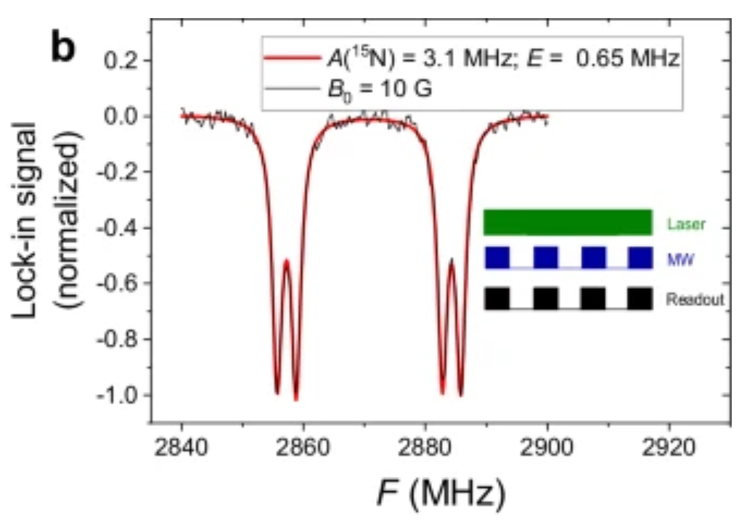
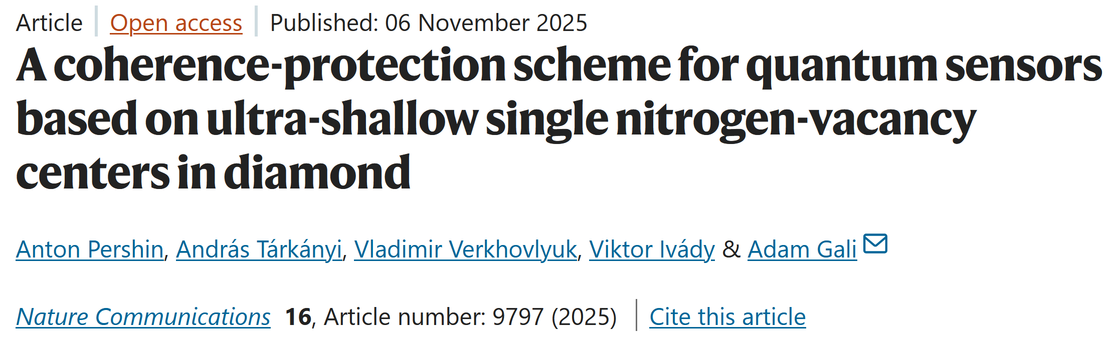
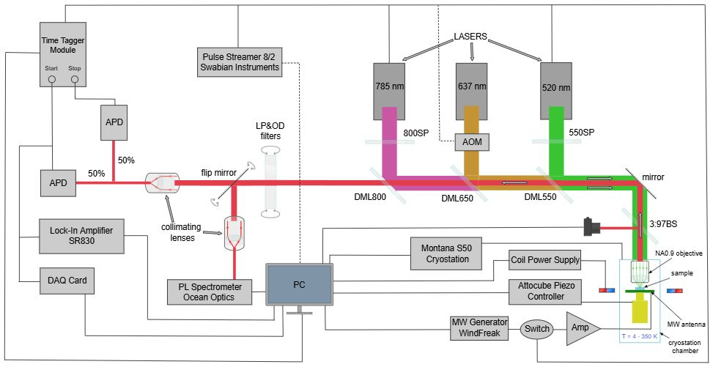
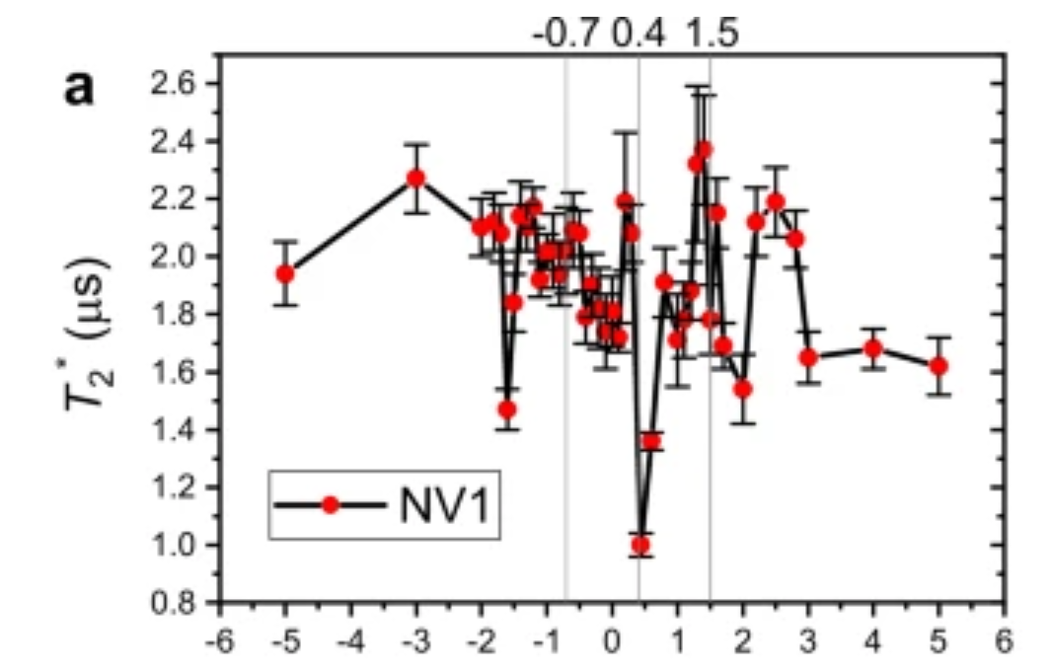
Nitrogen-vacancy center in diamond: concept for AI algorithms
@Wigner RCP: proof of control single electron spin coupled to nuclear spins

Slide 19
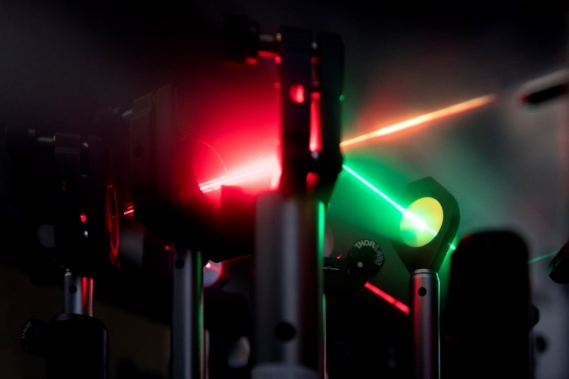



Summary & Challenges
Quantum computers can be realized in various platforms
Fault-tolerant quantum computers may be in reach but not yet realized
Quantum simulation is doable and can be useful
Diamond nitrogen-vacancy spins based quantum simulators for efficient AI algorithms
Device can be realized in Hungary
Horizon Europe

Slide 20
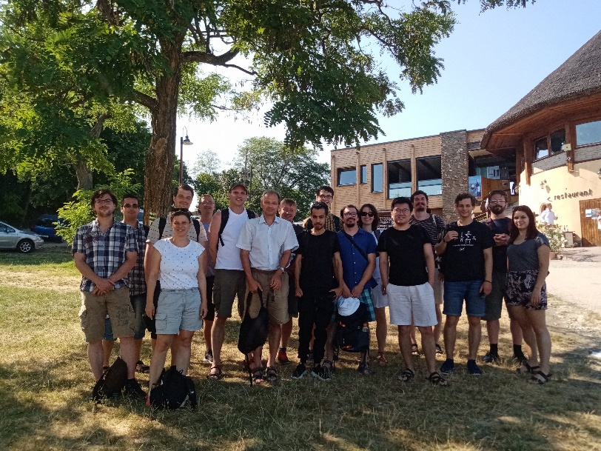

Welcome to Budapest
MSCA (EU) postdoc award will be available
Defects in Solids for Semiconductor Technologies (DSQT 2026), June 8-12, 2026, Budapest, Hungary

