Slide 1
Hungarian AI Factory Antenna Róbert Lovas, Tamás Máray, Barbara Tóth, Edina Németh (HUN-REN SZTAKI) Roland Jakab, Gergely Szertics (HUN-REN HQ)
HUN-REN Institute for Computer Science and Control (HUN-REN SZTAKI)

Slide 2
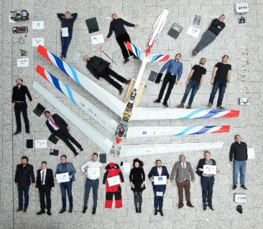
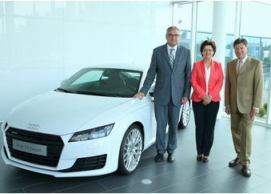
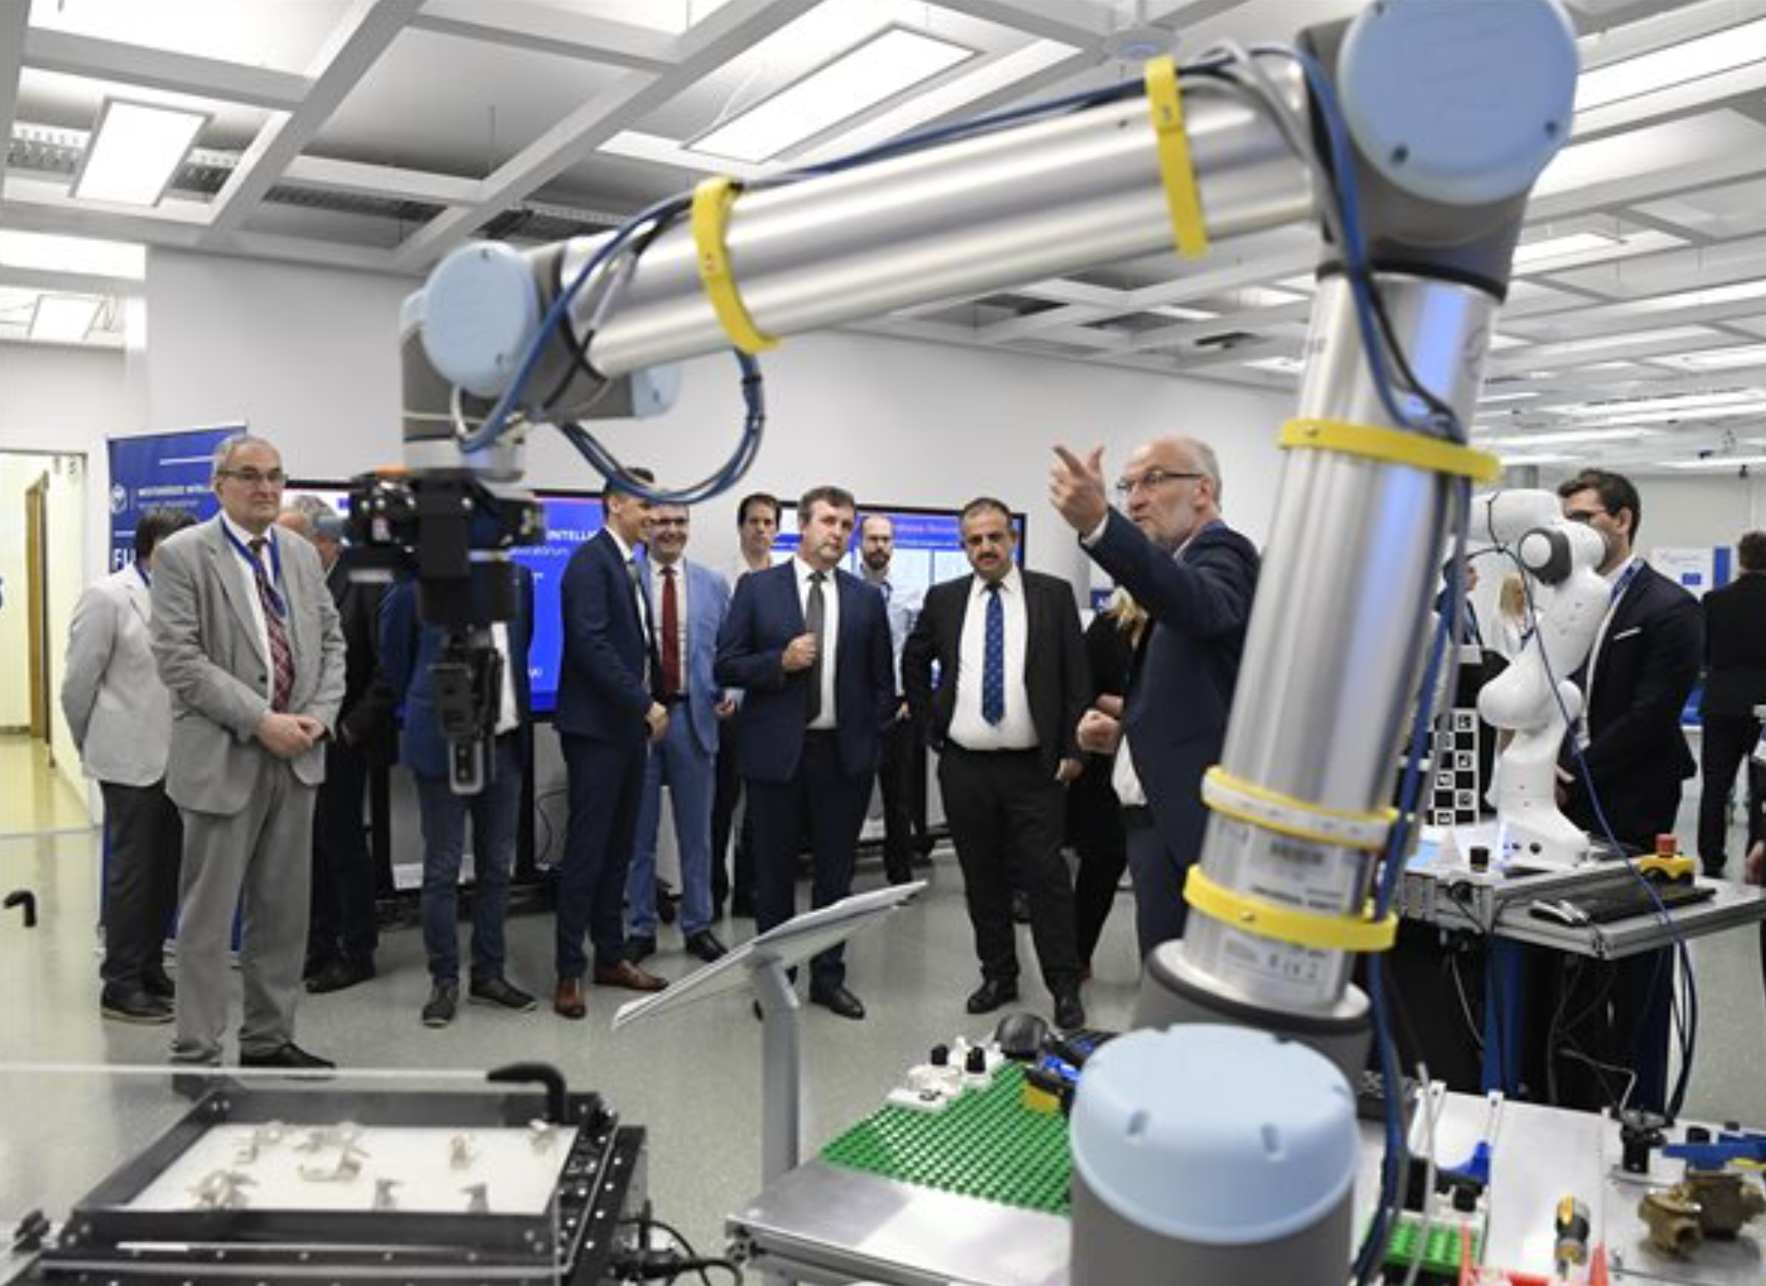
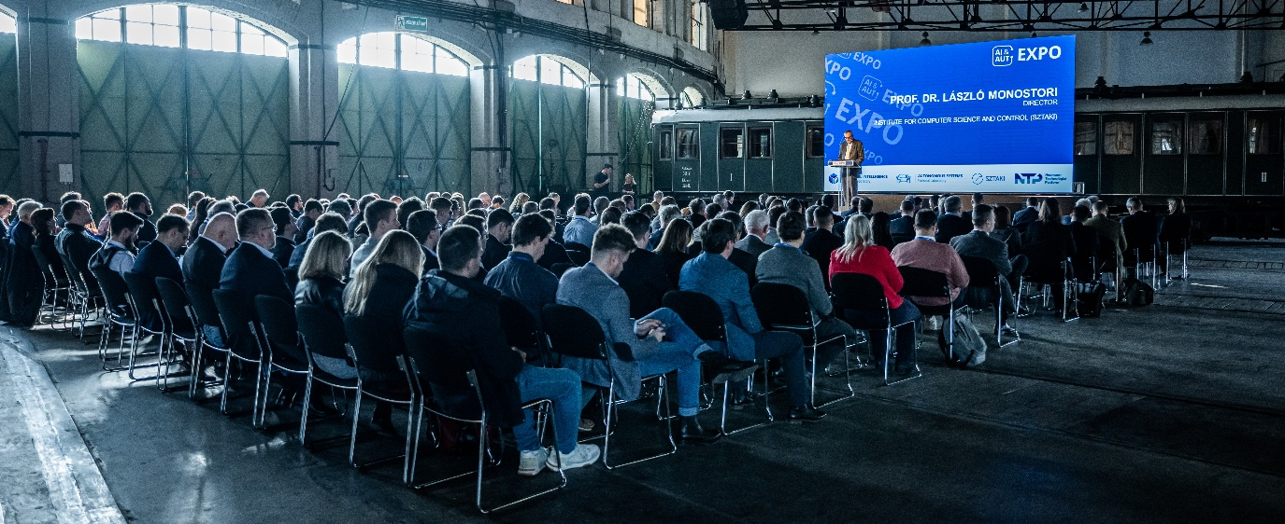
HUN-REN INSTITUTE FOR COMPUTER SCIENCE AND CONTROL (SZTAKI)
Established in 1964
EU Centre of Excellence in IT (since 2001)
Computer Science and Control
Basic and applied research
Contract-based R&Đ&I activity mainly on complex systems, turnkey realizations:
GE, Hitachi, Audi, Hungarian Telekom, MOL, Knorr-Bremse, Bosch, Opel, ESA, etc.
Transferring up-to-date results to industry and universities
BASIC RESEARCH &
Computer science
Systems- and control theory
Engineering and business intelligence
Machine perception and human-computer interaction
Applied research and innovation
Vehicles and transportation systems
Production informatics and logistics
APPLIED RESEARCH
Energy and sustainable development
Security and surveillance
Networking systems and services
Distributed, cloud, Big Data, AI, HPC, quantum computing

Slide 3







HUN-REN SZTAKI – Key facts and our contribution to the HUN-REN AI4Science Program
BUDGET
18 MEUR/year
~30% basic funding
100+ EU projects
20+ as coordinator
STAFF
300+ FTE
67% scientific
7 members of the Hungarian Academy of Sciences
Fraunhofer Project Center
EPIC Innolabs Ltd. (with Fraunhofer)
ERCIM (European Research Consortium for Informatics and Mathematics) member
Leader / founder of
Hungarian National Technology Platform on Industry 4.0
EPIC Centre of Excellence
Autonomous Systems National Lab
AI National Lab*
HUN-REN Cloud
HUN-REN ARP Data Repository

Slide 4
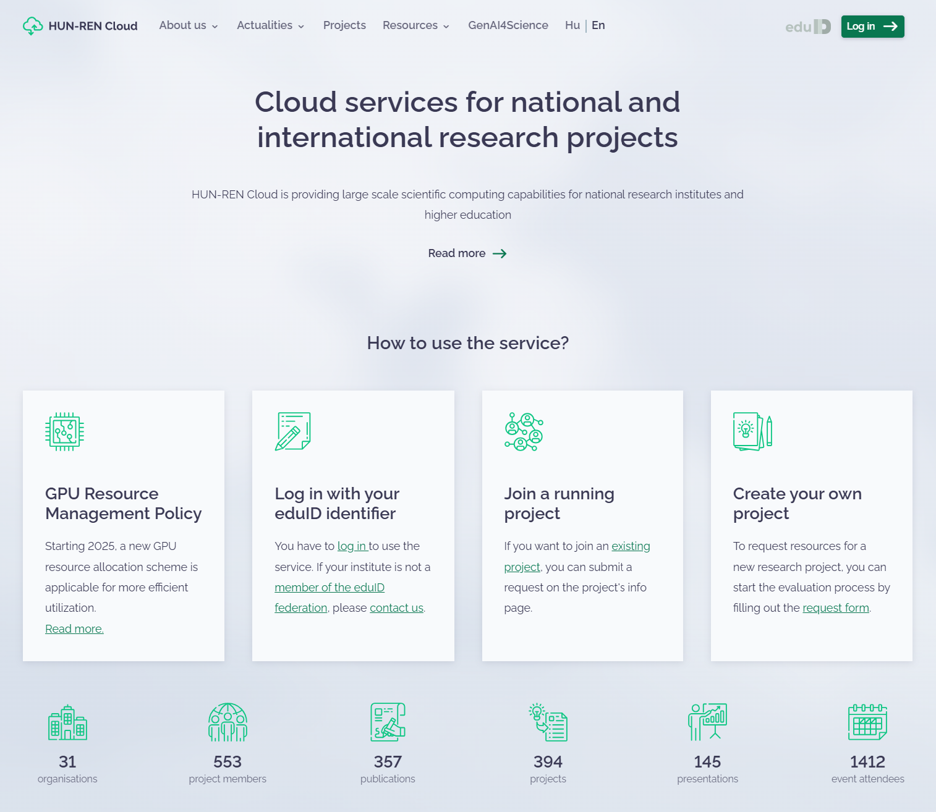
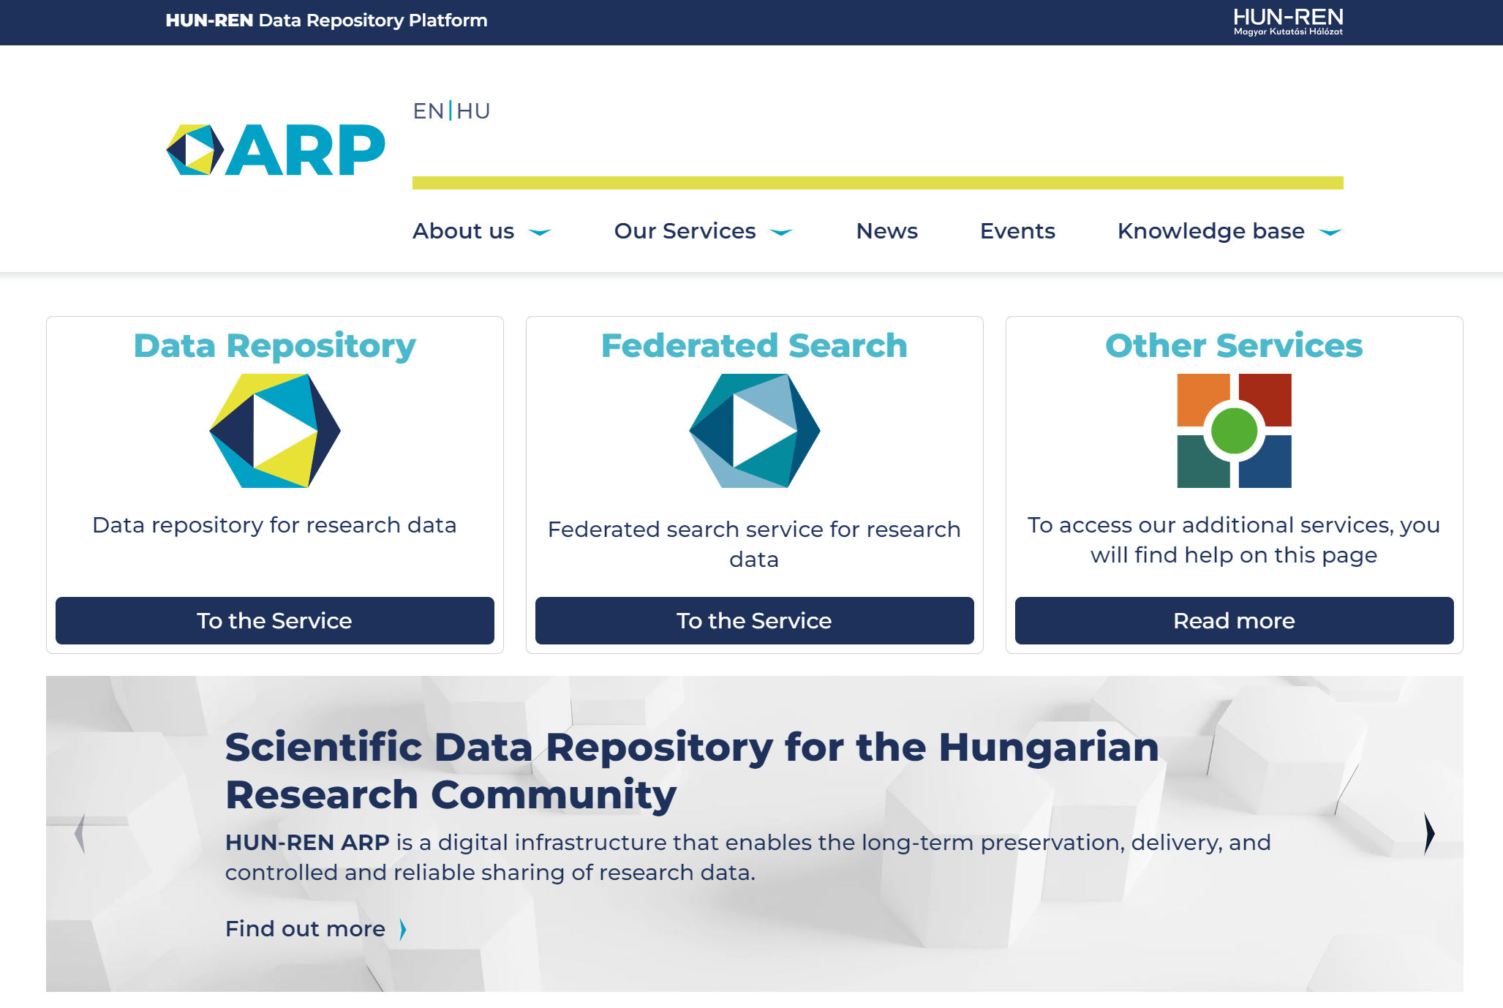

Slide 5

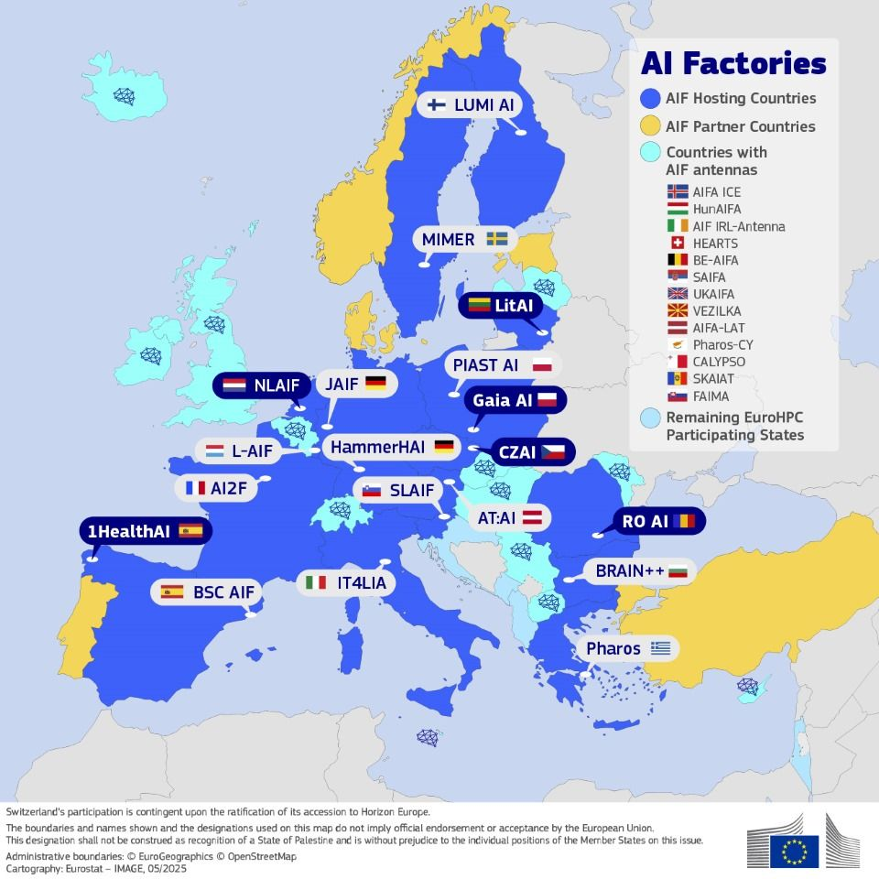

AI Continent Action Plan & AI Factories and Antennas

Slide 6
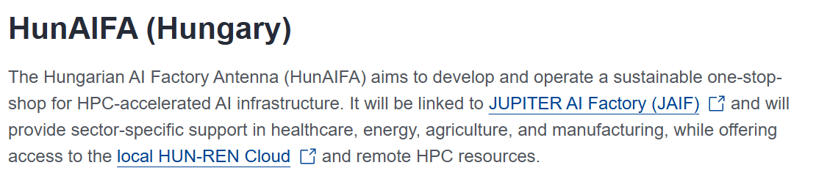
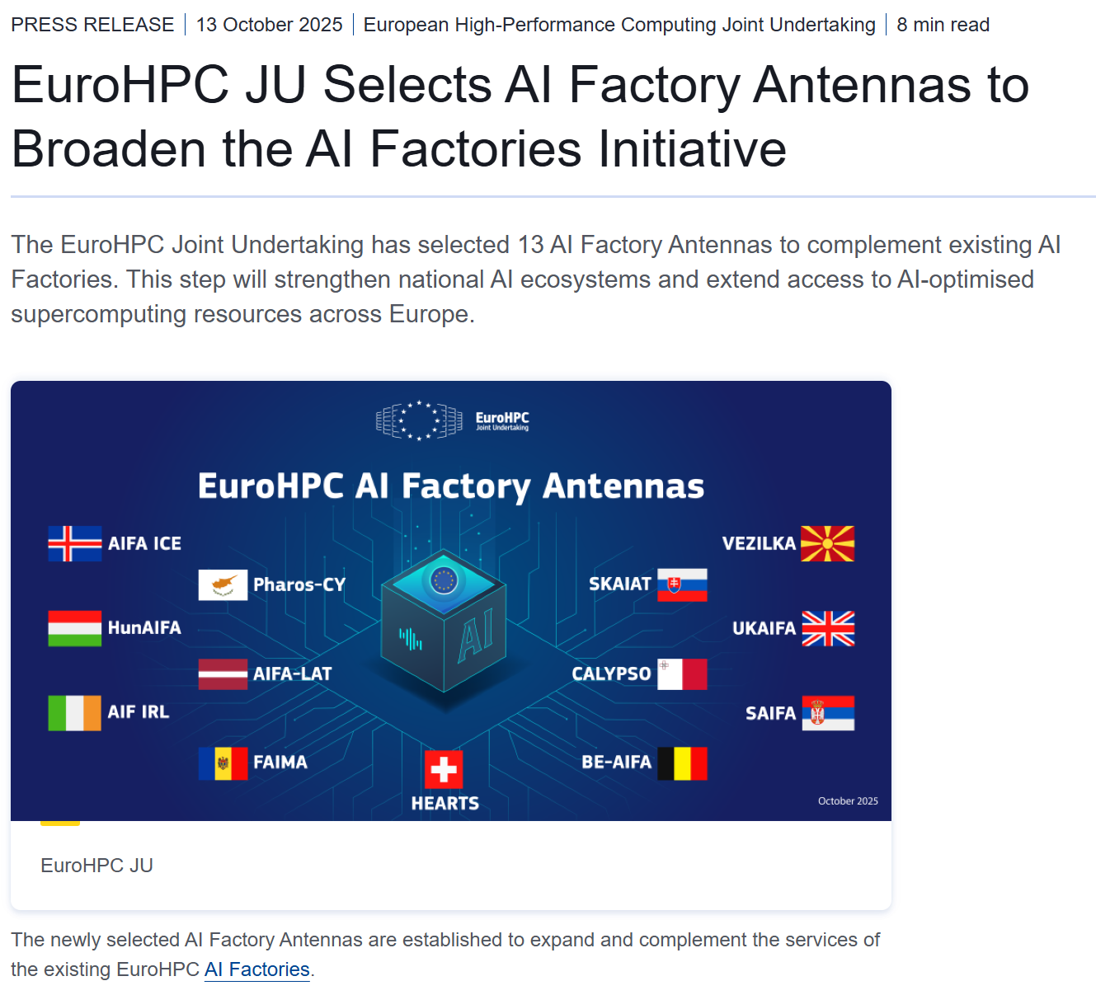
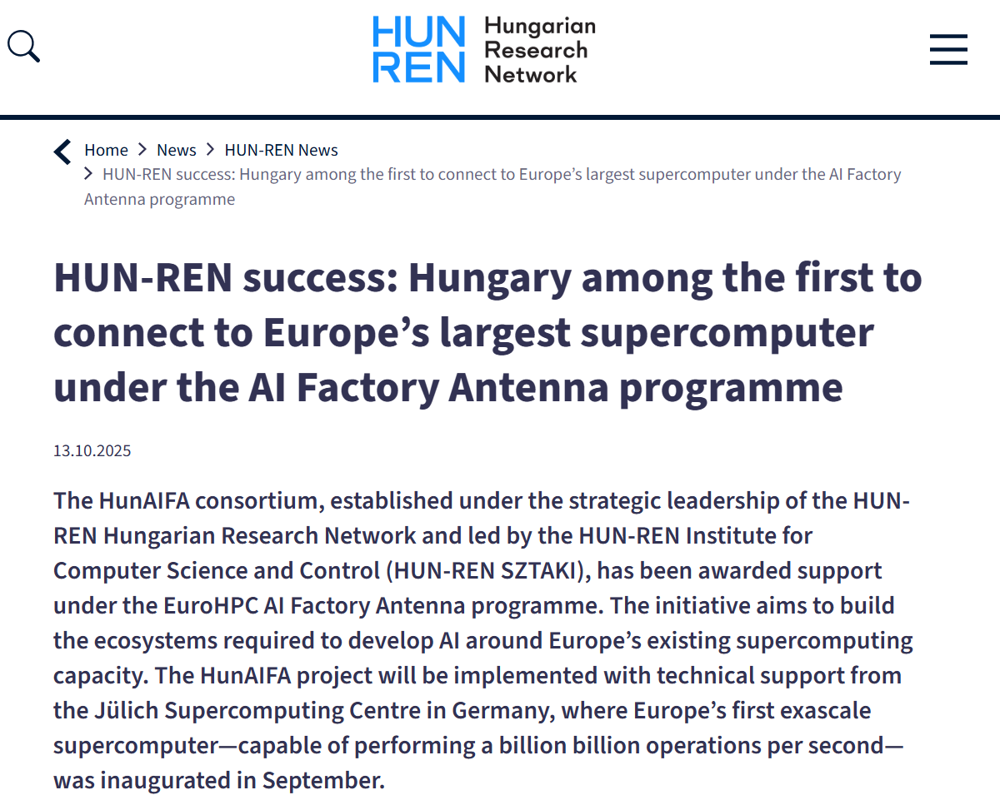
Hungary’s position

Slide 7
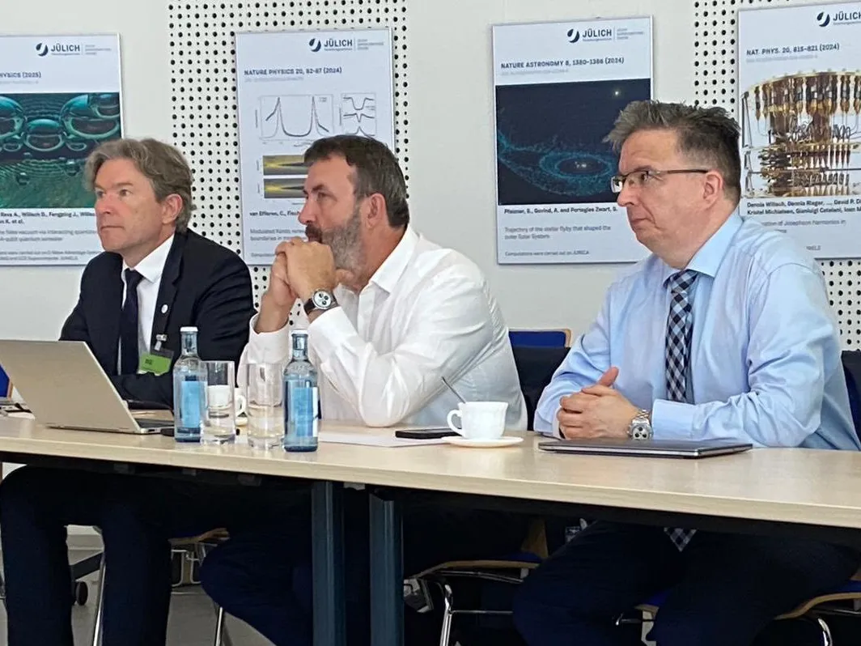

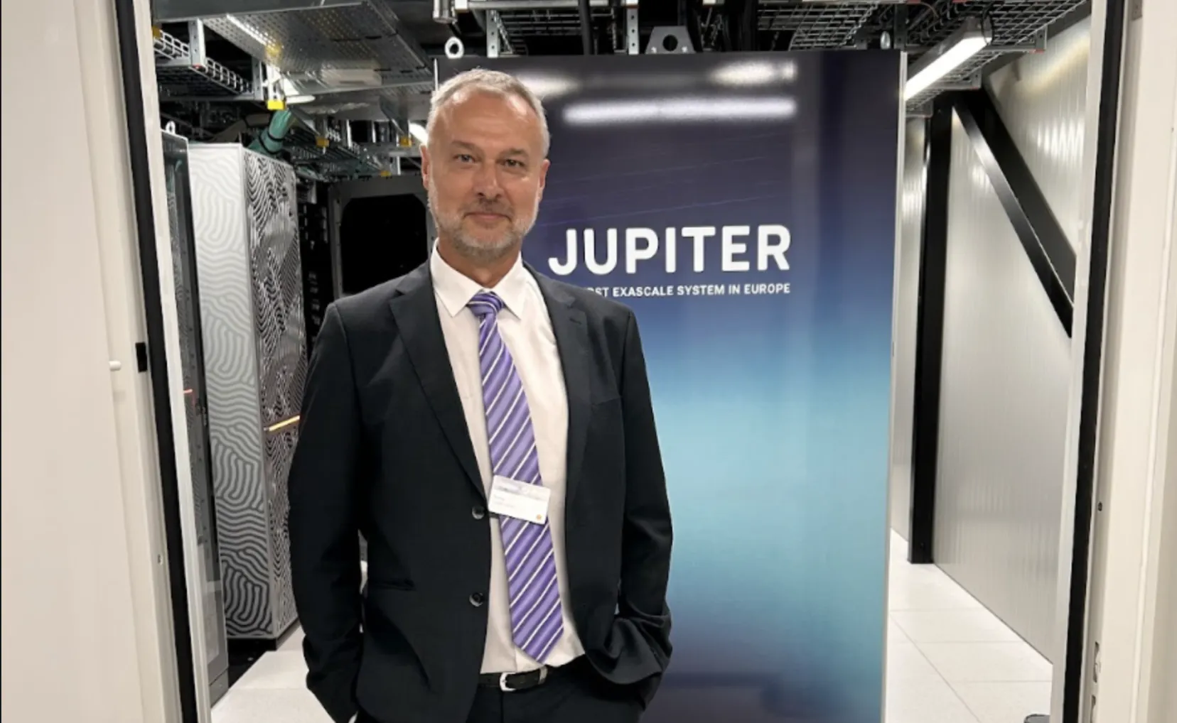






Project fact sheet
Total Budget: €5 + €5 million (EU + PS)
Duration: 3 years
Coordinator: Robert Lovas, HUN-REN SZTAKI
Linked AI Factory: JUPITER AI Factory Jülich Supercomputing Centre (JAIF / JSC)
1st Exascale supercomputer in Europe with 24.000 GPUs (17 MW)
Focus areas: Health/Life Sciences, Energy, Agriculture, Manufacturing / autonomous systems
according to the AI National Strategy & John von Neumann Program
Consortium:

Slide 8




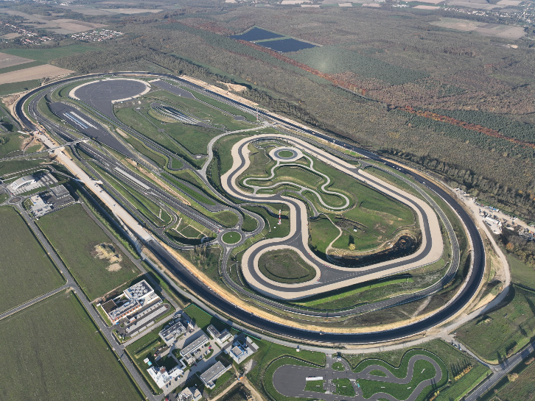

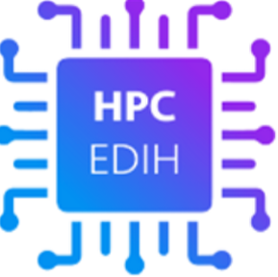



General concept – with key partners / initiatives / backgrounds

Slide 9
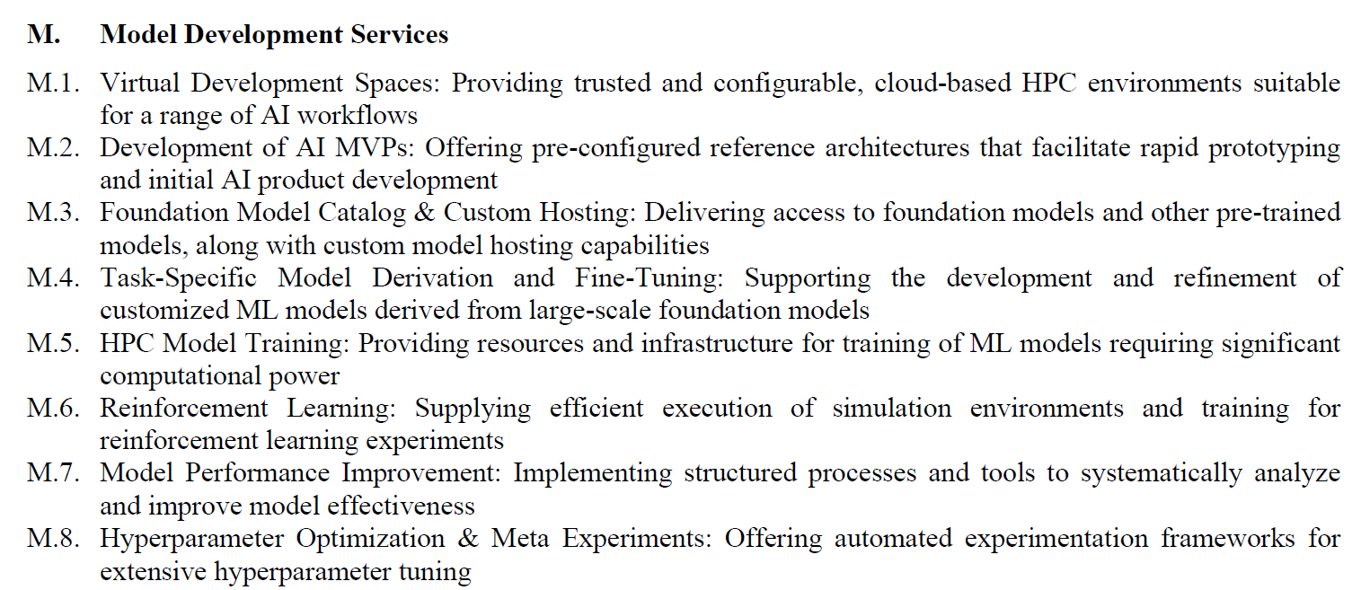



Model development and other major service categories

Slide 10
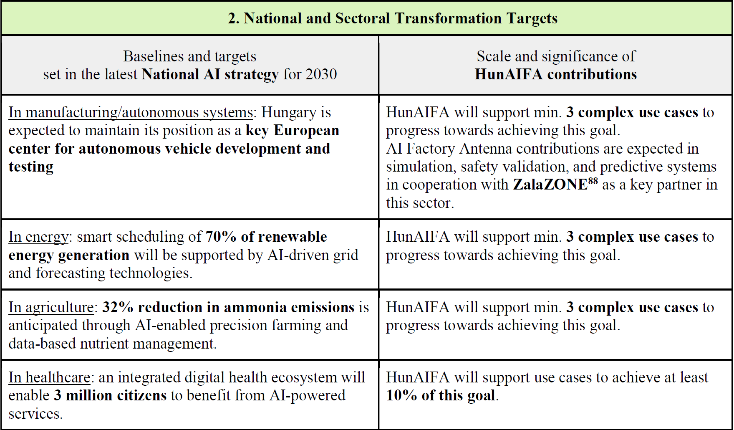

Sectoral transformation and other main targets

Slide 11
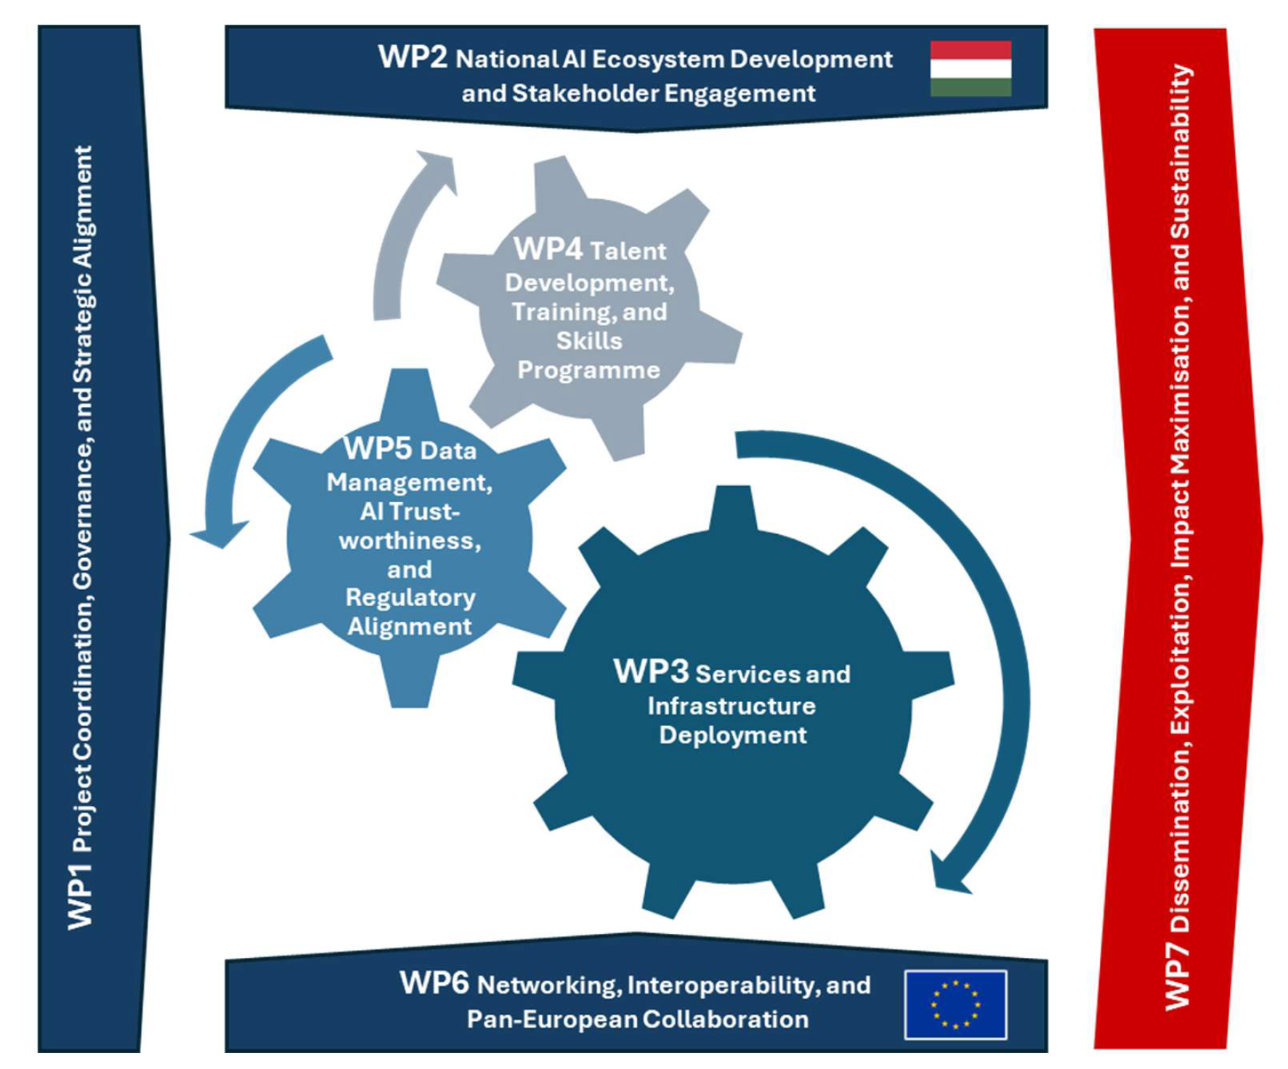
WP structure

Slide 12
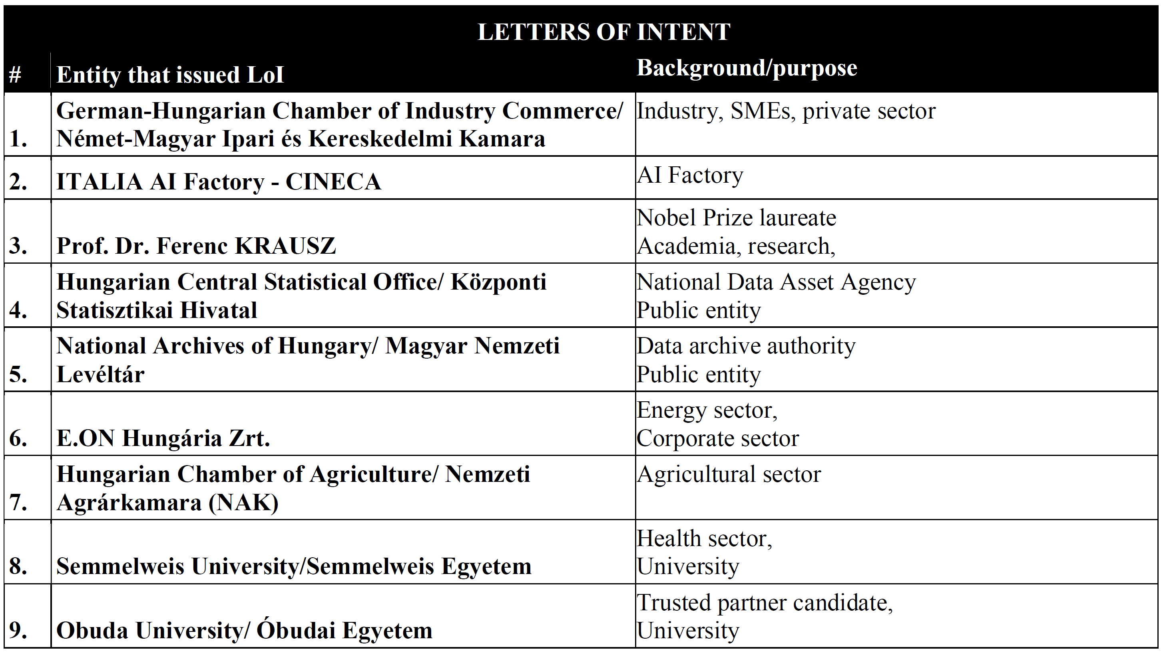
Endorsements from some ecosystem representatives

Slide 13
Summary I
The Hungarian AI Factory Antenna (HunAIFA) project establishes a national AI innovation hub integrated into the pan-European AI and HPC ecosystem, leveraging the AI4Science and AI4Impact programmes of the Hungarian Research Network (HUN-REN). The core objective is to develop and operate a sustainable AI Factory Antenna that serves as a one-stop-shop for HPC-accelerated AI infrastructure –particularly JUPITER AI Factory (JAIF)–, services, training, and policy alignment. HunAIFA will provide sector-specific support in healthcare, energy, agriculture, and manufacturing, while offering access to the local HUN-REN Cloud and remote HPC resources.
HunAIFA will deliver a service portfolio designed to address the practical and regulatory needs of a wide range of users, from SMEs to academia and public institutions. The three-tier support mechanism will include domain-specific AI consultancy, sandboxed AI model development environments, and guidance for high-risk AI systems under the EU AI Act. Data governance guidelines and tools will align with European values of privacy, transparency, and interoperability, contributing to the adoption of Common European Data Spaces.

Slide 14
Summary II
To maximise outcomes and long-term impact, HunAIFA combines an 8-stream modular training plan with engagement activities tailored to various user profiles. It will build an extensive dual-matrix ambassador and internal/external expert and talent network and implement dedicated outreach campaigns, particularly targeting digitally mature SMEs. A co-creation-driven sustainability plan will ensure post-project continuity. Interoperability with EuroHPC infrastructure, AIFs, and initiatives like EDIHs and ALT-EDIC will be prioritised to foster cross-border collaboration and pilot projects.
HunAIFA directly supports the objectives of the EuroHPC Work Programme by scaling up AI capabilities in Member States, enabling data ecosystems, and lowering the adoption barriers to trustworthy, HPC-enabled AI across sectors.

Slide 15
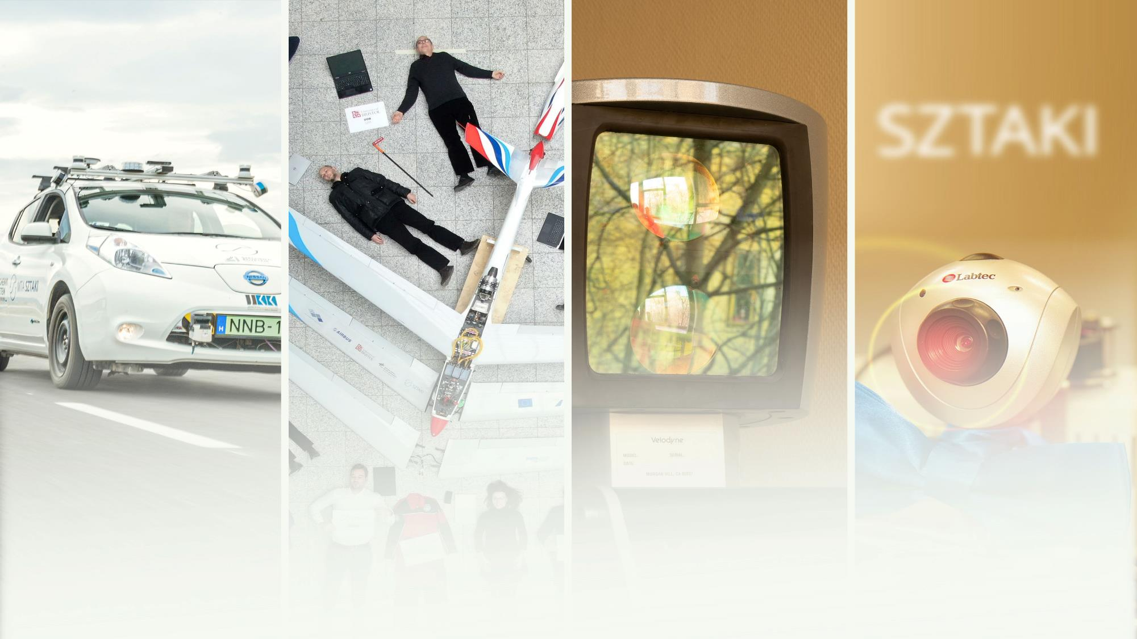
THANK YOU FOR YOUR ATTENTION!
www.sztaki.hun-ren.hu/en

