Slide 1

AIME 2025
Designing (Chasing) topologial qubit with HPC
Balázs Újfalussy
HUN-REN Wigner Research Center for Physics, Budapest
Notes:
Fundametals of SKKR-Bogoliubov-deGennes theory

Slide 2
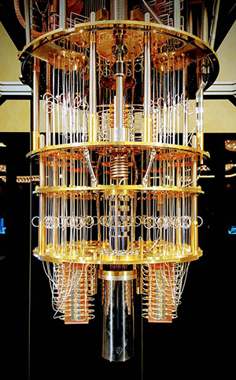
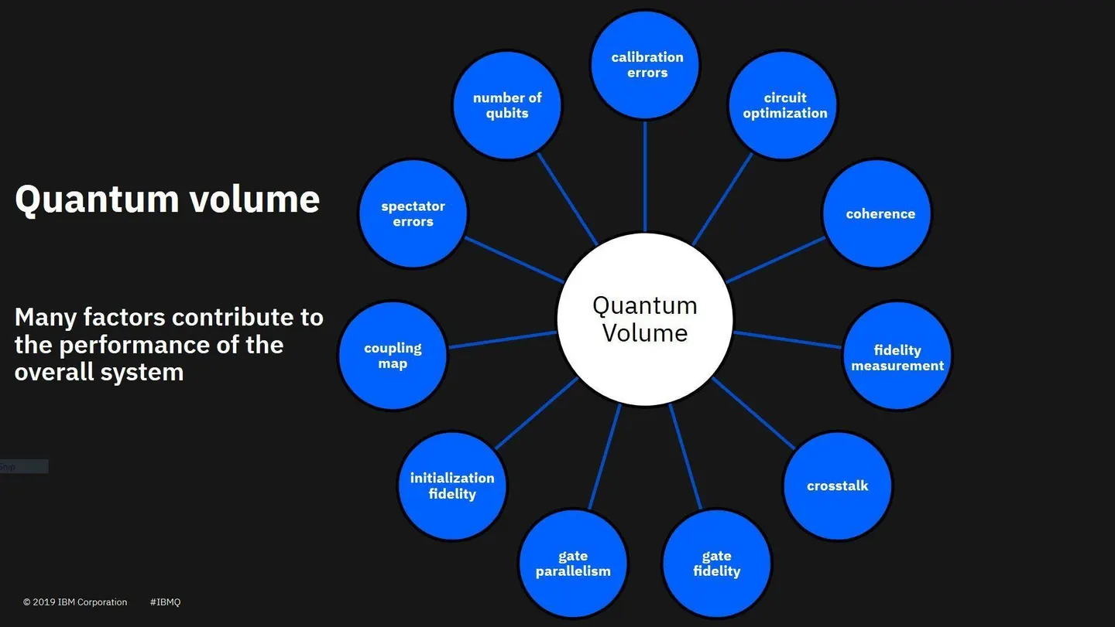
Quantum computers
(2)
    noisy intermediate-scale quantum computers: operations limited by coherence time and gate fidelity
(1)

Slide 3
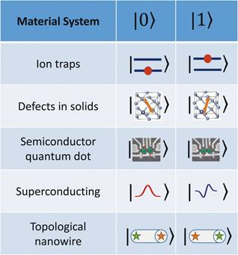

Potential qubits
Majorana 1: chip with 8 topological qubit
Nature 638, 872 (2025)
https://news.microsoft.com/azure-quantum/
Topological protection solves
the decoherence problem
Small
Scalable
James N. Eckstein and Jeremy Levy, MRS Bulletin 38, 783, (October 2013)

Slide 4
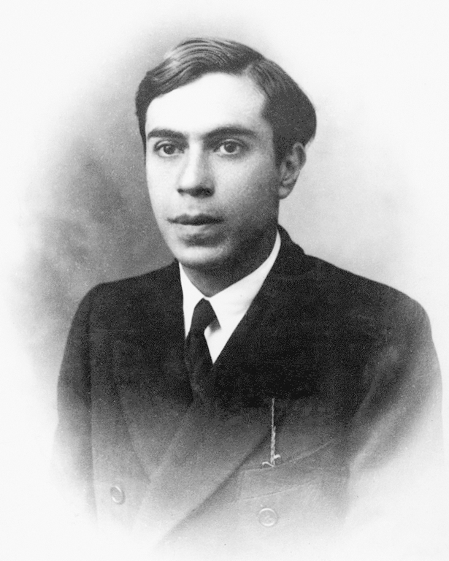

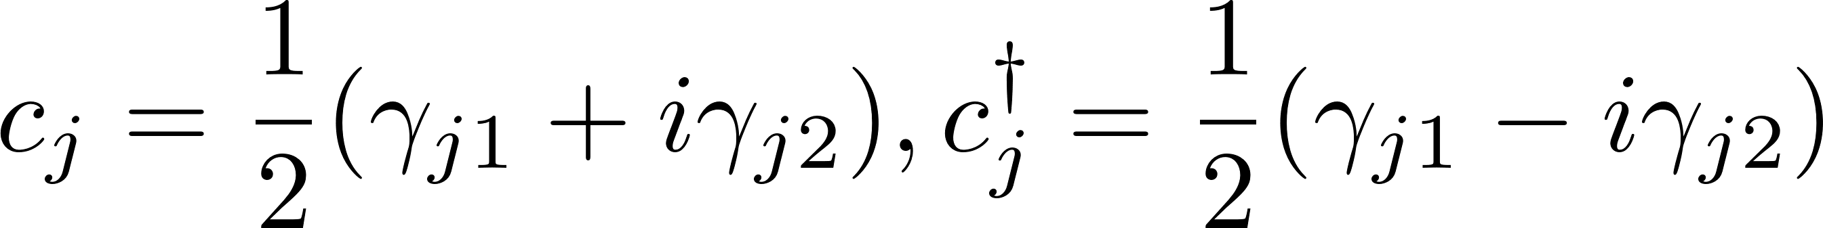
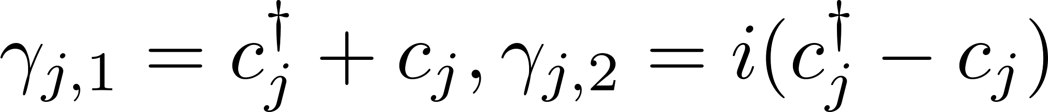


Majorana Fermions
Ettore Majorana, 1937, Nuovo Cimento 5, 171
Fermionic basis:
Majorana basis:
it’s own antiparticle
Neutrinoless double beta decay (0νββ) not yet detected
Notes:
Dirac fermion is described by a (non-Hermitian) Dirac operator ci that satisfies fermionic anticommutation relations,

Slide 5
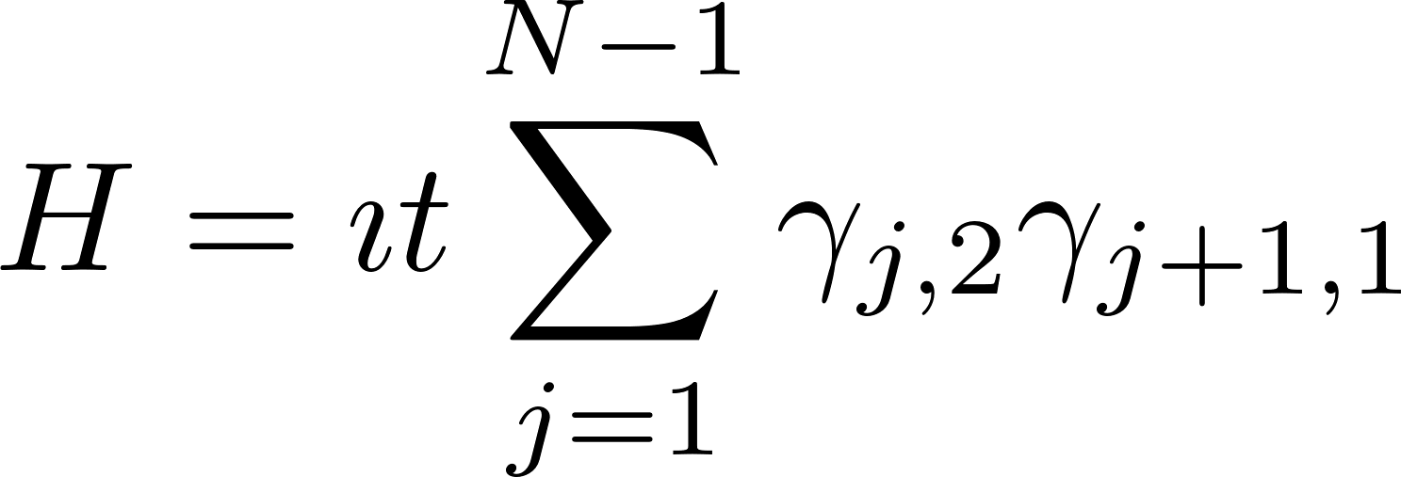
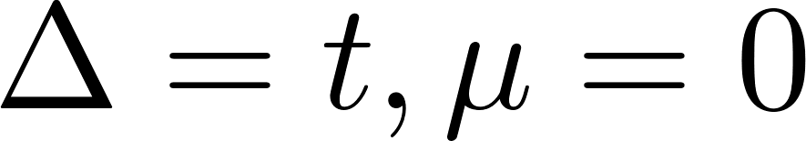
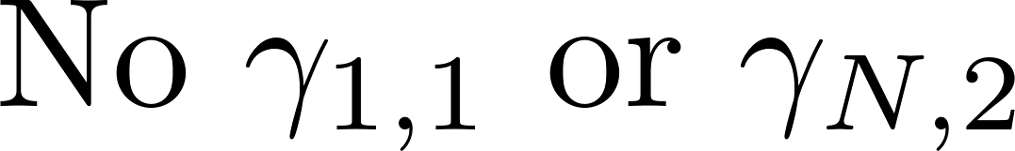
Kitaev chain and Majorana Zero Modes
Kitaev, A., 2001, Phys. Usp. 44, 131.
N.N. hopping
Chemical potential
Spinless p-wave pairing
In Majorana basis:
zero-energy MZM at the end of the chain

Slide 6
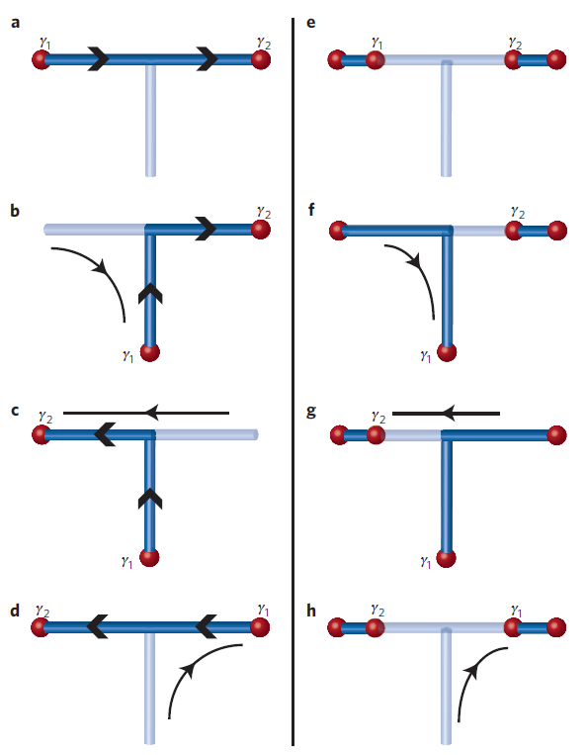
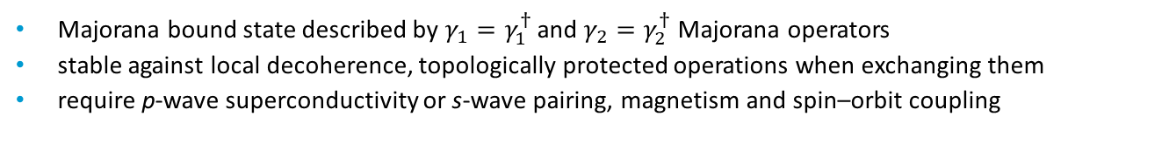
Topological quantum computation with MZM
J. Alicea et al., Nat. Phys. 7, 412 (2011)
    Majorana bound state described by $γ_{1}=γ_{1}^{†}$ and $γ_{2}=γ_{2}^{†}$ Majorana operators
    stable against local decoherence, topologically protected operations when exchanging them
    require p-wave superconductivity or s-wave pairing, magnetism and spin–orbit coupling

Slide 7
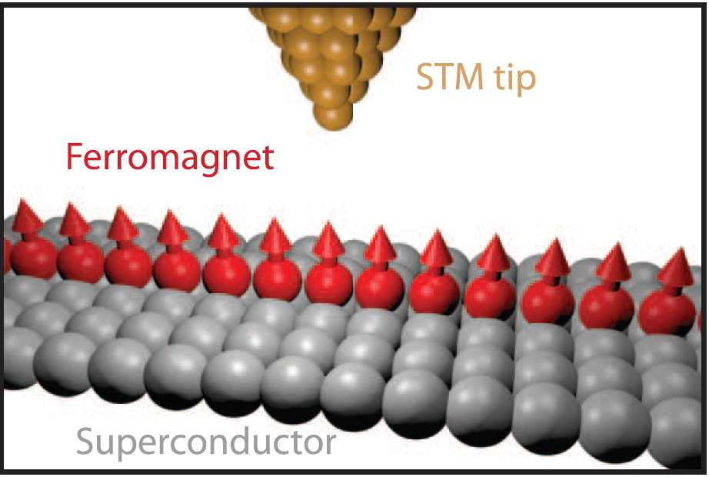
STM/STS experiments on magnetic chains
Fe chains on Pb(110)
S. Nadj-Perge et al. Science, 346, 622 (2014)
Fe chains on Re(0001)
H. Kim et al., Sci. Adv. 4 eaar525111 (2018)
Majoranas, precursors, topological ???
Way forward: Better modelling
Parameter free
Includes proper geometry
Material specific
Mn chains on Nb(110)
L. Schneider et al. Nat. Nanotechnol. 17, 384–389 (2022)

Slide 8


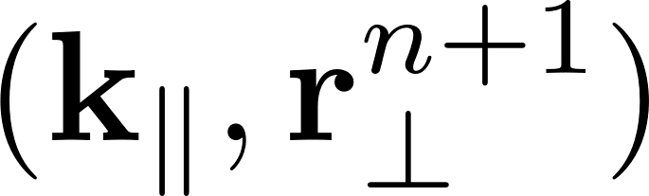
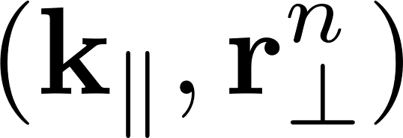
Why is it difficult?
„semi-infinite” material
Surface nanostructure
Magnetism
Relativistic effects
Superconductivity
(coherence length)
SSKKR code
n+1
n
G = G
BULK

Slide 9
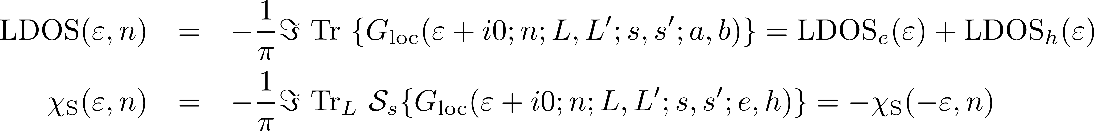
What is the computational task?
Local Green’s function MST:
z: complex energy, 16-500
I,I’ : layer index, = 20-100
L,L’: angular momentum, 9, 16
s,s’: spin, 2
a,b: electron, lyuk, 2
K|| : 250-10 000

Slide 10
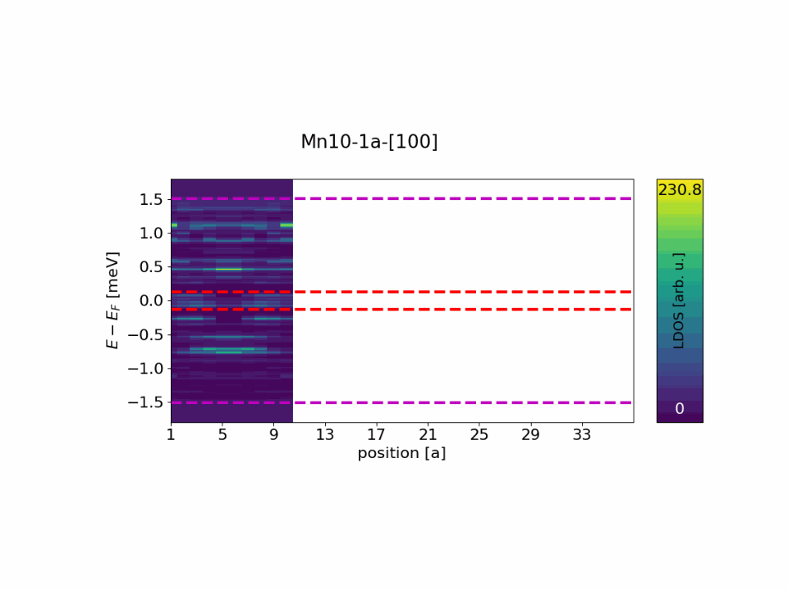
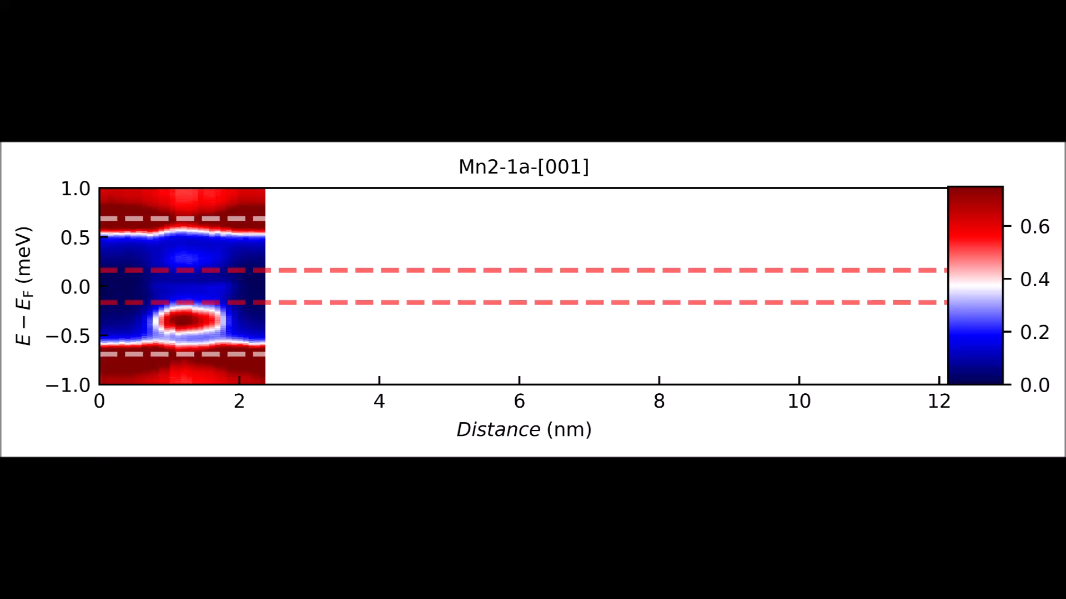


Shiba bands in Mn/Nb(100) chains
Calculate the spectrum of the QPI states
The Fourirer series coefficients gives the intensities in the spectrum
This is a sampling of the k space, average over different chains provide more k points

Slide 11
Fe chain on Au covered Nb(110)

Slide 12

DOS of Fe chains on Au covered Nb(110) at various spiraling angles
SOC=1
…
…
DOS: LDOS summed over
chain atoms
State is from F to AF
E
…
…
Atomic position
LDOS:
along the Fe atoms at E=0

Slide 13
Artificial Fe atomic chains on Nb(110) covered by a Au ML
Band inversion reasoning
Difference between electron and hole parts of LDOS
band inversion
tiltott sáv
tiltott sáv
L. Schneider et al.
Nat. Phys. 17, 943 (2021)
tiltott sáv
tiltott sáv
no band inversion
The edge states are (most likely) Majoranas !

Slide 14
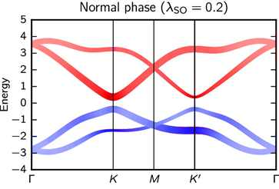
Topological band structure and band inversion
See for example A. Bansil et al, arXiv:1603.03576
Colloquium: Topological band theory
A. Bansil, Hsin Lin, and Tanmoy Das
Rev. Mod. Phys. 88, 021004 – Published 29 June 2016
Topologically trivial phase

Slide 15
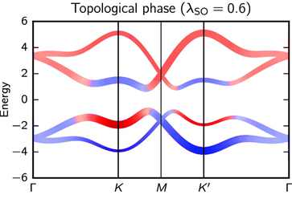
Topological band structure and band inversion
See for example A. Bansil et al, arXiv:1603.03576
Colloquium: Topological band theory
A. Bansil, Hsin Lin, and Tanmoy Das
Rev. Mod. Phys. 88, 021004 – Published 29 June 2016
Topological phase

Slide 16
Bulk-edge correspondence
Topological
Phase 1
Topological
Phase 2
Something special at the boundary
What defines topology in the magnetic wire/superconductor system?

Slide 17
Majorana Zero Mode at the boundary of topological trivial and topological region
U
V
U
V
U
V
V
U
V
U
V
U
V
U
V
U
V
U
V
U
U
V
U
V
Zero energy state at the transition
(50%)
LDOS
CDOS

Slide 18
Artificial Fe atomic chains
A. Lászlóffy et al., Phys. Rev. B 108, 134513 (2023)
Stability of MZMs against white noise
modify spin directions randomly
Δϑ
ϑ₀= 100º
Δϑ_{max}= 60º
Δϑ_{max}= 90º
MZMs
Δϑ_{max}= 120º
Δϑ_{max}= 172º

Slide 19
Fe adatoms on IrNb(110), ferromagnetic state
[110](x)
[001](y)
[111](xy)
0⁰ (F)
90⁰
180⁰ (AF)
-90⁰

Slide 20
Mn adatoms on IrNb(110), ferromagnetic state
[110](x)
[001](y)
[111](xy)
0⁰ (F)
90⁰
180⁰ (AF)
-90⁰

Slide 21
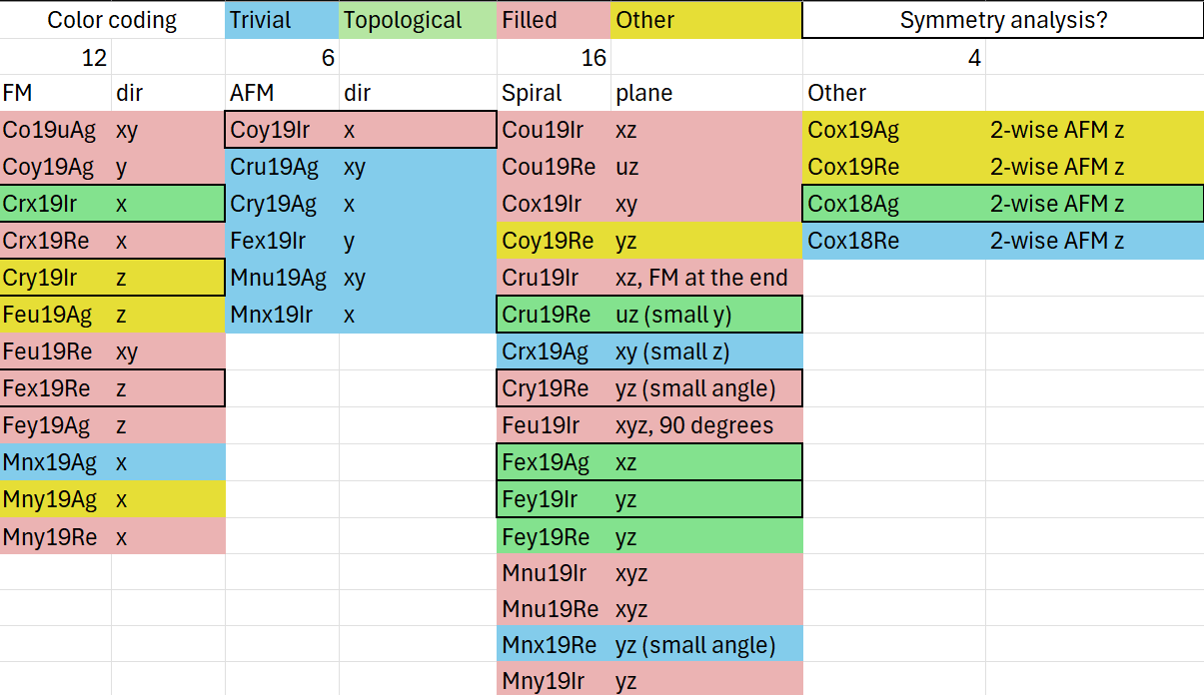
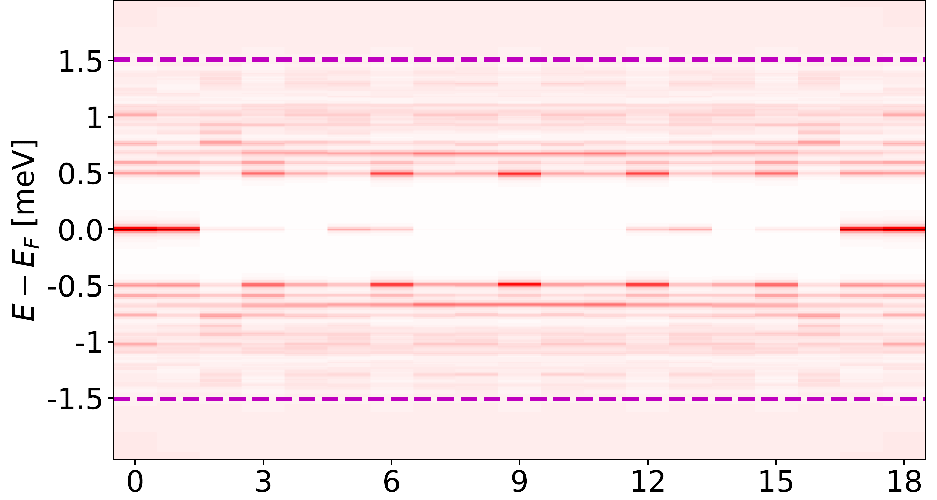
Fully relaxed spirals, ground state and topological analysis
Relaxing the chains both spatially and magnetically results in surprisingly many
number of spirals. However very few has Majorana edge states.
Overlayers: Ag, Re, Ir Chains: Mn, Fe, Co, Cr
Trivial | Gap
Topological | Gap with MZM
Other | Maybe longer chain?
Filled | Entire gap is filled

Slide 22
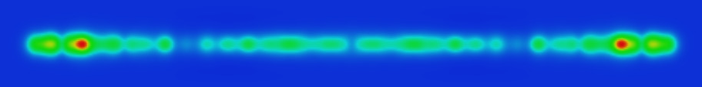
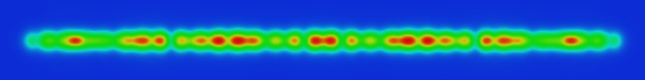
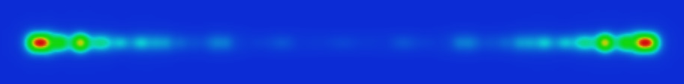
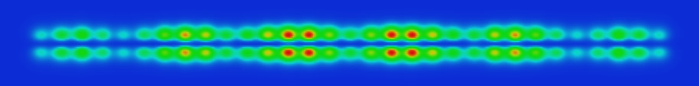
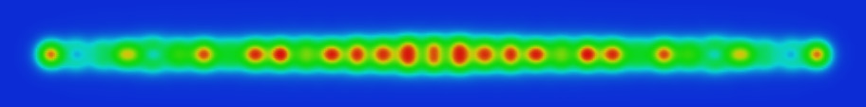
Simulation of chain AND tip
Current:
Palotás, Mándi, Hofer,
Frontiers of Physics 9, 711 (2014)

Slide 23



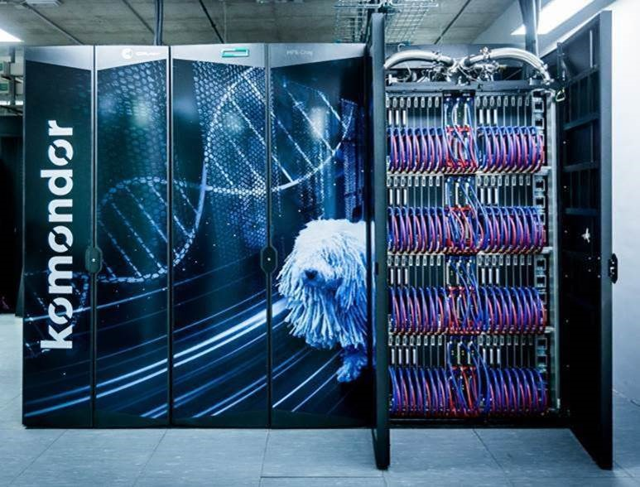
    University of Hamburg
    Philip Beck
    Lucas Schneider
    Jens Wiebe
    Roland Wiesendanger
    Jannis Neuhaus-Steinmetz
    Thore Posske
    HUN-REN Wigner Research Centre for Physics
    András Lászlóffy
    Krisztián Palotás
    Levente Rózsa
    Kyungwha Park
    Budapest University of Technology
    and Economics
    Bendegúz Nyári
    László Szunyogh
Star of the show:
KOMONDOR

Slide 24
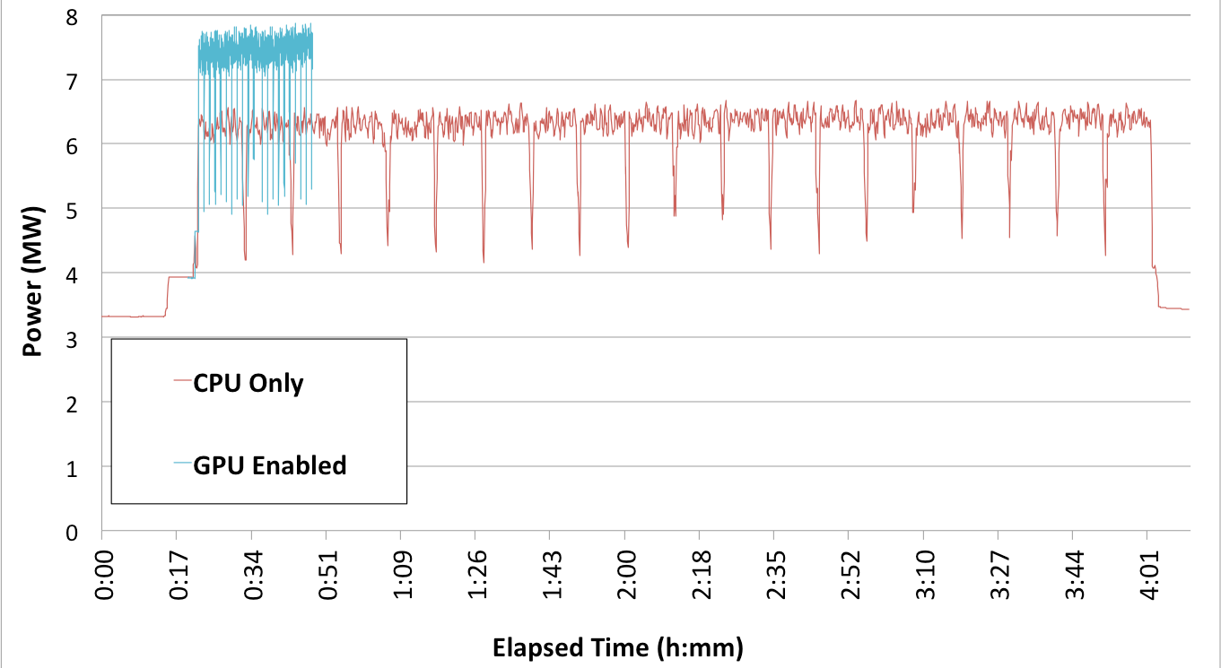
Power Efficiency on Titan (ORNL)
Power consumption traces for identical WL-LSMS runs with 1024 Fe atoms on 18,561 Titan nodes (99% of Titan)
Runtime is 8.6X faster for the GPU code (14.5 PFlop/s)
Energy consumed Is 7.3X less
  GPU accelerated code consumed 3,500 kW-hr
  CPU only code consumed 25,700 kW-hr
M. Eisenbach et al. CPC 212, 2 (2017)
Notes:
WL-LSMS effectively utilizes compute resources on both x86-only and GPU-accelerated implementations.
The GPU accelerated run aggregate was 3,526.72kW-hr
the CPU only run aggregate was 25,692.12kW-hr.

Slide 25
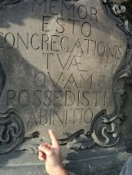
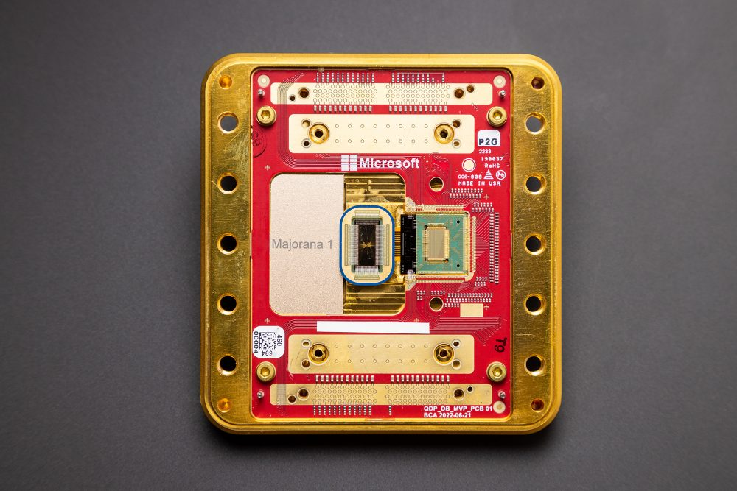

Summary
We successfuly generalised the SKKR method to solve the Kohn-Sham-Dirac Bogoliubov-deGennes equations for embedded clusters
Studied chariousains on Nb(110) superconductor surface
  We found an internal topological gap within the Shiba bands at a wide range of spiraling angles.
  Here some zero bias peaks còuld be observed on the edge atoms.
  A special kind of triplet states are indicated by the order parameter.
Indications point towards a Majorana state from first principles
The Majorana states are robust against perturbation in the magnetization direction of the spiral
Easy to get Quasi-Majorana states
Overlayer systems may support Majorana’s on rear occasion
Thank you for your attention!

Slide 26
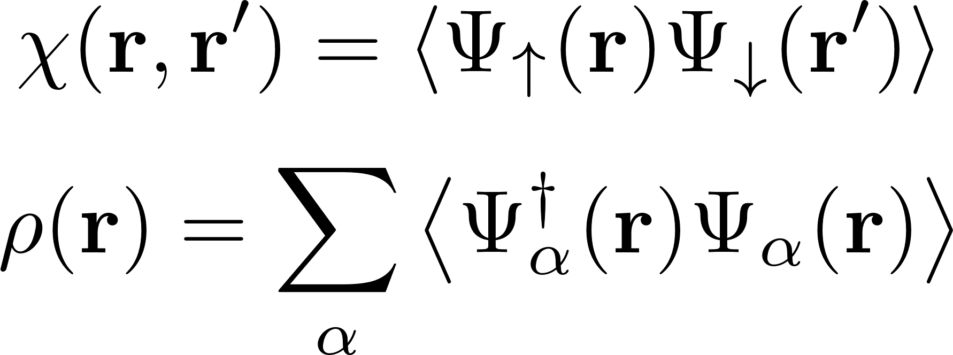
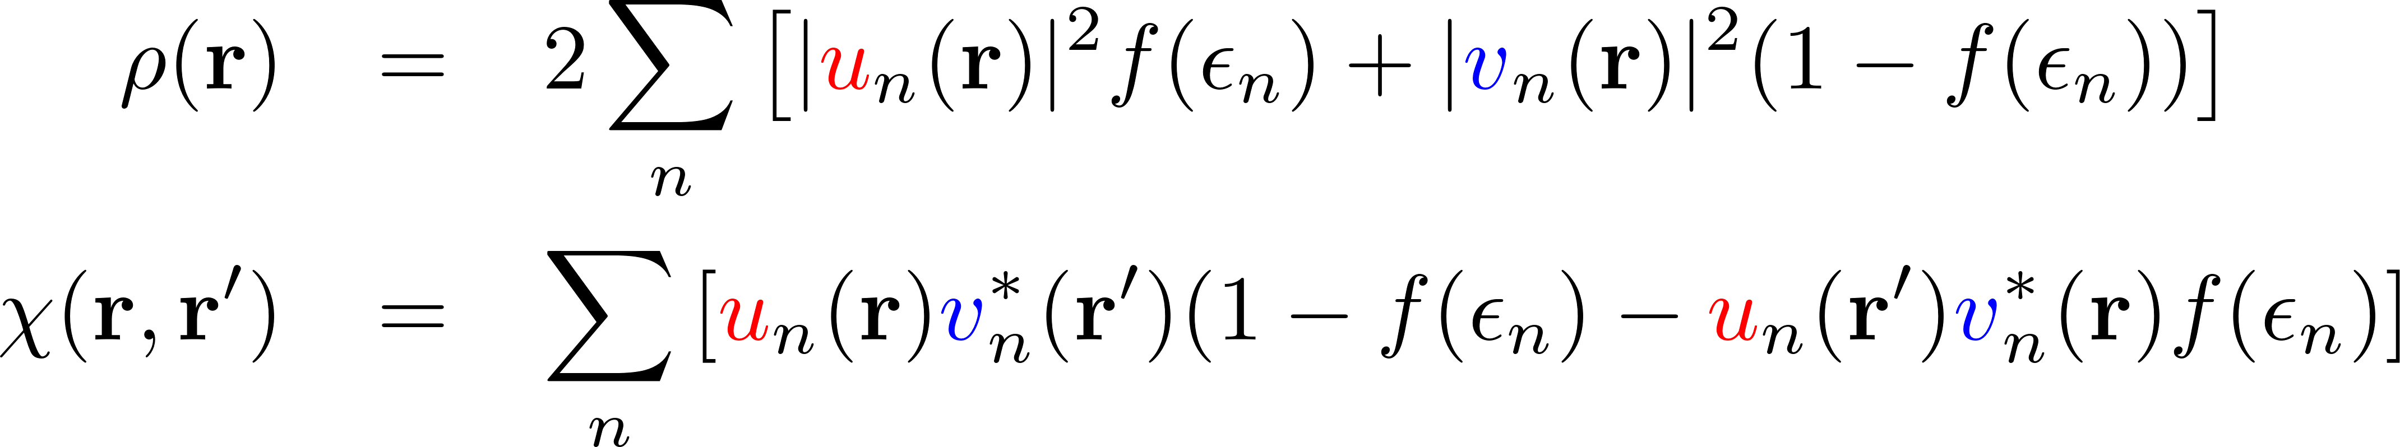
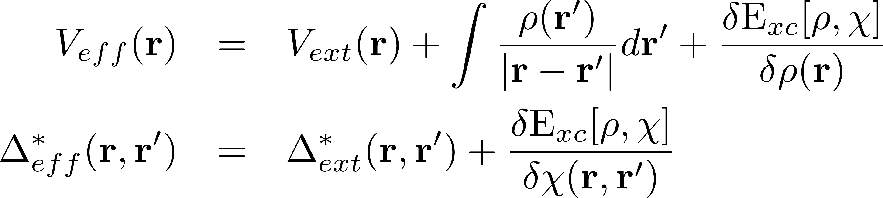
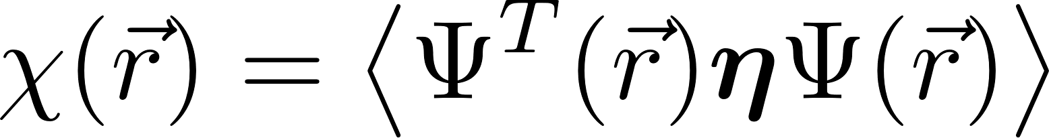
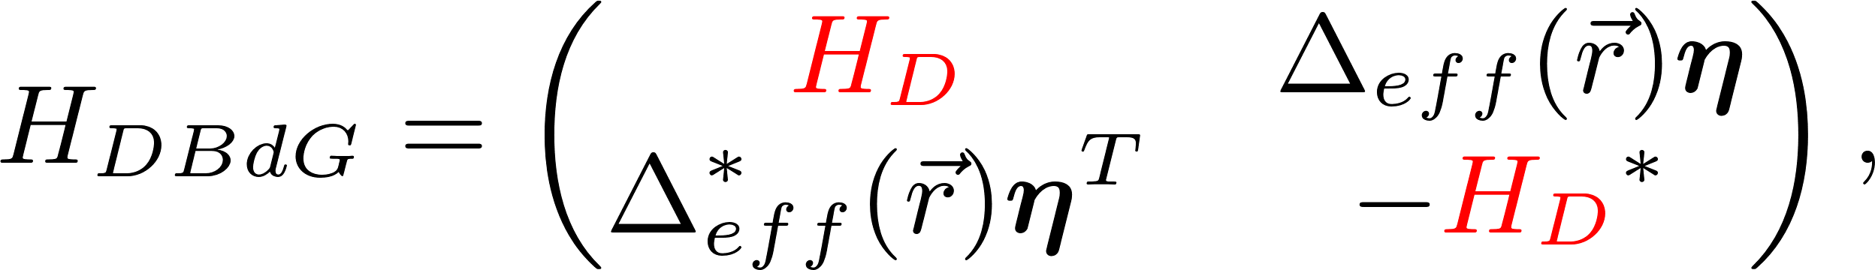
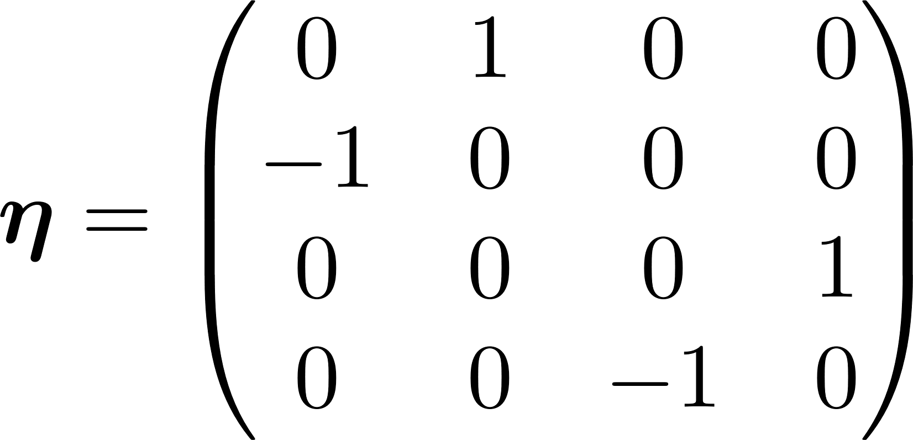
Methodology
Density functional Theory for superconductors
Oliviera, Gross, Kohn, Phys. Rev. Letters, 60 2430 (1988)
Suvasini, Temmerman, Győrffy, Phys. Rev. Letters, 48 1202 (1999)
Superconducting order parameter, Charge density:
For Inhomogeneous superconducting materials:
Surface and interface systems
semi-infinite, inhomogeneous
Semi-infinite Green function in MST
(NO supercell)
BULK
Impurity systems
Green’s function embedding
Surface impurities, nanostructures
(NO supercell)
Solution with band theoretical methods:
implementation in Relativistic SKKR
Conventional or Unconventional
pairing can be included
Four component Dirac Spinor operator Ѱ
Csire et al, Phys. Rev. B 97, 024514 (2018)
K. Capelle and E. K. U. Gross, Phys. Rev. B 59, 7140 (1999), Phys. Rev. B 59, 7155 (1999)

Slide 27
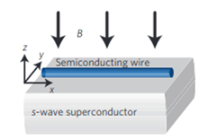
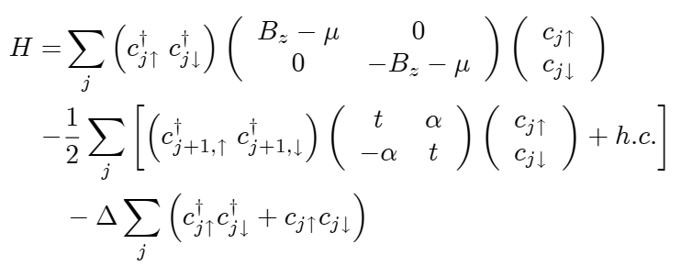
The Lutchyn-Oreg wire
R. M. Lutchyn et al, Phys. Rev. Lett. 105, 077001 (2010)
Y. Oreg et al, Phys. Rev. Lett. 105, 177002 (2010)
s=1/2 particles
Zeemann
splitting
Rashba SOC
s-wave pairing
Needs irrealistic parameters (Δ ∼t ) to get realistic observables (localization length of MZM)
Supercondutor surface is not included (Δ is on the wire)
J. Li et al., Phys. Rev. B 90, 235433 (2014)
L. Schneider et al. Nat. Commun. 11, 4707 (2020)

Slide 28
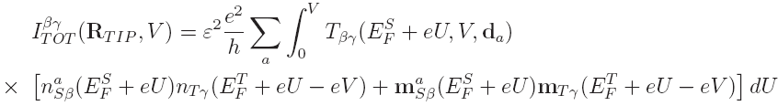
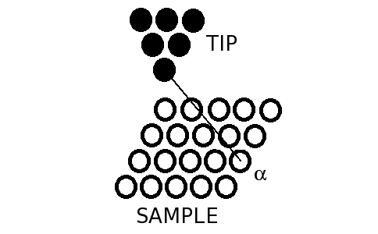
3D-WKB-STM method:
Orbital- and spin-dependent electron tunneling
Current:
Palotás, Mándi, Hofer,
Frontiers of Physics 9, 711 (2014)
Transmission
non-spin-polarized part
spin-polarized part
Transmission:
χ: electron orbital character: s, pz, dz2, etc.
n_{sβ} , n_{Tγ}: orbital-decomposed atom-projected
charge DOS (↑+↓)
m_{sβ} , m_{Tγ}: orbital-decomposed atom-projected
magnetization DOS (↑-↓) vector
Atom-
superposition
approach:
Σ_{α}
In effect
3D-WKB
Mándi and Palotás, Appl. Surf. Sci. 304, 65 (2014)
Palotás et al., Phys. Rev. B 86, 235415 (2012)
1D-WKB
transitions

Slide 29
Computer experiments to prove Majorana behaviour

Slide 30
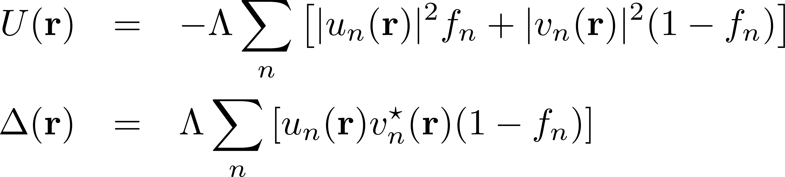
The BdG equations
Description of non-homogeneous superconductor-superconductor systems
non-homogeneous superconductor-normal metal systems
non homogeneous superconductor-magnet systems
We turn to the Bogoliubov de Gennes equations:
Elektron-like
hole-like

Slide 31
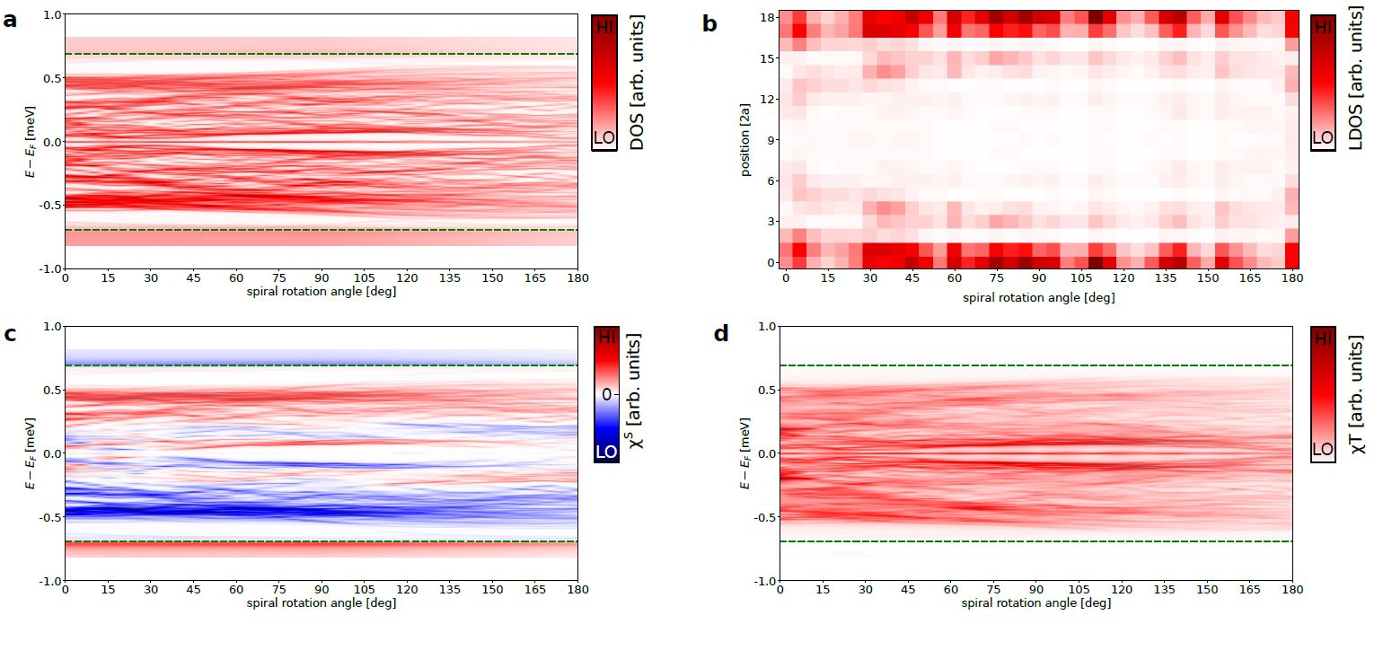
Mn chain on Ta(110)
DOS
LDOS(ɛ=0)
ꭕ^{s}
ꭕ^{T}

Slide 32
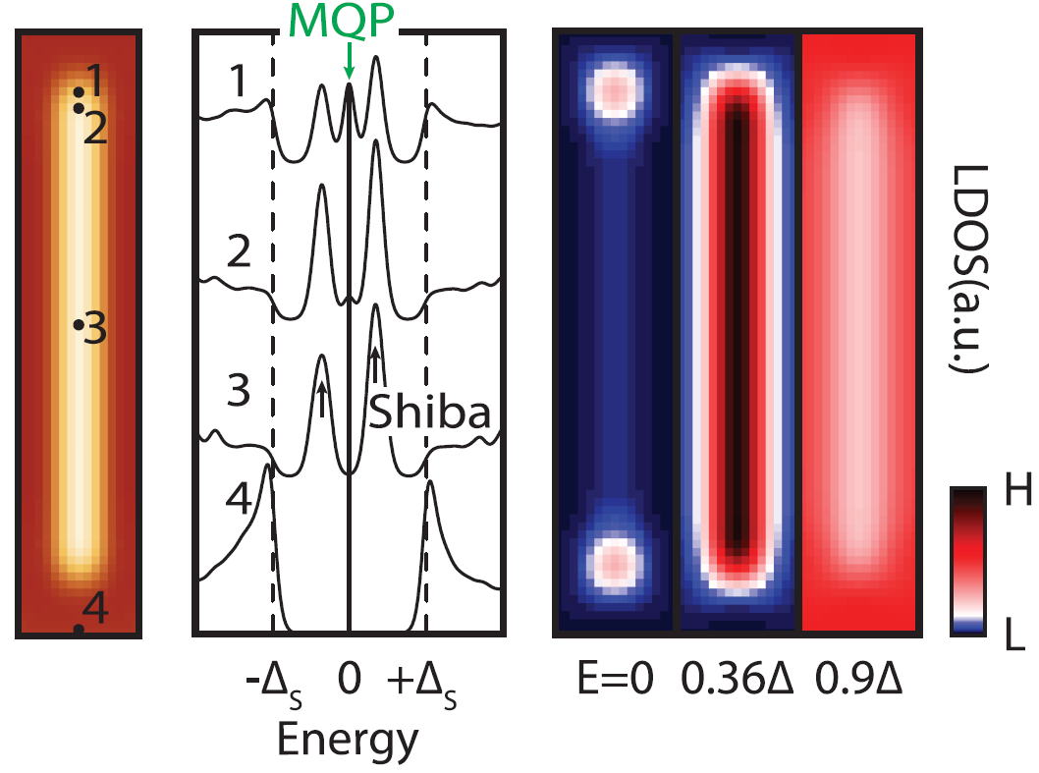
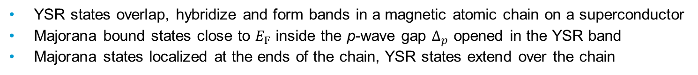
Majorana bound states in ferromagnetic YSR chains
(5) S. Nadj-Perge et al., Science 346, 602 (2014)
    YSR states overlap, hybridize and form bands in a magnetic atomic chain on a superconductor
    Majorana bound states close to $E_{F}$ inside the p-wave gap $Δ_{p}$ opened in the YSR band
    Majorana states localized at the ends of the chain, YSR states extend over the chain

Slide 33
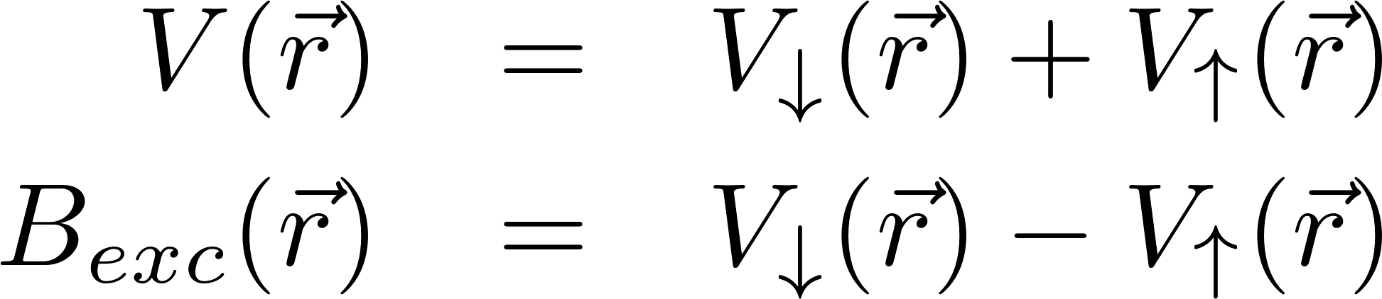
Quasi Majorana Bound States (QMBS) aka „Fake” Majorana
Perturbation of the local exchange
field at the last atoms of a chain in
a non-topological regime: B_{exc}=0.95 B⁰_{exc}
LDOS shows edge state
Topologically trivial order parameter ꭕ_{s}(ɛ)

