Slide 1






RenyiAI focusing on patient journey analysis
Adrián Csiszárik, Péter Kőrösi-Szabó, Judit Laki, Dániel Varga,
Balázs Szegedy, Dezső Miklós
Rényi AI / Predictive Healthcare AI
HUN-REN Alfréd Rényi Institute of Mathematics
Academia-Industry Matching Event (AIME25), Budapest, 27th November 2025

Slide 2
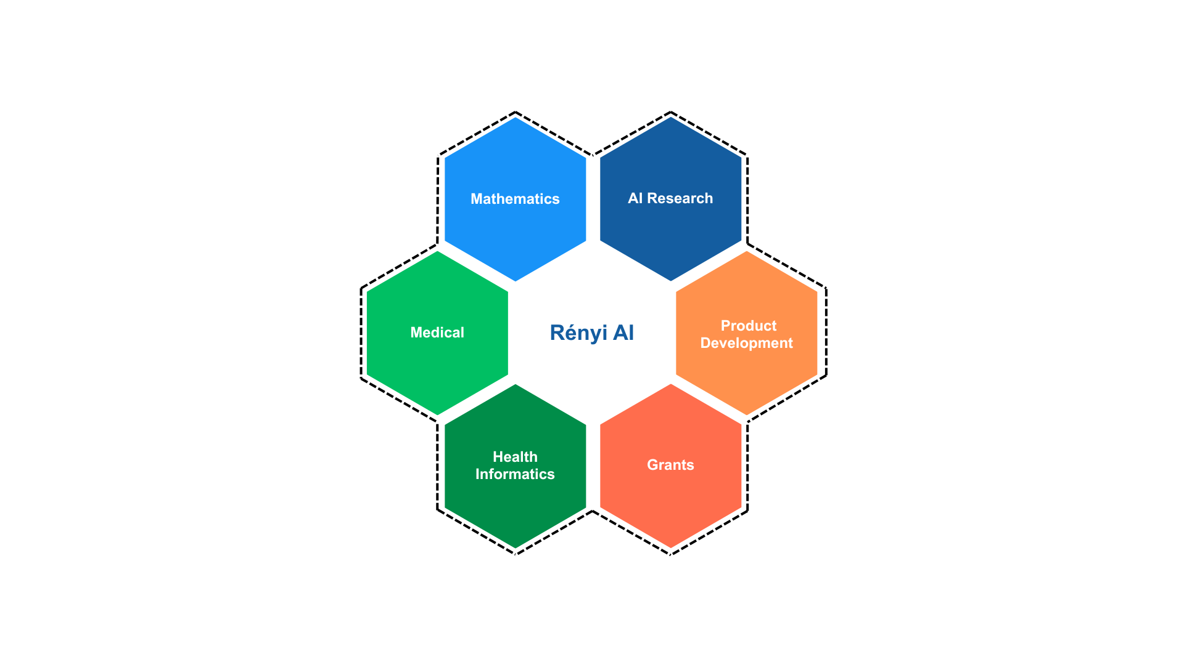
Competences in the team
Rényi AI / Predictive Healthcare

Slide 3
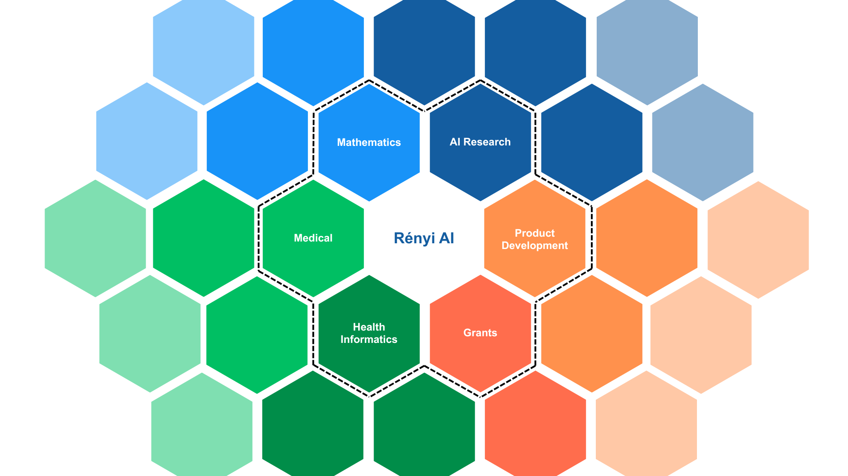

Slide 4
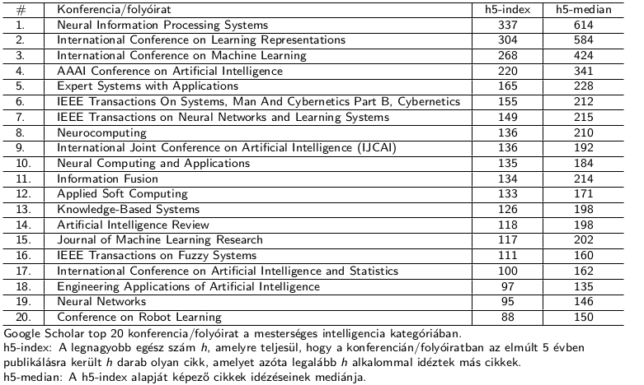
Most Important AI conferences and journals

Slide 5
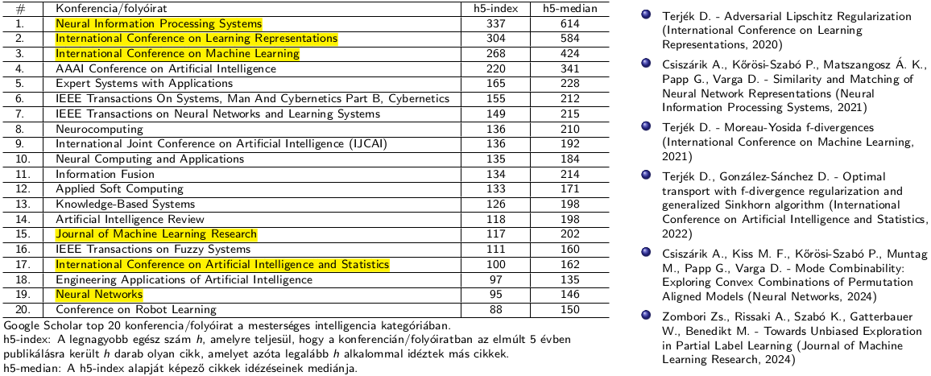
Rényi AI team’s results, contributions

Slide 6
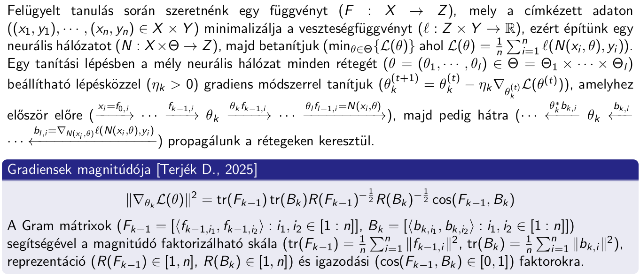
Representation learning in deep neural networks

Slide 7
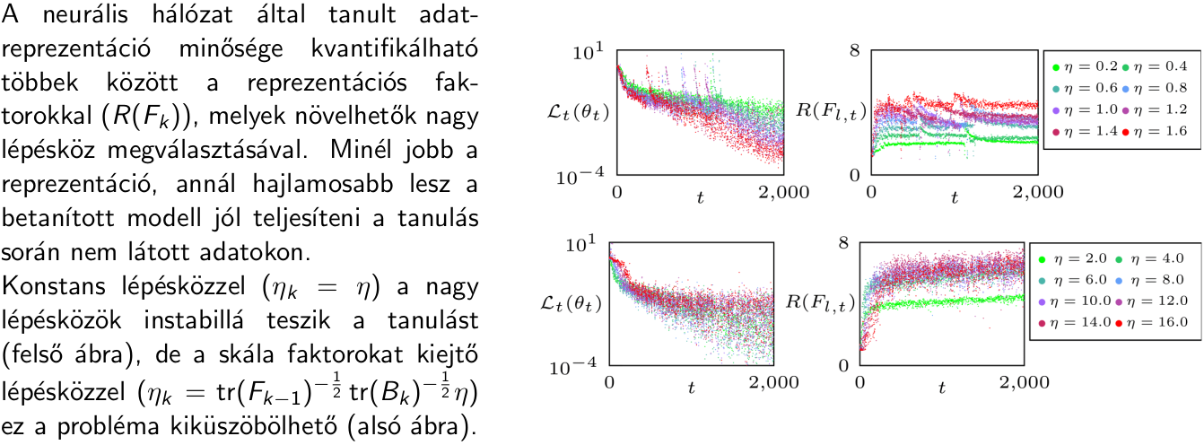
Representation learning in deep neural networks

Slide 8

A classic question of Paul Erdős asks whether at least one quarter of the plane can be colored in such a way that no two colored points are ever at unit distance from each other.
Our researchers have developed a method that answers this and similar questions using so-called probe point sets.

Slide 9
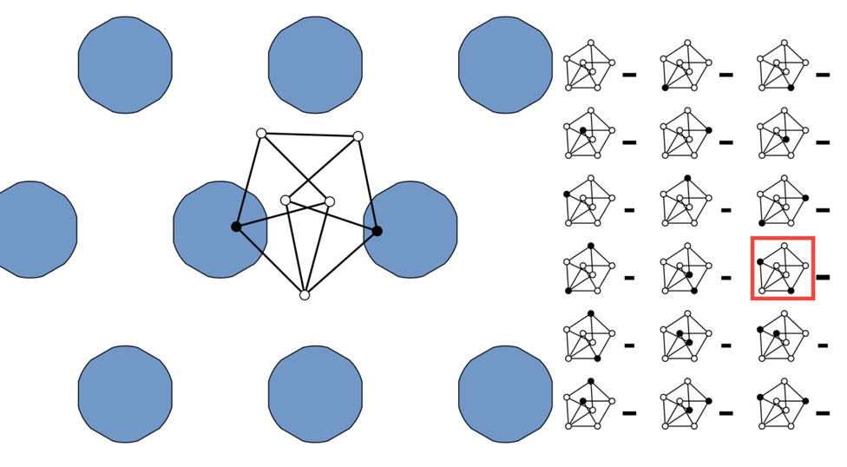
We randomly drop the probe X onto the plane.
Which points of X fall into the unit-distance–free set AAA?
We can derive inequalities for the probabilities of the occurring patterns.

Slide 10
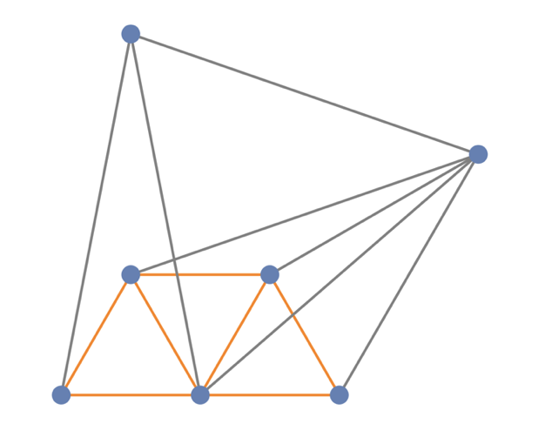
Relying solely on human ingenuity, we were unable to find sufficiently good probes.

Slide 11
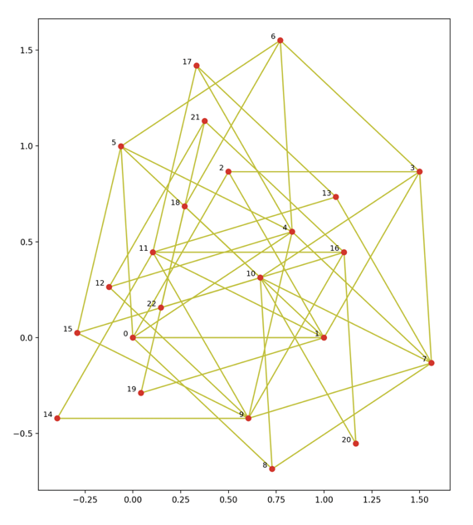
The probe shown in the image is the result of a large-scale computer search, and it answers Paul Erdős’s question.
Ambrus et al., The density of planar sets avoiding unit distances, Mathematical Programming (2023)

Slide 12
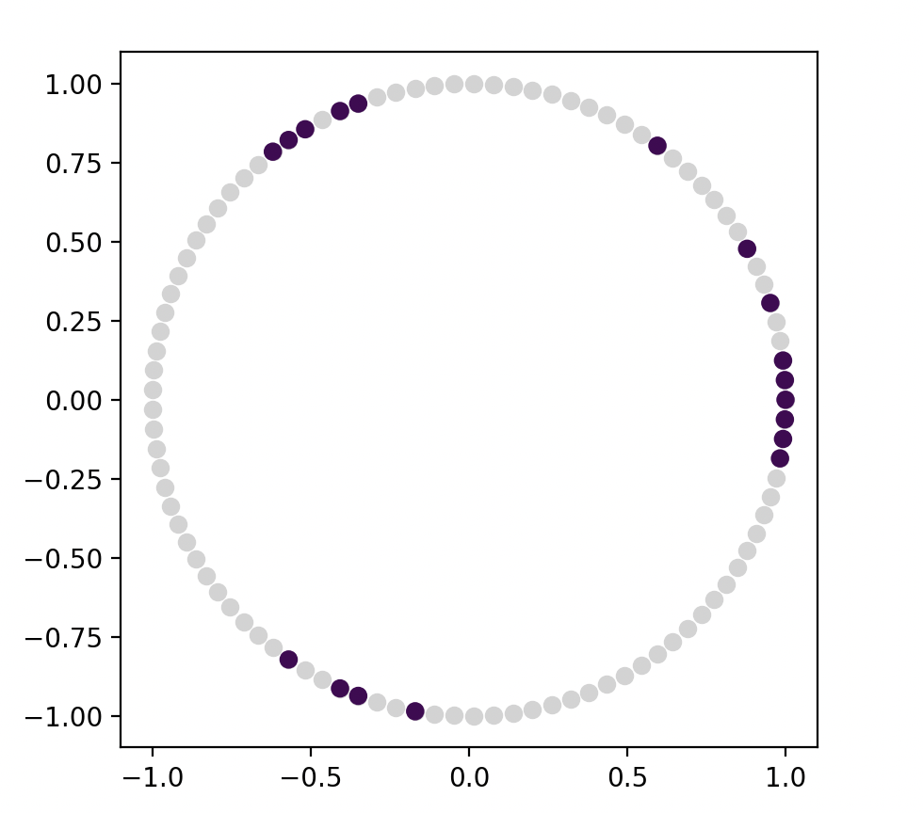
We used the probe shown in the image to answer a number-theoretic question:
How large a subset A of 𝔽ₚ ​ can be chosen so that 1∉A+A−2A?
This was found by a search algorithm that applies state-of-the-art AI techniques inspired by the AlphaGo system.

Slide 13





Our main applied AI projects
Energy – ALTEO
Balancing power forecasting
Renewable energy forecasting
Energy price prediction
Document processing
Document workflow separation and classification (MÁK)
Restoration of degraded documents (ÁBTL, MNL - archives)
Optical Character Recognition (ÁBTL, MNL - archives)
Sensitive information filtering (ÁBTL - archives)
Summarization of document collections (ÁBTL - archives)
Retrieval Augmented Generation (ÁBTL, MNL - archives)
Healthcare
Processing unstructured medical PDFs with LLMs (Own dataset)
Laboratory reports, outpatient reports, discharge summaries, etc.
Patient journey analysis (EMK)
Healthcare event prediction (EMK)

Slide 14
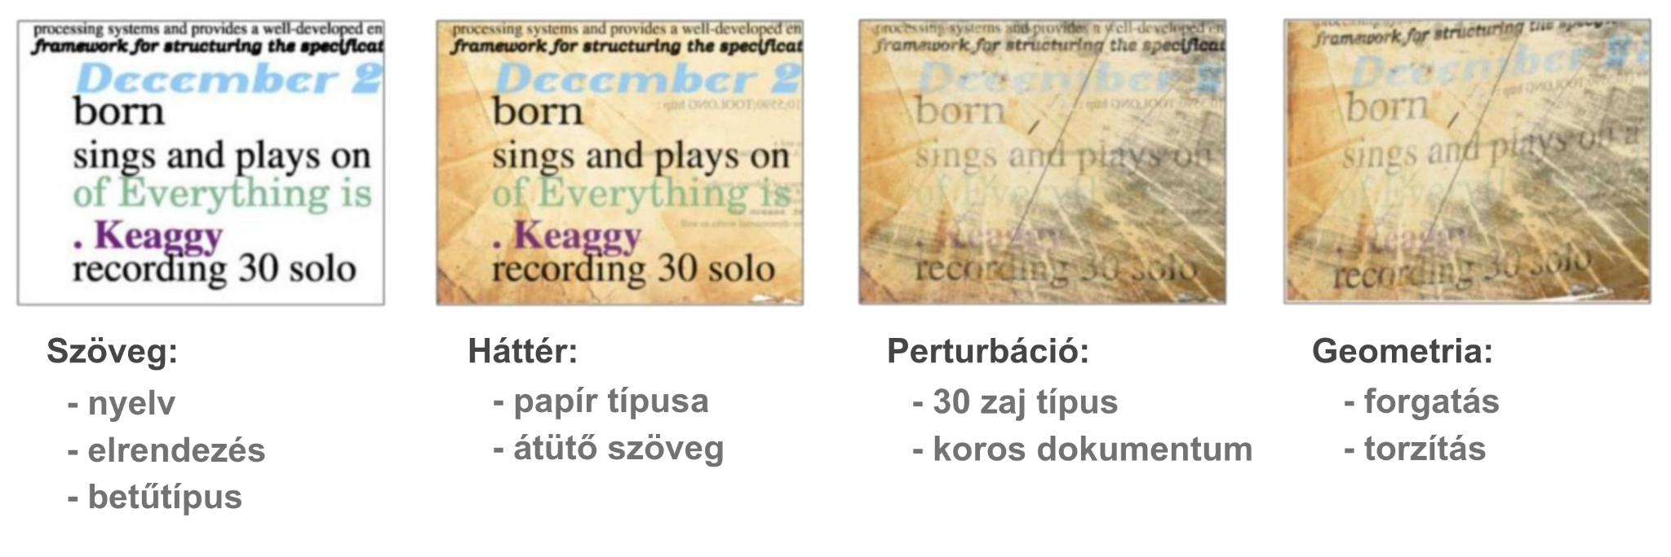
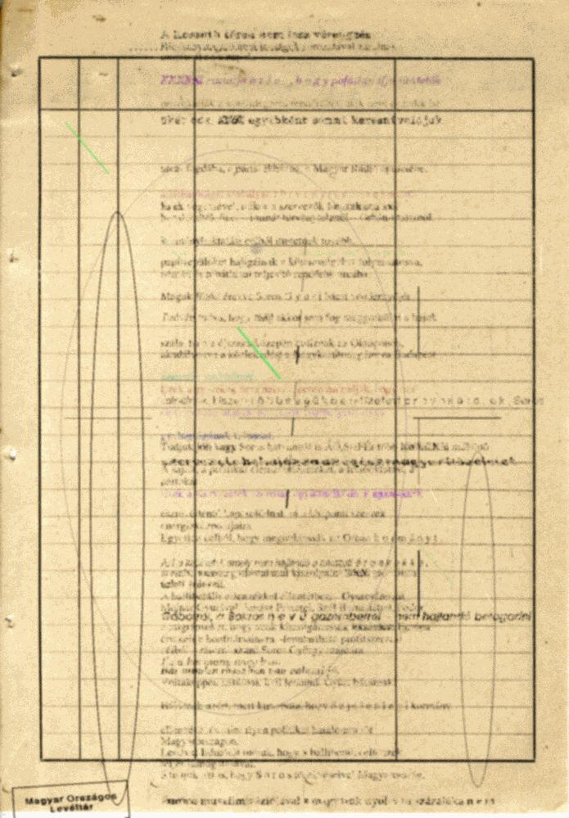


Restoration of degraded documents
Task
Old degraded documents
Different types of typewriters
Many millions of documents
Our solution
Synthetic data, artificial degradation
Clean–noisy document pairs
Training an AI model to remove noise
Szintetikusan generált zajos dokumentumok

Slide 15
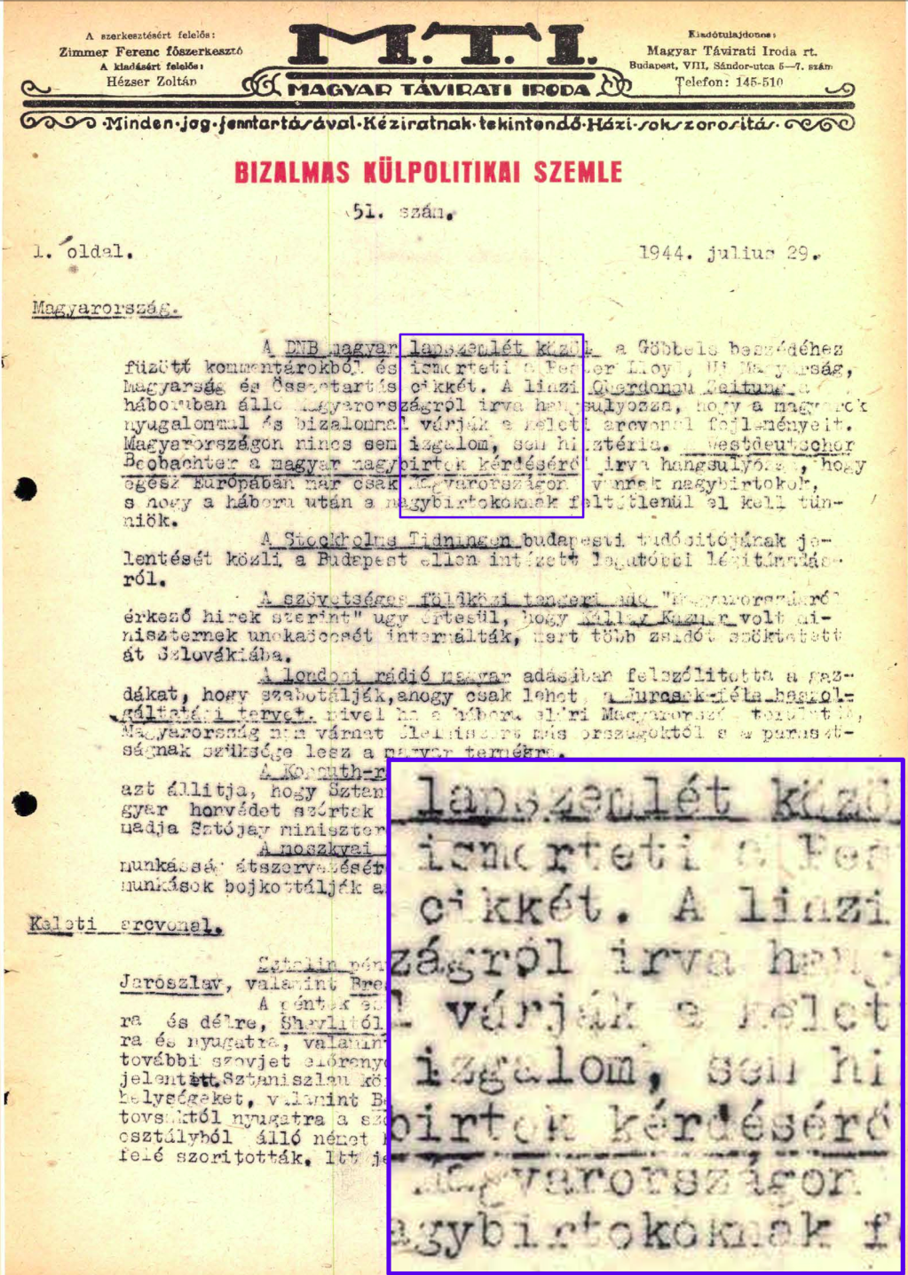
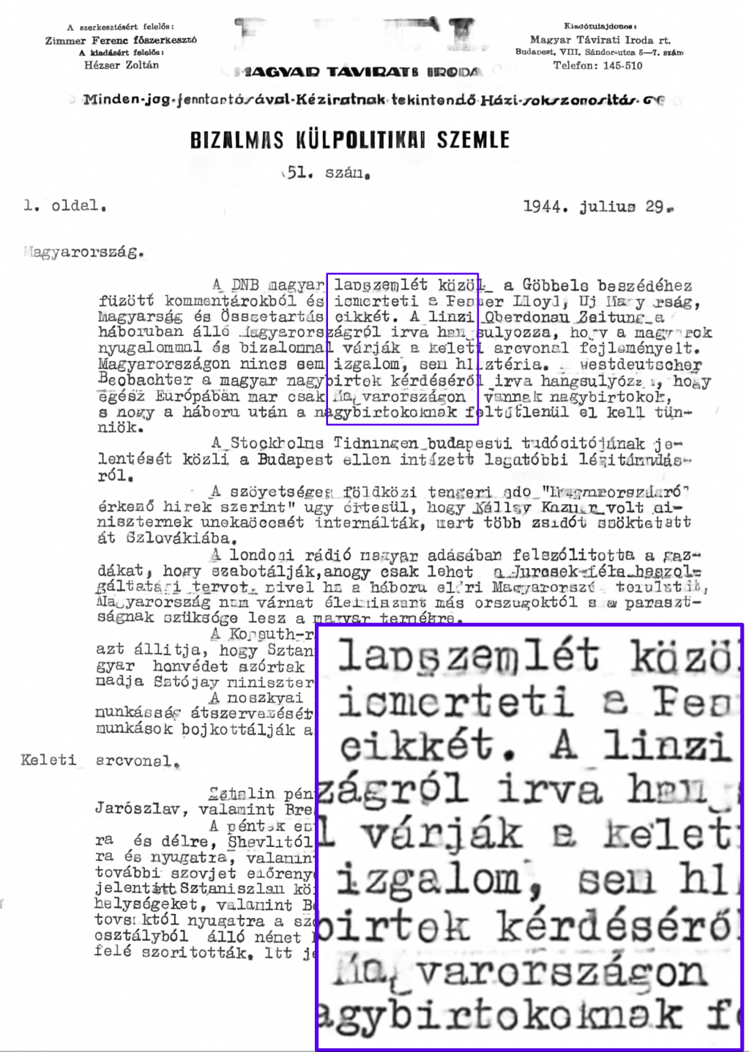
Notes:
Ez még egy korai kép. M.T.I. azért nem lett jól megtisztítva, mert a betűtípusa és mérete kívül esik a tanítóadat eloszlásán (azóta javítottuk).
Jól demonstrálja, hogy szintetikus adat esetén figyelni kell arra, hogy lefedjük a valós eloszlást!

Slide 16
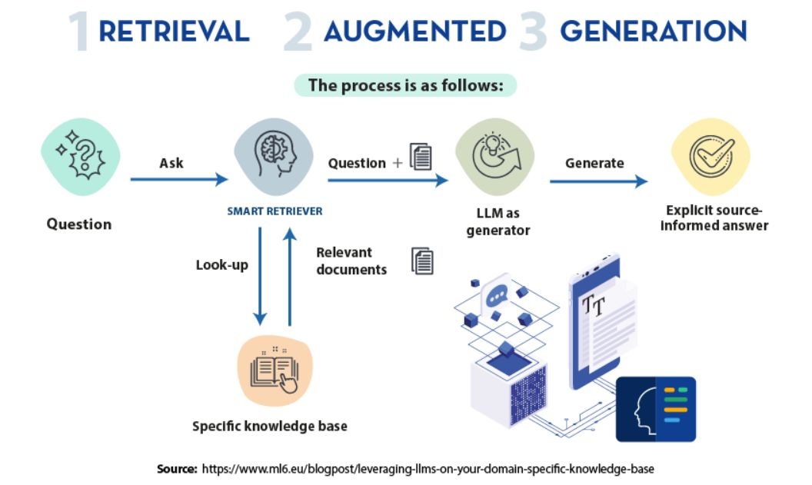
Retrieval Augmented Generation
Motivation
Searching large document
collections with free text
Displaying the source
Solution
Augmenting LLM with private data
Constraining the LLM’s
knowledge

Slide 17
Toward High-Fidelity Patient Journeys for Predictive Healthcare Modeling in Hungary
Our mission:
Harness the Hungarian patient journey data treasure

Slide 18













Rényi AI / Predictive Healthcare
the team
Botond
Forrai
Péter
Kőrösi-Szabó
Adrián Csiszárik
István Miklós
András Hubai
Dezső Miklós
Judit Laki
Zoltán Ruzsa
Zsolt Parisek
Attila Börcs
Miklós Szócska Jr.
Gábor Kovács
in close collaboration with

Slide 19
Modeling the Hungarian healthcare system

Slide 20
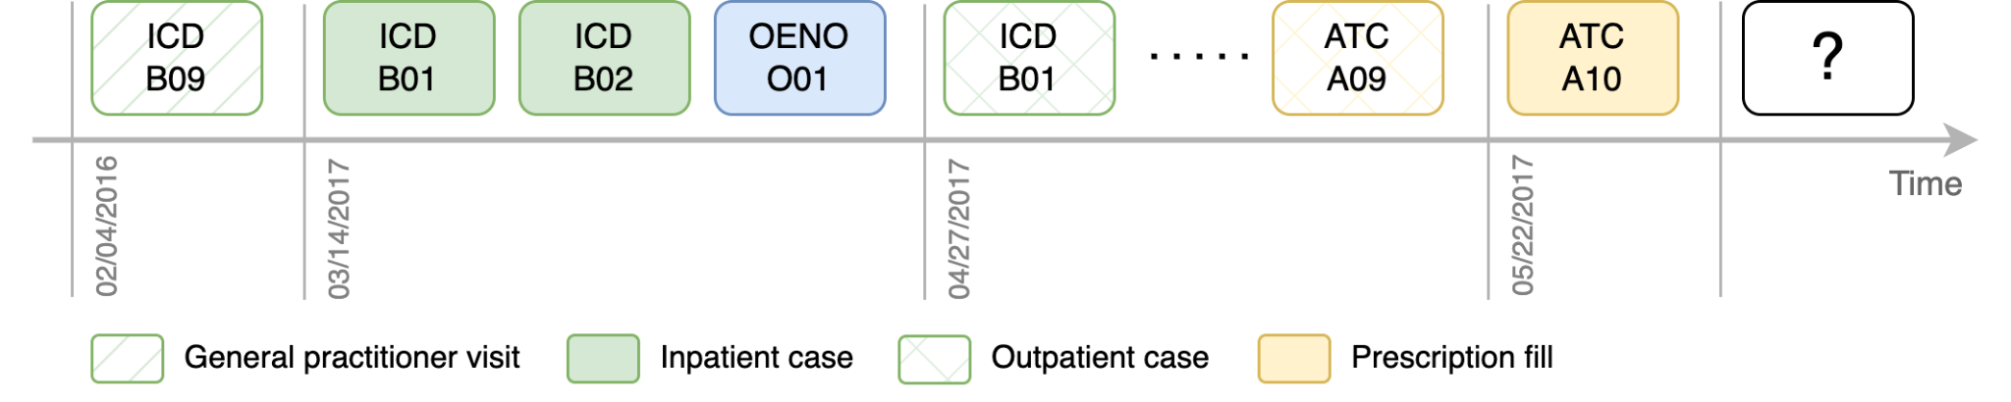
Modeling healthcare by predicting the next token
Large language models
Patient journey models
Modeling the world
Modeling healthcare
Data of an entire country!
Hundreds of millions of patient journey events…

Slide 21
Predictive modeling
Examples
“What is the probability of the progression of diabetes of this patient?”
“What is the probability of death in 1 year?”
Model interpretability and explainability
Examples
Answers to the question of “why”?
“Why does the model predict high probability of death in one year?”
“What are the most important variables for a specific prediction?”

Slide 22
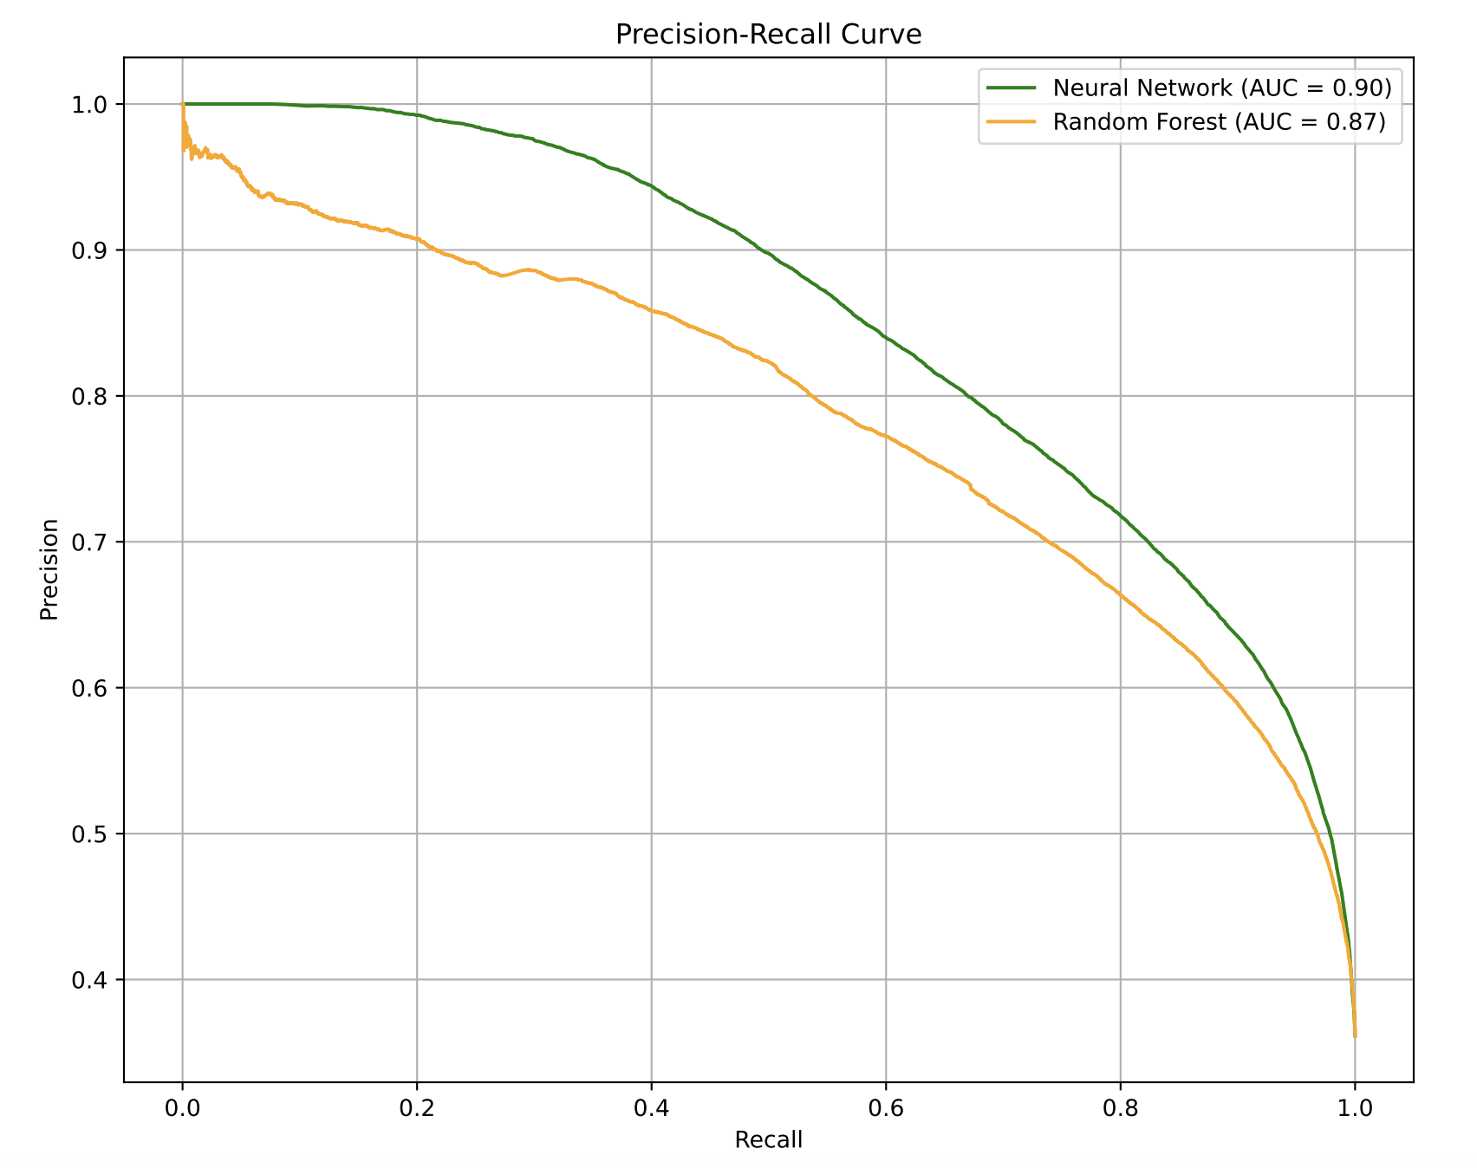
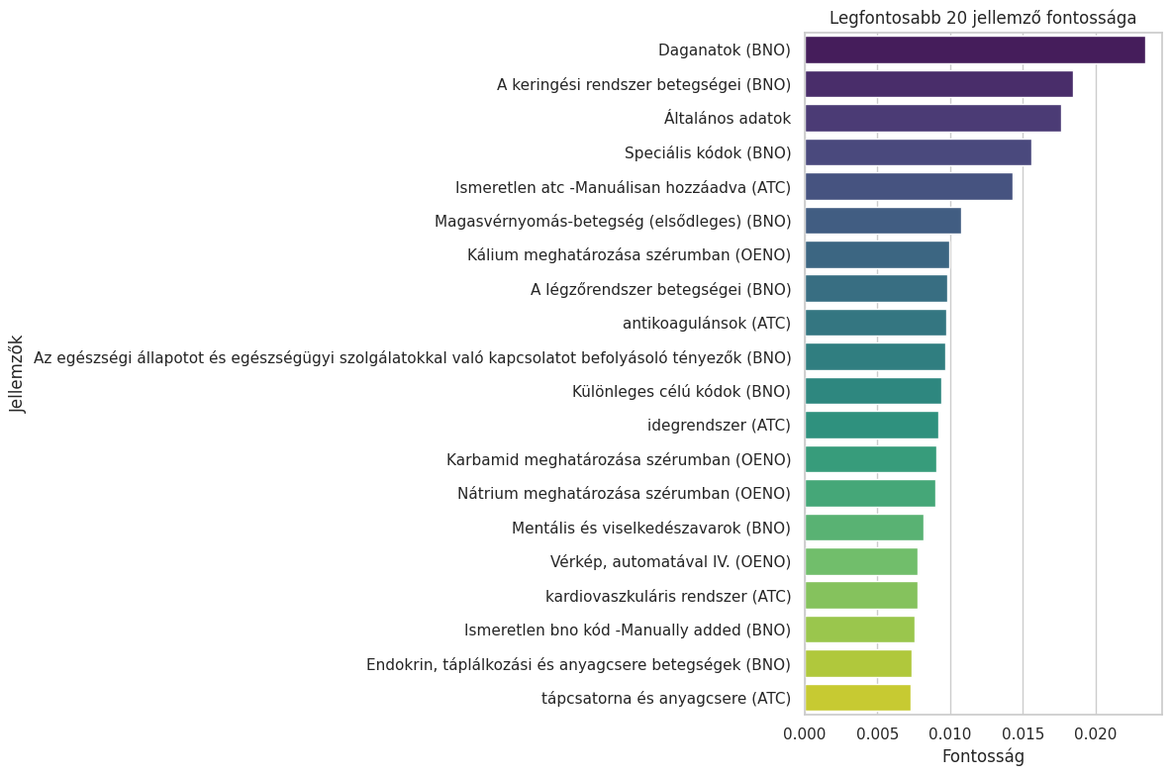
Predictive modeling
Tools for interpreting and explaining the model

Slide 23
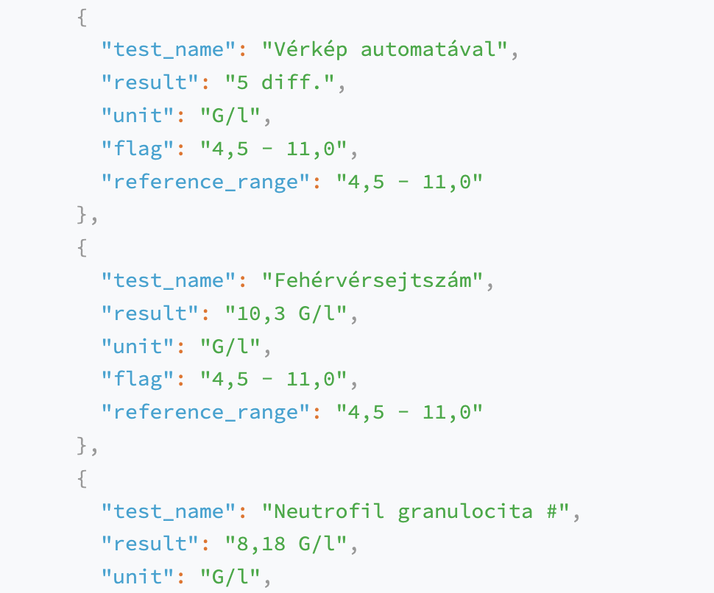
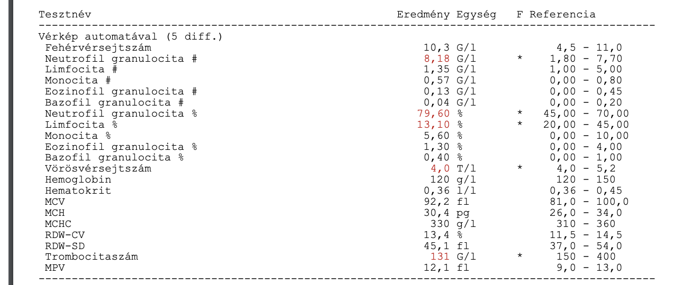



Transform medical documents into structured format
First target: lab results
Lab result document
Structured format
More than 60.000.000 lab result documents
are ready to be transformed with our toolset.

Slide 24
Even more data…
Done
✓ Administrative data
✓ Lab test results (blood tests and urine tests)
Coming up
Outpatient report
Inpatient report
…with the goal of high fidelity, rich patient journey data

Slide 25





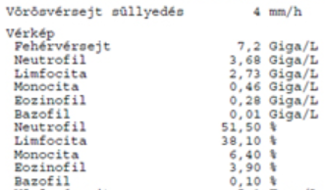
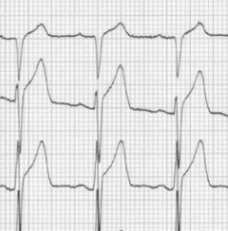
Healthcare Journey Data Platform
Predictive and Information
Services
Raw data
Structured or
half-structured
data
Machine learning,
analytics
Predictive
modelling
Interface
to results and infos
Human-AI interfaces
ICD
CODE
ATC
AI
AI
AI
AI
AI
Data
ingestion
Discovering correlations
Predictive
modelling
Patient journey summary
Natural
language
interfaces
Lab result
AI-powered analytical assistant
Discharge rep.

Slide 26
Clinical applications:
precision (cancer) screening

Slide 27
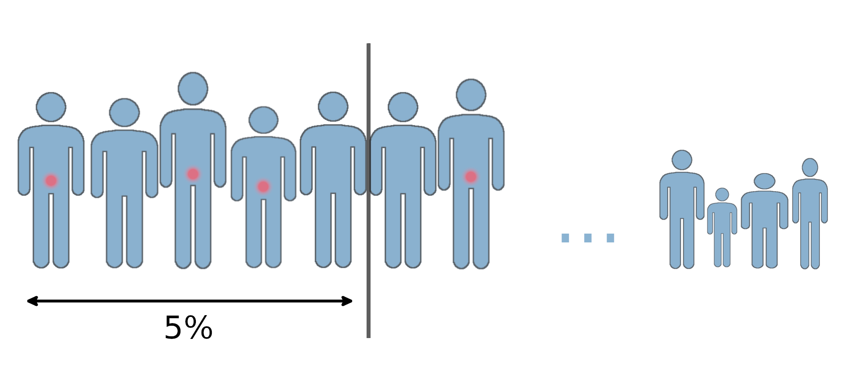

Screening: prostate cancer
Screening strategy = ranking the population for screening
Current Hungarian guideline:
screening recommended, not (yet) centrally organized
annual screening between ages 50 and 70
Can we perform better with data?

Slide 28
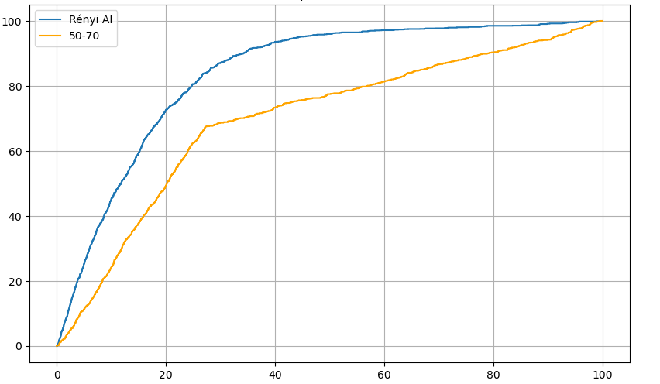
Screening: prostate cancer
Men Aged 50–70
Achieved Health Benefit
Rényi AI Model
Percentage (%) of Screened Population
Notes:
Our analysis: 2010 (January) - 2019 (December); according to the guideline of this period: screening was considered the combination of PSA lab test + manual examination.
Manual examination is very rarely registered due to technical reasons (a more universal examination is registered instead that pays more).
Therefore, in our analysis PSA lab test (alone) was considered as screening.
Current guideline (2025): screening = PSA lab test + MRI for the (positively) screened cases [so our approach for the analysed (previous) period is in concordance with the current guideline].

Slide 29
Screening: colorectal cancer
Screening strategy = ranking the population for screening
Current Hungarian guideline:
screening recommended and centrally organized
annual screening between ages 50 and 70
Can we perform better with data?

Slide 30
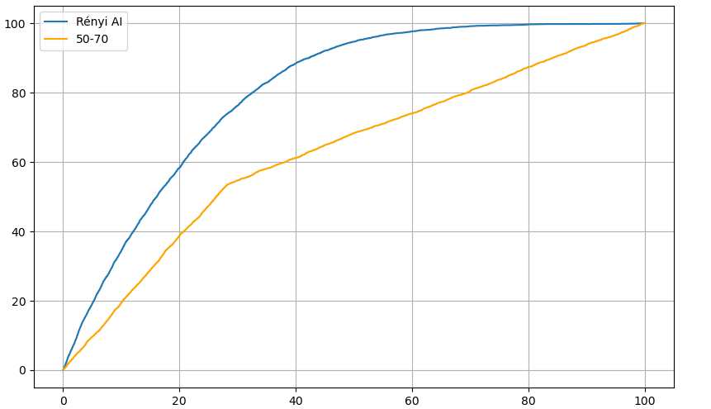
Screening: colorectal cancer
Achieved Health Benefit
Everyone
Aged 50–70
Rényi AI Model
Percentage (%) of Screened Population
Notes:
Our analysis: 2010 (January) - 2019 (December); according to the guideline of this period: screening was considered fecal blood test.

Slide 31
Comorbidity

Slide 32
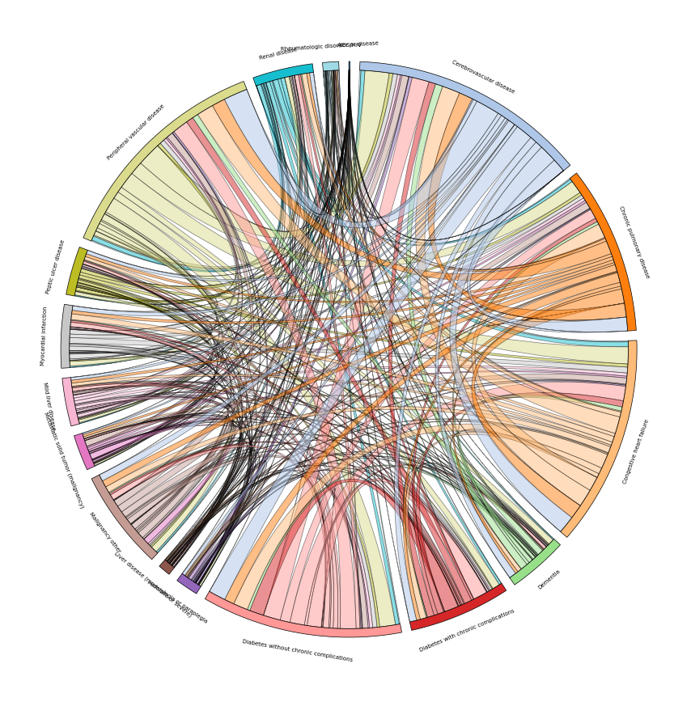
Data Platform / Analytics & Visualization
Pairwise Comorbidity Graph

Slide 33
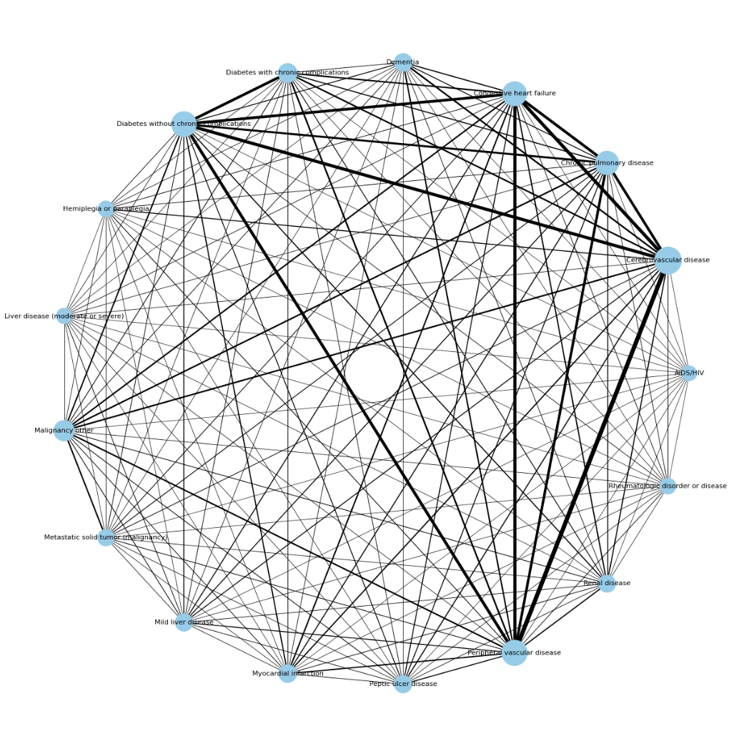
Data Platform / Analytics & Visualization
Pairwise Comorbidity Graph
diabetes with chronic complications
diabetes without chronic complications
congestive heart failure
chronic pulmonary disease
cerebrovascular disease
malignancy (other)
metastatic solid tumor
peripheral vascular disease

Slide 34
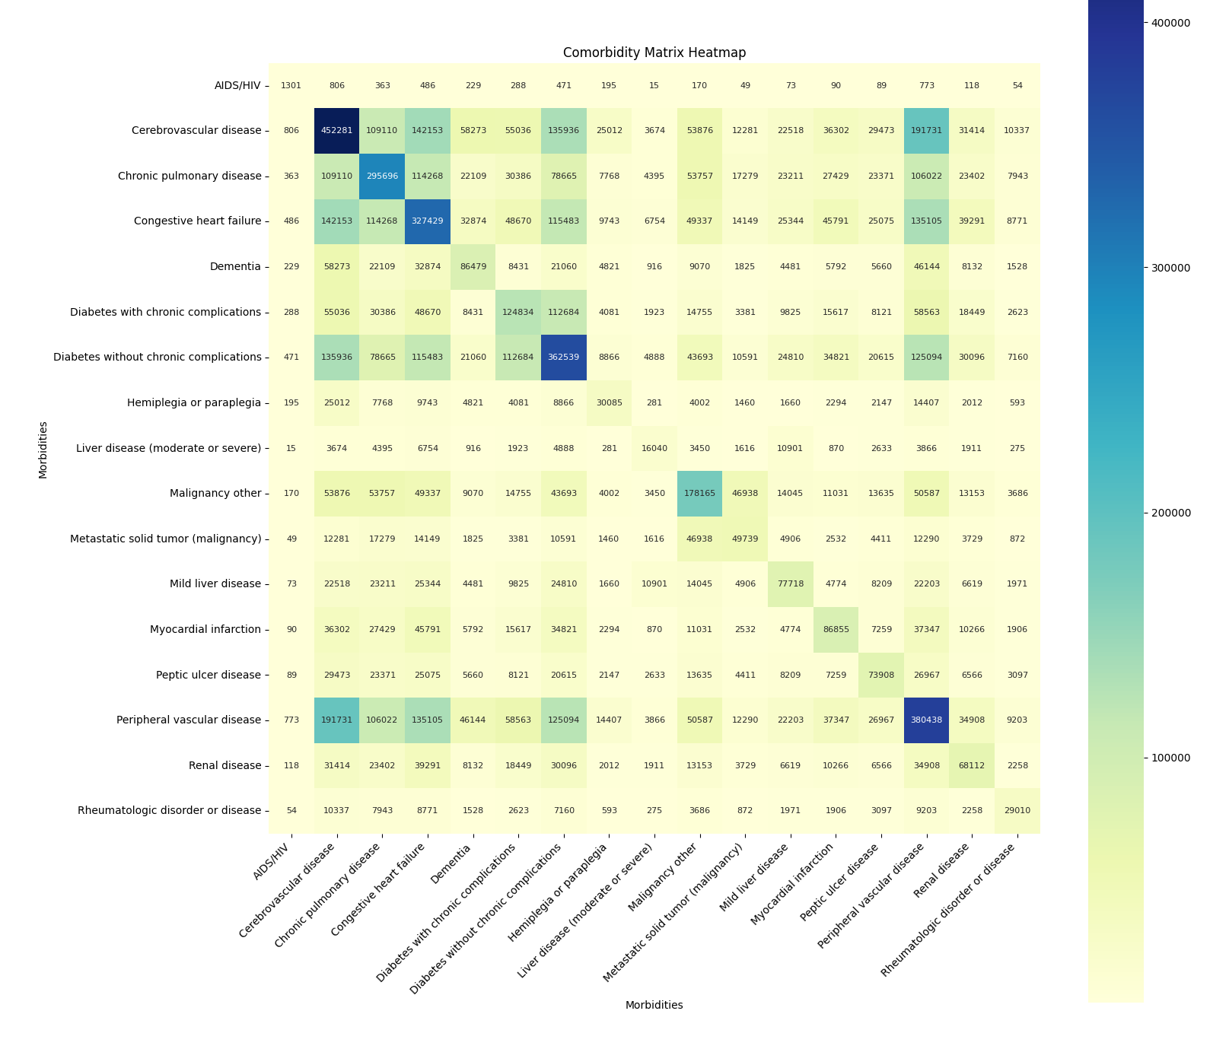
Data Platform / Analytics & Visualization
Pairwise Comorbidity Matrix
2010, full adult population, all ICD-10, CCI index

Slide 35
Data Platform / Analytics & Visualization
Pairwise Comorbidity Graph
diabetes with chronic complications
diabetes without chronic complications
congestive heart failure
chronic pulmonary disease
cerebrovascular disease
malignancy (other)
metastatic solid tumor
?
peripheral vascular disease

Slide 36
ICD-10 code | ICD-10 subdivision designation | comorbidity category designation
E10-14 x.60 | Diabetes with other specified complications | Diabetes without complications
E10-14 x.80 | Diabetes with unspecified complications | Diabetes without complications
?
?
Next steps:
Revise the content (ICD-10 codes) in the diabetes comorbidity categories
Perform mortality prediction with revised categories
Apply mortality prediction model in patient care

Slide 37

Get in contact with us!
healthcare@renyi.hu
https://ai.renyi.hu/healthcare

