Slide 1


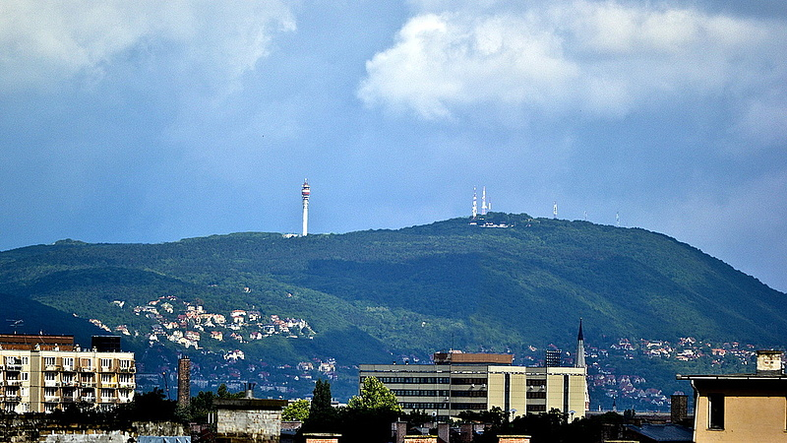
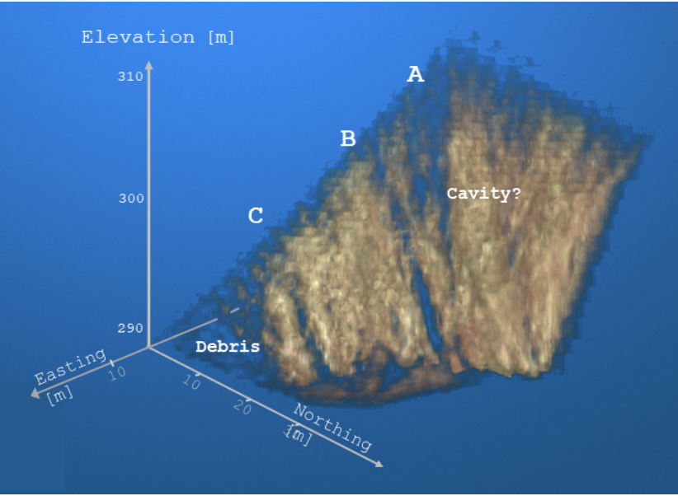
Experiences with tomographic inversion of subsurface muographic measurements (bias and artifacts)
László Balázs
Gergely Surányi
Gergő Hamar
Dezső Varga
Wigner RCP
MUOGRAPHERS
2026
Budapest
Key words:
Regularization, Bias, Covariance, Artifacts
High-Energy Geophysics Research Group
https://wigner.hu/s/high-energy-geophysics/
Innovative gaseous detector development GROUP

Slide 2
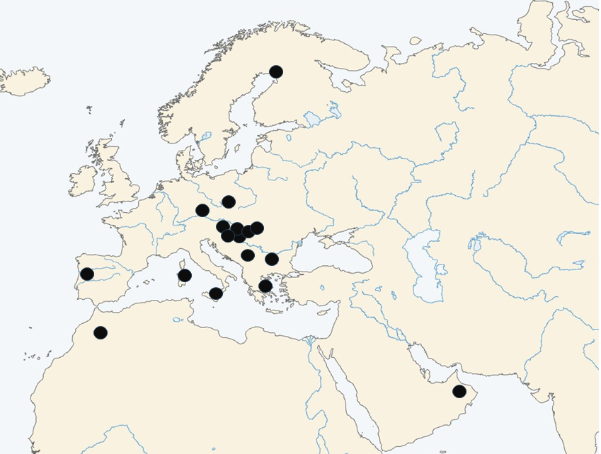
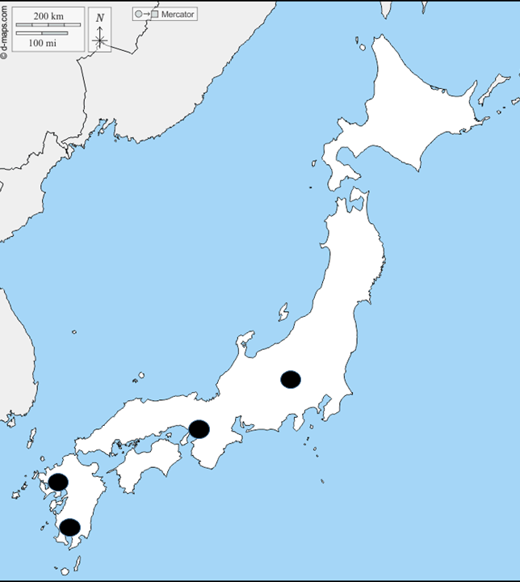
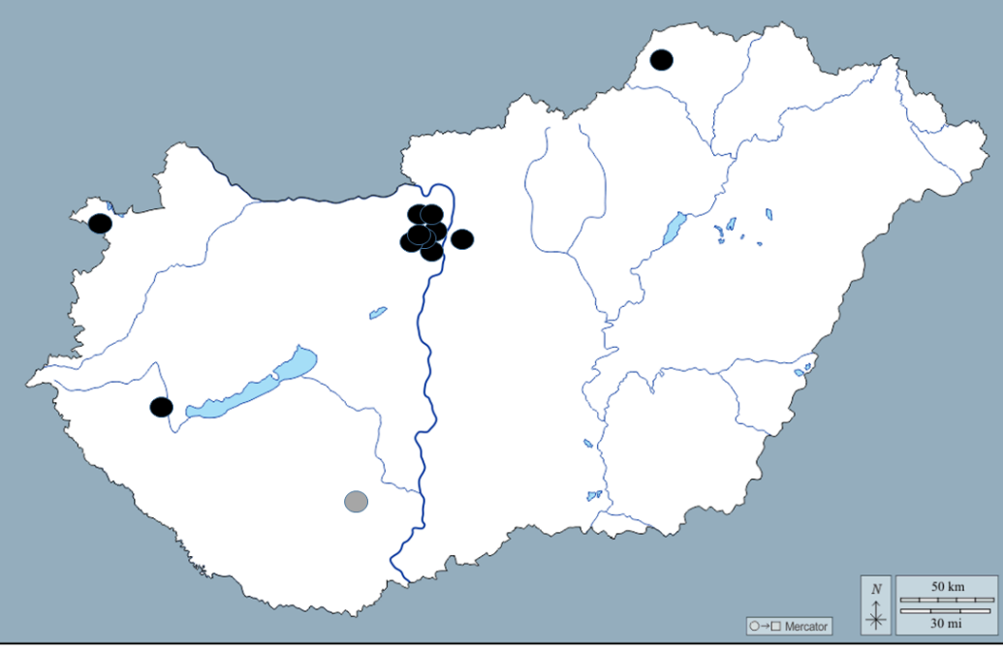
Muon tomography: experiences (Muographic projects)
Hundreds of measurement campaigns
High-resolution measurements at
27 locations
High resolution measurements
In extreme environments

Slide 3
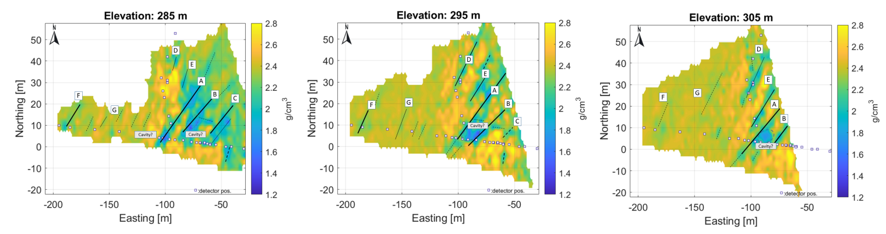
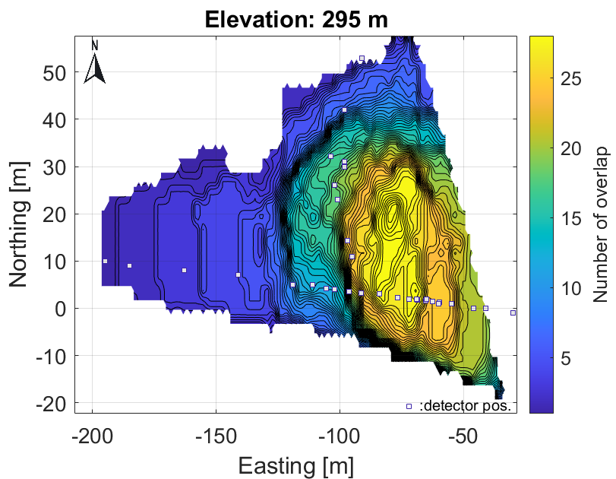
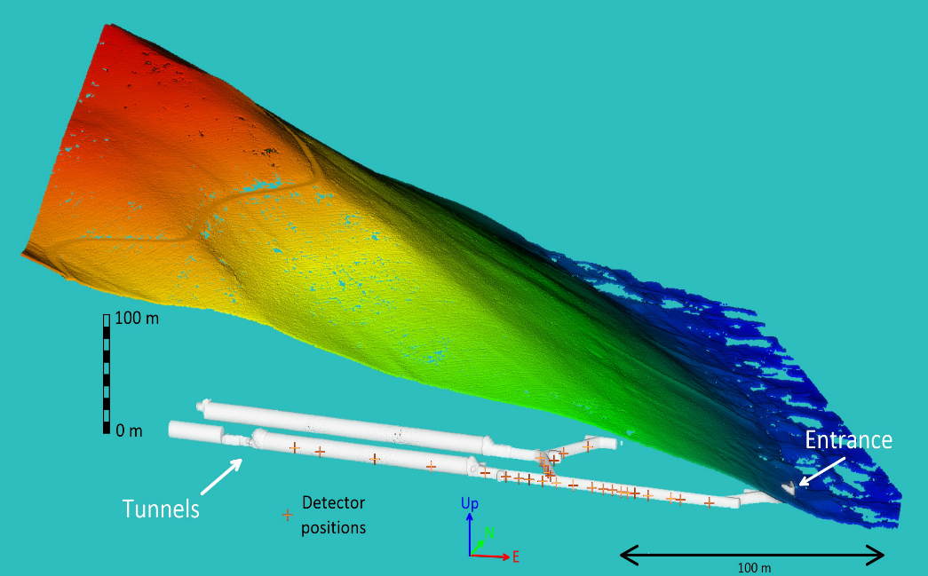
Muon tomography: Muographic projects (Budapest, Hármashatár hill)
reduced dynamic range
Low-dynamic peripheral zone
Hármashatár-hegy
Keleti oldal, 3D,
Bayesian L2-L2 reconstruction

Slide 4
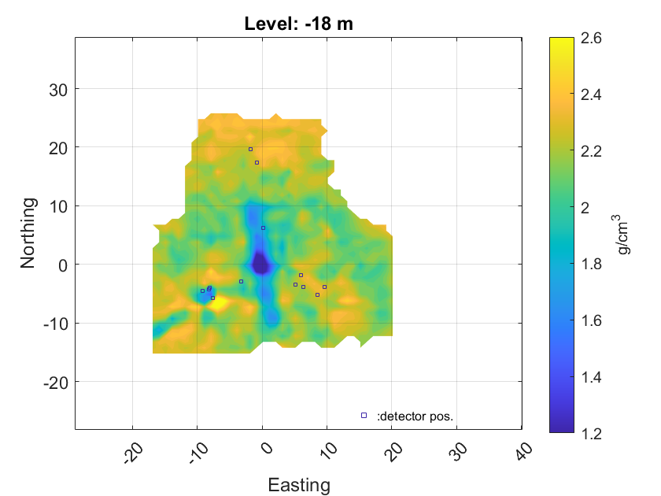
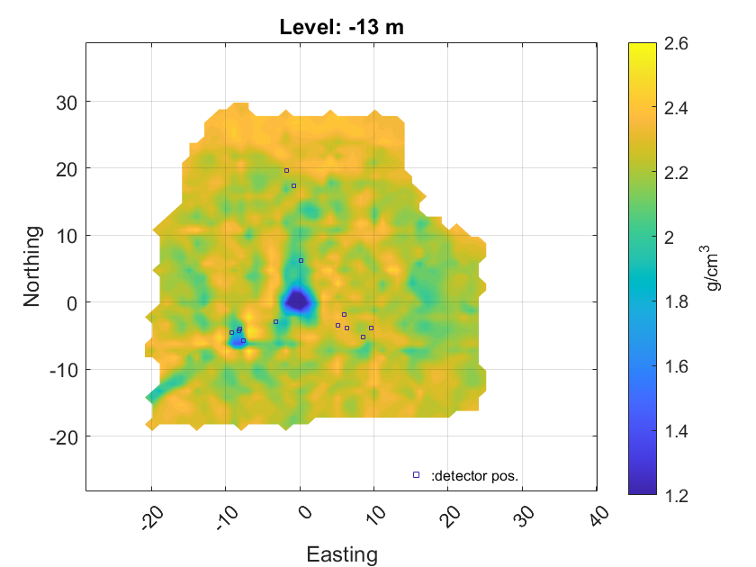
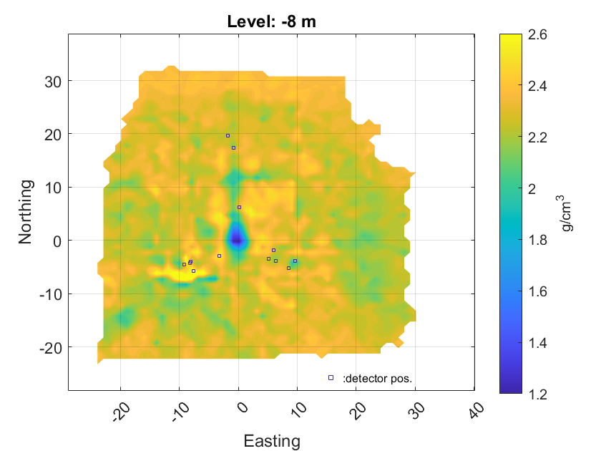
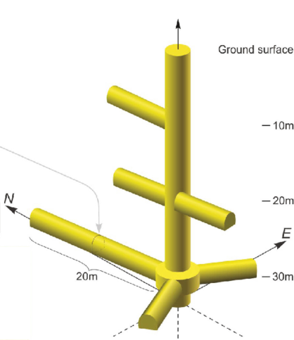
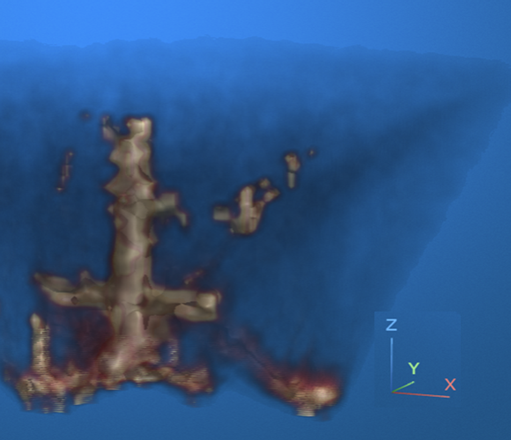
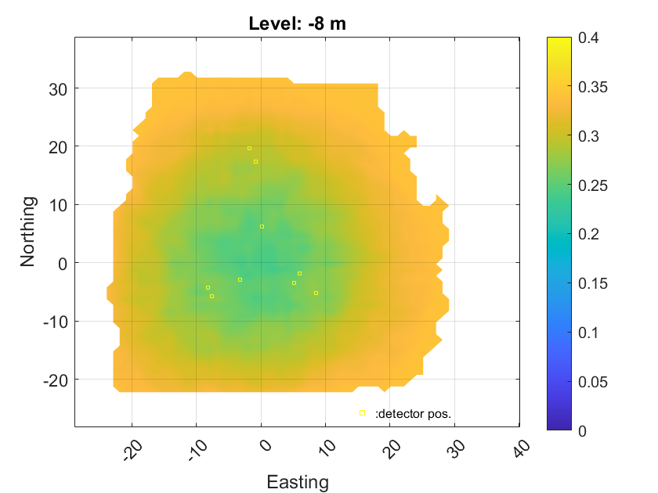
Muon tomography: Muographic projects: Jánossy Underground Lab.
Vertical and horizontal ojects on 3D tomographic results
(Bayesian L2-L2 reconstruction)
Standard deviation
Reference measuring site with known geometry

Slide 5
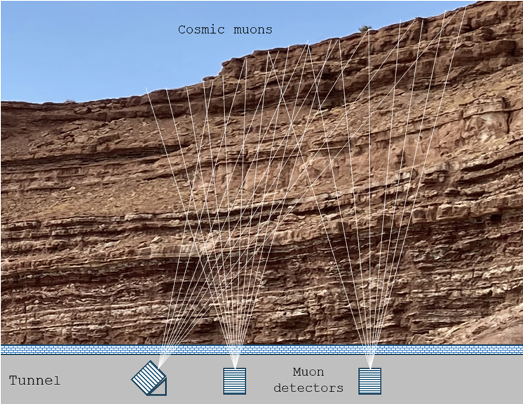
Muon tomography: What is causing the problem?
Limited azimuth range
(sampling problem)
,
Interchangeable subsets in the solution set (on the same set of trajectory)
Jacobian (permutation) symmetry (equivalences)
High-dimensional null space
(with vertically oriented base vectors)
Nullity>Rank situation
Singular pseudo inverse
Limited number of measuring position
with limited measirement time
Regularization is necessary, with all that it entails

Slide 6





Muon tomography: Tomogrpahic inverse problem
Linearized direct problem
of discrete tomography
Density length error distribution
prior distribution
(informative or noninformative,
generally smooth)
Pixel-voxel transformation
ML-term (loss)
Prior-term
Fisher-matrix
The result vector is the weighted sum of the two types of information (flexibility)
From the null space, prior selects one element ~ NS(prior)
Unique solution with prior dependent bias

Slide 7
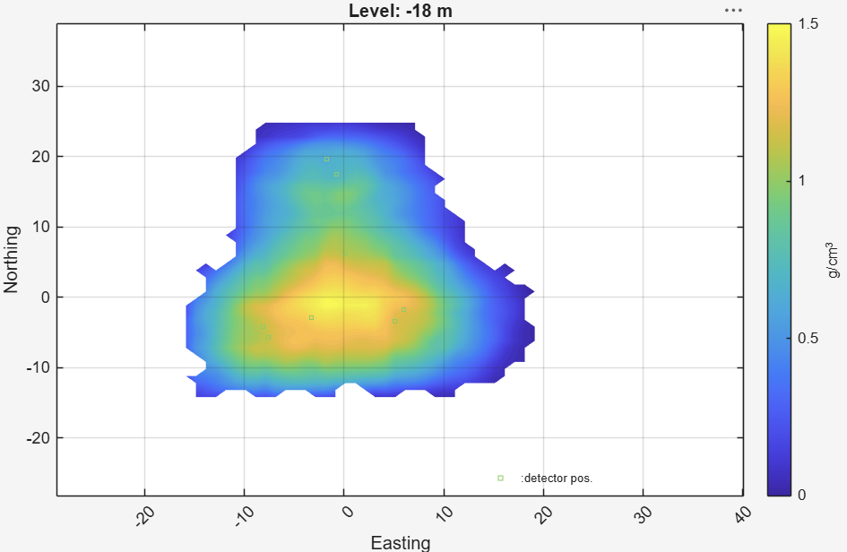

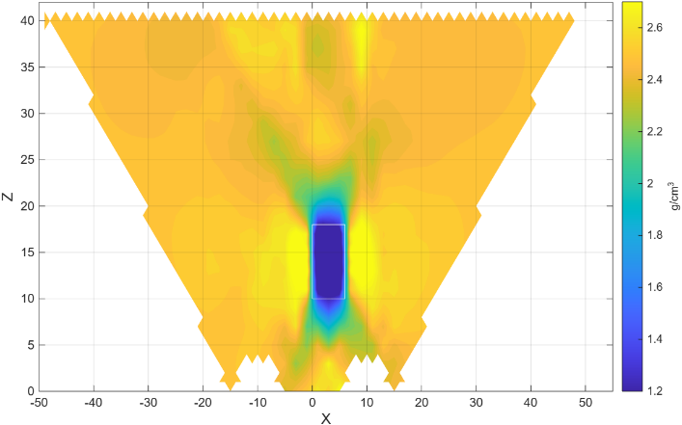
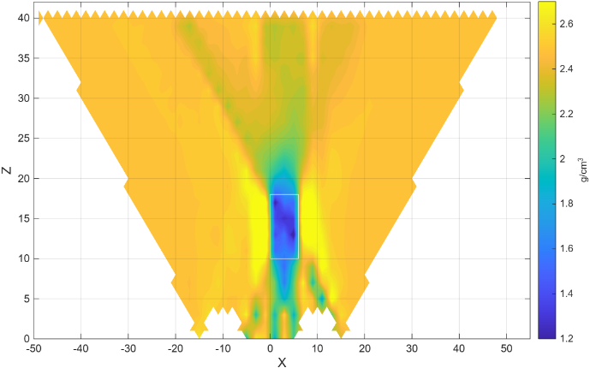
Muon tomography: Error term: bias and variance
The source of bias is always a real anomaly
Bias
Density range. [g/ccm}
Posterior distribution
Parameter Covariance-matrix
Formally, variance and bias are linked through the covariance matrix
Jánossy Lab.
„Trade-off”
„point” spread function (on Simulated 2D inversion)
Localized inversion
Non localized inversion
Result of regularization: Smoothing around the prior: dynamic range compression +
Fisher-matrix baked correlations
Correlation spikes
-
+
+
Anomaly leak along the trajectories
Anomaly at the detector position: Compensation artifact
-

Slide 8
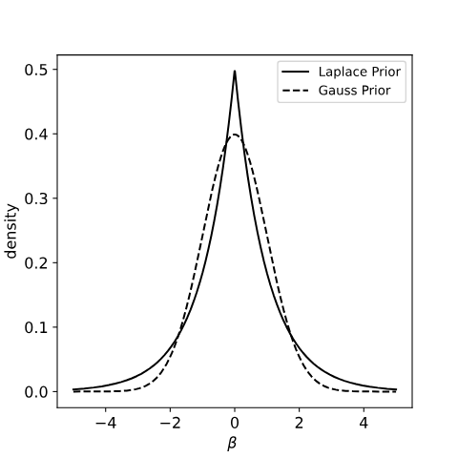
Muon tomography: Algorithms and priors
Key inversion algorithms
Prior
SVD: Spectral Value Decomposition
Tikhonov-type regularization
Bayes-type estimation (Geologic prior)
Filtered Back Projection
Expectation Maximalization (MLEM)
Early stop Iterations
Minimum norm
Smoothness (spatial correlations)
Prior density distribution (large scale geology)
Z dependent
Fisher information dependent
Because of fan-shaped imaging
Metric and pdf
Gauss or Mixed Gaussian L2 norm
Laplacean L1 norm
Sparsity handling
+ bias reduction post process

Slide 9
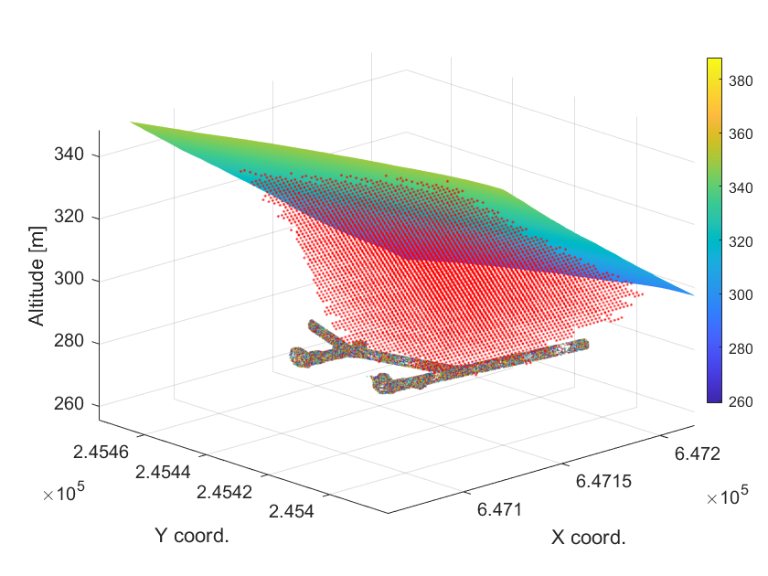
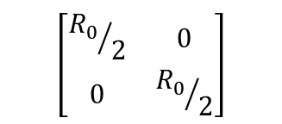
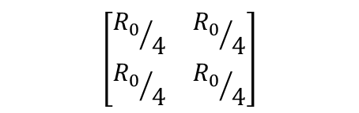
Muon tomography: Voxel grid and adaptive prior
The prior distribution relates to voxel based densities, so it depends on the voxel size.
Dependence requires an appropriate averaging model.
(scalable prior)
Averaging : small scale bias
Voxel grid – Hármashatár hill
Ro
Fisher-information
Muon trajectory
An overly refined model increases the correlation among voxel elements. Changing the correlation structure (associated with the mapping) can reduce the rank of the Fisher matrix
Information loss and voxel split

Slide 10
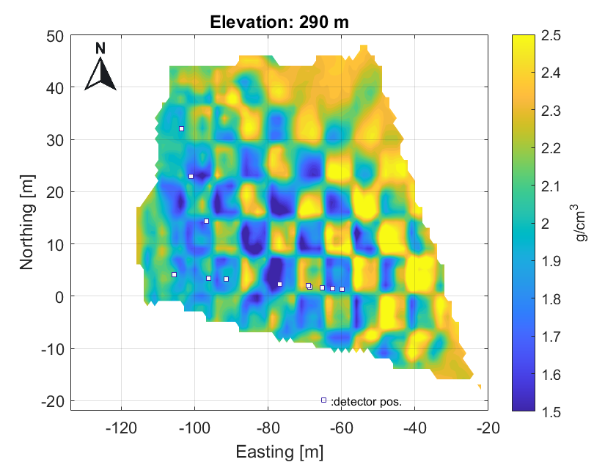
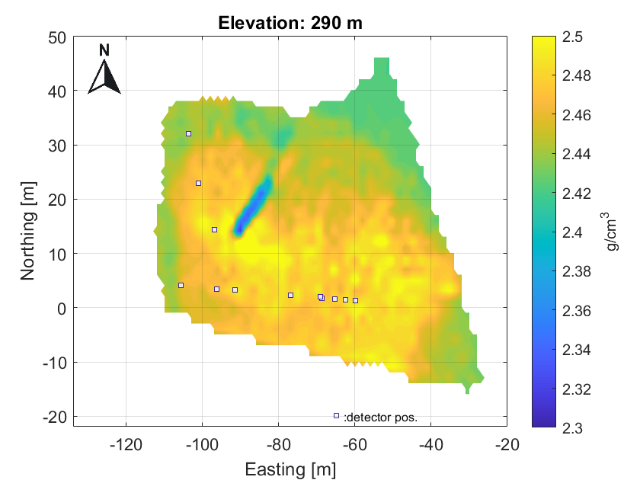
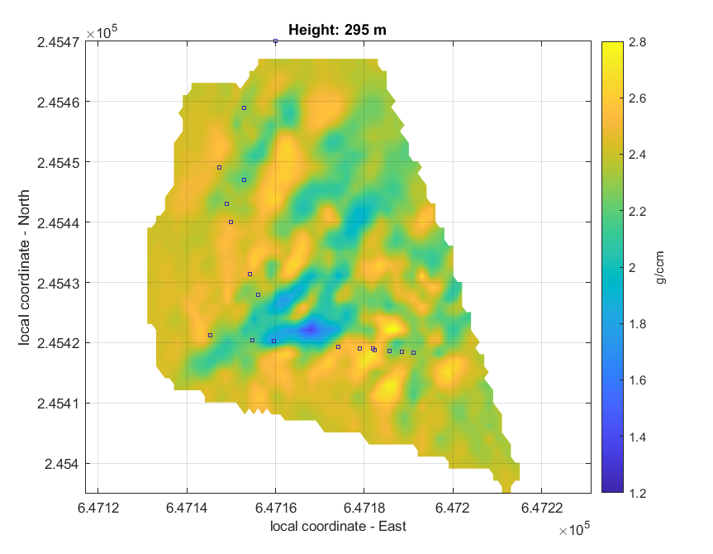
Muon tomography: Simulation and tests
Chessboard-test
For focus range definition
(Bias mapping)
Fault-test for detectability
(Hármashatár hill)
The detection limit changes with the regularization parameters

Slide 11
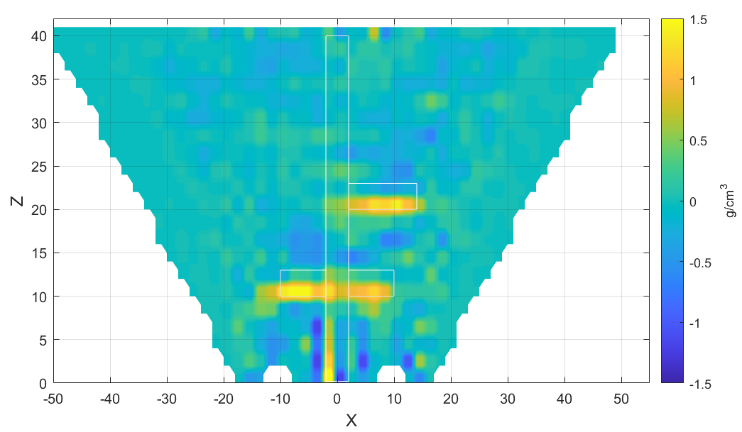
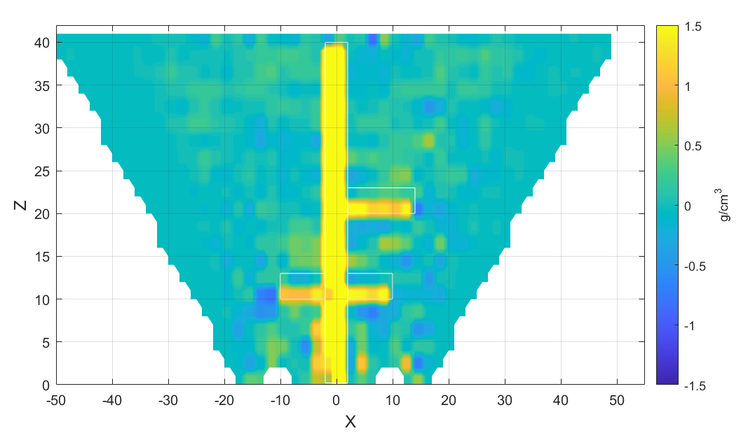

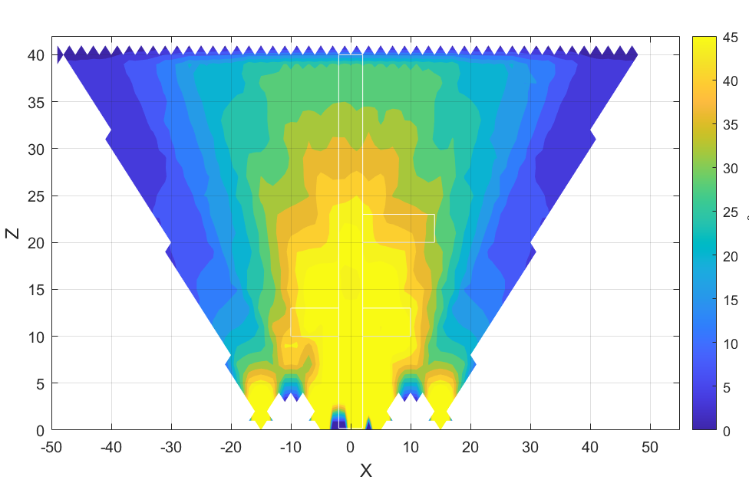
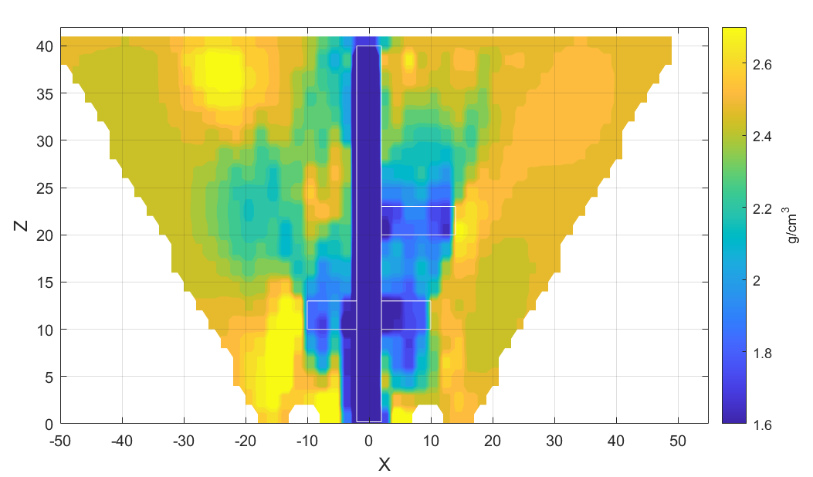
Muon tomography: Horizontal and vertical object distortion
unvisible
visible
Trajectory lengths [m]
In pixels
Inversion results
2D simulation in Janossy geometry (2D is the worst case in term of artifact)

Slide 12
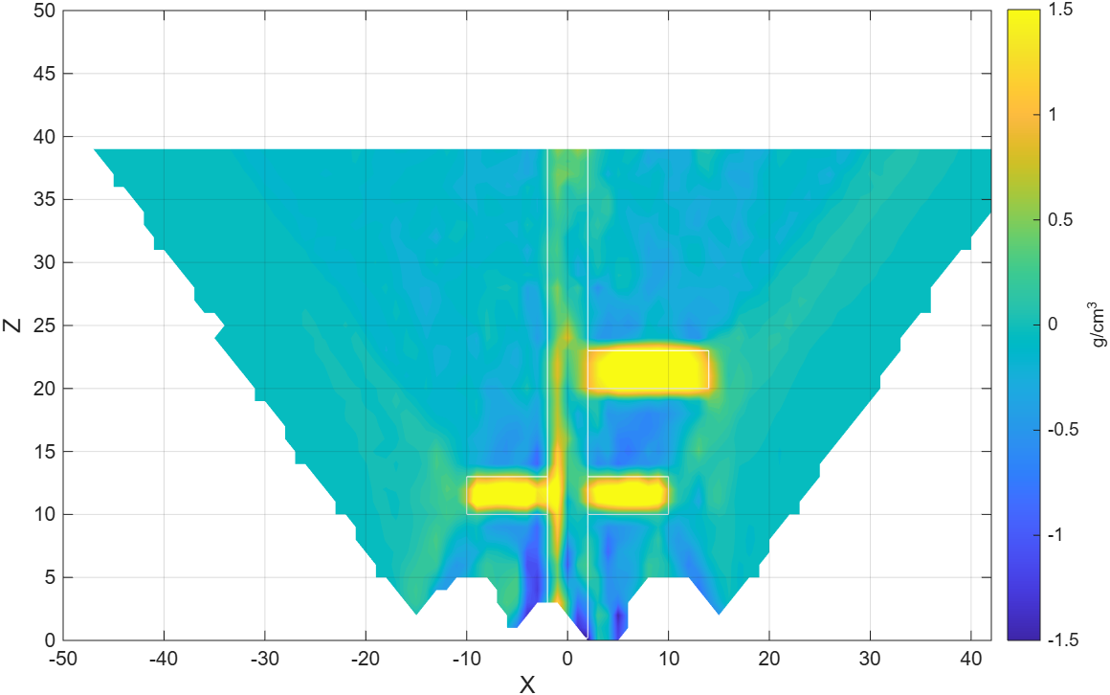
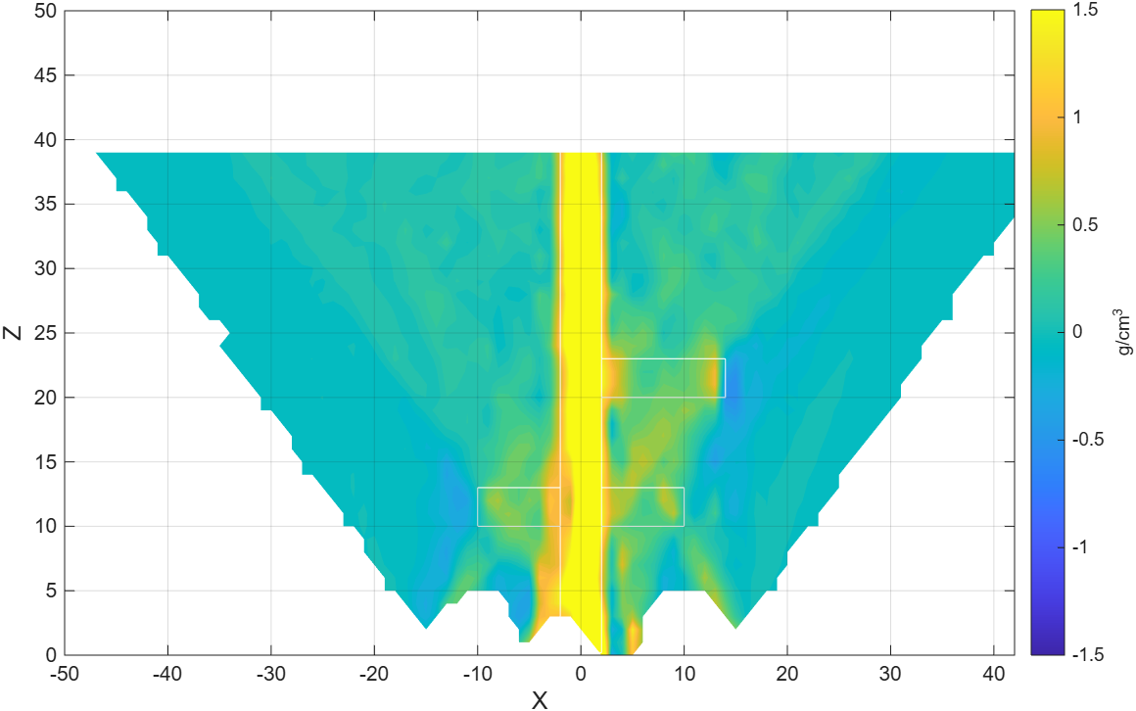
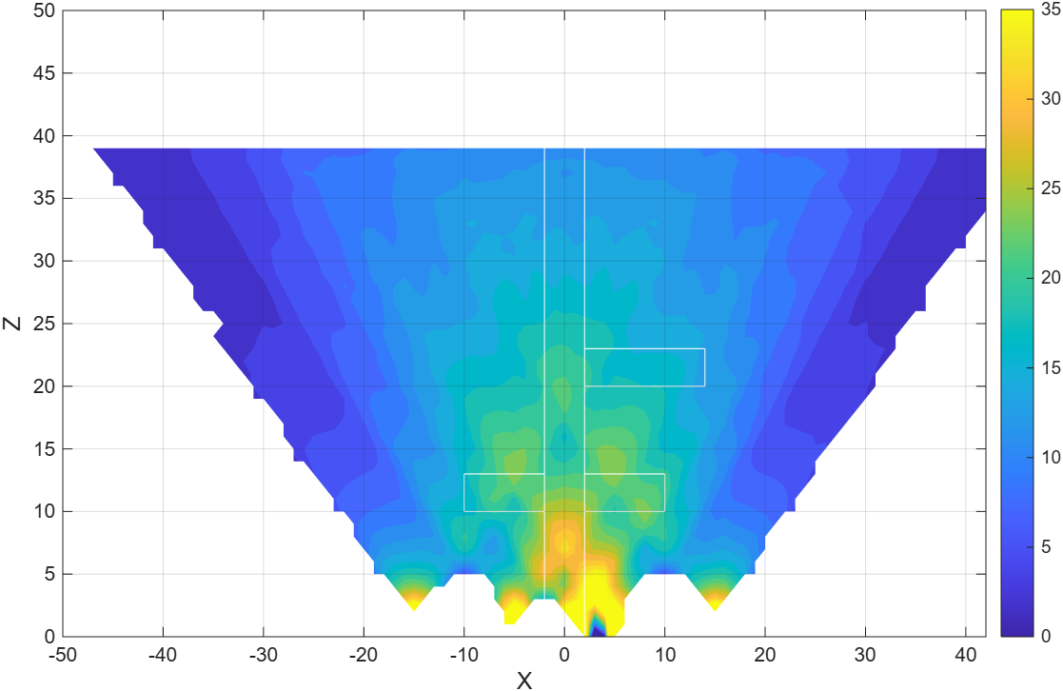
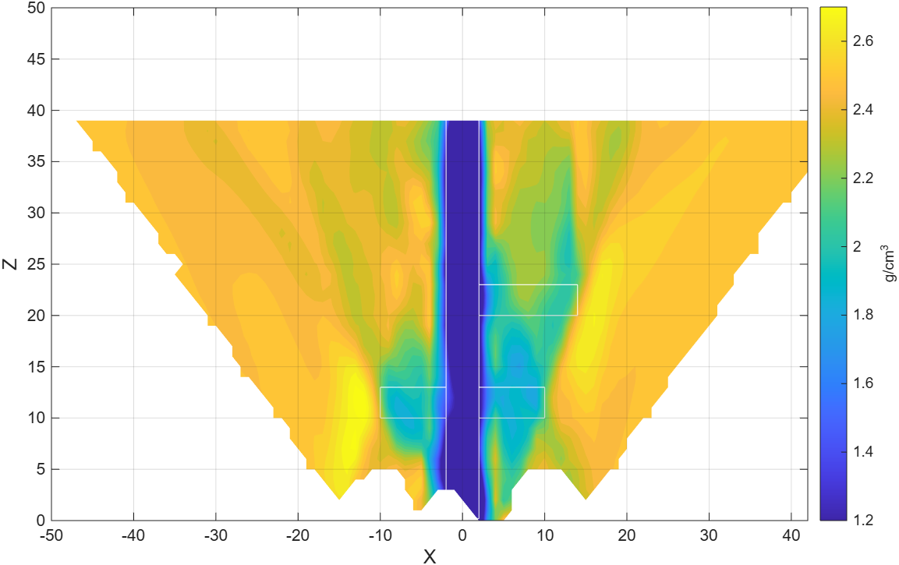
Muon tomography: Horizontal and vertical object distortion
unvisible
Visible
2D simulation in Janossy geometry
Not localizable
Trajectory lengths [m]
Inversion results

Slide 13
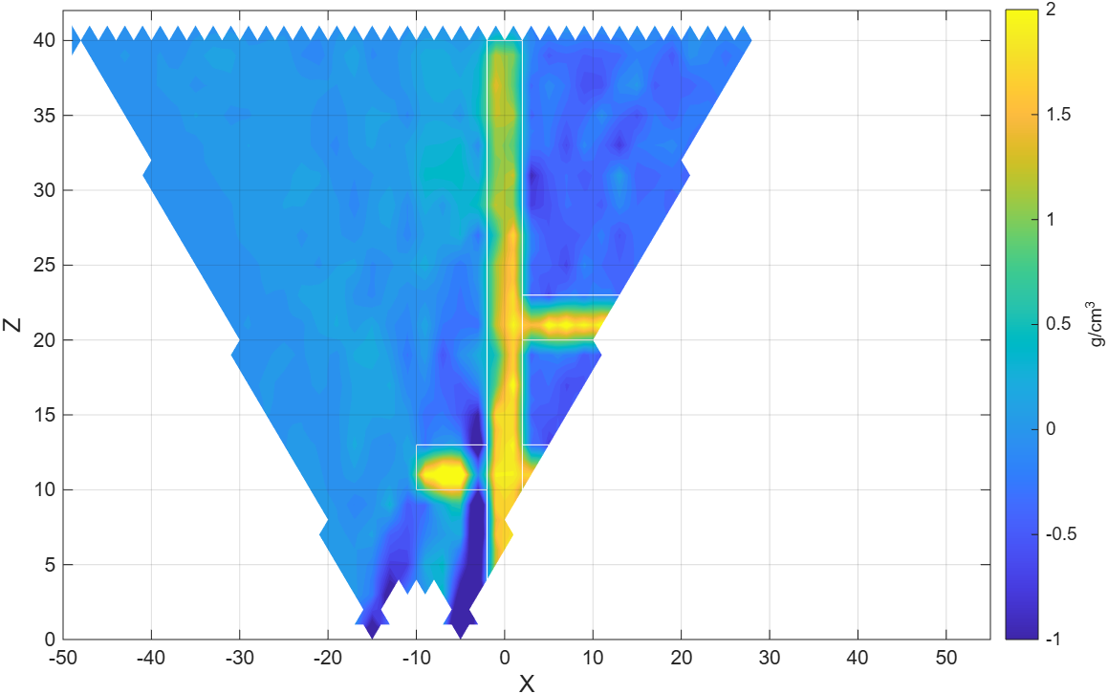
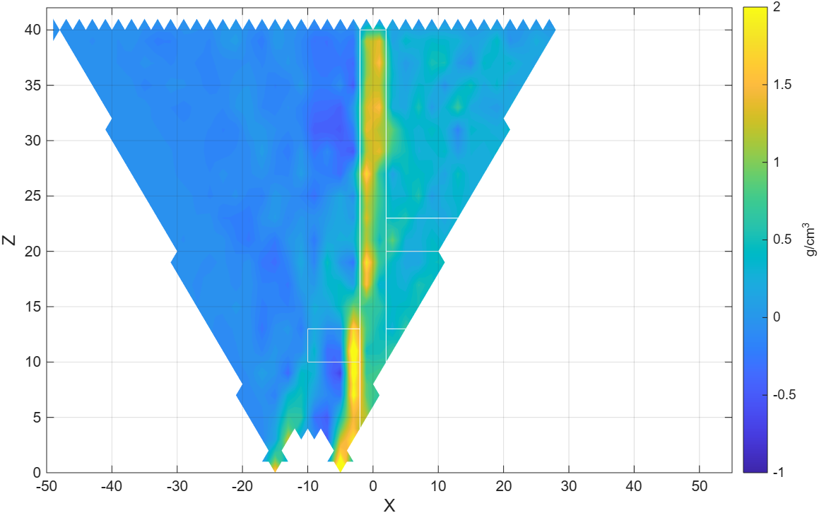
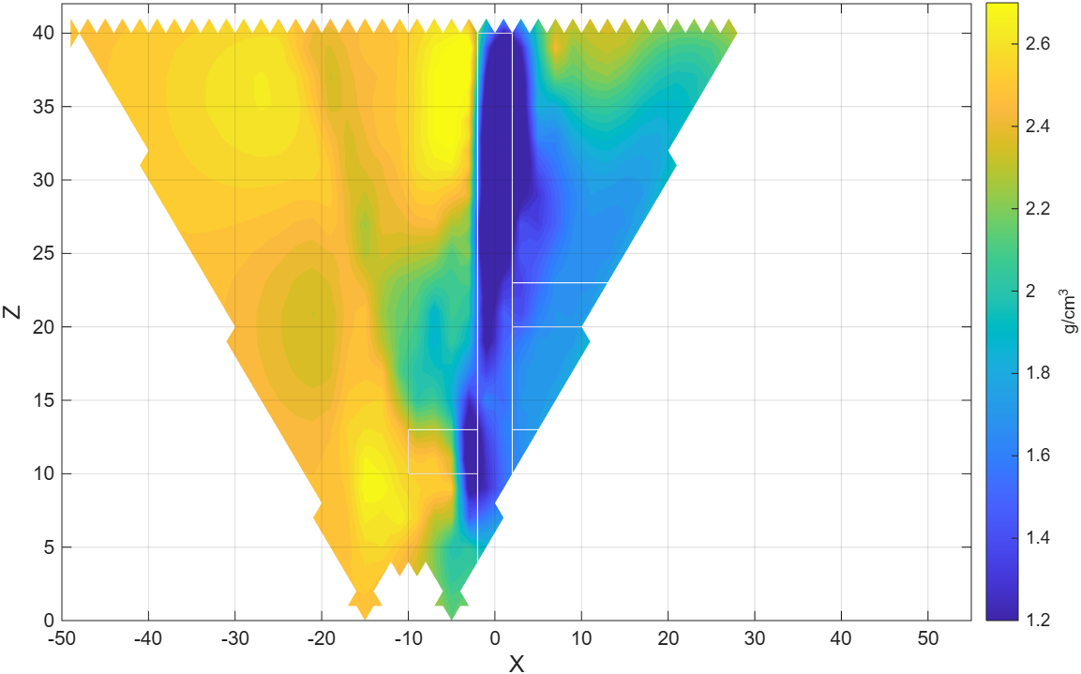
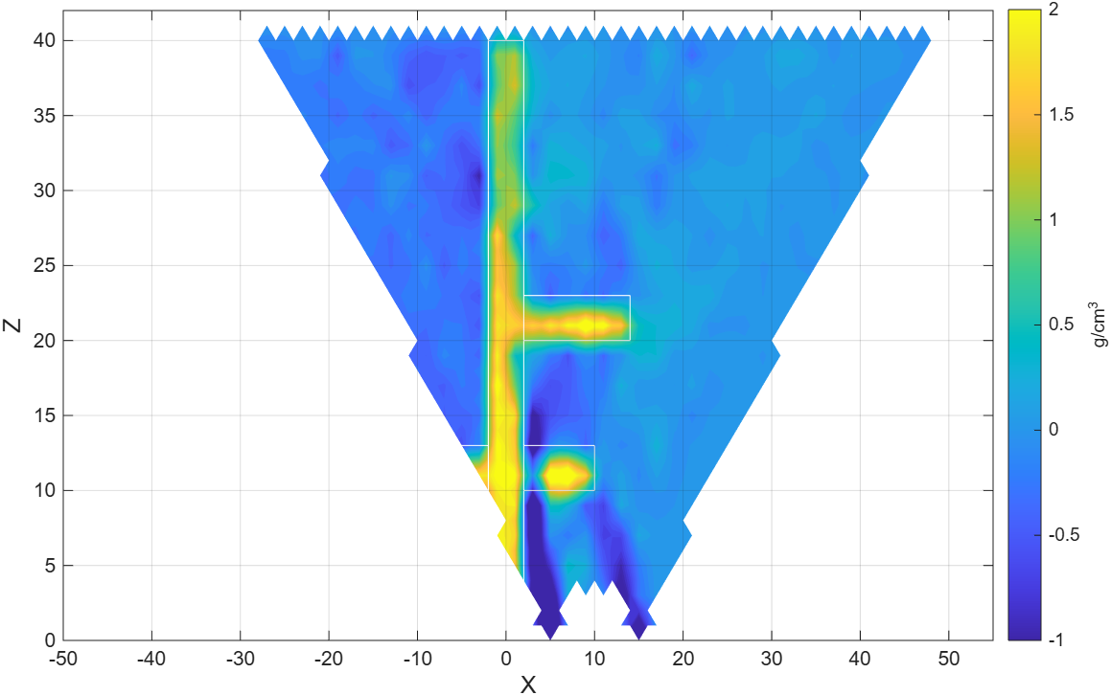
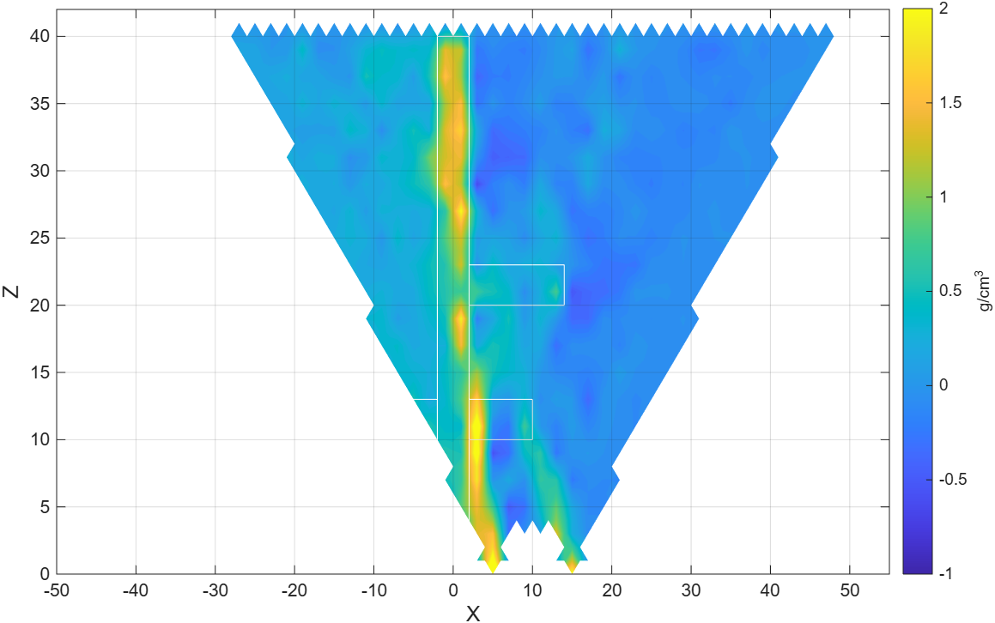
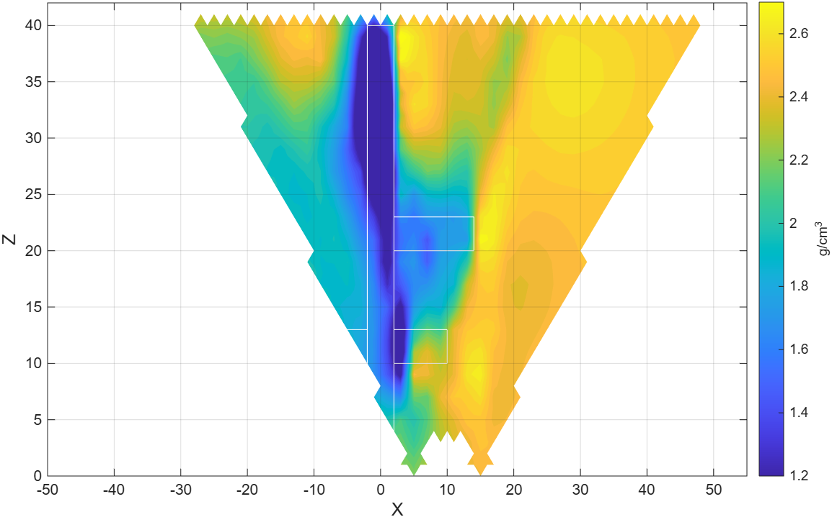
Muon tomography: One-sided measurements
unvisible
visible
Shadow zone
unvisible
visible
One-sided mapping – apparently tilted object + shadow zone

Slide 14




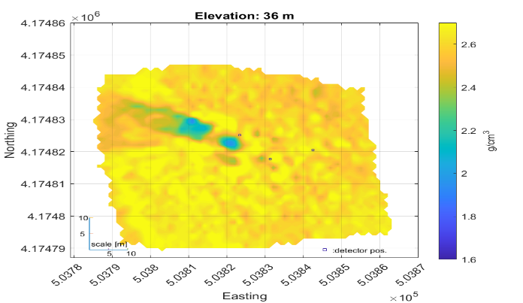
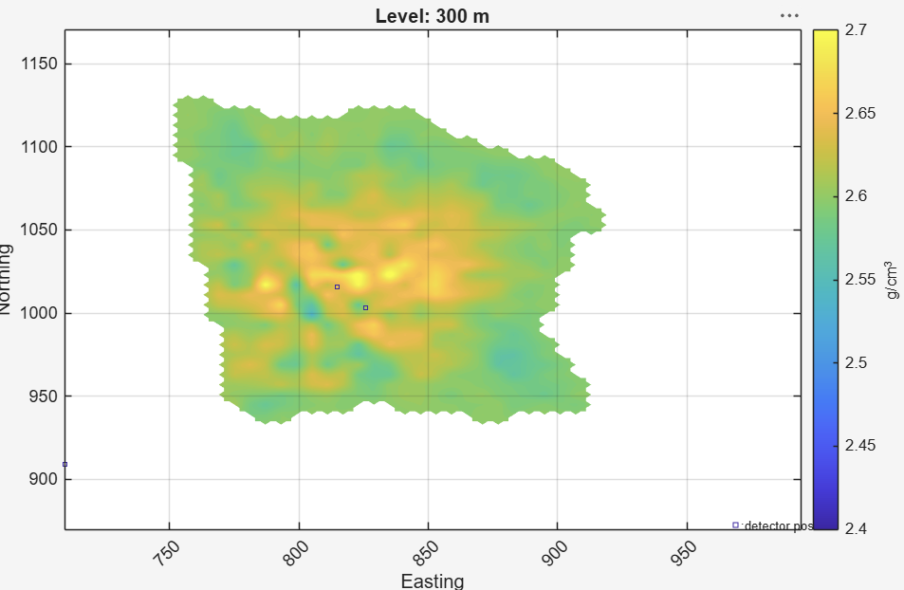
Muon tomography
Thank you for your attention!
An album of characteristic bias and artefacts

Slide 18
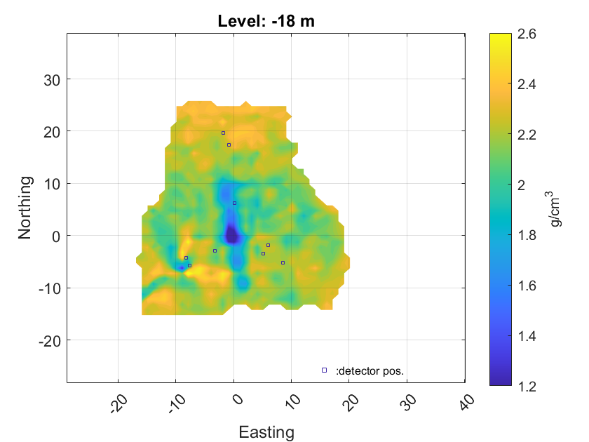
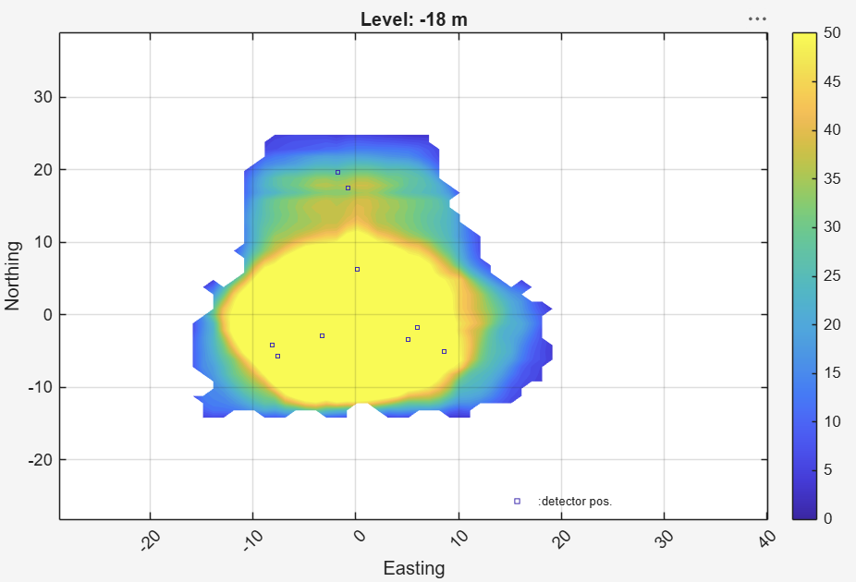
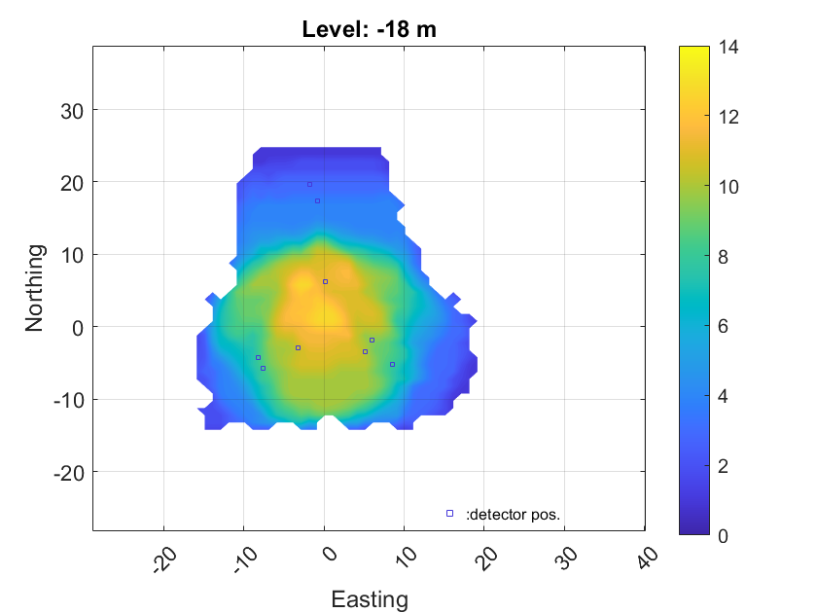
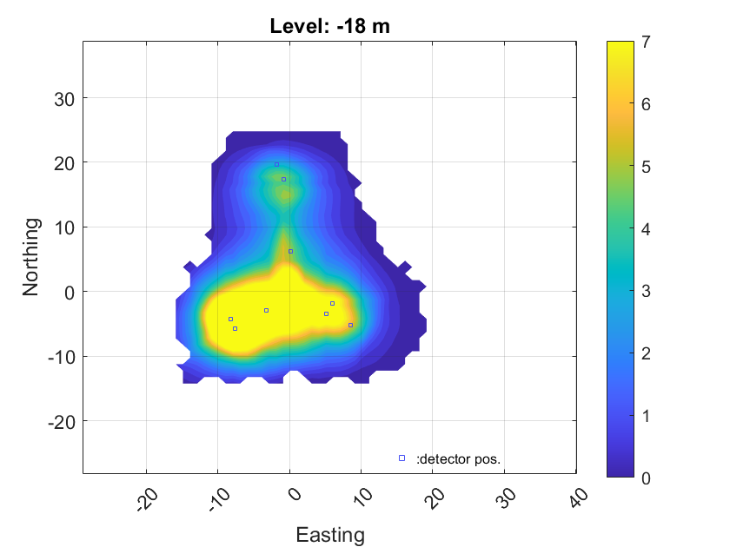
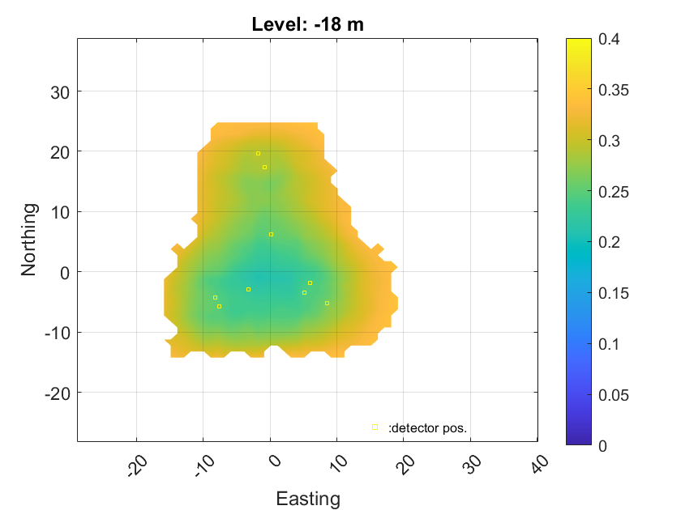
Muon tomography: Focus range - Information distribution
Result
Sum of trajectory lengths [m]
No of overlaping detector cone
Relative Fisher-information
Standard dev. [g/ccm}
Density range. [g/ccm}

Slide 19

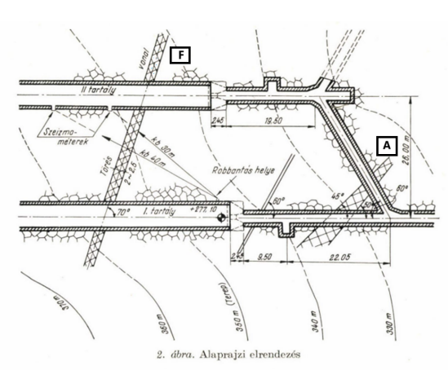
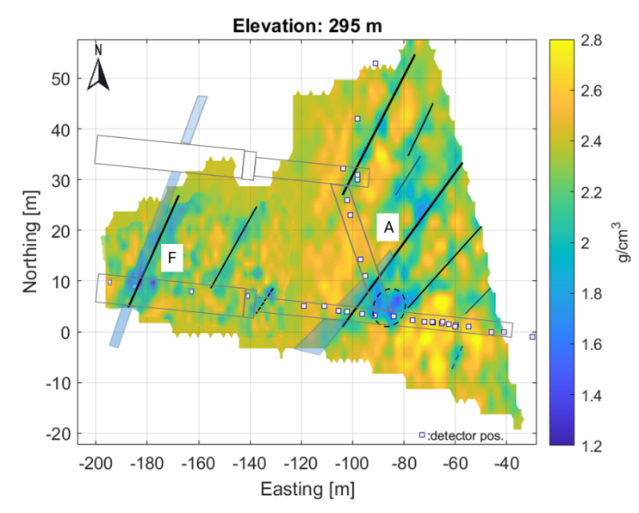
Muon tomography: Extra
Táró alaprajza
Justification of fault indication

