Slide 1
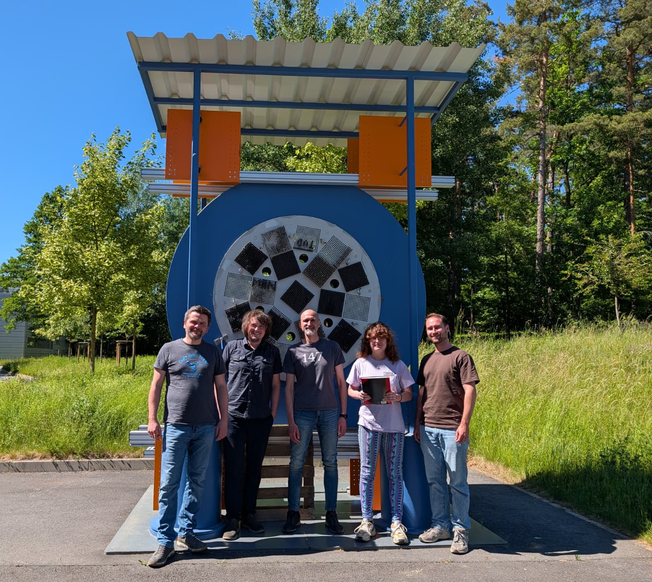
Methodical and experimental muon imaging for monitoring of industrial facilities
Suzanne Eisenhofer, Johann Wolf, André Bieberle, Michael Wagner, Uwe Hampel
TU Dresden / HZDR
Muographers 2026 - Budapest // 04.06.2026

Slide 2
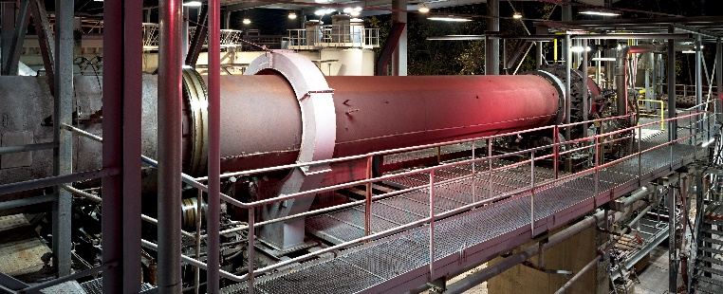

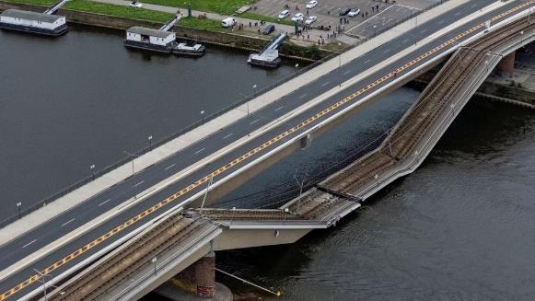
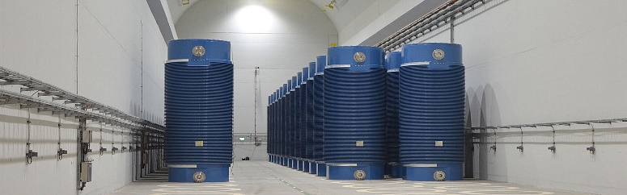
Overview
Motivation
Objectives
Detector system arrangement
Large-scale measurements
Outlook and conclusion
Evonik
[https://www.ibu-tec.de]
02.06. | 11:35 => Johann Wolf , An algorithm to localize position indicators using atmospheric muons
[www.tagesschau.de]
EWN
01.06. | 5:30 => Andre Bieberle, First results of modular drift chamber design based hodoscopes
Notes:
It’s clear from all these presentations these past few days there are many applications for muography
I’m part of a series of presentations that focused on using muons industrial applictions.
Andre Bieberle presented on Monday the development of the muon detection system and first images of reinforced concrete and Johann presented Tuesday on using muons to localize position indicators. This could be beneficial for locating denser objects in media made of much lighter material, such as position markers in distillation columns.
I will talk about using muons for imaging of storage casks
We already know muons can be used for a variety of applications
I’m part of a presentation series that focuses on industrial applications
You have listened to Andre Bieberle on Monday present the muon detector system and measurement results for reinforced concrete, which is of course relevant for all sorts of infrastructures
On Tuesday my colleague Johann Wolf also shared his work on localising position indicators with muons, which is relevant in applications where one wants to locate small objects in much lighter surroundings, such as with distillation columns
Today I am focusing on non-invasive monitoring for transport and storage casks for spent nuclear fuel – its handling is a big topic right now for Germany

Slide 3
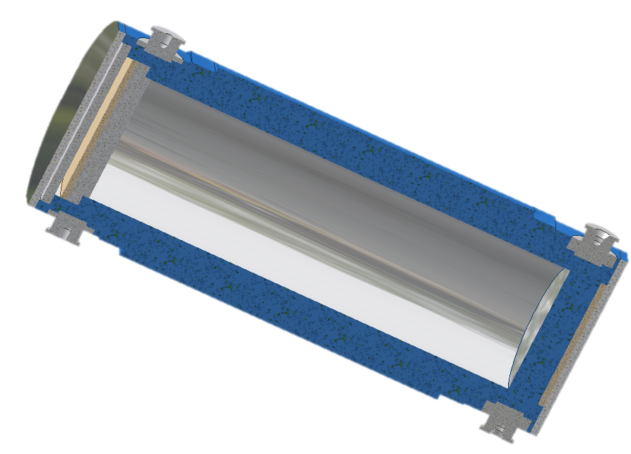

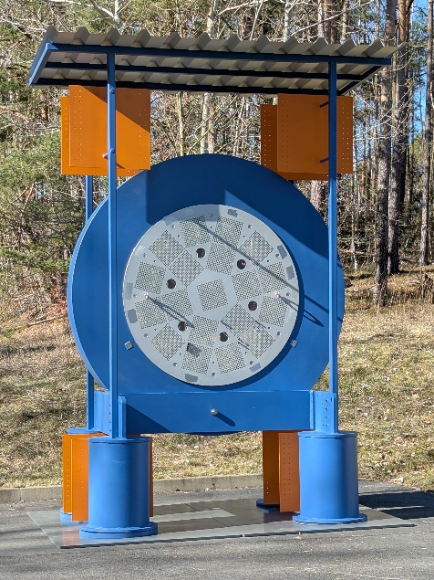
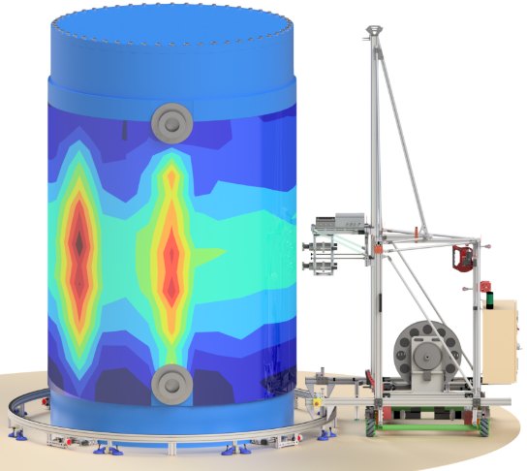

Motivation
?
Germany will not have access to a final repository for at least several decades
Unclear status of inventory after long interim storage
Necessary to monitor the integrity of the inventory
Promising radiation-based methods for non-invasive monitoring of casks:
Muon imaging
Gamma / neutron radiography
Notes:
Germany will not have access to a final repository for spent fuel for at many decades. Until then, spent fuel is stored in transport and storage casks.
After a long period of storage, the condition of the inventory is not fully clear, especially after eventual transportation to the repository
It is important to know to the best of our ability the condition of the inventory before opening the cask, because if there is an unexpected failure in the cladding, the process of handling and final repository reloading becomes more complex
This leads to the need for a safe, non-invasive way to monitor the inventory of the interim storage casks.

Slide 4

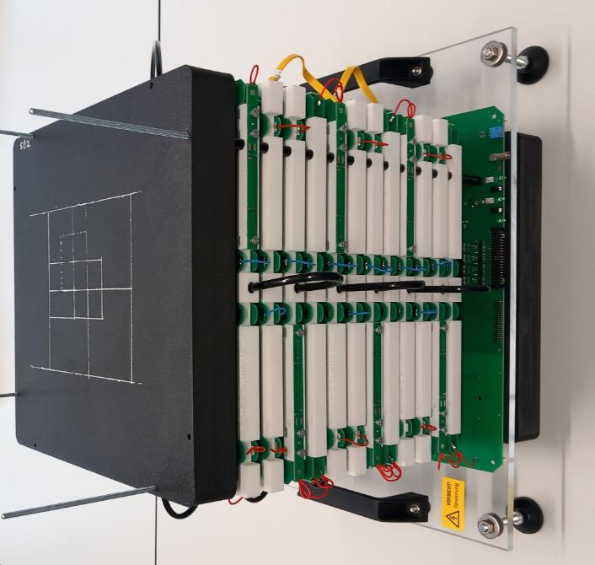
Muon imaging: objectives
Algebraic image reconstruction for muon scattering computed tomography without tracing| https://doi.org/10.1063/5.0273571 | Michael Wagner|m.wagner@hzdr.de
Muographic Imaging of a Storage Cask
Image Reconstruction
(Algorithms)
Test- and Field- Measurements
Numerical Studies
Detection Systems
01.06. => An modular and stackable drift chamber detector design for muon imaging applications | André Bieberle | a.bieberle@hzdr.de
Notes:
This leads me to firstly talk about the objectives when it comes to approaching muon imaging – what do we need?
We need robust and adequate image reconstruction algorithms. We have developed a novel algebraic approach that was presented last muographer’s workshop by my colleague Michael Wagner, and here is the publication if you are interested.
We also need a modular efficient detector system, as presented by Andre Bieberle on Monday.
But what I am going to present are the two other elements we need, which are numerical studies and test and field measurements – applying the detector reconstruction algorithms to simulations and real measurements obtained using the detector system to validate each other.

Slide 5
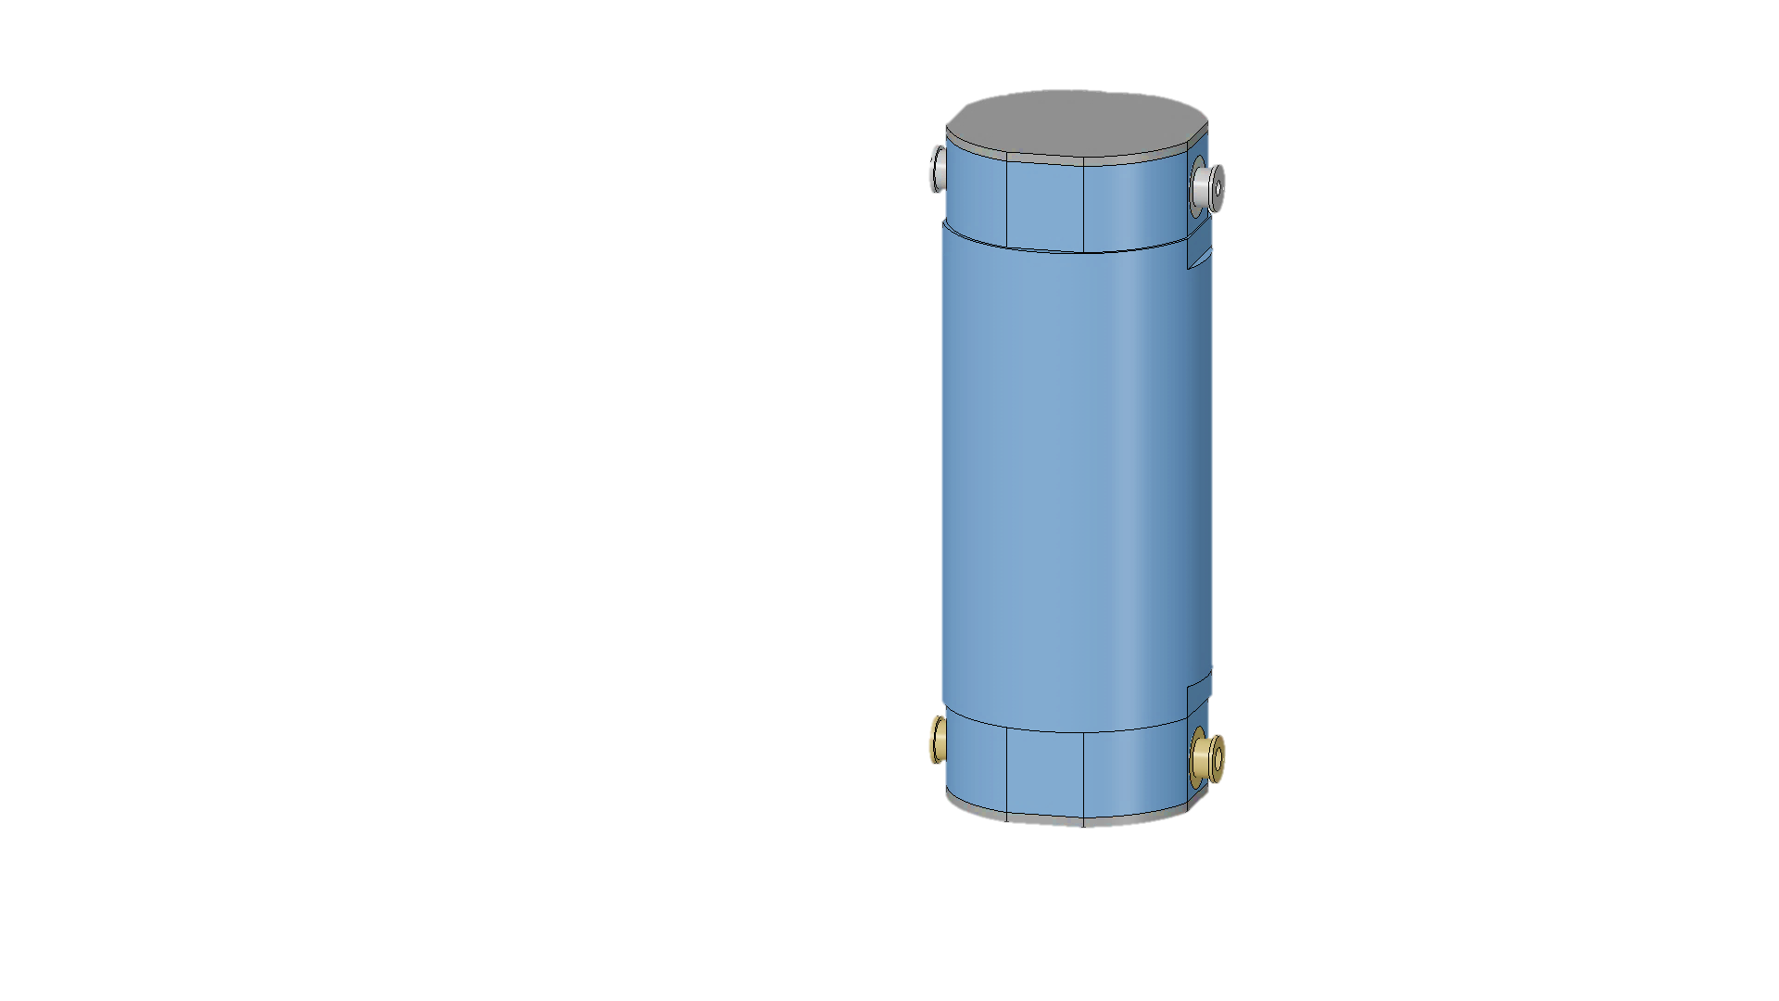
Large-scale measurements: detector system arrangement
Several configurations can be considered
µ⁻,µ⁺
µ⁻,µ⁺
µ⁻,µ⁺
Performed by MUTOMCA
Possible interim storage scenario
Large-scale phantom experiment
Notes:
Cylindrical detector around cask → performed by MUTOMCA
Detectors at top and bottom of vertical cask, which we are considering within an interim storage facility Zwischenlager Nord in Germany
Detectors above and below a horizontal cask (transport position) → test with large-scale phantom

Slide 6
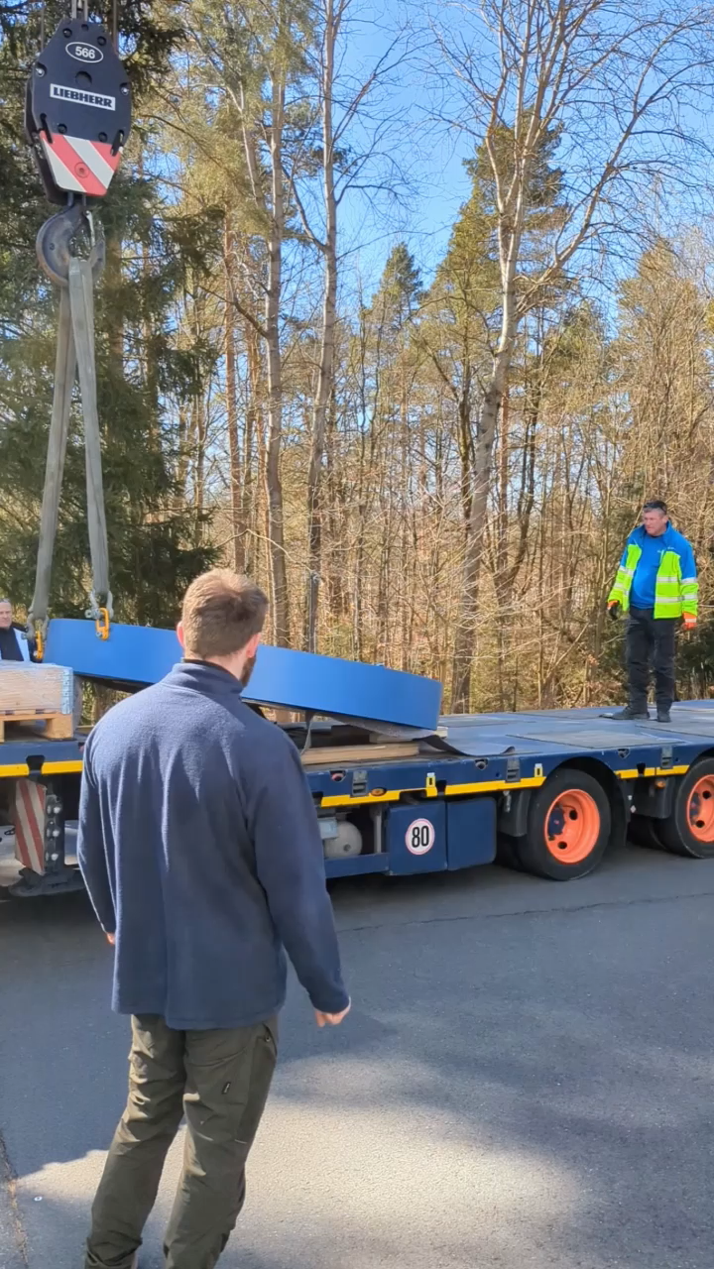
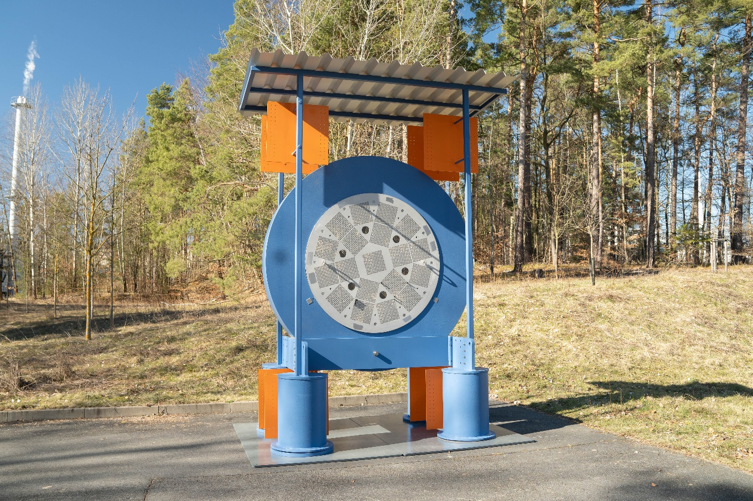
Large-scale measurements: phantom cask slice
Want to test your detectors and/or reconstruction algorithms?
Measure phantom alongside simulations for benchmark data to be made public
CASTOR V/19 mockup
Length = 30 cm
Inner diameter = 1.5 m
Outer diameter = 2.5 m
Mass = 8850 kg
Notes:
We want to test our detector system on a large-scale and we also invite you to our facility at HZDR if you want to test your detectors and reconstruction algorithms
we have constructed one of the biggest phantoms ever produced for muon scattering tomography
So, a bit more about this phantom
The goal of the experiment is to conduct long-term tests on a mockup that replicates a cask in transport position, which measuring in this position is unrealistic, but are curious to see if we to what scattering information for horizontal monitoring.
The mockup consists of a 30-cm thick “slice” of horizontal CASTOR V/19 cask. A steel ring with an outer diameter of 2.5 meters and inner diameter of 1.5 meters serves as the cask shell. A combination of steel and possibly lead rods are used as inventory and held in between 2 perforated steel plates.
The steal plates can also be rotated so cask rotation can be simulated for a full tomographic image
Differently loaded inventory geometries can be considered and imitated and even different cask types by selecting differently perforated steel plates.
Hence, many different loading scenarios can be studied, which provides the opportunity to obtain experimental benchmark data for muon imaging for transport storage cask geometries.
The goal of the experiment is to conduct long-term tests on a mockup that to test and validate our measurement system and reconstruction algorithm approach to produce benchmark data for a CASTOR cask to be made to the public.
Comparison between measurement and simulation data will help demonstrate that our approach to muon scattering imaging can handle large, complex geometries.

Slide 7

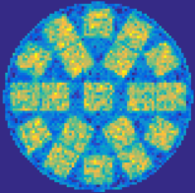
5. Large-scale measurements: simulation of rotating inlay
96 h measurement time
Iron rods
720 h measurement time
Lead rods
720 h measurement time
Uranium rods
Notes:
-To the suitability for this large-scale phantom setup, initially used G4Beamline to simulate the rotating inlay for the CASTOR Cask filled with steel, lead and uranium rods
Can see that even with iron rods, which is very similar in Z to the steel used for shielding, the assemblies can be seen. This shows that even for this worst-case scattering scenario, it is possible to generate a resolved image
Naturally, with lead and uranium rods the resolution only becomes higher
- Now of course, these simulation results under ideal circumstances, but curious to see how the reconstructions from measurement data compare.

Slide 8
Motivation
?
Germany will not have access to a final repository for at least several decades
Unclear status of inventory after long interim storage
Necessary to monitor the integrity of the inventory
Promising radiation-based methods for non-invasive monitoring of casks:
Muon imaging
Gamma / neutron radiography
Notes:
So back to the motivation
Currently this muon imaging is only experimental, we are not sure entirely what the results will be, but are very optimistic

Slide 9
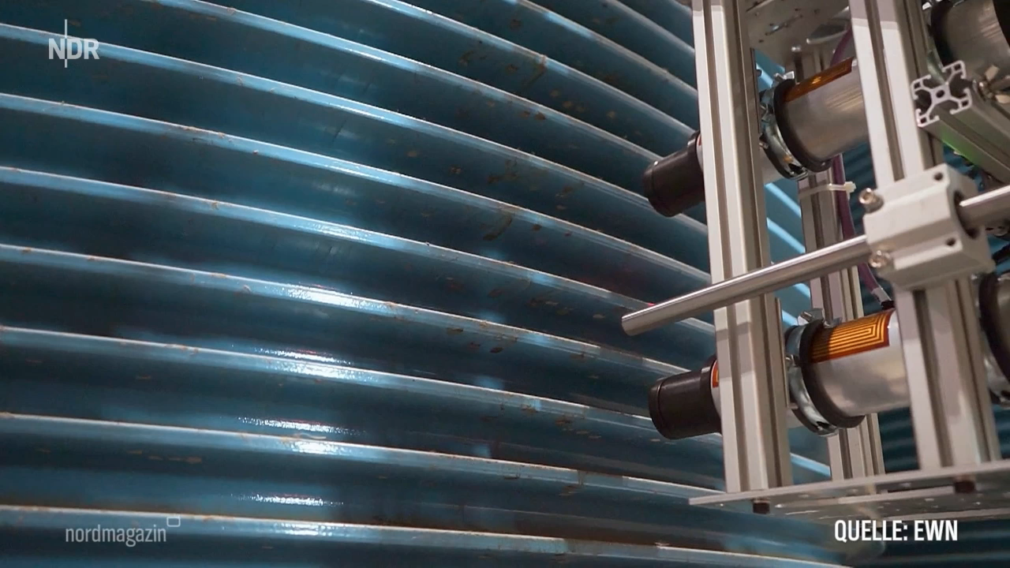
Motivation
?
Germany will not have access to a final repository for at least several decades
Unclear status of inventory after long interim storage
Necessary to monitor the integrity of the inventory
Promising radiation-based methods for non-invasive monitoring of casks:
https://www.ardmediathek.de/video/nordmagazin/messroboter-untersuchen-castorbehaelter-in-lubmin/ndr/...
Muon imaging
Gamma / neutron radiography
Notes:
However, we have already obtained successful images using gamma and neutron measurements with an interim storage facility, as you can see in this video
We deployed our automated measurement system consisting of a traversing unit, a rail system for protection and two CLYC detectors.
The system can move around the cask at different circumferential angles and heights and take measurements at precise locations
We are in collaboration with an interim storage facility in Germany, Zwischenlager Nord, so we are confident we can apply another detector system to their casks

Slide 10
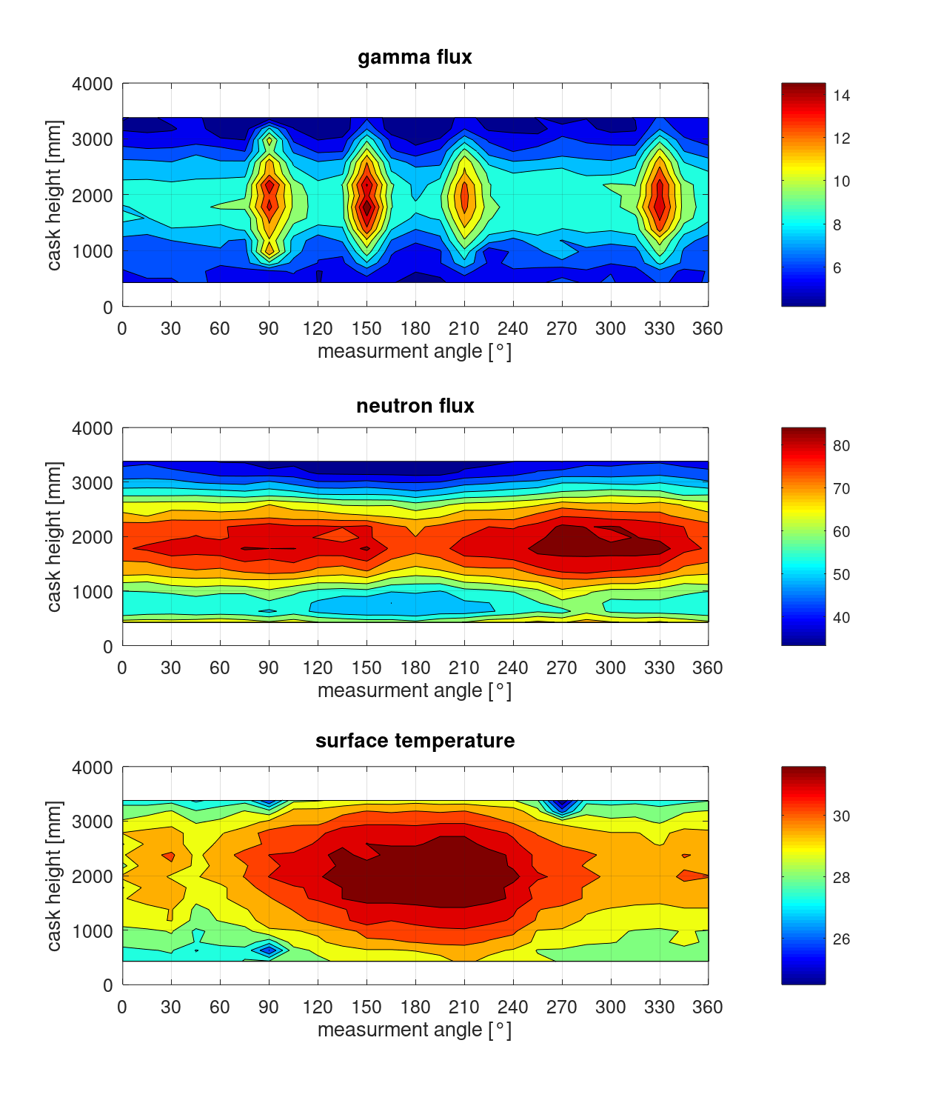
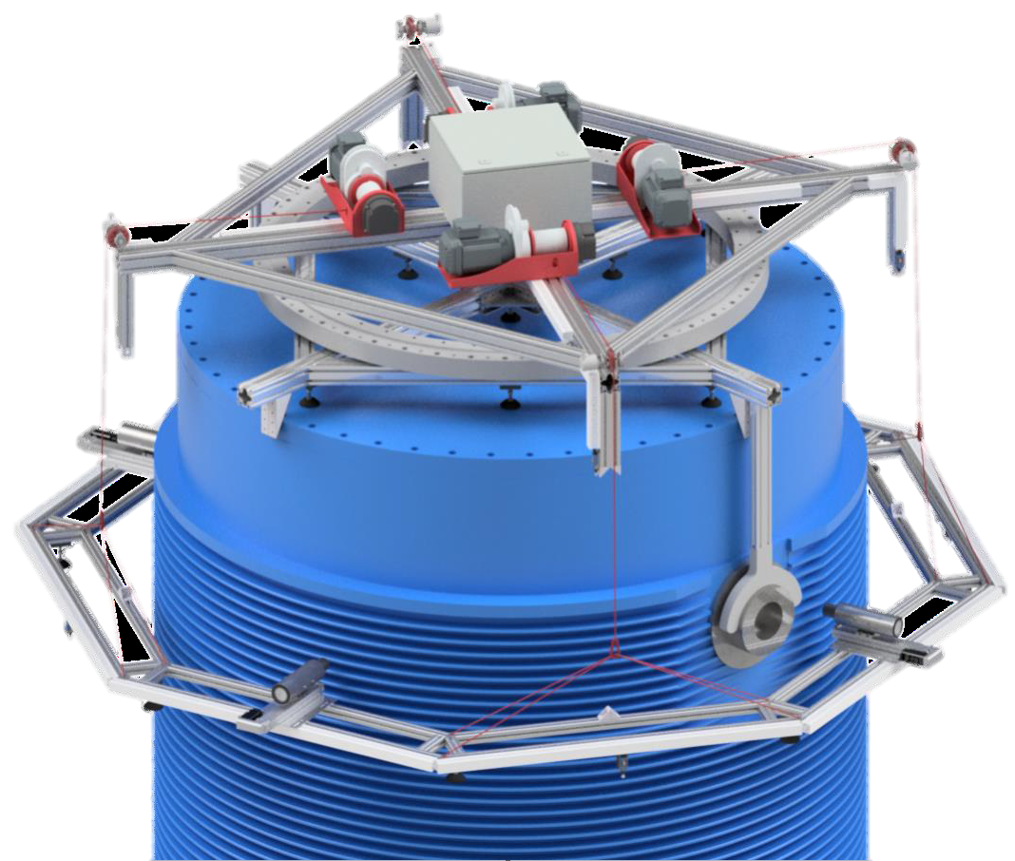
Gamma and neutron measurements
Heat map from 400 measurement points
25 circumferential angles
16 heights
3 min / measurement point
Gamma flux
circumferential angle [°]
Neutron flux
New detector design:
Improved concept for a floor-decoupled measurement system
New data acquisition system for the evaluation of the energy spectrum
circumferential angle [°]
Notes:
To the right are flux distributions outside of the cask for both gamma and neutron radiation heat map from the measurement campaign for 400 measurement points.
25 circumferential angels for 16 heights – each measurement point took around 3 minutes
One can see that the system is sensitive enough to detect the asymmetric loading of this particular cask with gamma flux measurements.
You can see a heightened flux distribution at the four outer positions of the fuel elements that had a higher burnup at the time of loading compared to the other elements
Both the simulation study and measurements indicate that to identify inhomogeneities or fuel relocation with neutrons, flux difference images are necessary, as the differences are still very minimal due to lack of directional information
New detector design
Signal-to-noise ratio decreases as the radiation intensity decreases over time, lower quality images in the future + provide less certainty
This is not a factor with muoagraphy, hence focusing now on muon imaging for non-invasive monitoring

Slide 11

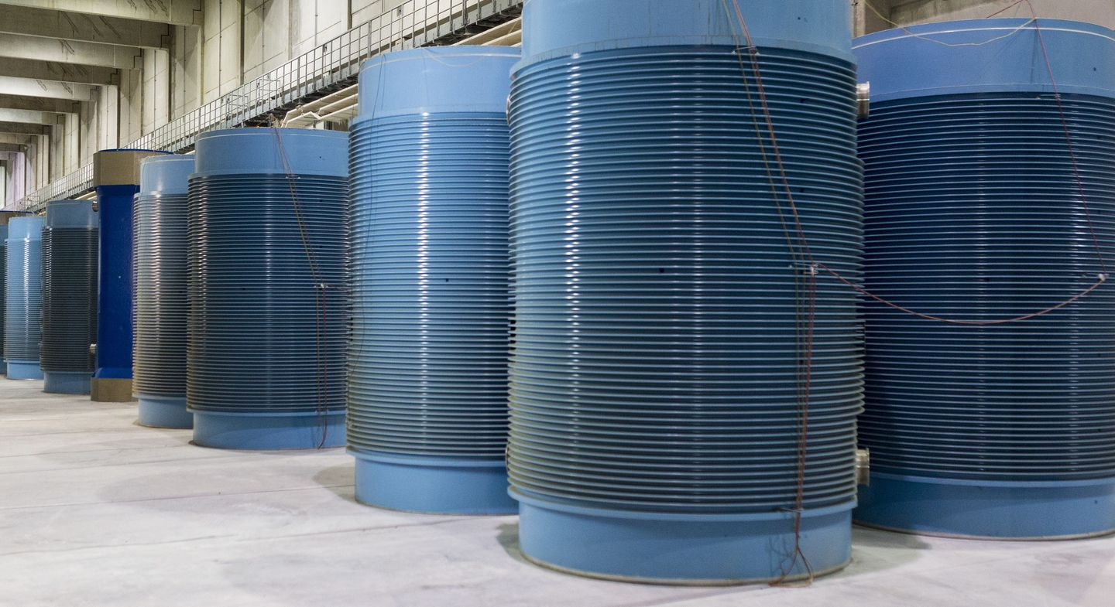
Conclusion and outlook
  Develop modular muon detector for industrial applications
  Preparation for large-scale experiments
  Gamma and neutron measurements of a cask within an interim storage facility
  Looking forward:
    Measurements on phantom
    Test measurements with detector of background radiation in Zwischenlager Nord
    Measurement and image reconstruction of cask with muons
    Improve gamma and neutron detection system and take new measurements
This work was funded by the Helmholtz Association (Germany) with the grant number KA-TVP-37 and by the Federal Ministry for the Environment, Climate Action, Nature Conservation and Nuclear Safety (BMUKN) with the grant numbers 1501661 and 1501606A.

