Slide 1

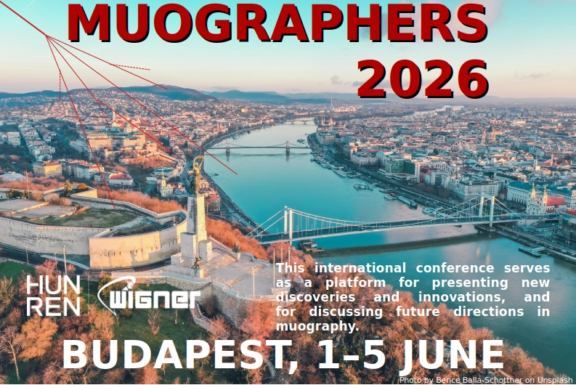
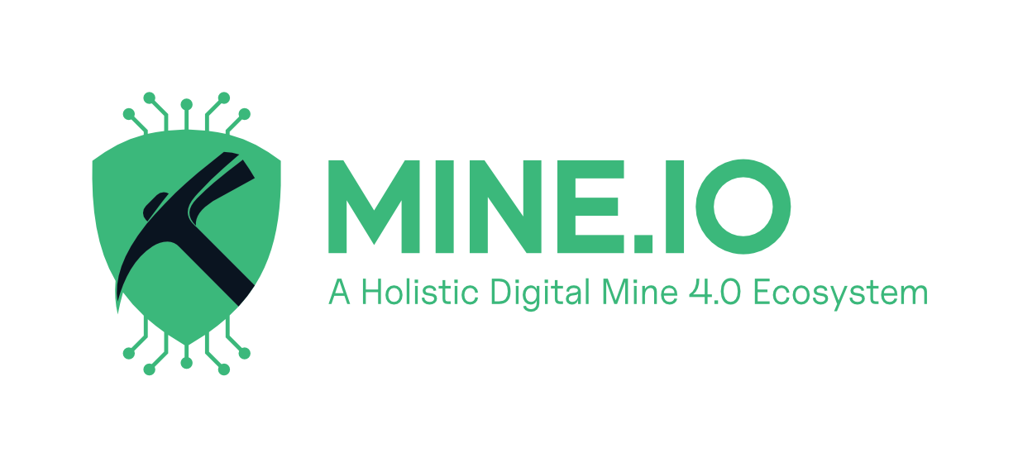


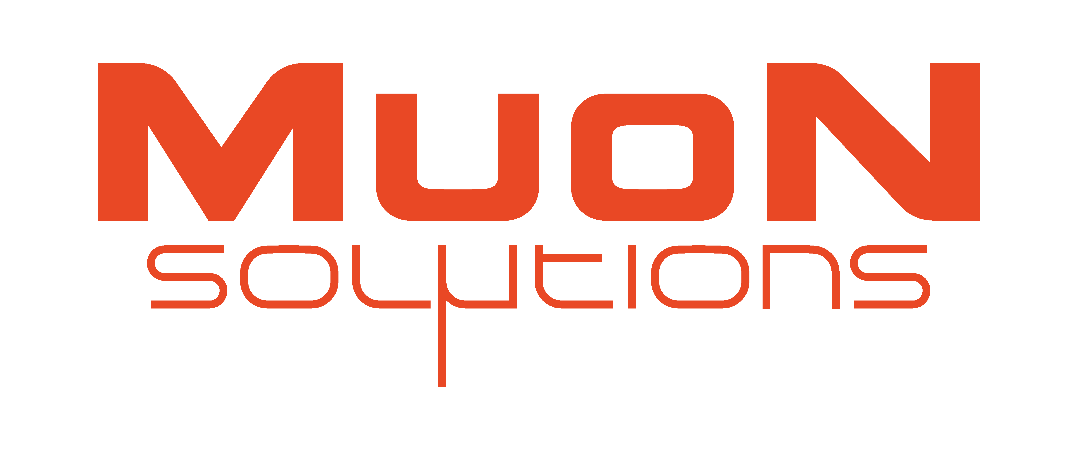
Towards the Integration of Muography into EPOS
A new observational data type for geosciences
Jari Joutsenvaara¹^{,2,3} & Marko Holma¹^{,2,3}
¹ Kerttu Saalasti Institute, University of Oulu, Finland
² Muon Solutions Oy, Finland
³ International Virtual Muography Institute (VMI)
MUOGRAPHERS 2026 · Budapest
MUOGRAPHERS 2026 | EPOS ON | University of Oulu
01

Slide 2
EPOS
EPOS?
EPOS, the European Plate Observing System, is a multidisciplinary, distributed research infrastructure that facilitates the integrated use of data, data products, and facilities from the solid Earth science community in Europe.
The bottleneck is no longer only detector performance; it is shared language, metadata, services and community governance.
MUOGRAPHERS 2026 | EPOS ON | University of Oulu
02

Slide 3
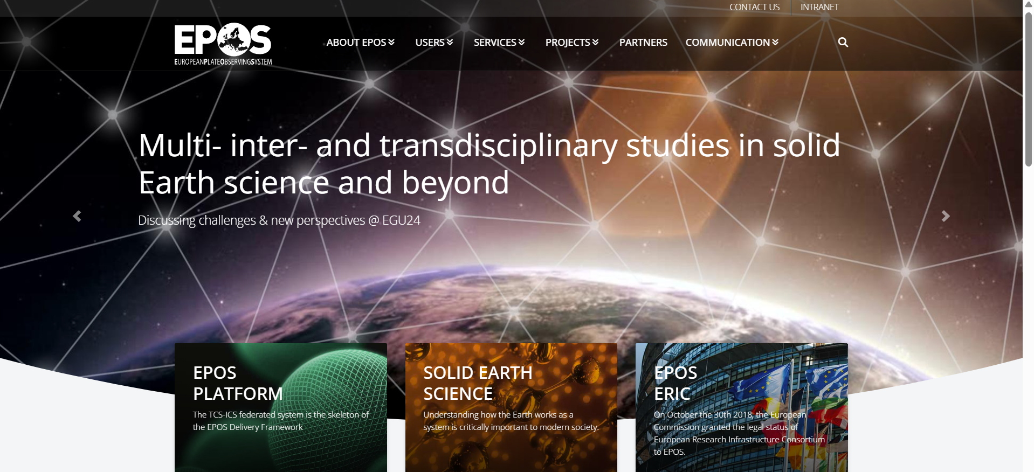
03

Slide 4
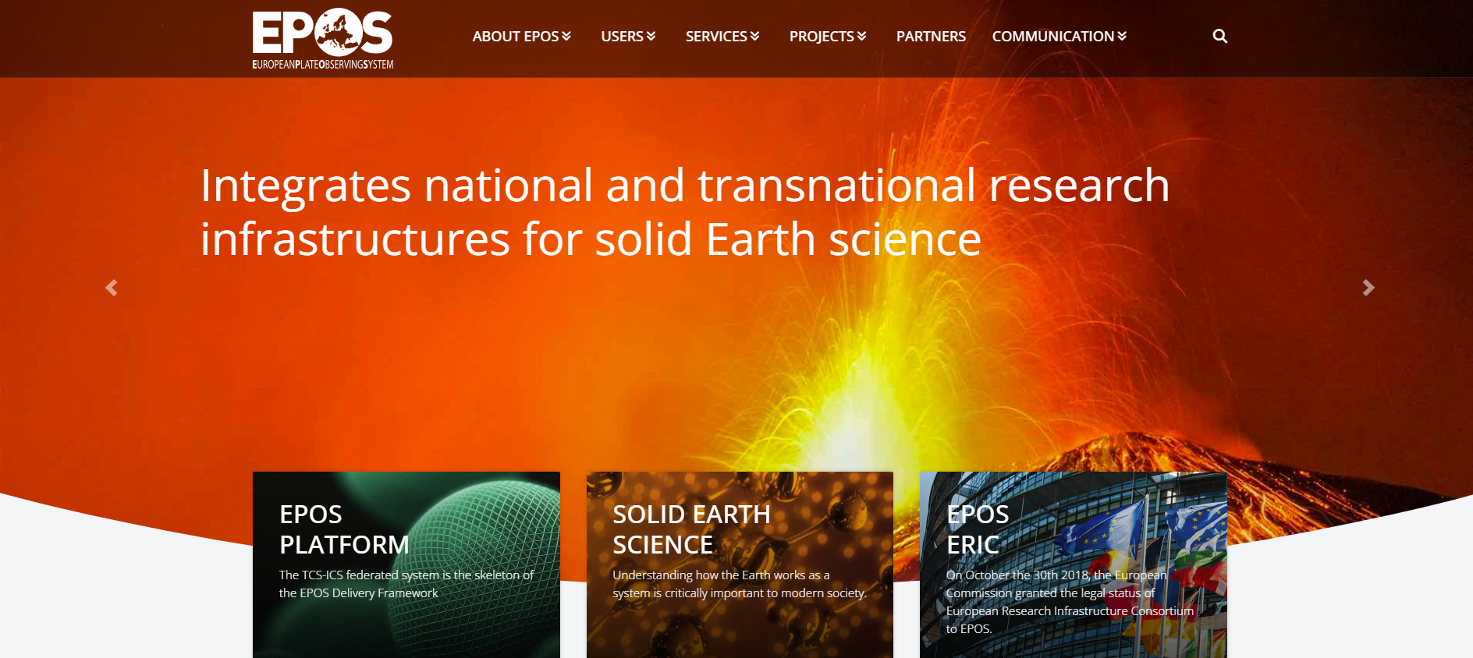
04

Slide 5
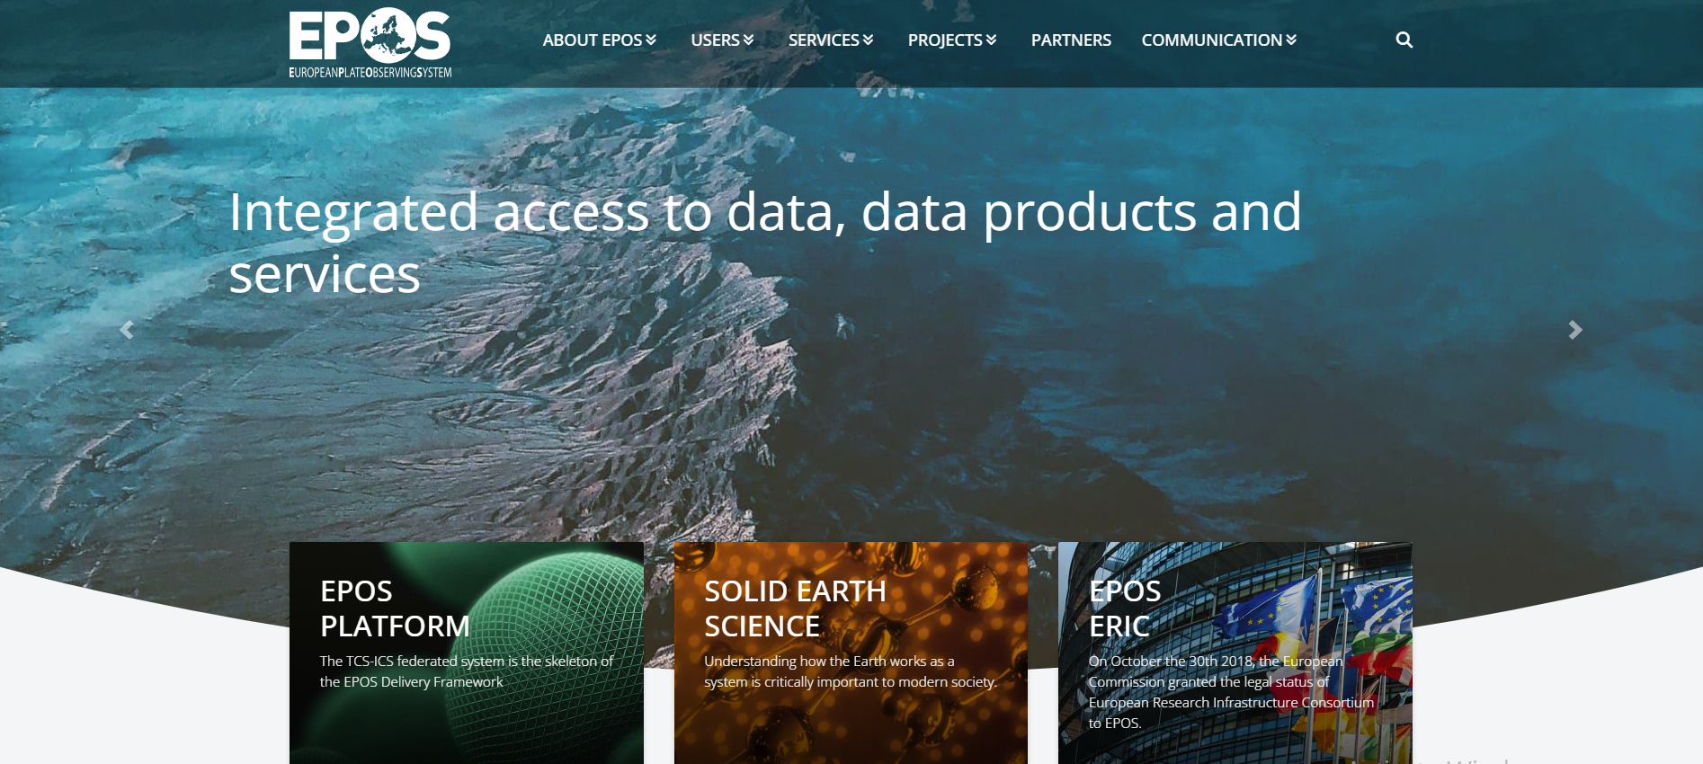
05

Slide 6
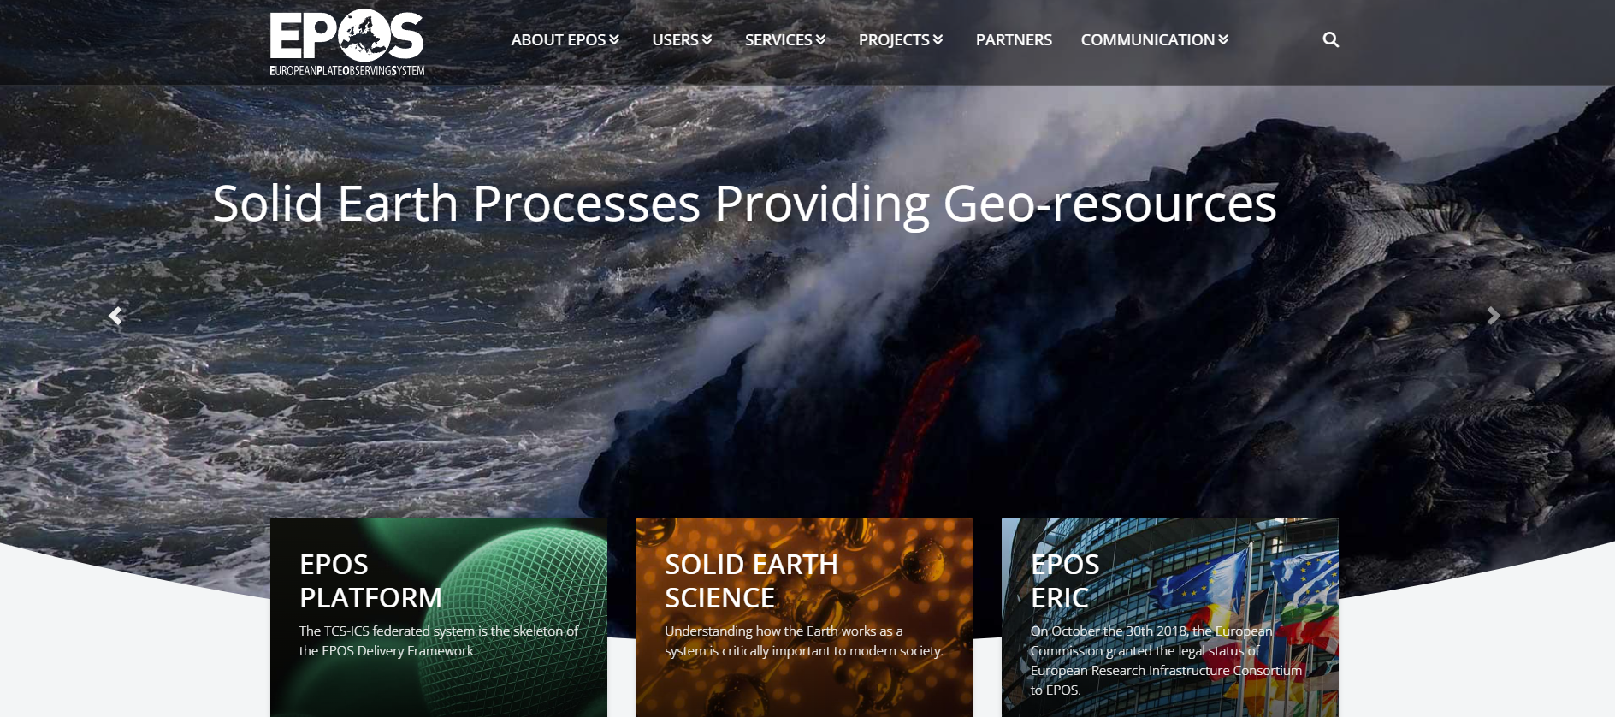
06

Slide 7
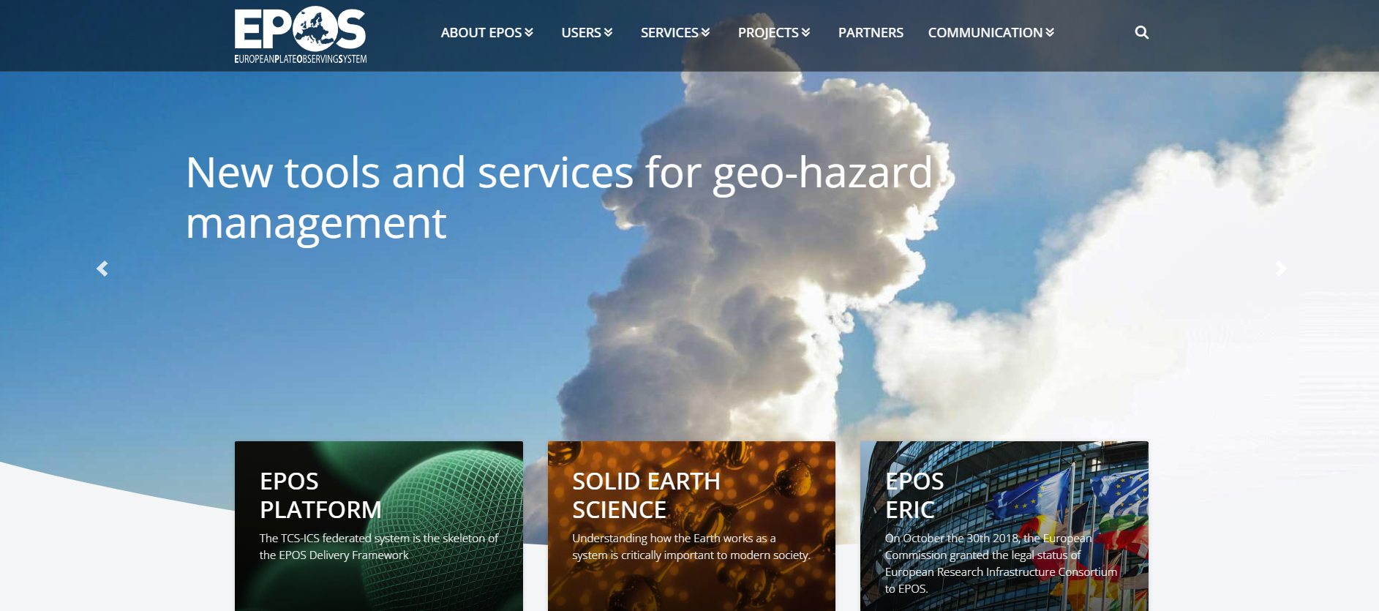
07

Slide 8
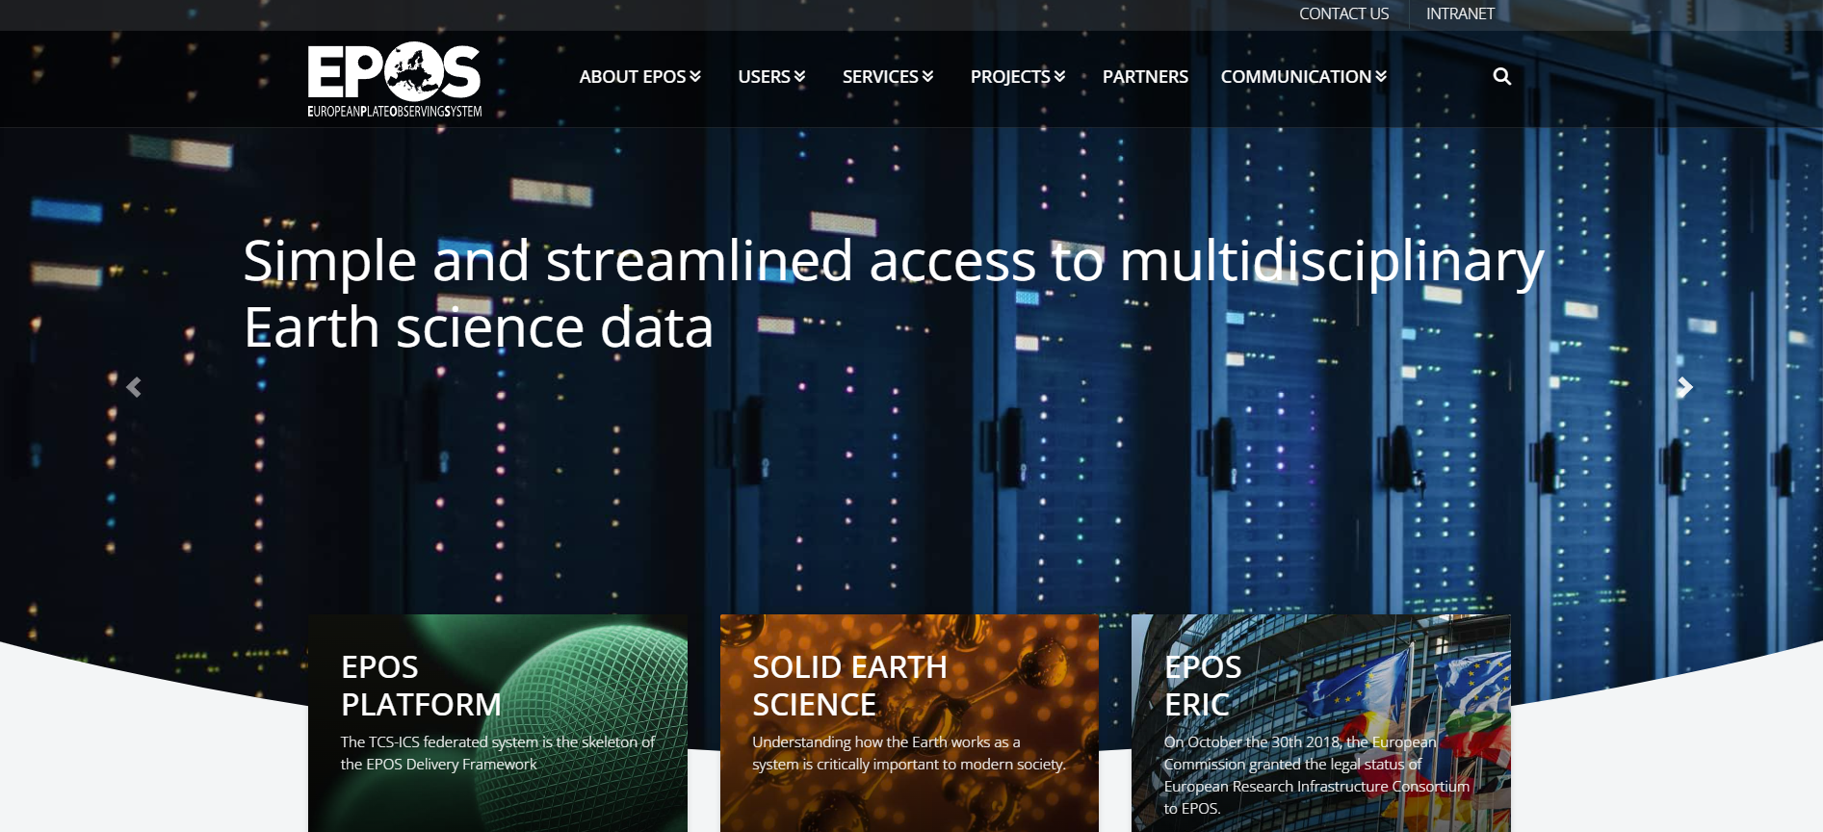
08

Slide 9
PROBLEM
EPOS is going international
EPOS is evolving beyond a purely European platform and moving toward a more international / global research infrastructure. This trend shows up in strategy, partnerships, and project design, even if formal governance (ERIC membership) is still mostly European.
EPOS aims to:
build partnerships with other research infrastructures globally
expand access to EPOS data and services internationally
MUOGRAPHERS 2026 | EPOS ON | University of Oulu
09

Slide 10
PROBLEM
Core thesis
A method becomes infrastructure only when its data can travel.
Muography has matured as a measurement technique.
The next step is making muography data interoperable.
Technique / Method
Observation
Data product
EPOS service
Geoscience reuse
The bottleneck is no longer only detector performance; it is shared language, metadata, services and community governance.
MUOGRAPHERS 2026 | EPOS ON | University of Oulu
10

Slide 11
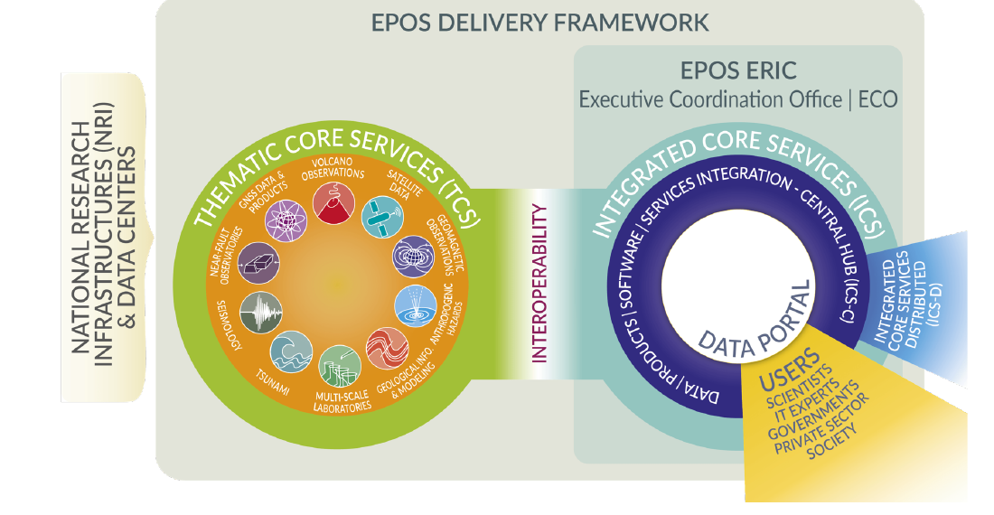
EPOS
EPOS in one slide
A federated research infrastructure for solid Earth science.
TCS
Community-specific Thematic Core Services organise data and services in established domains.
ICS-C / portal
Integrated Core Services provide discovery, access and interoperability across services.
FAIR logic
Findable, accessible, interoperable and reusable data products.
Users
Researchers, infrastructure actors, policy, industry and wider communities.
For muography, EPOS is not just a repository.
It is a route into the language and workflows of solid Earth science.
MUOGRAPHERS 2026 | EPOS ON | University of Oulu
11

Slide 12
SCOPE
Why muography belongs in geoscience infrastructures
The same observation principle now appears across multiple solid Earth domains.
1
2
3
4
5
Volcanology
Glaciology
Mining
Geotechnics
Environment
conduit / density change
ice thickness / dynamics
ore bodies / voids
stability / cavities
water / density change
Common denominator: directional muon attenuation → density / opacity information → geoscientific interpretation.
MUOGRAPHERS 2026 | EPOS ON | University of Oulu
12

Slide 13
DATA
What is a muography observation?
From directional particles to geoscientific data products.
Hits
detector events
Tracks
trajectory estimates
Flux
directional rate
Opacity
2D line integral
Density
2D/3D model
Interpretation
geological meaning
Different communities may need different levels of access
Reusable observations
flux / exposure / geometry / uncertainty
Analysis products
opacity / density maps / covariance
Interpretive products
geological model / hazard or resource interpretation
We need to decide which levels are useful, reproducible and sufficiently documented.
MUOGRAPHERS 2026 | EPOS ON | University of Oulu
13

Slide 14
CHALLENGE
The integration challenge
Muography data are heterogeneous, but EPOS needs consistency.
Heterogeneity
2D radiography and 3D tomography
Time-lapse monitoring and static surveys
Different detector technologies
Different geometries and rock volumes
Different inversion and uncertainty conventions
Minimum EPOS-facing questions
What was measured?
Where and when?
With what geometry?
How was flux normalized?
What product is being shared?
What uncertainty and limitations apply?
The technical bottleneck is solvable; the community bottleneck is deciding shared metadata, products and governance.
MUOGRAPHERS 2026 | EPOS ON | University of Oulu
14

Slide 15
EPOS ON
What EPOS ON enables
A preparatory route: community, metadata and integration logic.
1
Introduce muography
Make the field legible to established EPOS communities
Important framing
This is not yet a claim of finished operational integration. It is a structured step toward data sharing and recognition.
2
Define service logic
Clarify what data products and metadata could be exposed
3
Test a pathway
Use volcanological / solid Earth use cases as a bridge
4
Feed EPOS evolution
Turn lessons into recommendations and future integration routes
MUOGRAPHERS 2026 | EPOS ON | University of Oulu
15

Slide 16
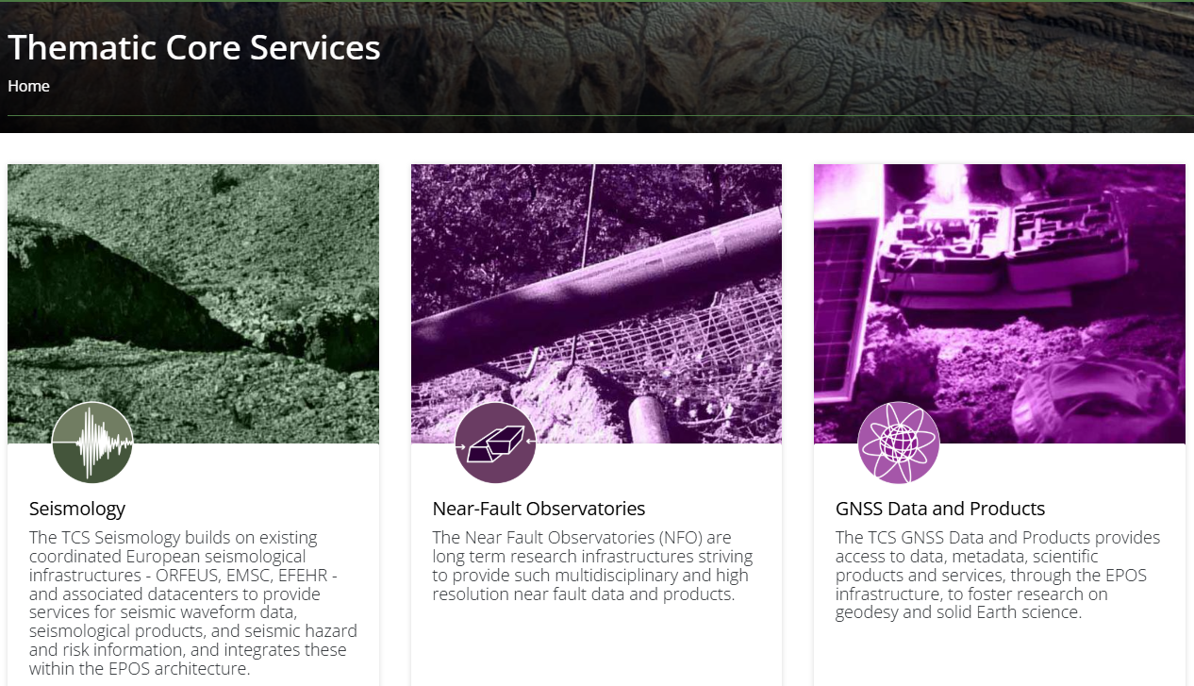

Slide 17
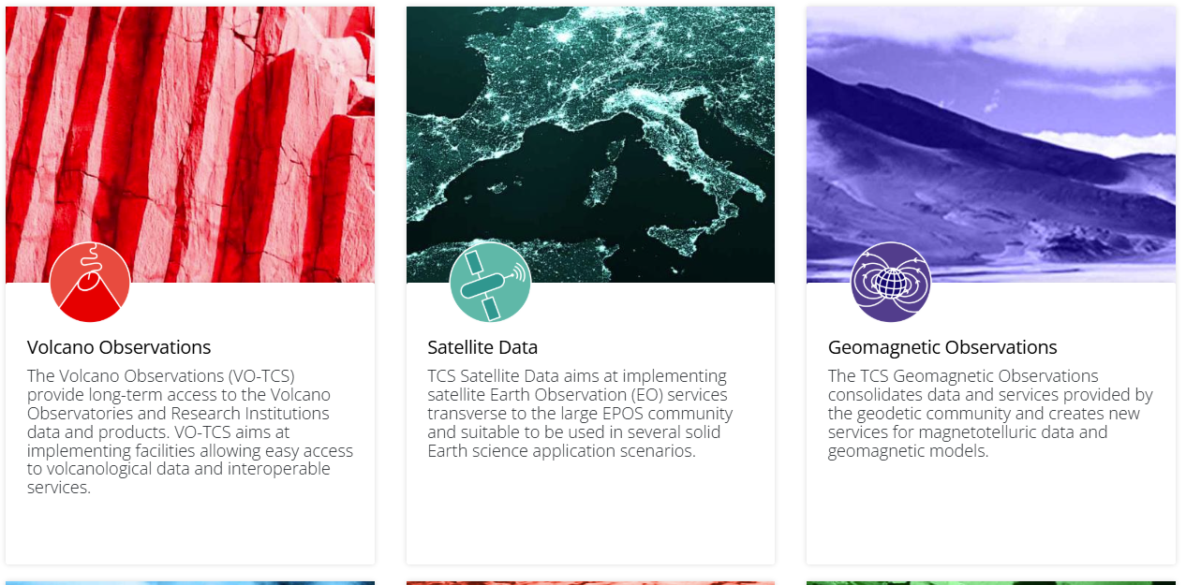

Slide 18
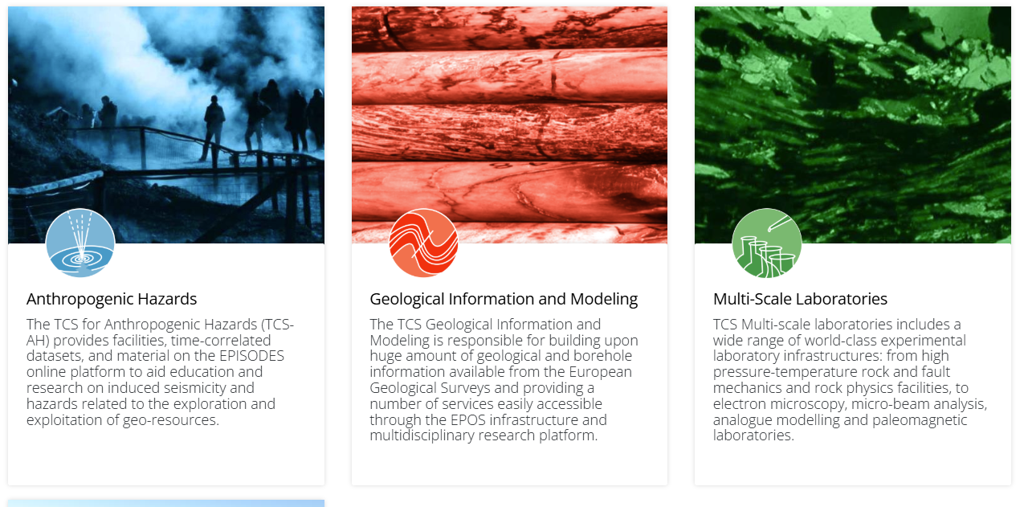

Slide 19
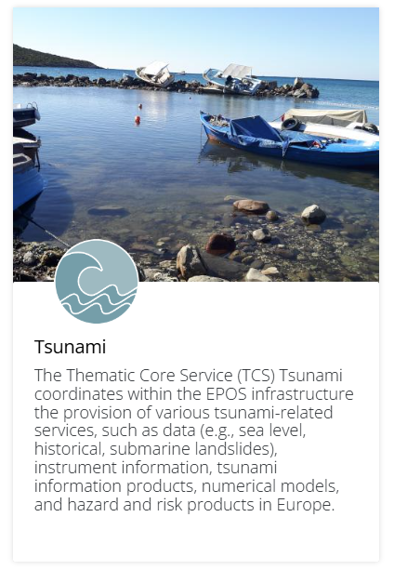

Slide 20
GOVERNANCE
Where could muography live inside EPOS?
A data type that cuts across domains needs a community decision.
Path A: join an existing TCS
e.g. volcanology or another domain where first use cases are most mature
simpler first bridge, but may underrepresent cross-domain muography
Path B: dedicated muography community
build a recognisable data type and governance interface
stronger identity, but more administrative effort
Path C: staged approach
start through use cases, then evaluate whether dedicated governance is needed
probably the most realistic near-term path
The practical question for the community is not “Can EPOS store muography?” but “How do we organise muography so EPOS can trust and expose it?”
MUOGRAPHERS 2026 | EPOS ON | University of Oulu
16

Slide 21
METADATA
A practical metadata minimum set
What a geoscientist/engineer needs before reusing a muography product.
Survey geometry
detector position, attitude, target geometry, line of sight
Detector / exposure
technology, acceptance, survey length, thresholds, calibration
Flux convention
total/directional flux, units, model assumptions
Site context
topography, DEM, rock density assumptions, coordinate system
Product level
raw hits, tracks, flux map, opacity, density model, interpretation
Uncertainty
counting statistics, model uncertainty, resolution, limitations
MUOGRAPHERS 2026 | EPOS ON | University of Oulu
17

Slide 22
METADATA
A practical metadata minimum set
Minimum interface logic for EPOS-facing reuse.
Access & licence
persistent identifiers, provenance, citation, reuse conditions
Service exposure
discoverable metadata, accessible products, community contact
Principle: standardise the interface — not detector architecture or proprietary reconstruction workflows.
Why this matters
Non-muographers need enough context to discover, compare, and reuse
Product providers need room to innovate without exposing internal know-how
MUOGRAPHERS 2026 | EPOS ON | University of Oulu
18

Slide 23
STANDARDS
Standardisation is the bridge
Mine.io and EPOS ON point toward the same need from different directions.
Mine.io perspective
No formal muography standards yet. Recognised candidate concepts include density distribution, muon flux, m.w.e. and standard rock. Discussion should continue through the wider muography community.
EPOS ON perspective
Integration requires interoperable observational data, metadata and service exposure, connected to established geoscience communities.
shared
language
A useful standardisation agenda should be modular, consensus-driven and evidence-aware.
MUOGRAPHERS 2026 | EPOS ON | University of Oulu
19

Slide 24
ROADMAP
A staged pathway for muography → EPOS
From exploratory discussion to recognised data type.
1
2
3
4
5
Community
alignment
Use-case
packaging
Metadata
profile
Service
prototype
Validation
loop
Agree first scope: terminology, data products, metadata
Prepare one or two volcanology / solid Earth examples
Define minimum metadata and product-level conventions
Expose discoverable metadata and accessible products
Test with geoscientists, TCS actors and infrastructure users
Success criterion: a non-muographer geoscientist can discover, understand and reuse a muography product without reconstructing the whole measurement context from scratch.
MUOGRAPHERS 2026 | EPOS ON | University of Oulu
20

Slide 25
DISCUSSION
Questions for the muography community
What should we decide together before EPOS can recognise muography as a data type?
Scope
What is the minimum common product: flux map, opacity map, density model, or all of these?
Metadata
Which fields are mandatory across detector types and applications?
Governance
Who represents the muography community toward EPOS and other infrastructures?
Validation
How do we compare results across instruments and analysis chains?
MUOGRAPHERS 2026 | EPOS ON | University of Oulu
21

Slide 26
DISCUSSION
Questions for the muography community
Interoperability needs community decisions, not only technical fixes.
Openness
What can be open, what must be embargoed, and how should citation work?
User value
What would make a volcanologist, geologist or hazard researcher actually reuse the data?
The aim is not to standardise everything now. The aim is to start with the pieces that enable interoperability and trust.
MUOGRAPHERS 2026 | EPOS ON | University of Oulu
22

Slide 27
Muography can become a recognised geoscientific observational data type — if the community makes it interoperable.
CLOSE
Take-home message
EPOS provides a pathway.
The muography community must provide the interface.
1
Move beyond demonstrations
2
Build shared conventions
Treat muography outputs as reusable observations.
Terminology, metadata, units and product levels.
3
Start with practical use cases
4
Keep standards enabling
Volcanology and solid Earth data provide a natural bridge.
Support trust and interoperability without freezing innovation.
MUOGRAPHERS 2026 | EPOS ON | University of Oulu
23

Slide 28
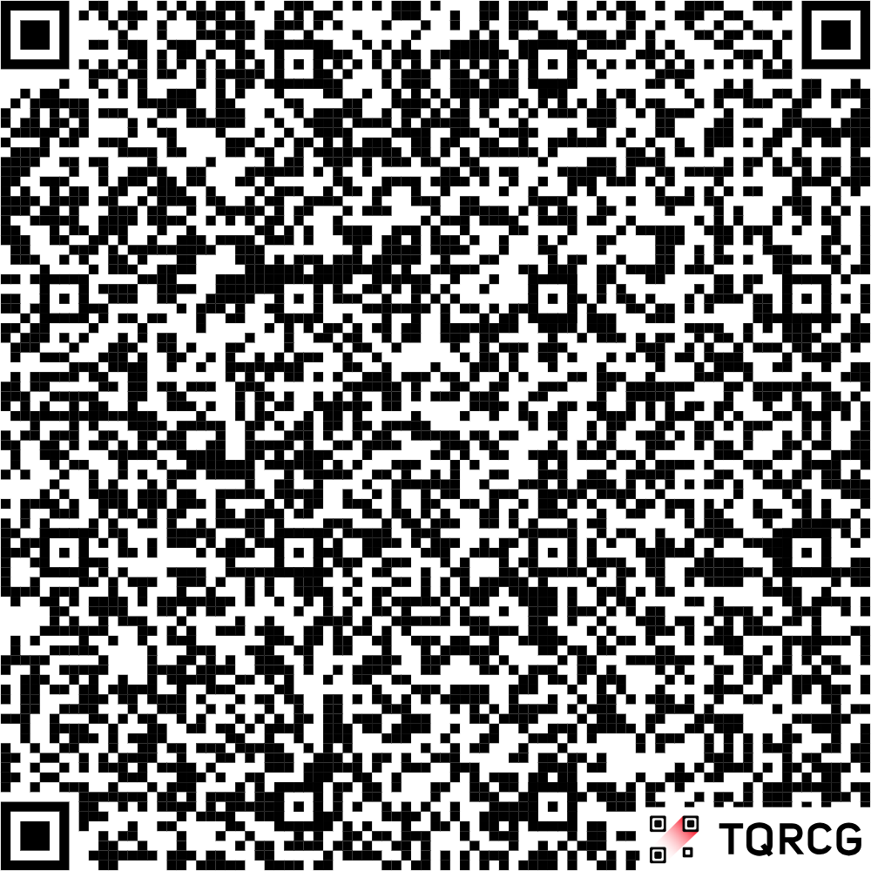
EXTRA
Save the date
EPOS ON Muon Imaging Workshop
Oulu, Finland, 28–29 September 2026
More information: scan the QR code
To be followed by the Oulu Mining Summit on 29 September – 1 October 2026
Thank you — discussion welcome
MUOGRAPHERS 2026 | EPOS ON | University of Oulu
24

