Slide 1

Muon Tomography at 1 km - Hardware
Jean-Luc Gauvreau
Occidental College, Los Angeles, USA
Muographers 2026 – Budapest
June 3, 2026

Slide 2
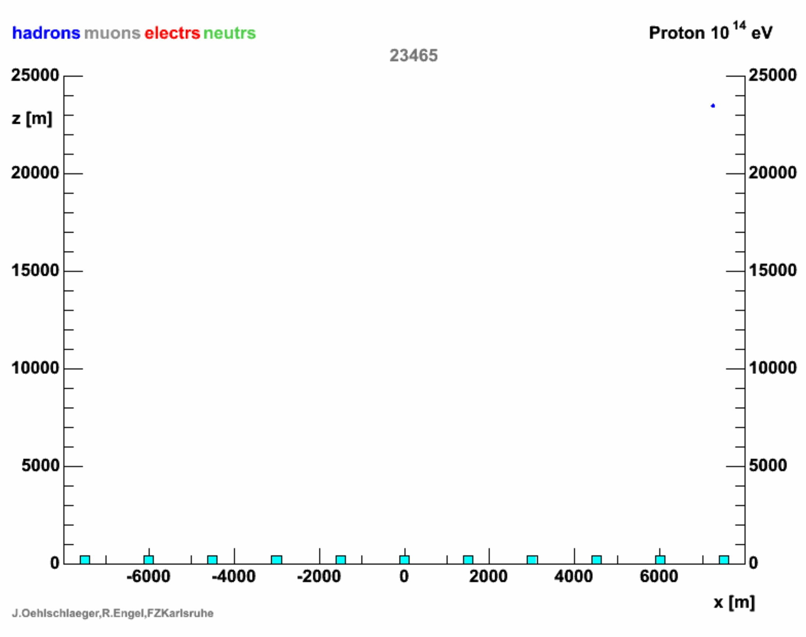
To do muography you need θ, ɸ and depth of detection.
Depth is easy and cheap to measure if θ, ɸ could be measured in some other way.
Muons often arrive together in a pancake structure spread over length scales of ~100 m (air shower)
At depths > 25 m all detected muons are associated with a shower on the surface.
Air shower muography
Notes:
Gas Detector gives muon directional information but is expensive.
Using Low cost (non-directional) BH detectors coupled with a surface array we can detect air showers.
Angle is measured by the array while depth is measured by the BH detectors.
Protons of very high energies produce air showers with length scales ~ 100m
At depths > 25m all detected muons are associated with a surface air shower.

Slide 3
electron path
Concept
muon path
Example of a muon air shower creating hits in
three surface detectors and one borehole detector.
D4
D2
D3
D1
BH1
D1
D2
D3
BH2
Signal
t1
t2
t3
Time
t4
BH2
Notes:
Air showers: surface detectors detect electrons mostly
BH detectors at depths > 25m detect muons mostly.
In the example above, an incoming air shower hits 3 surface detectors and 1 BH detector
The resulting peaks would look as shown.

Slide 4
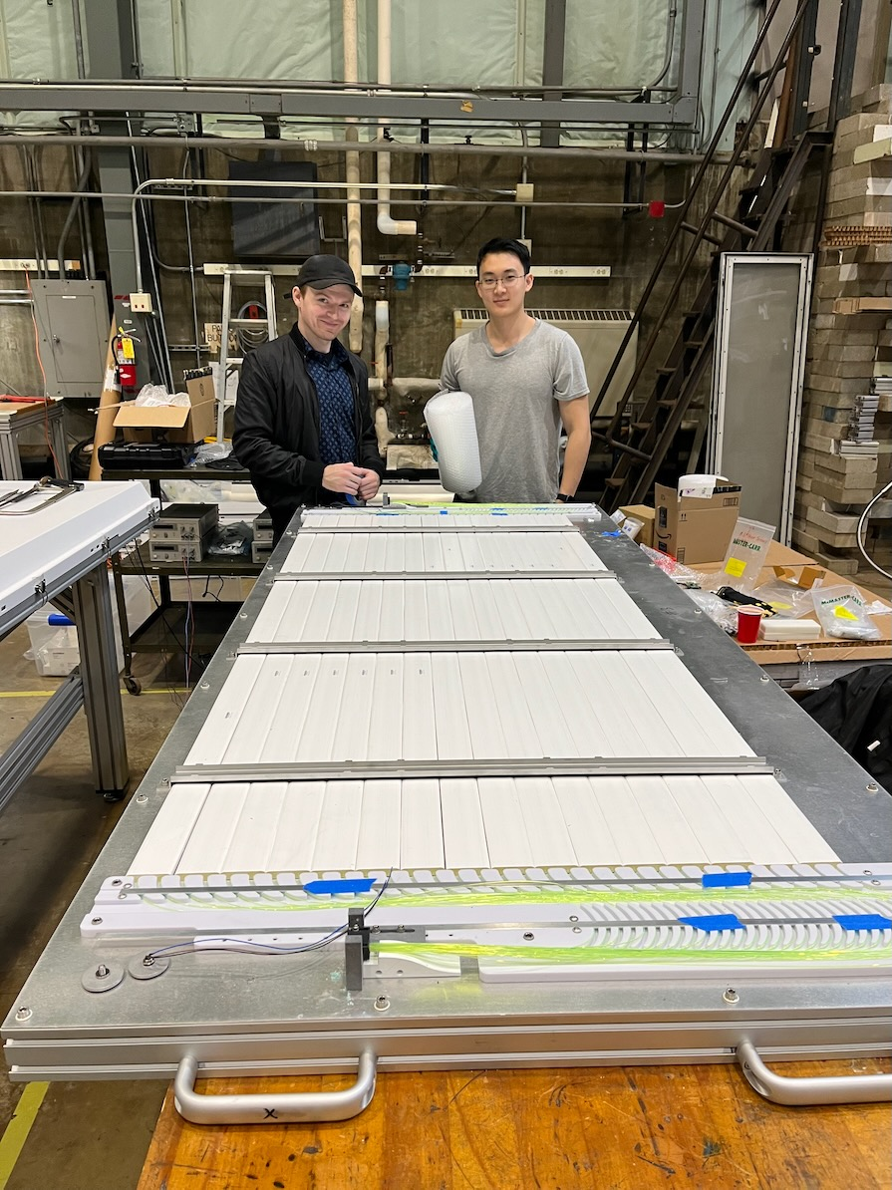
Assembled Detector
Alex Clark and Haoran Sun assembling a detector at UI.
Onsemi 6mm x 6mm SiPM
16 scintillating bars from Fermi Lab
With total area of 1.5m²
32 Wavelength Shifting Optical Fibers
Onsemi 6mm x 6mm SiPM
Notes:
The surface detectors were assembled at UI.
The bars were produced by extrusion at Fermi Lab. The bars have two holes lengthwise to insert 2 x 1mm fibers
The detector contains: 16 scintillating bars, 32 Wavelength shifting fibers, 2 SiPM boards, temp/hum sensors
We detect the light at both ends of the fibers
A Muon creates an ionizing track in a bar.
The light is captured by a fiber. The SiPMs transform the light pulses into an electric signal. The peaking time of the pulse is recorded using a 1GHz DRS digitizer or a GPS based time stamp.

Slide 5

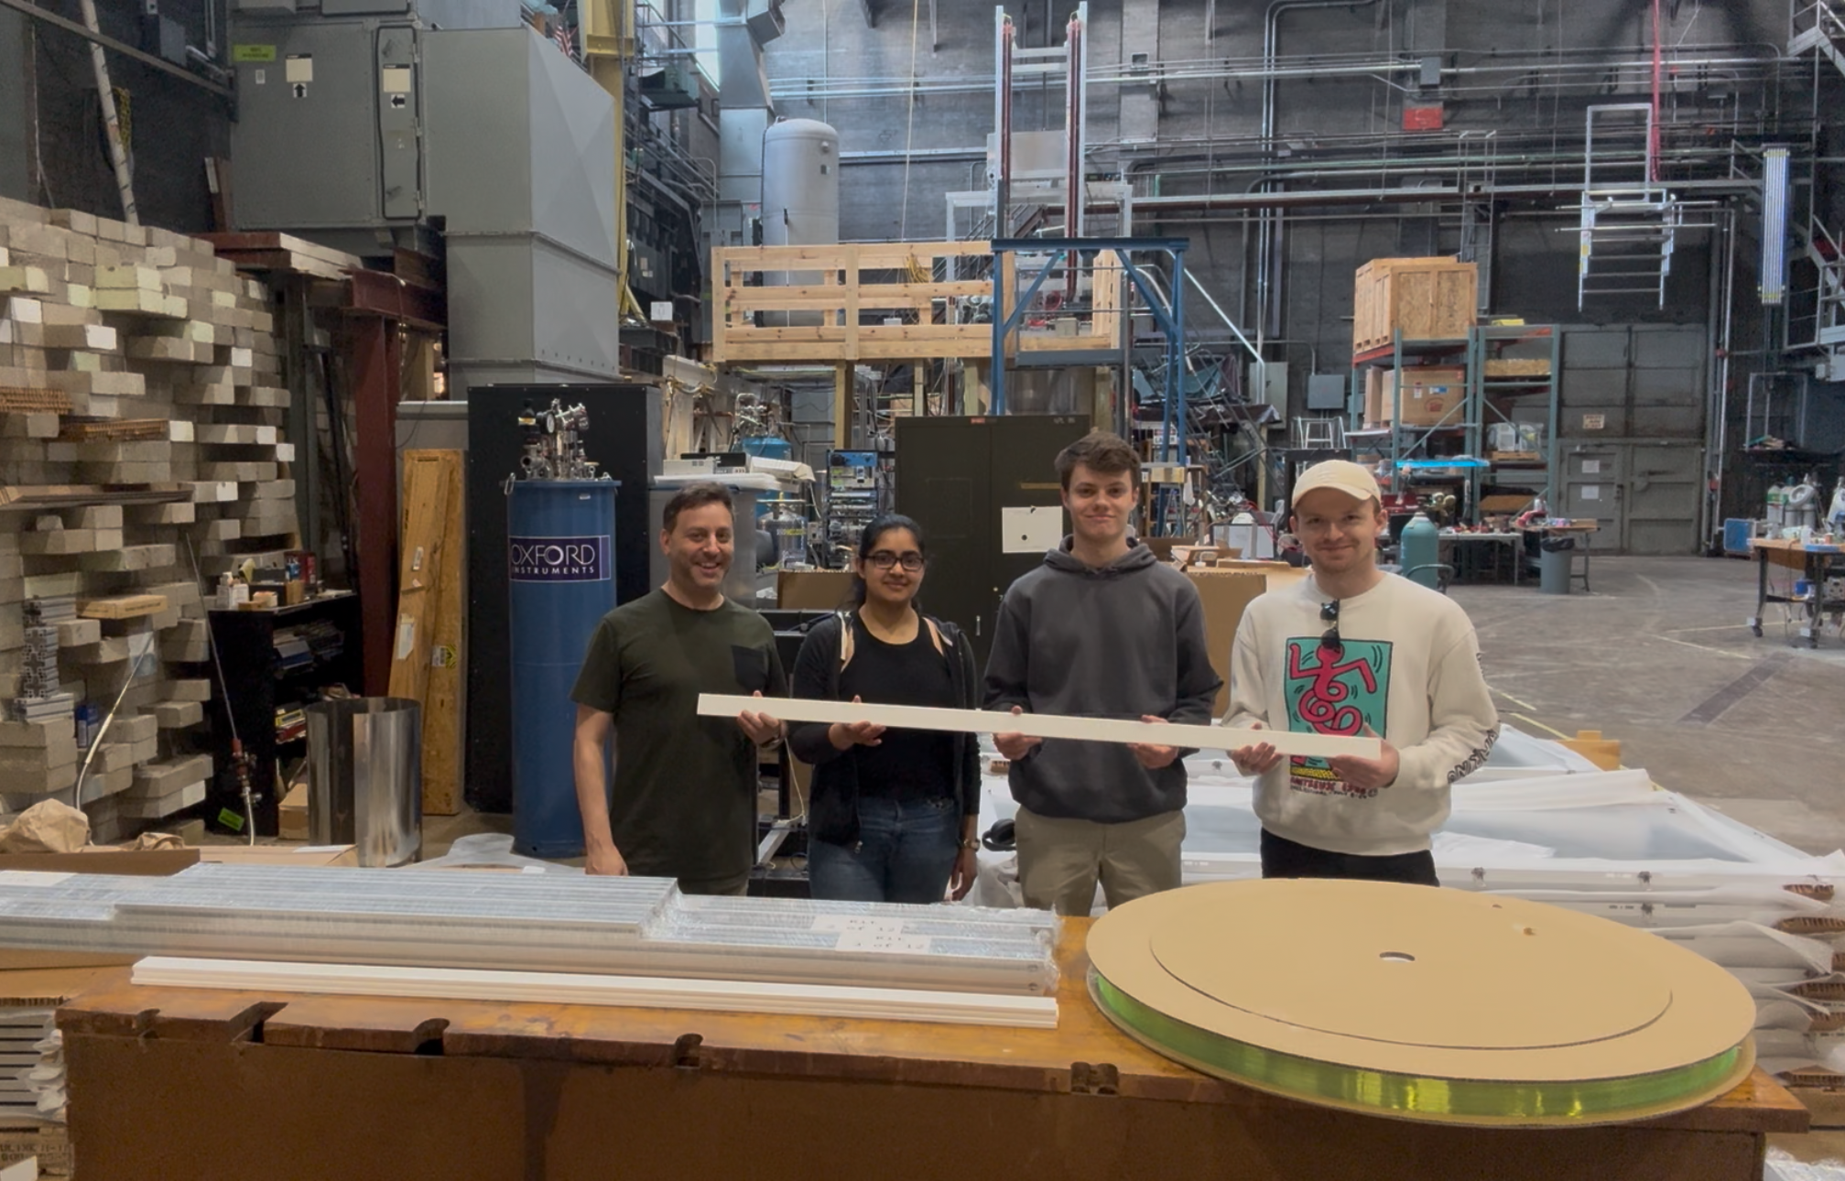
Assembly at UI
12 detectors were assembled at UI.
Ben Hooberman, Ipsita Chaudhary, Tim Healy and Alex Clark
Notes:
Thanks to UI
Shown: Ben Hooberman, his student and two Oxy researchers.

Slide 6
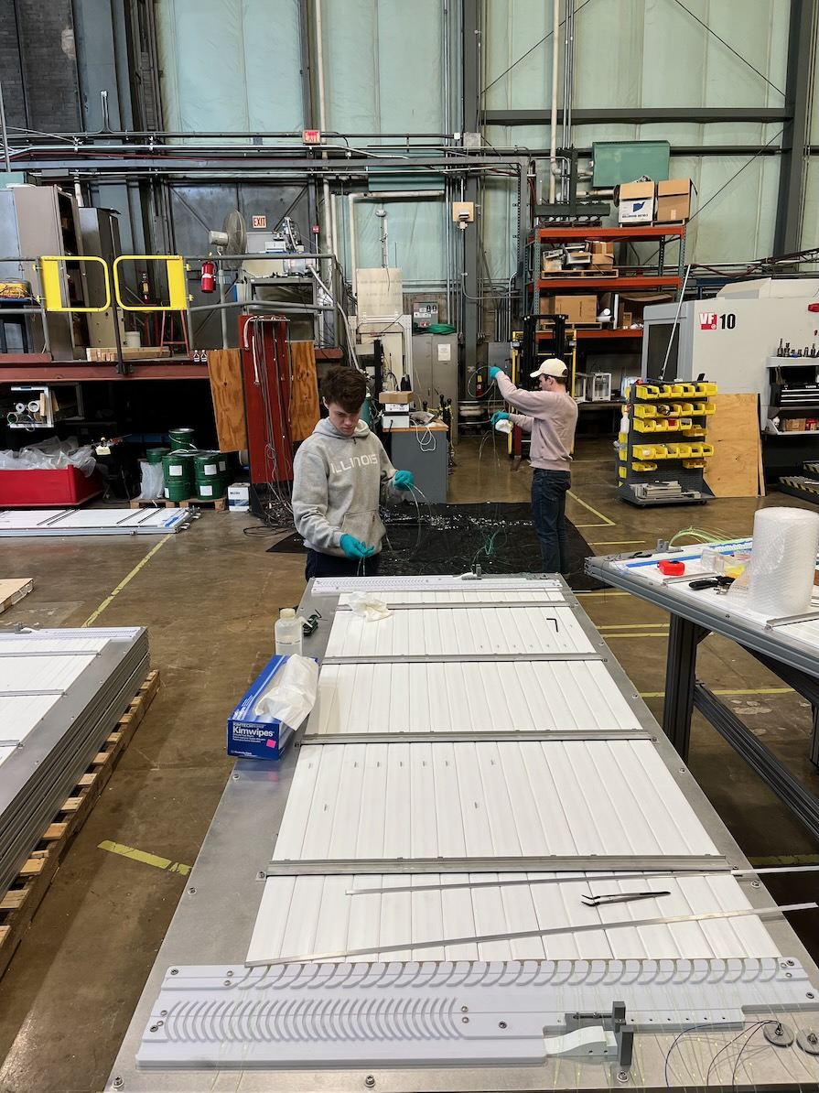
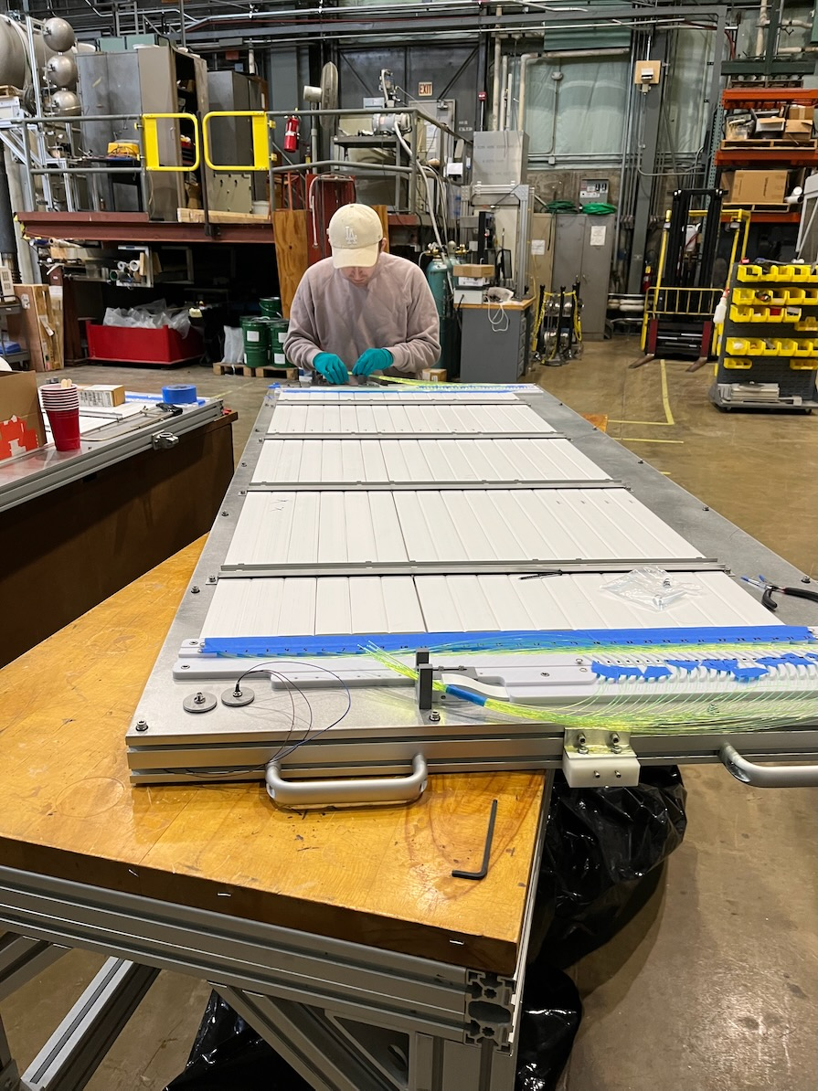
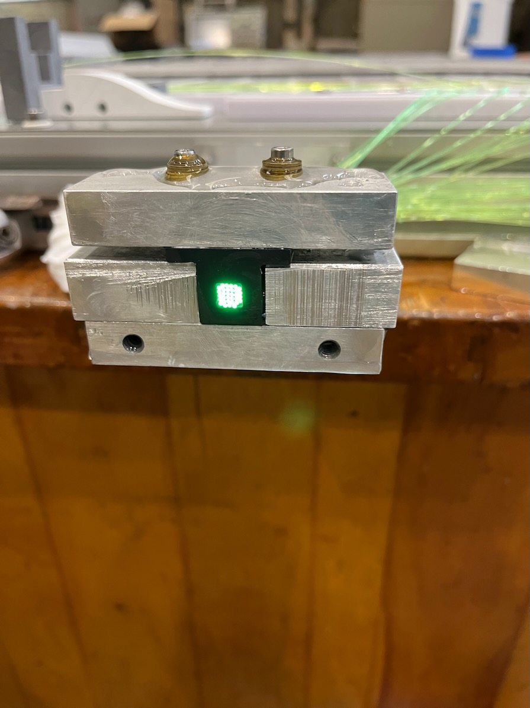
Assembly at UI
Fibers polished and ready for SiPM assembly
Bars and grooves installed.
Fiber installation. Two per bar.

Slide 7
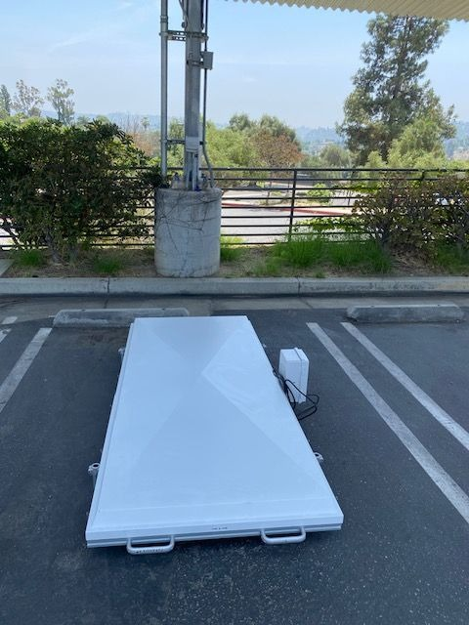
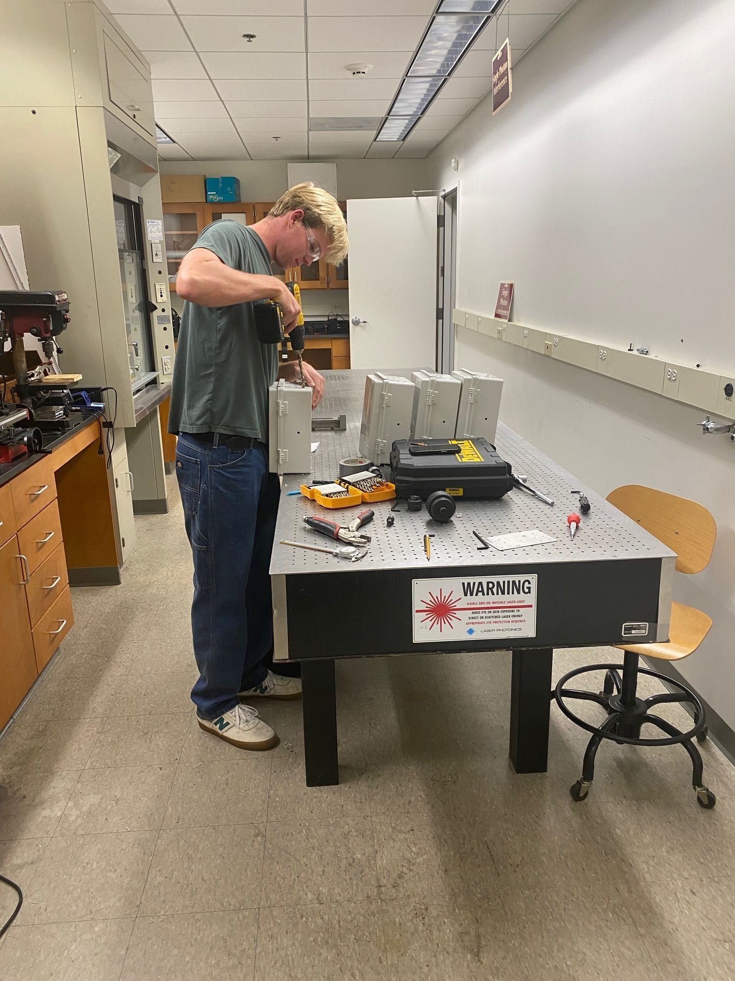
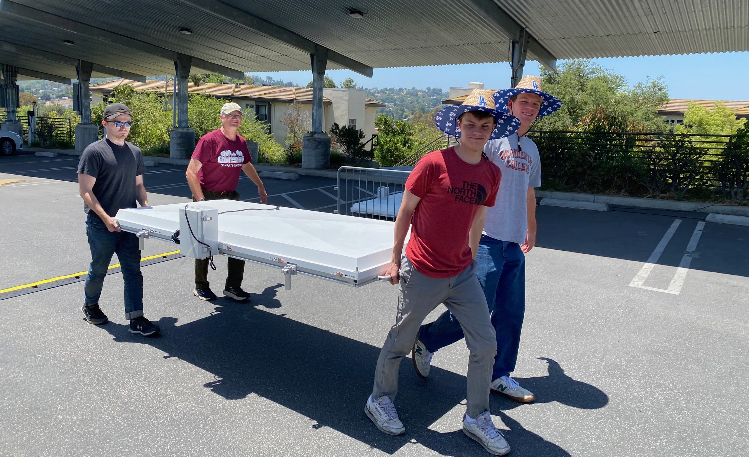
Final Assembly and Deployment ay Oxy
Notes:
An electric box was added. It contains a GPS module and discrimination electronics.

Slide 8
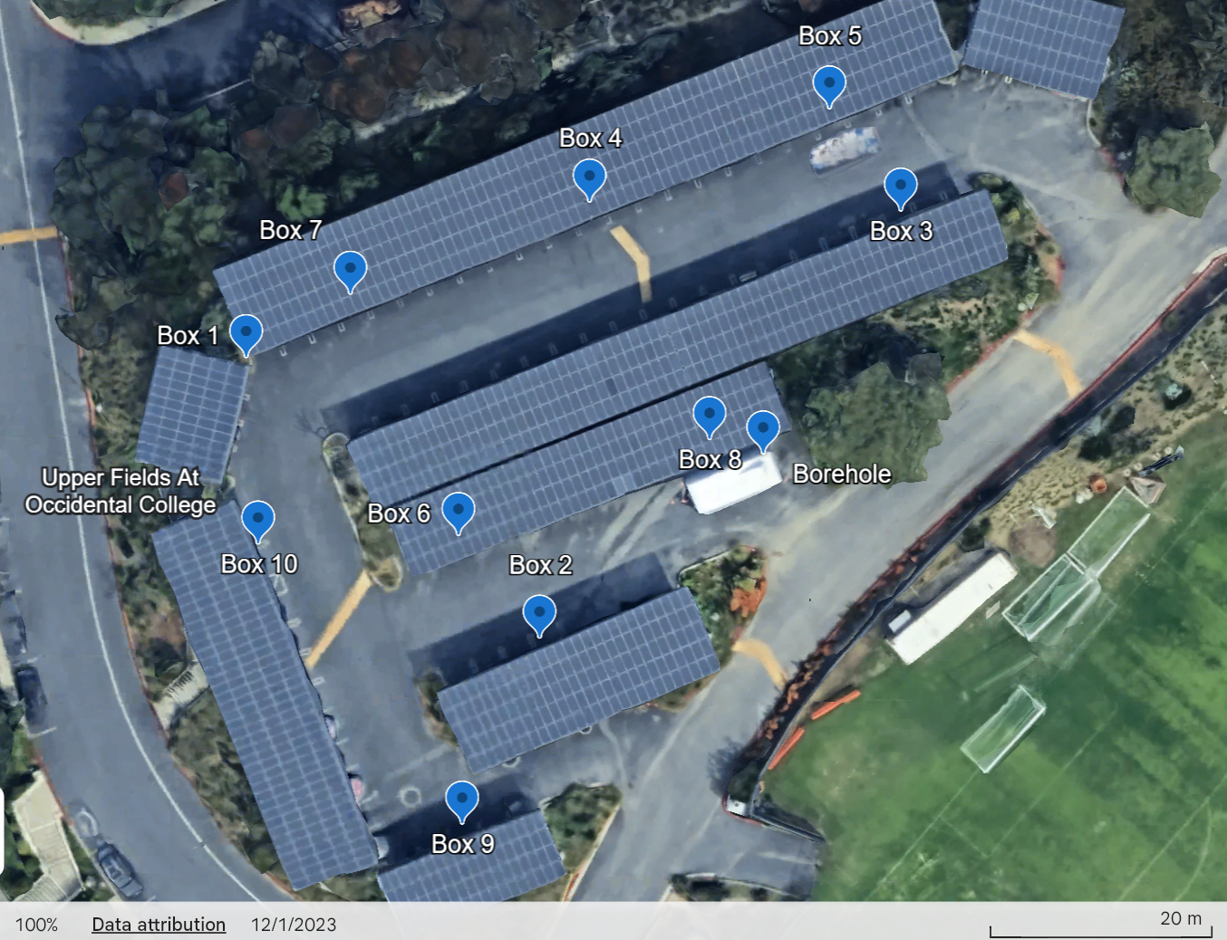
Array Deployment in Oxy Upper parking lot
10 detectors were deployed at Oxy.
Notes:
Each detector was self-surveyed by its GPS over 24 hours.
Cross-checks were made using a Lidar and laser level.
The position accuracy is 15cm rms
Timing tests were made by sending a pulse per second between adjacent detectors.
The timing accuracy is ~ 2.5ns, mainly due to the inherent +/-4ns jitter of the GPS
The trailer contains a winch for the gas detector.
The borehole is located at the right end of the trailer.

Slide 9
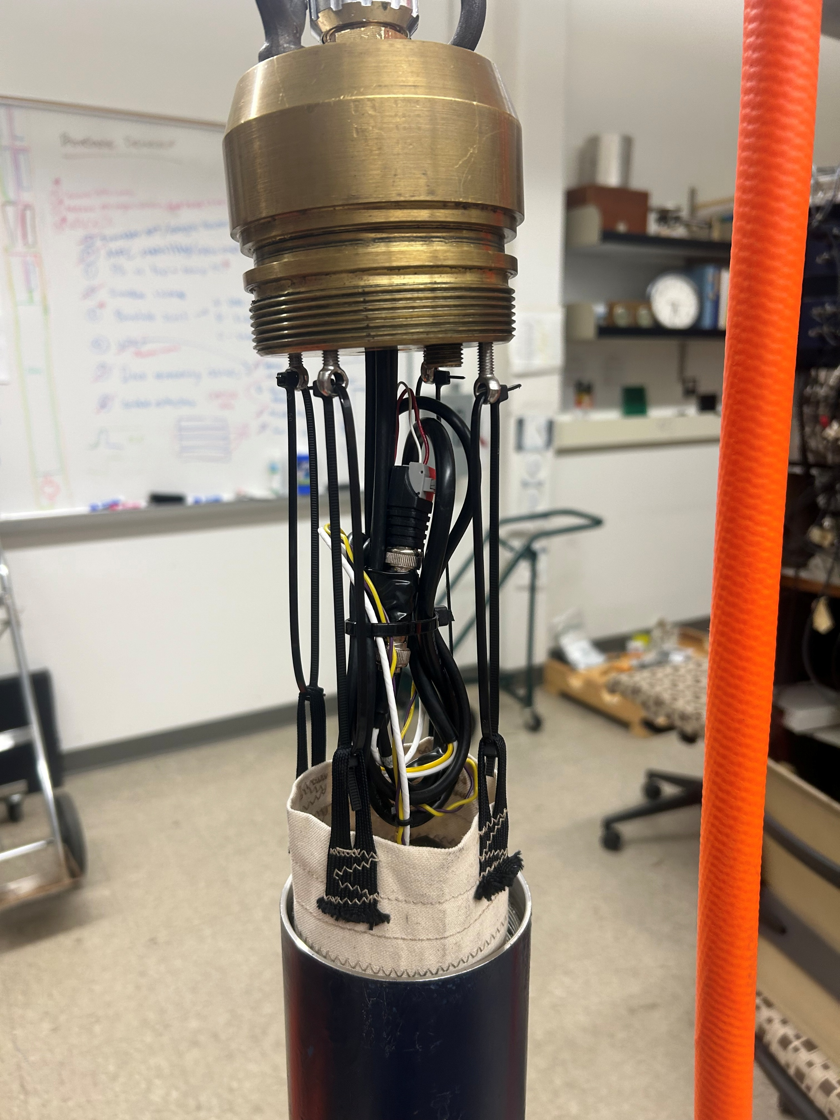
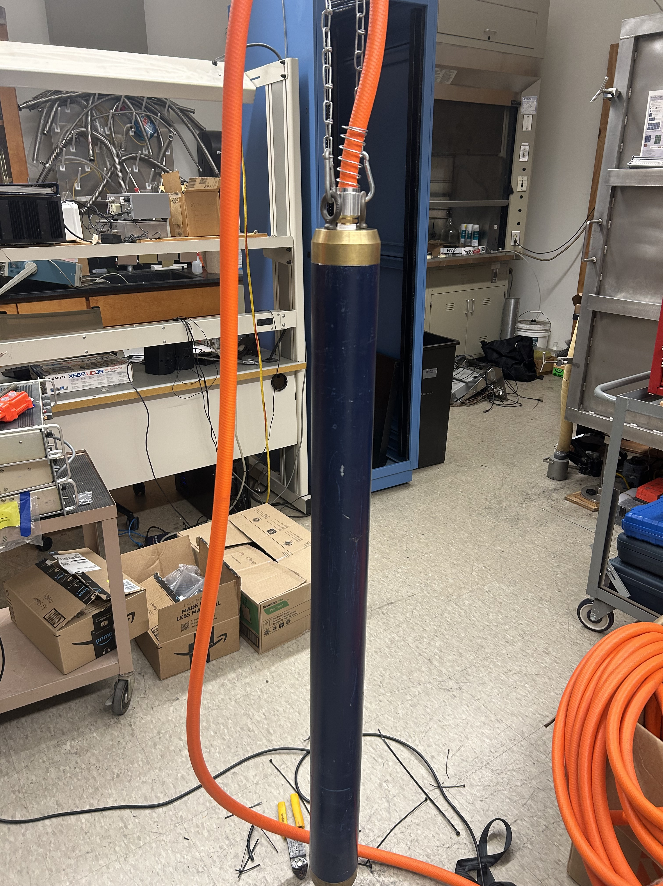
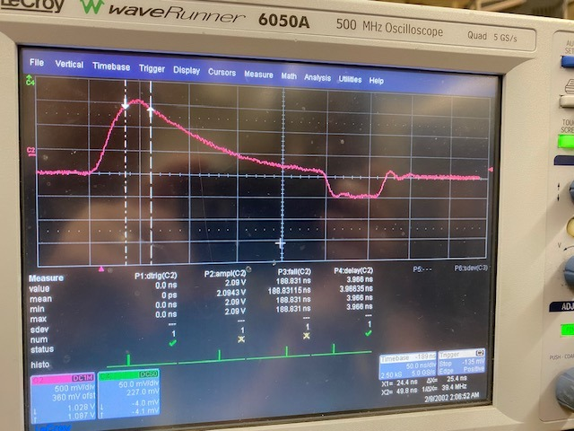
BH Scintillators
9cm x 50cm scintillator
SiPM board, no fiber.
Electric signal sent using a BNC cable.
Time stamp on the surface.

Slide 10
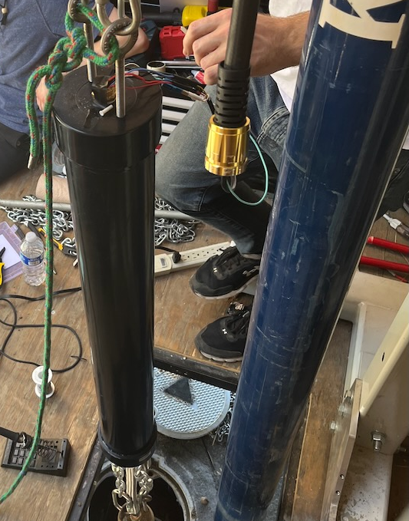
Borehole Deployment
Sealed BH detectors
3 cylindrical scintillator BH deployed
1 directional gas detector
1 Veto scintillator
The borehole is 30m deep at Oxy

Slide 11
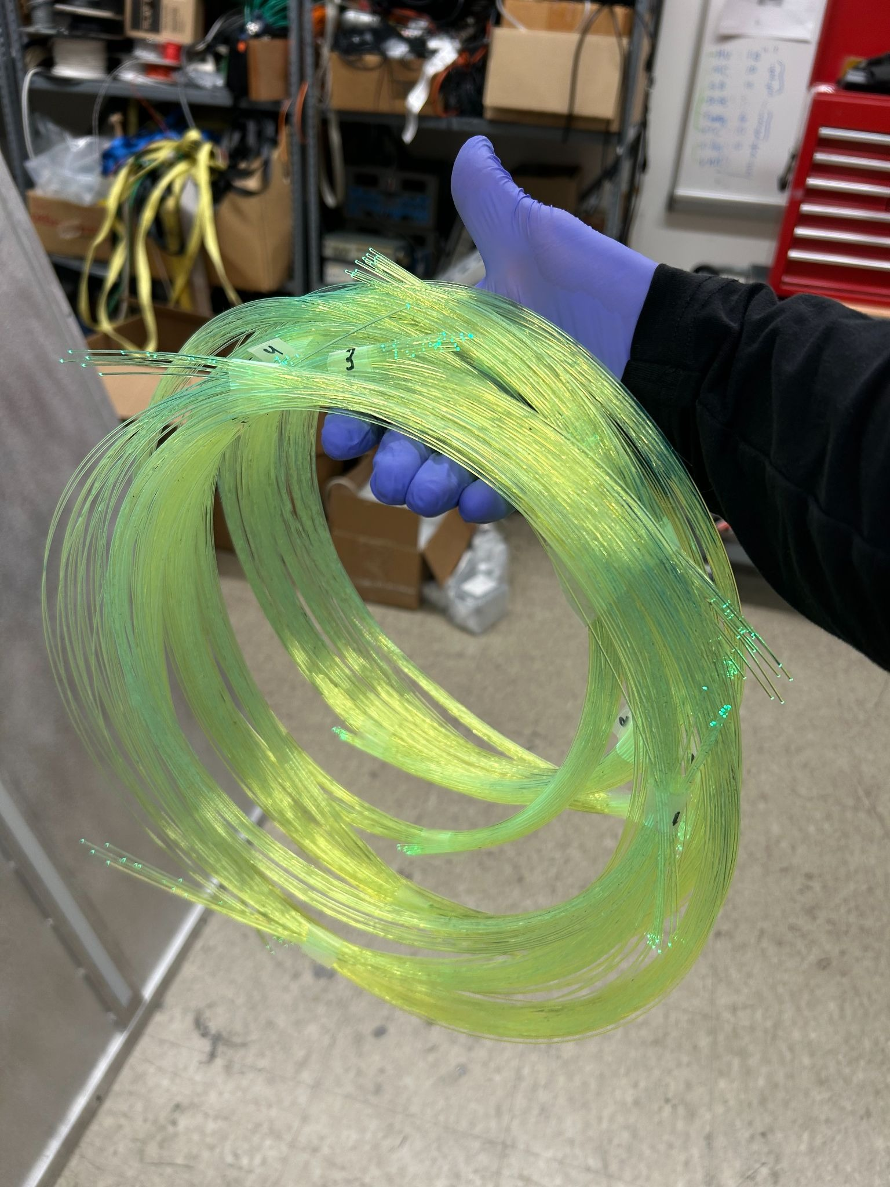
Wavelength Shifting Fibers
Kuraray Y-11
  Absorption peak: 430nm (Blue)
  Emission peak: 476nm (Green)
  Attenuation length = 4m
  Diameter of fiber: 1mm

Slide 12
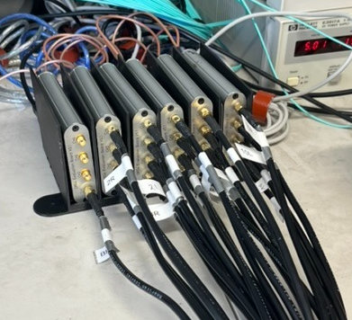
Timing and Data Collection (Phase 1)
Timing: DRS acquisition
  time accuracy: 1ns
  4 channels per module
  Long BNC cables required
  Trigger from borehole
Data discrimination: by software
Data parsing: by software during post-analysis
Data transmission: BNC
Notes:
For a large 1600 detector array, the cost of cables and labor may be prohibitive

Slide 13
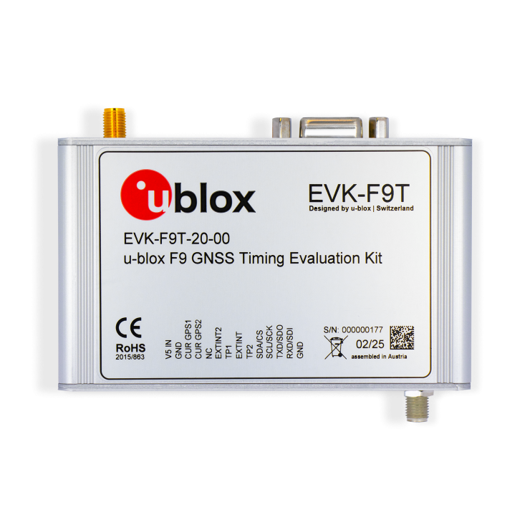
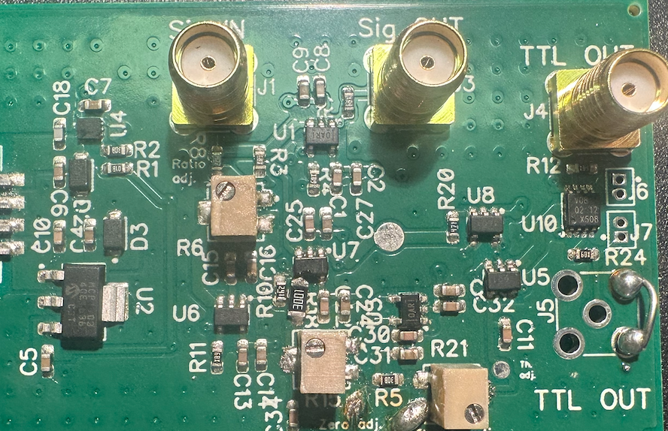
Timing and Data Collection (Phase 2)
Timing: GPS acquisition
  jitter: ± 4ns → accuracy: 2.3ns rms
  2 channels per module
  Self-survey spatial accuracy: 15cm
Data discrimination: by hardware
Data parsing: ESP32 μ-Processor
Data transmission: WiFi
Notes:
No data cables, cheaper for a large array.

Slide 14
Time and Angle Uncertainties
_{rms times} | σ_{t} (ns)
Scintillator/Fiber | 1.7
Fiber Length | 2.6
SiPM + electronics | 2
GPS | 2.5
Total | 4.5
Estimated errors on angles using a simplified model for the current array :
Zenith: 3.4° rms
Azimuth: 3.7° rms
To be compared with Monte Carlo simulation and actual data in Dan Snowden-Ifft’s talk
Notes:
We tabulated the sources of time uncertainties above.
If needed, with some efforts, we could reduce the total time uncertainty to ~ 3ns.

Slide 15
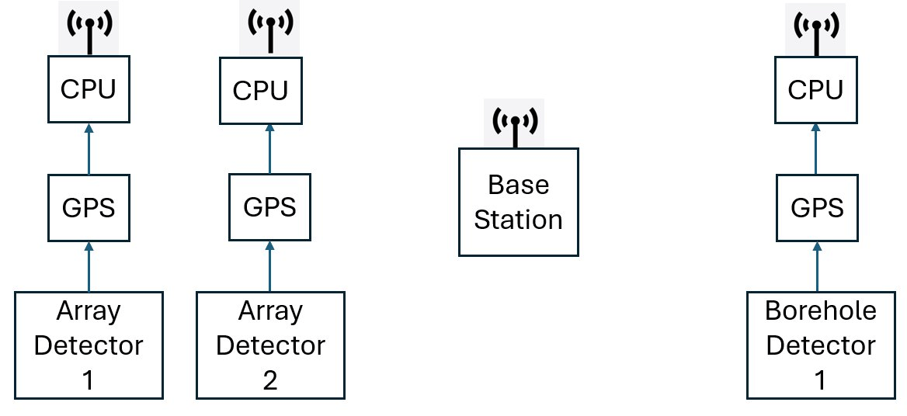
Data Flow

Slide 16
Data Flow
Muon rate: ~ 200Hz per surface detector
Array events are only sent to the server when coincident with a borehole event.
In post analysis, we identify events that have 4 hits or more.
The direction of the muon shower is obtained from the position and timing of the hits.
Actual shower detection rate in coincidence with a borehole: ~ 10⁻³ Hz
The data rate transmitted by WiFi is low.

Slide 17
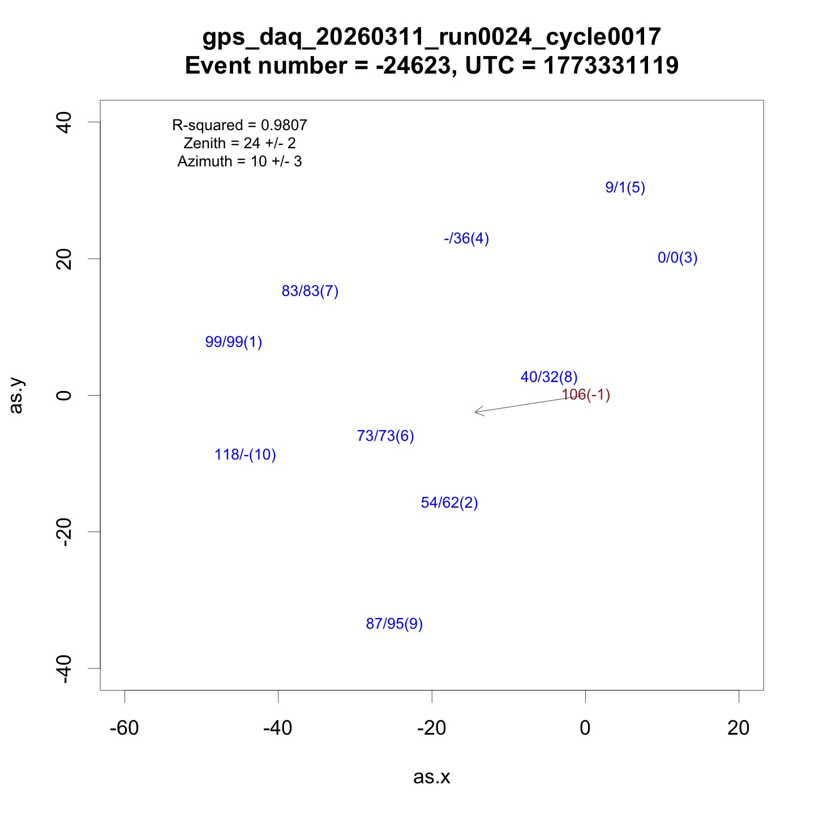
Map of directional muons
In red: Borehole detector
In blue: Surface detectors
Format: t1/t2(det#)
Arrow: Muon direction in x-y plane
Dotted lines: 10ns increments

Slide 18
Improvements for a Completely Wireless Larger Array
1600 surface detectors over a circle of 1km radius
300 borehole detectors distributed over a depth of 1km.
Long range communication using Wifi HaLow
  Range > 1km
  Sub GHz frequency
  32.5 Mbps data rate
FPGA based acquisition
  ns resolution
  GPS as primary clock
Solar + Battery Powered
  5 watts per detector

Slide 19
Thanks
Oxy Team:
Dan Snowden-Ifft, Alex Clark, Tim Healy, John Halloran, Jack Davis
Kobold Metals team:
Bill Page and Tom Hunt
UI Team:
Ben Hooberman, Haoran Sun, Ipsita Chaudhary, Prathik Boyella, Matthia Perdekamp

Slide 20

Data Flow
Array events are only sent to the server when coincident with a borehole event.
In post analysis, we identify events that have 4 hits or more.
The direction of the muon shower is obtained from the position and timing of the hits.
Detector muon rate: ~ 200Hz per detector
Actual shower detection rate in coincidence with a borehole: ~ 10⁻³ Hz
CPU
CPU
CPU
Base Station
GPS
GPS
GPS
Array
Detector 1
Array
Detector 2
Borehole
Detector 1

Slide 21
Data Flow
Array events are only sent to the server when coincident with a borehole event.
In post analysis, we identify events that have 4 hits or more.
The direction of the muon shower is obtained from the position and timing of the hits.
Detector muon rate: ~ 200Hz per detector
Actual shower detection rate in coincidence with a borehole: ~ 10⁻³ Hz
CPU
CPU
CPU
Base Station
GPS
GPS
GPS
Array
Detector 1
Array
Detector 2
Borehole
Detector 1

Slide 22
Data Flow
Array events are only sent to the server when coincident with a borehole event.
In post analysis, we identify events that have 4 hits or more.
The direction of the muon shower is obtained from the position and timing of the hits.
Detector muon rate: ~ 200Hz per detector
Actual shower detection rate in coincidence with a borehole: ~ 10⁻³ Hz
CPU
CPU
CPU
Base Station
GPS
GPS
GPS
Array
Detector 1
Array
Detector 2
Borehole
Detector 1

Slide 23
Data Flow
Array events are only sent to the server when coincident with a borehole event.
In post analysis, we identify events that have 4 hits or more.
The direction of the muon shower is obtained from the position and timing of the hits.
Detector muon rate: ~ 200Hz per detector
Actual shower detection rate in coincidence with a borehole: ~ 10⁻³ Hz
CPU
CPU
CPU
Base Station
GPS
GPS
GPS
Array
Detector 1
Array
Detector 2
Borehole
Detector 1

Slide 24
Data Flow
Array events are only sent to the server when coincident with a borehole event.
In post analysis, we identify events that have 4 hits or more.
The direction of the muon shower is obtained from the position and timing of the hits.
Detector muon rate: ~ 200Hz per detector
Actual shower detection rate in coincidence with a borehole: ~ 10⁻³ Hz
CPU
CPU
CPU
Base Station
GPS
GPS
GPS
Array
Detector 1
Array
Detector 2
Borehole
Detector 1

Slide 25
Data Flow
Array events are only sent to the server when coincident with a borehole event.
In post analysis, we identify events that have 4 hits or more.
The direction of the muon shower is obtained from the position and timing of the hits.
Detector muon rate: ~ 200Hz per detector
Actual shower detection rate in coincidence with a borehole: ~ 10⁻³ Hz
CPU
CPU
CPU
Base Station
GPS
GPS
GPS
Array
Detector 1
Array
Detector 2
Borehole
Detector 1

Slide 26
Data Flow
Array events are only sent to the server when coincident with a borehole event.
In post analysis, we identify events that have 4 hits or more.
The direction of the muon shower is obtained from the position and timing of the hits.
Detector muon rate: ~ 200Hz per detector
Actual shower detection rate in coincidence with a borehole: ~ 10⁻³ Hz
CPU
CPU
CPU
Base Station
GPS
GPS
GPS
Array
Detector 1
Array
Detector 2
Borehole
Detector 1

Slide 27
Data Flow
Array events are only sent to the server when coincident with a borehole event.
In post analysis, we identify events that have 4 hits or more.
The direction of the muon shower is obtained from the position and timing of the hits.
Detector muon rate: ~ 200Hz per detector
Actual shower detection rate in coincidence with a borehole: ~ 10⁻³ Hz
CPU
CPU
CPU
Base Station
GPS
GPS
GPS
Array
Detector 1
Array
Detector 2
Borehole
Detector 1

Slide 28
Data Flow
Array events are only sent to the server when coincident with a borehole event.
In post analysis, we identify events that have 4 hits or more.
The direction of the muon shower is obtained from the position and timing of the hits.
Detector muon rate: ~ 200Hz per detector
Actual shower detection rate in coincidence with a borehole: ~ 10⁻³ Hz
CPU
CPU
CPU
Base Station
GPS
GPS
GPS
Array
Detector 1
Array
Detector 2
Borehole
Detector 1

Slide 29
Data Flow
Array events are only sent to the server when coincident with a borehole event.
In post analysis, we identify events that have 4 hits or more.
The direction of the muon shower is obtained from the position and timing of the hits.
Detector muon rate: ~ 200Hz per detector
Actual shower detection rate in coincidence with a borehole: ~ 10⁻³ Hz
CPU
CPU
CPU
Base Station
GPS
GPS
GPS
Array
Detector 1
Array
Detector 2
Borehole
Detector 1

Slide 30
Data Flow
Array events are only sent to the server when coincident with a borehole event.
In post analysis, we identify events that have 4 hits or more.
The direction of the muon shower is obtained from the position and timing of the hits.
Detector muon rate: ~ 200Hz per detector
Actual shower detection rate in coincidence with a borehole: ~ 10⁻³ Hz
CPU
CPU
CPU
Base Station
GPS
GPS
GPS
Array
Detector 1
Array
Detector 2
Borehole
Detector 1

Slide 31
Data Flow
Array events are only sent to the server when coincident with a borehole event.
In post analysis, we identify events that have 4 hits or more.
The direction of the muon shower is obtained from the position and timing of the hits.
Detector muon rate: ~ 200Hz per detector
Actual shower detection rate in coincidence with a borehole: ~ 10⁻³ Hz
CPU
CPU
CPU
Base Station
GPS
GPS
GPS
Array
Detector 1
Array
Detector 2
Borehole
Detector 1

Slide 32
Data Flow
Array events are only sent to the server when coincident with a borehole event.
In post analysis, we identify events that have 4 hits or more.
The direction of the muon shower is obtained from the position and timing of the hits.
Detector muon rate: ~ 200Hz per detector
Actual shower detection rate in coincidence with a borehole: ~ 10⁻³ Hz
CPU
CPU
CPU
Base Station
GPS
GPS
GPS
Array
Detector 1
Array
Detector 2
Borehole
Detector 1

Slide 33
Data Flow
Array events are only sent to the server when coincident with a borehole event.
In post analysis, we identify events that have 4 hits or more.
The direction of the muon shower is obtained from the position and timing of the hits.
Detector muon rate: ~ 200Hz per detector
Actual shower detection rate in coincidence with a borehole: ~ 10⁻³ Hz
CPU
CPU
CPU
Base Station
GPS
GPS
GPS
Array
Detector 1
Array
Detector 2
Borehole
Detector 1

