Slide 1
Cosmic-ray-muon Scattering for
Nuclear Material Measurement
HN-2026-1710
Haruo Miyadera
Senior Manager Governor
Corporate Laboratory Toshiba Europe GmbH
Toshiba Corporation
Naoto Kume, Yuki Nakai, Kyohei Noguchi, Takuro Fujimaki, Tsukasa Sugita Fumihito Shinozaki
Toshiba Corporation

Slide 2
Cosmic-ray Muon Scattering Imaging
01

Slide 3
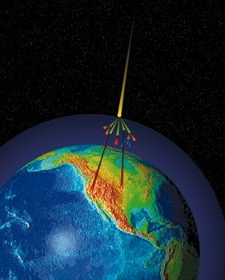
Cosmic-ray Muon
Pions (π⁺, π⁻) generated when cosmic rays collide with the Earth’s atmosphere
Pions decay into muons (μ⁺, μ⁻)
Muons have relatively long life time of 2.2 μs
    Relativistic effect helps them survive to the Earth’s surface
  Cosmic-ray muon
    Muons are the major components of cosmic ray at the surface
    Muon flux: 10,000 /m²·min
    Accounts for 20％ of annual dose
Primary cosmic ray
Pions
Muons
Image from cosmic.lbl.gov

Slide 4
Muon’s Interaction with Material
Energy loss
  Muon losses energy through interaction with atomic/molecular electrons
    -dE/dx depends on electron density
Multiple Coulomb scattering
  Muons are distorted by interaction with nuclear charge
  Scattering angle:
    Larger the Z, larger the scattering angle
    Depends on material
Material
Low energy muon
Energy loss
Muon stop
High energy muon
Energy loss
Transmitted
Material
Scattering Angle
Multiple Coulomb scatterings
x=material length
X₀=radiation length of material
βcp＝muon energy
Direction changed
Energy loss and multiple Coulomb scattering are the major interactions of muon

Slide 5
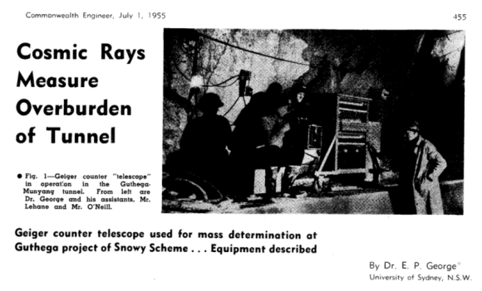
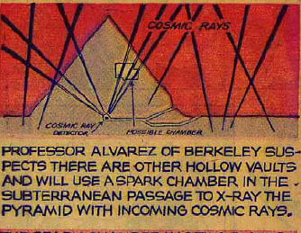
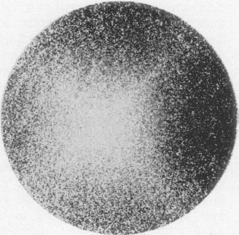
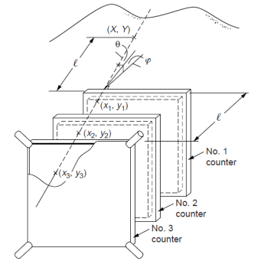
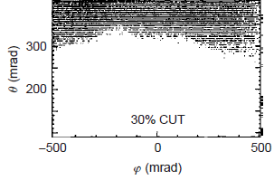

Muon Imaging - Transmission Method
Transmission Method is muon roentgenography.
  Mine overburden, E.P. George (1955).
  Egyptian pyramid, L.W. Alvarez (1970).
  Temple gate, S. Minato (1988).
  Density map of volcano, K. Nagamine (1995).
  Blast furnace, K. Nagamine (2005).
Attenuation of muon flux
  Resolution degraded by continuous scattering
  along the muon path.
  Sometimes, incident muon flux not easy
  to estimate.
K. Nagamine, et al., Nucl. Instr. and Meth. A 356 (1995) 585.

Slide 6
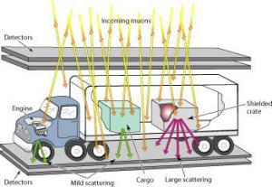
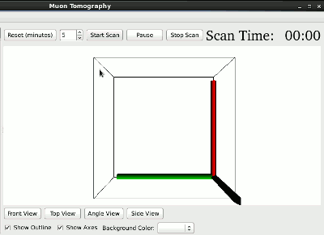
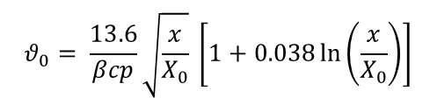
Muon Scattering Imaging Develop at LANL
10,000 muon/m²·min at the surface
(1) Location of scatterer identified by point-of-closest-approach
(2) Scattering angle provides material info
  Scattering angle approximately scales with atominc number
Container
Scanner
Muon
Muon tracker
C. Morris et al., Science & Global Security 16, 37 (2008).
High-Z material
(1) PoCA identifies the location
min sec
$$θ_{0}= \frac{13.6}{βcp}\sqrt{\frac{x}{X_{0}}} \left[1+0.038\ln\left(\frac{x}{X_{0}}\right)\right]$$
Fe
Pb
θ₀ scattering angle βc velocity p momentum
x material thickness X_{0:} radiation length
Container (low Z)
(2) Scattering angle provides
material info
Muon tracker
Muon scattering angle provides material information

Slide 7
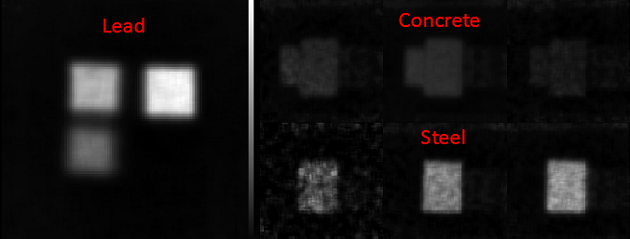
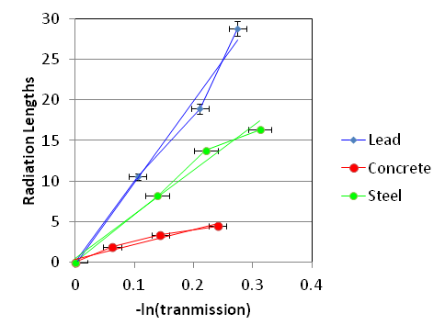
Material Identification of Scattering Method
Energy Loss obtained by muon attenuation
Radiation Length obtained by muon scattering angle
Radiation Length
C. Morris et al., AIP Advances 3, 082128 (2013).
Energy loss and scattering combined for material identification

Slide 8
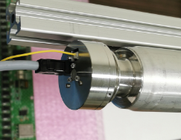
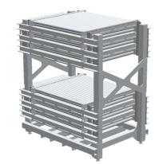
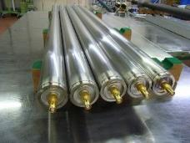
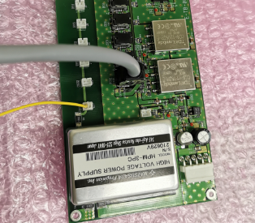
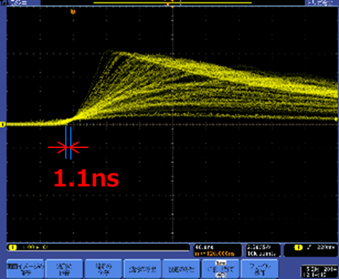
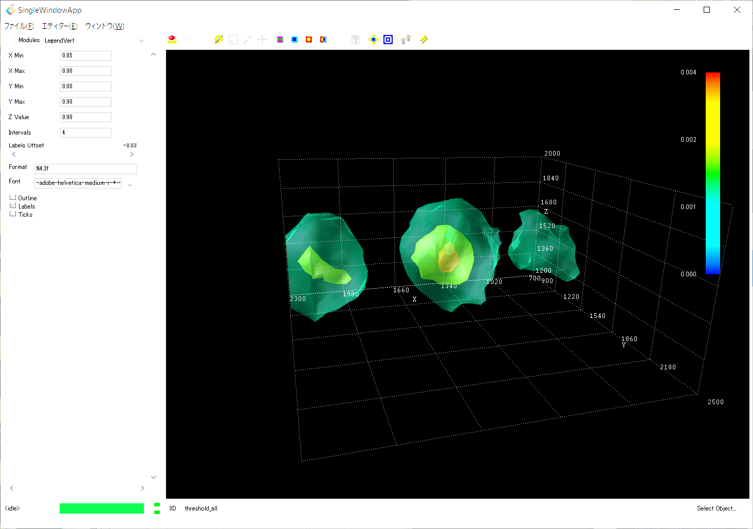
Muon Tracker for Scattering Imaging
High energy physics + nuclear ＋ consumer technologies
Amplifier
（Nuclear technology）
Muon
Drift tube detector
（High energy physics）
FPGA
（Consumer technology）
Detection
Area
Analysis
Muon tracking
Image output
Material identification

Slide 9
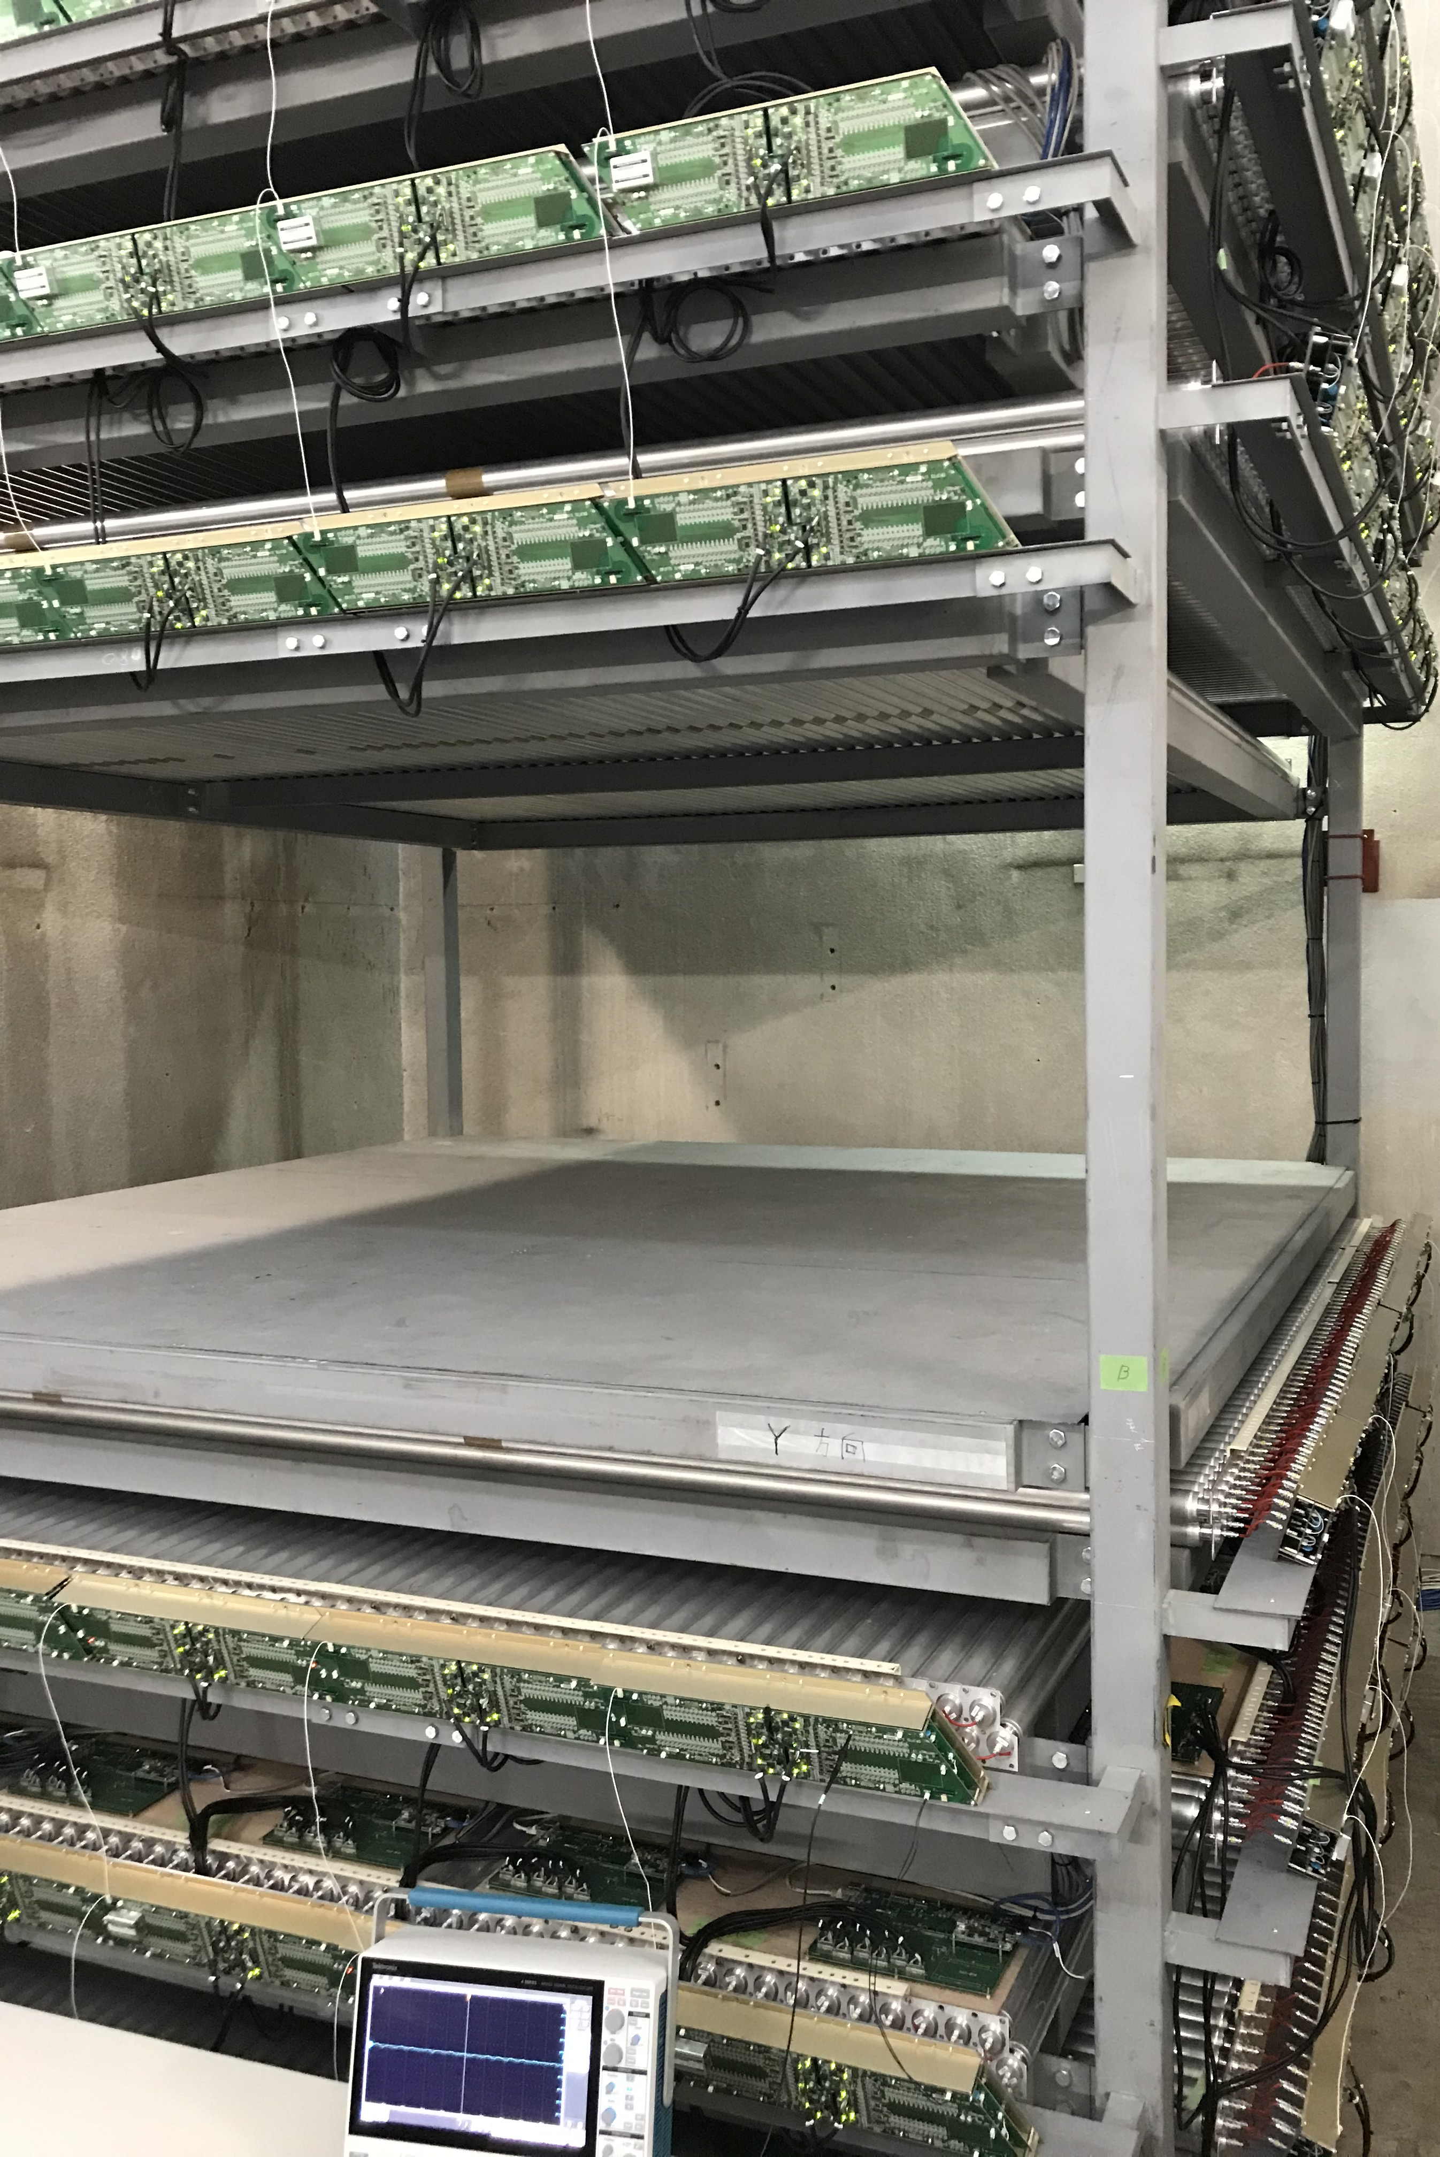
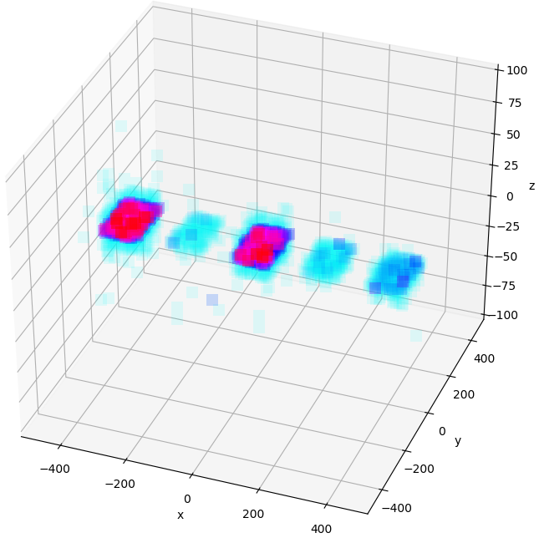
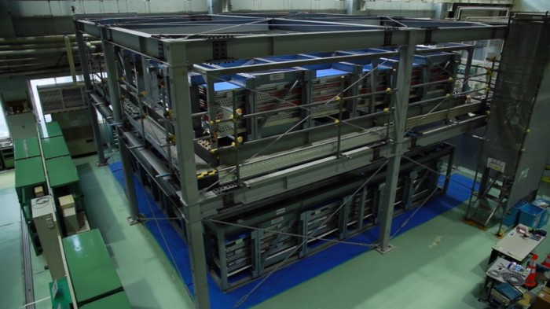
Muon Trackers Developed at TOSHIBA
Drug A
Muon trackers
7mx7m
Explosive B
Muon trackers
3.5mx3.5m
Gold
Mock
nuclear
material
Toxic material C
2015
7m x 7m muon tracker for reactor imaging
  Collaborative effort with LANL and DSIC
  6,720 drift tubes used
  Can operate under radiation environment of
  50 μSv/h
2020
https://www.global.toshiba/jp/news/corporate/2015/03/pr2701.html
3.5m x 3.5m muon tracker for R&D
  1,680 drift tubes used
  Non-destructive evaluation of infrastructures
  Material accounting
Fukushima Daiichi muon imaging project was carried out as a part of “Project of Decommissioning and Contaminated Water Management” supported by Ministry of Economy, Trade and Industry, Japan.

Slide 10
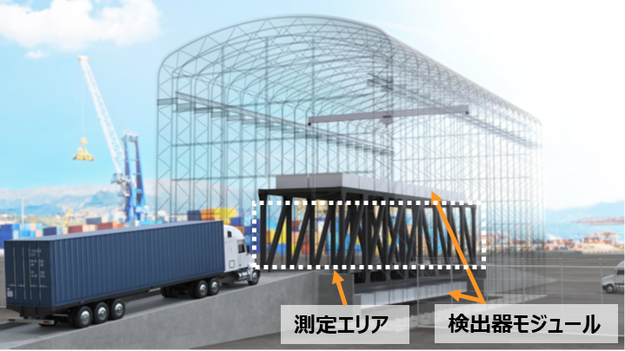
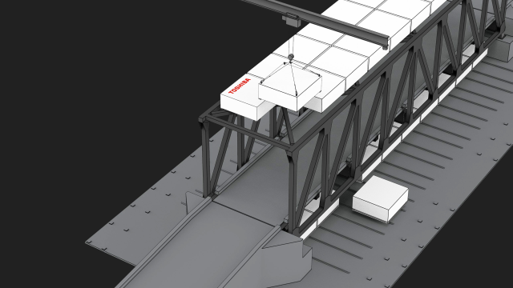
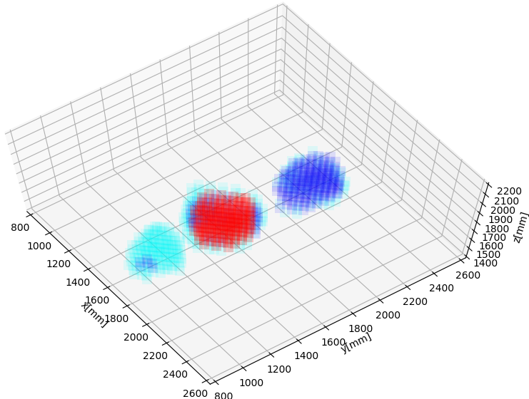
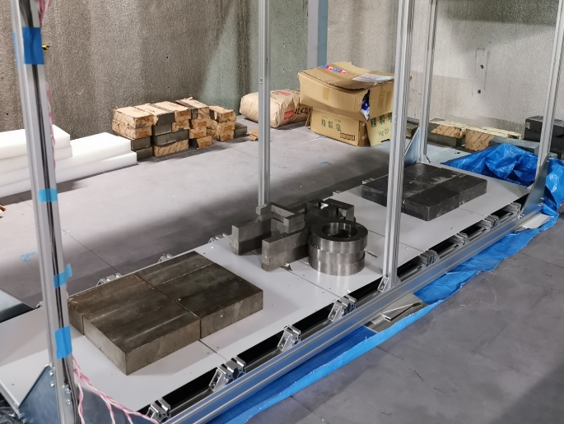
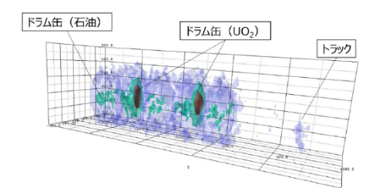
Muon Container Scanner
Detect smuggling across borders
Muon container scanners were installed at:
・Bahama ・Singapore
・UAE ・US – Mexico border
Muon container scanner assembly
Detection area
Detector modules
■Gold
■Lead
■Steel
Mock gold
Lead
Material
identification
by AI
Oil
Oil + UO₂
Z [mm]
Truck
Steel
Z
Y
X [mm]
X
Y [mm]
Detected object

Slide 11
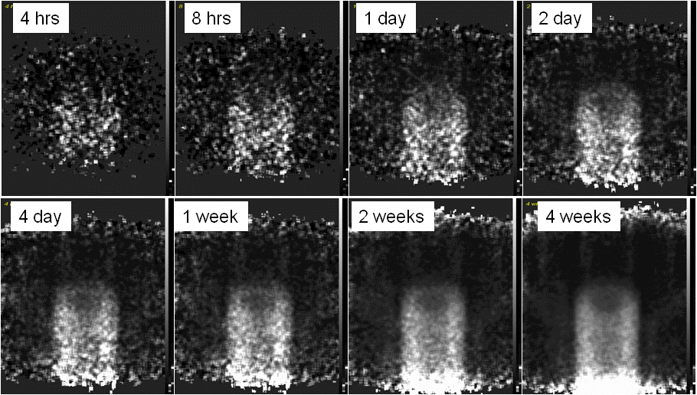
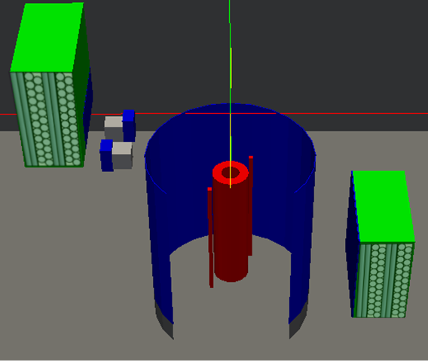
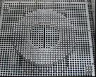
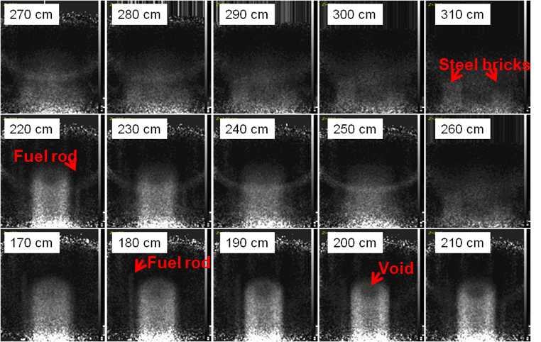
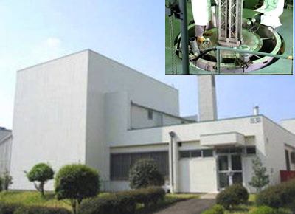

Reactor Imaging at TOSHIBA Nuclear Critical Assembly
Technical demo with “real” reactor core at TOSHIBA’s research reactor.
Mini Muon Tracker of 1.2m x 1.2m size shipped from LANL and was installed to NCA.
C.Morris et al., APL 104, 024110 (2014).
T.Sugita et al., JNST 51, 7-8 (2014).
Muon
Steel/concrete
bricks
Core
Tank
Fuel
0.4m
Muon tracker
TOSHIBA Nuclear Critical Assembly
(Kawasaki, Japan)
Muon tracker
Core
World’s first muon reactor imaging with real UO₂ core

Slide 12
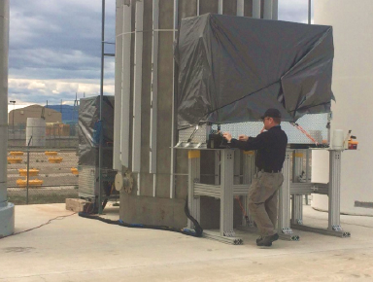
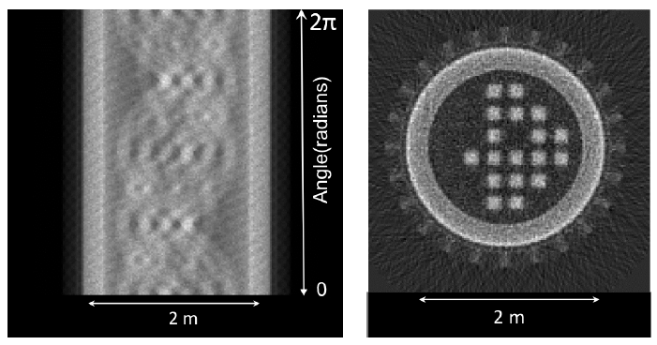
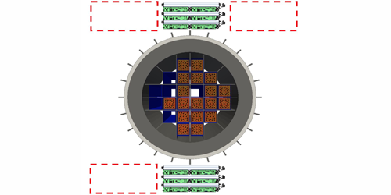
Nuclear Security
Most of the plutonium on earth is stored in steel dry-storage
casks of a few meter in diameter
Fuel assemblies inside a dry cask can be imaged
by muon scattering imaging
D. Poulson et al., NIM A 842, 17 (2017).
LANL news 2018
J.M Durham et al., Physical Review Applied 9,
044013 (2018)
Fuel assembly
in a cask
Muon trackers
Muon technology capable of identifying fuel assemblies inside a cask

Slide 13
Material Accounting of Fukushima Daiichi’s
Nuclear Debris using Cosmic-ray Muon Scattering
02
Haruo Miyadera
Naoto Kume, Yuki Nakai, Kyohei Noguchi, Takuro Fujimaki, Tsukasa Sugita, Fumihito Shinozaki
Toshiba Corporation
Shin Takasaki, Takahiro Tanaka, Ryunosuke Mizuguchi
Tousou Mirai Technology Company Limited (Decom.Tech)
This research was implemented under the Decommissioning, Contaminated Water and Treated Water Management project supported by Ministry of Economy, Trade and Industry, Japan.

Slide 14
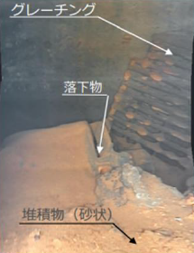
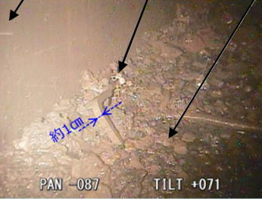
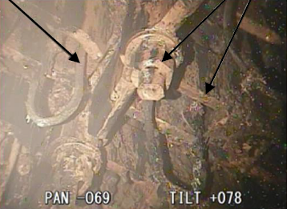
Fuel Debris in Fukushima Daiichi Decommissioning
Fuel debris will be retrieved and stored safely during Fukushima Daiichi decommissioning
No established technology exists to non-destructively estimate nuclear fuel content in debris
Retrieved materials may include structural components with adhered molten fuel
Measurement is hindered by materials such as control rods (neutron absorbers) and moisture
Pedestal
inner wall
A portion of a fuel assembly
Peddle
debris
Peddle
debris
Control Rod Drive
housing support parts
Sand
Peddle
Structure material with adhered debris
Photo source: TEPCO “48th and 50th Secretariat Meeting of the Decommissioning and Contaminated Water Countermeasures Team”

Slide 15
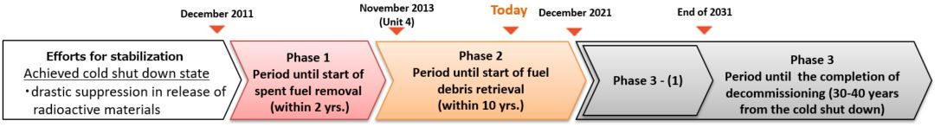
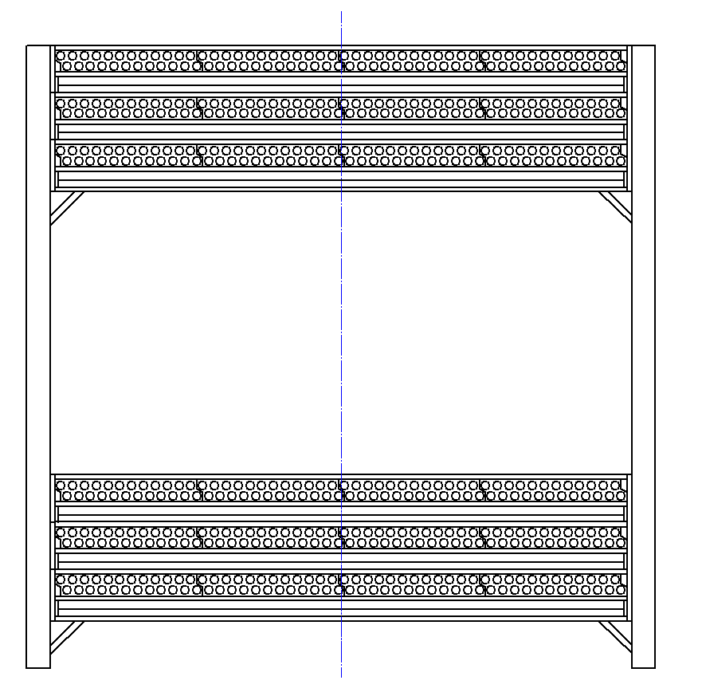

Amount of Nuclear Fuel Needs to be Estimated
Muon
Muon Tracker
Mid-and-Long-Term Roadmap towards the
Decommissioning of TEPCO's Fukushima Daiichi
Nuclear Power Station Units 1-4
METI
It is desirable to measure amounts of nuclear fuel in the removed debris from Fukushima Daiichi
Debris container
Radiation
Detector
Radiation
Detector
Muon Tracker
Uniform
Non-
uniform
Non-
uniform
Muon
Can muon scattering measure amount of nuclear fuel?

Slide 16
Measurement of Nuclear Material inside Debris is Challenging
Non-destructive measurement of debris inside a container
  Gammas and neutrons are measurable
    However it is not easy to estimate amounts of nuclear materials inside debris
Challenges measuring amount of nuclear materials
Materials distributed non-uniformly
Different burn up
・Different elements and densities
・Self shielding effect
・Neutron deceleration
and capture
・Radiations depends on the burn up
Nuclear fuel
Structural materials
Contaminated structural materials
Container
・Radiations coming from everywhere
Debris inside container

Slide 17
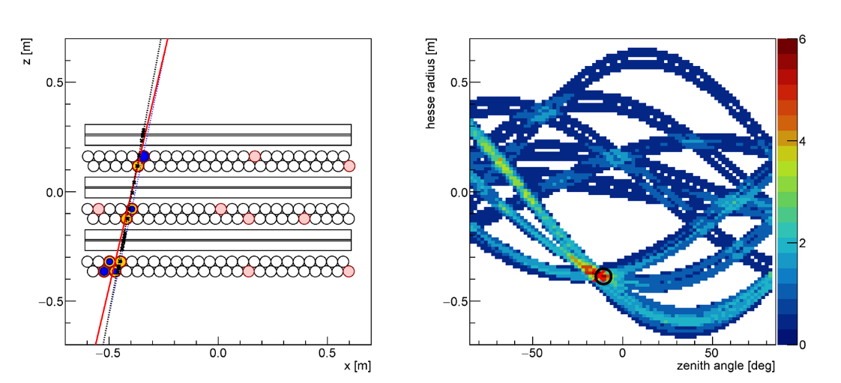
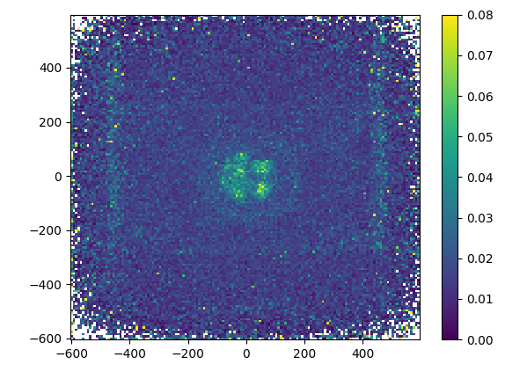
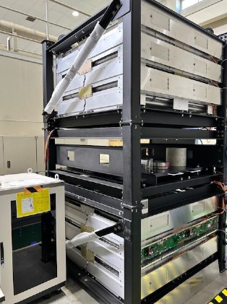
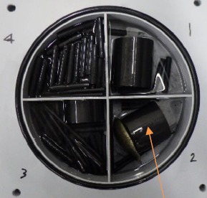
Muon Scattering Method to Measure Uranium Contents in Debris
Muon Tracking under Radiation Environment
Prototype muon scanner
1.2x1.2m² detection area
Left: track Hough transformation (blue dashed line), χ² minimization of line fit (red solid line) and true muon track (black dashed line).
Right: Hough voting histogram and position obtained by χ² minimization (red cross) and true muon track (black circle). Each drift tube is assumed to suffer 40-kHz noise which corresponds to the γ environment of 200 μSv/h .
Uranium
H. Miyadera et al., Applied Optics 63 (2024) A52.
Prototype detector developed for mock-debris demonstration

Slide 18
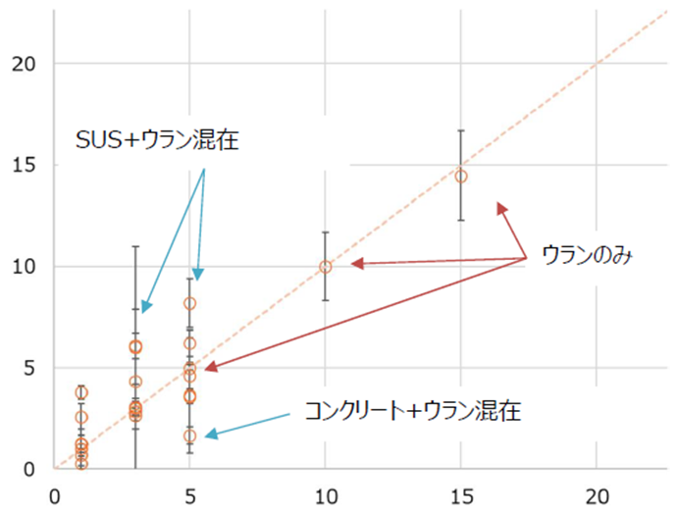
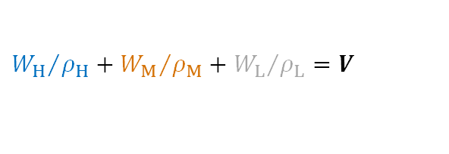


Analysis to Estimate Uranium Contents
Material | Density [g/cm³] | Classification
Pb | 11.35 | High Z
UO₂ | 10.96
SUS304 | 7.93 | Meddeum Z
Gd₂O₃ | 7.41
ZrO₂ | 5.68
Al | 2.70 | Low Z
B₄C | 2.52
Concrete | 2.30
H₂O | 1.00
Air | 0.0012 | -
Uranium contents cannot be determined just by the muon scattering angle.
Analysis using total weight and volume of debris, muon scattering and attenuation developed.
<Debris analysis>
Classify into three elements: high Z, medium Z and low Z
UO₂, SUS304 and concrete chosen as representative high-Z, medium-Z and low-Z materials
3 hours measurement
Error bar: 3σ
<Analysis>
Four equations on total weight, volume and average scattering angle:
where f(x) and R(x) give correlations between average muon scattering angles and attenuation, and material weights.
SUS304 + Uranium
$$W_{H}+W_{M}+W_{L}=W_{total}$$
H: high Z
M: medium Z
L: low z
$${W_{H}}/{ρ_{H}}+{W_{M}}/{ρ_{M}}+{W_{L}}/{ρ_{L}}=V$$
Estimated amount [kg]
Uranium
$$f_{H}\left(W_{H}\right)+f_{M}\left(W_{M}\right)+f_{L}\left(W_{L}\right)=Δθ^{2}$$
$$R_{H}\left(W_{H}\right)+R_{M}\left(W_{M}\right)+R_{L}\left(W_{L}\right)=R_{stop}$$
Concrete + Uranium
Amount of nuclear fuel in the measurement [kg]
UO₂ contents can be obtained by solving simultaneous equations

Slide 19
Conclusion and Future Prospect
Material identification based on muon scattering has been applied to cargo scanner, detection of pipe valve without stopping the plant operation and inspection of reinforced concrete
Since muon scattering is sensitive to high-Z materials, muon scattering imaging is very useful for nuclear industry
  Core monitor for SMR
  Nuclear security such as dry cask imaging
Feasibility study performed to apply muon scattering to estimate amounts of nuclear materials in debris
A pair of prototype muon trackers are currently under development. Technical demonstrations with simulated debris carried out.

