Slide 1
Performance Analysis and Optimization of a Parallel GPU-accelerated Low-Temperature 2D Particle-in-Cell Plasma Simulation Code
Zoltan Juhasz¹, Balint Toth¹, Peter Hartmann² and Zoltan Donko²
¹Dept. of Electrical Engineering and Information Systems,
University of Pannonia, Veszprem, Hungary
²Dept. of Complex Fluids, Institute for Solid State Physics and Optics,
Wigner Research Centre for Physics, Budapest, Hungary

Slide 2
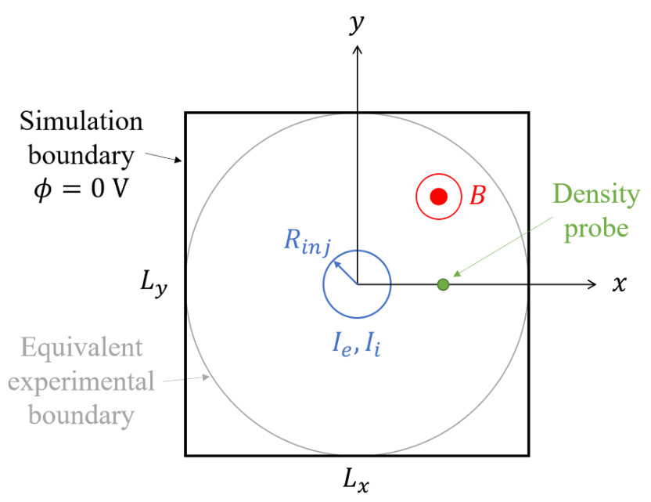
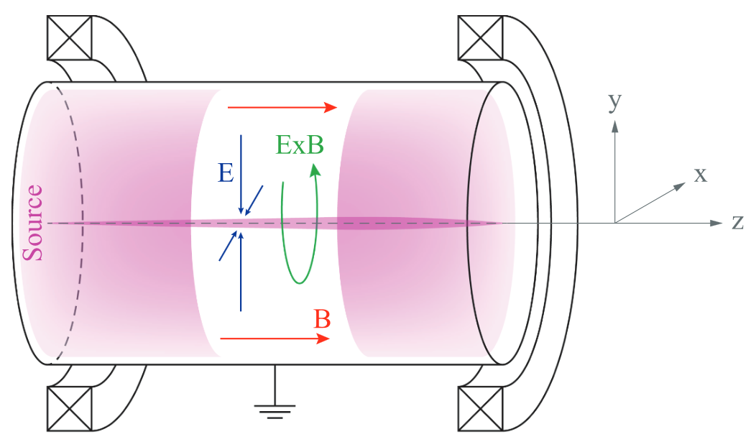
Magnetised (Penning discharge) Plasma Study
2D Particle-in-Cell simulation for investigating low frequency instabilities
~10 M superparticles, no collisions, 12.5 M simulation steps
particle injection at the centre

Slide 3
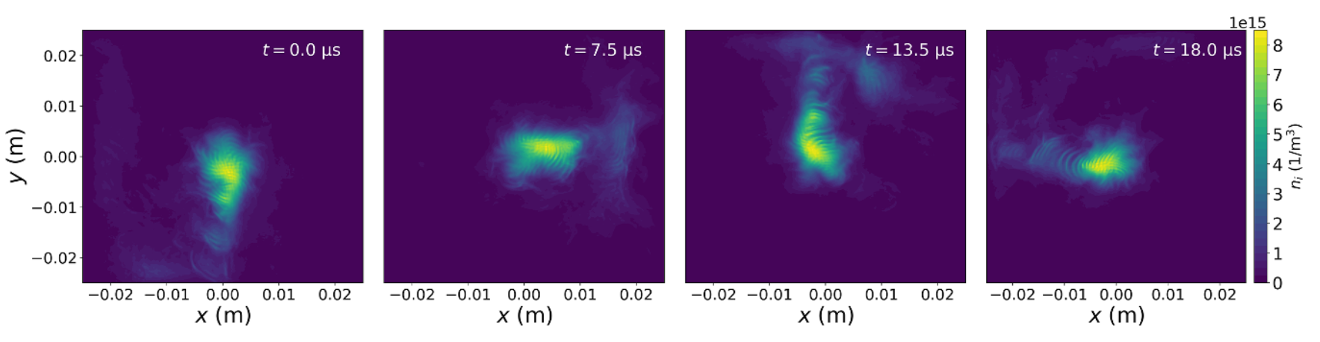
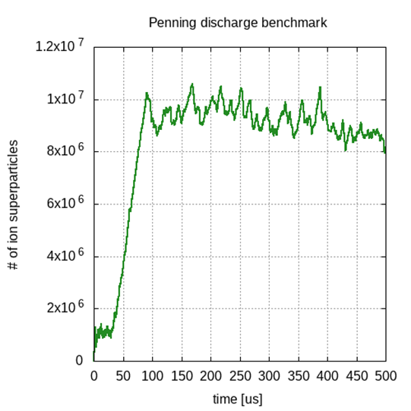
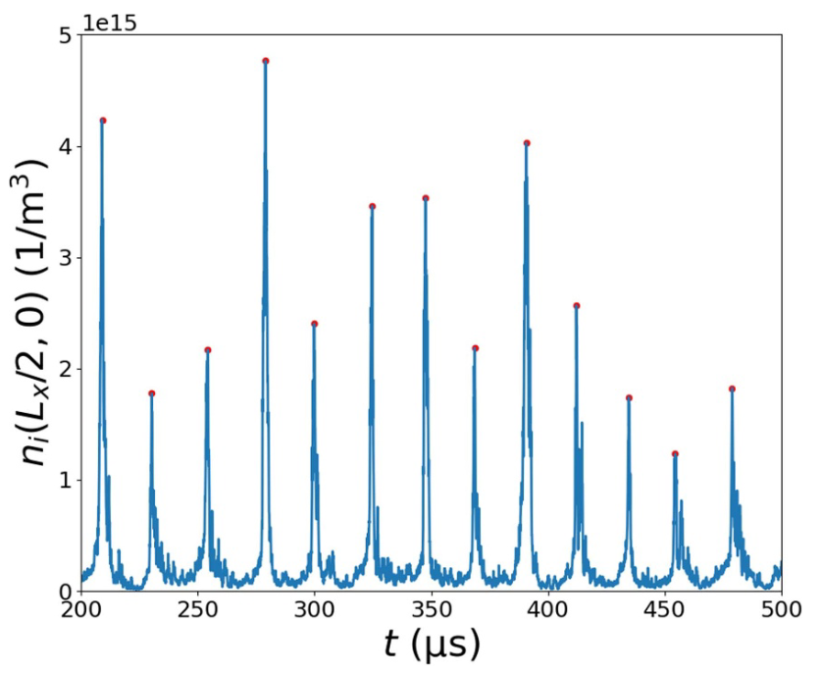

Slide 4
Landmark Benchmarking Effort
Princeton Plasma Physics Laboratory, Princeton, USA
Universidad Carlos III de Madrid, Spain
Laboratoire de Physique des Plasmas (LPP), CNRS, Sorbonne Université, ´Ecole Polytechnique, Institut Polytechnique de Paris,
Sandia National Laboratories, USA
Université de Toulouse, Toulouse INP, CNRS, LAPLACE, France
CERFACS, Toulouse, France
Nuclear (NUC) Department, ENEA C.R. Frascati, Frascati, Rome, Italy
Stanford University, USA
HUN-REN Wigner Research Centre for Physics, Hungary
DPHY, ONERA, Université Paris-Saclay, France
Ruhr University Bochum, Germany
Imperial College London, United Kingdom
Aeronautics and Aerospace Department, von Karman Institute for Fluid Dynamics, Belgium
KU Leuven, Belgium
Université Libre de Bruxelles, Belgium
Institute for Plasma Science and Technology (ISTP), CNR, Bari, Italy
University of Saskatchewan, Canada
University of Alberta, Canada
Dublin City University, Ireland
Powis, Andrew T., et al. "Benchmark for two-dimensional large scale coherent structures in partially magnetized E × B plasmas—community collaboration & lessons learned." Plasma Sources Science and Technology 35.2 (2026): 025002.

Slide 5
Execution times for 500 μs simulation

Slide 6
1-2 months
1-2 weeks
days

Slide 7
1-2 months
1-2 weeks
days

Slide 8
Wigner MZ/X Penning code
Hybrid CPU-GPU implementation
  particle move, density calculation, direct spectral Poisson solver on GPU
  particle injection, diagnostics, particle management on CPU
Using managed memory for simplified programming style
100 µs simulation time section is used for profiling
  2.5 million simulation step

Slide 9
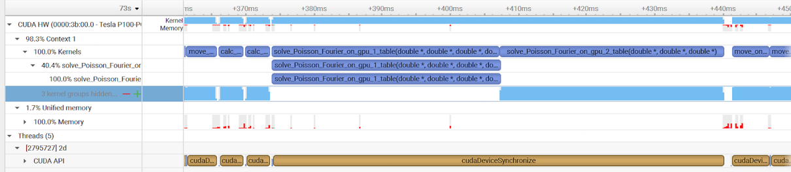
Baseline Performance Profiling
Poisson solver dominates execution time
frequent host-device data transfers

Slide 11
Optimisations steps
Explicit memory management, removing managed memory
Moving all simulation steps to GPU
Implementing new Poisson solvers
  Multigrid
  Spectral solver
Optimising diagnostics computation

Slide 12
Execution time results
Four GPU architectures: P100, V100, A100, RTX 6000 Ada
Execution time for 100 μs simulation
Results for
  original,
  multigrid and
  spectral solver versions

Slide 14
Why stop here?

Slide 15
Multi-GPU implementation
Target systems
  Wigner: 2 RTX 6000 Ada GPUs
  Komondor: 1-16? A100 GPUs
Particle partitioning
Relying on superposition principle
MPI and NCCL collective communications
  automatic particle partitioning based on GPU configuration
  AllReduce before Poisson solver
Diagnostics running overlapped in host thread
Multi-GPU advantage:
introduce further speedup for a system of given size (strong scaling)
increase particle count without increasing execution time (weak scaling)

Slide 16
Scalability
100 µs simulation
strong scaling
  1 to 8 GPUs
weak scaling
  9.5 to 72.6 M particles
Best time on A100
  26 mins (100 µs)
  ~ 2 hours (full simulation)

Slide 17
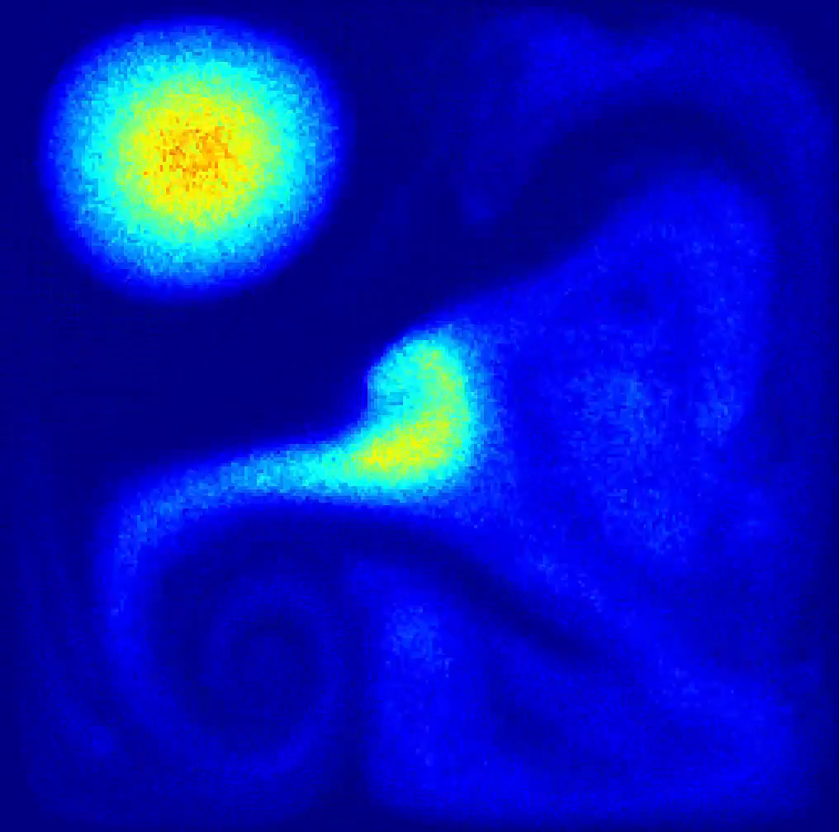
Conclusions
Algorithmic and implementation optimisations paid off
  fastest Penning simulation within the Benchmark Team
Opened new opportunities
  higher spatial resolution
  effect of injecting current amplitude
  full 3D simulation
Next steps
  Large-scale scalability benchmarking is planned on the MareNostrum 5 (H100 GPUs, Barcelona) and Leonardo (A100 GPUs, Bologna) supercomputers; larger grids, up to 1 billion particles
  3D Penning code development
  Collisional 2D and 3D simulation
Acknowledgements: NVIDIA Academic Grant Program, DKF Kft for access to the Komondor supercomputer

Slide 19
Approach: Particle-in-Cell (PIC) simulation
N-body problem
  no direct particle interaction, particles interact
  with the field
  place particle charges to grid
  solve grid for field – Poisson equation
  move particles based on field forces
Particle count: from 100k to 10m particles
Complication: collision!
CPU execution is long: ranging from days to months
  parallel solutions: OpenMP and/or MPI code
  irregular memory accesses make code difficult to parallelise efficiently

Slide 20
Data distribution
each GPU moves particles locally and computes new charge densities
Poisson solver on CPU or on each GPU (requires collective communication)

Slide 21
Problems
Requires collective communication operations involving CPU and GPU memory
  traditional MPI is not suitable – requires extra copy operations from GPU to CPU
  CUDA-aware MPI is OK, can use GPU pointers
Communication initiation is on CPU
  difficult to overlap comms. with GPU kernel execution
  communication can eventually become a performance bottleneck
  scalability limit

Slide 22
Alternative No 1 – NCCL
NVIDIA Collective Communication Library
Provides uniform API for all-gather, all-reduce, broadcast, reduce, reduce-scatter, point-to-point send and receive comm. routines
Optimized to achieve high bandwidth and low latency over PCIe, NVLink and other high-speed interconnects
Automatic topology detection for high bandwidth paths on AMD, ARM, PCI Gen4 and InfiniBand
Supports multi-threaded and multi-process applications
InfiniBand, RoCE and IP Socket internode communication
NCCL 2.4 introduced tree-based all-reduce instead of rings

Slide 23
Mismatch of communication libraries and the CUDA model
MPI and NCCL provide CPU-initiated communication routines
Assumes separate computation and communication steps
Fine for synchronous execution where all processes execute in parallel
CUDA model relies on large number of threads to hide memory and instruction latency: threads >> cores
Internal scheduling of kernels (thread blocks) makes it difficult to hide communication
Need a distributed model more aligned with the CUDA programming model

Slide 24
Summary
Still in progress, single node and rudimentary MPI versions are complete, NVSHMEM version coming soon
There are many alternatives for structuring and implementing pre-exascale multi-GPU programs
Selecting the best strategy and creating efficient code might not be easy
Following implementation patterns developed for much smaller CPU-based systems might not be a good long-term choice
Do not be afraid to re-design, re-structure your program
Programs with hundreds of millions or billions of threads can be executed efficiently on state-of-the-art systems

Slide 25
Abstract
In this talk, we plan to report the results of our performance optimisation effort aimed at speeding up a GPU-accelerated 2D Particle-in-Cell plasma simulation code, following an international plasma simulation benchmarking effort of 19 leading plasma research groups. We studied the effects of memory management, data movements, the choice and implementation of the Poisson solver, the use of mixed precision computation and various kernel-level optimisation techniques. Finally, the optimised version was improved to support multi-GPU execution as well. The key steps of the optimisation, the performance critical factors and our decisions will be presented in detail in the talk. Compared to the original baseline version that executed the simulation in 10 days, the runtime was reduced to less than 10 hours on an NVIDIA A100 GPU. Taking into account the performance increase of each new generation of GPU cards (from P100 to A100) as well, the overall speedup achieved with the optimised version exceeds 30×. The multi-GPU implementation will further reduce the execution time; using 4 A100 GPUs, we expect the final runtime to be less than 3 hours (note: final steps of the implementation and testing are currently underway, exact timings will be presented at the conference), that will make our implementation the fastest Penning discharge simulation code available. This level of performance not only means that we can execute simulations within a few hours instead of several days or weeks on GPUs, but it also allows for tackling large and complex simulation problems that were previously thought to be impossible to execute.

Slide 26
draft
Penning benchmark effort: simulation, participant groups
some outputs, execution time histogram
architecture and parallelism analysis
GPU code v0 → fast development, correct operation, no pre-mature optimisation
profiling: Poisson solver, managed memory
optimisation process on single GPU → steps, speedup, live simulation video
multi-GPU work current results → scalability, times, etc.
Next steps: 3D Penning, 3D collisional PIC/MCC

Slide 27
Single node, single thread multi-GPU program
// distributing the workload across multiple devices
for (int i = 0; i < ngpus; i++) {
cudaSetDevice(i);
cudaMemcpyAsync(d_A[i], h_A[i], iBytes,
cudaMemcpyHostToDevice, stream[i]);
cudaMemcpyAsync(d_B[i], h_B[i], iBytes,
cudaMemcpyHostToDevice, stream[i]);
kernel<<<grid, block, 0, stream[i]>>> (d_A[i], d_B[i], d_C[i], iSize);
cudaMemcpyAsync(h_C[i], d_C[i], iBytes,
cudaMemcpyDeviceToHost, stream[i]);
}
cudaDeviceSynchronize();

Slide 28
communication
data distribution, AllReduce
MPI vs NCCL
NCCL issue

Slide 29
Single node, 4 GPUs
Host
GPU 1
GPU 2
GPU 3
GPU 4
inject electrons and ions
Broadcast electrons and ions
electron/ion move 0/4
electron/ion move 1/4
electron/ion move 2/4
electron/ion move 3/4
Target runtime: 2.5 hours
density A
density B
density A
density B
Poisson
Poisson
Poisson
Poisson
AllReduce Sum (field)

Slide 30
Pre-exascale multi-GPU architecture
At least three different
communication fabrics
  PCI-e (CPU-GPU)
  Nvlink (GPU-GPU)
  Slingshot or
  Infiniband (node-
  node)
HPE Cray EX
MARCONI 100
LEONARDO

Slide 31
2D geometry
1D case
  particle count up to 1-10 millions: 1k cells, 1-10k particles per cell
2D case
  500 x 500 or 1k x 1k grid
  100 to 1k particles per cell
  25 M – 1 B particles
e_field should be in shared memory on each GPU
  1M instead of 1K elements
  Ampere persistent shared memory could help, otherwise must be moved into global memory

Slide 32
single node 1,2 ,4 GPUs
multi-node
strong scaling
weak scaling

