Slide 1
Deciphering the LILRB4 Immunosuppressive Landscape in Colorectal Tumors for De Novo Therapeutic Intervention
GPU Day
28 May 2026
Péter Hunyadi
HUN-REN TKI
PhD Student @ Pázmány ITK
Biophysics & Radiation Biology, SE
SEMMELWEIS UNIVERSITY 1769 I Institute of Biophysics and Radiation Biology I hegelab.org

Slide 2
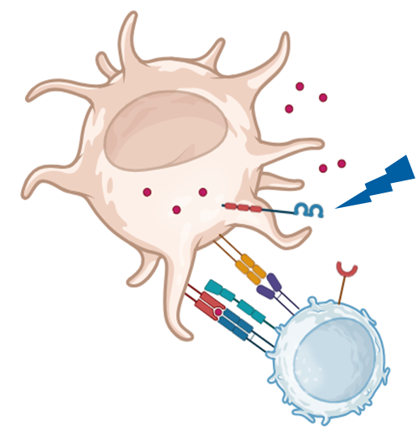
1/10
LILRB receptors - immune checkpoint molecules
Cancer is highly adaptive: avoids immune response
Immunosuppression > immune checkpoint (ICs) molecules
Ligands (expressed by tumor cells) bind ICs to suppress the immune cells
LILRB receptor family are immune suppressor receptors
LILRB4: antibody therapy on clinical trial
> study in colorectal cancer (CRC) context
SEMMELWEIS UNIVERSITY 1769 I Institute of Biophysics and Radiation Biology I hegelab.org
Notes:
These receptors are bound from the extracellular space by specific interaction partners called ligands, which initiate a signalling cascade to downregulate the effect of the immune cell they are on and overall weaken the anti-tumor response.

Slide 3
2/10
Study plan
Inhibit LILRB4 function!
In silico design of a LILRB4 binding nanobody
Test its ability in vitro
Challenges
Design a strongly binding nanobody
1/13
SEMMELWEIS UNIVERSITY 1769 I Institute of Biophysics and Radiation Biology I hegelab.org
Notes:
upsides of nanobody compared to antibodies
in this topic we faced two computational challenges which I am going to describe here

Slide 4
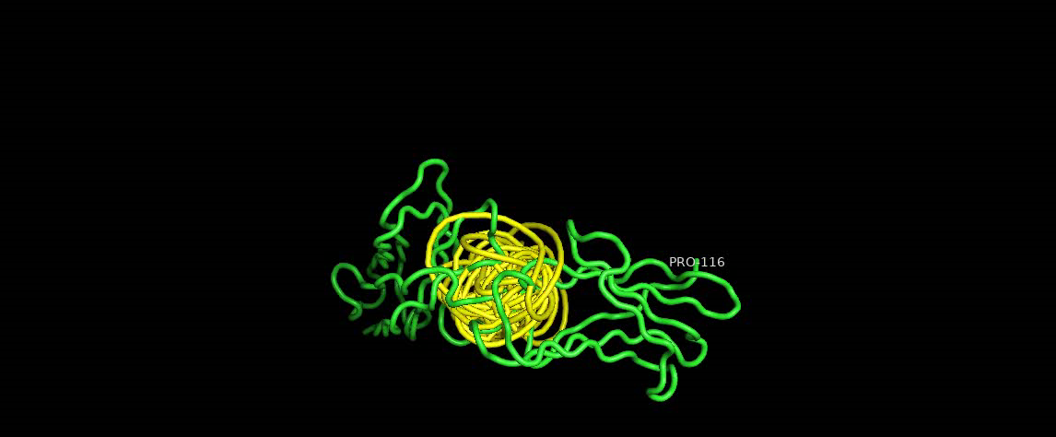
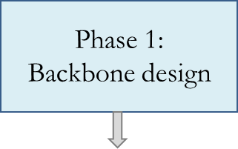
3/10
1. Nanobody design
Nanobody design
RFDiffusion
Start from constrained backbone
Diffusion introduces small changes
SEMMELWEIS UNIVERSITY 1769 I Institute of Biophysics and Radiation Biology I hegelab.org
Notes:
Backbone Design (RFdiffusion): We start with known nanobody secondary structure templates and use RFdiffusion to generate a diverse set of novel, stable backbone scaffolds.

Slide 5
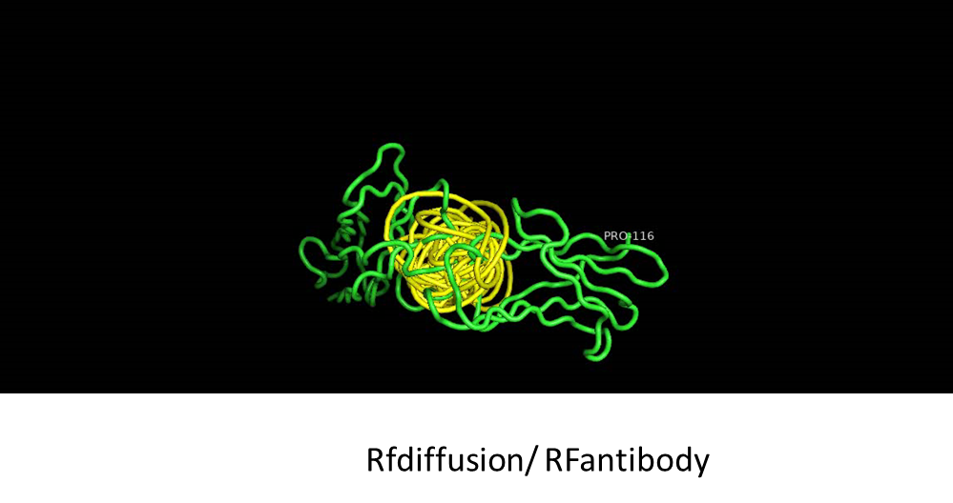
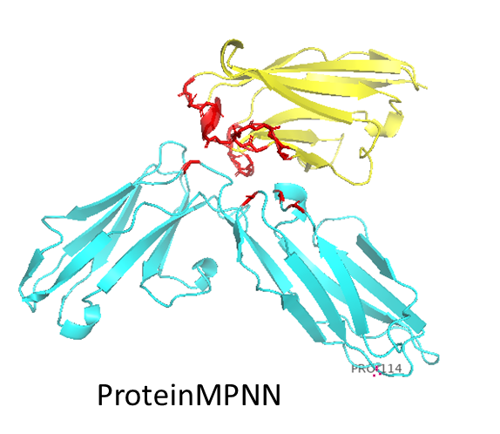
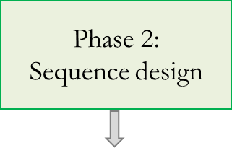
3/10
1. Nanobody design
Nanobody design
RFDiffusion
Start from constrained backbone
Diffusion introduces small changes
Adds sequence to the structure
We get a lot of sequences this way
SEMMELWEIS UNIVERSITY 1769 I Institute of Biophysics and Radiation Biology I hegelab.org
Notes:
Sequence Design (LigandMPNN): Once the backbone is fixed, LigandMPNN calculates the specific amino acid sequence most likely to fold into that exact 3D shape.

Slide 6
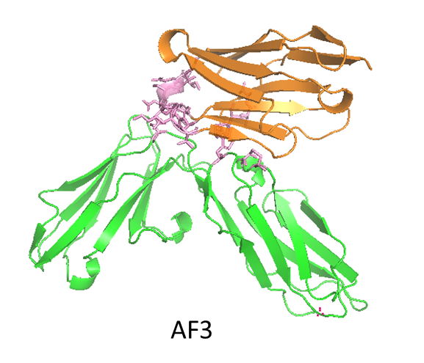
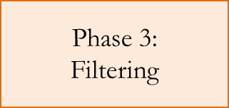
3/10
1. Nanobody design
Nanobody design
RFDiffusion
Start from constrained backbone
Diffusion introduces small changes
Adds sequence to the structure
We get a lot of sequences this way
AlphaFold3 predicts complexes well
Filter out incorrectly folding sequences
SEMMELWEIS UNIVERSITY 1769 I Institute of Biophysics and Radiation Biology I hegelab.org
Notes:
We can run all the resulting designs in AF in complex with the receptor
"We use AF3 here specifically because of its improved handling of chemical interactions and ligands compared to previous versions."

Slide 7
4/10
Conclusion
A set of nanobodies were designed in silico and their binding ability to LILRB4 is being validated in the lab right now.
SEMMELWEIS UNIVERSITY 1769 I Institute of Biophysics and Radiation Biology I hegelab.org

Slide 8
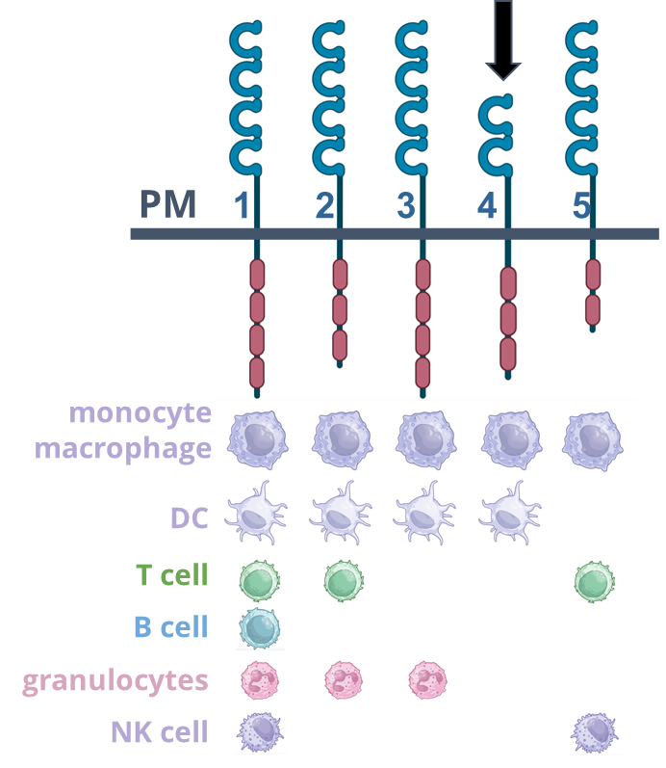
5/10
Study plan
LILRB receptor family
Inhibit LILRB4 function!
In silico design of a LILRB4 binding nanobody
Test its ability in vitro
Challenges
Design a strongly binding nanobody
Identify LILRB4 expressing cells in CRC
1/13
SEMMELWEIS UNIVERSITY 1769 I Institute of Biophysics and Radiation Biology I hegelab.org
Notes:
this can be measured in the lab as well with binding antibodies, but it is interesting for us to see that this information can be gathered from publicly available data, radically cutting costs.

Slide 9
6/10
2. LILRB4 expression
single-cell RNA sequencing data
RNA amount > good proxy for protein levels!
Single-cell resolution
Widely used (eg. monitoring of disease progression)
Dataset used here:
62 samples
370.000 cells from colorectal tumors and adjacent normal tissues
Pelka et al. Spatially organized multicellular immune hubs in human colorectal cancer. Cell. 2021
2/13
SEMMELWEIS UNIVERSITY 1769 I Institute of Biophysics and Radiation Biology I hegelab.org
Notes:
needs to be said, that we are quantifying mRNA values because we want to know the amount of protein that is made in the cell and the easiest way to discern this is by quantifying RNA, the precursor of protein.
(Improved biomarker identification; Precise monitoring of drug response and disease progression)

Slide 10
7/10
2. LILRB4 expression
Cell type annotation with LLM
Based on transcription difficult to guess cell type
Precise annotation of single cells
3/13
SEMMELWEIS UNIVERSITY 1769 I Institute of Biophysics and Radiation Biology I hegelab.org

Slide 11
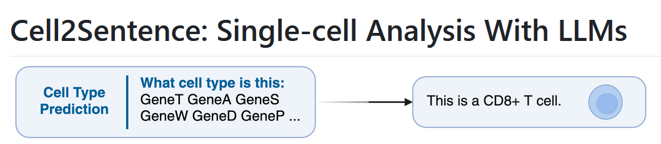
7/10
2. LILRB4 expression
Cell type annotation with LLM
Based on transcription difficult to guess cell type
Precise annotation of single cells
A new LLM based tool: Cell2Sentence (Google DeepMind/Yale 2024-25)
2B param. version - runs locally
Input: “sentence” of most expressed gene names in descending order
Good performance (88% accuracy) of cell type prediction, but at the cost of the ability to argue about the output!
https://github.com/vandijklab/cell2sentence
3/13
SEMMELWEIS UNIVERSITY 1769 I Institute of Biophysics and Radiation Biology I hegelab.org

Slide 12
8/10
2. LILRB4 expression
Comparison with general LLM
Comparing with Deepseek-v4-flash general model
Comparison scheme:
Same prompts to analyse the same 1000 cells
LLM compares the two answers - rates correspondence 1-5
The scores are mined from the answers and summarized
SEMMELWEIS UNIVERSITY 1769 I Institute of Biophysics and Radiation Biology I hegelab.org
Notes:
followup question - which cells cause difference between the two annotations?

Slide 13
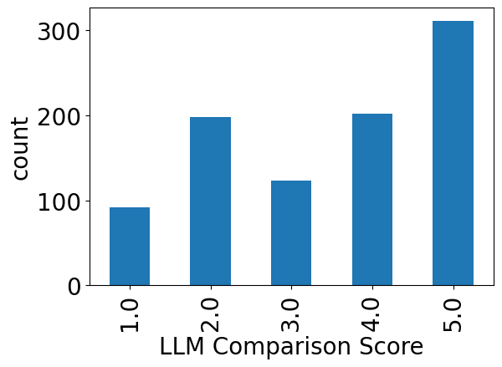
8/10
2. LILRB4 expression
Comparison with general LLM
31,3% (290)
13,3% (123)
55,4% (513)
Comparing with Deepseek-v4-flash general model
Comparison scheme:
Same prompts to analyse the same 1000 cells
LLM compares the two answers - rates correspondence 1-5
The scores are mined from the answers and summarized
Results of the experiment
~40% difference suggests that Deepseek is less accurate
Tradeoff is that Deepseek argues about its output, while C2S does not have natural language answer capabilities right now
3/13
SEMMELWEIS UNIVERSITY 1769 I Institute of Biophysics and Radiation Biology I hegelab.org
Notes:
followup question - which cells cause difference between the two annotations?

Slide 14
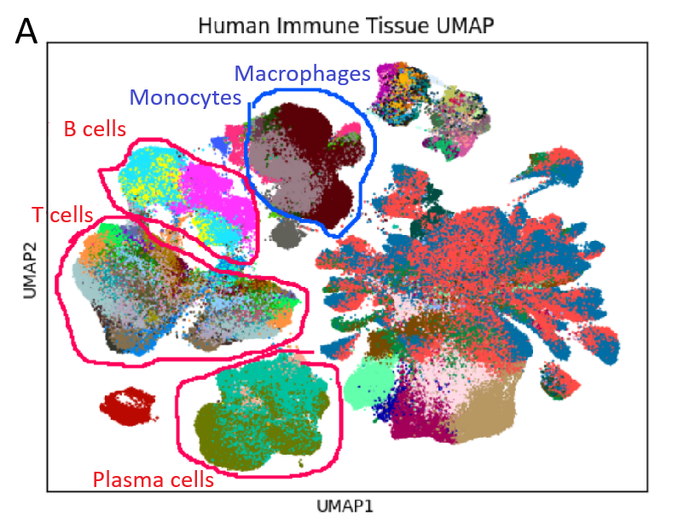
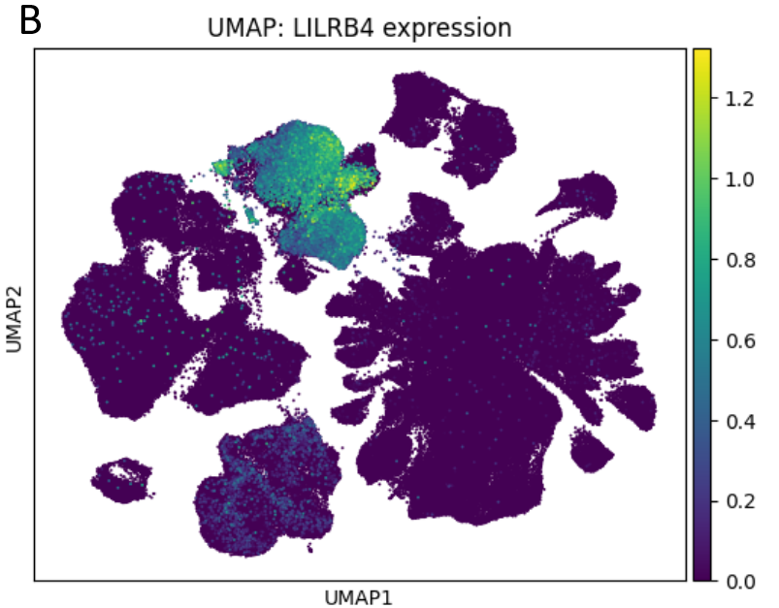
9/10
2. LILRB4 expression
LILRB4 is expressed by myeloid immune cells
LILRB receptor family
SEMMELWEIS UNIVERSITY 1769 I Institute of Biophysics and Radiation Biology I hegelab.org

Slide 15
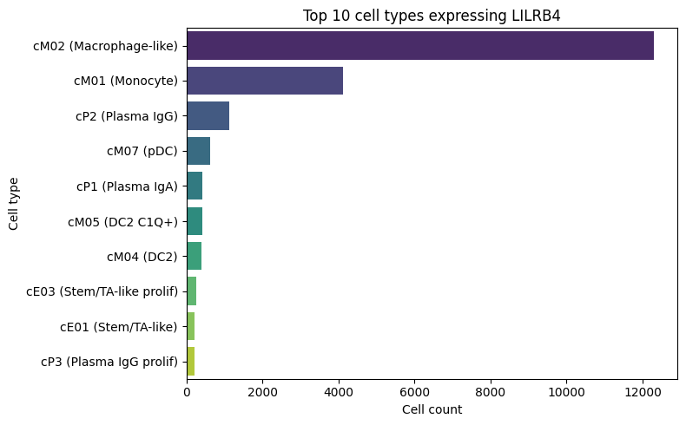
9/10
2. LILRB4 expression
LILRB4 is expressed by myeloid immune cells
SEMMELWEIS UNIVERSITY 1769 I Institute of Biophysics and Radiation Biology I hegelab.org

Slide 16
9/10
2. LILRB4 expression
LILRB4 is expressed by myeloid immune cells
Interestingly we also found lymphoid immune cell expression!
SEMMELWEIS UNIVERSITY 1769 I Institute of Biophysics and Radiation Biology I hegelab.org

Slide 17
10/10
Study plan
LILRB receptor family
In silico design of a LILRB4 binding nanobody To inhibit LILRB4 function
Test its ability in vitro
Challenges
Design a strongly binding nanobody
Identify LILRB4 expressing cells in CRC
Separate expression in differentially activated macrophages!
1/13
SEMMELWEIS UNIVERSITY 1769 I Institute of Biophysics and Radiation Biology I hegelab.org

Slide 18
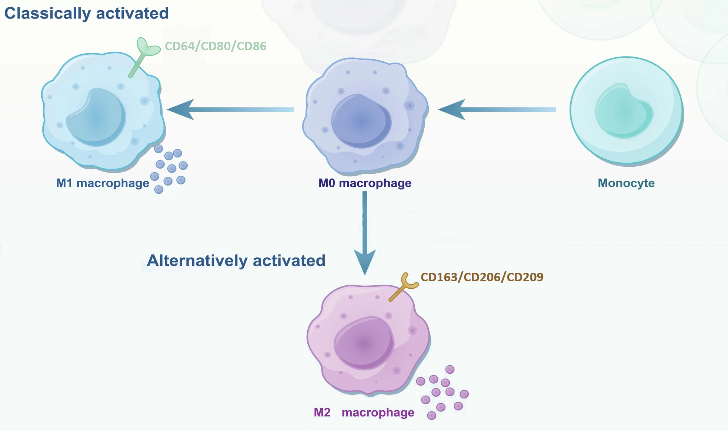
11/10
2. Specifying immune cell subtypes
Defining macrophage subtypes
Importantly: determine expression within different activation states
M1 (classically activated) or M2 (alternatively activated)
Stratified into six marker-defined subgroups based on the highest expression of characteristic macrophage markers
Guan, F., Wang, R., Yi, Z. et al. Tissue macrophages: origin, heterogenity, biological functions, diseases and therapeutic targets. Sig Transduct Target Ther 10, 93 (2025)
SEMMELWEIS UNIVERSITY 1769 I Institute of Biophysics and Radiation Biology I hegelab.org
Notes:
*surface markers are easy to profile - eg. with staining as they are located outside of the cells.
*

Slide 19
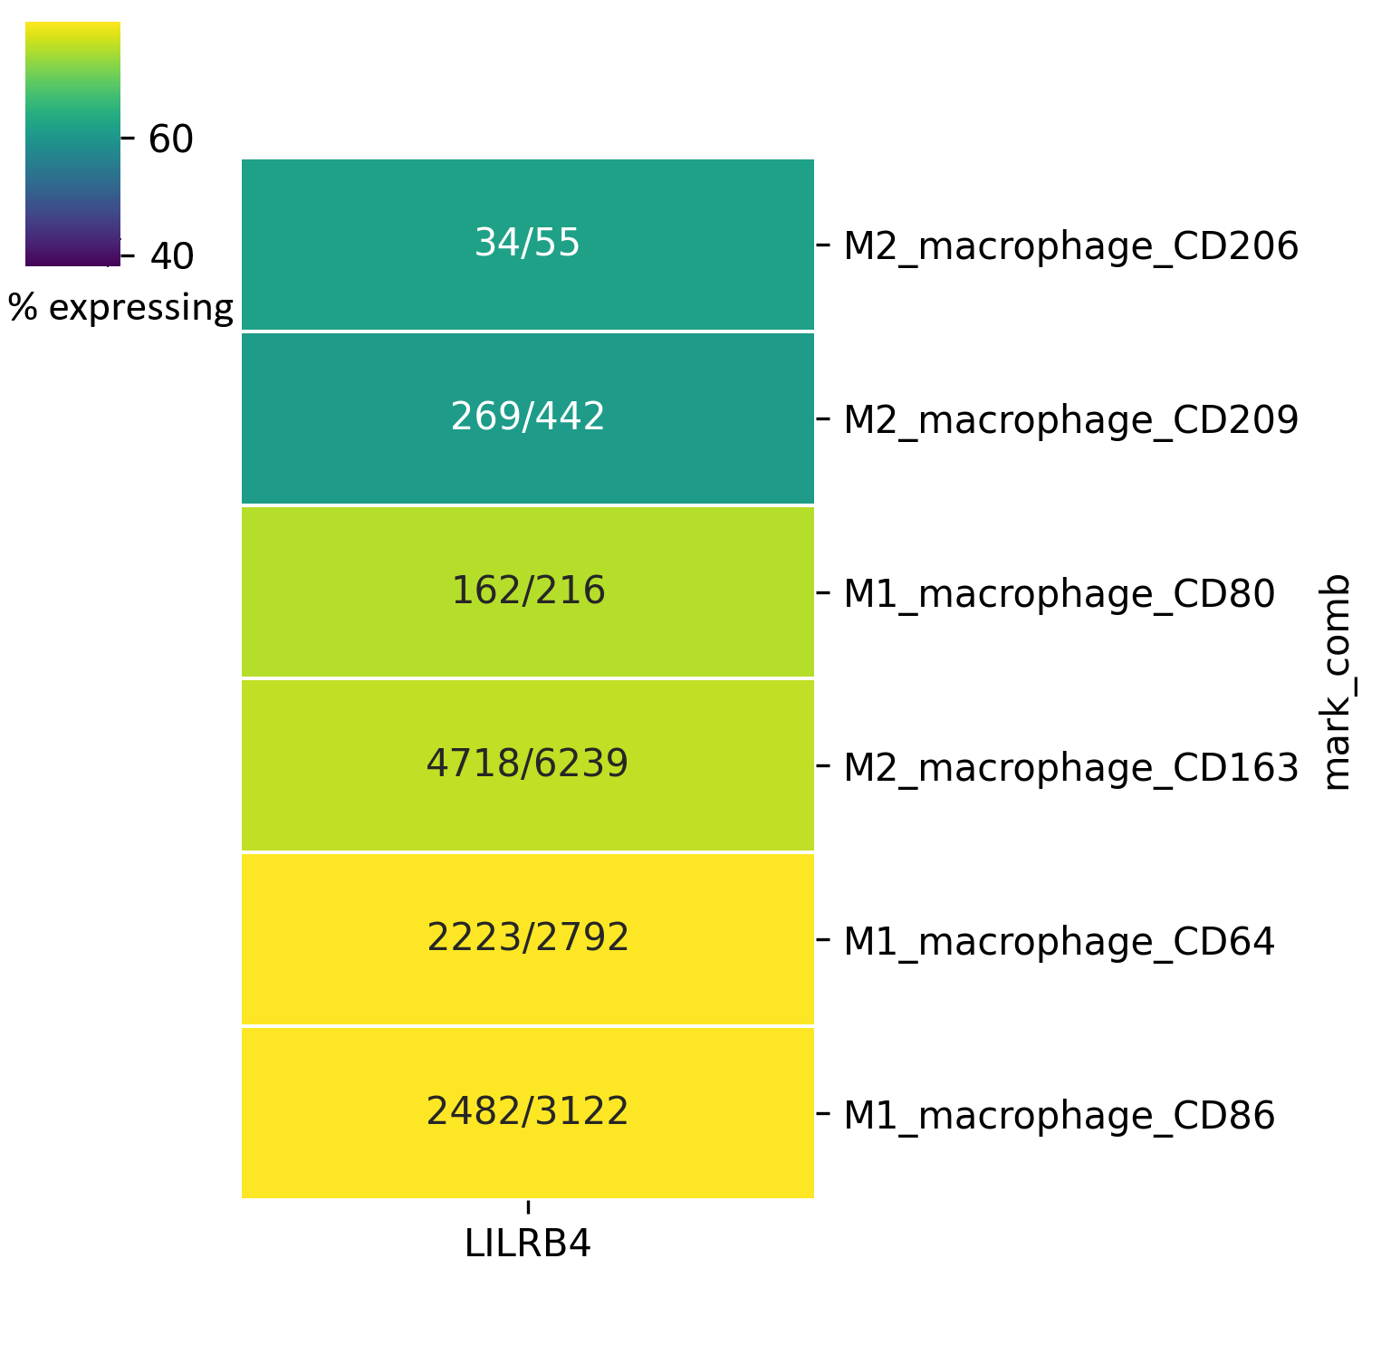
12/10
2. Specifying immune cell subtypes
B4 corresponds to M1 macrophages, B2 to M2
Two M1 macrophage subgroups have the highest percentage of LILRB4 expressing cells
Overall M1 macrophages have larger LILRB4 expression ratio
M1 | 4867/6130 (79,4%)
M2 | 5021/6736 (74,5%)
SEMMELWEIS UNIVERSITY 1769 I Institute of Biophysics and Radiation Biology I hegelab.org

Slide 20
10/10
Conclusion
A set of nanobodies were designed in silico and their binding ability to LILRB4 is being validated in the lab right now.
2. Comparing language model performance on biological tasks is an understudied, but important question.
- We argue for a trade-off between using a specialized and a general model
SEMMELWEIS UNIVERSITY 1769 I Institute of Biophysics and Radiation Biology I hegelab.org

Slide 21
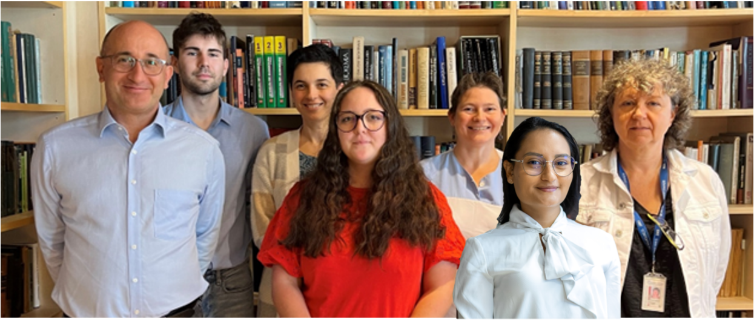

Thank you for your attention!
Contributors:
Department of Biophysics and Radiation Biology
Semmelweis University, Budapest
Zoltán Wiener, Dávid Kis and colleagues
Institute of Genetics, Cell- and Immunobiology
Semmelweis University, Budapest
Hegedűs Tamás
Tordai Hedvig
Kozák Eszter
Padányi Rita
Lór Kriszti
Gereben Orsolya
Berta Blanka
Lana Khamisi
Karen Torres
NKFIH 137610
HU-RIZONT 2024-0003
HUN-REN Wigner GPU-lab
KIFÜ HPC KK
SEMMELWEIS UNIVERSITY 1769 I Institute of Biophysics and Radiation Biology I hegelab.org
Notes:
Meg szeretném köszönni a segítséget együttműködőinknek, Wiener Zoltánnak és Kis Dávidnak a Semmelweis Egyetem Genetika- Sejt- és Immunbiológia Intézetéből.
illetve a csapatomnak, kiemelten Hegedűs Tamásnak és Tordai Hedvignek a Biofizika Intézetből.
Köszönöm szépen a figyelmet!

