Slide 1

AI from a High-Performance Computing Perspective: CPUs, GPUs, and the Quantum Convergence
Attila Csaba Marosi
NTT DATA
GPU Day 2026 — May 28-29, 2026, Budapest

Slide 2
NTT DATA — Global at a glance
Global telecommunications and IT services provider, headquartered in Tokyo, Japan. NTT DATA delivers infrastructure, cloud and AI services across regulated industries worldwide.
80+
~198K
Tokyo
IT & Telecom
Countries
Employees
Global HQ
Services focus
Key strategic priorities
Data center growth
AI & IoT integration
Sustainability
5G & next-gen networks
Hyperscale expansion across key regions
Embedded intelligence across services
Carbon neutrality goals and green operations
Advanced connectivity infrastructure
GPU Day 2026 — May 28-29, 2026, Budapest

Slide 3
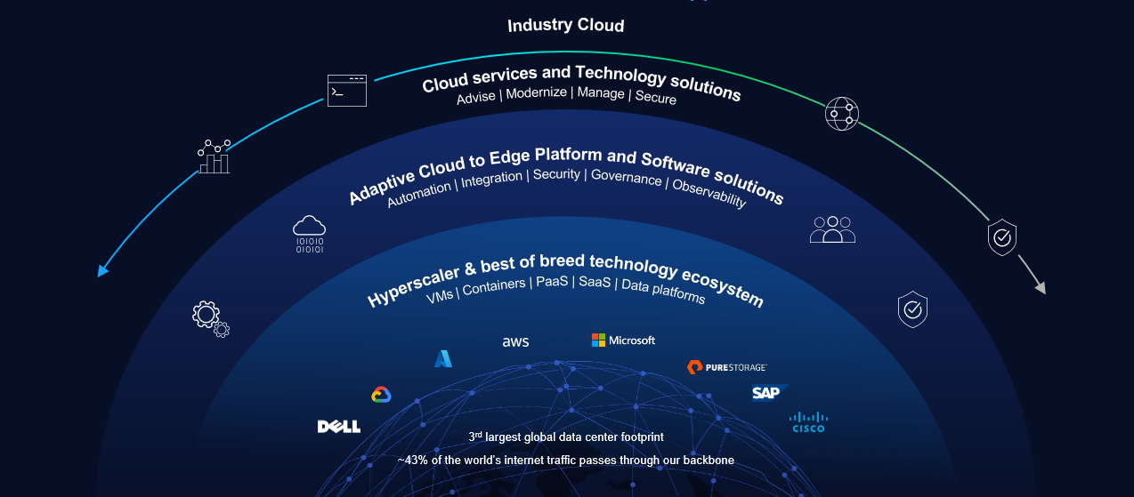
Our technology stack and partner ecosystem
GPU Day 2026 — May 28-29, 2026, Budapest

Slide 4
NTT Hungary
Hungarian subsidiary delivering enterprise technology services since 2001, backed by NTT DATA's global capabilities and partner ecosystem.
2001
180+
Budapest
ISO 27001
Established
Employees
Local office
Certified
Core services delivered locally
Data centers & networks
Cloud & infrastructure
AI, GenAI & AIOps
Cybersecurity
Enterprise data center and network infrastructure
Hybrid cloud, server, and storage solutions
Generative AI solutions and AI-driven IT operations
Security advisory, monitoring, and response
GPU Day 2026 — May 28-29, 2026, Budapest

Slide 5
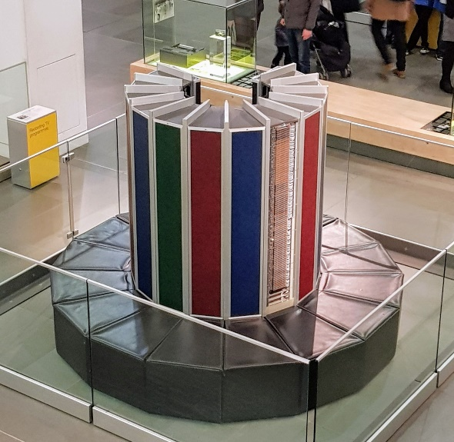
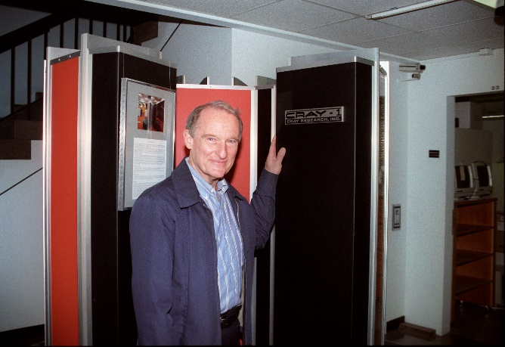
Supercomputers – High Performance Computing
Definition: A computer system that can solve complex computational tasks far faster than average for the current technology level — within a timeframe that makes the result relevant.
Typical building blocks
Classical components: CPU, GPU, memory, interconnect, storage, network
Massively parallel architecture, UNIX/Linux OS
Batch processing with a job scheduler
Parallel programming environments — MPI, OpenMP
Core use cases
Simulation and modeling
Big-data analytics
AI (training and inference)
A short history
Cray-1 (1976) → commodity clusters (1990s) → petascale (2008) → exascale (Frontier, 2022)
GPUs and AI accelerators now dominate — paving the way for AI-first supercomputers: the EuroHPC AI Factories
TOP500 list: http://top500.org

Slide 6
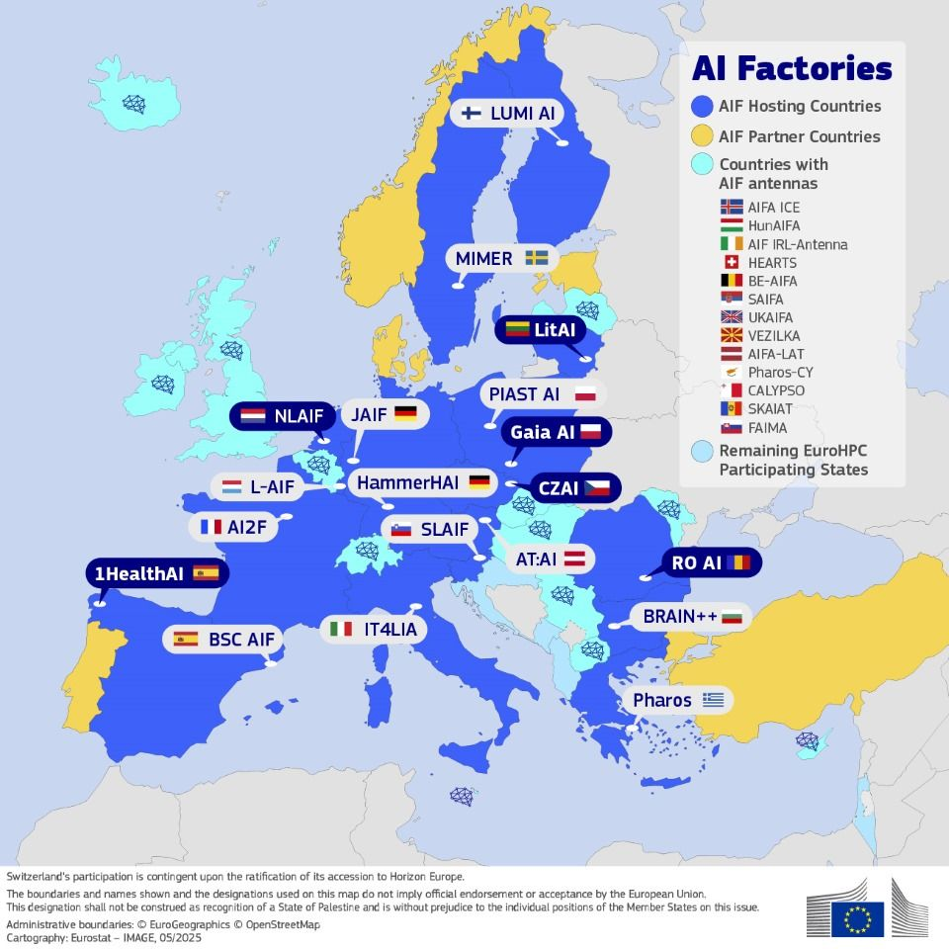
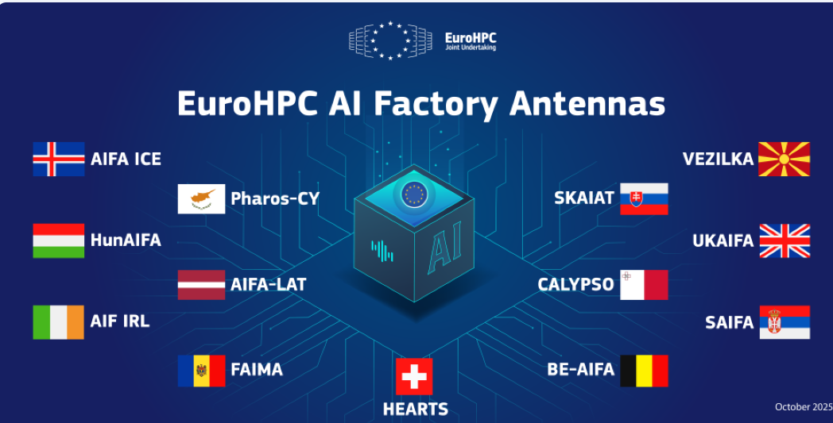
AI Factories
EU-backed network of high-performance computing hubs giving European startups, researchers, and industry sovereign access to AI supercomputing
19 AI Factories and 13 AI Factory Antennas spanning the EU, anchored on AI-optimised supercomputers (LUMI, Leonardo, MareNostrum, and others)
3 AI access modes tailored to users, with 40+ key industrial sectors covered across the network
Provide GPU clusters, data infrastructure, and expert support to develop, train, and deploy trustworthy AI solutions
Built around European SMEs, public-sector users, and strategic sectors
Coordinated by EuroHPC JU

Slide 7
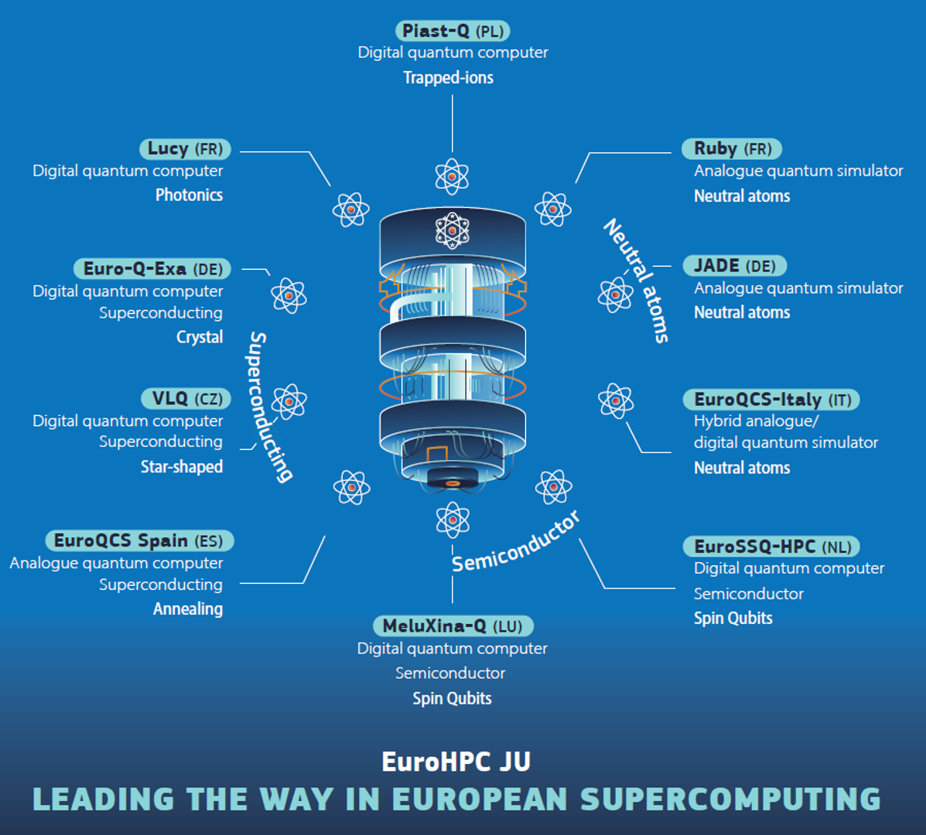
EuroHPC: HPC – AI – QC Convergence 1.
2022: EuroHPC += QC
2023: EuroHPC += AI
2026: EuroHPC += Everything Quantum (e.g., sensing, communication)
Two closed calls for proposals: 8 + 2 = 10 quantum computers
120 million EUR
European manufacturers
6 different qubit technologies
650 qubits in total
1 system is annealing; the others are gate based
GPU Day 2026 — May 28-29, 2026, Budapest

Slide 8
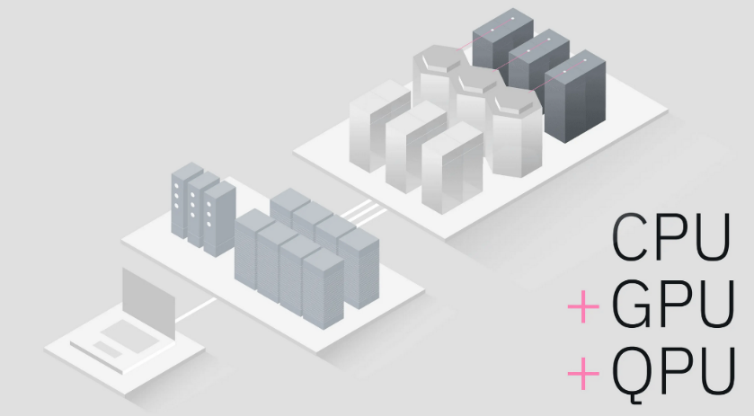
Key Challenges of HPC – AI – QC
Convergence 2.
Hardware architecture: integrating CPU, GPU, and QPU resources
Software stack: unified programming across classical and quantum
Maturing portfolio of quantum algorithms
Hybrid algorithms orchestrating HPC, AI, and quantum together
Existing and emerging enabling technologies:
  Qubernetes
  Slurm quantum support (SPANK)
  MQSS — Munich Quantum Software Stack
  NVQLink — quantum-GPU interconnect
  NVIDIA CUDA-Q
  QBridge — HPC–quantum integration
GPU Day 2026 — May 28-29, 2026, Budapest
Notes:
Bringing HPC, AI, and quantum together is more than just plugging machines into the same rack. There are five challenges that really shape the work today.
First, the hardware side — we need to integrate CPUs, GPUs, and QPUs as peers in the same system, not as isolated islands.
Second, the software stack: developers shouldn't have to learn a completely separate world to use a quantum resource — we need unified programming across classical and quantum.
Third, the algorithms themselves are still maturing. The portfolio of useful quantum algorithms is growing, but it's far from complete.
Fourth, even the algorithms we have are rarely purely quantum — they're hybrid, and orchestrating HPC, AI, and quantum together is its own engineering problem.
And finally, the good news: a real ecosystem of enabling technologies is emerging to make this practical — things like
- Qubernetes and Slurm quantum extensions for scheduling,
- the Munich Quantum Software Stack,
- NVIDIA's CUDA-Q and NVQLink for tight GPU–quantum coupling, and
- QBridge for HPC–quantum integration.
So the convergence isn't a future vision — the building blocks are already being assembled.

Slide 9
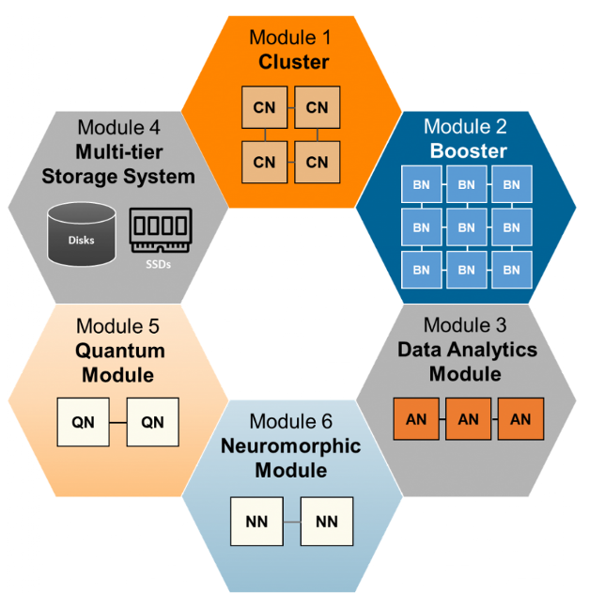
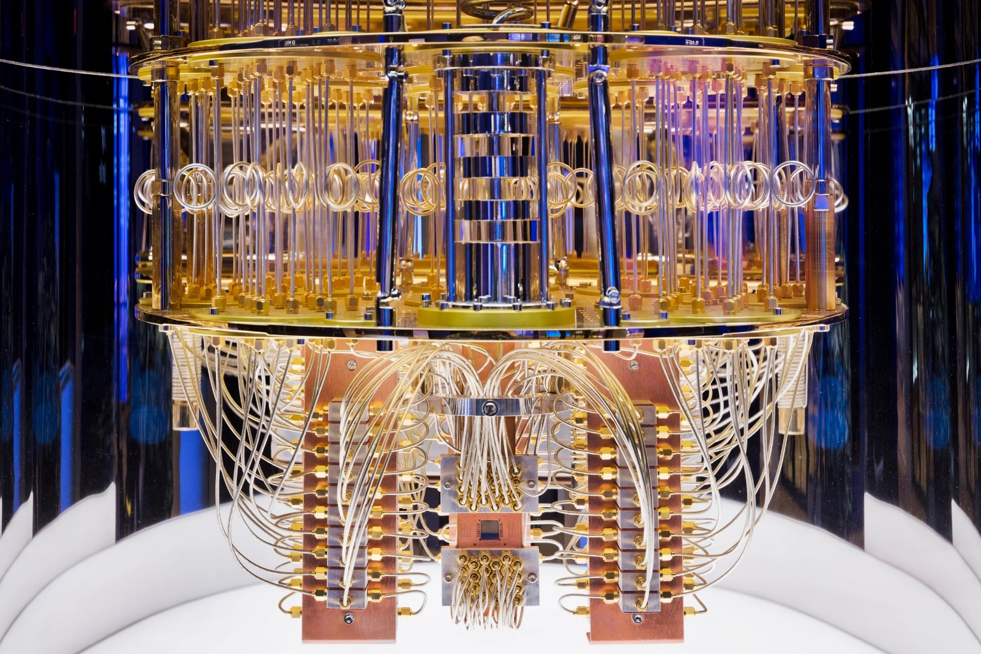
EuroHPC: HPC – AI – QC
Convergence 3.
Modular architecture bringing classical HPC, AI, and quantum computing into a single system
Specialized modules for simulation, AI training, data analytics, and emerging quantum and neuromorphic workloads
Shared storage and high-speed interconnects let workloads use the right resource at the right time
Enables hybrid pipelines: HPC simulation feeding AI models, with quantum acceleration
Energy efficiency and sustainability are central design drivers as performance scales
A blueprint for Europe's next generation of exascale and post-exascale systems
Jülich Supercomputing Centre (JSC), ParTec
GPU Day 2026 — May 28-29, 2026, Budapest

Slide 10
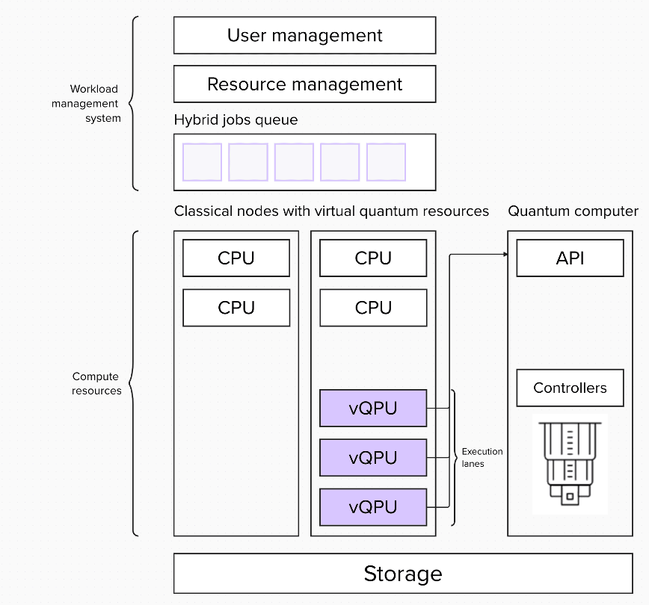
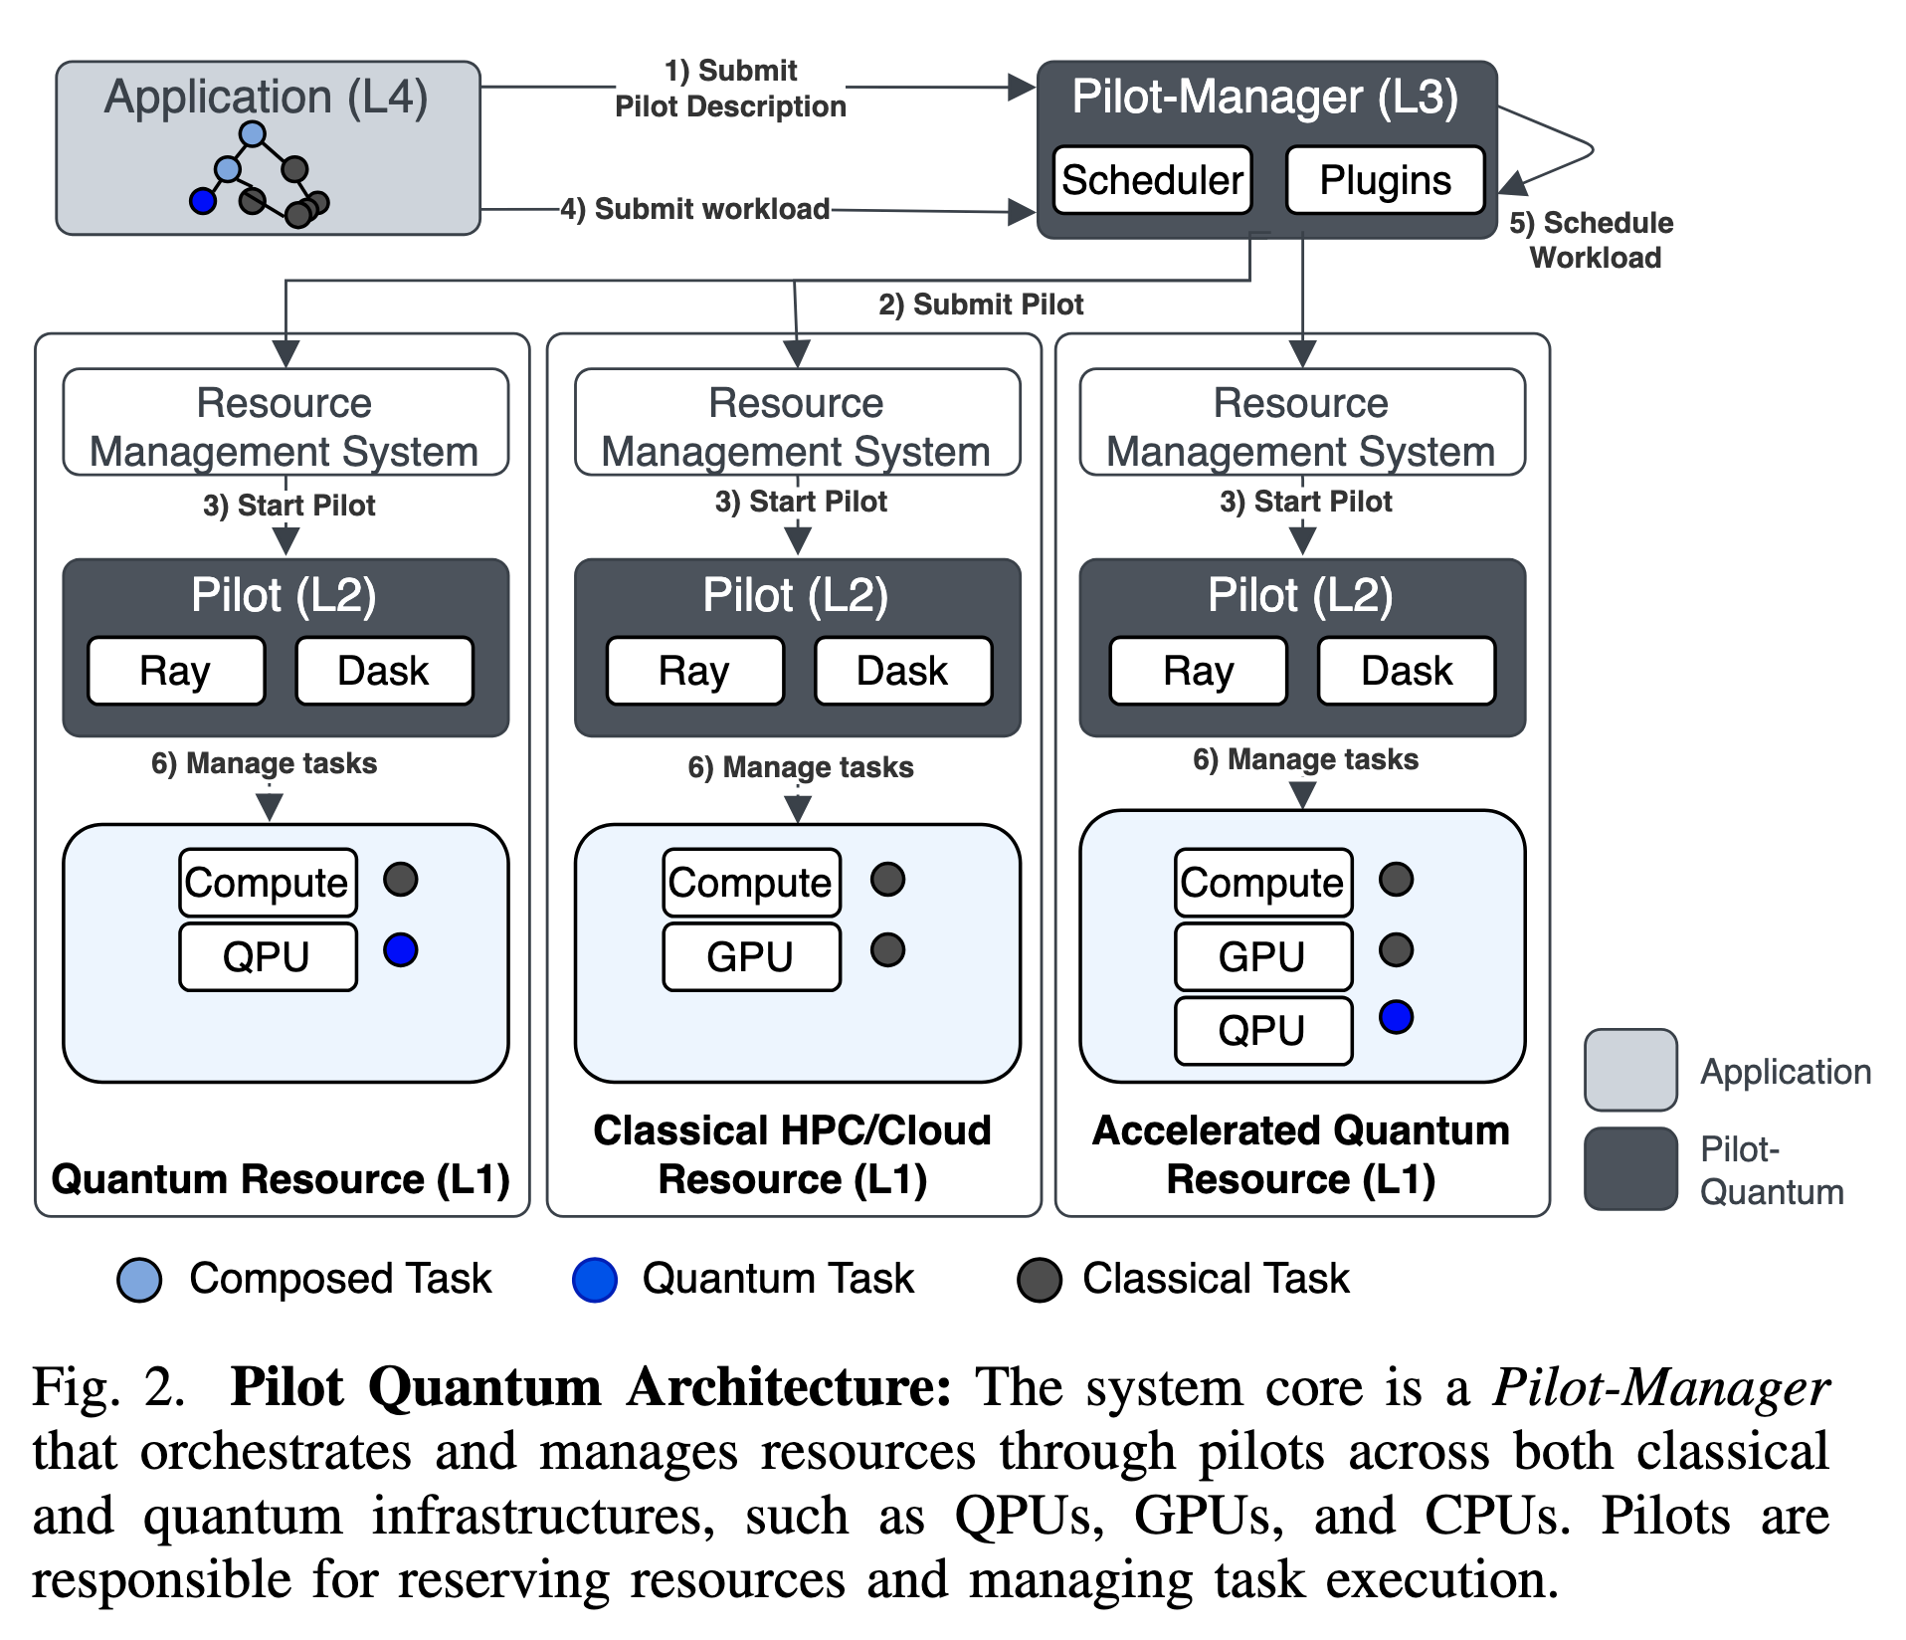
Possible Architectures
Mantha, Pradeep, Florian J. Kiwit, Nishant Saurabh, Shantenu Jha, and Andre Luckow. “Pilot-Quantum: A Quantum-HPC Middleware for Resource, Workload and Task Management.” arXiv:2412.18519. Preprint, arXiv, May 28, 2025. https://doi.org/10.48550/arXiv.2412.18519.
GPU Day 2026 — May 28-29, 2026, Budapest
Notes:
On the left, you can see the conceptual picture: a familiar workload management layer on top — user management, resource management, a hybrid jobs queue — and underneath it, classical compute nodes with CPUs sitting side by side with virtual QPUs. Those vQPUs are the bridge to the real quantum hardware on the right, accessed through an API and controllers.
On the right is one concrete realization of this idea, the Pilot-Quantum architecture from Mantha and colleagues. The key element is a Pilot-Manager that orchestrates work across three kinds of resources in a unified way — pure quantum, classical HPC and cloud, and accelerated quantum nodes that combine GPUs and QPUs.
It then schedules three flavors of tasks across them: classical, quantum, and composed tasks that mix both.
The takeaway is simple: the architectures are no longer purely theoretical — concrete designs already exist for treating CPUs, GPUs, and QPUs as peers in the same system.

Slide 11
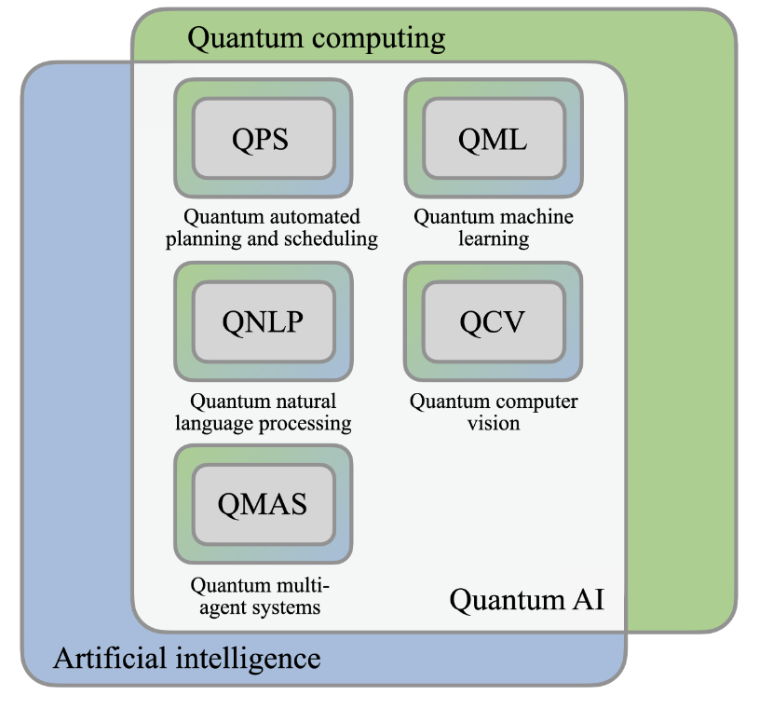
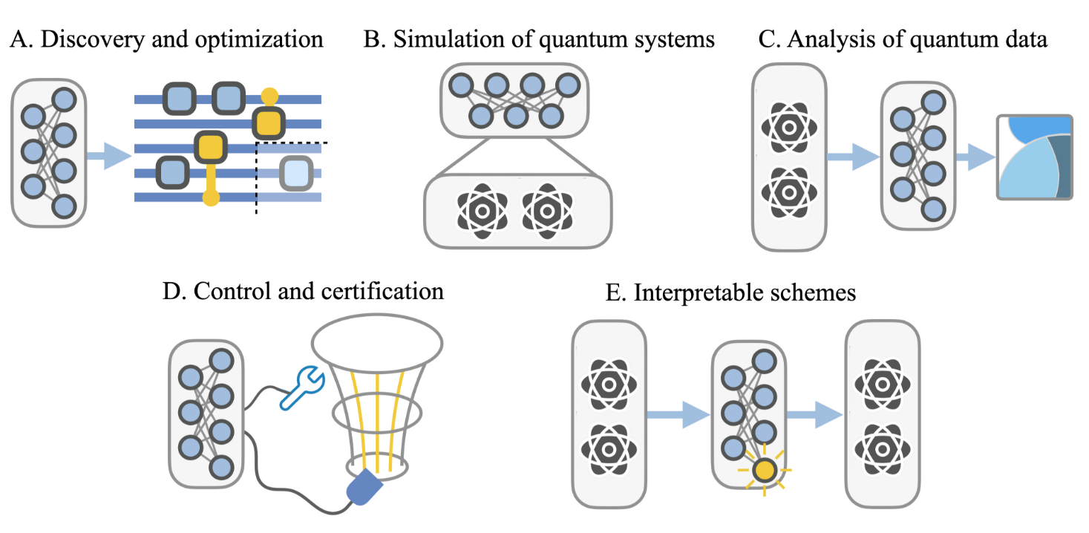
AI-for-Quantum or Quantum-for-AI?
Quantum-for-AI: Utilizing quantum computing to accelerate AI tasks like optimization and data processing beyond classical computational limits.
AI-for-Quantum: Applying classical machine learning to optimize quantum hardware design, control, error correction, and numerical simulations.
Acampora, Giovanni, Andris Ambainis, Natalia Ares, et al. “Quantum Computing and Artificial Intelligence: Status and Perspectives.” Version 3. Preprint, arXiv, 2025. https://doi.org/10.48550/ARXIV.2505.23860.
GPU Day 2026 — May 28-29, 2026, Budapest
Notes:
Once we have a converged platform, a natural question follows: how do quantum and AI actually help each other? There are really two directions, and it's worth keeping them clearly apart.
The first is Quantum-for-AI — using quantum computing to accelerate AI tasks like optimization and data processing, beyond what classical hardware can do. This is the direction most people think of first: quantum as a new kind of accelerator for machine learning.
The second is AI-for-Quantum — and this one is just as important, even if it gets less attention. Here, we apply classical machine learning to make quantum systems themselves better: optimizing hardware design, control pulses, error correction, and numerical simulations of quantum systems.
So it's a two-way street. Quantum can help AI tackle harder problems, and AI is already helping us build and operate quantum machines today. We'll look at each direction in turn on the next slides.

Slide 12
AI-for-Quantum
AI-for-Quantum: Applying classical machine learning to optimize quantum hardware design, control, error correction, and numerical simulations.
Hardware & Algorithm Discovery: Automates experimental design, circuit compilation, and the creation of new error-correction codes.
Automated Control & Calibration: Applies reinforcement learning to precisely tune quantum devices and optimize real-time gate operations.
Analysis of Quantum Data: Utilizes ML for quantum state and process tomography, extracting relevant physical features from high-dimensional or noisy experimental data, and performing quantum error mitigation through AI-driven post-processing.
Acampora, Giovanni, Andris Ambainis, Natalia Ares, et al. “Quantum Computing and Artificial Intelligence: Status and Perspectives.” Version 3. Preprint, arXiv, 2025. https://doi.org/10.48550/ARXIV.2505.23860.
GPU Day 2026 — May 28-29, 2026, Budapest
Notes:
Let's start with AI-for-Quantum — using classical machine learning to make quantum systems work better. For example:
First, hardware and algorithm discovery. Machine learning is being used to automate experimental design, compile quantum circuits more efficiently, and even discover new error-correction codes.
Second, automated control and calibration. Quantum devices are notoriously sensitive, and keeping them tuned is a constant battle. Reinforcement learning is now being used to fine-tune devices and optimize gate operations in real time, well beyond what humans can do by hand.
And third, analysis of quantum data. ML helps with quantum state and process tomography, pulls meaningful signals out of noisy high-dimensional measurements, and supports AI-driven error mitigation in post-processing.
So before quantum even helps AI, AI is already helping quantum — quietly, but in some very concrete ways.

Slide 13
Quantum-for-AI (Quantum AI)
Quantum-for-AI: Utilizing quantum computing to accelerate AI tasks like optimization and data processing beyond classical computational limits.
Quantum Machine Learning (Supervised & Unsupervised): For example, enhances classification, regression, and clustering tasks by using quantum algorithms to accelerate training.
Quantum Reasoning and NLP: Uses quantum parallelism and entanglement to speed up logical inference and represent complex semantic relationships in natural language processing
Quantum Multi-Agent Systems (QMAS): Improves coordination and resource allocation among multiple autonomous agents through quantum-supported negotiation and coalition protocols
Quantum Optimization and Planning: Addresses combinatorial problems and industrial scheduling by exploring massive search spaces more effectively than classical solvers.
Acampora, Giovanni, Andris Ambainis, Natalia Ares, et al. “Quantum Computing and Artificial Intelligence: Status and Perspectives.” Version 3. Preprint, arXiv, 2025. https://doi.org/10.48550/ARXIV.2505.23860.
GPU Day 2026 — May 28-29, 2026, Budapest
Notes:
Now the other direction — Quantum-for-AI: using quantum computing to push AI tasks like optimization and data processing beyond what classical hardware can do. The research here is grouped into four broad areas.
The first and most mature is Quantum Machine Learning — both supervised and unsupervised. The idea is to use quantum algorithms to speed up training and to do efficient distance and similarity calculations in very high-dimensional data, which is exactly where classical methods get expensive.
The second is quantum reasoning and natural language processing. Here, quantum parallelism and entanglement are used to speed up logical inference and to represent the complex semantic relationships that language carries.
The third is quantum multi-agent systems — improving how multiple autonomous agents coordinate, negotiate, and share resources, using quantum-supported protocols.
And the fourth, perhaps the most promising near-term direction, is quantum optimization and planning — tackling NP-hard combinatorial problems and industrial scheduling by exploring search spaces more effectively than classical solvers.
In the next slides, we'll zoom into Quantum Machine Learning, since that's where lot of the practical work today is happening, or at least is the topic I am mainly interested in ☺

Slide 14
Quantum Machine Learning
Combine concepts from machine learning and quantum computing.
Learn patterns and relations from given training data.
Use quantum mechanical resources to solve computational problems - potentially more efficiently or accurately than classical computers.
Acampora, Giovanni, Andris Ambainis, Natalia Ares, et al. “Quantum Computing and Artificial Intelligence: Status and Perspectives.” Version 3. Preprint, arXiv, 2025. https://doi.org/10.48550/ARXIV.2505.23860.
GPU Day 2026 — May 28-29, 2026, Budapest

Slide 15
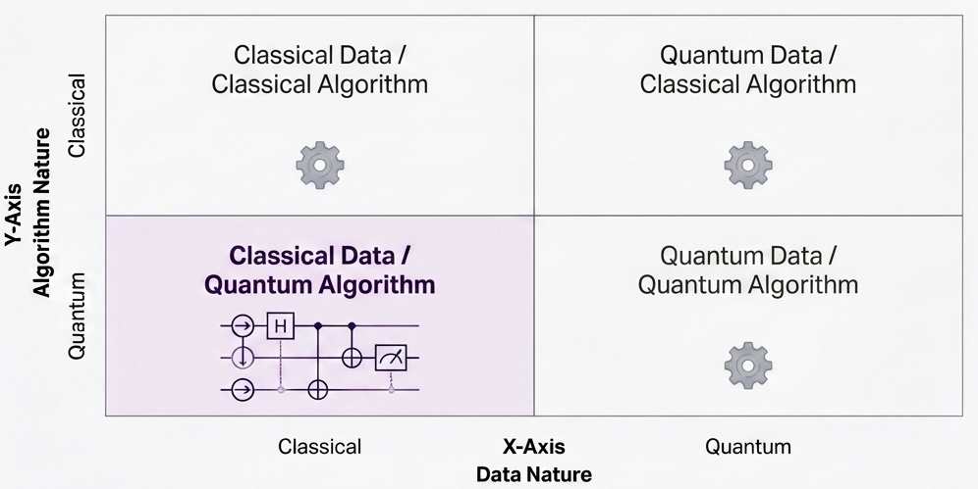
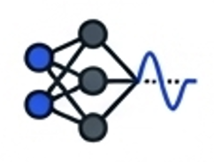
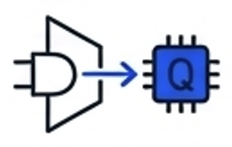


Quantum
Machine
Learning
Quantum Support
Vector Machines
(SVMs)
Quantum Neural
Networks (QNN)
Hybrid
Architectures
Quantum Generative
Adversarial Network (QGAN)
…
GPU Day 2026 — May 28-29, 2026, Budapest

Slide 16
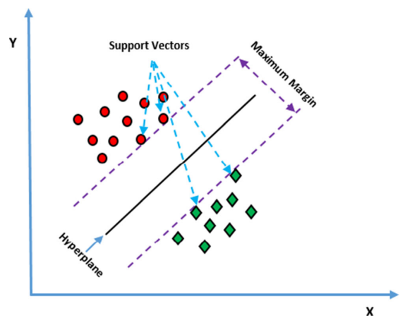
Quantum Support Vector Machines
Supervised learning algorithm used primarily for classification and regression tasks.
Finds the optimal hyperplane that best separates data points of different classes.
Maximizes the margin between support vectors — the points closest to the decision boundary.
Classical data is mapped into quantum states via a quantum circuit, producing what is known as a quantum kernel function.
QSVM is a hybrid algorithm, not purely quantum:
  The quantum computer evaluates the inner product of the kernel function.
  Mathematical optimization still runs on a classical computer.
GPU Day 2026 — May 28-29, 2026, Budapest
GPU Day 2026 — May 28-29, 2026, Budapest

Slide 17
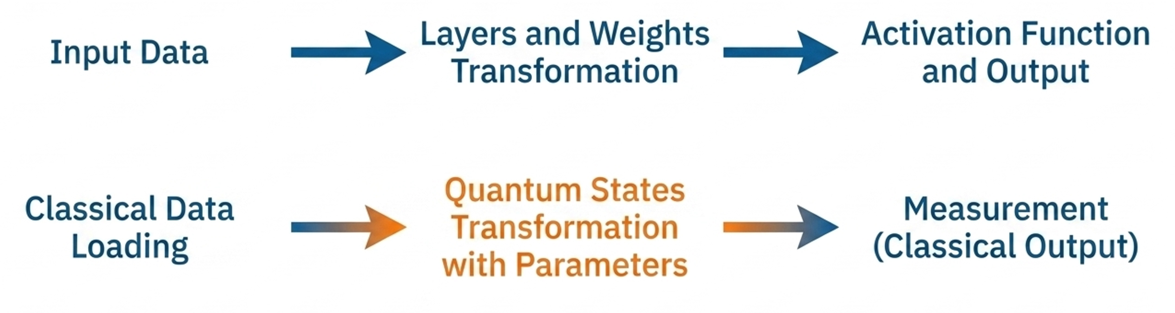
Quantum Neural Networks (QNN)
QNNs are CQ models — they have purely classical input and output with intermediate quantum processing.
GPU Day 2026 — May 28-29, 2026, Budapest

Slide 18
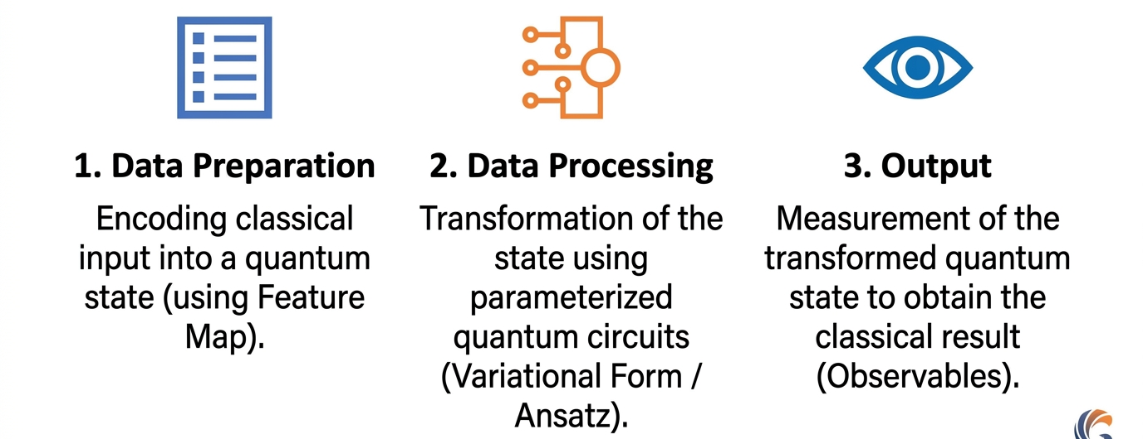
The Three Pillars of QNN Architecture
GPU Day 2026 — May 28-29, 2026, Budapest

Slide 19
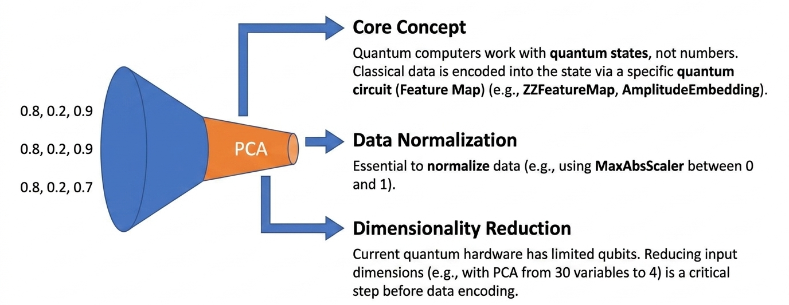
QNN: Data Loading (Step 1)

Slide 20
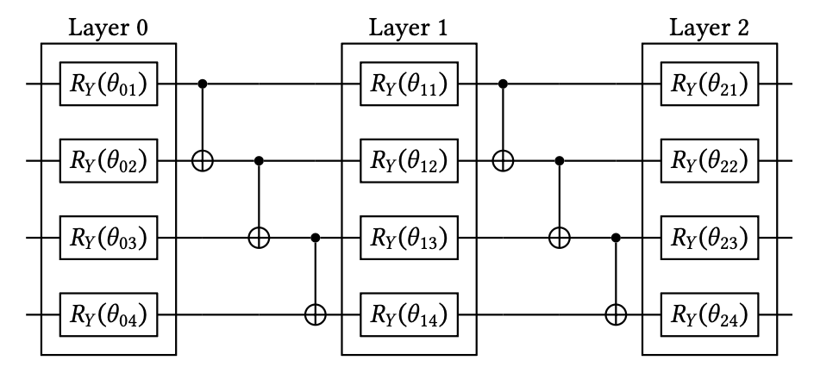
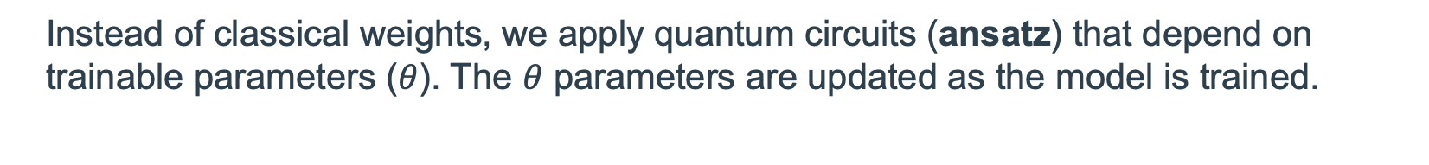
QNN: The Processing Engine (Variational Forms, Step 2)
Instead of classical weights, we apply quantum circuits (ansatz) that depend on trainable parameters ($θ$). The $θ$ parameters are updated as the model is trained.
Rotation gates: adjust the state of individual qubits using independent parameters.
Two-local variational form on four qubits and two repetitions.

Slide 21
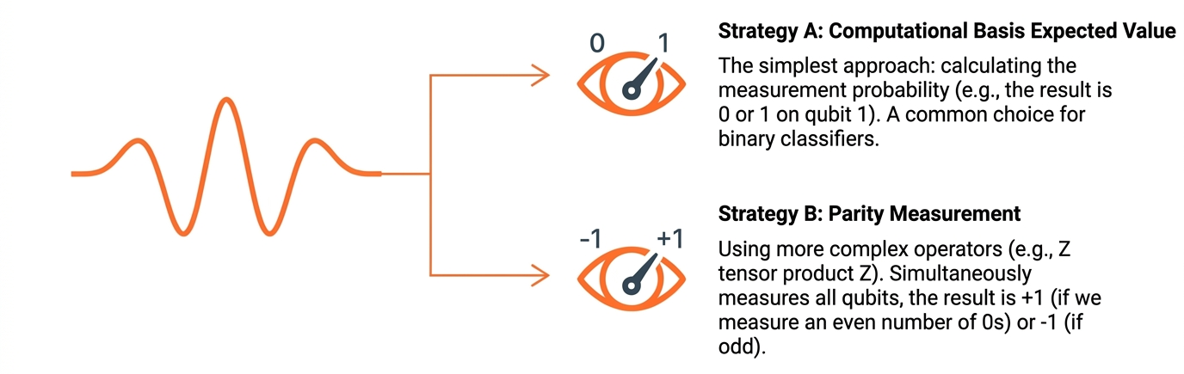
QNN: Extracting the Classical Output (Step 3)
We need to extract a classical numerical value from the transformed quantum state by measuring an observable quantity (Hermitian operator).
Notes:
We're now at step three of the QNN pipeline: getting a usable, classical number back out of the quantum circuit. A quantum state by itself isn't directly readable — we have to measure it, and that measurement turns the quantum state into a classical value we can feed into the rest of our model.
Formally, this is done by measuring an observable — a Hermitian operator — on the final state. In practice, there are two common strategies.
The first, computational basis expected value, is the simplest: we look at the measurement probability of a single qubit — say, the chance it comes out as 0 or 1. This is a very natural fit for binary classifiers.
The second, parity measurement, uses a more complex operator across all qubits at once — for example, a tensor product of Z operators. The result is +1 if we measure an even number of zeros and −1 if odd. This gives us a single global value that depends on the whole state.
Which strategy you pick depends on the task — but in both cases, this is the bridge that turns a quantum computation back into a classical output.

Slide 22
Hybrid Neural Networks
Classical
Input
Quantum Layer
Classical
Output
Classical layers process
the input data.
A parameterized
quantum circuit that
behaves as
a classical layer.
Classical processing
of the quantum
layer's output.
The full hybrid architecture is trained end-to-end as a single unit.

Slide 23
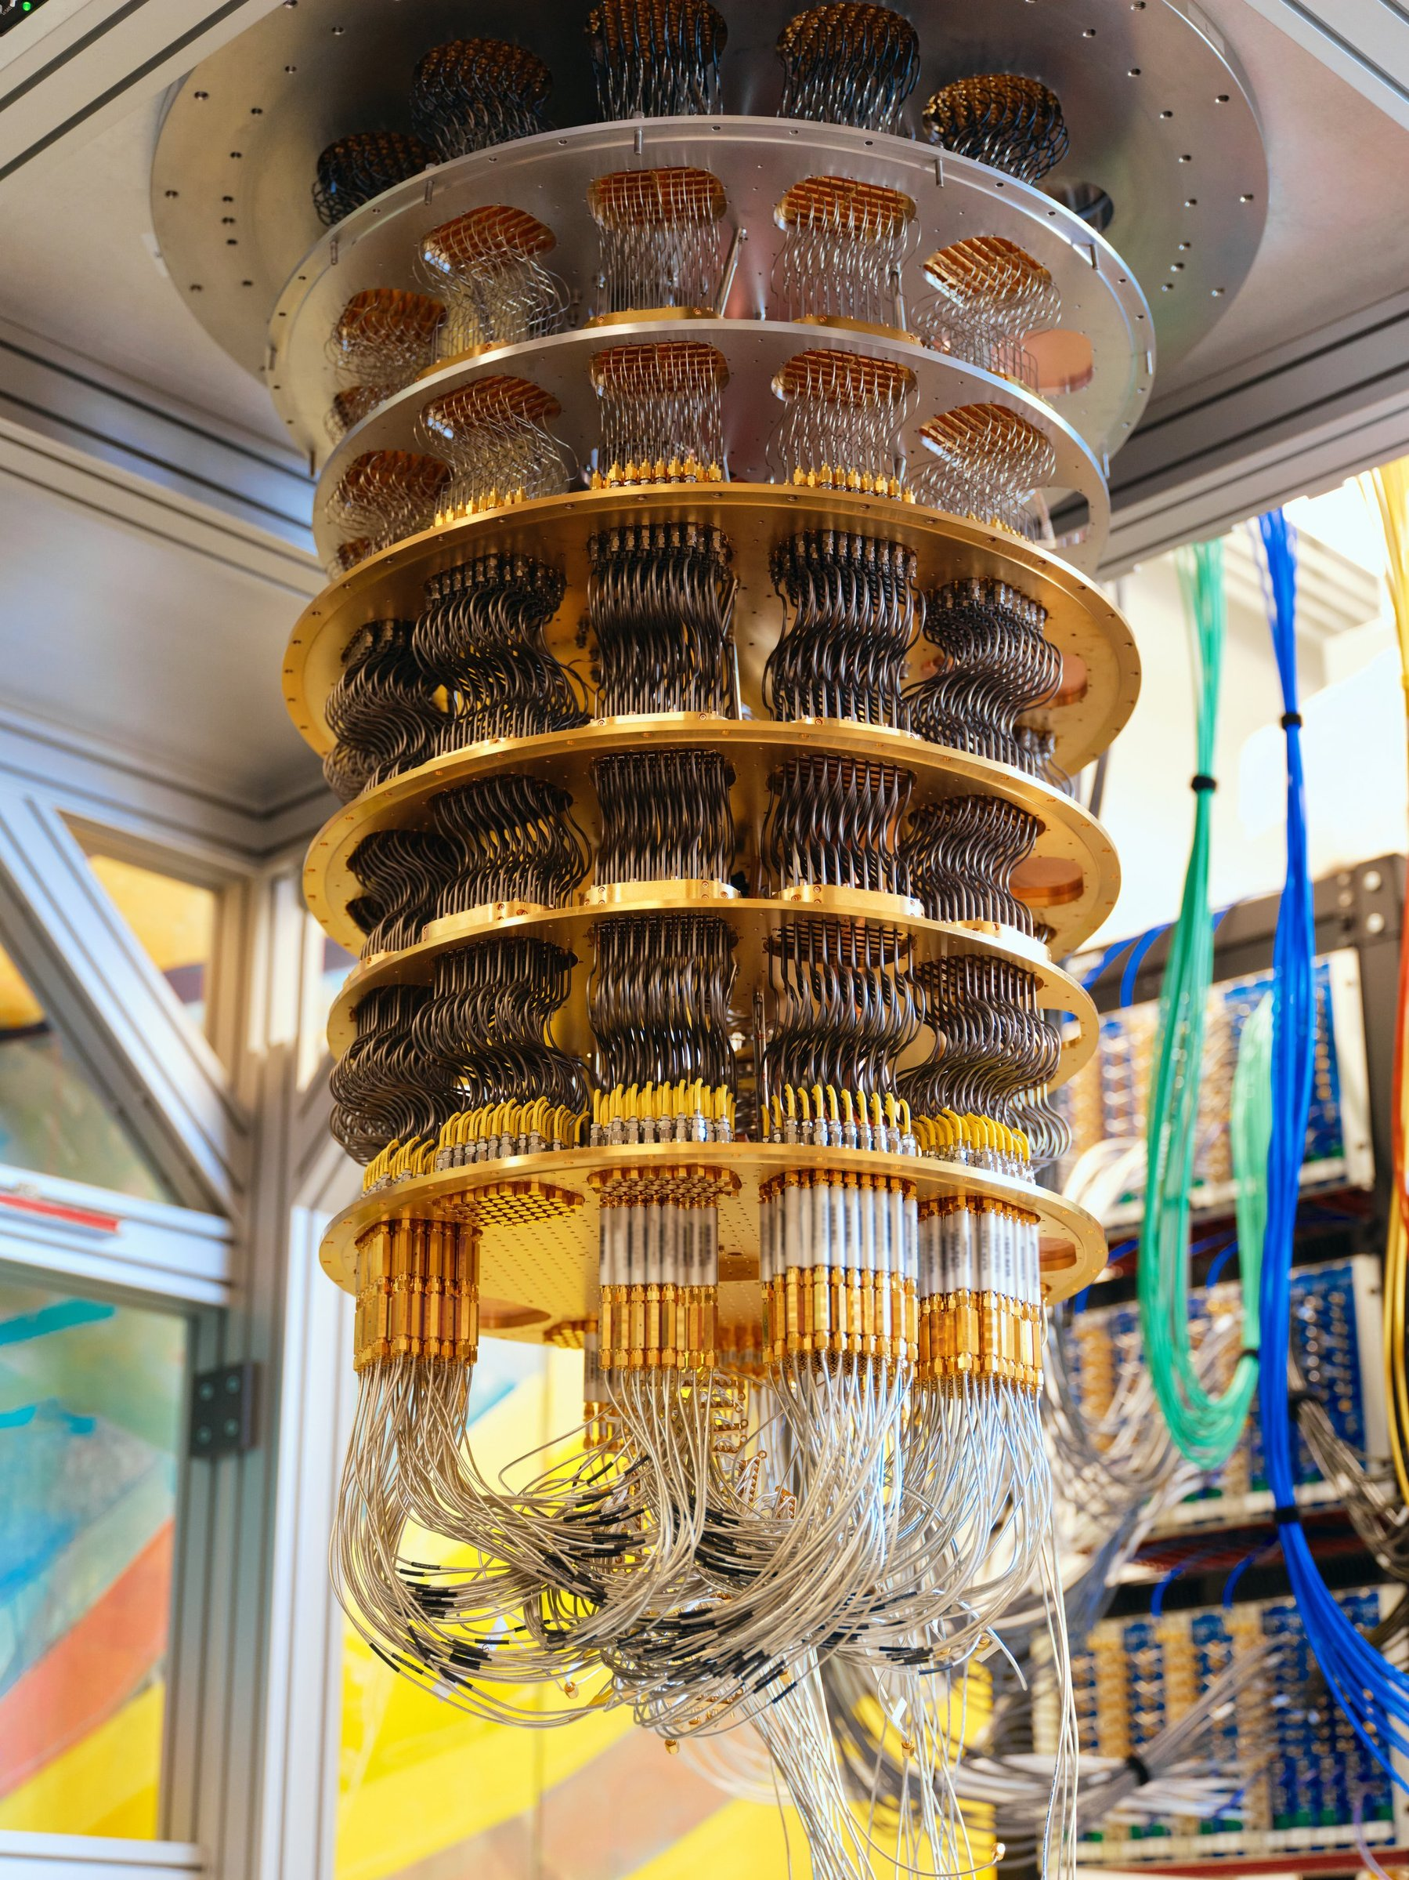
Quantum Machine Learning – Speedup
Rigorous analysis of a quantum speedup for supervised learning [1].
Unsupervised case of training generative models, quantum speedups for carefully crafted learning tasks have likewise been established [2,3].
[1] Liu, Y., Arunachalam, S., Temme, K.: A rigorous and robust quantum speed-up in supervised machine learning (2020). arXiv preprint arXiv:2010.02174
[2] Gao, X., Zhang, Z.Y., Duan, L.M.: A quantum machine learning algorithm based on generative models. Sci. Adv. 4(12), eaat9004 (2018)
[3] Sweke, R., Seifert, J.P., Hangleiter, D., Eisert, J.: On the quantum versus classical learnability of discrete distributions. Quantum 5, 417 (2021)
Notes:
Does quantum machine learning actually deliver a real speedup over classical methods? And here, the picture is more nuanced than the headlines sometimes suggest.
First, in the supervised learning setting, there is a rigorous mathematical proof of a quantum speedup — Liu, Arunachalam and Temme showed this in 2020.
Second, on the unsupervised side, quantum speedups have likewise been established for training generative models — at least on carefully crafted learning tasks designed to expose the advantage.
The important caveat is in that phrase, carefully crafted. These are tasks chosen specifically to highlight where quantum methods can outperform classical ones. They demonstrate that a quantum advantage in learning is mathematically possible — but turning that into a broad, practical speedup on everyday datasets is still very much an open question.
In other words: the proofs exist, the principle is sound — the engineering reality is still catching up.

Slide 24
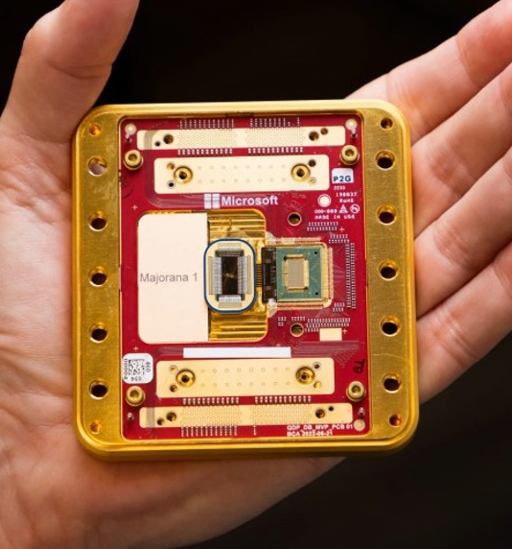
Outlook of Quantum Machine Learning – I.
Still very early days.
A young field — researchers are still discovering what works and what doesn't.
The big question: can it actually do better?
The aim is to show that quantum methods can outperform today's already powerful classical AI — but no clear practical advantage has been demonstrated yet.
Machine learning is a particularly hard domain.
Unlike well-defined problems (e.g. shortest path), ML builds models that recognize patterns in messy real-world data — which makes any quantum advantage harder to prove.
Strong open-source tools are accelerating progress.
Platforms like PennyLane and TensorFlow Quantum make it easy to prototype and simulate new ideas.
GPU Day 2026 — May 28-29, 2026, Budapest

Slide 25
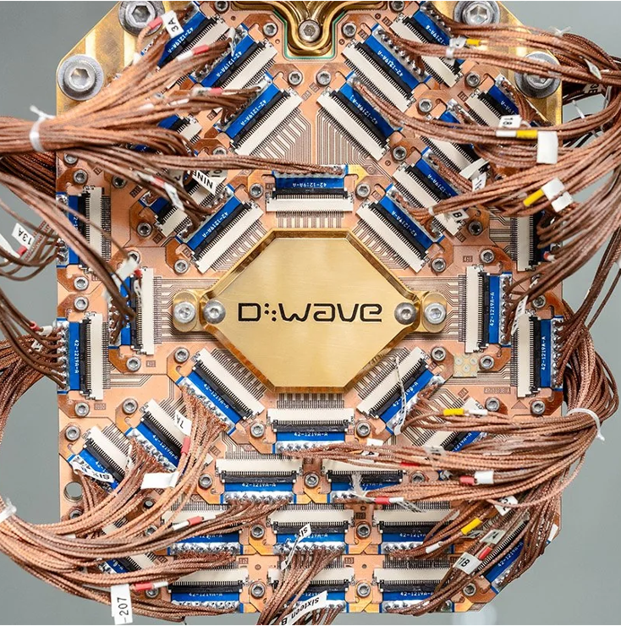
Outlook of Quantum Machine Learning – II.
The focus is shifting from "faster" to "smarter."
  Early research concentrated on speeding up existing algorithms.
  The question now is what quantum models can actually learn, and how.
The best model architecture is still unknown.
  Classical AI has proven structures.
  Quantum ML is still searching for the foundational model type that fits learning tasks naturally.
The impact will likely be in specialized problems.
  Quantum computers won't replace classical ones — they'll be useful in specific domains such as complex network analysis, medical imaging, and physics simulation.
GPU Day 2026 — May 28-29, 2026, Budapest

Slide 26
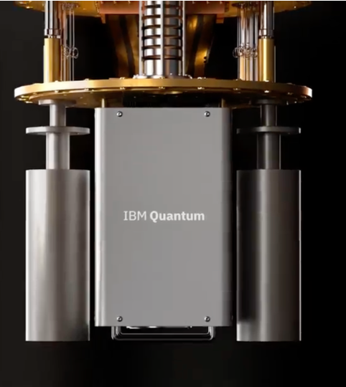
Outlook of Quantum Machine Learning – III.
There may not be a single "killer app."
Rather than one breakthrough application, quantum ML is more likely to serve as a specialized accelerator within targeted domains.
Business value is still uncertain.
Classical AI is already extremely powerful, so it's not yet clear when or how quantum ML will deliver a real commercial advantage.
At heart, it's a deep scientific question.
Quantum ML asks what "learning" really means when information is processed under the laws of quantum physics — a fascinating research frontier in its own right.
GPU Day 2026 — May 28-29, 2026, Budapest

Slide 27
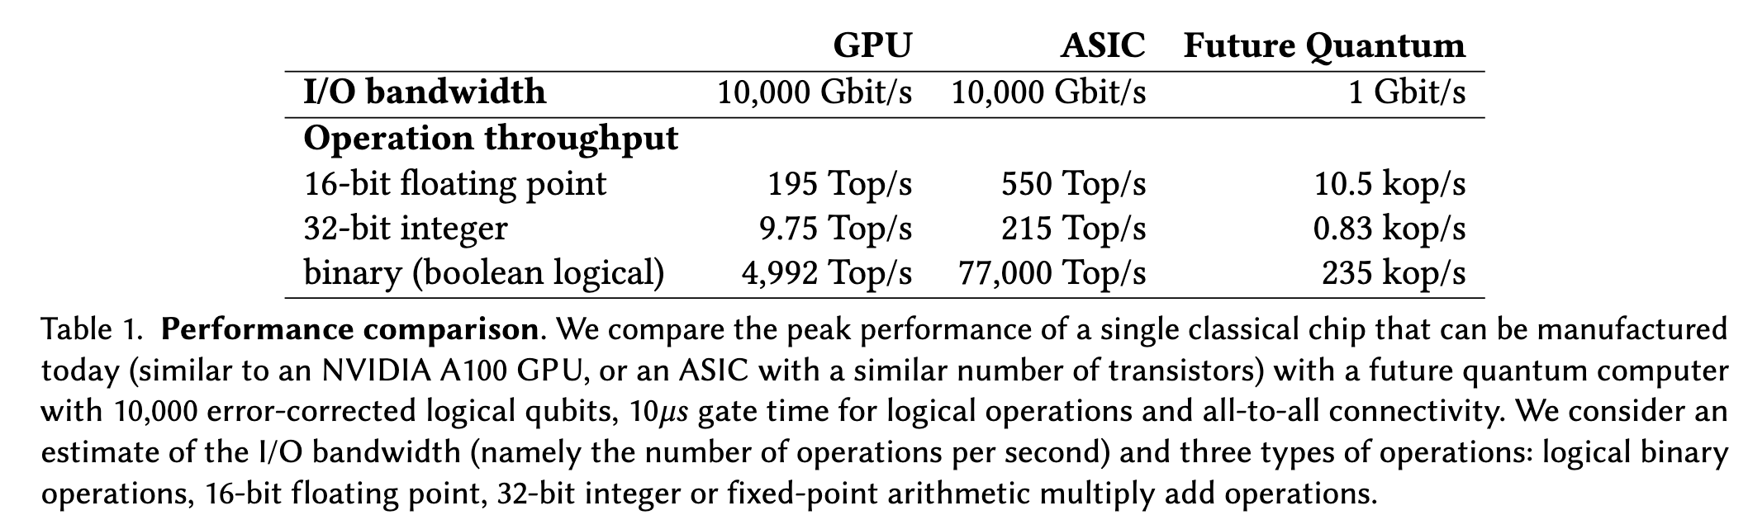
Classical Throughput vs. Quantum Gates
A fundamental performance gap exists between classical parallel processors and projected quantum hardware, necessitating a clear understanding of where each excels.
The continued evolution of classical heuristics and accelerated simulation means the bar for "advantage" is a rapidly moving target.
Classical chips operate with cycle times around 0.7ns, while logical gate times for future error-corrected quantum computers are optimistically estimated at 10µs.
Because of this gap, classical systems are the engines for high-throughput, data-intensive tasks.
Quantum processors are fundamentally better suited for "big compute" on small data sets rather than high-volume data processing.
Quantum Random Access Memory (qRAM) is an essential but currently under-resourced enabling technology for data-intensive quantum machine learning.
Practical utility requires that the quantum computer be "verifiable," so that its output can be efficiently checked by classical or other quantum systems.
Hoefler, Torsten, Thomas Haener, and Matthias Troyer. “Disentangling Hype from Practicality: On Realistically Achieving Quantum Advantage.” arXiv:2307.00523. Preprint, arXiv, July 2, 2023. https://doi.org/10.48550/arXiv.2307.00523.
GPU Day 2026 — May 28-29, 2026, Budapest
Notes:
To understand where quantum actually has a chance to win, we have to be honest about the raw performance gap with classical hardware.
Look at the table: a single modern GPU and a custom ASIC each push around 10,000 Gbit/s of I/O bandwidth, while even an optimistic future error-corrected quantum computer comes in around 1 Gbit/s — four orders of magnitude lower. The operation throughput tells the same story. On 16-bit floating point, GPUs deliver almost 200 tera-operations per second and ASICs over 500, while a future quantum system is estimated in the range of 10 kilo-operations per second. For binary logical operations the gap stretches further — nearly 80 tera-ops classically versus a few hundred kilo-ops quantum.
The underlying numbers are easy to explain: classical chips have cycle times around 0.7 nanoseconds, while logical quantum gates — even optimistically — are around 10 microseconds. That's roughly a ten-thousand-times difference per operation.
There are two consequences. First, the bar for what counts as a quantum advantage keeps moving, because classical heuristics and accelerated simulation keep getting better. And second, this tells us where each technology actually fits: classical systems are the engines for high-throughput, data-intensive workloads, while quantum is fundamentally better suited to big compute on small data — problems where the data is small but the search space is enormous.
That's also why qRAM — quantum random access memory — is so important and so under-resourced; without it, feeding large datasets into a quantum machine is itself the bottleneck.
And it's why verifiability matters: any practical quantum advantage has to produce outputs we can efficiently check, classically or otherwise.

Slide 28
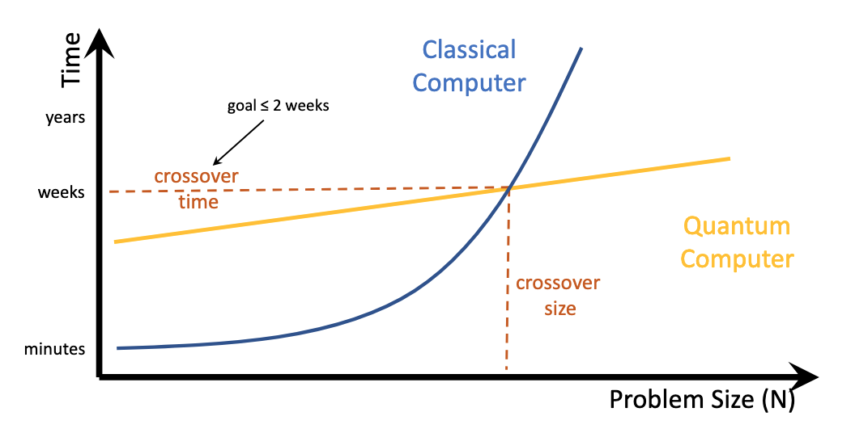
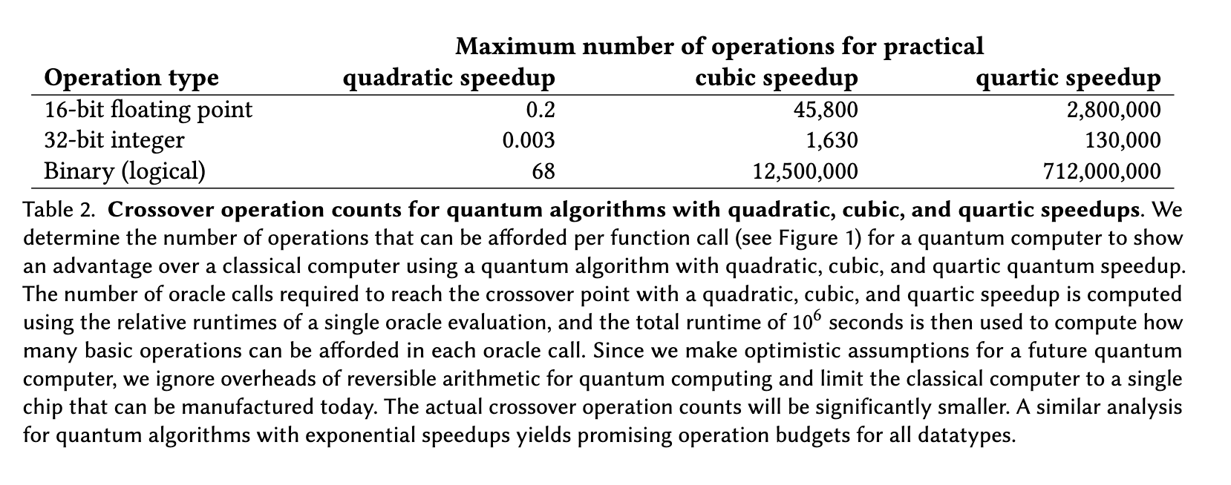
Defining Practical Advantage: Beyond Quadratic Speedups
To overcome the massive throughput lead of modern parallel hardware, quantum algorithms must provide super-quadratic speedups to be commercially viable.
Quadratic speedups (e.g., Grover’s algorithm) are generally insufficient to achieve a practical crossover point within reasonable timeframes (e.g., two weeks).
A quantum algorithm providing only quadratic speedup would require a problem size so large that even one floating-point operation would take months to show an advantage.
Practical quantum advantage likely requires super-quadratic (cubic, quartic) or exponential speedups.
Identifying "data-hard" problem instances that are classically intractable on average is a critical bottleneck in current research.
Asymptotic scaling is less important for industrial utility than performance on specific, finite problem instances, such as chemical active spaces.
Hoefler, Torsten, Thomas Haener, and Matthias Troyer. “Disentangling Hype from Practicality: On Realistically Achieving Quantum Advantage.” arXiv:2307.00523. Preprint, arXiv, July 2, 2023. https://doi.org/10.48550/arXiv.2307.00523.
GPU Day 2026 — May 28-29, 2026, Budapest
Notes:
This slide gets to the heart of when a quantum advantage actually becomes practical. The chart on the right tells the story in one picture: the blue curve is classical compute time growing steeply with problem size, the yellow line is quantum. They cross — but only at a certain crossover size. The whole question is: how big does the problem have to be before quantum wins, and how long will it take? The realistic goal is that the crossover happens within a couple of weeks of runtime, not years.
Now look at the table. It shows how many basic operations a quantum computer can afford per oracle call if we want to beat a single classical chip within roughly 10⁶ seconds — about two weeks of compute.
With only a quadratic speedup — that's Grover-class algorithms — the budget is brutal: just 0.2 floating-point operations, fewer than one. 68 binary logical operations. Practically zero room to do useful work. That's why quadratic speedups, on their own, don't get you a commercial quantum advantage.
Move to a cubic speedup and suddenly you have room: about 46,000 floating-point ops, 12.5 million binary ops per oracle call. With a quartic speedup the budget explodes to 2.8 million floating-point ops and 712 million binary ops.
So the takeaway is sharp: practical quantum advantage requires super-quadratic — cubic, quartic, or exponential — speedups. And the open research problem isn't just inventing faster algorithms; it's identifying the data-hard problem instances where those speedups apply, and focusing on finite, industrially-relevant cases like chemical active spaces, rather than chasing asymptotic scaling for its own sake.

Slide 29
Summary
HPC: AI, and quantum are converging into one platform.
  EuroHPC and the AI Factories network are positioning Europe to offer CPUs, GPUs, and QPUs through a single sovereign infrastructure.
Quantum and AI reinforce each other in two directions.
  Quantum-for-AI uses quantum computing to accelerate AI tasks such as optimization and data processing beyond classical computational limits.
  AI-for-Quantum applies classical machine learning to optimize quantum hardware design, control, error correction, and numerical simulations.
Hybrid architectures are the practical path forward.
  For example, classical layers handle data preparation and output, while parameterized quantum circuits act as trainable components inside the same end-to-end model.
Convergence still has open challenges.
  Unified hardware integration, a common software stack across classical and quantum, and orchestration of hybrid algorithms remain active areas of work.
Value will come from specialized, domain-specific use cases.
  Quantum will complement classical computing in targeted domains, not replace it.

Slide 30
References
M. A. Nielsen and I. L. Chuang. Quantum Computation and Quantum Information. Cambridge University Press, 2010.
S. Aaronson and A. Arkhipov. The computational complexity of linear optics. 2011.
D. Shepherd and M. J. Bremner. Temporally unstructured quantum computation. 2009.
V. Havlíček, et al. Supervised learning with quantum-enhanced feature spaces. 2019.
S. Aaronson. Read the fine print. 2015.
J. McClean, et al. Barren plateaus in quantum neural network training landscapes. 2018.
Schuld, Maria, and Francesco Petruccione. Machine Learning with Quantum Computers. Quantum Science and Technology. Springer International Publishing, 2021. https://doi.org/10.1007/978-3-030-83098-4.
Alvarez, Elias Fernandez-Combarro, and Samuel Gonzalez Castillo. PRACTICAL GUIDE TO QUANTUM MACHINE LEARNING AND QUANTUM OPTIMISATION Hands-on Approach to Modern Quantum Algorithms. First edition. PACKT PUBLISHING LIMITED, 2023.
Hoefler, Torsten, Thomas Haener, and Matthias Troyer. “Disentangling Hype from Practicality: On Realistically Achieving Quantum Advantage.” arXiv:2307.00523. Preprint, arXiv, July 2, 2023. https://doi.org/10.48550/arXiv.2307.00523.
Babbush, Ryan, Robbie King, Sergio Boixo, et al. “The Grand Challenge of Quantum Applications.” arXiv:2511.09124. Preprint, arXiv, December 4, 2025. https://doi.org/10.48550/arXiv.2511.09124.

Slide 31
Thank You!

