Slide 1
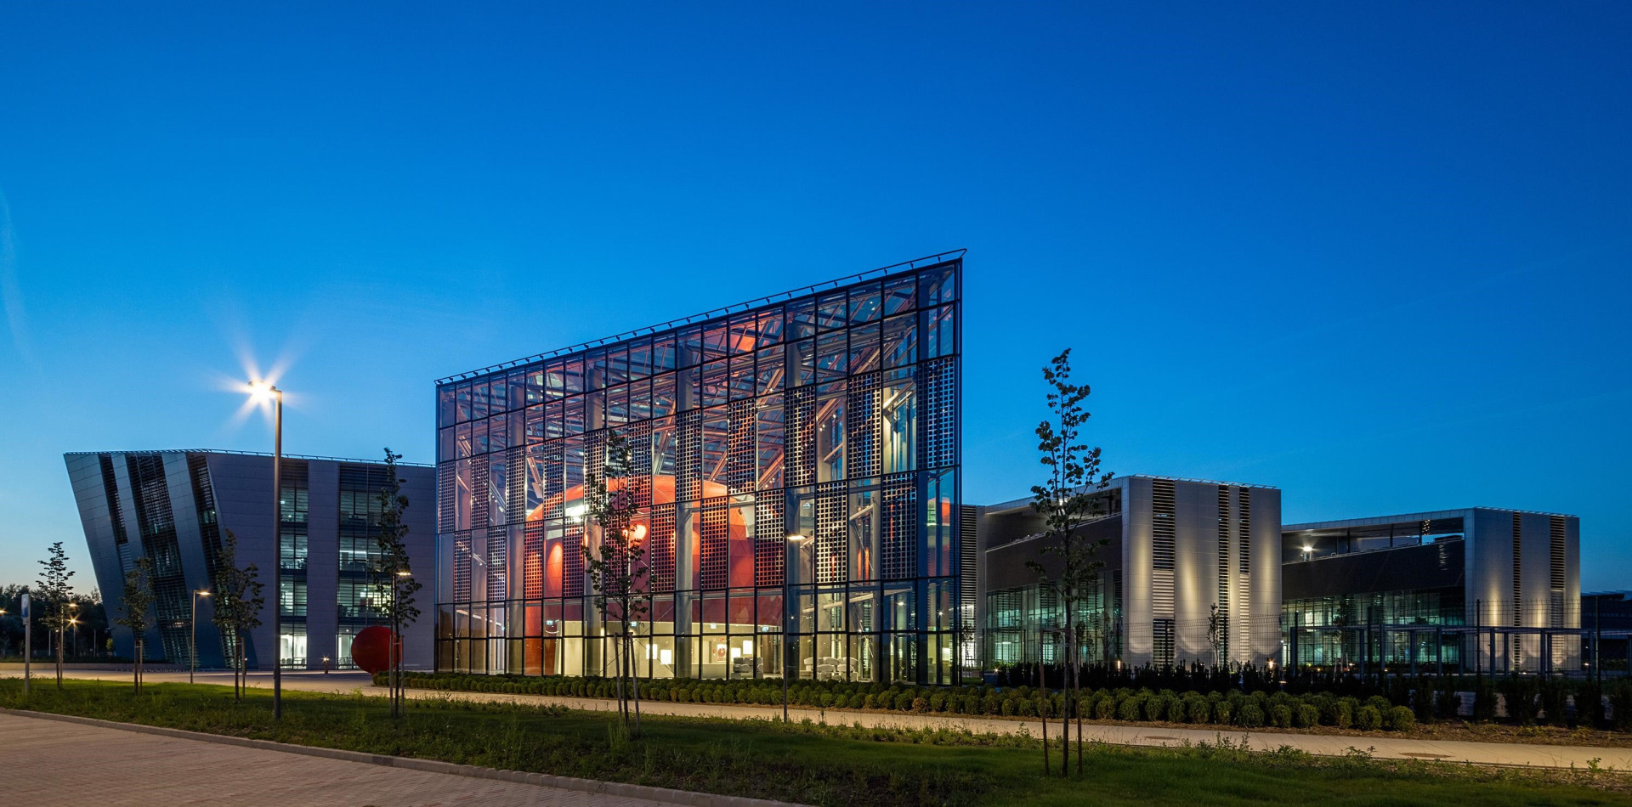
Perspectives of the NAPLIFE project
ELI-ALPS, Szeged
Laszlo P. Csernai
for the NAPLIFE and
FUSENOW Collaborations
⁻ Department of Physics and Technology, Uiversity of Bergen, Bergen, Norway
- Csernai Consult Bergen, Ulset, Norway
BTSLXX Workshop, HUN-REN Wigner RCP,
Budapest, Jun 11 – 12, 2026

Slide 2

The NAPLIFE & FUSENOW Collaborations
Nour Jalal Abdulameer, Tibor Ajtai, Márk Aladi, D. Alkhalil, L. Balázs, Balázs Bánhelyi, Á. Bélteki, Tamás S. Biró, Attila Bonyár, Alexandra Borók, Larissa Bravina, J.A. Burunkova, F.A. Casian-Plaza, N.Q. Chinh, István Csarnovics, T. Csendes, László Pál Csernai, Mária Csete, A. Csik, Tamás Csörgő, Odd Erik Garcia, Gábor Galbács, Z. Galbács, Zs. Geretovszky, Tibor Gilinger, Chris Grayson, Martin Greve, Olivér Fekete, Zsolt Fogarassy, J.P. Hansen, Ali Hassan, L. Himics, Román Holomb, P.M. Janovszky, L. Juhász, Gyula Kajner, Gábor Kasza, Judit Kámán, Miklós Kedves, Albert Kéri, A. Kohut, J. Kopniczky, Rebeka Kovács, Éva Kovács-Széles, S. Kökényesi, Anna Kőházi Kiss, Norbert Kroó, Archana Kumari, Tomás Lednický, Bálint Leits, Péter József Lévai, Zs. Márton, Igor N. Mishustin, Dénes Molnár, Kolos Molnár, Anton Motornenko, Ágnes Nagyné Szokol, Károly Osvay, D.J. Palásti, István Papp, Petra Pál, Péter Petrik, Béla Ráczkevi, Péter Rácz, Johann Rafelski, István Rigó, Leonid M. Satarov, Horst Stöcker, Daniel D. Strottman, F. Schubert, DS. Svjazhina, G. Szabó, Melinda Szalóki, Géza Szántó, András Szenes, R. Szipőcs, Karolis Tamosiunas, Nóra Tarpataki, Bálint Ferenc Tóth, Emese Tóth, O. Urbán, P. Varmazyar, Dávid Vass, Miklós Veres, Lajos Villy, Shereen Zangana, Konstantin Zhukovsky, S. Zivkovic,
~88 participants
Dujuan Wang, Wuhan University of Technology
Dieter D.D. Hoffmann, Xi'an Jiaotong University

Slide 3



















~1500 mHUF
2025-
1360 mHUF
Csernai László
University of Bergen, Norway

Slide 4
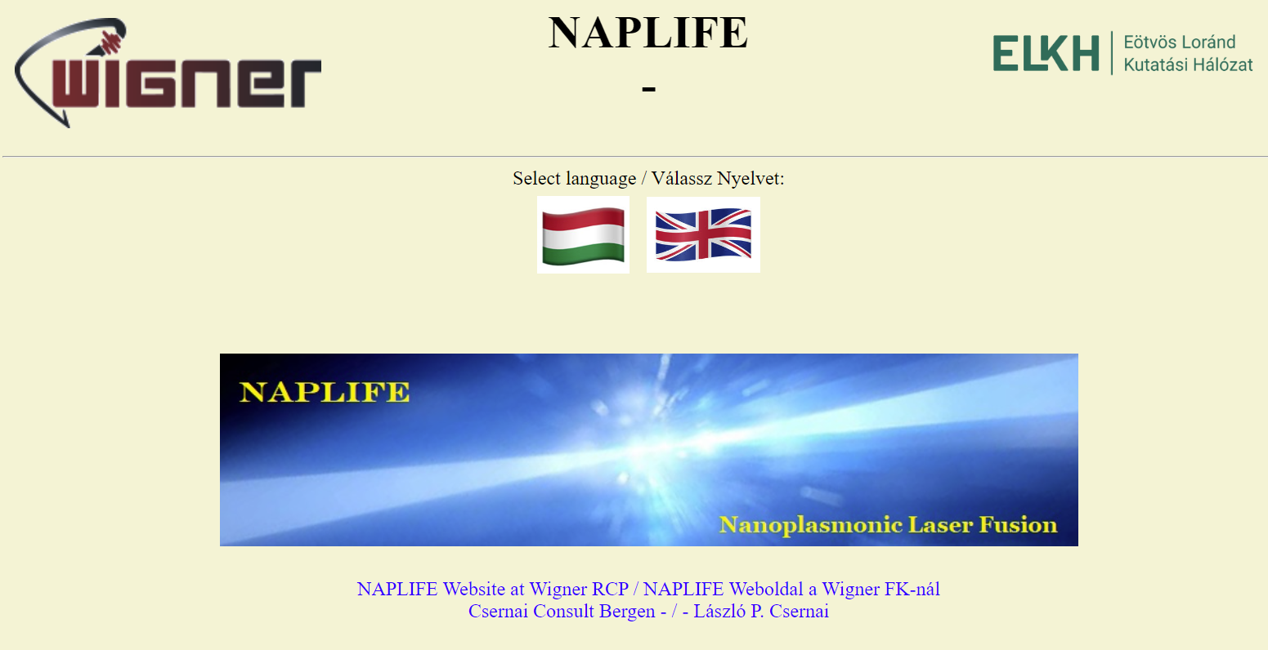
https://csernai.no/naplife/
(2019 → )
90+ Publications
150+ Talks
News

Slide 5
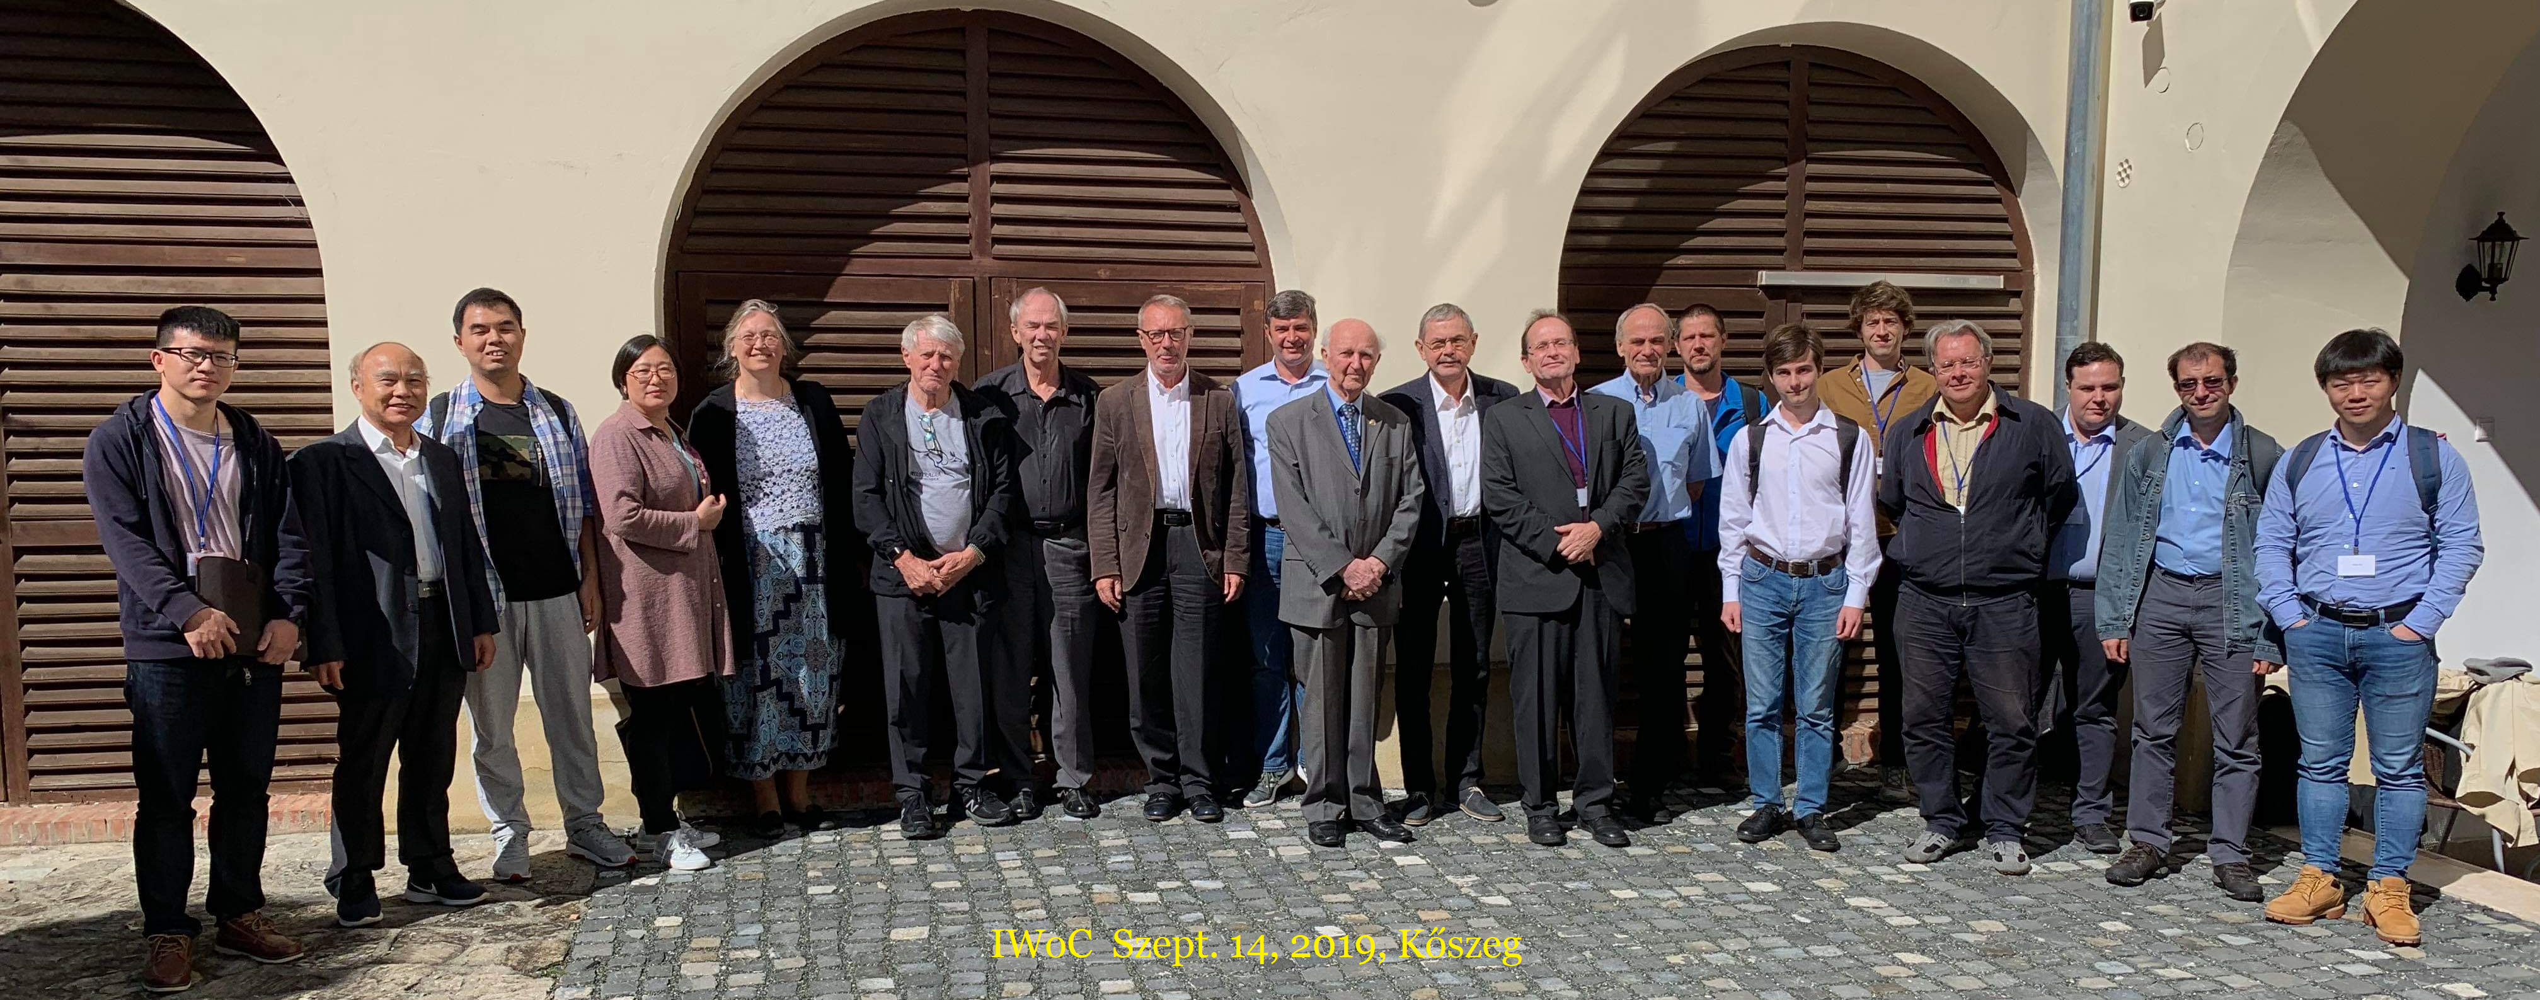
Inaugural Meeting of NAPLIFE Collaboration 2019

Slide 6
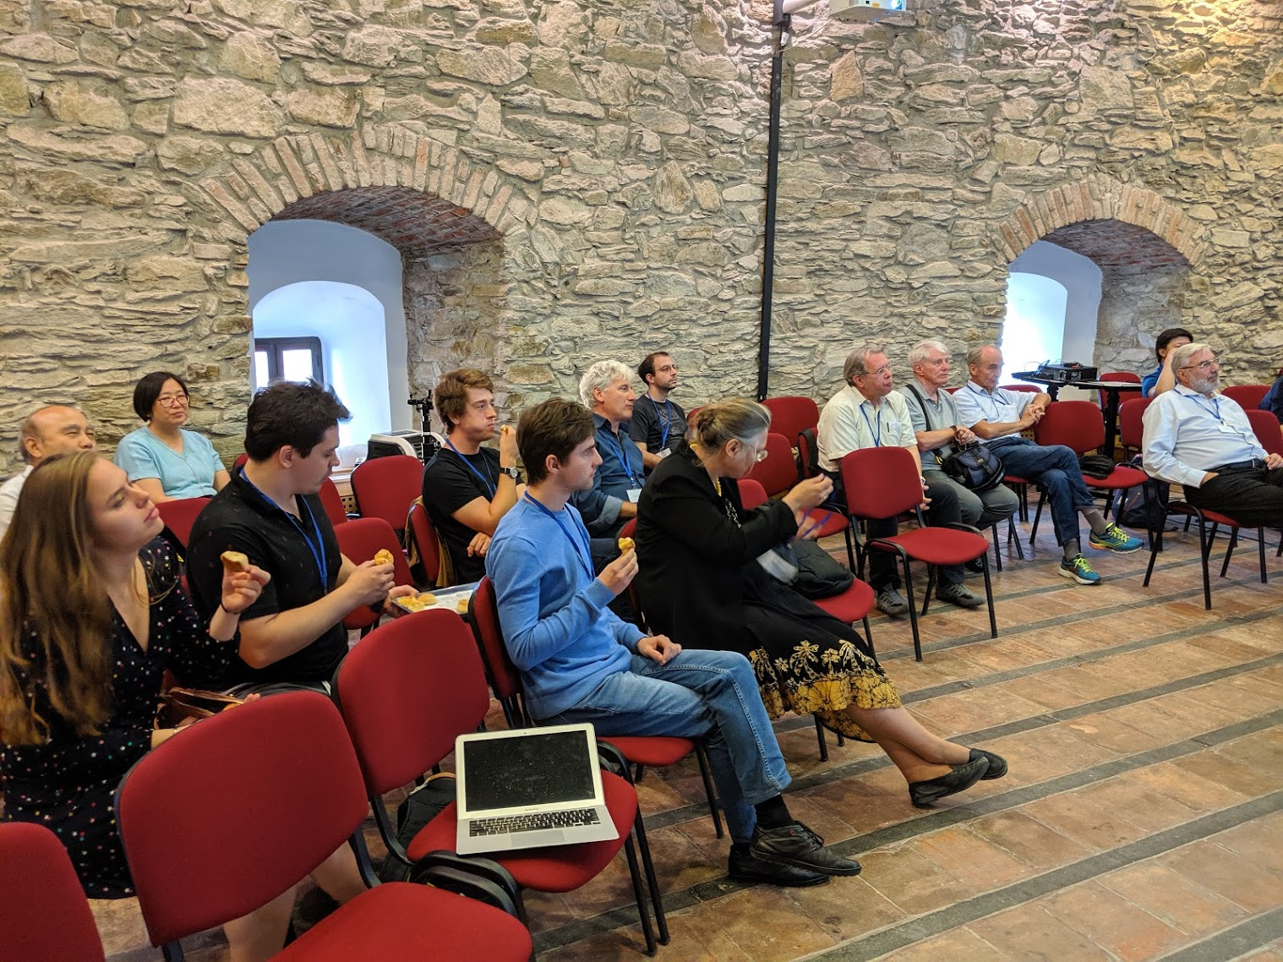
2019
Kőszeg

Slide 7
2019: Many of the participants of this meeting came from High Energy Heavy Ion field where hadronization (ignition or burning) of the QGPlasma happens everywhere at the same time, τ . This was not known in other fields so then and even today only burning spreading from a single hot spot was considered. Simultaneous, two-sided ignition was not trivial to achieve [Cs, Str.’2015], but in 2017 [Cs,K,P,2017] found a method to regulate and catalyze fusion by
nanotechnology. ➔ NAPLIFE
Tamás was in this team from the beginning and became the project leader (2022-) of the first Hungarian NAPLIFE project at Wigner RCP as National Laboratory.
We have ~20 joint publications, 5 on Heavy Ions, and the rest on Fusion.

Slide 8
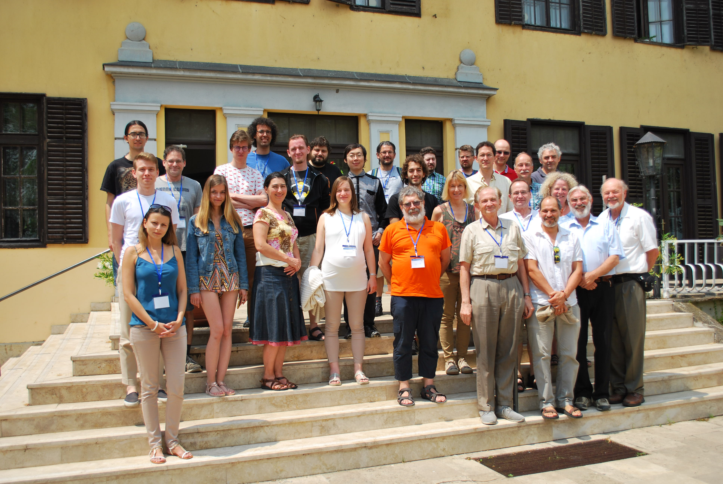
2019
Tihany
Heavy Ions
& Fusion

Slide 9
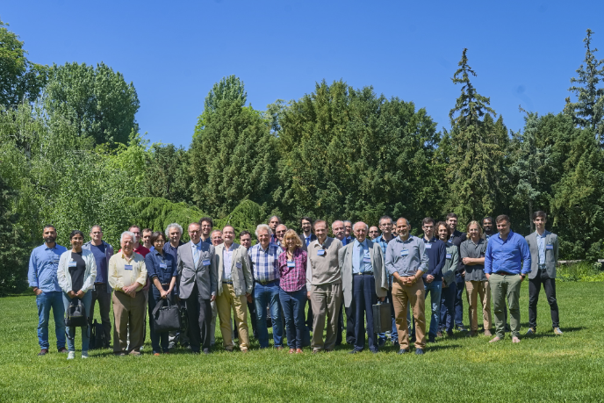
2022
Budapest

Slide 10
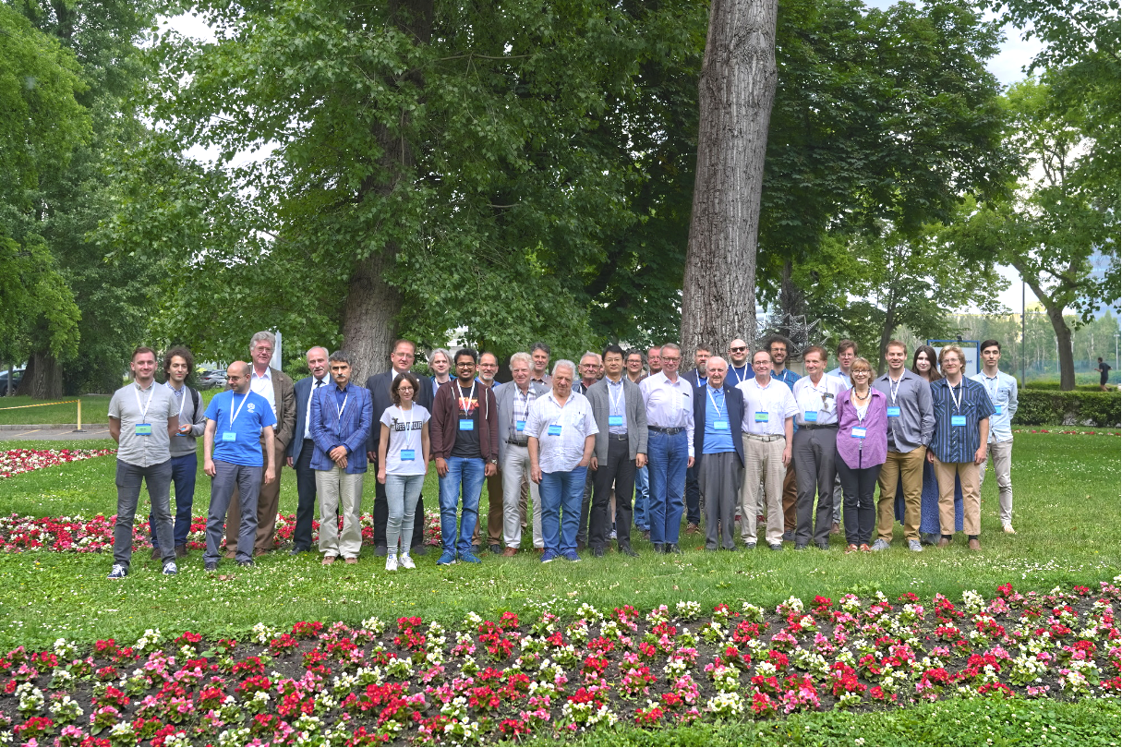
2023
Budapest

Slide 11
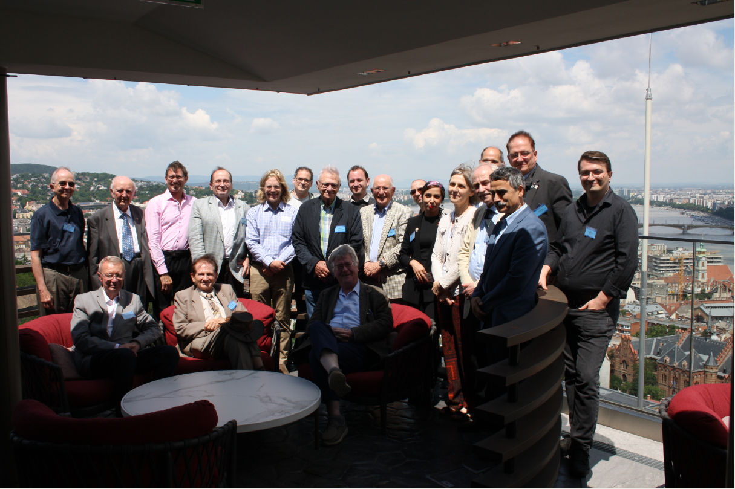
2024
Budapest

Slide 12
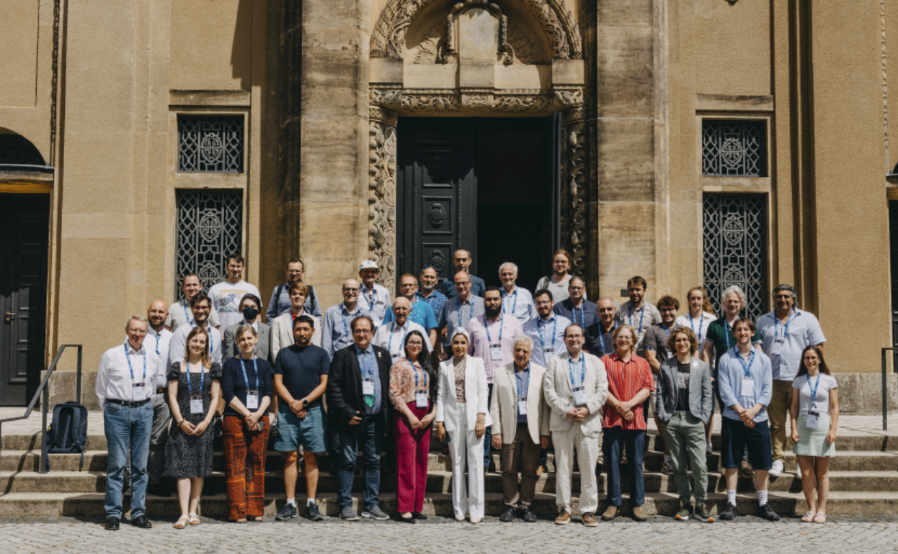
2025
Dresden-
Görlitz

Slide 13
Inertial Confinement Laser Fusion
Typical Example
Laser pulse energy increased ➔
Ignition by 192 lasers made possible
Spherical, LLNL NIF (hohlraum) thermal, 400 → 8 MJ, ~ 1/day, extreme compression: expansion is faster than spread of burning, d+t reaction, fuel & products are radioactive.
Q_{target} = 4
Focused Energy M.Roth -> Bibli NPP

Slide 14
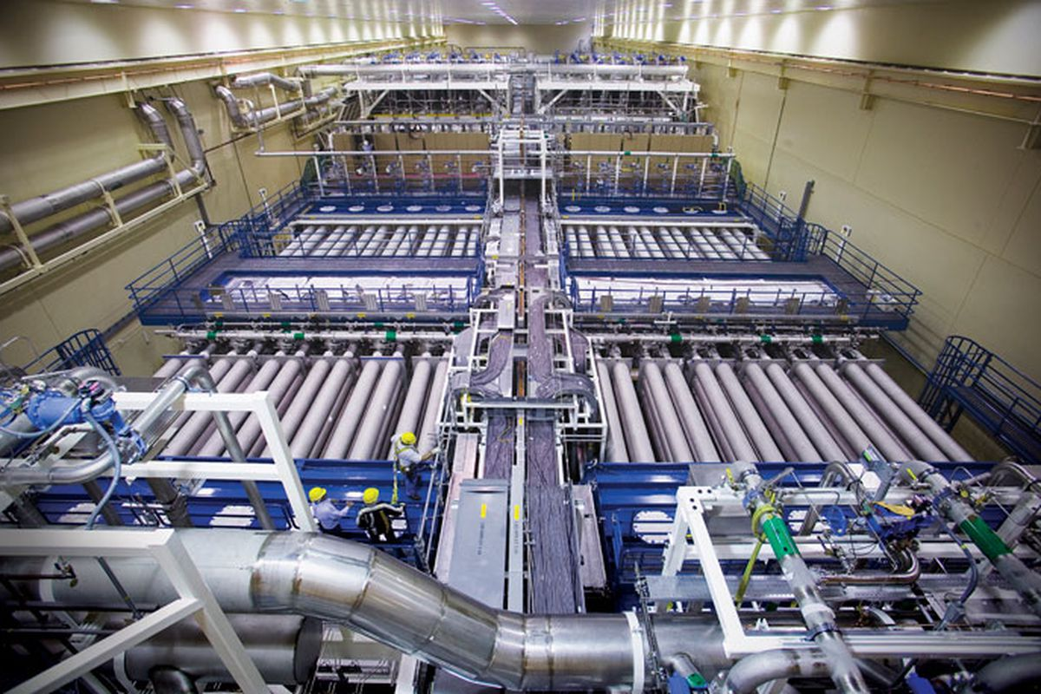
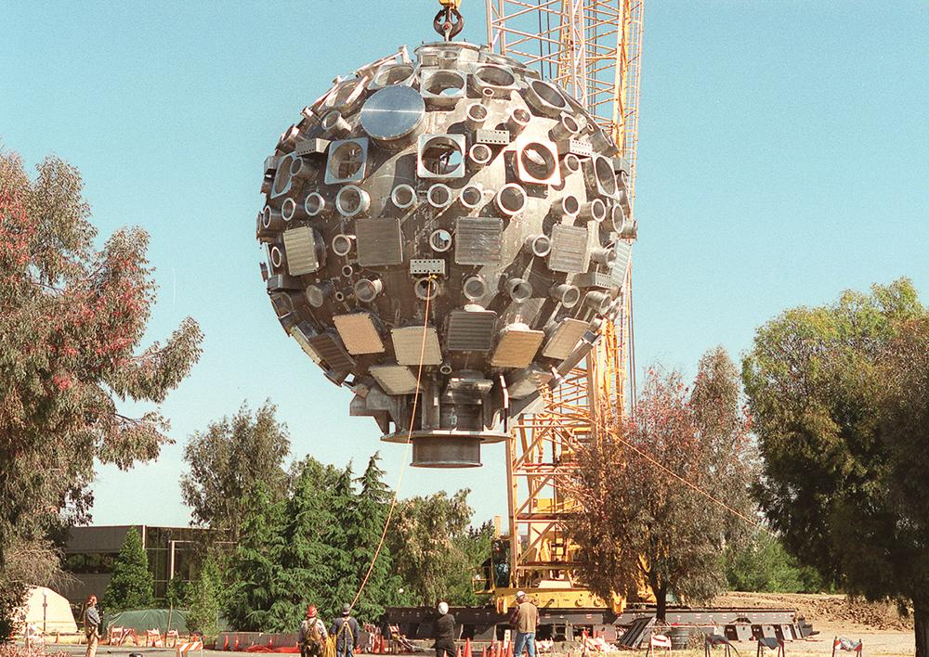
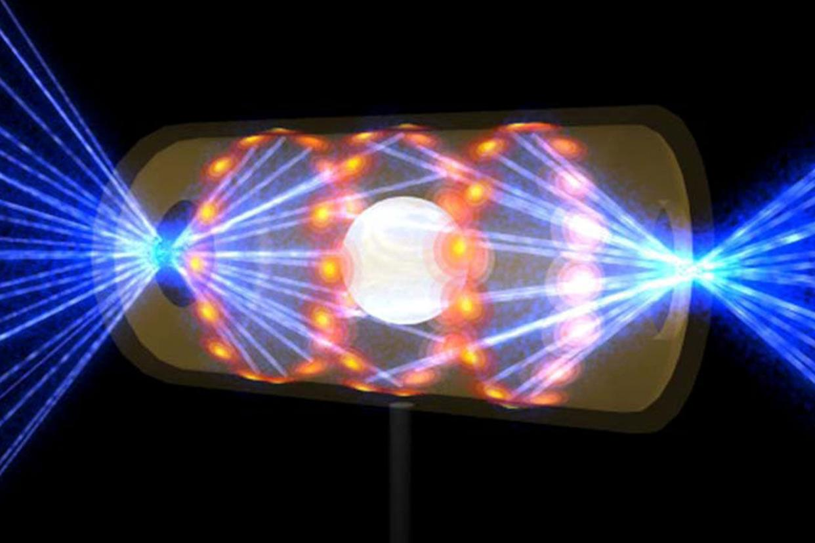
Spherical, LLNL NIF (hohlraum) thermal, 400 → 8 MJ, ~ 1/day, extreme compression: expansion is faster than spread of burning, d+t reaction,
fuel & products are radioactive.
~ Ø 10 m
10 mm x Ø 5mm
400 → 8 MJ, ~ 1/day
Used also by Focused Energy, M.Roth converting Biblis NPP.

Slide 15
Our Method of Laser Fusion
Ǝ two-sided irradiation: (Exists @ Shanghai SG-IIU, planned @ GSI )
ELI – ALPS Szeged HU NAPLIFE unique:
Nanoplasmonic resonant antennas
- to amplify and regulate light absorption,
- radiation dominated &
- non-thermal (→ Highly efficient, high Q ! )

Slide 16
How can we
achieve this ?
With nano-antennas !
Ignition is reached at contour line Q = 1.
[ L. P. Csernai, M. Csete, I. N. Mishustin, A. Motornenko, I. Papp, L. M. Satarov, H. Stöcker, N. Kroo, Physics of Wave Phenomena, 28 (3), 187-199 (2020).]

Slide 17
Simultaneous ignition – no instabilities
M. Csete
et al., (2021)
COMSOL Simulation

Slide 18
Laser-induced proton acceleration
by a resonant nanoantenna
EPOCH PIC
Simulation
[arXiv:2306.13445v2, István Papp, Larissa Bravina, Mária Csete, Archana Kumari, Igor N. Mishustin, Anton Motornenko, Péter Rácz, Leonid M. Satarov, Horst Stöcker, András Szenes, Dávid Vass, Tamás S. Biró, László P. Csernai, Norbert Kroó; EPOCH – PIC ]

Slide 19
Nuclear transmutation ➔ Deuterium
[ I. Papp et al. PRX Energy 1, 023001 (2022)]

Slide 20
Experimental Validation Status

Slide 21
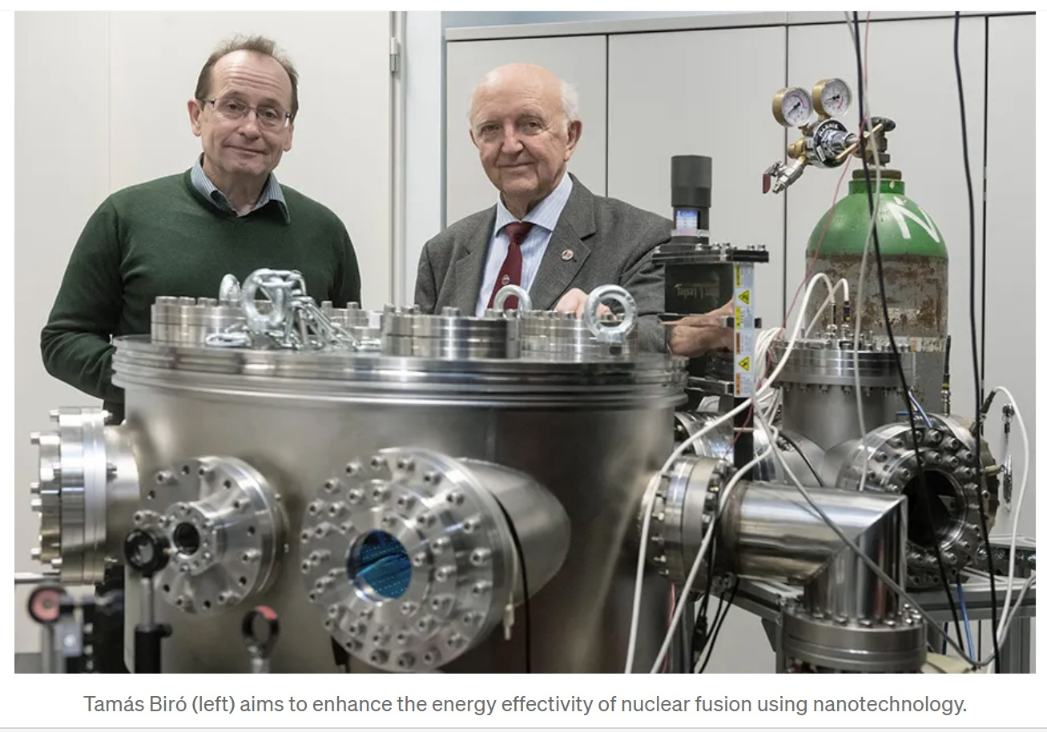


Slide 22
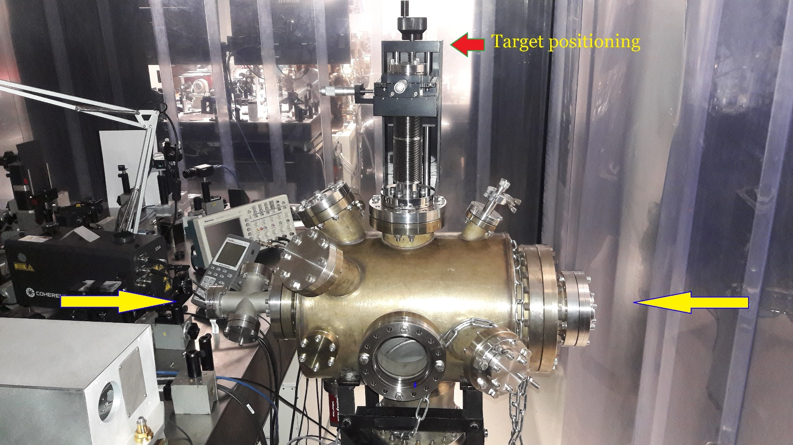
First experimental setup at Wigner RCP
Péter Rácz
et al.
2021

Slide 23
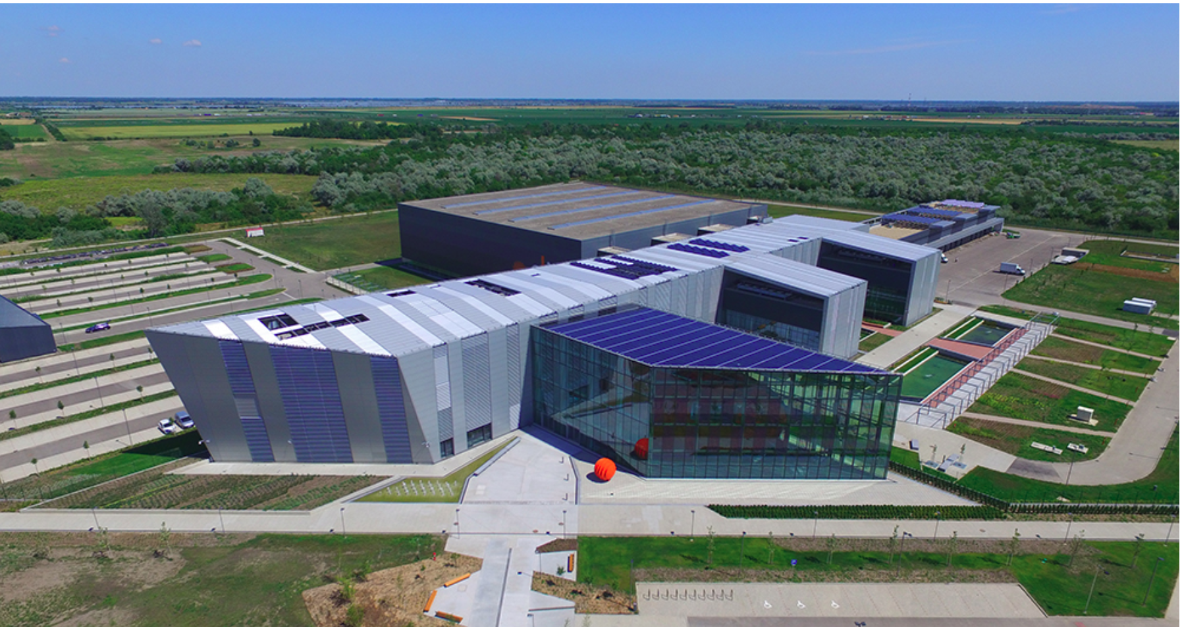
European Laser Infrastructure – Szeged, HU
Only @ ELI-ALPS Szeged: EU Extr. Light Infrastructure , Attosec. Light Pulse Source
2PW High Field laser, 10 Hz, <10fs, 20 J
2022 100 mJ
2026 8.5 J !

Slide 24
ELI-ALPS
Target chamber
[K. Osvay
et al.]

Slide 25
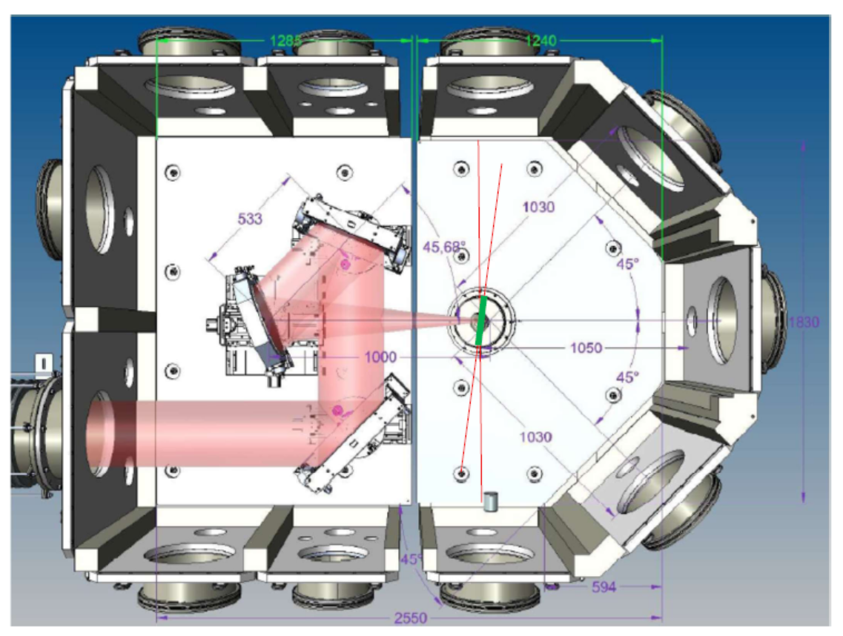
FUSENOW (Bergen) Proposal
8.5 Joule pulse energy
Jan Petter Hansen,
L.P. Csernai, et al.
ELI 7th Call (2025),
Etc.
Directed targets by
Attila Bonyár
In: 8.5 J x 12 Hz = 100 W → if Q=10 ➔ 1kW

Slide 26
Fusion Targets

Slide 27
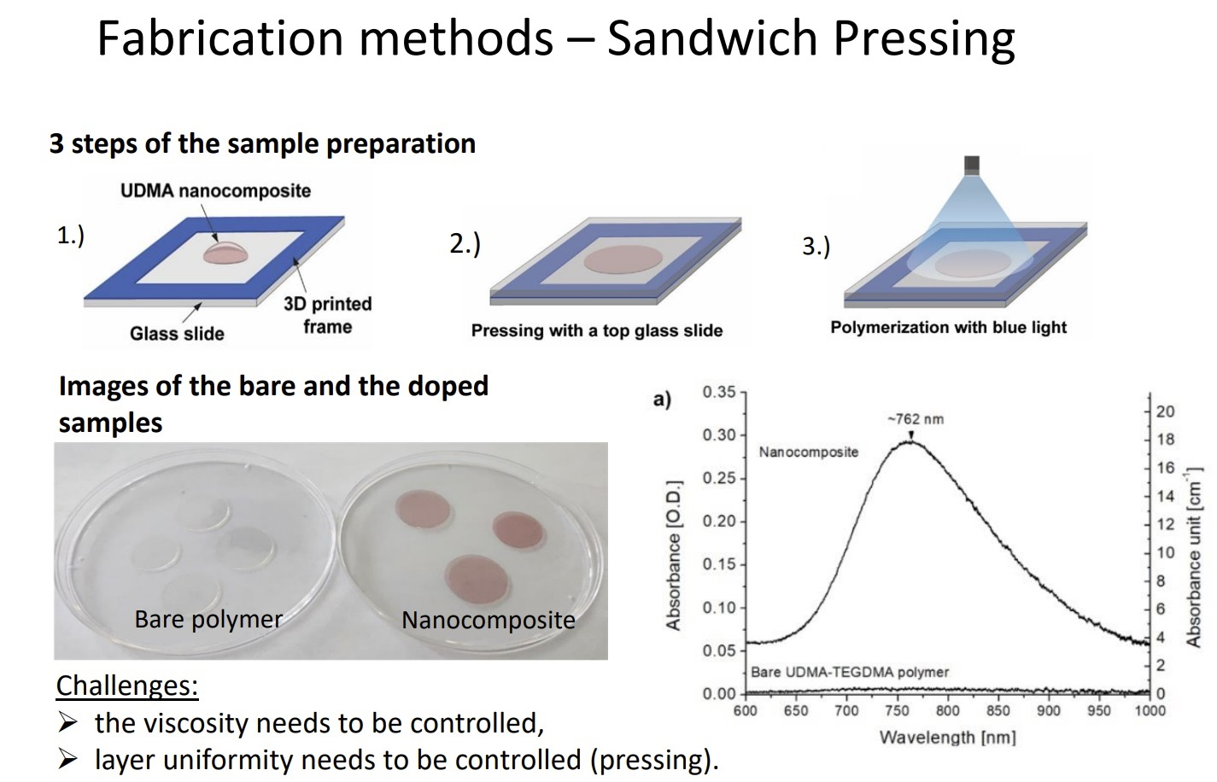
A. Bonyár
et al. (2023)

Slide 28
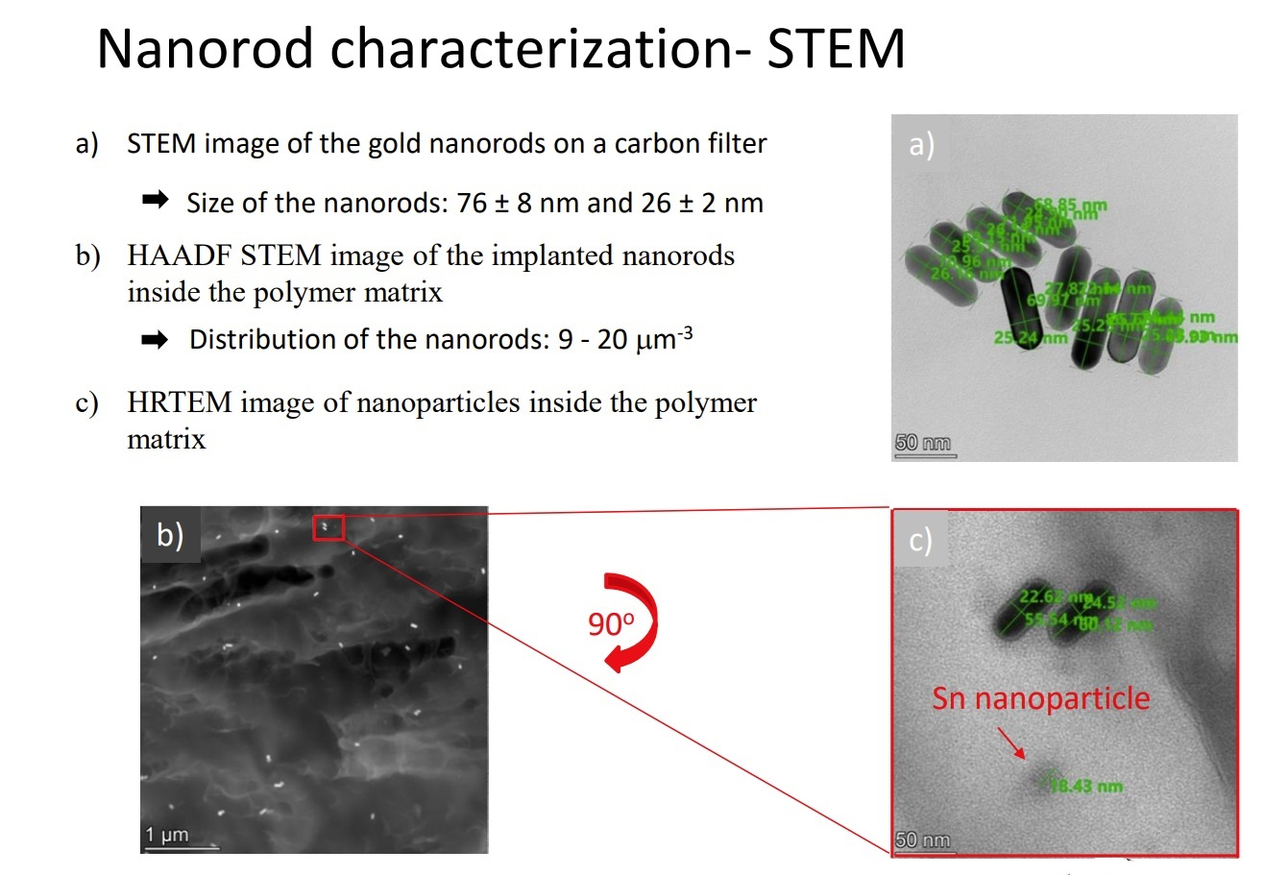
[ A. Bonyár et al. (2023) ]

Slide 29
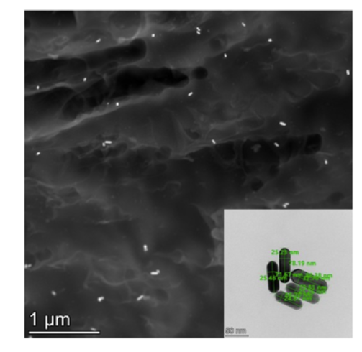
Resonant targets (Unique ! )
Solid targets at room temperature → hard polymer: UDMA (470: H38, C23, O8, N2), TEGDMA, MMA - large hydrogen content (evt. deuterated) & 85x25 nm nanorod antennas (sort !)
1st random orientation, 85x25nm, Au0,
Au1 (0.1m%),
Au2 (0.2m%)
[A. Bonyár et al., (BME)] These targets are used up to now >>
Directed & ordered nanoantennas
[Zs. Márton, J. Budai,
M. Csete et al., ELI-ALPS

Slide 30
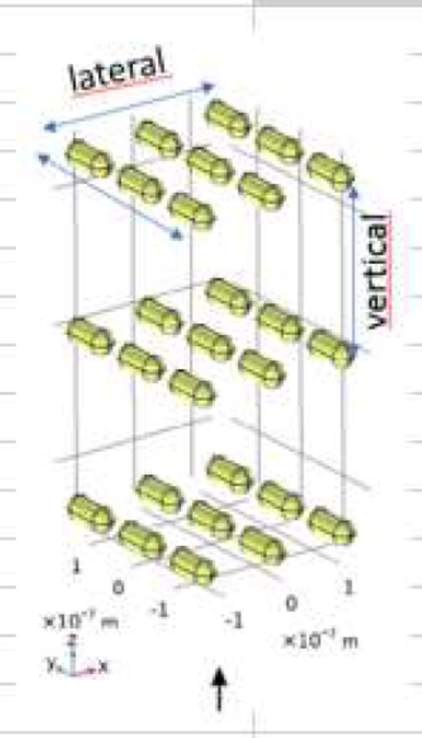
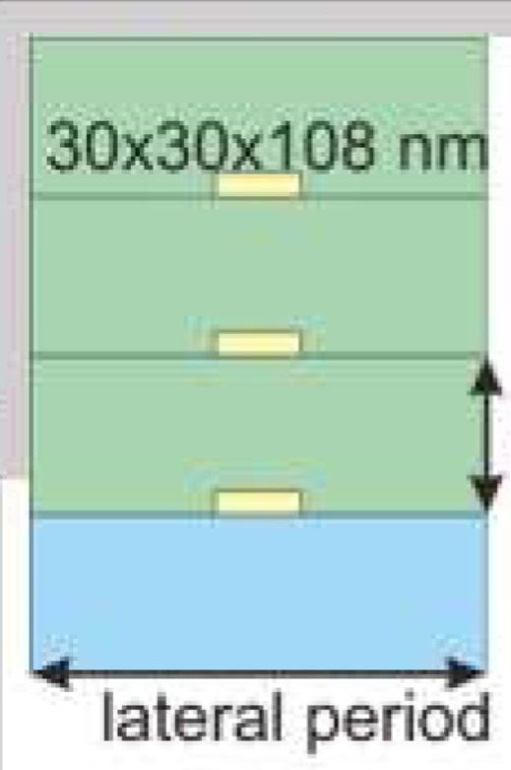
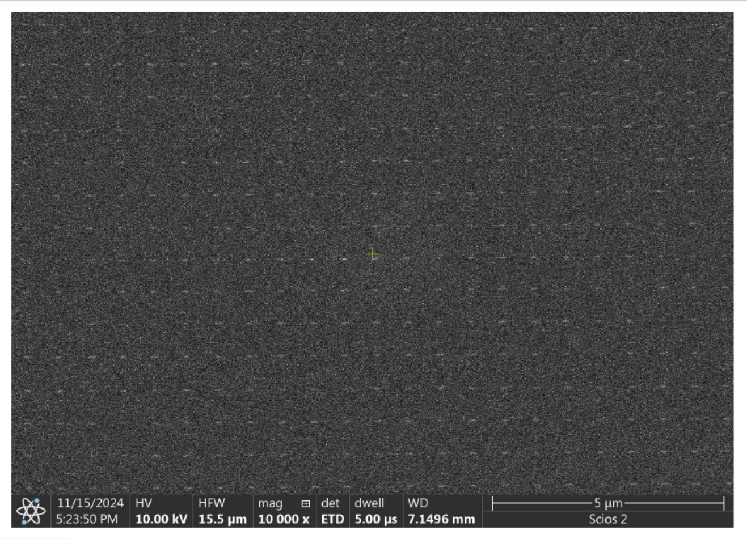
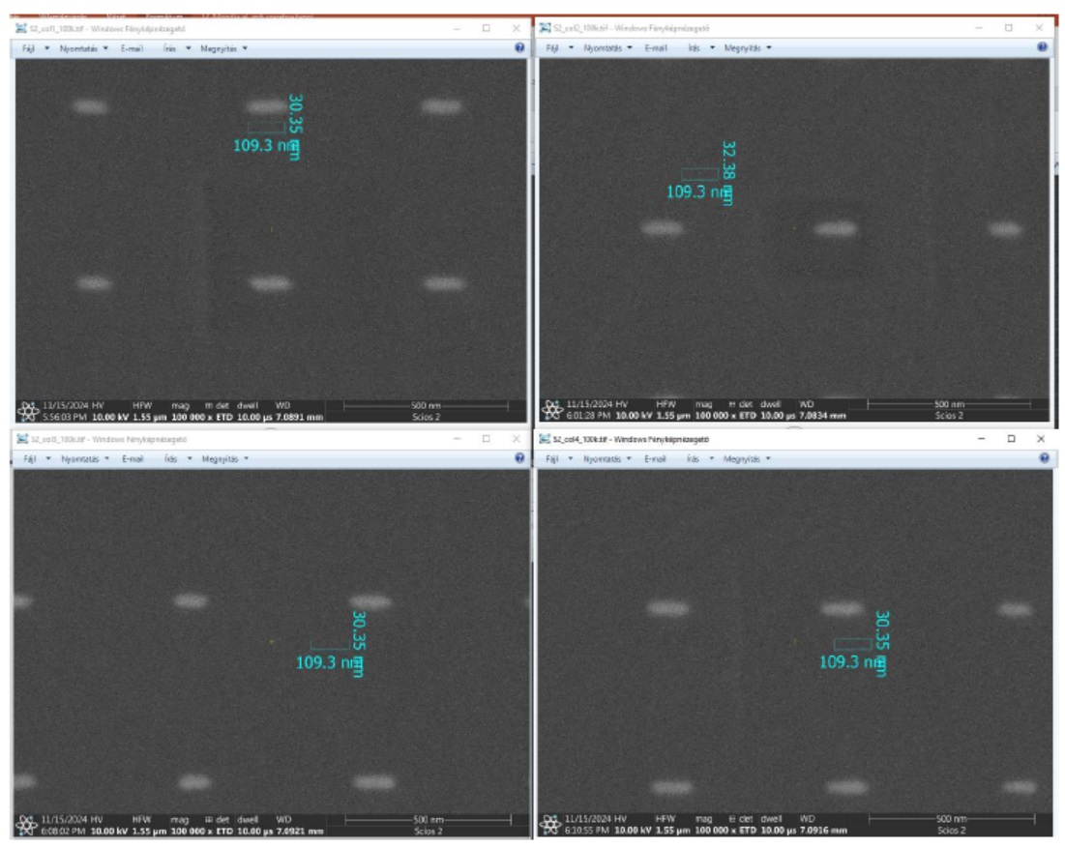

New: Directed multi-layer
antenna array targets @ ELI-APLS
HSQ
Vertical period: 410nm, 480 nm
Longitudinal p.: n x λ_{eff} , n > 2. λ_{eff} /2 = 108 nm in HSQ
HSQ
Directed proton emission ? Will be tested at ELI !!!
Si, SiO_{2,}
530nm, 570nm
500 nm
[Zs. Márton, J. Budai, M. Csete et al., ]
1.0 x 0.6 mm

Slide 31
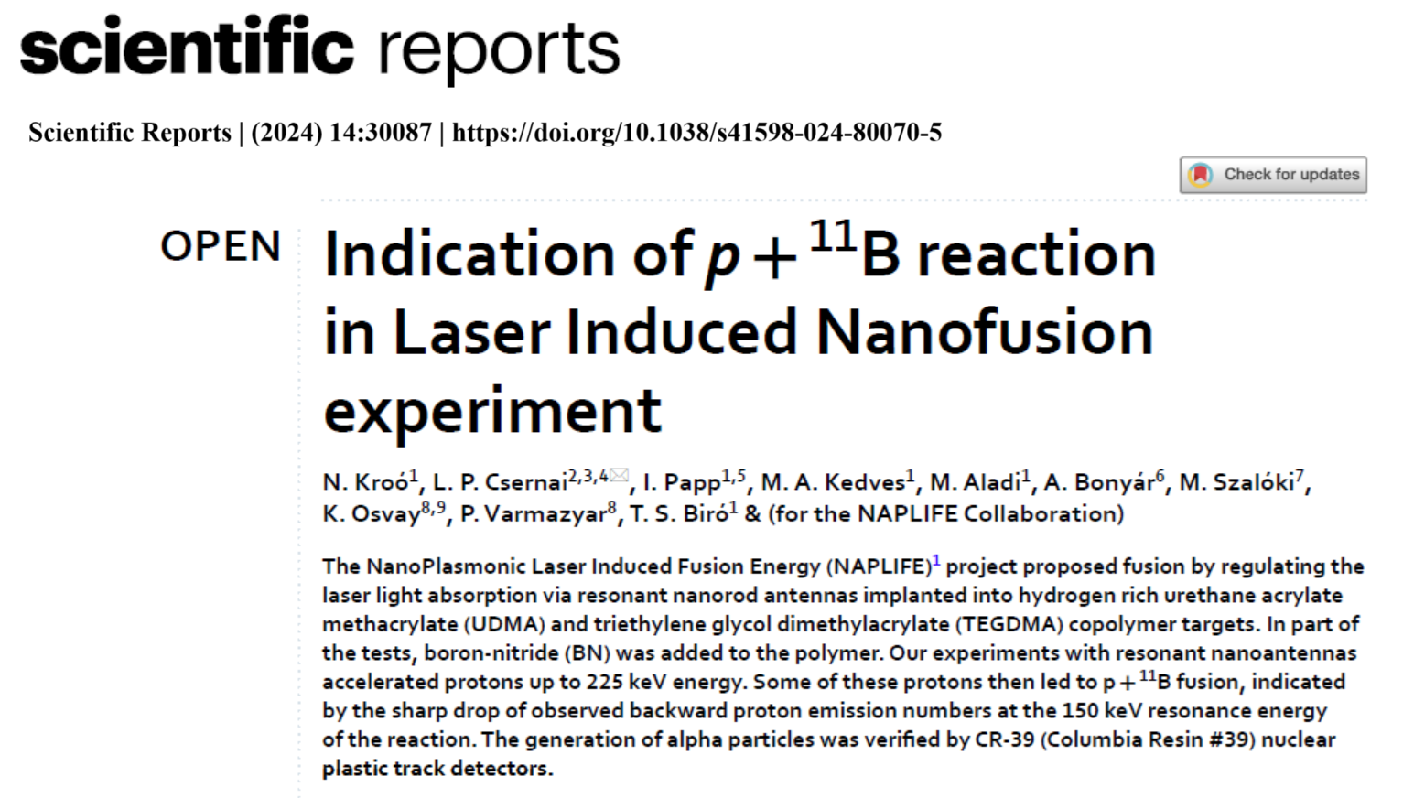
2024
Only two other such measurements are reported up to now:
"First measurements of p11B fusion in a magnetically confined plasma“ R.M. Magee et al., Nature Commun. (2023) 14:955, (M.C.) and
"A multi-MeV alpha particle source via proton boron fusion driven by a 10-GW tabletop laser" V. Istokskaia et al., (nature) Commun. Physics (2023) 6:27. ELI-Beamlines.

Slide 32
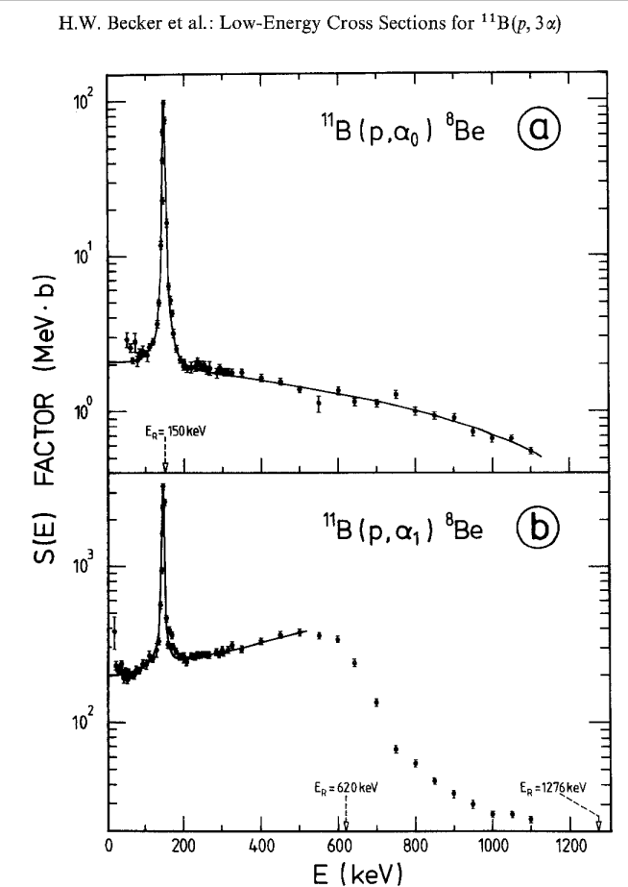
Indication of p + 11B
Reaction
Cross section resonance
at 148 keV
[ N. Kroo, L.P. Csernai, I. Papp, M.´A. Kedves, M. Aladi, A. Bonyar, M. Szaloki, K. Osvay, P. Varmazyar, and T.S. Biro, (for the NAPLIFE Collaboration) Sci.Rep. 14, 30087 (2024)]

Slide 33
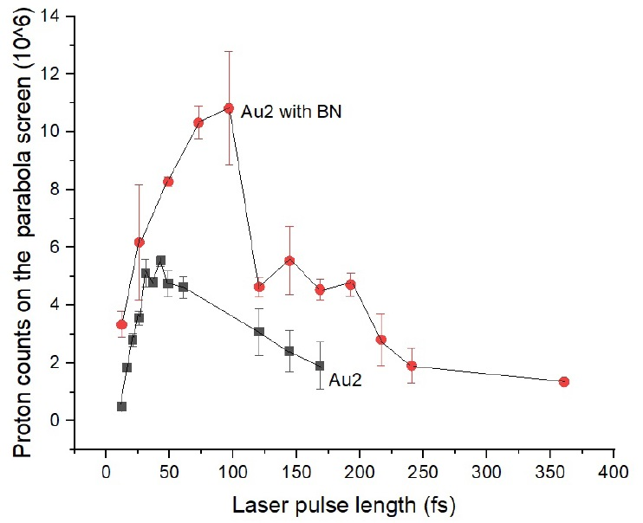
Indication of p + 11B Reaction
T=2.65 fs
The integral number of proton signal in a backward direction, measured at ELI-ALPS SEA laser with pulse energy 25 mJ, applying various pulse lengths from 12.3 to 360 fs.
The maximum beam intensity at 12.3 fs was I= 8.3×10¹⁸ W/cm2. The target was an UDMA-TEGDMA copolymer with embedded resonant gold nanorod antennas at the density Au2=0.182 m/m%, and boron-nitride (BN) with 2.5m/m% density. This BN number density corresponds to 43% of the number of UDMA-TEGDMA monomers. Averaged numbers are shown for 2-12 shots at each laser pulse length, with the corresponding root mean squares indicated by error bars.

Slide 34
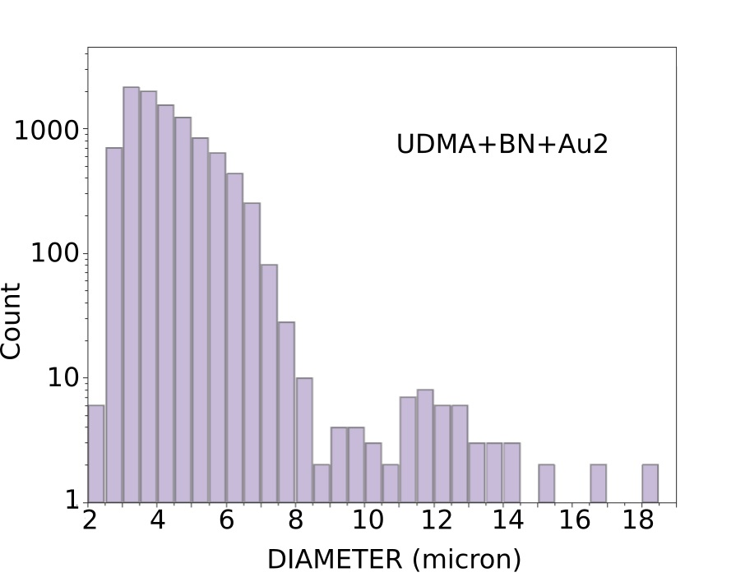
Indication of p + 11B Reaction
Number of impact traces versus the diameter of the trace spot in μm in CR-39 detections with boron-nitride in the target shows a second peak at diameter ∼12 μm, corresponding
to the emitted α particles.

Slide 35
Directed Resonant
Nanoantenna Arrays
parallel to the polarization
of the laser bean (horizontal)
Comparison of horizontal and
vertical directed antennas in
the target [ Zs. Márton et a. ]
Uunder publicatoion
(arXiv 2601.05331v3)

Slide 36
June. 2025
Laser
beam is
horizontally
polarized !!!
➔
Nanorod
antennas
accelerate
protons
horizontally
!!!
Preliminary
Aug.’25
Preliminary
Dec. ‘25
Imene Benabdelghani et al., (NAPLIFE Collaboration) @ ELI-ALPS: XIV ICNFP July 2025

Slide 37
Measured BWD TP Spectrum
The laser beam pulse energy was 30 mJ, the pulse duration was 120.5 fs, and the
target thickness was 170 μm. The length of the nanorod antennas was 102 nm.
H
V

Slide 38
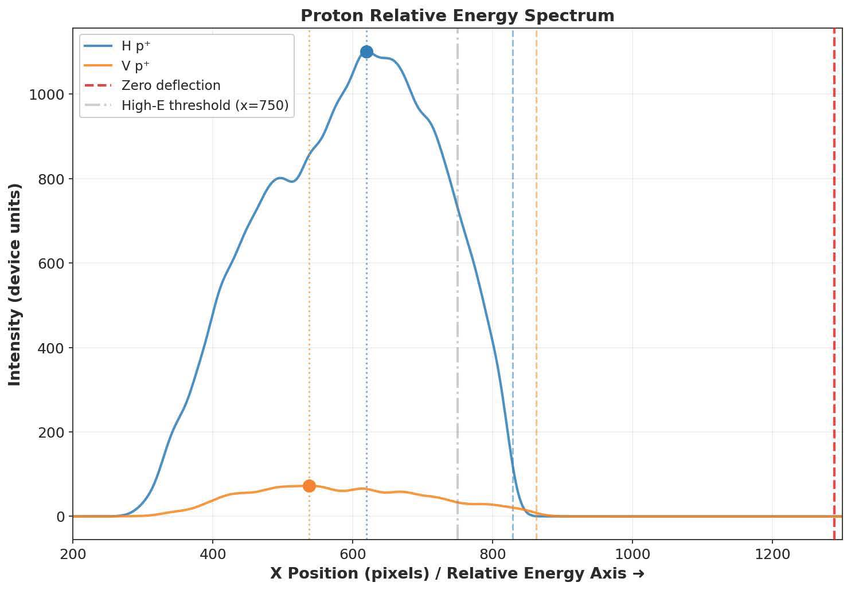
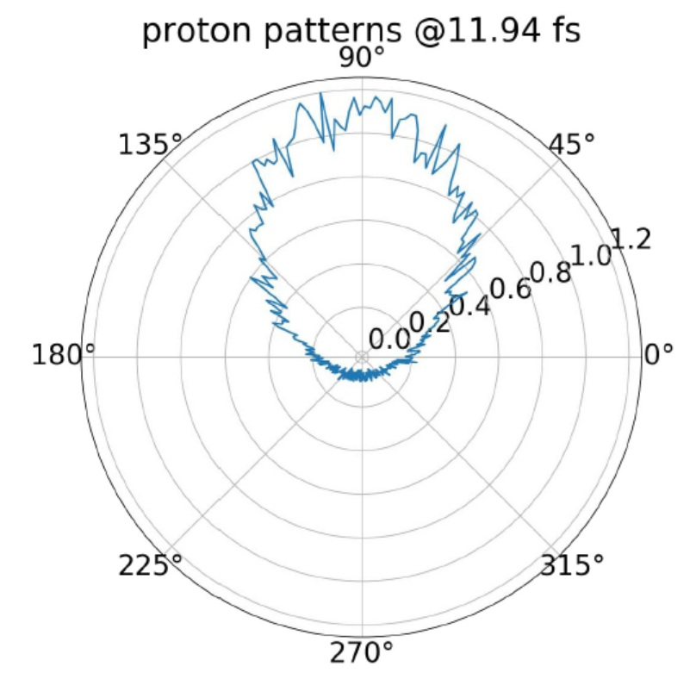
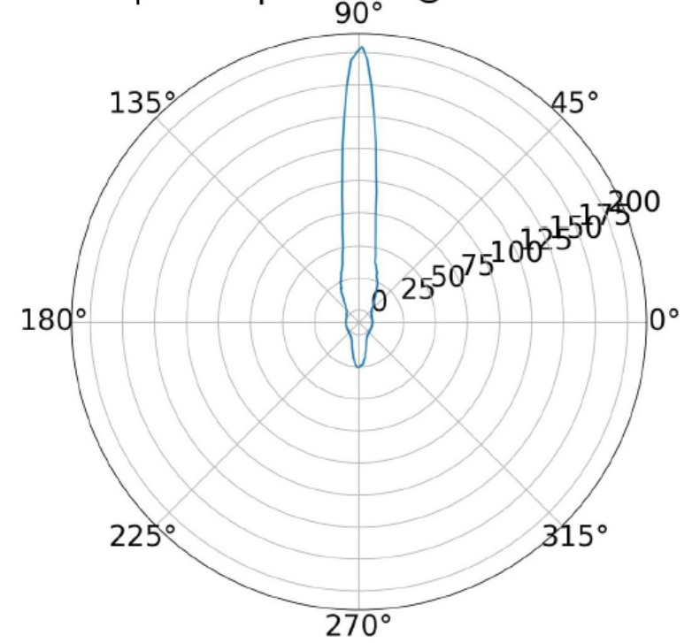
Measured BWD TP Spectrum
The relative energy spectrum of emitted protons with respect to the Zero deflection point energy after irradiation of targets with Horizontal (H, blue line) and Vertical (V yellow line) nanorod targets, measured by the BKW TP detector in the z -direction. The Horizontal target has nanorod antennas that are 45⁰ from the polarization vector direction of the infalling laser light, while the Vertical target has nanorod antennas orthogonal to the polarization of the laser light. Partly parallel polarization leads to increased resonance and proton acceleration, both the energy and proton number are significantly larger in this case.
EPOCH PIC simulations by I. Papp (IJMPE 2026) ➔

Slide 39
Present antenna developments:
Phased Antenna Arrays
Elon Musk: STAR Link, 12k sat.
NAVY ship radars (Br/Re)
Industrial
setup
possible
[ L.P. Cs., Eur. Phys. J. Spec. Top. (2025),
https://doi.org/10.1140/epjs/s11734-025-01466-6 ]

Slide 40
Industrial energetics
Ranges achievable at ELI-ALPS Szeged:
PRESENT ELI-ALPS : in: 8.5 J x 12 Hz = 100 W → if Q=10 ➔ out: 1kW
Higher frequency : in: 8.5 J x 60 Hz = 500 W → if Q=10 ➔ out: 5 kW
Higher laser pulse : in: 25 J x 50 Hz = 1250 W → if Q=10 ➔ out: 12.5 kW
Higher Q value : in: 25 J x 50 Hz = 1250 W → if Q=100 ➔ out: 125 kW
My Skoda Superb 2L diesel engine is: 100 kW
LLNL NIF (400MJ !) : in 2 MJ x (1/86400)Hz= 23.15 W, Q_{target}=5 ➔ out: 115.75 W
=1/day ( = $ 100 000/day)
Next step industrial development: at Paks 1 VVER 440 MW (now 500) is 50yrs.
Reactor vessel could be replaced (like Biblis near FfM by M. Roth et al.) secondary circuit may still be operational.

Slide 41
CONCLUSIONS
Plasmonic amplification is verified
Proton acceleration is verified
Formation of Deuteron nuclei is verified
p+¹¹B fusion reaction is detected
Proton acceleration Parallel to laser polarization is verified
Contrary to the fact that
Only 40 mJ laser pulse energy was used
Only one-sided laser irradiation was available
planned progress for NAPLIFE & FUSENOW (Bergen)
~10 Joule project is planned, directed thick target (A. Bonyár)
Massive, directed p+¹¹B fusion is expected

Slide 42
Thanks for your attention

