Slide 1



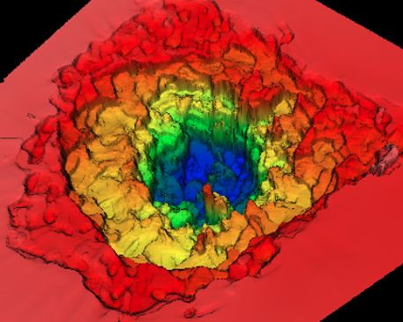
TAMÁS BÍRÓ 70
Norbert Kroo
(from the NAPLIFE cooperation)
Wigner Research Center of Physics, Hungary
Wigner 06.11.2026

Slide 2


Probably the greatest challenge of the next decades:
SECURE ENERGY FOR 10¹º HUMANS
At 2050 minimum 10 Terawatt additional
energy sources will be necessary.
And for global prosperity this energy
should be cheap.
WITH THE PRESENT TECHNOLOGIES THIS IS IS IMPOSSIBLE. NEW ONES ARE NEEDED.
AND THE NEEDS OF ARTIFICIAL
INTELLIGENCE?
GLOBAL INCREASE OF NUCLEAR FUSION R&D EFFORTS, INCLUDING THE LASER DRIVEN INERTIAL CONFINEMENT TECHNOLOGY (MATERIAL NEEDED FOR A GIVEN ENERGY?)

Slide 3
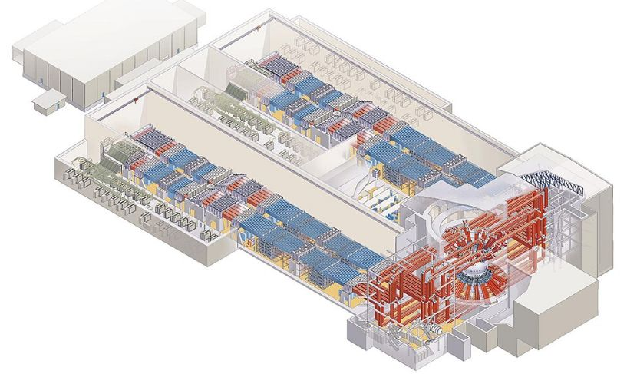
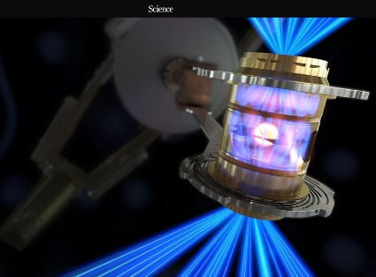
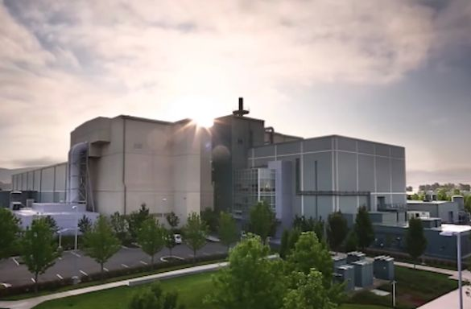
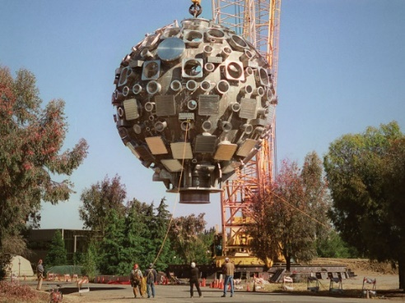
Q = 1.5
Q = 3 ?
10⁵ USD
192 laser, 400MJ, on target 2MJ. The generated nuclear energy 6MJ. The cost of one capsule ~10⁵USD. The length of the laser pulse : 10-50ns , 1 imp/day. Facility cost: multibillion USD.

Slide 4

OUR STARTING IDEA:
The invention of new technologies
The combination of exiting ones:
(e.g. laser nanoplasmonics and nuclear fusion)
Potential benefits:
-Laser energy injection into the fusion material
with light velocity.
-Collecting this energy with resonant plasmonic
nanoparticles (field amplification,
ponderomotiv acceleration of ions,
decreased Coulomb barrier).
-Only 2 beams needed.
-Process in the fs time range (10 times shorter than at NIF).
$$−6$$

Slide 5
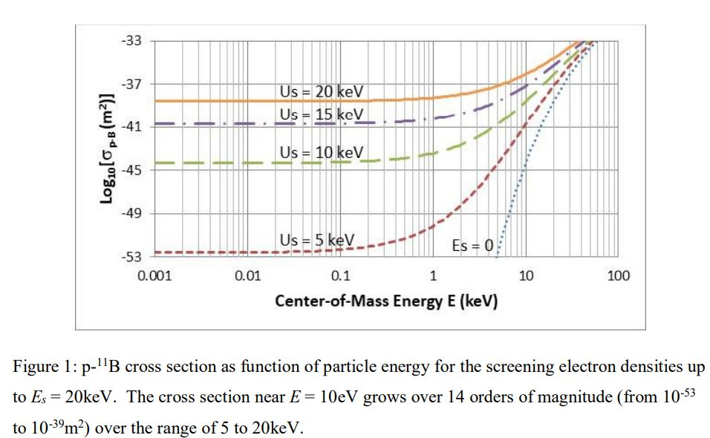
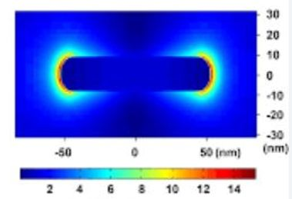
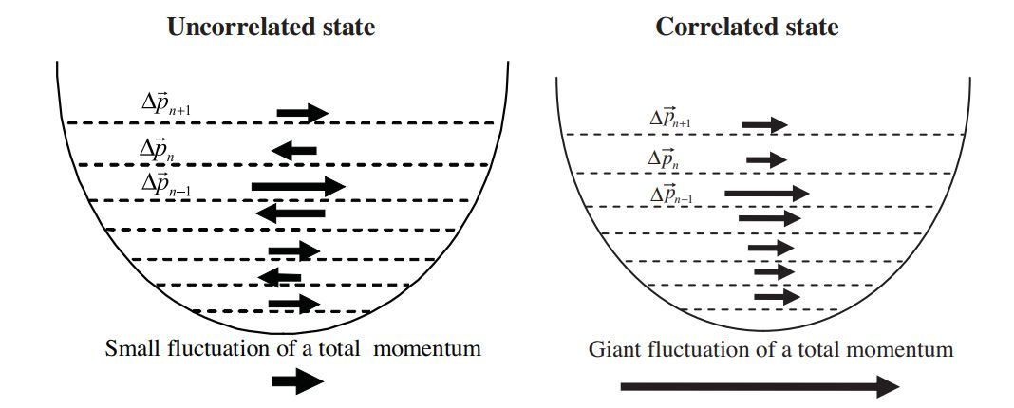
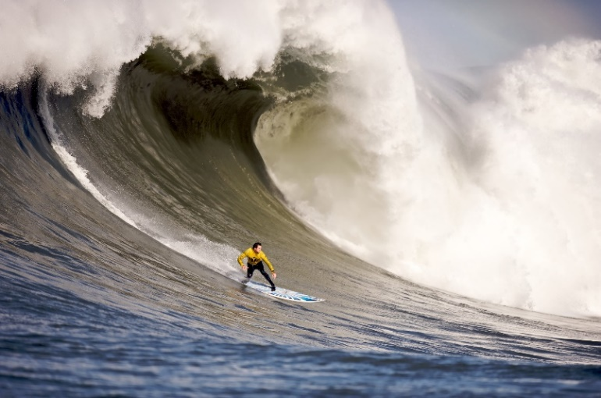
-HOT SPOT
-SCREENING
-PONDEROMOTORIC
ACCELERATION
-CORRELATED MOTION

Slide 6
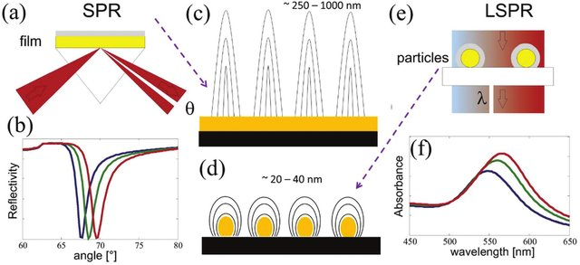
LOCALIZED PLASMONS (LSPP) UP TO 10²⁰ W/cm²)
(The basic difference between SPP-s and LSPP-s)
LSPR: -NO PENETRATION INTO THE PLASMONIC MATERIAL (e.g. metal)
- SMALLER PENETRATION INTO THE DIELECTRIC /VACUUM
-NO DISPERSION, RESONANCE DEPENDS ON SIZE, SHAPE, MATERIAL
-BROADER RESONANCE

Slide 7
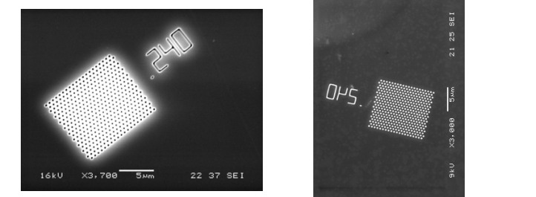
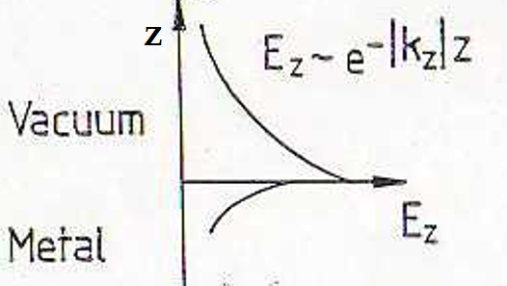
Light penetrates through much smaller holes (slits), than the wavelength of light.
VÁKUUM
MOST OF THE EM ENERGY IS CONCENTRATED AT THR SURFACE: GIANT FIELD AMPLIFICATION
FÉM
LARGE NUMBER OF POTENTIAL APPLICATIONS .

Slide 8
And how did it start?
Part of the Hungarian National Laboratory
Programme.
Headed by the Wigner Research Center of Physics.
Decision of the DG, Peter Lévay: the leader of the
project should be Tamás Biró.
A high risk high gain programme.
A short presentation of some of the results:
(proof of the concept)
SOME HURDLES? :

Slide 9
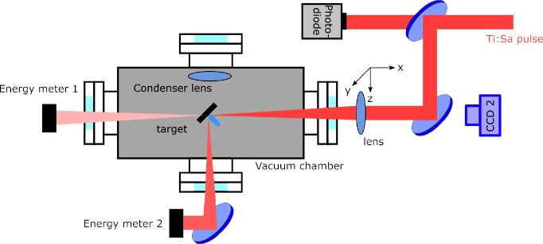
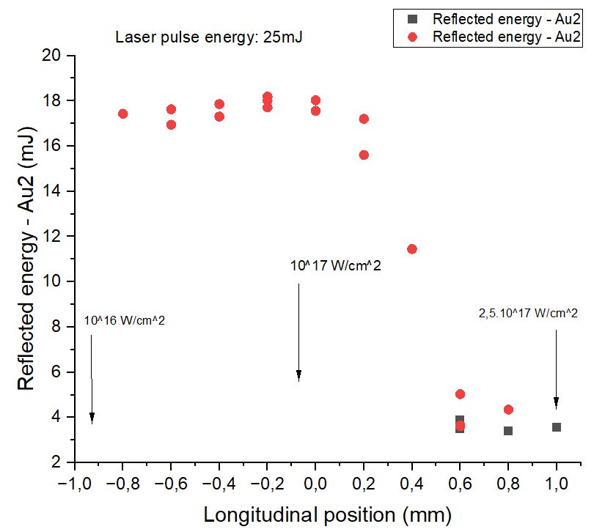
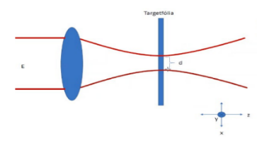
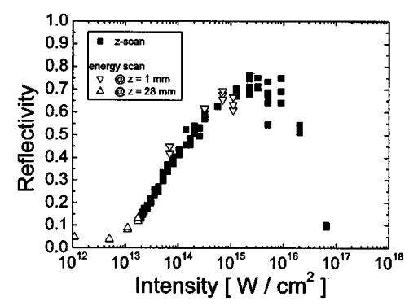
1.
MEASUREMENTS AT WIGNER R.C.
Au0
Sample: polymer (UDMA+ TEGDMA) Au2 (0.18m/m%) resonant nanorods
and Au0 (without nanorods)
10^17 W/cm^2

Slide 10
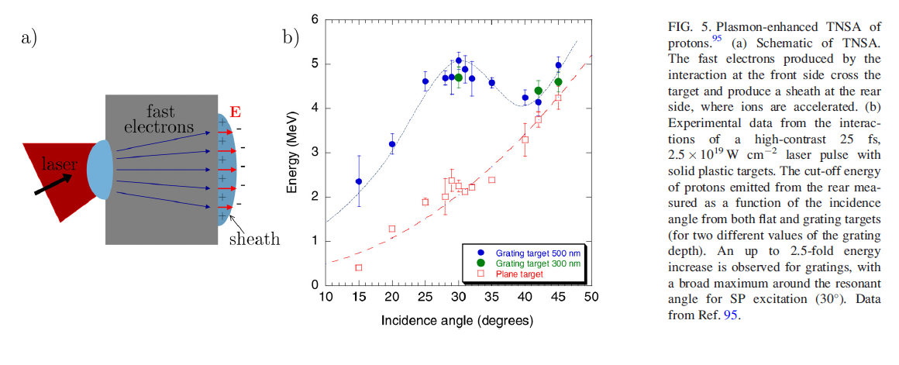
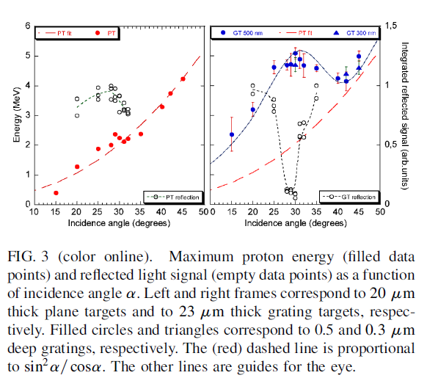
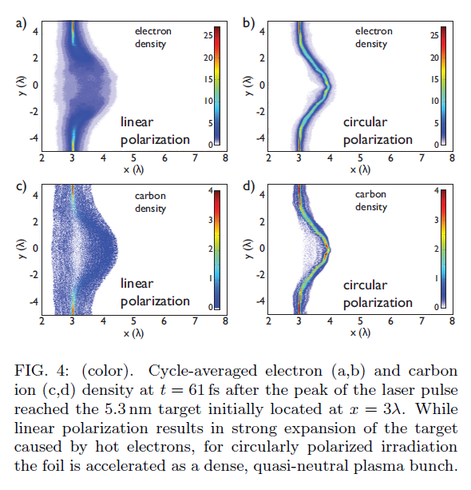
2.
AND UP TO ~10²⁰ W/cm²

Slide 11
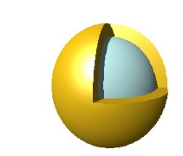
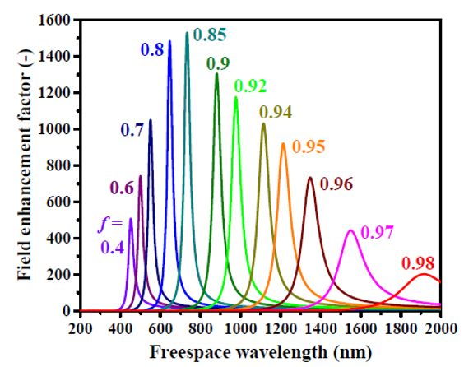
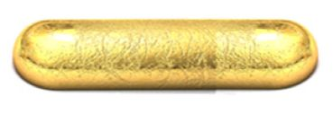
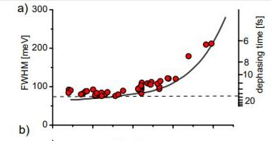
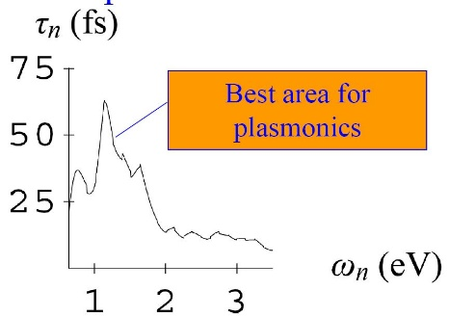
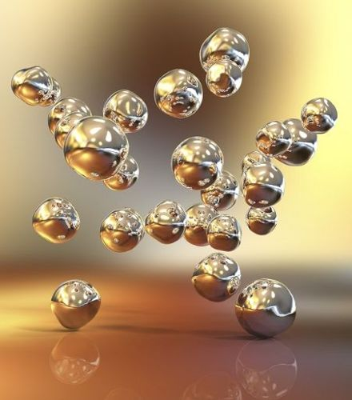
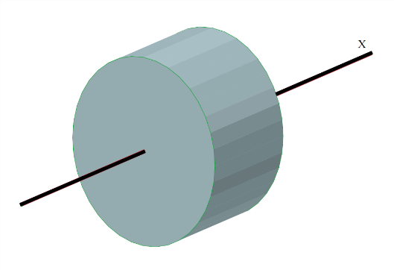
:
NANOPLASMONICS AND ENERGY CONCENTRATION
NANOROD (~85x25nm)
NANOSHELL(nx10nm)
Λ=800nm
1.55 eV
NANOPARTICLES IN THE FUSION MATERIAL
n.10μ
d ~ n.10μ
FEMTOSECOND LASER PULSES;
HIGH REPETITION FREQUENCY;
LIGHT SPEED: NO TIME FOR INSTABILITIES; ONLY TWO BEAMS; TIMELIKE VOLUME IGNITION

Slide 12
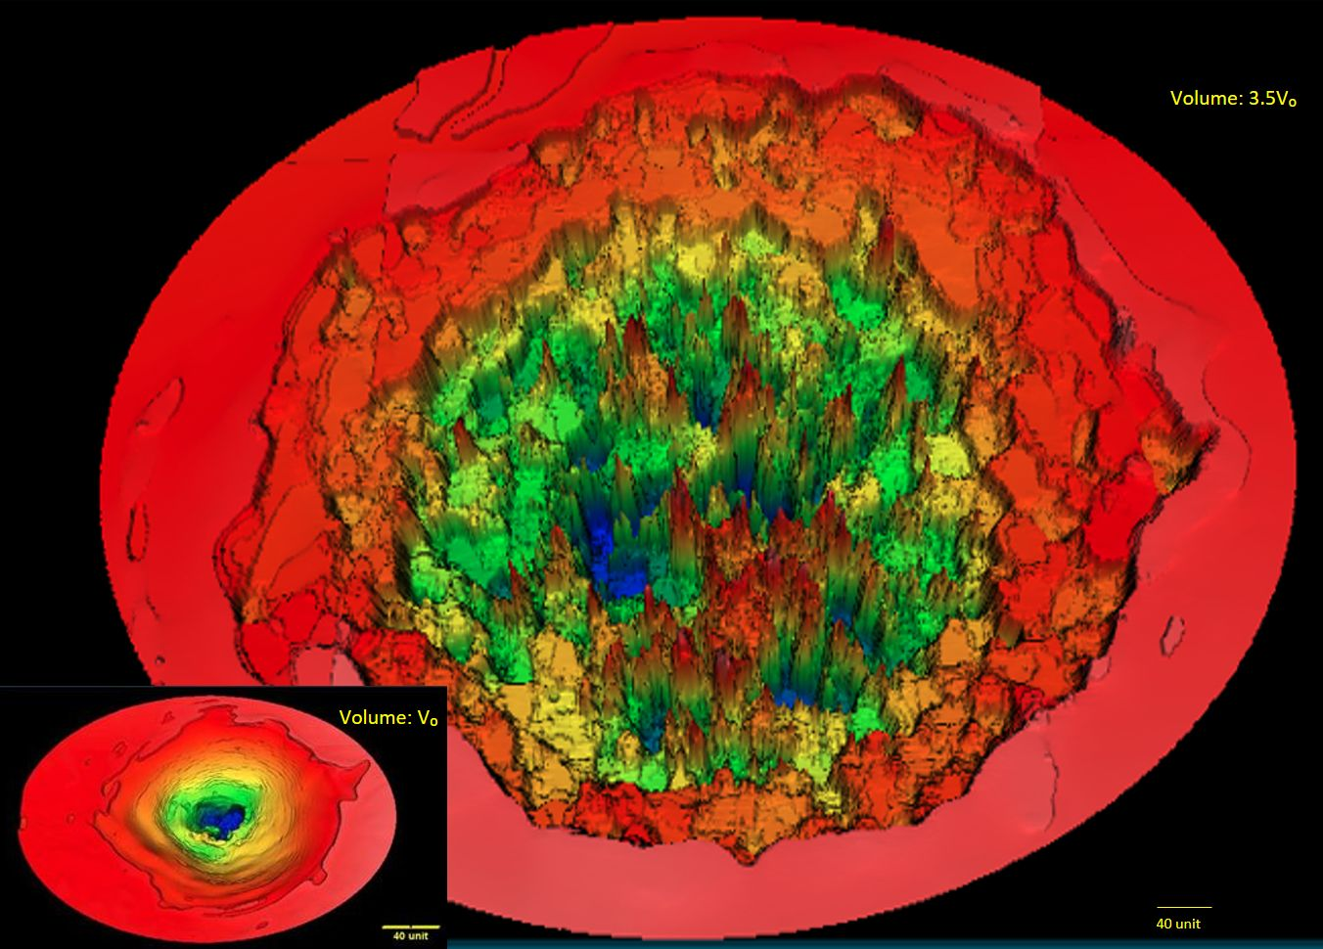
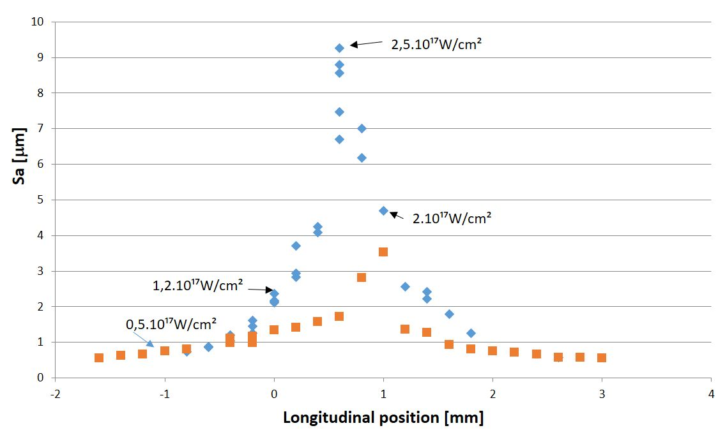
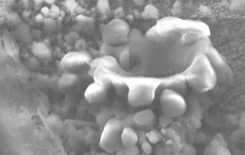
1,2.10¹⁷ W/cm²
Volume ~3,5 V₀

Slide 13
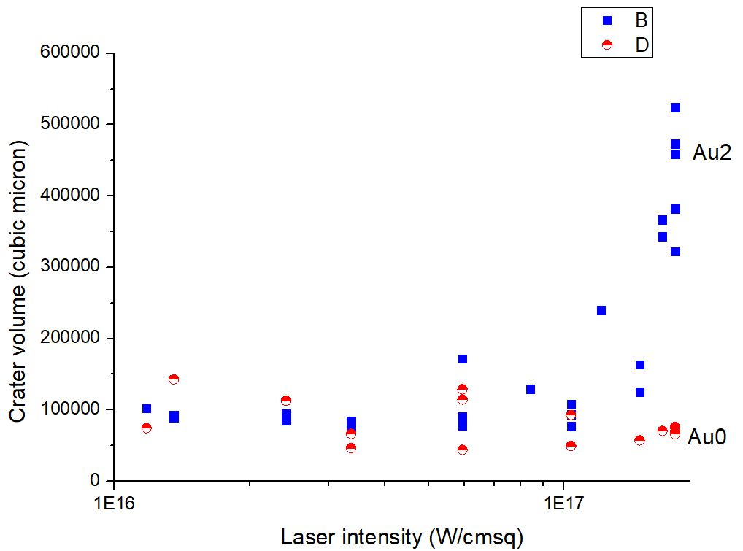
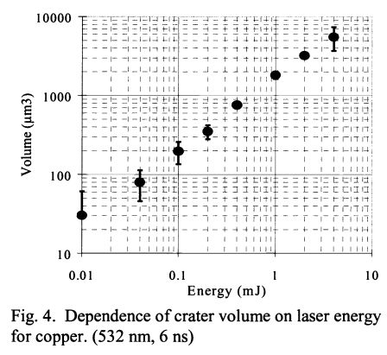
Crater volume: ~ Elaser imp.
Volume increases: ~ Ilaser imp
Q>6 ?
25mJ
27.5mJ

Slide 14
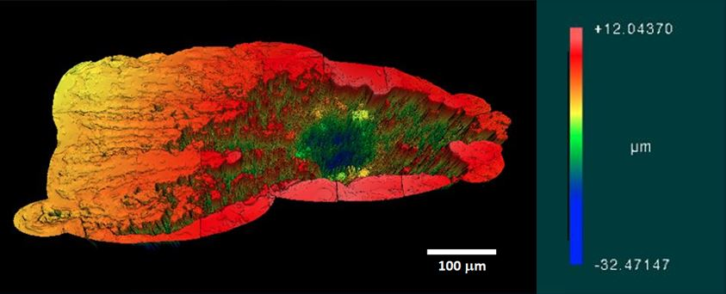
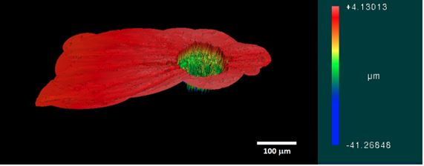
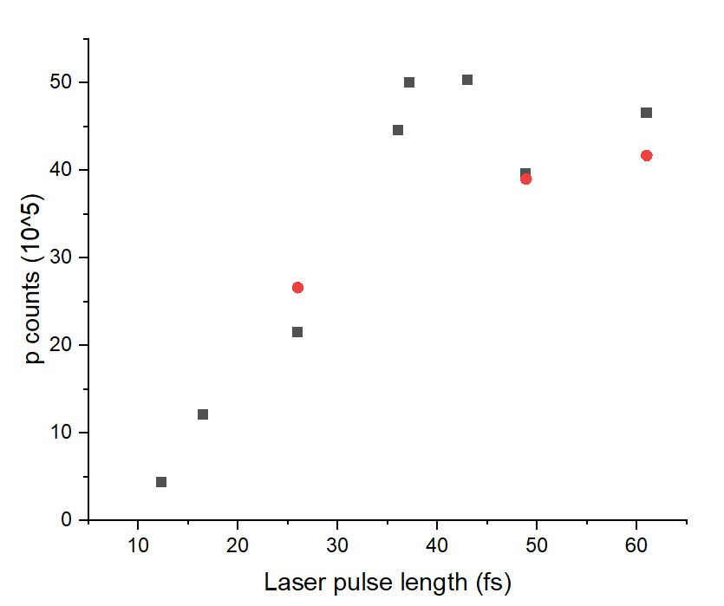
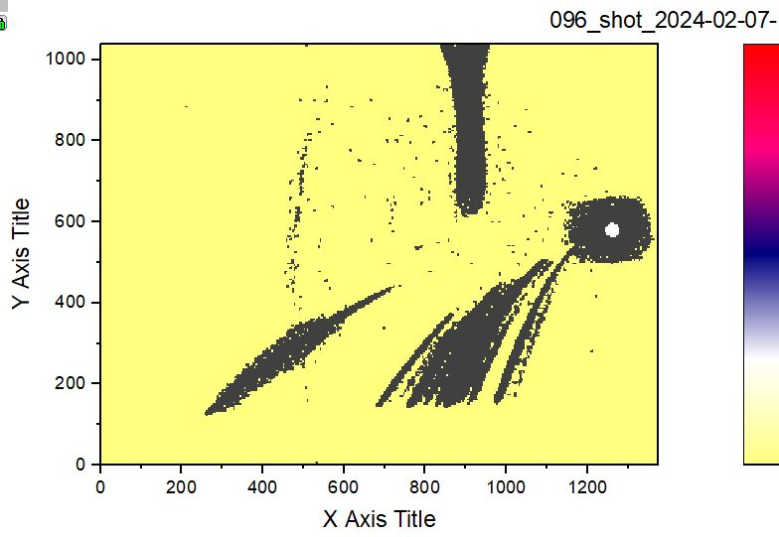
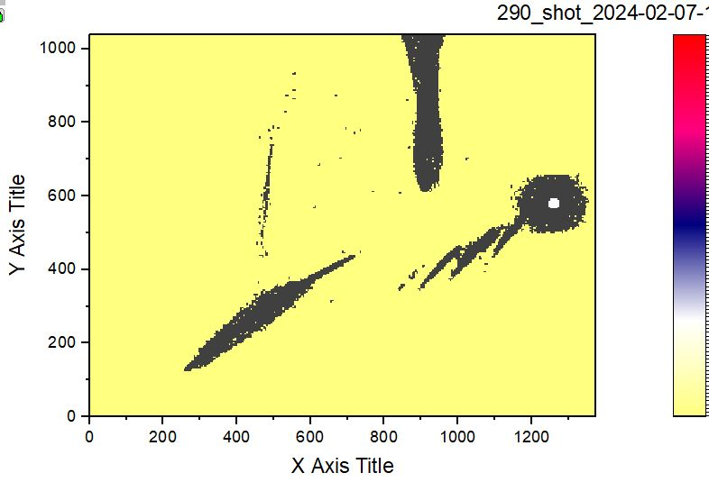
13,15.10⁵µ³
3,48.10⁵µ³
Images:Laser pulse length 43fs
3,48.10⁵µ³
Proton counts vs pulse length
Thomson spectrometer

Slide 15
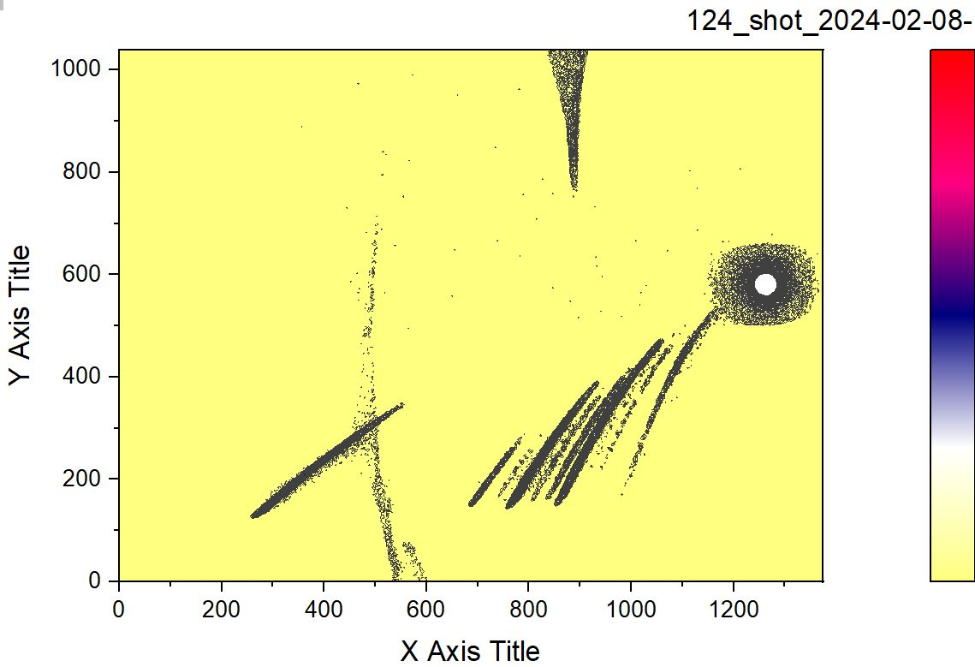
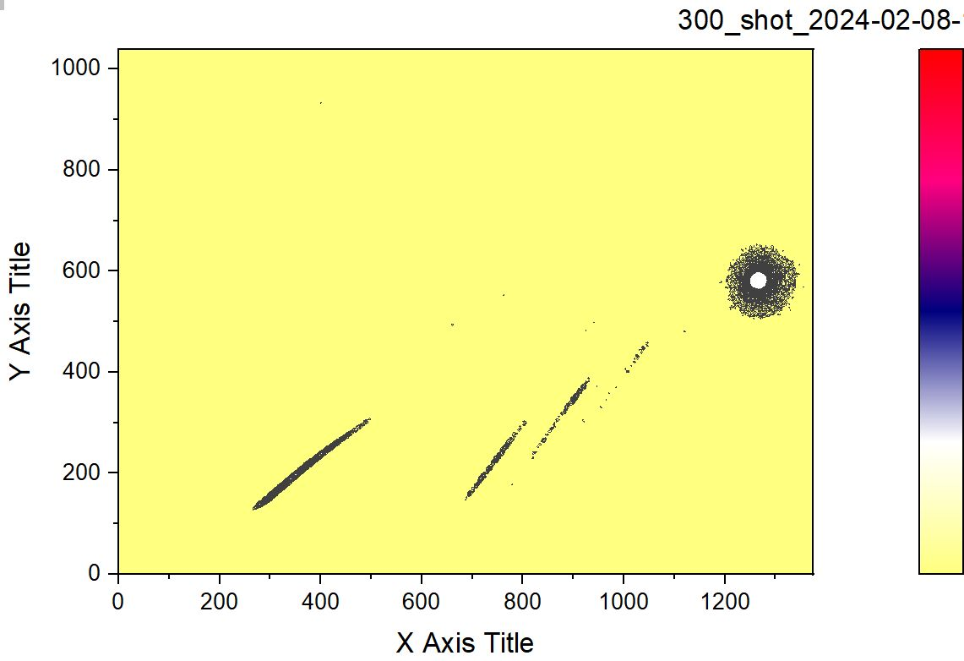
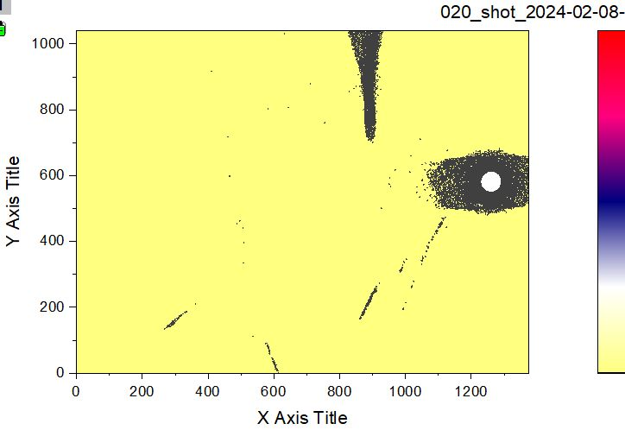
Au2 12.3fs R
Samples with BN
Au2 12.3fs NR
Au0 12.3fs

Slide 16
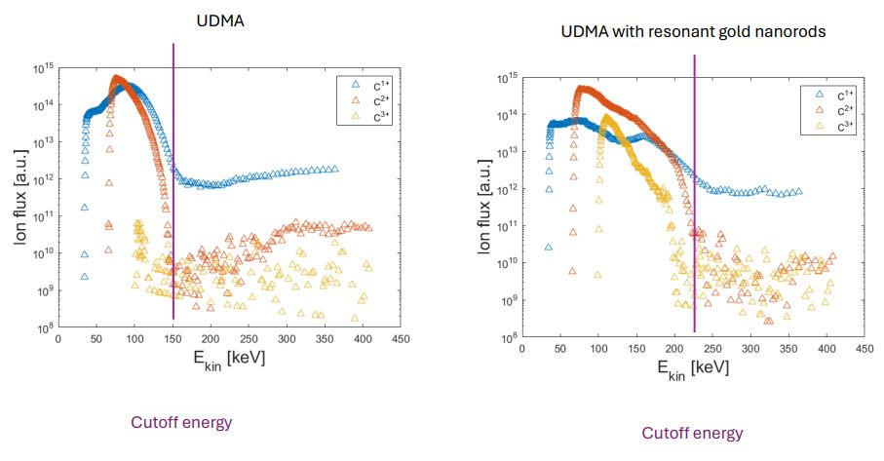
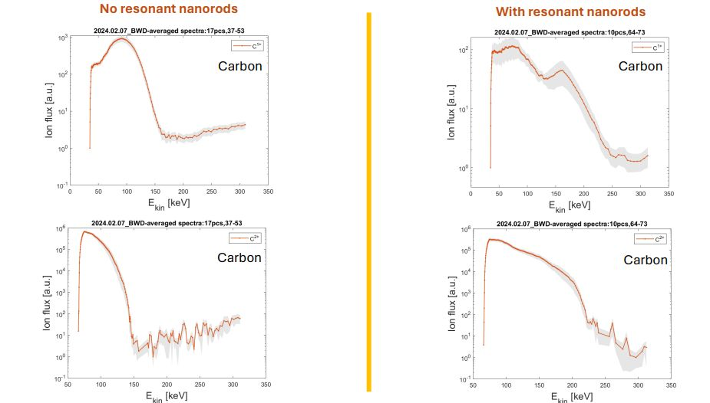
HIGH FIELD PLASMONICS WORKS

Slide 17
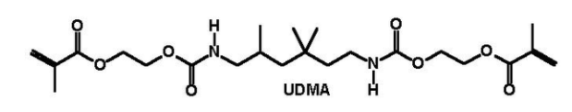
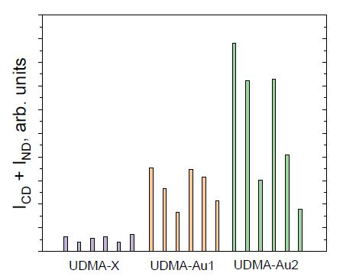
1.Diagnozis :Raman scattering from the crater surface
arXiv2210.00619(2022), (Nature) Scientific Reports, accepted
Ilaser > x.10¹⁶ W/cm²
a
Au2
Au1
b
Au0

Slide 18
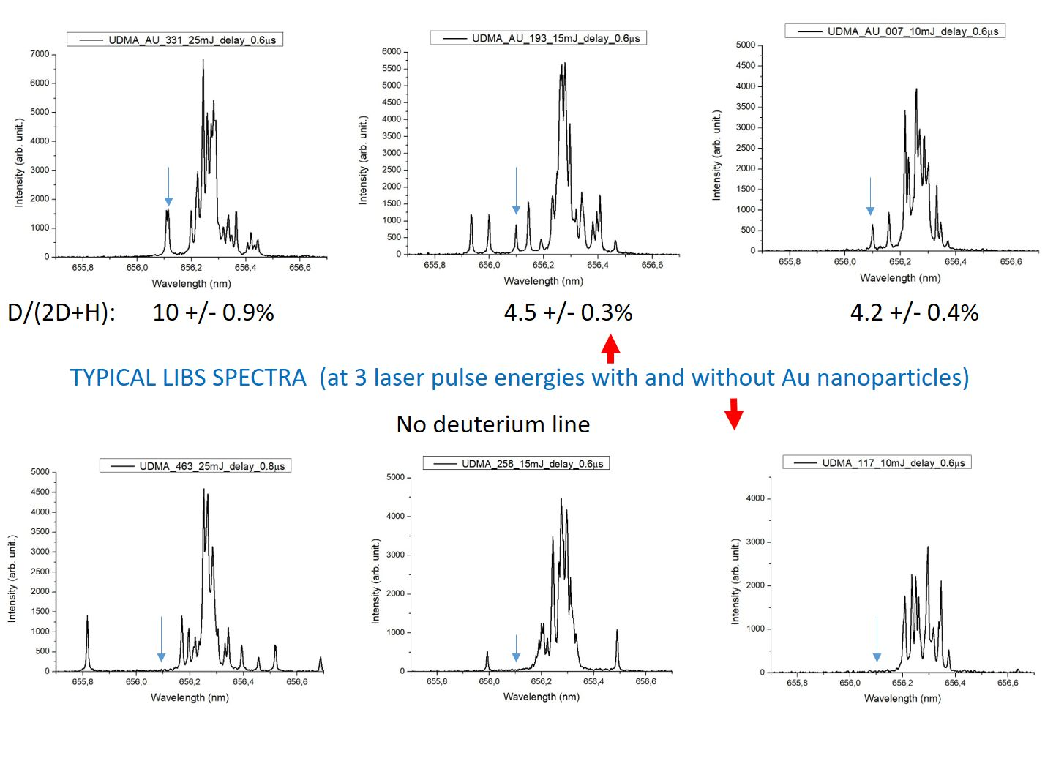
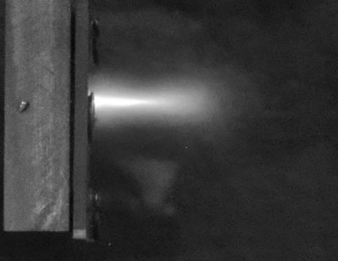
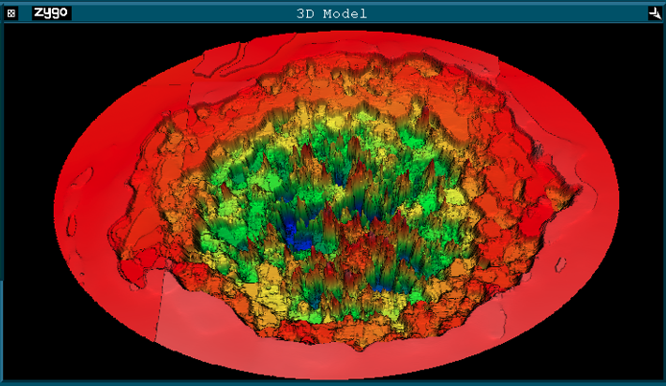
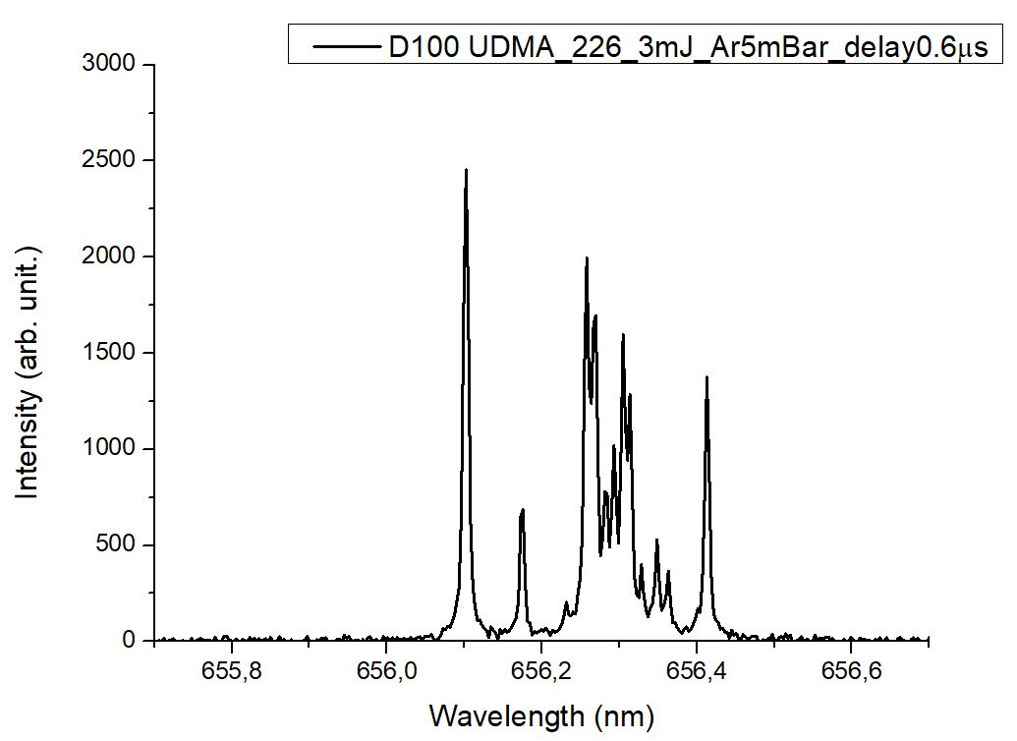
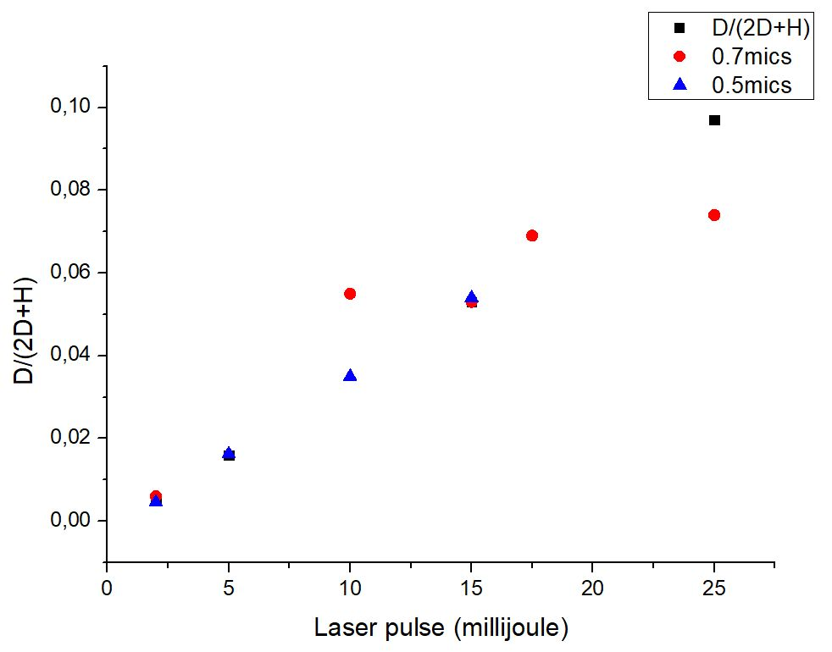
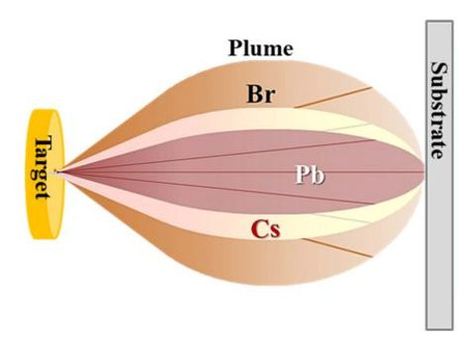
2.DIAGNOZIS: SOME RESULTS OF THE Hᵅ AND Dᵅ SPECTRAL LINES
H
D
D
H
Deuterated (30%) sample
2D+H The total number of H atoms before the transmutation process
Scientific Reports 14 (18288) 2024
Number of D atoms in the case of 25mJ laser pulses : ~1.76x10¹⁵

Slide 19
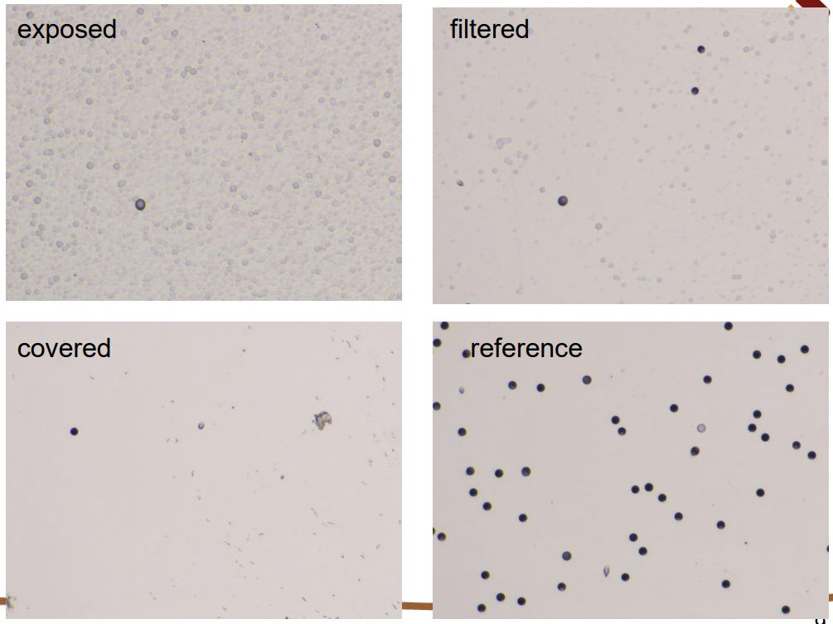





1. Atomic optical spectroscopy (LIBS)
2. Mass spectrometry.
3. Nuclear detection techniques.
4. Thomson parabola.
3: CR39 film, 1 laser shot
1
α
Au2
2
Au0
Au2
Bórnitride implanted samples
Au0

Slide 20





4
1

Slide 21

This has been the short review with which I wanted to honour Tamas Biro on this special occasion and wish
HAPPY 70TH, TAMÁS
MANY RETURNS TO THE DAY

Slide 22

THANKS FOR YOUR ATTENTION!

Slide 23


Au0
Au2
Au2 ‖
Au2 Ͱ
Au0 ‖ and Ͱ

Slide 24





Slide 25

CRATER VOLUMES
2,5.10¹⁷W/cm²
2.10¹⁷W/cm²
1,2.10¹⁷W/cm²
0,46.10¹⁷W/cm²
0,5.10¹⁷W/cm²
A NAGYTERŰ PLAZMONIKA MŰKÖDIK!

