Slide 1

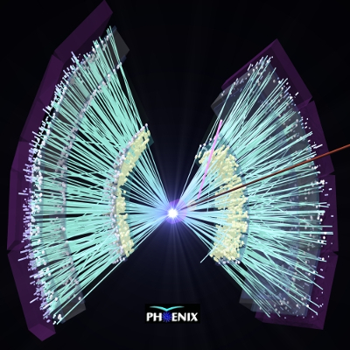
Indirect indications of
a 2nd QCD transition
in √s_{NN} = 200 GeV Au+Au collisions at RHIC
T. Csörgő ^{1,2}
¹ HUN-REN Wigner FK, Budapest, Hungary
² MATE Institute of Technology, Gyöngyös, Hungary
Timeline from 1974 to 2024
T.D.Lee and G.C. Wick
S. Weinberg
R. Pisarski and F. Wilczek
RHIC proposal and CERN QGP press release
ZBCsL: quark coalescence @ CERN SPS
PHENIX and STAR data re-analysis @ RHIC
Indirect observation of U_{A}(1) symmetry restoration by PHENIX
Based on: arXiv:2407.08586, Phys.Rev.C 110 (2024) 6, 6
See also Phys. Rev. C 97 (2018) 064911, and Phys. Rev. C 108 (2023) 049905
For detailed new results: see my PHENIX talk at WPCF 2026 on May 22, 2026

Slide 2
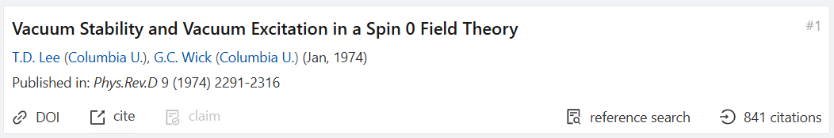
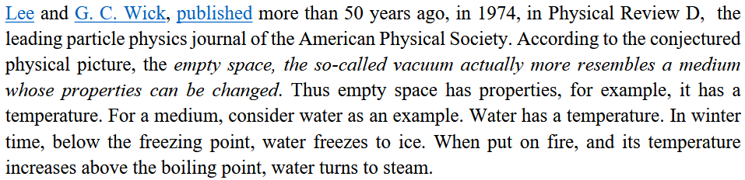
1974 – T.D. Lee and G.C. Wick

Slide 3
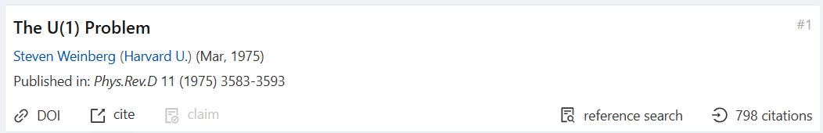
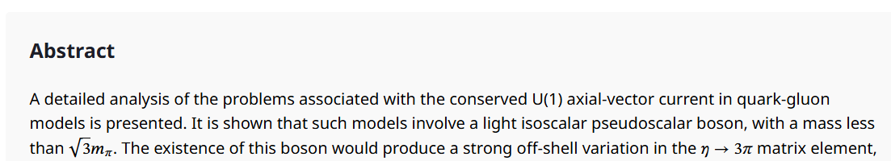
1975 – S. Weinberg

Slide 4
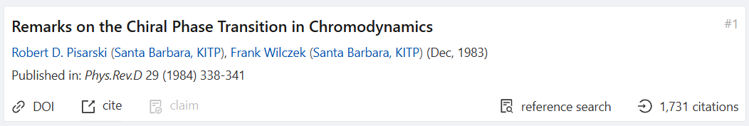
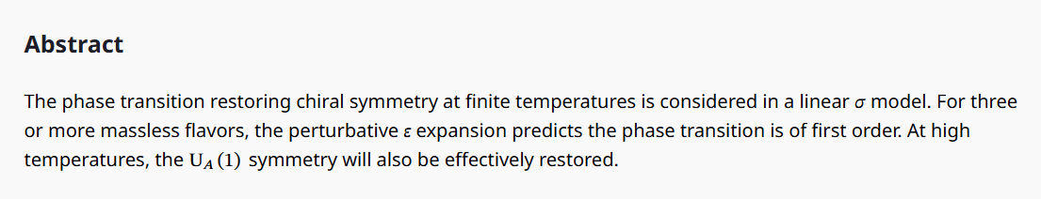
1984 – R. Pisarski and F. Wilczek

Slide 5
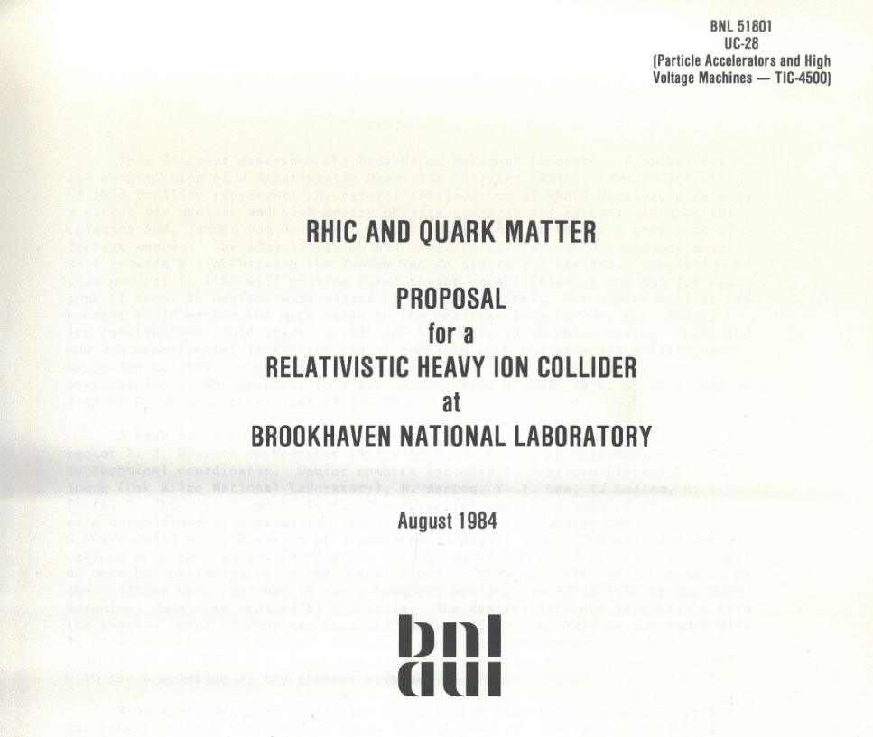
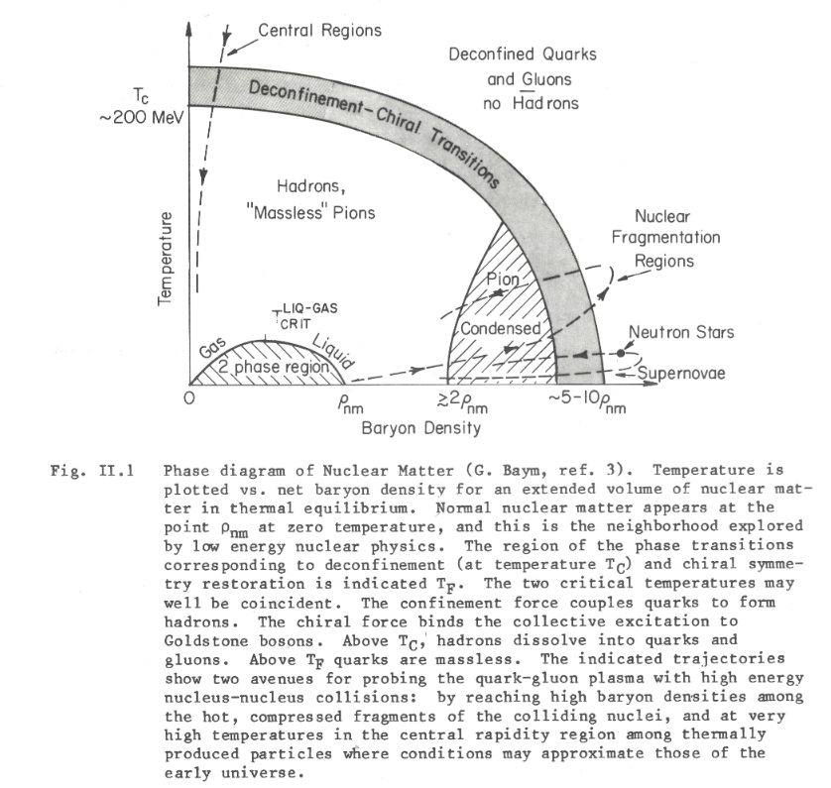
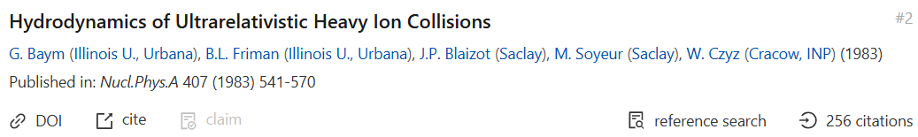
1984 – RHIC Proposal: One or two transitions on the phase diagram ?

Slide 6

1989: „Nuclei, as heavy as bulls, through collision
Generate new states of matter” /T.D. Lee/
Courtesy of the Tsung Dao (T.D) Lee Library
Poem by Prof. T. D. Lee,
Nobel Lauerate in Physics
Painting by Li Keran, 1989
Copyright: © 1989 CCAST:
Chinese Center for Advanced Science and Technology
© 2012 Shanghai Jiao Tong University, Shanghai, China: All Rights Reserved
Special thanks to: UNT Digital Library
New emphasis:
on plural of state
At least two new states!

Slide 7
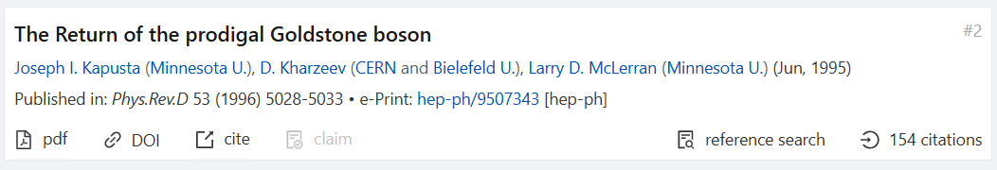
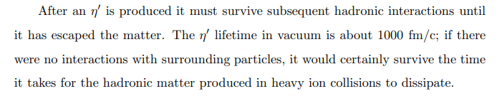
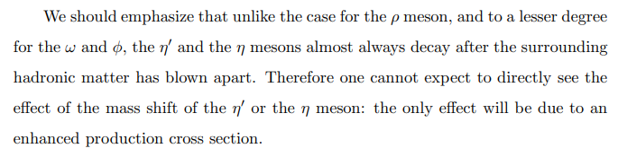
1996: return of the prodigal η’ goldstone boson
SIGNIFICANT
in-medium η’ modification,
predicted theoretically,
but
How to observe it?
in-medium η’ modification: Photons? Dileptons? Enhanced production cross-section?

Slide 8
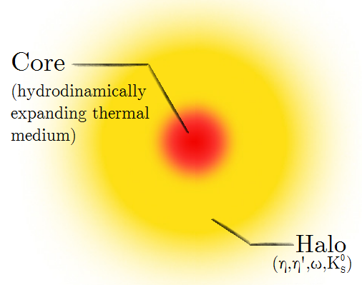
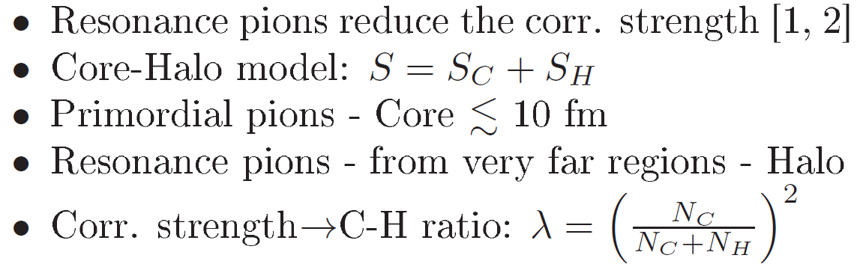

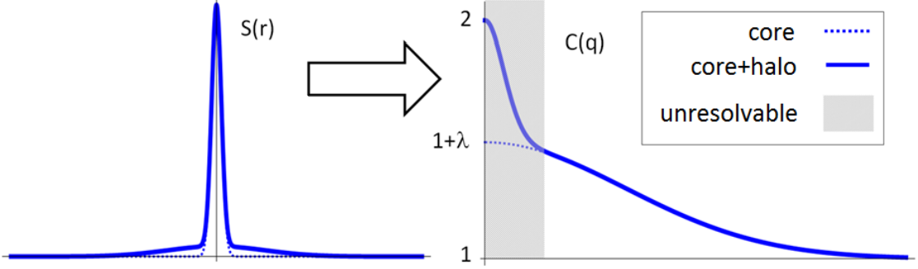
1996: Core/halo model, long-lived resonances
Variance: halo dominated!
Precise measurement of λ is
based on extrapolation to Q = 0,
needs precise measurement
of the shape of C(q):
→ Levy expansion
Precise measurement of λ important !
M.B.de Kock, H.C.Eggers, T.Cs.:
PoS WPCF2011 (2011) 033
T. Novák et al (WPCF 2015) :
Acta Phys.Polon.Supp. 9 (2016) 289
T. Cs., R. Paseschnik and A. Ster:
Eur. Phys. J. C 79 (2019) 1, 62
[1] J. Bolz et al: Phys.Rev. D47 (1993) 3860-3870
[2] T. Cs, B. Lörstad, J. Zimányi: hep-ph/9411307, Z.Phys. C71 (1996) 491-497
8

Slide 9
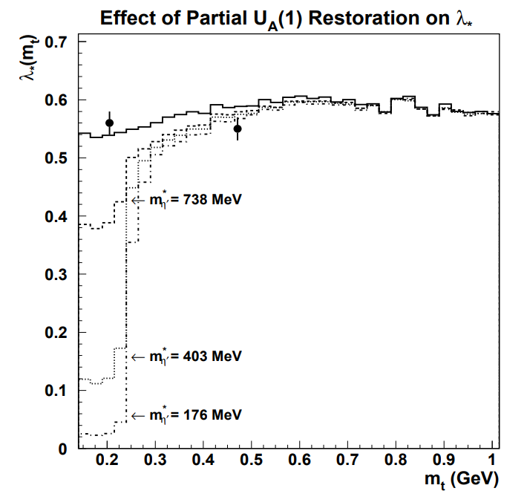
1998: Sensitive to in-medium η’ mass modification
NA44 S+Pb data + Monte Carlo,
NA44 E_{lab} = 200 AGeV (SPS)
S+Pb data sensitive to
in-medium η’ modification, but
NO EFFECT
S. Vance, T. Cs, D. Kharzeev,
PRL 81 (1998) 2205-2208
nucl-th/9802074 [nucl-th]
in-medium η’ modification: can it be switched on and off? Centrality? Energy? System size?

Slide 10
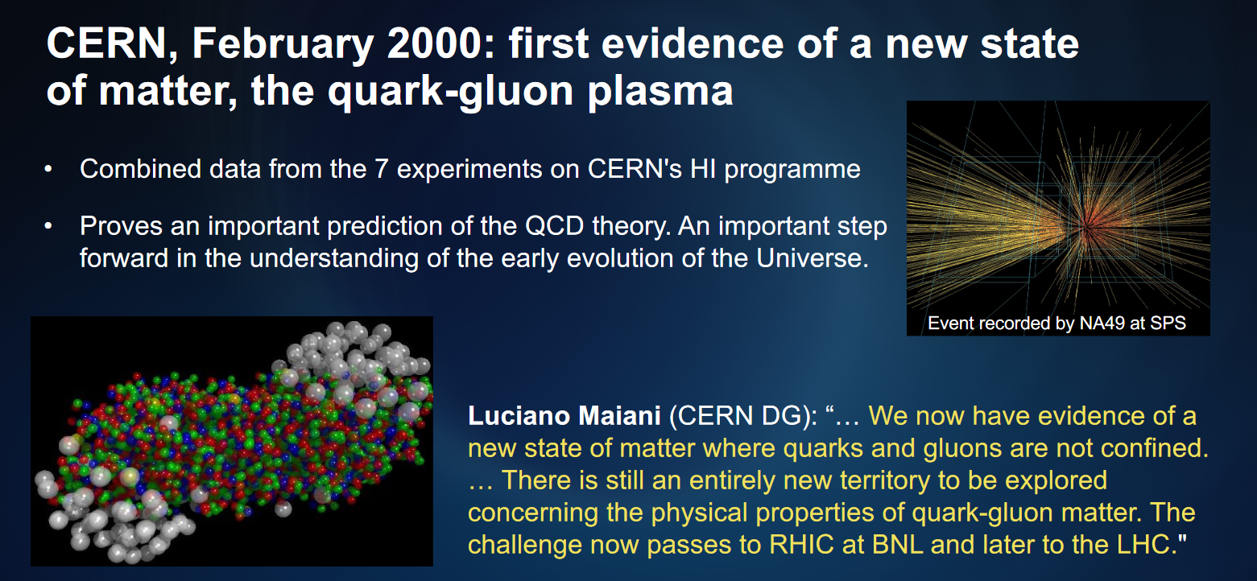

2000: „A NEW STATE OF MATTER, the QGP” /CERN/
New emphasis:
Singular, only one new state …

Slide 11
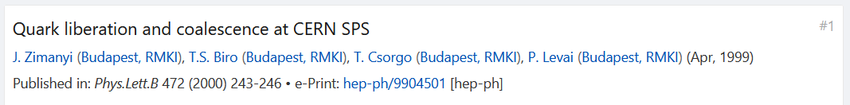
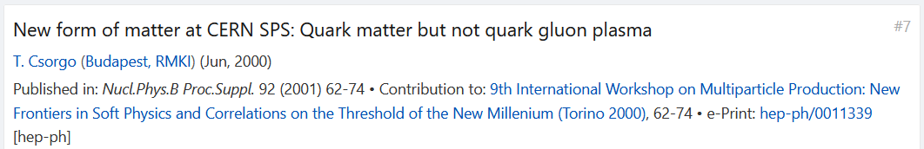
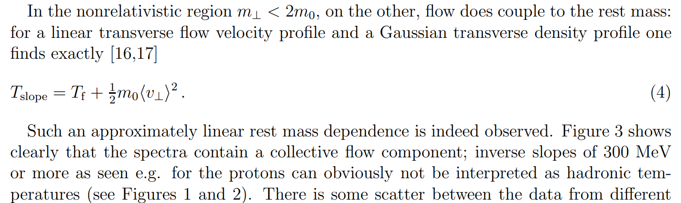
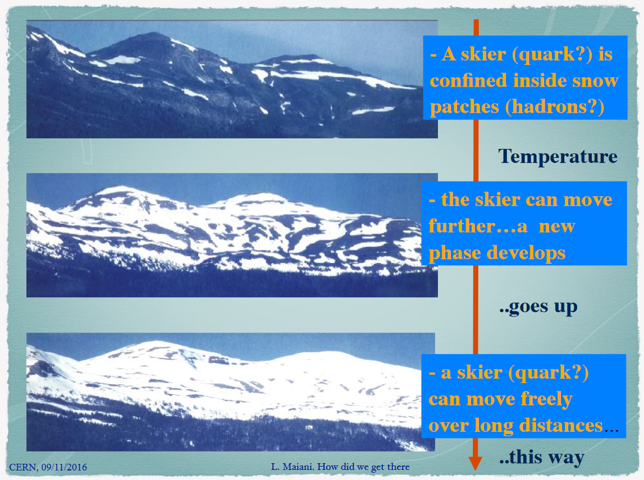
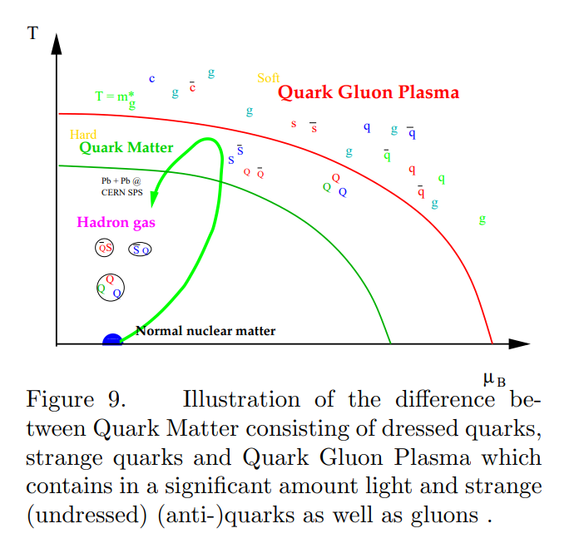
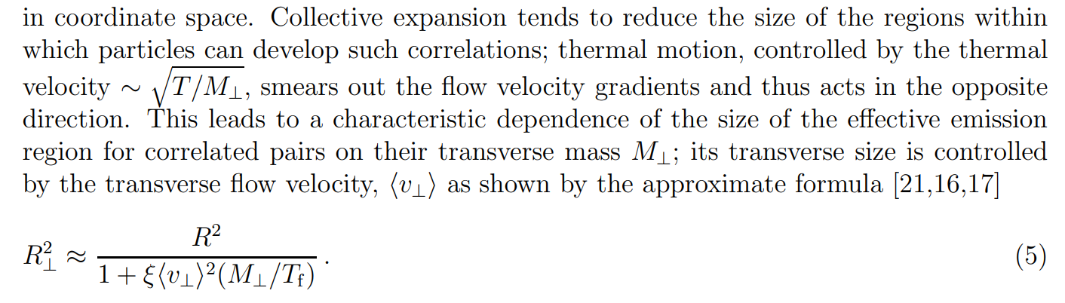
2000 – CERN Press Release: How big is the mean free path of quarks ?
U. W. Heinz: signs of hydro, it is a fluid,
Mean free path tends to zero,
with references to hydro results:
Nucl.Phys.A 685 (2001) 414-431,PRC54 (1996) 1390
Proc. NN2000, e-Print: hep-ph/0009170 [hep-ph]
L. Maiani, DG OF CERN :
MEAN FREE PATH OF QUARKS
tends to infinity (macroscopic)
T. Csörgő: Quark Matter, but not QGP!,
Hard Quark Matter instead of soft QGP! Only ONE of the TWO transitions is seen:
Nucl.Phys.B Proc.Suppl. 92 (2001) 62-74, e-Print: hep-ph/0011339 [hep-ph]
11

Slide 12
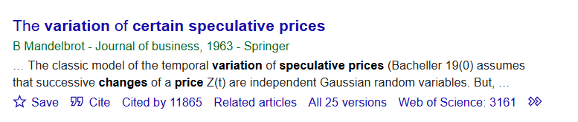
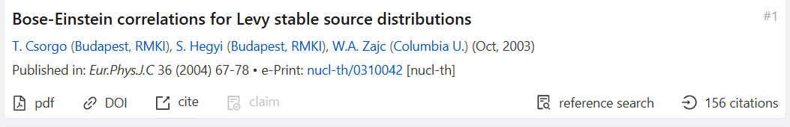
1963 – 2004 Applications of Levy source distributions
Note number of citations:
11865 (and increasing)
Levy stable source distributions in HEP:
Cs.T., S. Hegyi and W.A. Zajc (2004)
12

Slide 13
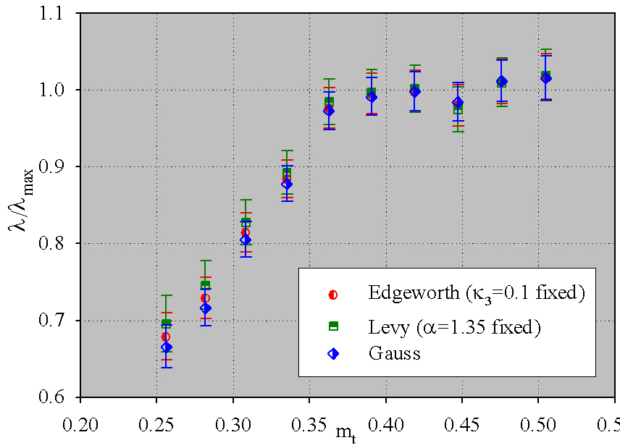
2005 – M. Csanád for PHENIX @ QM 2005, ELTE, Budapest, Hungary
M. Csanád for PHENIX Collaboration,
arXiv:nucl-ex/0509042:
/ λ_{max} is independent of
the method of extrapolation
of C₂(q) to q = 0
Important systematic errors cancel
13

Slide 14
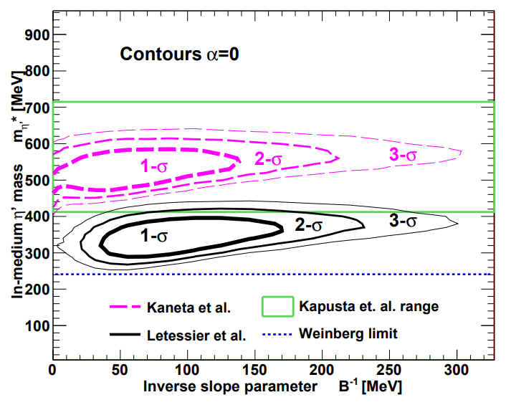
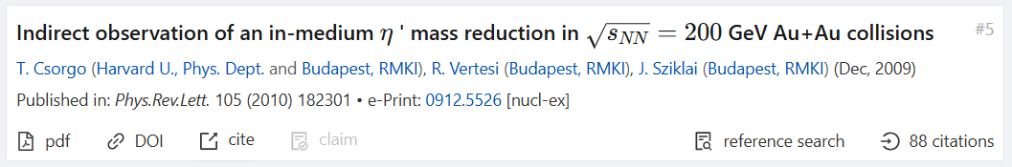
2010: re-analysis of PHENIX and STAR DATA,
at least 200 MeV limit on η’ mass drop @ CL 99.9%
PHENIX and STAR 200 GeV Au+Au data @RHIC
sensitive to
in-medium η’ modification,
At least 200 MeV mass drop
EFFECT FOUND
- but without unique minimum
in-medium η’ modification: can it be switched on and off? YES!
Centrality? Energy? System size?

Slide 15
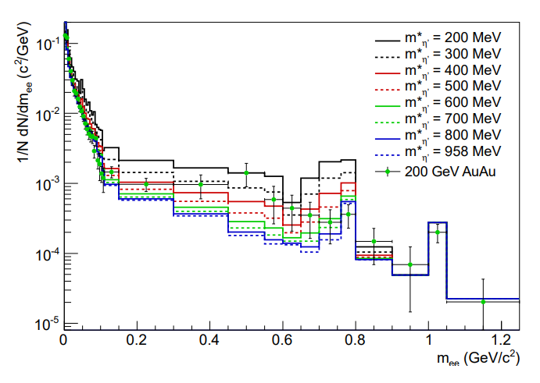
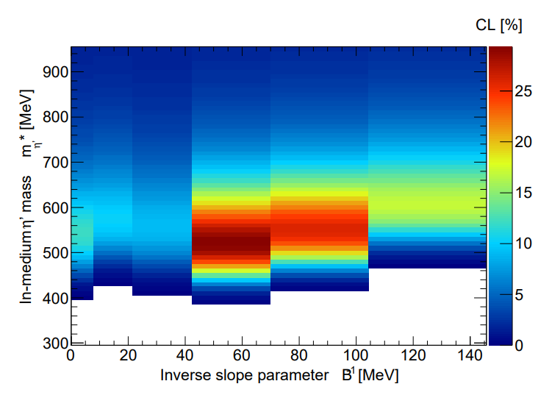
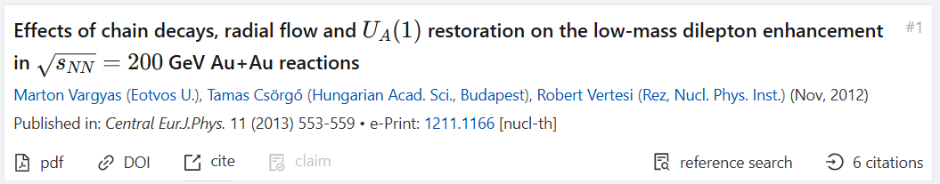
2013: re-analysis, PHENIX 200 GeV Au+Au dielectron,
sensitive, but no need for mass-shift in min bias
in-medium η’ modification: is it significant? Not in PHENIX min bias Au+Au data…

Slide 16
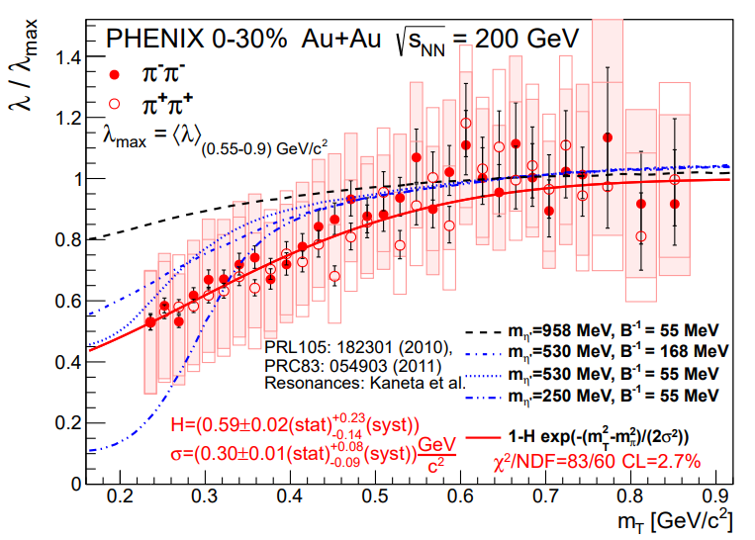
2018: Sensitive to in-medium η’ mass modification
PHENIX data + Monte Carlo,
PHENIX Phys. Rev. C 97
(2018) 064911:
0-30 % Au+Au @ 200 GeV
Lévy Bose-Einstein
PHENIX data sensitive to
in-medium η’ modification
centrality dependence = ?
in-medium η’ modification: It can be switched on/off with √s and/or system size

Slide 17
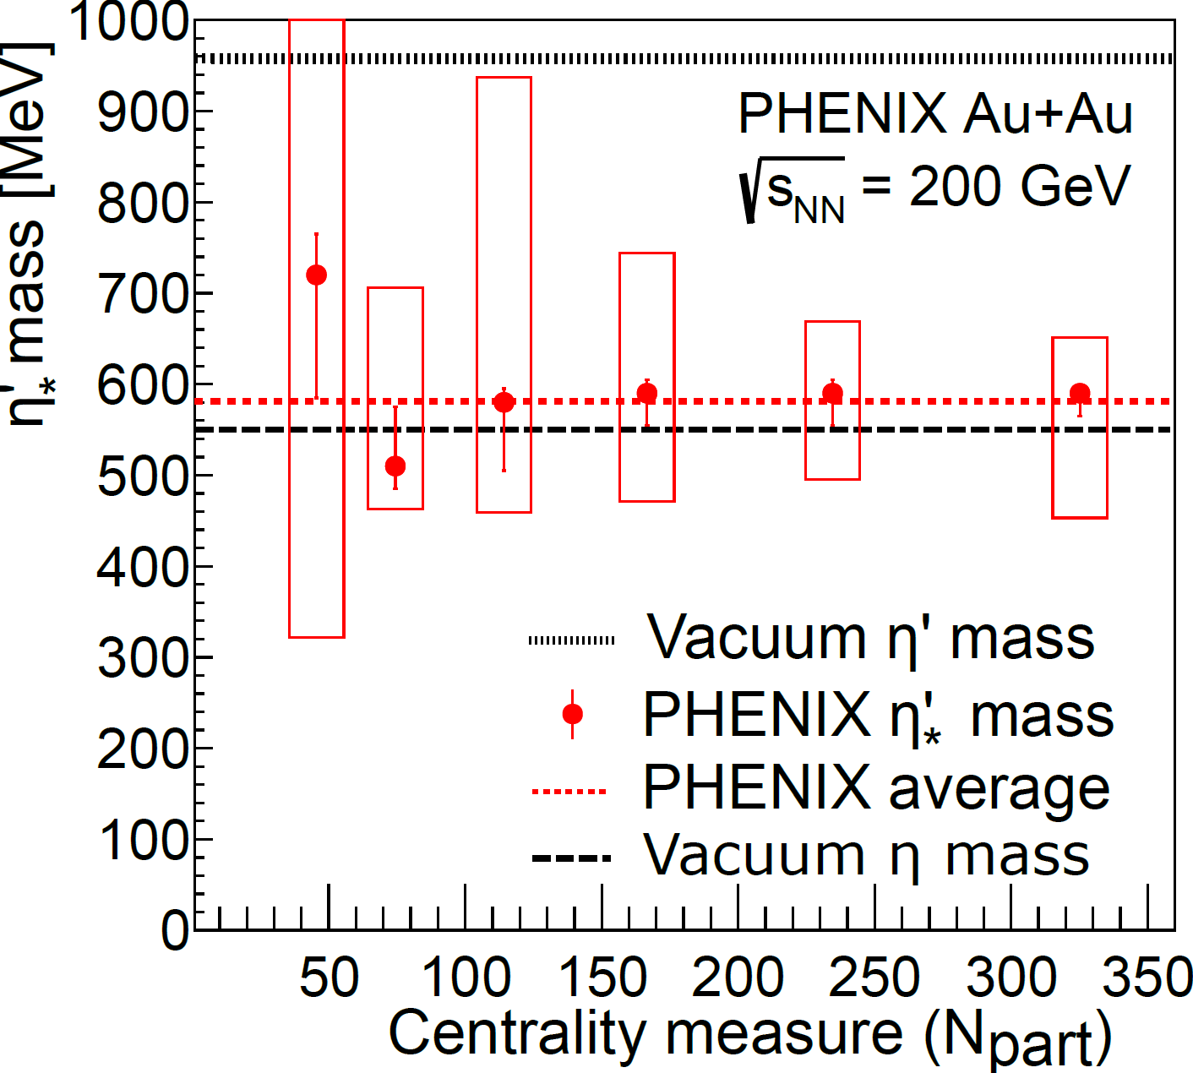
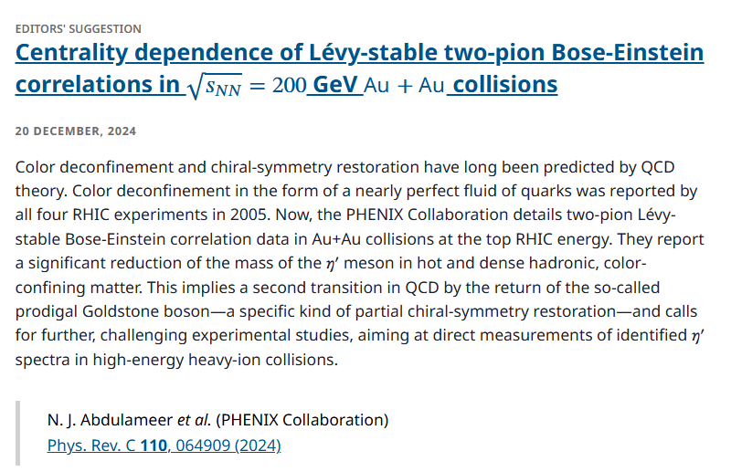
2024: „This implies a second transition in QCD …” /PRC Editors/

Slide 18
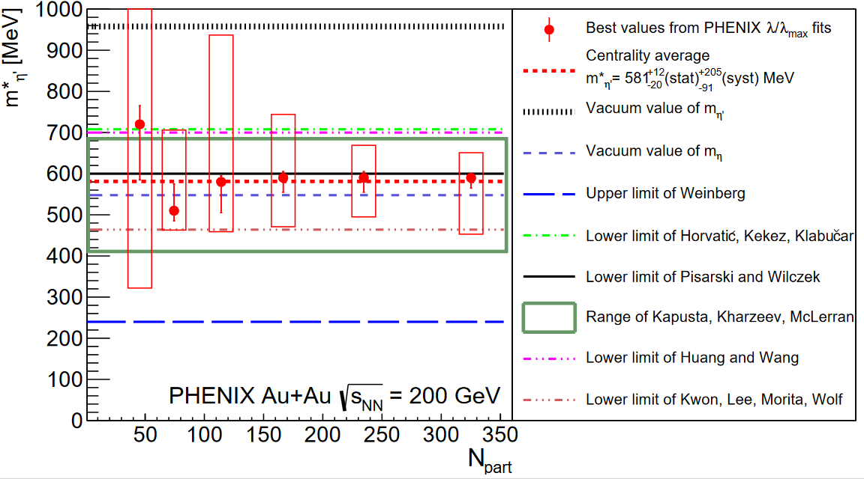
N_{part} dependence of in-MEDIUM MASS OF η’
In-medium mass of η’ is determined with the help of Levy Bose-Einstein correlation measurements and Monte-Carlo simulations to be similar to the vacuum mass of η
in each centrality class: indirectly, return of the prodigal Goldstone boson η’
Centrality dependent selection power, successful: KHM, KLMW, PW: m*(η’) ~ m(η)
18

Slide 19
DETAILES OF PHENIX results
https://wpcf2026.elte.hu/press/
19

Slide 20
SUMMARY AND CONCLUSIONS
Timeline from 1974 to 2024 summarized
From T.D.Lee (1974), S. Weinberg (1975) and F. Wilczek (1984)
through the RHIC proposal (1984) and
PHENIX and STAR Bose-Einstein data re-analysis (2010)
PHENIX dielectron spectra re-analysis (2013) to an
Indirect observation of a prodigal Goldstone boson (PHENIX , 2024):
Centrality dependent Levy stable Bose-Einstein correlations
measured in √s_{NN} = 200 GeV Au+Au collisions by PHENIX
With 1 < α < 2 singificantly, Levy shape describes data
decreasing with increasing N_{part}
Unexpected scaling laws found
Data not inconsistent with U_{A}(1) symmetry restoration:
In-medium mass modification of η’ with indirect method
Direct observation e.g. η’ → γ + γ is particularly challenging
but also particularly rewarding:
Challenge for B. Tamás (BST-70) !
20
20

Slide 21
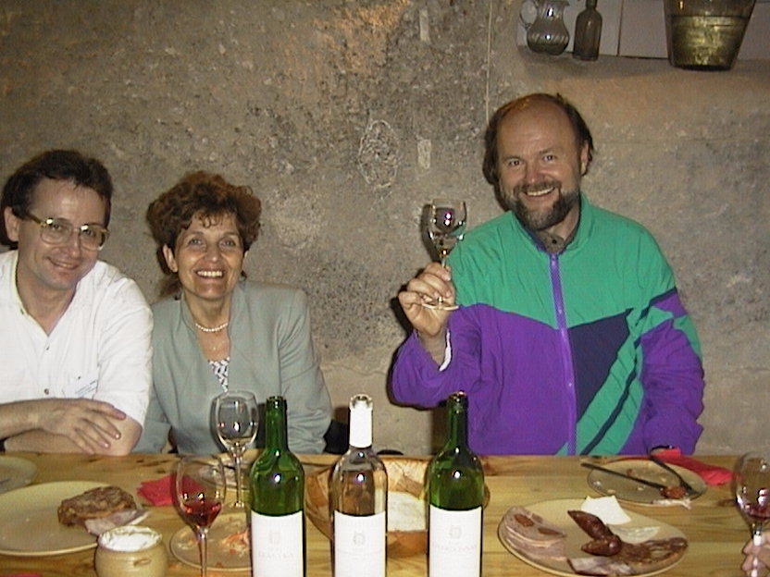
SUMMARY AND CONCLUSIONS
Timeline from 1974 to 2024 summarized
From T.D.Lee (1974), S. Weinberg (1975) and F. Wilczek (1984)
through the RHIC proposal (1984) and
PHENIX and STAR Bose-Einstein data re-analysis (2010)
PHENIX dielectron spectra re-analysis (2013) to an
Indirect observation of a prodigal Goldstone boson (PHENIX , 2024):
Centrality dependent Levy stable Bose-Einstein correlations
measured in √s_{NN} = 200 GeV Au+Au collisions by PHENIX
With 1 < α < 2 singificantly, Levy shape describes data
decreasing with increasing N_{part}
Unexpected scaling laws found
Data not inconsistent with U_{A}(1) symmetry restoration:
In-medium mass modification of η’ with indirect method
Direct observation e.g. η’ → γ + γ is particularly challenging
but also particularly rewarding:
Challenge for B. Tamás (BST-70) !
HAPPY 70TH BIRTHDAY,
to B. Tamás,
from Cs. Tamás and friends
21
21

Slide 22
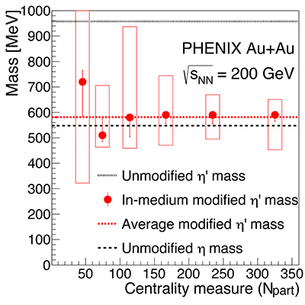

„THIS IMPLIES A SECOND TRANSITION IN QCD”
PRC Editors
η’
η’
η
*

Slide 23
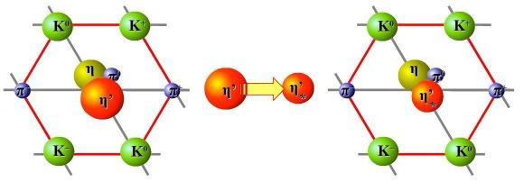
Thank you for your attention!
Questions?
Partially supported by NKFIH and MATE KKP FRG and HUN-REN Wigner RCP, Hungary
and by the PHENIX funding agencies and organizations listed at https://www.bnl.gov/rhic/phenix.php
23
23

Slide 24
Q&A: Expected questions and their ANSWERs
24

Slide 25
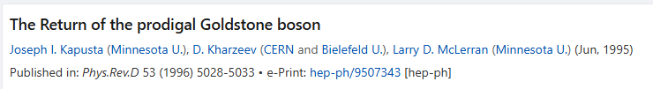
Q1: Can we see the η’ mass in dilepton spectra?
25

Slide 26
Q2: Indirect signal in dilepton spectrum?
26

Slide 27
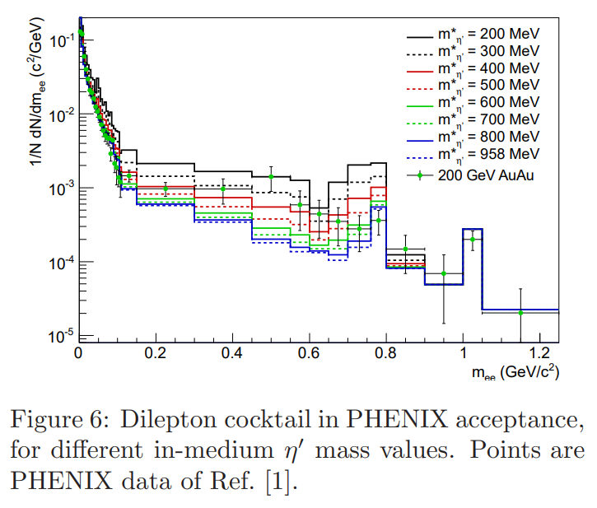
A2: In-medium η’ mass vs PHENIX MIN BIAS DILEPTON
Cross-check with earlier dielectron analysis of arXiv:1211.1166, 200 GeV min bias Au+Au

Slide 28
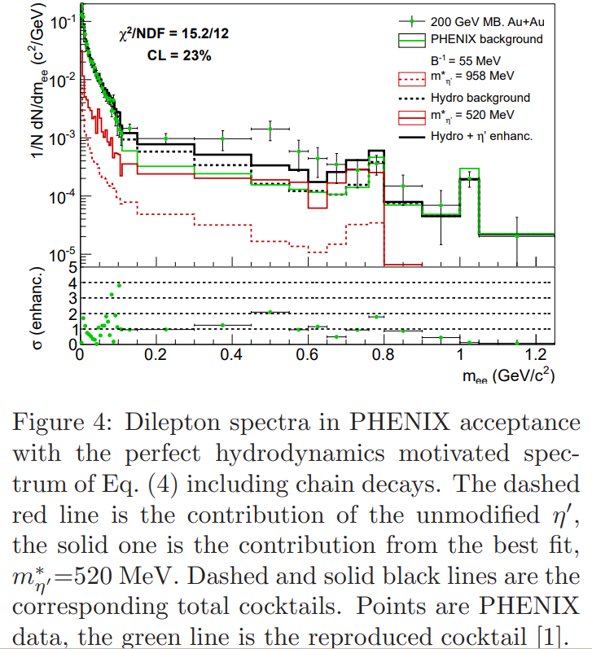
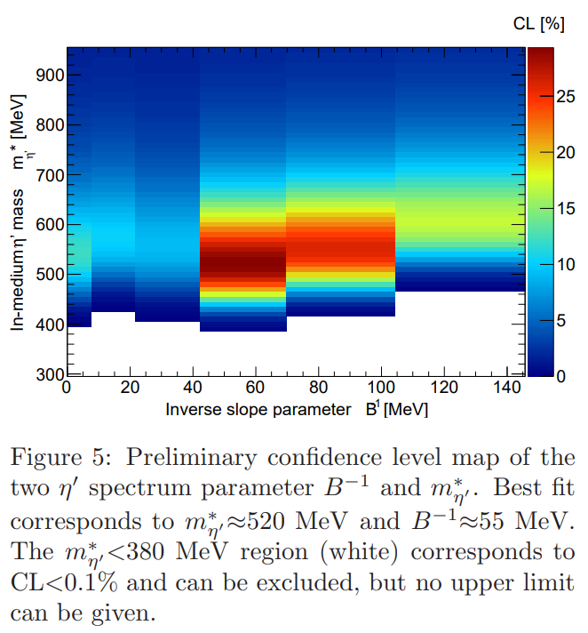
CL (or p-value) maps FROM PHENIX MIN BIAS DILEPTON
Cross-check with earlier dielectron analysis of
arXiv:1211.1166, 200 GeV min bias (0-92%) Au+Au

Slide 29
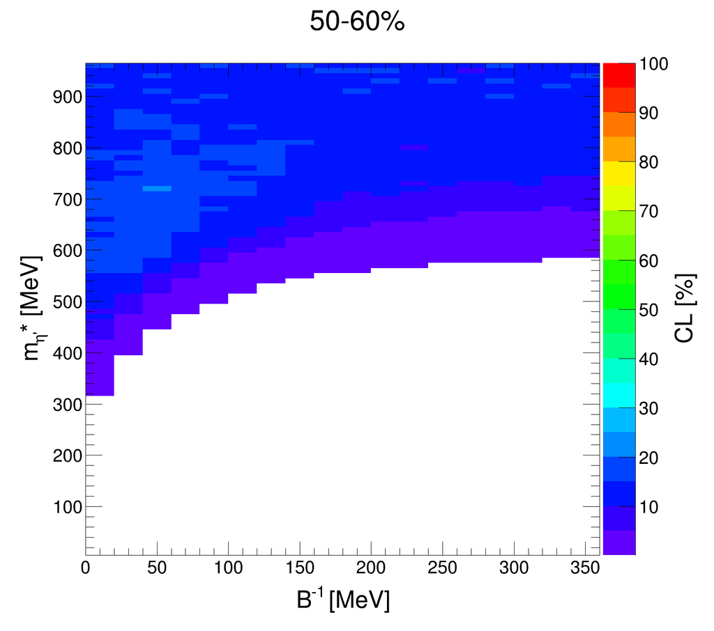
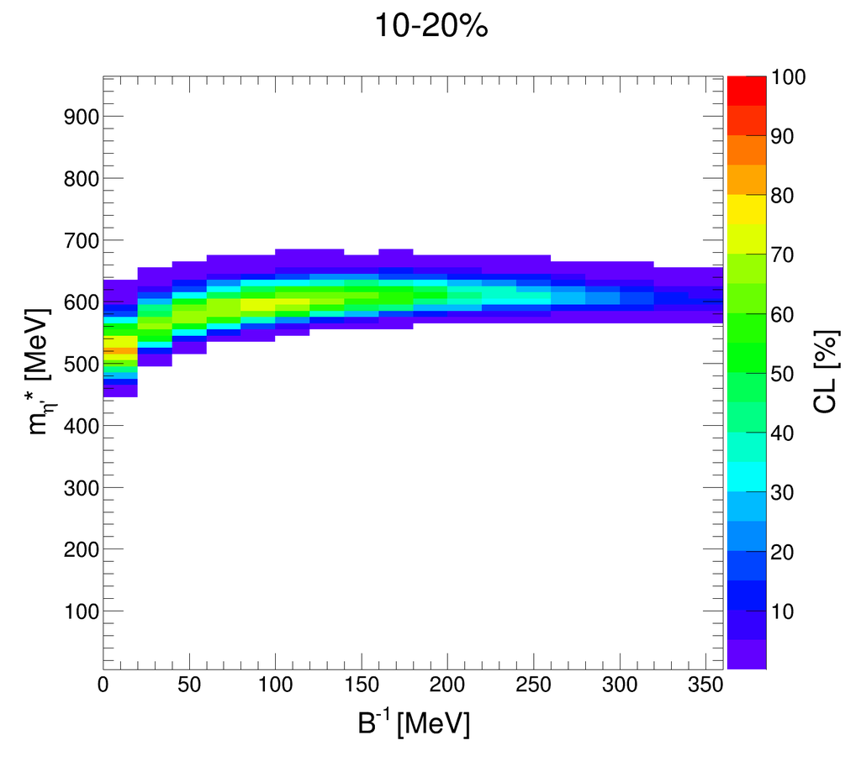
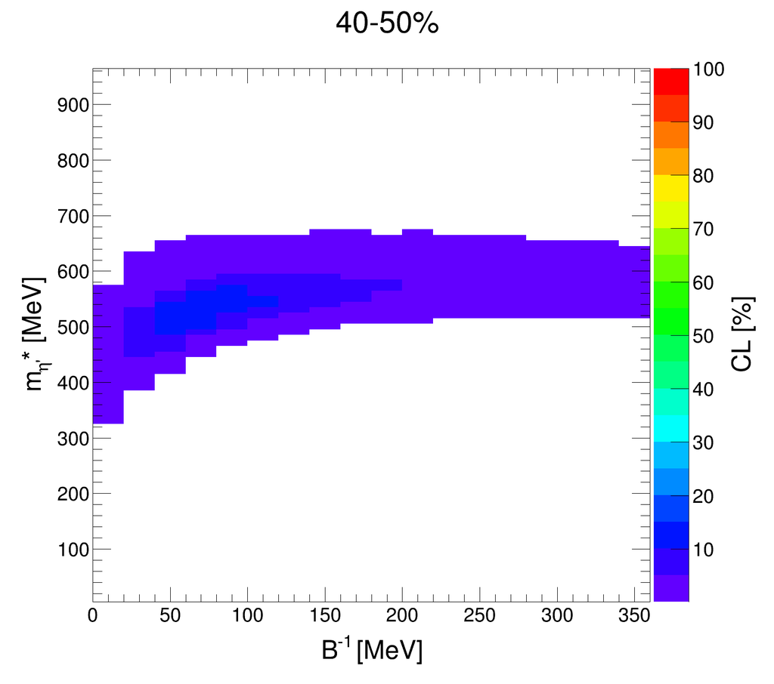
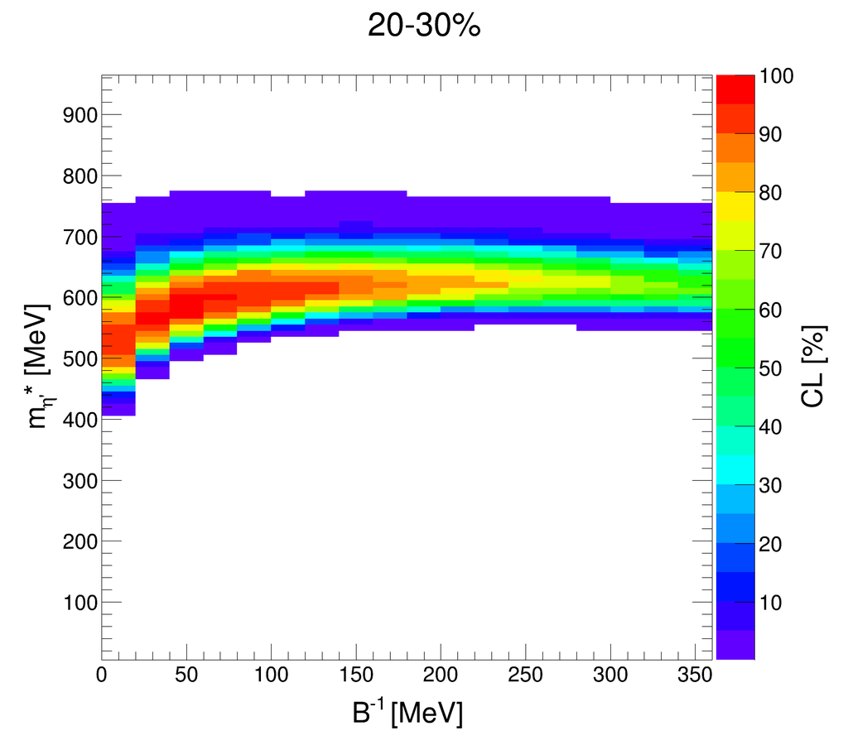
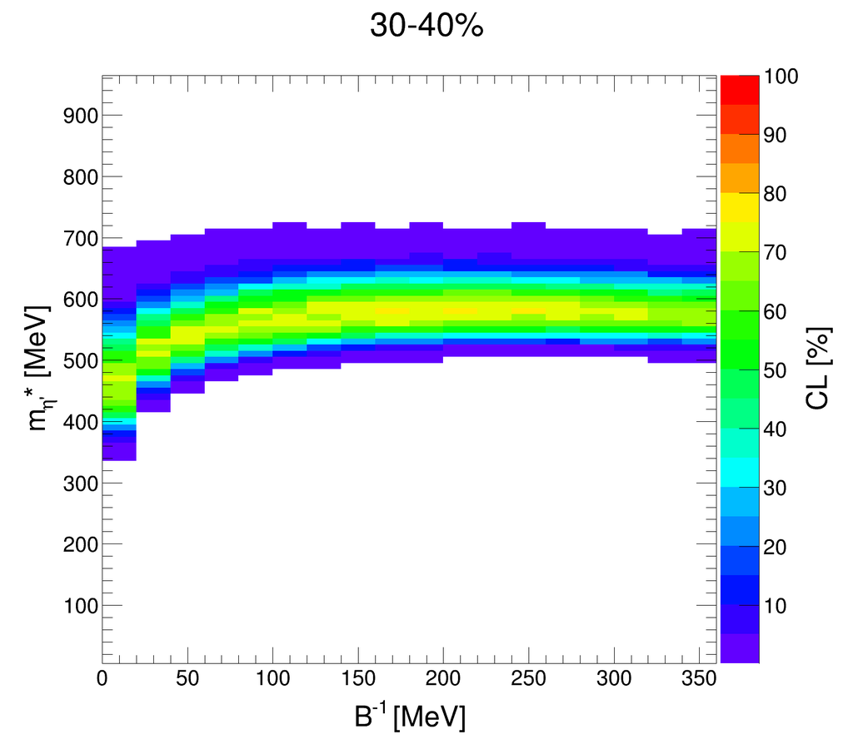
10 → 60 % Levy HBT vs min bias dielectron

Slide 30
N_{part} dependence of in-MEDIUM MASS OF η’
Fig. 5 of https://arxiv.org/pdf/1211.1166 , min bias PHENIX dielectron
In-medium mass of η’ is determined with the help of Levy Bose-Einstein correlation measurements and Monte-Carlo simulations to be similar to the vacuum mass of η
in each centrality class: indirectly, return of the prodigal Goldstone boson η’
Centrality average consistent with earlier (0-92%) dielectron analysis of arXiv:1211.1166
30

Slide 31
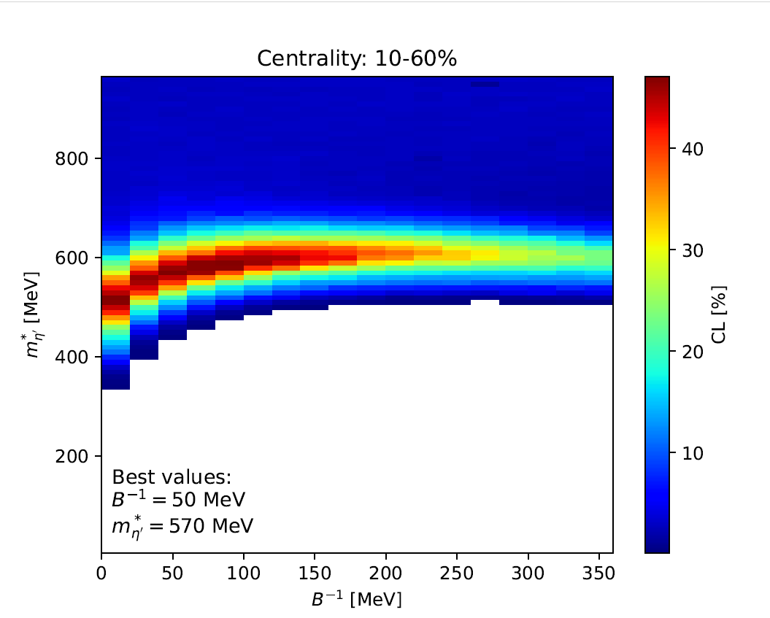
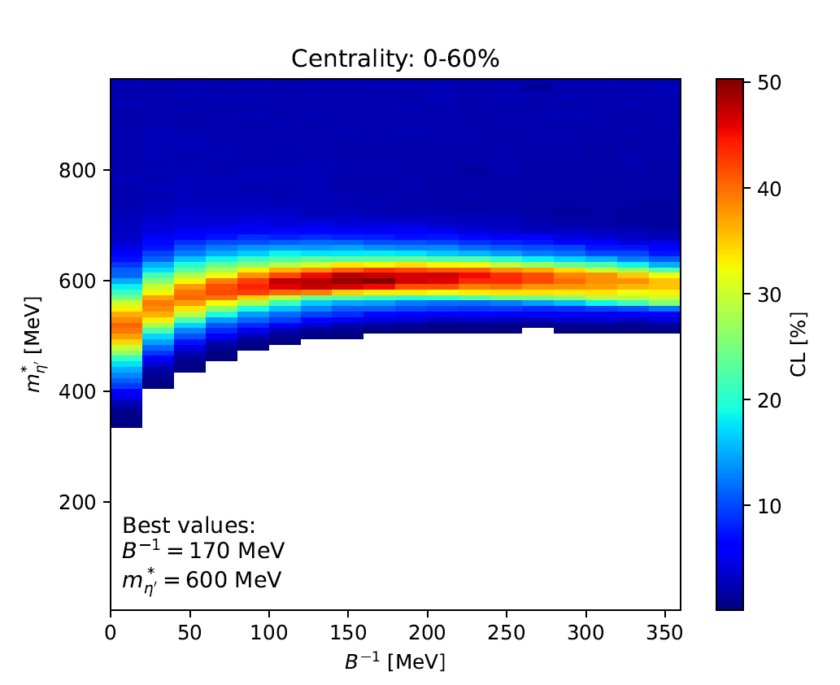
UNItING CL MAPS (10-60 %, 0-60 %) vs min. bias dielectroN
Note: IF CL(i) is a uniformly distributed random variable in interval (0,1)
Then ( CL(1)+ CL(2) + … + CL(n) )/n is also a uniformly distributed in (0,1)
So CL maps for various centrality classes can be averaged over
result yields an effective CL map for the merged centrality classes
Lines from Fig. 5 of
https://arxiv.org/pdf/1211.1166 ,
min bias PHENIX dielectron
vs united 10-60 % CL maps of PPG232
united 0-60 % CL maps of PPG232
note the shift of B**(-1) in
0-10 % centrality class

Slide 32
Q3: CAN WE RECONSTRUCT THE η and η’ spectra?
32

Slide 33


A3: INDIRECTLY RECONSTRUCTED η and η’ spectra
33

Slide 34


NEW: CENTRALITY DEPENDENT η spectra
η and η’ spectra, G. Kasza and T. Cs. In preparation
34

Slide 35

NEW: CENTRALITY DEPENDENT η’ spectra
Enhancement factor f_{η’} determined similarly as in Cs.T., R. Vértesi and J. Sziklai, Phys.Rev.Lett. 105 (2010) 182301
e-Print: 0912.5526 [nucl-ex]
Enhancement factor
4 < f_{η’} < 20,
greatest in
most central collisions
η and η’ spectra, G. Kasza and T. Cs. In preparation
35

Slide 36
Q4: Can we reproduce pion spectra?
36

Slide 37

A4: cross-check: core-halo corrected π⁻ spectra
π⁻ spectra OK, T. Novák and T. Cs. In preparation
37

Slide 38

A4: cross-check: core-halo corrected π⁺ spectra
π⁺ spectra OK, T. Novák and T. Cs. In preparation
38

Slide 39
BACKUP SLIDES
39

Slide 40


CENTRALITY dependence of in-MEDIUM MASS OF η’
In-medium mass of η’ determined indirectly
from Levy Bose-Einstein correlations.
Similar to the vacuum mass of η (548 MeV)
in each centrality class!
Lower, than the vacuum mass of η’ (958 MeV)
except the 50-60% centrality class!
40

Slide 41




CENTRALITY dependence of in-MEDIUM MASS OF η’
In-medium mass of η’ determined indirectly
from Levy Bose-Einstein correlations.
Similar to the vacuum mass of η (548 MeV)
in each centrality class!
Lower, than the vacuum mass of η’ (958 MeV)
except the 50-60% centrality class!
41

Slide 42
„THIS IMPLIES A SECOND TRANSITION IN QCD”
PRC Editors’ Suggestion (2024/12)
42
42

Slide 43



Variables and Coulomb corrections for Levy C₂(Q)
From PHENIX, Phys.Rev.C 97 (2018) 6, 064911 and 2407.08586 [nucl-ex]
For recent results on Coulomb corrections for a Levy source, see:
M. Nagy, A. Purzsa et al, Eur.Phys.J.C 83 (2023) 11, 1015, arXiv:2308.10745 [nucl-th]
For a recent review on Levy Bose-Einstein correlations in heavy ions:
M. Csanád and D. Kincses, Universe 10 (2024) 2, 54, arXiv:2401.01249 [hep-ph]
43

Slide 44




Quality plot for Levy fits of C₂(Q)
$$λ$$
$$α$$
$$R$$
√s_{NN} = 200 GeV 0-30 % Au+Au collisions, from Phys.Rev.C 97 (2018) 6, 064911
Note the good fit quality, p-value or CL > 0.1 %
44

Slide 45






Levy C(Q) for kaons: no U_{A}(1), but new m_{T} scalings
PHENIX preliminary, charged KK correlations, √s_{NN} = 200 GeV min bias Au+Au:
λ(KK) ~ λ_{max}(ππ), no λ(KK)/λ_{max} signal for U_{A}(1), as expected.
α(KK) ~ α(ππ): no anomalous diffusion??
L. Kovács for the PHENIX Collaboration, Universe 2023, 9(7), 336 , arXiv:2307.09573 [nucl-ex]
45

Slide 46








HBT: Two-particle symmetrization, chaotic source
- or not ? Partial coherence: 3 vs 2 particle correlations
arXiv:0604021: R. J. Glauber noted that partial coherence may be present, but swamped in a large background. Check it with three-particle vs two-particle Bose-Einstein correlations!
Three-body Coulomb correction in Riverside approximation,
domain of validity checked.
PHENIX preliminary data on three-pion Bose-Einstein: A.Bagoly, poster at QM17 Partial coherence measurement possible!
B. Kurgyis for the PHENIX Collaboration, Phys.Part.Nucl. 51 (2020) 3, 263-266, arXiv:1910.05019 [nucl-ex]]
46

Slide 47



HBT: Two-particle symmetrization, chaotic source
- or not ? Partial coherence: 3 vs 2 particle correlations
PHENIX preliminary data on three-pion Bose-Einstein: A.Bagoly, poster at QM17 Partial coherence measurement possible!
B. Kurgyis for the PHENIX Collaboration, Phys.Part.Nucl. 51 (2020) 3, 263-266, arXiv:1910.05019 [nucl-ex]]
47

Slide 48

HBT: Two-particle symmetrization, chaotic source
- or not ? Partial coherence: 3 vs 2 particle correlations
κ₃ ~ 1
within errors
→
No signal for
partial coherence
(p_{c} > 0), so
→
p_{c} cannot mask U_{A}(1)
B. Kurgyis for the PHENIX Collaboration, Phys.Part.Nucl. 51 (2020) 3, 263-266, arXiv:1910.05019 [nucl-ex]]
48

Slide 49

Can λ/λ_{max} U_{A}(1) restoration signal be switched off?
Yes, as known from the first papers!
NA44 data on charged pion Bose-Einstein correlation indicate a null effect in S+Pb at √s_{NN} = 19.4 GeV !
Contrasted to STAR data on charged pion B-E correlation in √s_{NN} = 62 and 200 GeV Au+Au collisions:
suppression signal of U_{A}(1) restoration. R. Vértesi, T.Cs., J. Sziklai , arXiv:2307.09573 [nucl-ex]
49

Slide 50


Can λ(m_{T}) be used for other things?
Yes, at 0.4 <m_{T}< 1 GeV, λ(m_{T}) measures radial flow !

Slide 51


Can λ/λ_{max} U_{A}(1) restoration signal be switched off?
Yes, as known from the first papers, but confirmed by NA61!
NA61 data: no signal of decrease of λ/λ_{max} for m_{T} < 0.5 GeV, no signal of U_{A}(1) symmetry restoration
Small systems (Be+Be) and relatively low energy, √s < 20 GeV.
NA61 data on charged ππ correlation in 150 AGeV Be+Be collisions
Eur.Phys.J.C 83 (2023) 10, 919, e-Print: 2302.04593 [nucl-ex]
51

Slide 52

Can λ/λ_{max} U_{A}(1) restoration signal be switched off?
NA61:
YES!
NA61 data: no signal of decrease of λ/λ_{max} for m_{T} < 0.5 GeV, no signal of U_{A}(1) symmetry restoration
Small AND intermediate systems (Be+Be and Ar+Sc) and relatively low energy, √s < 20 GeV.
NA61 data on charged ππ correlation in 150 AGeV Be+Be and E_{lab} ≤ 150 GeV Ar+Sc collisions
B. Pórffy for the NA61 Collaboration, e-Print: 2406.022423 [nucl-ex]
52

Slide 53

Is λ(m_{T})/λ_{max} confirmed in √s_{NN} = 200 GeV Au+Au?
STAR
preliminary:
YES!
STAR preliminary, charged ππ correlation in 0-10%, 10-20%, 20-30% and 30-40% Au+Au @ 200 GeV
D. KIncses for the STAR Collaboration, Universe 10 (2024) 3, 102, e-Print: 2401.11169 [nucl-ex]
53

Slide 54

Can λ/λ_{max} U_{A}(1) restoration signal be switched off?
PHENIX preliminary data: qualitatively a of decrease of λ/λ_{max} for m_{T} < 0.5 GeV, but limited statistics!
both at √s_{NN} = 39 and 62 GeV: greater magnetic field, less momentum resolution at low m_{T}
as compared to Run-10 Au+Au data.
54
D. Kincses for the PHENIX Collaboration, Universe 4 (2018) 1, 11, e-Print: 1711.06891 [nucl-ex]

Slide 55

Excitation function of λ(m_{T})/λ_{max} in Au+Au@RHIC BES?
STAR
preliminary:
in 0-10% Au+Au,
λ_{min}/λ_{max}
decreases
with decreasing √s_{NN}
Note: the results obtained
in assuming a Gaussian
might be altered if one utilizes Lévy-stable source.
M. Csanád and D. Kincses,
J.Phys.G 52 (2025) 2, 025102
STAR preliminary, charged ππ correlation in 0-10% Au+Au @ 200, 54.4, 27, 19.6, 14.5 and 7.7 GeV
D. Kincses for the STAR Collaboration, Universe 10 (2024) 3, 102, e-Print: 2401.11169 [nucl-ex]
55

Slide 56

NEW PAIR CUTS and systematic errors
Systematic errors fully propagated to the very end
of this analysis chain:
Cross-checks with three alternative syst error calculation methods.
Most conservative estimate of the systematic errors is shown.
Correlated error propagation is taken into account.
Improvements in Coulomb corrections not detailed in this talk due to time limitations.
56

Slide 57





HBT: Signals of 3d hydro flow, ONLY for α = 2
Theory challenge for Levy α < 2
Indication of hydro scaling behaviour of Gaussian R(side,out,long) at low m_{T}
R_{long} m_{t}-scaling: Yu. Sinyukov and A. Makhlin: Z.Phys. C39 (1988) 69
R_{side} , R_{out} , R_{long} m_{t}-scaling: T. Cs, B. Lörstad, hep-ph/9509213 (shells of fire vs fireballs)
S. Chapman, P. Scotto, U. W. Heinz, hep-ph/9408207
57

Slide 58

A DIRECT OBSERVATION: APPLICATION

Slide 59


DIRECT vs INDIRECT OBSERVATION

Slide 60

Confidence Levels (CL-s or p-values) from λ/ λ_{max} MAPS
Maps out
allowed
regions
& best values
CL_{max} = 99.9%
CL_{max} = 73.1%
CL_{max} = 96.3%
in-medium
η’ mass
modification
CL_{MAX} =
CL of the
peak
(best fit)
CL_{max} = 75.8%
CL_{max} = 26.7%
CL_{max} = 24.9%
Colored region
allowed with
CL > 0.1 %
Selective,
except
in 50-60 %
centrality class
60

