Slide 1

From Noisy Signals
to Scientific Evidence
Trustworthy and Explainable AI for PhD Research
Assoc. Prof. D-r Petre Lameski
Notes:
Welcome. This lecture is called From Noisy Signals to Scientific Evidence. It is designed for researchers arriving from many
scientific backgrounds, so we will define the technical vocabulary before using it. Our examples use sensor recordings, but the
same problems occur with medical images, laboratory measurements, ecological observations, survey records, and many other forms
of scientific data.
The central rule for the session is: validate first, explain second, and interpret scientifically third. Validation asks whether
the model was evaluated honestly on data that represent its intended future use. Explanation asks what information the fitted
model relied on. Scientific interpretation asks what the result tells us about the phenomenon in the world. These are connected,
but they are not interchangeable. A model can be accurate for the wrong reason, and an explanation can faithfully describe a
model without explaining nature. We will follow one synthetic weak-signal problem from raw acquisition to the strongest conclusion
that its evidence can support.

Slide 2




Shameless self promotion
Assoc. prof., Dean of FCSE Skopje,
father, husband, scientist, engineer
Coordinator of Digitmak EDIH, (currently leading/participating in 5 other projects)
Over 20 scientific research projects
Over 50 projects with industry
Over 150 scientific publications
The "Successful youth" award, awarded by the president for the best young scientist under 35 years of age in the field of technical sciences.
Award from University for the best scientist in the field of technical science in 2021.
Contact:
  lameski@finki.ukim.mk
  +38971387585
FROM NOISY SIGNALS TO SCIENTIFIC EVIDENCE

Slide 3
ORIENTATION
The central rule
1 VALIDATE
2 EXPLAIN
3 INTERPRET
Does the full pipeline work on genuinely new data for the intended use?
What information changed this fitted model's output?
What scientific claim does the design actually support?
Trustworthy AI is a chain of evidence, not a property of one algorithm.
FROM NOISY SIGNALS TO SCIENTIFIC EVIDENCE
3
Notes:
The lecture follows three ordered actions. First, validate. Validation means checking whether the complete procedure works for the
purpose we claim. It includes data provenance, quality control, preprocessing, feature construction, the train-test split, metrics,
and uncertainty. A high score is not useful if the test data leaked into training or if related observations occur on both sides
of a split that was supposed to represent new people, stations, or sites.
Second, explain. Once the evaluation is credible, explanation methods can reveal the features or patterns that affected the model.
We use explanation as an audit: it may expose a shortcut, a quality artifact, or an unavailable variable. Explanation does not repair
invalid validation.
Third, interpret scientifically. We ask whether the model's pattern is reproducible, whether alternative explanations have been
excluded, and whether a mechanism predicts new observations. Causal language requires causal evidence. The order matters. Explaining
an invalid model produces a detailed description of an invalid result, and interpreting that description scientifically compounds
the error.

Slide 4
ORIENTATION
Our learning journey
• Define the scientific task and the unit of independence.
• Separate weak signal, noise, and failed acquisition.
• Preprocess without erasing evidence or leaking test information.
• Evaluate on unseen groups with meaningful metrics.
• Use explainability to audit; report quality, coverage, and bounded claims.
validate first, explain second, and interpret scientifically third
FROM NOISY SIGNALS TO SCIENTIFIC EVIDENCE
4
Notes:
We will move through the analysis in the same order that a defensible research project should. We begin with the scientific task:
what is being predicted, and what must be genuinely new when the model is used? Next we examine the measurement itself. A weak but
valid signal is not the same as a broken sensor, and different noise mechanisms require different responses.
We then examine preprocessing. Every transformation changes the evidence, so each step needs a scientific reason and must respect
the boundary between training and test data. After converting the waveforms into transparent numerical features, we compare several
validation designs. The deliberately invalid designs produce impressive numbers, which helps us recognise how easy it is to answer
the wrong question convincingly.
Only after the validation design is credible do we use explainability. We ask whether the model relies on signal-related structure,
acquisition quality, or a shortcut. Finally, we study performance across noise conditions, make abstention coverage explicit, and
calibrate the final scientific claim. Think of this as a chain: weaknesses early in the chain cannot be repaired by sophistication later.

Slide 5
FOUNDATIONS
The data vocabulary
OBSERVATION
SAMPLE POINT
GROUP
FEATURE + LABEL
One complete four-second window used as a model row.
One measured amplitude at one instant in one channel.
A station, patient, device, or site producing related observations.
A numerical input and the answer the model learns to predict.
Be precise: a signal sample point is not the same as a machine-learning example.
FROM NOISY SIGNALS TO SCIENTIFIC EVIDENCE
5
Notes:
We need a shared vocabulary because different disciplines reuse the same words. One observation, example, or row in this lecture is
a complete four-second recording window. A window is a short piece cut from a longer recording. Within each window, a sample point
is one amplitude value measured at one instant. Signal-processing texts often call that point a sample, while machine-learning texts
may call the entire row a sample. To avoid ambiguity, I will say sample point for the time value and observation for the full window.
A channel is one simultaneous measurement stream. Three channels might represent three sensor directions, three electrodes, or three
instruments. A station is the physical source that produces many windows. It is also our group. A feature is a numerical summary
supplied to the model, such as signal variability or power in a frequency band. The label or target is the answer: one for event and
zero for no event. Metadata describe collection context, such as station, site, or time. These distinctions will determine how we split
data and which variables are legitimate at prediction time.

Slide 6
FOUNDATIONS
Prediction, model explanation, and causality
PREDICTION
MODEL EXPLANATION
CAUSALITY
Can available measurements identify the outcome in new cases?
Which inputs changed this fitted model's output?
What would change under an intervention?
A model can predict accurately without discovering why a phenomenon occurs.
FROM NOISY SIGNALS TO SCIENTIFIC EVIDENCE
6
Notes:
Prediction, model explanation, and causal explanation answer different questions. Prediction asks whether measurements available now
can identify or forecast an outcome in new cases. Evidence for prediction comes from leakage-aware held-out evaluation that matches
the intended deployment.
A model explanation asks which inputs affected a particular fitted model or its predictions. We can answer this with tools such as
feature importance and perturbation. The answer describes model behaviour. It does not automatically describe the physical process
that produced the data.
Causality asks what would change if we intervened on one factor. A hospital model might predict disease from scanner type because one
scanner is used mainly for ill patients. An explanation may correctly show that scanner type matters to the model. That does not mean
the scanner causes disease. A causal claim requires a design that addresses interventions and alternative explanations, often through
randomisation, careful causal assumptions, or prospective experimentation. Throughout the lecture, notice which of these questions a
result answers. Scientific overclaiming often begins when a valid answer to one question is presented as an answer to another.

Slide 7
01
The scientific scenario
Weak transient events recorded repeatedly by noisy stations
7
Notes:
We now introduce the scientific scenario. A network of stations records short windows from three synchronised channels. A minority
of windows contains a weak transient event. Transient means short-lived: the event briefly appears and then decays. Weak means its
signal power is small compared with background variation.
The scenario is abstract on purpose. A station could be a seismometer, a wearable monitor, a laboratory instrument, or a machine
sensor. The repeated-station structure could equally represent repeated measurements from a patient, animal, plant, laboratory, or
device. Our central deployment question is whether a model trained on some stations can generalise to stations it has never seen.
As we examine the scenario, keep two questions separate. First, can the event be detected despite noise? Second, is each acquisition
sufficiently valid to support a prediction? A low signal-to-noise ratio addresses the first relationship. Missing samples, clipping,
and flatlines address the second. Mixing them leads to inappropriate preprocessing and misleading evaluation.

Slide 8
SCENARIO
The synthetic dataset at a glance
1,200
24
3
four-second windows
stations
synchronised channels
64 Hz
22.0%
23.0%
sample points per second
event prevalence
injected artifacts
Each station contributes 50 related windows; the rows are not independent replicates.
FROM NOISY SIGNALS TO SCIENTIFIC EVIDENCE
8
Notes:
This slide summarises the dataset. There are one thousand two hundred observations. Each observation is a four-second window. The
windows come from twenty-four stations, and every station contributes fifty windows. Each window has three channels recorded at
the same times.
The sampling rate is sixty-four hertz. Hertz means per second, so each channel contains sixty-four sample points per second. Four
seconds times sixty-four gives two hundred fifty-six points per channel. Conceptually, the signal array has the shape one thousand
two hundred windows by three channels by two hundred fifty-six time points.
Event prevalence is twenty-two percent. Prevalence means the proportion of observations in the positive class, so about twenty-two
of every one hundred windows contain an event. Twenty-three percent of windows have an injected acquisition artifact. Synthetic means
computer-generated according to known rules. That lets us know the hidden clean signal and inserted artifacts for teaching. It does
not support claims about a real population. Most importantly, fifty windows from one station share hardware and conditions. They are
related measurements, not fifty independent scientific replications.

Slide 9
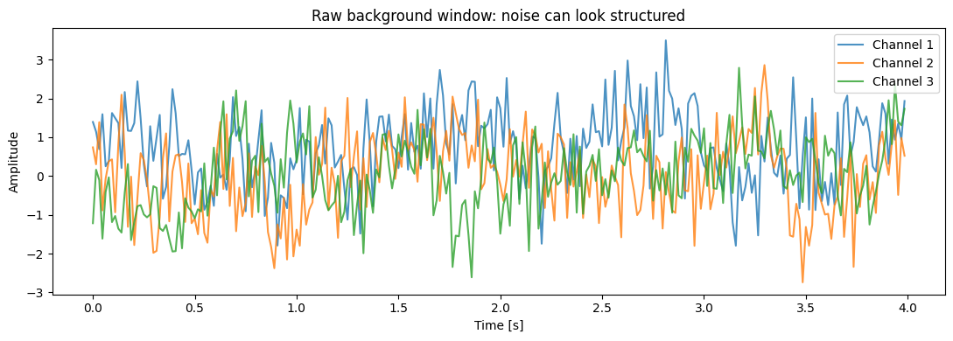
SCENARIO
Raw background window: noise can look structured
HOW TO READ THIS
• Horizontal axis: time in seconds.
• Vertical axis: recorded amplitude.
• Colours: three simultaneous channels.
• Structure alone does not prove an event.
Three raw channels over four seconds · synthetic data
A background recording may contain patterns that resemble signal.
FROM NOISY SIGNALS TO SCIENTIFIC EVIDENCE
9
Notes:
This is the first picture. The horizontal axis shows time from zero to four seconds. The vertical axis shows recorded amplitude,
an arbitrary numerical measure of sensor response. The blue, orange, and green lines are three channels measured simultaneously.
This window has no simulated event and no deliberately injected artifact.
Notice that the lines are not visually featureless. They contain peaks, valleys, slow movements, and short oscillations. Coloured
noise means neighbouring time points are related, so background variation can form runs and shapes rather than independent random
dots. Station offset and gain also influence the trace. A human looking for a weak transient can easily see suggestive patterns in
this background example.
The important lesson is that visual structure is not automatically scientific signal. We need a predeclared event definition and
evaluation across many labelled examples. This plot also warns against selecting only persuasive examples for a paper. A fair figure
should show ordinary backgrounds and difficult cases, not just the cleanest events. The picture demonstrates ambiguity; it does not
prove that detection is impossible.

Slide 10
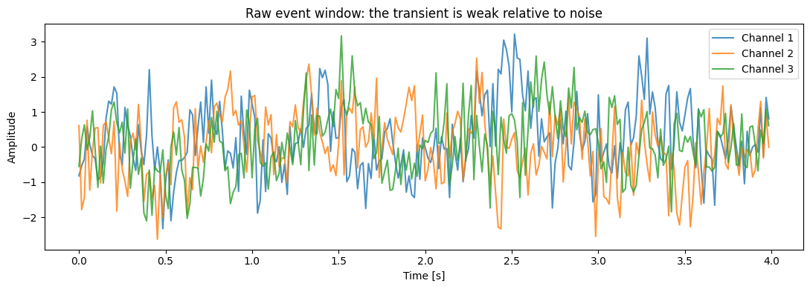
SCENARIO
Raw event window: the transient is weak
HOW TO READ THIS
• Use the same axes as the background.
• Look for a brief cross-channel pattern.
• Noise amplitude remains large.
• Compare populations, not one selected trace.
Three raw channels over four seconds · synthetic event present
Weak signal can be detectable through shape and agreement across channels.
FROM NOISY SIGNALS TO SCIENTIFIC EVIDENCE
10
Notes:
This second picture uses the same horizontal axis, vertical axis, colours, and four-second duration. This time the simulation contains
a transient event. The event is a short pulse followed by a small decaying oscillation. It appears most strongly in channel one and
more weakly and slightly later in channels two and three.
Do not expect a large clean spike. The raw trace contains station offset, slow drift, coloured noise, white noise, and higher-frequency
oscillation. The event is weak relative to that background. We may nevertheless detect it because it has structure: a characteristic
shape, concentration in a particular time region and frequency band, and related appearances across channels.
When comparing this figure with the background, resist deciding that one visual example validates the model. Examples are useful for
understanding the measurement, but performance must be calculated over held-out observations. We also selected a window without an
injected artifact so the event can be seen. Harder event windows exist. The justified takeaway is that weak does not mean absent and
that structured features may help; the picture alone says nothing about generalisation.

Slide 11
SCENARIO
Why station is the unit of independence
STATION S03
50 WINDOWS
MODEL
offset · gain · noise · prevalence
→
related recordings
→
can learn the station fingerprint
Analogy: repeated scans from one patient share anatomy and history.
Hold out the unit that must be genuinely new when the model is used.
FROM NOISY SIGNALS TO SCIENTIFIC EVIDENCE
11
Notes:
This diagram moves from a station to its fifty windows and then to the model. The first box lists station-specific properties: offset,
gain, noise characteristics, and event prevalence. The arrow to fifty windows means that these properties leave traces in every
recording from that station. The next arrow means a flexible model can learn that fingerprint, even if we delete the station-name column.
Independence means that one observation does not give special information about another beyond the general phenomenon being studied.
Here, windows from the same station are not fully independent. The situation is similar to multiple scans from one patient: the scans
share anatomy, disease history, scanner settings, and clinical context. Randomly placing some scans in training and other scans from
the same patient in testing would not estimate performance on a new patient.
The correct independent unit depends on intended use. If future windows come from already-installed stations, a within-station test
may be relevant. Our stated question is generalisation to unseen stations, so complete stations must be held out. This choice is a
scientific design decision, not a software preference. The group identity can remain encoded in measurements even after identifiers
are removed.

Slide 12
02
Signal-to-noise ratio
A documented measurement model, not an intrinsic label
12
Notes:
We now turn to signal-to-noise ratio, abbreviated SNR. SNR compares the power assigned to the signal with the power assigned to noise.
The crucial phrase is assigned to. In a simulation, we know which component we generated as signal. In a real experiment, the clean
signal is usually not separately observable. Researchers choose a baseline interval, frequency band, reference sensor, or statistical
model that operationally defines noise.
A reported SNR is therefore not self-explanatory. We need to know what counted as signal, what counted as noise, which time or frequency
region was used, whether power or amplitude was calculated, whether filtering occurred first, and how channels or repeated units were
combined. Negative SNR is also not a synonym for impossible detection. It means signal power is below noise power under the stated
definition. Structured timing, spectral shape, repetition, and multichannel agreement can still support detection.

Slide 13
SNR
Unpacking the equation
SNRdB = 10 log10 ( Psignal / Pnoise )
POWER
RATIO
DECIBEL
Average squared amplitude. Squaring makes positive and negative oscillations contribute positively.
Signal power divided by noise power. Above 1 favours signal; below 1 favours noise.
Ten times a base-10 logarithm compresses a wide range of power ratios.
An SNR number is reproducible only when both powers are explicitly defined.
FROM NOISY SIGNALS TO SCIENTIFIC EVIDENCE
13
Notes:
The equation reads: SNR in decibels equals ten times the base-ten logarithm of signal power divided by noise power. Let us unpack every part.
Signal is the component connected to the phenomenon of interest. Noise is remaining variation under our measurement model. Power is the
average squared amplitude. We square because positive and negative oscillations would otherwise cancel, and because larger amplitudes
should contribute more strongly. The ratio compares signal power with noise power. A ratio above one means more signal power; below one
means more noise power.
A logarithm answers the question: to what power must a base be raised to obtain this number? The base-ten logarithm of one hundred is two,
because ten squared is one hundred. Decibels use a logarithmic scale to compress very large ranges. For power ratios we multiply by ten.
Amplitude ratios commonly use twenty because power is proportional to amplitude squared. That is why a report must state whether power or
amplitude was used. Most importantly, neither P-signal nor P-noise is supplied by nature with a label. Their operational definitions are
part of the scientific method.

Slide 14
SNR
Decibels by example
Signal / noise power | SNR | Meaning
10 | +10 dB | Signal power is ten times noise power
1 | 0 dB | Signal and noise power are equal
0.1 | −10 dB | Signal power is one tenth of noise power
0.01 | −20 dB | Signal power is one hundredth of noise power
Every −10 dB step divides the signal-to-noise power ratio by ten.
FROM NOISY SIGNALS TO SCIENTIFIC EVIDENCE
14
Notes:
This table translates power ratios into decibels. Start with the first row. If signal power is ten times noise power, the ratio is ten.
The base-ten logarithm of ten is one, and ten times one gives plus ten decibels.
In the second row, equal powers give a ratio of one. The logarithm of one is zero, so SNR is zero decibels. Zero decibels does not mean
zero signal. It means equal signal and noise power.
In the third row, signal power is one tenth of noise power. The ratio is zero point one, the logarithm is minus one, and SNR is minus ten
decibels. In the final row, signal power is one hundredth of noise power, giving minus twenty decibels. Each decrease of ten decibels
divides the power ratio by ten.
Negative values therefore have a concrete meaning. They say noise power is greater under the definition used. Detection can still work
if the signal has a recognisable shape, timing, frequency, or cross-channel pattern. SNR summarises power; it does not summarise every
useful structure in the data.

Slide 15
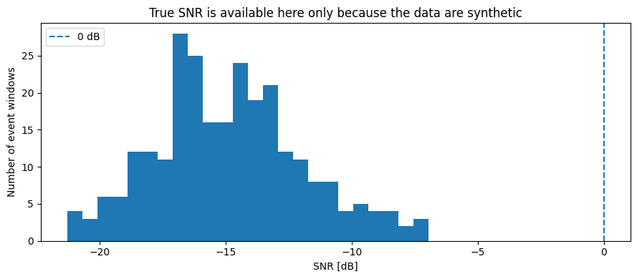
SNR
True event-window SNR in the simulation
HOW TO READ THIS
• Horizontal axis: SNR in decibels.
• Vertical axis: number of event windows.
• Dashed line: equal signal and noise power.
• Most events lie well below 0 dB.
Histogram of true SNR for event windows · dashed line marks 0 dB
The median true SNR is about −14.9 dB: these are deliberately weak events.
FROM NOISY SIGNALS TO SCIENTIFIC EVIDENCE
15
Notes:
This histogram shows true SNR for simulated event windows. A histogram groups numerical values into intervals called bins. The horizontal
axis is SNR in decibels. The vertical axis counts how many event windows fall into each bin. The dashed vertical line at zero decibels
marks equal signal and noise power.
Almost the entire distribution lies to the left of zero. The fifth percentile is about minus nineteen point four decibels, the median
is minus fourteen point nine, and the ninety-fifth percentile is minus nine point four. The median means half of event windows have SNR
below approximately minus fourteen point nine and half above it. These signals are deliberately weak in power.
We can call this true SNR only because the simulation stores the clean event waveform separately. Subtracting that component from the
observed recording reveals the generated noise. In a real experiment we usually cannot perform that separation, so an estimated SNR
depends on assumptions. This figure establishes the challenge built into the simulation. It does not establish the SNR of any real
sensor or show that a particular detector generalises.

Slide 16
SNR
True SNR versus an observable proxy
TRUE SNR
PROXY SNR
ASSUMPTIONS
Uses the hidden clean signal. Available here only because the data are synthetic.
Uses an early noise reference and central-window excess power that can be observed.
Baseline contains no event; noise is comparable; chosen intervals are meaningful.
A proxy is useful only to the extent that its assumptions match the acquisition.
FROM NOISY SIGNALS TO SCIENTIFIC EVIDENCE
16
Notes:
True SNR is inaccessible in most real data because we do not possess the same measurement both with and without the phenomenon. We
therefore use a proxy, meaning an observable quantity intended to approximate an inaccessible concept.
The notebook treats the first second of channel one as a baseline. Baseline means a reference interval expected to contain noise but
not the event. It compares power in a central candidate interval with baseline power. The difference is interpreted as possible excess
signal power, and the ratio is converted to decibels. If candidate power is not greater than baseline power, positive excess power
cannot be estimated and the proxy is recorded as missing.
Each step is an assumption. The baseline may already contain event activity. Noise may change later in the window. Unrelated activity
may occur in the candidate region. Channel one may not represent other channels. Calling the result a proxy keeps those limitations
visible. A defensible report names the intervals, frequency range, preprocessing state, channel aggregation, and uncertainty across
stations or subjects. It also prevents final test labels from being used to choose a favourable SNR threshold.

Slide 17
03
Acquisition quality
A weak valid signal is different from a failed measurement
17
Notes:
This section separates acquisition quality from ordinary noise. Quality control asks whether a measurement is valid enough for a
stated use. Denoising transforms a valid but noisy measurement in an attempt to reduce unwanted variation. The distinction matters
because a filter cannot recover information that the instrument never recorded.
Imagine a sensor whose maximum representable value is three point two. If the true signal rises above that limit, every larger value
is stored as three point two. The peak information is gone. Smoothing the flat top may make it attractive, but it cannot reveal the
lost amplitudes. Missing intervals and flatlines have similar problems.
We will name several acquisition mechanisms, show how transparent diagnostics respond, and inspect a simple severe-quality rule. The
rule is not presented as a universal detector. It demonstrates that thresholds trade missed artifacts against false flags and that
quality policies must themselves be validated.

Slide 18
QUALITY
Seven common acquisition problems
• Missing samples — expected values were not recorded.
• Flatline — the channel remains constant, often indicating sensor failure.
• Clipping — values exceed the instrument range and are stored at its limit.
• Impulse — one or a few extreme spikes.
• Drift — the baseline moves slowly through time.
• Narrow-band interference — unwanted oscillation near one frequency.
• Broadband low SNR — unwanted power is spread across many frequencies.
Name the mechanism before choosing interpolation, rejection, filtering, or review.
FROM NOISY SIGNALS TO SCIENTIFIC EVIDENCE
18
Notes:
These seven problems are not interchangeable. Missing samples are absent values. A short gap may be estimated from neighbours, while
a long gap contains too little information for confident reconstruction. A flatline is a constant interval and may indicate a frozen
or disconnected sensor rather than a perfectly stable phenomenon.
Clipping occurs when the true value exceeds the range of the analogue-to-digital converter, the electronics that turn physical voltage
into a stored number. An impulse is an isolated extreme spike; it may be interference, motion, or a genuine rapid event. Drift is slow
baseline movement that may be nuisance or the actual scientific effect. Narrow-band interference concentrates around one frequency,
such as electrical mains hum. Broadband noise spreads across many frequencies and cannot be removed with one narrow notch.
Each mechanism suggests different evidence and a different response. Interpolation does not repair clipping. A median filter may remove
spikes but also genuine transients. A high-pass filter removes slow drift but may erase meaningful slow change. Preserve the raw data,
declare the rule, and test whether conclusions survive plausible alternatives.

Slide 19
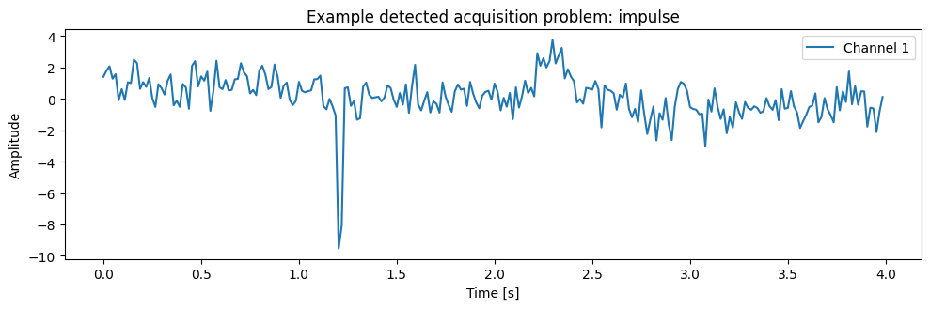
QUALITY
Picture: an impulsive artifact
HOW TO READ THIS
• Horizontal axis: time.
• Vertical axis: raw amplitude.
• Look for an isolated extreme jump.
• A real transient may also be sharp.
Channel 1 over four seconds · one short extreme excursion
Detecting a spike is easier than deciding whether it is artifact or phenomenon.
FROM NOISY SIGNALS TO SCIENTIFIC EVIDENCE
19
Notes:
This picture shows an impulsive artifact. Time is on the horizontal axis and recorded amplitude is on the vertical axis. Most of the
trace follows the usual noisy background, but one very short interval jumps to an extreme value. Because the jump is large relative
to typical variation, a robust diagnostic can flag it.
Robust means resistant to distortion by a few extreme values. The notebook uses the median, the middle value after sorting, and the
median absolute deviation, or MAD. MAD is the median distance from the median. Dividing an extreme distance by this robust spread creates
an impulse score. A large score indicates an unusual point.
The figure does not tell us automatically that the point should be deleted. The scientific event is itself transient, so aggressive
despiking could erase the phenomenon. Context matters: does the excursion appear across channels with plausible timing? Does it match
instrument limits or known interference? Was movement recorded? A quality rule can flag the case for review or robust processing, but
the raw signal must remain available. The takeaway is mechanism-aware caution, not automatic cleaning.

Slide 20
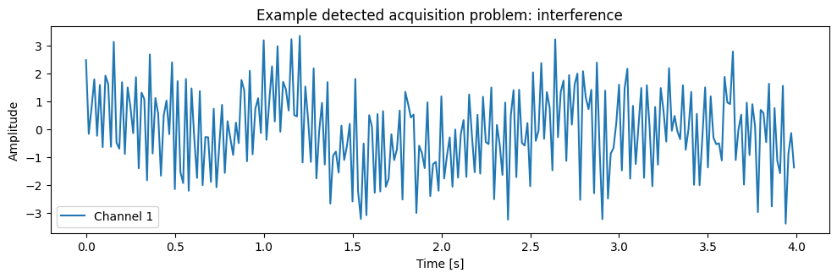
QUALITY
Picture: narrow-band interference
HOW TO READ THIS
• Dense oscillation is sustained, not isolated.
• Regular spacing suggests a frequency source.
• The spectrum helps locate it.
• A notch can also remove real signal.
Channel 1 over four seconds · strong regular high-frequency oscillation
Match the remedy to the interference frequency and verify that the band is not scientifically meaningful.
FROM NOISY SIGNALS TO SCIENTIFIC EVIDENCE
20
Notes:
This picture shows narrow-band interference. The axes again show time and amplitude. Unlike the isolated impulse, this trace contains
rapid oscillations throughout much of the window. The regular spacing suggests energy concentrated near a particular frequency. In
the simulation, interference is added around twenty-five hertz.
A time plot shows that something is oscillating, but a power spectrum is usually better for identifying the frequency. A notch filter
attenuates a narrow frequency region; reference-channel regression may help if a separate interference measurement exists. The method
should follow the known source.
There are important limitations. The interference frequency may drift. A sharp filter may produce ringing, which is an artificial
oscillation around abrupt changes. Most importantly, a real biological, physical, or mechanical process may occupy the same frequency.
Removing that band would remove evidence along with interference. The appropriate sequence is to identify the source, justify the
response, preserve raw data, and examine sensitivity. A visually smoother trace is not sufficient validation.

Slide 21
QUALITY
How the severe-quality rule behaved
Rule decision | No injected artifact | Injected artifact
Not flagged | 747 true negatives | 152 false negatives
Flagged severe | 177 false positives | 124 true positives
FLAG RATE
ARTIFACT SENSITIVITY
SPECIFICITY
25.1% of all windows
124 / 276 = 44.9%
747 / 924 = 80.8%
A transparent rule is still a policy that needs validation and purpose-specific thresholds.
FROM NOISY SIGNALS TO SCIENTIFIC EVIDENCE
21
Notes:
This table compares the severe-quality rule with the artifacts known from the simulation. Rows are rule decisions and columns are
injected truth. The lower-right cell contains one hundred twenty-four true positives: an artifact was inserted and the rule flagged
the window. The upper-right contains one hundred fifty-two false negatives: an artifact existed but the rule did not flag it.
The lower-left contains one hundred seventy-seven false positives relative to the injected label: the rule flagged a window where no
artifact was deliberately inserted. The upper-left contains seven hundred forty-seven true negatives. Overall, the rule flags twenty-
five point one percent of windows.
Artifact sensitivity is true positives divided by all artifact windows: one hundred twenty-four divided by two hundred seventy-six,
about forty-four point nine percent. Specificity is true negatives divided by all windows without an injected artifact: seven hundred
forty-seven divided by nine hundred twenty-four, about eighty point eight percent. These values are not universally good or bad. A safety
application may prefer sensitivity, while an expensive review process may require specificity. Real artifact truth is often incomplete,
so the rule should be treated as a transparent policy, not a validated universal detector.

Slide 22
QUALITY
Choose a response that matches the mechanism
DETECT
DECIDE
DOCUMENT
Name the failure using missingness, limits, robust statistics, or the spectrum.
Repair, flag, reject, request review, collect again, or abstain.
Preserve raw data, parameters, flags, transformed data, and sensitivity checks.
Filtering is one possible response—not a universal repair operation.
FROM NOISY SIGNALS TO SCIENTIFIC EVIDENCE
22
Notes:
This slide pairs acquisition mechanisms with possible responses. Short missing gaps may be interpolated; long gaps should normally be
flagged or rejected. Flatlined channels may be marked unavailable. Instrument clipping may require rejection or treatment as censored
data, meaning we know only that the true value exceeded a limit. Isolated spikes may be handled with robust clipping or a Hampel filter,
but genuine sharp events are at risk.
Slow drift can be modelled, detrended, or attenuated with a high-pass filter if slow variation is not scientifically meaningful. Narrow-
band interference may motivate a notch filter after its source is identified. Broadband low SNR may require better acquisition, more
repeated measurements, multiple sensors, uncertainty reporting, or abstention rather than filtering.
Notice that quality actions include flagging, review, rejection, and workflow changes—not just mathematical transformations. A good
response preserves the raw observation and records what was done. Sensitivity analysis repeats the conclusion under several plausible
choices. If a result disappears when one arbitrary cutoff changes slightly, the evidence is fragile. Mechanism-aware processing makes
assumptions visible and testable.

Slide 23
04
Preprocessing
Change the signal only for a documented scientific reason
23
Notes:
Preprocessing includes every operation applied before the main model. It may fill missing values, reduce known nuisance variation,
express domain knowledge, or convert data into a numerically usable form. Every operation changes the evidence and therefore belongs
in the scientific method.
The demonstrated pipeline fills gaps, robustly limits isolated extremes, removes a linear trend, and applies a one-to-twelve hertz
band-pass filter. These choices match the simulation, not every domain. A transformation encodes a belief about what the scientific
signal cannot be. Detrending says slow linear movement is nuisance. Band-pass filtering says useful information lies within a chosen
frequency range. Those beliefs must be justified and tested.
We will also distinguish offline zero-phase filtering from causal real-time processing and show why a cleaner-looking waveform or a
larger SNR proxy does not prove improved generalisation.

Slide 24
PREPROCESSING
The demonstrated four-step pipeline
1
2
3
4
FILL SHORT GAPS
LIMIT SPIKES
REMOVE TREND
BAND-PASS
linear interpolation
→
median + MAD
→
subtract fitted line
→
retain 1–12 Hz
RAW
preserve
TRANSFORMED
The pipeline is an ordered set of assumptions; save the raw data and every parameter.
FROM NOISY SIGNALS TO SCIENTIFIC EVIDENCE
24
Notes:
This diagram should be read from left to right. Step one fills missing values. Linear interpolation draws a straight line between the
nearest observed neighbours. It can be reasonable for a short gap in a smooth signal, but it becomes speculative for long gaps or rapid
events. A real protocol should define the maximum gap length and retain a missingness indicator.
Step two limits isolated extremes using the median and median absolute deviation. This statistical clipping deliberately caps extreme
values; it is different from instrument clipping, which is accidental information loss at the measurement limit. Step three estimates
a straight-line trend and subtracts it. That is appropriate only when slow movement is nuisance rather than the phenomenon of interest.
Step four applies a band-pass filter that retains approximately one to twelve hertz and attenuates slower and faster components. The
arrows indicate order: changing the order can change the result. The words raw and transformed at the bottom remind us to preserve both.
A reproducible analysis stores the original data, code, filter order, cutoffs, gap rule, and robust threshold, then checks conclusions
under other plausible settings.

Slide 25
PREPROCESSING
Frequency and filtering from first principles
• Frequency = cycles per second; one hertz means one cycle each second.
• At 64 samples per second, the Nyquist frequency is 32 Hz.
• A band-pass retains a selected range and attenuates frequencies outside it.
• Butterworth describes a smooth filter response; fourth order controls transition steepness.
• Filtering may remove noise, real signal, or both.
A frequency band is a scientific hypothesis about where useful information lives.
FROM NOISY SIGNALS TO SCIENTIFIC EVIDENCE
25
Notes:
Frequency counts oscillation cycles per second. One hertz is one cycle each second; ten hertz is ten cycles each second. The sampling
rate is sixty-four points per second. Under ideal sampling, the highest frequency represented without ambiguity is half the sampling
rate, thirty-two hertz, called the Nyquist frequency. Faster oscillations can masquerade as slower ones, a problem called aliasing.
A band-pass filter retains a chosen frequency interval and attenuates components below and above it. Attenuate means reduce, not always
eliminate. Here the pass band is one to twelve hertz because the simulated event was designed to occupy that range. A Butterworth filter
has a smoothly changing frequency response without pass-band ripples. Fourth order controls how steeply attenuation grows outside the
band; steeper is not always better because sharp filters can produce time-domain artifacts and numerical sensitivity.
The selected band is a hypothesis. In another scientific setting, slow change or high-frequency activity may be essential evidence.
Trying many bands and choosing the one with the best final test score leaks test information into method selection. Choose from domain
knowledge and training or validation data, then reserve the final test for evaluation.

Slide 26
PREPROCESSING
Zero-phase is offline, not real-time
OFFLINE
REAL-TIME
The complete window exists. Forward-and-backward filtering may be appropriate.
Future points do not yet exist. Use a causal method or declare the latency.
Non-causal processing is valid for retrospective analysis only when the intended use permits future samples.
FROM NOISY SIGNALS TO SCIENTIFIC EVIDENCE
26
Notes:
Phase describes where an oscillation sits in its cycle. An ordinary one-direction filter can delay or shift peaks. The notebook uses
forward-and-backward filtering. It runs the filter forward, reverses the sequence, and filters again. The phase shifts largely cancel,
producing a zero-phase result.
The benefit is alignment: peaks are not moved in time by the filter. The cost is that the processed value at a particular time depends
on later sample points. Causal means that an output at time t uses only information available at or before time t. Non-causal means it
uses future information. Non-causal is not automatically invalid. If an offline scientist analyses a completed four-second window, all
samples are available. If a real-time early-warning system claims to decide immediately, future samples do not yet exist.
The diagram contrasts these settings. In retrospective analysis, the full window can legitimately be used. In real-time deployment,
either use a causal filter or state the required delay before a decision. Timing is a form of feature availability and therefore a
potential leakage pathway.

Slide 27
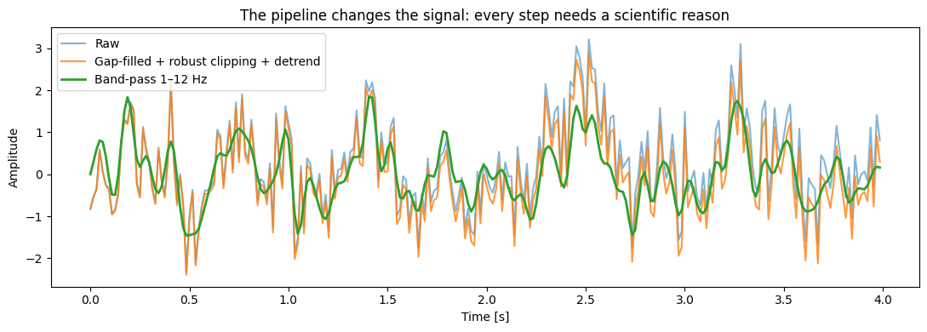
PREPROCESSING
Picture: the waveform changes at every step
HOW TO READ THIS
• Horizontal axis: time in seconds.
• Vertical axis: amplitude.
• Three lines are transformations of one trace.
• Cleaner appearance is not proof of validity.
Raw, clipped/detrended, and 1–12 Hz band-passed versions of the same channel
Every preprocessing step removes or reshapes information according to an assumption.
FROM NOISY SIGNALS TO SCIENTIFIC EVIDENCE
27
Notes:
This picture overlays three versions of the same event channel. Time is on the horizontal axis and amplitude on the vertical axis. The
faint raw line contains the original filled trace. The second line shows gap filling, robust limiting of extreme values, and removal of
a linear trend. The thicker line adds the one-to-twelve hertz band-pass.
Compare the lines rather than searching for the prettiest one. The band-passed trace is smoother and emphasises the central transient.
Slow movement and high-frequency variation are reduced. That may improve detection because the simulation placed useful event structure
inside the band. It also means information outside the band has been deliberately discarded. In a real study, some discarded variation
could be scientifically meaningful.
This figure shows the effect of a transformation on one selected window. It does not demonstrate better prediction, less bias, or
generalisation to new stations. Those claims require controlled held-out evaluation. A defensible caption should name the steps and
settings rather than say only that the signal was cleaned. Preserve the raw trace so later researchers can question these choices.

Slide 28
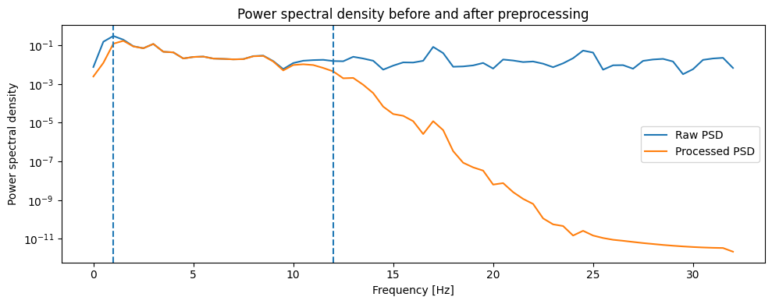
PREPROCESSING
Picture: power before and after filtering
HOW TO READ THIS
• Horizontal axis: frequency in hertz.
• Vertical axis: power density on a log scale.
• Dashed lines: 1 and 12 Hz cutoffs.
• Processed power falls outside the band.
Power spectral density of the raw and processed channel
The spectrum confirms what the filter did; it does not prove that the retained band is correct.
FROM NOISY SIGNALS TO SCIENTIFIC EVIDENCE
28
Notes:
This picture shows power spectral density, abbreviated PSD. The horizontal axis is frequency in hertz. The vertical axis is power per
frequency region and uses a logarithmic scale, allowing small and large values to appear together. The raw PSD and processed PSD are
shown as separate curves. Vertical dashed lines mark the one-hertz and twelve-hertz filter cutoffs.
Between the dashed lines, the processed curve retains much of the signal's power. Below one hertz, slow drift is strongly reduced. Above
twelve hertz, high-frequency noise and interference are attenuated. This is exactly the behaviour intended by a band-pass filter. PSD is
estimated with Welch's method, which divides the signal into overlapping segments, calculates spectra, and averages them to reduce random
variability.
The plot confirms implementation: the output behaves like a one-to-twelve hertz band-pass. It does not confirm scientific correctness.
A real phenomenon might contain useful power outside the selected band, and filter edges are gradual rather than perfect walls. The band
should follow domain knowledge and sensitivity analysis. The correct statement is that specified frequencies were attenuated, not that
all noise was removed.

Slide 29
PREPROCESSING
Filtering changes the SNR proxy
Statistic for event windows | Raw proxy | Processed proxy
Estimable count | 214 | 199
Median | −3.143 dB | −1.218 dB
Interquartile range | −6.651 to −0.850 | −4.858 to 1.686
Estimable fraction | 81.1% | 75.4%
A better-looking proxy is not evidence of better generalisation—and missingness also changed.
FROM NOISY SIGNALS TO SCIENTIFIC EVIDENCE
29
Notes:
This table compares the proxy SNR before and after preprocessing for event windows. The raw median is minus three point one four three
decibels. The processed median is minus one point two one eight, so the typical estimable value moves closer to zero and appears better.
The interquartile range, containing the middle half of values, also shifts upward.
However, the proxy can be calculated only when central-window power exceeds baseline power. Two hundred fourteen raw event windows meet
that condition, compared with one hundred ninety-nine processed windows. The estimable fraction falls from eighty-one point one percent
to seventy-five point four percent. Filtering changed both the numerical distribution and which cases received a value.
This is a useful warning against one-number storytelling. A higher median among remaining values does not imply more information or
better predictions. The filter changes the numerator, denominator, and missingness mechanism of the proxy. We should report all three.
To ask whether preprocessing improves generalisation, we must compare raw and processed representations on identical held-out cases.
That controlled predictive comparison appears later.

Slide 30
05
Features and validation
Transparent representations, honest splits, and meaningful metrics
30
Notes:
We now convert each waveform into numerical features and train a classifier. A feature is a summary supplied to a model. Transparent
feature engineering makes assumptions visible and provides a useful scientific baseline before moving to a complex neural network.
The algorithm is a random forest, an average of many decision trees. Algorithm choice is not the main lesson. The same data provenance,
split design, and metrics would be required for any model. We deliberately run four experiments that become progressively more honest.
The first includes a post-outcome field. The second removes that direct leak but randomly splits windows. The third holds out stations.
The fourth uses the same held-out stations and rows while changing from raw to processed features.
We will define the features, model, leakage pathways, confusion-matrix metrics, ranking metrics, and repeated group evaluation before
interpreting the results.

Slide 31
FEATURES
What the 51 corrected features describe
TIME
FREQUENCY
RELATION + QUALITY
mean · spread · RMS · range · extremes · zero crossings
band power · spectral entropy · high-frequency ratio
channel correlation · SNR proxy · missingness · impulses
A feature has a numerical definition; its scientific meaning still requires validation.
FROM NOISY SIGNALS TO SCIENTIFIC EVIDENCE
31
Notes:
The corrected feature matrix contains fifty-one columns. Time-domain features are calculated directly from the waveform. The mean is
average amplitude. Standard deviation is typical spread around that mean. RMS, or root mean square, is the square root of average squared
amplitude and describes overall magnitude. Peak-to-peak is maximum minus minimum. Kurtosis describes how strongly extreme values dominate.
Zero-crossing rate counts how often neighbouring values cross zero.
Frequency-domain features begin with a power spectral density. Band power measures the fraction of power in low, event, or high-frequency
ranges. Spectral entropy describes how evenly power is distributed: low when concentrated in a few frequencies, high when spread broadly.
Cross-channel correlation describes how similarly two channels rise and fall. Values near plus one indicate positive linear co-movement;
near zero indicates little linear relation.
The matrix also includes a proxy SNR and explicit quality measures such as missing fraction, impulse score, and high-frequency ratio. A
feature name suggests interpretation but does not guarantee it. High spectral entropy may represent complex signal or broadband noise;
correlation may represent a coherent event or shared interference. Explanations will turn these ambiguities into new validation questions.

Slide 32
FEATURES
How a random forest makes a prediction
TREE 1
TREE 3
FEATURE ROW
threshold questions
→ event probability
threshold questions
→ event probability
AVERAGE
TREE 2
51 numerical values for one window
→
→
combine 120 tree predictions
threshold questions
→ event probability
Threshold 0.25 converts the averaged score into EVENT or NO EVENT.
A flexible model can learn useful structure or shortcuts; validation determines which travels.
FROM NOISY SIGNALS TO SCIENTIFIC EVIDENCE
32
Notes:
Read this diagram from left to right. One feature row contains fifty-one numbers describing a window. A decision tree asks a sequence of
threshold questions, such as whether event-band power exceeds a value or spectral entropy falls below a value. Each answer sends the row
down a branch until the tree produces an event probability.
A random forest contains many trees. The notebook uses one hundred twenty. The trees are trained on varied versions of the training data
and varied subsets of features. Their probabilities are averaged. Averaging usually reduces sensitivity to one peculiar training sample
compared with a single tree. Class weighting gives additional training influence to the less common event class, and a minimum leaf size
prevents decisions from being based on extremely tiny groups.
The averaged score is continuous. The predeclared threshold is zero point two five. Scores at or above it become event predictions. A low
threshold favours recall but creates more false alarms. This algorithm can represent nonlinear relationships and interactions, but it has
no understanding of scientific validity. It will exploit leaked fields or station fingerprints if they predict the label. Validation, not
model sophistication, determines whether learned patterns answer the intended question.

Slide 33
FEATURES
Learned preprocessing stays inside training data
1 SPLIT GROUPS
2 FIT ON TRAIN
3 APPLY TO TEST
Create training and held-out stations before learned preprocessing.
Estimate medians and model parameters from training rows only.
Use the stored transformation unchanged on held-out rows.
Fit on training data; apply unchanged to validation and test data.
FROM NOISY SIGNALS TO SCIENTIFIC EVIDENCE
33
Notes:
Some proxy-SNR features are missing because estimated central excess power is not positive. The software pipeline uses a median imputer.
Imputation means replacing a missing value according to a declared rule. The median is the middle training value after sorting and is less
affected by extremes than the mean.
The crucial word is training. First split the groups. Then calculate each feature's median only from training rows. Replace missing training
values and fit the classifier. At evaluation time, use those same stored medians on test rows. If we calculated the median from the entire
dataset before splitting, the test distribution would influence the fitted procedure. That is preprocessing leakage.
The same principle applies to normalisation, feature selection, learned denoisers, dimensionality reduction, and calibration. In cross-
validation, every fold must independently fit these operations on its training portion. A software pipeline helps enforce the sequence by
linking the imputer and model. Fixed transforms still require scientific justification, and if their settings were selected using final
test performance, selection leakage would remain.

Slide 34
VALIDATION
Five ways information can leak
Leakage | Example | Protection
Post-outcome | Review flag entered after the event is seen | Audit prediction-time availability
Group | Same station appears in train and test | Split by deployment group
Temporal | Future measurements predict an earlier decision | Respect time order and latency
Preprocessing | Imputer fitted before the split | Fit transformations inside folds
Selection | Best pipeline chosen on final test | Separate validation from final test
Leakage makes evaluation easier than the real task and produces optimistic evidence.
FROM NOISY SIGNALS TO SCIENTIFIC EVIDENCE
34
Notes:
Data leakage means that model development or evaluation uses information that would not legitimately be available for the intended future
prediction. The first row is post-outcome leakage. The review flag is entered after experts inspect the complete window, so it cannot be
used for an earlier prediction.
Group leakage occurs when related observations from the same station appear in both training and test data. Temporal leakage occurs when
future data help predict an earlier decision, including non-causal processing presented as immediate. Preprocessing leakage occurs when an
imputer, normaliser, selector, or learned transform sees the test data before evaluation. Selection leakage occurs when researchers compare
many methods on the final test set and report the best; repeated use turns the test set into a development set.
Leakage is broader than accidentally including the label column. It concerns provenance, timing, relationships, and repeated decision-
making. Protection begins by writing the deployment scenario: when is a prediction made, which variables exist then, which unit must be new,
and which choices may use which data? Strong-looking performance should trigger a leakage audit, especially when it greatly exceeds domain
expectations.

Slide 35
VALIDATION
Random rows versus held-out groups
RANDOM ROW SPLIT
GROUP HOLDOUT
S1
S2
S3
S4
S1
S2
S3
S4
TRAIN
TRAIN
TRAIN
TEST
station colours appear on both sides
complete station S4 is unseen
QUESTION ANSWERED
QUESTION ANSWERED
More windows from known stations?
Generalise to an unseen station?
Neither split is universally right; the correct split matches what will be new in use.
FROM NOISY SIGNALS TO SCIENTIFIC EVIDENCE
35
Notes:
This diagram compares two validation questions. On the left, the random-row split takes windows from each station and distributes some to
training and some to testing. The repeated colours on both sides represent shared station identity. This design asks whether the model can
recognise additional windows from stations it has already encountered. That may be valid for monitoring known stations, but not for our
new-station claim.
On the right, stations one, two, and three are training groups, while complete station four is the test group. No window from station four
is available during fitting. This asks whether the procedure generalises to an unseen station. The same logic applies to patients, animals,
devices, laboratories, and sites.
Random splitting is not inherently bad, and group splitting is not automatically sufficient. The intended deployment determines what must
be independent. If deployment is future time on known stations, a temporal split within station may be needed. If it is new countries, hold
out countries. The scientifically correct split is the one that recreates the novelty and dependence structure of future use.

Slide 36
VALIDATION
Four experiments, each answering a different question
• 1. Random split + post-outcome field — impressive and invalid.
• 2. Same random split, field removed — direct leak fixed; stations still repeat.
• 3. Station-group holdout + raw defensible features — unseen stations.
• 4. Same held-out stations and rows + processed features — controlled preprocessing comparison.
Changing the data or split changes the scientific question, not merely the score.
FROM NOISY SIGNALS TO SCIENTIFIC EVIDENCE
36
Notes:
Experiment one uses a random row split and includes the post-event quality flag. The flag is recorded after expert review and agrees with
the label almost perfectly by construction. This experiment is designed to fail scientifically while looking excellent numerically.
Experiment two removes that direct leak but keeps exactly the same random split. Because the test rows are unchanged, the performance drop
isolates the influence of the post-outcome field. However, stations still appear in both training and test data, so the estimate remains
unsuitable for new-station deployment.
Experiment three creates a station-group holdout and uses raw defensible features. Defensible means available at prediction time and not the
deliberately leaked metadata. This asks the stronger question about unseen stations. Experiment four uses processed defensible features but
keeps exactly the same training and test indices as experiment three. That controlled comparison prevents one feature set from receiving an
easier set of stations or rows. Severe-quality rows are retained in both; later we report an explicit abstention policy rather than silently
deleting difficult cases.

Slide 37
METRICS
The four outcomes behind classification metrics
TRUE CONDITION
 | Event | No event
Event | TRUE POSITIVE correct alarm | FALSE POSITIVE false alarm
No event | FALSE NEGATIVE missed event | TRUE NEGATIVE correct quiet
PRECISION
TP / (TP + FP)
How many alarms are right?
PREDICTION
RECALL
TP / (TP + FN)
How many events are found?
Threshold choice trades missed events against false alarms.
FROM NOISY SIGNALS TO SCIENTIFIC EVIDENCE
37
Notes:
This two-by-two table is a confusion matrix. Columns show the true condition and rows show the model prediction. A true positive is a
correct event alarm. A false positive is an alarm when no event exists, also called a false alarm. A false negative is a missed event.
A true negative is a correctly quiet non-event.
Precision equals true positives divided by all positive predictions, true positives plus false positives. It asks: among alarms, what
fraction were correct? Recall, also called sensitivity, equals true positives divided by all real events, true positives plus false negatives.
It asks: among real events, what fraction did we detect? Specificity, not shown in a card, is true negatives divided by all real non-events.
Imagine one hundred alarms, thirty of which are real events. Precision is thirty percent. If forty events existed in total, recall is thirty
divided by forty, or seventy-five percent. A system can therefore have high recall and low precision by alarming frequently. Moving the
probability threshold changes these counts. The preferred balance depends on the cost of misses, false alarms, delayed decisions, and human
review—not on a universal mathematical rule.

Slide 38
METRICS
Why accuracy is not enough
• At 22% prevalence, always predicting ‘no event’ is about 78% accurate—and detects nothing.
• Balanced accuracy gives event recall and non-event specificity equal weight.
• ROC AUC measures positive-versus-negative ranking across thresholds.
• A precision–recall curve exposes the alarm-quality tradeoff.
• Average precision summarises that curve and depends on prevalence.
Interpret metrics together, with prevalence, threshold, uncertainty, and operational costs.
FROM NOISY SIGNALS TO SCIENTIFIC EVIDENCE
38
Notes:
Accuracy is the fraction of all predictions that are correct. With twenty-two percent event prevalence, a model that always predicts no
event would be correct about seventy-eight percent of the time while detecting zero events. Balanced accuracy avoids that particular trap
by averaging event recall and non-event specificity, giving both classes equal weight.
ROC AUC is the area under the receiver operating characteristic curve. It can be interpreted as the chance that a randomly selected event
receives a higher score than a randomly selected non-event. Zero point five is random ranking and one is perfect ranking. It covers all
thresholds but does not directly state the number of false alarms at the selected threshold.
A precision–recall curve traces precision and recall as the threshold changes. Average precision, or AP, summarises this curve. For an
uninformative ranking, AP is approximately the event prevalence, making prevalence an important reference. Precision and AP can change
when deployment prevalence changes, so a balanced benchmark may produce disappointing real-world alarm precision. Report several metrics,
the threshold, prevalence, confidence or variability, and consequences of errors.

Slide 39
RESULTS
The cost of a more honest question
Experiment | AP | AUC | Precision | Recall | False alarms / 100 neg.
1 Random + post-outcome | 0.957 | 0.991 | 0.890 | 0.986 | 3.4
2 Random, leakage removed | 0.510 | 0.739 | 0.333 | 0.703 | 39.5
3 Group holdout, raw | 0.369 | 0.712 | 0.228 | 0.750 | 48.3
4 Same group holdout, processed | 0.471 | 0.753 | 0.236 | 0.732 | 45.2
All thresholded metrics use the predeclared threshold 0.25.
A lower honest score is more useful than an impressive estimate of the wrong task.
FROM NOISY SIGNALS TO SCIENTIFIC EVIDENCE
39
Notes:
This table is the numerical centre of the lecture. Experiment one has average precision zero point nine five seven and ROC AUC zero point
nine nine one. Those near-perfect values are an alarm, because the post-outcome review flag nearly copies the answer and is unavailable at
prediction time. Explainability will confirm that shortcut. This is not evidence of discovery.
On the same random split, removing the field reduces AP to zero point five one zero. The difference shows how much the leaked field inflated
performance. But stations still repeat. Holding out entire stations with raw features reduces AP to zero point three six nine. That lower
number answers a harder, deployment-relevant question.
Processed features evaluated on exactly the same held-out rows raise AP to zero point four seven one and AUC to zero point seven five three.
The ranking improves, but threshold performance remains operationally difficult: precision is zero point two three six and there are about
forty-five false alarms per one hundred negatives at threshold zero point two five. Recall is prioritised, so many events are found at the
cost of alarms. The proper conclusion is bounded: preprocessing helped internal group-held-out ranking in this simulation, not that it
universally cleans signals or creates a deployable system.

Slide 40
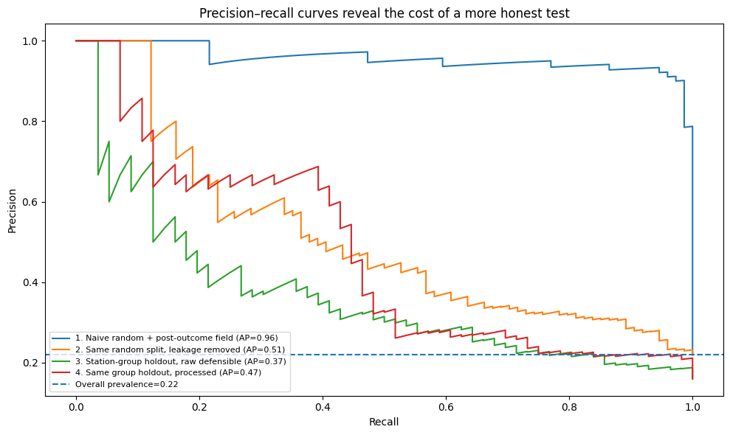
RESULTS
Picture: precision–recall curves
HOW TO READ THIS
• Horizontal axis: recall.
• Vertical axis: precision.
• Each curve: one experiment.
• Higher and farther right is better.
Each curve varies the decision threshold; dashed line is overall prevalence
The invalid leaked model dominates; honest models reveal the false-alarm cost.
FROM NOISY SIGNALS TO SCIENTIFIC EVIDENCE
40
Notes:
This picture plots precision on the vertical axis against recall on the horizontal axis as the decision threshold changes. Moving along a
curve corresponds to becoming more or less willing to predict an event. Higher precision means a larger fraction of alarms is correct;
higher recall means more real events are found. A curve that remains high while moving right is better.
The dashed horizontal line marks overall event prevalence, about zero point two two. An uninformative ranking has average precision near
this baseline. The leaked model's curve stays near the upper-right corner and has AP zero point nine six because the post-outcome field
nearly reveals the label. The random split without that field is much lower. The station-group raw and processed curves reflect the harder
unseen-station question; processed features improve the curve but do not eliminate the tradeoff.
Curves should be compared only with awareness of the population and split. The leaked curve is not a valid competitor simply because it is
visually superior. This plot helps select an operating threshold using validation data, but the final choice must account for false-alarm
and missed-event costs and then be evaluated on reserved test data.

Slide 41
RESULTS
Repeated station holdouts reveal uncertainty
Features | AP 25% | AP median | AP 75% | AUC 25% | AUC median | AUC 75%
Raw | 0.323 | 0.466 | 0.487 | 0.691 | 0.710 | 0.719
Processed | 0.500 | 0.528 | 0.542 | 0.732 | 0.764 | 0.780
WHY REPEAT?
WHAT IT SHOWS
WHAT IT IS NOT
Processed representations rank better across these eight internal splits.
Not an external, temporal, geographic, or prospective validation.
Only 24 stations: which ones are held out changes difficulty.
Report distributions across valid splits; never present one convenient fold as universal.
FROM NOISY SIGNALS TO SCIENTIFIC EVIDENCE
41
Notes:
The single group split depends on which stations happen to be held out. With only twenty-four stations, one test set may contain unusually
noisy stations, different event prevalence, or distinct signal shapes. The notebook therefore repeats a valid station-group holdout eight
times. Every repeat keeps stations intact.
The table reports the twenty-fifth percentile, median, and seventy-fifth percentile. The median is the middle result. The outer values contain
the middle half of the eight results and compactly show split-to-split variation. They are not a formal confidence interval. Raw average
precision has median zero point four six six, while processed AP has median zero point five two eight. Processed AUC is also higher across
these summaries.
This strengthens the bounded comparison: in this simulation, processed features perform better across several internal group splits. It does
not establish performance on a different study, time period, country, or sensor family. Nested group cross-validation would be appropriate
if model settings were selected, using inner folds for selection and outer folds for estimation. Genuinely independent external data remain
necessary when the scientific claim extends beyond this dataset.

Slide 42
06
Explainability as an audit
Describe model behaviour, expose shortcuts, and create new tests
42
Notes:
We now use explainability only after establishing a defensible validation design. Explainable AI, or XAI, includes methods that make model
inputs, outputs, or behaviour more understandable. It does not guarantee that a model is correct, fair, causal, or scientifically valid.
A global explanation summarises behaviour across many observations. A local explanation concerns one prediction. We will use permutation
importance for the global view and median replacement for a simple local view. Both methods perturb data and observe model output changes.
Their answers depend on the fitted model, evaluation population, metric, and perturbation.
Our most useful explanation is applied to the invalid model. It shows overwhelming reliance on the post-outcome review flag. That does not
rescue the model; it confirms the shortcut and sends us back to provenance. The corrected explanation then raises questions about spectral
and quality features. Explanation is successful here because it produces tests and caution rather than decoration.

Slide 43
EXPLAINABILITY
Global and local are different scopes
GLOBAL
LOCAL
SCIENTIFIC
Which features matter across this held-out population?
Which feature perturbations change this one prediction?
Which mechanisms survive independent tests and alternatives?
Every explanation needs a scope: which model, data, output, metric, and perturbation?
FROM NOISY SIGNALS TO SCIENTIFIC EVIDENCE
43
Notes:
A global explanation asks what the model relies on across a specified set of observations. It may rank features by their average effect on
held-out performance. A local explanation asks why one particular score changes under selected perturbations. A feature can be globally
important but irrelevant to one case, while an unusual feature can dominate one local prediction but matter little on average.
Neither scope is a complete scientific explanation. A global result may differ across sites, time periods, or model versions. A local result
may be unstable and may use an unrealistic comparison. We therefore name the model, held-out population, target output, performance metric,
and perturbation rule.
Interpretability and explainability are defined differently across communities. In this lecture, an interpretable representation has features
whose calculations can be inspected, and an explanation is an analysis of fitted-model behaviour. These are useful properties, not certificates.
A transparent model trained on leaked data remains invalid, while a complex model can still be rigorously evaluated. Methodological validity
comes from the full evidence chain.

Slide 44
EXPLAINABILITY
Permutation importance: break one relationship
1 BASELINE
2 SHUFFLE
3 RESCORE
4 COMPARE
score untouched held-out data
reorder one feature column
run the same fitted model
baseline AP minus shuffled AP
→
→
→
Repeat each shuffle to measure random variation.
A large performance drop shows model dependence—not causal or physical importance.
FROM NOISY SIGNALS TO SCIENTIFIC EVIDENCE
44
Notes:
This diagram explains permutation importance in four steps. First, measure average precision on untouched held-out data. Second, choose one
feature and randomly reorder its values across rows. Shuffling preserves the feature's overall distribution but breaks its relationship with
each row's label and other features. Third, run the same fitted model on the perturbed data. Fourth, subtract the shuffled average precision
from the baseline score. A large drop suggests that the model depended strongly on information in that feature.
Each feature is shuffled several times because one random ordering may be unusual. We report the mean drop and variation. The method is
model-agnostic: it treats the fitted model as a prediction function and does not need to inspect internal tree structure.
Limitations are essential. Correlated features can substitute for one another, making each appear less important, or shuffling can create
unrealistic combinations. Importance depends on the metric and held-out population. A drop of zero point six does not mean a feature causes
sixty percent of events or contributes that amount to every prediction. It is a performance sensitivity under this exact intervention.

Slide 45
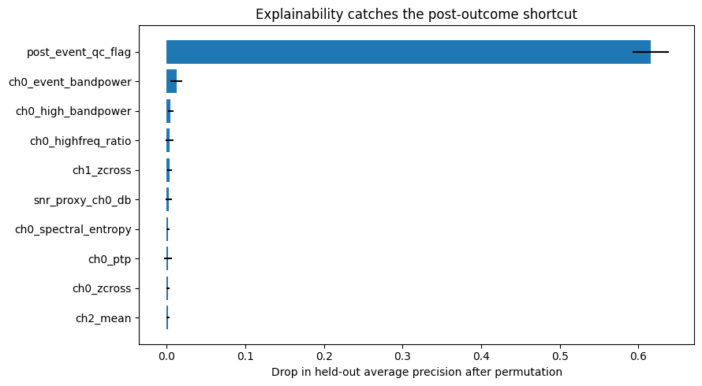
EXPLAINABILITY
Picture: explainability catches the shortcut
HOW TO READ THIS
• Vertical axis: feature names.
• Horizontal axis: average-precision drop.
• Longer bar: more model dependence.
• Post-outcome flag dominates.
Permutation importance for the invalid random-split model
The best explanation of this model is that the experiment is invalid.
FROM NOISY SIGNALS TO SCIENTIFIC EVIDENCE
45
Notes:
This horizontal bar chart shows permutation importance for the invalid model. Feature names are listed vertically. The horizontal axis is
the reduction in held-out average precision after one feature is shuffled. Longer bars indicate greater model dependence under this test.
Error bars show variation across repeated random shuffles.
The post-event quality flag has a mean importance around zero point six one six. Every other feature is tiny by comparison. This is exactly
what we should expect: the field is entered after experts inspect the full window and nearly copies the event label. Destroying its information
causes the model's apparent performance to collapse.
This is explainability doing valuable audit work. It identifies a shortcut and directs us to investigate when and how the variable was created.
It does not make the model acceptable by making the shortcut transparent. An invalid model with an accurate explanation remains invalid.
The figure also shows why plausible feature names are insufficient. Provenance and prediction-time availability must be checked before model
fitting. The correct action is to remove the field and redesign evaluation, not to publish the explanation as scientific discovery.

Slide 46
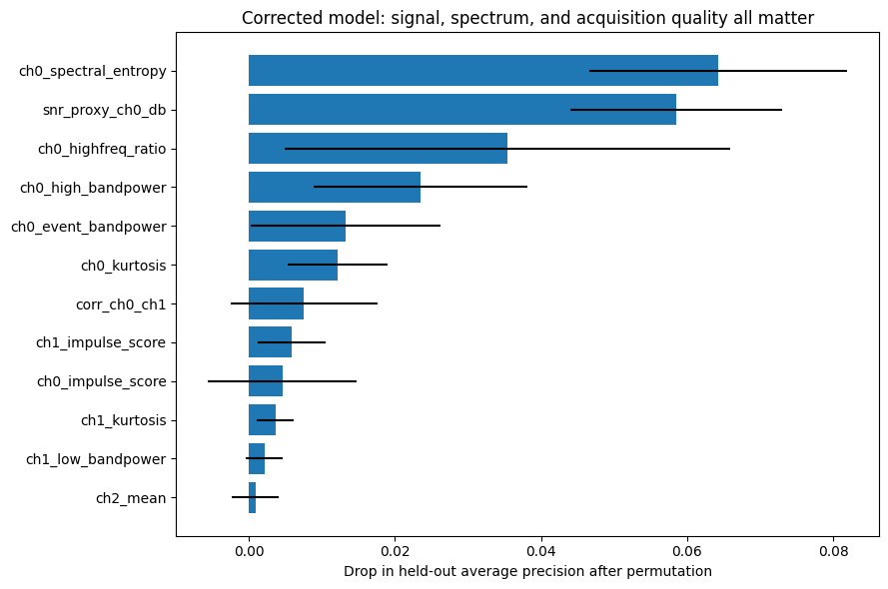
EXPLAINABILITY
Picture: what the corrected model uses
HOW TO READ THIS
• Spectral entropy and SNR proxy rank highest.
• Quality and high-frequency features also matter.
• Error bars overlap for several features.
• Importance suggests tests, not causes.
Signal-related and acquisition-related features are entangled; investigate both interpretations.
Permutation importance on unseen stations for processed + quality features
46
FROM NOISY SIGNALS TO SCIENTIFIC EVIDENCE
Notes:
This chart uses the same axes as the previous importance plot but applies the corrected processed-feature model to held-out stations. Channel
zero spectral entropy has the largest mean drop, around zero point zero six four. The SNR proxy follows at about zero point zero five nine.
High-frequency ratio, high-band power, event-band power, kurtosis, correlation, and impulse scores also appear.
These names invite interpretations but do not settle them. Spectral entropy might capture event structure or station-specific broadband noise.
The SNR proxy might represent genuine central excess power or dependence on the chosen time windows. High-frequency ratio may help suppress
false alarms, or it may identify sensor quality and station hardware. Error bars overlap for several features, showing shuffle variability.
Each result should become a question. Does importance remain stable across station splits, sites, time periods, models, and preprocessing
settings? Is the feature available at decision time? Does removing it harm performance consistently? Does a physically motivated experiment
change it as predicted? The chart explains aspects of this model's ranking on this held-out set. It does not prove that these variables are
physical causes of events.

Slide 47
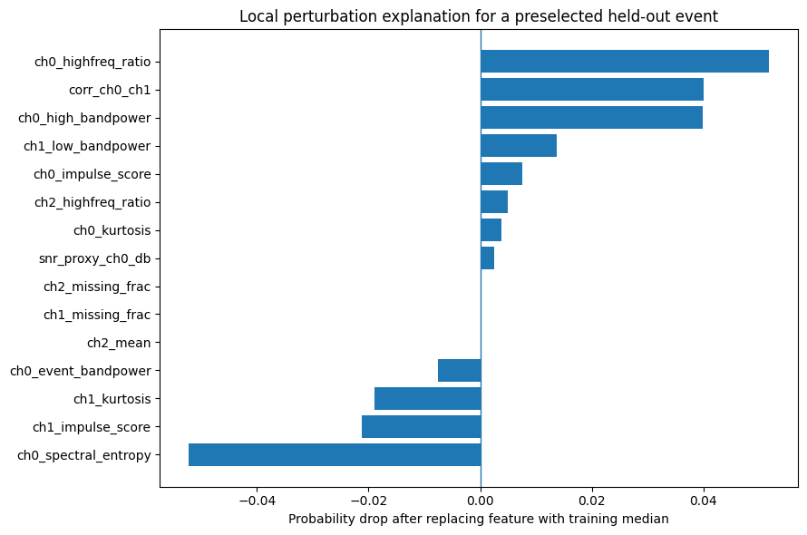
EXPLAINABILITY
Picture: a local perturbation explanation
HOW TO READ THIS
• Vertical axis: tested features.
• Horizontal axis: probability change.
• Positive: observed value supported event score.
• Negative: observed value opposed it.
This is a sensitivity analysis for one output, not a decomposition of the physical event.
One preselected held-out event · model probability = 0.331
47
FROM NOISY SIGNALS TO SCIENTIFIC EVIDENCE
Notes:
This local plot concerns one held-out positive window selected before examining its predicted probability. The model assigns probability zero
point three three one. Feature names appear vertically. For each feature, the notebook replaces its observed value with the median from the
training set, predicts again, and calculates original probability minus modified probability.
A positive bar means the probability falls after replacement, so the observed feature value supported the event score under this perturbation.
A negative bar means replacement raises the probability, so the observed value opposed it. The horizontal axis is a probability change, not
a percentage of physical causation.
The bars do not add neatly to zero point three three one because the random forest contains interactions: the effect of one feature depends
on others. Replacing one feature while holding correlated features fixed may also create a combination that never occurs physically. The use
of training medians avoids test leakage but does not make the perturbation a real intervention. This picture helps inspect one model output;
it does not explain why the physical event occurred or show that the case represents the population.

Slide 48
EXPLAINABILITY
From importance to a scientific test
MODEL OBSERVATION
ALTERNATIVES
NEXT TEST
High-frequency ratio is important on held-out stations.
Artifact suppression? Device fingerprint? Shared interference?
Hold out devices, ablate the feature, use references, and replicate.
An explanation is useful when it produces a falsifiable next question.
FROM NOISY SIGNALS TO SCIENTIFIC EVIDENCE
48
Notes:
This slide converts model observations into scientific checks. If the SNR proxy is important, one interpretation is that the model detects
event energy. Another is that it exploits our chosen baseline and candidate windows. We can vary those windows using training data and test
whether the relationship survives independent stations.
If high-frequency ratio is important, perhaps the model suppresses artifacts. Alternatively, it may identify particular devices. Holding out
devices or sites, equalising acquisition settings, and examining error types can distinguish these stories. If cross-channel correlation
matters, perhaps the event is coherent across sensors, or perhaps shared interference creates the relation. Reference sensors and controlled
simulations can test those alternatives.
Association means quantities vary together. A mechanism proposes a process producing the observation. Causality concerns what would change
under intervention. Feature importance establishes model dependence under a perturbation, not mechanism or causality. The scientific value
of explainability lies in generating specific predictions, ablations, robustness checks, and experiments that could contradict our preferred
story. Avoid causal verbs such as caused or drove unless the design supports them; say relied on, was associated with, or changed the model
output under perturbation.

Slide 49
07
Quality, abstention, and coverage
Show where the model struggles and when it refuses to decide
49
Notes:
An overall metric combines easy and difficult conditions. A model may be moderately reliable everywhere, or excellent on clean signals and
unusable on noisy ones, yet both can share the same average. We therefore divide held-out predictions into strata and report each separately.
Stratification must avoid circular definitions. The candidate-window SNR proxy partly measures the hypothesised event, so using it to define
quality groups would change event prevalence by construction. Instead, the notebook uses noise from an early baseline interval that does not
use the label.
We also treat the severe-quality flag as an explicit abstention policy. Abstention means declining to issue a normal prediction and instead
requesting review, a new measurement, or another workflow. Any apparent performance benefit must be reported together with coverage—the
proportion of cases that still receive predictions.

Slide 50
QUALITY
Performance across baseline-noise quartiles
Noise stratum | N | Prevalence | Recall | Precision | AP
Lowest | 88 | 9.1% | 0.750 | 0.400 | 0.743
Low-mid | 87 | 17.2% | 0.733 | 0.306 | 0.553
High-mid | 87 | 20.7% | 0.556 | 0.208 | 0.493
Highest | 88 | 17.0% | 0.933 | 0.187 | 0.348
Average precision worsens as baseline noise rises; thresholded recall alone hides the false alarms.
FROM NOISY SIGNALS TO SCIENTIFIC EVIDENCE
50
Notes:
This table divides held-out windows into four nearly equal quartiles ordered by baseline noise. Quartile means one of four groups. The lowest-
noise group contains the quietest quarter and the highest-noise group the noisiest quarter. N is the number of windows, and prevalence is the
fraction containing events.
Average precision declines from zero point seven four three in the lowest-noise quartile to zero point three four eight in the highest-noise
quartile. That indicates substantially weaker ranking under noisy acquisition. Recall is not monotonic and reaches zero point nine three three
in the highest-noise group. If we looked only at recall, we might call that excellent. Precision there is only zero point one eight seven,
meaning fewer than one in five event predictions is correct at threshold zero point two five. The model finds events by alarming frequently.
Prevalence also differs across quartiles, which affects precision and AP. Each group has only eighty-seven or eighty-eight rows and fewer
positive events, so uncertainty is substantial. A real paper should include uncertainty intervals and predeclared groups. The justified
message is that performance depends on acquisition noise and no single average or thresholded metric describes robustness.

Slide 51
QUALITY
Abstention changes coverage
Policy outcome | N | Coverage | Recall | Precision | AP
Abstain: severe | 75 | 21.4% | 0.846 | 0.200 | 0.382
Prediction issued | 275 | 78.6% | 0.698 | 0.252 | 0.500
COVERAGE
REJECT OPTION
WORKFLOW
275 / 350 = 78.6% receive predictions
75 / 350 = 21.4% require another pathway
review · recollect · defer · safe default
Never report the score after exclusions without the rule, coverage, and fate of rejected cases.
FROM NOISY SIGNALS TO SCIENTIFIC EVIDENCE
51
Notes:
Abstention means the system deliberately declines to issue its normal prediction when a predeclared condition is met. Here, the severe-quality
rule abstains on seventy-five of three hundred fifty held-out windows. The remaining two hundred seventy-five receive predictions.
Coverage is the proportion receiving predictions: two hundred seventy-five divided by three hundred fifty equals seventy-eight point six
percent. The abstained portion is twenty-one point four percent. The table reports metrics for both groups where labels are available. Issued
predictions have AP zero point five zero zero, while severe cases have AP zero point three eight two. This difference does not prove that the
quality rule caused better performance. It describes two different subsets and changes the population on which predictions are made.
A selective system needs a workflow. Can a sensor recollect the measurement? Does a clinician review the case? Is there a safe default? Does
the rule reject one site or population disproportionately? Silently deleting severe cases and reporting only the remaining score would be
misleading. State the rule before evaluation, report coverage and subgroup composition, evaluate rejected cases when possible, and explain
the operational consequence of withholding a decision.

Slide 52
08
From patterns to evidence
Calibrate the final claim to the strongest completed validation step
52
Notes:
We have built a pattern detector, exposed direct and group leakage, compared raw and processed features on identical cases, repeated station
holdouts, audited feature dependence, and reported quality-specific behaviour and abstention coverage. These steps strengthen evidence, but
they do not establish a real-world physical mechanism.
Scientific evidence grows through a sequence of increasingly demanding tests. A pattern must survive honest held-out validation, relevant
groups and time periods, plausible preprocessing choices, explanation stability, confounder checks, independent replication, mechanistic
predictions, and finally prospective or controlled experiments when causal language is desired.
The final claim should name the synthetic setting, unseen-station evaluation, controlled comparison, explanation scope, quality policy, and
missing external evidence. Precision in language is not weakness. It lets other researchers understand exactly what was learned and what
remains to be tested.

Slide 53
EVIDENCE
The scientific evidence ladder
8 Prospective or controlled test
7 Domain mechanism predicts the observation
6 Independent data reproduce the result
5 Acquisition and environmental confounders excluded
4 Explanations stable across models and resamples
3 Stable across groups, time, sites, preprocessing
2 Leakage-aware held-out validation
1 Model identifies a pattern
Explainability improves hypotheses near the lower rungs; it does not jump directly to mechanism or causality.
FROM NOISY SIGNALS TO SCIENTIFIC EVIDENCE
53
Notes:
Read this ladder from the bottom upward. The first rung is that a model identifies a pattern. That is necessary but weak because leakage,
chance, confounding, or artifacts can create patterns. The second rung is leakage-aware held-out validation. The third asks whether performance
remains stable across groups, time, sites, and plausible preprocessing.
The fourth asks whether explanations are stable across models and resamples. The fifth excludes known acquisition and environmental confounders.
The sixth is independent replication using genuinely new data, not another random split of the same file. The seventh connects observations
to a domain mechanism that predicts additional results. The eighth uses a prospective or controlled experiment to test that mechanism.
A prospective study declares the procedure before future data arrive. A controlled experiment deliberately changes a condition while managing
alternatives, often through randomisation. Falsification means designing a test that could show the preferred hypothesis is wrong. Each rung
requires new evidence, not simply a more attractive visualisation. Explainability helps create hypotheses and tests but does not transport a
result directly from prediction to physical cause.

Slide 54
EVIDENCE
Rewrite the overclaim
“Our explainable AI accurately discovers the physical causes of events.”
WHY IT FAILS
• Synthetic data are not a real-world discovery.
• ‘Accurately’ hides the metric, threshold, population, and uncertainty.
• Feature importance describes model dependence, not physical causes.
• No external, prospective, or controlled experiment was performed.
Strong science uses the most precise claim - not the most dramatic wording.
FROM NOISY SIGNALS TO SCIENTIFIC EVIDENCE
54
Notes:
The sentence on screen is deliberately unjustified: Our explainable AI accurately discovers the physical causes of events. Let us examine
every problematic phrase. Our can suggest evidence about a real deployed system, but this is a teaching simulation. Accurately hides which
metric, threshold, prevalence, population, and uncertainty are meant. Discovers suggests a new property of nature rather than a pattern built
into synthetic data. Physical causes is a causal-mechanistic claim, while the analysis is predictive. Events is too broad without a defined
event and target population.
A defensible conclusion is longer because it carries its scope. We can say that in synthetic multi-station data with weak transients and
acquisition noise, leakage-aware models were evaluated on unseen stations. Raw and processed features were compared on identical held-out
rows, repeated group holdouts exposed variation, and perturbation suggested reliance on both signal-related and quality-related features.
An explicit severe-quality policy had stated coverage. External, temporal, and prospective validation would be required before interpreting
the patterns as robust properties of a real phenomenon.
Precise language is not timid. It tells readers what was tested and makes the next study possible.

Slide 55
EVIDENCE
Minimum checklist for a scientific AI claim
• Question and target
• Independent unit
• Feature availability
• Noise + quality
• Preprocessing
• Transparent baseline
• Validation design
• Metrics + uncertainty
• Explanation scope
• Reproducible bounded claim
If one essential answer is missing, strengthen the study before strengthening the claim.
FROM NOISY SIGNALS TO SCIENTIFIC EVIDENCE
55
Notes:
Use this checklist before making a scientific AI claim. First, state the question: prediction, detection, estimation, model explanation, or
causality. Define the target and intended decision. Second, identify the independent unit—person, station, device, experiment, site, event,
or time period—and match the split to what will be new.
Third, verify that every feature exists at prediction time. Fourth, document signal, noise, missingness, artifacts, SNR, and exclusion rules.
Fifth, justify preprocessing and fit learned steps only inside training folds. Sixth, compare against a transparent domain baseline. Seventh,
choose group, temporal, geographic, external, or prospective validation to match the claim.
Eighth, report metrics appropriate for prevalence and operational costs, including thresholds, uncertainty, and calibration where probabilities
matter. Ninth, state whether explanations are global or local, whether they are stable, and whether they describe model behaviour or a tested
mechanism. Finally, preserve data versions, code, environments, splits, seeds, sensitivity analyses, and negative results. The final claim
should be no stronger than the weakest essential part of this chain.

Slide 56
CONCLUSION
Nine ideas to carry into your own research
• Start with the scientific question and intended use, not the algorithm.
• Define signal, noise, SNR, labels, quality, and the independent unit.
• Preserve raw data; treat preprocessing as assumptions about evidence.
• Prevent post-outcome, group, temporal, preprocessing, and selection leakage.
• Use realistic held-out groups and report variation across valid splits.
• Interpret metrics with prevalence, threshold, costs, and uncertainty.
• Use explanations to find shortcuts and design new tests.
• Report subgroup behaviour and abstention coverage.
• Make the claim no stronger than the validation supports.
Validate first. Explain second. Interpret scientifically third.
FROM NOISY SIGNALS TO SCIENTIFIC EVIDENCE
56
Notes:
Let us close with nine practical ideas. Begin with the scientific question and intended use, not a preferred algorithm. Define the measurement:
signal, noise, SNR, labels, quality failures, and the independent unit. Preserve raw data and treat every preprocessing operation as an assumption
about evidence rather than cosmetic cleaning.
Prevent leakage through post-outcome variables, repeated groups, future information, preprocessing, and repeated selection on the test set.
Hold out the units that will truly be new and report variation across valid splits. Interpret metrics together with prevalence, threshold,
error costs, calibration, and uncertainty.
Use explainability to challenge the model. An important feature should generate questions, ablations, robustness checks, and independent tests.
Report where performance changes across acquisition conditions. If the system abstains, state the rule, coverage, and workflow for rejected cases.
Finally, calibrate the words of the conclusion to the design.
Trustworthy scientific AI is not the pursuit of the largest headline number. It is the production of evidence that another researcher can
understand, challenge, reproduce, and use without being misled. The central rule is therefore worth repeating: validate first, explain second,
and interpret scientifically third.

Slide 57
CONCLUSION
Further reading and discussion
DISCUSSION
Which single safeguard would most improve the evidence in your current project?
NEXT STEP
Write the deployment unit, feature-availability time, and strongest defensible claim.
Questions are welcome—especially questions that could change the design.
FROM NOISY SIGNALS TO SCIENTIFIC EVIDENCE
57
Notes:
These readings extend the lecture. Veridical Data Science develops a framework for predictable and computable scientific analysis. Interpretable
Machine Learning provides accessible explanations of explanation methods and their limitations. Cynthia Rudin argues for directly interpretable
models in high-stakes settings where possible. Kapoor and Narayanan examine leakage and reproducibility failures in machine-learning-based
science. Machine Learning Evaluation provides a broad treatment of evaluation principles.
To end the session, ask participants which single safeguard would most improve the evidence in their current project. Useful answers may include
holding out patients instead of images, separating future information, preserving a final test set, documenting SNR assumptions, validating a
quality rule, reporting uncertainty, or weakening a causal claim.
A concrete next step is to write three sentences. First: the unit that must be new when the method is used. Second: the exact time at which every
feature becomes available. Third: the strongest conclusion the current validation can support without adjectives that hide metrics or uncertainty.
Thank the audience, invite questions, and return to the central rule whenever discussion becomes model-centred: validation determines whether the
pattern travels, explanation shows how the model behaved, and scientific interpretation requires additional evidence.

