Slide 1
The tricky side of observations
Istvan Ballai
Solar Physics and Space Plasmas Research Centre, University of Sheffield, UK

Slide 2
Motivation
Observations are very useful for any areas of space research
They can drive advances in theoretical studies (analytical and numerical) but also can serve as verification/validation of previous theoretical studies
The amount of collected data is tremendous, only 30% of it has ever been touched…we are good at generating data
One cannot avoid observational facts, funding is almost impossible without an observational backing/driving/validation
However the set of conclusions we draw from observations is a dangerous and skiddish field, sometimes a different interpretation can lead us to a very different result.
In reality very few observations can be interpreted in an unambiguous way

Slide 3
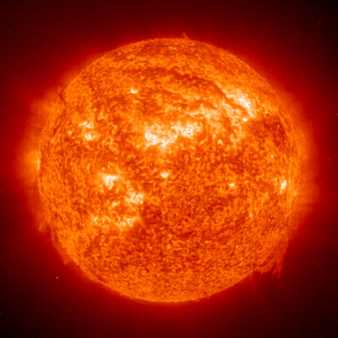
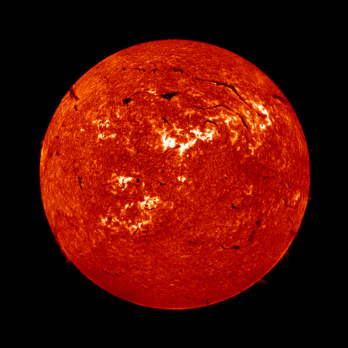
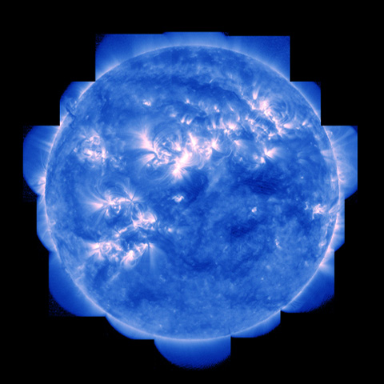
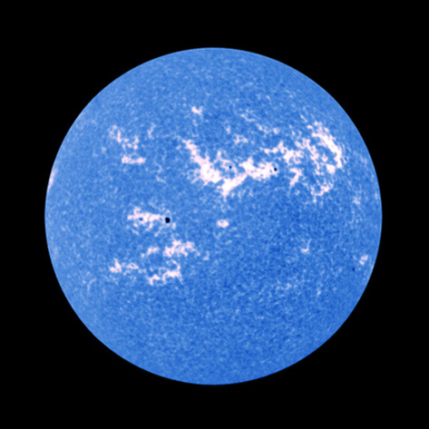
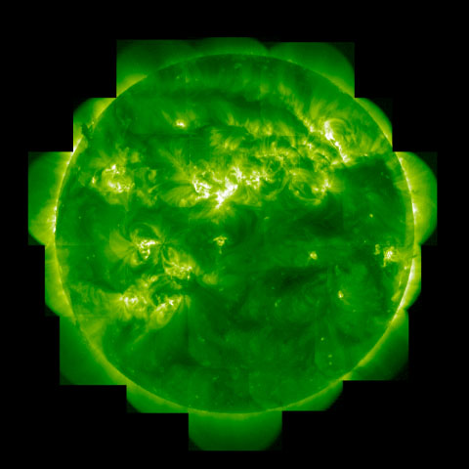
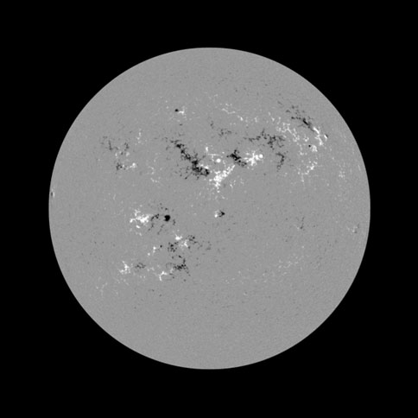
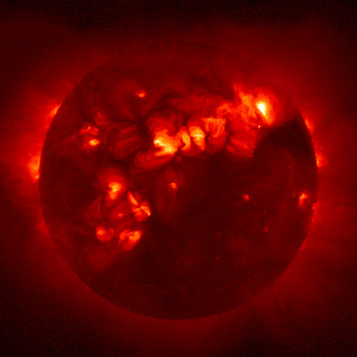
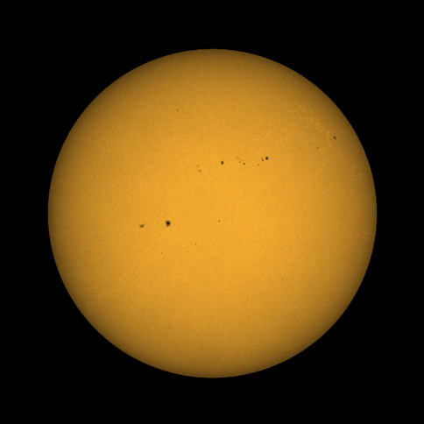
Observational facts
Highly inhomogeneous
Concentrations of magnetic field correspond to high temperature regions in the solar corona

Slide 4
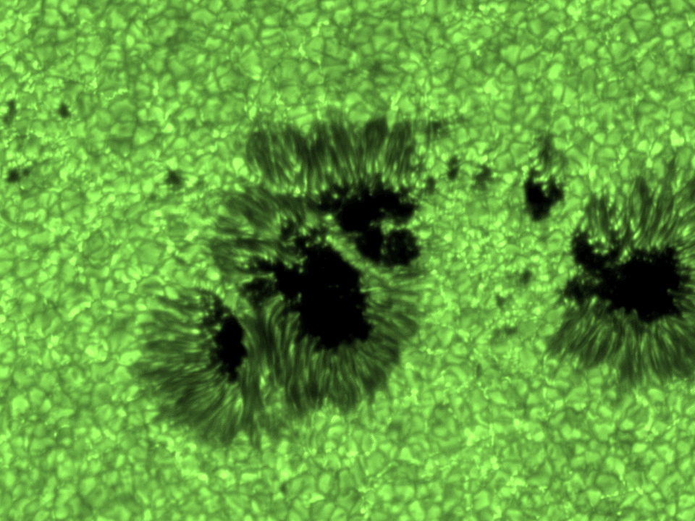
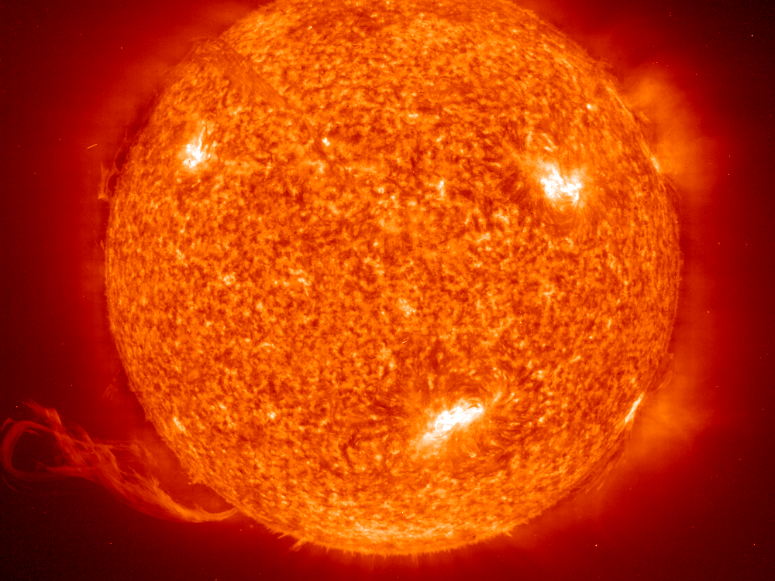
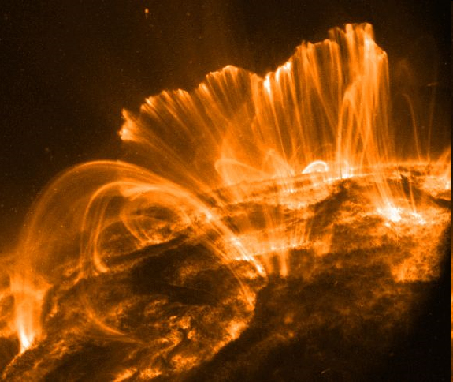
The role of the magnetic field

Slide 5
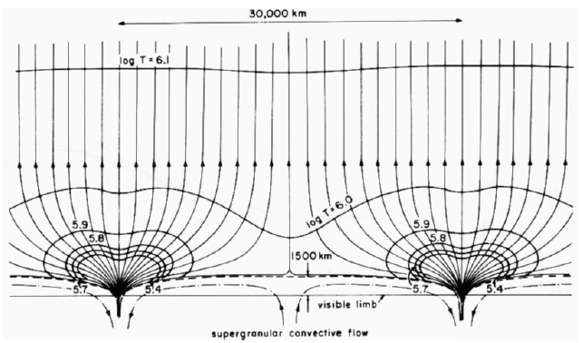
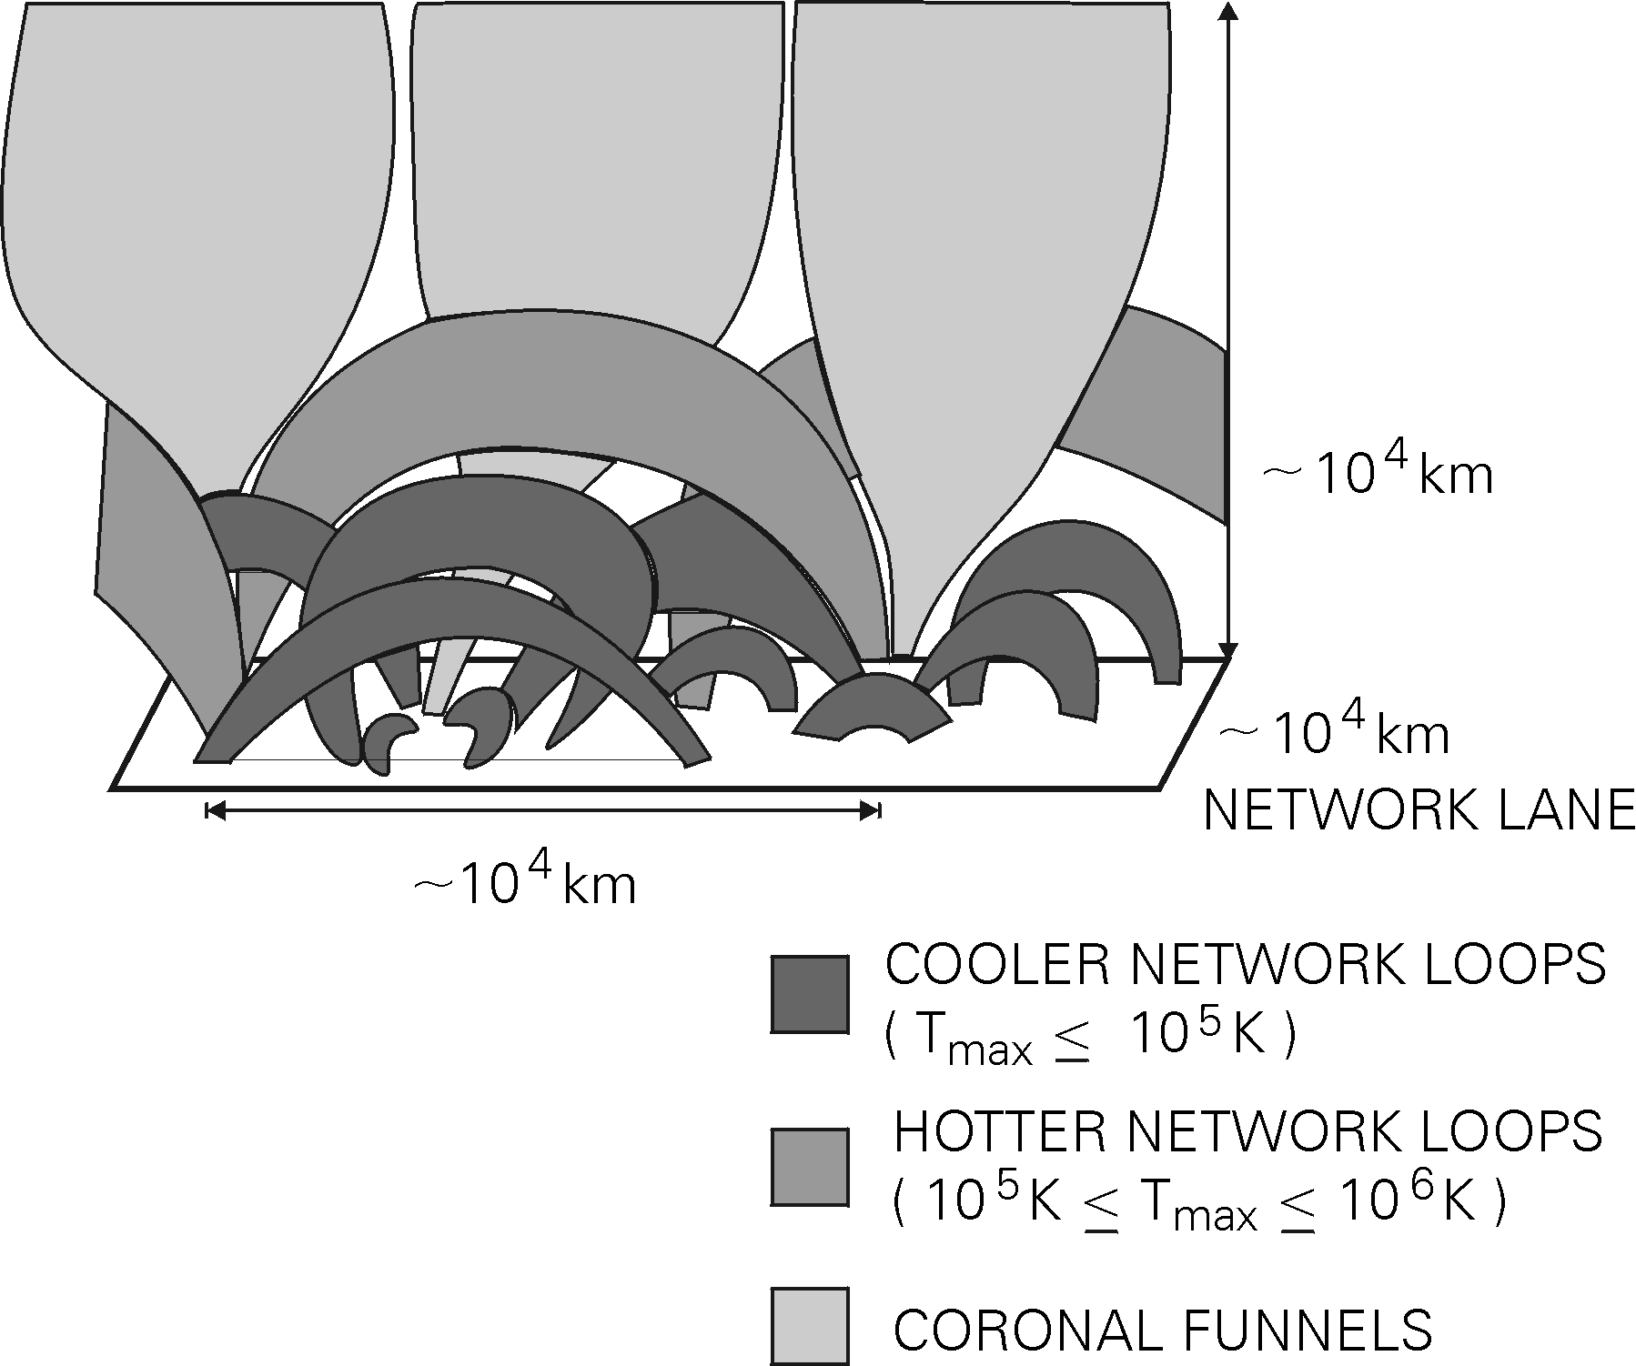
Magnetism on the Sun
Dowdy et al. (1986)
Solar Phys., 105, 35
2D static magnetic model of the transition region by Gabriel (1976)

Slide 6
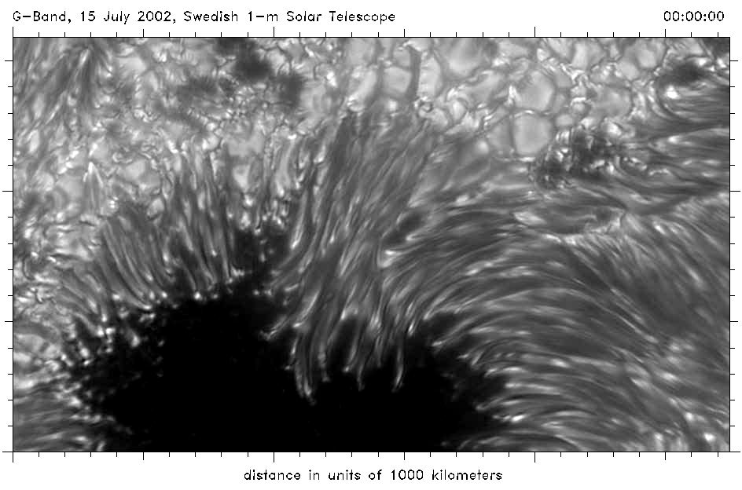
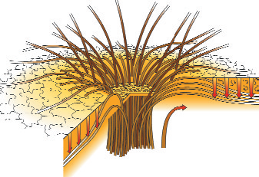
Magnetism in the photosphere
Courtesy of E. Priest (Physics World, February, 2003)
striated penumbra
inclined magnetic field
continuous out/inflow

Slide 7
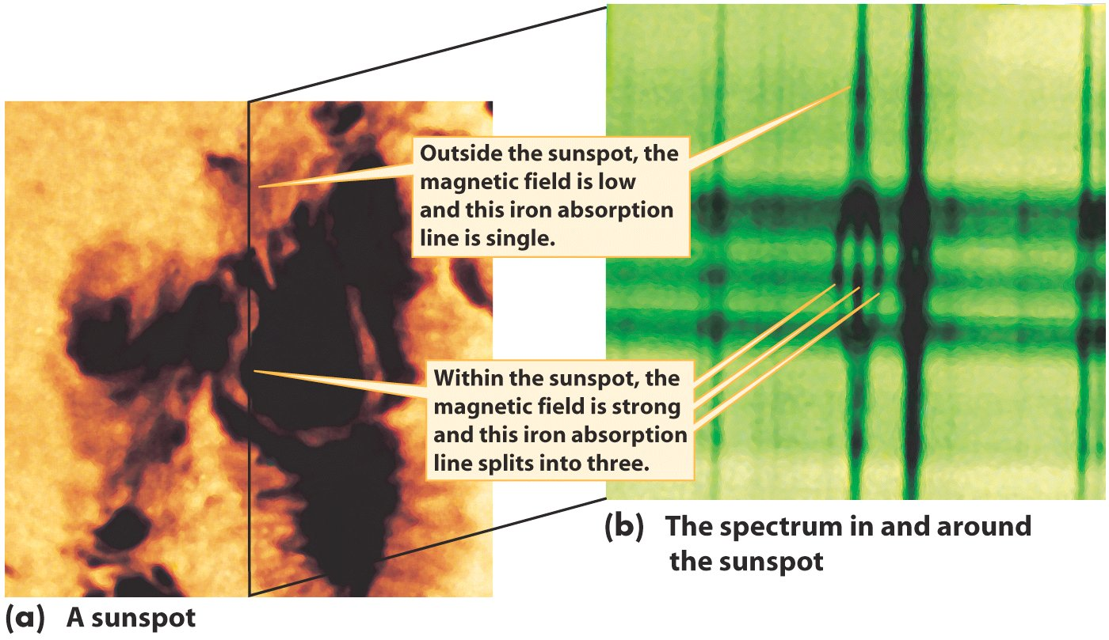
Problems with measuring magnetic field intensity in rarefied regions

Slide 8
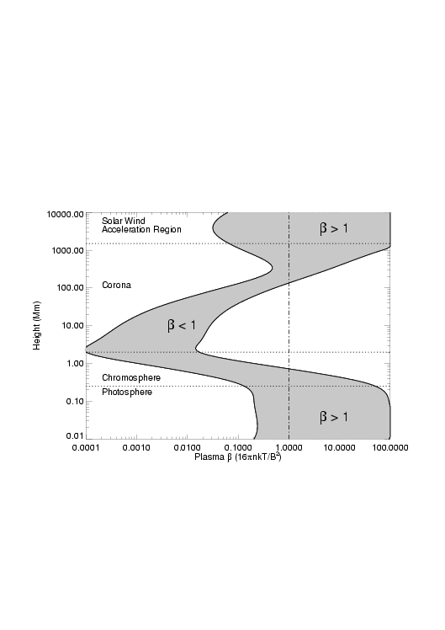
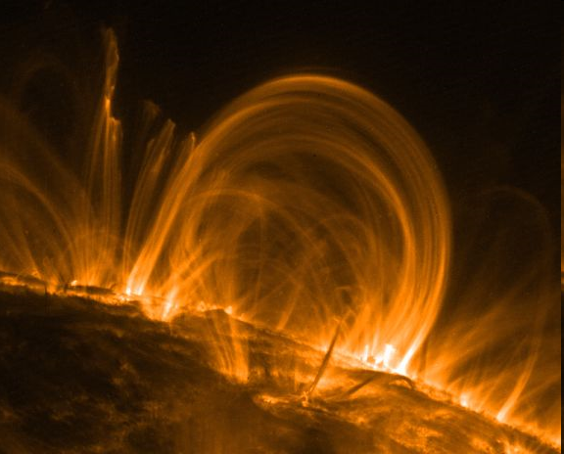
Magnetic field in the corona
The solar corona consists of myriad of loops
Coronal loops are perfect channels for the propagation of waves, flows
Anisotropy helps the propagation along loops rather than across
Gary, 2001

Slide 9
MHD wave theory development
Since the first observations there has been much work to see how the eigenmodes of coronal loops might be affected by plasma inhomogeneities. These can be separated into two main effects.
PLASMA INHOMOGENEITY
RADIAL INHOMOGENEITY
LONGITUDINAL INHOMOGENEITY
AFFECTS DAMPING RATE
AFFECTS EIGENFREQUENCIES AND EIGENMODES
9
Notes:
9

Slide 10
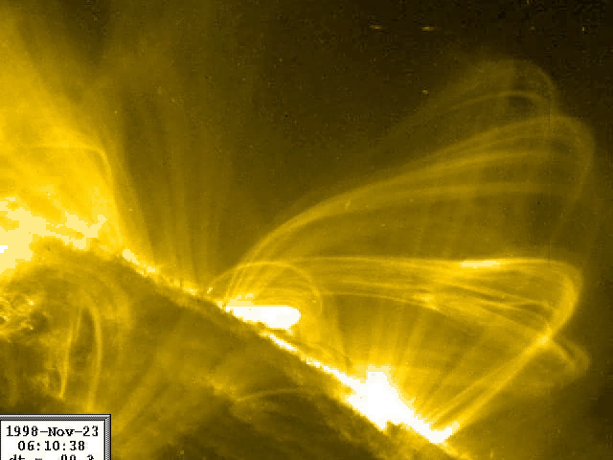
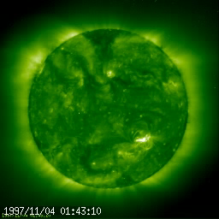
Practical use of waves: Coronal seismology
Local seismology: using waves propagating in magnetic structures (coronal loops, filaments, solar wind, etc)
Global seismology: using waves propagating over very large distances in the quiet Sun, e.g. EIT waves
Roberts et al. 1983, Aschwanden et al. 1999, Nakariakov et al. 1999+many others
Uchida 1970, Ballai et al. 2005, Ballai 2007, Long et al. 2008, Vrsnak et al. 2010, etc.
Although they may look separate aspects, in reality they are strongly correlated

Slide 11
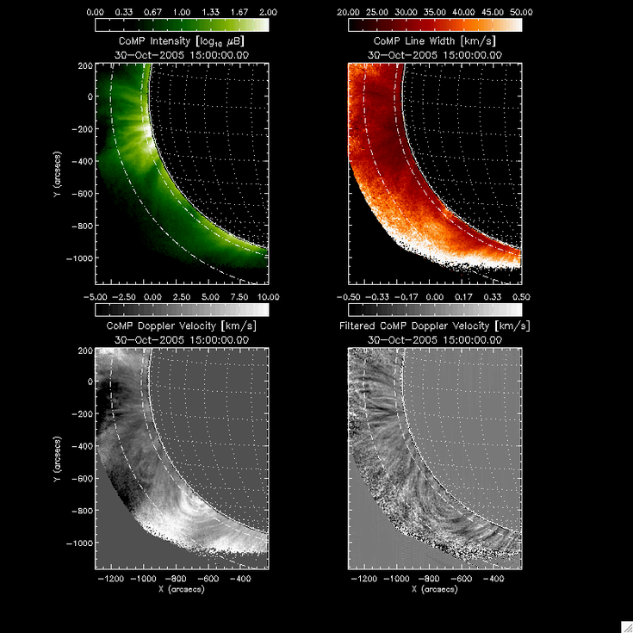
How dynamical is the solar corona?
CoMP measurement
Tomczyk et al. (2007)
The determination of the magnetic field is essential!

Slide 12
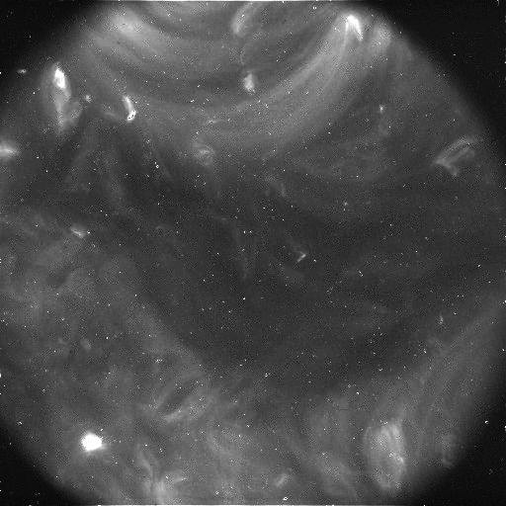

Case study: global and local oscillations in the solar corona--Observational background
TRACE 195 A EUV observations (1.5 MK)
Limited FOV (8.5’x8.5’), with spatial resolution of about 1’’
Typical temporal resolution ≈1 min
Observed the effect of a GOES C2.9 flare occurring outside the FOV on 13 June 1998
This event was associated with a halo CME observed in WL by LASCO C2, with a leading edge propagating with 190 km/s (Delanee 2000)
The maximum flare intensity occurred between the eastern part of the main negative polarity and the western part of the main positive polarity regions of AR 8237
The standard calibration/correction packages available in the SolarSoft library were used: removal of spikes from cosmic rays, normalization of frames to a constant exposure time, de-rotation of image sequences, etc.

Slide 14
Observational characteristics
The global disturbance was observed to have wave-like behaviour, with periods of around 400 s (Ballai et al. 2005)
For a better/accurate analysis some preliminary work is needed.
First, a segment of the loop between the footpoint and apex was passed through a Laplacian filter to sharpen the images and make the edges more pronounced
A lower intensity threshold was applied to the data to remove contributions from the underlying quiet Sun
To emphasize the edges and remove shallow intensity gradients, we used a binary format for mapping: all pixels of values above the lower flux intensity threshold were assigned a value of 1, below the threshold a value of 0
All images were rotated 45 degrees clockwise to bring the southern edge of the loop was made parallel to the x-axis, and displacement is only in the y direction

Slide 15
What can we do with the observations
1. Determine the characteristics of the loop
Assume a semi-circular loop (L=πD/2), where D=46.4±1.8 Mm, i.e. L=72.9±2.8 Mm
The density of the loop can be determined using a DEM technique by comparing the line intensities detected at different wavelengths. Here we apply the filter-ratio method
Assume a structure seen in, e.g. 171 A and 195 A bandpass will be isothermal with the associated temperature falling between the two peaks of the temperature response function of the instrument, so we obtain EM=(4±0.2)x10²⁵ cm⁻⁵, averaged over the 30 pixel loop, i.e. this is the emission integrated over the entite LOS.
Density can be calculated using
Assuming a cylindrical loop, and using the FWHM to estimate the loop cross section, we obtain a loop depth of d=8.1 pixels=(29.2±3.6)x10⁷ cm, i.e. n_{e}=(3.7±2.3)x10⁸ cm⁻³

Slide 16
What can we do with observations?
2. Characteristics of dynamical phenomena
It is clear that the loop under investigation supports the propagation of two transversal waves.

Slide 17
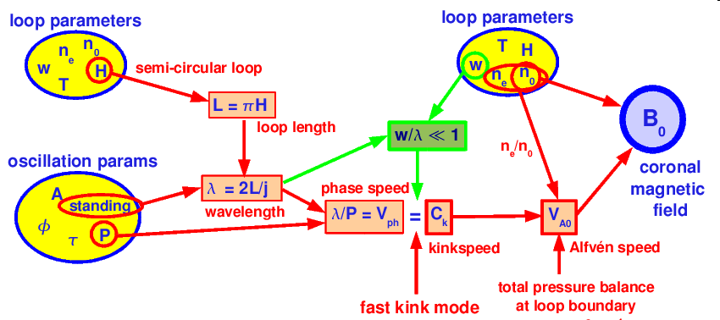
How can we use observations (seismology)

Slide 18
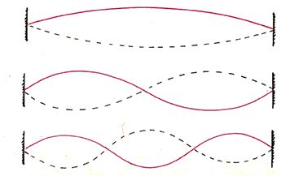
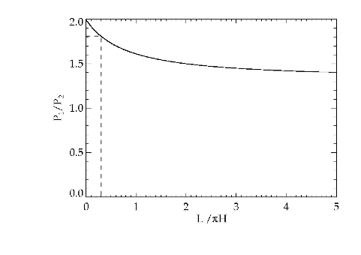
How can we use observations (seismology)
In a homogeneous string/loop/waveguide the period of standing oscillations are clearly connected, i.e. P1/P2=2, P1/P3=3, etc
In an inhomogeneous medium these ratios are distorted, in general inhomogeneity makes the ratio below 2. The alteration is a measure of inhomogeneity
Inhomogeneity comes from gravitational stratification. Assuming a hydrostatic equilibrium ρ=ρ₀exp[-z/H], but H is unknown
In our case P1/P2=1.82±0.02, so H=73±3 Mm
Again, assuming a hydrostatic equilibrium H=47 (T/10⁶ K),
i.e. T=1.5±0.6MK

Slide 19
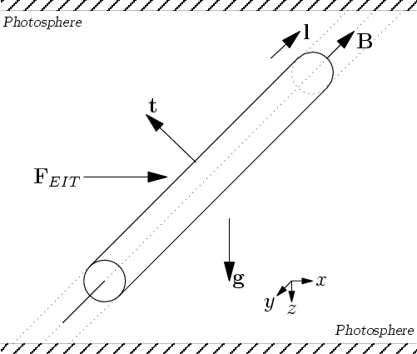
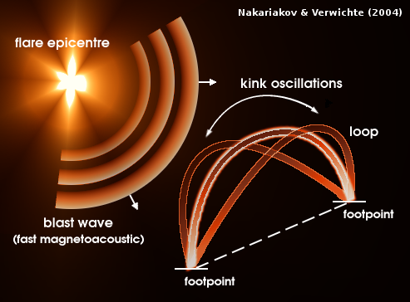
How can we use observations (seismology)
The observed wave is a fast m.a. kink oscillations, i.e. periodic motion around its symmetry axis
On the basis of the period of the fundamental mode (501 s), it is possible to calculate the kink speed c_{K}=2L/P₁=291±8.2 km/s
But the kink speed is after all is an Alfvenic speed, i.e.
However, this interpretation is not unique
Any signal in a loop should contain information also about the driver (here a global EIT wave)

Slide 20
Again…seismology
The governing equation
The kink speed and the cut-off frequency appear naturally

Slide 21
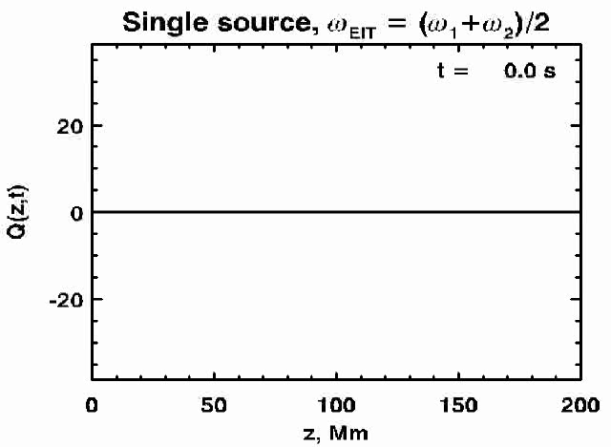
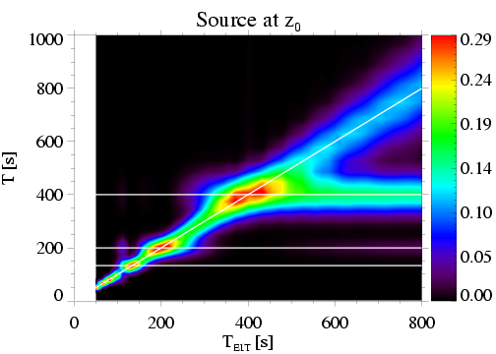
Seismology…again
The result is a sequence of superimposed signals of the form

Slide 22
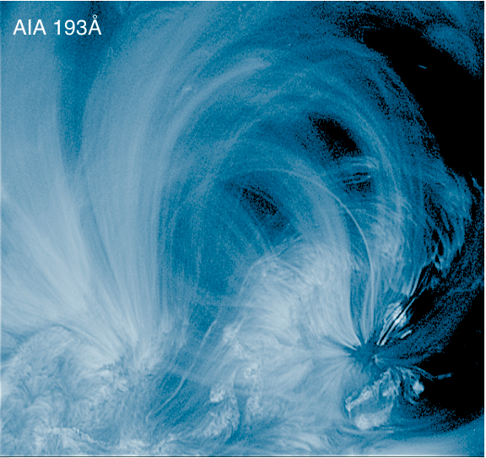
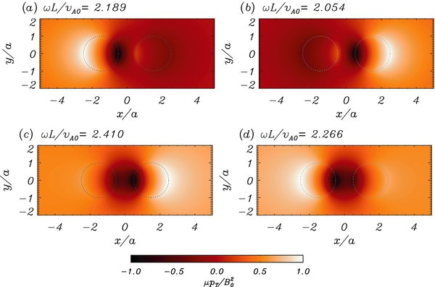
Seismology again
But
However, the two periods could belong to adjacent structured that are below the spatial resolution of TRACE, i.e. to two strands that are very close to each other.
We can estimate d/R=2±0.11
Using the technique developed by van Doorselaere et al. (2008) we can find B=2.6±0.4 G

Slide 23
Conclusions
Big data is great, but their interpretation is not always obvious
Waves (and in general dynamics) are very good for diagnostics, however the diagnostic possibility is strongly influenced by the temporal/spatial resolution
However, every instrument (by default) is an improvement of any existing ones, so there is hope.
Nevertheless, sadly small scale dynamics (turbulence, phase mixing, reconnection, resonance, etc.) will always be beyond any resolution, i.e. indirect methods will be needed.

