Slide 1
Semianalytic modeling of galaxy spectra
Dezső Ribli, Supervisor : László Dobos

Slide 2
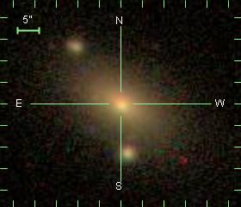
Spectral Energy Distribution (SED) of galaxies
Studying distant galaxies:
Structure is not resolved
Not much information in 2D pictures
Especially the very distant ones
the more distant, the more interesting
galaxy picture here

Slide 3
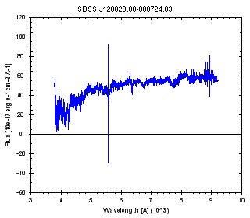
Spectral Energy Distribution (SED) of galaxies
Studying distant galaxies:
Structure is not resolved
Not much information in 2D pictures
Especially the very distant ones
the more distant, the more interesting
galaxy picture here
More information in SEDs!
e.g.: redshift (distance)

Slide 4
Spectral Energy Distribution (SED) of galaxies
The origin of galaxy SED:
Integrated light of all objects in the galaxy
stars
active nucleus
emission, and absorption of interstellar matter (ISM)
Information in galaxy SED:
redshift
age
velocity dispersion of stars
amount of ISM
more?

Slide 5
Stellar Population Synthesis model (SPS)
Assumptions:
SED of a star is given if we know:
initial mass
initial chemical composition
age
SED is given by stellar evolution models
universal Initial Mass Function (IMF)
the most important
and debated

Slide 6
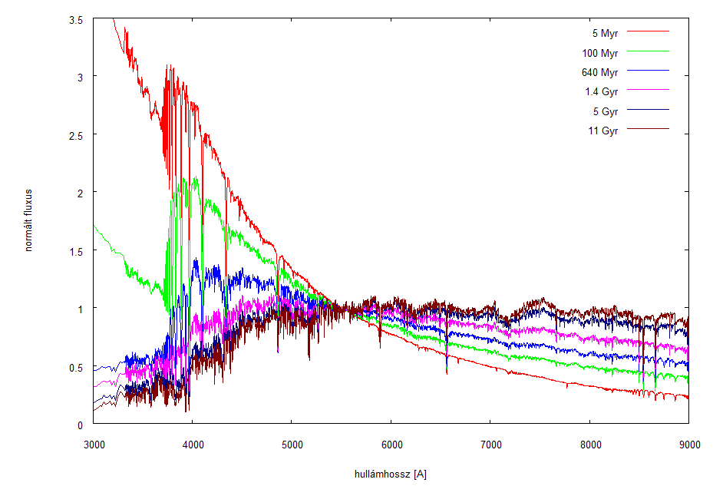
Stellar Population Synthesis model (SPS)
Stellar Population:
SED of stars + IMF : Population of stars
variables: age, chemical comp.

Slide 7
Stellar Population Synthesis model (SPS)
Stellar Population:
SED of stars + IMF : Population of stars
variables: age, chemical comp.
Stellar Population Synthesis:
Multiple populations - > GALAXY
variables:
ages of populations (star formation history)
chemical composition

Slide 8
Stellar Population Synthesis model (SPS)
Other factors:
redshift
velocity dispersion
convolution of spectra with Gauss
Interstellar matter simple model
simple model is needed
there are very complicated ones, there is not enough information in the spectra to account for these complicated models

Slide 9
Computation
Isochrone synthesis:
Convolution of SSP-SEDs, and SFH
~4000 wavelengths, ~200 timesteps
Age dependent effect of ISM
Velocity distribution: convolution with a Gaussian
Interpolation in chemical composition

Slide 10
Computation on GPU:
~4000 (almost) independent points
massive parallelization
Interpolation between original models, convolution in time, convolution in wavelengths all can be done in parallel:
Performance:
GALAXEV: seconds
SPS-FAST (c++, OpenCL):
GTX 670: 0.3 ms
Intel core i7-2600: 2.5 ms

Slide 11
Fitting
5-8 parameters
Degenerate parameter space (age-chemical composition)
Model needs refinement

Slide 12
Fitting methods
In practice now:
with pre-generated sample galaxies
small discrete grid
only reduced parameters used (spectral indices)
approximation: MOPED
MCMC fitting:
Explores the parameter space
Robust
Shows degenerations, and other problems
~50000 points needed, (~15 seconds )

Slide 13
MCMC SPS model fitting example
Based on GALAXEV:
Bruzual and Charlot models
Exponential decay in SFH
2 component Charlot and Fall ISM model
Random high SNR galaxy from SDSS spectral survey
50000 iterations

Slide 14
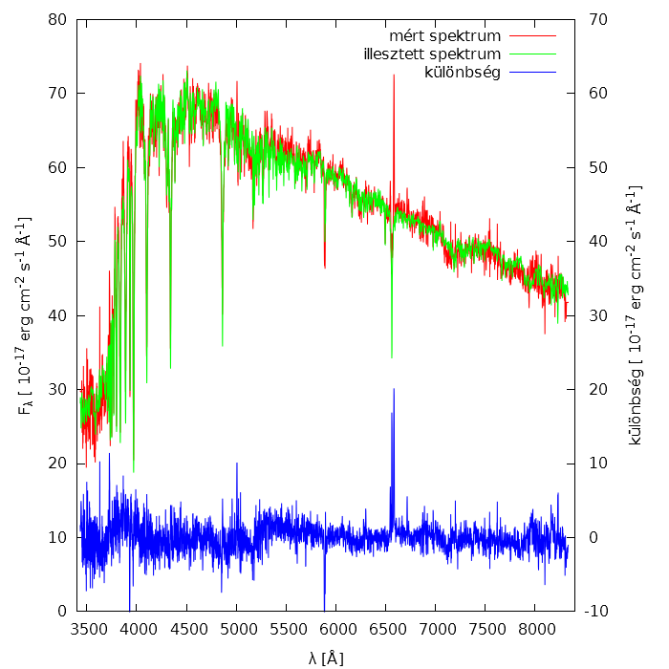
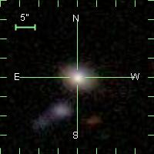
Results

Slide 15
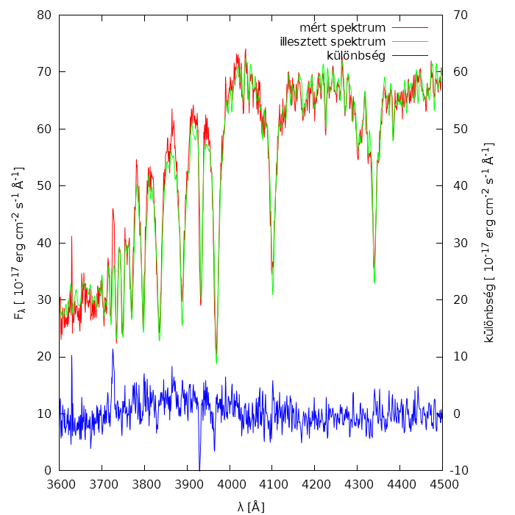
Results

Slide 16
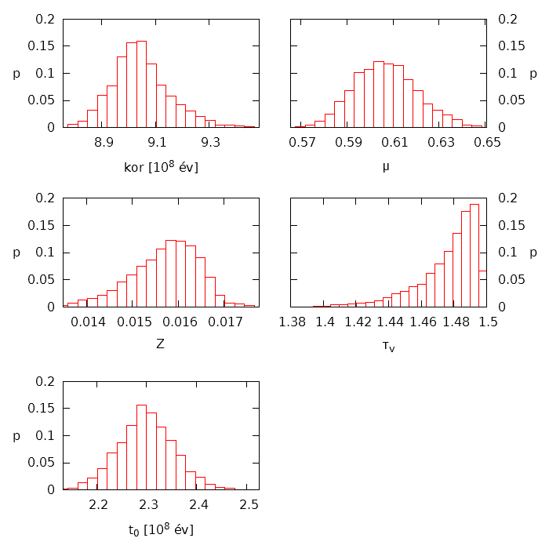
Results

Slide 17
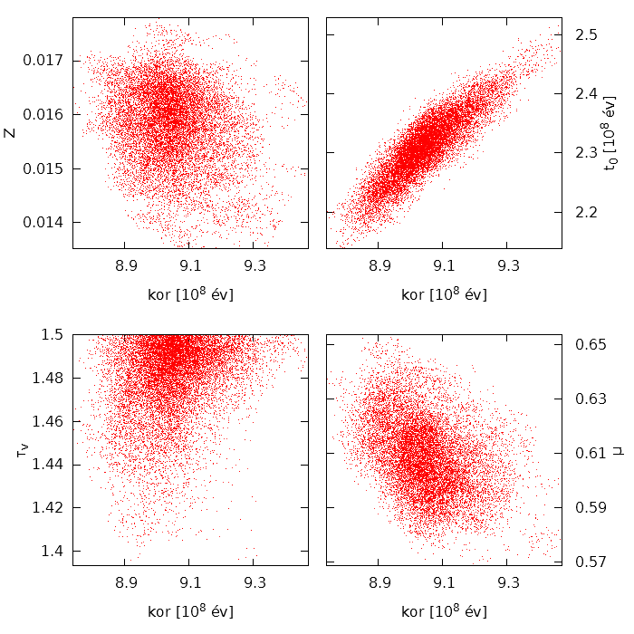
Results

Slide 18
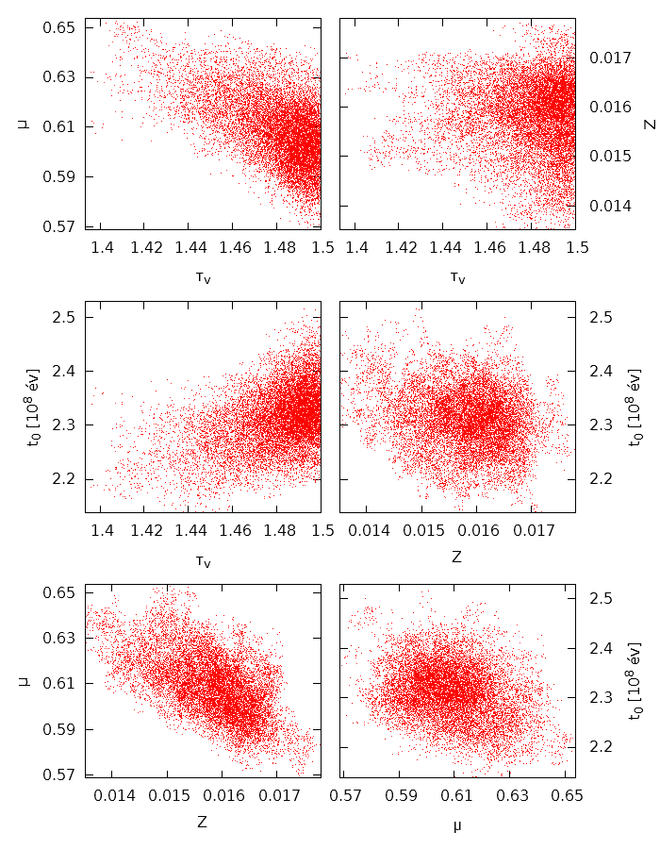
Results

Slide 19
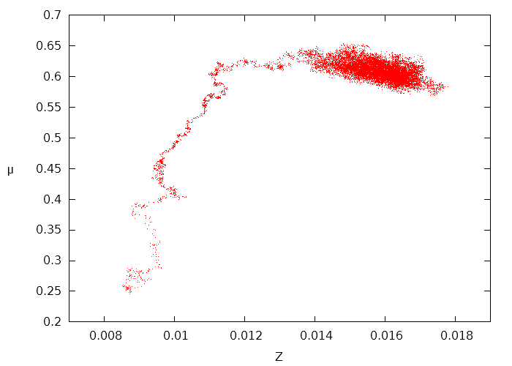
MCMC
Burn-in

Slide 20
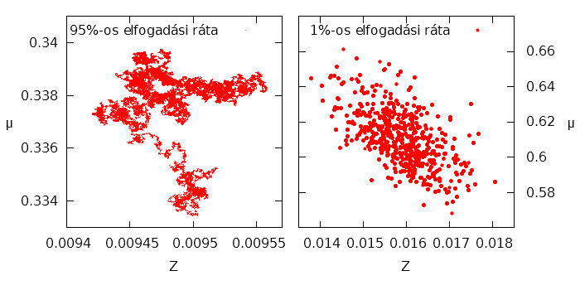
MCMC

Slide 21
Usage, goals
Usage:
Analysis of big databases
improvement of SPS models
detailed inspection of a galaxy in seconds
Goals:
introduce it to the researches of the field
incorporate different SPS models

Slide 22
Thank you for your attention!
The research was supported by the Hungarian OTKA grants 103244 and 114560

