Slide 1
X-ray and gamma-ray observations of Rotation Powered Pulsars
Oleg Kargaltsev
(George Washington University)
George Pavlov (Penn State)
Martin Durant (Univ. of Toronto)
Bettina Posselt (Penn State)
Blagoy Rangelov (George Washington University)
NEWCOMPSTAR 2015

Slide 2
Isolated neutron stars - no accretion
Diverse population:
Rotation powered pulsars (RPPs)
Rotating radio transients (RRATs)
Central Compact Objects (CCOs) in SNRs
Thermally emitting NSs (TEINSs = XDINSs = XINSs = RQINs)
Anomalous X-ray pulsars (AXPs) - Sandro Mereghetti’s talk
Soft gamma repeaters (SGRs) - Sandro Mereghetti’s talk
What (fundamental?) property makes them different?
How these phemenologically different NSs can be related?

Slide 3
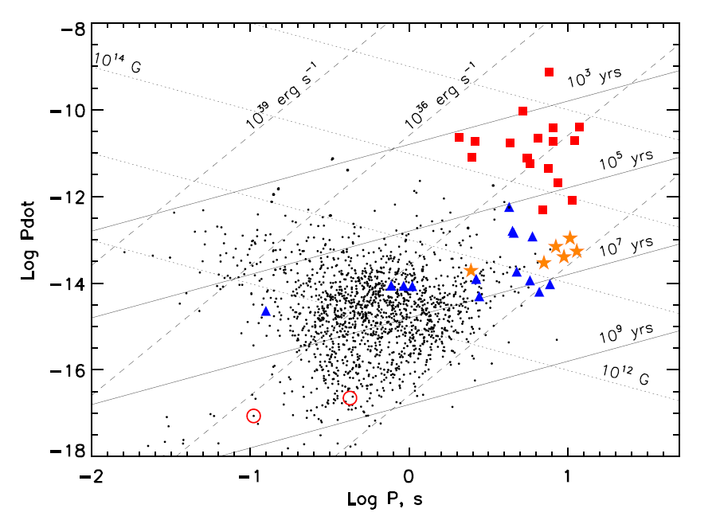
P-Pdot diagram for pulsars
magnetars
high-B TENSs
RRATs
RPPs
low-B TENSs
Notes:
8

Slide 4
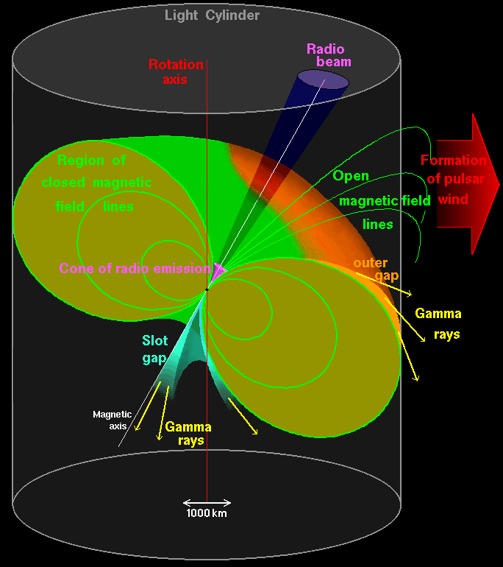
Rotation-Powered Pulsars (RPPs):
Neutron stars (NSs) whose radiation is powered by
loss of NS rotation energy (via creation and acceleration
of e+e- pairs in strong magnetic field, B~10¹¹ – 10¹³ G)
Spin-down power
Edot = dE_{rot}/dt = 4π²I Pdot P⁻³
L = η Edot
L – luminosity
η – radiative efficiency
Detected RPPs:
~2000 in radio
~10 in optical (+NIR+UV)
~130 in X-rays
~170 in γ-rays
Notes:
7

Slide 5
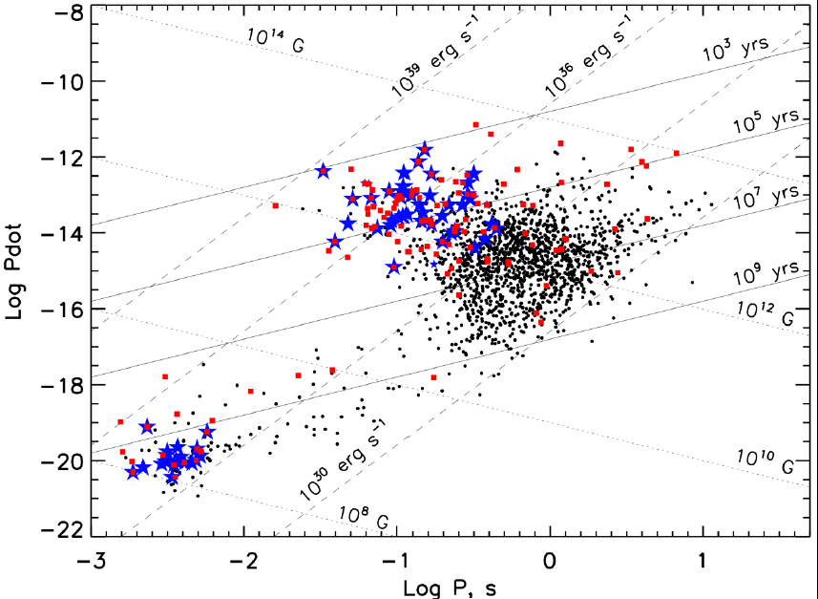
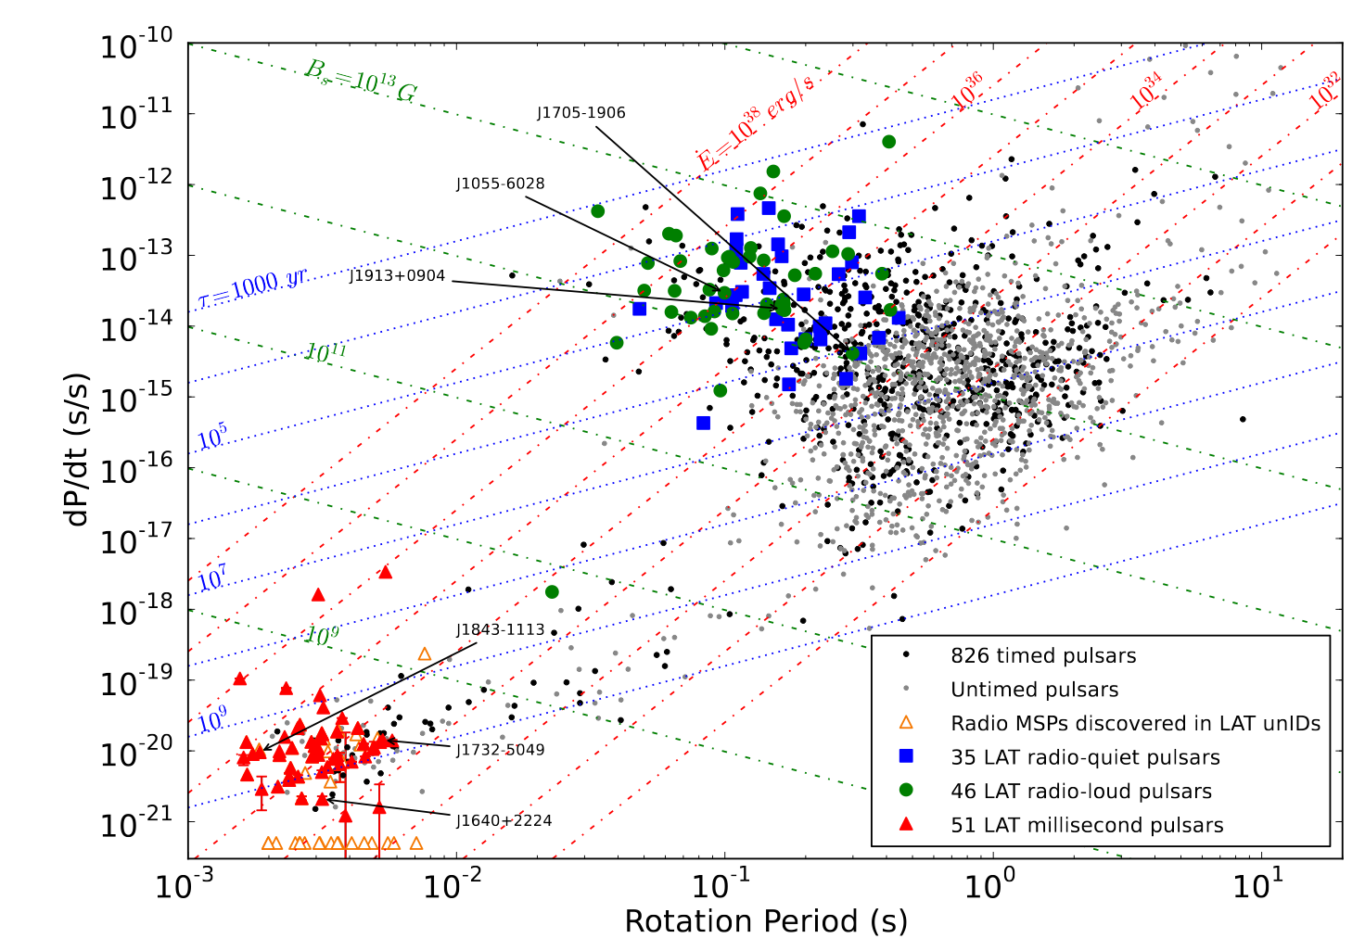
RPPs detected in X-rays (red dots) and γ-rays (blue stars)
RPPs detected in γ-rays (Hou et al. 2014)

Slide 6
RPPs exist due to constant supply of relativistic e-e+ into magnetosphere.
X-rays from magnetosphere, PWN, and NS surface
fast rotation + strong magnetic field
electric field
relativistic e+e- in
magnetosphere
pulsar wind
magnetospheric emission
(synchrotron & curvature)
heated polar caps
(thermal)
PWN
(synchrotron)
hot bulk NS surface
(thermal)
X-rays
Notes:
9

Slide 7
Emission components in RPPs:
Nonthermal – seen from radio to gamma-rays
Magnetosphere (pulsed)
PWN (if the PWN is not resolved; unpulsed)
Thermal – seen from UV to soft X-rays
Bulk NS surface (heat is stored/produced inside NS)
Hot polar caps (heated by magnetospheric activity)
Notes:
10

Slide 8
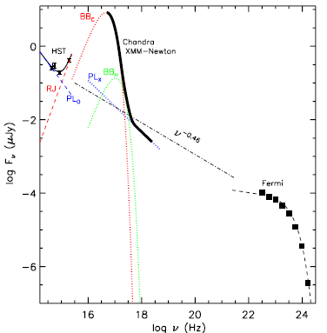
Multiwavelength spectra of RPPs
Example: Spectrum of PSR B1055-52 (τ = 535 kyr,
Edot = 3×10³⁴ erg/s) from optical to gamma-rays
Optical, hard X-rays, γ-rays:
magnetospheric emission –
~ power law with exponential cutoff at GeV energies
F_{ν} (ν)
UV, soft X-rays:
thermal emission from NS
surface – resembles black-
body, seen as a“hump” on
the magnetospheric
spectrum
(Mignani, Pavlov, Kargaltsev 2011)

Slide 9
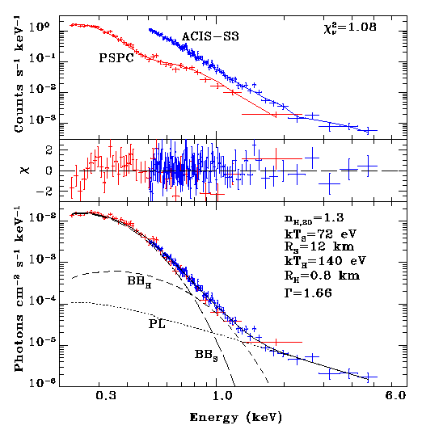
Zoom-in on X-ray spectrum of PSR 1055-52
(Chandra+ROSAT)
Two thermal
components:
Soft thermal:
72 eV, 12 km
Hard thermal:
140 eV, 0.8 km
Magnetospheric
component:
power-law,
photon index
Γ = 1.7
(Pavlov et al. 2002)

Slide 10
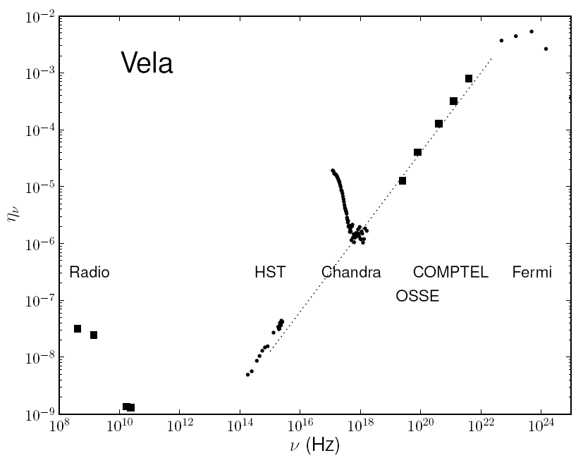
Another example: Spectral efficiency of the Vela pulsar
(τ = 11 kyr, Edot = 7×10³⁶ erg/s) from radio to gamma-rays
η_{ν} = ν F_{ν} 4πd²/ Edot -- “spectral efficiency”
thermal hump
Three main components: coherent magnetospheric (radio), incoherent
magnetospheric (NIR through gamma-rays), thermal from NS surface,
including polar caps (FUV – soft X-rays)

Slide 11
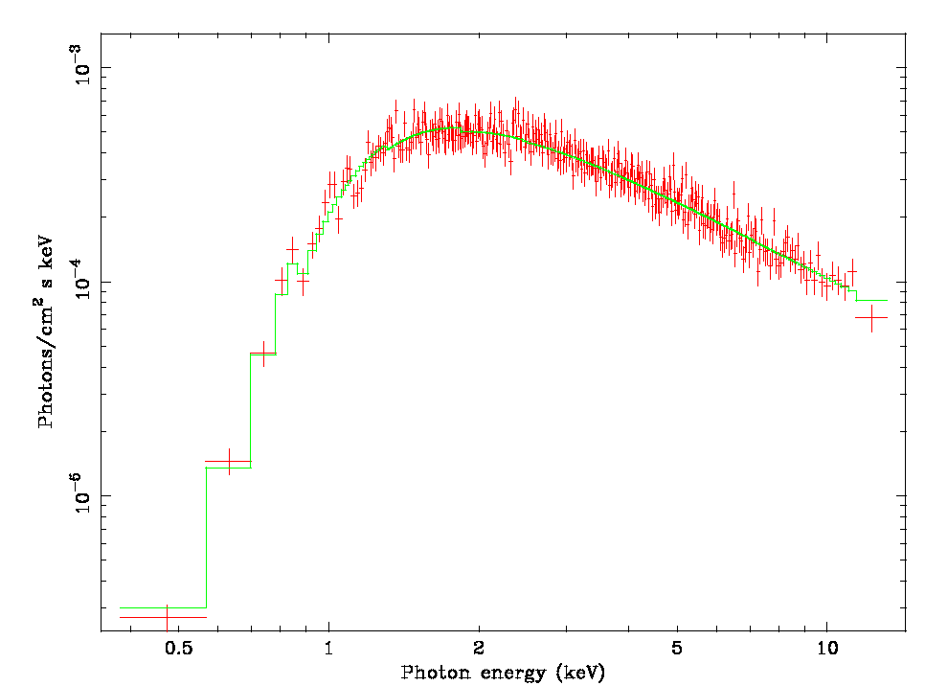
In some young RPPs the magnetospheric component buries the thermal one. Example: XMM spectrum of PSR B1509-58
(τ = 1600 yrs, Edot = 1.8⋅10³⁷ erg/s)
No “thermal hump”
Photon index
Γ = 1.3
Absorbing column
N_{H} = 9⋅10²¹ cm⁻²

Slide 12
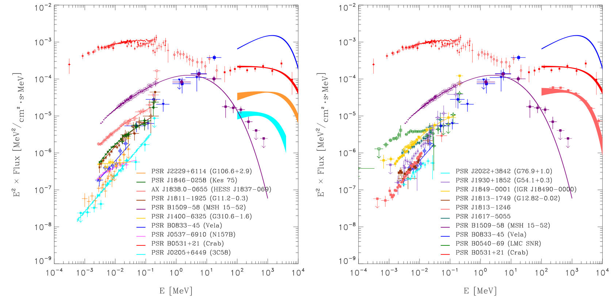
Hard X-ray properties of pulsars
Kuiper and Hermsen (2015)
There can be bright gamma-ray pulsars that are dim in hard X-rays.
Example: PSR J1833-1034 in SNR G21.5-0.9
Different geometry of the beams in gamma-rays and hard X-rays or different components?

Slide 13
Non-thermal (magnetospheric) X-ray emission from RPPs

Slide 14
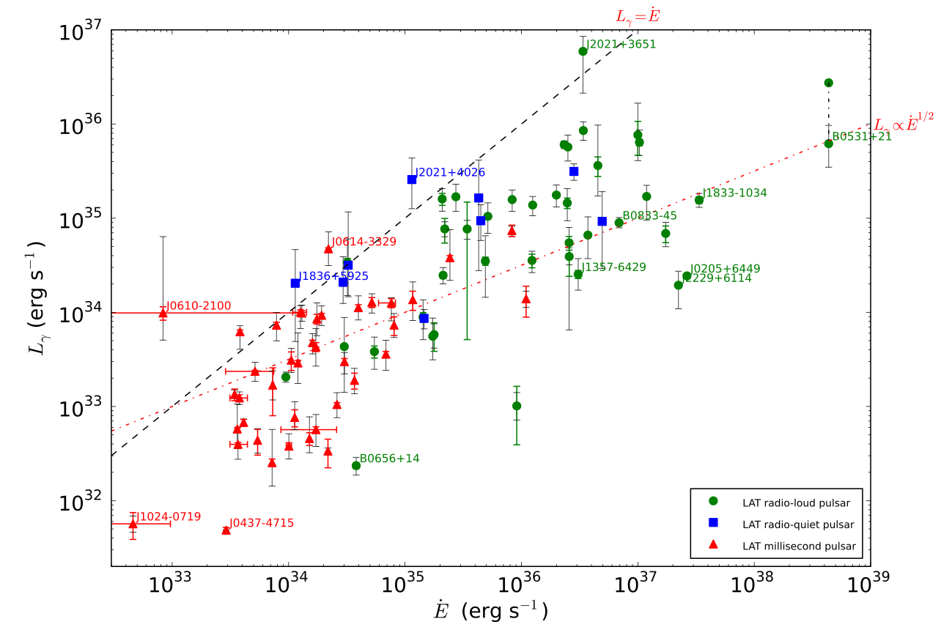
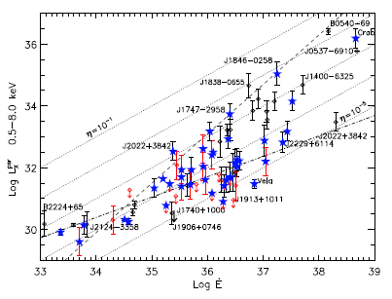
X-ray luminosity and efficiency of magnetospheric emission vs. Edot
L_{x} generally grows with Edot (as expected) but η_{X} shows a very large
scatter, η_{X} ~ 10⁻⁶ – 10⁻² →  L_{x} depends not only on Edot !
Abdo et. Al. 2012
Kargaltsev. et al 2012
There may be the change in the correlations between around
Edot~10³⁴-10³⁵ erg/s
Notes:
MOVE

Slide 15
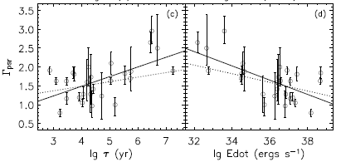
Nonthermal X-ray spectra of RPPs
Magnetospheric component: usually F_{ν} ~ ν ^{̵Γ+1}
Slopes (photon indices)
Γ ~ 1 ̵ 3
Spectra tend to become
steeper (softer) with
increasing age
(i.e., decreasing Edot)?
However, photon indices
may be overestimated
for old pulsars (if there is
a thermal polar cap
component).
(Li, Lu, Li 2008)
Magnetospheric component is probably synchrotron radiation generated by power-law distribution of accelerated electrons
(p = 2Γ-1 ~ 1 – 5) in the “outer (slot) gap” (B ~ 10⁶ – 10⁸ G).
See, however, recent critique in Kisaka & Tanaka 2015
Notes:
MOVE

Slide 16
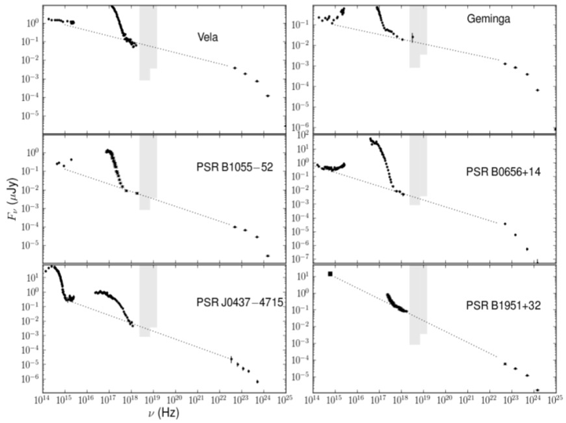
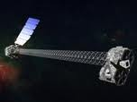
Multiwavelengths spectra of nearby middle-aged bright pulsars
Shaded areas
are the NuStar
sensitivity limits
and energy range
Durant et al. (2011)
Questions: What is the physical mechanism(s) of the multiwavelength nonthermal emission? Where in the magnetosphere it is produced? Do different frequencies correspond to different regions of magnetosphere or different emission mechanisms?

Slide 17
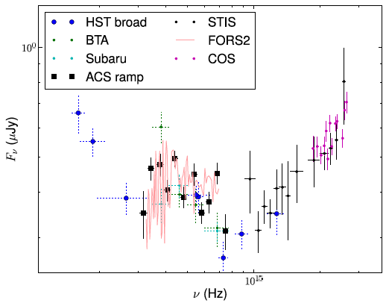
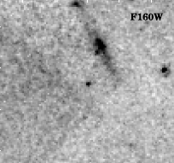
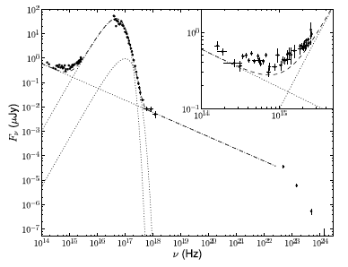
A nearby neutron star PSR B0656+14: Multiwavelength observations
Non-monotonic, NIR through
far-UV spectrum
The field of B0656+14 in the
near-infrared.
Multiwavelength spectrum:
Durant et al. (2011) - photometry
Zharikov et al. (2006) - spectroscopy
Durant et al. 2011

Slide 18
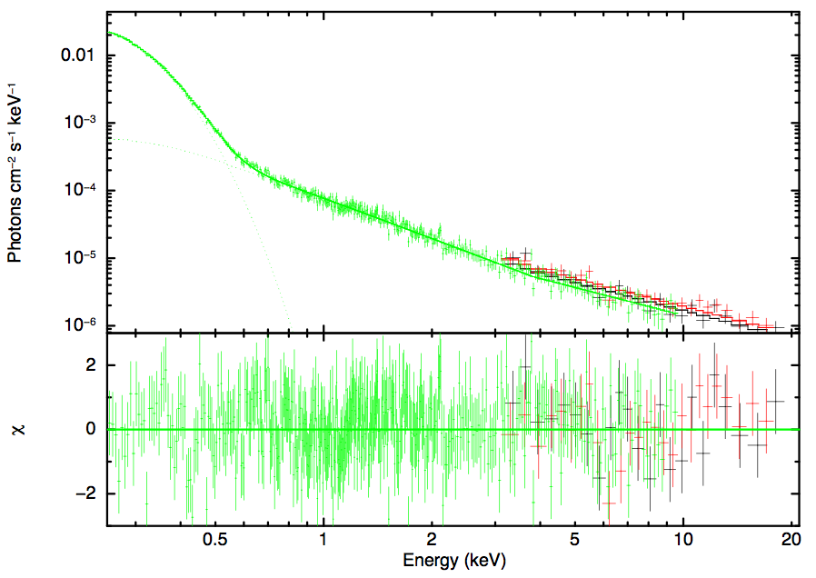
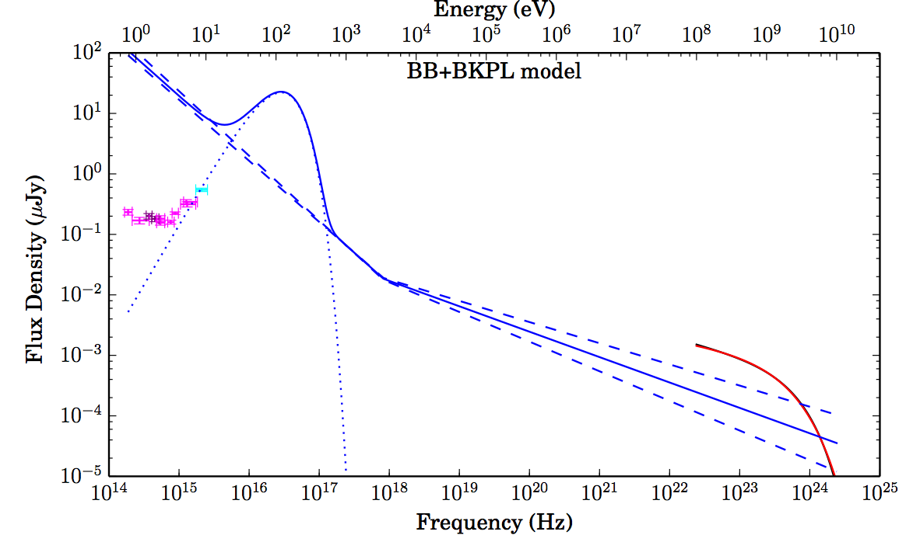
Green – XMM
Red - Nustar
Gotthelf et al. 2014
Gotthelf et al. 2014

Slide 19
Thermal emission from the bulk of NS surface

Slide 20
Heat is stored (produced) inside the NS:
Residual heat from NS formation: Amount of heat decreases with age (NS cooling via neutrino and photon emission)
Internal heating (e.g., magnetic field decay, frictional heating,
rotochemical heating, etc): Additional heat is supplied throughout
NS lifetime.
Is seen from NSs of all types; shifts from X-rays to UV-optical
with age; optimal age for X-ray observations: 10 kyr – 1 Myr.
Notes:
17

Slide 21
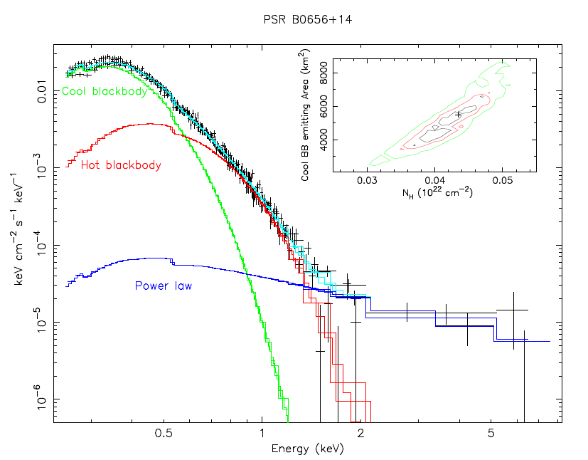
Thermal soft (bulk surface) and thermal hard (polar
cap) components: Usually fitted by blackbody spectra.
Example: XMM spectrum of PSR B0656+14 (τ = 110 kyr, Edot = 3.8×10³⁴ erg/s
kT_{S} = 55 eV, R_{S} = 20 km
kT_{H} = 110 eV, R_{H}=1.8 km
Γ = 2.1
Typical blackbody
temperatures:
kT_{S} = 30 – 200 eV
(seen up to t ~ 1 Myr)
kT_{H} ~ 100 – 400 eV
(possibly seen in old
RPPs also)
(De Luca et al. 2005)

Slide 22
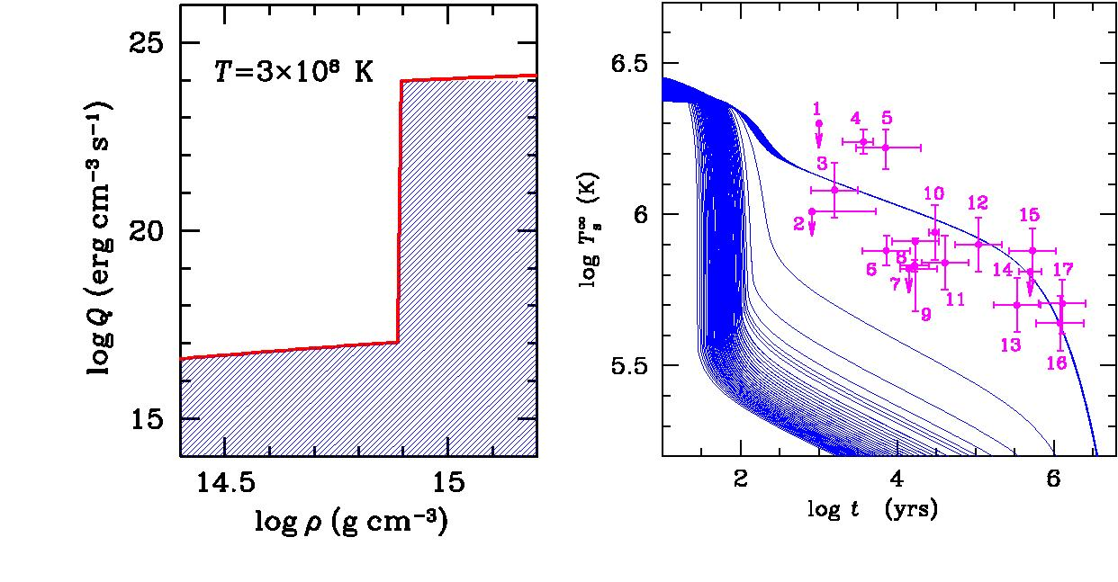
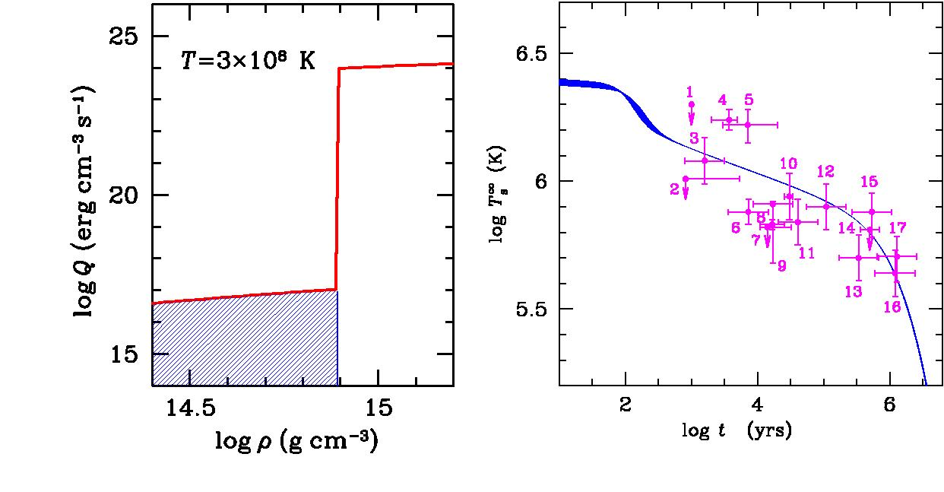
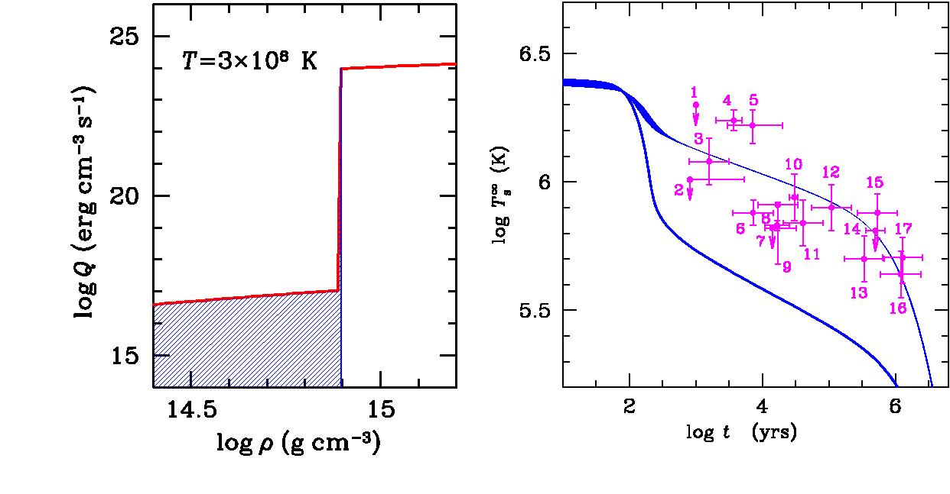
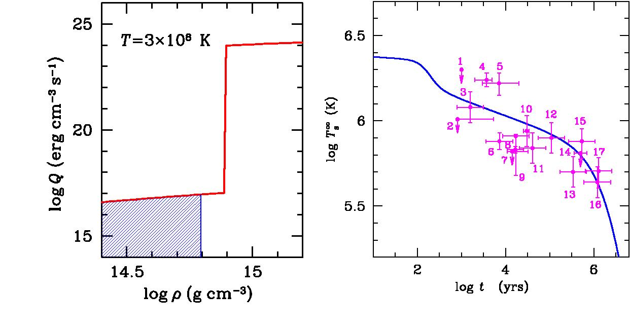
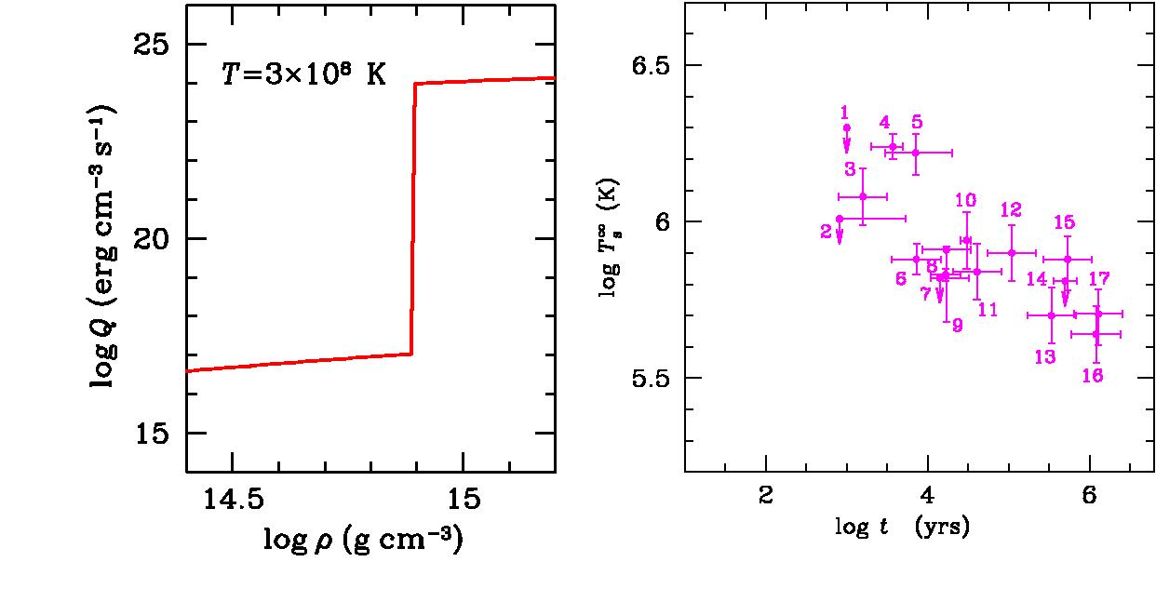
Cooling evolution depends on the properties internal NS matter
(equation of state, superfluidity) and NS mass (core density)
ν emissivity vs. density
Temperature vs. age
1=Crab
2=PSR J0205+6449
3=PSR J1119-6127
4=RX J0822-43
5=1E 1207-52
6=PSR J1357-6429
7=RX J0007.0+7303
8=Vela
9=PSR B1706-44
10=PSR J0538+2817
11=PSR B2234+61
12=PSR 0656+14
13=Geminga
14=RX J1856.4-3754
15=PSR 1055-52
16=PSR J2043+2740
17=PSR J0720.4-3125
Modified and direct URCA
(Courtesy of D. Yakovlev)
Notes:
18

Slide 23
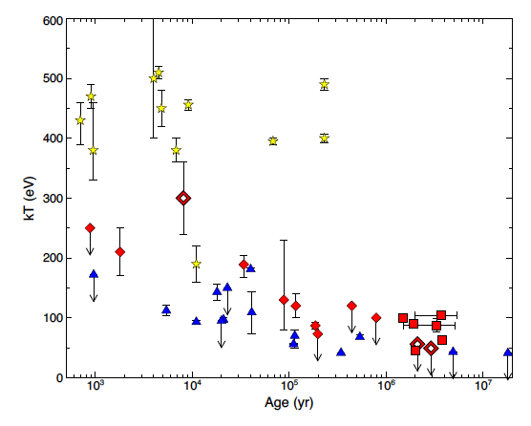
The above cooling models neglect effects of magnetic fields, which may be substantial if (internal) B >10¹³⁻¹⁴ G at the present time or it was large in the past.
Indications of positive correlation between surface
temperature and magnetic field (Pons et al. 2007).
magnetars
high-B pulsars
TEINSs
Olausen et al. 2013
normal RPPs

Slide 24
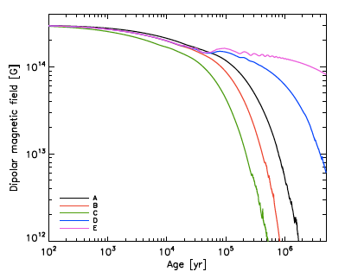
RPPs could have higher magnetic fields at younger ages
due to magnetothermal evolution (Aguilera et al. 2008,
Pons et al. 2009, Vigano et al. 2013)
(Vigano et al. 2013)

Slide 25
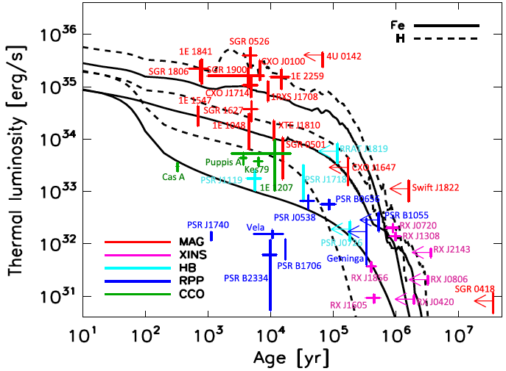
This leads to hotter NS surface due to Joule dissipation, with
different temperatures at the magnetic pole and equator
(Vigano et al. 2013)
Note the uncertainties are still quite large for many objects
because the are multiple components in their X-ray spectra
and one needs to isolate the one corresponding to the
emission form bulk of the NS surface.

Slide 26
About old RPPs spectra:
Spectra of old pulsars can be fitted by PL models with large
photon indices, Γ ~ 3 – 4, but such fits usually yield too high
absorbing column N_{H} (sometimes higher than the total
Galactic N_{H}).
Reasonable N_{H} values can be obtained in two-component
PL+BB fits, indicating that there are magnetospheric and
thermal (polar cap) components.

Slide 27
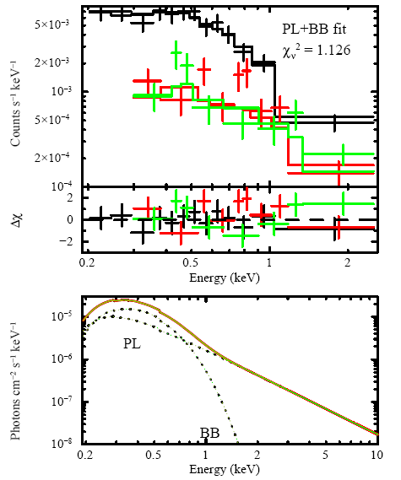
Example: Spectrum of PSR J0108-1431, the oldest
nonrecycled RPP detected in X-rays (Posselt et al. 2012)
PL fit: Γ = 3.1, N_{H} = 5.5×10²⁰ cm⁻² (vs. total Galactic
N_{H} = 2.1×10²⁰ cm⁻²)
PL+BB fit:
= 2,
kT = 110 eV, R = 46 m,
N_{H} = 2.3×10²⁰ cm⁻²

Slide 28
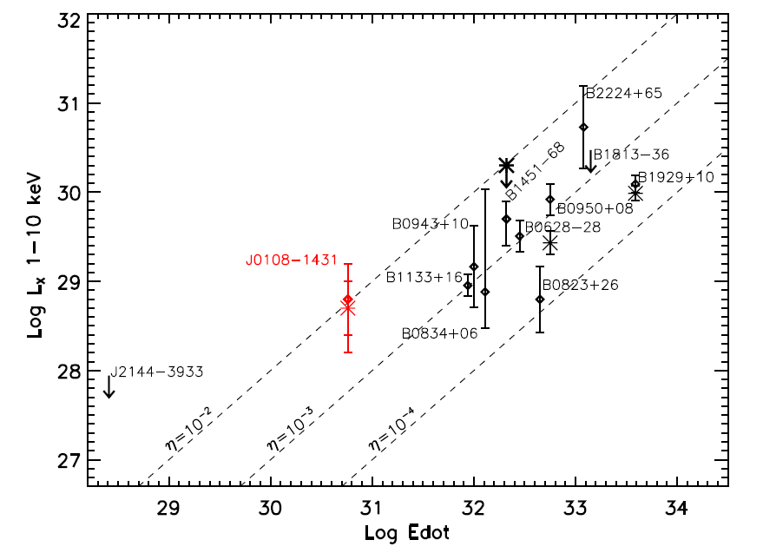
A dozen of “old” (τ ≥ 1 Myr, Edot ≤ 10³⁴ erg/s) non-recycled RPPs have been detected recently with Chandra and XMM, including the 170 Myr old PSR J0108-1431 (Posselt et al. 2012).
X-ray efficiency of old RPPs, η_{X} ~ 10⁻³ – 10⁻², is higher that in
younger ones (~ 10⁻⁵ – 10⁻³).
Possible reasons:
e-e+ are accelerated to
lower maximum energies → 
maximum of spectral
efficiency moves to lower
photon energies
Efficiency of polar cap
heating grows with
decreasing Edot
(Harding & Muslimov 2001)
Notes:
MOVE

Slide 29
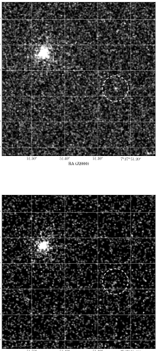
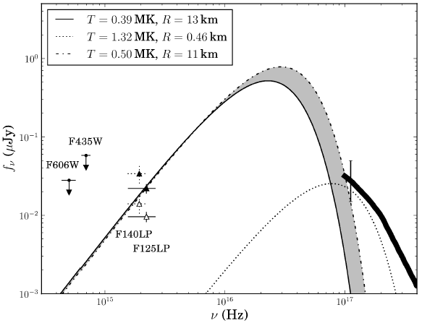
Recent detection of “Double pulsar” system in far-UV
We believe we measured the NS surface temperature
of 0.4-0.5 MK, although the spectral slope could not be
measured in our observations.
Most likely the emission comes from millisecond pulsar.
F125LP
Durant et al. (2014)
F140LP
Notes:
REFERENCE

Slide 30
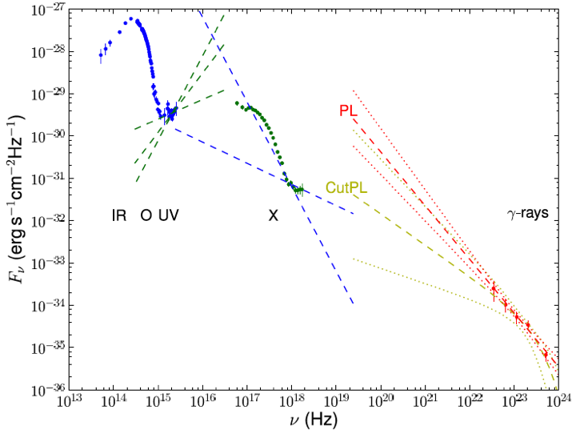
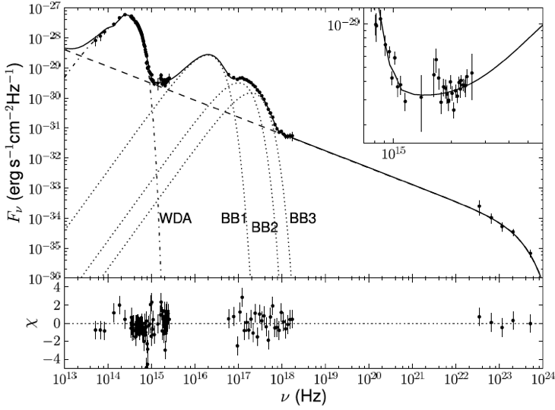
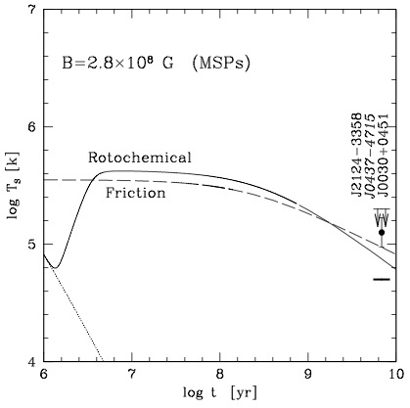
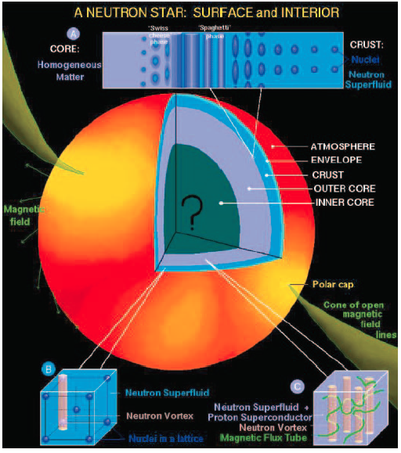
A nearby 5-Gyr-old, millisecond PSR J0437-4715
Multiwavelength spectrum:
Thermal components:
T=100,000K
We need to
understand
full surface
T distribution.
Durant, Kagaltsev et al. 2012
Result: surface temperature measurement for a
5-Gyr-old neutron star. The temperature much
higher than standard model predictions, there
could be a heat source inside this very old star.
Fernandez & Reisenegger 2005

Slide 31
Note:
True shapes of thermal spectra (hence inferred temperatures
and sizes) are not very certain
Reason: Spectra emitted from atmospheres or solid surfaces
differ from the Planck spectra, may also show spectral features.
For instance, H or He atmosphere model fits yield effective
temperatures a factor of ~1.5 – 2 lower, and sizes ~3 – 10 times
larger than the BB fits (Pavlov et al. 1995; Zavlin et al. 1996).
Therefore, the surface temperatures and NS radii inferred from
spectral fits should be used with caution. The bolometric
luminosities are less sensitive to spectral models, more certain
if the distance is known with a reasonable accuracy.

Slide 32
Evidence for spectral features in the X-ray spectra of RPPs

Slide 33
Modification of surface emission (in UV and soft X-rays) by resonant cyclotron scattering in the magnetosphere, or absorption in atmosphere:
Theoretical insights for pulsars:
Mitrofanov & Pavlov 1982
Rajagopal & Romani 1997
Ruderman 2005
Lyutikov & Gavriil 2006
…
Is there a mildly-relativistic plasma in the closed field zone?
Luo & Melrose 2007
Timokhin et al. 2012

Slide 34
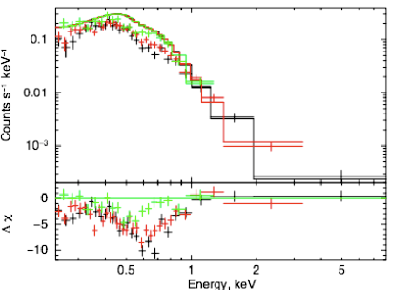
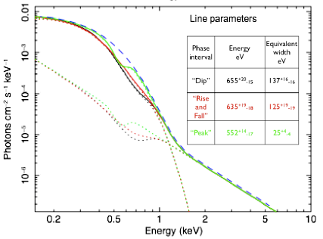
Some RPPs may show phase-dependent absorption features
Example: XMM data on PSR J1740+1000
(Edot = 2.3×10³⁵ erg/s, τ = 23 kyr, B=1.8×10¹² G)
Spectra at three phase intervals
(Kargaltsev et al. 2012)
Absorption feature(s) @ 0.5-0.6 keV and perhaps 0.2-0.3 keV
Central energy and depth vary with rotation phase
Cyclotron absorption in “radiation belts” (closed magnetic field line zone),
@ B ~ 5×10¹⁰ G?
Absorption by “metals” in the NS atmosphere??
Notes:
21

Slide 35
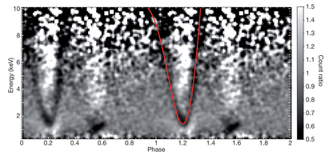
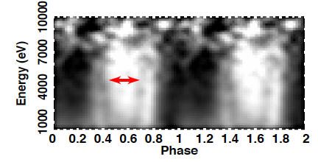
Spectral features in magnetars:
Clear phase-dependent spectral feature:
SGR 0418+5729 (Tiengo et al. 2013)
A hint of phase-dependent spectral feature:
SGR 0501+4516 (Camero et al. 2014)
Long XMM-Newton observations
are needed to produce comparable
quality phase-energy diagrams for
the three RRPs whose spectra
suggest spectral features.
Notes:
REFERENCE

Slide 36
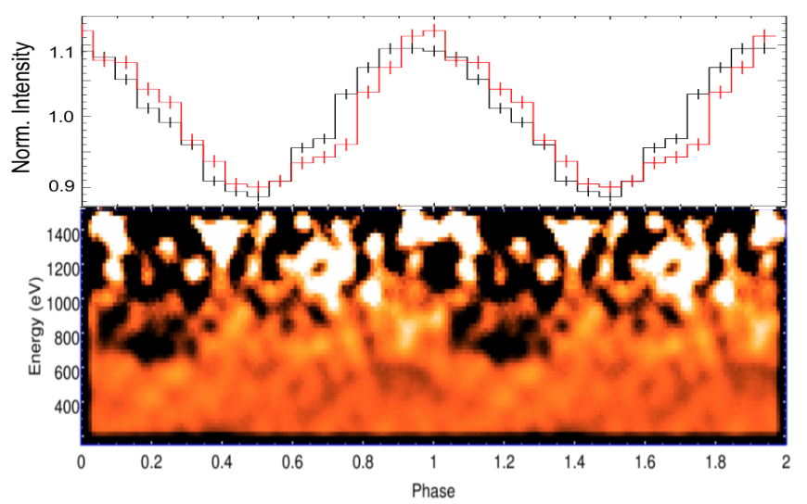
Spectral features in thermally-emitting INS (TEINSs):
Borghese et al. 2015
Slide adopted from
Frank Haberl

Slide 37
The nature of observed spectral features
At least in some objects the features could be explained by non-uniform temperature distribution (Viganò et al. 2014)
In others they seem too narrow for such interpretation
Further modeling and high-quality data are needed to understand the nature.
Notes:
REFERENCE

