Slide 1




From Virgo to ET: the evolution of the GW detectors from the 1st to 3rd generation
Michele Punturo
INFN Perugia and EGO

Slide 2
Talk outline
Initial GW detectors
  Achievements
Advanced detectors
  Where we are
  Scientific targets
3G:
  Strategy and perspectives

Slide 3
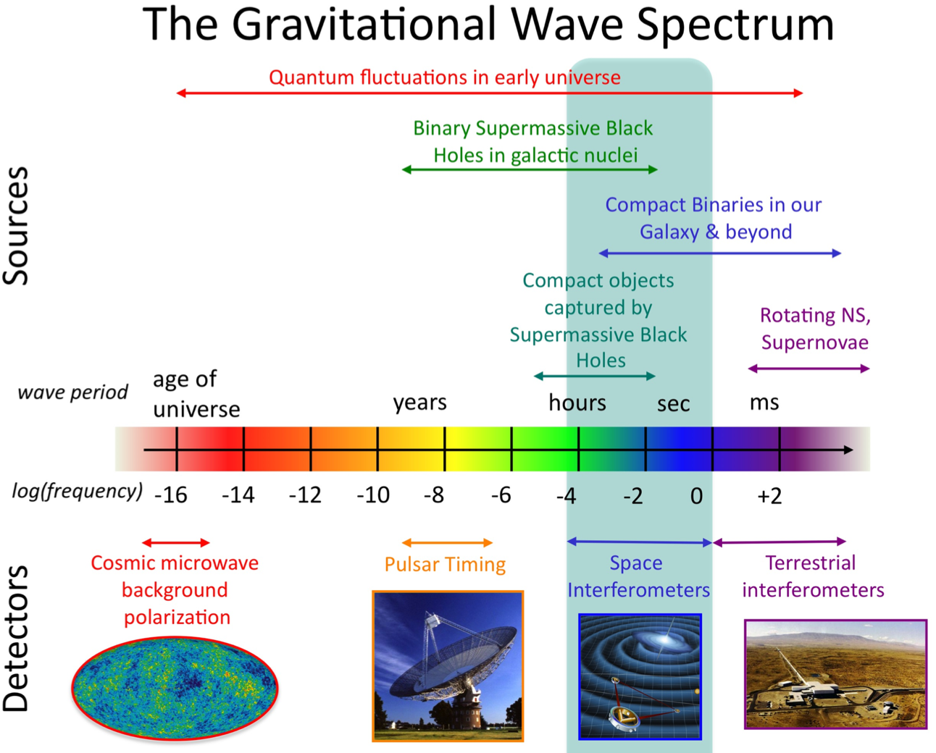
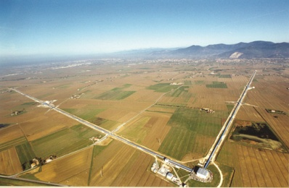
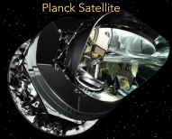

Slide 4
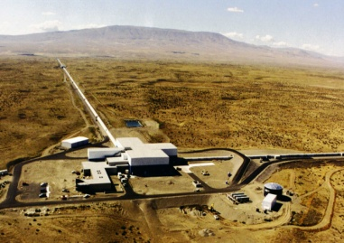


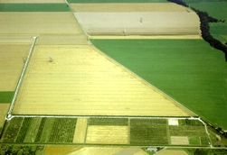
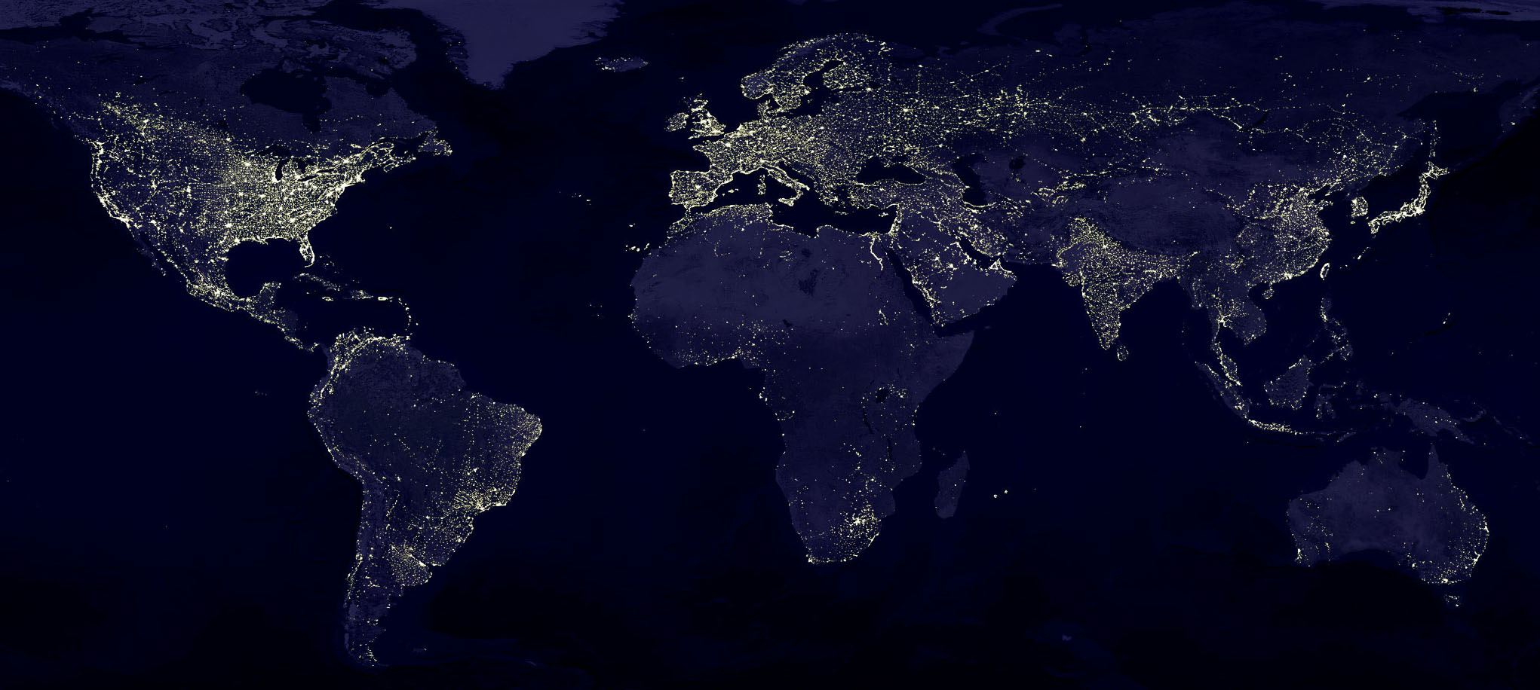
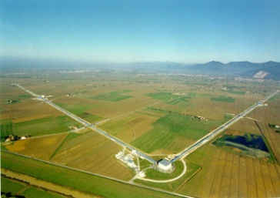
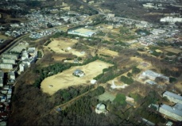

Terrestrial Detectors
Past decade, the Initial interferometers era (~2000-2011)
Data exchange
since 2007.
GWD network!
GEO, Hannover, 600 m
LIGO Hanford, 4 km: 2 ITF on the same site!
TAMA, Tokyo, 300 m
Virgo, Cascina, 3 km
LIGO Livingston, 4 km

Slide 5
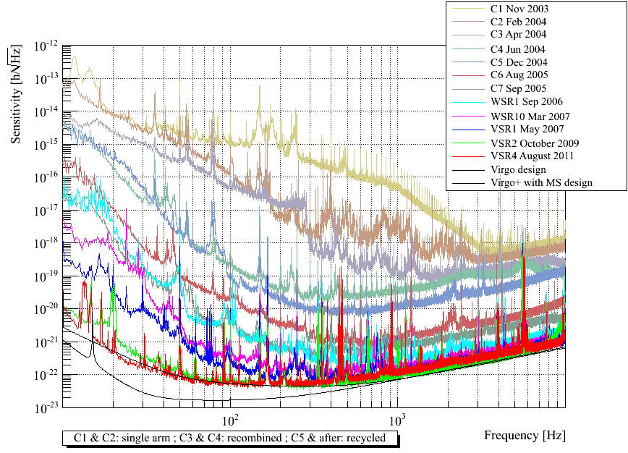
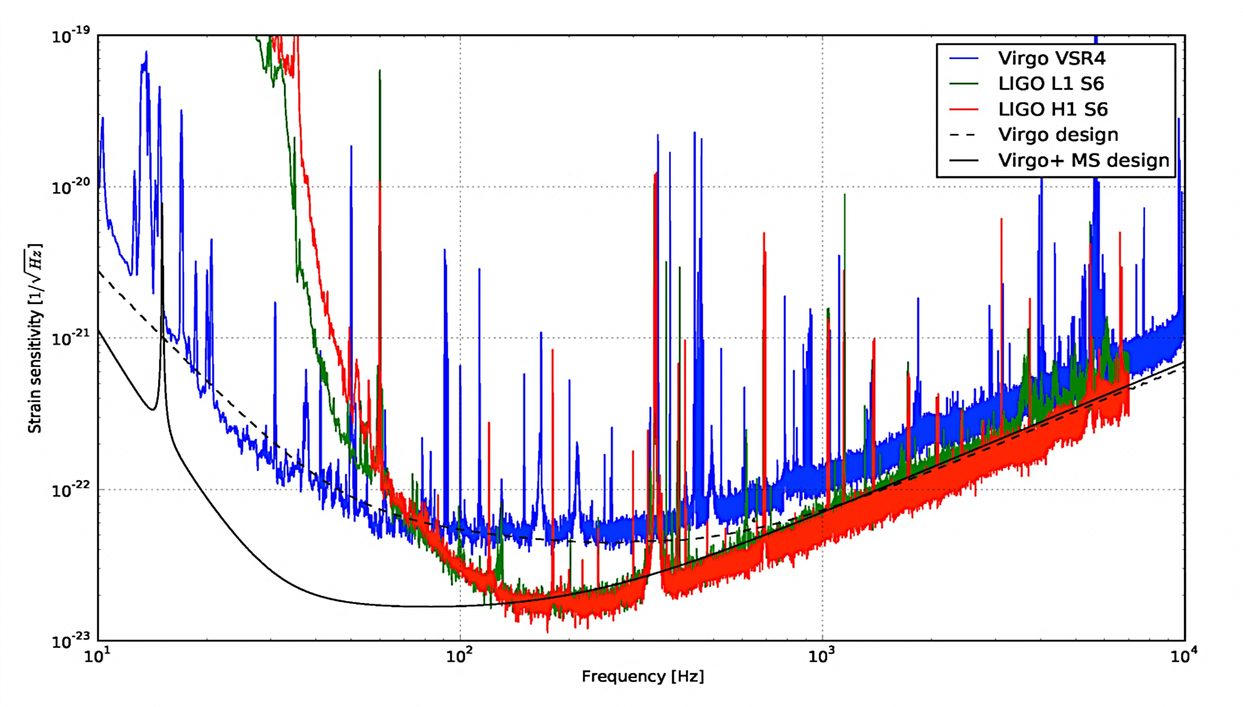
Initial detectors: Performances
The crucial technical target achieved by the initial detectors is the demonstration of the capability to achieve the design sensitivity
Virgo
Duty cycle ~80%

Slide 6
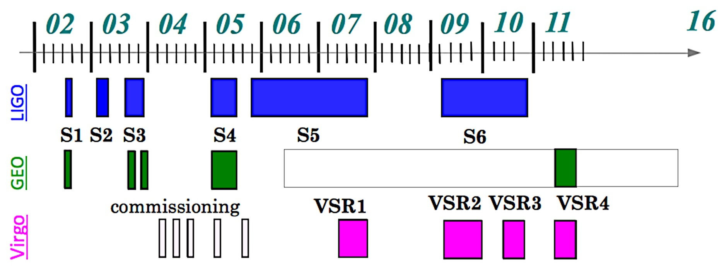
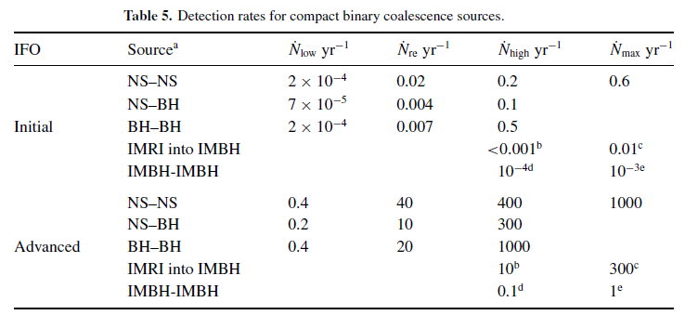
Initial Detectors: Science Runs
Science runs have been interlaced to the long commissioning/upgrade phases of such innovative detectors
No detection occurred, but was it expectable?
Abadie et al. (LSC & Virgo),
CQG 27, 173001 (2010)

Slide 7
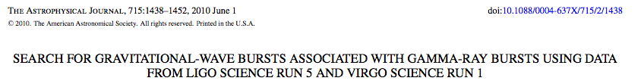


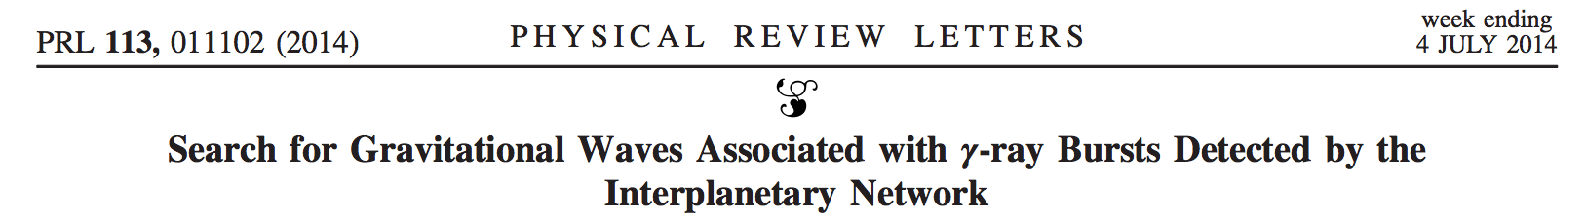
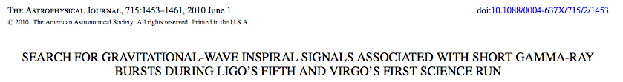
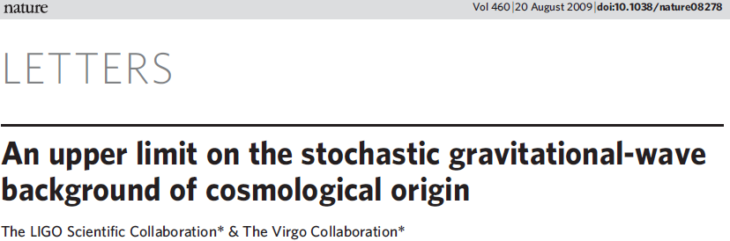
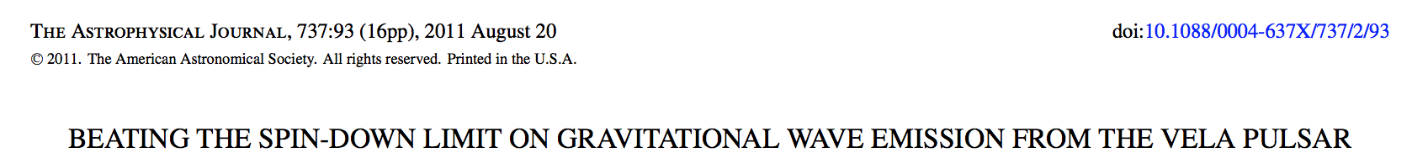
Initial detectors: Science achievements
No detection: upper limit physics
CBC
Bursts
Multi-messenger
O(100) PAPERS ON
ASTROPHYSICS/COSMOLOGY/
ASTROPARTICLE PHYSICS
Continuous waves
Stochastic background

Slide 8
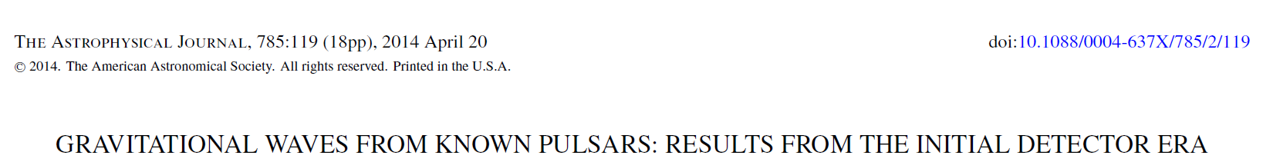
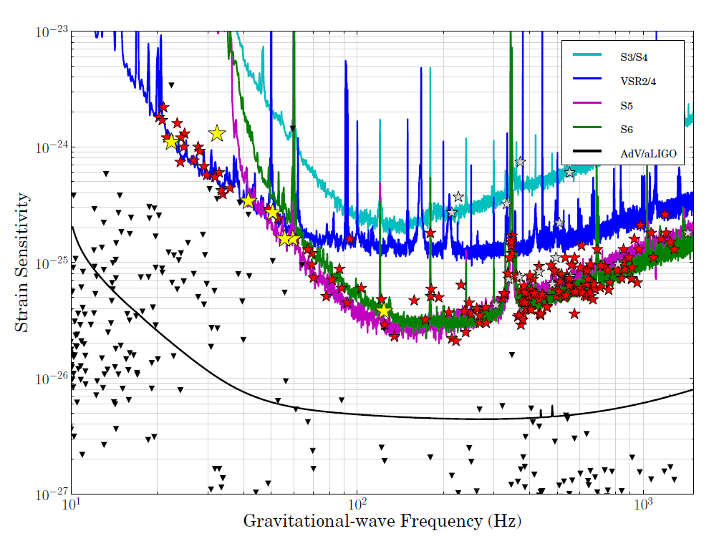
Continuous Waves
Upper limits on the gravitational wave strain amplitude for 195
pulsars using data from the LIGO S3, S4, S5 and S6, and Virgo VSR2 and VSR4 runs. The triangles show the spin-down limits for a selection of these stars. The curves give estimates of the expected sensitivity of the runs and also future runs with Advanced LIGO and Advanced Virgo.

Slide 9
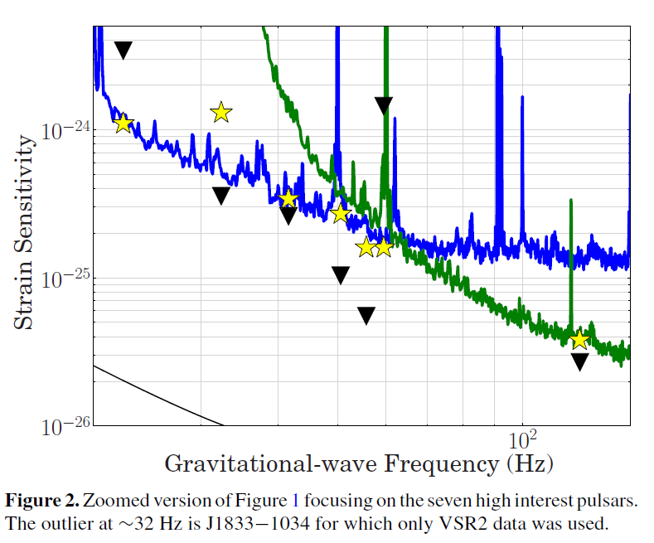
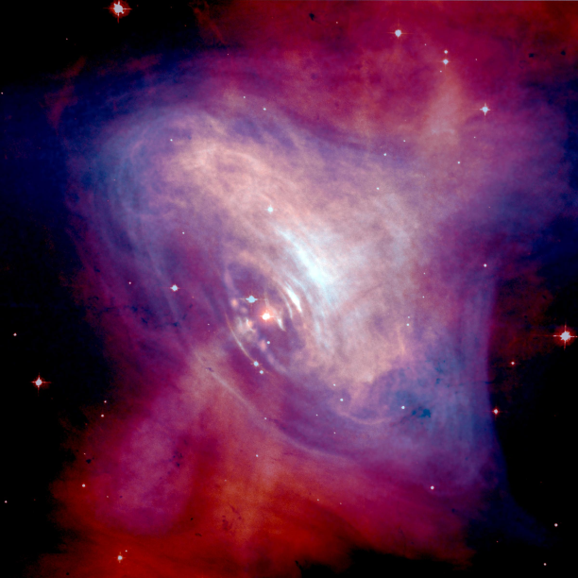
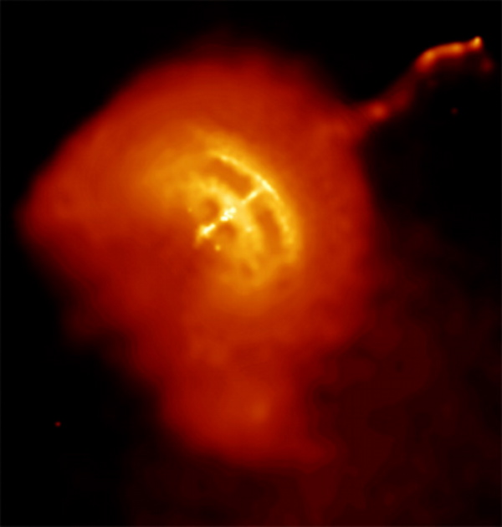
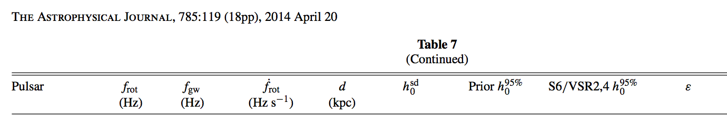
Low frequency pulsars
Crab (J0534+2200)
Vela (J0835−4510)
Mountains in the NS?

Slide 10
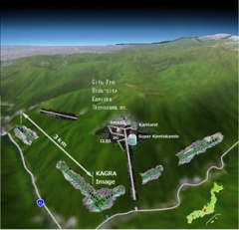


Terrestrial Detectors
Advanced detectors 2015-2025
Data exchange
MOU signed:
aGWD network!
GEO, Hannover, 600 m
~2018
aLIGO Hanford, 4 km
2015
~2022
2016
AdV, Cascina, 3 km
aLIGO Livingston, 4 km

Slide 11
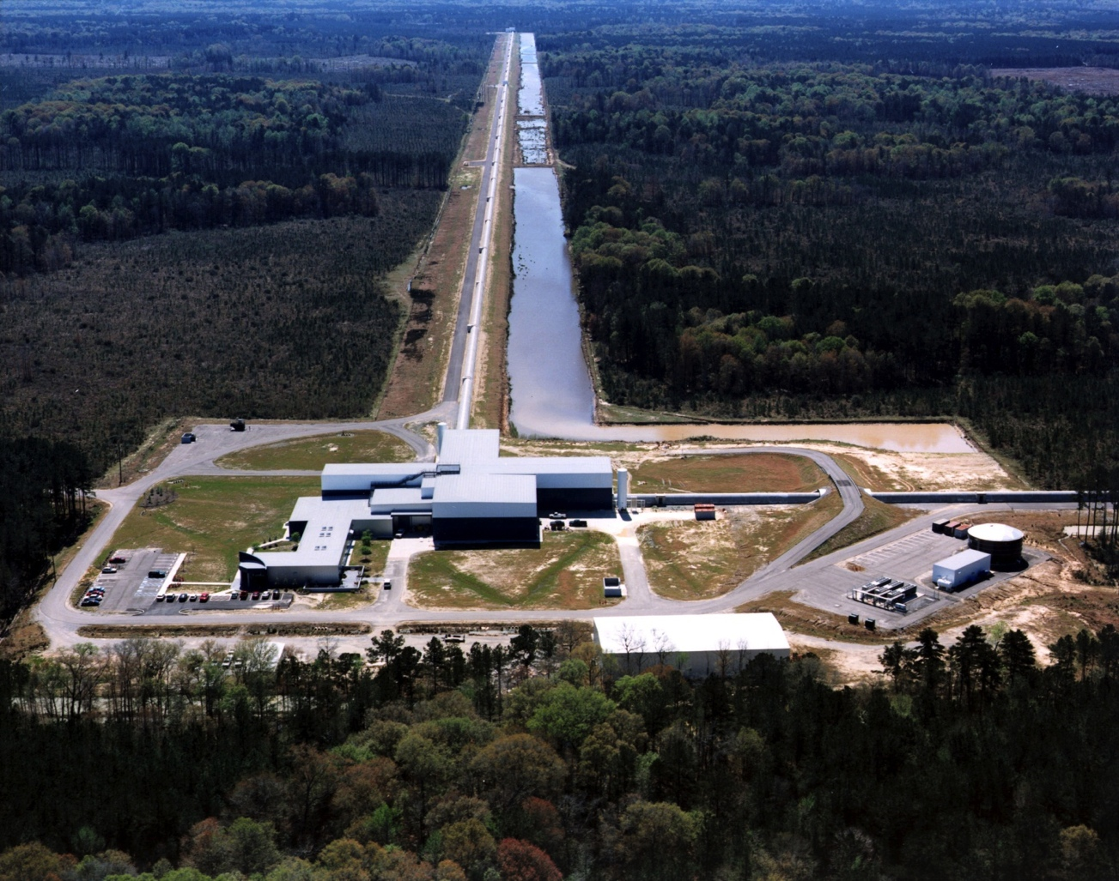
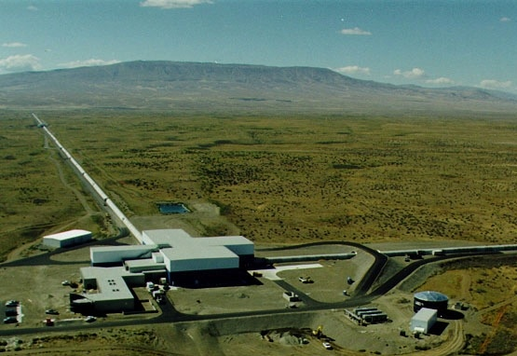
ADVANCED LIGO
Concept: ~1999
Project start: April 2008
Funding: $205 M$ from NSF, in-kind contribution from D/UK/AUS
Installation completed, commissioning well started
  >65Mpc on BNS reached

Slide 12
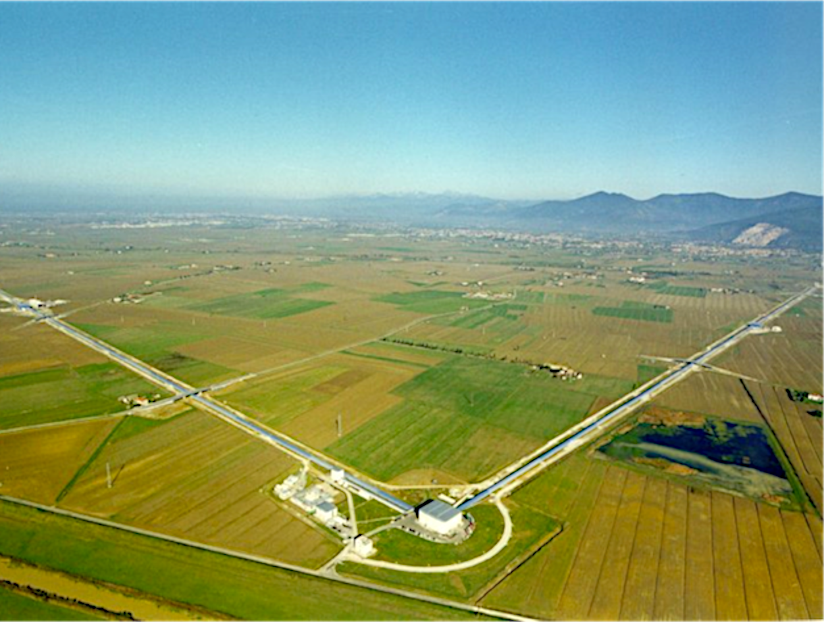






ADVANCED VIRGO
THE VIRGO COLLABORATION:
5 European countries
19 labs, ~200 authors
Participated by scientists from Italy and France (former founders of Virgo), The Netherlands, Poland and Hungary
Funding approved in Dec 2009 (21.8 ME + Nikhef in kind contribution)
Construction in progress. End of installation: end 2015
First science run in 2016
APC Paris
ARTEMIS Nice
EGO Cascina
INFN Firenze-Urbino
INFN Genova
INFN Napoli
INFN Perugia
INFN Pisa
INFN Roma La Sapienza
INFN Roma Tor Vergata
INFN Trento-Padova
LAL Orsay – ESPCI Paris
LAPP Annecy
LKB Paris
LMA Lyon
NIKHEF Amsterdam
POLGRAW(Poland)
RADBOUD Uni. Nijmegen
RMKI Budapest

Slide 13
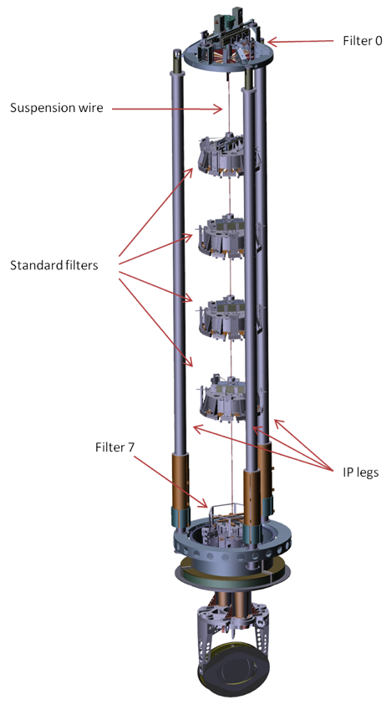
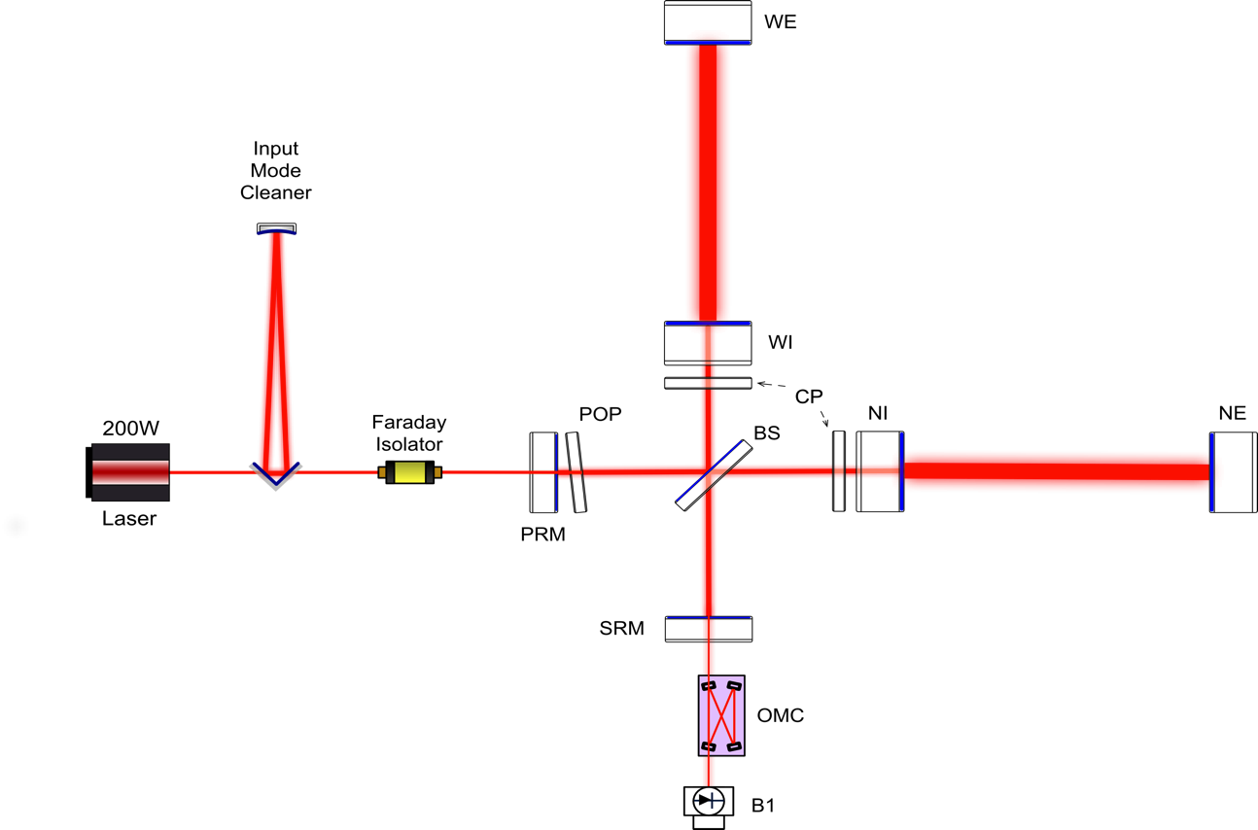
AdV DETECTOR DESIGN
MAIN CHANGES wrt Virgo
  larger beam
  heavier mirrors
  higher quality optics
  thermal control of aberrations
  Stray light control
  200W fiber laser
  signal recycling
Vibration isolation by Virgo superattenuators
  performance demonstrated
  large experience gained with commissioning at low frequency

Slide 14
AdV expected sensitivity
Nominal sensitivities expected in AdV

Slide 15
AdV installation: where we are?

Slide 16
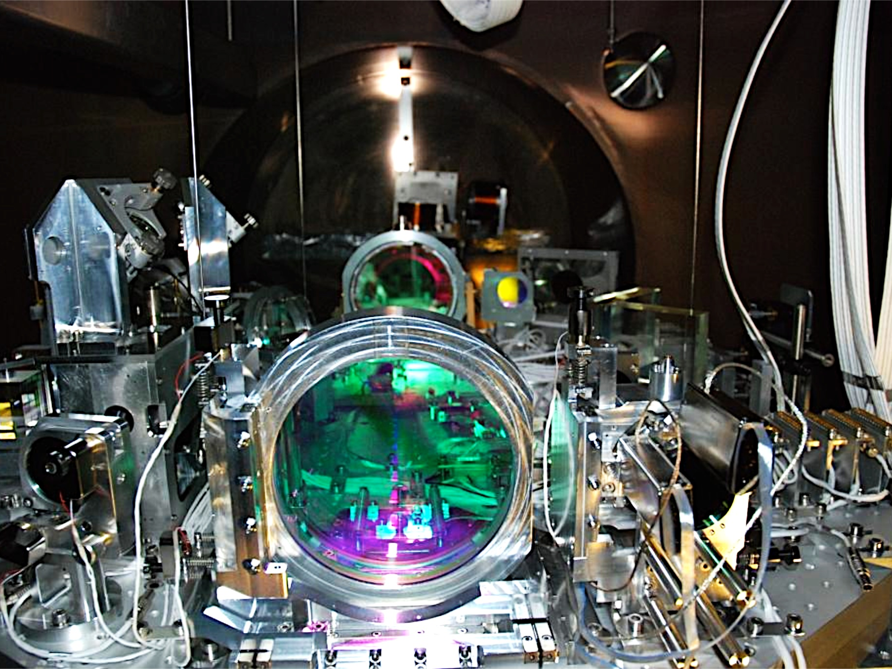
SUSPENDED INPUT OPTICS BENCH

Slide 17
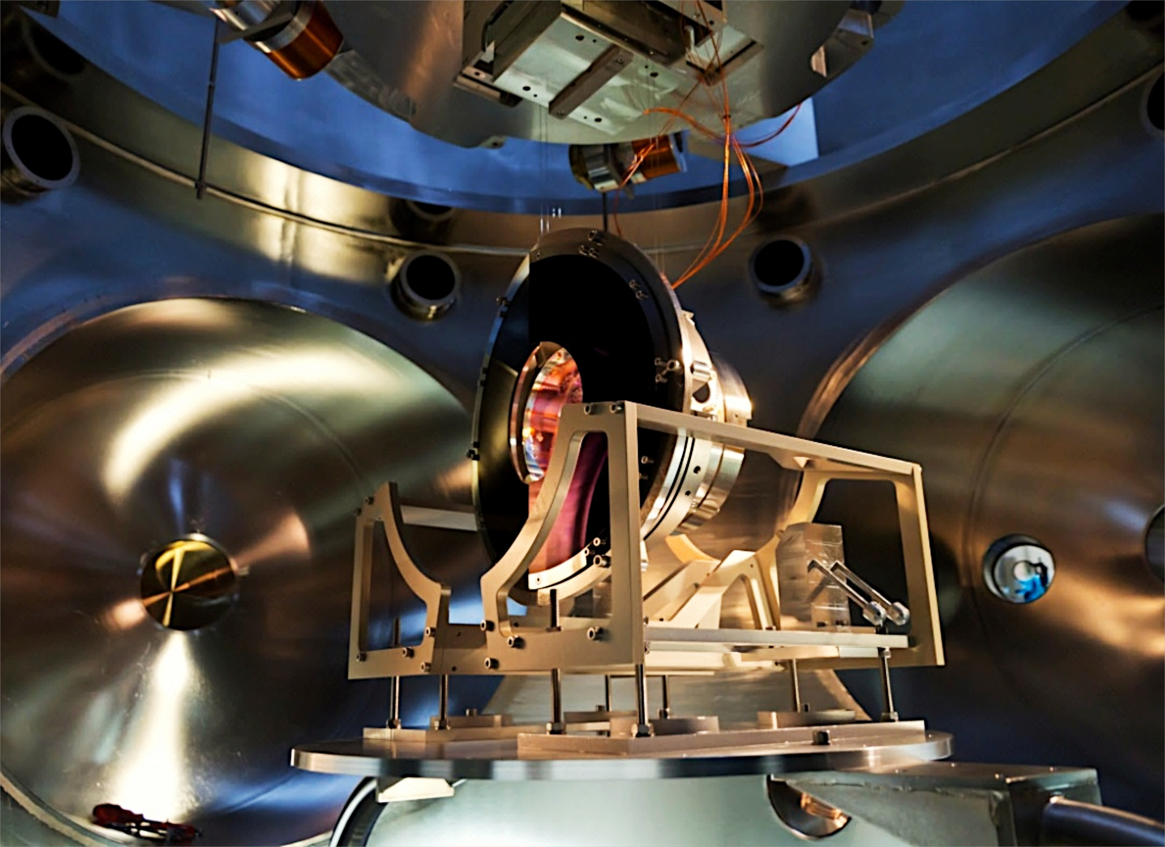
Input mode cleaner
End mirror with baffle

Slide 18
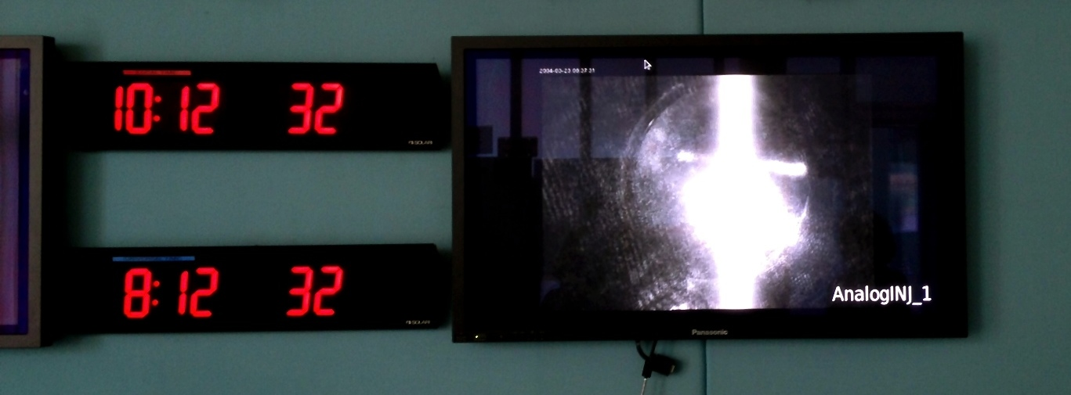
IMC LOCKED
Input mode cleaner locked, Commissioning progressing

Slide 19
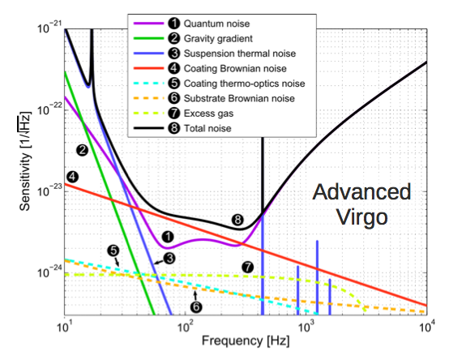
HIGH QUALITY OPTICS
Focus on mirror quality & design, because they may limit the sensitivity in a wide frequency range…
REQUIREMENTS: large mass/diameter, good flatness/roughness, low absorption, good homogeneity, good coating uniformity, high Q
RADIATION PRESSURE
and SUSPENSION THERMAL
noises depend on mirror mass
Mirror geometry/flatness
may change the optical
gain and, thus, the
SHOT NOISE
Scattered light from
flatness/roughness
Aberrations depend on
coating absorption (thermal
lensing) and substrate
inomogeneity
Mid-frequency range
dominated by coating
THERMAL NOISE

Slide 20
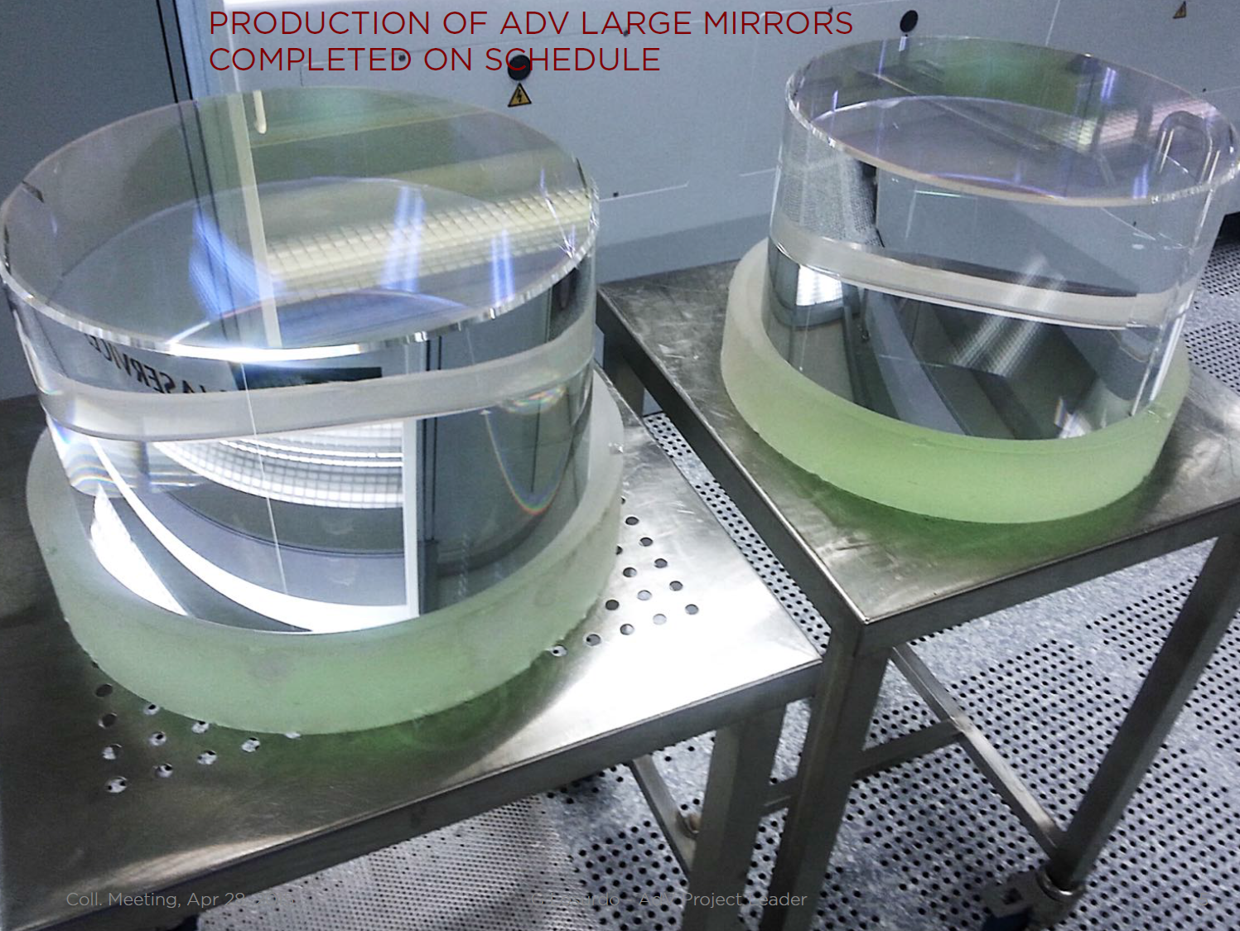
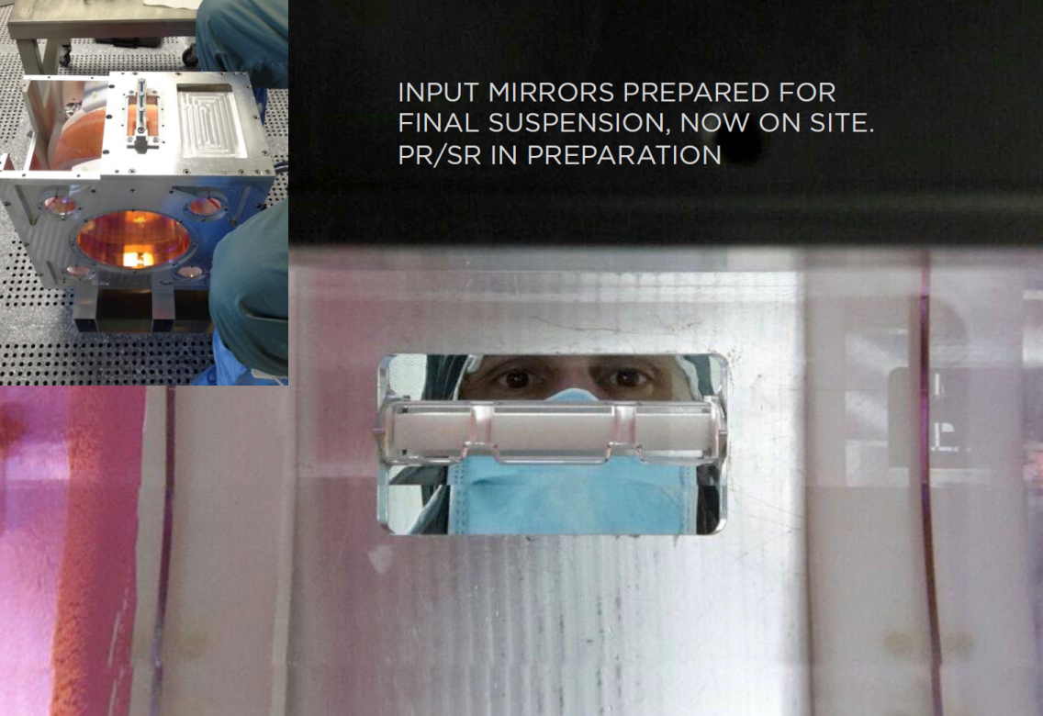
Large
Mirrors
Test mass:
35 cm Ø, 20 cm thick, 42 kg

Slide 21
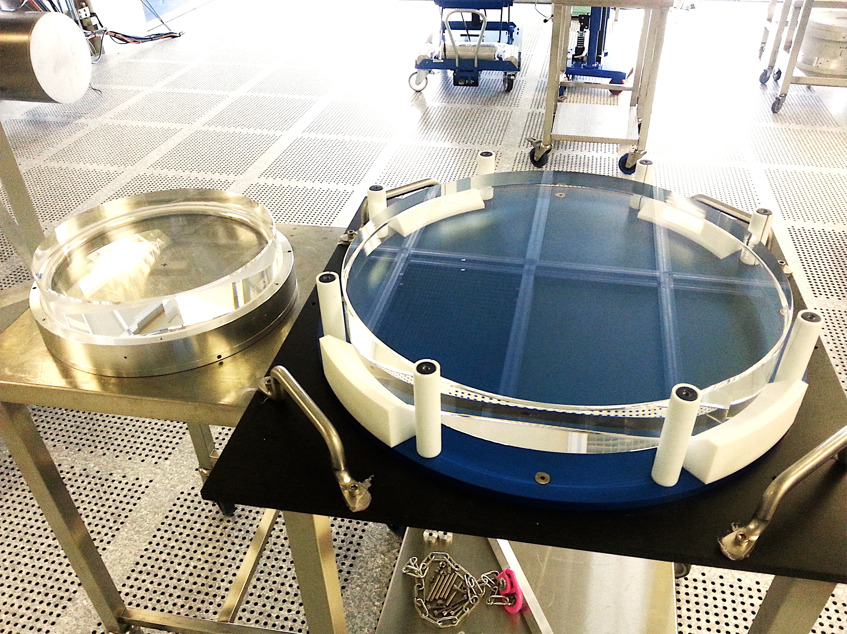
MIRRORS
PR
BS

Slide 22
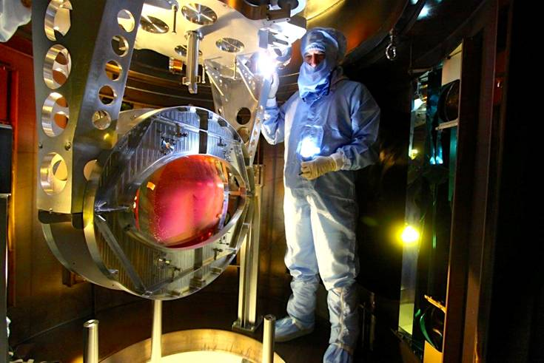
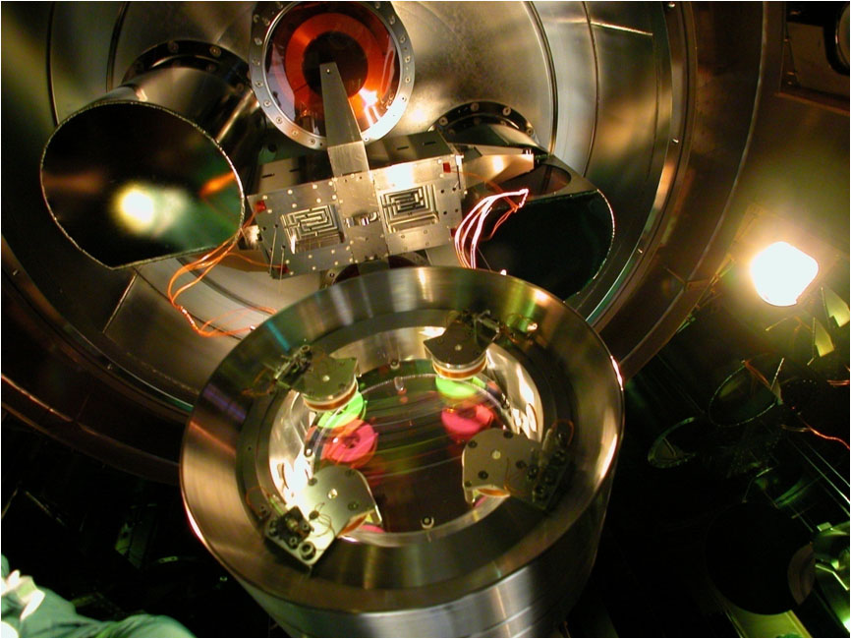
BS suspended

Slide 23
AdV: Status & Scheduling
Budget: 80% of cost committed so far
End of the assembling expected within the end of the year
Pre-commissioning of some of the apparatuses already started
Main Goal:
Join aLIGO in the 2016 science run

Slide 24
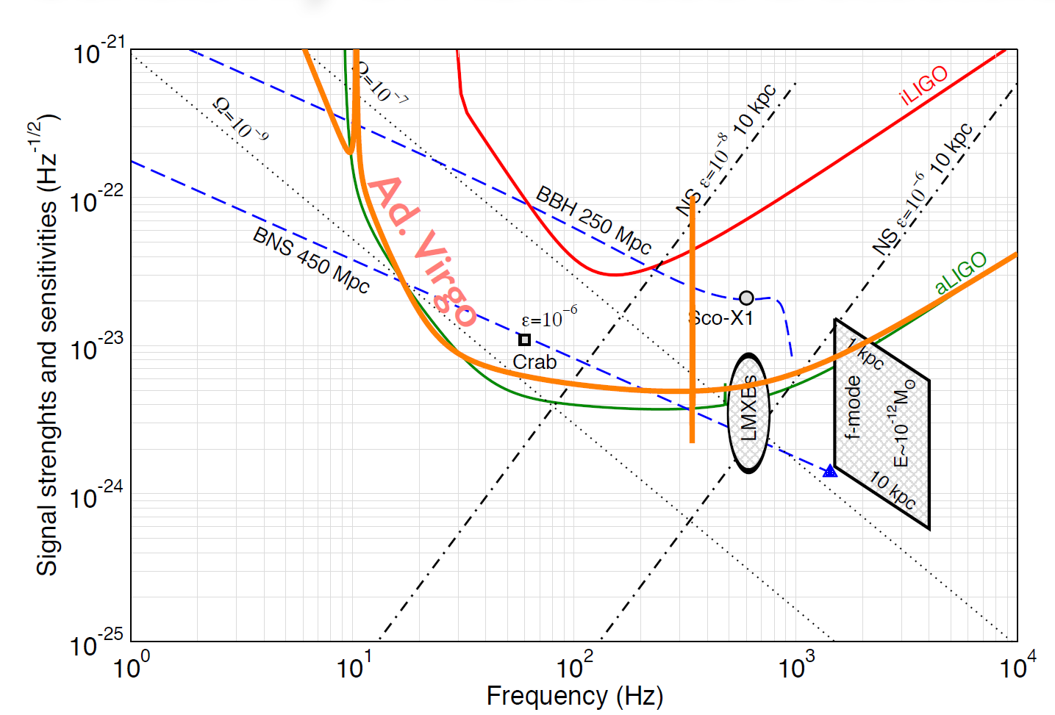
GW sources for Advanced detectors
Several GW sources are detectable by aGWDs at nominal sensitivity
But achieving the nominal sensitivity isn’t an easy task

Slide 25
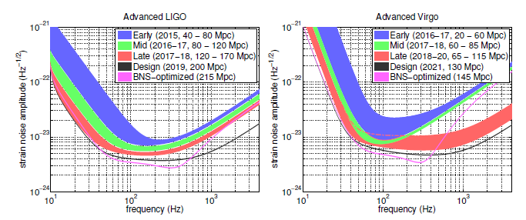
Advanced detectors: commissioning & science runs
aGWDs are complex machines:
  Commissioning will be needed to approach the nominal sensitivities

Slide 26
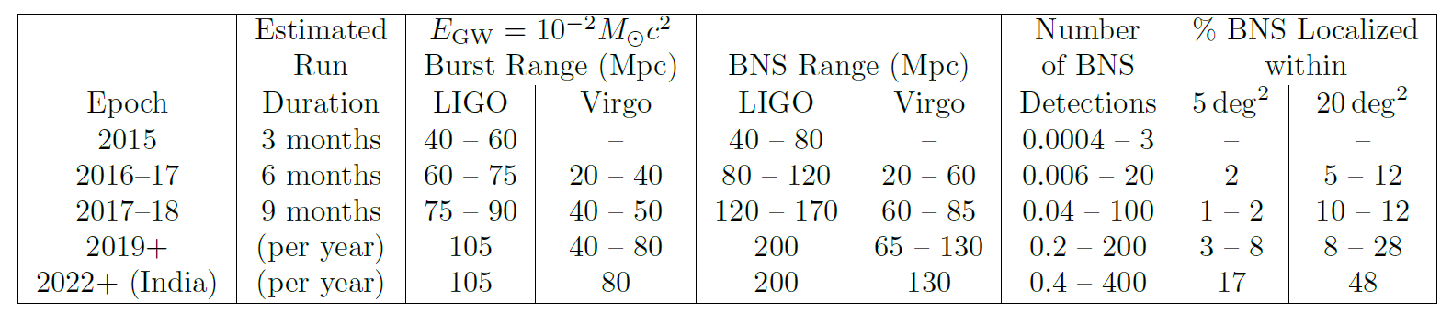
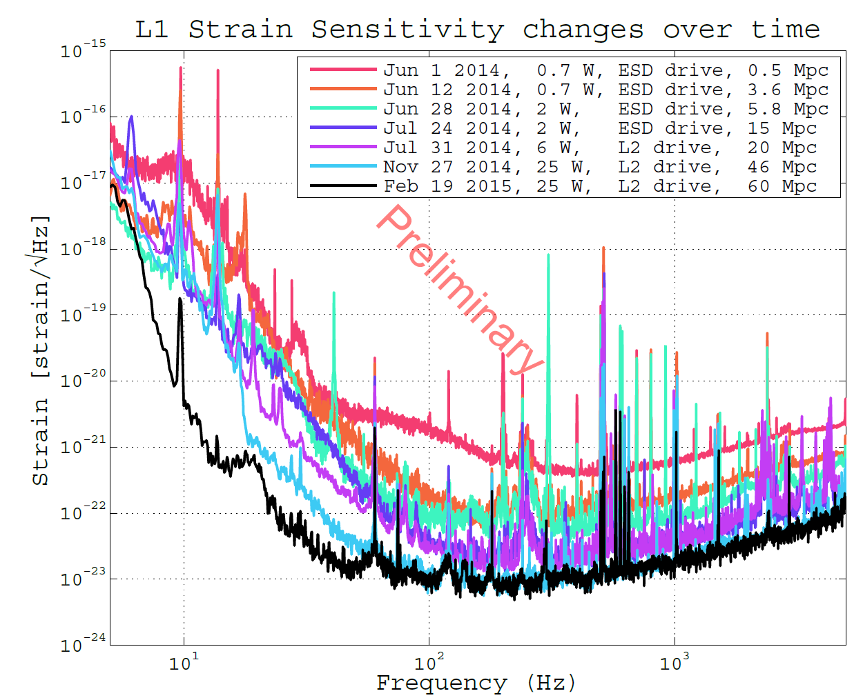
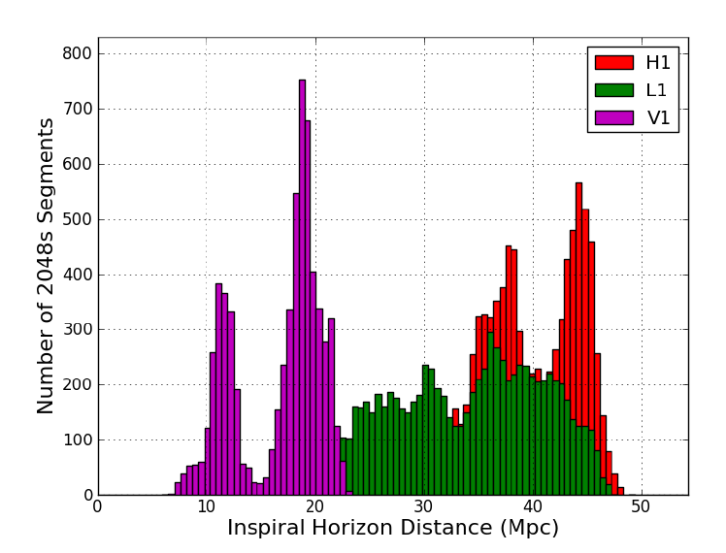
Detection probabilities in the next years
Considering the sensitivity evolutions and the run durations:
Aasi et al. 2013 (arXiv: 1304.0670)
Is it plausible?
aLIGO: >60Mpc
During S6
Is it plausible?

Slide 27
Binary compact stars
Expected detection rates at the nominal sensitivity
Abadie et al. (LSC & Virgo), arXiv:1003.2480;
CQG 27, 173001 (2010)

Slide 28
Fundamental physics with GW detectors?
surely
OK, advanced detectors will probably see GW emitted by BNS
But, do we can say more beyond the detection?
Fundamental physics?
  Neutron star physics

Slide 29
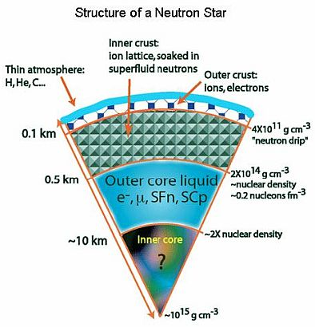
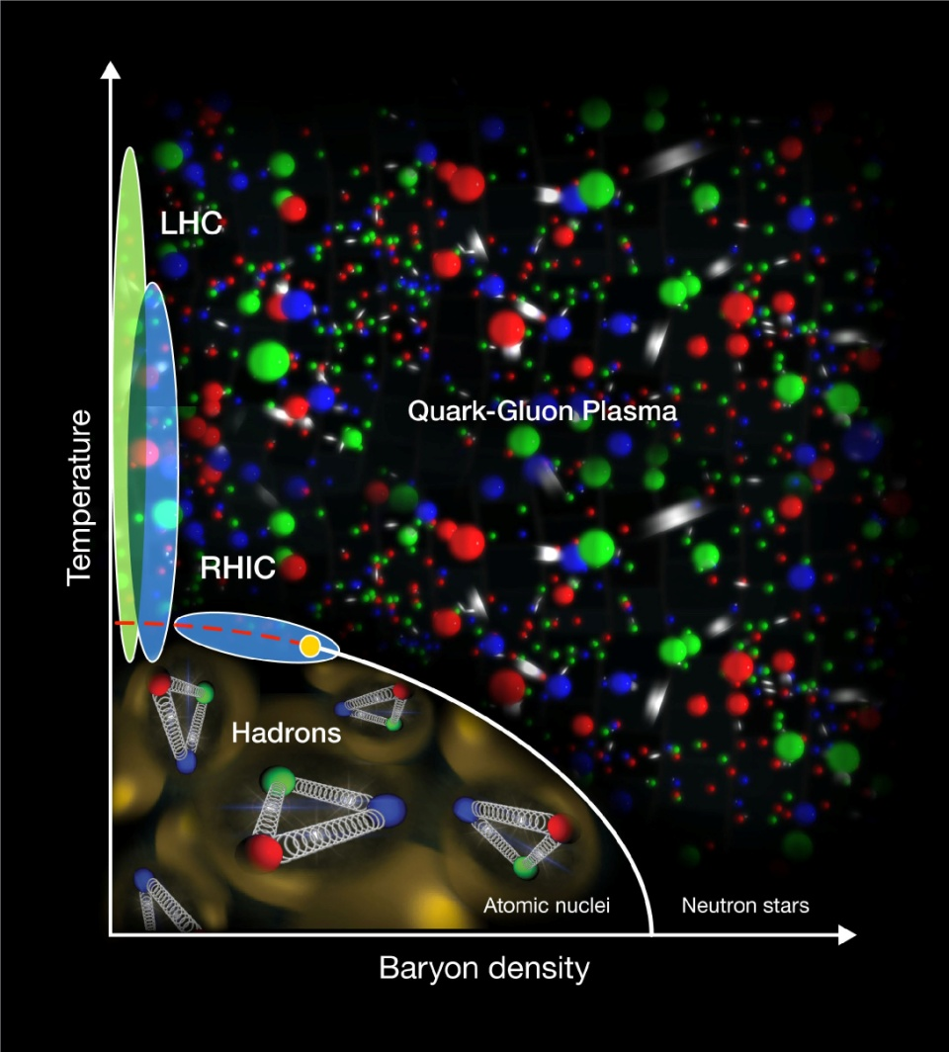
NS: lab for nuclear physics
Understanding the EOS of a NS is a fundamental physics problem:

Slide 30
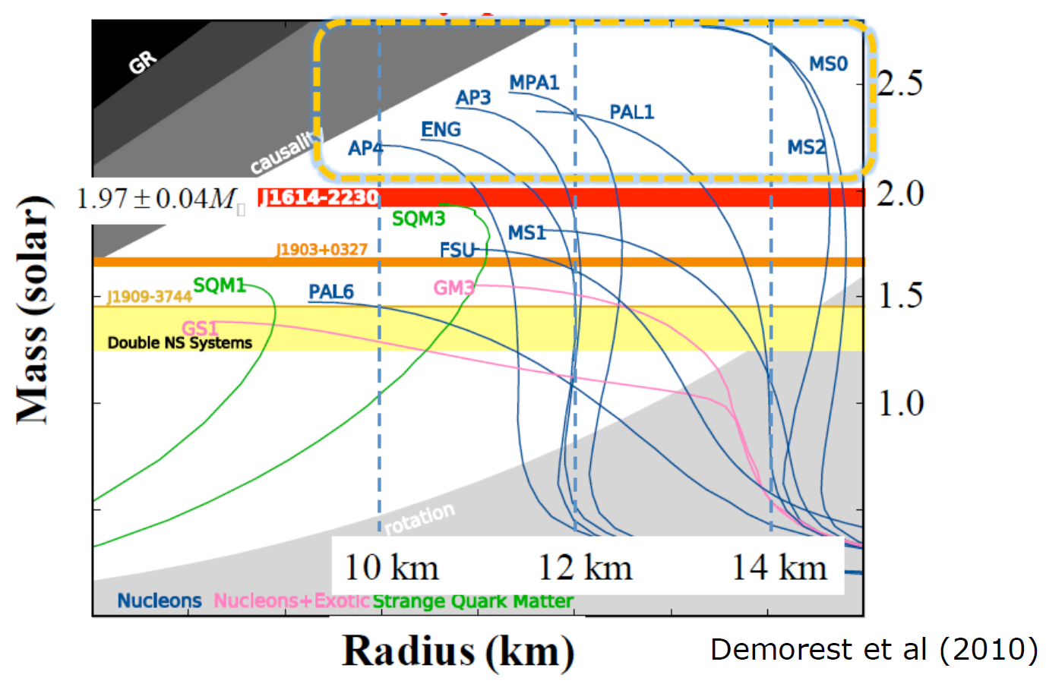
BNS: test for nuclear physics
But, there is a plethora of equations of state compatible with the current observations of NS mass and radii:

Slide 31
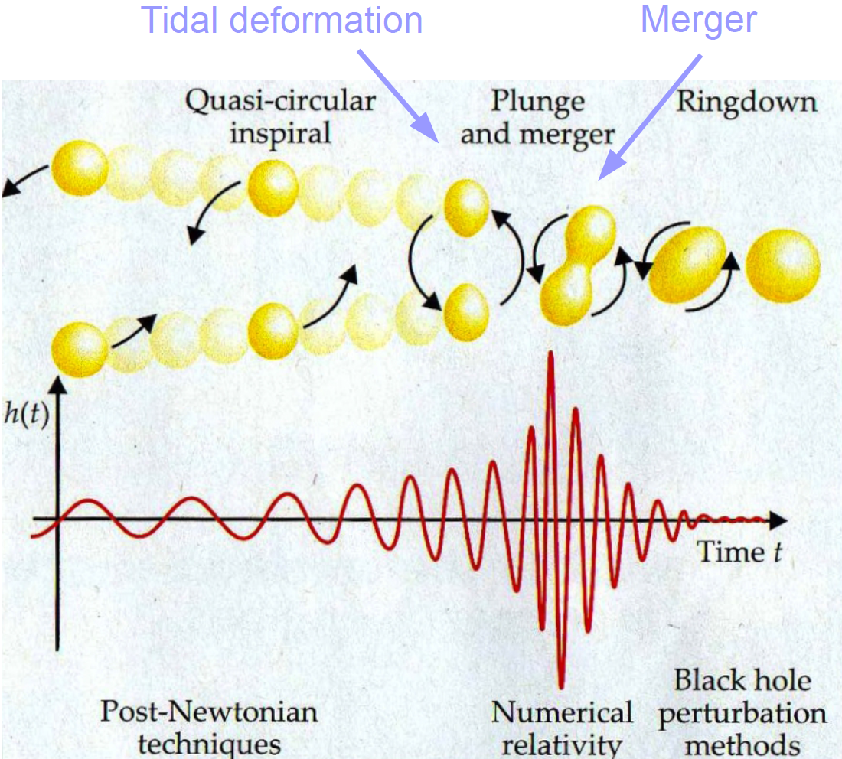
Observing BNS deformation
GW observation from NS coalescing binaries could constrain the EOS:
  Tidal deformation λ of the NS under external field is related to its EOS and it affects the binary orbital evolution

Slide 32
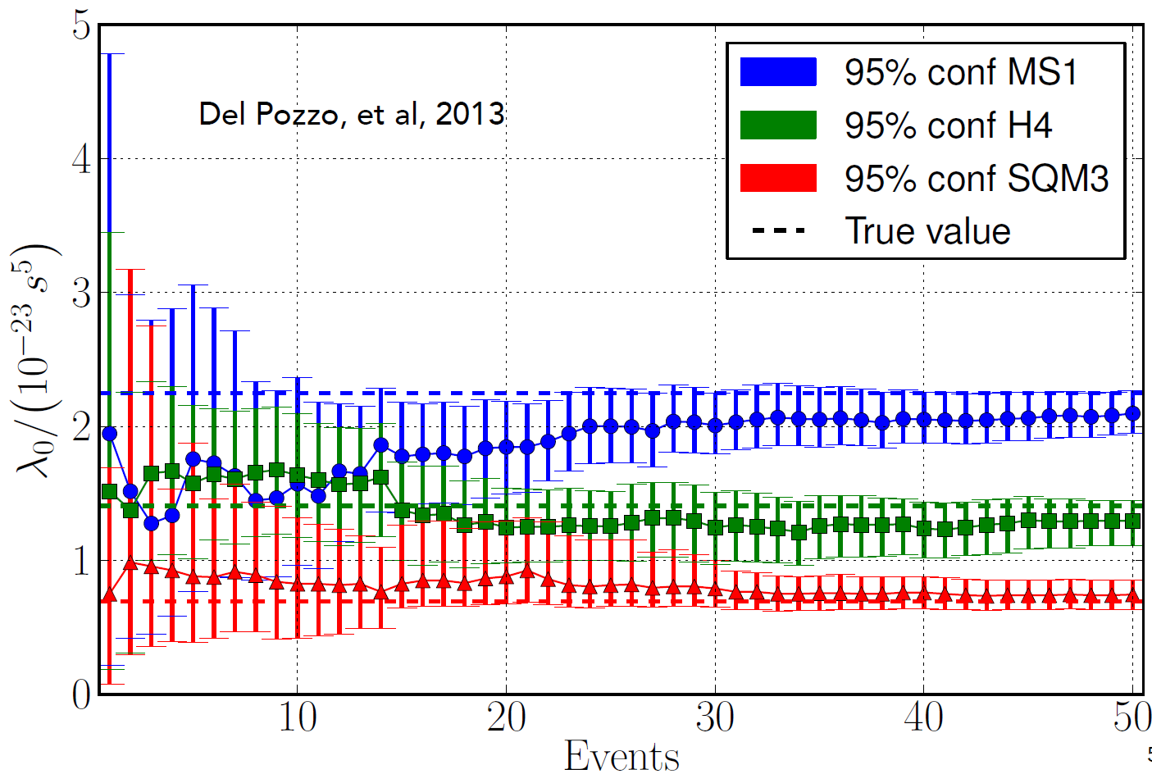
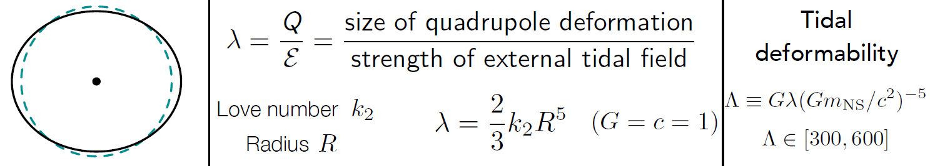
What Advanced detectors can say on EOS constrain using BNS?
Measuring a number (>10) of BNS it is possible the infer the EOS model (in aGWDs)
Hinderer 2008, Flanagan and Hinderer 2008, Hinderer+ 2010, Read+ 2009, 2013,
Pannarale+ 2011, Damour+ 2012, Lackey+ 2012, Del Pozzo+ 2012, Lackey & Wade
2014; image and equation curtsey J. Read

Slide 33
Isolated NS
aGWDs can monitor a large number of known pulsars, beating their spin-down limits

Slide 34
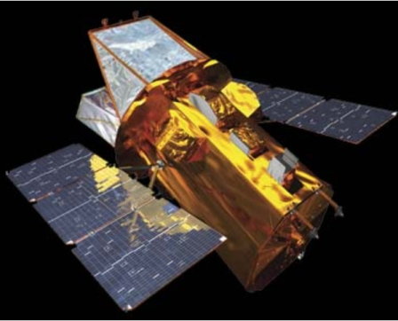





Multimessenger physics
aGWDs will open a new way to investigate the universe:
  Multi-messenger observation
γ-ray detectors
Neutrino-detectors
telescopes
Radio-telescopes

Slide 35
em-follow up programme
Obviously, GW detection supported by an external em trigger, has a superior confidence
But, it is quite appealing the opposite process:
  Drive em observations with a GW trigger:

Slide 36
~75
Workshop just concluded (23rd of April) at EGO/Virgo

Slide 38
Toward a 3G of GW observatories

Slide 39
3rd generation?
Evolution of the GW detectors (Virgo example):
Short term uprades (a+, AdV+): Squeezing, better coatings, heavier masses, …
First detection
Initial astrophysics
Test of “advanced” techs
UL physics
Advanced
detectors
Detection distance (a.u.)
Proof of the working principle
Upper Limit physics
enhanceddetectors
Commissioning
& first runs
Infrastructure realization and detector assembling
Same
infrastructure
Same
infrastructure
Same
infrastructure
Same
Infrastructure
(≥20 years old for Virgo, even more for LIGO & GEO600)
year
2003
2008
2011
2017
2022

Slide 40
3rd generation?
Precision Astrophysics
Cosmology
?
Evolution of the GW detectors (Virgo example):
Limit of the current infrastructures
First detection
Initial astrophysics
Test of “advanced” techs
UL physics
Advanced
detectors
Detection distance (a.u.)
Proof of the working principle
Upper Limit physics
enhanceddetectors
Commissioning
& first runs
Infrastructure realization and detector assembling
Same
infrastructure
Same
infrastructure
Same
infrastructure
Same
Infrastructure
(≥20 years old for Virgo, even more for LIGO & GEO600)
year
2003
2008
2011
2017
2022

Slide 41


Improving the sensitivity
http://rhcole.com/apps/GWplotter/
Fill the gap

Slide 42
The Einstein Telescope Project
The design study of the ET project has been funded by the European Commission under FP7
  The interest has been primarily focused on the Infrastructure rather than on the detector and its technologies
  The infrastructure should no limit the sensitivity of the future hosted detectors
    Size
    Environmental noises (mainly, seismic and GGN)

Slide 43




Seismic and Newtonian noises
Virgo and advanced Virgo seismic filtering is already close to the top of the possible performances
  Longer suspensions to facilitate the low frequency access
Gravity gradient noise bypasses the seismic filtering
SEISMIC NOISE
NEWTONIAN NOISE
43
Credit M.Lorenzini

Slide 44

Gravity Gradient noise in AdV
The GGN noise could limit the AdV sensitivity during high seismic activity days:
M. Punturo (VIR-0073B-12)
M.Beker (GWADW 2012

Slide 45

Seismic noise model
Peterson's background noise model

Slide 46



WP1: Site search:
Many sites visited in Europe

Slide 47


Underground Seismic noise Measurement
Underground sites are the candidates for a very quiet site

Slide 48




Day/Night variability vs population density

Slide 49

Credits: J.v.d.Brand, GWADW2015

Slide 50


The Netherlands
Credits: J.v.d.Brand, GWADW2015

Slide 51


Detector Geometry
45° stream generated by virtual interferometry
Fully resolve polarizations
Null stream
L
Redundancy
L
45°
5+ end caverns
7+ end caverns
4×L long tunnels
6×L long tunnels
Fully resolve polarizations by virtual interferometry
LISA approach
Null stream
Equivalent to
Redundancy
60°
3 end caverns
3.45×L long tunnels
(but larger diameter)
L
L’=L/sin(60°)=1.15×L
A Freise et al 2009 Class. Quantum Grav. 26
Optimal geometry, but the design is not “frozen”

Slide 52

ET technologies
The ET design study focused on the “research infrastructure”, designing an observatory able to host the evolution of the GW detectors in the next decades
Nevertheless, a (brute force) attempt to describe the ET technologies has been performed
Low frequency:
  Long suspension chains of seismic filters (“à la Virgo”)
  Cryogenic and massive payloads
  Silicon mirrors and new 1.55μm wavelength laser
  High power to reduce the shot noise
  Frequency dependent squeezing
These technologies need to be developed:
  ET R&D: small R&D activity funded under an European coordination by few national funding agencies in Europe
  ELiTES

Slide 53


Xylophone design
The issues raised by the cross-compatibility between all these technologies:
  ET implements a Xylophone approach, where the overall sensitivity is given by the combination of the performances of two “frequency specialised” interferometers

Slide 54


Synergies with KAGRA
The Japanese detector, under construction, KAGRA is pioneering the development of an underground infrastructure and of the cryogenic interferometer for GW detection
For ET is mandatory to have a synergy with KAGRA
A 4 years European-Japanese joint project “ELiTES” supported by European Commission under FP7-IRSES is started in 2013
  Exchange of scientists focused mainly on cryogenic issues common to ET and KAGRA

Slide 55

ET: Science targets
ET, embedded in a network of 3G and 2G detectors, can push forward the limits of the detection
But the unprecedented sensitivity of ET can contribute to solve some of the enigmas in the Universe

Slide 56


Supernova explosion
Mechanisms of SNe are still under investigation
The energy emitted in GW can characterize the explosion nuclear mechanism
Only ET could be enough sensitive to promise a decent event rate (1 evt every few years)
[C.D. Ott CQG 2009]
Distance [Mpc]

Slide 57



GRB progenitors
Short GRB are probably emitted by BNS
In a multi-messenger context, if GRB are observed simultaneously with GW, it is possible to fit the cosmological model of the Universe
GW
GRB
ET will observe 100’s of BNS coalescences associated with GRB in one year
It will be possible to reconstruct Dark Energy parameters with relevant precision
Ω_{M}: total mass density
Ω_{Λ}: Dark energy density
H₀: Hubble parameter
w: Dark energy equation of state parameter
B.S.Sathyaprakas et al, CQG 27 (2010) 2015006
Notes:
Cosmological model: spatially flat Friedman-Robertson-Walker universe

Slide 58




ET Conceptual design
ET Roadmap
ELiTES
R&D
GraWIToN
Technical design
First detection on advanced interferometers
ET Observatory Funding
Site preparation
ET Site and infrastructures realisation
ESFRI
2018
ESFRI
2020
2012
2013
2014
2015
2016
2017
2018
2019
2020
2021
2022
2023
2024
2025
2026
2027
2028
2029

Slide 59
Virgo
AdV
aLIGO
ET
1985
R&D
1990
15 years
White Paper, CDR (1989)
R&D
Approval (1994)
R&D
1995
Final Design, TDR (1995)
Beginning
Infrastructure (1996)
2000
R&D
CDR (1999)
Completion installation
Detector (2003)
First AdV
sensitivity projection (2004)
R&D
2005
AdV White Paper, CDR (2005)
First Idea (2005)
Scientific data taking
(2007)
Funding (2006)
Approval (2009)
Building (2008)
R&D
2010
Decommissioning (2011)
First orders (2010)
CDR (2011)
TDR (2012)
Installing completion
(2014)
Completion Installation (2015)
R&D
2015
Data taking (2015)
First data taking (2016)
2020
TDR ?
2025
Construction ?

Slide 60
3G: not only an EU idea
ET is a pioneer for the 3G concept:
  LSC is now discussing a long term plan with huge similarities

Slide 61
END
Advertising:
Two PhD positions, supported by EU within the GraWIToN ITN project, open @GSSI, Italy
Next ET meeting 2-3 February 2016, Villa Finaly, Florence (Italy)

Slide 62

New EGWII call?

