Slide 1
The Role of Catalysis in Chemical Energy Storage
József Sándor Pap Surface Chemistry and Catalysis Department
MTA EK, 2015.05.04.
Notes:
1

Slide 2
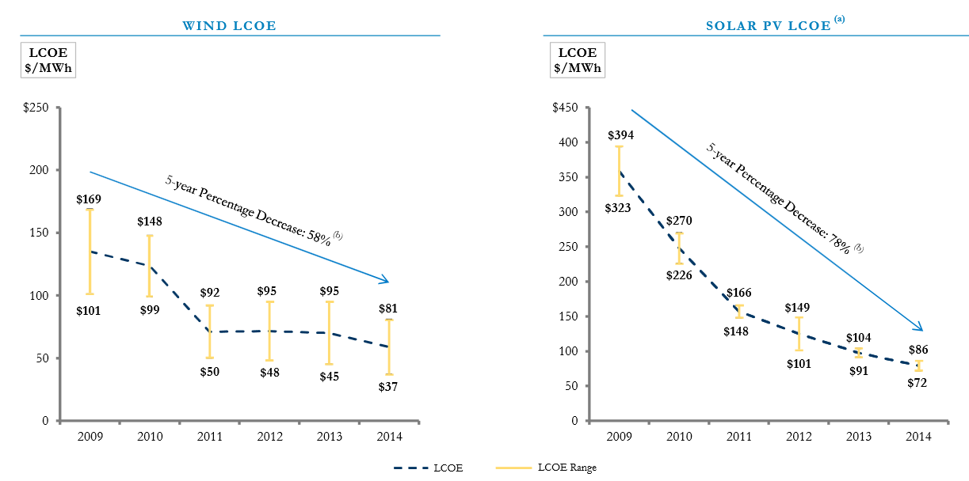
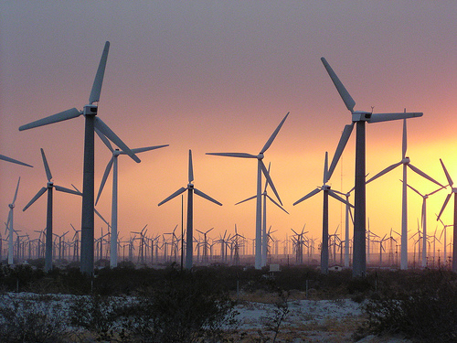
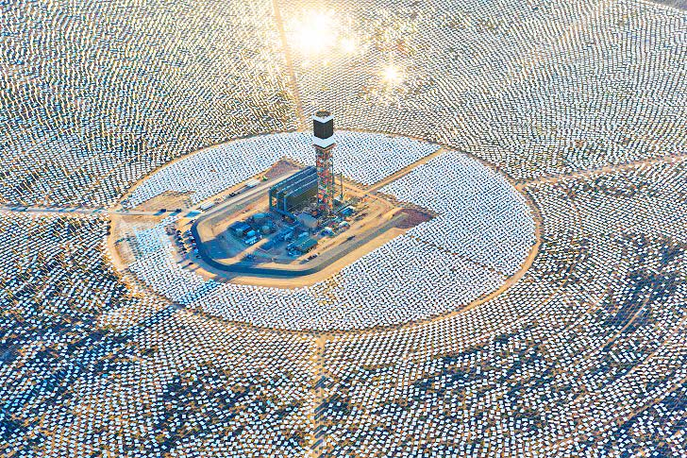
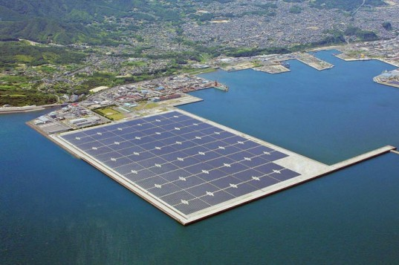
Renewable energy sources –how to store the produced energy?
Wind turbines – low energy density
Israel – 10 MW solar thermal pp.
(with backup biomass facility)
Renewables are either
INTERMITTENT
DIFFUSE or
LOW DENSITY!
Japan – 30 MW offshore solar pp.

Slide 3

Renewable energy sources –how to store the produced energy?
"Getting battery cost down is key, but on the stationary storage side there is a lot of questions about which chemistry will dominate long term. It might not be lithium…”
- Colin Langan at UBS on Tesla’s announcement of Powerwall Li batteries

Slide 4
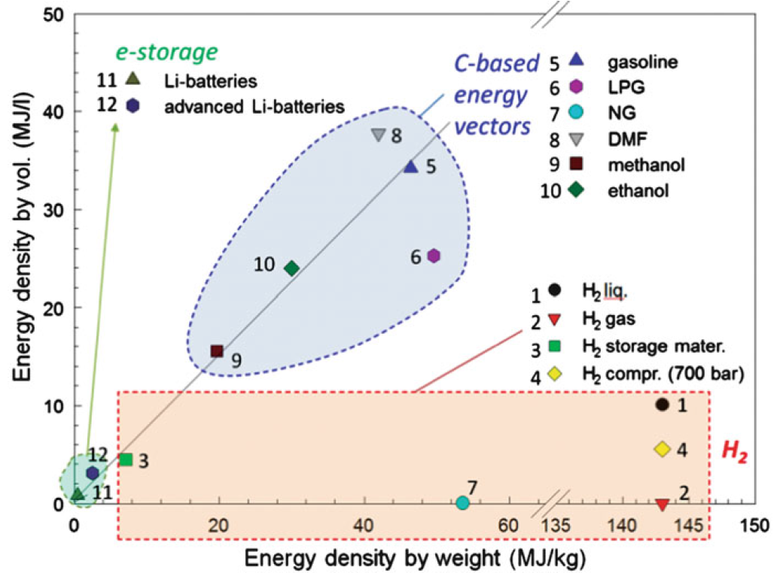
Energy density becomes decisive when it comes to applications
ESSENTIALS…
Appropriate volumetric AND gravimetric energy density.
Ease of storage (C-based).
Less toxic, safety of precesses.
Can be used with the existing technologies for fossils.
Low environmental impact (both production and use).
G. Centi, et al. in Catalysis for Alternative Energy Generation,
Eds. L. Guczi and A. Erdőhelyi, Springer (2012)

Slide 5
Hydrogen economy
(an attractive way to store
and distribute energy)

Slide 6
Analogy to fossil fuels – long ago stored energy of sunlight
Hydrocarbons
Hydrogen
ΔH_{r}° = -286 kJ/mol
ΔH_{r}° = -890 kJ/mol
Pros:
- Cheap access
- Cheap storage, process and distribution
- Optimal energy density
- Established technologies
(power plants and internal combustion engines)
- Accepted by society
Cons:
- CO₂ emission
- Finite sources
- efficiency limits
(power plants and engines)
- Air pollution
43 % percent of current energy usage comes from fossils!

Slide 7
Role of H₂ today – production and use
Production
Consumption
Only 0.25% of hydrogen is produced by electrolysis.
…because it is profitable only when electric power is cheap.
Privileged attention to water electrolysis comes with the hydrogen economy concept.
10⁹ m³_{N}
10⁹ m³_{N}
Steam reforming of nat. gas or naphta
200
Synthesis of ammonia
190
Partial oxidation of heavy oil
120
150
Process heat generation
Benzine reforming
90
100
Processing of mineral oil
Coal gasification
H YD R O G EN
50
Synthesis of ethene
25
Benzine reforming
33
Chlor-alkali industry
10
15
Fisher-Tropsch synthesis
Other
7
10
Other
(oxo synth.,
hydrogenation, reductions)
Water electrolysis
1,3
Encyclopedia of Electrochemistry, Vol. 5: Electrochemical Engineering, Wiley (2007)

Slide 8
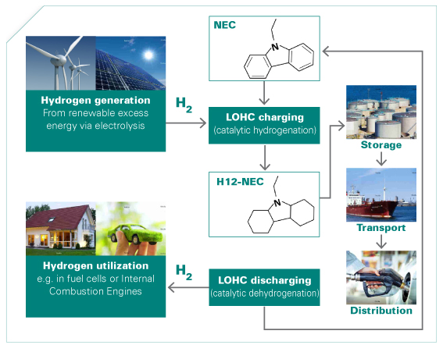
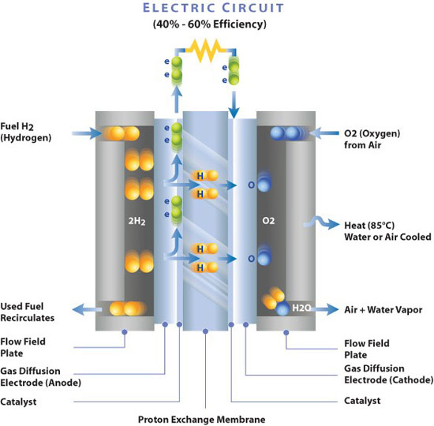
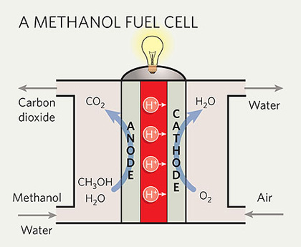
Use of H2 (or derived products) as energy carrier
Fuel cells
Methanol fuel cells
liquid H₂ carriers
Surya Prakash & Oláh György (1990)
The key to efficiency and to pay-off is CATALYSIS!

Slide 9
Production of H2 (or derived products) as energy carrier
Brown-H₂ example: reforming - net carbon reduction of 30%.
Green-H₂ example: electrolysis renewable - emissions-free.
Central
Coal
Gasification
(carbon capture)
High-Temp.
Water Electrolysis*
100,000,000
Coal
Gasification
(no carbon capture)
Biomass
Gasification
Water
Electrolysis
(solar)
Thermo-
Chemical*
Ethanol
Reforming
100,000
Water
Electrolysis
(wind)
Photo-
Electro-
chemical
Biological
50,000
Capacity (kg/day)
Distributed
10,000
Natural Gas
Reforming
Water
Electrolysis
(grid)
Bio-Derived
Liquids
Reforming
1,000
10
- 2015
2015-2020
2020-2030
Target: 0.15 € / kWh
*either solar or nuclear

Slide 10
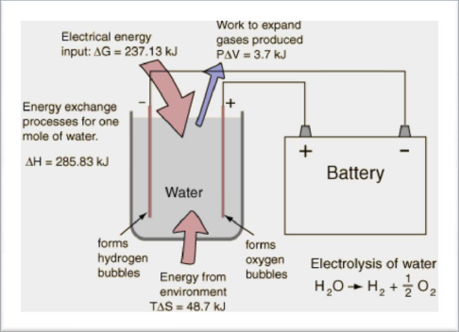
A considerable advantage of H₂ over CHs
Electrochemistry! Water electrolysis can be directly
connected with renewable power plants!

Slide 11
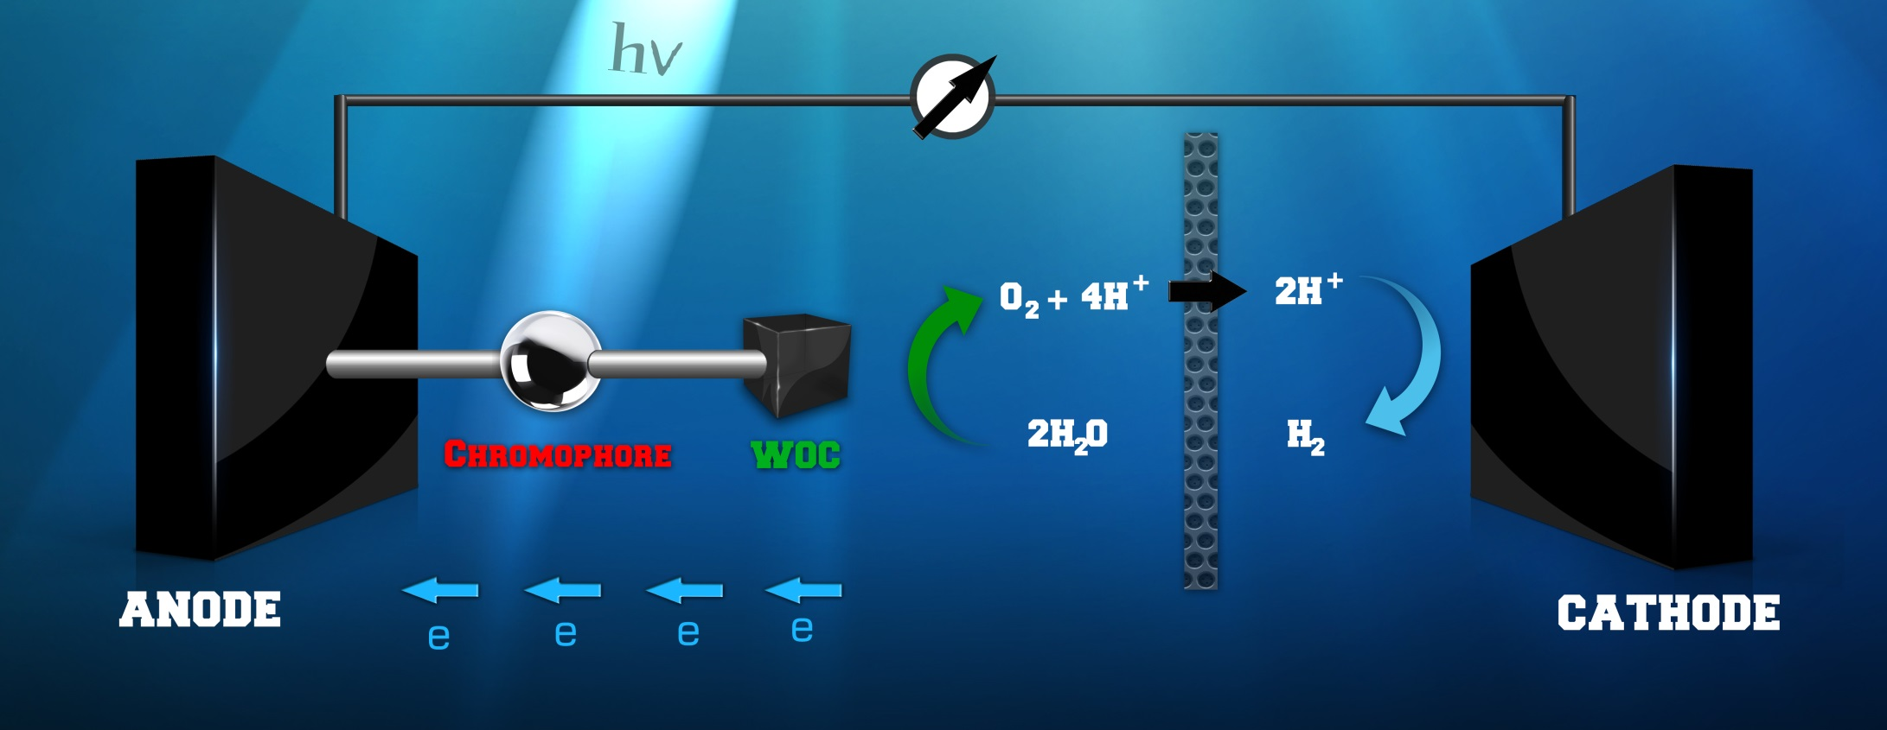
What is water oxidation and why is it important?
WOC: water oxidation catalyst,
a compound that can accelerate the evolution of O₂ from water and can be attached to electrode surface.

Slide 12
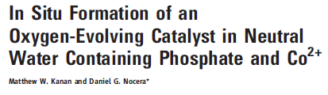
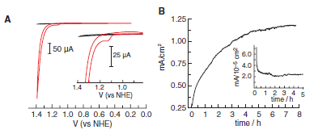
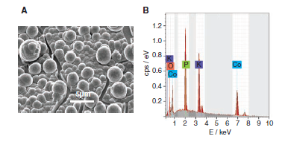
Self-organized metal oxides and hydroxides

Slide 13
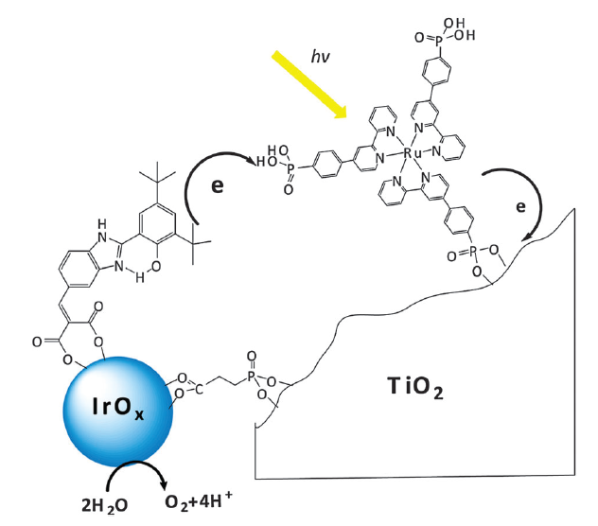
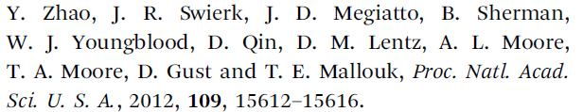
Photosensitized supramolecular systems

Slide 14
There is plenty of space for further research, because…
Homogeneous catalysts: stability (10⁴>TON), sensitivity (anions, contaminants)
Heterogeneous catalysts: rate (small TOF), deactivation (nano)
Electrocatalysts: overpotential
homogeneous: 0,6-0,9 V
heterogeneous: 0,2-0,4 V
Photocatalysts:
small quantum efficiency in the visible range of activation

Slide 15
…and studies in
our laboratory

Slide 16
Considerations
Transition metals that are cheap, abundant, have more available oxidation states.
Sc | Ti | V | Cr | Mn | Fe | Co | Ni | Cu | Zn
Y | Zr | Nb | Mo | Tc | Ru | Rh | Pd | Ag | Cd
La | Hf | Ta | W | Re | Os | Ir | Pt | Au | Hg
AIM: studying
supramolecular systems that in part
exploit molecular catalysts and carry potential
to merge advantages of the different approaches.
Three directions:
(1) Ru-based catalysts and related metal-organic frameworks,
(2) Cu complexes for electrocatalysis
(3) Photosensitized layered double hydroxides (LDHs) for photo(electro)catalysis.

Slide 17
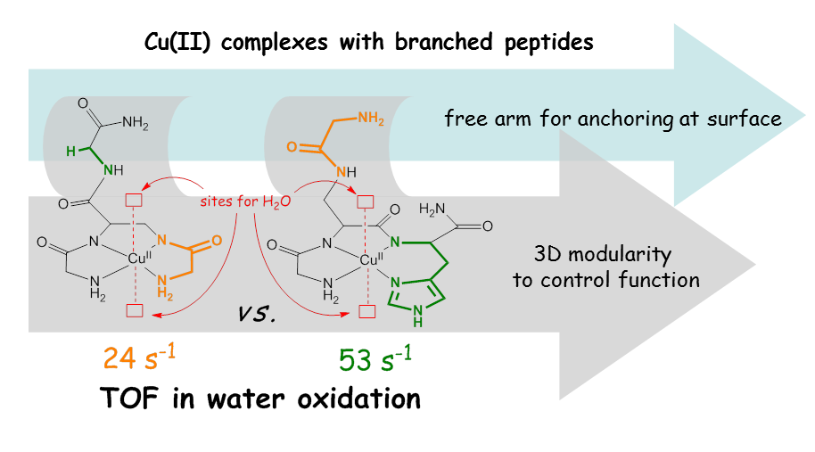
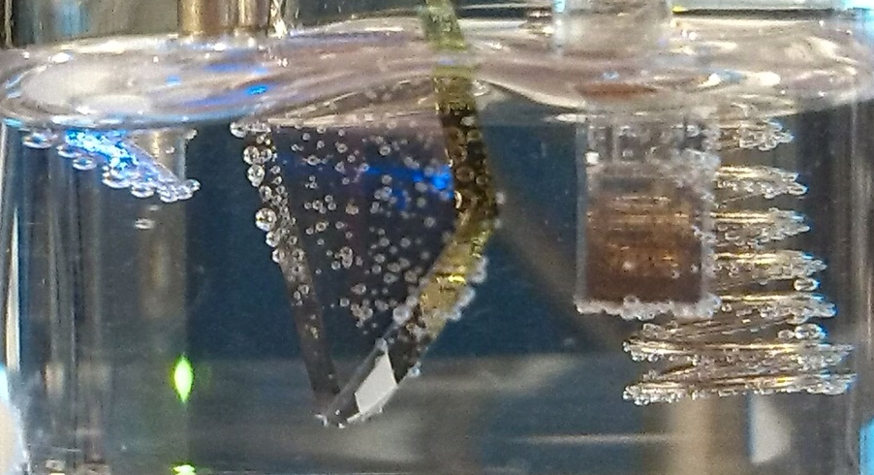

Slide 18

Ru-based MOFs
Problem:
ligand dissociation leads to rapid deactivation
Advantage:
complexes with no open sites are the most active catalysts
Molecular catalysts
Problem:
the lack of open sites bottlenecks catalytic applications
Advantage:
porous materials, existing options for surface anchoring (SURMOF)
MOFs

Slide 19
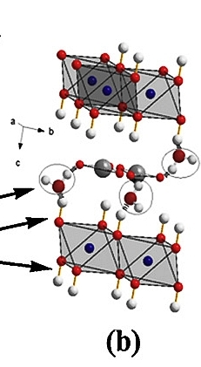
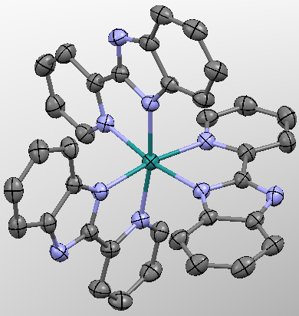
Photosensitized LDHs with abundant metals
Layered double hydroxides (LDH) [M’(II)_{1-x}M(III)_{x}(OH)₂]^{x+}[A^{m-}_{x/m}•nH₂O]^{x-}
- M’(II) and M(III) are variable
- r_{M’(II)} ≈ r_{M(III)}
Small molecule
photosensitizer
- Surface adsorbed water
- Weakly bound water
- Strogly bound water
- Intercalation options
Heat induces reversible
changes (memory effect)

Slide 20
Thank you for attention!
Köszönöm a figyelmet!

