Slide 1
Recent projects and possible cooperation topics with QERI
Dr. Bálint Hartmann
Renewable Energy Research group
Dr. Attila Talamon
Thermal Energy Research group

Slide 2
Recent projects
Possibilities of the utilisation of renewable and fossil energy sources at the site of Tisza II power plant
  Four-step evaluation (assessment of initial conditions, evaluation of energy sources, risk assessment, boundary conditions of national energy policies)
  Both conventional and renewable sources
  Recommendation prepared for the site owner
Feasibility and environmental economic evaluation of electricity and heat generation technologies
  MCDA (Multi-Criteria Decision Analysis) focusing on arbitrarily selected aspects
  Both conventional and renewable
  LCOE calculations
  Revision of the Hungarian Renewable Energy Action Plan for the Ministry of National Development

Slide 3
Recent projects
Development of highly energy-efficient data centre infrastructure (ongoing)
  Low PUE (Power Usage Effectiveness), decrease of AC and DC losses
  Utilisation of locally available renewable energy sources
  Integration of energy storage (kinetical, electrochemical, etc.)
  Waste heat reutilisation
Smart power from bioenergy by underground heat storage hybrid system (BUHS)
  Access to the electricity grid and also to traditional district heating systems
  Interseasonal energy management with underground heat storage
  New approach of energy producers and consumers
  Renewable energy hybrid system; integration of bio- and geoenergy technologies

Slide 4
Possible cooperation topics with QERI
#1: Building integrated renewable energy utilisation and energy management system, using energy storage
#2: Utilisation of energy storage to facilitate the integration of intermittent renewable energy sources into a power system, operating in islanded mode
#3: Implementing multifunctional building energy typology as a basis of future national/regional/district renewable energy research strategies and action plans
#4: Highlighting renewable energy potential at national and urban level using GIS mapping technology as an online DSS (Decision Support System)
#5: Facing Qatar 2022 FIFA World Cup residential energy challenges. District Cooling System (based on renewable energy) potential of Doha

Slide 5
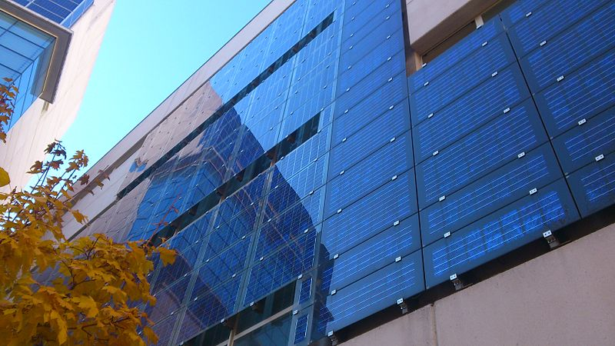

Topic #1
Building integrated renewable energy utilisation and energy management system, using energy storage
  Small-to-medium scale generation units
  Solar and wind energy

Slide 6
Topic #1
Advantages
  Decreasing power losses of urban distribution networks
    5-10%
    „Prosumer concept”
  Better MW/space ratio than conventional deployment
  Low cost local production
Challenges
  Generation potential estimation
  Energy Management System control algorithms
  New building designs (could be an advantage)

Slide 7
Topic #1 – selected publications
Talamon A, Hartmann B, Szoó D, Csoknyai T: Photovoltaic Cells vs. Solar Collectors: Primary Energy Generation Based Assessment Report
37th World Energy Engineering Congress, Washington DC, USA, 2014
Hartmann B, Török Sz, Börcsök E, Oláhné Groma V: Multi-objective method for energy purpose redevelopment of brownfield sites
JOURNAL OF CLEANER PRODUCTION 82: pp. 202-212., 2014
Papp Sz, Hartmann B: Examination of the impacts of solar panels on low-voltage distribution grid depending on the placement.
IEEE 4th IYCE, Siófok, Hungary, 2013
Vokony I, Hartmann B: Proposal of a Novel Operation and Control System for a Micro Renewable Energy Farm
IEEE 4th IYCE, Siófok, Hungary, 2013

Slide 8
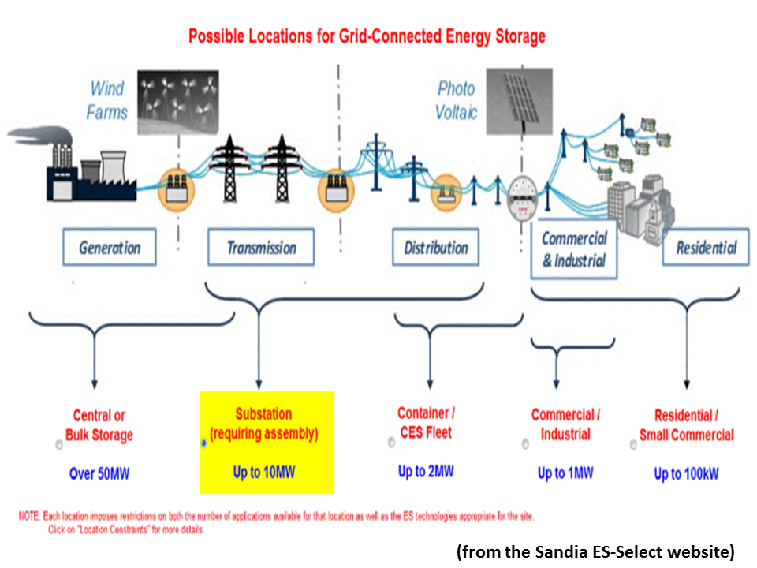
Topic #2
Utilisation of energy storage to facilitate the integration of intermittent renewable energy sources into a power system, operating in islanded mode
  Integration of intermittent
  renewable sources
  Distributed but centrally
  controlled units
  Capable of providing
  reserves and ancillary
  services

Slide 9
Topic #2
Advantages
  „Two birds with one stone”
    Increased renewable penetration
    Decreased reserve capacities, different allocation mechanisms
  High quality of supply in load centres with high power density
  Possibility to postpone strengthening and upgrading of network elements
Challenges
  Requirements of islanded operation
  Integration of electric vehicles
    Distributed storage units
  Control and management system (software)
  Necessity, feasibility

Slide 10
Topic #2 – selected publications
Hartmann B, Dán A: Methodologies for Storage Size Determination for the Integration of Wind Power
IEEE TRANSACTIONS ON SUSTAINABLE ENERGY 5:(1) pp. 182-189., 2014
Hartmann B, Dán A: Cooperation of a Grid-Connected Wind Farm and an Energy Storage Unit—Demonstration of a Simulation Tool
IEEE TRANSACTIONS ON SUSTAINABLE ENERGY 3:(1) pp. 49-56., 2012

Slide 11
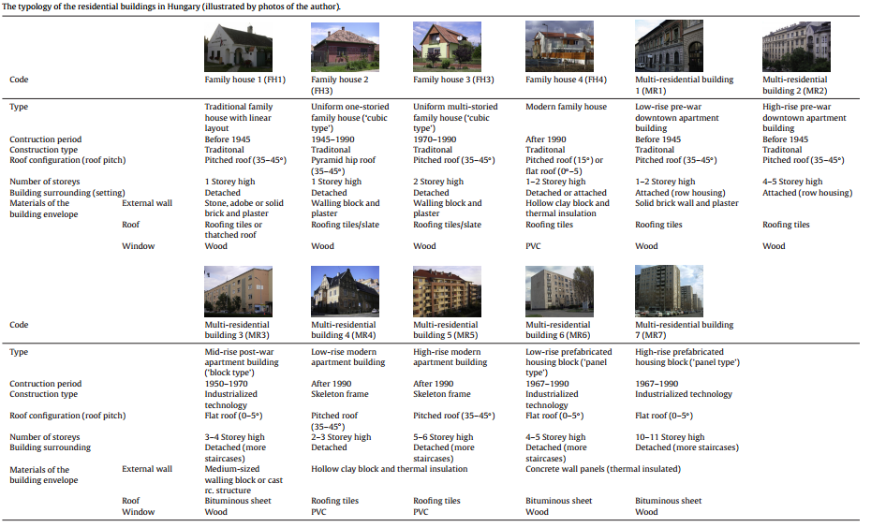
Topic #3
  Implementing multifunctional building energy typology as a basis of future national/ regional/ district renewable energy research strategies and action plans
  Setting up national
  building cadastre
  Energy efficiency and
  renewable energy
  utilization potential
  analysis
  Evaluation of
  possible hybrid
  energy systems
  GHG emission
  reduction

Slide 12
Topic #3
Advantages
  Multilateral usability
    Energy & Environmental potentials
  Useful in Decision Support Systems
  High quality of statistic data
  Possibility of developing GIS tools
Challenges
  Synchronizing existing statistical databases
  Architectural and engineering field surveys
  Adapting building sector to climate change

Slide 13
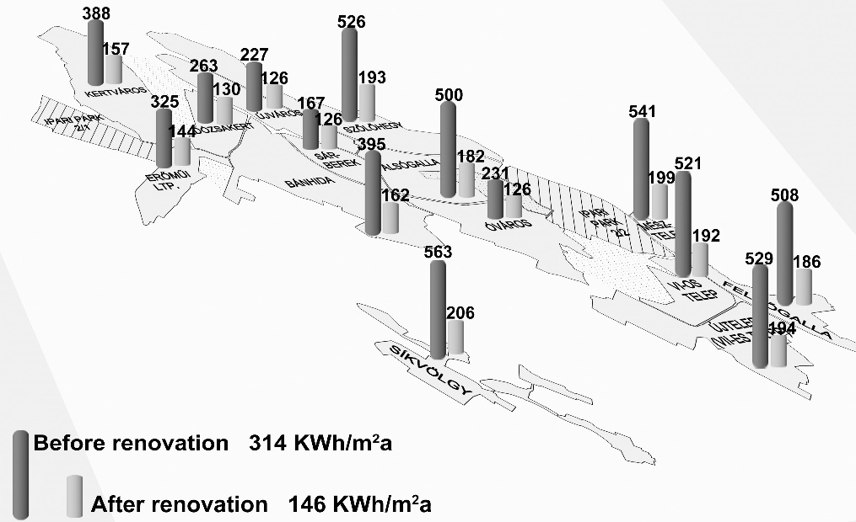
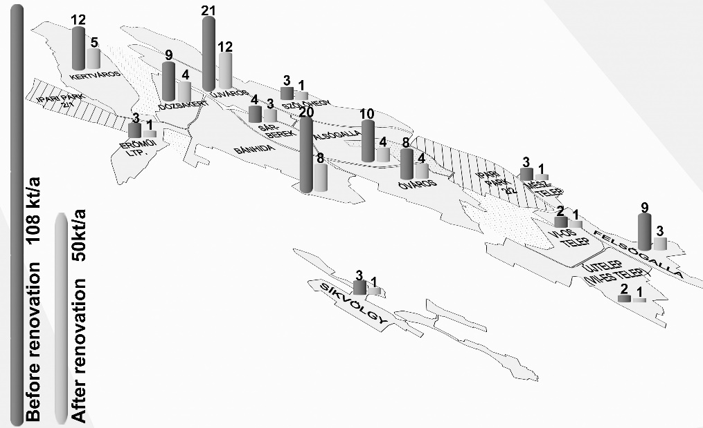
Topic #3
  Implementing multifunctional building energy typology as a basis of future national/ regional/ district renewable energy research strategies and action plans:
Hrabovszky-Horváth, S., Pálvölgyi, T., Csoknyai, T., Talamon, A.,, Generalized Residential Building Typology for Urban Climate Change Mitigation and Adaptation Atrategies: The Case of Hungary, Energy and Buildings Journal, Vol. 62/2013, pp: 475-485, Impact Factor: 2,809

Slide 14
Topic #3 – selected publications
Hrabovszky-Horváth S, Pálvölgyi T, Csoknyai T, Talamon A: Generalized Residential Building Typology for Urban Climate Change Mitigation and Adaptation Atrategies: The Case of Hungary
Energy and Buildings Journal, Vol. 62/2013, pp: 475-485
Talamon A, Hartmann B, Vokony I: Towards Zero Energy Buildings in Central Europe
34th World Energy Engineering Congress, Chicago, USA, 2011
Talamon A: Energy Efficiency Opportunities of the Public Buildings in Central Europe
33th World Energy Engineering Congress, Washington DC, USA, 2010

Slide 15
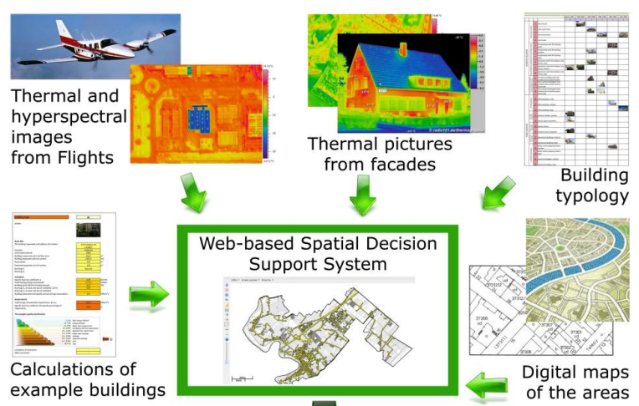
Topic #4
  Highlighting renewable energy potential at national and urban level using GIS mapping technology as an online DSS (Decision Support System)
  Analysing renewable
  energy potential on
  national level
  Nearly zero energy
  solutions for building
  sector
  Limitations of renewable
  energy solutions,
  particularly in case of
  densely built urban areas

Slide 16
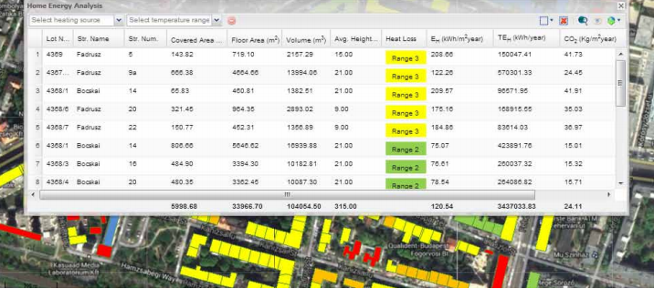
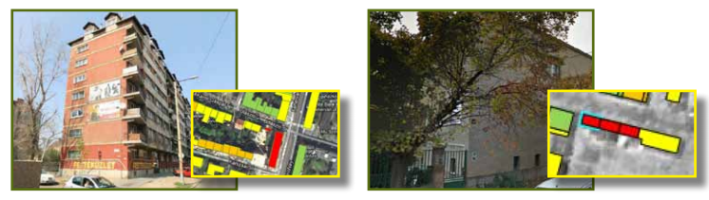
Topic #4
Advantages
  Multilateral usability
    Energy &
    Environmental
    potentials
  Useful in Decision
  Support Systems
  High quality of
  statistic data
  Possibility of developing GIS tools
Challenges
  Synchronizing existing
  statistical databases
  Architectural and
  engineering field surveys
  Adapting building sector to climate change

Slide 17
Topic #4 – selected publications
Talamon A, Csoknyai T, Szendrő G: Towards Zero Energy Buildings in Central Europe - GIS-based Mapping Tool of Urban Energy Potential
Book: Fuelling the Future - Advances in Science and Technologies for Energy Generation, Transmission and Storage, pp. 544-550, BrownWalker Press, Florida, USA, 2013
Pálvölgyi T, Csoknyai T, Hess N, Szendrő G, Talamon A: Remote sensing for energy saving,18th Building Services
Mechanical and Building Industry Days International Conference, Urban Energy Conference, Debrecen, Hungary, 2012

Slide 18

Topic #5
  Facing Qatar 2022 FIFA World Cup residential energy challenges. District Cooling System (based on renewable energy) potential of Doha
    High potential of district cooling
    technology
    Newly-built World Cup
    residental and other-function
    buildings
    Existing densily-built urban area
    Possible impact of the climate change
    in the framework of World Cup Schedule
    (Heating or Cooling?)

Slide 19
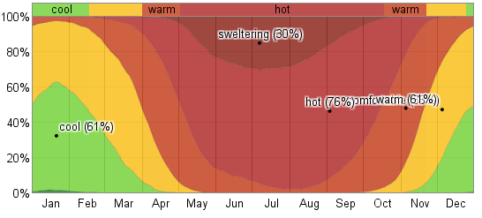
Topic #5
Challenges
  Performance of urban-level
  vulnerability assessments are
  strongly interlinked by the
  structure and composition of
  building stock
  Adapting the building sector to climate change
Advantages
  Multilateral usability
  Useful in Decision
  Support Systems
  Vulnerability
  evaluation
https://weatherspark.com

Slide 20
Topic #5 – selected publications
Talamon A, Csoknyai T: Monitoring of a Performance-oriented Policy Model for Retrofitting ’Panel Buildings’
Environmental Engineering and Management Journal, Vol. 10/2011, No. 9.
Talamon A: Building sector and climate change: The case of Hungary
Advanced Materials Research Journal, Volume 899, 2014, pp 99-104.
Talamon A: Climate Parameters in Built Environment from Energetic Point of View – Towards Climate Severity Index in Hungary
Ybl Journal of Built Environment, I., 2013/2, Versita, De Gruyter, London

Slide 21
Thank you for your attention!
hartmann.balint@energia.mta.hu
talamon.attila@energia.mta.hu

