Slide 1
Build Systems, Version Control, Integrated Development Environment

Slide 2
Build System
Please, no more compile.sh

Slide 3
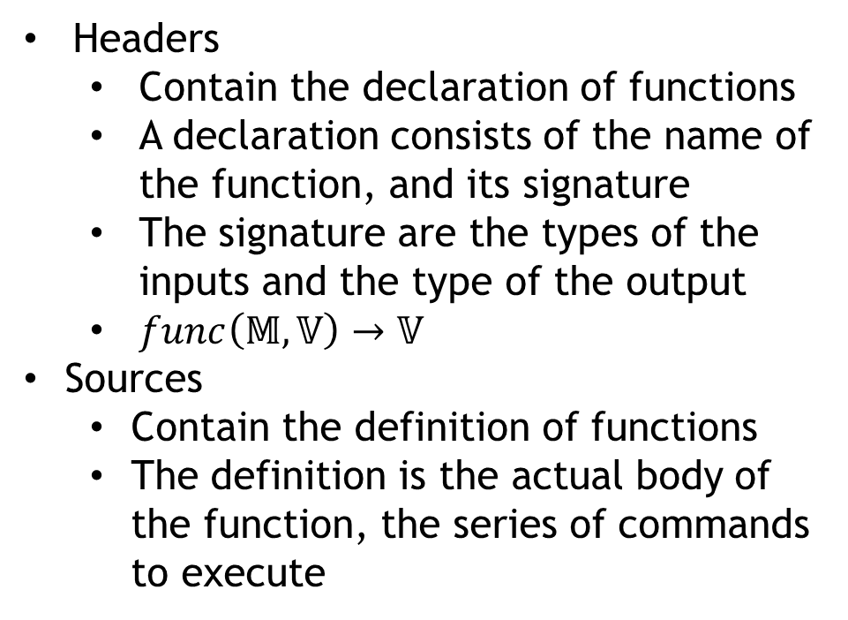
How does a C/C++ application compile?
vector
Headers
Contain the declaration of functions
A declaration consists of the name of the function, and its signature
The signature are the types of the inputs and the type of the output
$func\left(𝕄,𝕍\right)→𝕍$
Sources
Contain the definition of functions
The definition is the actual body of the function, the series of commands to execute
Application.cpp
algorithm
FileReader.cpp
iostream
Particle.cpp
RK4.hpp
Solver.cpp
Interaction.hpp
Sources
Headers

Slide 4
How does a C/C++ application compile?
vector
Each source file references (includes) $n$ headers
Headers may reference each other
C/C++ has a One Defintion Rule
Multiple inclusions of a header would violate ODR
Headers can be guarded against multiple inclusions (Include Guard)
Why do we split code like this if it’s so complicated?
Clear seperation of features from implementation
Compile times (see later)
Application.cpp
algorithm
FileReader.cpp
iostream
Particle.cpp
RK4.hpp
Solver.cpp
Interaction.hpp
Sources
Headers

Slide 5
How does a C++ application compile?
vector
Object files contain decorated machine code
They contain the native binary of the function bodies
Decoration consists of compiler generated identifiers to functions called symbols
Application.cpp
Application.o
algorithm
FileReader.cpp
FileReader.o
iostream
Particle.cpp
Particle.o
RK4.hpp
Solver.cpp
Solver.o
Interaction.hpp
Objects
Compiler
__operator*(classMat,classVec)->classVec

Slide 6
How does a C++ application compile?
vector
Application.cpp
Application.o
algorithm
MyApp.exe
FileReader.cpp
FileReader.o
iostream
Particle.cpp
Particle.o
RK4.hpp
MyLib.dll
Solver.cpp
Solver.o
Interaction.hpp
Compiler
Linker

Slide 7
How does a C++ application compile?
Linking an executable
The linker inspects all object files, and looks for a special function (called main)
Checks which functions are actually needed to create a functional executable and throw away the rest
If some library is marked for linking, include those symbols too
Some functions may be compiled multiple times
If the binaries to the same symbol match, throw away all but one
If they mismatch, throw a link time error
If there is some symbol missing, throw a link time error
By separating code to headers and sources, we minimize the chance of compiling the same function multiple times

Slide 8
Static versus dynamic libraries
Static
Dynamic
Linking statically triggers inclusion of symbols directly into the executable
Results in faster code
If many executables refer to the same library, they all include the same code
Linking dynamically triggers including only a reference to the symbol
Results in smaller executable
If many executable refer to the same library, the code exists only once on disk

Slide 9
What is a Build System?
A tool that takes care of building your application in the fastest way possible with minimal user effort.
The input is a make file, and the output is one or more binary/ies (hopefully). ☺
Examples of build Systems:
GNU Make
NMake
MSBuild
Ninja
Qmake
CMake

Slide 10
Why use a Build System?
Didn’t I just say „Minimal user effort”?!
Build Systems aim at being as comfortable to use as possible
User declares the task, instead of specifying what to do
Declarative DSL, not imperative
Didn’t I just say „Maximum throughput”?!
Detects the minimal portion of the program that must be recompiled when editing code.
Uses time stamps
Processes independent parts of the build tasks in parallel
Requires learning, but pays off in the long run!

Slide 11
Choosing a build system
Build System | Human readable | Graphical front-end | Portable | Generator
GNU Make | ✓
NMake | ✓
MSBuild | (✓) | ✓ | ✓
Ninja |  |  | ✓
Scons
Waf
Invoke-Build
QMake | ✓ | ✓ | ✓ | ✓
CMake | ✓ | (✓) | ✓ | ✓

Slide 12
GNU Make
Part of the GNU open-source software stack
It is included in all Linux distributions
User provides set of tasks
Task name
Dependency of task
Command-line to execute
edit : main.o kbd.o command.o display.o \ insert.o search.o files.o utils.o cc -o edit main.o kbd.o command.o display.o \ insert.o search.o files.o utils.o main.o : main.c defs.h cc -c main.c kbd.o : kbd.c defs.h command.h cc -c kbd.c command.o : command.c defs.h command.h cc -c command.c display.o : display.c defs.h buffer.h cc -c display.c insert.o : insert.c defs.h buffer.h cc -c insert.c search.o : search.c defs.h buffer.h cc -c search.c files.o : files.c defs.h buffer.h command.h cc -c files.c utils.o : utils.c defs.h cc -c utils.c clean : rm edit main.o kbd.o command.o display.o \ insert.o search.o files.o utils.o

Slide 13
NMake
Part of Microsoft’s Visual Studio software stack
Should be considered legacy
User provides set of tasks
Task name
Dependency of task
Command-line to execute
Cannot perform tasks in parallel
Sample pending

Slide 14
MSBuild
The build system that is currently used by Microsoft’s Visual Studio
It has been open-sourced and is available on Linux
XML-based
Limited human-readability
Best used with a graphical front-end
Sample pending

Slide 15
Ninja
Incredibly fast build system
Sacrifices human readability
DSL favors not the user, but the machine
It is meant to be generated by other tools, not hand authored
Portable
Open-source

Slide 16
QMake
Make file generator
Provide one input
Ability to produce make files for multiple other build systems
Portable
Open-source
Designed to serve the needs of the Qt Project

Slide 17
CMake
Make file generator
Portable
Open-source
Knows most languages by default
The known ones are EASY to use
Others can be taught
DSL script language sometimes unfriendly
Most cross-platform projects use it
PROJECT(my_app)
LIST(SOURCES)
APPEND(SOURCES main.cpp vector.cpp)
ADD_EXECUTABLE(${PROJECT_NAME} SOURCES)

Slide 18
Use something
We are not workflow nazis anything is better than compile.sh
If you don’t know any build system, we highly recommend learning CMake
Extremely simple for small projects
Scales well (depending on scripting affinity/skill)
It is portable
It is mainstream (has great momentum)
Actively being developed (and is actually evolving)
Even if you know one, we recommend giving CMake a chance

Slide 19
CMake + CTest + CPack + Cdash = EXIT_SUCCESS
Kitware is the company behind the CMake suite of tools
Full-fledged scripting language to do virtually anything
It is (finally) documented
Gazillions of tutorials online
Feature missing?
It’s open-source, so feel free to contribute
Don’t have time? Hire us to do it!
Big projects using CMake suite of tools
Bullet Physics Engine, CLion, Compiz, cURL, ROOT, GEANT4, GROMACS, KDE, libPNG, LAPACK, LLVM, Clang, MySQL, OGRE, OpenCV, SFML, zlib, …

Slide 20
Why strive on remaining portable
Portability is important!
Today, you might write the code for yourself, but tomorrow you might have to give it to a collegue
If your code is bound to a specific OS, compiler, etc. They will be more reluctant to use your code
Dependencies
The portability of code is the union of restrictions imposed by:
Tools required to build the application
Environment required to run the application
Prefer portable tools over non-portable (have good reason to defect)
Understand the costs of depending upon external software (even OSS)

Slide 21
What can CMake do for you?
A decent scripting language for authoring make files.
It is not declarative, but imperative (more powerful, but makes room for errors)
Multiple (semi-)automated ways of discovering dependencies
Ability to separate common build rules from platform, compiler specific rules

Slide 22
What can CMake do for you?
Research project
./
Physics library
./phys
Application
./app
src
./app/src
inc
./app/inc
src
./phys/src
inc
./phys/inc
Phys stuff
stuff.cpp
More stuff
more.cpp
Declarations
decl.hpp
Main
main.cpp
Header
header.hpp

Slide 23
What can CMake do for you?
Research project
./
Physics library
./phys
Application
./app
src
./app/src
inc
./app/inc
src
./phys/src
inc
./phys/inc
Phys stuff
stuff.cpp
More stuff
more.cpp
Declarations
decl.hpp
Main
main.cpp
Header
header.hpp
Top-level make file
CMakeLists.txt
Library make file
CMakeLists.txt
Application make file
CMakeLists.txt

Slide 24
Top-level CMakeLists.txt
cmake_minimum_required (VERSION 2.8.11)
# CMakeLists files in this project can
# refer to the root source directory of the project as ${RESEARCH_SOURCE_DIR} and
# to the root binary directory of the project as ${RESEARCH_BINARY_DIR}.
project (RESEARCH)
# Recurse into the „phys" and „app" subdirectories. This does not actually
# cause another cmake executable to run. The same process will walk through
# the project's entire directory structure.
add_subdirectory (phys)
add_subdirectory (app)

Slide 25
Library CMakeLists.txt
cmake_minimum_required (VERSION 2.8.11)
# Create a library called „Phys" which includes the source files „stuff.cpp” and „more.cpp”.
# The extension is already found. Any number of sources could be listed here.
add_library (Phys src/stuff.cpp src/more.cpp)
# Make sure the compiler can find include files for our Phys library
# when other libraries or executables link to Phys
target_include_directories (Phys PUBLIC ${CMAKE_CURRENT_SOURCE_DIR}/inc)

Slide 26
Application CMakeLists.txt
cmake_minimum_required (VERSION 2.8.11)
# Add executable called „Application" that is built from the source files
# „main.cpp”. The extensions are automatically found.
add_executable (Application src/main.cpp)
# Make sure the compiler can find include files for our Application sources
target_include_directories (Application PUBLIC ${CMAKE_CURRENT_SOURCE_DIR}/inc)
# Link the executable to the Phys library. Since the Phys library has
# public include directories we will use those link directories when building
# Application
target_link_libraries (Application LINK_PUBLIC Phys)

Slide 27
Configuring the build system
PS C:\Users\Matty\Build\Research\NMake> cmake -G "NMake Makefiles" C:\Users\Matty\OneDrive\Develop\Tests\CMake\CMake_example\
-- The C compiler identification is MSVC 19.0.23026.0
-- The CXX compiler identification is MSVC 19.0.23026.0
-- Check for working C compiler: C:/Kellekek/Microsoft/Visual Studio/14.0/VC/bin/amd64/cl.exe
-- Check for working C compiler: C:/Kellekek/Microsoft/Visual Studio/14.0/VC/bin/amd64/cl.exe -- works
-- Detecting C compiler ABI info
-- Detecting C compiler ABI info - done
-- Check for working CXX compiler: C:/Kellekek/Microsoft/Visual Studio/14.0/VC/bin/amd64/cl.exe
-- Check for working CXX compiler: C:/Kellekek/Microsoft/Visual Studio/14.0/VC/bin/amd64/cl.exe -- works
-- Detecting CXX compiler ABI info
-- Detecting CXX compiler ABI info - done
-- Detecting CXX compile features
-- Detecting CXX compile features - done
-- Configuring done
-- Generating done
-- Build files have been written to: C:/Users/Matty/Build/Research/NMake

Slide 28
Invoking the build system
PS C:\Users\Matty\Build\Research\NMake> nmake
Microsoft (R) Program Maintenance Utility Version 14.00.23026.0
Copyright (C) Microsoft Corporation. All rights reserved.
Scanning dependencies of target Phys
[ 20%] Building CXX object phys/CMakeFiles/Phys.dir/src/stuff.cpp.obj
stuff.cpp
[ 40%] Building CXX object phys/CMakeFiles/Phys.dir/src/more.cpp.obj
more.cpp
[ 60%] Linking CXX static library Phys.lib
[ 60%] Built target Phys
Scanning dependencies of target Application
[ 80%] Building CXX object app/CMakeFiles/Application.dir/src/main.cpp.obj
main.cpp
[100%] Linking CXX executable Application.exe
[100%] Built target Application

Slide 29
Few things to note
Where did we specify in the make scripts how to invoke the compiler?
CMake looks for installed compilers and choses one it likes
Can be overriden when configuring the build
What are the actual compiler switches, to make things work?
User must not need to know compiler options in the most common cases
Can be extensively customized if needed
What order must things be built?
CMake builds dependency graph and generates make files accordingly

Slide 30
Just the tip of the iceberg
CMake scripts are not declarative, but an imperative script language
Turing complete (you can do ANYTHING with it)
file command
Write to a file
Read from a file
Hash a file
Create directories
Download files
Upload files
Collect file names matching regex

Slide 31
What about my dependencies?
Depending on a library built alongside the application is simple, but what about external dependencies?
Find module
Module config files look for a given library in the most common install locations
On Linux it’s fairly trivial, on Windows it usually relies on env. vars.
If the library is found, it sets some variables that facilitate consumption
If not, it prompts the user to provide the root directory of the installation
There are 143 pre-installed FindModule.cmake files shipping with CMake.
Let us omit the body of such a file. No black magic, but it is vastly outside to scope of this showcase.

Slide 32
Application CMakeLists.txt
# Look for common installation layouts of MPI
# If found, it will set some variables, otherwise it will throw an error
find_package (MPI REQUIRED)
# Make sure our application’s sources find the include files of MPI
target_include_directories (Application PUBLIC ${MPI_INCLUDE_DIRS})
# Link the executable to the MPI library.
target_link_libraries (Application ${MPI_LIBRARIES})

Slide 33
But we can do better
Couldn’t everything be done automatically?
Package config
Package config files provide end-users with the exact layout of a given installation and all the tasks needed to consume the library
The libraries will always be found without user interaction, no matter how exotic the installation is
How does it work?
Windows, HKEY_CURRENT_USER and HKEY_LOCAL_MACHINE registry entries hold paths for user wide and system wide registered packages
Linux, $(HOME)/.cmake/packages folder holds files with package paths

Slide 34
Application CMakeLists.txt
# Look for a registered clFFT installation
# Without „PACKAGE” it starts by looking for package and then for modules
find_package (CLFFT PACKAGE REQUIRED)
# We don’t need to set any include directories, as the package promotes
# usage to consumers
# Link the executable to the clFFT library.
target_link_libraries (Application PUBLIC CLFFT)

Slide 35
Unit Testing
Writing modular code is good
Easier to maintain
Better chance at being reusable
Faster to compile (!)
Testable
Imagine our phys library to contain only the impementations of physical phenomena
This code might be reused elsewhere, our concrete simulation might only be one use case
Seeing the expected results in one application does not mean that phys contains no bugs

Slide 36
Unit Testing
Isolate parts of the code that can stand on it’s own
Create minimal use cases that have predictable outcome
Vector addition
Matrix multiplication
Periodic boundaries
Numerical stability
Etc.
Check if all of your code behaves as expected in these minimal use cases
If all your code passes Unit Testing, you have a much better chance to avoid bugs in consuming code

Slide 37
Enter CTest
# Enable testing functionality
enable_testing ()
add_executable (UnitTest1 src/test1.cpp)
target_link_libraries (UnitTest1 LINK_PUBLIC Phys)
# Add unit test that reads an input file, processes it and validates against
# a file of known correct results
add_test (NAME „Vector operations”
COMMAND UnitTest1 --input detector.dat --validate result.dat)

Slide 38
CTest output
PS C:\Users\Matty\Build\Research\NMake> ctest
Test project C:/Users/Matty/Build/Research/NMake
Start 1: Vector operations
1/1 Test #1: UnitTest1 ...................... Passed 1.58 sec
100% tests passed, 0 tests failed out of 1
Total Test time (real) = 1.58 sec
By default checks if the exit code of UnitTest1 is 0 or not.
Can be customized to match console or file output to another file or even a regular expression instead
The formatting of CTest’s output can also be customized

Slide 39
CPack for cross-platform packaging
Applications built with CMake can trivially be packaged for distribution
Because packaging varies greatly between platforms, requires duplicated „boilerplate”
Boilerplate is package author, company name, version, icons, contact, etc.
10-20 lines per platform can create
DEB packages
RPM packages
Self-extracting EXE installers

Slide 40
Version Control
The art of roll-back

Slide 41
Version Control: Why should you care?
Short version: the entire world is using it, so should you.
Long version: even small scale software development is full of „trial and error”, which is not a linear workflow, but rather tree-like.
Updating the working copy of the source tree will result in times when your application is not functioning (might not even build)
Manually keeping functioning copies of the code base with feature A, feature A+B, feature A+C-B, etc. is tedious and you WILL MESS UP
Back-up is essential, cloud storage helps, but not alone
Collaborating without version control is very hard
There is no holy grail, the best kind depends on your workflow

Slide 42
Centrallized Version Control - Locking

Slide 43
Centrallized Version Control - Merging

Slide 44
Distributed Version Control - Merging

Slide 45
Differences between
 | Centrallized | Distributed
Hard drive space required for history? | None | Could be a lot
Who has the latest version? | Central „master version” | Depends on policy
Where is the full history? | Central machine | Local machine
Work offline? | No* | Yes
How fast are operations? | Network-dependent | Blazing, most are local
Branching and merging? | Reliable, use with caution | Reliable, use often
Learning curve? | Relatively simple | Relatively hard

Slide 46
Chosing the right one
Examples of VCS
CVS
Subversion
Bazaar
VSS
TFVC
Mercurial
Git
Some might suit your needs better than others, but we recommend one of two:
Git: very powerful, widespread/mainstream, fairly hard to learn
Mercurial: very good, widespread, easier to learn

Slide 47
Comparing Mercurial to Git
Mercurial is like James Bond
Git is like MacGyver
Has all those sexy and easy to use gadgets
Solves most problems in an instant
In the rare cases when none of the gadgets are useful, he’s pretty much screwed
Has a screwdriver and a hammer
Can solve anything, with the given time and effort
When hell breaks loose, he can assemble some ugly script that will ultimately save the day

Slide 48
Git FTW
There are too many good tutorials online to provide an in-depth course in this limited time
Using Git with Visual Studio 2013
Learn Git branching
There is a decent set of IDE support available as well as GUI and command line auxiliary tools
Posh-git
Tortoise Git
Git Extensions

Slide 49
General Git/Mercurial workflow
Declare one branch as stable and always functional (master)
Create branches for features/fixes you want to implement
When a feature is ready, merge it into master
This way
Switching between branches to work on half-baked features is safe and trivial
If your collegue asks you to do something with your app, there is always a functioning master to switch to

Slide 50
Setting up Git
Set the default name, e-mail and push method associated with your commits
git config --global user.name "Gipsz Jakab„
git config --global user.name gipsz.jakab@wigner.mta.hu
git config --global push.default simple
Set up SSH authentication to the Wigner Git server
In your $(HOME)/.ssh/config create an entry like
host wigner-git
hostname git.wigner.mta.hu
user gitolite
port 9419
identityfile ~/.ssh/id_rsa
Write an e-mail to admin@wigner.mta.hu with your Public SSH Key for authetntication

Slide 51
Start working with Git
Create a local repository on your dev box
git init
The repo is initially empty, at least one commit is required to create the default master branch
git commit -a
Create a repository on a remote machine
Write an e-mail to admin@wigner.mta.hu with repo name and access control
Clone (fetch) the remote content (initially empty)
git clone wigner-git:reponame
Do the first commit to create the master branch

Slide 52
A simple development cycle
Create a branch for a given feature
git branch my-feature
Change to seeing the new branch (initially identical to master)
git checkout my-feature
Create/delete/modify files, folders as needed
Occasionally commit your work to the local repo
git commit -A
When the feature is done and tested, merge it into master
git checkout master
git pull master
git merge my-feature
Push your work to the remote repository
git push

Slide 53
Help?
Whenever in doubt
git branch
git status
http://google.com

Slide 54
Integrated Development Environment
The swiss army knife of programming

Slide 55
The lazy programmer
“I will always choose a lazy person to do a difficult job because a lazy person will find an easy way to do it.” – Bill Gates, former Microsoft CEO

Slide 56
What is an IDE?
Text editor
Compiler
Build System
Versioning Control
Profiler
Documentation Generator
Bug tracker
Collaboration tool
…

Slide 57
IDE versus toolchain
Integrated Development Environment
Toolchain
Pro
End-to-end automation
Workflow is natural
Easy to learn, hard to master
Con
Gotta cook with what you got
Con
Distinct tools for everything
Some glitches here and there
Hard to learn, hard to master
Pro
Choose the best of everything

Slide 58
Visual Studio
The industry standard IDE
Used to develop all of Microsoft’s software
By far the most full feautered IDE
Exhaustive list of Add-Ins
Is totally free for small dev teams or non-profit use

Slide 59
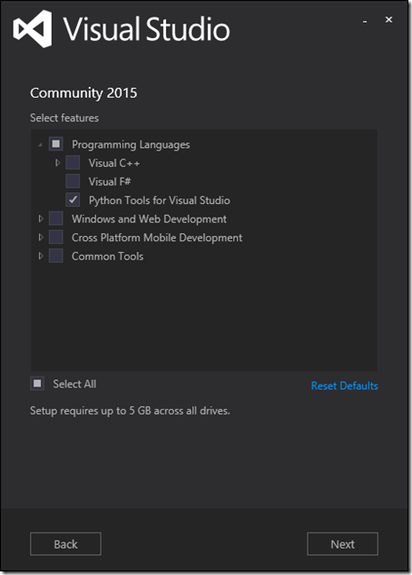
Installing Visual Studio
https://www.visualstudio.com/
Download Community 2015
Run the installer
Select development tools you need
Visual C++
Visual F#
Python
Go and have lunch

Slide 60
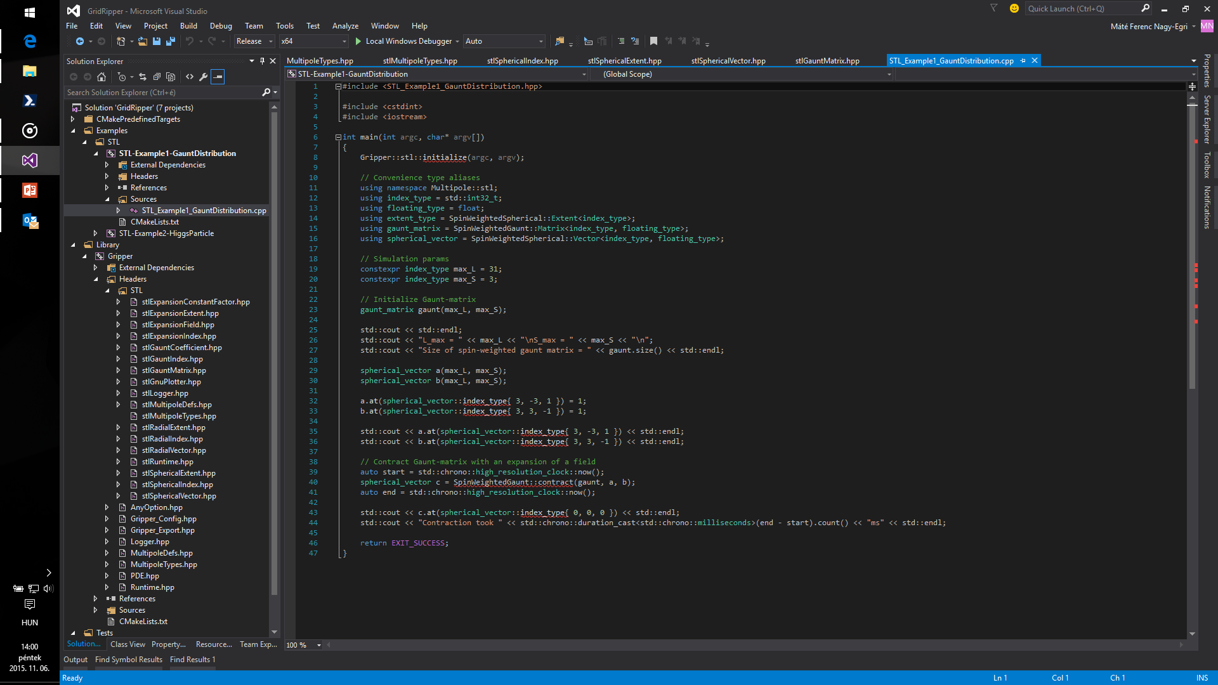
How it looks like
Text editor usually dominates the UI
IntelliSense
Visual representation of the build system
Debug code visually
Performance counters visualized
Source Control integrated

Slide 61
Developing on Linux
While Visual Studio pretty much rocks, not everyone is content with having to work on a Windows desktop
Using IDEs are somewhat alien to the Linux developer community
Usually toolchains are preferred
While there are good IDEs out there, there is no real competition
A non-exhaustive list of decent IDEs
Qt Creator
Code::Blocks
Eclipse
KDevelop

Slide 62
Qt Creator
Widespread IDE for cross-platform development
Used to develop most Qt applications
Easy to install
Easy to learn
Is totally free for developers of open-source software

Slide 63
Installing Qt Creator
Ubuntu
sudo apt-get install qtcreator
OpenSUSE
zypper install qt-creator
Scientific Linux
Yum install qt-creator

Slide 64
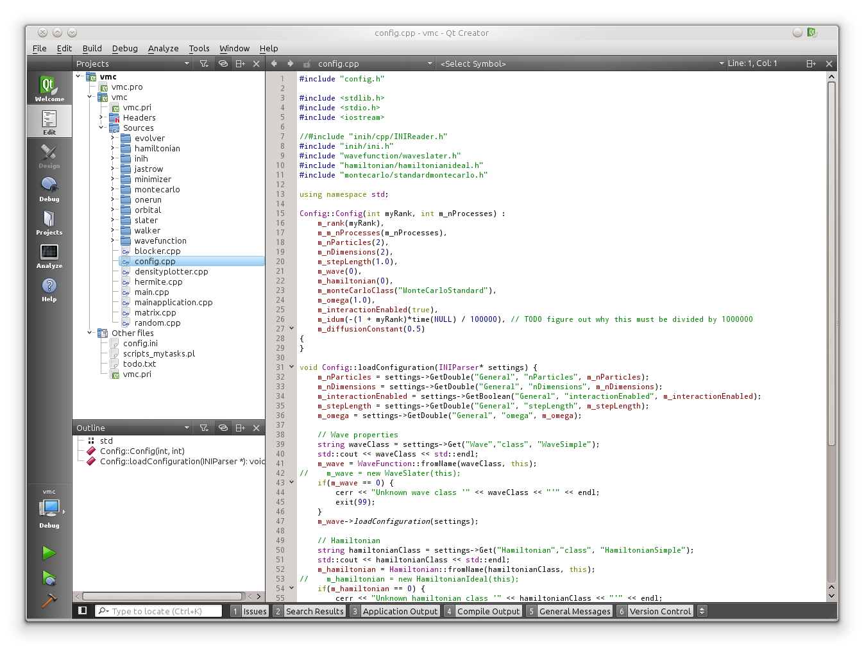
How it looks like
Text editor usually dominates the UI
Code completion
Visual representation of the build system
Debug code visually
Create portable projects

