Slide 2
Beam transfer opportunities
Brennan Goddard
Group Leader, CERN TE/ABT
Wigner Institute 7th June 2016

Slide 3
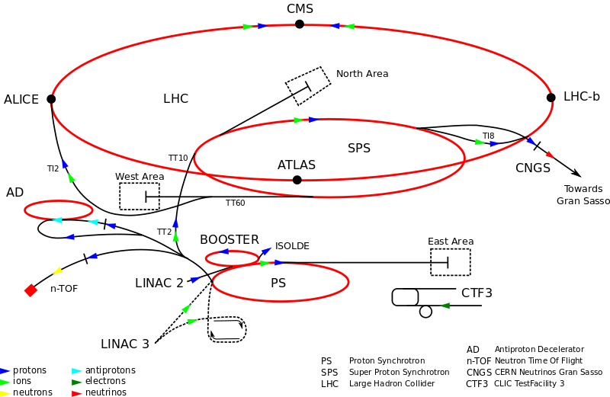
CERN’s particle accelerators
Many clients for beam!

Slide 4
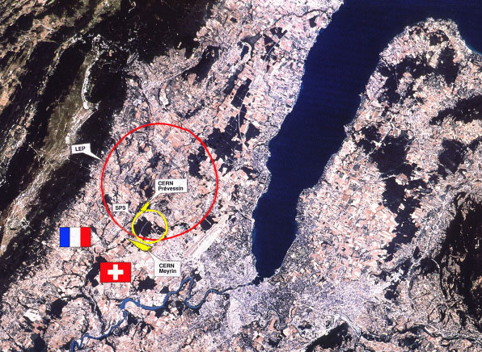
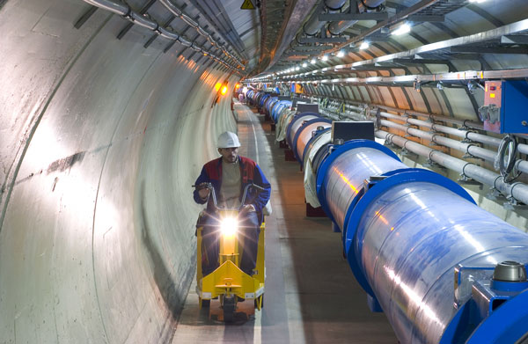
CERN’s flagship - LHC
The Large Hadron Collider (LHC):
  Two beams of trillions of protons flying around a 27km ring at 0.999999991 times the speed of light in opposite directions ....
  ...each proton has 7’500 time the mass of a stationary proton
  7 TeV beam mean 8.3 T for 3 km bending radius....

Slide 5
“HEP” programs at CERN
LHC – 14 TeV c.o.m. energy frontier, and heavy ions
SPS – various experiments (CP violation, neutrinos, …)
PS – various experiments (dimesons, clouds, …)
AD/ELENA – antiproton and antihydrogen
AWAKE – plasma wakefield acceleration
CTF/CLIC/ILC – linear colliders
ISOLDE – radioactive nuclear beams
Others – search for axions, medical accelerators, neutron interaction cross sections, …

Slide 6
Where are HEP accelerators headed?
An exciting time in HEP and for accelerators at the energy frontier
  LHC taking data at 13 TeV c.o.m.
    More confirmation of the standard model validity…?
    Or will it see some signs of Supersymmetry…??
    Or is there a 750 GeV scalar…???
  Next generation of large colliders being studied
    Linear collider effort well advanced (CLIC, ILC)
    Recent focus on circular colliders: FCC study
  Aiming high: FCC
    100 km circumference, 16-20 T dipoles, 100 TeV c.o.m. p
    Possible use as Higgs factory, with 500 GeV c.o.m. e-e-

Slide 7
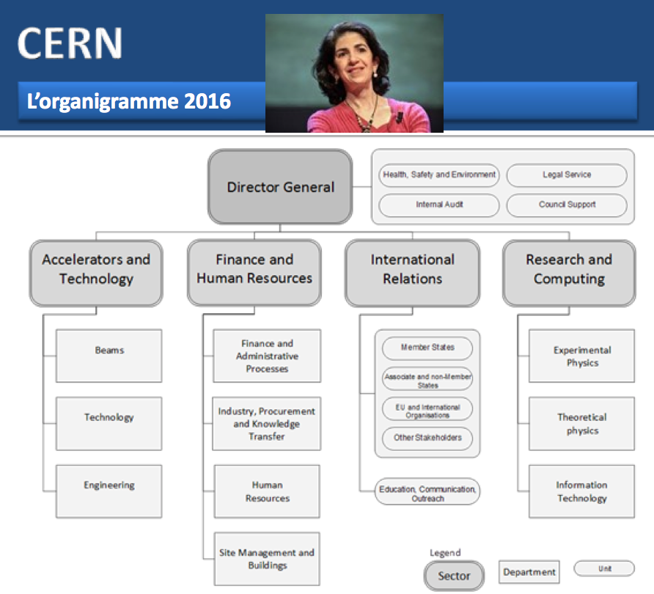
CERN
c

Slide 8
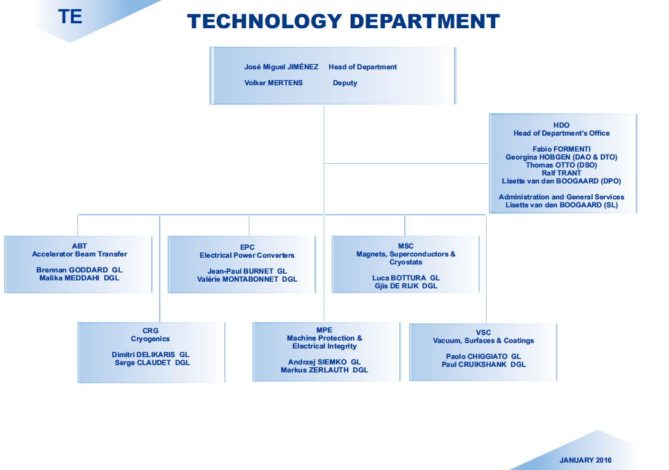

Slide 9
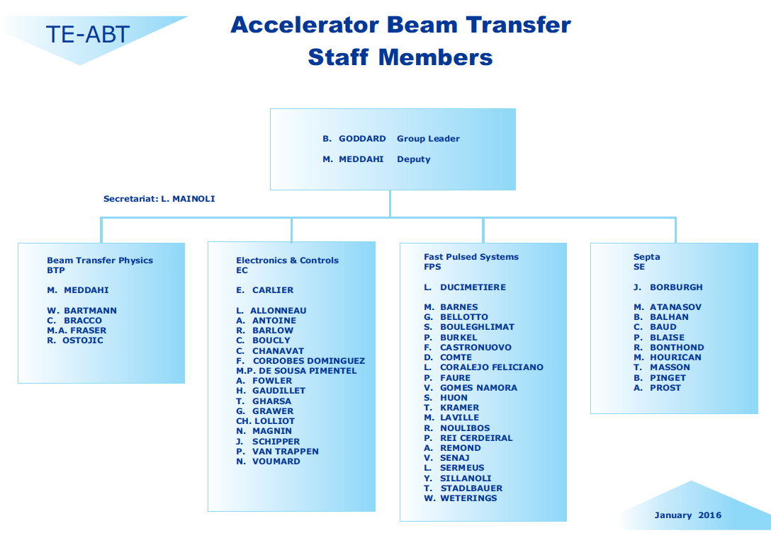

Slide 10
CERN ABT group
Design, produce and operate over 80 kicker systems.
  Rise times: 5ns (CLIC) to 2.8 µs (LHC).
  Pulse durations up to 90 µs (typically <1% ripple).
  Pulsed currents up to 20 kA (LHC MKD).
  Voltages up to 80 kV (PS).
Design, build and operate septum magnets
  From DC to ~ms pulse length
  Fields from 0.05 to 1.6 T
  Currents up to 24 kA DC.
Competencies in pulsed power technology, high voltage engineering, mechanical design and production, handling of UHV, testing and maintenance.

Slide 11
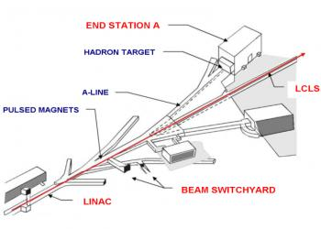
Beam Transfer Systems
Switching beams in or out of accelerators, or between beamlines
Kickers and septa (and special beamline magnets)
Performance: field strength, rise time, field quality, aperture, …

Slide 12
Kickers and septa
Beam injection, extraction, disposal
Tune Measurements
Beam chopping

Slide 13
Selected Kicker Hardware

Slide 14
Usual Kicker system topology

Slide 15
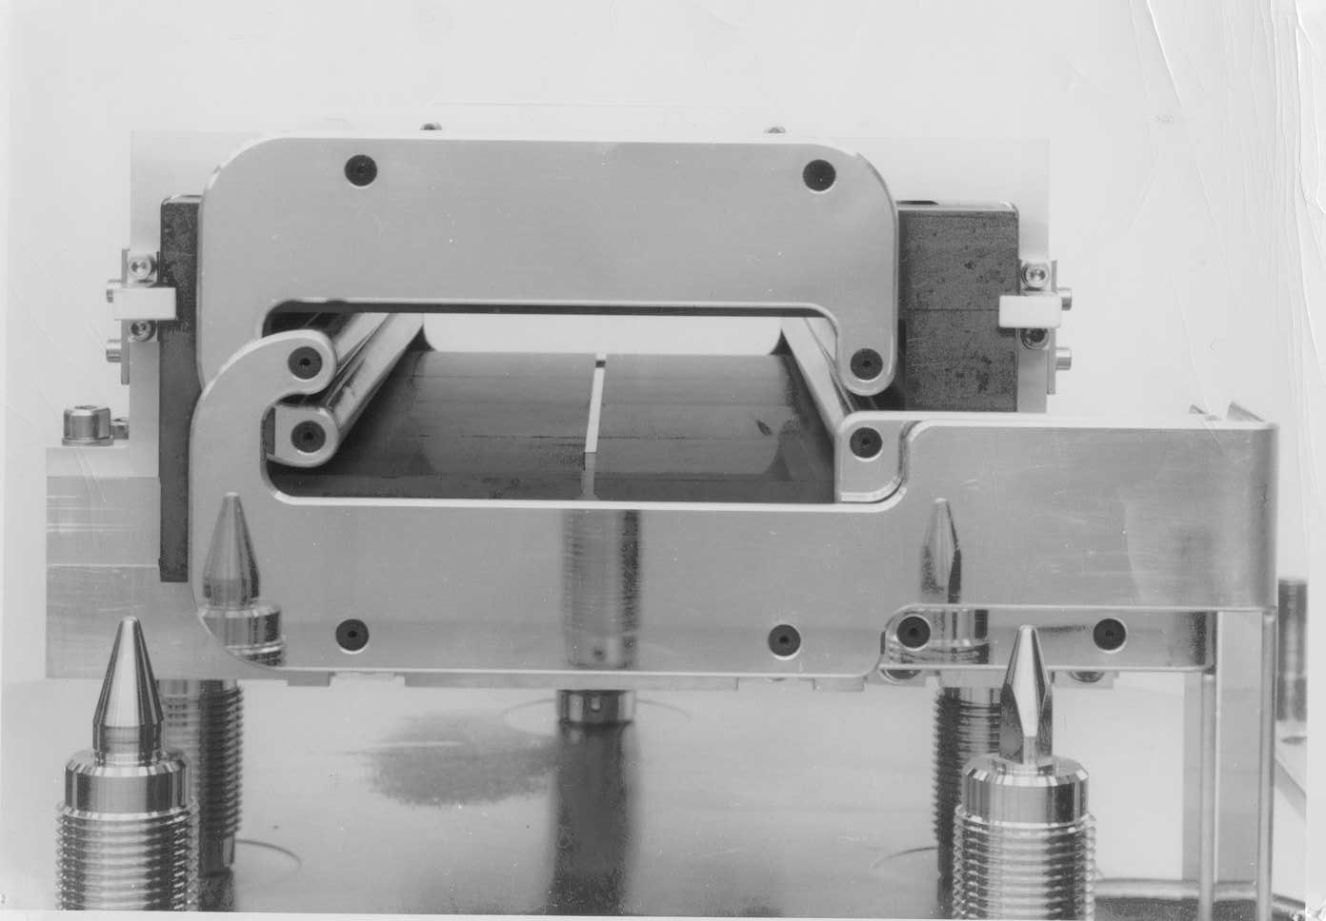
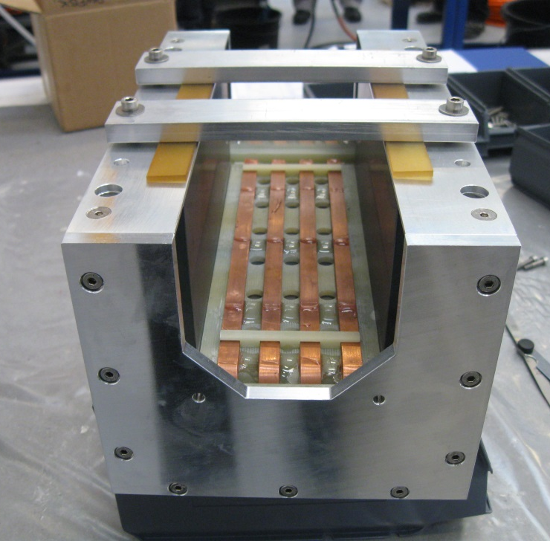
Lumped inductance magnets
Used for “slower” systems (> 0.4µs range)
Currents up to 3kA
Voltages up to 40 kV

Slide 16
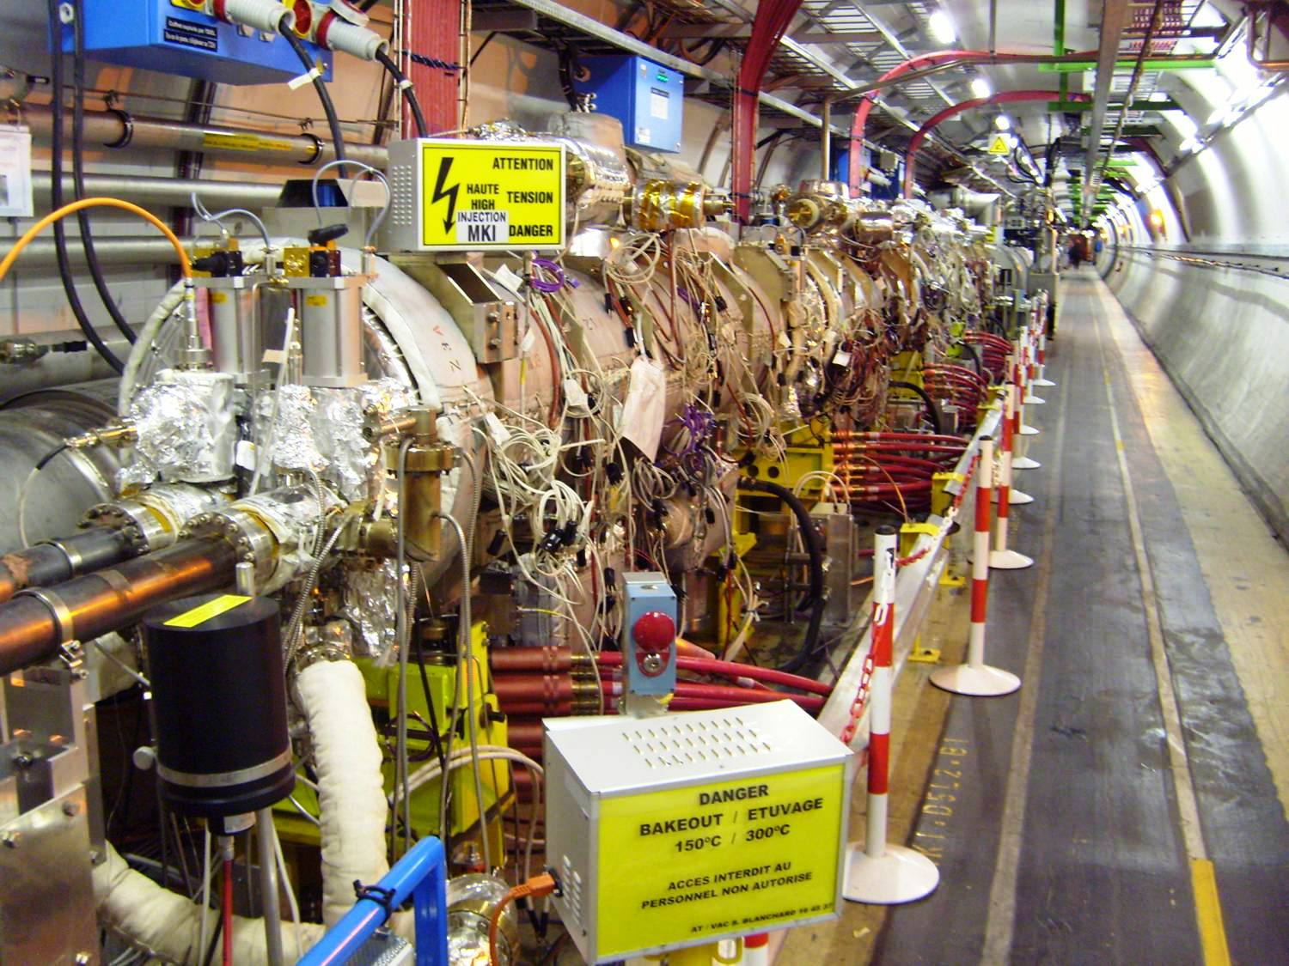
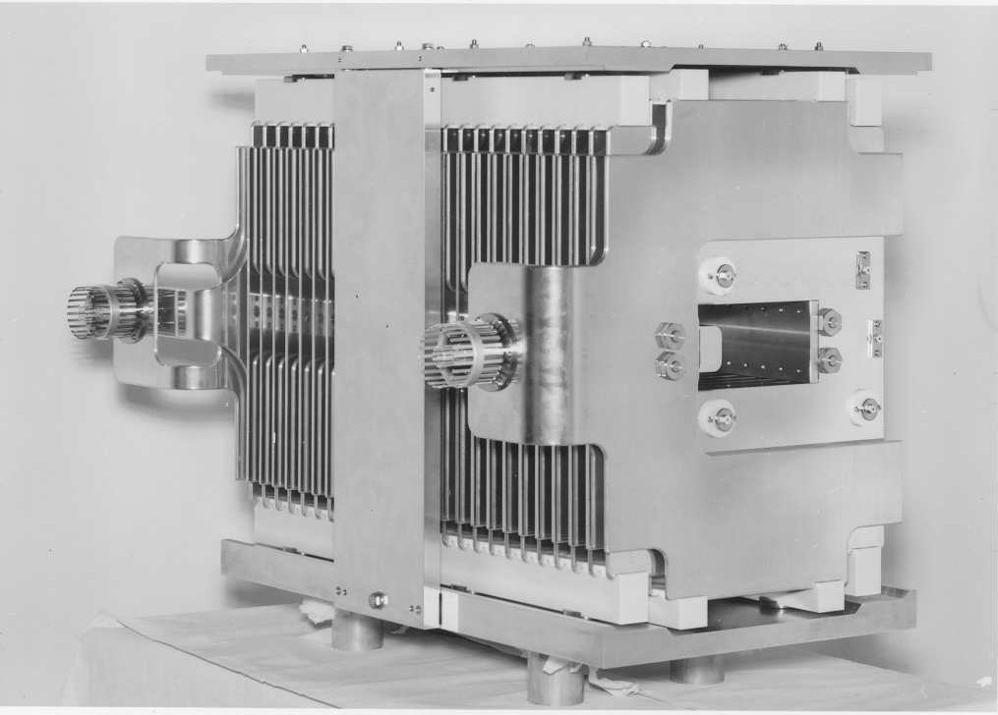
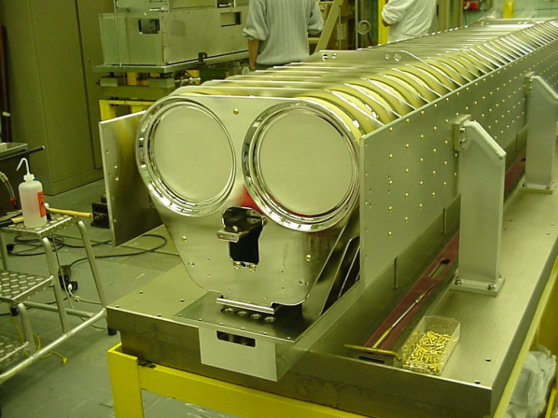
Transmission Line Kickers
Used for “faster” systems (50ns-200ns range)
Currents up to 5 kA
Voltages up to 80 kV

Slide 17
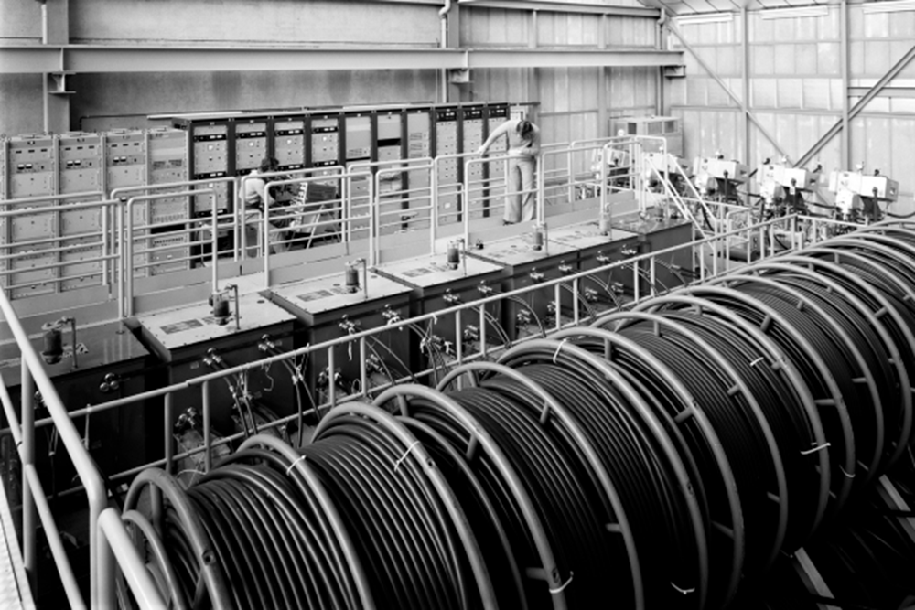
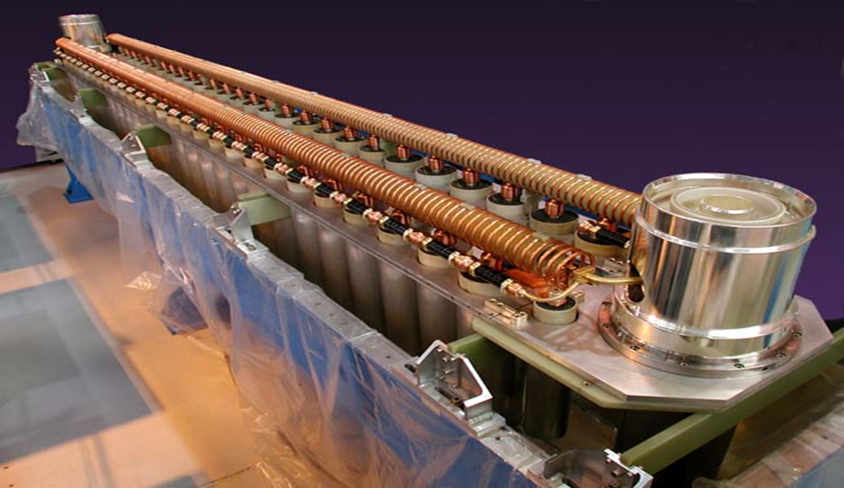
Pulse Generators
PFL and PFN based Generators
Very fast systems (50ns range) are mostly using PFL’s and thyratron switches (di/dt)
“Slower” systems (0.2-3µs) are based on PFN and GTO technology (stacked).

Slide 18
LHC Extraction Kicker System

Slide 19
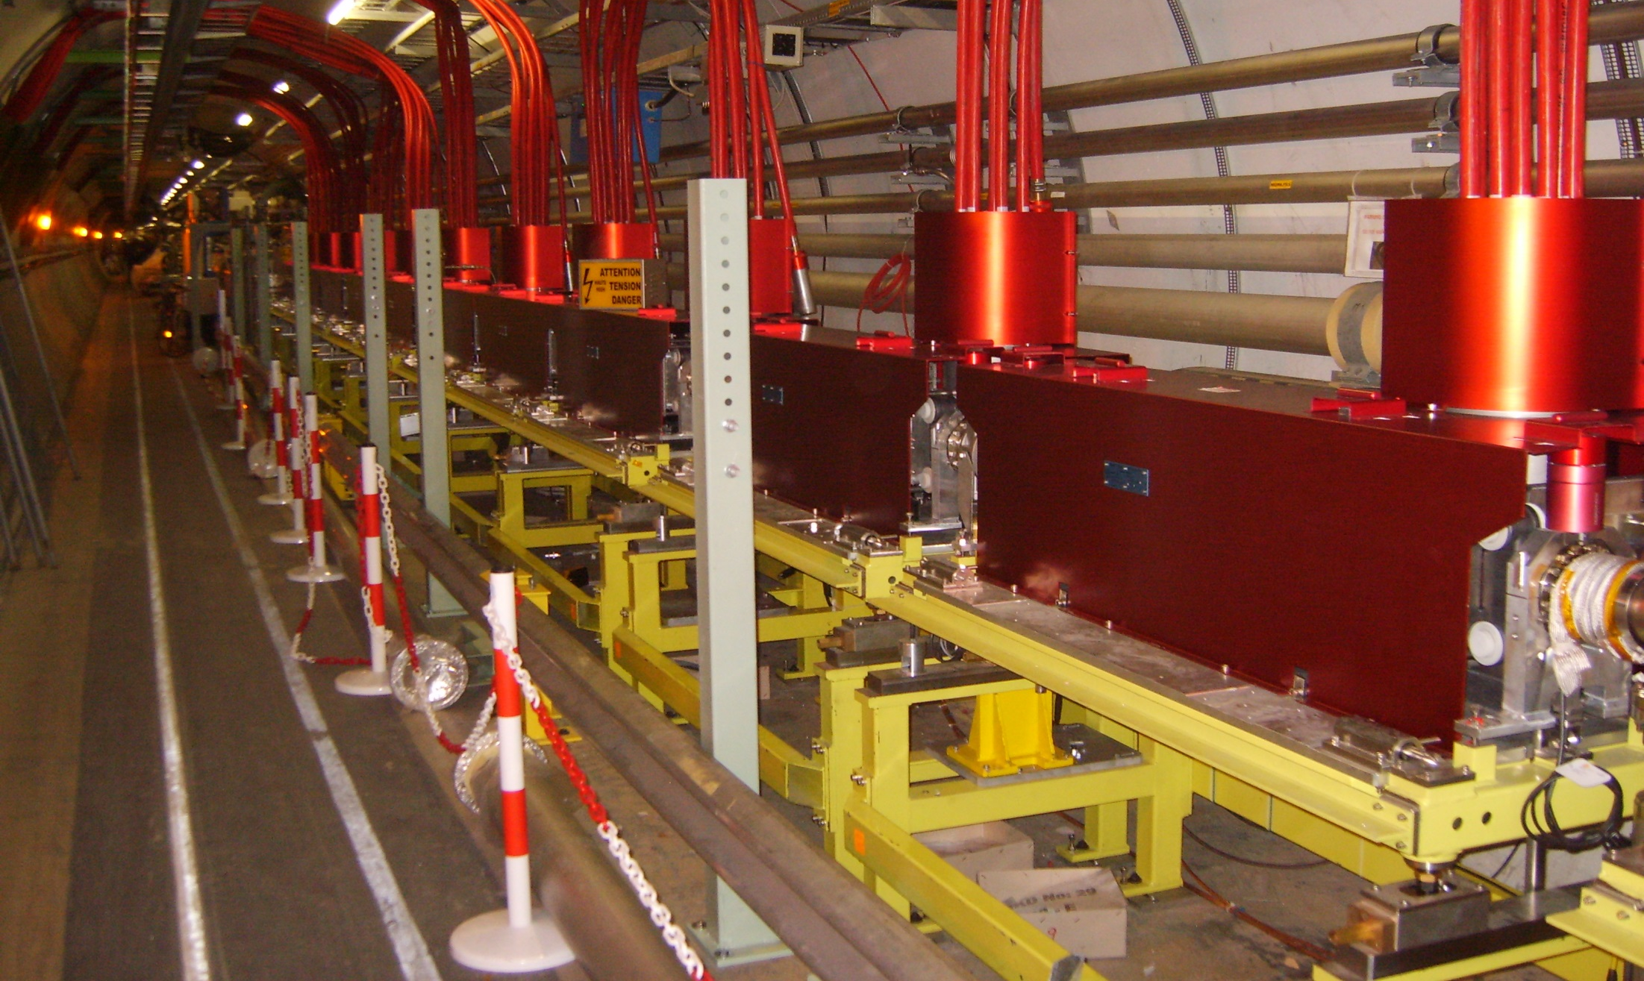
LHC extraction kickers “MKD”
15 magnets provide a total horizontal deflection of 0.28 mrad
18.5 kA / 30 kV
0.3 T peak field
73 mm aperture
1.4 m magnet length

Slide 20
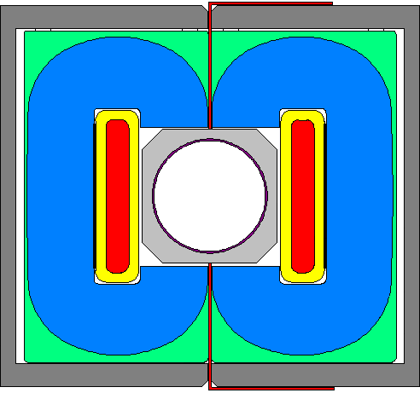
Extraction kicker magnet - MKD
Magnets are built around a metallized ceramic vacuum chamber
high voltage coil
(red: conductor, yellow: insulation)
Ceramic vacuum chamber
C-core (Si-Fe tape)
Epoxy moulding
Mechanical frame
Screen

Slide 21
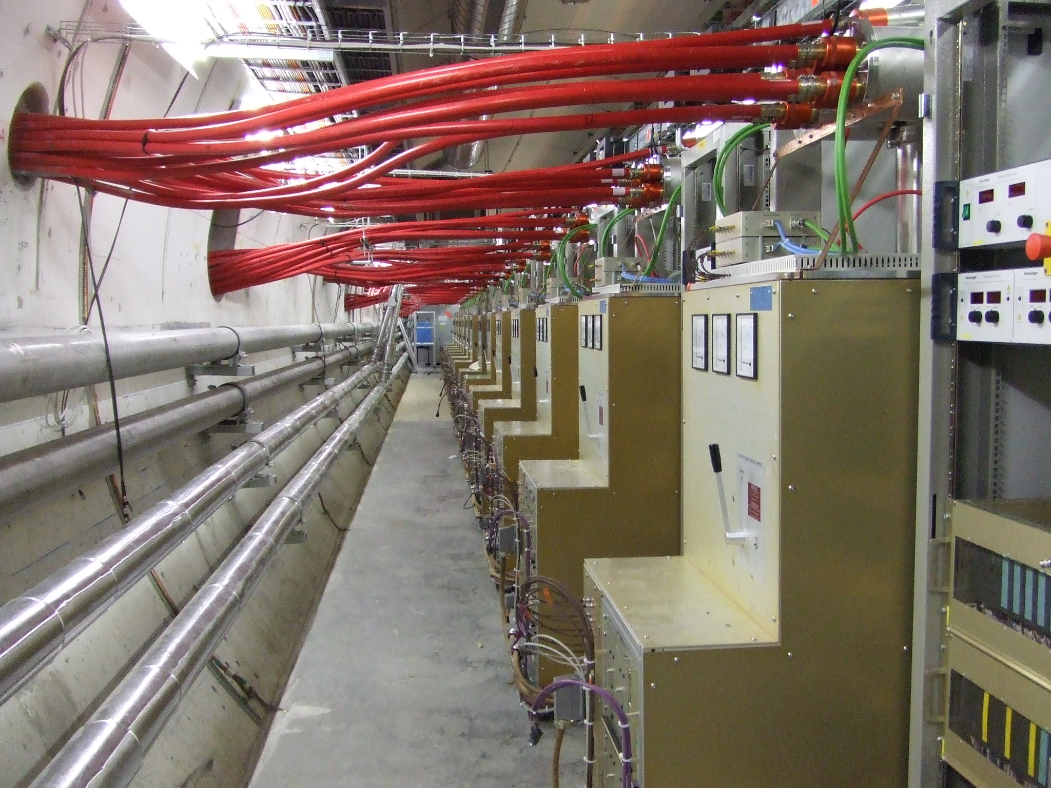
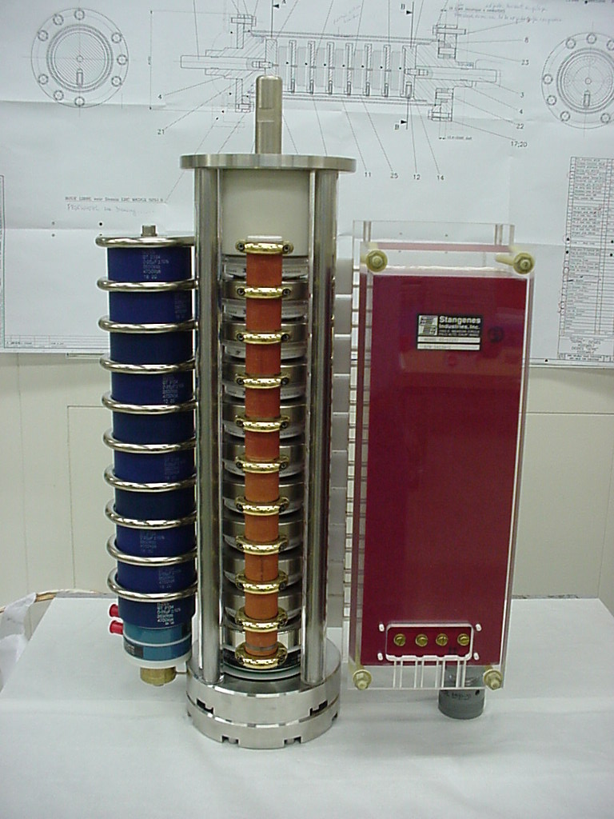
MKD pulse generators
FHCT stack with
trigger transformer
15 Pulse generators in gallery parallel to LHC tunnel.
Connected to the magnets via ~30 m of 8 parallel transmission cables.
Notes:
21

Slide 22
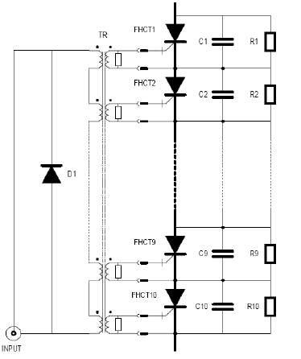
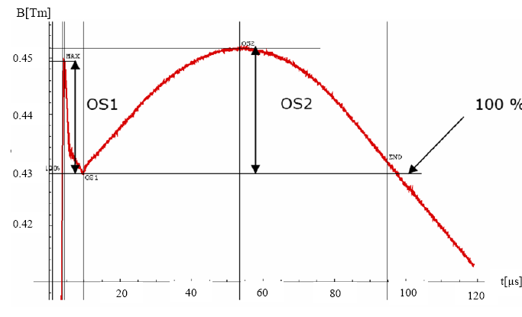
MKD Pulse & Generator
B.dl [Tm]
18.5 kA, 30 kV
FHCT (10x GTO stack)
max. di/dt ~20kA/µs

Slide 23
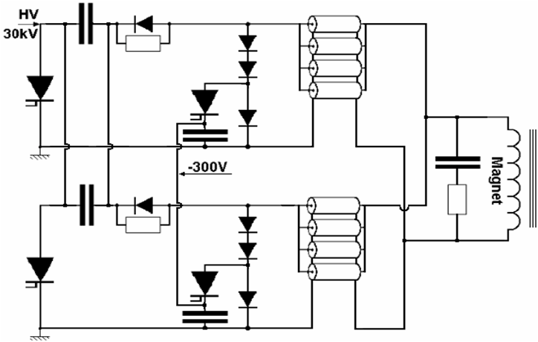
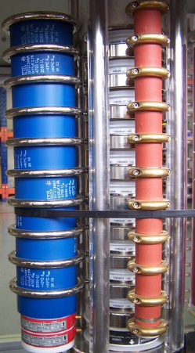
MKD Generator Circuit
C_{M}
SW A₁
SW B₁
C_{c}
Cable
C_{M}
SW A₂
SW B₂
C_{c}

Slide 24
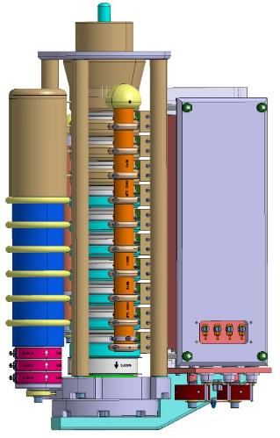
Switch and trigger transformer
10:1 step down transformer with 3 kV on primary, 300 V and 250 A on secondaries
Needs to be insulated at above 30 KV
Large part of switch mechanical and electrical design

Slide 25
ABT Septum systems

Slide 26
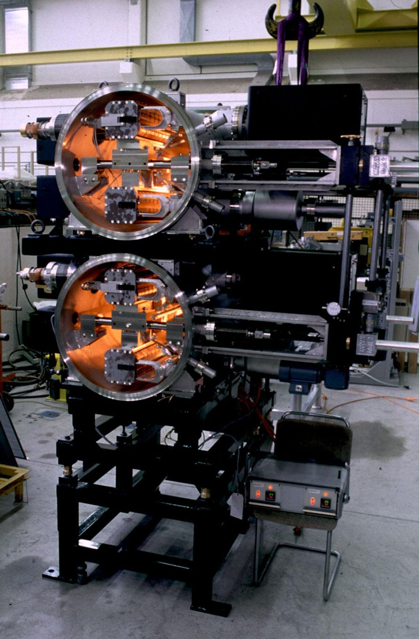
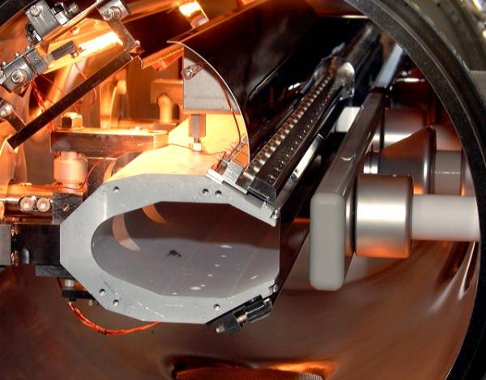
Septa section
septum magnet
HV deflector
foil tensioners
insulators
positioning system
HV electrode
beam screen
thin foil (or wires)
vacuum tank
typically high radiation levels
high voltage (up to 300 kV) electrostatic devices and accessories (cables, switches, resistors, …)
pulsed (ms to s), high current (up to 40 kA, 100 A/mm²), thin water-cooled septum coils
ultra high vacuum (down to 10⁻¹² mbar)

Slide 27
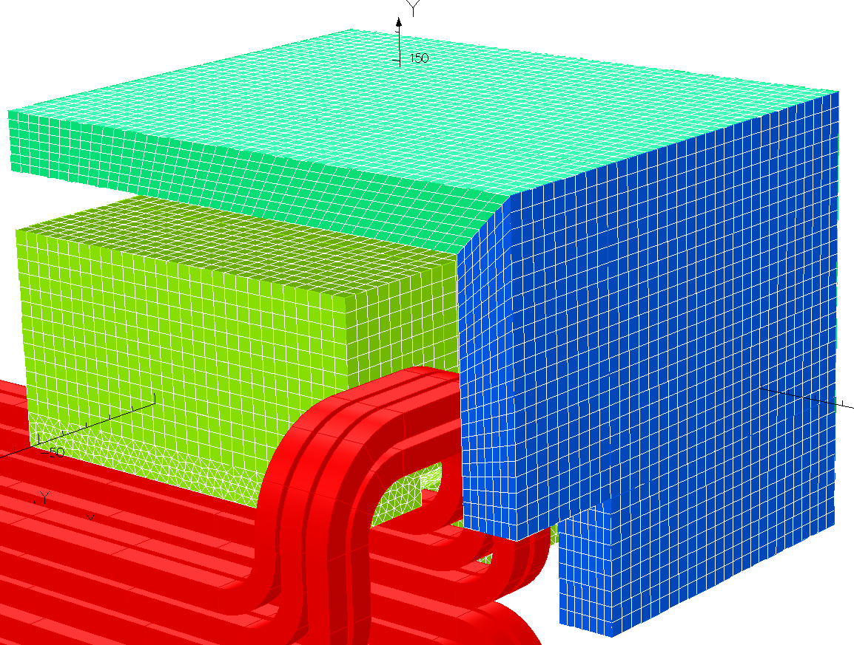
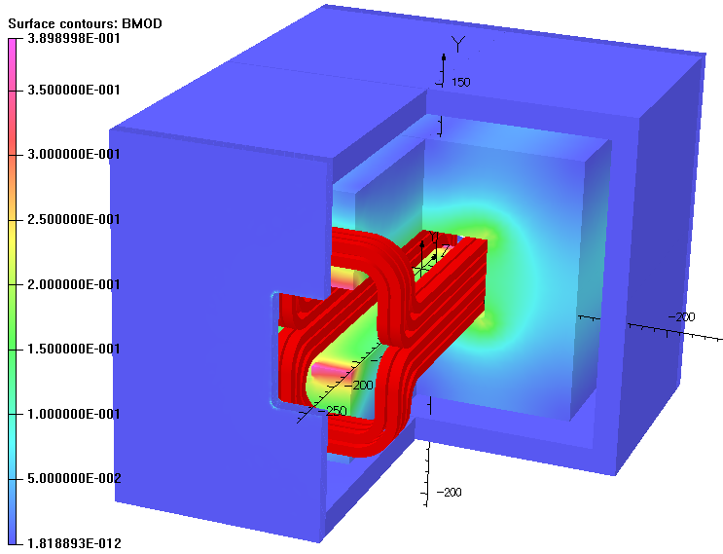
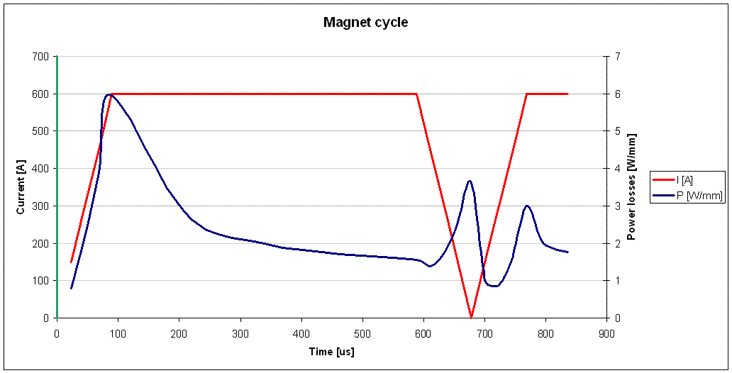
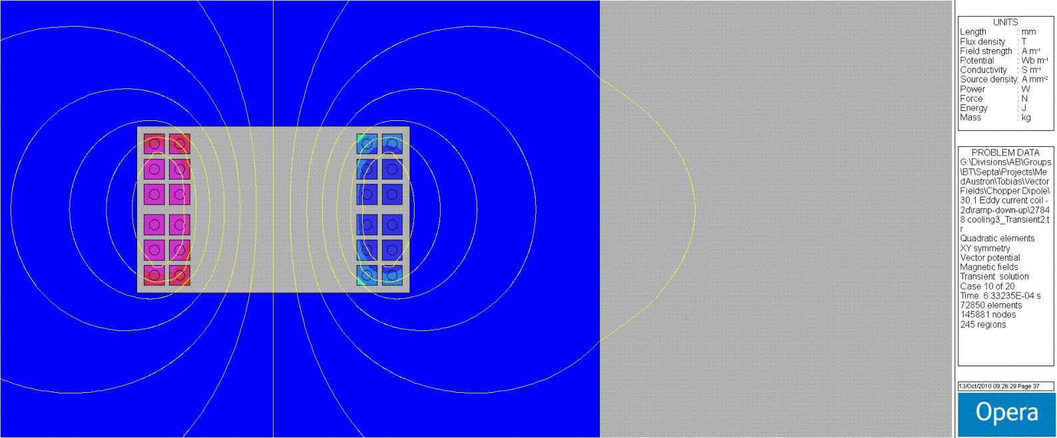
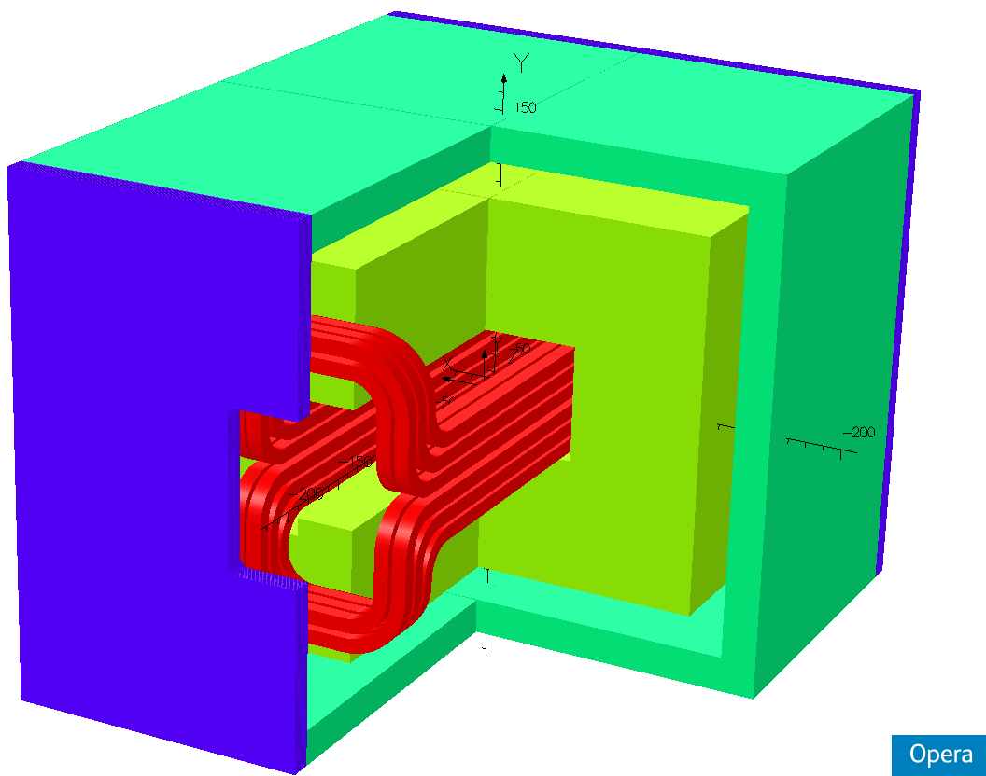
Septa section, 2D/3D Finite Element Simulations
Simulation model
Finite element mesh
Component Contours: B
Eddy currents in conductors during a cycle
Excitation current
LHC injection commissioning
Power losses
Current density
Flux lines
Aluminum
Eddy Current Shield
Aluminum
Eddy Current Shield
Aluminum
Eddy Current Shield
Aluminum
Eddy Current Shield
Aluminum
Eddy Current Shield
Laminated
Steel
Endplate
Laminated
Steel
Endplate
Ferrite
Yoke
Laminated
Steel
Endplate
Ferrite
Yoke
Laminated
Steel
Endplate
Ferrite
Yoke
Laminated
Steel
Endplate
Ferrite
Yoke
Ferrite
Yoke
Notes:
27

Slide 28
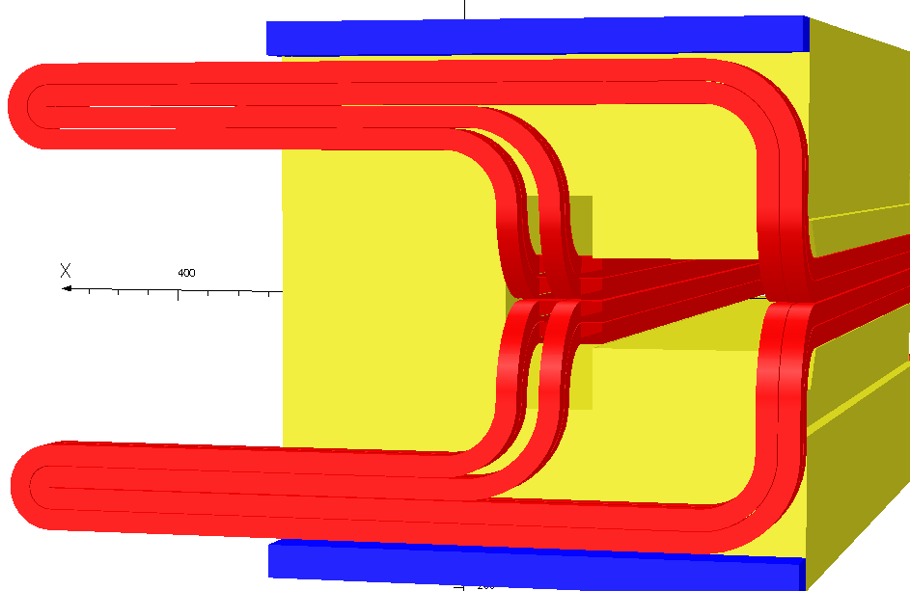
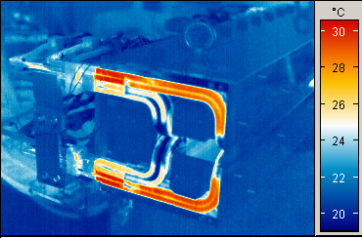
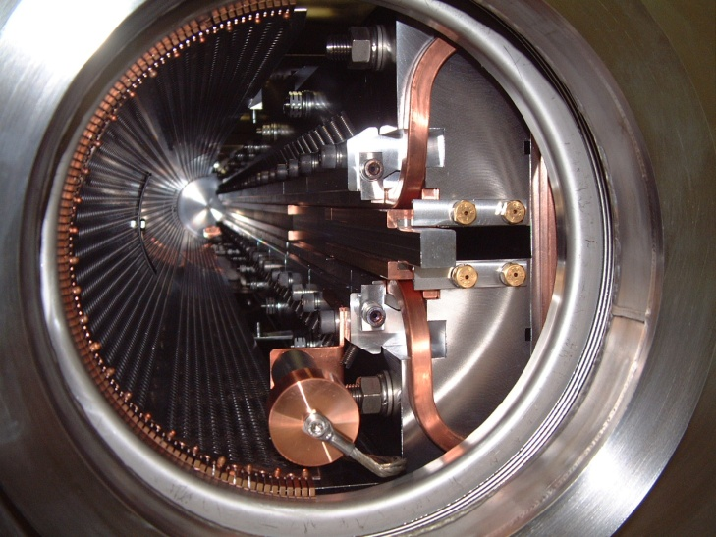
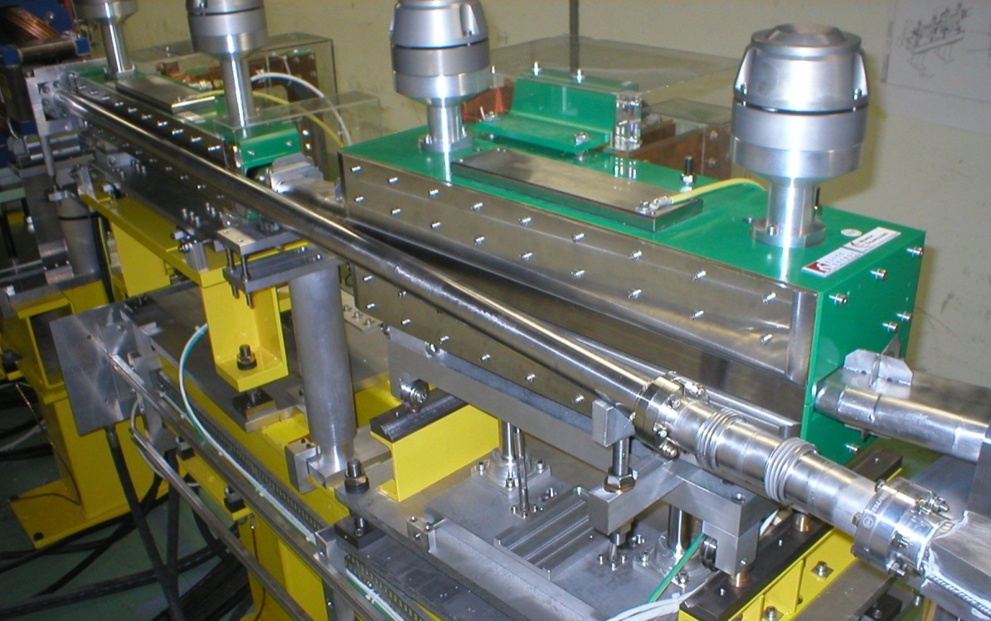
Septa section, DC Septa magnets and protection elements
LEIR Injection 10 turn DC coil
Typical operating parameters
Up to 4000 Amps DC
Current densities up to 70 A/mm² DC
Infra red picture of septum coil with field clamp removed from magnet.
Septum protection diluter
CTF3: DC injection septa

Slide 29
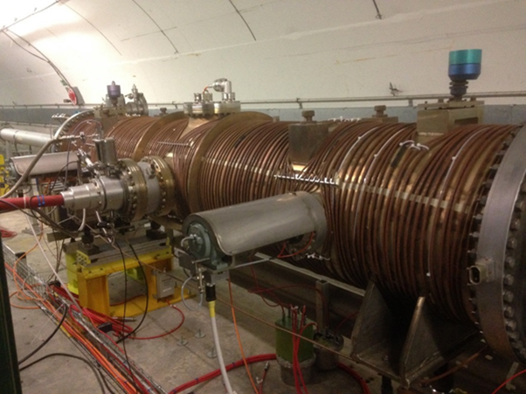
Presently operational electrostatic septa
Low Energy Ion Ring
SEH10, injection from Linac 3, 70 kV
Proton Synchrotron
SEH23, extraction East Area 170 kV
SEH31, CT extraction towards SPS, 180 kV
Super Proton Synchrotron
5 ZS, extraction towards North Area, 220 kV
ZSTF, test facility, 220 kV

Slide 30
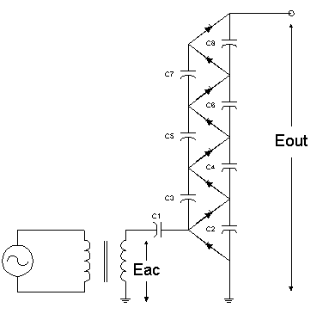
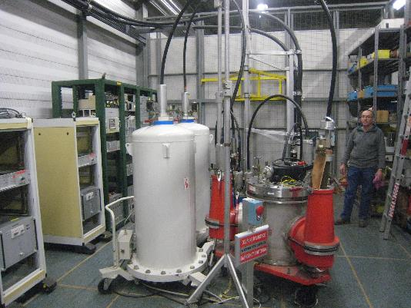
HV generation
Cockroft Walton stages, 10 mA 300 kV, generated from 220V.

Slide 31
Connectors
In house designed in 1970s.
Several types used: resistors, HV generator, ZS feedthrough.

Slide 32
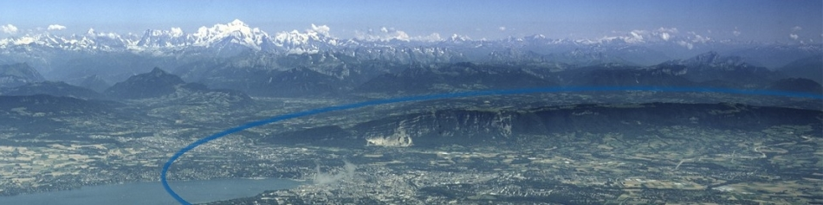
Preliminary Requirements for FCC kicker systems

Slide 33
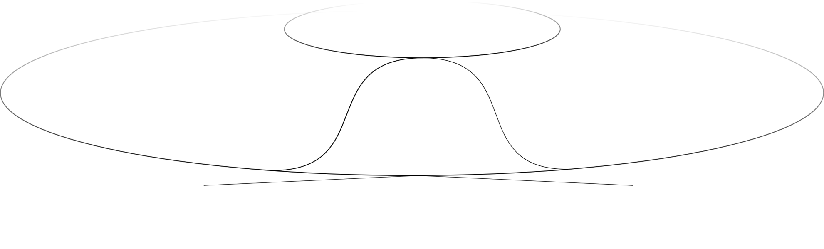
FCC study
ABT group will provide a conceptual design for:
  LHC to FCC extraction system
  Transfer lines
  FCC injection system
  FCC extraction system (dump)
3-4 TeV extraction
LHC
Circumference: 80-100km
Revolution time: 334 µs
Abort gap: 10 µs
3-4 TeV
transfer lines
FCC
3-4 TeV injection
50 TeV extraction

Slide 34
FCC Extraction
Up to 8.5 GJ to be safely extracted and dumped.
Integrated pulsed dipole field: 55 Tm
Magnet aperture: 36 mm
Actual field strength has to follow from injection to extraction energy.
Repetition time (at injection): 60s (requested for system set up)
Repetition rate (during operation): several hours

Slide 35
FCC Extraction – Pulse requirements
Field rise time < 10µs
Assumption for rise time definition: 0.5% to 95%
Flat top length: ~350µs
Less stringent requirements on field quality and flat top ripples as beam is anyway dumped.
Max. ripple assumption:10%
Fall time not critical.

Slide 36
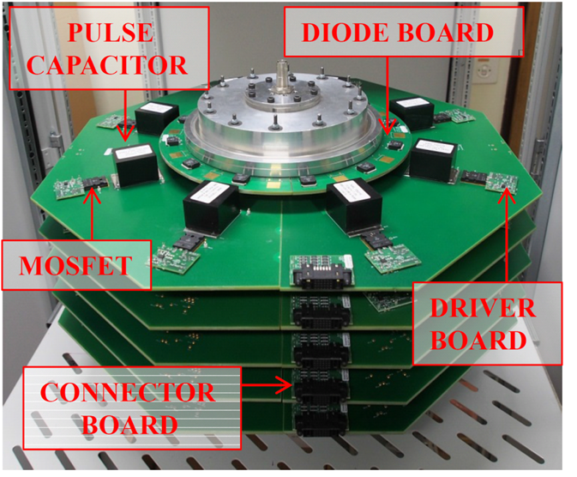
Selected R&D activity: Inductive Adder
Prototype under design: 200 ns rise time, 12.5 kV, 250 A, 1 µs pulse length
Excellent scalability.
Typical specifications: Output voltage 10-50 kV, output current 100-1000 A, pulse duration less than 1000 ns, repetition rate up to tens of kHz
Inherently fault-tolerant design
Output voltage can be modulated during pulse
Very high flat-top stability

Slide 37
Preliminary Requirements for FCC septum systems

Slide 38

Pursued extraction septa layout
Presentation D. Barna
Poster presentation A. Sanz ULL
Presentation E. Fischer
Superconducting septa
Iron-dominated septa
~1.8T
3-4T
245 m
Septum protection
QF
Dump Kickers
Dump septa
Quadrupole protection
QD

Slide 39
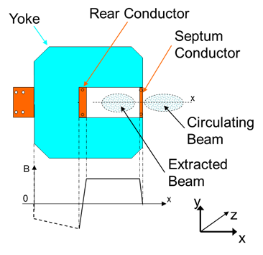
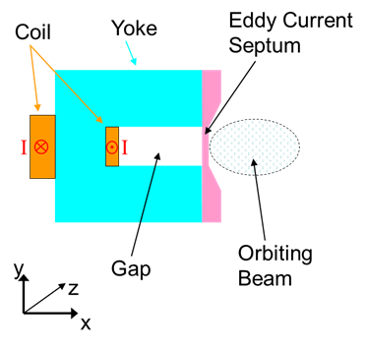
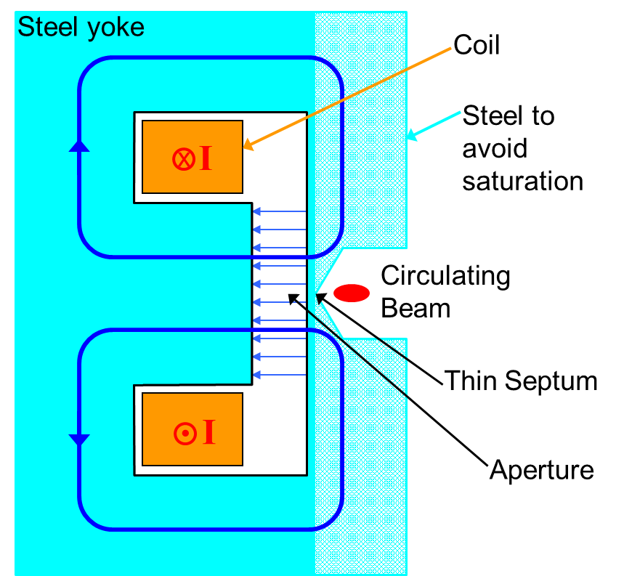
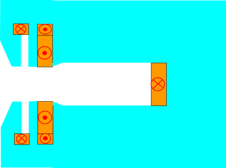


First stage septum magnet topologies considered
Current carrying septum | Eddy current septum | Massless septum | Lambertson septum
+ Thin apparent septum thickness - Power dissipation and cooling issues for DC operation | + Thin apparent septum thickness - Incompatible with DC operation | + No active parts in the path of the beam - Thick apparent septum - Gradient rather than a cut-off | + Robust design - Two-plane beam transfer - Shielding of circulating beam challenging for high B
Iron dominated, hence 2 T maximum field
Compensation coil
Main coil
Yoke
Gap
Septum region
Beam dump septum concepts
M. Atanasov

Slide 40
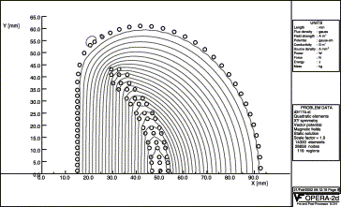
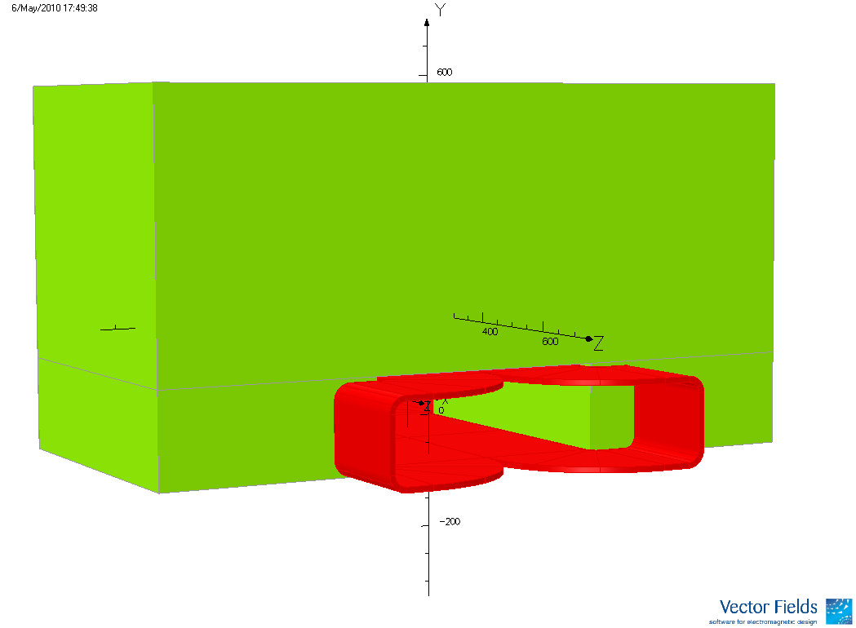

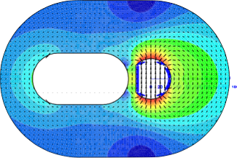
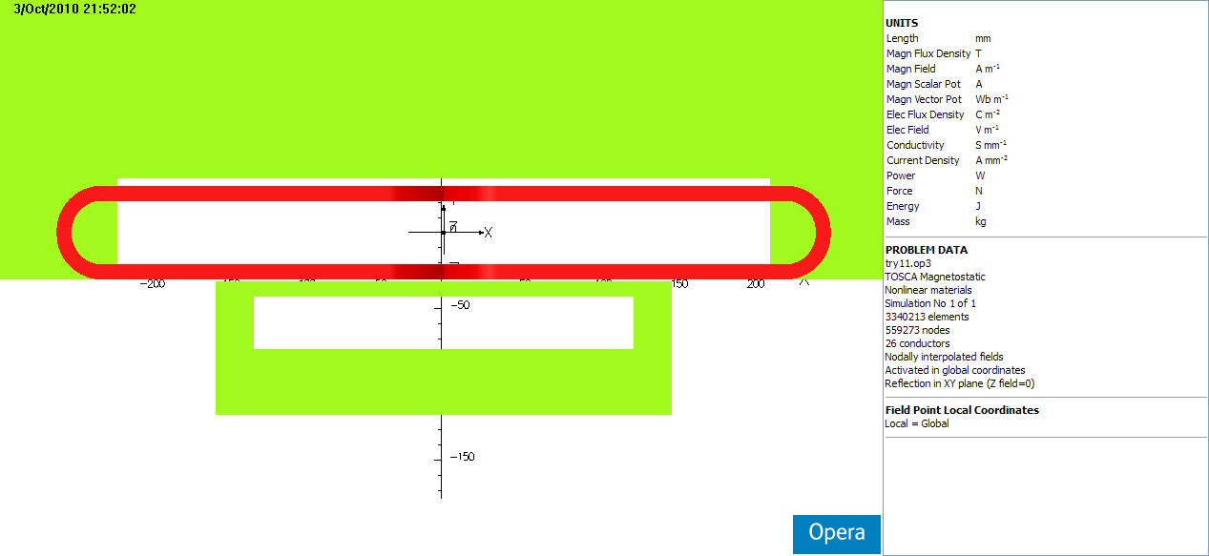
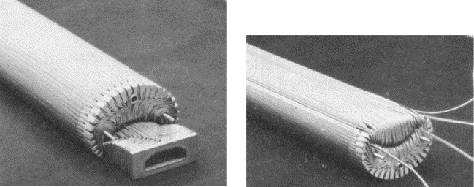
Second stage septum magnet topologies considered
Truncated double cosine (g-2) (BNL/FNAL) [1] | SIS300 proposal (GSI) [2] | Pamela proposal (BNL) [3] | Superconducting sheet topology (Wigner Institute) [4]
Used for muon beams that could traverse the coil without damaging or quenching | Both concepts rely on significant amounts of iron to shield the orbiting beam aperture. Very challenging to obtain both a thin septum as well as a low leak field. |  | Persistent currents excited in a superconducting tube by a ramped external field. Needs R&D to manufacture s.c. shields.
D. Barna
Iron Yoke
Extracted Beam
Circulating Beam
340mm
14mm
493mm
20 mm
40 mm
Maximum magnetic field in the iron
3.45T
250 mm
40mm
350 mm

Slide 41
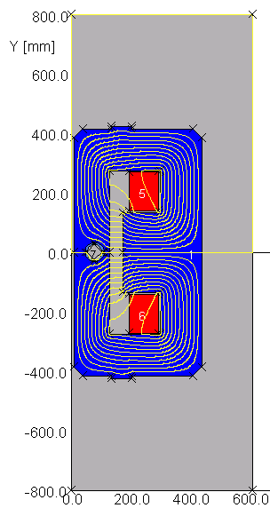


Iron-dominated topologies for FCC extraction
LHC type Lambertson septa are the baseline
Robust conservative design
Normal-conducting coils for the first units to avoid quenches caused by particle showers from the protection elements.
Pole tip saturation an issue. Can be solved with normal conducting bedstead coils in a window frame like topology.
Superferric version can be considered further downstream to reduce the power dissipation.
LHC type magnet
FCC normal conducting magnet
FCC superferric magnet

Slide 42



Leak field mitigation measures being explored
A challenge to keep the leak fields to an acceptable minimum at high levels of saturation (for 2 T gap field)
Fields below 2 T for the thinnest septa upstream
Compensating coils as a means of minimizing the leak field on the circulating beam, as well as different hole geometries are being studied.
Need continuous, non-linear powering of the compensation coil as a function of the main field.

Slide 43
R&D opportunities with ABT

Slide 44
Selected R&D directions I
Solid state pulse generators (inductive adder, Marx generators, …)
  Topologies, magnetic materials, high performance capacitors, short-circuit protection, laser triggering, radiation resistance of electronics, reliability, availability, …
High field normal conducting septa
  High saturation steel, field precision, active leakage field compensation, mechanical engineering, vacuum systems, radiation resistance, reliability, …

Slide 45
Selected R&D directions II
Superconducting septa
  Topologies, flux-shield design, field precision, stability, quench protection, reliability and availability, radiation resistance, mechanical design, cryogenics and cryostats, …
Distributed electronics and controls
  Reliability and availability, radiation resistance, triggering, redundancy design, modularity, big data and machine learning, …

Slide 46
Selected R&D directions III
Kicker magnets
  Electromagnetic design, high saturation/high Currie temperature ferrites, impedance shielding, field quality and rise time, insulators and surface treatments, high voltage behavior, UHV, …
Beam loss reduction for slow extraction
  Carbon fibres or nano-tubes for anode wires, high voltage performance, cathode materials, diffuser technologies, energy deposition simulations, …

