Slide 1


Future Circular Collider Study
Michael Benedikt
gratefully acknowledging input from FCC coordination group global design study team and all contributors
LHC
PS
FCC
SPS
http://cern.ch/fcc
Work supported by the European Commission under the HORIZON 2020 project EuroCirCol, grant agreement 654305

Slide 2
Outline
Motivation
FCC Study Scope & Timeline
Machine Parameters & Design Progress
FCC Organisation & Collaboration Status

Slide 3

FCC strategic motivation
European Strategy for Particle Physics 2013:
  “…to propose an ambitious post-LHC accelerator project….., CERN should undertake design studies for accelerator projects in a global context,…with emphasis on proton-proton and electron-positron high-energy frontier machines….coupled to a vigorous accelerator R&D programme, including high-field magnets and high-gradient accelerating structures,….”
U.S. strategy and P5 recommendation 2014:
  ”….A very high-energy proton-proton collider is the most powerful tool for direct discovery of new particles and interactions under any scenario of physics results that can be acquired in the P5 time window….”
ICFA statement 2014:
  ”…. ICFA supports studies of energy frontier circular colliders and encourages global coordination.….”

Slide 4

FCC motivation:
pushing the energy frontier
A very large circular hadron collider seems the only approach to reach 100 TeV c.m. collision energy in coming decades
Access to new particles (direct production) in the few TeV to 30 TeV mass range, far beyond LHC reach.
Much-increased rates for phenomena in the sub-TeV mass range →increased precision w.r.t. LHC and possibly ILC
The name of the game of a hadron collider is energy reach
Cf. LHC: factor ~4 in radius, factor ~2 in field → O(10) in E_{cms}
$$E∝B_{dipole}{×ρ}_{bending}$$

Slide 5

Future Circular Collider Study
GOAL: CDR and cost review for the next ESU (2018)
International FCC collaboration (CERN as host lab) to study:
pp-collider O(100) TeV (FCC-hh) → main emphasis, defining infrastructure requirements
80-100 km tunnel infrastructure in Geneva area
e⁺e⁻ collider (FCC-ee) as potential intermediate step
p-e (FCC-he) option
HE-LHC with FCC-hh technology
~16 T ⇒ 100 TeV pp in 100 km

Slide 6
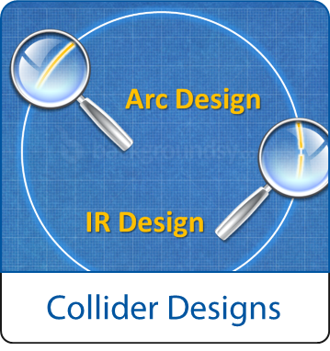
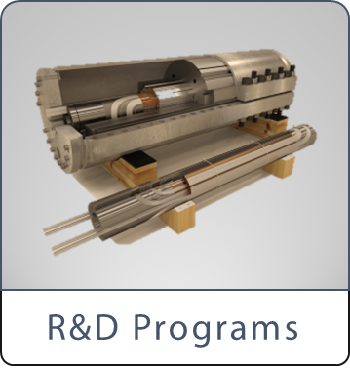
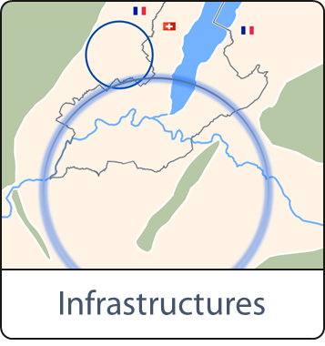
FCC Scope:
Accelerator and Infrastructure
FCC-hh: 100 TeV pp collider as long-term goal
→ defines infrastructure needs
FCC-ee: e⁺e⁻ collider, potential intermediate step
HE-LHC: based on FCC-hh technology
key technologies
pushed in dedicated R&D programmes, e.g.
16 Tesla magnets for 100 TeV pp in 100 km
SRF technologies and RF power sources
tunnel infrastructure in Geneva area, linked to CERN accelerator complex;
site-specific, as requested by European strategy

Slide 7

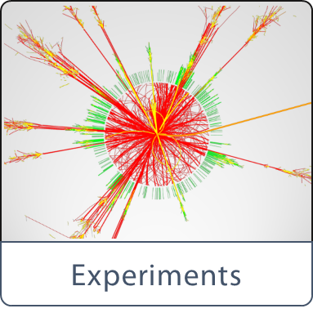
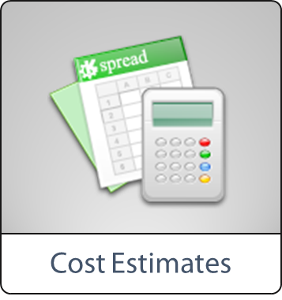
FCC Scope:
Physics & Experiments
physics opportunities
discovery potentials
experiment concepts for hh, ee and he
machine Detector Interface studies
concepts for worldwide data services
overall cost model ;
cost scenarios for collider options
including infrastructure and injectors ;
implementation and governance models

Slide 8
CERN Circular Colliders and FCC
1980
1985
1990
1995
2000
2005
2010
2015
2020
2025
2030
2035
Constr.
Physics
LEP
Design
Proto
Construction
Physics
LHC
Design
Construction
Physics
HL-LHC
20 years
FCC
Design
Proto
Construction
Physics
Now is the right time to plan for the period 2035 – 2040
Goal of phase 1: CDR by end 2018 for next update of European Strategy

Slide 9
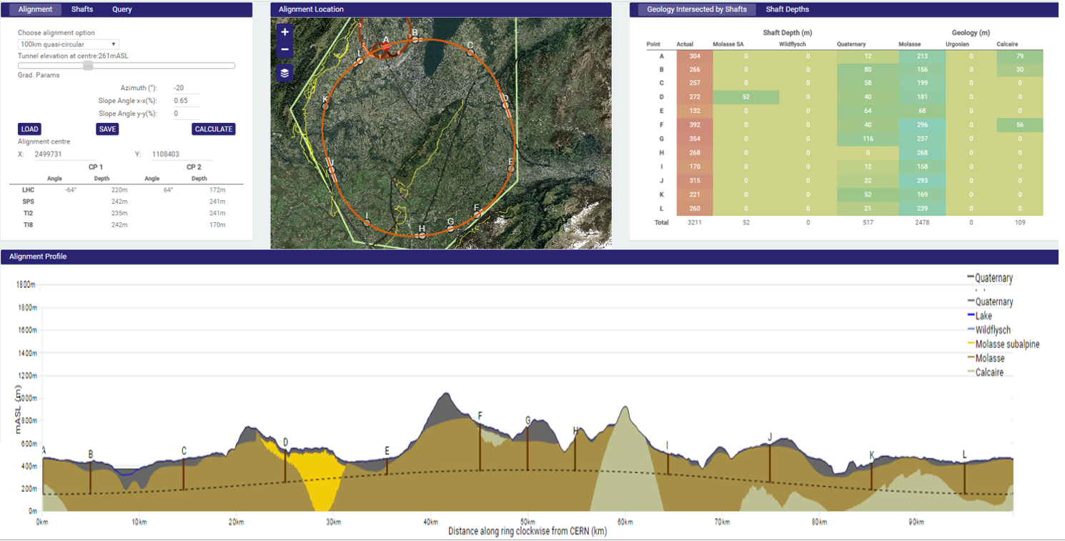
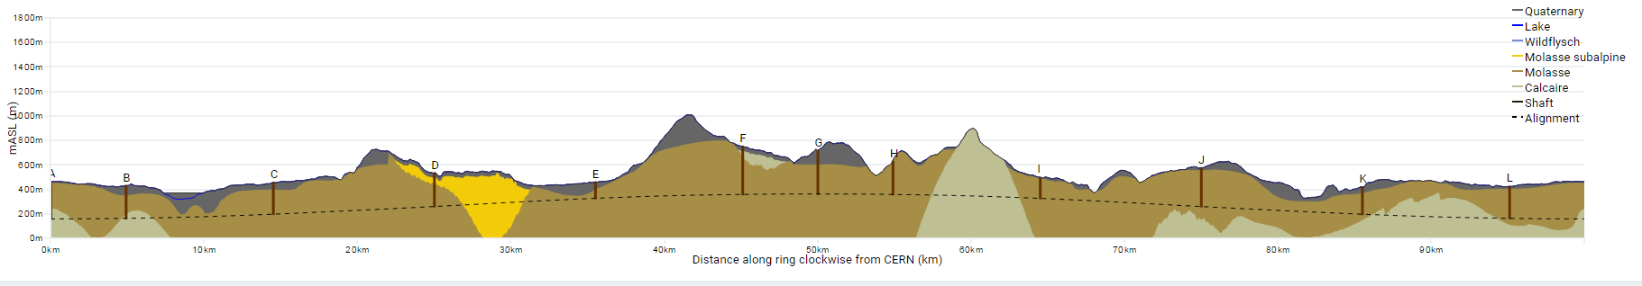
Progress on site investigations
90 – 100 km fits geological situation well
LHC suitable as potential injector
The 100 km version, intersecting LHC, is being studied now in more detail
Notes:
Use the latest slides from John/Charlie.
100 km machines, possibly with both versions intersecting and non-intersecting?

Slide 10
Hadron collider parameters
parameter | FCC-hh |  | HE-LHC* | (HL) LHC
collision energy cms [TeV] | 100 |  | >25 | 14
dipole field [T] | 16 |  | 16 | 8.3
circumference [km] | 100 |  | 27 | 27
# IP | 2 main & 2 |  | 2 & 2 | 2 & 2
beam current [A] | 0.5 |  | 1.12 | (1.12) 0.58
bunch intensity [10¹¹] | 1 | 1 (0.2) | 2.2 | (2.2) 1.15
bunch spacing [ns] | 25 | 25 (5) | 25 | 25
beta* [m] | 1.1 | 0.3 | 0.25 | (0.15) 0.55
luminosity/IP [10³⁴ cm⁻²s⁻¹] | 5 | 20 - 30 | >25 | (5) 1
events/bunch crossing | 170 | <1020 (204) | 850 | (135) 27
stored energy/beam [GJ] | 8.4 |  | 1.2 | (0.7) 0.36
synchrotron rad. [W/m/beam] | 30 |  | 3.6 | (0.35) 0.18
*tentative

Slide 11
FCC-hh MDI studies
Design of interaction region
consistent for machine and detector
  L*=45 m
  integrated spectrometer and compensation dipoles
optics with long triplet with large aperture
  Helps distributing collision debris
  more beam stay clear
Notes:
Add one slide showing optics, possibly with some smaller plots on insertions?
Detailed optimisation on optics of each insertion within overall defined boundaries.

Slide 12
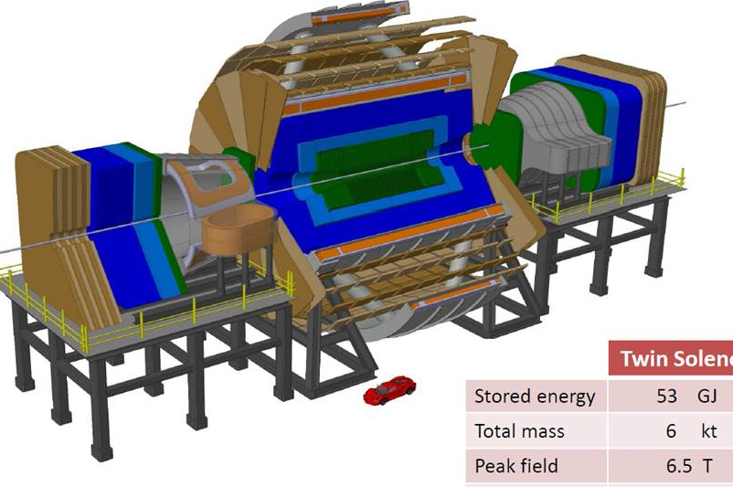
Detector concepts for 100 TeV pp
A B=6 T, R=6 m solenoid with shielding coil and 2 dipoles has been engineered in detail. Alternative magnet systems are being studied
Parametrized detector performance model (DELPHES) is available and integrated in FCC software framework for physics simulations
  https://twiki.cern.ch/twiki/bin/view/FCC/FccPythiaDelphes
Some design challenges:
large η acceptance
radiation levels of >50 x LHC Phase II
pileup of ~1000
R&D for FCC detectors is a natural continuation of the R&D for LHC Phase II upgrade
Notes:
See with Werner about detector

Slide 13
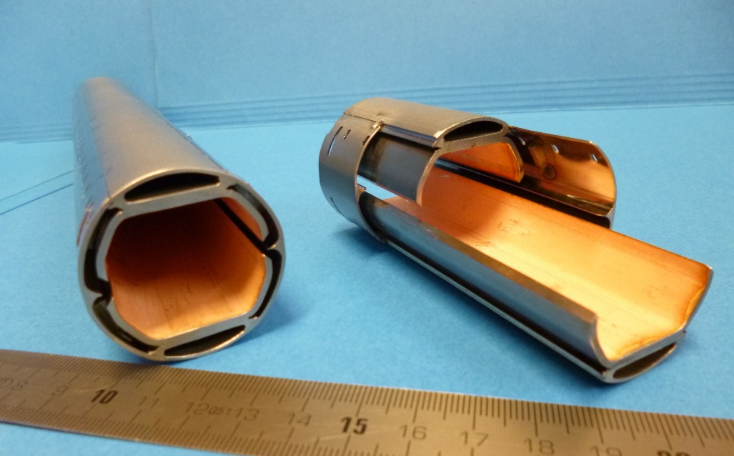
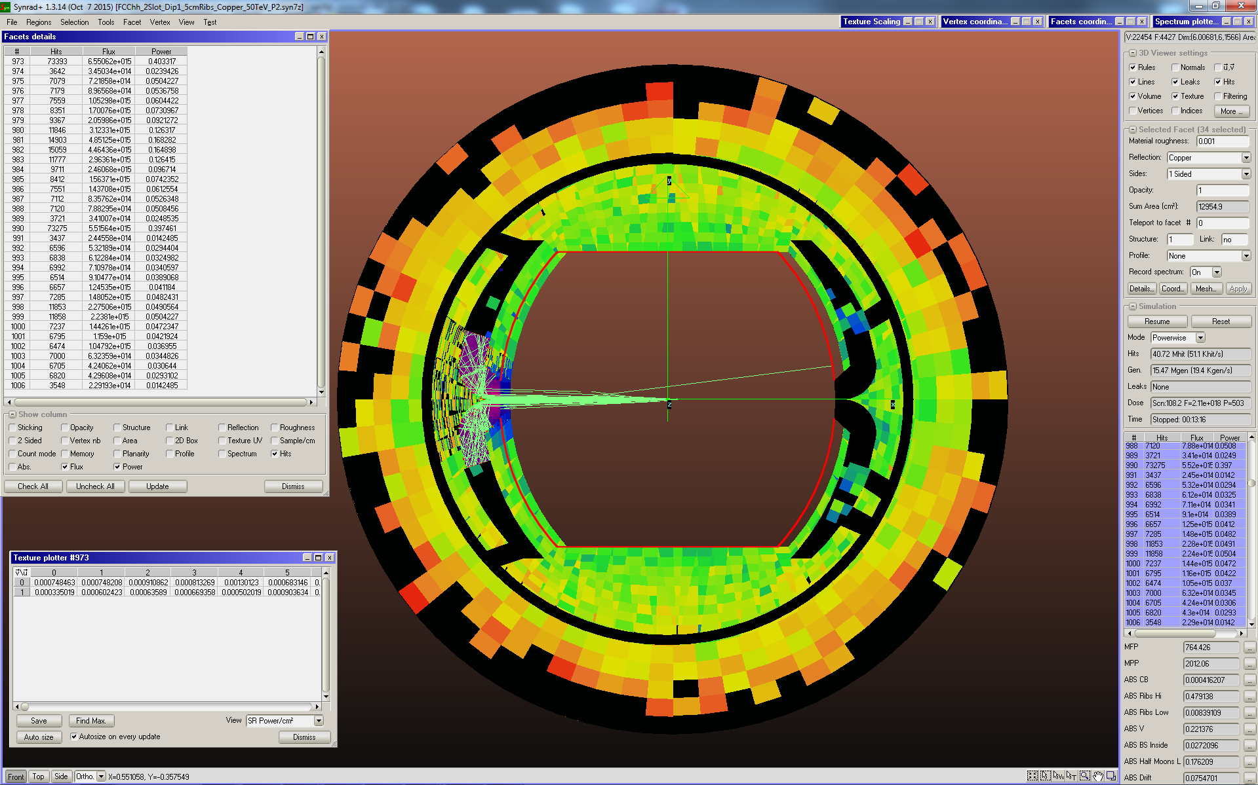
Synchrotron radiation/beam screen
Handling of high synchrotron radiation load of protons @ 50 TeV:
~30 W/m/beam (@16 T) (LHC <0.2W/m)
5 MW total in arcs
New beam screen with ante-chamber
absorption of synchrotron radiation at 50 K to reduce cryogenic power
avoids photo-electrons, helps vacuum
First FCC-hh beam screen prototype
Testing 2017 in ANKA light facility
Photon distribution

Slide 14
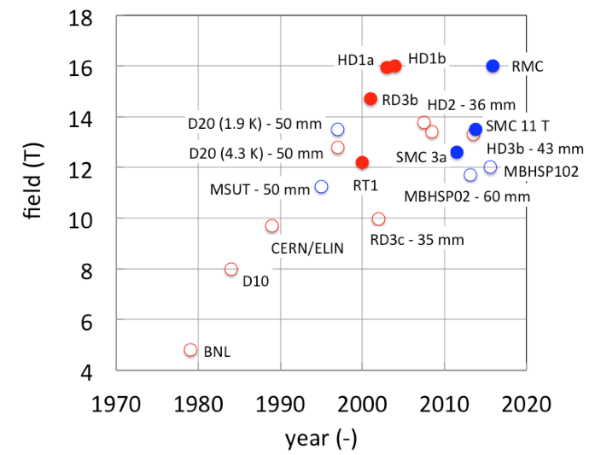
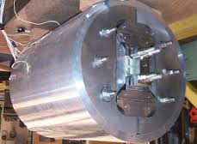
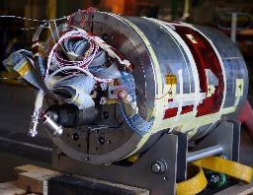
CERN & EuroCirCol 16T programs
Main Milestones of the FCC Magnet Program 2016 - 2019
Milestone | Description | 15 | 2016 |  | 2017 |  | 2018 |  | 2019 |  | 2020 |  | 21
M0 | High J_{c} wire development with industry
M1 | Supporting wound conductor test program
M2 | Design & manufacture 16T ERMC with existing wire
M3 | Design & manufacture 16 T RMM with existing wire
M4 | Design & manufacture 16T demonstrator magnet
M5 | Procurement of enhanced high J_{c} wire
M6 | EuroCirCol design 16T accelerator quality model
 | Manufacture and test of the 16 T EuroCirCol model
Magnets with bore
LBNL HD1
Field records
16 T “dipole” levels reached with small racetrack coils
LBNL 2004, CERN 2015
CERN RMC
ERMC (16 T mid-plane field) RMM (16 T in 50 mm cavity) Demonstrator (16 T, 50 mm gap) mid 2017 end 2017 end 2018

Slide 15
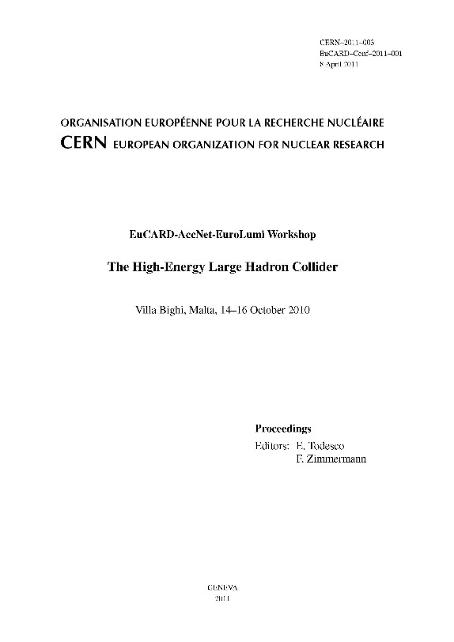
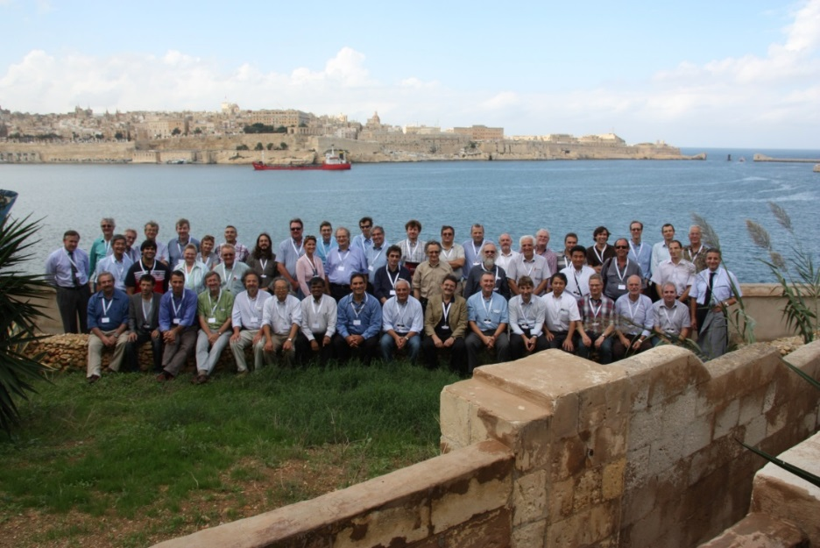
High-Energy LHC
FCC study continues effort on high-field collider in LHC tunnel
2010 EuCARD Workshop Malta;
Yellow Report CERN-2011-1
based on 16-T dipoles developed for FCC-hh
extrapolation of other parts from the present (HL-)LHC
and from FCC developments
EuCARD-AccNet-EuroLumi Workshop: The High-Energy Large Hadron Collider - HE-LHC10,
E. Todesco and F. Zimmermann (eds.), EuCARD-CON-2011-001; arXiv:1111.7188; CERN-2011-003 (2011)

Slide 16
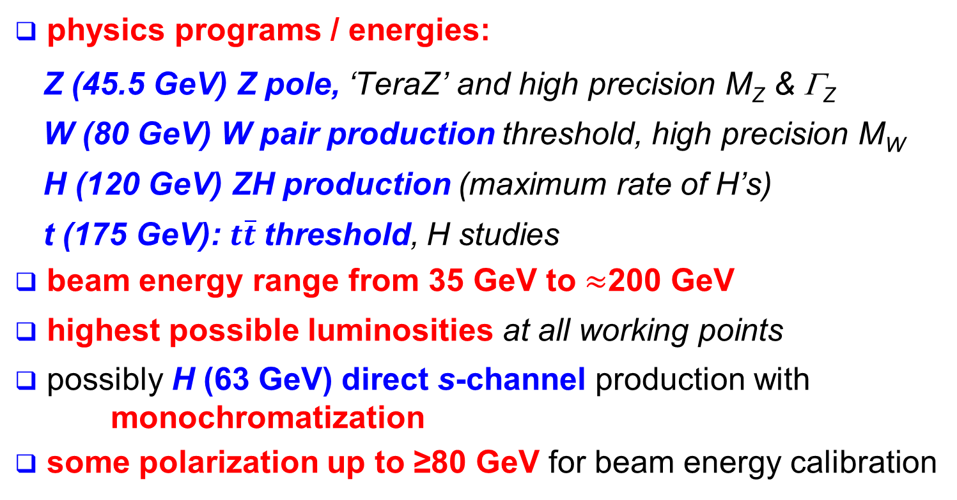
FCC–ee physics requirements
physics programs / energies:
  Z (45.5 GeV) Z pole, ‘TeraZ’ and high precision M_{Z} & Γ_{Z}
  W (80 GeV) W pair production threshold, high precision M_{W}
  H (120 GeV) ZH production (maximum rate of H’s)
  t (175 GeV): $t\overline{t}$threshold, H studies
beam energy range from 35 GeV to $≈$200 GeV
highest possible luminosities at all working points
possibly H (63 GeV) direct s-channel production with monochromatization
some polarization up to ≥80 GeV for beam energy calibration

Slide 17
lepton collider parameters
parameter | FCC-ee (400 MHz) |  |  |  |  | LEP2
Physics working point | Z |  | WW | ZH | tt_{bar}
energy/beam [GeV] | 45.6 |  | 80 | 120 | 175 | 105
bunches/beam | 30180 | 91500 | 5260 | 780 | 81 | 4
bunch spacing [ns] | 7.5 | 2.5 | 50 | 400 | 4000 | 22000
bunch population [10¹¹] | 1.0 | 0.33 | 0.6 | 0.8 | 1.7 | 4.2
beam current [mA] | 1450 | 1450 | 152 | 30 | 6.6 | 3
luminosity/IP x 10³⁴cm⁻²s⁻¹ | 210 | 90 | 19 | 5.1 | 1.3 | 0.0012
energy loss/turn [GeV] | 0.03 | 0.03 | 0.33 | 1.67 | 7.55 | 3.34
synchrotron power [MW] | 100 |  |  |  |  | 22
RF voltage [GV] | 0.4 | 0.2 | 0.8 | 3.0 | 10 | 3.5
identical FCC-ee baseline optics for all energies
FCC-ee: 2 separate rings LEP: single beam pipe

Slide 18
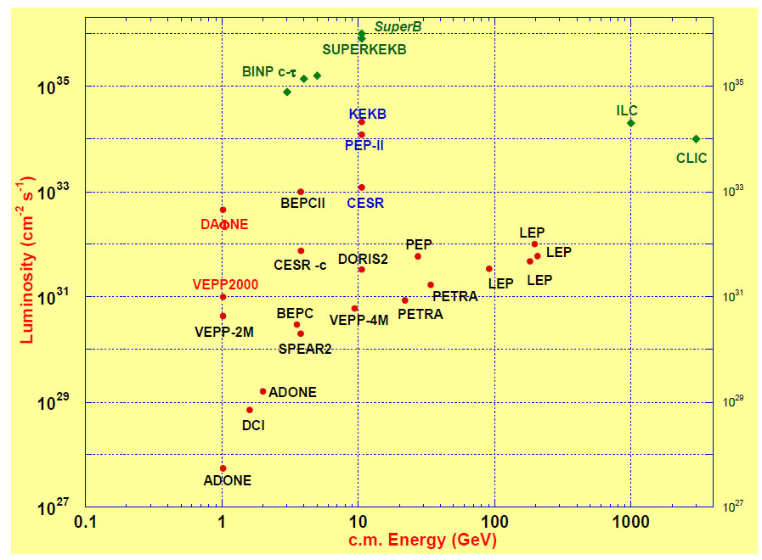
FCC-ee exploits lessons & recipes from past e⁺e⁻ and pp colliders
LEP:
high energy
SR effects
B-factories:
KEKB & PEP-II:
high beam
currents
top-up injection
DAFNE: crab waist
Super B-factories
S-KEKB: low β_{y}*
KEKB: e⁺ source
HERA, LEP, RHIC:
spin
gymnastics
FCC-ee
DAΦNE
VEPP2000
combining successful ingredients of recent colliders → extremely high luminosity at high energies
Barry Barish
13 January 2011

Slide 19
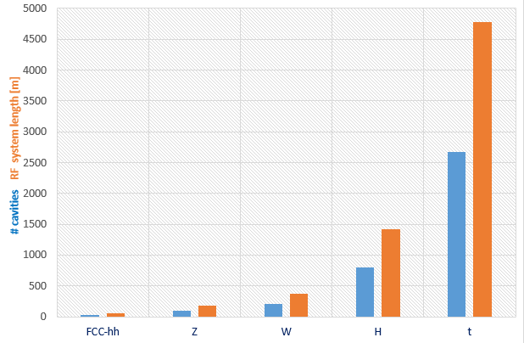

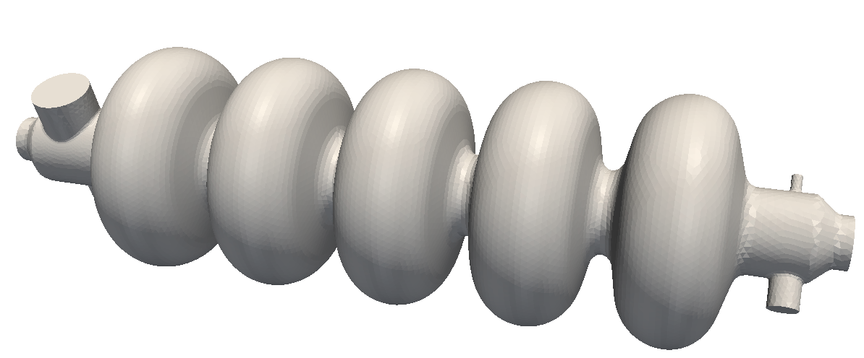
RF system requirements
Very large range of operation parameters
“Ampere-class” machines
Naive scale up from an hh system
 | V_{total} GV | n_{bunches} | I_{beam} mA | ΔE/turn GeV
hh | 0.032 |  | 500
Z | 0.4/0.2 | 30000/90000 | 1450 | 0.034
W | 0.8 | 5162 | 152 | 0.33
H | 5.5 | 770 | 30 | 1.67
t | 10 | 78 | 6.6 | 7.55
x6
x12
≈ 16 x 1 cell 400MHz,
“high gradient” machines
Voltage and beam current ranges span more than factor > 10²
No well-adapted single RF system solution satisfying requirements
Notes:
New slide from Olivier
Common design for hadron and lepton low energy-high currecnt system
Synergies HL-LHC, HE LHC, FCC-hh, FCC-ee Z pole

Slide 20
RF system R&D lines
400 MHz single-cell cavities preferred for hh and ee-Z (few MeV/m)
Baseline Nb/Cu @4.5 K, development with synergies to HL-LHC, HE-LHC
R&D: power coupling 1 MW/cell, HOM power handling (damper, cryomodule)
hh
Z
W
≈ 16 cells per beam
≈ 100 per beam
(+ 100 for booster ring)
≈ 210 per beam
(+ 210 for booster ring)
400 or 800 MHz multi-cell cavities preferred for ee-H, ee-tt and ee-W
Baseline options 400 MHz Nb/Cu @4.5 K, ◄▬► 800 MHz bulk Nb system @2K
R&D: High Q₀ cavities, coating, long-term: Nb₃Sn like components
W
H
t
≈ 200 per beam
(+ 200 for booster)
≈ 800 per beam
(+ 800 for booster)
≈ common 2600 cells for both beams
(+ 2600 for booster)
Notes:
New slide from Olivier
Common design for hadron and lepton low energy-high currecnt system
Synergies HL-LHC, HE LHC, FCC-hh, FCC-ee Z pole

Slide 21
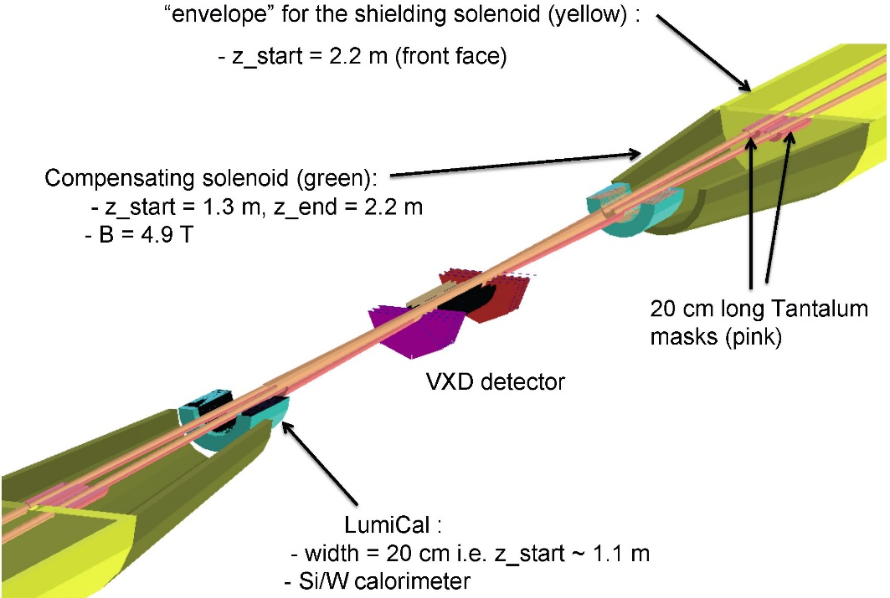
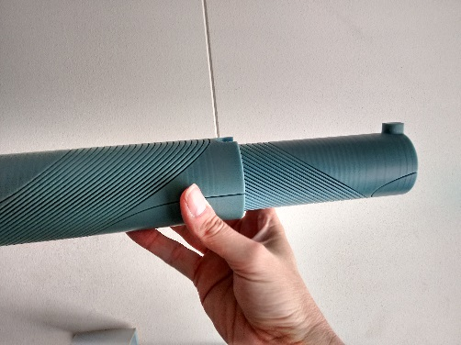
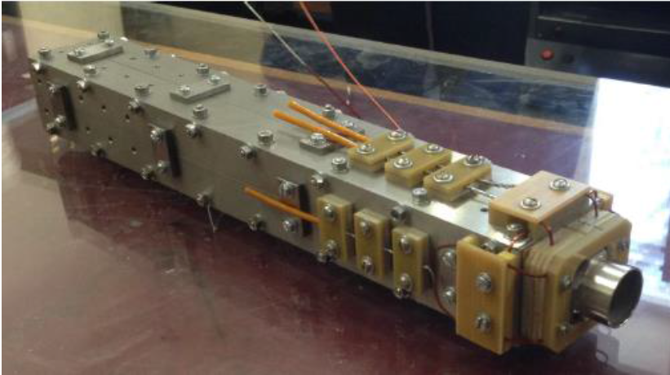
FCC-ee MDI optimisation
MDI work focused on optimization of
l*, IR quadrupole design
compensation & shielding solenoid
SR masking and chamber layout
CERN model of
CCT IR quadrupole
BINP prototype IR quadr.
2 cm aperture, 100 T/m
Notes:
New slide on MDI optimisation, L*, solenoid compensation, lumi monitoring, etc.
Slide from Mike Sullivan talk, synchrotron radiation IR, masking?
Possibly one slide on magnet design of Attilio?

Slide 22
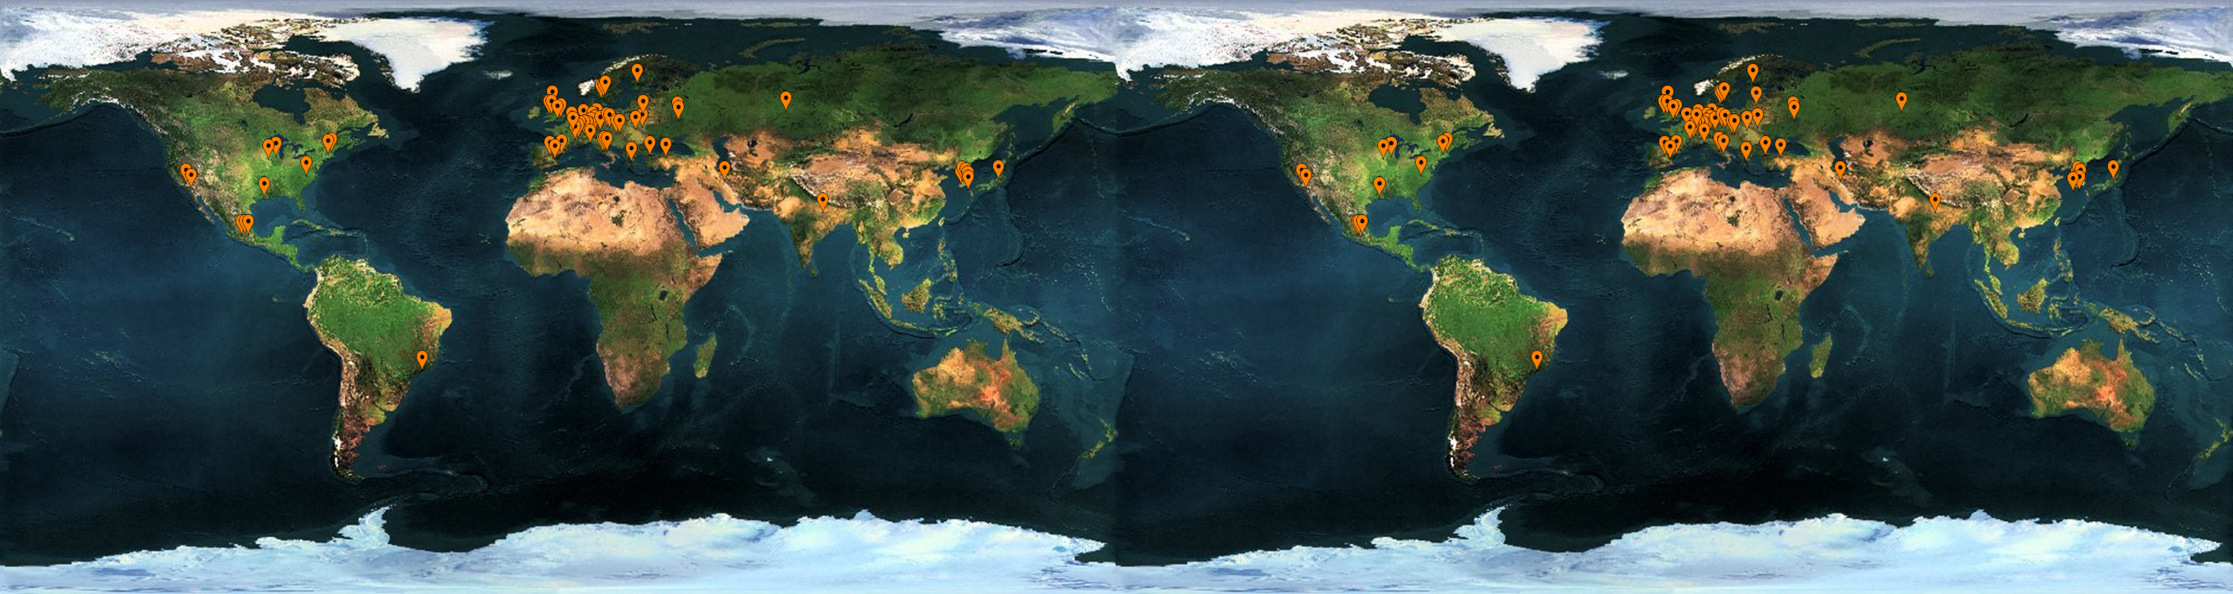



























FCC International Collaboration
75 institutes
26 countries + EC
Status: April, 2016

Slide 23
FCC Collaboration Status
75 collaboration members & CERN as host institute, April 2016
UT Enschede, Netherlands
U Geneva, Switzerland
Goethe U Frankfurt, Germany
GSI, Germany
GWNU, Korea
U. Guanajuato, Mexico
Hellenic Open U, Greece
HEPHY, Austria
U Houston, USA
IIT Kanpur, India
IFJ PAN Krakow, Poland
INFN, Italy
INP Minsk, Belarus
U Iowa, USA
IPM, Iran
UC Irvine, USA
Istanbul Aydin U., Turkey
JAI, UK
JINR Dubna, Russia
Jefferson LAB, USA
FZ Jülich, Germany
KAIST, Korea
KEK, Japan
KIAS, Korea
King’s College London, UK
KIT Karlsruhe, Germany
KU, Seoul, Korea
Korea U Sejong, Korea
U. Liverpool, UK
U. Lund, Sweden
MAX IV, Lund, Sweden
MEPhI, Russia
UNIMI, Milan, Italy
MIT, USA
Northern Illinois U, USA
NC PHEP Minsk, Belarus
U Oxford, UK
PSI, Switzerland
U. Rostock, Germany
RTU, Riga, Latvia
UC Santa Barbara, USA
Sapienza/Roma, Italy
U Siegen, Germany
U Silesia, Poland
TU Tampere, Finland
TOBB, Turkey
U Twente, Netherlands
TU Vienna, Austria
Wigner RCP, Budapest, Hungary
Wroclaw UT, Poland
ALBA/CELLS, Spain
Ankara U., Turkey
U Belgrade, Serbia
U Bern, Switzerland
BINP, Russia
CASE (SUNY/BNL), USA
CBPF, Brazil
CEA Grenoble, France
CEA Saclay, France
CIEMAT, Spain
Cinvestav, Mexico
CNRS, France
CNR-SPIN, Italy
Cockcroft Institute, UK
U Colima, Mexico
UCPH Copenhagen, Denmark
CSIC/IFIC, Spain
TU Darmstadt, Germany
TU Delft, Netherlands
DESY, Germany
DOE, Washington, USA
ESS, Lund, Sweden
TU Dresden, Germany
Duke U, USA
EPFL, Switzerland

Slide 24
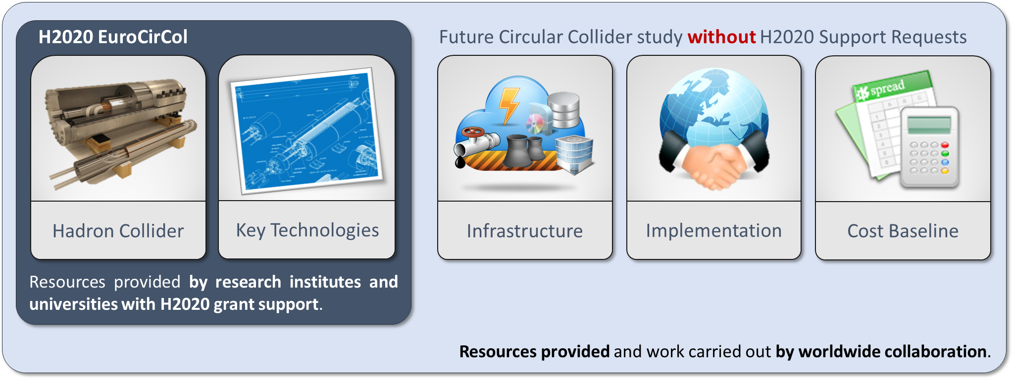
EuroCirCol EU Horizon 2020 Grant
European Union contributes with funding to FCC-hh study
Supports and makes essential contributions to the FCC-hh work packages:
Arc & IR optics design, 16 T dipole design, cryogenic beam vacuum system
Recognition of FCC Study by European Commission.

Slide 25
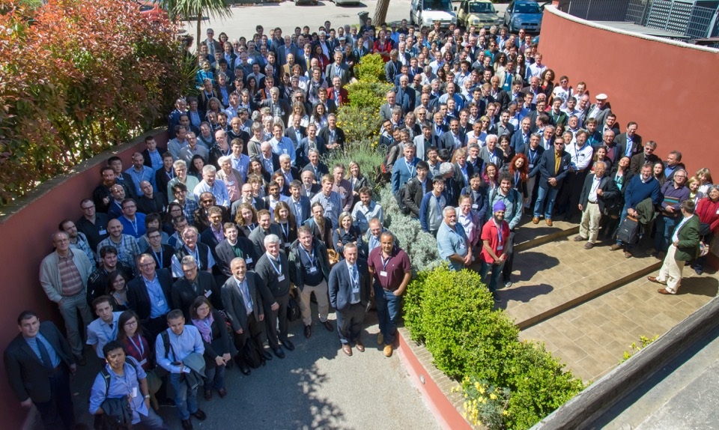
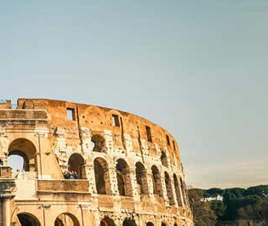
First FCC Week
Conference
Washington DC
23-27 March 2015
http://cern.ch/fccw2016
468
Participants
168
Institutes
http://cern.ch/fccw2015
24
Countries

Slide 26
Conclusions
There is a strong rising interest in Future Circular Colliders and a community is forming to study these machines
International collaboration is needed to advance with this study on all the challenging subjects
Many technical challenges in field or SC magnets, RF, coatings, materials, vacuum, etc.
Consolidated parameter sets for both machines FCC-hh and FCC-ee have been established and work on all areas, accelerator physics, technologies, infrastructures, detectors and physics is advancing well.
Next milestone is a study review at FCC Week in Berlin in 2017, to define contents of CDR.

Slide 27



FCC Week 2017
29 May – 2 June 2017
Berlin, Germany

