Slide 1
Nano-containers and nano-scaffolds
Katalin Kamarás
Institute for Solid State Physics and Optics,
Wigner Research Centre for Physics,
Hungarian Academy of Sciences, Budapest

Slide 2
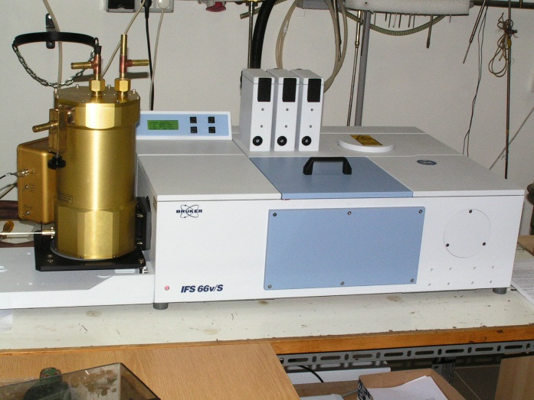
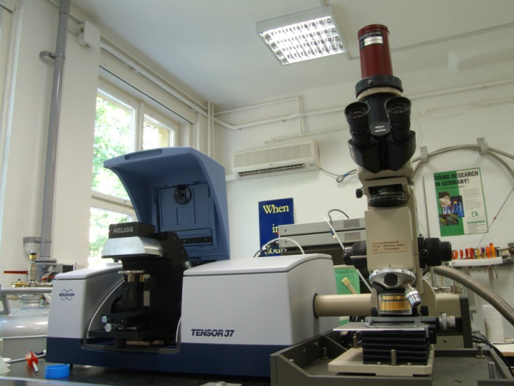
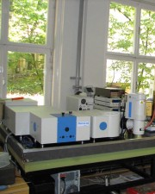
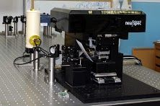
Wigner Research Centre for Physics
Advanced Structural Laboratory
FIR/MIR
MIR/NIR
Photoluminescence
Near field/SNOM

Slide 3
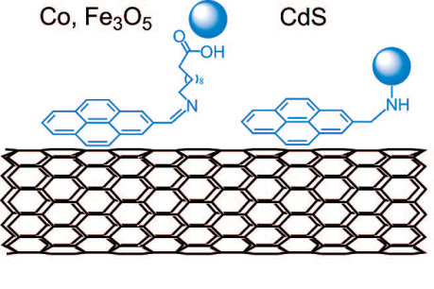
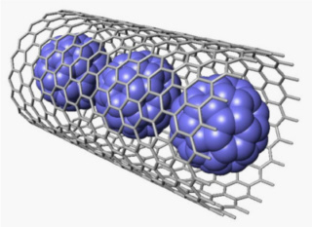
Hybrid structures from nanotubes
exceptional properties of nanotubes:
  mechanical stability
  electric conductivity
organic components:
  selectivity
  function
D. Eder:
Chem. Rev. 110,
1348 (2010)
peapod
adsorbed organic molecule
  Nano-containers
  van der Waals interaction inside
  nanosize reaction vessel
  packaging of unstable, toxic molecules
  Nano-supports
  π-π interaction on surface
  increased solubility
  “glue”
Incorporation of functional units

Slide 4
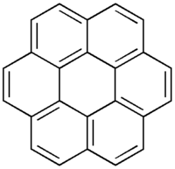
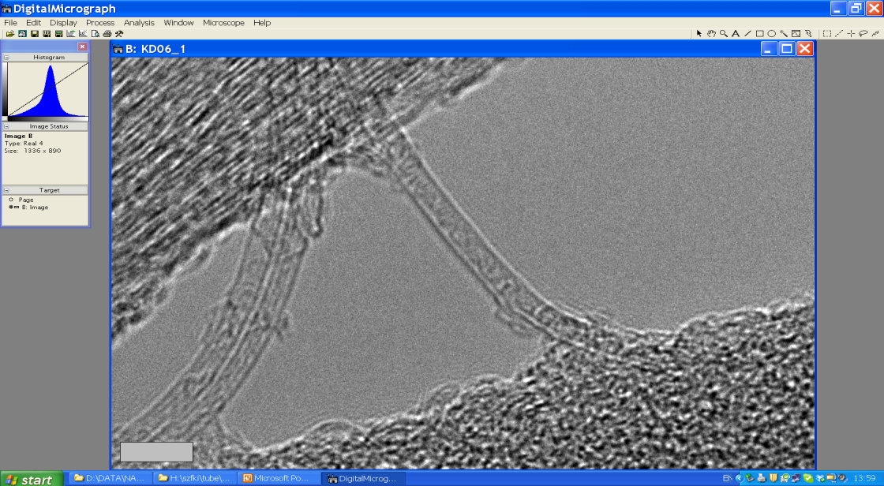
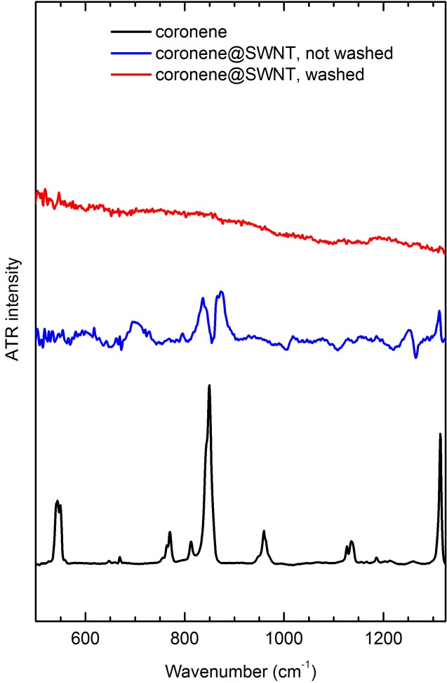
Coronene@SWNT
ATR-IR
coronene both encapsulated and adsorbed
adsorbed coronene dissolves in toluene

Slide 5
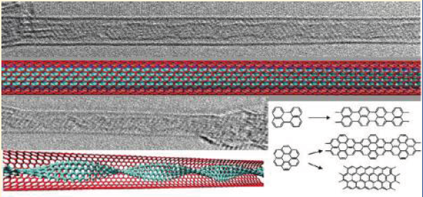
Reactions inside nanotube
low-temperature filled nanotubes: no side reactions on adsorbed molecules
surface can be cleaned by toluene washing
adsorbed molecules do not obscure encapsulated ones
Can we stop the process at the nanoribbon stage?
A.V. Talyzin, I.V. Anoshkin,
A.V. Krasheninnikov, R.M. Nieminen,
A.G. Nasibulin, H. Jian, E.I. Kauppinen:
Nano Lett. 11, 4352 (2011)

Slide 6
Following reactions by Raman spectroscopy
Resonance with nanoribbons:
500, 700, 900 ºC
Resonance with nanoribbons:
700, 900 ºC
DWNT formation: 1250 ºC

Slide 7
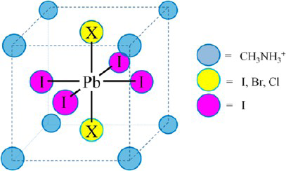
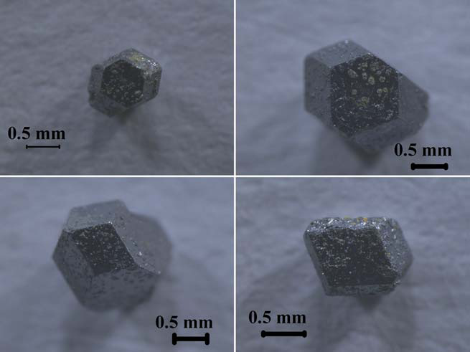
Lead halide perovskites
the solar cells of the future
E. Mosconi, A. Amat, Md.K. Nazeeruddin, M. Grätzel, F. De Angelis:
J. Phys. Chem. C 117, 13902 (2013)
T. Baikie, Y. Fang, J.M. Kadro, M. Schreyer, F. Wei,
S.G. Mhaisalkar, M. Grätzel, T.J. White:
J. Mater. Chem. A 1, 5628 (2013)

Slide 8
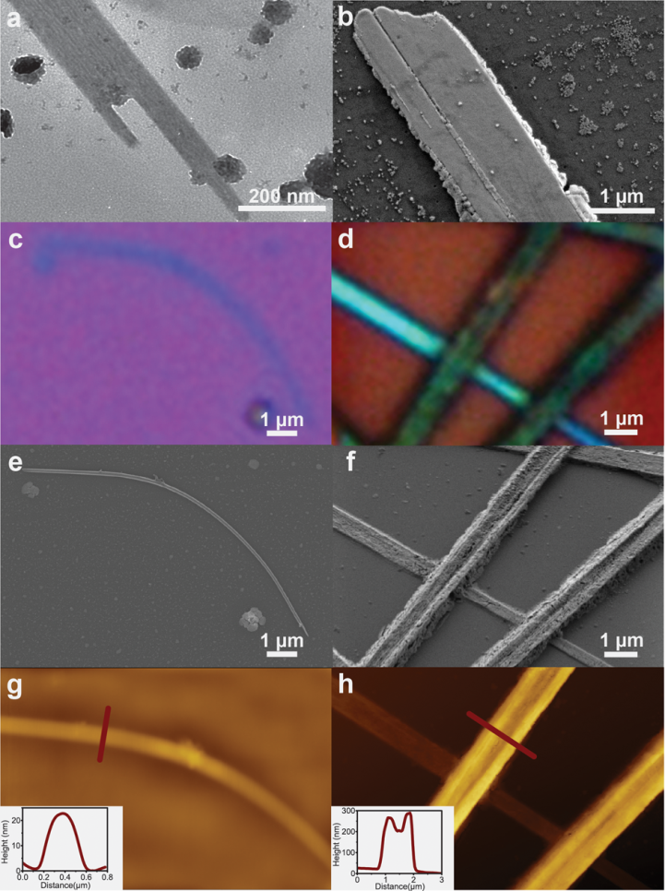
Lead halide perovskites: nanoscale
E. Horváth, M. Spina, Zs. Szekrényes, K. Kamarás, R. Gaal, D. Gachet, L. Forró:
Nano Lett. 14, 6761-6766 (2014)
CH₃NH₃PbI₃ nanowires with 50 – 200 nm diameter

Slide 9
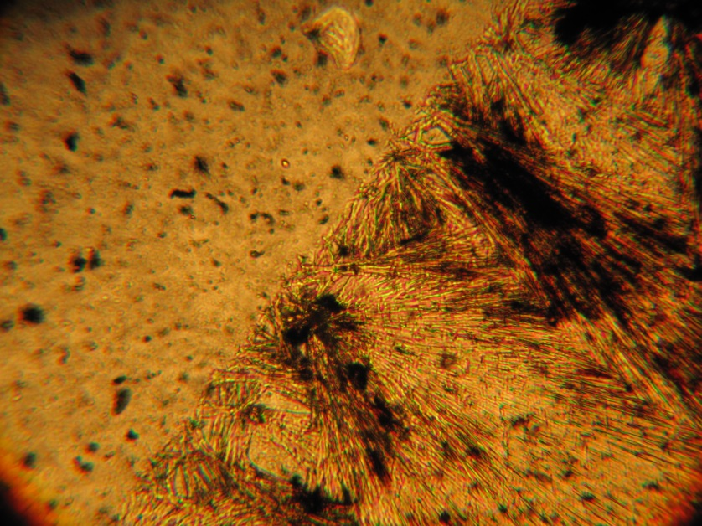
Perovskite nanowires: using carbon nanotubes as scaffolds
Transparent CNT film
CH₃NH₃PbI₃ nanowire
M. Spina, B. Náfrádi, H.M. Tóháti, K. Kamarás, E. Bonvin, R. Gaal,
L. Forró, E. Horváth:
Nanoscale 8, 4888 (2016)
strong
transparent
chemically inert?
yes

Slide 10

Photoinduced spectral changes
Illumination by 633 nm light
Presented as $∆A = \frac{T_{dark}− T_{illum}}{T_{dark}}$
Carbon nanotubes are
ideal hole transport layers!

Slide 11
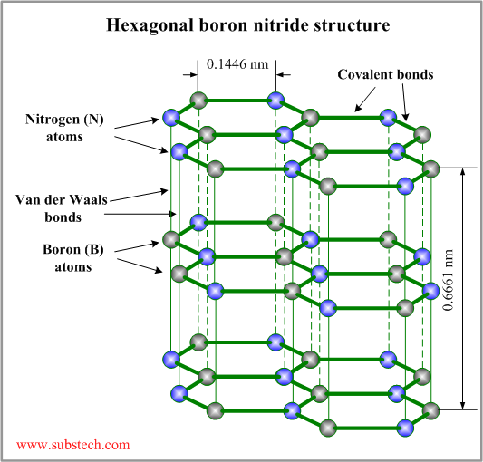
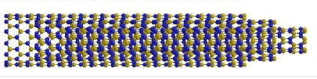
Boron nitride nanotubes
Both covalent and van der Waals bonds have ionic character
electrons are less delocalized
h-BN is an insulator with a bandgap of 6 eV
folding
BNNT nanotube
Z. Gao et al.: Nanobiomedicine, 2014, 1:7.

Slide 12
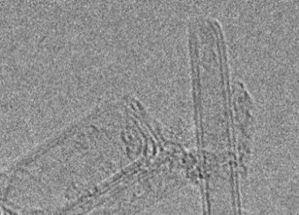
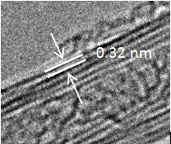
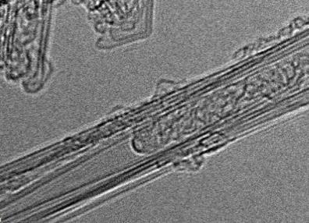
Electron microscopy of BNNT
external diameter 5.62 ± 2.16 nm
internal diameter 2.61 ± 1.05 nm
interlayer spacing 0.32 nm (h-BN)
Samples: BNNT LLC
Measurements: Andrei N. Khlobystov

Slide 13
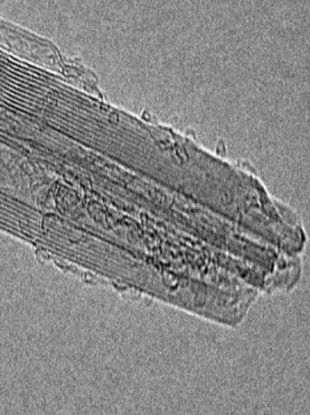
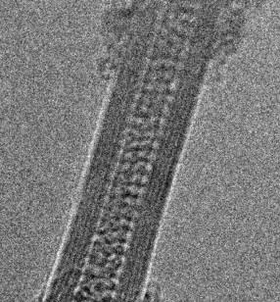
Filling of BNNT
BNNT as is
shortening (~2 μm → ~500 nm)
opening
purification (ammonia, annealing)
BNNT open
sublimation filling 600 °C
W. Mickelson, S. Aloni, W.-Q. Han, J. Cumings, A. Zettl: Science 300, 467 (2004)
C₆₀@BNNT

Slide 14
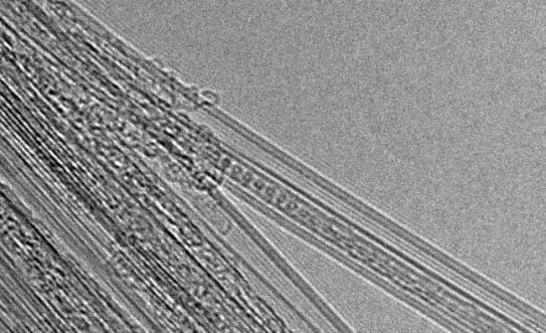
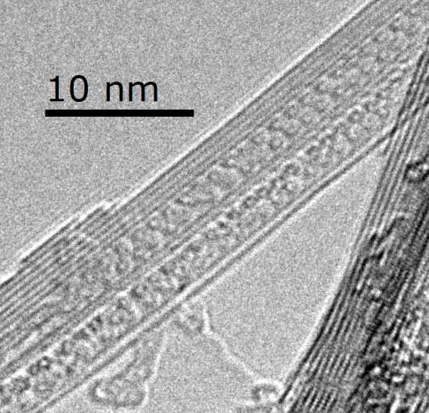
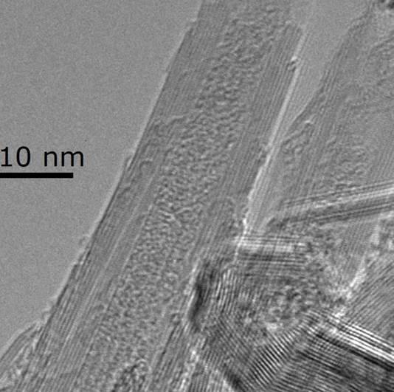
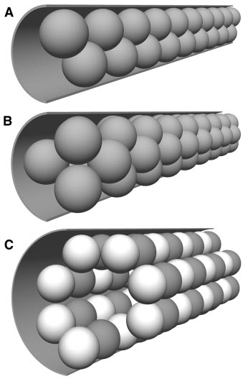
Microscopy of BNNT peapods
linear chain
zigzag
A.N. Khlobystov, D.A. Britz, J. Wang, S.A. O’Neil, M. Poliakoff, G.A.D. Briggs: J. Mater. Chem. 14, 2852 (2004)
two-molecule layer
W. Mickelson, S. Aloni, W.-Q. Han, J. Cumings, A. Zettl: Science 300, 467 (2004)

Slide 15
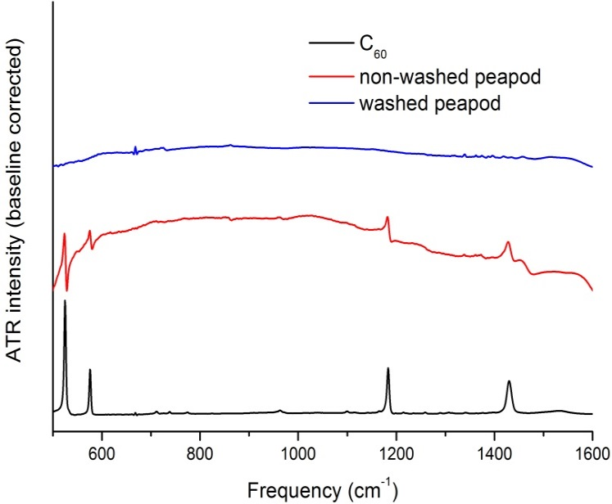
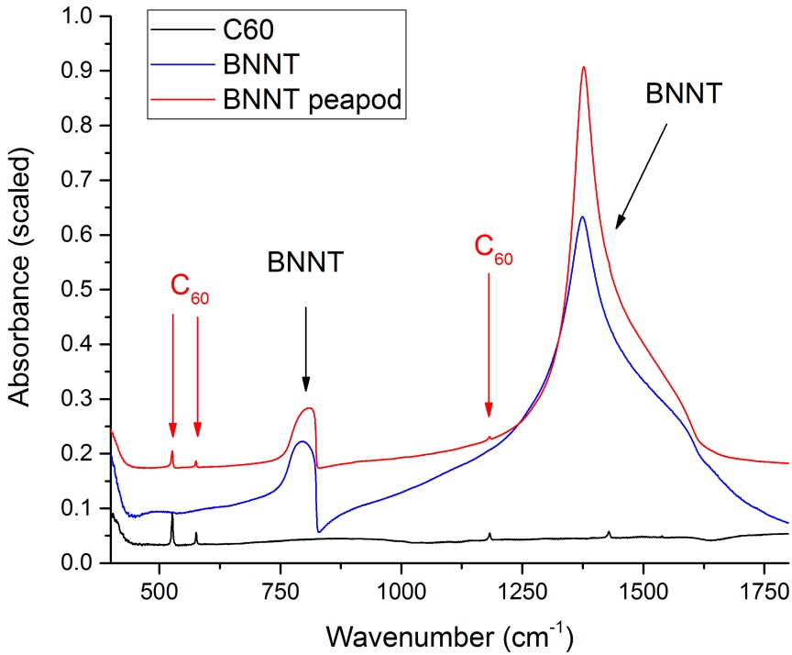
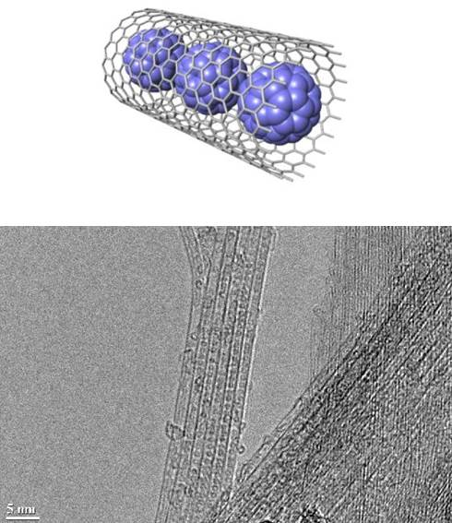
Infrared spectra of peapods
CNT
Infrared spectra
of C₆₀ shielded
BNNT
C₆₀ vibrations can be
clearly seen
C₆₀ retains I_{h} symmetry
(no splitting of
vibrational bands)
free rotation at room temperature

Slide 16
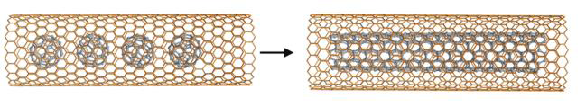
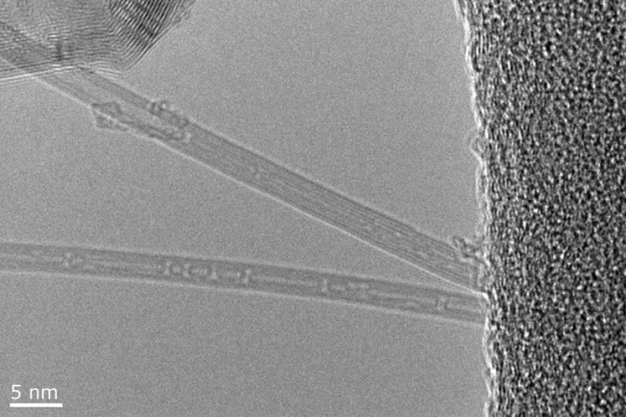
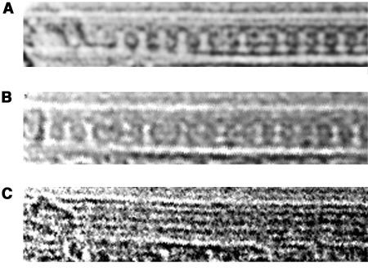
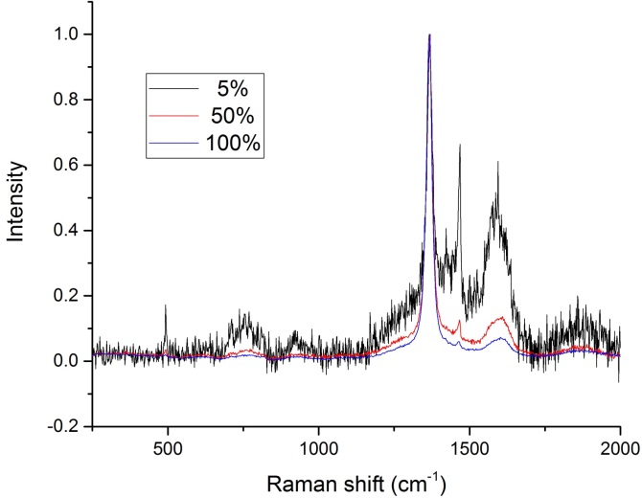
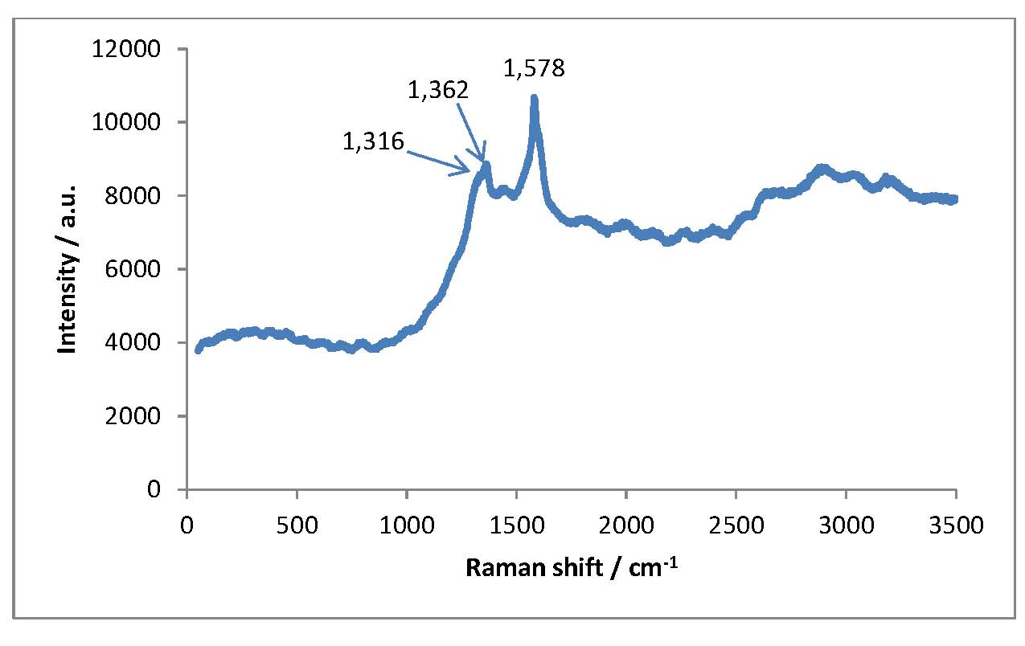
Formation of inner nanotube
annealing 1200 °C
electron beam
W. Mickelson, S. Aloni, W.-Q. Han, J. Cumings, A. Zettl: Science 300, 467 (2004)
laser 355 nm

Slide 17
“Towards the world’s smallest coaxial cable”
K.E. Walker, G.A. Rance, Á. Pekker, H.M. Tóháti, M.W. Fay, R.W. Lodge, C.T. Stoppiello, K. Kamarás, A.N. Khlobystov:
Small Methods, published online, DOI: 10.1002/smtd.201700184

Slide 18




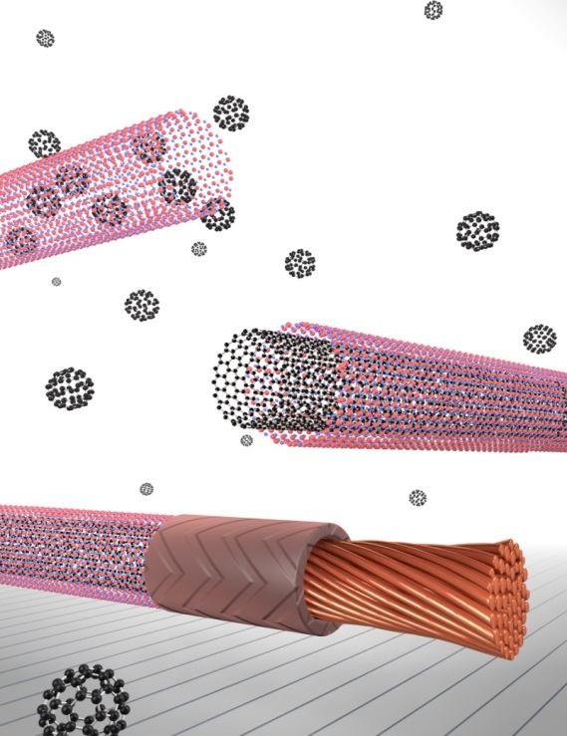


Collaborators
Bea Botka
Ákos Botos
Melinda Füstös
Áron Pekker
Zsolt Szekrényes
Hajnalka M. Tóháti
Miklós Veres
Endre Horváth
Bálint Náfrádi
László Forró
Kate E. Walker
Graham A. Rance
Thomas W. Chamberlain
Andrei N. Khlobystov
Funding:
EU PITN-GA 2008-215399
FINELUMEN
NK 105691
SNN 118012
VEKOP 2.3.2-16-2016-00011
VEKOP 2.3.3-15-2016-00001

