Slide 1
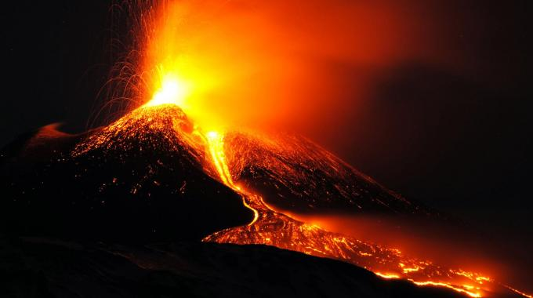


Gazing at Matter above a Trillion of degrees
_______________________________________________________________________________________________
Vincenzo Greco - University of Catania
Inaugural Lecture AE P&E sciences, 3rd September 2017, Budapest, Hungary

Slide 2
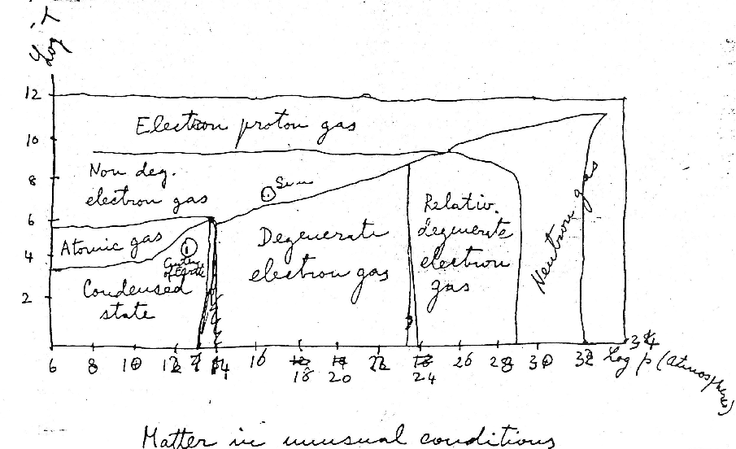
Matter in unusual conditions…
Fermi’s Notes on Thermodynamics and Statistics (1953)
Atoms, electrons, protons, neutrons, …
Temperature
Pressure
dyne/cm²

Slide 3
Matter in unusual conditions…
Fermi’s Notes on Thermodynamics and Statistics (1953)
Atoms, electrons, protons, neutrons, …
Temperature
Pressure
dyne/cm²
Fermi put Nothing above 10¹²K!
if T >10¹²K ≈ 200 MeV → KT= E ≈ 1/L
→ L < 1 fm go inside a proton
In the ‘50 and ‘60 there was nothing inside a proton

Slide 4
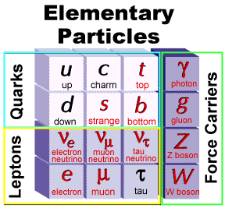
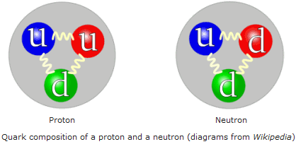
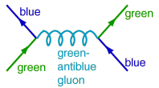
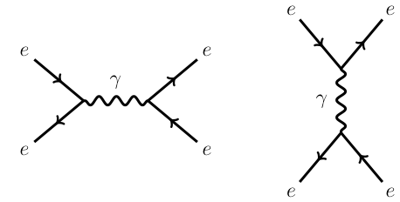
Now we know that…
proton
neutron
Quarks and Gluons dynamics is driven
by The Strong Interaction
QuantumChromoDynamics (QCD) - 1973
Gluons
Quantum Electrodynamics (QED)
Photons

Slide 5
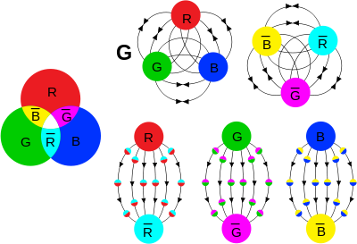

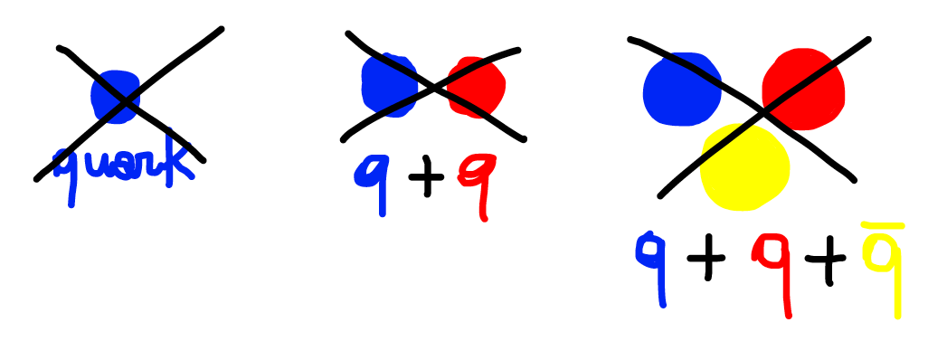
Quantum Chromodynamics
There are no free quark! → Confinement
There are only white (neutral) objects
with 2 colors “protons” would
have been bosons!
Baryons: qqq
Mesons : qq
All non-white combination do not exist!
Does not exist the standard
particle in the vacuum
QCD is very strange and unique: built on particles that cannot be detected experimentally. Before QCD this would have been seen as anti(pre)-scientific!

Slide 6
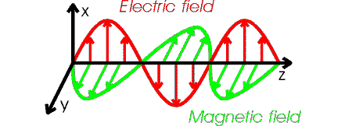
Quantum Chromodynamics ≠ QED
There are no free quark! → Confinement
There are only white (neutral) objects
Baryons: qqq
Mesons : qq
Does not exist the standard
particle in the vacuum
QCD is very strange and unique: built on particles that cannot be detected experimentally. Before QCD this would have been seen as anti(pre)-scientific!
No Chromomagnetic waves propagating in the vacuum!

Slide 7
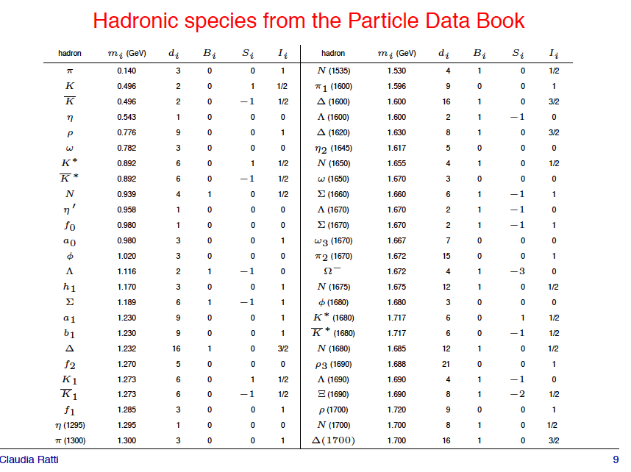
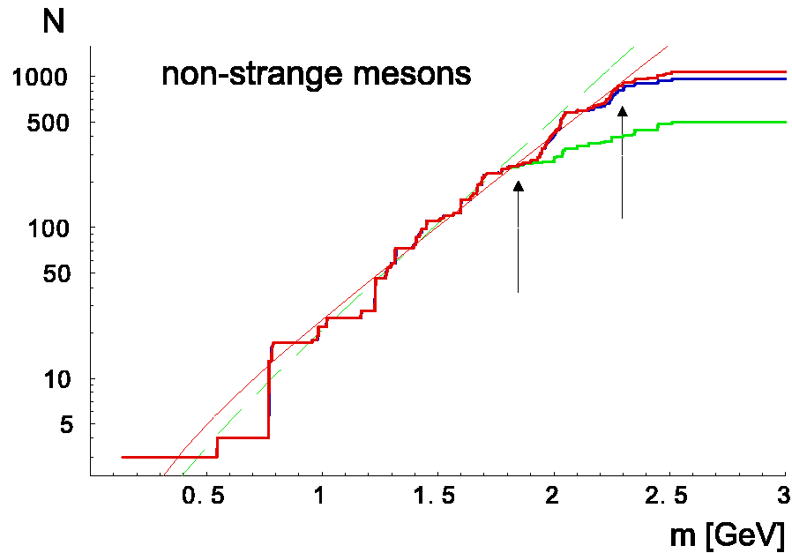
There are still a lot of hadrons …
Density of state increase exp. with m

Slide 8
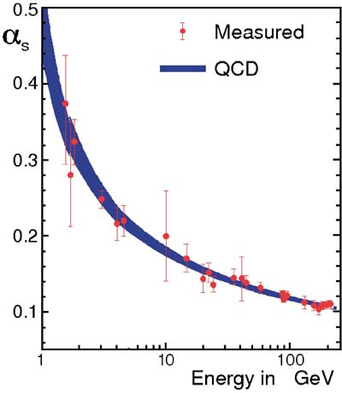
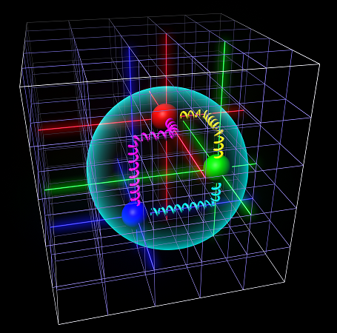
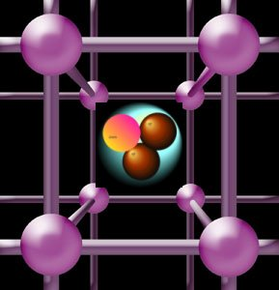
Quantum Chromodynamics
Strong coupling constant
e.m. coupling
← Confinement
Two regimes:
Perturbative: Asymptotic freedom (Q ≥ 20 Λ_{QCD})
→ Interaction Increase with distance ≠ other interaction
precise results for Early Universe at energies we
can reach on Earth!!!
Non-Perturbative : Confinement
solvable only on Lattice QCD
(i.e. integrating over about 10⁷ variables…)
Asymptotic freedom →
Q
Confinement means “No Ionization” → No colored plasma (“charged” gas) like for atoms!?

Slide 9
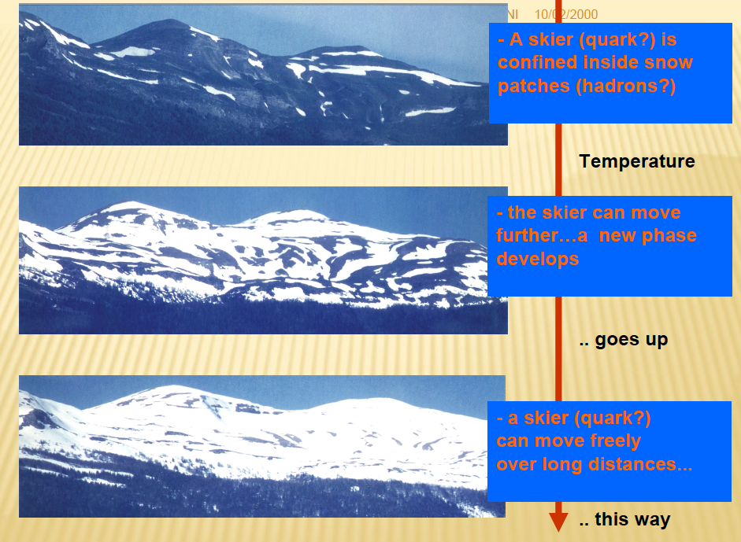
If you have to stay confined to white spots how can you move freely?
A skier (quark) is
Confined inside snow
patches (hadrons)

Slide 10
If you have to stay confined to white spots how can you move freely?
A skier (quark) is
Confined inside snow
patches (hadrons)
The skier can move
further … a new phase
develops
A skier (quark) can move
freely … over long distances

Slide 11
Quark-Gluon Plasma (5th state of matter)
1975: J.C. Collins M.J. Perry, “Superdense Matter or Asymptotically Free Quarks?”,
Phys. Rev. Lett. 34, 1353: “…matter at densities higher than nuclear consists of a quark soup. The quarks become free at sufficiently high density or temperature.”
2000 – CERN Statement, Nature 403 : ”evidence for the existence of a new state of quark-gluon matter in which quarks … are liberated to roam freely… in which quarks and gluons are no longer confined but free to move around over a volume… quarks would then freely roam.”
Notes:
Think it is asymptotic freedom comes from the fascination of this qcd property

Slide 12
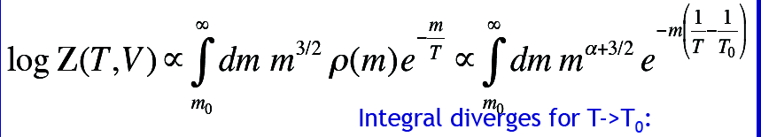
Quark-Gluon Plasma (5th state of matter)
1975: J.C. Collins M.J. Perry, “Superdense Matter or Asymptotically Free Quarks?”,
Phys. Rev. Lett. 34, 1353: “…matter at densities higher than nuclear consists of a quark soup. The quarks become free at sufficiently high density or temperature.”
2000 – CERN Statement, Nature 403 : ”evidence for the existence of a new state of quark-gluon matter in which quarks … are liberated to roam freely… in which quarks and gluons are no longer confined but free to move around over a volume… quarks would then freely roam.”
1975: Cabibbo & Parisi, Phys.Lett.B 59, 67, “Exponential hadronic spectrum and quark liberation“. An hadronic resonance gas has a divergency in the partition function
at T=T₀ ≈ 160 MeV → phase transitions.
Note: Before “73 there was nothing to transit to. T₀ was limiting Temperature (Hagedorn)
Density of states ρ(m) of hadronic matter wins over Boltmann suppression factor
Not related to Asymptotic Freedom!
Notes:
Think it is asymptotic freedom comes from the fascination of this qcd property

Slide 13
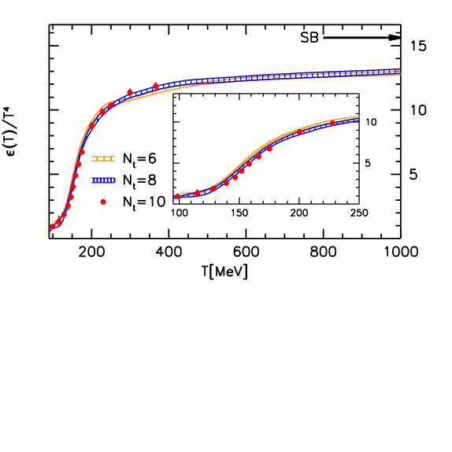
Beyond naive argument: lattice QCD
Rescaled Energy Density
Free-gas of quarks & gluons
Hadron gas
Colored Matter
about 45 d.o.f.
d= 3_{fl}*3_{col}*2_{s}*2_{anti} + 16_{gluon}
T_{c}≈ 160 MeV
Wuppertal-Budapest Collab. (2010)
Stefan-Boltzmann limit not reached
by 15-20 % : QGP as a weak interacting gas?
But ε-3p>>0 strong interaction …

Slide 14
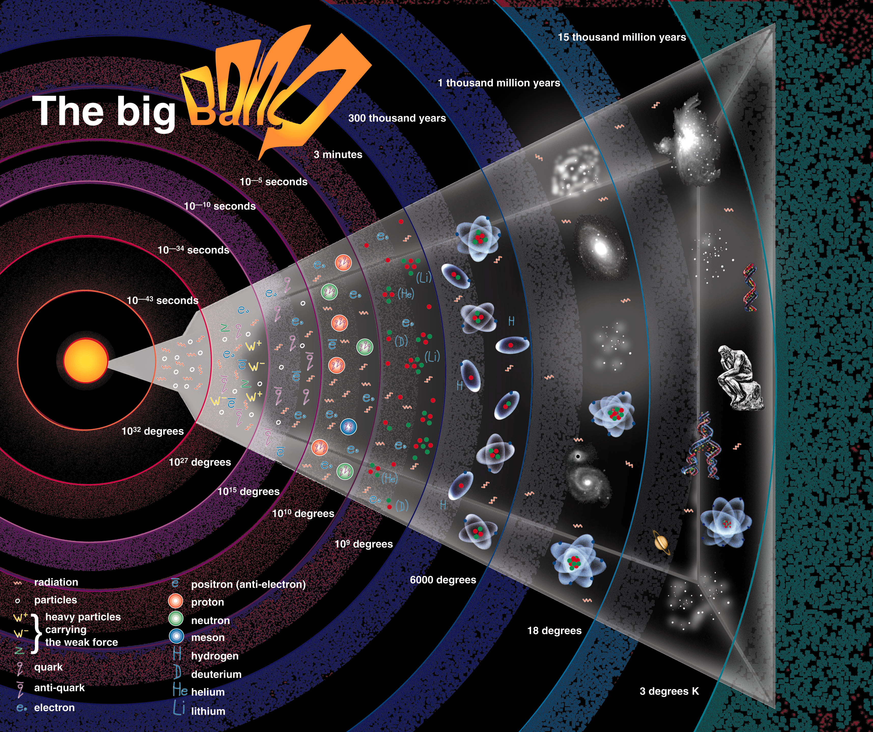
13.7 billion years
Matter evolution in the Universe
1 billion years
380,000 years
Time after Big Bang
3 min.
10⁻⁶ sec.
10⁻⁴³ seconds
BIG
BANG
T ~ 10³² °K
Quark & Gluons (T=10¹² °K)
Particles
Atomic Nuclei
Relativistic Heavy-Ion Collisions
Atoms
(3,000 °K)
Last time we reached T > 10¹² K
was 13.7 bilion years ago - 10 μs
Galaxies
(3 °K)
Man
Notes:
Fgura reticolo da rete

Slide 15
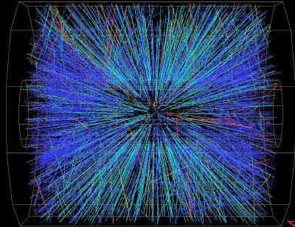

Uninteresting question:
What happens when I crash two gold nuclei together?
RHIC-BNL
LHC-CERN
Au+Au at √s= 200 AGeV
Pb+Pb at √s= 2.76 ATeV
Do we create fireworks?
Or a plasma at some finite temperature?

Slide 16
Hadrons produced at T<T₀
E=mc² (+) E=KT energy used to produced new particles
of mass m_{j} (j= π,Κ, p, Λ, Ω, … )
T
Particle Abundancy
Notes:
Does this mean it is a first order phase transition?
- No, lattice QCD says it is a cross-over.
- No, this behavior is due to confinement. This is a special matter!

Slide 17

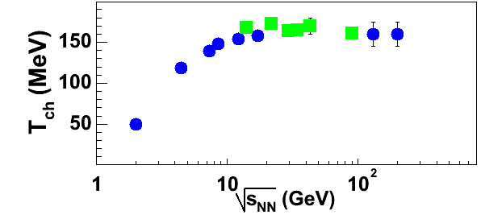
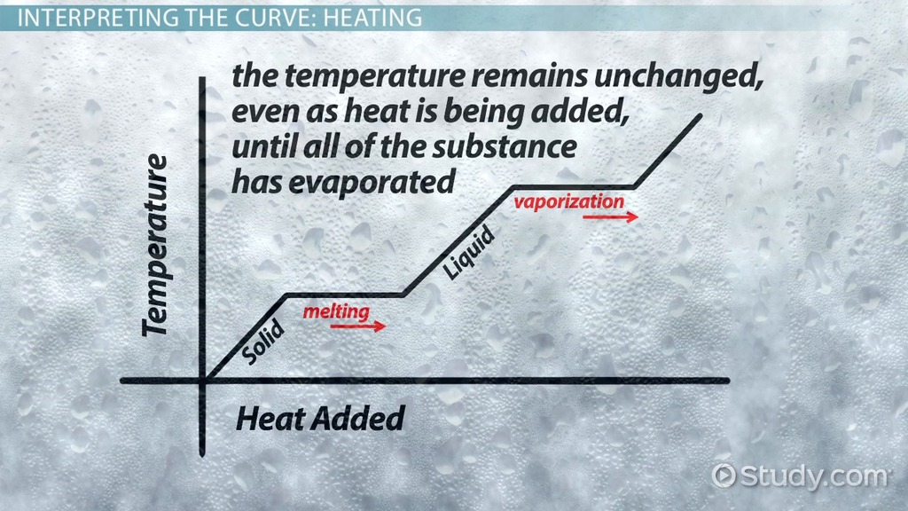
Hadrons produced at T<T₀
E=mc² (+) E=KT energy used to produced new particles
of mass m_{j} (j= π,Κ, p, Λ, Ω, … )
T
Particle Abundancy – Statistical Hadronization
Hot QCD matter from HIC
Water Phase transition
SPS
RHIC
LHC
Energy – Heat →
Does this mean it is a first order phase transition?
- No, lattice QCD says it is a cross-over.
- No, this behavior is due to confinement. This is a special matter!
Notes:
Does this mean it is a first order phase transition?
- No, lattice QCD says it is a cross-over.
- No, this behavior is due to confinement. This is a special matter!

Slide 18
How to study the properties of this strange QGP matter!
Having a sample of 10⁻¹⁴ m that last for 10⁻²³ sec?
I will pick-up one example …

Slide 19
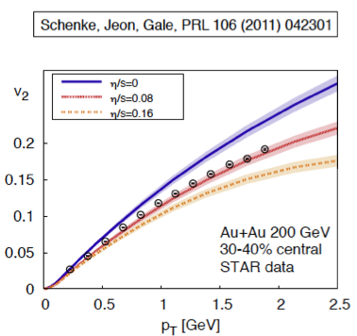
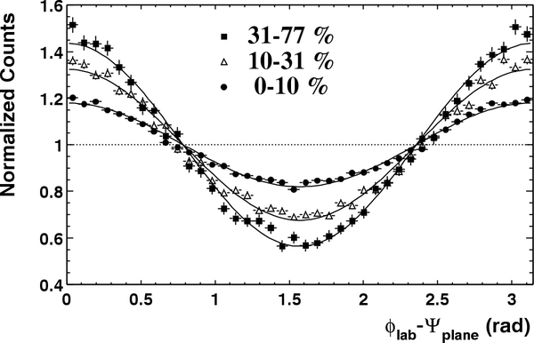
Anisotropic Expansion in the tranverse plane
Space Eccentricity
Elliptic Flow
η/s viscosity
y
z
c²_{s}=dP/dε - EoS
x
Coefficient Fourier expansion
Elliptic Flow vs Viscosity
η/s=0
b=4 fm
b= 6.5 fm
b= 9.5 fm
b ≈ 6.5 fm
η/s=1/4π
η/s=1/2π
Angle of emission

Slide 20
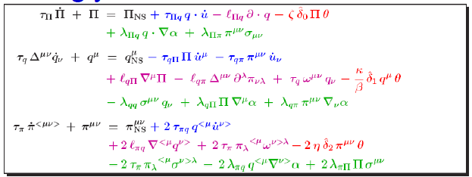
Just one Note …
1) Trivial after solving …. Relativistic Viscous Hydrodynamics at II° order
All is done assuming that matter created is thermal at τ ≈ O(1fm/c)

Slide 21
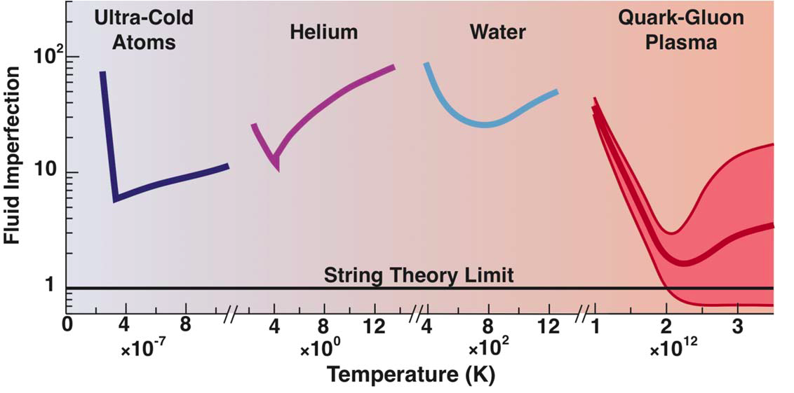
Shear Viscosity for systems in 20 order of T magnitudes!
×4π
pQCD- plasma
Report to the Nuclear Science Advisory Committee in 2013
Notes:
Da dove e’ repsa questa figura?

Slide 22
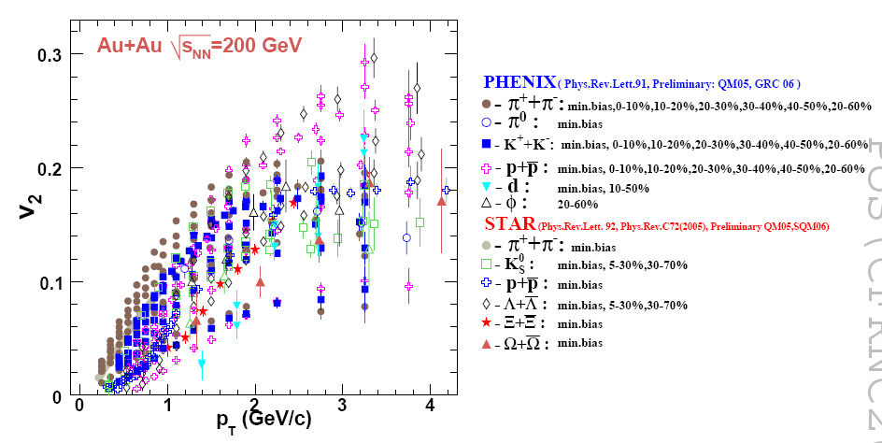
One more thing about elliptic flow
V₂ baryons and mesons
Lacey and Taranenenko, PoS 2006
Always one question bounces back!
Can we see how and if quarks are flowing?
Confinement: we can see only hadrons flowing

Slide 23
My first Proceedings on QGP…
Texas A&M, October 2002 – gift from Peter Levai

Slide 24

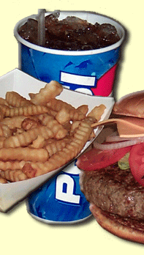
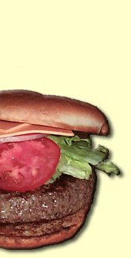
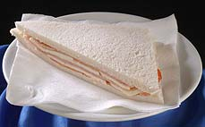
My first Proceedings on QGP…
Disccusing at lunch with Peter Levai
(Director of MTA Wigner-Budapest…)
P. Levai
Fat Burger
V. Greco
Texas A&M, October 2012 – gift from Peter Levai

Slide 25

My first Proceedings on QGP…
“In ALgebraic COalescenceRecombination model we assume that just before the hadronization the dense matter
can be described as a mixture of dressed up, massive quarks and antiquarks … “
By J. Zimanyi and the Budapest group
If you have a medium of quarks
Why you need the vacuum to hadronize?
?
In Texas we moved to
observables in momentum space
Texas A&M, October 2012 – gift from Peter Levai

Slide 26
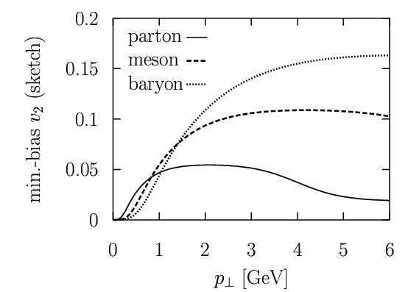
Recombination enhances Anisotropies
Meson recombination(qq)
Baryon recombination(qqq)
Two branches
Baryon (qqq)
Meson (qq)
quark(q)
Discarding space-momentum correlation,
hadron wave function width,
event-by-even fluctuations, Resonance decays, …
VG, Ko, Levai, PRL 90(2003)

Slide 27
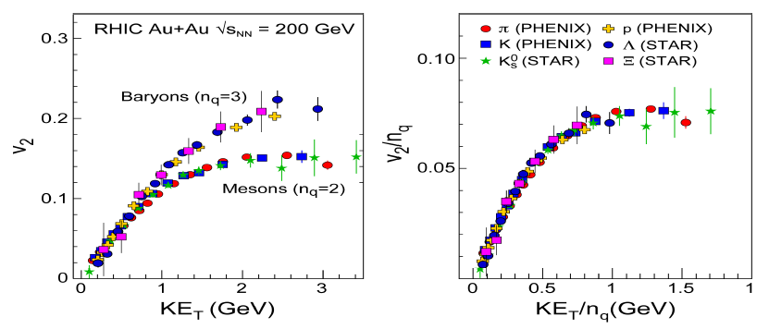
Too beautiful to be true? …
Quark n_{q} scaling
Baryons
Mesons
PHENIX, PRL 98(2007)
Anisotropic Flow formed at partonic level, one common QGP flow
Flow depends on quark content → two branches; Meson and Baryon

Slide 28
Too beautiful to be true …
All centralities and particles in once
Lacey and Taranenenko, PoS 2006
Everything rescales in one common flow!
We “see” the underlying quark flow.. with some distorsion

Slide 29

an elephant in the liquid

Slide 30
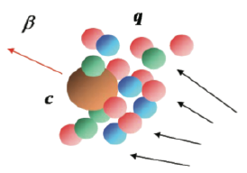
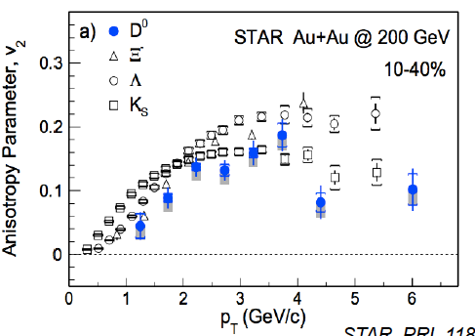
An elephant in the liquid: Heavy Charm Quark
QGP created is made by 99% of q=u,d,s, m_{q} ≈ 10 MeV
+ few Heavy Charm Quarks: M_{c} ≈ 1500 MeV
Standard Kinetic theory:
Poorly dragged & long thermalization time
τ_{C,therm} ≈ O(10²)>> τ_{QGP} >> τ_{q,therm} ≈ O(1) fm/c
Brownian motion
How they flow
Drag
Diffusion
1992: B. Muller, NATO Advanced Study Institute
“For plasma conditions realistically obtainable in
the nuclear collisions (T ~250 MeV, g = 2)
the effective quark & gluon mass m*~400 MeV.
We must conclude, therefore, that the notion of almost free gluons and quarks in the high T phase of QCD is quite far from the truth.”
Light hadrons
Charm hadrons
STAR, PRL 118 (2016)

Slide 31
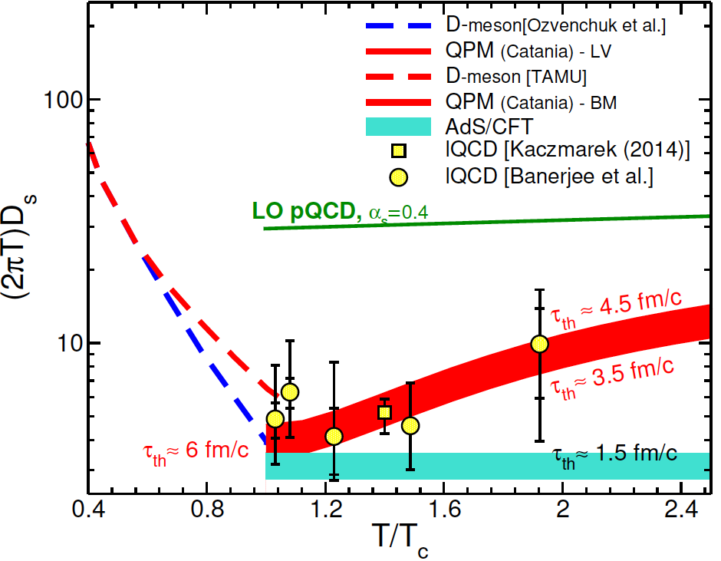
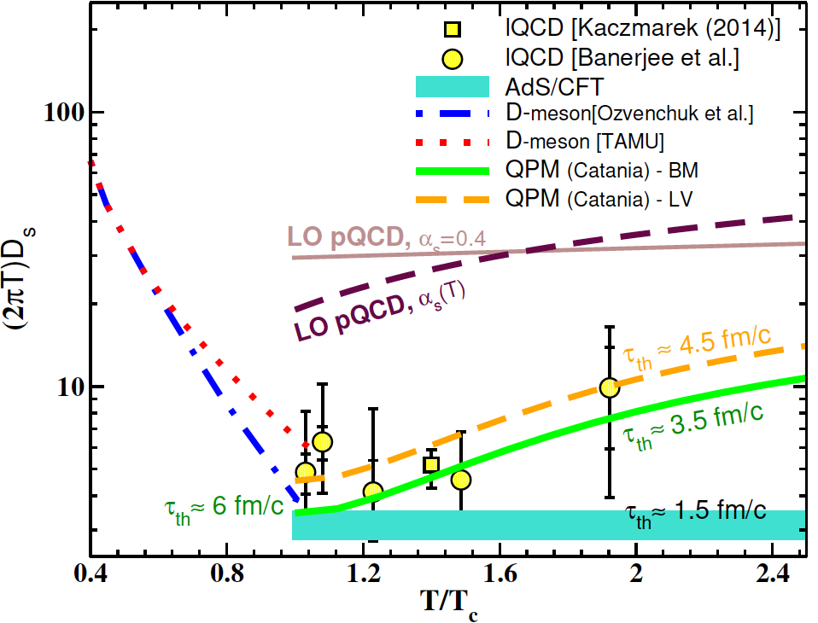

Diffusion Coefficient of Charm Quark
Asymptotic free regime
Not a model fit to lQCD data!
Phenomenology ≈ lattice QCD
Infinite Strong Coupling (AdS/CFT)
VG et al., arXiV: 1707.05452
VG et al., PLB747 (2015)
Created matter is the Hot QCD matter in non perturbative regime!
Likely a U shape typical of matter undergoing a phase transition
T→ Tc gets close to the AdS/CFT limit
Notes:
U shape typical of phase trnsition
As T→Tc ticuhe the AdS limit

Slide 32
Perspectives…
Characterizing viscosity η/s, bulk ζ/σ, conductivity σ_{el}, diffusion D_{s} :
  Important to understand QCD at high T up to pert. QCD regime
  Provide a precise background for cosmology
  (Ex. WIMP relic density…)
Study Matter behavior under Huge Magnetic fields (10¹⁸ Gauss)
- Charge-Parity violation in Strong Interaction?
At TeV scale new view on pp collisions is emerging
→ relevance for High-Energy Astrophysics at PeV scale and above

Slide 33


A Great Honor to be a member of this Academia!
A very pleasant feeling to see the benevolent
view of elder Collegueas!
An emotional coincidence to enter AE in Budapest!

Slide 34
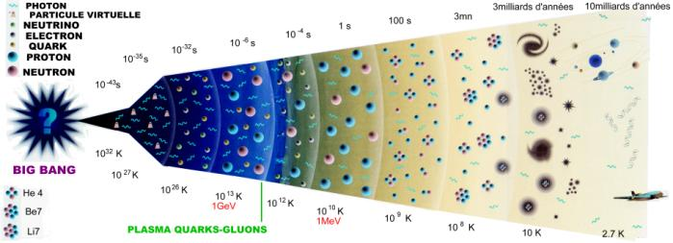
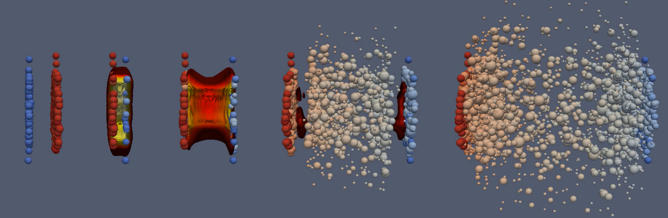
Degrees of freedom in the Universe
lQCD
10⁻⁵s
g(T)
Quark-Gluon Plasma
Disappeareance of colored matter the most drastic event
D.J.Schwartz, Ann. Phys. 2004

Slide 35
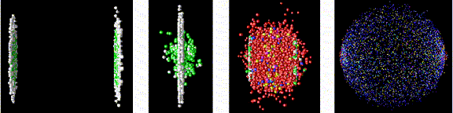
Degrees of freedom in the Universe
lQCD
10⁻⁵s
HIC
g(T)
Quark-Gluon Plasma
Disappeareance of colored matter the most drastic event

Slide 36
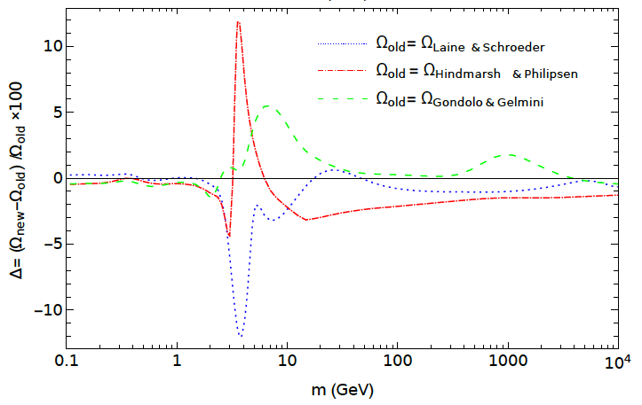
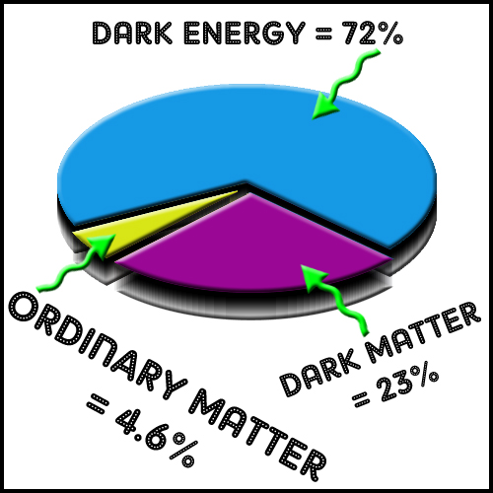

QCD EoS and the Relic WIMP Dark Matter
% variation of Ω due to different QCD EoS
PLANCK estimate to
determine Ω
with 1% precisions
old m_{TOP} estimate
M. Drees et al., JCAP 1506 (2015)
WIMP mass
Under the assumption of isoentropic Early Universe expansion
- We are now determining visccosities η/s(T), ζ/s(T) → entropy production
- We will see in the future the impact of the knowledge of Hot QCD
Notes:
E.W. Kolb and M.S. Turner, The Early Universe, Westview Press (1990).
the required value of hvi exceeds 4 10􀀀26 cm3 s􀀀1 .
Producing a suciently large annihilation cross section for such light WIMPs typically requires the introduction of
new light \mediators" between the WIMPs and SM particles.

Slide 37
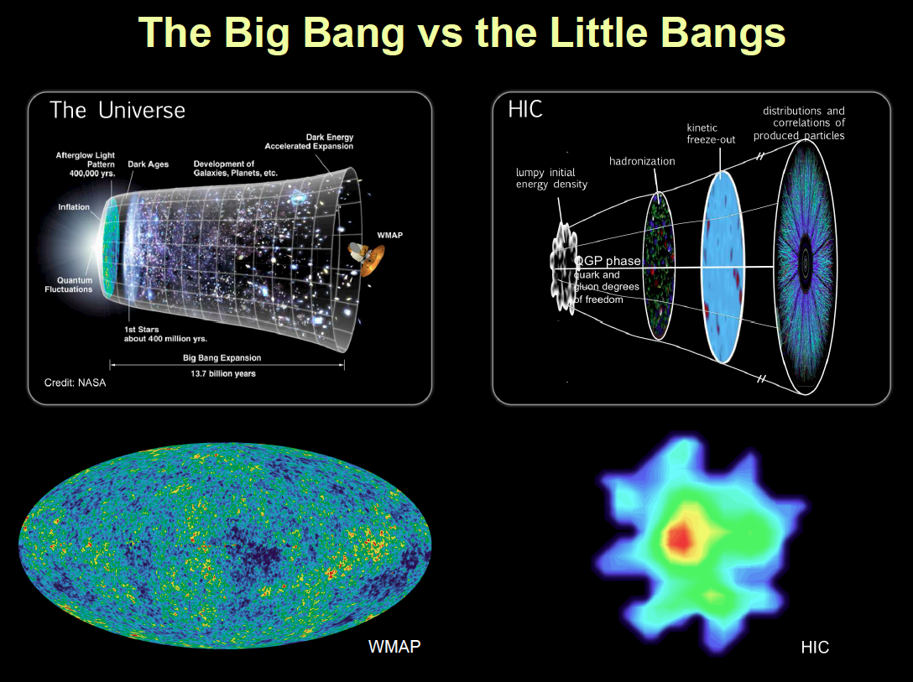
Another analogy with Early Universe expansion

Slide 38
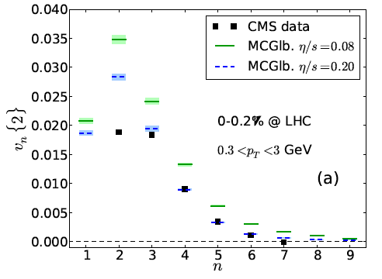
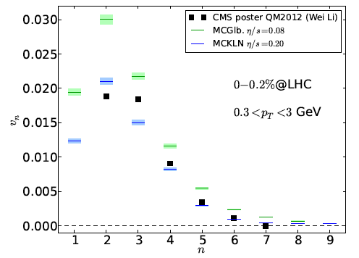
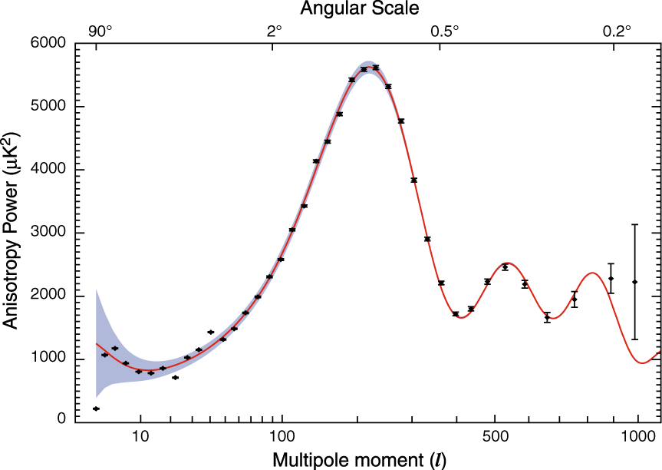
Going deeply into Hot QCD matter
why the v₃ is so large?
Initial QCD quantum fluctuations
T dependence of η/s
Equation of State
Freeze-out dynamics
Keeping size and life-time of QGP
Standard Model Matter
Cold Dark Matter
Dark Energy
Hubble Constant
Keeping Age and Flatness of the Universe
Possible because at LHC one starts to create about than 10,000 particle per event

Slide 39
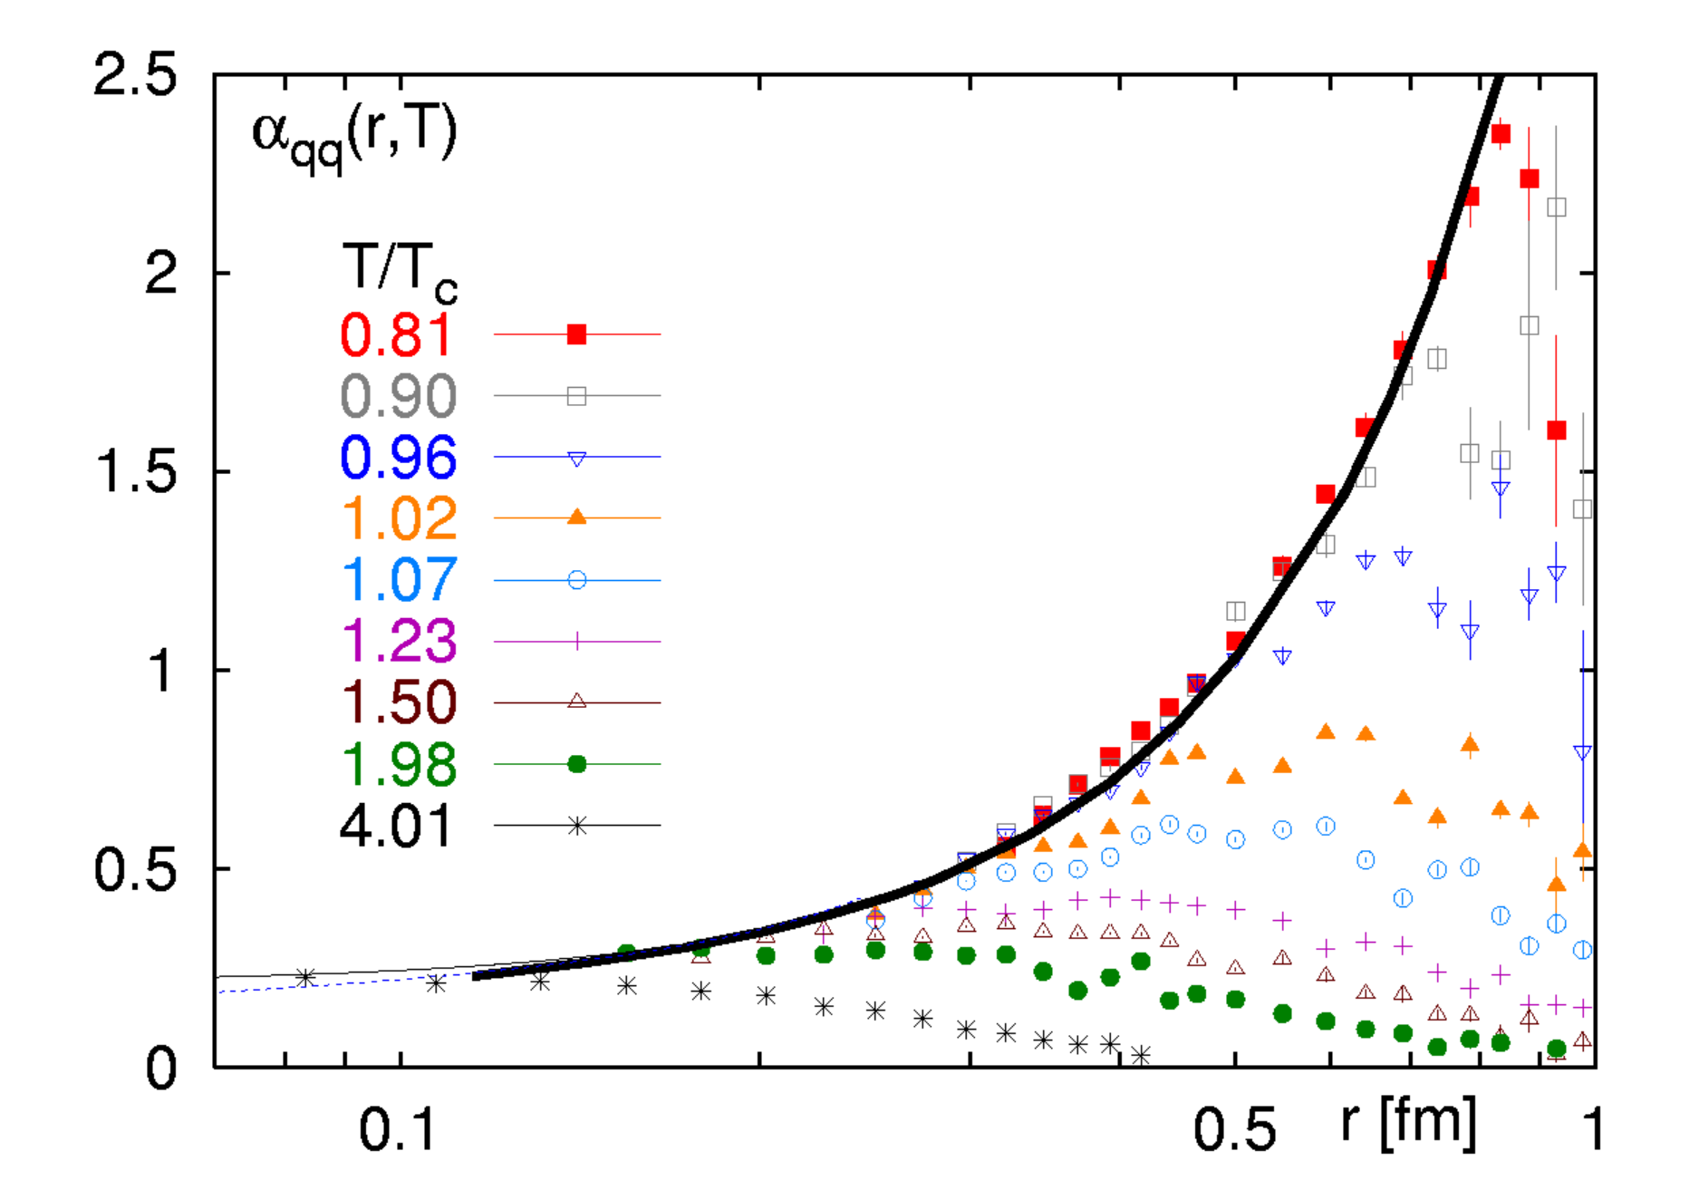
Beyond naive argument: lattice QCD
T=0
T=0.8 T_{c}
α ≈ r² → V ≈ Kr
T=T_{c}
High- Temperature medium
screens the Confinement
QCD vacuum is diamagnetic:
repels fields lines
Perturbative regime
α ≈ log(r/r₀) ≤ 0.25
Average distance
at ρ_{c}

Slide 40
Multifacets Physics
Initial Conditions
Quark-Gluon Plasma
Hadronization
γ
BULK
(p_{T}~ T)
e⁺
Microscopic
Mechanism
Matters!
μ⁺
e⁻
μ⁻
Going from p_{T} ≈ 1 to 10³ Λ_{QCD} and m_{q} ≈ 1/20 to 20 Λ_{QCD}
ColorGlassCond.
Gluon saturation
JETS
(p_{T}>>>T,Λ_{QCD})
Heavy Quarks
(m_{q}>>T,Λ_{QCD})

Slide 41
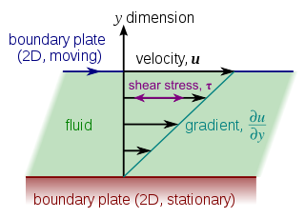
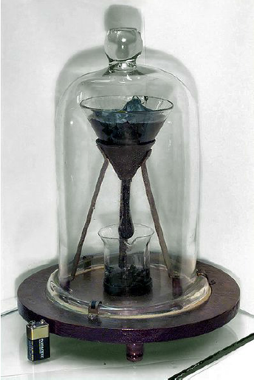

Why is Shear Viscosity is relevant
pitch
Text book kinetic theory
Small η/s → small mean free path λ
→ strongly coupled system
8 drops 1932-2013
At limits of Quantum mechanism (<p>≈ ΔE, λ≈ cΔt)
which for QGP mean η> 10¹¹ Pa•s
AdS/CFT, based on the conjecture that a Gauge theory in 4D (in the infinite
coupling limit) is dual to a gravitational calculation in 5D gives η/s> 1/4π

Slide 42
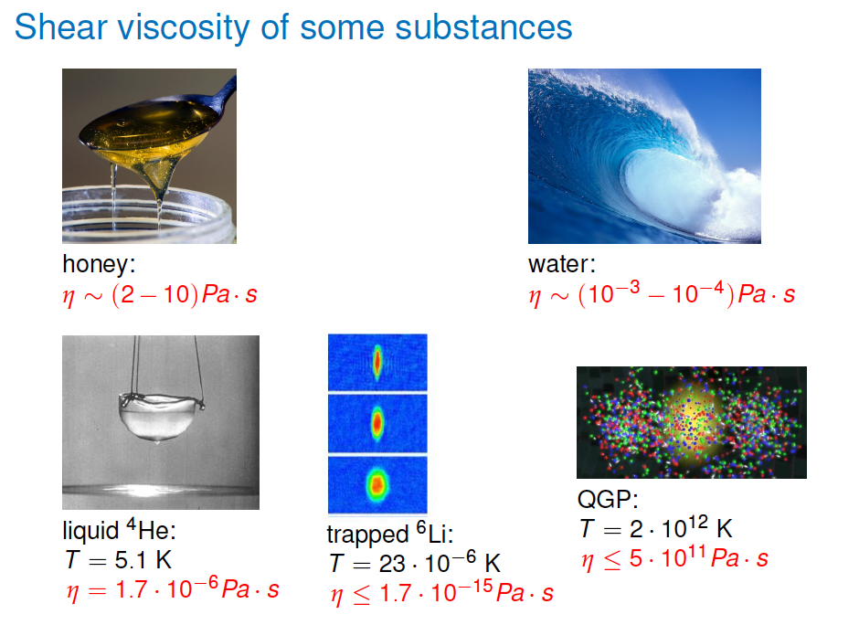

Slide 43
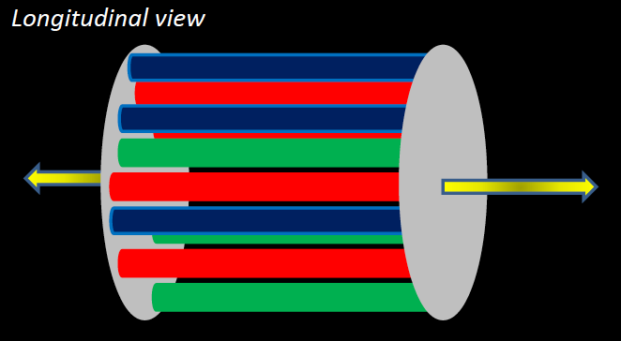
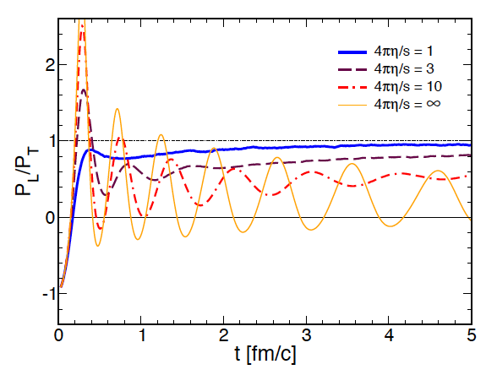

Two Notes …
1) Trivial after solving …. Relativistic Viscous Hydrodynamics at II° order
2) All is done assuming that matter created is thermal at τ ≈ O(1fm/c)
Initial Field Configuration
Longitud./Transverse Pressure
×
×
×
Negative
VG & Ruggieri, PRC92(2015)

Slide 44



η/s smoothen fluctuations and affect more higher harmonics
Ideal
Viscous
η/s=0
η/s=0.16

Slide 45

Shear Viscosity for systems in 20 order of T magnitudes!
pQCD- plasma
O’Hara et al., Science 298(2002)
Notes:
Da dove e’ repsa questa figura?

Slide 46
Modified Hadronization in AA w.r.t. to ee, ep, pp
Fragmentation: e⁺e⁻,ep,pp
Quark recombination
h
q
h
h
q
Forced by Confinement
Favored by DeConfinement
Meson recombination(qq)

Slide 47



Ideal Hydrodynamics: a perfect fluid?
T_{f} ~ 120 MeV
<β_{T}> ~ 0.5
No microscopic description (λ ->0), no dissipation,…only conservation laws!
Blue shift of dN/dp_{T} hadron spectra
Large v₂/ε
Mass ordering of v₂(p_{T})
For the first time very close
to ideal Hydrodynamics
Not superposition of pp collisions, but a nearly thermalized matter which behaves like a perfect fluid!
Zero dissipation?

Slide 48



Hadronization Modified
Baryon/Mesons
Quark number scaling
Au+Au
Baryon
Meson
p+p
PHENIX, PRL89(2003)
Use medium and not vacuum
-> Quark coalescence
More easy to produce baryons!
Hadronization is modified
Dynamical quarks are visible
Fries-Greco-Sorensen - Ann. Rev. Part. Sci. 58, 177 (2008)

Slide 49

Last Result from LHC: φ flows also with n_{q}
P (qqq), φ(qq) with M_{p} ≈ M_{φ}
So do they flow at the same way: hydrodynamic flow?
proton
QM2017
Φ
flow with its constituent quark number!!!

Slide 50


Hadronization Modified: B/M Ratios
Ratio in Hadronization by Coalecence
Central Collisions

Slide 51


What is the impact of coalescence?
__________________________________________________________________________________________________________________
R_{AA}(p_{T}) signficant reshaped → exp. data
Opposite to energy loss Coalescence brings up both R_{AA} and v₂

Slide 52

Notes:
Per Marco
-perche E e B sono paralleli?
Schwinger meccanism mai visto in QED perche?
Charge parity violation sarebbe sempre s c’e’ la presenza del campo magnetico anche nell’early unvierse
*****
Effetti relatiistici in hydro:
polarizzazione

Slide 53
Relativistic Heavy-Ion Collision when I was Young
Transverse view of HIC
Longitudinal View
y
ϕ
x
With years we have been able to look inside the created matter
deeper than expected …

Slide 54


Upgrading the view on the matter created in HIC
Transverse view of HIC
y
Relativistic HIC
in ’90s, ’00 till about 2005
ϕ
Anisotropies v_{n}=<cos(nφ_{p})> only
with even parity due to symmetry
x
Jacak & Muller, Science 337 (2012)
Due to fluctuations
we can have odd v₃ harmonic!
All harmonics appearing
with different weights.
Thanks to the great endeavor of experimentalist to measure even-by-event
[Prof. R. Snelling at 17.50]

Slide 55






Upgrading Longitudinal View
Nature 548 – August 2017
Longitudinal View up to ≈ 2010
Vorticity →Polarization
Quantum-Relativistic
effect
Theory from
Becattini & Csernai (MAE)
F. Becattini et al.,Ann. Phys. 338 (2013)32
In Hydrodynamics
ħω ≈ K_{B}TP_{Λ}
≈ 10²² s⁻¹
Superfluid nanodroplets
ω ≈ 10⁷ s⁻¹
L ≈ 10⁴ ħ
Λ Polarization
Beam Energy
Notes:
Vedere nell’articolo cosa c’e’ in figura

Slide 56



Quantum Chromodynamics
Similar to QED but 3 charges!!!
Because they are “3” they are named “color charges”:
With more than 1 charge → carrier of the interaction
→ must also be colored “charged”
more color (charge)
more interaction
Quantum Flutuations

Slide 57

Quantum Chromodynamics
Similar to QED but 3 charges!!!
Because they are “3” they are named “color charges”
With more than 1 charge → carrier of the interaction
has to be colored → completely different from QED!
Strong Force Potential
more color (charge)
more interaction
V≈ Kr
Difference #1: At small distance quarks interacts less, this is a different World!
Asymptotic freedom (Nobel 2004)

